Slide 1
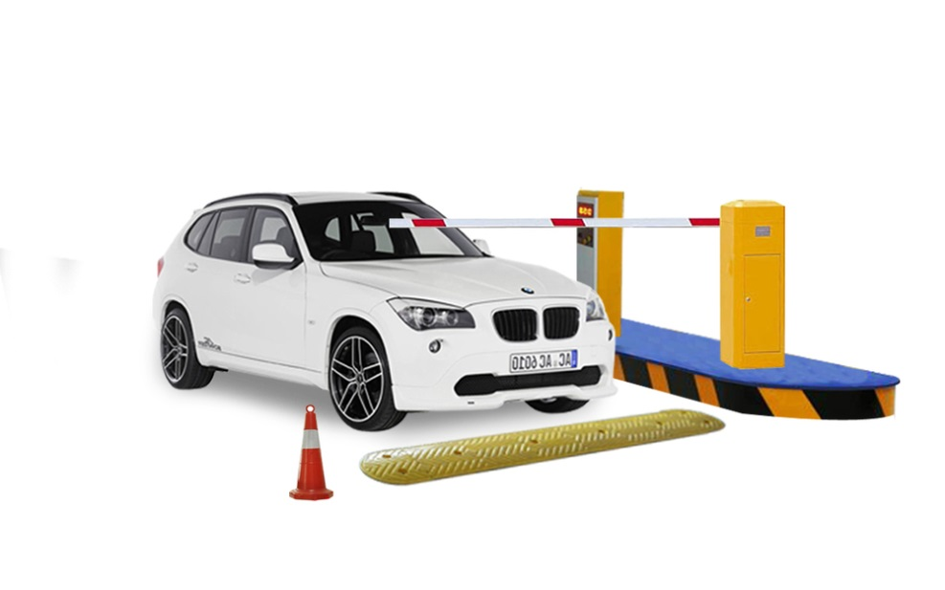
Smart Parking Application
Graduation Project II
20/12/2015
Supervised by :
Dr. Saed Tarapiah
Aya Burhan Saeed 11142755
Noora Saleh Zaid 11106728

Slide 2
Outline
Introduction .
Project Motivations .
System Methodology and Flow-Chart .
System Implementations .
System Main Components .
System Discussion and SWOT Analysis .
Conclusions and Recommendations .
Future Work .

Slide 3
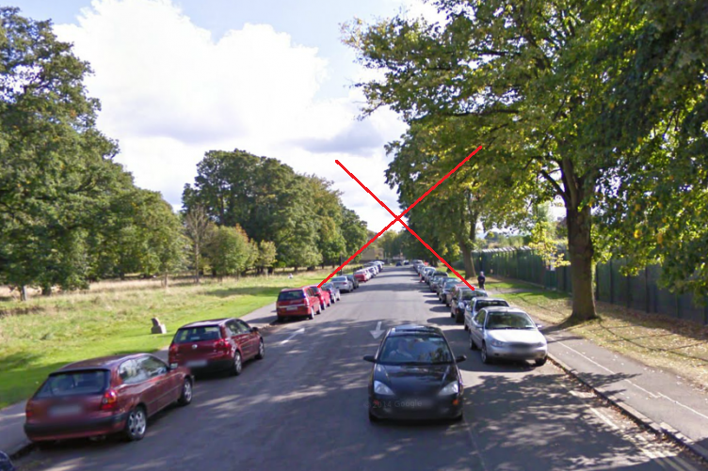
Introduction
The goal of parking system project is to reserve parking spot for a car/vehicle before it arrives .
One of the most problems that the driver faces is finding a free parking spot , so many driver stopping their cars at the edges of the street . Therefor, we choose this project to prevent the frustration of
finding a parking spot and they
can reserve a spot when they stay
at home.

Slide 4
System Motivations
Save time .
Reduce fuel consumption .
User friendly system .
Controllable system .
Become more important in the urban crisis .
Make a smart city and climbed for the best .

Slide 5
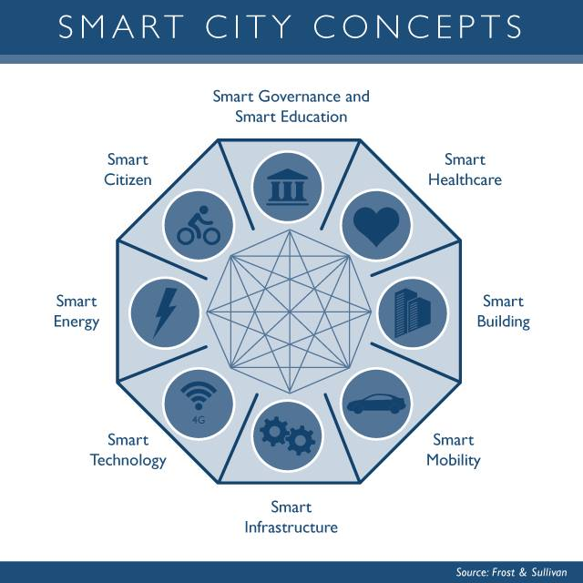
System Motivations

Slide 6
System Methodology and Flow-Chart
Start
All the spots are free and LEDs shine green and the #of free spot at LCD = X ( 1,2,3,..,X)
Driver reserve one of the free spots by using WI-Fi and telnet APP.
NO
Did the driver make reservation ?
YES
the LED of this spot will shine blue and the #of free spots = X-1
Driver arrive the parking and check if that is the reserving car by crossing RFID reader
The gate will stay close and the #of free space stay = X
NO
Is this the reserving car ?
YES
The gate will open and its spot will shine red and the # of free space = X-1
NO
the reserving car leave the spot ?
YES
The Led again shine green and the #of free spot increasing by 1
The led stay red until leaving
Finish

Slide 7
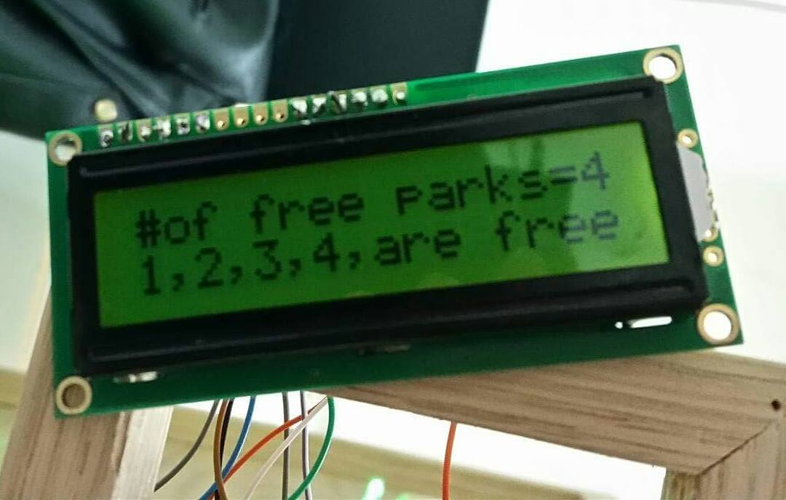
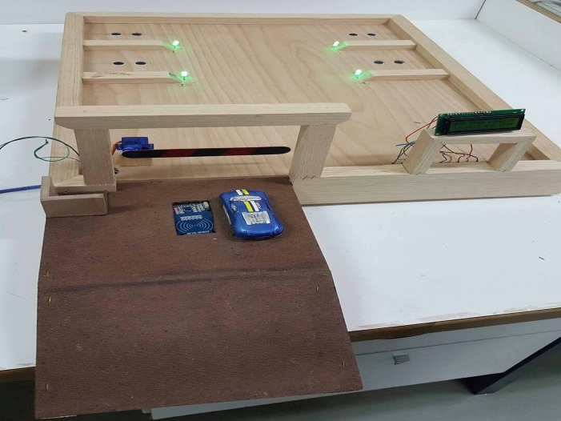
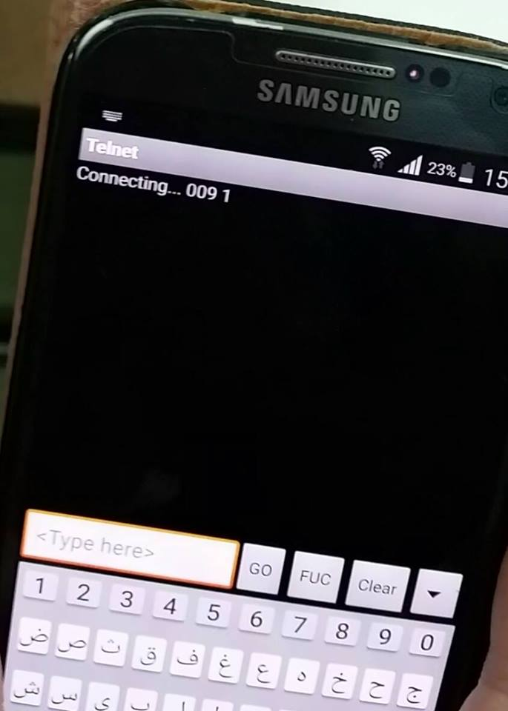
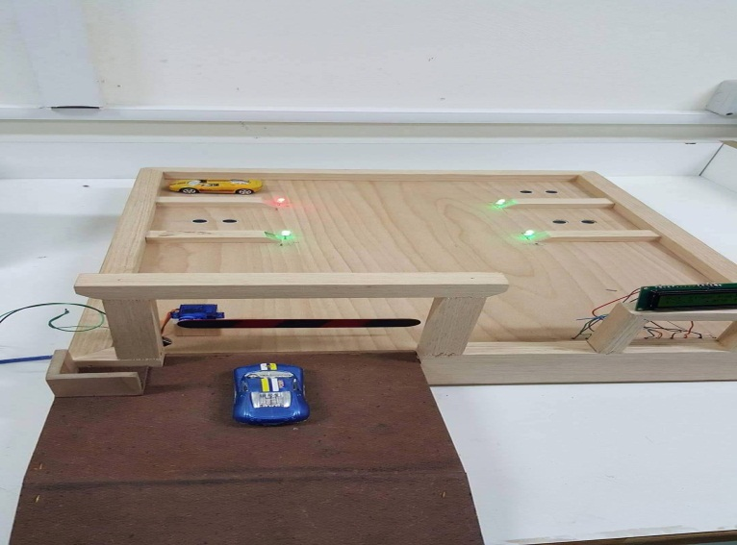
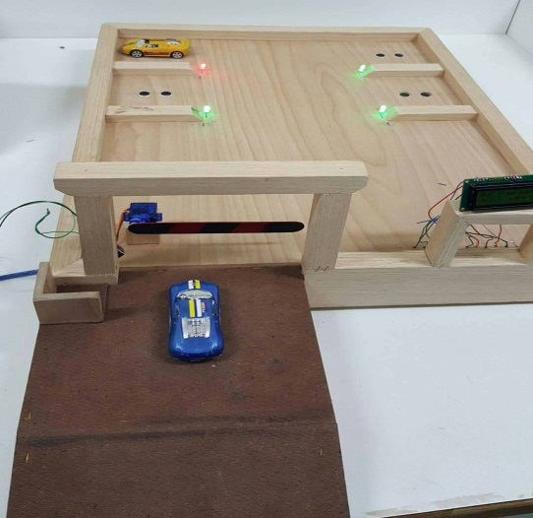
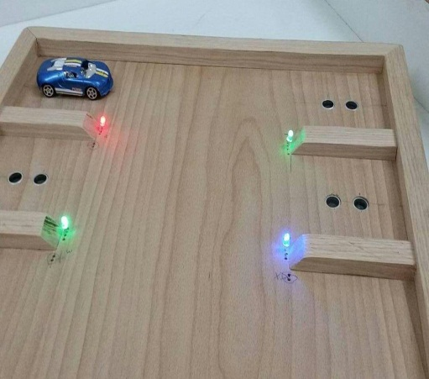
System Implementations

Slide 8
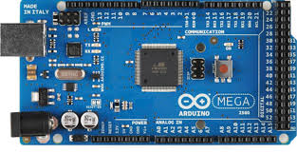
System Main Components
Arduino MEGA
The Arduino Mega is a microcontroller board . It has 54 digital input/output pins , 16 analog inputs, 4 UARTs (hardware serial ports), a 16 MHz crystal oscillator, a USB connection , and a reset button. It contains everything needed to support the microcontroller; simply connect it to a computer with a USB cable or power it with a AC-to-DC adapter or battery to get started .
In our project I we used Arduino UNO but it doesn’t have enough pins , but Arduino MEGA does .

Slide 9
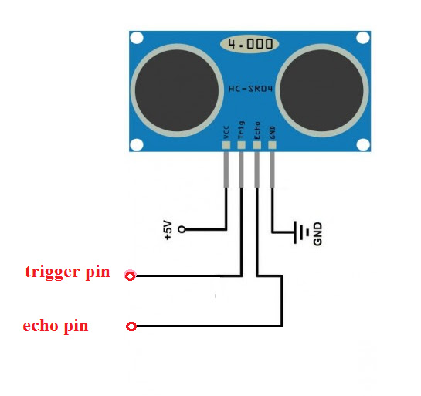
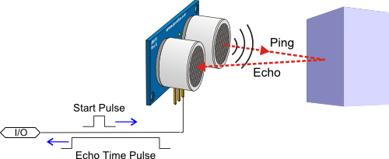
System Main Components
Ultrasonic Sensor
Ultrasonic sensors are devices that use electrical–mechanical energy transformation to measure distance from the sensor to the target object .
In our project we use it to detect the presence of a car in the spot to change the color of LEDs in deferent cases .

Slide 10
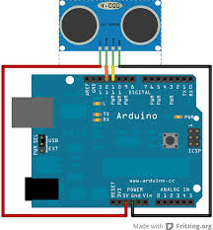
System Main Components
Interfacing Ultrasonic With Arduino

Slide 11
System Main Components
LCD ( Liquid Crystal Display )
in our project we used LCD to show the # of free spot and their location in the parking .

Slide 12
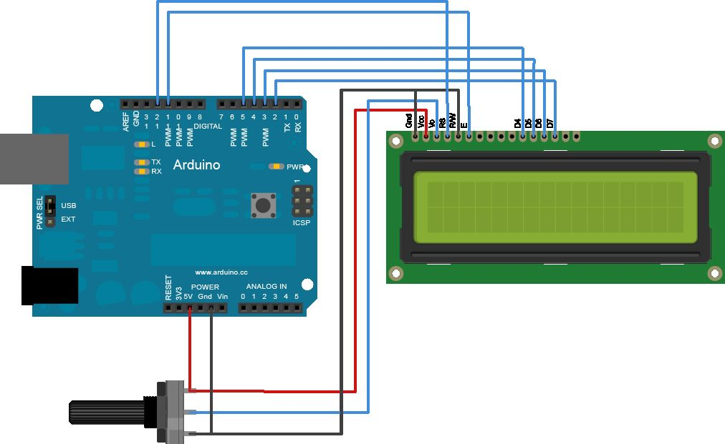
System Main Components
Interfacing LCD With Arduino

Slide 13
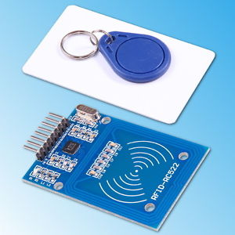
System Main Components
RFID Reader ( Radio Frequency Identification )
RFID system consists of 2 parts. A Reader, and one or more transponders , also known as Tags.
RFID systems evolved from barcode labels as a means to automatically identify and track products and people .
In our project we use an RFID reader at the entrance of the parking and RFID tags under the cars to identify the reserving car and making the gate open for it .

Slide 14
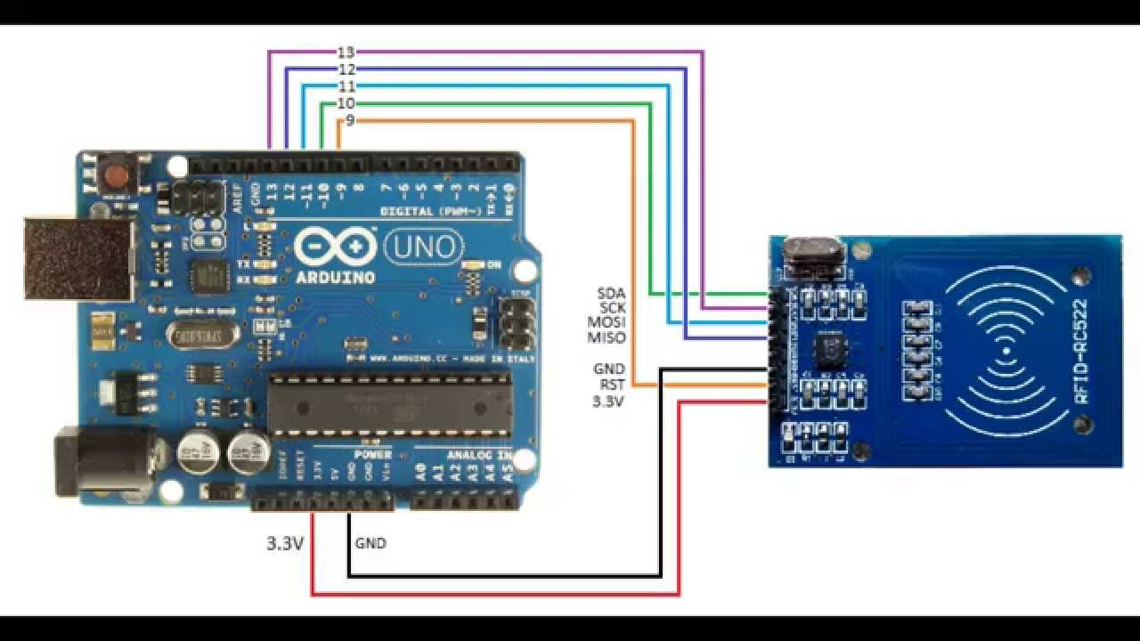
System Main Components
Interfacing RFID With Arduino

Slide 15
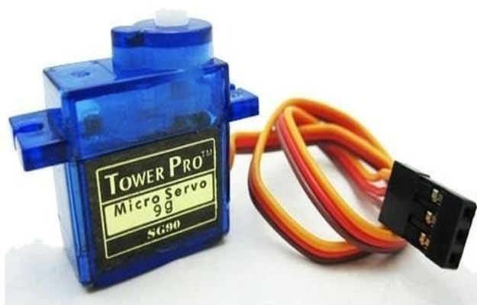
System Main Components
Servo Motor
Servos are controlled by sending an electrical pulse of variable width, or pulse width modulation (PWM), through the control wire.
In our project we used a servo motor to control opening and closing the gate at the entrance of the parking .

Slide 16
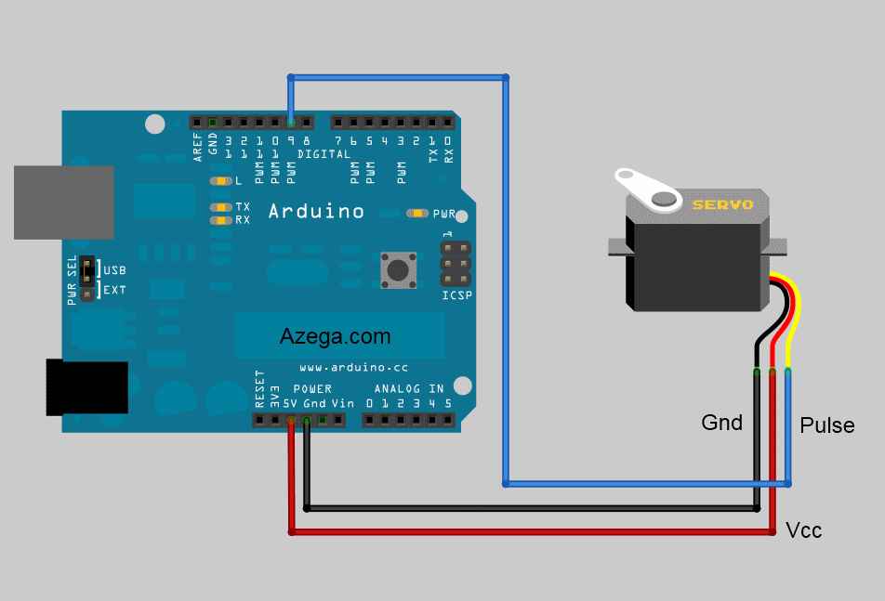
System Main Components
Interfacing Servo Motor With Arduino

Slide 17
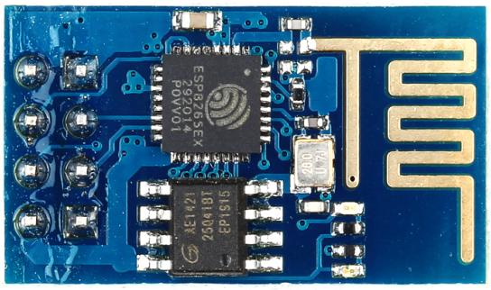
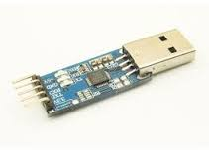
System Main Components
ESP8266 Serial Wi-Fi Module
ESP8266 ESP-01 Serial WIFI Transceiver Module is a cheap and easy way to connect any small microcontroller platform, like Arduino, wirelessly to Internet .
In our project we use it to make private network so we reserve a spot
( for terminals we have internet in our city street ) .

Slide 18
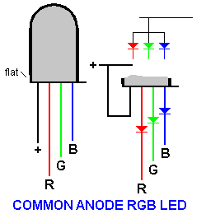
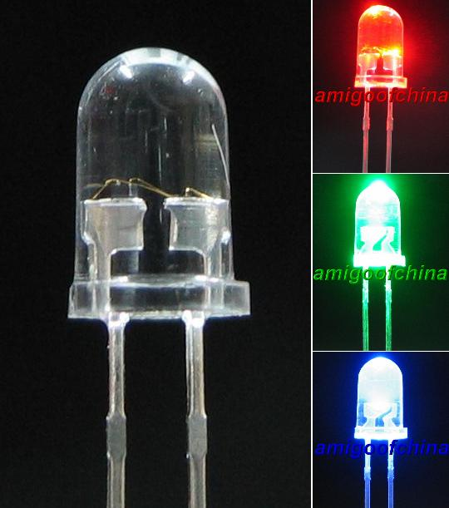
System Main Components
RGB – LEDs ( Red , Green , Blue )
These units have four pins - Cathode is the longest pin. One for each color and a common cathode. Use this one LED for three status indicators or pulse width modulate all three and get mixed colors .
We use it in our project to indicate the state of spot , if the spot is free the LED is green , if it is reserved the LED is blue , and if it is full the LED is red .

Slide 19
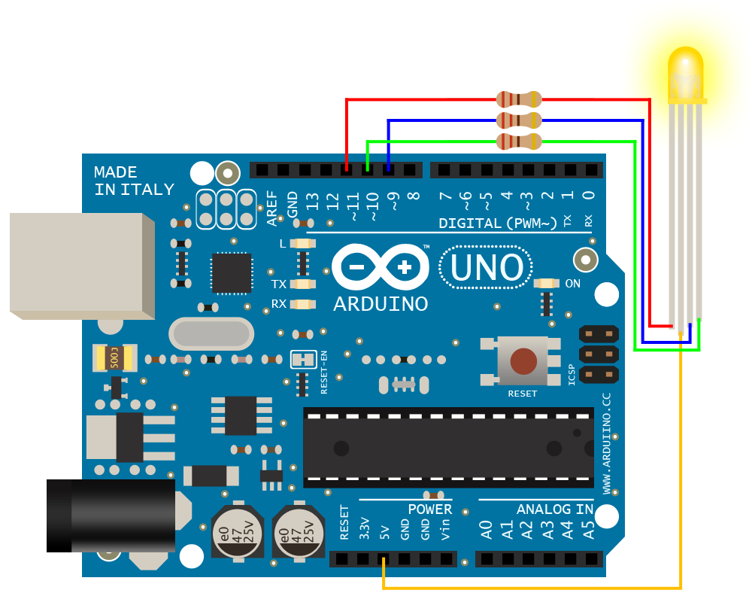
System Main Components
Interfacing RGB LED with Arduino

Slide 20
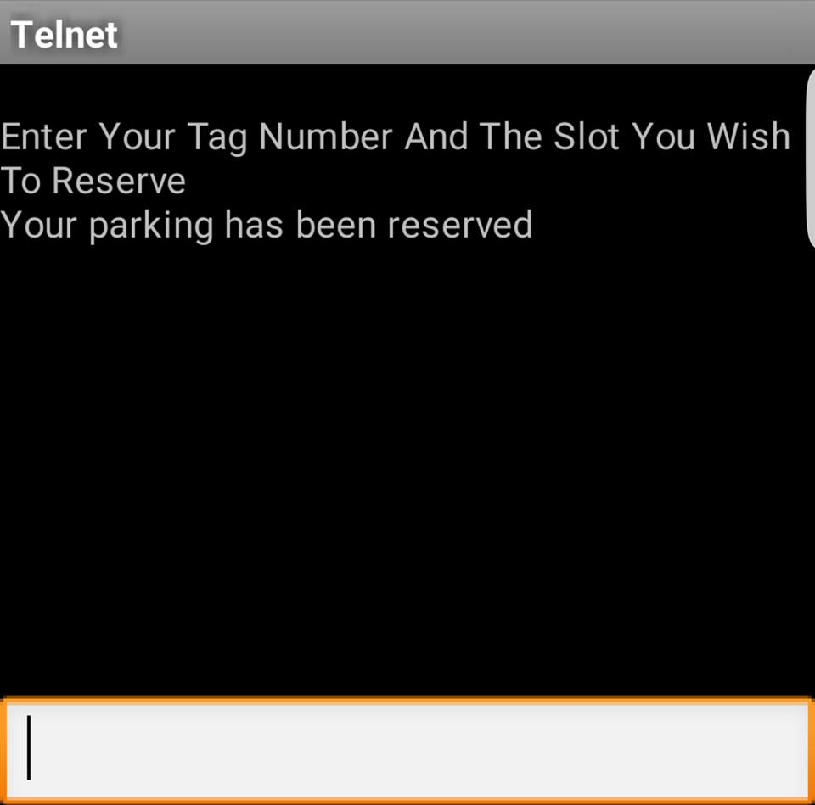
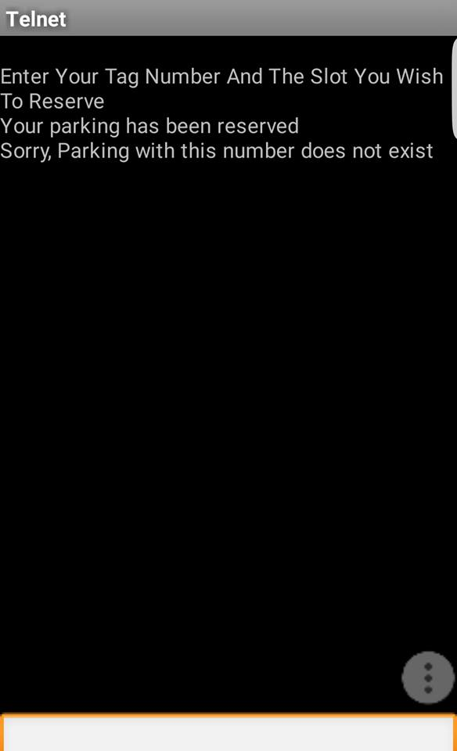
System Main Components
Telnet Application
Is an application layer protocol used on the internet or local area networks .

Slide 21
System Discussion and SWOT Analysis
Strengths S - Saves time and energy - Easy to implement - Free and easy access to the App - Manage the parking system | Weaknesses W - single point of failure - Jamming R.F frequency interference - Parking at the center of ultrasonic sensor
Opportunities O - Can be implemented in any parking system ( university, offices, etc. - Save in nature ( reduce pollution ) | Threats T - To be acceptable by the driver culture - There are similar application developed in world wide .

Slide 22
Conclusions and Recommendations
Reliable, well functioning system model for smart parking system.
This system Built to identify the main problem
Propose a solution
Start the implementations of design .

Slide 23
Future Work
Expanding the system .
Draw the way of cars in the ground of the parking to make the presses of entering the reserving cars to the spots more ease .
Add more features as SMS notifications or remote communication .
Add more features to the Telnet program to help the drivers more and more .

Slide 24
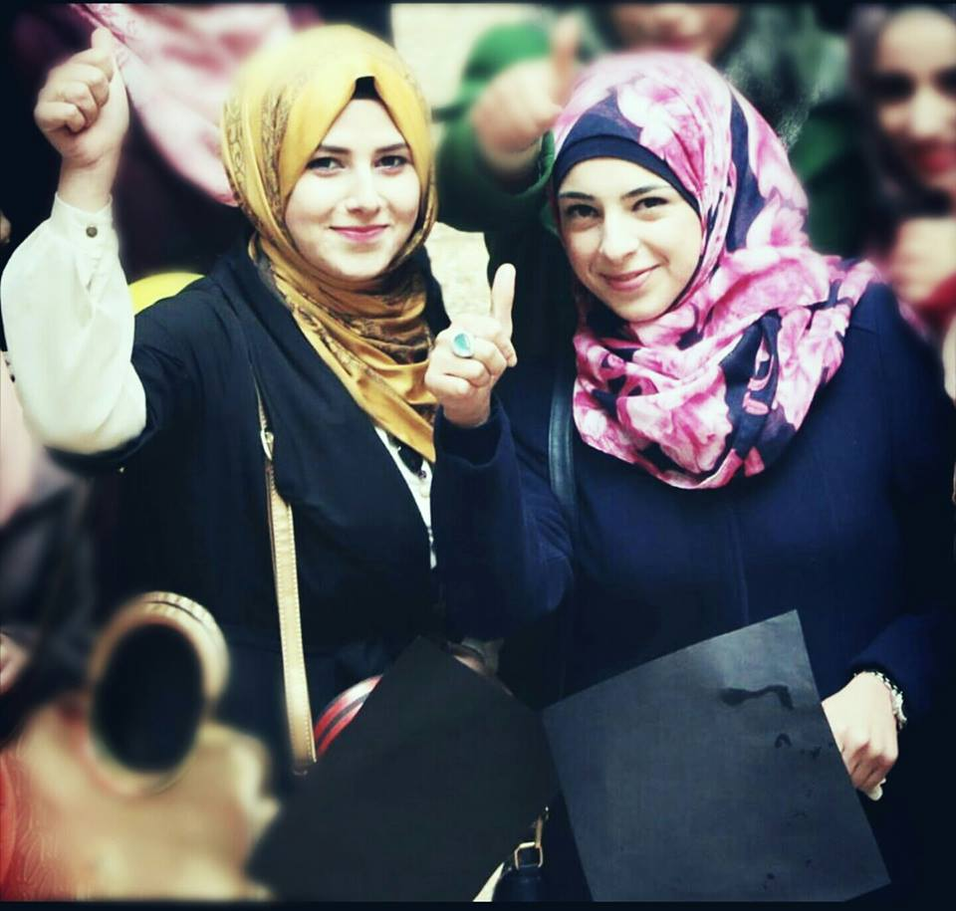
Thanks FoR yOur ATTENTION

