Slide 1

An-Najah National University
Analysis and Development of the Western Entrance of Nablus
city Center
Prepared by:
Mohammad Abu Hijleh
Alaa Darweesh Alhaj
Omar Menawi
Supervisor :
Prof. Sameer Abu Eisheh

Slide 2
Outline
Introduction
Study area
Existing problem
Objective
Methodology
Results and Conclusions
Recommendations

Slide 3
Introduction
Nablus is one of the largest Palestinian urban areas with its important sites. Moreover, it’s ahead quarter of the largest Palestinian university.
Nablus city, one of the main commercial centers in the West Bank.

Slide 4
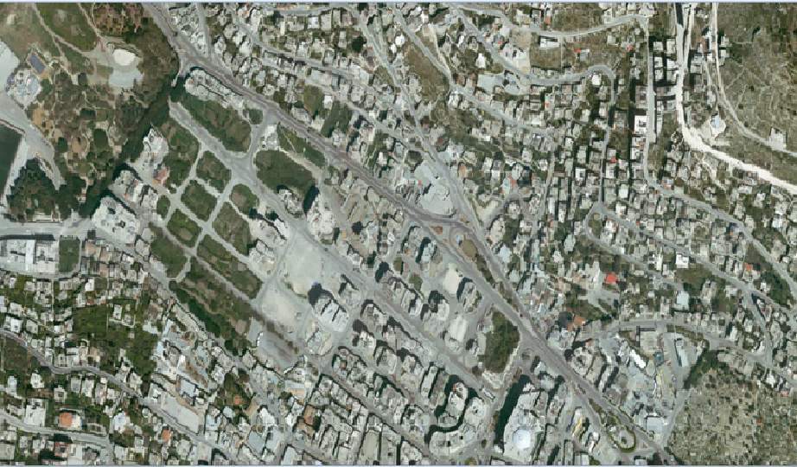
Study Area

Slide 5
Existing problems
Safety problem
Parking problem
Congestion problem

Slide 6
Objective
The main objective of this project is to analyze and develop the western entrance of Nablus city center.
The study will propose solutions to study area problems.

Slide 7
Methodology
Data Collection
Data Analysis

Slide 8
Methodology
Data collection
Basic information, including general layout map, contour maps, aerial photograph.
Inventory study.
Traffic volume counts.
Accident data.

Slide 9
Methodology
Types of studies done in the project:
1- Accidents studies.
2- Intersections traffic manual count studies.
3- Video recording supplementary traffic studies.
4- Level of service an analysis studies.
5-Traffic simulation.

Slide 10
Accidents studies
Crashes are classified according to Traffic and Highway Engineering Garber and A.Hoel 2006
Type of crash | Category number
Rear end crash | 1
Angle (turning) crash | 2
Side crash | 3
Head-on-crash | 4
Rollover crash | 5
Pedestrian crash | 6
Fixed object crash | 7

Slide 11
Intersections traffic manual count studies
The main locations that we have in the project are
The combined intersection which consists of two intersections, the first one is As-Salam Mosque intersection and the intersection of Hamdi Kanaan Street with Prince Mohammad Street.
Entrance of West Nablus Complex for shared-taxis to cities.
Al- Arz intersection.
Western Entrance of Nablus Municipal Complex.
Intersection near the Entrance of West Nablus Complex for shared-taxis to villages.

Slide 12
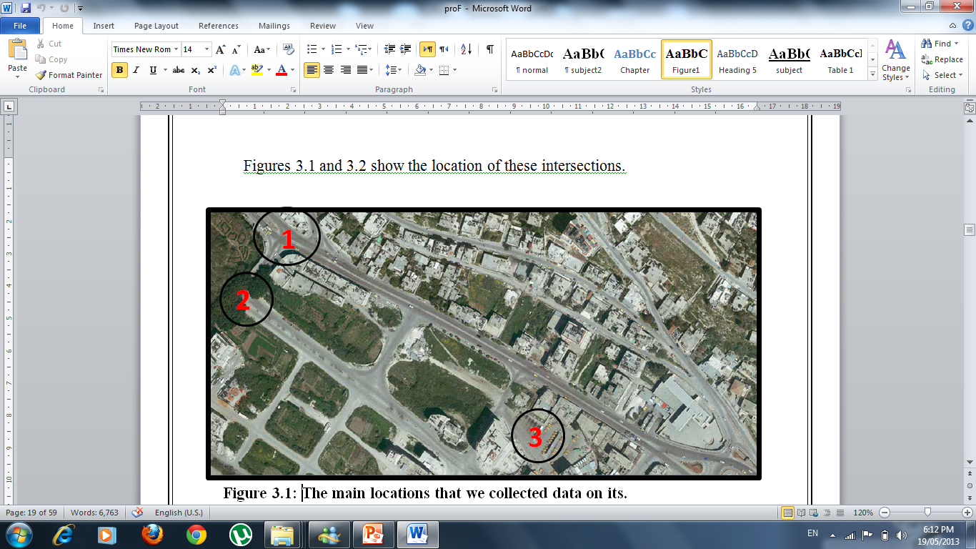

Slide 13
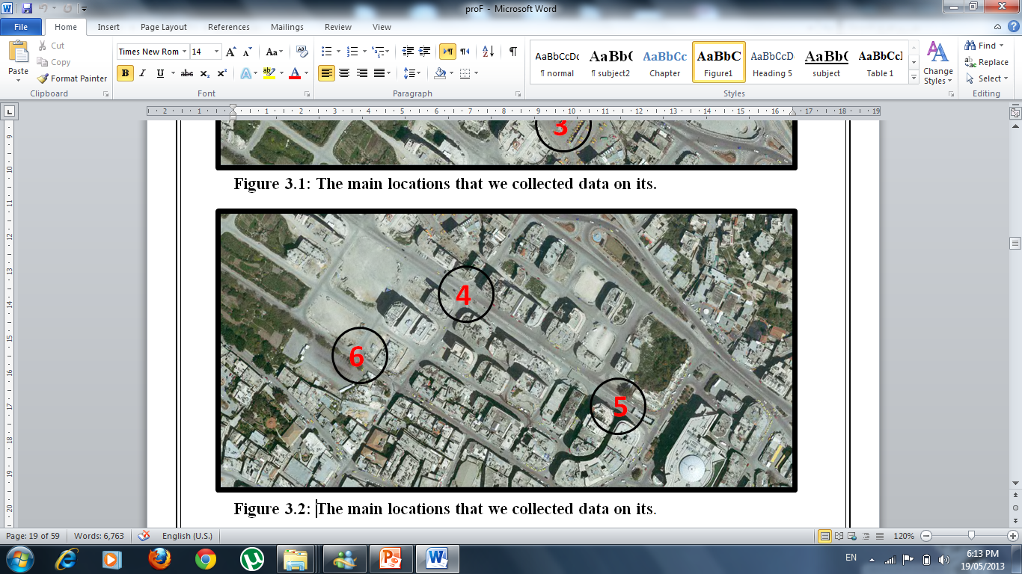

Slide 15
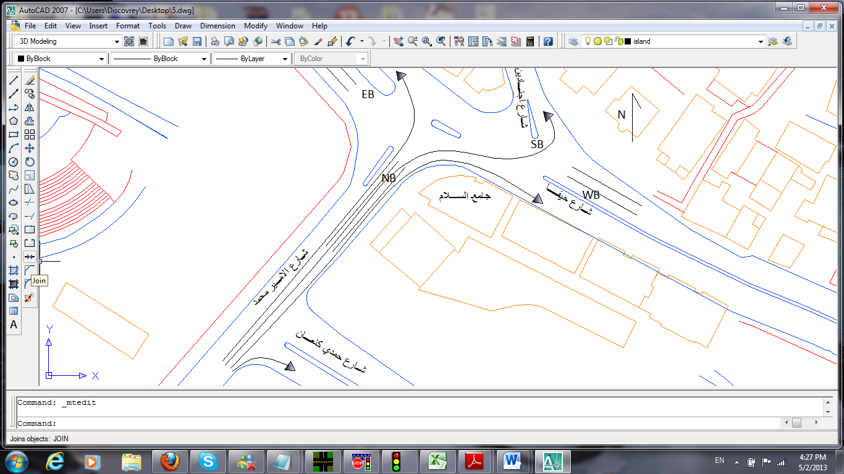
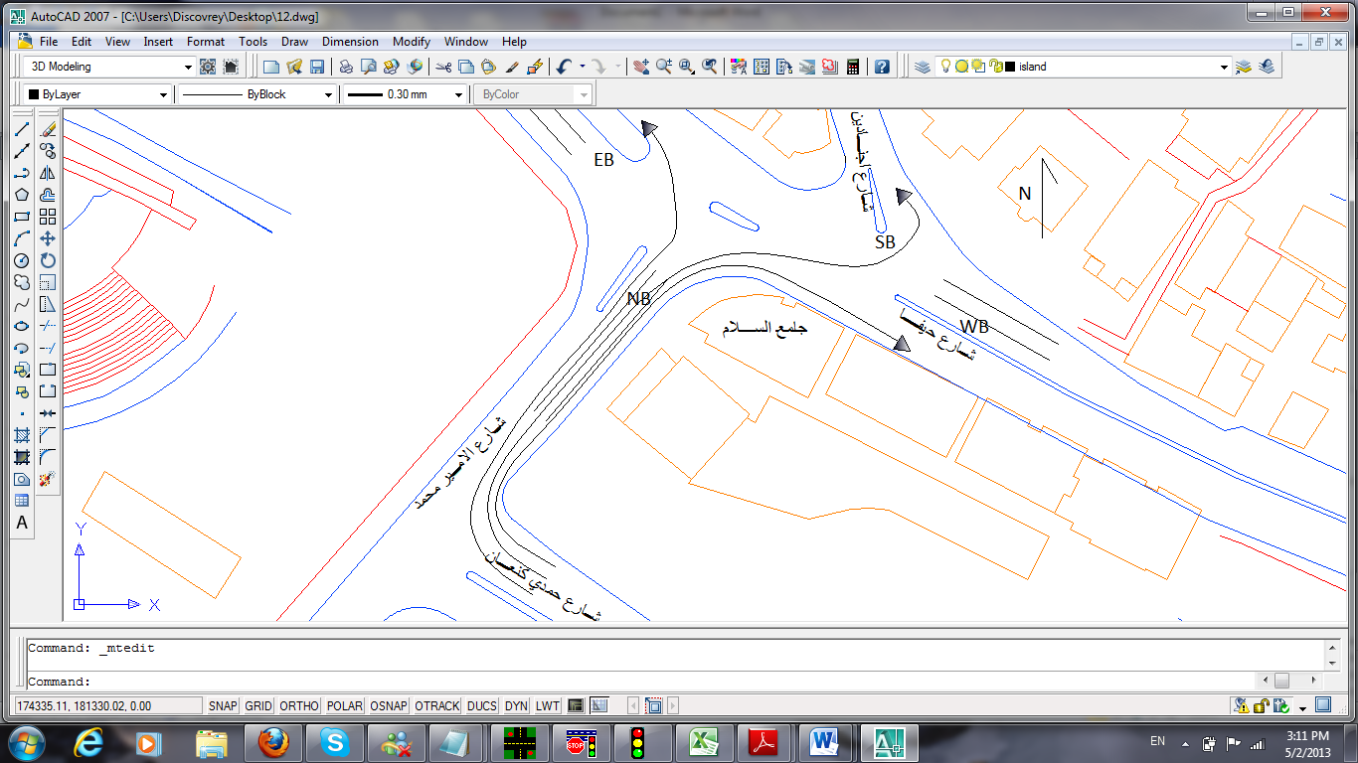
Video recording supplementary traffic studies
The team will supplement the manual intersection counting with video recordings

Slide 16
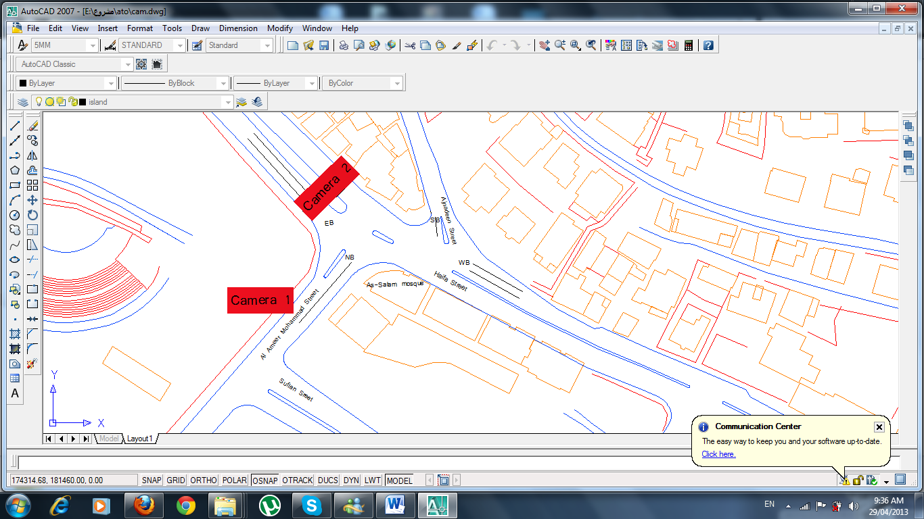
The locations of cameras

Slide 17
Level of service an analysis studies
The team conduct the level of service analysis in order to evaluate the performance of the intersections.
the team use HCS program in order to determine the level of service at specific intersections.

Slide 18
Traffic simulation
Synchro is used to provide traffic analysis, optimization, and simulation applications

Slide 19
Data Analysis
The collected data are used to calculate :
Peak Hour(PH)
Peak Hour Volume (PHV)
Peak Hour Factor (PHF)
Percent of Heavy Vehicle (HV)
Determining vehicle classification of through and turning movements at intersections.
These data used to determine the level of service

Slide 20
Growth factor
The team use this equation to determine the growth factor
Vf =Vi (1+r) ^{n}
Then the value of growth factor value =4.49 %
This value used to predict the volumes in the study area after five years.

Slide 21
Design Criteria
For a design speed of 50 Kmph
Super elevation (e)=4%
Friction factor (f) =0.155
Minimum horizontal radius =101m

Slide 22
Proposed Solutions to Solve Study Area Problems
Building an underpass (tunnel) which connects Haifa Street with Hamdi Kanaan Street.
Proper separation shared taxis that enter and exit Nablus Municipal Complex.

Slide 23
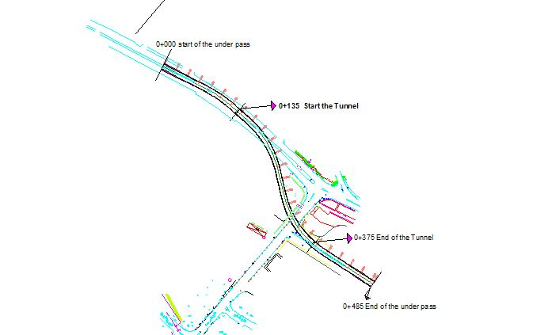
Underpass (Tunnel)

Slide 24
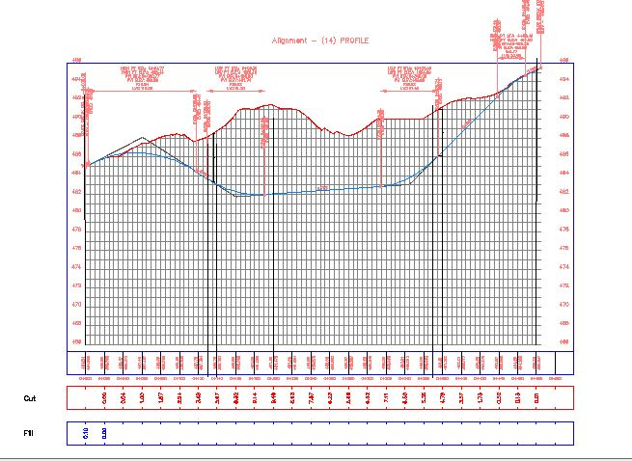
Profile

Slide 25
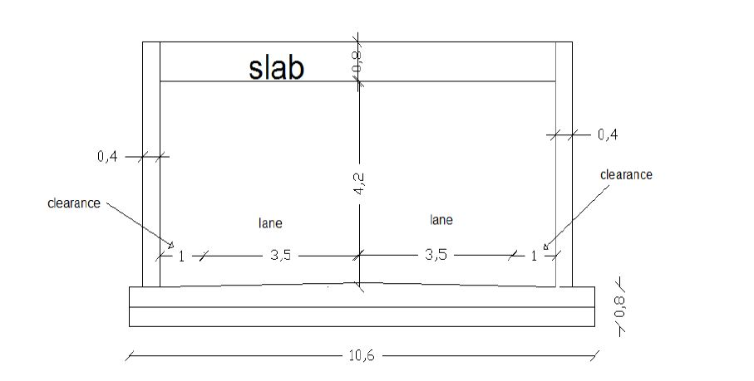
Cross section

Slide 26
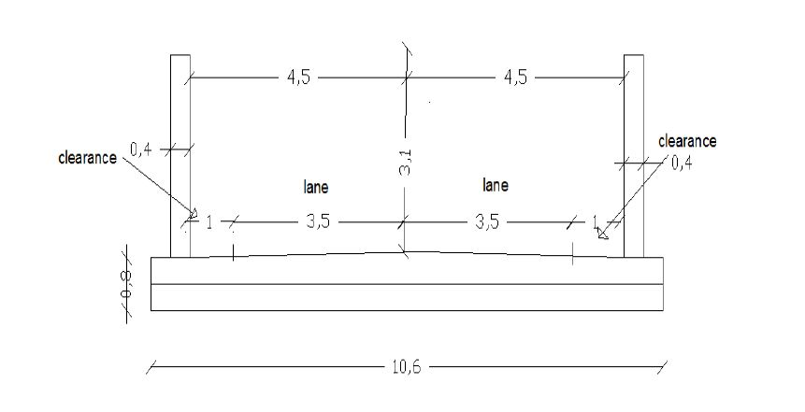

Slide 27
Design of proposed separation
The team designed the separation lane in order to facility the movement of vehicle and pedestrian and to reduce the congestion in the vital street.

Slide 28
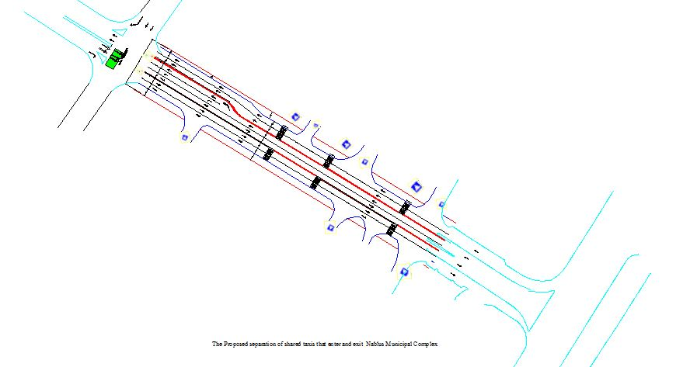

Slide 29
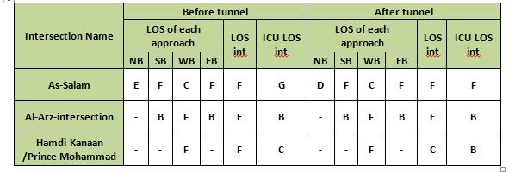
Results and conclusions

Slide 30
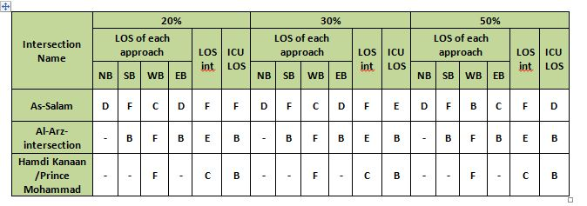
Results and conclusions

Slide 31
Recommendations
Transfer the West Nablus Complex for cities and West Nablus Complex for villages and examine the use of these sites for parking.
Another solution recommended is change Al-Jed intersection from unsignalized to signalized intersection because has a high traffic volumes.

Slide 32
Thank you

