Slide 1

Supply and demand analysis at Palestine poultry company (AZIZA)
Prepared by:
Ahmad Shahrori
Bilal Ghazi
Osma Dawabshh
Waleed Abbas
Supervisor
Dr. Mohammad Othman

Slide 2
Outline
Background
project goals
Problem statement
literature review
Methodology
CURRENT SITUATION
Demand forecasting
centralization and decentralization
Transportation
Conclusion
Recommendation

Slide 3
Background
Palestine Poultry Company (AZIZA) was established as a public shareholding company in Nablus – Palestine in 1997
Palestine Industrial Investment Company (PIIC)
The leader in the Palestinian poultry sector
More than 250 employees
Vision pioneer in the poultry industry, achieving Palestinian food security
Mission high- quality national products--international quality standards

Slide 4
project goals
Identify the optimum way for fulfilling the customer order.
Reduce the amount of poultry waste.
Determine the optimal distance for each cluster.
Obtain the best way to deal with retailers.

Slide 5
Problem statement
Determine the proper demand for each segment by subjective methods.
Centralization technique not adopted impacted in CSL.

Slide 6
literature review
perishable products: value of the products deteriorate dramatically with time.

Slide 7
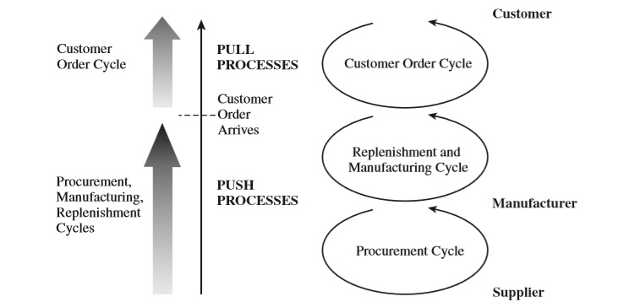
literature review

Slide 8
Methodology

Slide 9
CURRENT SITUATION

Slide 10
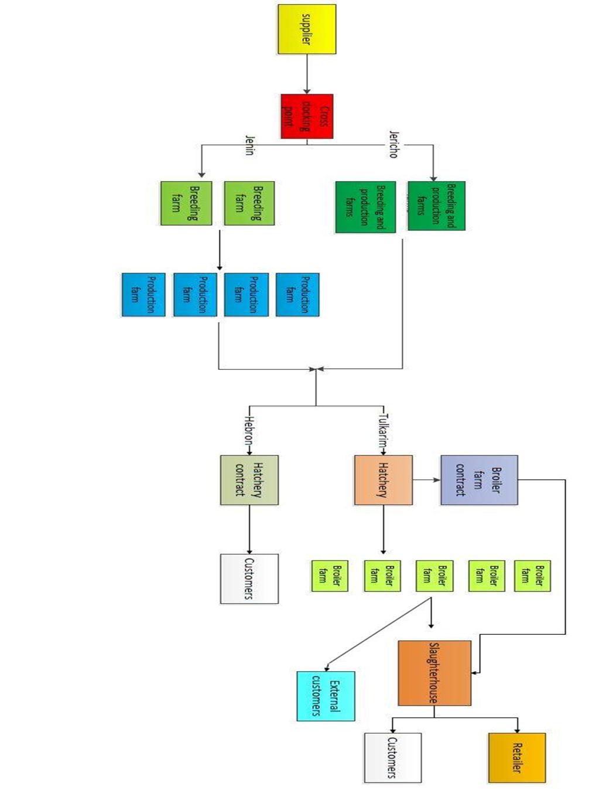
Current situation

Slide 11
Demand forecasting

Slide 12
Forecast types
Forecasting Method | Applicability
Moving average | No trend or seasonality
Simple exponential smoothing | No trend or seasonality
Holt’s method | Trend but no seasonality
Winter’s method | Trend and seasonality

Slide 13
Demand
Month | Demand(chicken)
January | 243,209
February | 283,620
March | 110,144
April | 291,321
May | 209,462
June | 309,364
July | 324,586
August | 300,839
September | 233,612
October | 195,096
November | 341,484
December | 210,851
Period | New demand (chicken)
1 | 337749
2 | 262509.3
3 | 328035.7
4 | 312583.3
5 | 422633.3
6 | 409034.3
7 | 298644
8 | 357720
9 | 324679
10 | 408362.3
11 | 323681.3
12 | 168222.3
13 | 447270
14 | 286679.3
15 | 334105.7
January | 309440
February | 296767
March | 188755
April | 105304
May | 409655
June | 112845
July | 317174
august | 228381

Slide 14
Demand for 40 days

Slide 15
Moving average

Slide 17
Moving average
Period time | Forecast(units or chicken)
16 | 309,069
17 | 309,069
18 | 309,069
19 | 309,069

Slide 18
Simple exponential

Slide 20
Simple EXPONENTISAL
α=0.1
Period | Forecast (units or chicken)
16 | 333,262
17 | 333,262
18 | 333,262
19 | 333,262

Slide 21
Trend-corrected exponential smoothing (holt’s model)

Slide 22
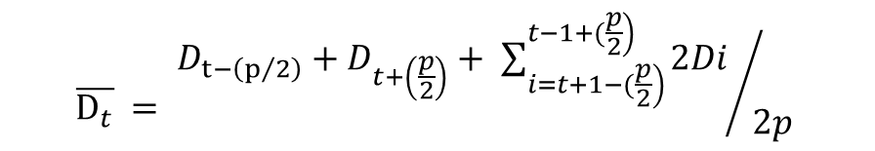
Deseasonalized demand
$$\overline{D_{t}} = {D_{t−\left(p/2\right)}+D_{t+\left(\frac{p}{2}\right)}+ \sum_{\left.i=t+1−(\frac{p}{2}\right)}^{\left.t−1+(\frac{p}{2}\right)}{2Di }}/{2p}$$
Lₒ=343844
Tₒ=-858.13

Slide 24
trend-exponential smoothing
Period time | Units
16 | 328,384
17 | 327,401
18 | 326,419
19 | 325,437
α=0.1 and β=0.1

Slide 25
Forecast Results
Forecasting Method | MAD
Four-period moving average | 72,595
Simple exponential smoothing | 52,050
Holt's model | 53,174

Slide 26
centralization and decentralization

Slide 27
centralization and decentralization
C_{M}: manufacture cost/ Kg (AZIZA)
C_{R}: retailer cost (Price for AZIZA)
P: price for retailer to the end costumer
D: forecasted demand for year 2019

Slide 28
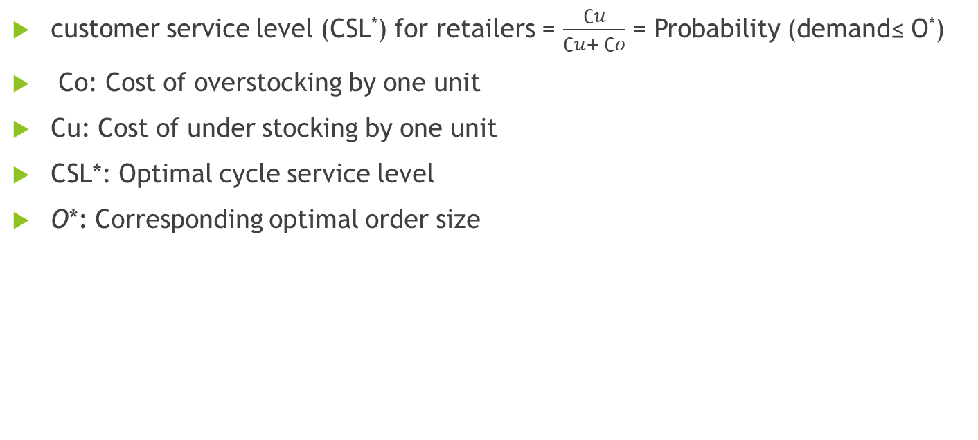
centralization and decentralization
customer service level (CSL*) for retailers = $\frac{∁u}{∁u+ ∁o}$ = Probability (demand≤ O*)
Co: Cost of overstocking by one unit
Cu: Cost of under stocking by one unit
CSL*: Optimal cycle service level
O*: Corresponding optimal order size

Slide 29
centralization and decentralization
Month | Forecasted Demand (in Kg)
January | 2,704
February | 2,803
March | 2,836
April | 2,867
June | 2,941
July | 3,038
August | 3,064
September | 3,146
October | 3,275

Slide 30
Normality test

Slide 31
decentralization
C_{M}= 7NIS/Kg
C_{R}= 12NIS/Kg
P = 14NIS/Kg
Price of over stock = 13 NIS/Kg
Overstock cost =1NIS/Kg
D ~ N (3241, 294.7)
AZIZA
Retailers
Demand
Cost of overstocking by one kilogram = 14-13 = 1NIS /Kg
Cost of under stocking by one kilogram = 14 – 12 = 2 NIS/Kg
Cost of overstocking by one kilogram = 1NIS /Kg

Slide 32
decentralization result
Profit of manufacture (AZIZA) = O* (C_{R} – C_{M}) = 16839.68
Profit of retailers = 6480.912NIS
Total profit = 16839.68+6480.912 = 23320.592NIS
Expected overstock = 191.7728 Kg
Expected under stock = 64.84 Kg
CSL =.66
By use Excel O* = NORMINV (CSL*, μ, σ,) = 3367.935

Slide 33
Centralization
AZIZA
C_{R}= 7NIS /Kg
P = 14 NIS/Kg
D ~ N (3241, 294.7)
Retailers
Demand

Slide 34
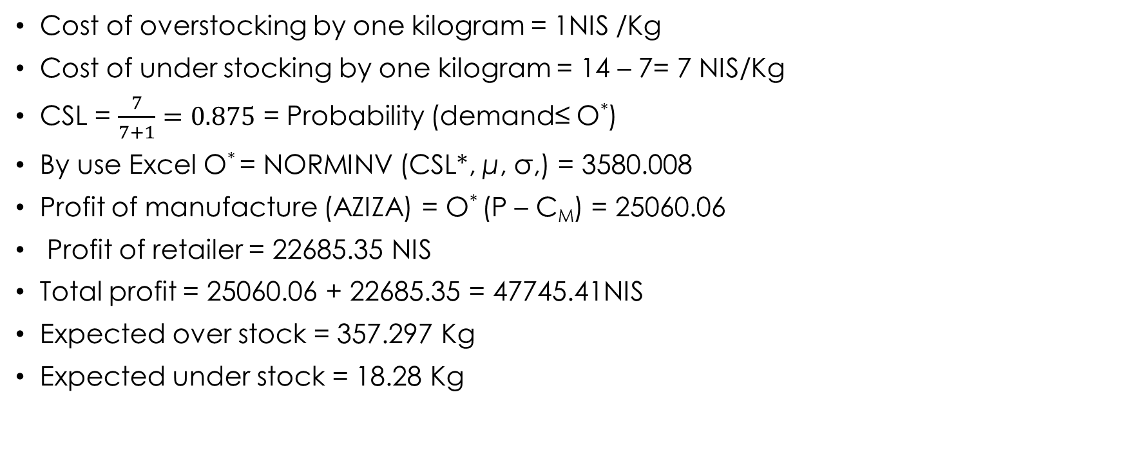
centralization results
Cost of overstocking by one kilogram = 1NIS /Kg
Cost of under stocking by one kilogram = 14 – 7= 7 NIS/Kg
CSL = $\frac{7}{7+1}=0.875$ = Probability (demand≤ O*)
By use Excel O* = NORMINV (CSL*, μ, σ,) = 3580.008
Profit of manufacture (AZIZA) = O* (P – C_{M}) = 25060.06
Profit of retailer = 22685.35 NIS
Total profit = 25060.06 + 22685.35 = 47745.41NIS
Expected over stock = 357.297 Kg
Expected under stock = 18.28 Kg

Slide 35
Comparing between centralization
Decentralization | Centralization | Comparison
0.666 | 0.875 | CSL
23320.592 | 47745.41 | Total Profit
3580.008 | 3367.935 | Optimal Quantity

Slide 36
Transportation Model
Why is Transportation importance?
Limitations and constrains
Why using transportation in AZIZA?

Slide 37
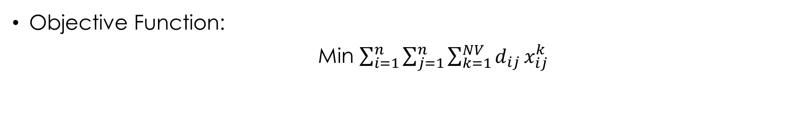
Model
Objective Function:
Min $\sum_{i=1}^{n}{\sum_{j=1}^{n}{\sum_{k=1}^{NV}{d_{ij}}}}x_{ij}^{k}$

Slide 38
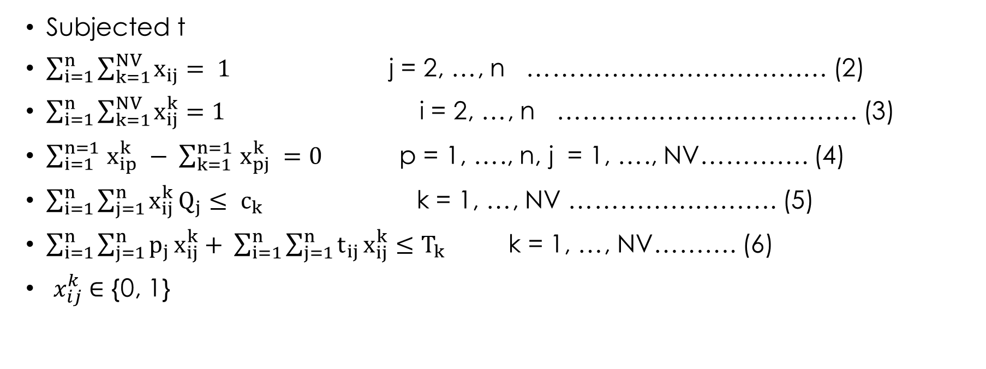
constrains
Subjected t
$\sum_{i=1}^{n}{\sum_{k=1}^{NV}{x_{ij}}}= 1$ j = 2, …, n ……………………………… (2)
$\sum_{i=1}^{n}{\sum_{k=1}^{NV}{x_{ij}^{k}}}=1$ i = 2, …, n ……………………………… (3)
$\sum_{i=1}^{n=1 }{x_{ip}^{k} }− \sum_{k=1}^{n=1 }{x_{pj}^{k} }=0$ p = 1, …., n, j = 1, …., NV…………. (4)
$\sum_{i=1}^{n}{\sum_{j=1}^{n}{x_{ij}^{k}}}Q_{j}≤ c_{k}$ k = 1, …, NV ……………………. (5)
$\sum_{i=1}^{n}{\sum_{j=1}^{n}{p_{j}}}x_{ij}^{k}+ \sum_{i=1}^{n}{\sum_{j=1}^{n}{t_{ij}}}x_{ij}^{k}≤T_{k}$ k = 1, …, NV………. (6)
$x_{ij}^{k}$∈ {0, 1}

Slide 39
Conclusion
Analyze the supply and the demand of AZIZA company by using different scientific models.
Using scientific forecasting techniques to predict the demand, applied different mathematical models to increase AZIZA supply chain profitability and customers’ satisfaction.
Applying the mathematical models, we used real data that collected from AZIZA company.

Slide 40
Recommendation
Increase customer service level decreasing the product cost as much as possible
Implement the mode
Take the consideration into forecast

Slide 41


