Slide 1

An-Najah National University
Faculty of Engineering
Building Engineering Department
Graduation Project 2
Redesigning a Villa
Prepared By :
Muna Abdulhaq
Project supervisor:
Dr. Monther Dwaikat
2014-2015

Slide 2
Outline:
Project Definition
Architectural Design
Environmental Design.
Structural and Seismic Design
Mechanical Design
Electrical Design

Slide 3
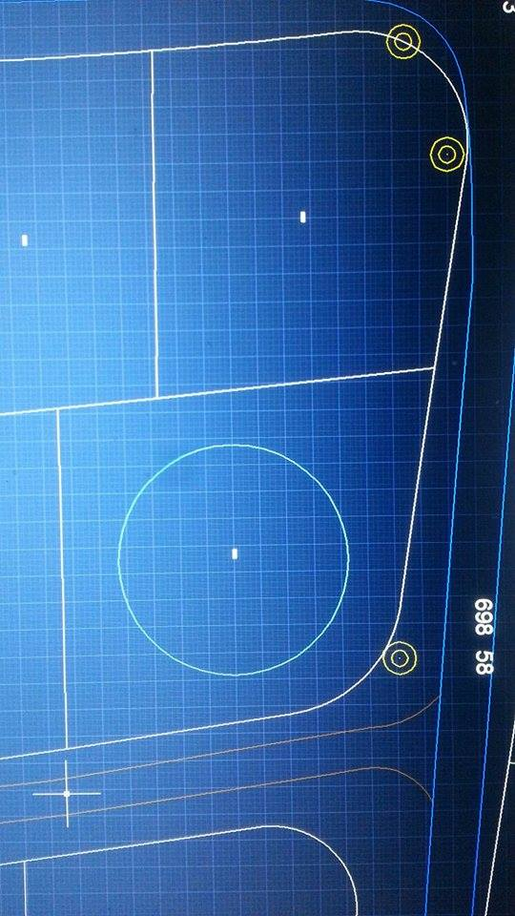
Site of the project:
Location and Site: Area = 420 m2 square meter.

Slide 4
Architectural Design

Slide 5
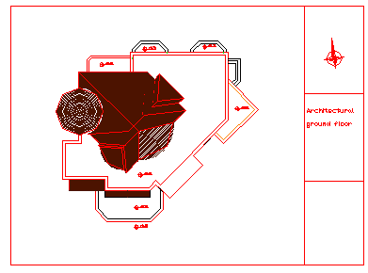
Site Plan :

Slide 6
Functional requirements

Slide 7
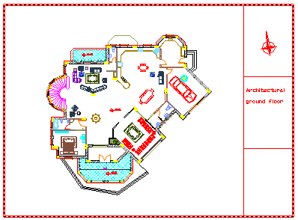
Ground Floor

Slide 8
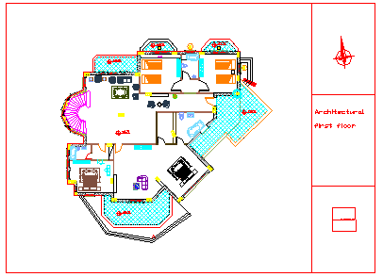
First Floor

Slide 9
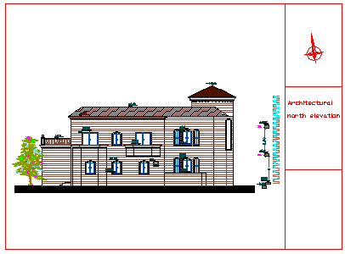
North Elevation:

Slide 10
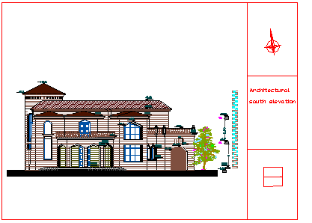
South Elevation:

Slide 11
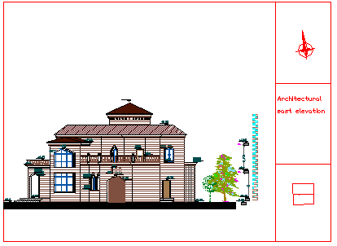
East elevation:

Slide 12
west elevation:

Slide 13
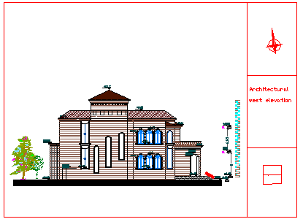
West elevation:

Slide 14
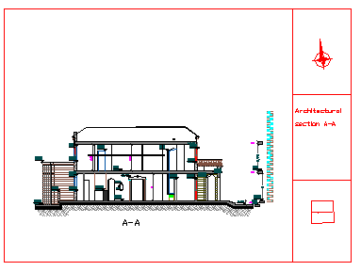
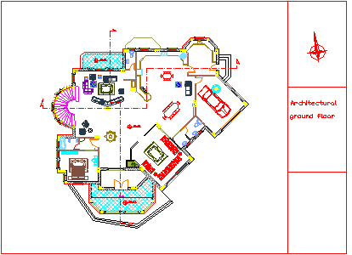
Section A-A

Slide 15
Environmental Design

Slide 16
Best orientation
The best orientation was obtained due to several factors.

Slide 17
Thermal Conductivity Values
U value for the walls= .25
U value for the ceiling=.31
U value doors= 2
U value windows= 2.34

Slide 18

Natural Lighting

Slide 19
Day light factors
The day light factor ranges between 2-3%

Slide 20

Acoustics Comfort

Slide 21
Acoustics design
 | Room | RT60
 | Guest room | .63
 | Guest bedroom | .57
 | Outside kitchen | .7
 | North East bedroom | .6
 | North west bedroom | .6
 | Master bedroom | .73
 | South west bedroom | .64
 | Living area in the first floor | .75
 | Living room+ kitchen in the GF | .7
RT60= 0.6 , it is accepted .

Slide 22
Structural and Seismic Design

Slide 23
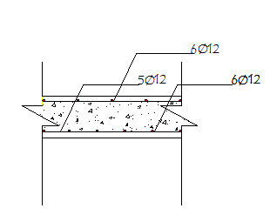
One way solid slab

Slide 24
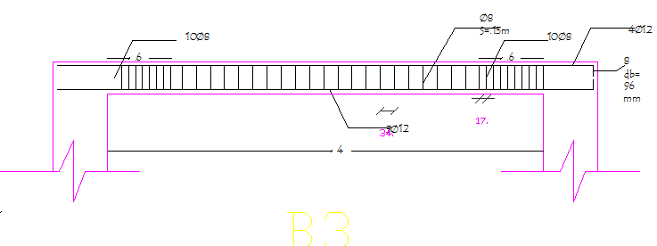
Beams

Slide 25
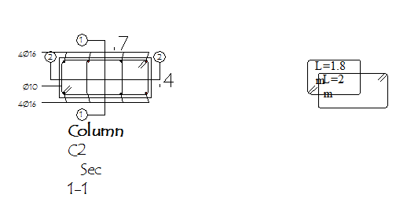
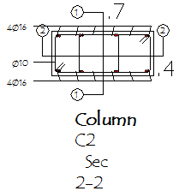
Block A (concrete frame ) : slab design
Column Reinforcement

Slide 26
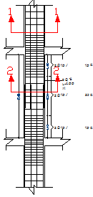

Slide 27
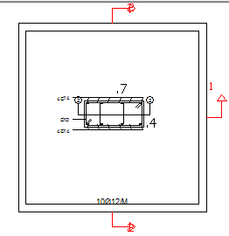
Footings reinforcement

Slide 28
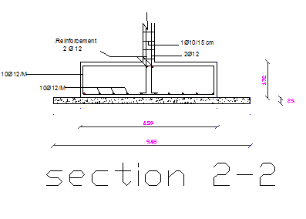

Slide 29
Electrical Design

Slide 30
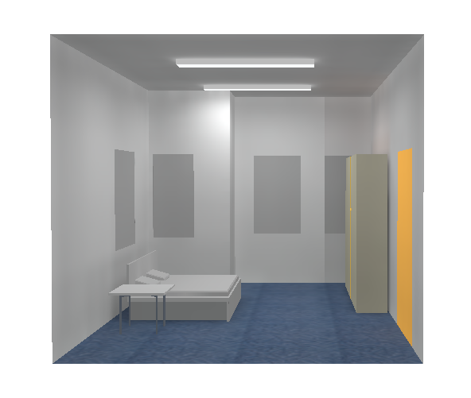
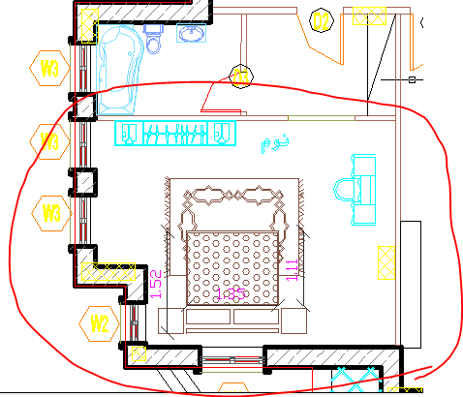
Lighting

Slide 31
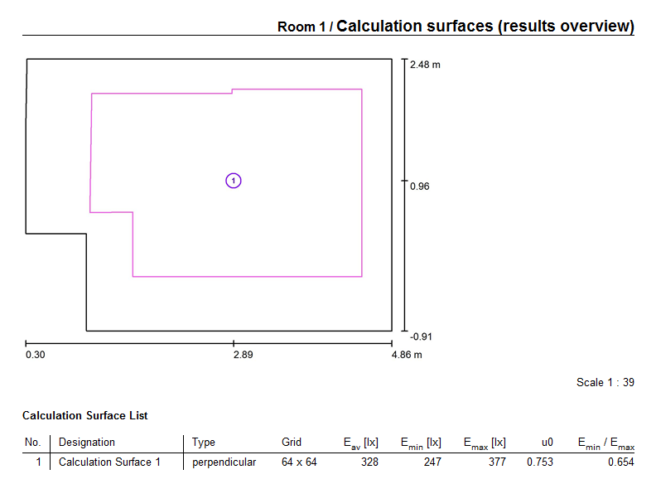

Slide 32
Uniformity is 0.753 as it is seen > 0.6 .. OK!
UGR value is<= 10 , means that the glare discomfort is imperceptible .. OK

Slide 33
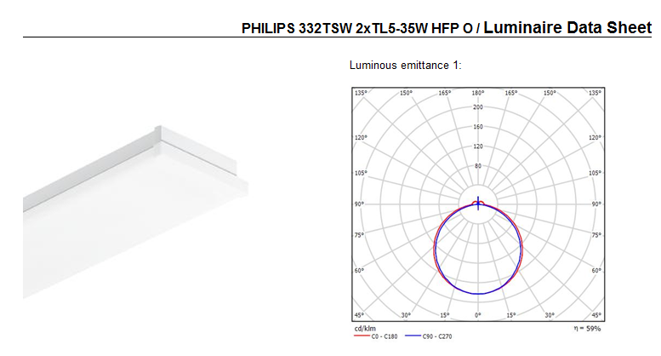

Slide 34
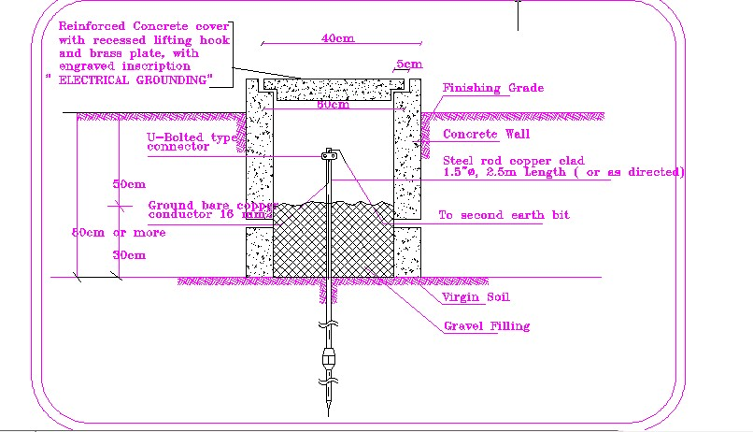
Earthing system

Slide 35
Mechanical
Design

Slide 36
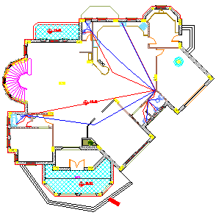
Water Supply System:
Water supply for GF

Slide 37
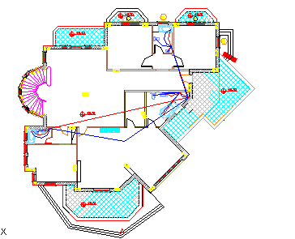
Drainage system:

Slide 38
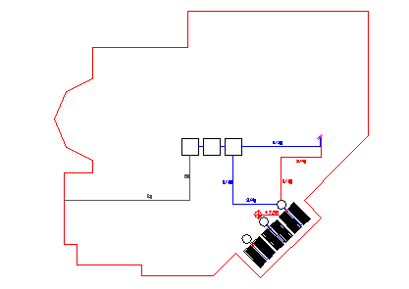

Slide 39
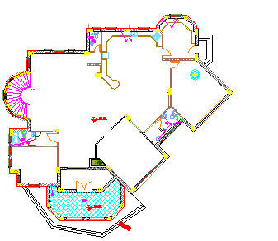
Drainage system
GF
Round floor drainage system

Slide 40
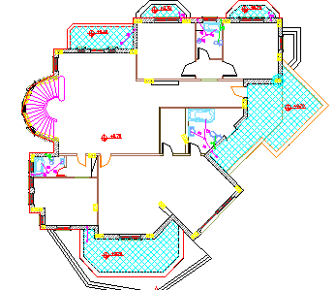
First floor drainage system

Slide 41
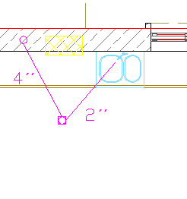

Slide 42
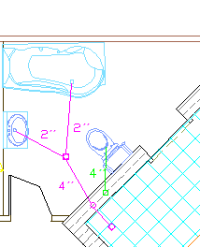

Slide 43
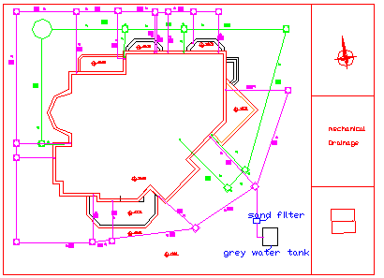

Slide 44
Heating and cooling system
room
living
North east bed room
North west bedroom
Master bedroom
Living room 1st floor
kitchen
Guest room
Guest bedroom
South west bed room 1st floor
Cooling load
3887.7
1283.3
1294.7
3014.7
3887.7
3631.2
1866.7
1057.4
1163.4
Heating load
2761.3
923.2
923.2
2259.9
2761.3
2884.1
956.1
969.1
987.3
# of tons
2 ton
1 ton
1 ton
2 ton
2 ton
2 ton
1 ton
.5 ton
.5 ton

Slide 45


