Slide 1

An-Najah National University
Graduation Project II
Structural Analysis and Design of
Childhood Center
Prepared by : Ahmed Younes Dafer

Slide 2


Slide 3
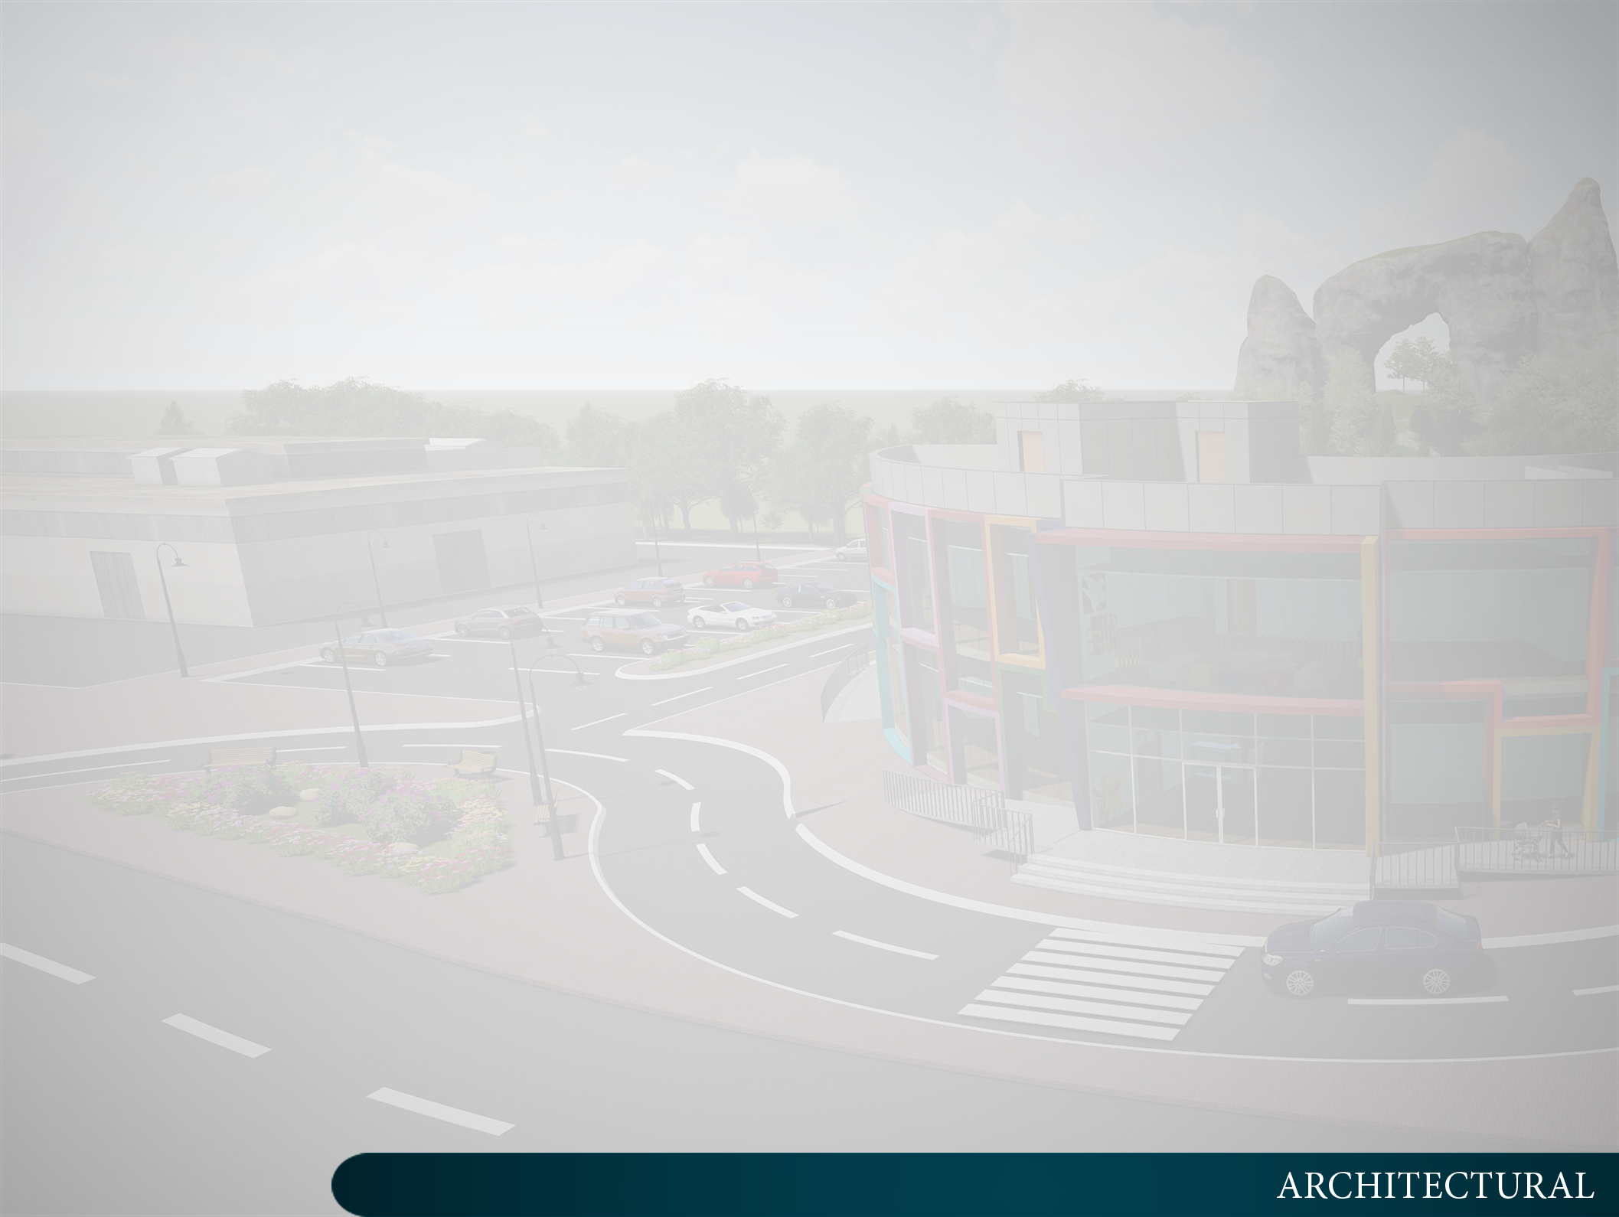
Architectural Design

Slide 4
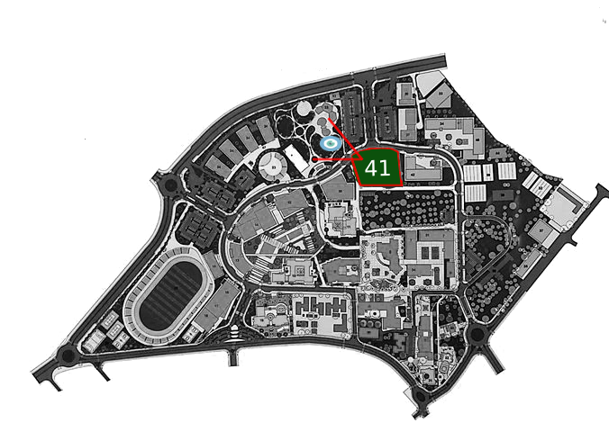
Site Location

Slide 5
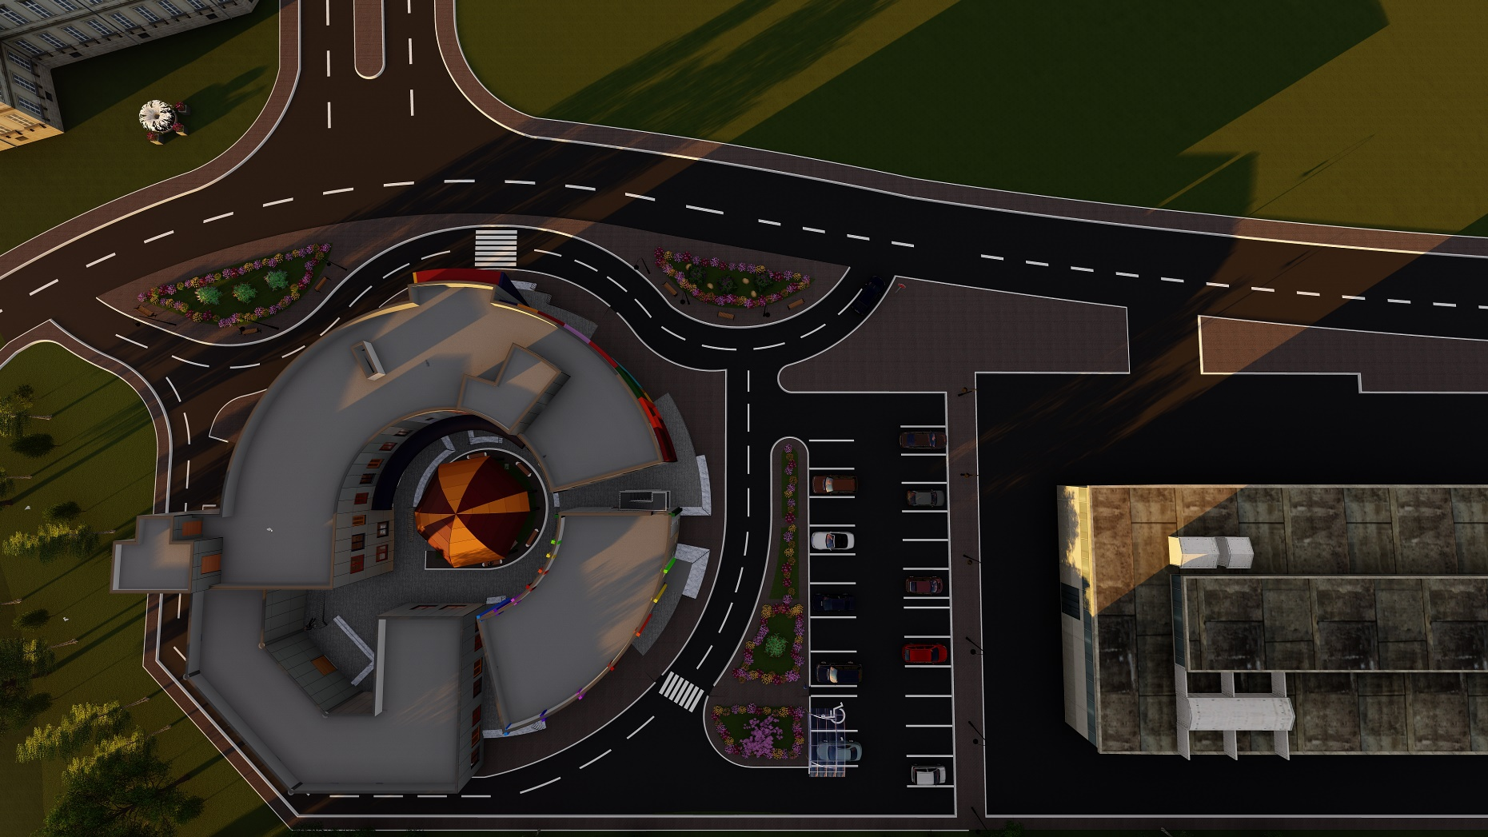
Site Plan

Slide 6


Design Consideration
Nursery
Kindergarten

Slide 7
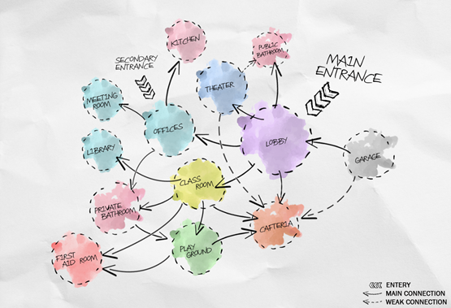
Bubbles Diagram

Slide 8
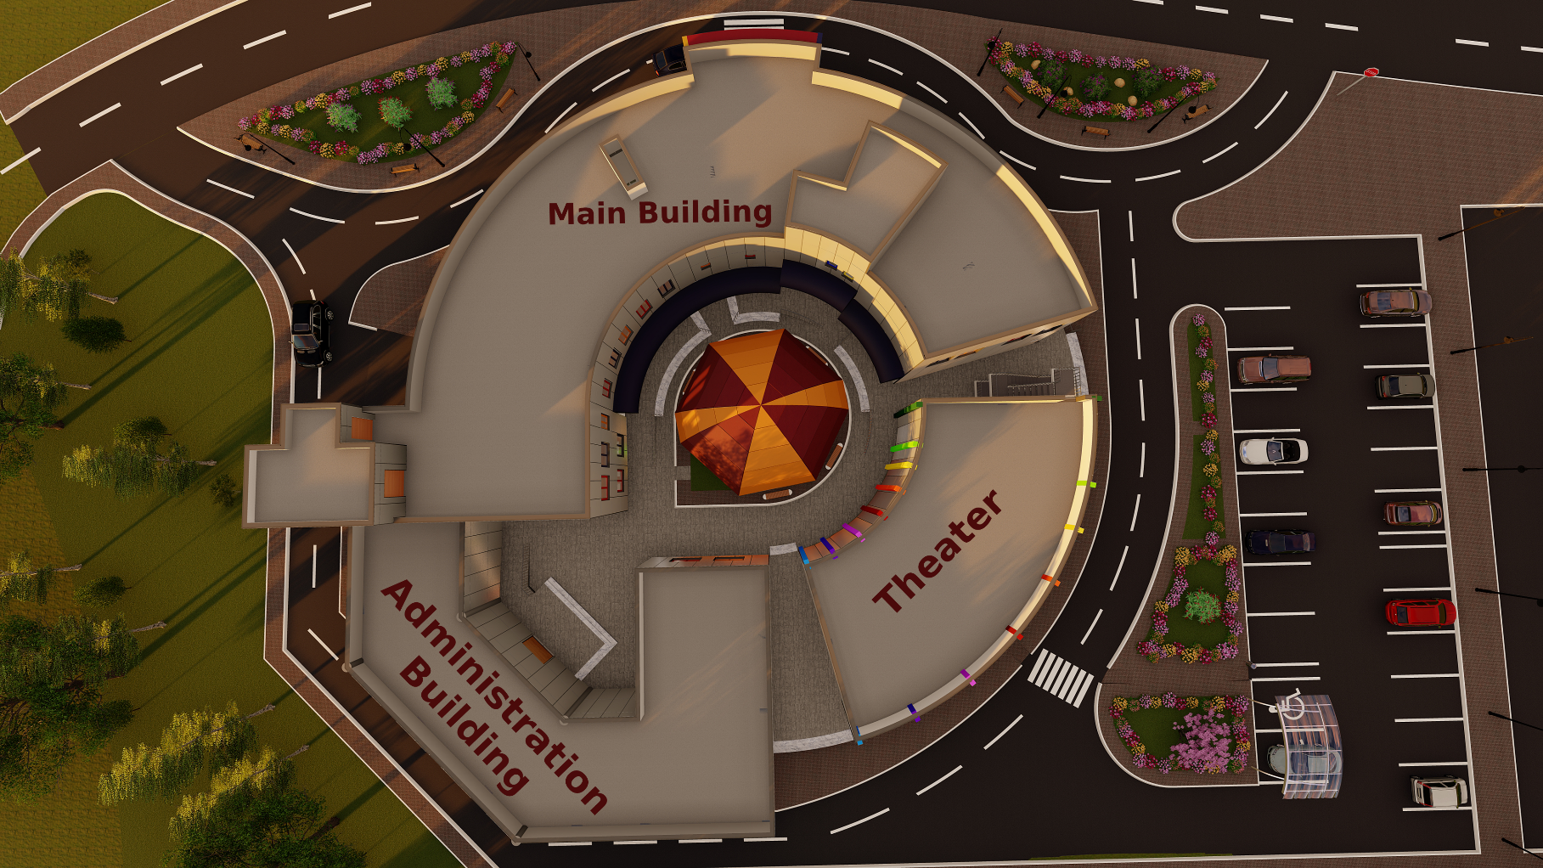
Building Parts

Slide 9
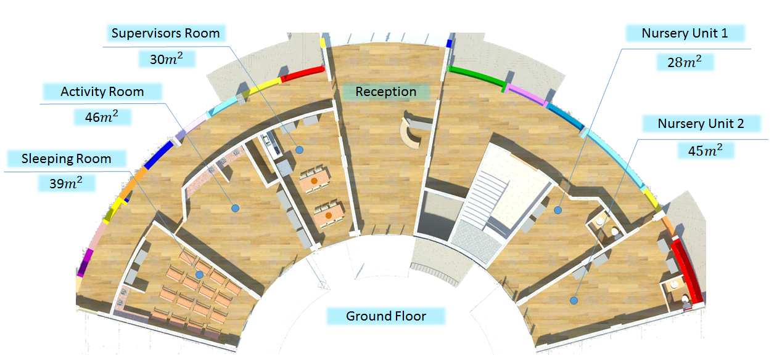
Main Building

Slide 10
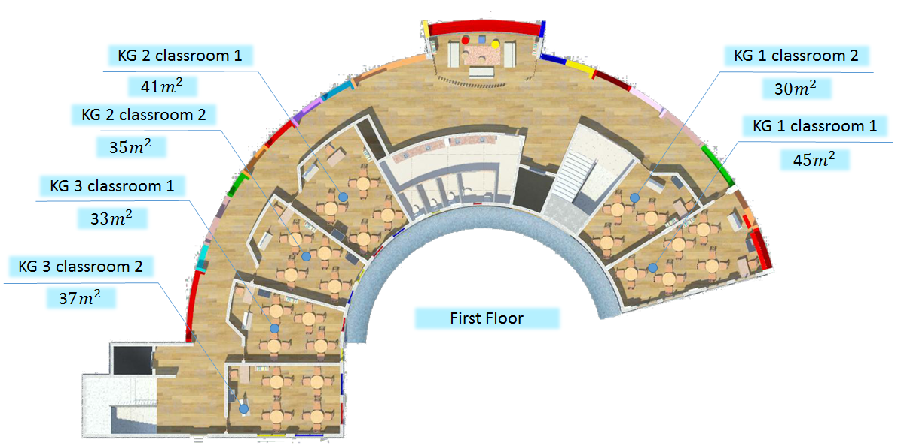
Main Building

Slide 11
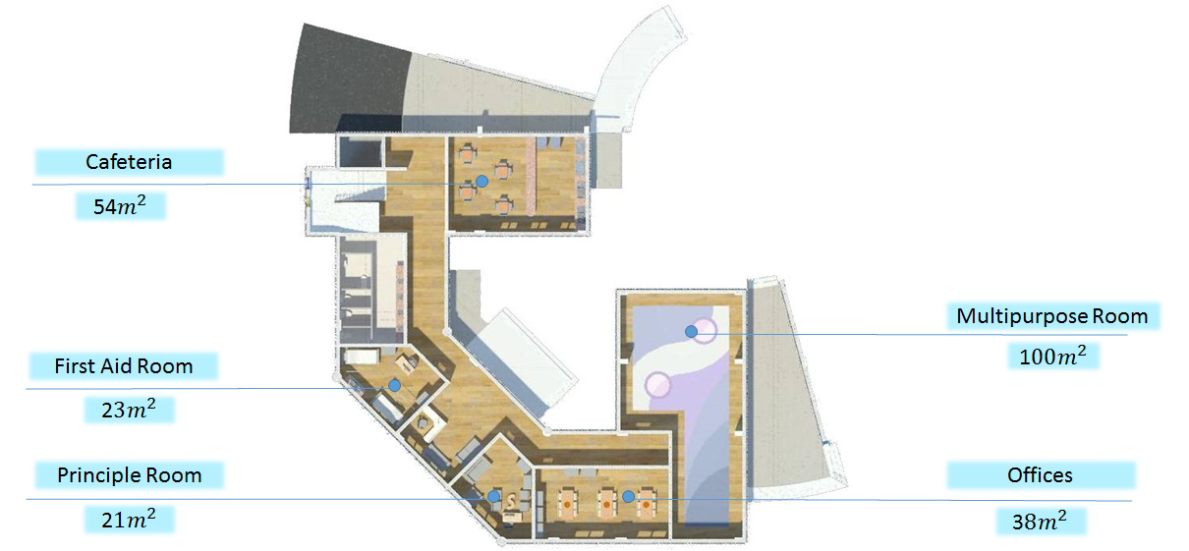
Administration Building

Slide 12
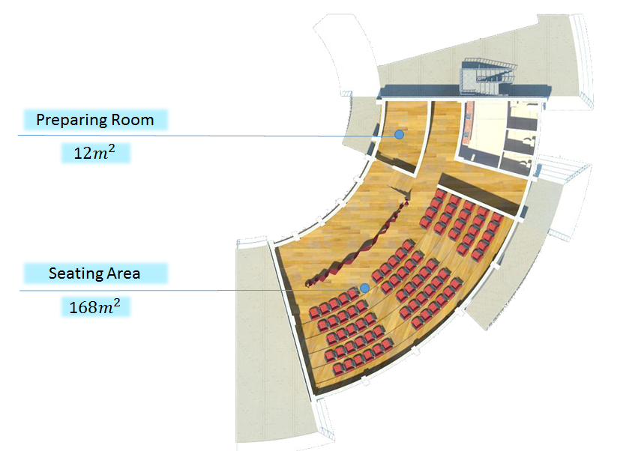
Theater

Slide 13
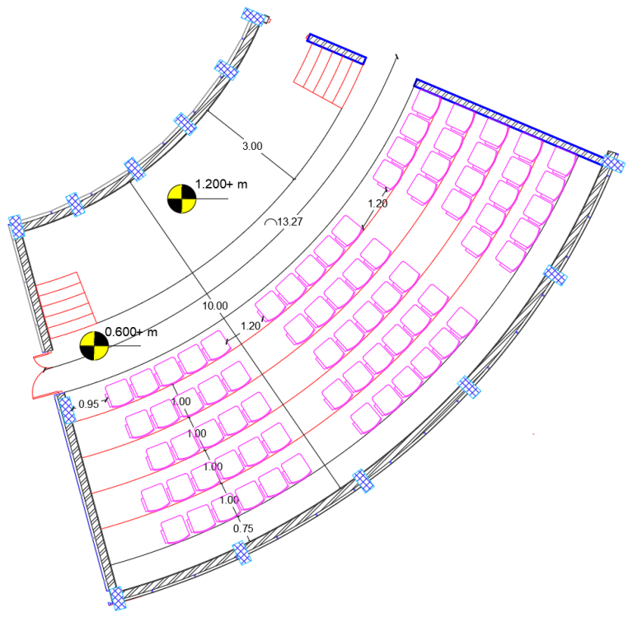
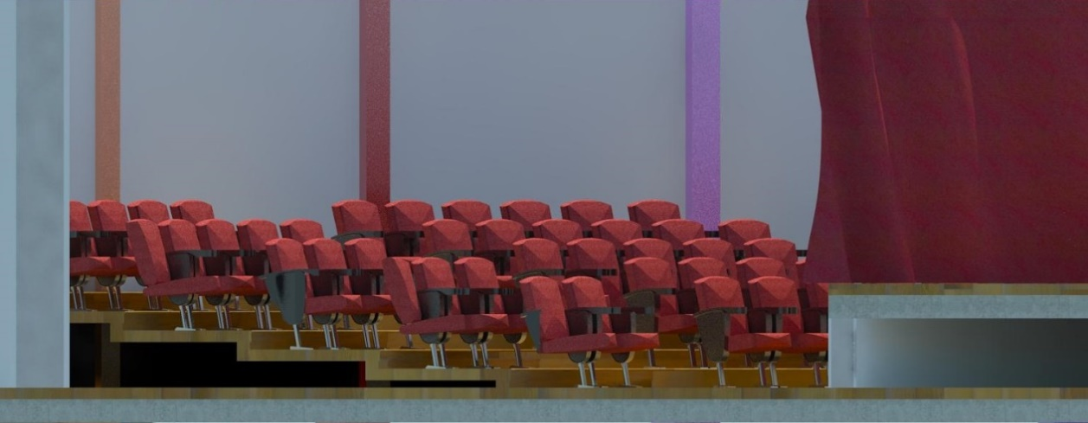
Theater Design

Slide 14
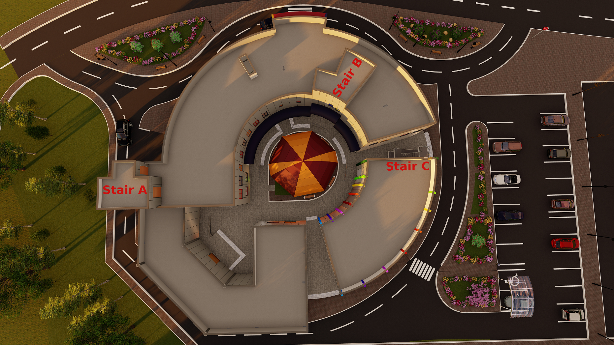
Stair Case

Slide 15
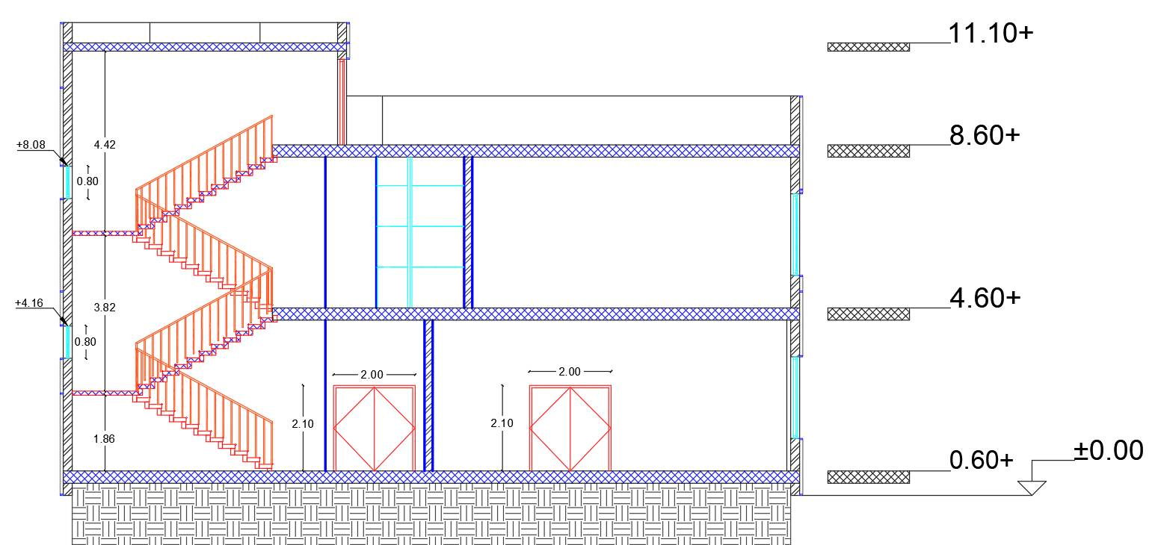
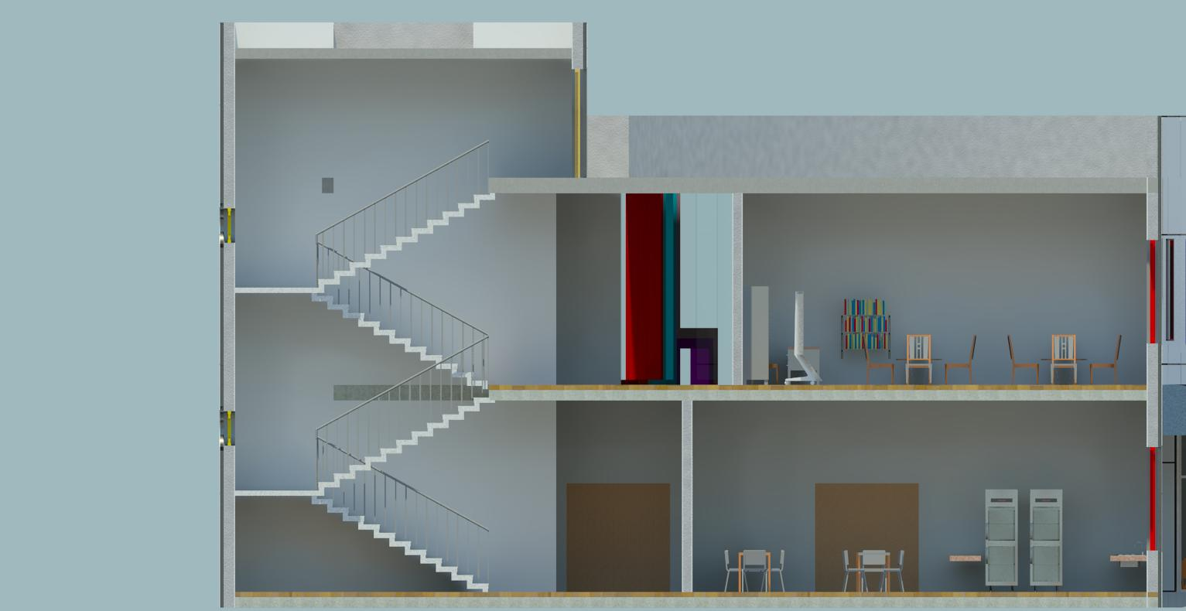
Stair-A Section

Slide 16
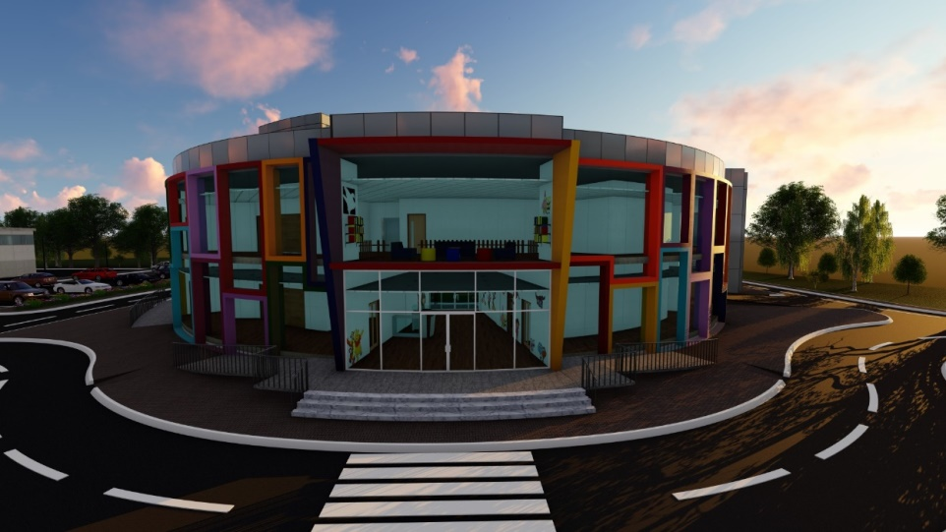
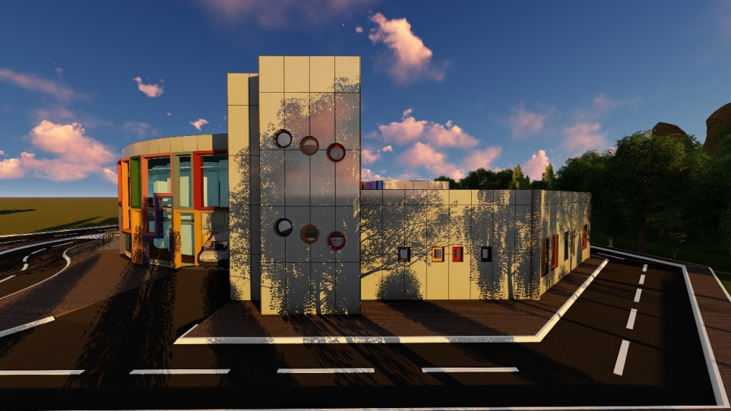
Elevations
North Elevation
West Elevation

Slide 17
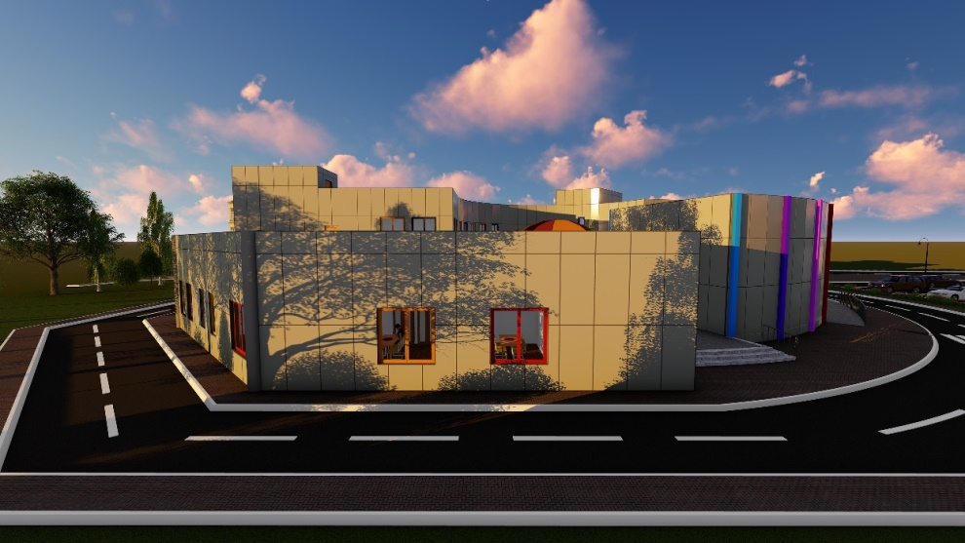
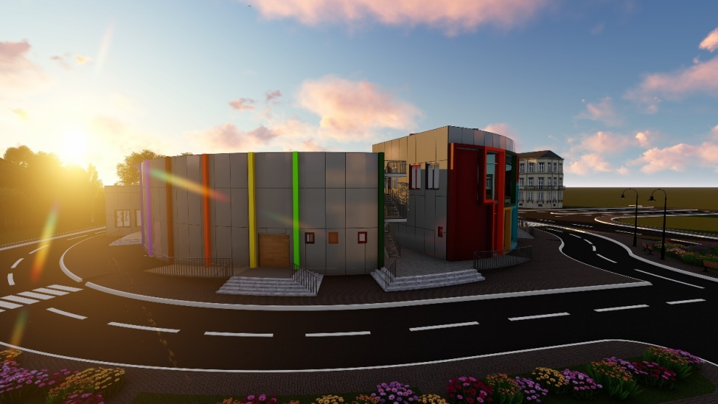
Elevations
South Elevation
East Elevation

Slide 18


Site Analysis

Slide 19

Structural Design

Slide 20
Design Codes
American Concrete Institute (ACI-318-14) Code 2014
American Society of Civil Engineering (ASCE)

Slide 21
Soil and materials properties
- Concrete strength for construction elements is B300 (f’c =24MPa).
Modulus of elasticity for concrete equals 4700* √24=23.03 GPa.
Unit weight for reinforced concrete is 2.5 ton/m3 = 25 kN/m3.
- Bearing capacity for soil is 250 kN/m2.
- Modulus of elasticity for steel equals 200 GPa.
Steel yield strength: For steel reinforcement, is 4200 kg/cm2 = 420 MPa.

Slide 22
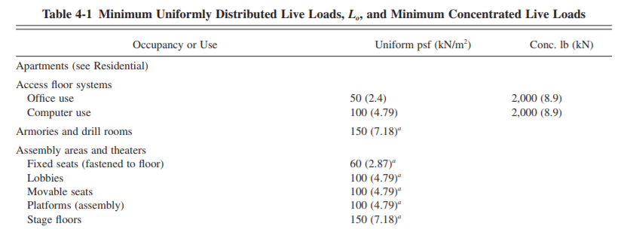
Loads and load combination
Super impose load = 4.3kN/m2.
According to ACI-318/9.2.1 the following load combinations was applied:
-1.2 × Dead Load + 1.6 × Live Load.
-1.4 × Dead Load.

Slide 23
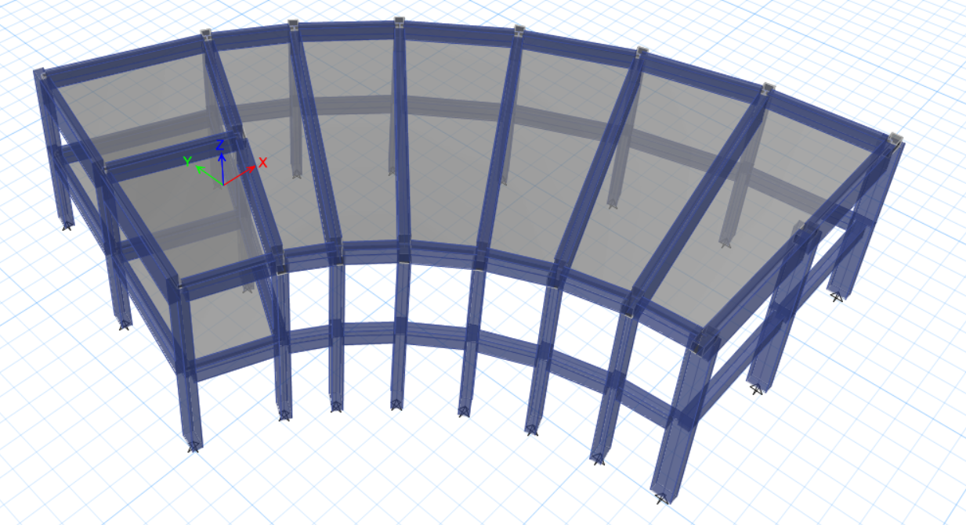
ETABS-Model

Slide 24
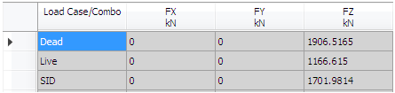
Model Checks - Equilibrium
ETABS results:
Manual calculations:
Load type | Manual | ETABS | Difference%
Dead load | 1975.189 | 1906.5165 | 3.6 % < 5% ok
Live load | 1166.75 | 1166.615 | 0.01 % < 5% ok
SID | 1702.1543 | 1701.9814 | 0.01 % < 5% ok

Slide 25
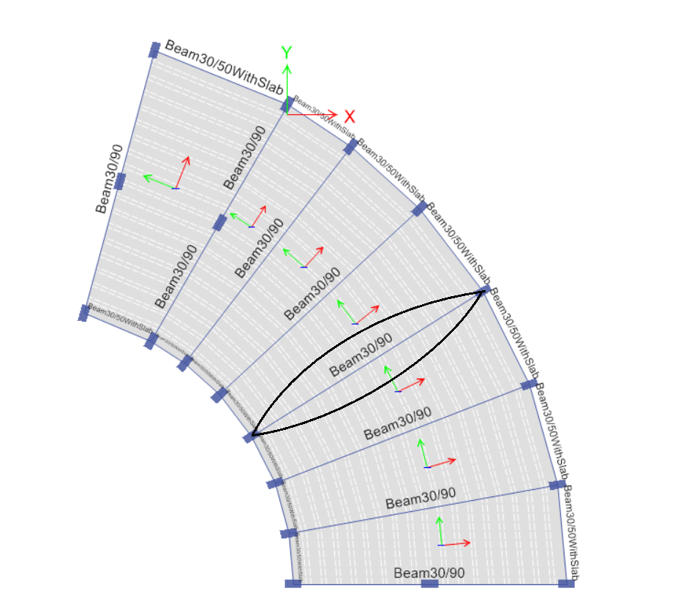
Model Checks – Internal stresses

Slide 26
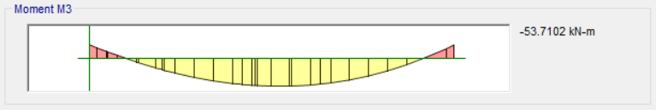
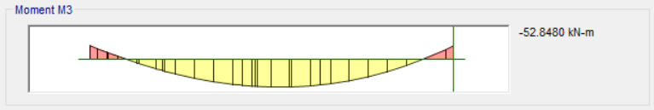
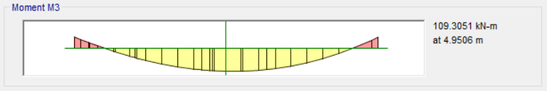
Model Checks – Internal stresses
Total Value from ETABS = 163kN-m.
Manual value = 186kN-m.
the difference between the two values = (186-162.55)*100%/186= 12%.

Slide 27
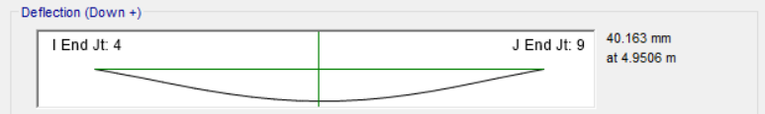
Model Checks – Long term deflection
for beam
From ACI-Code Long Term Deflection for Beam with block walls = L/240, → (10.8/240)*1000 = 45mm
40.1 < 45. ok

Slide 28
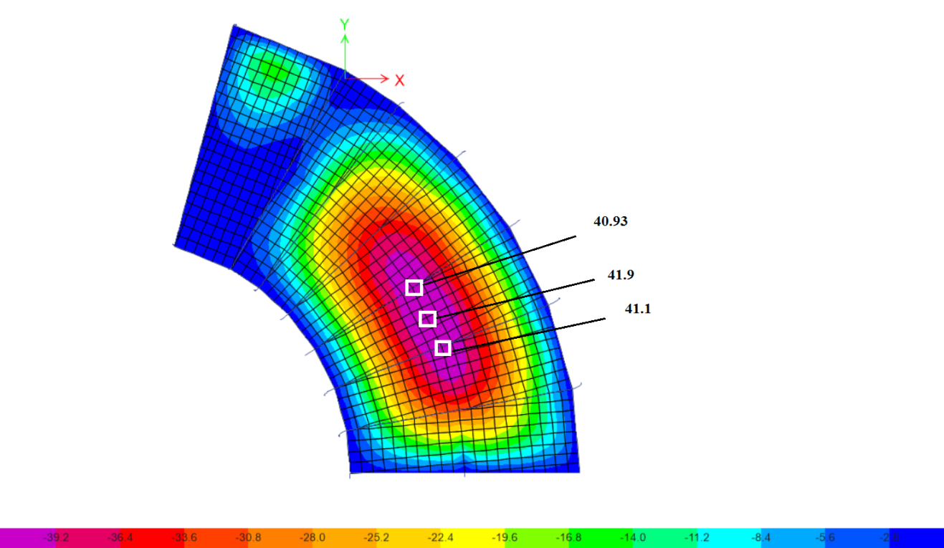
Model Checks – Long term deflection
for slab
For the critical span the deflection = 41.9 - (41.1+40.9)/2 = 0.9mm, the acceptable deflection = (3.9/240)*1000 = 16mm, 0.9 < 16, ok.

Slide 29
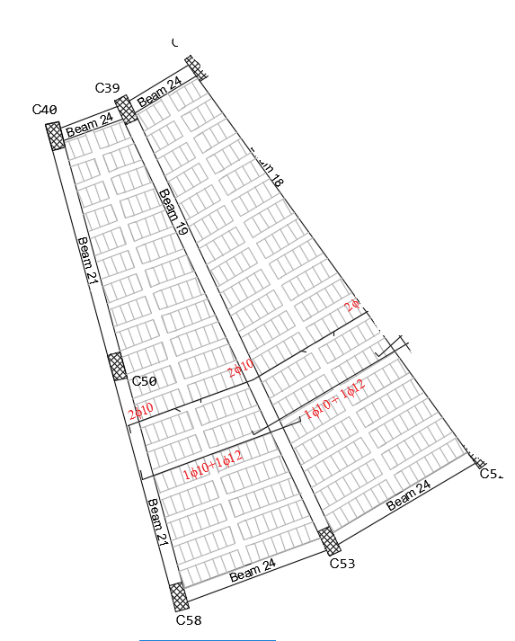
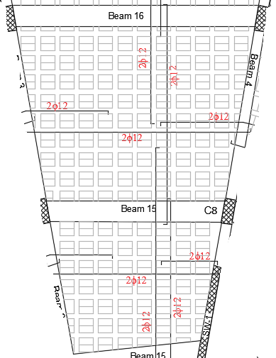
Slab design
One way ribbed slab
Two way ribbed slab

Slide 30
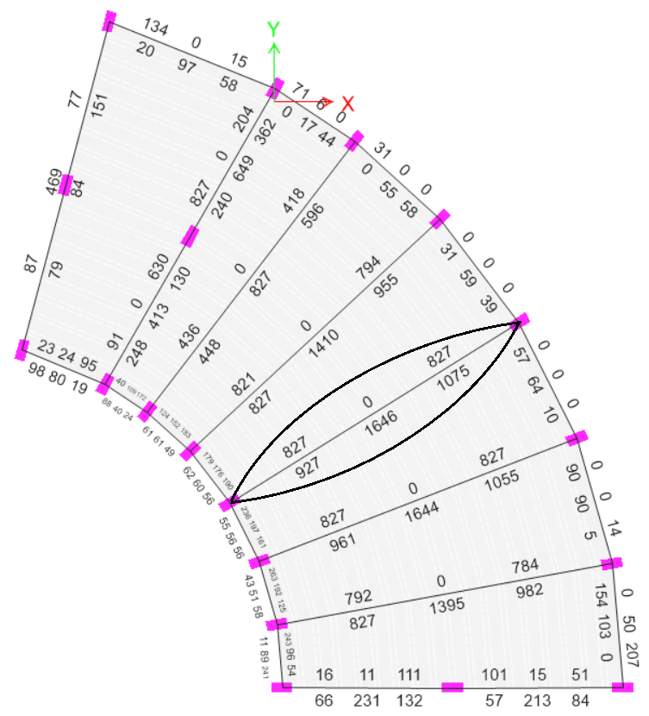
Beam design

Slide 31
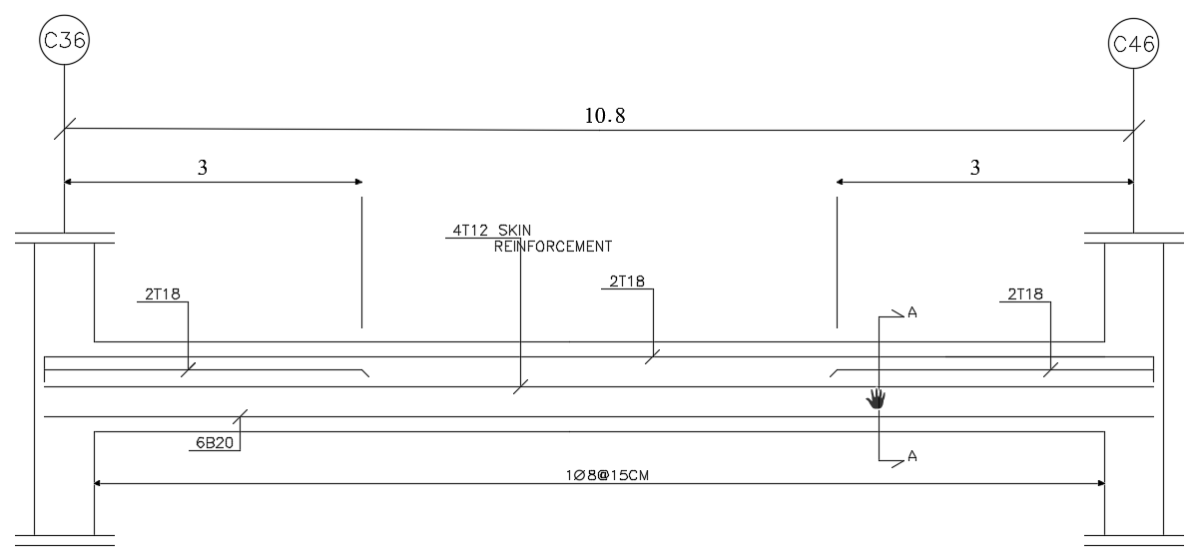
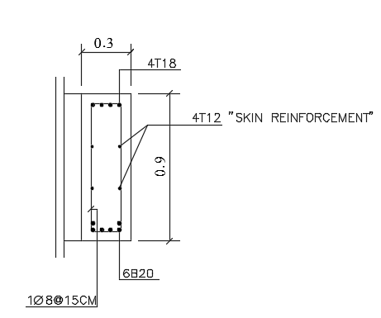
Beam design

Slide 32
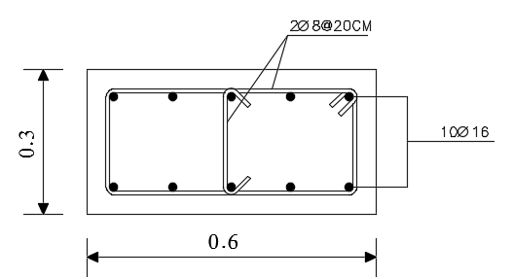
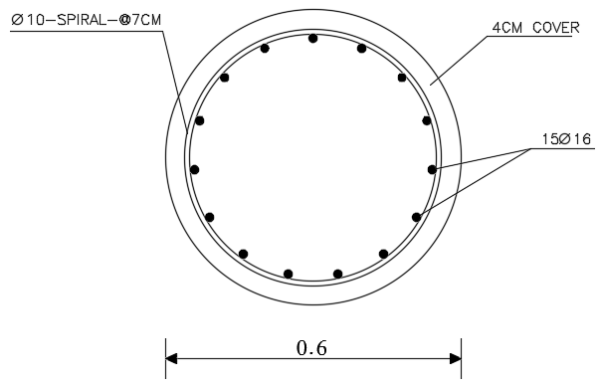
Columns Design

Slide 33
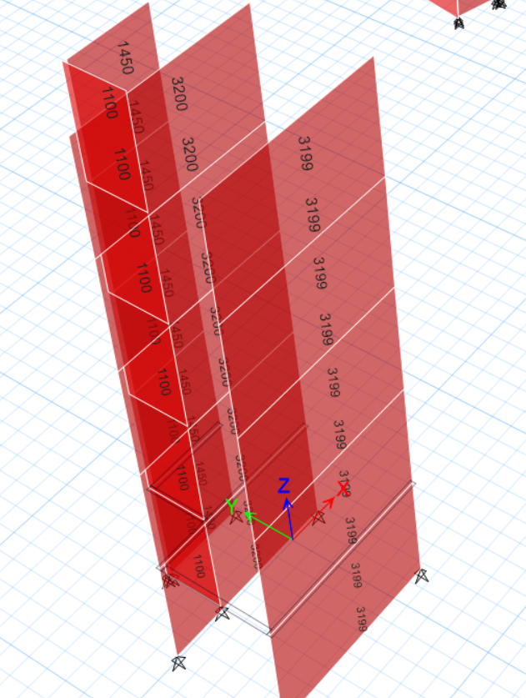
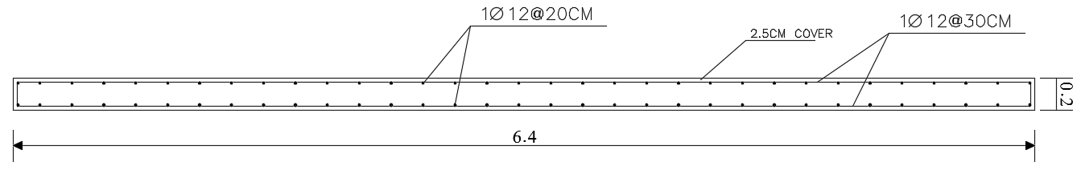
Shear Wall Design

Slide 34
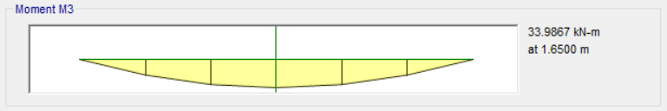
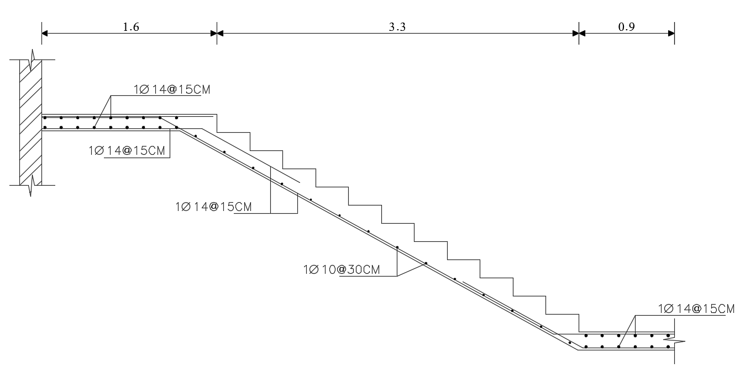
Stairs Design

Slide 35
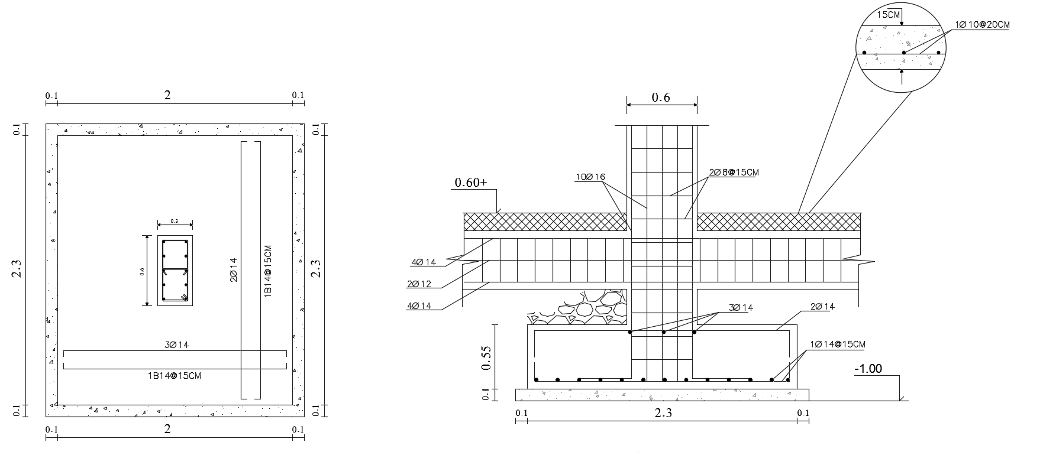
Footings and Tie beams Design

Slide 36
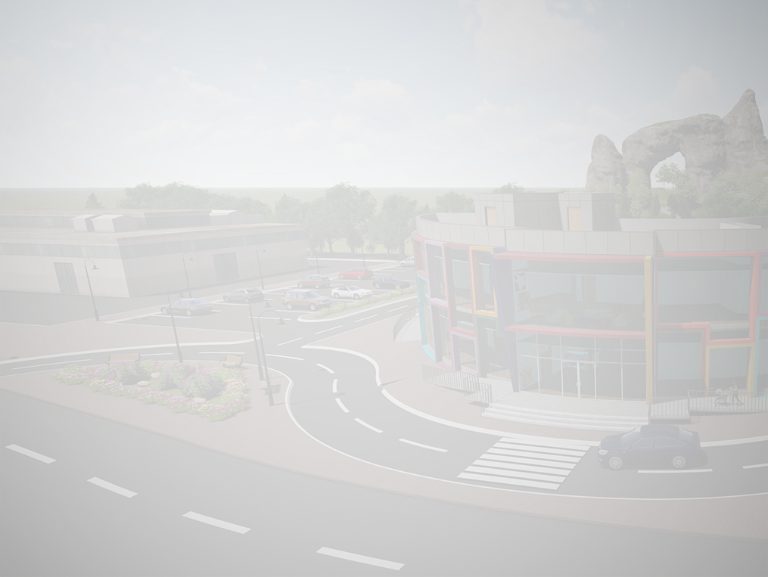
Quantities

Slide 37
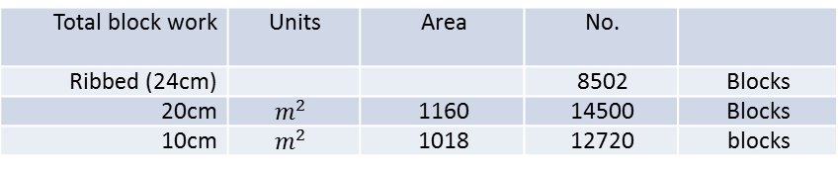
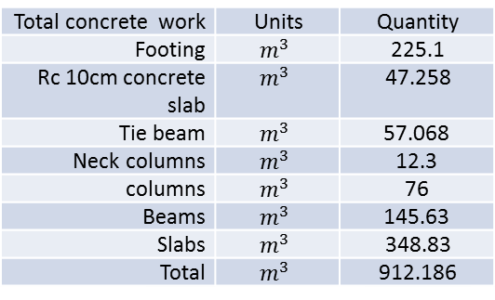
Total block work | Units | Area | No.
Ribbed (24cm) |  |  | 8502 | Blocks
20cm | $$m^{2}$$ | 1160 | 14500 | Blocks
10cm | $$m^{2}$$ | 1018 | 12720 | blocks
Total concrete work | Units | Quantity
Footing | $$m^{3}$$ | 225.1
Rc 10cm concrete slab | $$m^{3}$$ | 47.258
Tie beam | $$m^{3}$$ | 57.068
Neck columns | $$m^{3}$$ | 12.3
columns | $$m^{3}$$ | 76
Beams | $$m^{3}$$ | 145.63
Slabs | $$m^{3}$$ | 348.83
Total | $$m^{3}$$ | 912.186
Total steel work | Units | Quantity
Footing | Kg | 16728.7
Tie beam | Kg | 19244.93
Neck columns | Kg | 4334.8
columns | Kg | 9779.8
Beams | Kg | 18607.169
Slabs | Kg | 14129.37
Total | Kg | 78241.328

