Slide 1

AN-NAJAH NATIONAL UNIVERSITY
FACULTY OF ENGINEERING
DEPARTMENT OF ELECTRICAL ENGINEERING

Slide 2

Students name :
Osama Draidi
Ali Jomah
Diyaa Taslaq
Supervisor:
Dr.|Jammal Kharooshe
23/5/2012

Slide 3
Remote Sensing
Wagen
23/5/2012
Notes:
Jyrtftrttdderedrrerwrererererter

Slide 4
Objectives:
To Build up an Indoor machine(Bot-a half robotic) that can be Remotely controlled to be used for missions generally hazardous to humans. i.e.
1.To Discover Places which are considered Dangerous on humans.
2.To Discover if there are Alive People in Air Polluted Areas.
3.To Discover if there are Alive People in House Blazes.
4.To Assist the Cops in their Duties.
23/5/2012

Slide 5
Introduction
The Common Controller device controls the Unmanned Systems(Sensors, Camera).
This bot(a half robotic machine) is Multifunctional Utility. This a small Unmanned Ground bot is (a portable, tracked bot).It Has a network of detection sensors, monitoring camera.
23/5/2012

Slide 6
Introduction
This bot is Supposed to Send the Read Data remotely from these unmanned systems (i.e. sensors, camera) to land observer.
Once the bot finds an some action (i.e. person, blaze, gas… etc.) the bot could transmit a live video with text information (read data) to a land observer.
23/5/2012

Slide 7
Project flow and sequencing
* Learning how to program the microcontroller.
* Study the general concept of sensors.
* programing the PIC to work as ADC.
* Connect the basic circuit for the PIC, also connect the circuit for temperature and motion sensor with proper amplification.
* Testing the circuit of the PIC and sensors together without RF.
23/5/2012

Slide 8
Project flow and sequencing
* Connect the circuit of RF with encoder decoder.
* Programing PIC at the receiver side to take data from RX, analyzing it, and display it on the screen
* Connect the whole circuit together (RF TX, RX), (PIC at RX and TX side), (sensors).
* Preparing the Wagen and put the TX circuit on it.
23/5/2012

Slide 9
Components
a. Bots.
b. Microcontroller (PIC 18F4620).
c. RF transmitter receiver.
d. HT12E and HT12D decoder and encoder.
e. Serial cable.
f. Temperature sensor.
g. Motion sensor.
h. USB to RS232 convertor.
i. Batteries.
j. Wireless camera.
23/5/2012

Slide 10
Microcontroller
The Brain of the project, the center of process and the decision maker is microcontroller PIC. It’s very popular, easy to program, it has modules support our requirements, and we are well trained to use it.
* A programmer circuit was built to download code to PIC.
* Software used was PIC-C with CCS compiler.
23/5/2012

Slide 11
Microcontroller
Problems in Microcontroller:-
Noise and disturbances:
The biggest enemy to PIC was noise. The high frequency signals received from communication devices causes the PIC to become unstable and suffers from changing values of the registers which sometimes results in restart in PIC. When problem occurs and PIC outputs unpredicted results, it can be tested isolating PIC from input-output and then manually input data and test output on LEDs.
23/5/2012

Slide 12
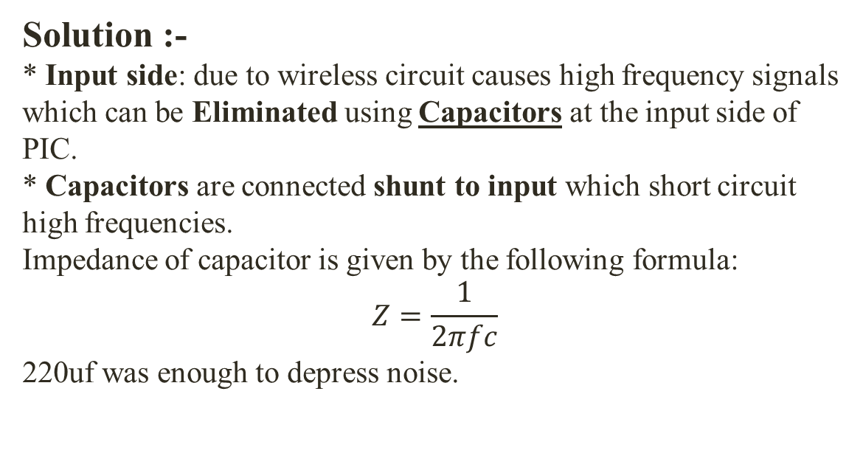
Microcontroller
Solution :-
* Input side: due to wireless circuit causes high frequency signals which can be Eliminated using Capacitors at the input side of PIC.
* Capacitors are connected shunt to input which short circuit high frequencies.
Impedance of capacitor is given by the following formula:
$$Z=\frac{1}{2πfc}$$
220uf was enough to depress noise.
23/5/2012

Slide 13
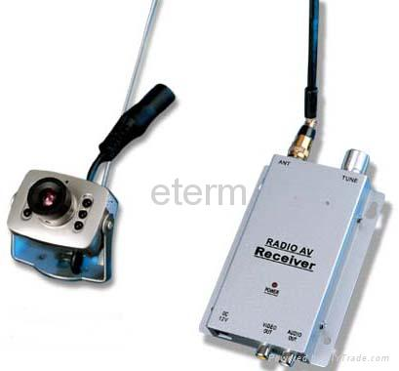
Wireless Camera
Features:
* 1.2G Wireless Mini Color Cmos Camera
* Voltage: DC+9V
* Current: 300mA
* 100ft
23/5/2012

Slide 14
Sensors
In order for the Wagen to interact with its environmental, several different sensors are necessary. Motion sensors are needed so we can determine if there is any human or any living body in the area.
A temperature sensor is used to give us reading for the temperature in the discovering area.
23/5/2012

Slide 15
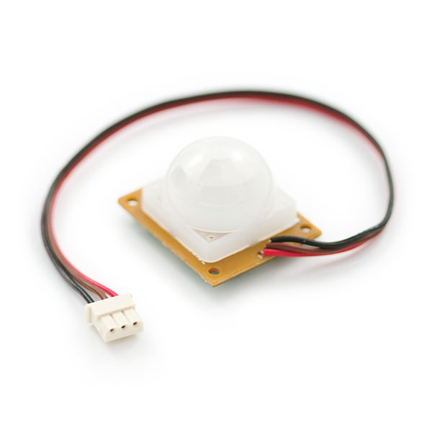
Motion Sensor
This is a simple to use motion sensor. Power it up and wait 1-2 (s) for the sensor to get a snapshot of the still room. If anything moves after that period, the 'alarm' pin will go low.
23/5/2012
Notes:
All the results of duct design based on equal pressure drop method

Slide 16
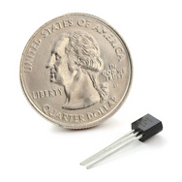
Temperature sensor
The LM335A is a very easy-to-use analog temperature sensor.
10mV/°C.
−40°C to 100°C.
23/5/2012

Slide 17
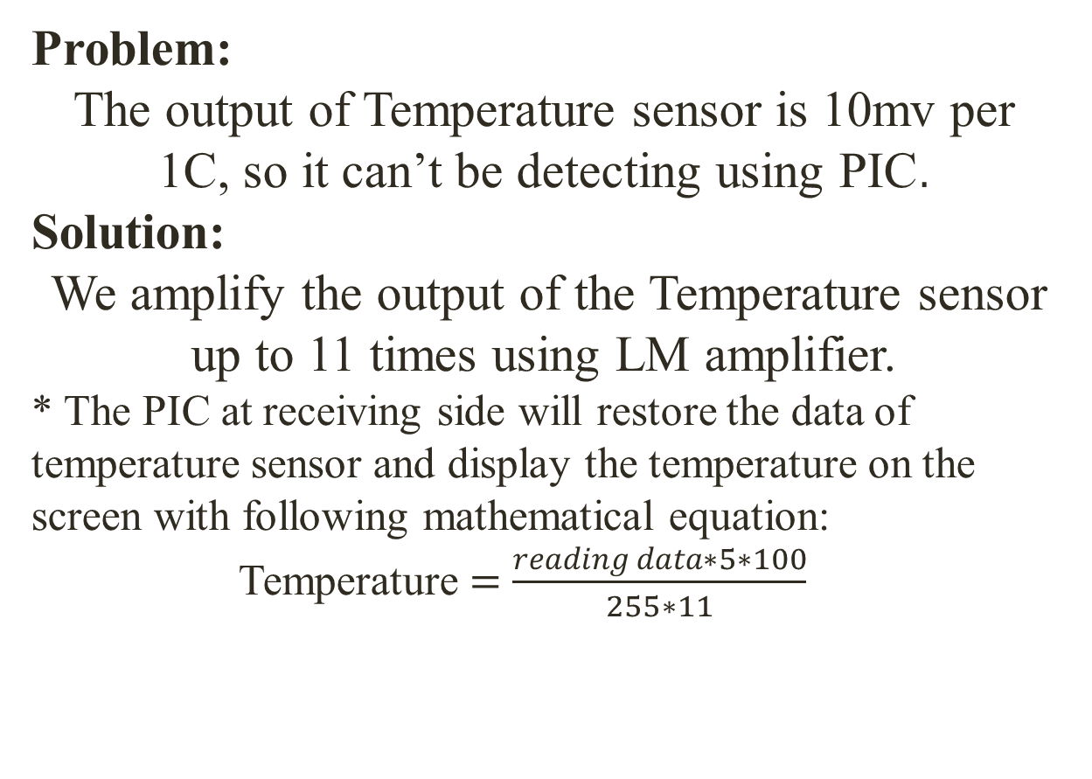
Problem & Solution
Problem:
The output of Temperature sensor is 10mv per 1C, so it can’t be detecting using PIC.
Solution:
We amplify the output of the Temperature sensor up to 11 times using LM amplifier.
* The PIC at receiving side will restore the data of temperature sensor and display the temperature on the screen with following mathematical equation:
Temperature $=$ $\frac{reading data∗5∗100}{255∗11}$
23/5/2012
Notes:
AIR HANDLING UNIT SELECTION

Slide 18
Wireless
* We want to add advantage to our project by adding wireless. This was done by using Transmitter and Receiver to send and receive the data of the sensors.
23/5/2012

Slide 19
Radio Frequency Transceiver
Because the signal is transmitted through infrared radiation, we faced a problem in the received signal, sometimes the transmitted signal arrives to the receiver and other times it doesn’t.
Solution:
We used a radio frequency (RF) radiation instead of infrared radiation.
23/5/2012

Slide 20
Radio Transmitter RT4-XXX
General description:
* The RT4-XXX is a hybrid circuit that allows realizing a complete radio transmitter by adding a coding circuit.
* It shows stable electric characteristics.
* Working frequency ( 433.92 MHz).
23/5/2012

Slide 21
Radio Receiver RR3-XXX
General description:
* The RR3-XXX is a super regenerative data receiver.
* It shows high frequency stability also in presence of mechanical vibrations.
* The frequency accuracy is very high.
* Working frequency (200 - 450 MHz).
23/5/2012
Notes:
AIR HANDLING UNIT SELECTION

Slide 22
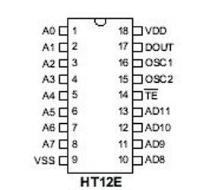
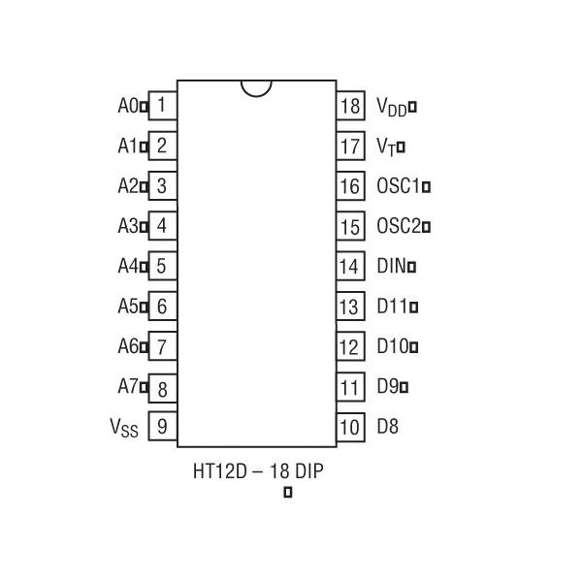
Problem & Solution
Problem:
We can’t send and receive the data from PIC immediately by using just RF Transceiver.
Solution:
To solve this problem we used encoder and decoder IC’s to send and receive data by using Manchester coding
23/5/2012

Slide 23
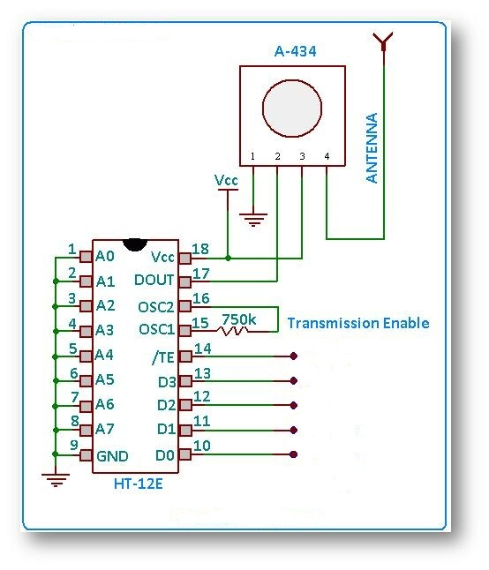
Encoder with RF-Tx

Slide 24
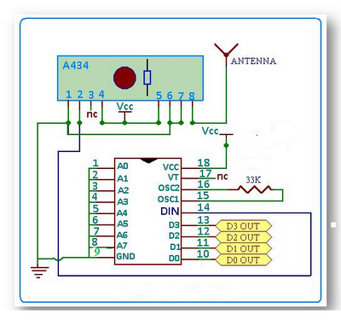
Decoder with RF-Rx

Slide 25
Final strategy
* The output voltage of the sensor will be converting to analogue signal using PIC microcontroller at transmission side.
* This signal will be send to another PIC at receiving side using RF (TX, RX).
* The PIC at receiving side will analyze incoming data and display it on the mentoring screen.
* Connecting the transmission side of wireless camera to supply voltage of 9V, and also at receiving side. Then connecting the receiving side of camera to another mentoring screen.
23/5/2012

Slide 26
Results
* Half automatic bot with full automatic of sending and receiving of sensors data.
* Good team work and planning skills as well as budget management
* Deep experience in HT’s encoder decoder, the ability to manipulate electronic circuits as well.
* Background about sensors specially motion sensor and temperature sensor and others.
* Interfacing circuits and the ability to solve problems of the transferred signals between different electronic devices.
* The ability to apply wireless communication either IR or RF and understand the limitations of IR transcieving.
* Breaking the limits, do the impossible and hoping for more.

