Slide 1
Pick at Locker

Slide 2
Agenda
  Introduction
Hardware Component
Constraints
1
3
5
2
4
6
Project Execution
Mobile Application
Future Work

Slide 3
1.
Introduction

Slide 4
PROBLEMS:
The street system in Palestine is unclear and undefined.
The customers are not present at the time of delivery at their homes.
Efforts to contact customers via phone calls.

Slide 5
OBJECTIVES:
Accuracy.
Time saving.
24/7 availability.
Efficient route planning.
Environmental impact.
Secure storage.

Slide 6
Pick at Locker
Where recipients can receive their
parcels from public lockers at any time.

Slide 7
Project Execution

Slide 8
Initial Ideas:
First Design:
Three sanding belts.
One Stepper motor for the Y-axis.
Three servo motors attached to each belt rotate 360˚.
Three servo motors to place the parcel.
Second Design:
Two stepper motors for the X-axis and Y-axis.
One servo motor to place the parcel.
One CNC XY LINEAR MOTION.

Slide 9
Initial Ideas:
Second Design:
Two stepper motors for the X-axis and Y-axis.
One servo motor to place the parcel.
One CNC XY LINEAR MOTION.

Slide 10
3.
Hardware Component

Slide 11
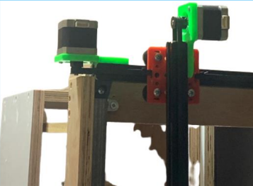
Motors and drivers
Two stepper motors

Slide 12
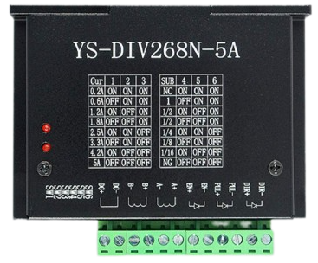
Motors and drivers
Two stepper motors
YS-DIV Driver

Slide 13
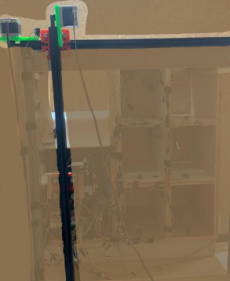
Motors and drivers
Two stepper motors
YS-DIV Driver
CNC XY Linear Motion

Slide 14
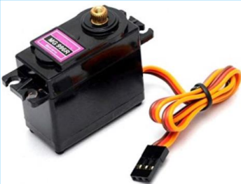
Motors and drivers
Servo motor mg996r

Slide 15
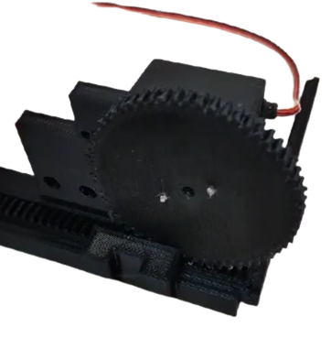
Motors and drivers
Servo motor mg996r
3D printing mechanism

Slide 16
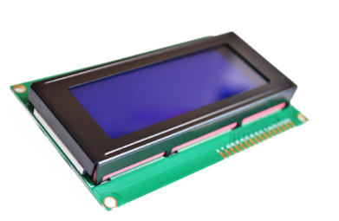
Input/Output Components
LCD

Slide 17
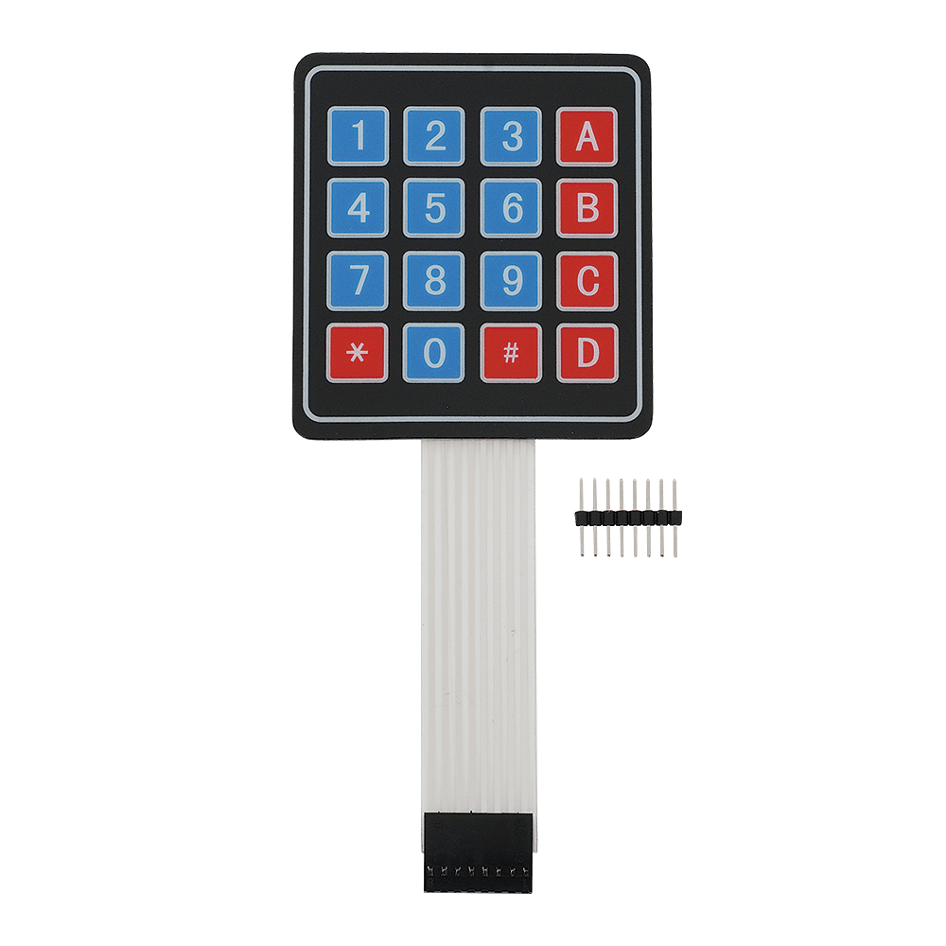
Input/Output Components
LCD
Keypad

Slide 18
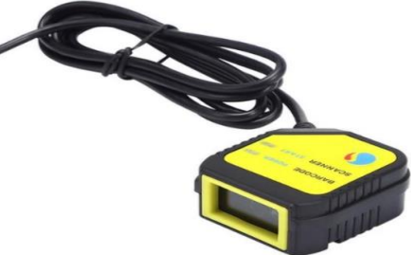
Input/Output Components
Barcode Scanner

Slide 19
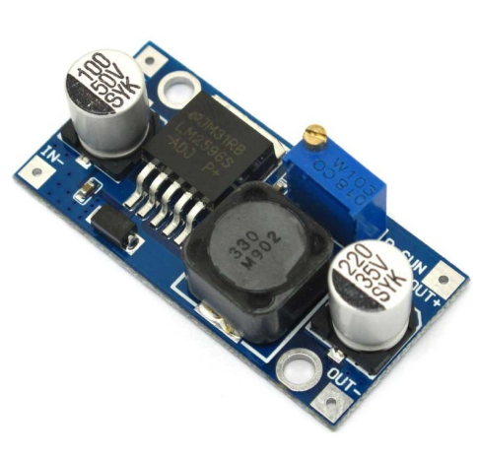
Input/Output Components
Barcode Scanner
DC-DC Converter

Slide 20
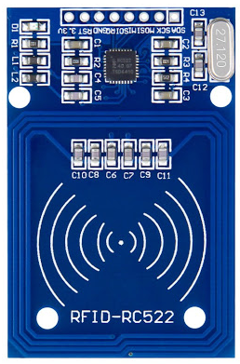
Input/Output Components
RFID

Slide 21
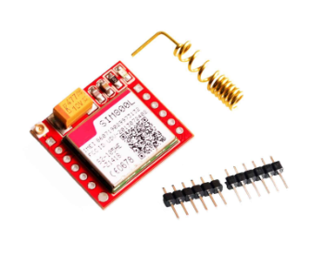
Input/Output Components
SIM800L GSM Module

Slide 22
Input/Output Components
SIM800L GSM Module
DC-DC Converter

Slide 23
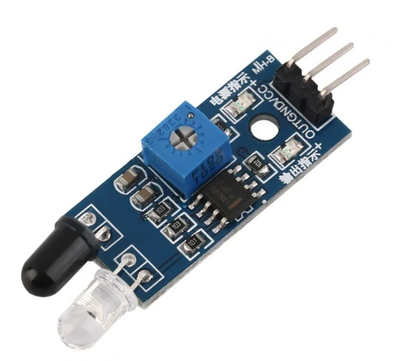
Hardware Components
IR Sensor

Slide 24
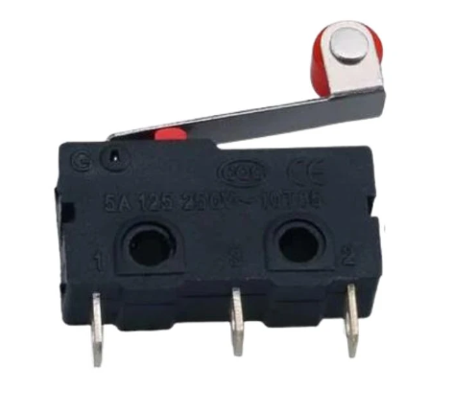
Hardware Components
Micro-Switch

Slide 25
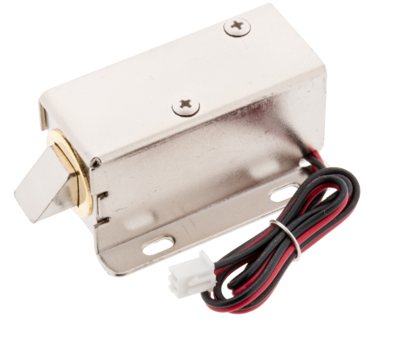
Hardware Components
Solenoid Electric Lock

Slide 26
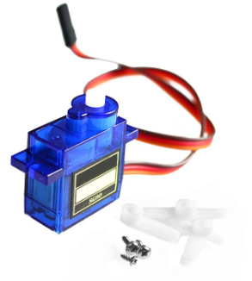
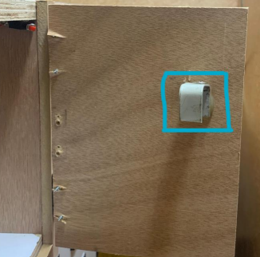
Hardware Components
Micro Servo SG90
Curve Stick

Slide 27
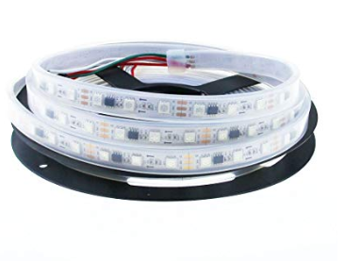
Hardware Components
Strip LED

Slide 28
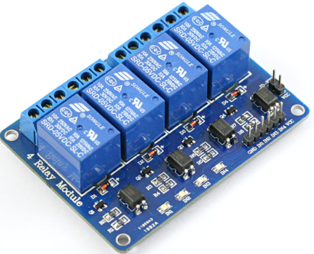
Hardware Components
Strip LED
4-Channel Relay

Slide 29
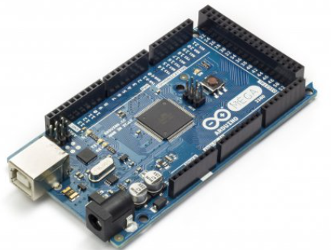
Microcontrollers
Arduino Mega 2560

Slide 30
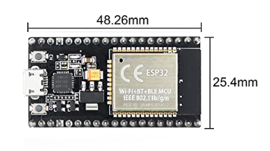
Microcontrollers
ESP32-WROOM-32

Slide 31
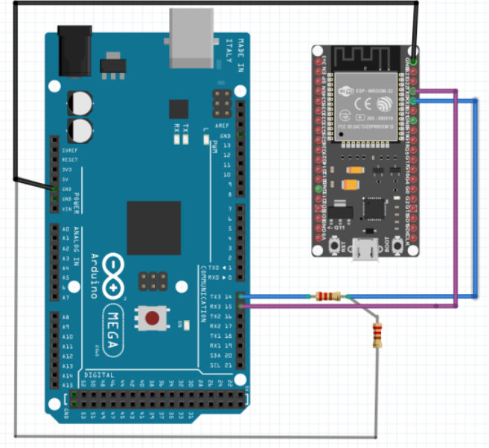
Microcontrollers
Connection ESP32 with Arduino Mega

Slide 32
Microcontrollers
ESP32 used as:
Firebase client.
Server for mobile application.

Slide 33
4.
Mobile Application

Slide 34
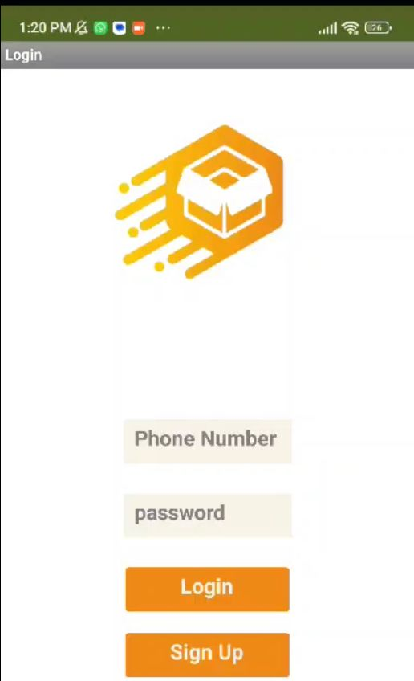
LOGIN/SIGNUP PAGE:

Slide 35
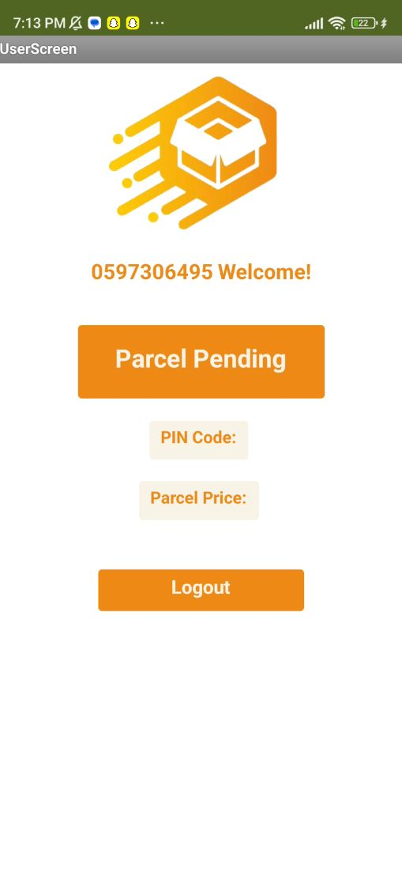
USER PAGE:

Slide 36
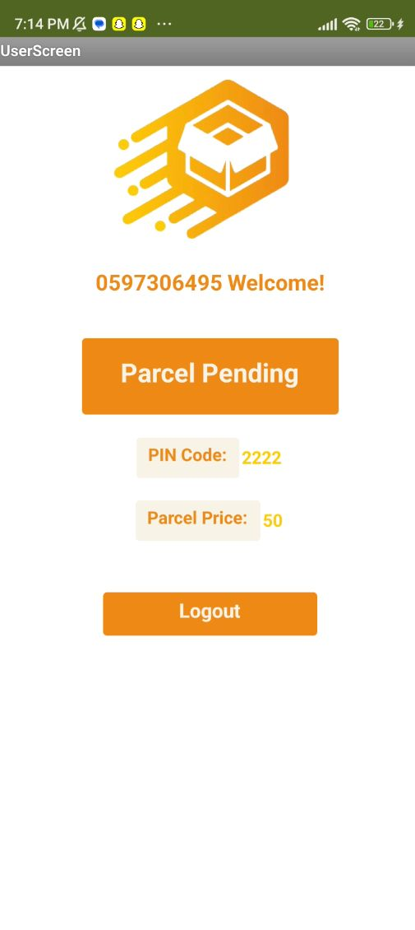
USER PAGE:

Slide 37
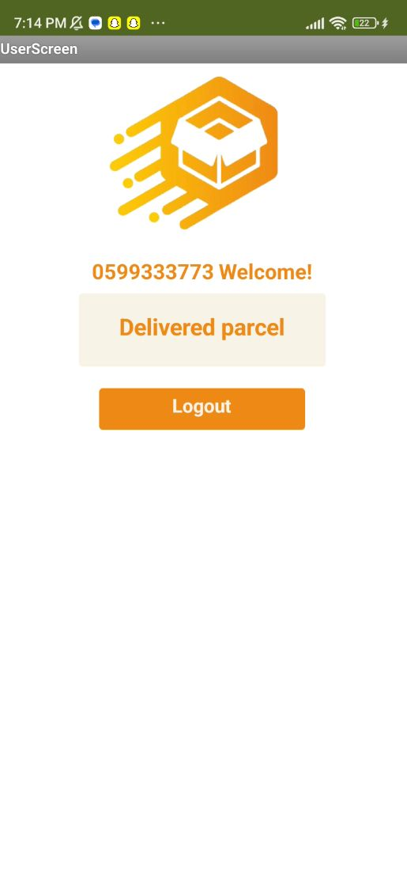
USER PAGE:

Slide 38
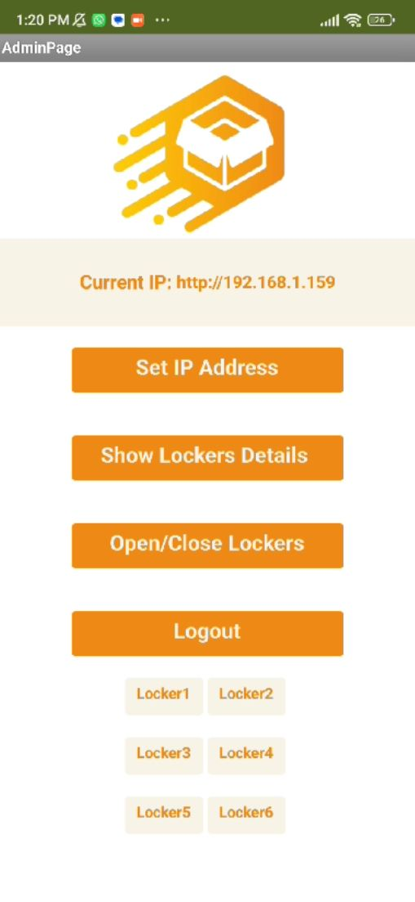
ADMIN PAGE:

Slide 39
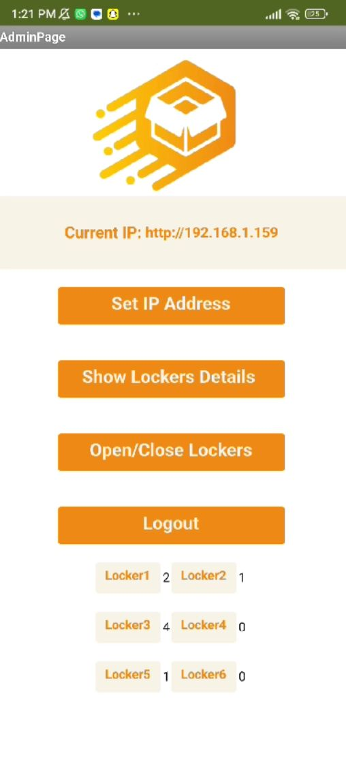
ADMIN PAGE:

Slide 40
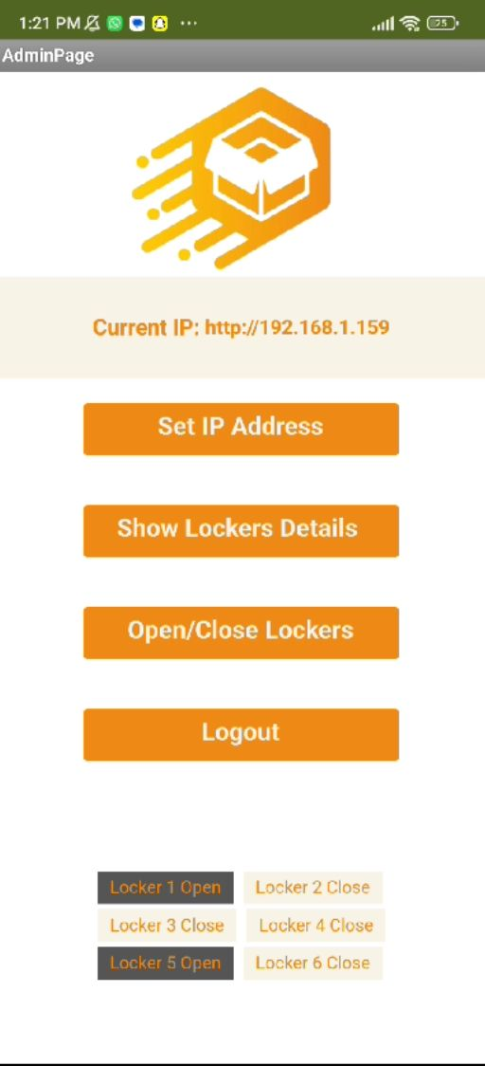
ADMIN PAGE:

Slide 41
5.
Constraints

Slide 42
Constraints
4
Providing power to the various components.
3
ESP32 damage.
2
Low signal problem with the GSM.
1
App inventor with Blynk.

Slide 43
6.
Future Work

Slide 44
Future Work:
Improve the mobile application.
Add a door on the parcel entry section.
Use material stronger than wood for more security.
Cash payment.

Slide 45
Thanks!
Any questions?

