Slide 1

An-Najah National University
Engineering Collage
Civil Engineering Department
Graduation project:
Prestressed Design Of Blue Sparkler Hotel
Supervised by: Dr. Wael Abu Assab
By : Ahmad Abu Farha
Ahmad Marei

Slide 2


Slide 3
Titles to be covered
Introduction
Building Loads
Preliminary Design
Prestressed Design & Three Dimensional Analysis
Columns & Footings Design
Special Design

Slide 4

Introduction

Slide 5
Project Description
Blue Sparkler Hotel is Proposed to be in Palestine , Nablus city.
Consists of 10 stories and roof
average height of 3.8 meters except the ground and basement floor which has 4.5, 3 meters height respectively.
The overall area (5703)meter square.
The basement floor includes parking with 31 car parks.

Slide 6
Project Description
The ground floor includes 9 car park, 2 water tank, offices , ladies saloon.
The mezzanine floor include a restaurant.
The remaining floors include residential apartments.
Type of soil is assumed to be as soft rock with a bearing
capacity of 350 KN/m2.
ACI -2008 (American Concrete Institute Code 2008
will be used.

Slide 7
Design Determinants
Structural Materials:
- Concrete:
f’c = 21- 40 Mpa (slab-on-grade, footings)
= 24-35 Mpa (beams, framed slabs)
= 21- 45 Mpa (columns and shear walls)
-Reinforcing Steel:
Es = 200,000 Mpa
fy = 420 MPa.
Grade 60

Slide 8
Design Determinants
Nonstructural Materials:
The following table shows the densities for materials used in construction:
Material | unit weight(KN/m³ )
Reinforced concrete | 25
Plain concrete | 23
Filler | 18
Blocks | 12
Polystyrene | 0.3
Masonry stone | 27
Light weight block | 6

Slide 9
Building Loads

Slide 10
Loads
The structural elements are subjected to different stresses and deformations due to the following loads:
Vertical loads : consist of dead and live loads.
Lateral loads: consist of wind and earthquake loads .
- Note : earthquake load will not be designed.

Slide 11
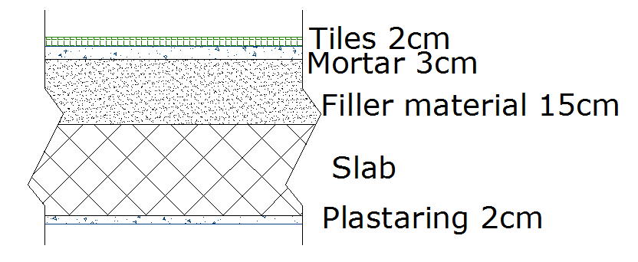
Dead load
Consist of weight of all permanent constructions such as:
- Slab own weight.
:- Super imposed dead load = 5.4kN/m² (as shown below)

Slide 12
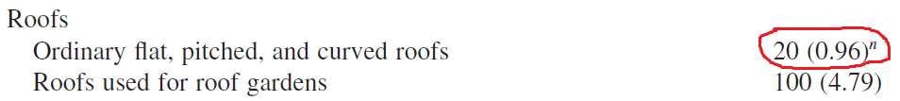
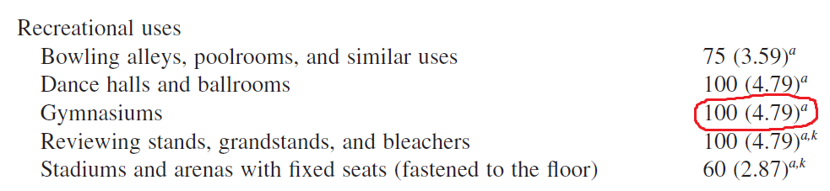
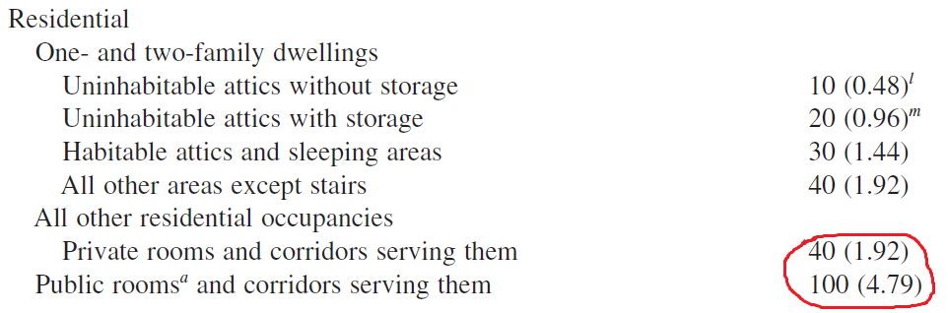
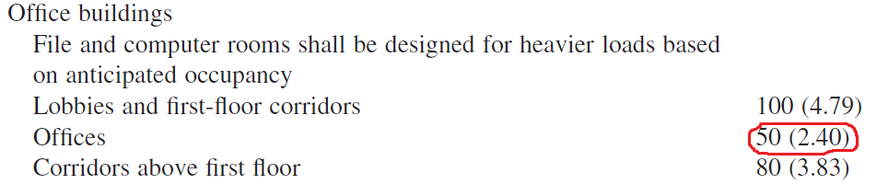
Live load
we specify the live load from table 4-1 in ASCE/SEI 7-05 code :

Slide 13
Wind load
The wind pressure is mainly affect all structures and has small effect in low structures.
This building is consisting of 10 floors + roof with average height of 3.8m and average area of floor of 575m² (for residential floors) and it is expected that the wind loads will not be critical, Jordanian code will be used to check that.
The design wind speed in this region can be taken as 120 km/hr as reasonable value for the country weather.

Slide 14
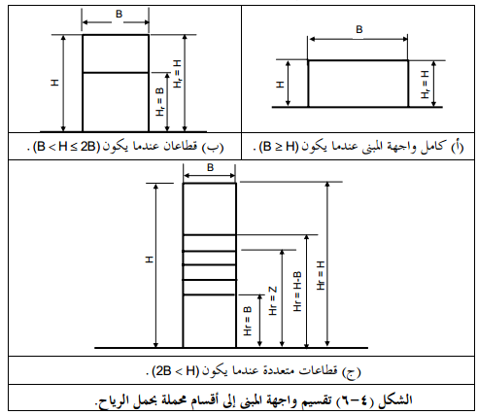
- بعد اجراء عمليات حسابية لأحمال الرياح تبعا للكود الاردني ,
- تم تقسيم واجهات المبنى وذلك حسب الجدول التالي:
*هنا تم استخدام الطريقة (أ)
والطريقة (ب) حيث تم تقسيم
المبنى الى ثلاث واجهات.

Slide 15
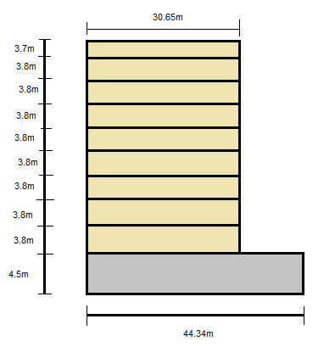
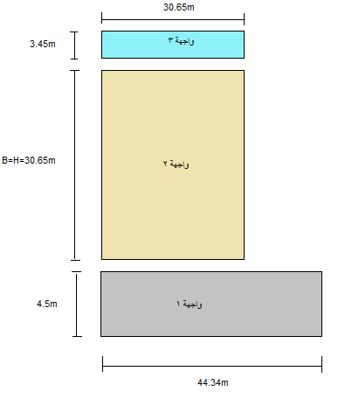
اكبر قيمة للحمل على الواجهة 2 :
P = p*A
=237.15* (30.65*30.65)
=222.78 KN
For meter square =
LOAD/ (NUMBER OF STORIES * STORY AREA)= 222.78/(8*581.43)=
0.05 KN/m² in Y direction ,
and 0.03 KN/m² in X direction.
- These values will be used in 3dimensional analysis.

Slide 16
Load Combination
The Code gives load factors for specific combinations of loads.
U = 1.4D (9-1)
U = 1.2D + 1.6L + 0.5(Lr or S or R) (9-2)
U = 1.2D + 1.6(Lr or S or R) + (1.0L or 0.5W) (9-3)
U = 1.2D + 1.0W + 1.0L + 0.5(Lr or S or R) (9-4)
U = 1.2D + 1.0E + 1.0L + 0.2S
U = 0.9D + 1.2W (9-6)
U = 0.9D + 1.0E (9-7)

Slide 17
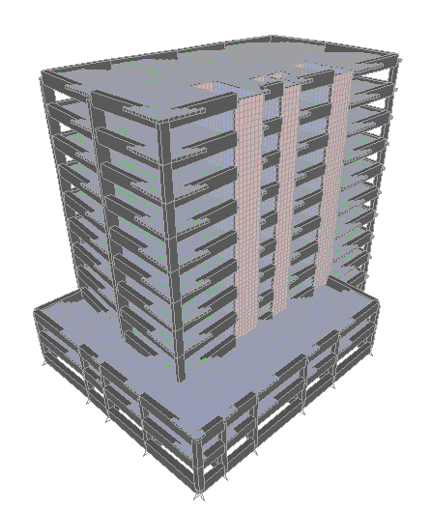
Preliminary Design

Slide 18
Design of reinforced concrete floor manually
The floor system as one way solid slab with drop beam
The ACI-code coefficient used in analysis
The design for second floor.
one way solid slab specification is ok as
(L/B ≥2.0)
Loads transfer in x-direction ,beams in y- direction

Slide 19
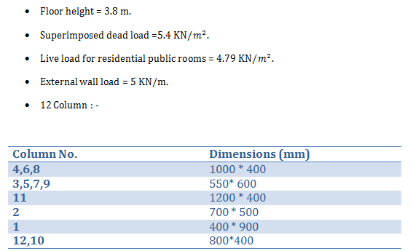
One way solid slab

Slide 20
Loads
Minimum slab thickness =(0.3) meter.
Own weight of slab =(7.5) KN/m²
S.I.D = (5.4) KN/m²
W_{u1} = 1.4 D.L = 18 KN/m²
W_{u2}=1.2 D.L + 1.6 L.L = 23 KN/m²
So, use W_{u} = 23 KN/m²

Slide 21
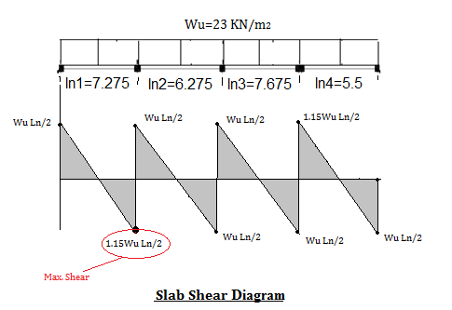
Check slab for shear

Slide 22
V_{u}= 92.8 KN
ØV_{c} = 159 KN
V_{u} < ØV_{c} ====>ok

Slide 23
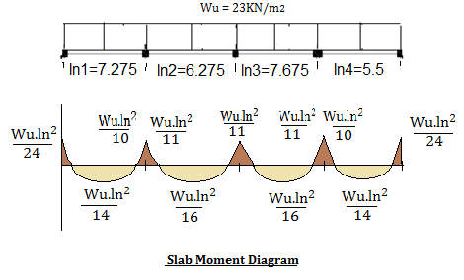
Design slab for flexure

Slide 24
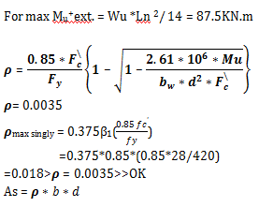

Slide 25
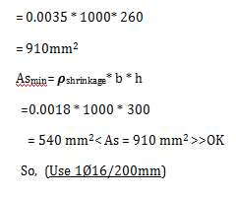

Slide 26
Design for flexure
For max. M_{u}⁺ int. = Wu Ln ²/ 16 = 85.2KN.m
(Use1Ø16 / 200mm)
For max. M_{u}⁻ int. = Wu Ln ²/ 10 = 124KN.m
( Use1Ø16 / 150mm )
For max. M_{u}⁻ ext. = Wu Ln ²/ 24 = 122.5KN.m
( Use1Ø16 / 150mm )

Slide 27
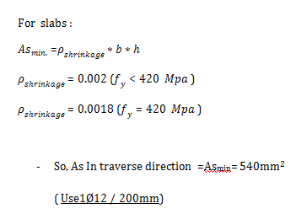
Transverse reinforcement

Slide 28
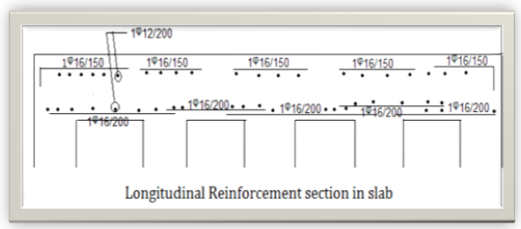

Slide 29
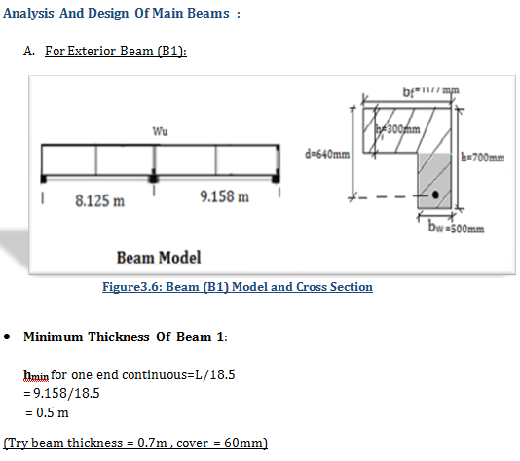

Slide 30
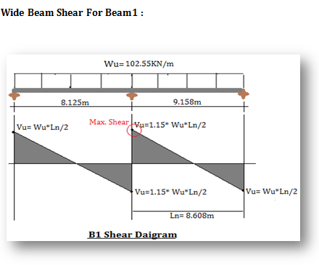

Slide 31
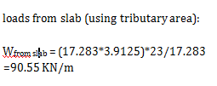
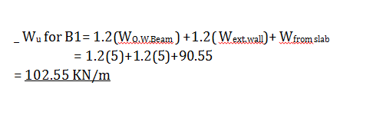

Slide 32
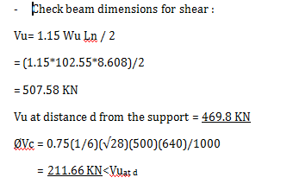
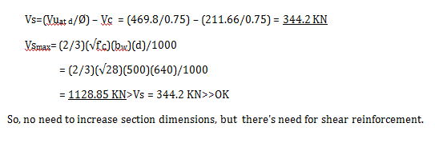

Slide 33
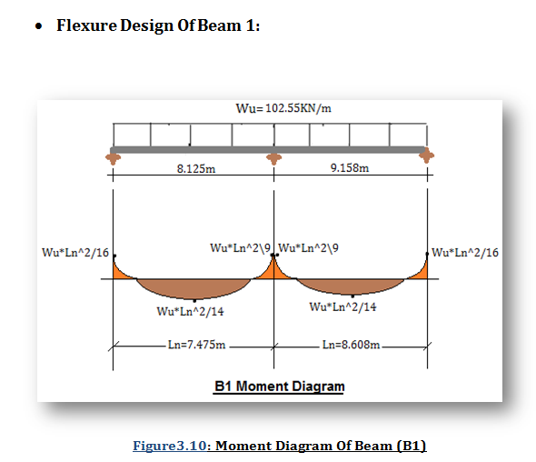

Slide 34
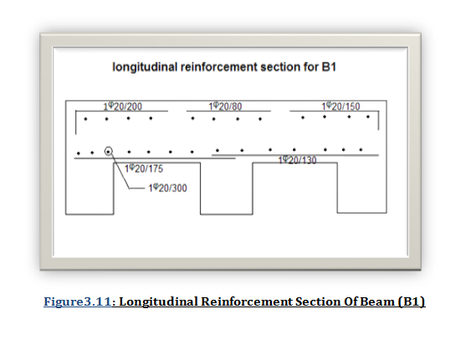

Slide 35
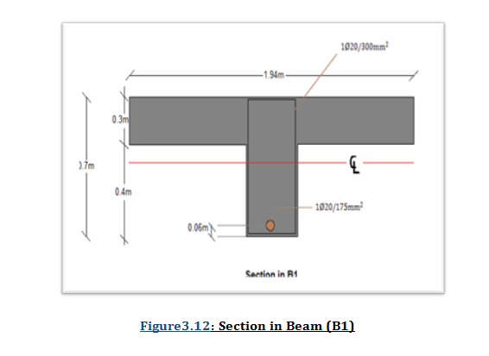

Slide 36

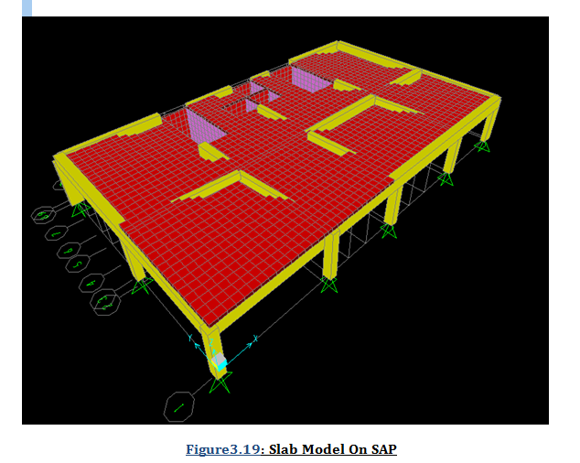

Slide 37
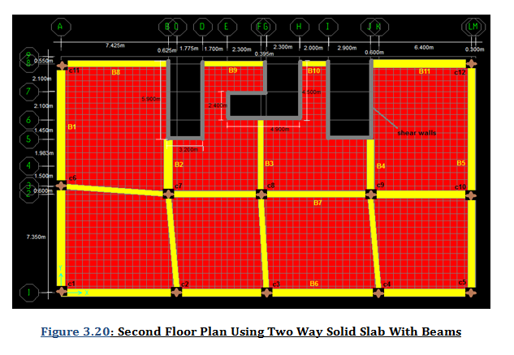

Slide 38
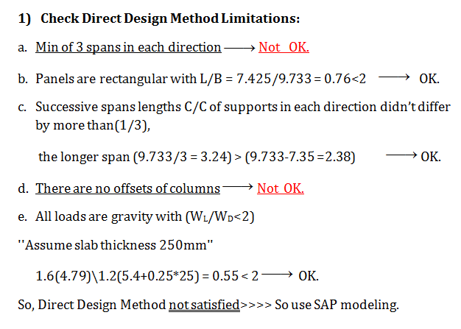

Slide 39
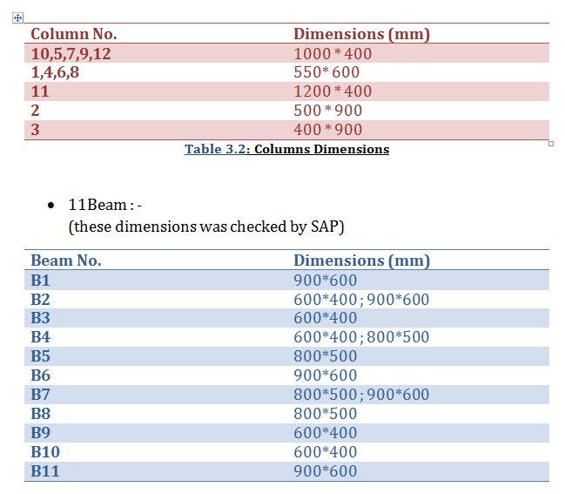
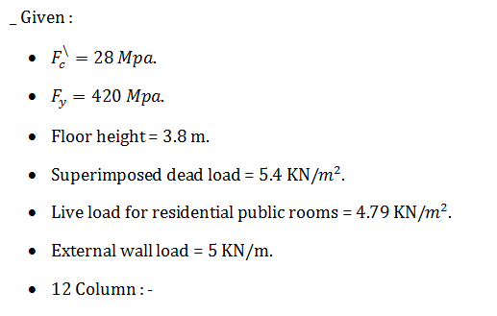

Slide 40
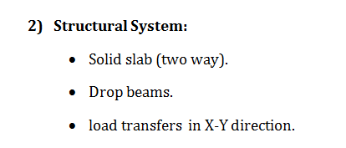

Slide 41
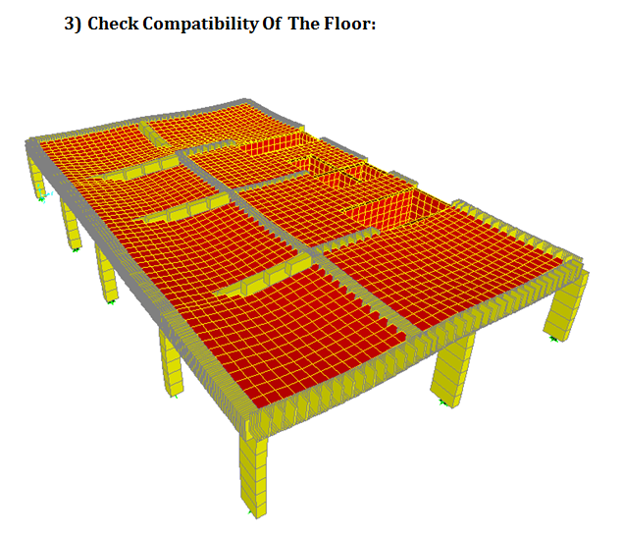

Slide 42
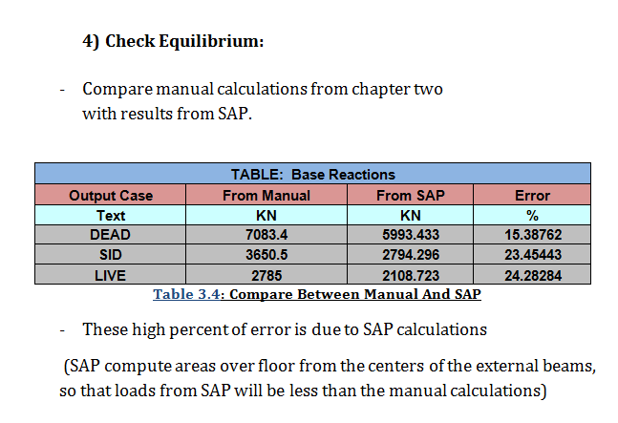

Slide 43
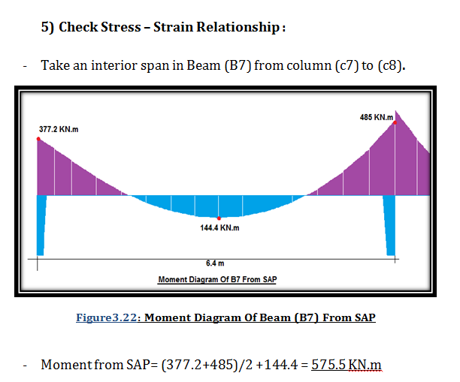
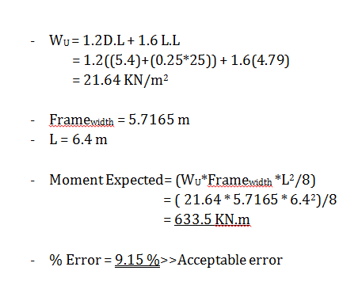

Slide 44
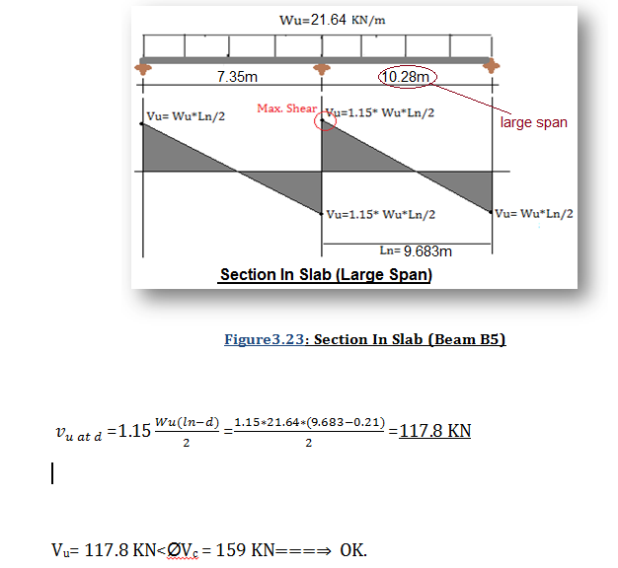
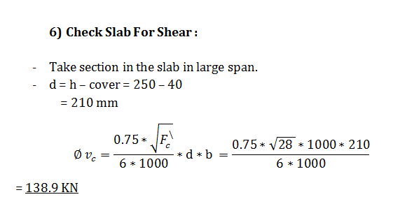

Slide 45
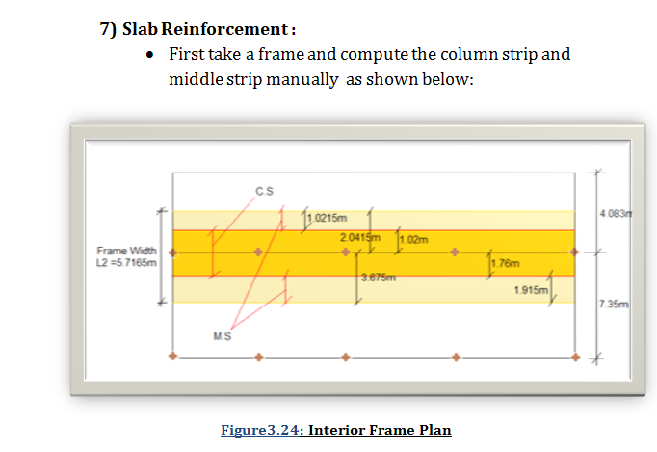

Slide 46
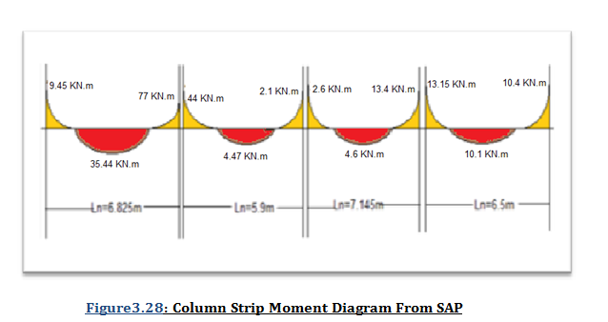

Slide 47
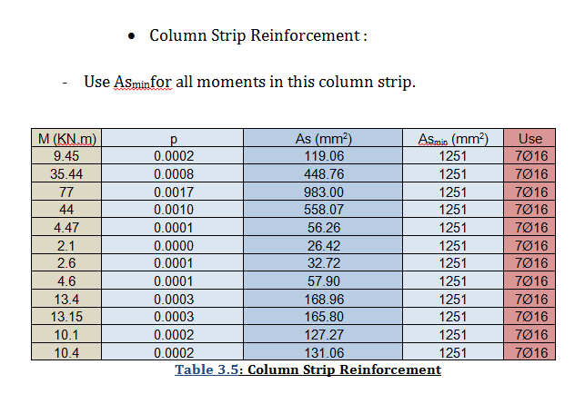

Slide 48
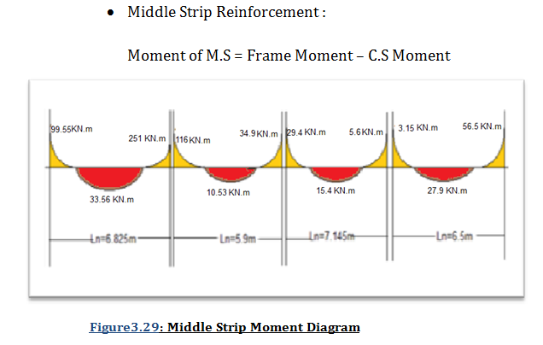

Slide 49
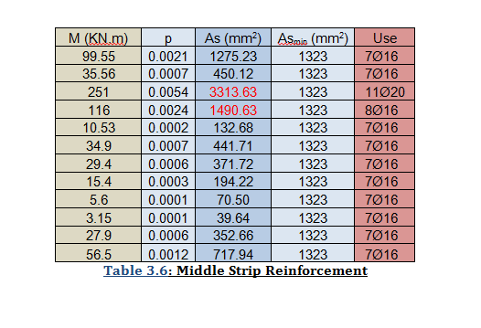

Slide 50
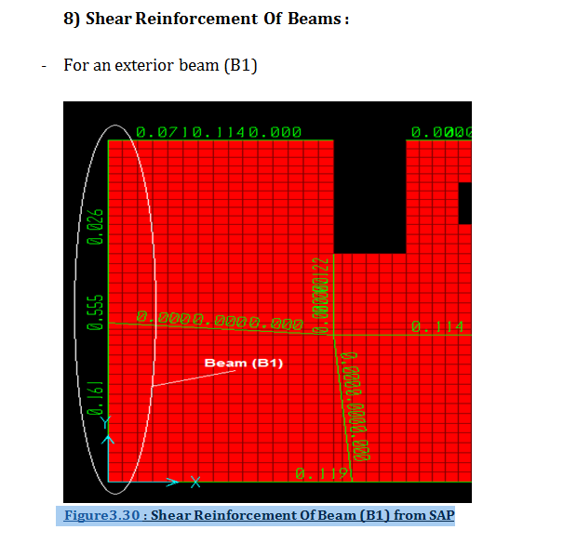

Slide 51
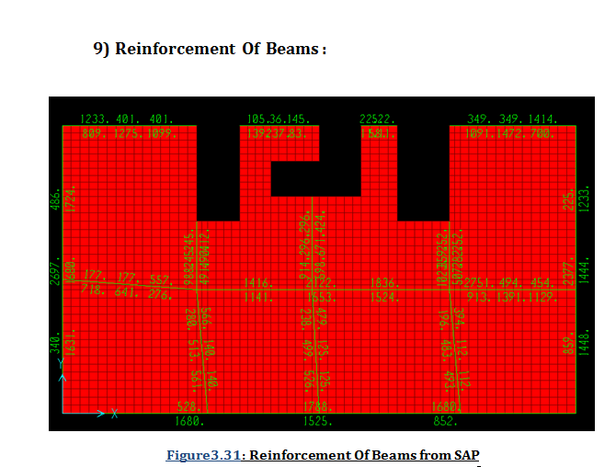

Slide 52
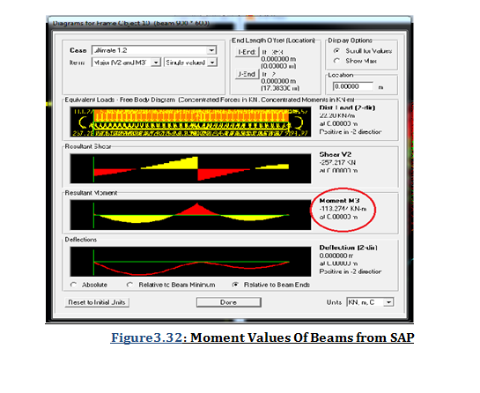

Slide 53
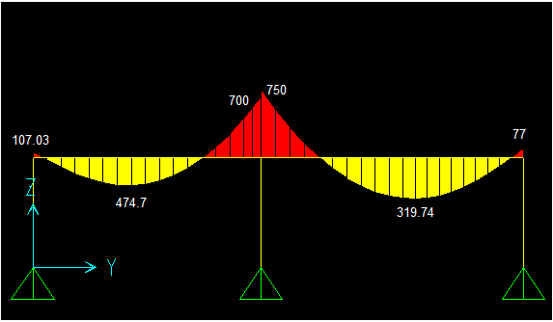

Slide 54
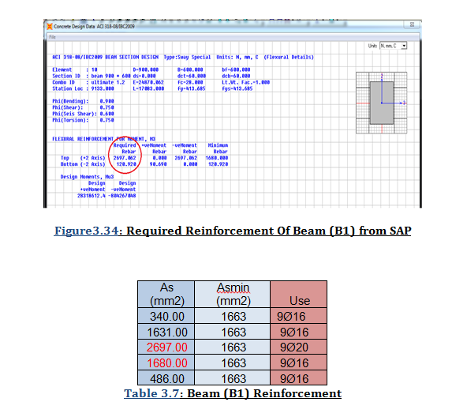

Slide 55
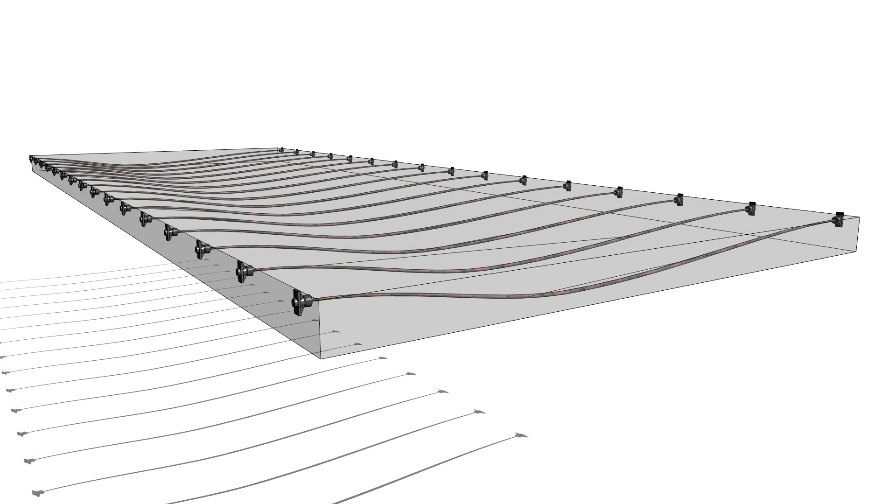
Prestressed Design

Slide 56
Prestressed background
A prestressed concrete member can be defined as one in which there have been introduced internal stresses of such magnitude and distribution that the stresses
resulting from the given external loading are counter forted to a desired value .
Concrete is strong in compression but weak in tension. Due to such a low tensile capacity, flexural cracks developed at early ages of loading .
in order to prevent or reduce such cracks from developing , a concentric or eccentric force is imposed in the longitudinal direction of the structural element.
This force prevents the cracks from developing by eliminating or considerably reducing the tensile stresses at the critical mid span or support sections at service load , thereby raising the binding, shear, and torsion capacities of the sections .
The sections are then able to behave elastically, and almost the full capacity of the concrete in compression can be efficiently utilized across the entire depth of the concrete sections when all loads act on the structure, such an imposed longitudinal force is called prestressing force.

Slide 57
Prestressed concrete properties
Most prestressed concrete elements are designed for a compressive strength above 35 MPa, the reason for this the high strength concrete normally has a higher modulus of elasticity. This means a reduction in initial elastic strain under application of prestress force and reduction in creep strain results in a reduction in loss of prestress.
In post-tensioned construction, high bearing stresses results at the ends of beams where the prestressing force is transferred from the tendons to anchorage fittings which bear directly against the concrete.
In pre-tensioned concrete construction, where transfer by bond is customary, the use of high strength concrete will permit the development of higher bond stresses.

Slide 58
Prestressing Reinforcement
Because of the high creep and shrinkage losses in concrete, effective prestressing can be achieved by using very high – strength steels, such high – stressed steels are able to counterbalance these losses in the surrounding concrete and have adequate leftover stress levels to sustain the required prestressing force.
Prestressing reinforcement can be in the form of single wires, strands composed of several wires twisted to form a single element, and high – strength bars. Three types of wires are commonly used are:
- Uncoated stress-relieved wires.
- Uncoated stress- relieved strands and low-relaxation strands.
- Uncoated high-strength steel bars.

Slide 59
Prestressing system
The design will deal with indeterminate post-tensioning two way flat slab with edge beams system. In post-tensioning, the strands, wires, or bars are tensioned after hardening of the concrete. The strands are placed in the longitudinal ducts within the precast concrete element. The prestressing force is transferred through end anchorages and the tendons of strands should not be bonded or grouted prior to full prestressing .
In order to provide permanent protection for the post-tensioned steel and to develop a bond between the prestressing steel and the surrounding concrete, the prestressing ducts have to be filled under pressure with the appropriate cement grout in an injection process.

Slide 60
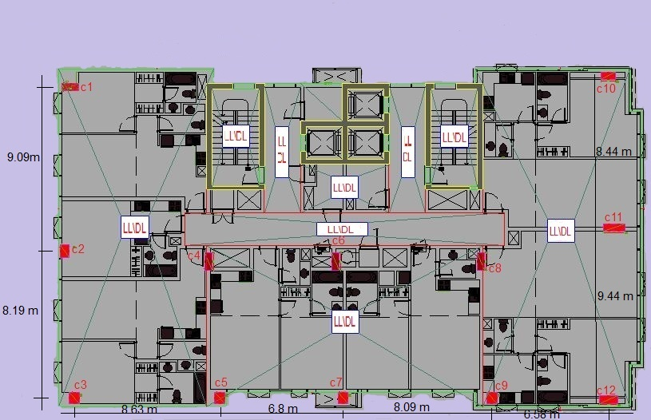
Slab Design Of Two Way Flat Plate(Manual)
Second floor plan

Slide 61
Material properties :
f'_{c} = 30 MPa f'_{c i} = 21 MPa
f p_{u} = 1862 MPa fy = 414 MPa
f p_{e} = 1096 MPa f py = 1675 MPa
Eps=200 000 MPa
Use strands diameter ɸ 12.7 mm

Slide 62
Loads :
Live Load (LL) = 4.79 KN/m²
Super Imposed Load (SID) = 5.4 KN/m²
Slab thickness = L/40 = 9.44 /40 = 0.236 ……..use = 25 cm slab
Total dead load = 0.25m * 25 KN/m³ = 6.25 KN/m²
Ultimate load (Wu) = 1.2(6.25+5.4) + 1.6(4.79) =21.644 KN/m²
Service load = 6.25 + 5.4 + 4.79 =16 .44 KN/m²
Frame width = 7.154 m

Slide 63
Load balancing:
- Assume an average intensity of compressive stress on the concrete due to load balancing of fc =1.2 MPa
Unit force = (1.2*1000*250)/ 1000 = 300 KN
P_{e} (effective prestressing force after losses) per strand = 99*1096 /1000
= 108.5 KN
F_{e} ( force in unit width of section) on concrete = unit force* frame width
= 300 * 7.154 =2146.2 KN
Number of strands = 2146.2/108.5 = 19.7……..Use 18 strands
Area of prestressing steel = 18 * 99 mm² = 1782 mm²
P_{e} = 18 * 108.5 = 1953 KN
fc = 1953*1000/(7154*250) = 1.092 MPa

Slide 64
Exterior span:
a = (169+187)/2 – 67= 111 mm
W balance = 8 F_{e} a / L² = 8(2146.2)(.111/ 7.154) / (7.89)² = 4.28 KN/m²
W unbalance = W ser. – W bal. = 16.44 – 4.28 = 12.16 KN/m²
Interior span:
a = (225 + 188) / 2 - 99 = 108 mm
W balance = 8(2146.2)(.108 / 7.154) / (7.99)² = 4.06 KN/m²
W unbalance = 16.44 – 4.06 = 12.38 KN/m²

Slide 65
Here Wunbalanced is not the same for the two spans. These values can be used or adjustment to eccentricities can be made to have equal Wunbalanced for all spans .

Slide 66
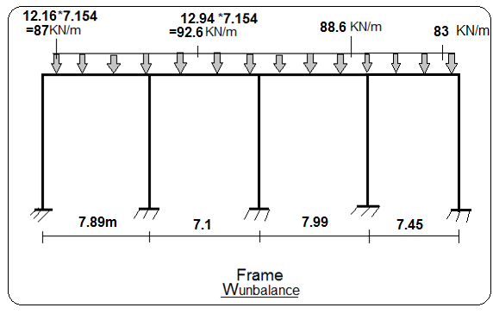


Slide 67


Slide 68


At support :
F_{top}=$\frac{ −Pi}{Ac}+\frac{Munbalanced}{S}$ = 1.9 < 5.48……ok
F_{bot}=$\frac{ −Pi}{Ac}−\frac{Munbalanced}{S}$ = -1.9 < 13.5 ……ok
At mid span:
F_{top}=$\frac{ −Pi}{Ac}−\frac{Munbalanced}{S}$= -2.7< 13.5 ……..ok
F_{bot}=$\frac{ −Pi}{Ac}+\frac{Munbalanced}{S}$= 2.6 < 5.48…..…ok
- Stresses at service loads ( compare with fc and ft )
F_{c} =.45*$F_{c}^{′}$= (0.45* 30)= 13.5 MPa
F_{t}= $\left\{\begin{aligned}.5\sqrt{F_{c}^{′}} =2.7MPa ,if deflection neglected. \\ 1\sqrt{F_{c}^{′}} = 5.48MPa,deflection must be calcolate.\end{aligned}\right.$

Slide 69

- Stresses at transfere(compare with fc_{i} and fti)
F_{ci} =0.6*$F_{ci}^{′}$=18 MPa
F_{ti} = $\left\{\begin{aligned}.5\sqrt{F_{ci}^{′}} = 2.7MPa ,at end support \\ 0.25\sqrt{F_{ci}^{′}} =1.36MPa,at mid span \end{aligned}\right.$
$F_{pi}$=$min \left\{\begin{aligned}0.7∗F_{pu}=0.8∗1862=1303MPa. \\ 0.94∗{ F}_{py}=0.94∗1689=1587MPa. \\ value specified by the manu facture .\end{aligned}\right.$
Pi = Aps * fp_{i} = 1548 KN

Slide 70

- Stresses at transfere(compare with fc_{i} and fti)
At support:
F_{top}=$\frac{ −Pi}{Ac}∗\left[1+\frac{e Ct}{r∗r}\right]+\frac{MD}{St}$ = -1.3 < 18 …....ok
F_{bottom}=$\frac{−Pi}{Ac}∗\left[1−\frac{e Cb}{r∗r}\right]−\frac{MD}{St}$ = -2.44 < 18 …..ok
At mid span:
F_{top}=$\frac{ −Pi}{Ac}∗\left[1−\frac{e Ct}{r∗r}\right]−\frac{MD}{St}$ = 1.13 < 2.7…..ok
F_{bot}=$\frac{ −Pi}{Ac}∗\left[1+\frac{e Ct}{r∗r}\right]+\frac{MD}{St}$ = -1.3 < 18…...ok

Slide 71
Minimum top nonprestressed (bonded)steel is equal to:
As = .00075 h L
- Where L is length of half spans at the support along the frame
L= 7.99/2 + 7.45/2 =7.72 m
As= .00075*7720*250 = 1447.5 mm²
Use… 8 ɸ16 at supports
As min= .004*250*1000=1000 mm²/m
Use….1 ɸ12/110 mm.

Slide 72
Design Of Two Way Post tensioned Flat Slab With Edge Beams (By Using SAP Program)
here the design will deal with the second floor slab as shown in the plan below:

Slide 73

Design of Slab
Given:-
$f′c=30 Mpa$ , E = 4700$\sqrt{30}$ =814.0638 Mpa.
$F_{y}=420 Mpa$.
$F_{pu}=1862Mpa$.
$f^{′}ci=0.7f^{′}c=0.7\left(30\right)=21Mpa.$
Floor height = 3 m.
Superimposed dead load = 5.4 KN/$m^{2}$.
Live load for residential public rooms = 5 KN/$m^{2}$.
External wall load = 5 KN/m.
Wind load in X direction = 0.03 KN/m.
Wind load in Y direction = 0.05 KN/m.
12 Column

Slide 74

Design of Slab
${ F}_{py}=1689 Mpa$.{${ F}_{py}=\left\{\begin{aligned}0.9∗F_{pu}=.9∗1860=1698 \\ 0.85∗F_{pu}=.85∗1860=1582\end{aligned}\right.$
$F_{pi}=1350 Mpa$.{$F_{pi}$=$min \left\{\begin{aligned}0.7∗F_{pu}=0.7∗1862=1303MPa. \\ 0.94∗{ F}_{py}=0.94∗1689=1587MPa. \\ value specified by the manu facture .\end{aligned}\right.$
$F_{pe}=1096 Mpa$.{assumed [loss=254 MPa from AASHTO the avg. loss around 300Mpa]}
Slab Thickness :
hmin = max. span length/40 = 0.236 m (take it 25 cm)

Slide 75

Design of Slab
Calculate the Max. Moments :
- Here we take two frames in X
and Y directions and take
the max. and min. envelope moments from SAP ,
to use it in drawing the tendon layout.

Slide 76


Frame 1 in X-direction :

Slide 77


Frame 2 in Y-direction :

Slide 78


Drawings of Tendon Layout :
For Frame 1in X direction
- from the Max. moment = 170.84 take the cover = 25 mm
so the table below show the eccentricities of the tendon in X frame:

Slide 79


For Frame 2 in Y direction
from the Max. moment = 291.24 take the cover = 25 mm
so the table below show the eccentricities of the tendon in Y frame:

Slide 80
For Frame 1 in X direction :
Assume an average intensity of compressive stress on the concrete due to load balancing of fc =1.2 MPa
Unit force = (1.2*1000*250)/ 1000 = 300 KN
P_{e} (effective prestressing force after losses) per strand = 99*1096 /1000 = 108.5 KN
Total F_{e} ( force in unit width of section) on concrete = unit force* frame avg. width
= 300 * 7.154 = 2146.2 KN
Number of strands = 2146.2/108.5 = 19.7 >>>>>> Use 18 strands
Area of prestressing steel = 18 * 99 mm² = 1782 mm²
P_{e} = 18 * 108.5 = 1953 KN
fc = 1953*1000/(7154*250) = 1.092 MPa

Slide 81

Tendon Section Data for the frame X :
18 strands will be distributed as (1/3) for the middle strip and (2\3) for the column strip.
So, here C.S= 12 strands * area of strand
= 12*99= 1188 mm²
And M.S = 6 strands * area of strand
= 6*99= 594 mm²/2= 297 mm²

Slide 82

Drawing the tendon on SAP:
- Selecting the Parabolic Tendon 1
(as the moment diagram )

Slide 83

Define the eccentricities of tendon
that was calculated manually :

Slide 84

After defining the load pattern
(hyperstatic) on SAP, define the load
of tendon as a stress :

Slide 85
For Frame 2 in Y direction :
fc =1.2 MPa
Unit force = (1.2*1000*250)/ 1000 = 300 KN
P_{e} (effective prestressing force after losses) per strand = 99*1096 /1000 = 108.5 KN
1.2 = (Ape *1096)/(250*7495) >>> Ape = 2051.55 mm²
Number of strands = 2051.55/108.5 = 18.9 >>>>>> Use 17 strands
Area of prestressing steel = 18 * 99 mm² = 1782 mm²
Tendon Section Data for the frame X :
- 17 strands will be distributed as (1/3) for the middle strip and (2\3) for the column strip.
So, here C.S= 11 strands * area of strand = 11*99= 1089 mm²
And M.S= 6 strands * area of strand = 6*99= 594 mm²/2= 297 mm²

Slide 86

- Divided the plan into 3 frames in X direction and 5 frames in Y direction
and distribute the tendons in the column and middle strips in the frames as shown in figure below :

Slide 87


Slide 88

Quick check on the deformation shape of the slab after distribution of tendons
(the slab should deformed upward due to tendons)

Slide 89

* Check Stresses :
--we must check stress at transfer stage and at final stage for service and ultimate loads
The allowable stresses are shown below:
At transfer stage:
F_{ci}=0.6*$F_{ci}^{′}$= 0.6*21= 12.6 MPa.
F_{ti}= $\left\{\begin{aligned}.5\sqrt{F_{ci}^{′}} = 2.29 MPa ,at end support \\ 0.25\sqrt{F_{ci}^{′}} =1.15 MPa,at mid span \end{aligned}\right.$
At final stage:
F_{c} =.45*$F_{c}^{′}$= 0.45 * 30= 13.5 MPa.
F_{t}= $\left\{\begin{aligned}.5\sqrt{F_{c}^{′}} =2.74 MPa ,if deflection neglected. \\ 1\sqrt{F_{c}^{′}} = 5.48 MPa,deflection must be calcolate.\end{aligned}\right.$

Slide 90


* Check Stresses :
By using direct design method to calculate interior stresses:
-At transfer stage:
F_{top} =$\frac{−Pi}{Ac}∗\left[1−\frac{e Ct}{r∗r}\right]−\frac{MD}{St}$
F_{bottom} =$\frac{−Pi}{Ac}∗\left[1+\frac{e Cb}{r∗r}\right]+\frac{MD}{St}$
-At final stage :
F_{top} =$\frac{−Pe}{Ac}∗\left[1−\frac{e Ct}{r∗r}\right]−\frac{MT}{St}$
F_{bottom} =$\frac{−Pe}{Ac}∗\left[1+\frac{e Cb}{r∗r}\right]+\frac{MT}{St}$

Slide 91

- The tables below show the calculations of interior stresses :

Slide 92


Slide 93


Slide 94
- Compare the results from table (4.4.9) with the allowable stresses (OK)
for example Ftop= 0.688 < Fci= 12.6 MPa…………..ok
And it's OK for all stresses.

Slide 95
Bonded reinforcement:
- Because the member resists flexure; minimum bonded reinforcement must be put in the tensile zone (at the tendon zone) as a factor of safety and to bond the concrete with steel cause the tendon is non-bonded material (post tension).
As _{for bonding} =0.004*Act

Slide 96

The table below show the calculations of the frames bonded reinforcement:

Slide 97
Check Deflection for slab :
The max deflection obtained in the Second floor and the results were as follow:
Deflection from dead, live, super imposed and hyperstatic loads are taken from SAP , as shown in figures

Slide 98


Slide 99


Slide 100


Slide 101


Slide 102
The long term deflection is given by the following equation:
Δ long term = Δ L+ λ∞ ΔD + λTΔSL
λ∞ = 2
λT = 2 (( From equation 9-11 in ACI-318- sec 9.5.2.5))
Since the slab is attached to nonstructural elements not likely to be damaged by large deflections then:
The allowable deflection = L /240 = 7470/240 = 31.125 mm.
So the slab deflection = 30.13 mm. < allowable long term def. = 31.125 mm >>>OK.
It's so critical value because it was taken in the max. deflection zone, and the other values was ok too.

Slide 103

Design of slab for shear and bending
- Chick slab for wide beam shear :
Ø$V_{C}$=$\frac{0.75}{6}∗\sqrt{30 }$ *$\frac{1000∗250}{1000}$ = 171.16 KN
the max shear in the max. span = 117.8 KN/m.
Ø$V_{C}$>$V_{u}$171 > 117.8 >>>OK
So the slab is Ok for wide beam shear.

Slide 104
- Design Slab for Flexure :
Note that we use prestressed (post-tensioned) design ,
so here no need to calculate the moments.
* shrinkage steel will be used as follow :
As _{shrinkage} = 0.0018 *1000* 250 = 450mm²
As _{shrinkage} = 450mm²/m. ( use 4Ø 12 / 1000mm )

Slide 105

Slab Reinforcement
- By taking 2 sections: section 1 in the mid of span and section 2 at the support to see the steel and tendon distribution in the slab section (Frame X3) :

Slide 106


The figure below show a cross section 1,2 in slab with steel and tendon .
- (Note that the 18 strand will be distributed in column and middle strip as before).

Slide 107

Check Punching Shear :
column number (6) in 2 floor was taken to check punching shear as following :
Column dimension 1000 mm*400 mm (interior column)
The ultimate axial load and moments in X and Y directions was taken from SAP :

Slide 108


v_{c} = min {1.68 MPa or 1.22 MPa or 1.81MPa}
ʈ_{u}=$\frac{Vu}{Φ1∗b0∗d}+\frac{Mux}{Φ2∗Jx}+\frac{Muy }{Φ2∗Jy}$
ʈ_{u}=$\frac{4867.63∗10^{3}}{0.75∗3640∗2000}+\frac{17.6∗10^{6}}{0.9∗2.37∗10^9}+\frac{77.5∗10^{6}}{0.9∗2.37∗10^9}$
ʈ_{u} =0.89+0.082+ 0.036
ʈ_{u} = 1.008 < 1.22 MPa. >>>>>> OK

Slide 109

Design of Edge Beams :
Note that edge beams used as reinforced concrete member not prestressed .
The beam (B7) in 2nd floor was taken to show the design criteria (this beam has the longer span 9.44m).

Slide 110
The beam (B7) section dimensions are :
- Total depth (h) = 1200mm.
- The effective depth (d) = 1140mm.
- Beam width (b_{w}) = 600 mm.
- f’c = 30 Mpa.
- fy = 420 Mpa.

Slide 111


Design Beam for Shear
Vu= 483.58 KN
So,
Vu = 483.58 KN < Vc = $624.4KN$ >>>>>>> OK
Use $\left(\frac{A_{v}}{s}\right)min$ =0.31
$${\begin{aligned} \\ S\end{aligned}}_{max=1140/2= 570 mm}$$

Slide 112

Design Beam for Flexure
The figure below shows the moment diagram of beam B7 from SAP :

Slide 113



$$ρ_{min}=\max{of \left[\begin{matrix}\frac{1.4}{f_{y}} \\ \frac{0.25\sqrt{{f′}_{c}}}{f_{y}}\end{matrix}\right]}{ ρ}_{min}=\frac{1.4}{420}=0.0033$$
$$ρ=\frac{0.85x30}{420}\left(1−\sqrt{1−\frac{2.61x{10}^{6}x394.7}{600x{1140}^{2}x30}}\right)=0.00135<0.0035$$
all of computed steel ratios are less than $ρ_{min}$ so we will use the min. area of steel which is :
As_{min} = 0.0033*bw*d = 0.0035*600*1140= 2394mm² (use 8ø20)

Slide 114

Design Beam for Torsion
X1=600-2*44.5 = 511mm
Y1= 1200-2*44.5 =1111mm
Ph = 2X+2Y= 2(511+111) =3244mm
Aoh =X*Y= 511*1111=567721mm²
Ao= 0.85*Aoh =482563mm²

Slide 115


The value of tu = 378.5 KN.m-
$$\sqrt[2]{{(\frac{Vu}{bw d})}^{2}+\frac{tu Ph}{1.7 {Aoh}^{2}}}≤∅\frac{5}{6}\sqrt{fc}$$
$$\sqrt[2]{{(\frac{483.58∗{10}^{3}}{600∗1140})}^{2}+\frac{378.5∗{10}^{6}∗3244}{1.7 {∗567721}^{2}}}<0.75\frac{5}{6}\sqrt{30}$$
1.655 < 3.423 ……….
so the section is adequate

Slide 116



Travers reinforcement for torsion:
Calculate $\frac{At}{S}$ torsion:
$$\frac{At}{S}=\frac{Tu}{2Aofyt}$$
$$\frac{At}{S}=\frac{\frac{378.5}{0.75}∗{10}^{6}}{2∗482563∗420}=1.25 {mm}^{2}$$
use S = 250 mm
Travers reinforcement 1$∅$12 /250mm.

Slide 117

Longitudinal reinforcement for torsion:
Al = $\frac{At}{S}$ * Ph * $\frac{fyt}{fy}$
Al = 1.25 * 3244 * $\frac{420}{420}$ = 4055 mm²
- For negative moment = 731.2 KN.m:
- top reinforcement use:
As _{top final} = As _{top} + 4055(0.6/1.9)
- bottom reinforcement use:
As _{bottom final} = As _{bottom} + 4055(0.6/1.9)
- For each side :
As _{each side} = 4055(1.14/1.9)

Slide 118
Three Dimensional Structural Analysis

Slide 119
Structural Modeling
Figure(4.33):Structural Modal of the Building

Slide 120

Material Used
1- Concrete :
The compressive strength of concrete
f'c = 30 MPa

Slide 121

2- Steel :
The steel that used is (A615Gr60)
with maximum yield stress, Fy= 420MPa.

Slide 122

3- Tendon :
The tendon that used is (A416Gr270)
with maximum tensile stress of 1862 MPa.

Slide 123

: Loads Used
- (LL) : 5 KN/m²
- (SID) : 5.4 KN/m²
-(WL) : 0.03 KN/m² at X-direction
and 0.05 KN/m² at Y-direction
-(DL) : calculated by SAP
SID on edge beams from
the external cladding wall = 5 KN/m

Slide 124

Verification of structural analysis
- Compatibility
The whole building movements
(Joint displacements) are compatible as shown in figure below:

Slide 125

- Equilibrium
Show the calculation of the structure weight and the variance between the all loads by manually and SAP.

Slide 126
LL = 5 KN/m²
SID = 5.4 KN/m²
Total LL in all floors = (Area G. floor *LL)*2 + (Area 2nd floor *LL)*8
LL_{total} = (773.38*5)*2 + (538.18*5)*8 = 29261 KN/m²
Total SID in all floors = (Area G. floor *SID)*2 + (Area 2nd floor *SID)*8
SID_{total} = (773.38*5.4)*2 + (538.18*5.4)*8
= 31601.8 KN/m²

Slide 127

Structure Weight)dead load)
- Columns :

Slide 128
- Beams (1200*600 mm) :
Weight of beams in 2nd floor = beams length * beams dimensions * unit wt. of concrete
= 98.56 * (1.2*0.6) * 25 = 1774 KN
Weight of beams in G. floor = beams length * beams dimensions * unit wt. of concrete
= 153.99 * (1.2*0.6) * 25 = 2771.75 KN
Weight of beams in Structure = 2(Wt. of beams in G.floor) + 8(Wt. of beams in 2nd floor)
= 2(2771.75) + 8(1774) = 19735.5 KN

Slide 129
- Shear Walls :
Weight of Stairs Wall in Structure = 2(15.42)*10*25 = 7710 KN
Weight of Elevators Wall in Structure = 17.64 *10*25 = 4410 KN
So, The Total Weight of Shear Walls in the Structure = 7710+4410 =12120 KN

Slide 130
Slabs :
Weight of G. floor slab = 816.63 * 0.25 * 25 = 5104 KN
Weight of 2nd floor slab = 581.43 * 0.25 * 25 = 3634 KN
So, The Total Weight of Slabs in the Structure = 2(5104) + 8(3634) = 39280 KN
From the previous 4 steps ,
- The Total Weight of the Structure (DL) = 3517.5 + 19735.5 + 12120 + 39280
= 74653 KN

Slide 131

The figure below show the illustrates the results of DL, LL, SDL from SAP calculations :

Slide 132


Slide 133
Design of
Columns & Footing

Slide 134

design of columns Manual design
COLUMN DESIGN REQUIRMENT

Slide 135

Check slenderness ratio for column 11:

Slide 136

Design of column 11 using interaction diagram

Slide 137



Slide 138


Slide 139
Footing Design

Slide 140
Footing design
Single footing:
Is one of the most economical types of footing and is used when columns are spaced at relatively long distances .(12m)
Bearing capacity of the soil=350 KN/m².

Slide 141


Design Footing for column 11:

Slide 142


Slide 143
Design of group F1:
Check for punching shear:
Vn required =9038ton
Vn provided=9072>9038 …………………..OK
Check for wide beam shear:
Vn required =2823 KN
Vn provided=3087>2823 …………………..OK

Slide 144
Flexural design:
Mu= 892 KN.m
ρ=0.00064 > ρ min = 0.0018( min for shrinkage)
As=8910 mm²➔ Use 6ϕ20mm/m' in both directions.
Shrinkage steel:
From practical point of view use half of the shrinkage steel on top since footing thickness large( approximately when thickness >60cm).
A _{shrinkage} =0.0018Ag /2
A _{shrinkage} =8100cm²/m. ➔ use 6ϕ20/m in both direction.

Slide 145


Slide 146

footings details

Slide 147



Slide 148


Slide 149


Slide 150


Slide 151

  Design of Staircase :

Slide 152


Slide 153

  Design of Rectangular Water Tanks :

Slide 154
Thank you

