Slide 1
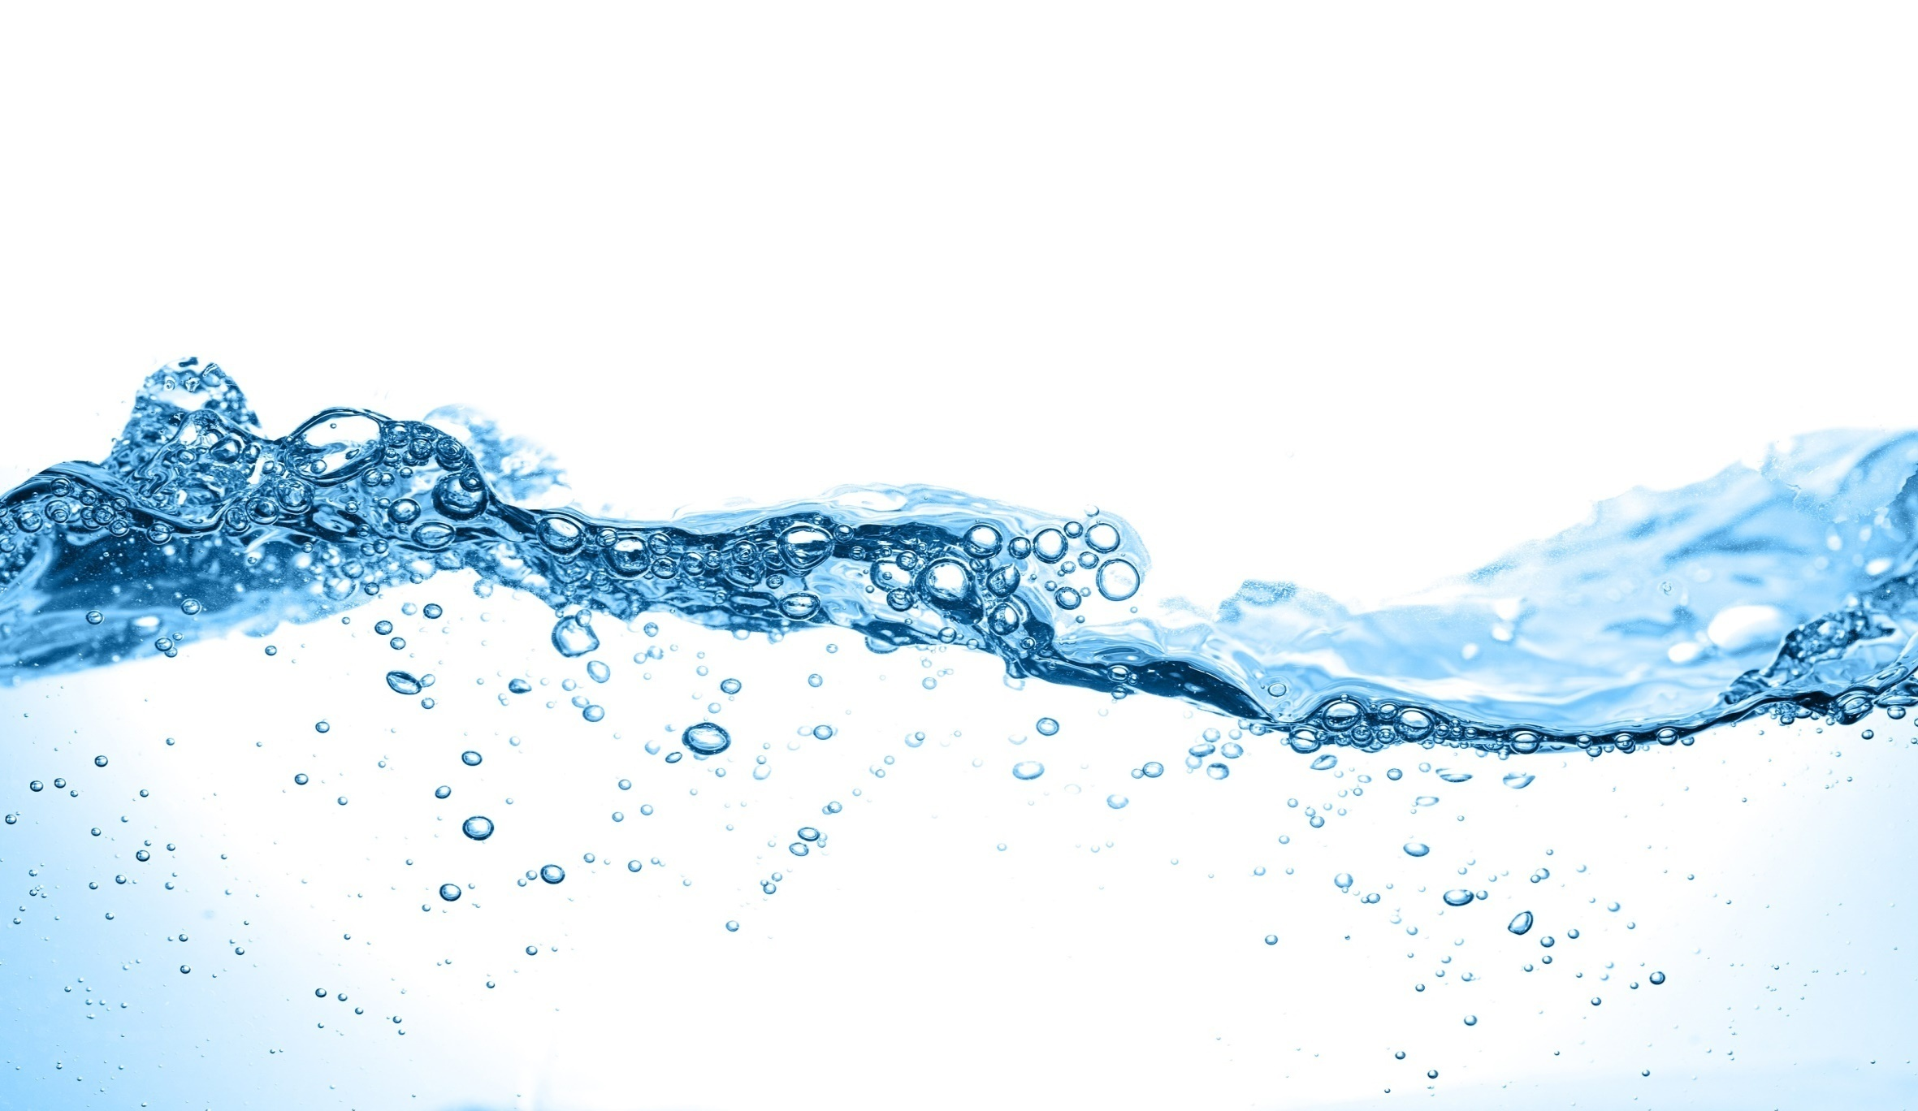
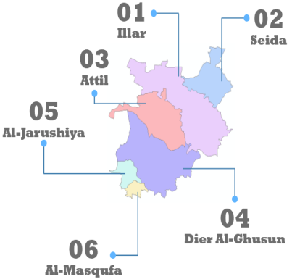
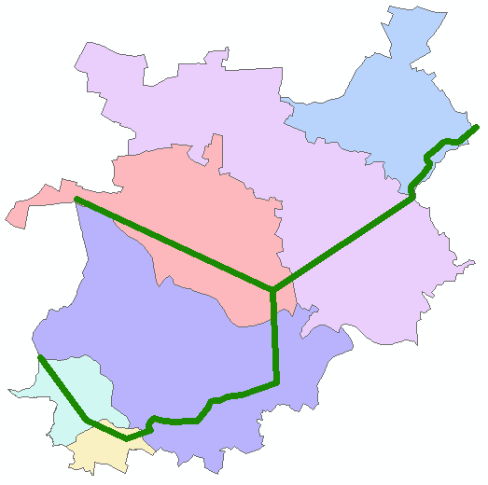
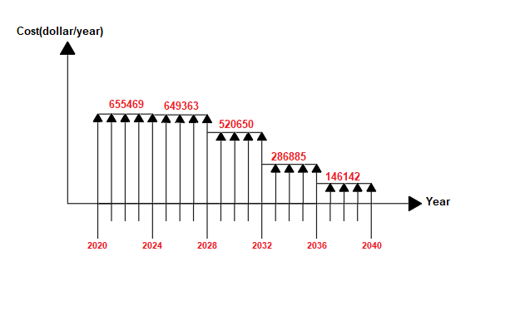


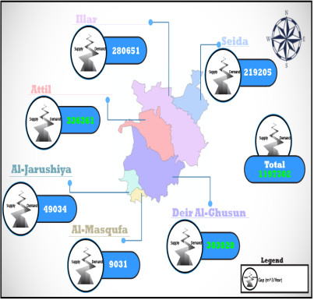
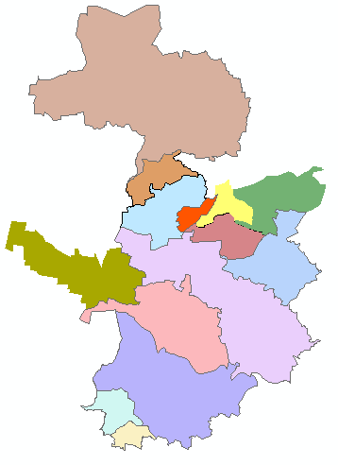
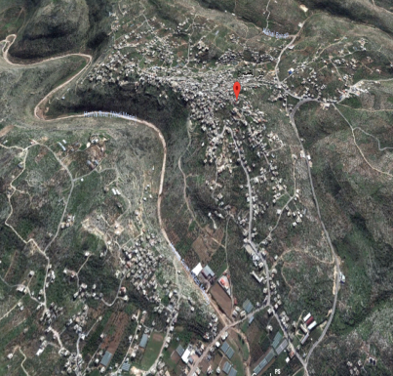
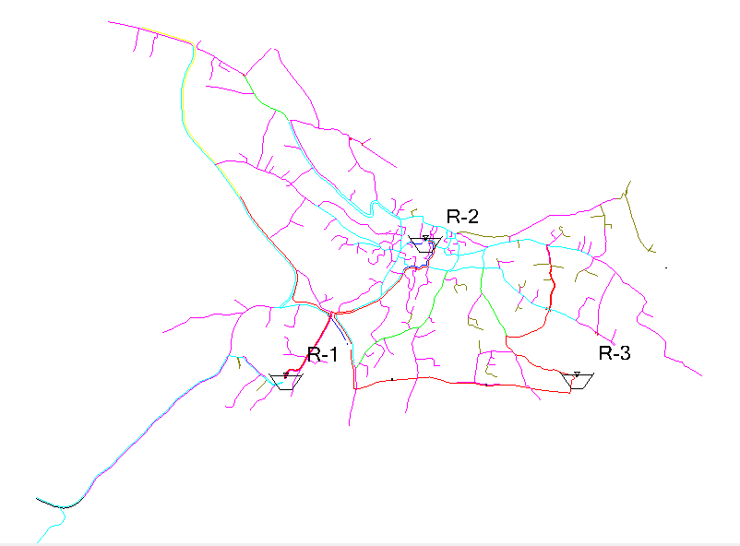
An-Najah National University
Faculty Of Engineering
Civil Engineering Department
Water Supply Sources
Management of
Al-Sha’rawiah Area
Prepared By: Ahmad Al-Ali
Jehad Awad
Zaher Saifi
Supervision of Dr. Anan Jayyousi

Slide 2
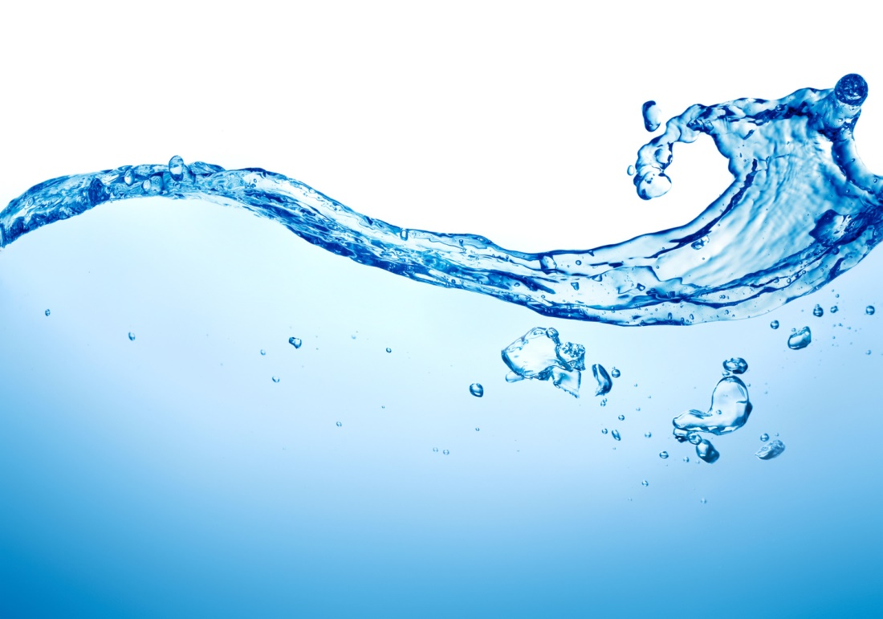
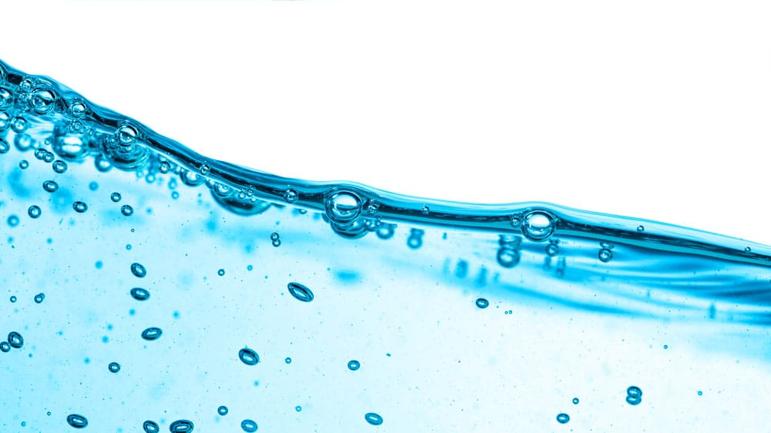
Project Objections
Analyze the water situation for Al-Sha’rawiah area for 23 years.
calculate the future gap.
Propose solutions to cover the gap.

Slide 3
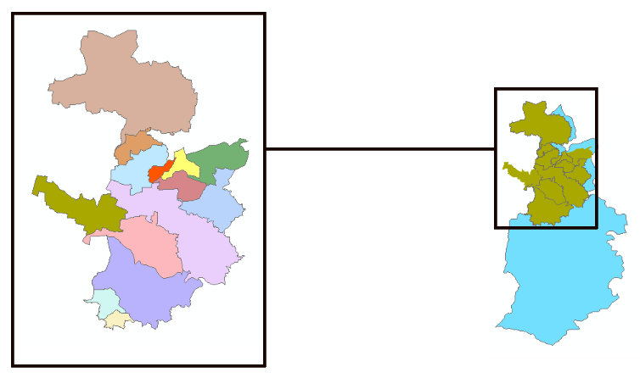


Study Area
Al-Sha’rawiah Area
Tulkarm
14 Agglomerations
To the north of Tulkarm city

Slide 4
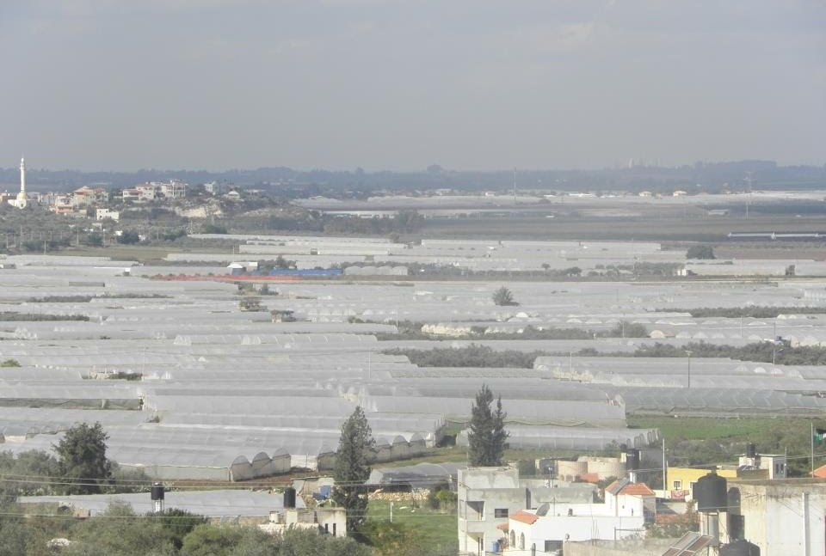
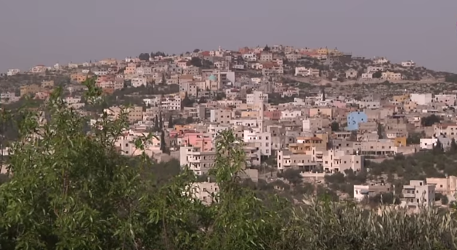
Study Area
91,000 Dunums
80-350 meter above sea level

Slide 5

Study Area
Mediterranean climate
Rain fall
Humidity
Temperature
Hot and dry in summer
Mild and wet in winter
600-700mm
50-70%
17-19 $C^{o}$

Slide 6
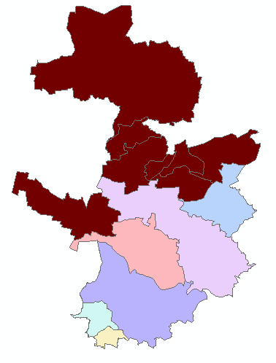

Gap calculation
Six chosen Agglomerations

Slide 7
Gap calculation
Three terms
5 years
Short term
10 years
Medium term
23years
Long term
2017

Slide 8

Gap calculation
Future population in three terms

Slide 9
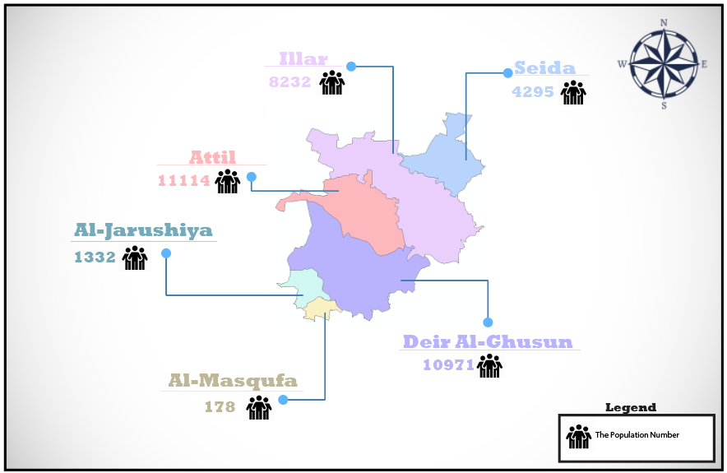
Gap calculation
Future population in short term

Slide 10
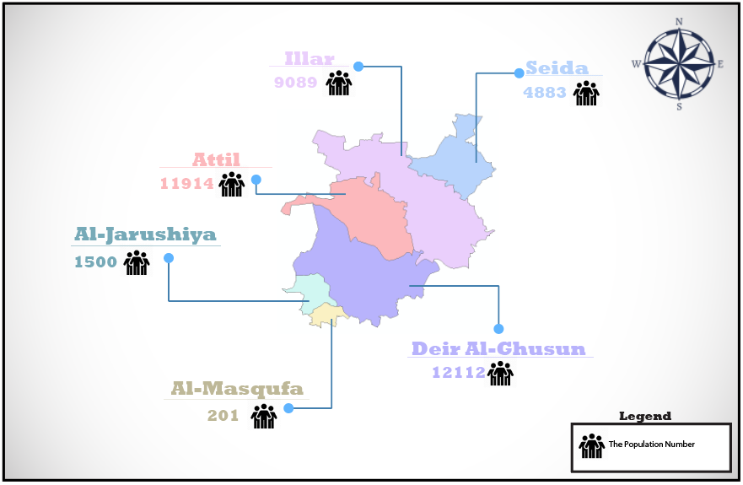
Gap calculation
Future population in medium term

Slide 11
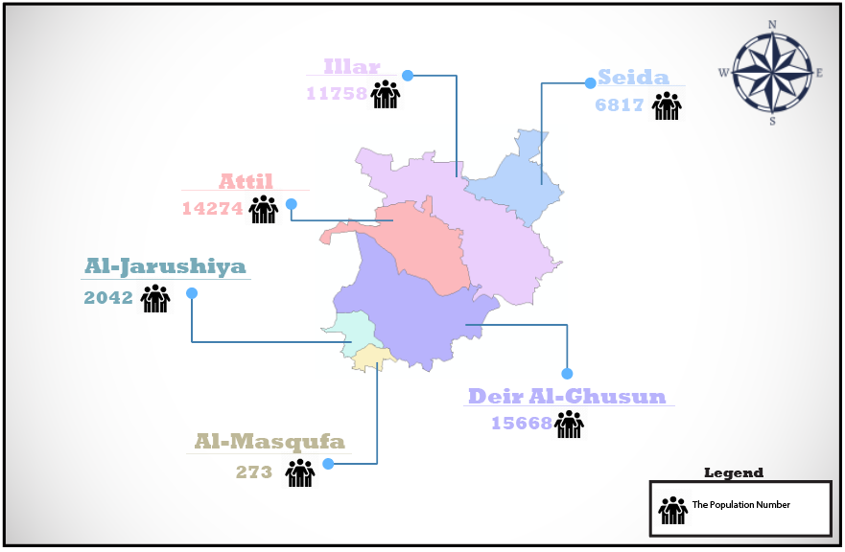
Gap calculation
Future population in long term

Slide 12
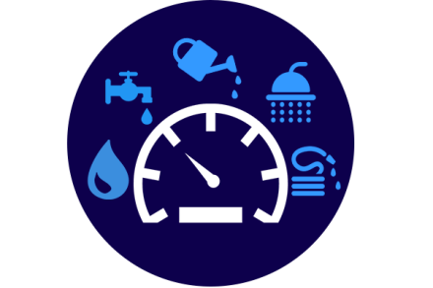
Gap calculation
Future water demand in three terms

Slide 13
Gap calculation
Total consumption
Palestinian Water Authirity
120 L/C.D
75%
160 L/C.D

Slide 14
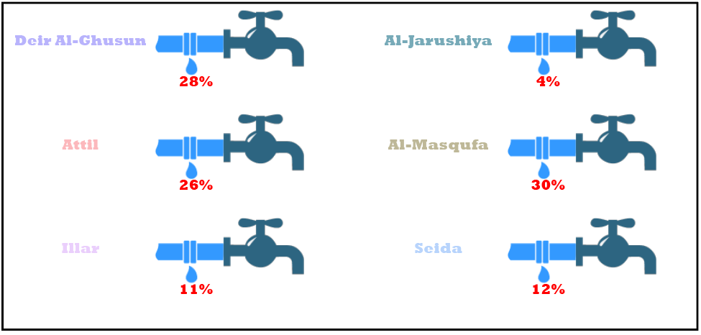
Gap calculation
Uncounted water

Slide 15
Gap calculation
Uncounted water
Uncounted water < = 15%
Uncounted water >15%
Short term
Medium term
Long term
25%
20%
15%

Slide 16
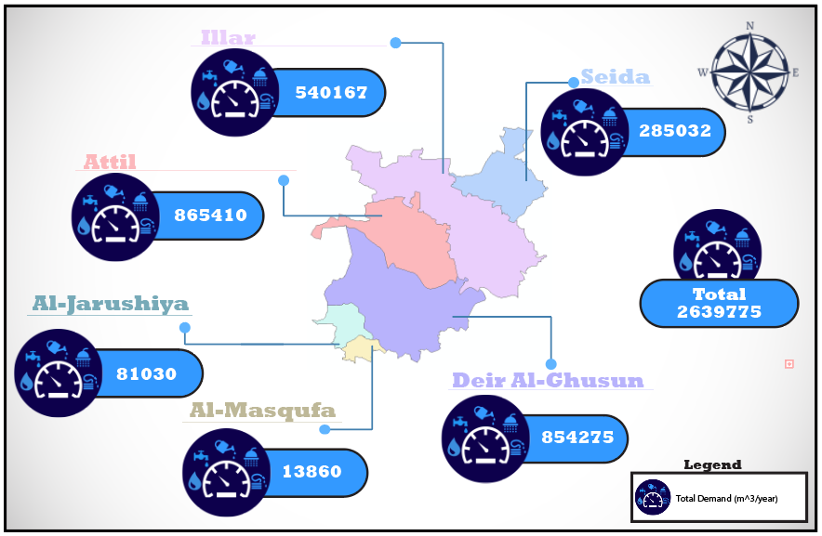
Gap calculation
Future water demand in short term

Slide 17

Gap calculation
Future water demand in medium term

Slide 18

Gap calculation
Future water demand in long term

Slide 19
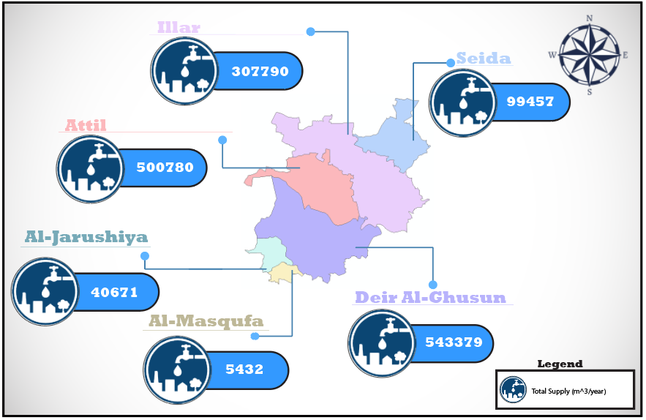
Gap calculation
Present supply in 2017

Slide 20
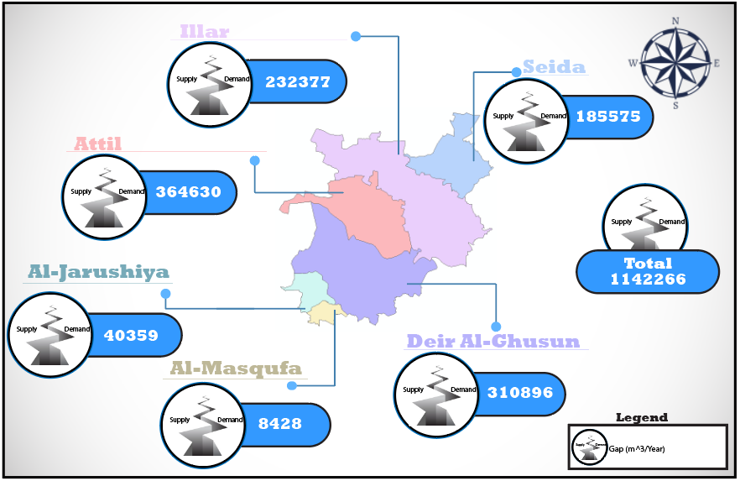
Gap calculation
Total gap in short term

Slide 21

Gap calculation
Total gap in medium term

Slide 22

Gap calculation
Total gap in long term

Slide 23
Gap reduction
Near Future Solutions
Long Term Solution
Rainwater Harvesting
Loss Reduction
Investment Plan

Slide 24
Rainwater Harvesting
Gap reduction
The Average Family Size = 5 Capita
The Building Average Area = 150 m2
Every Building Two Floors , Every Floor One Appartment
Average Annual Rainfall Depth = 650 mm
The Percentage of Collecting Rainwater = 50%
Volume =

Slide 25
Gap reduction
The Volume of Rainwater Harvested
Agglomeration name | 2022 | 2027 | 2040 | Unit
Seida | 2525 | 5392 | 14820 | M3/year
Illar | 3783 | 7961 | 20972 | m3/year
Attil | 3642 | 7542 | 19047 | M3/year
Deir AL – Ghusun | 5046 | 10608 | 27944 | M3/year
AL – Jarushiya | 726 | 1545 | 4188 | M3/year
AL – Masqufa | 98 | 210 | 561 | M3/year
Total | 15819 | 33257 | 87531 | M3/year

Slide 26

Now , Subtract The volume of harvested rainfall from total GAP (Short Term )
Gap reduction

Slide 27

Medium Term
Gap reduction

Slide 28

Long Term
Gap reduction

Slide 29
Loss Reduction
Gap reduction
The losses Should be Reduced to 15% of total current supply .
Short term ( 10% ) , Medium term ( 5% ) .

Slide 30
The Volume of water Saved from Loss Reduction
Gap reduction
Agglomeration name | 2022 | 2027 | Unit
Attil | 50078 | 25039 | M3/year
Deir AL – Ghusun | 54337.9 | 27168.9 | M3/year

Slide 31

Now Subtract the volume of water saved from loss reduction from Remaining GAP ( short term )
Gap reduction

Slide 32

Medium Term
Gap reduction

Slide 33
Investment Plan
Investment plan
Cover the Remaining GAP .
Finding New Water Sources .
Pumps , Conveyance Lines and Tanks .
Long Time to be Fulfilled .
So it will Go through phases Called Packages .

Slide 34
The selection of New Water Sources
Investment plan
The Total Remaining GAP in Long Term (2040) 1,839,067 m3/year
The best Solution is Groundwater Wells .
Every well will produce 1,050,000 m3/year

Slide 35
Design Criteria
Investment plan
For Conveyance Lines :
Use Continuity Equation ( Q = V.A )
For Planning Porposes ( V = 1 ) and (H_{L} = 0.01 L)
For the Pump head :
Use Bernoulli Equation (Z₁ + H_{P} = Z₂ + H_{L} )
Power = γ * Q * H_{P} / µ
For Tanks :
Volume = Total demand per year / 365

Slide 36
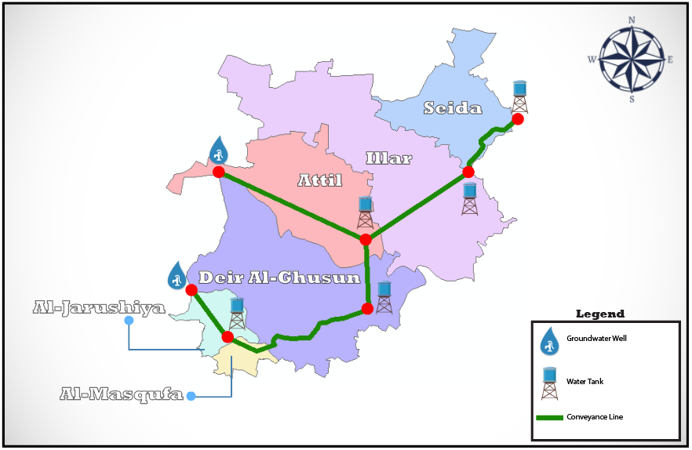
Proposed Investment Plan and Packages
Investment plan

Slide 37
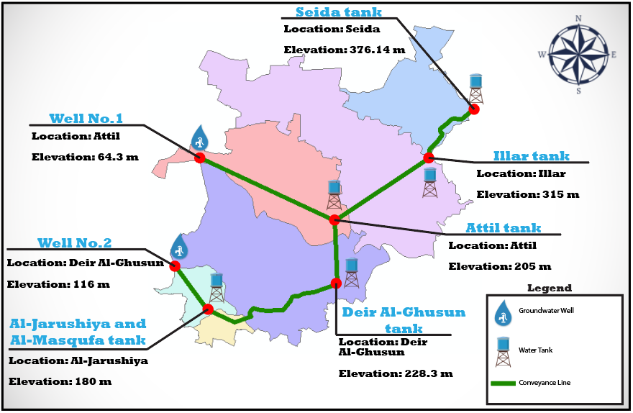
Investment plan

Slide 38
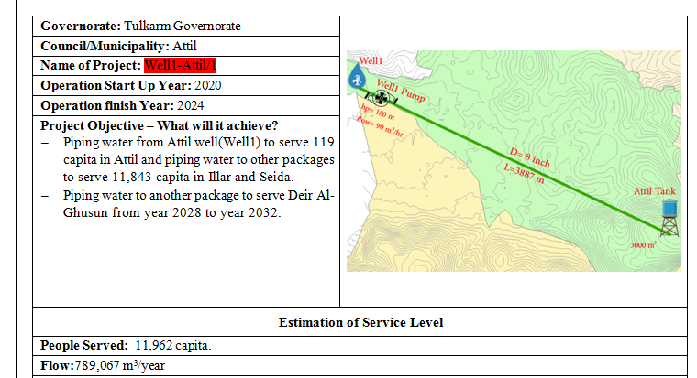
Investment plan

Slide 39
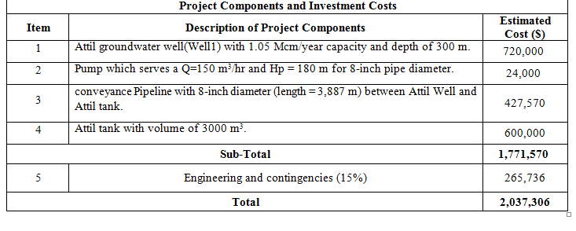
Investment plan

Slide 40
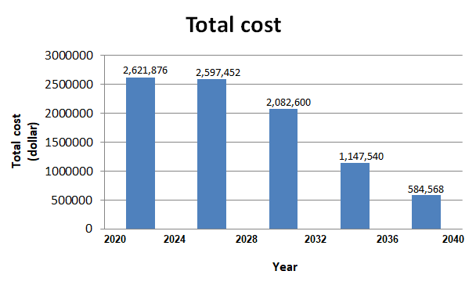
Total Cash Flow
Investment plan

Slide 41
Cash Flow (Cost Per Year )
Investment plan

Slide 42
Results
Investment plan
The total investment cost is approximately 9 Million dollar.
The average investment per year around 450,000 $/year.
The average investment per capita per year is about 8.9 $/capita.year

Slide 43
Project Objectives
Analyze the existing water distribution network.
Redesign the network for 30 years.

Slide 44
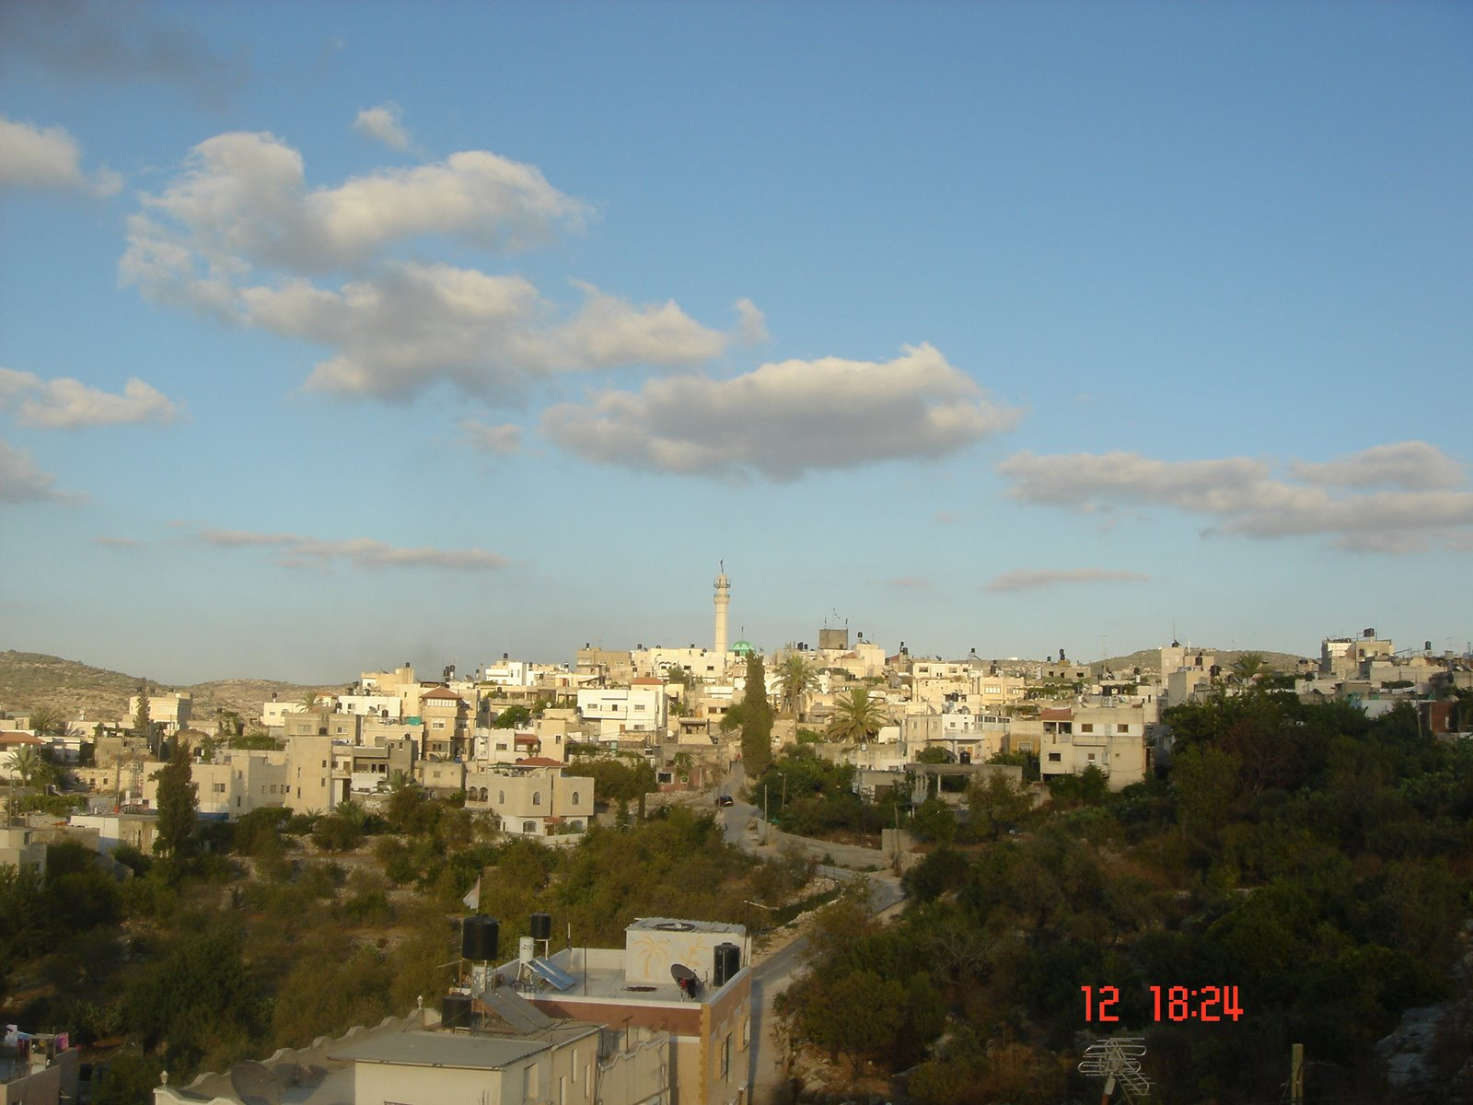
Study Area
Deir Al-Ghusun
7 Kilometers to the north of Tulkarm City.
242 meters above sea level.
9936 capita (2017).
32000 dunums. But 17250 dunums was
confiscated by Israeli occupation

Slide 45
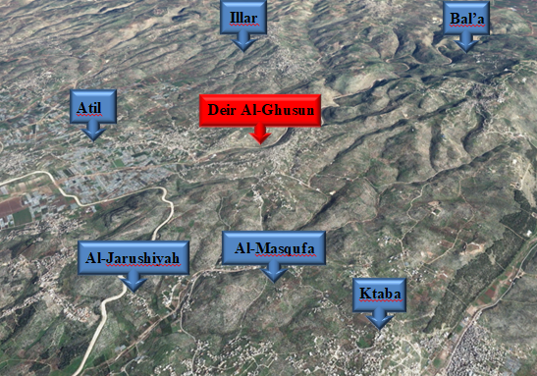
Study Area
E
N
Location
S
W

Slide 46
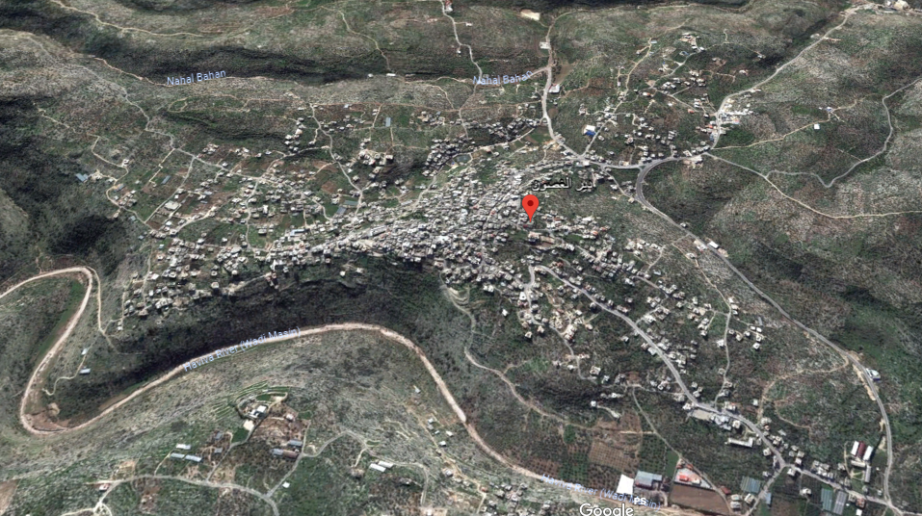
Study Area
Study Area Map

Slide 47
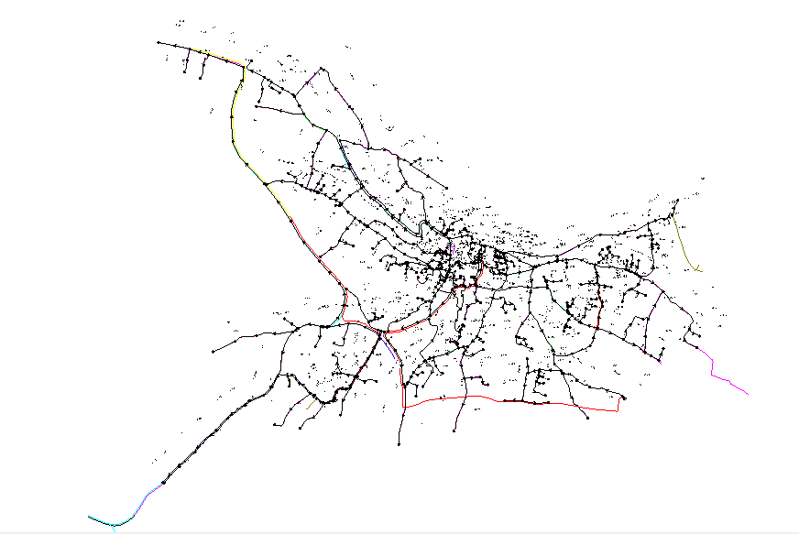
Study Area
Existing Water Network
Constructed before 35 years.
64 kilometers.
28%
3 parts.
1 Inch
3 Inch
2 Inch
4 Inch
6 Inch

Slide 48
Study Area
Existing Water Network

Slide 49
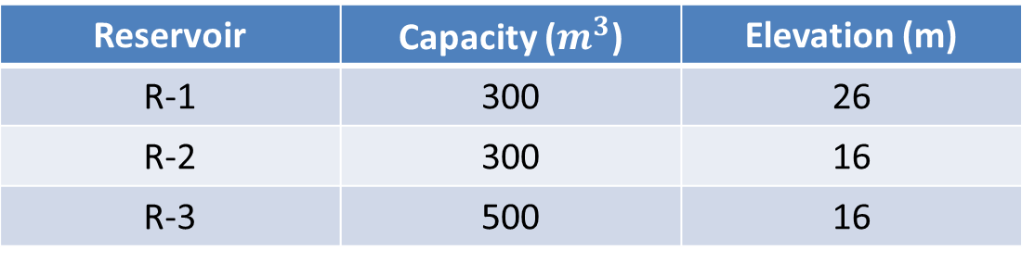
Study Area
Existing Water Network
Reservoir | Capacity ($m^{3}$) | Elevation (m)
R-1 | 300 | 26
R-2 | 300 | 16
R-3 | 500 | 16

Slide 50
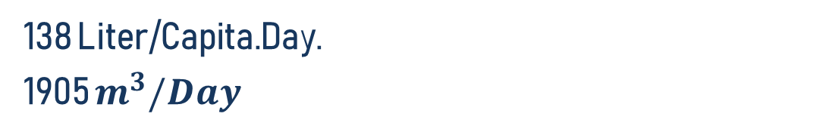
Questionnaire Analysis
01
35 Families and 24 Questions.
02
Some Information About The Network.
03
138 Liter/Capita.Day.
1905 $m^{3}/Day$
04
Questionnaire Results.

Slide 51
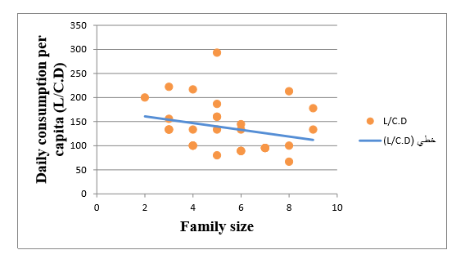
Questionnaire Analysis

Slide 52
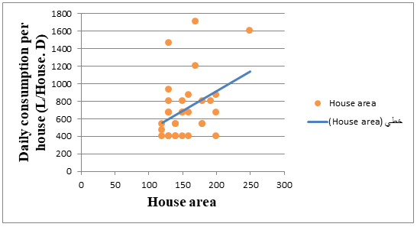
Questionnaire Analysis

Slide 53
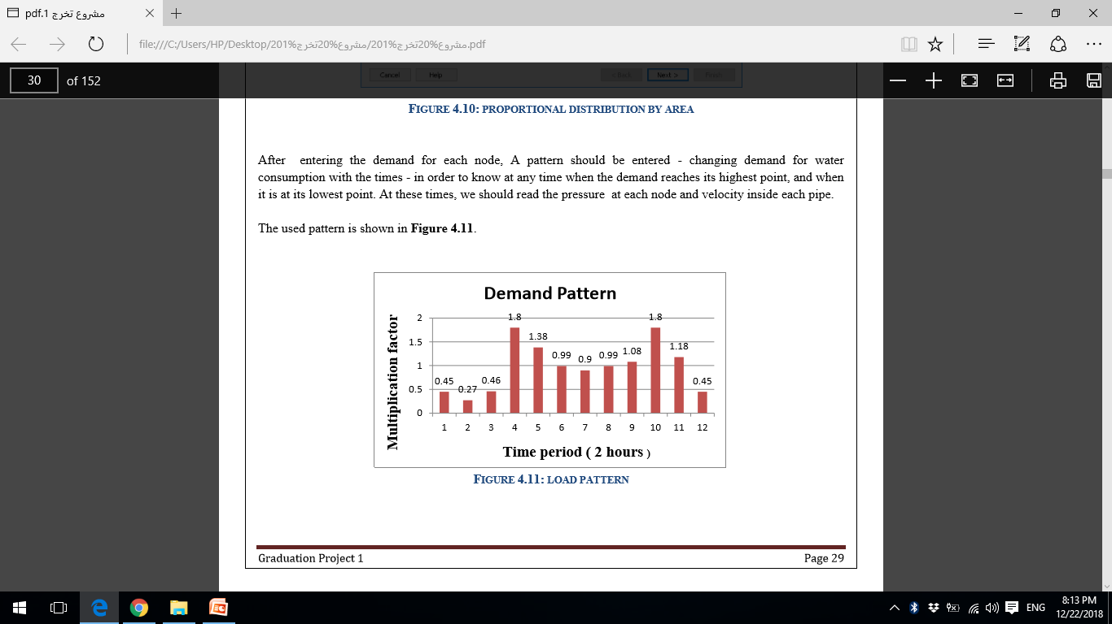
WaterCAD Data
Demand Pattern.

Slide 54
WaterCAD Data
Network On WaterCAD.

Slide 55


Slide 56
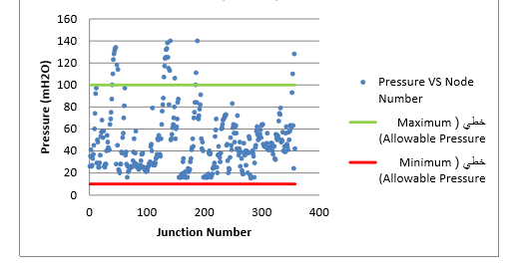
Analysis Results
Pressure At Minimum Flow (2:00Am)

Slide 57
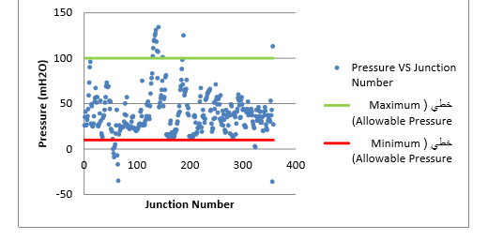
Analysis Results
Pressure At Maximum Flow (6:00Am)

Slide 58
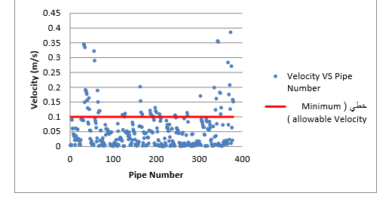
Analysis Results
Velocity At Minimum Flow (2:00Am)

Slide 59
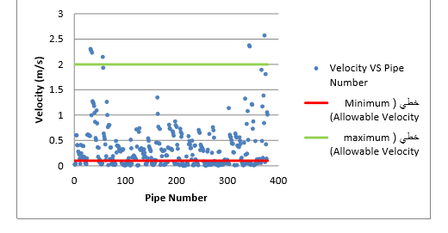
Analysis Results
Velocity At Maximum Flow (6:00Am)

Slide 60


Slide 61
Redesign
01
Future Calculations
02
P₂₀₀₇ = 8242 capita.
P₂₀₁₇ = 9936 capita.
K = 0.02
Thus;
P₂₀₄₇ = 17998 capita.
03

Slide 62
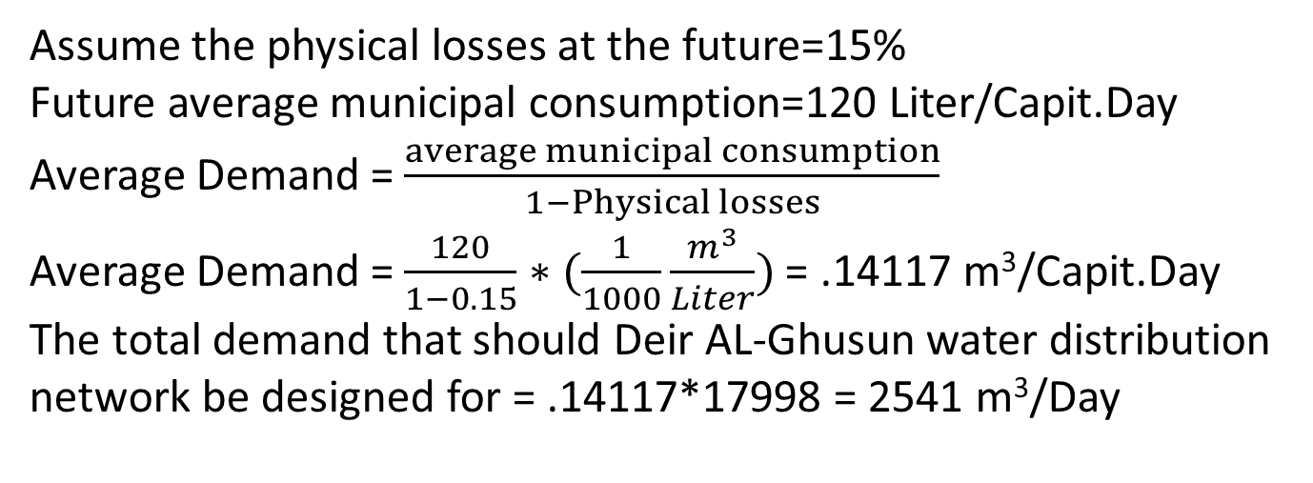
Redesign
01
Future Calculations
02
Assume the physical losses at the future=15%
Future average municipal consumption=120 Liter/Capit.Day
Average Demand = $\frac{average municipal consumption}{1−Physical losses}$
Average Demand = $\frac{120}{1−0.15}∗(\frac{1}{1000}\frac{m^{3}}{Liter})$ = .14117 m³/Capit.Day
The total demand that should Deir AL-Ghusun water distribution network be designed for = .14117*17998 = 2541 m³/Day
03

Slide 63
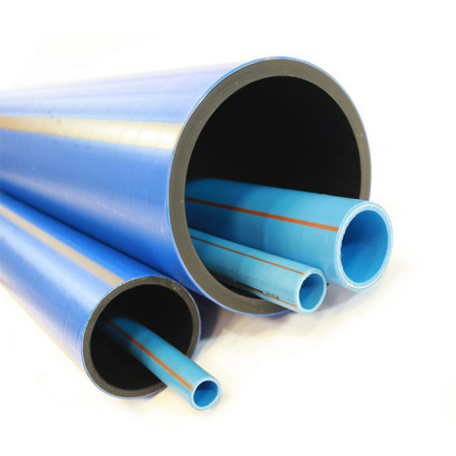
Redesign
Redesign
03
Results After Adjustment
Change the diameters of pipes to make pressure and velocity values to meet the criteria.
Criteria:
Pressure (10-100) mH2o
Velocity (0.1-2) m/s

Slide 64
Redesign
03
Results After Adjustment

Slide 65
Redesign
03
Results After Adjustment

Slide 66
Redesign
03
Results After Adjustment

Slide 67
Redesign
03
Results After Adjustment

