Slide 1
Design of Foundation System for Multistory Building
Prepared by :
Hamza khwayre
Ruaa Khaled Mustafa
Under supervision of:
Dr. Isam Jardaneh

Slide 2
Outline
Review of types of the Foundation
The Purpose of the Project
Site Investigation
Gravity Load Analysis
Seismic Load Analysis
Result of analysis

Slide 3
Type of Foundation
1) shallow foundation
  Single footings
      strip footings
  raft foundations (mat foundation)
2) deep foundation
  piles

Slide 4
The purpose of the project
The aim of this project is figure out the most appropriate foundation type for Residential Multistory Building suggested to be designed in this project
First case: under gravity load.
Second case: under seismic load and gravity load.

Slide 5
Site Investigation Report
It Is a report which provide the geotechnical situation and parameters for a certain site.
Three borehole were dug out in the soil ,(13 m depth , and the others was 9 m depth) .

Slide 6
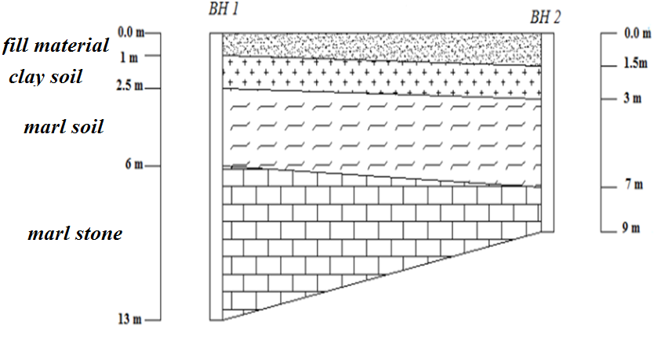
Geological Section
allowable Bearing capacity = 220 kn/m^2 at depth 3 m
allowable Bearing capacity = 350kn/m^2 at depth 7 m
allowable Bearing capacity = 114 kn/m^2 at depth 1 m

Slide 7
Gravity Load Analysis
Structural analysis including ETAB analysis for static and earthquake loads is presented
Area of the building =450 m^2
Number of story = 7
Height of story =4m
Depth of foundation we are going to build =4m
Type of soil is marl soil with bearing capacity q all =220 kn/m^2.
Live load on the slab =2kn/m^2
Super imposed dead load on the slab = 3.5 kn/m^2
The slap is two way ribbed with block

Slide 8
Seismic Load Analysis
IBC 2015 – CODE
Z factor equal to 0.2g
Site classification according to shear velocity The site class is site class (D)
Seismic design category (D)
Type of Analysis is Equivalent static Method (ELF)
Sway Special Moment Resisting Frame

Slide 9
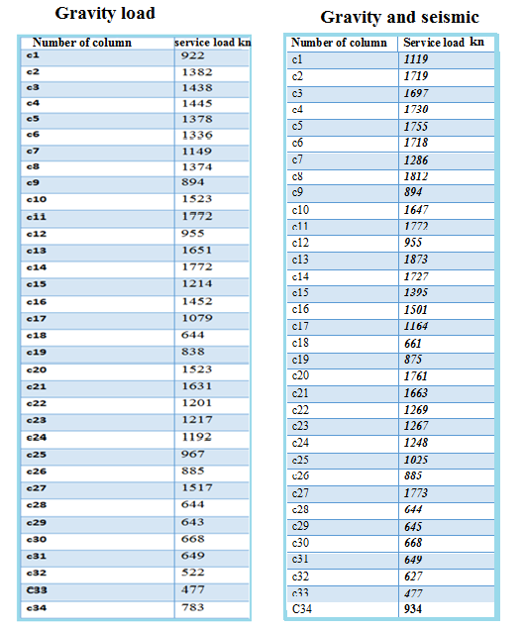
Result of Analysis

Slide 10
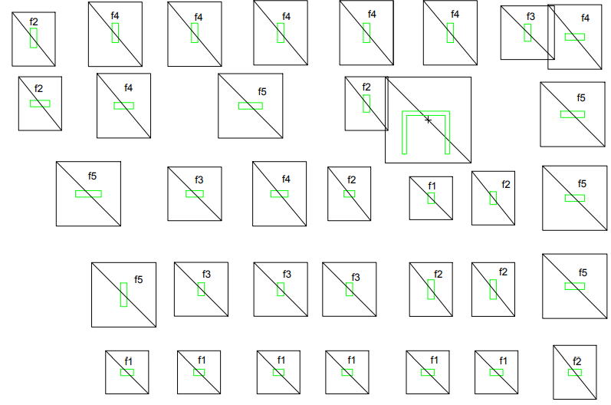
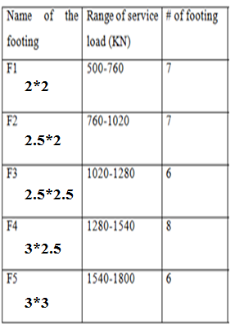

Dimension of the Footings
(Gravity Load)
$\frac{service load}{Area}≤$bearing capacity

Slide 11
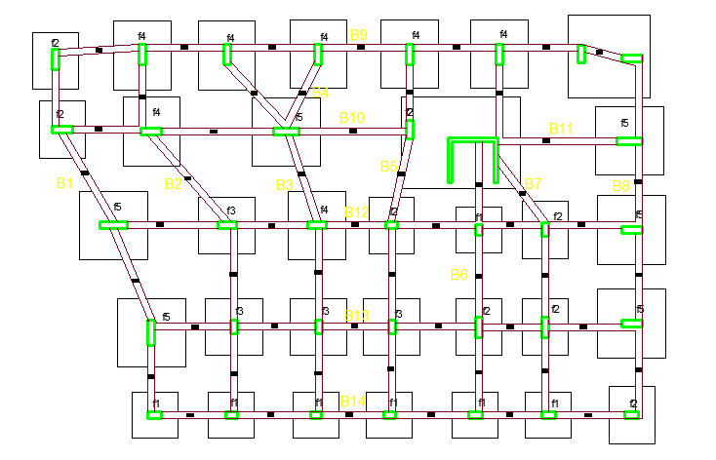
Foundation Plan

Slide 12
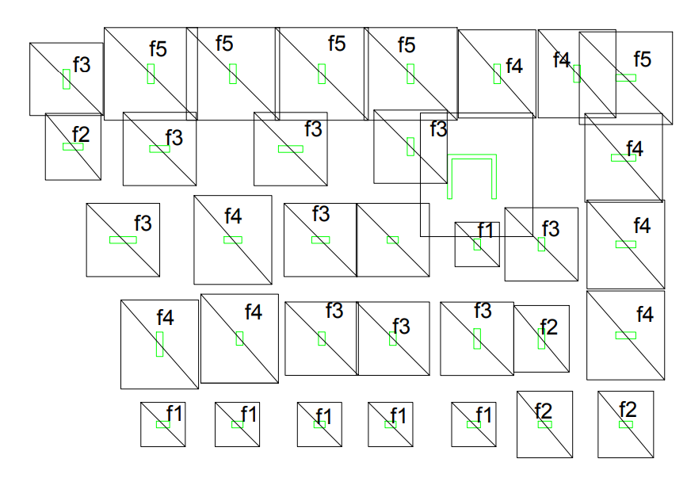
Dimension of the Footing
(Seismic and Gravity Load)

Slide 13
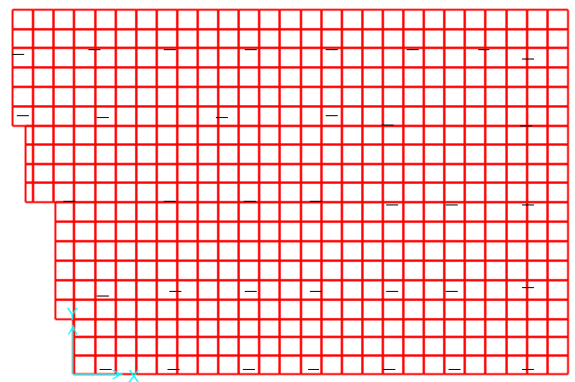
Mat Foundation

Slide 14
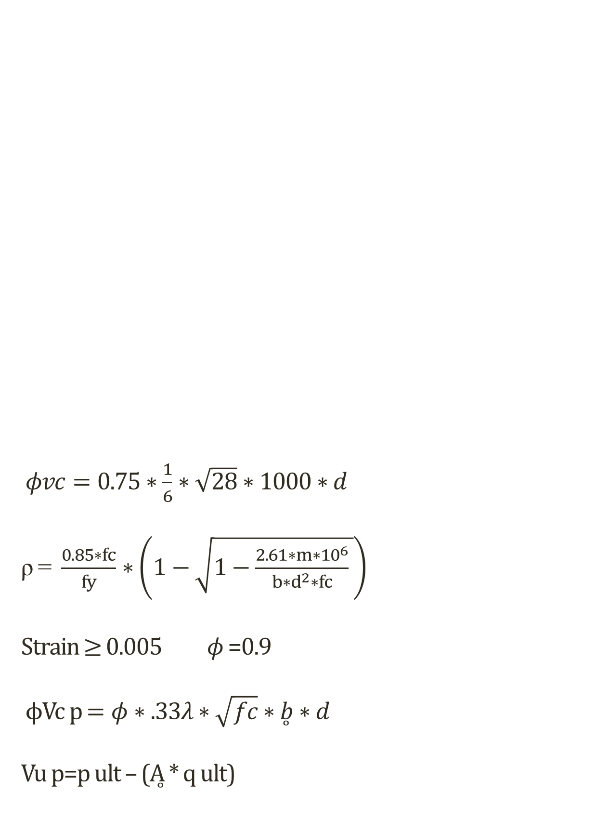
$φvc=0.75∗\frac{1}{6}∗\sqrt{28}∗1000∗d$ ρ = $\frac{0.85∗fc}{fy}∗\left(1−\sqrt{1−\frac{2.61∗m∗{10}^{6}}{b∗d^{2}∗fc} }\right)$
Strain $≥$0.005 $φ$ =0.9 ϕVc p $=φ∗.33λ∗\sqrt{fc}∗\overset{̥}{b}∗d$
Vu p=p ult – (Ḁ * q ult)
Checks for Design

Slide 15
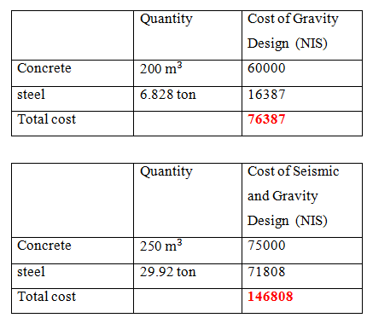
Cost of the Project

Slide 16
Thank you

