Slide 1
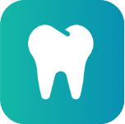
A Comprehensive Dental Clinic Management System
Dentify
DCMS
Ala'a Abdelrahim & Abdullah Shabib
Supervisor: Dr. Anas Toma
January 2026

Slide 2
What is a Dental Clinic Management System?
A dental clinic management system is a digital platform that helps clinics manage:
  Patients
  Appointments
  Treatments
  Payments
  Communication
It replaces paper records and manual coordination with a centralized system.

Slide 3
Why Dentify?
Growing patient load
Dental clinics are facing increasing numbers of patients, making manual management inefficient.
Fragmented systems
Many clinics use separate tools for appointments, billing, and records, leading to errors and delays.
Poor patient experience
Patients rely on phone calls and physical visits for simple tasks like booking or follow-up.
Lack of intelligent automation
Most existing systems do not use AI to reduce staff workload or improve accessibility.

Slide 4
Need for a Smart & Integrated Solution
There is a strong need for:
  A single unified platform
  Web and mobile access
  Secure medical data handling
  Intelligent assistance
  Real-time communication
Dentify was created to fill this gap.

Slide 5
What is Dentify?
All-in-one clinic platform
A complete system covering administration, clinical work, and patient interaction.
Web & mobile based
Accessible anytime through browsers and smartphones.
AI-powered
Uses artificial intelligence to assist patients and clinics.
Role-based
Different interfaces for admins, dentists, patients, and staff.

Slide 6
Key Features

Slide 7
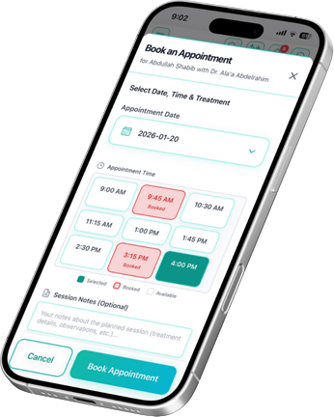
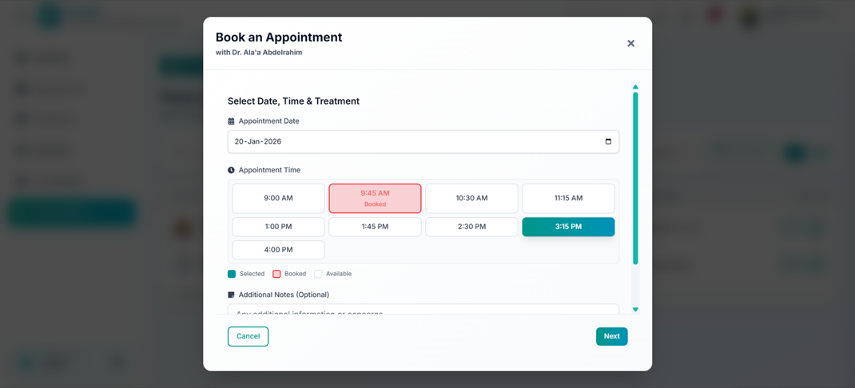
Smart Appointment Booking
For real-time scheduling with conflict prevention.

Slide 8
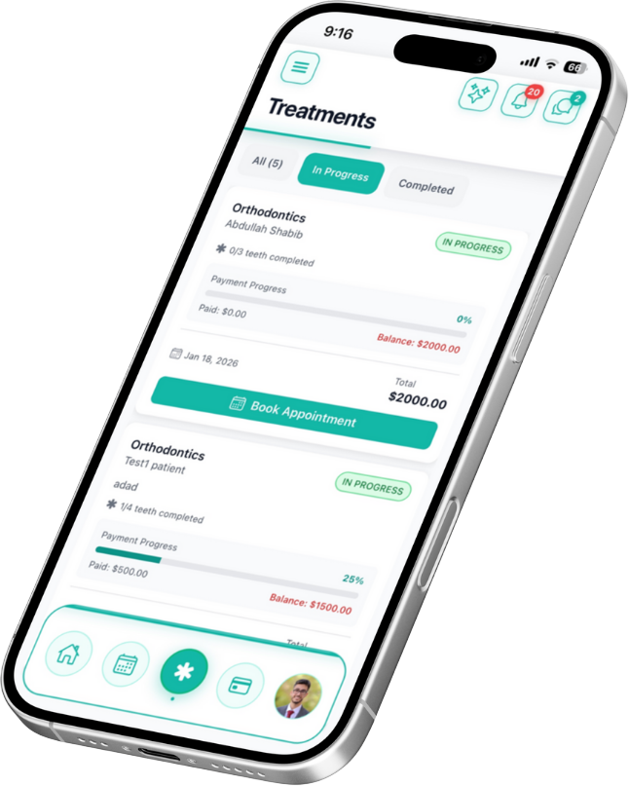
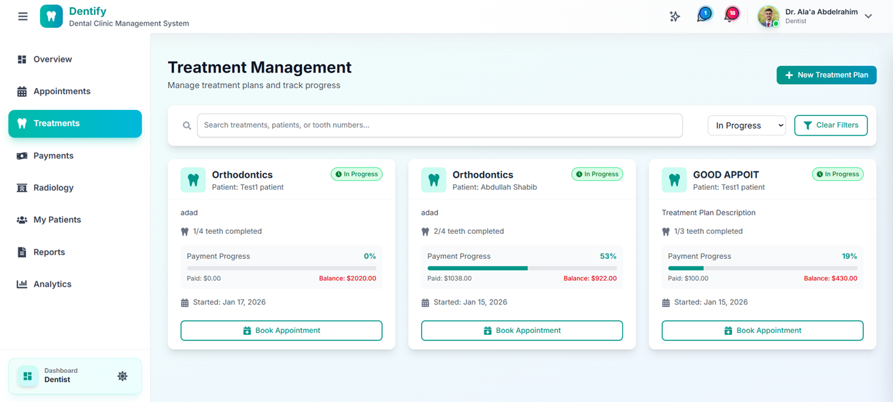
Patient Record Management
For secure storage of medical history
and treatments.

Slide 9
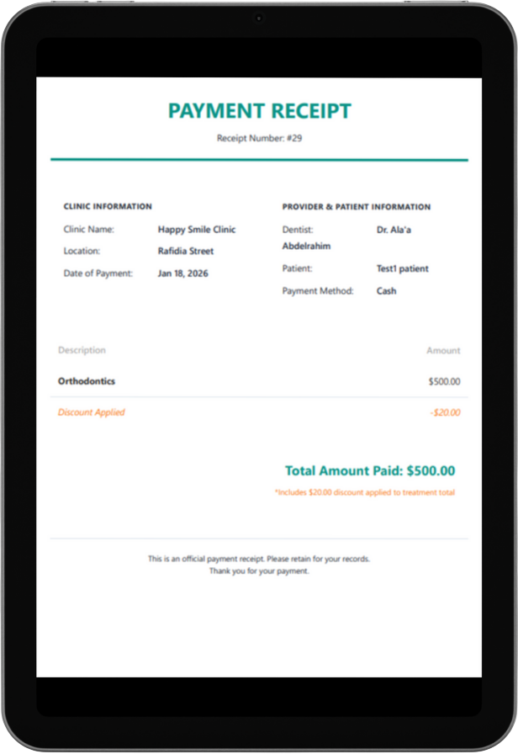
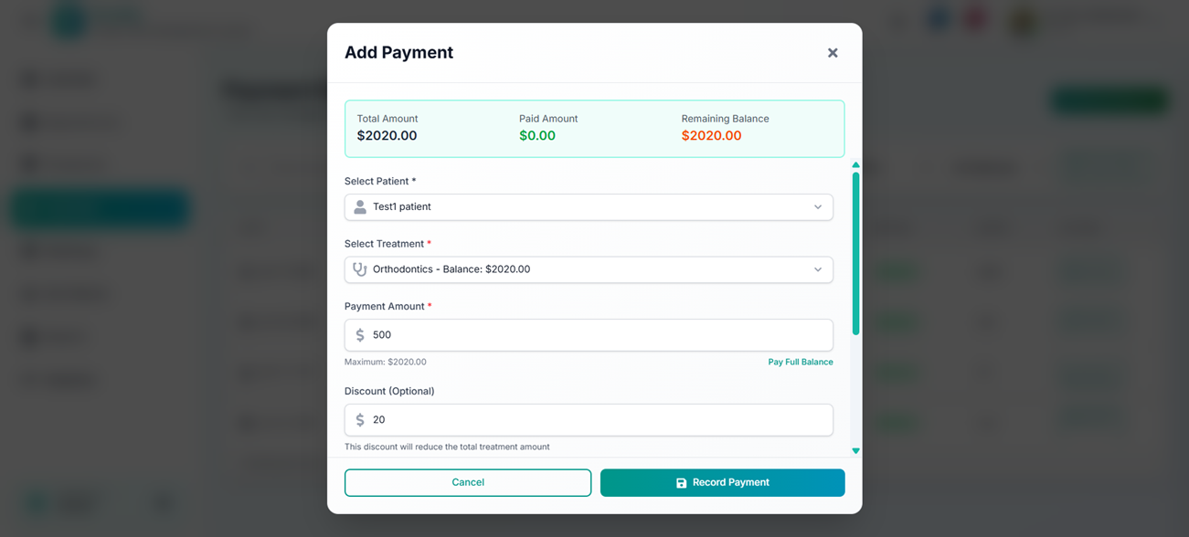
Payment and Billings
For digital payment tracking and receipts.

Slide 10
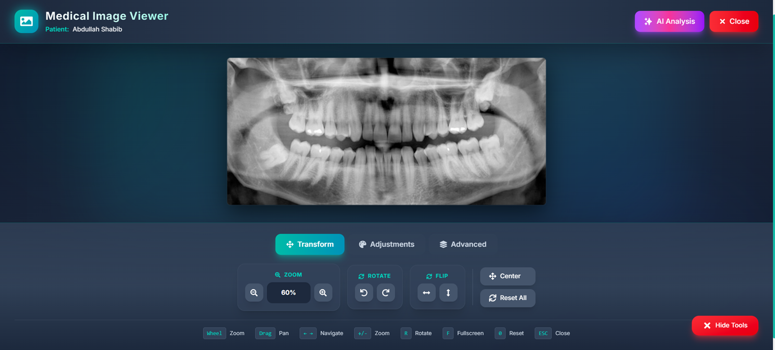
Radiology Integration
For digital imaging requests and results.

Slide 11
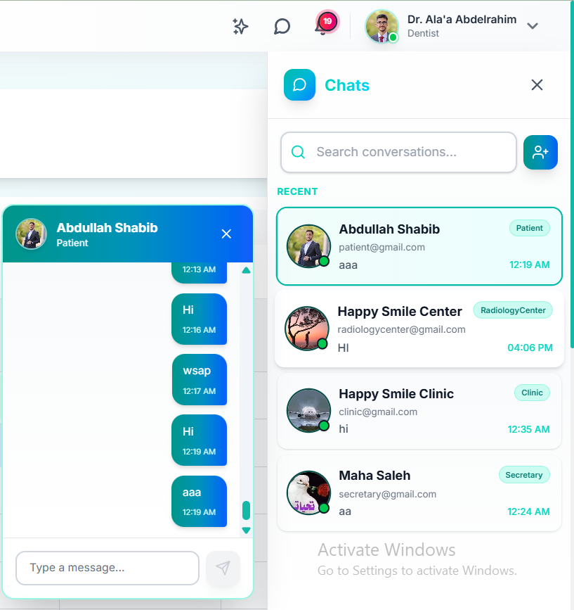
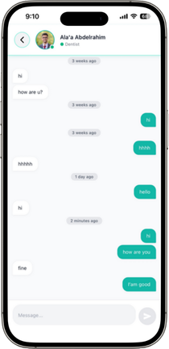
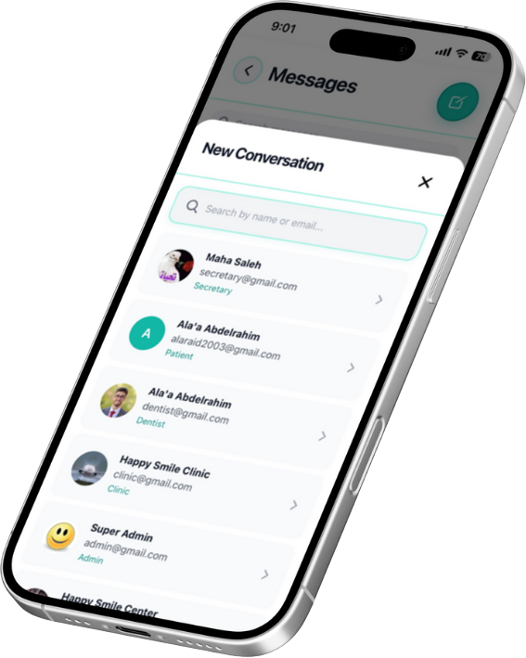
Chatting System
For real-time communication between users.

Slide 12
AI Chatbot (1)
A virtual assistant for booking and inquiries.
AI chatbot for booking dental appointments
Understands patient messages in natural language
Built using Gemini 2.5 Flash
RAG-based booking
  Uses Retrieval-Augmented Generation (RAG)
  Retrieves real clinic data (dentists, hours, slots)
  Ensures accurate and safe bookings

Slide 13
AI Chatbot (2)
Patient requests an appointment
RAG retrieves valid booking data
AI converts request into exact date & time
System checks availability and conflicts
Appointment is confirmed inside the chat

Slide 14
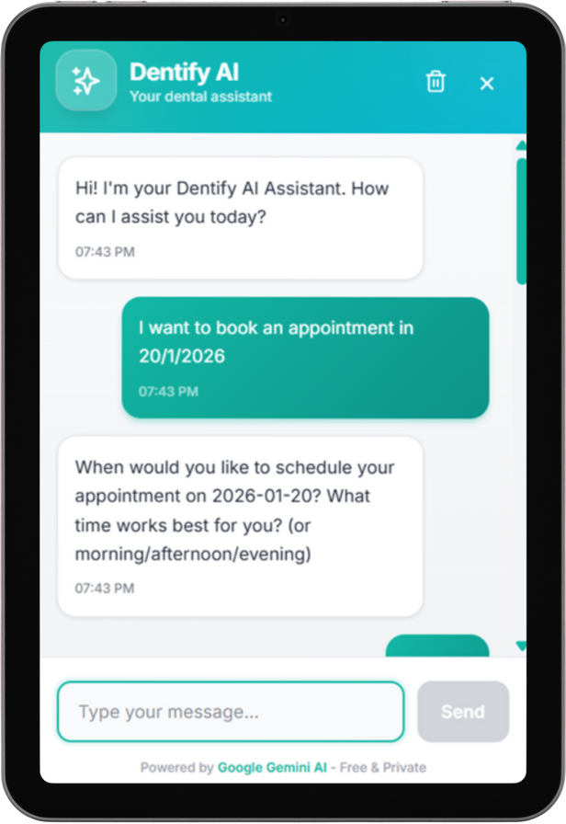
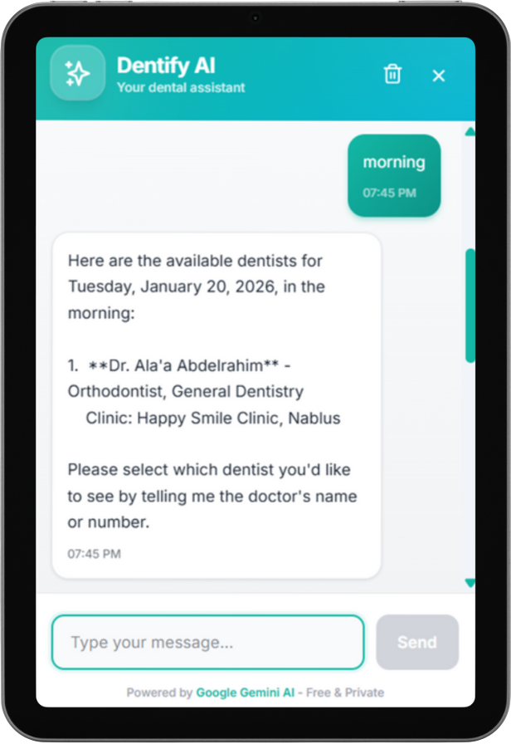
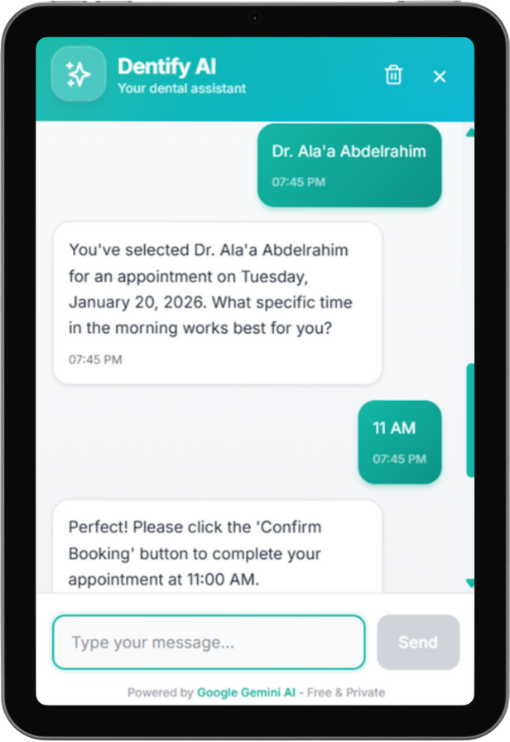
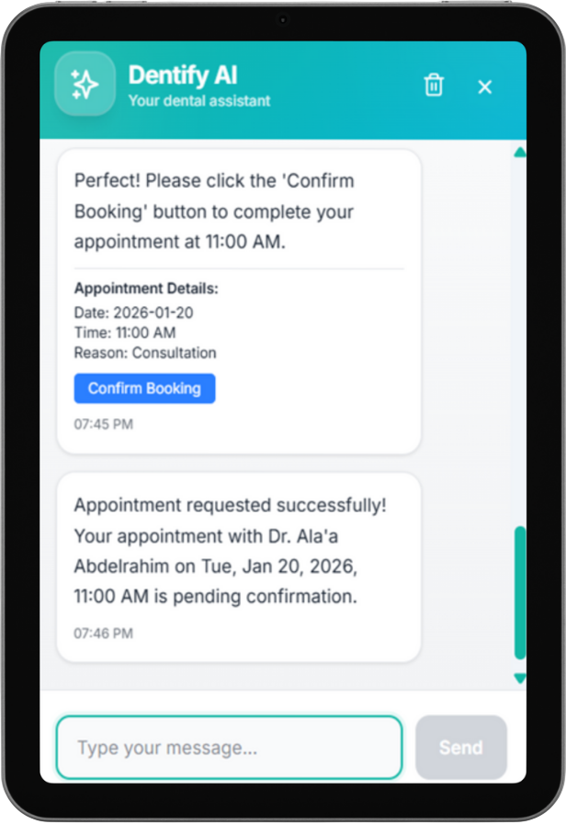
AI Chatbot (3)

Slide 15
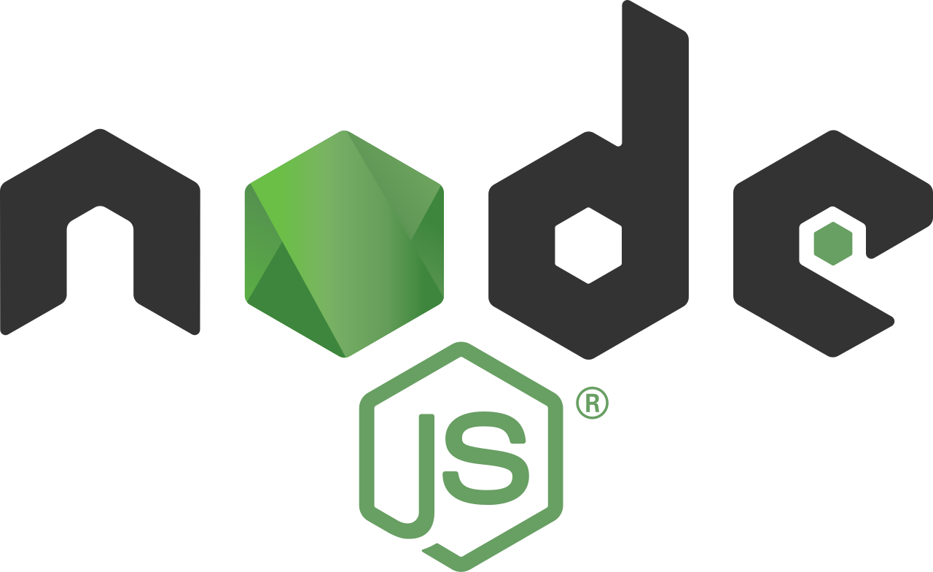


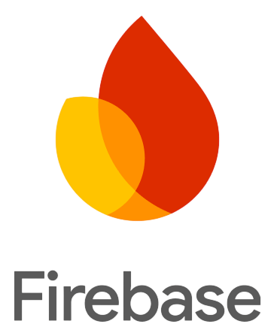




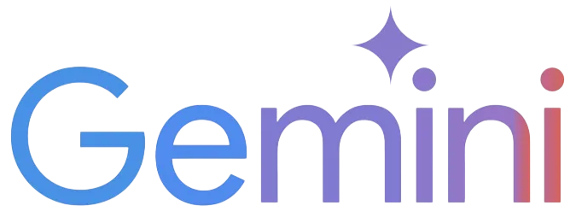


Software & Technology
Backend
Frontend
Cloud & Services
AI

Slide 16
Web Application

Slide 17
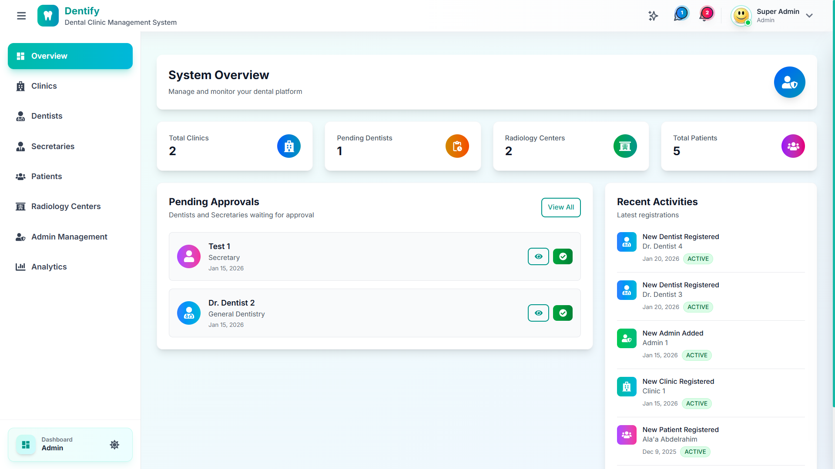
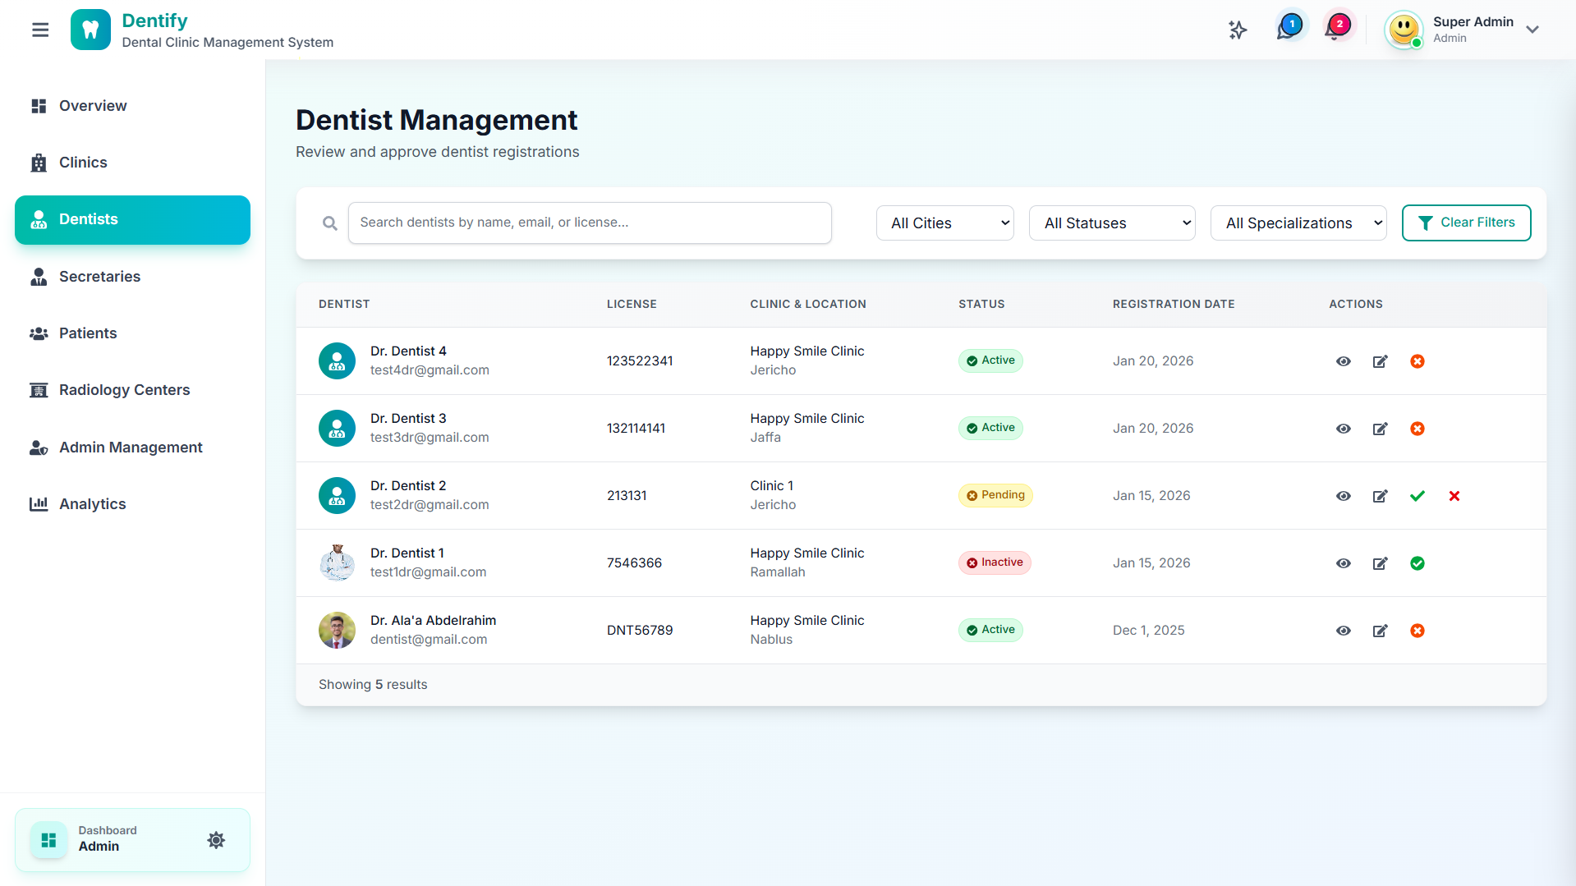
Admin Dashboard
Used system configuration, user management, and analytics

Slide 18
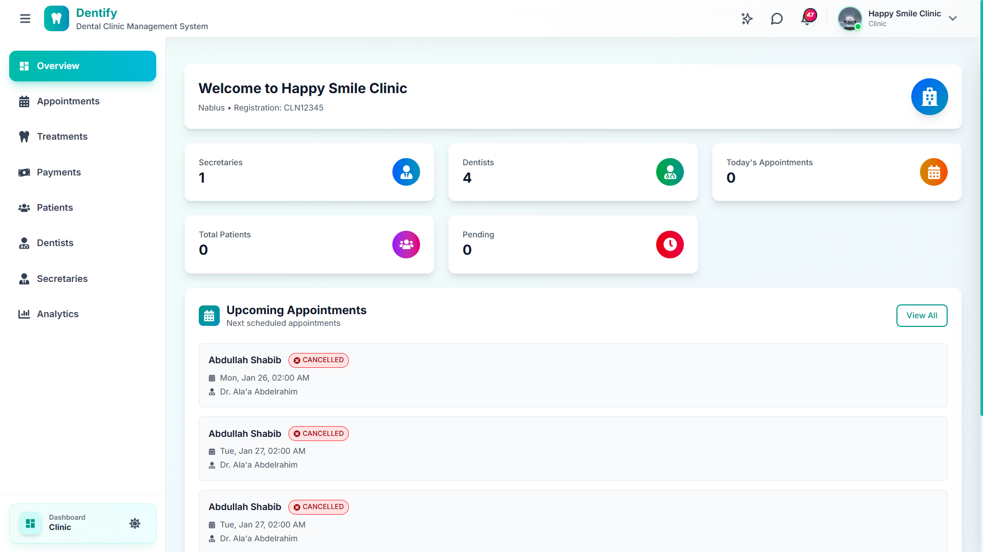
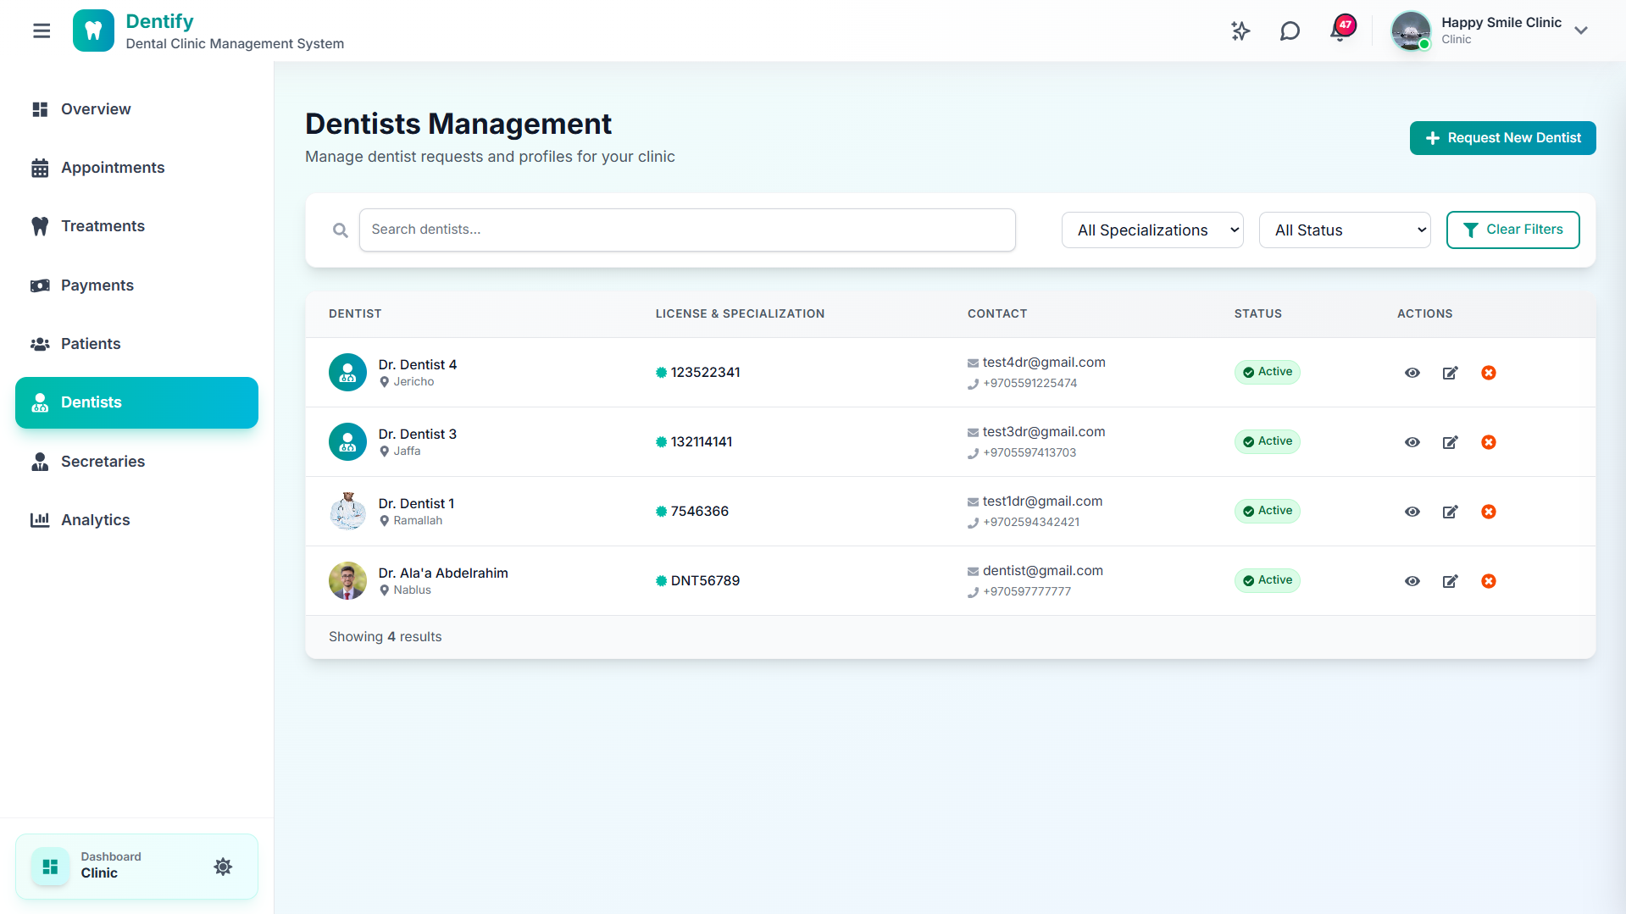
Clinic Dashboard
Can manage dentists, secretaries, services, and schedules

Slide 19
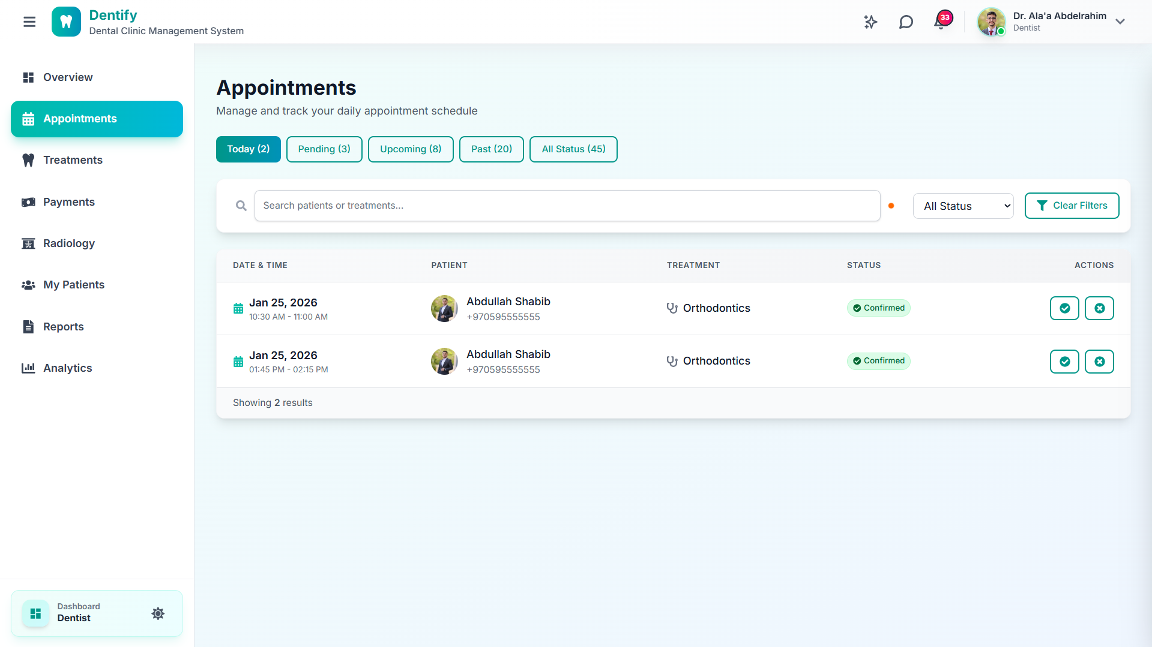
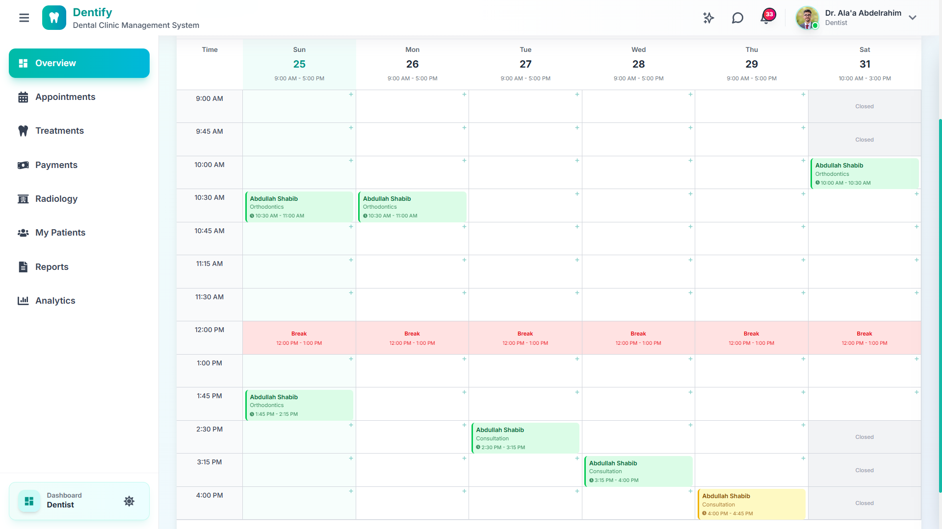
Dentist Dashboard (1)
Can manage appointments and daily schedule

Slide 20
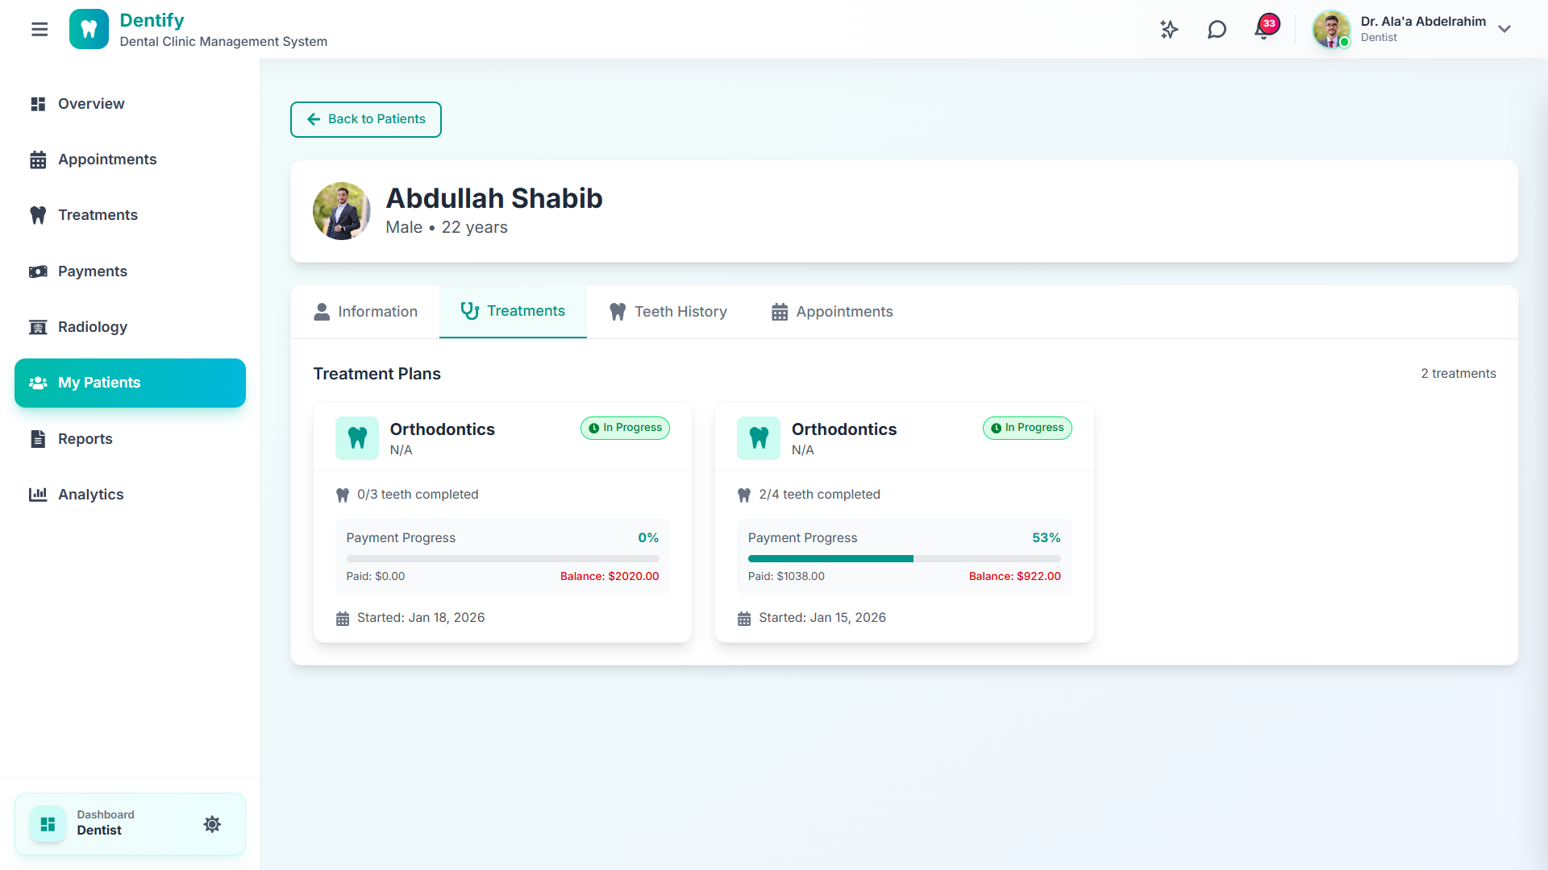
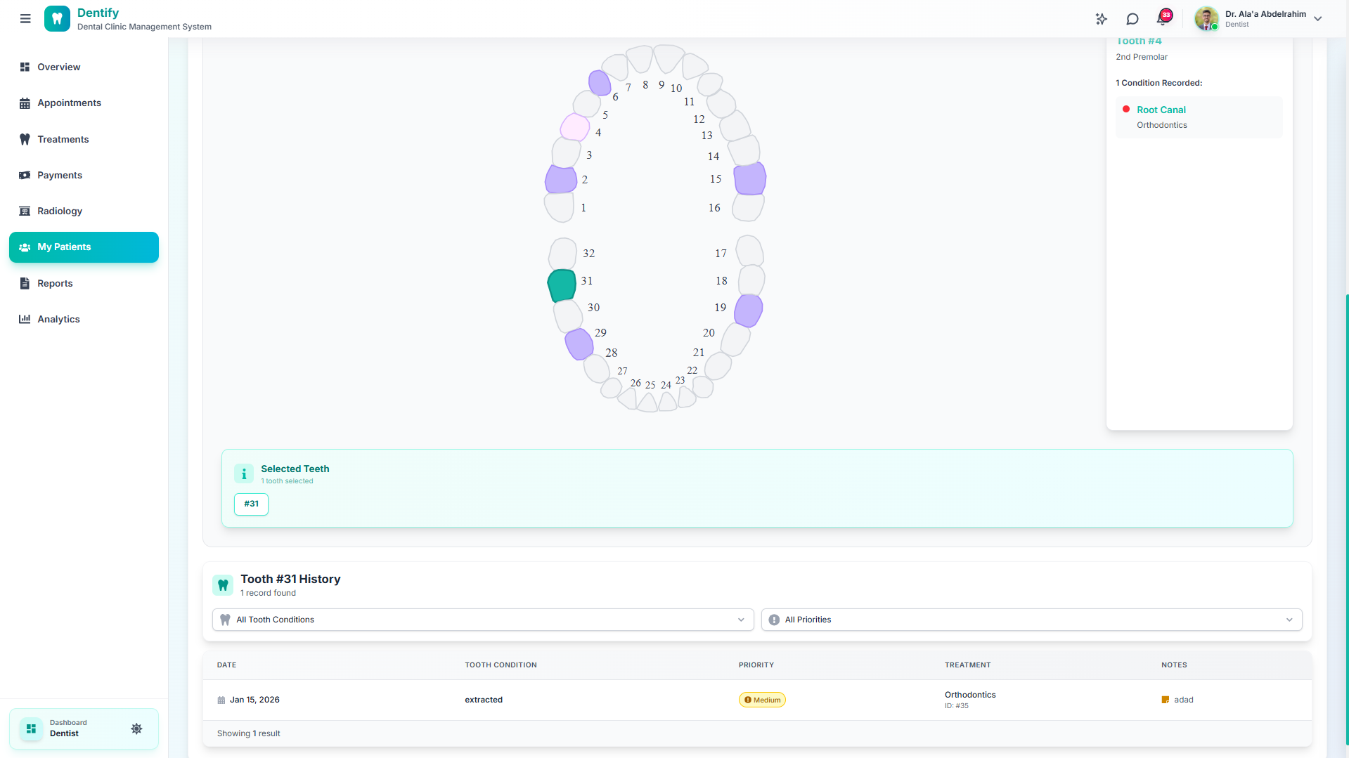
Dentist Dashboard (2)
They can also access patient records and treatment history

Slide 21
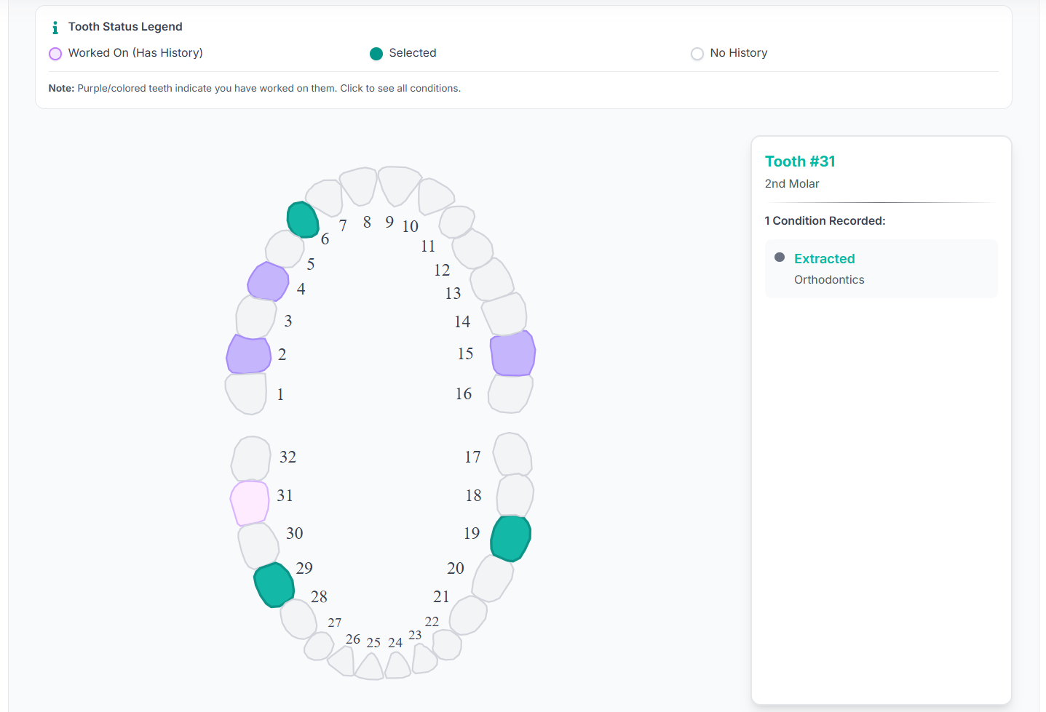
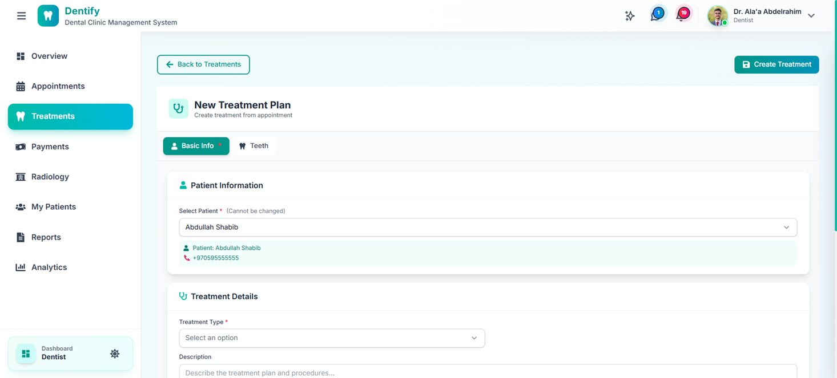
Dentist Dashboard (3)
Dentists can create treatment plans

Slide 22
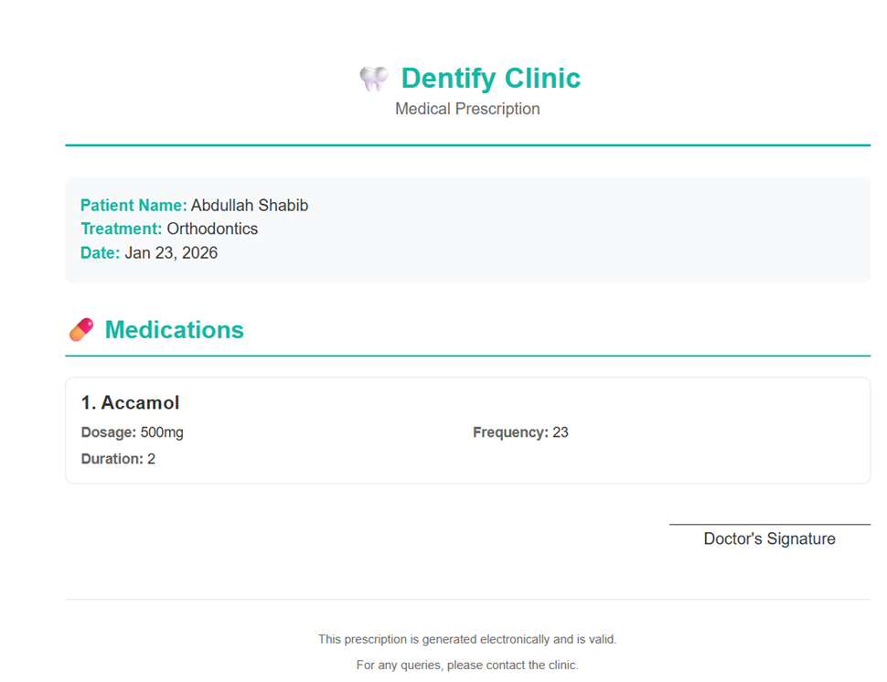
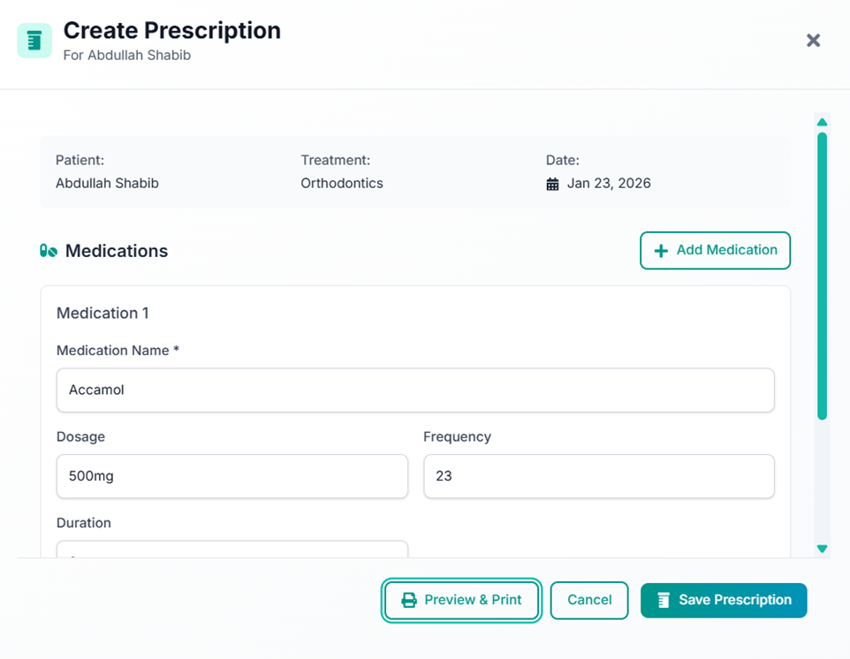
Dentist Dashboard (4)
Also create prescriptions

Slide 23
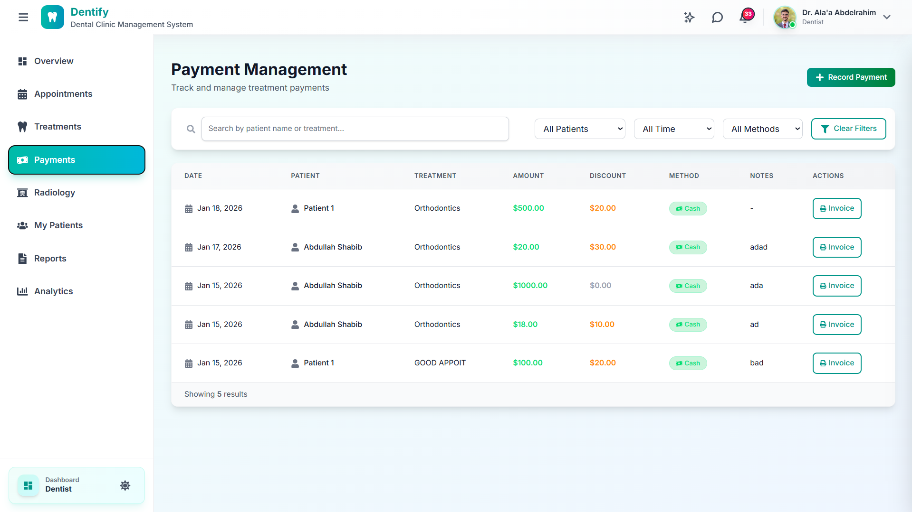
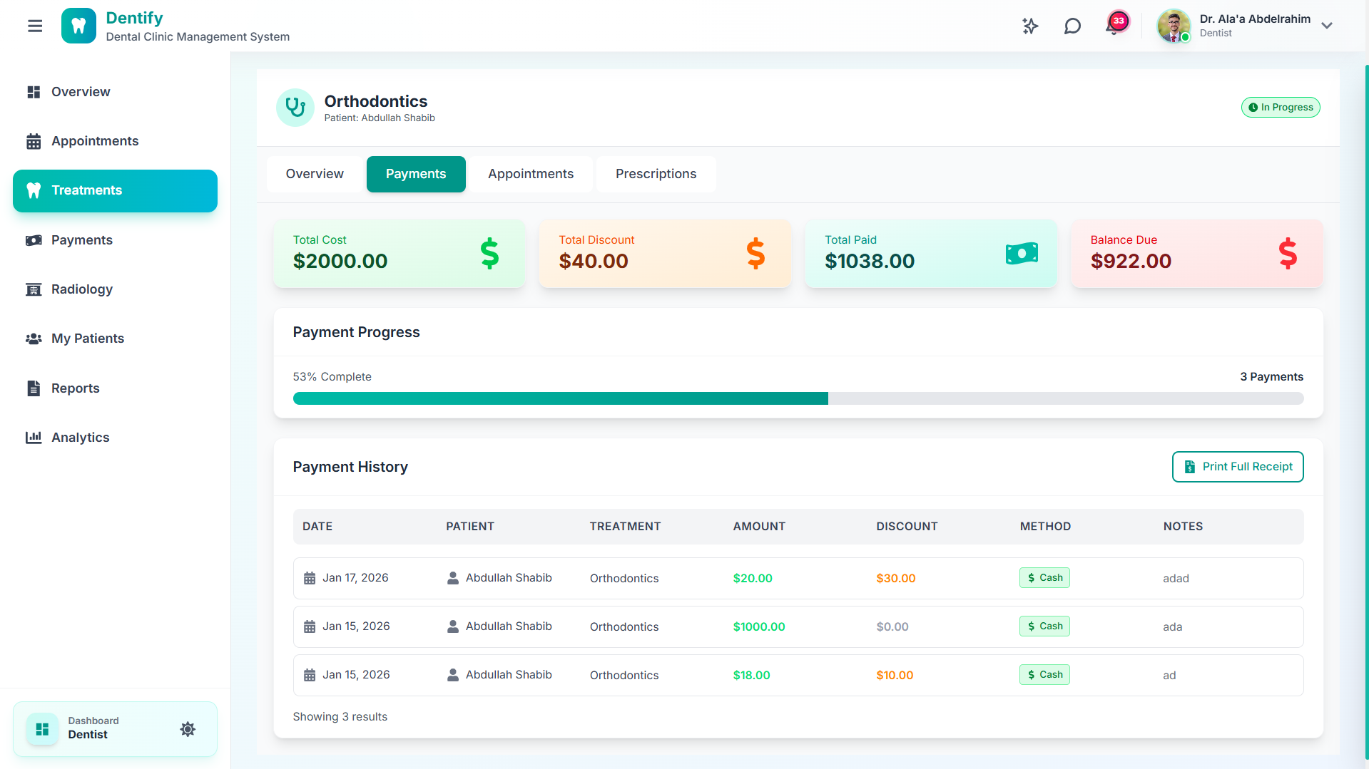
Dentist Dashboard (5)
The system allows dentists track payments and financial status

Slide 24
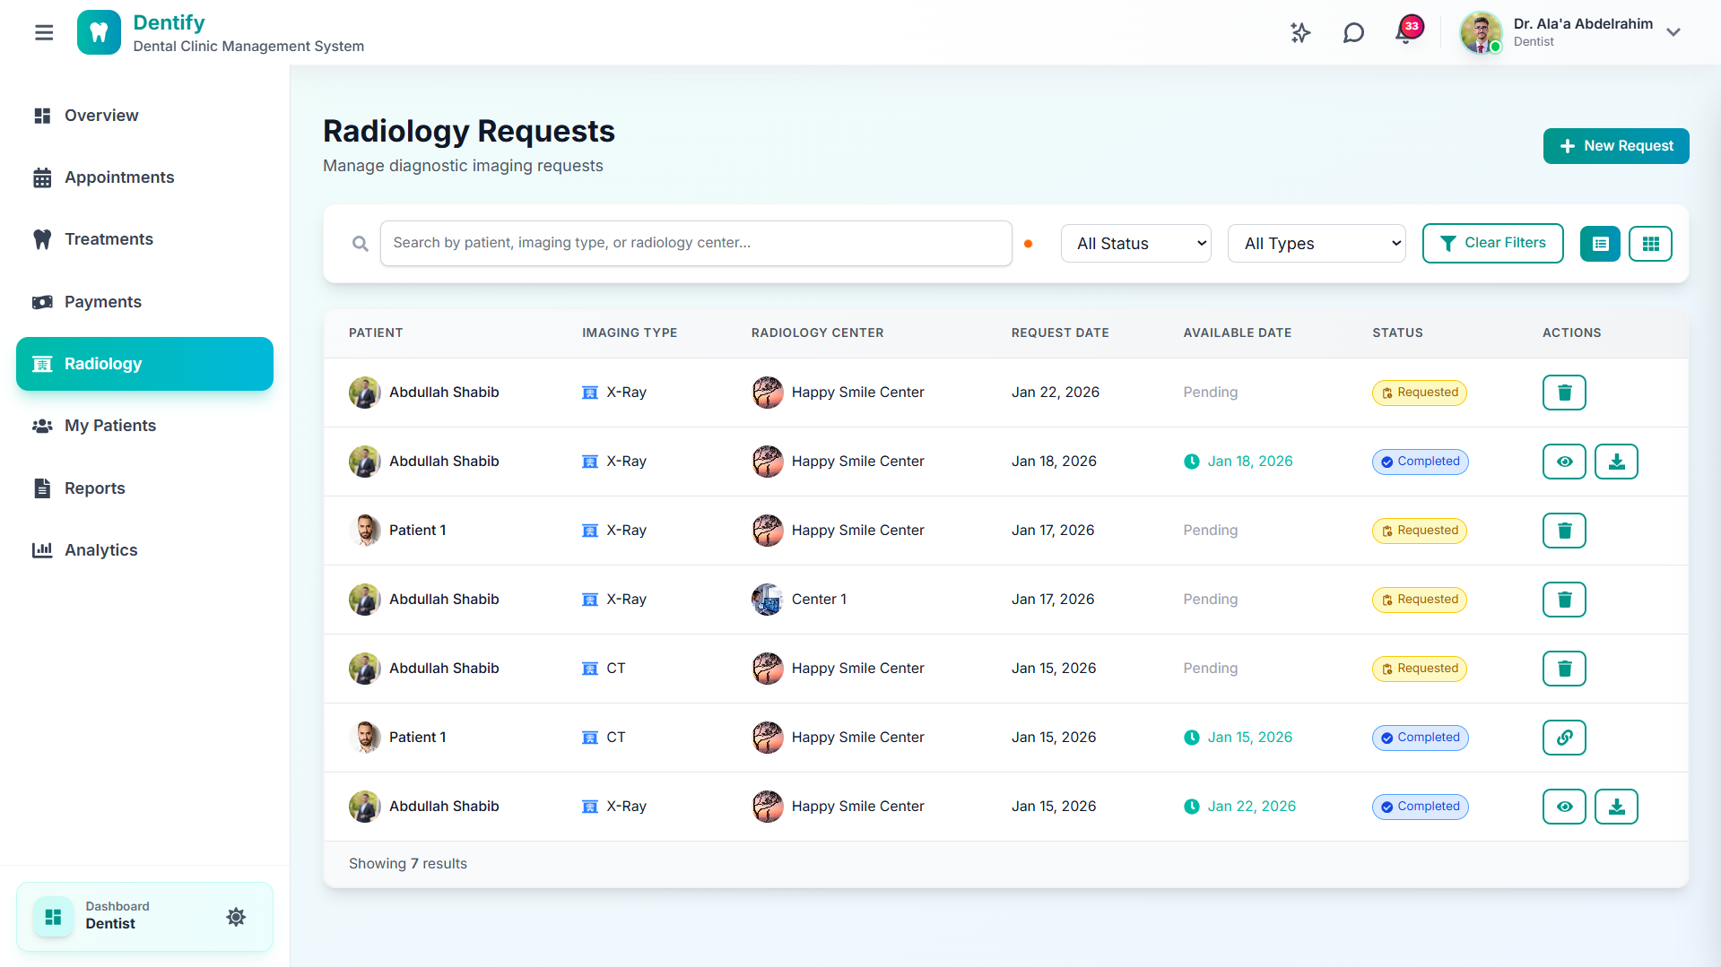
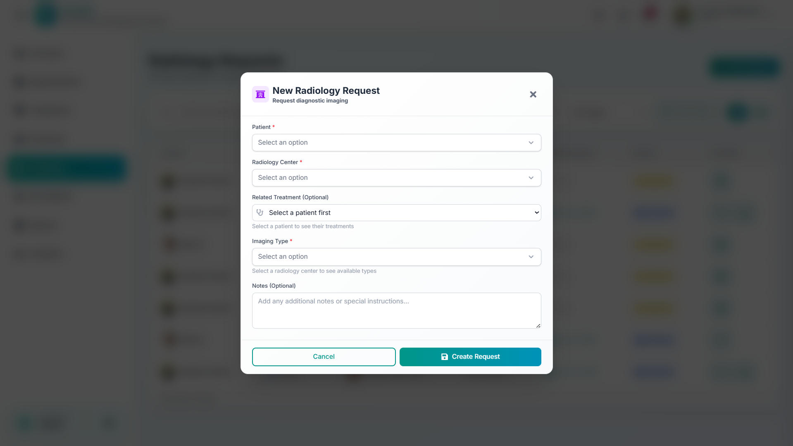
Dentist Dashboard (6)
Send and receive radiology requests

Slide 25
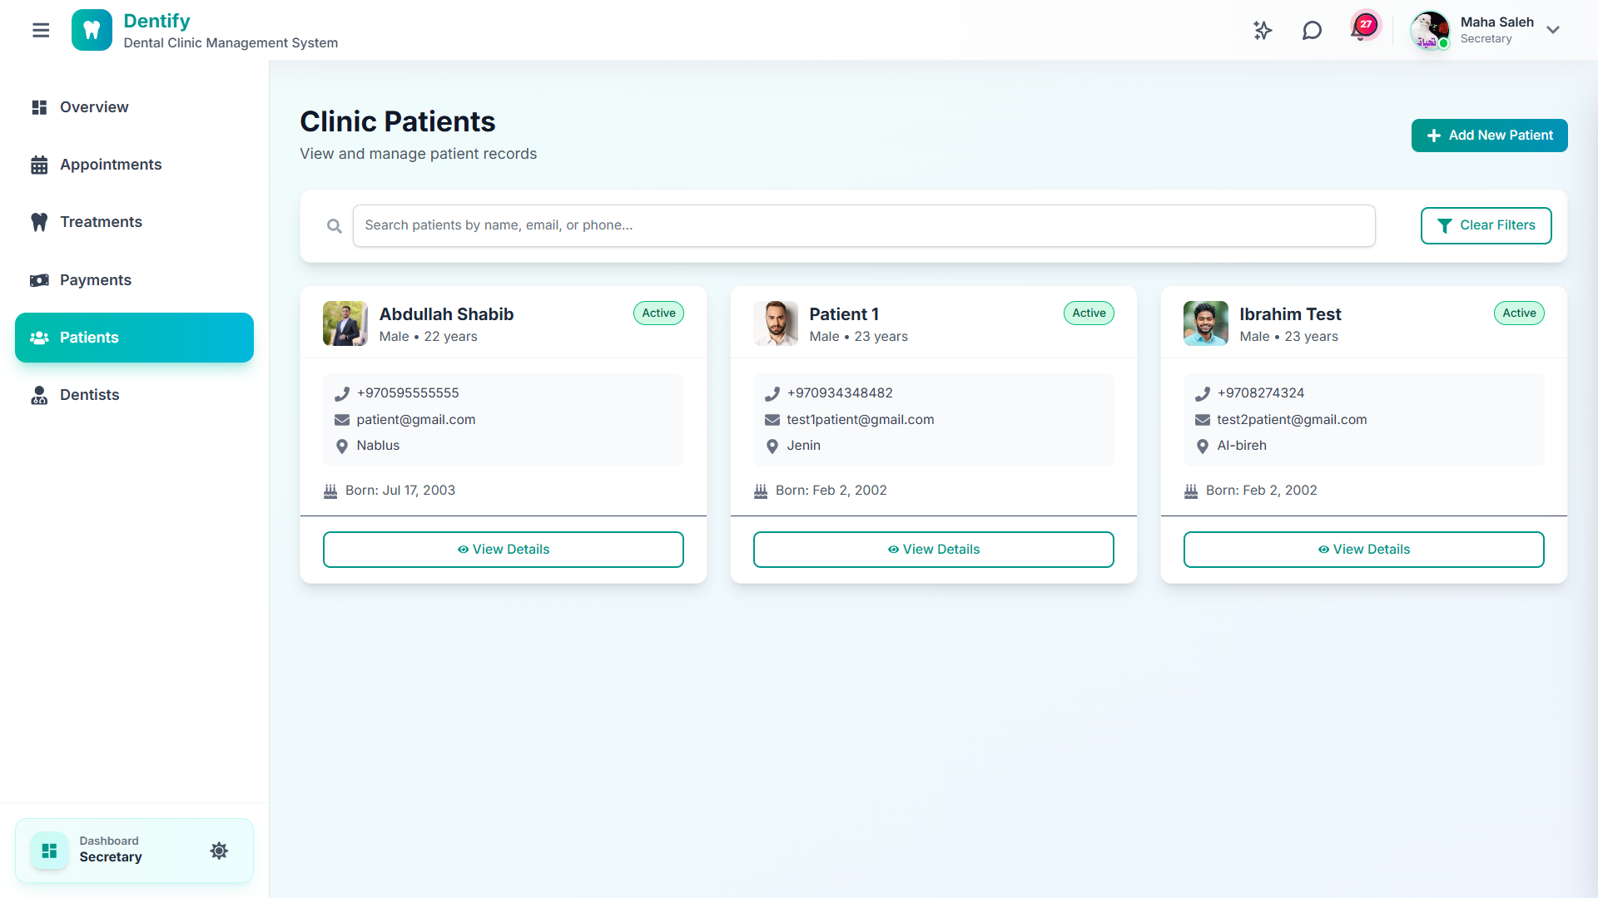
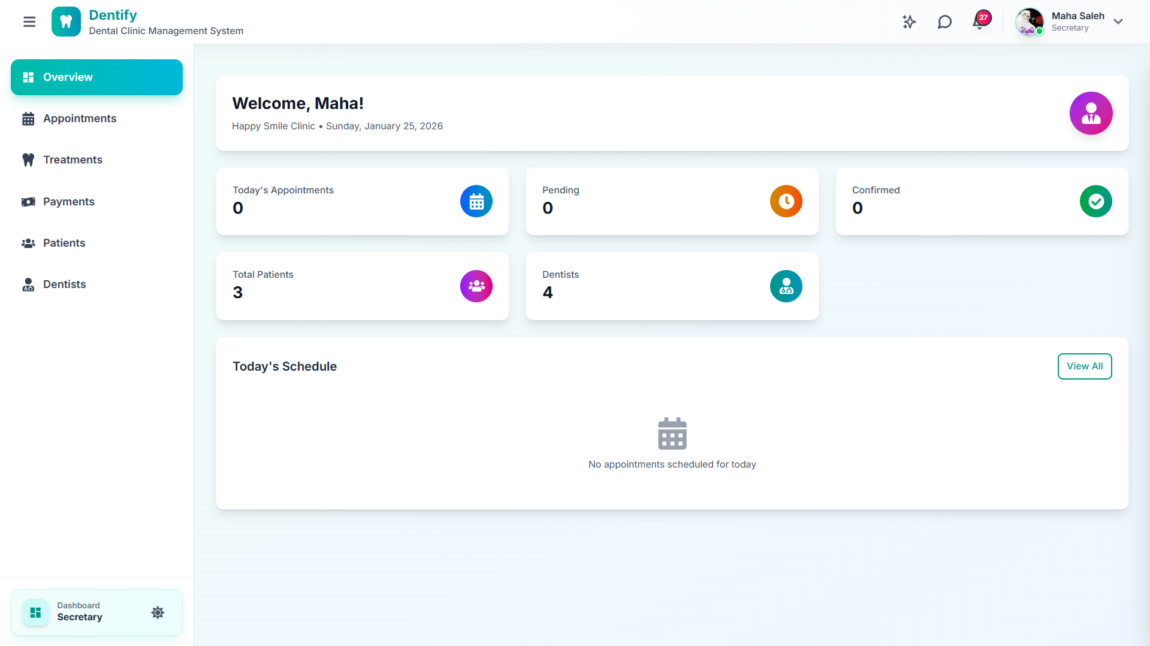
Secretary Dashboard
Handle daily scheduling, appointment management, and patient follow-up

Slide 26
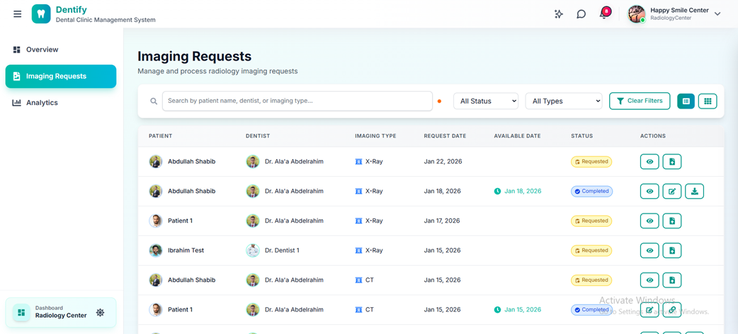
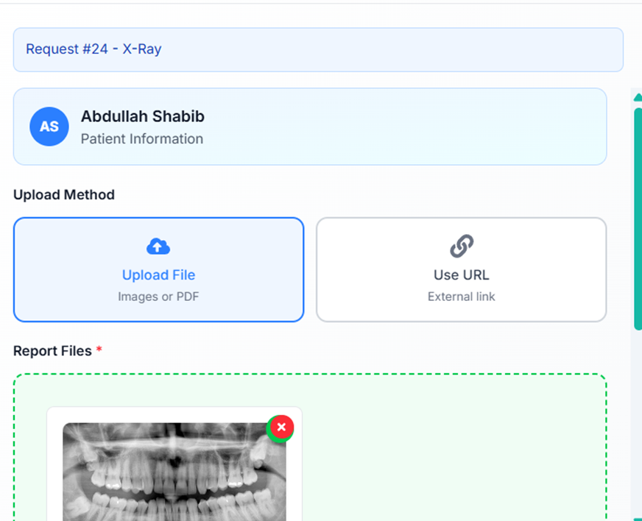
Radiology Center Dashboard
Receive imaging requests and upload medical results

Slide 27
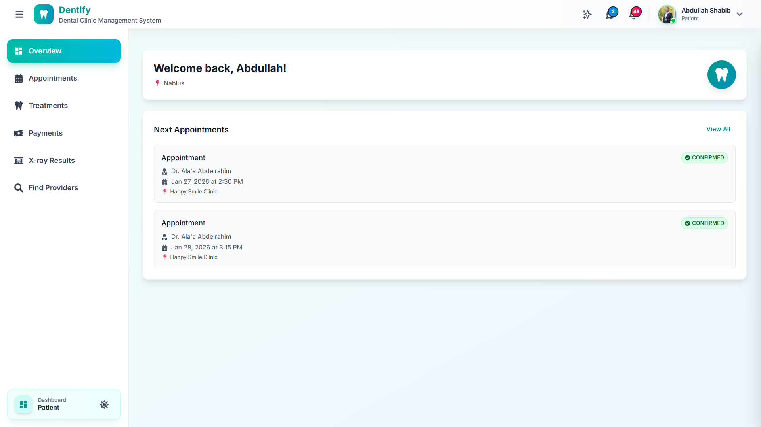
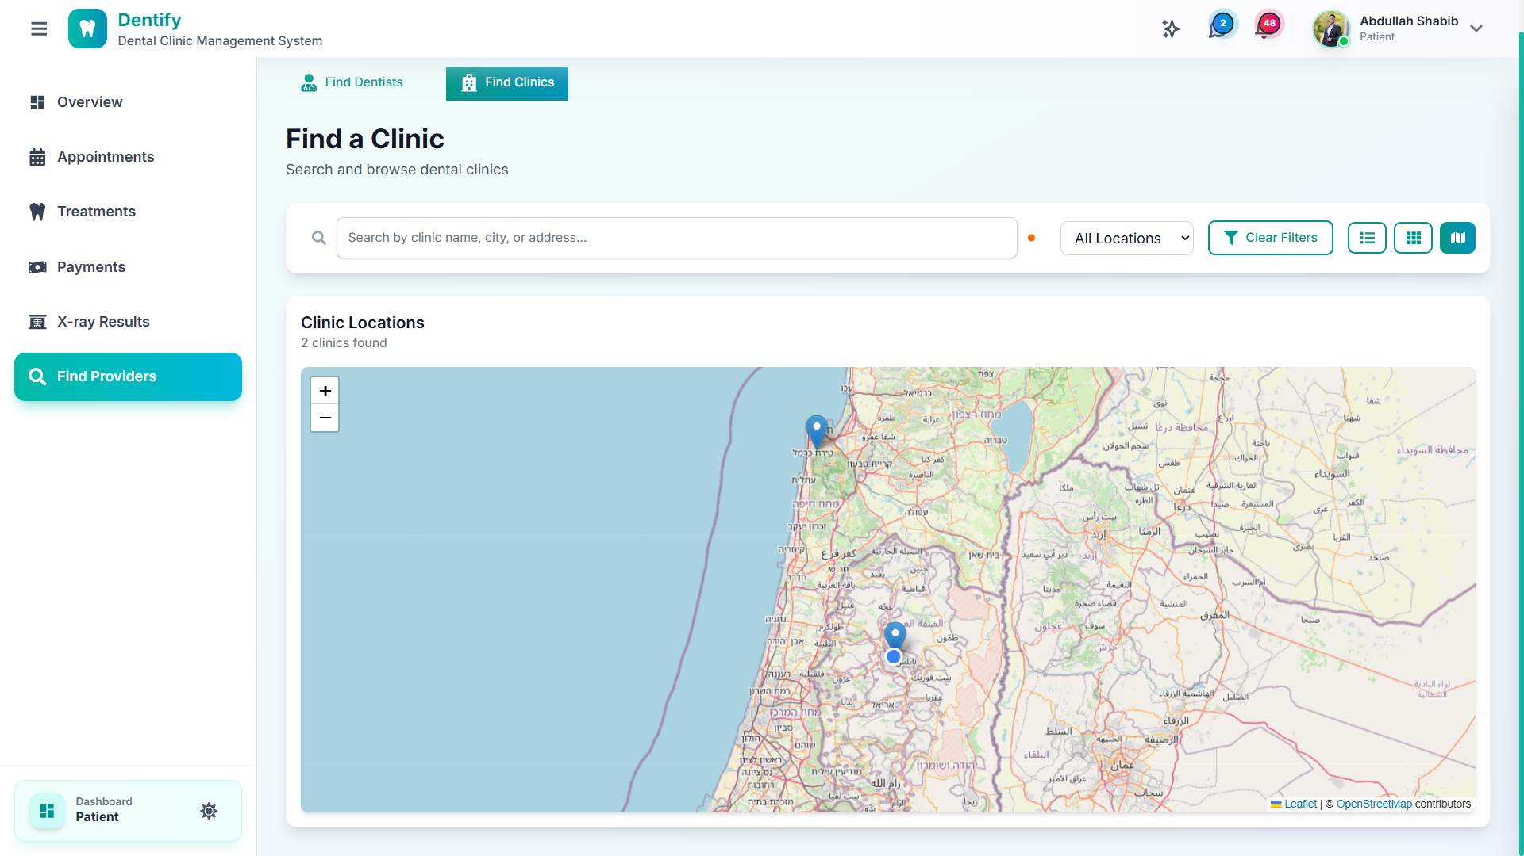
Patient Dashboard
Can book appointments, view records, and payments

Slide 28
Mobile App

Slide 29
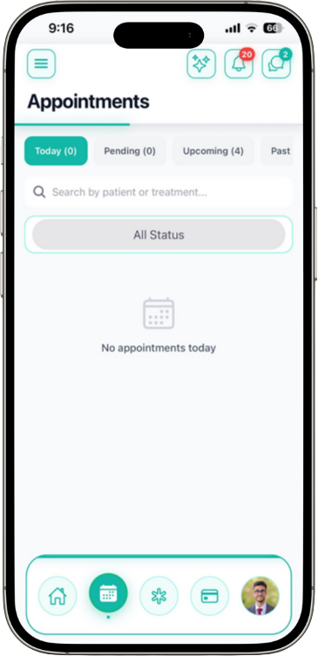
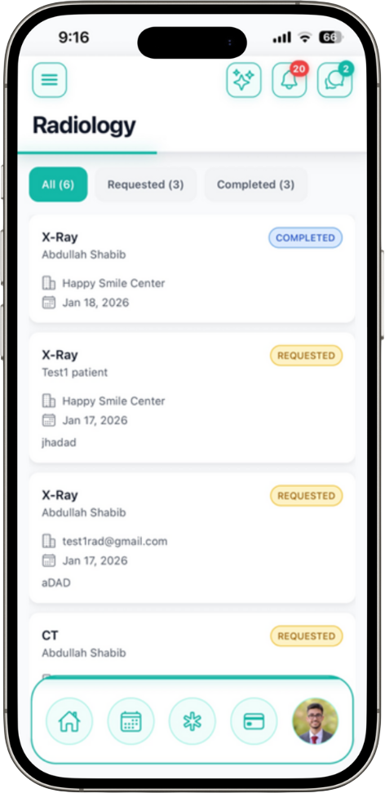
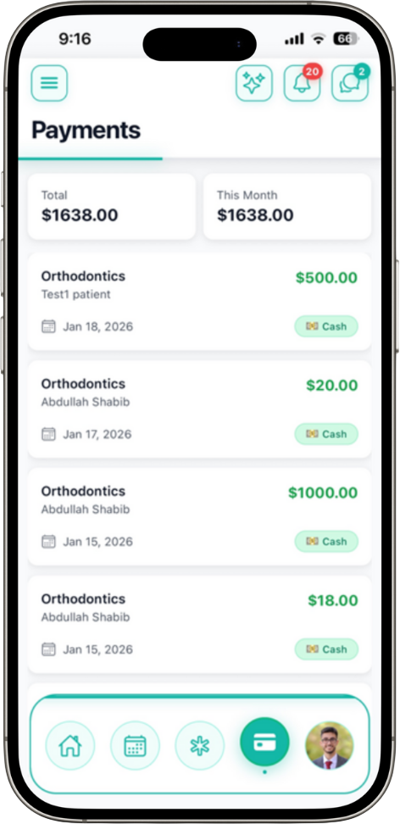
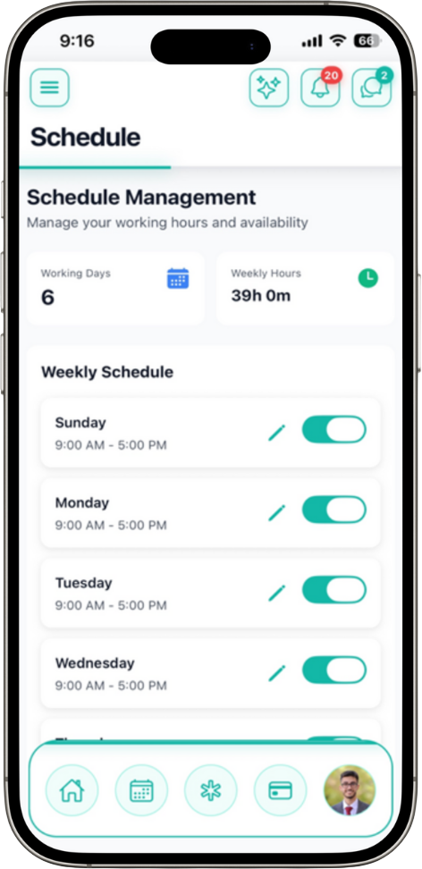
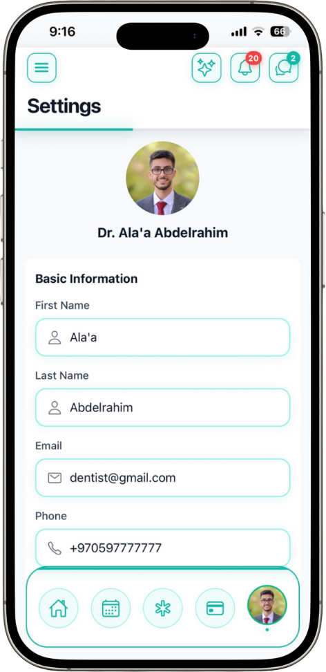
Dentist Dashboard

Slide 30
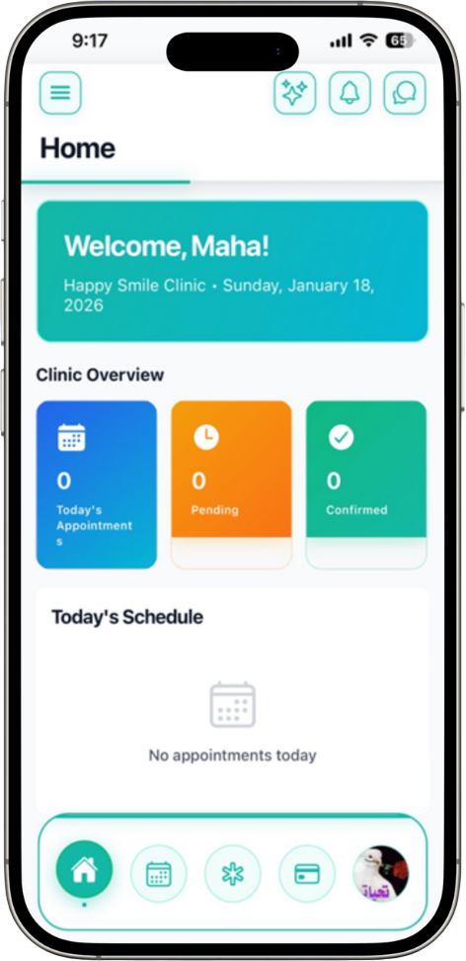
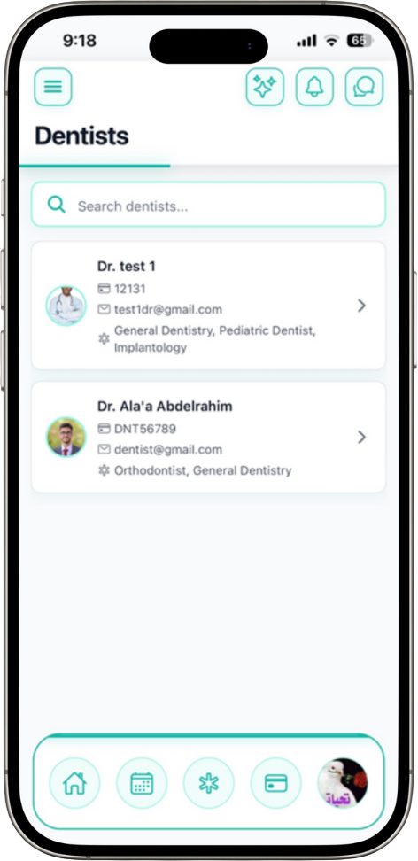
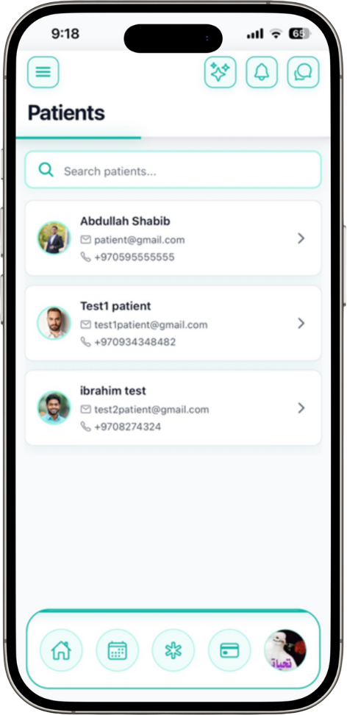
Secretary Dashboard

Slide 31
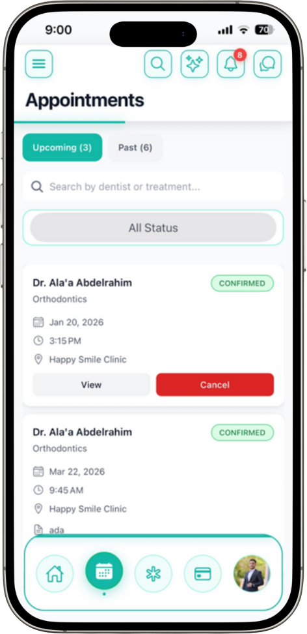
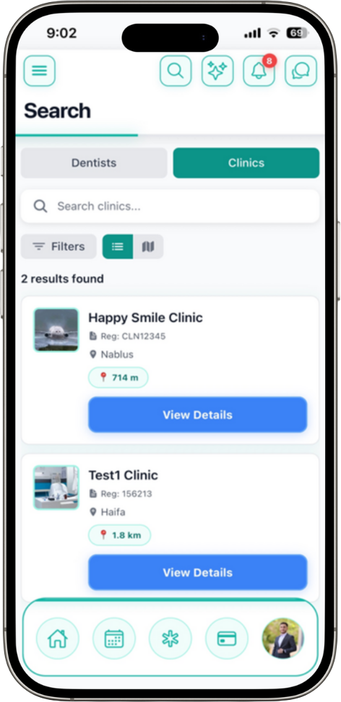


Patient Dashboard

Slide 32
Results
The system successfully:
  Centralized clinic operations
  Reduced administrative workload
  Improved patient experience
  Enabled AI-driven automation
  Worked across web and mobile platforms

Slide 33
Future Work
Rating & feedback system
Patients rate dentists and clinic services
Enhanced AI features
Smarter recommendations and expanded chatbot functions
Tele-dentistry
Online consultations and follow-ups.
Multi-language support
Improve accessibility for wider populations.

Slide 34
Conclusion
Modern & efficient
Dentify modernizes dental clinic management.
Combines AI & healthcare
Brings intelligent automation into daily practice.
Improves accessibility
For clinics, dentists, and patients alike.
Dentify demonstrates how software engineering can directly improve healthcare services.

Slide 35
Thank You
Do you have any questions?

