Slide 1
Demeter
Supervised by:
Ra’ed Alqadi
Presented by:
Nura H. Qasrawi
&
Raghad M. Abu Lebdeh

Slide 2
Outline
Name inspiration
What is Demeter?
What is the motivation?
What was used to built Demeter?
Irrigation
Light Searching
Challenges
Future Work

Slide 3
The idea behind the name
1- The name is a two part name:
The first part which is ‘De’, most scholars, associated it with Gaea which means Land.
The second which is ‘Meter’, which is linked to the meaning of Mother
Thus Demeter means --- > Mother land
2- It was inspired from the Greek Mythology.

Slide 4
What is Demeter?
A robot
Smart plant
A way to relieve people

Slide 5
What was the motivation?
Agriculture is the main source of life, literally !!
Life is getting busier and busier
People like to enjoy a beautiful views

Slide 6
What was used to build Demeter?
A lot of models and sensors were used to build Demeter to the way it looks today; each one of those components has its major role to play.

Slide 7
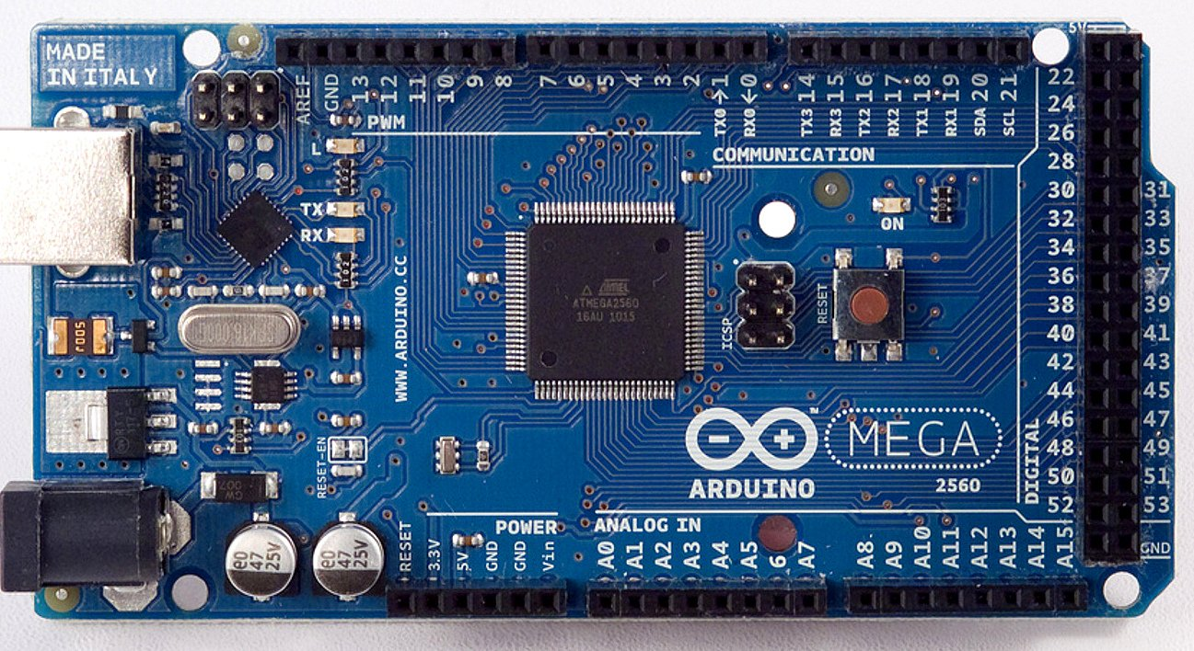
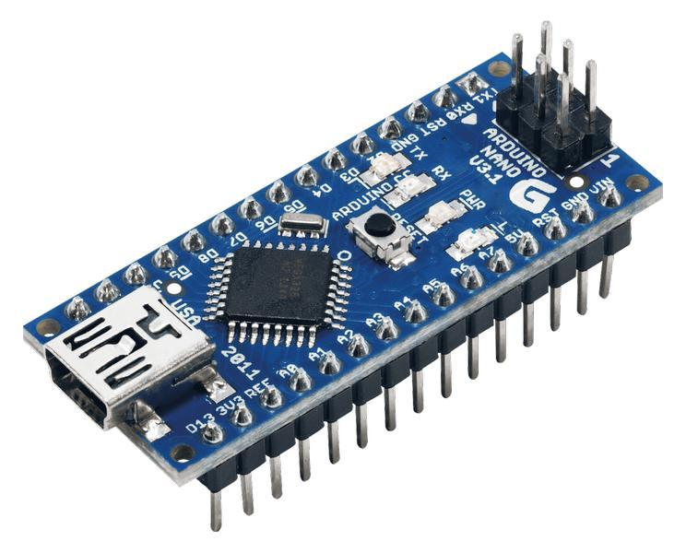

Slide 8
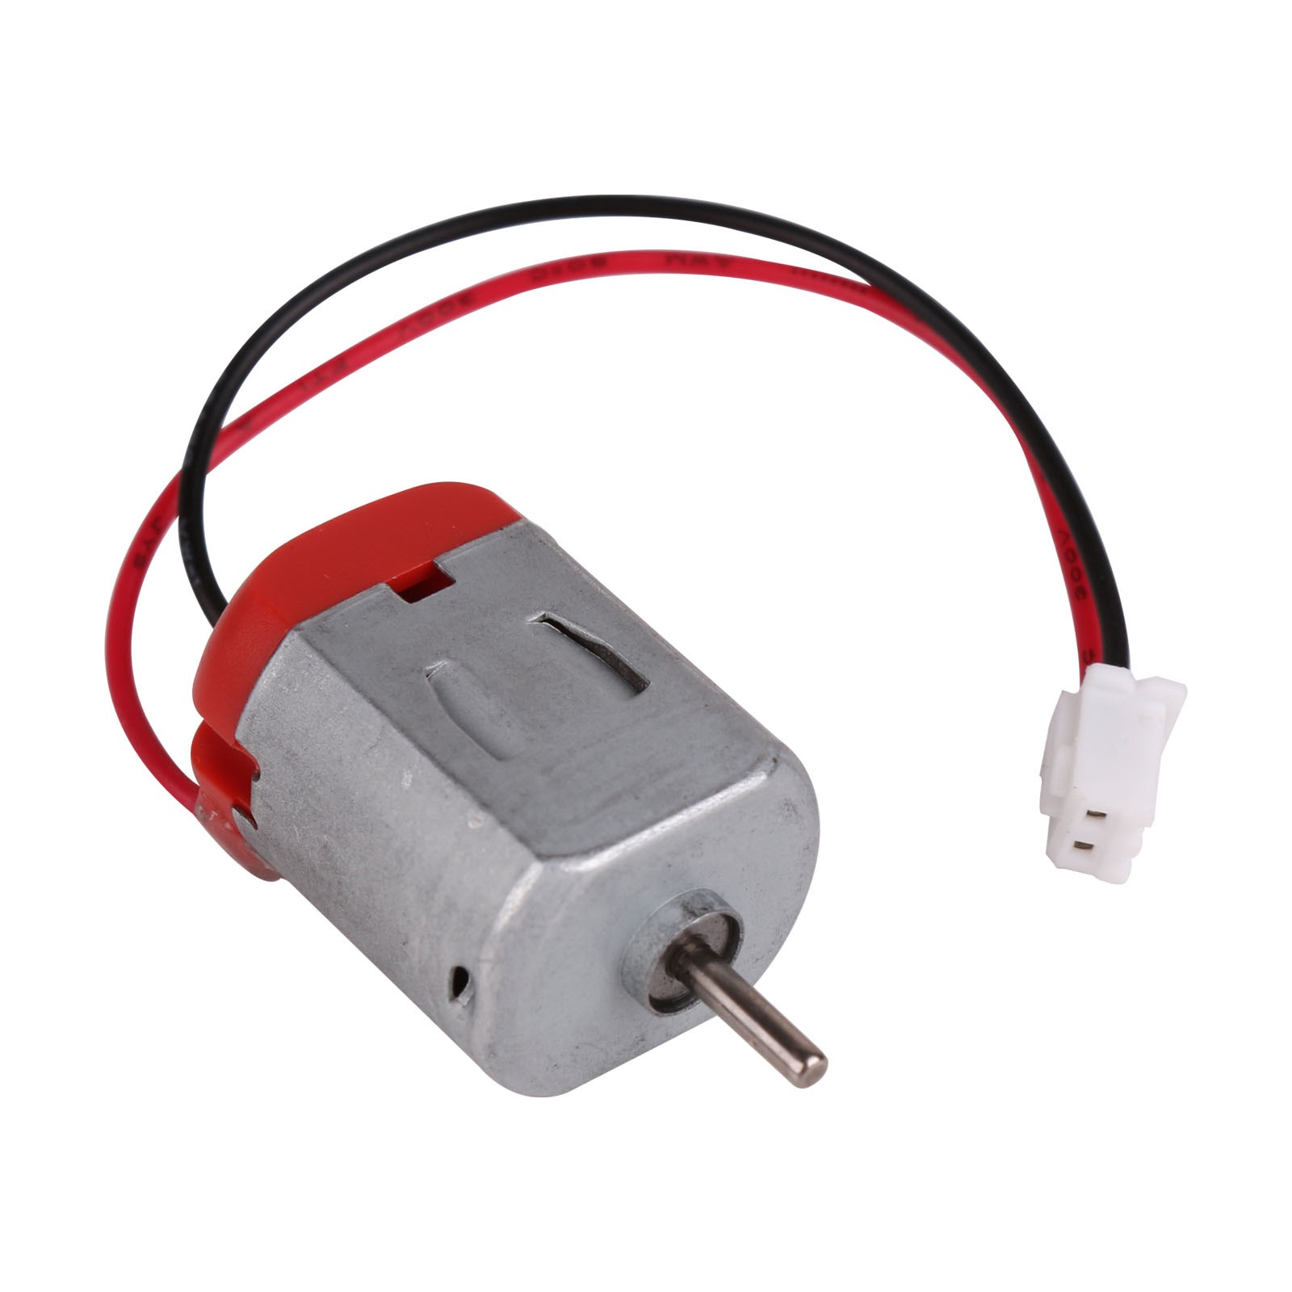
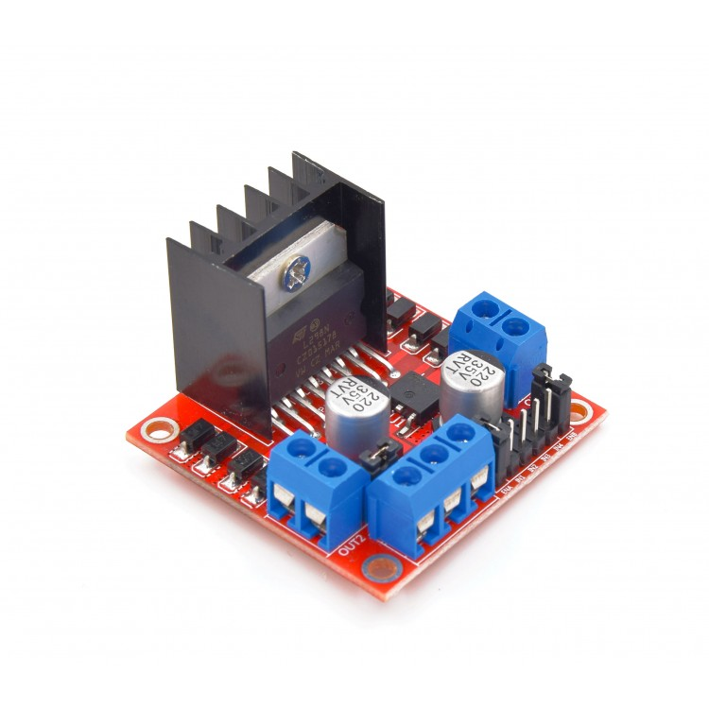

Slide 9
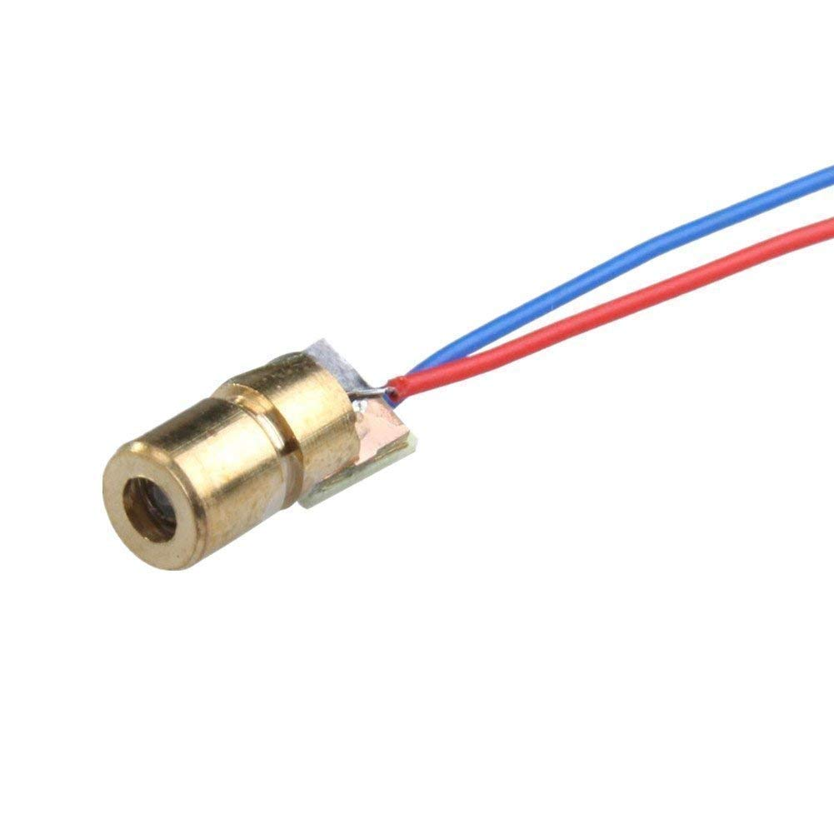
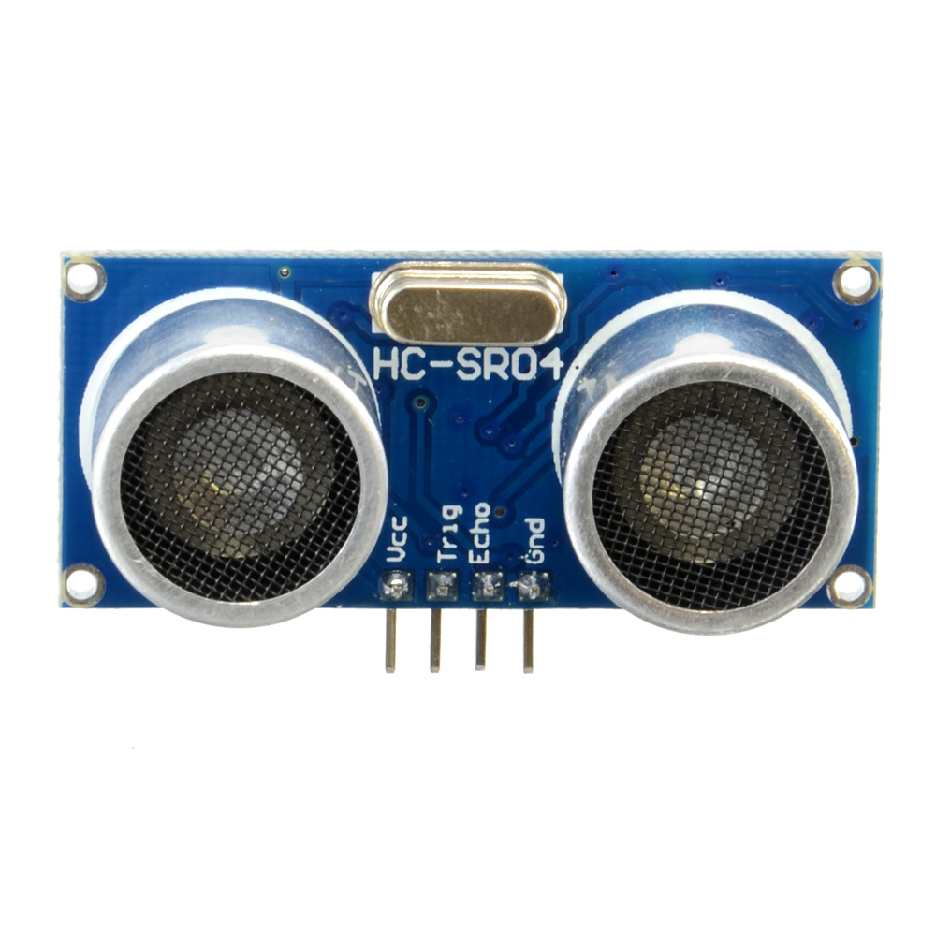
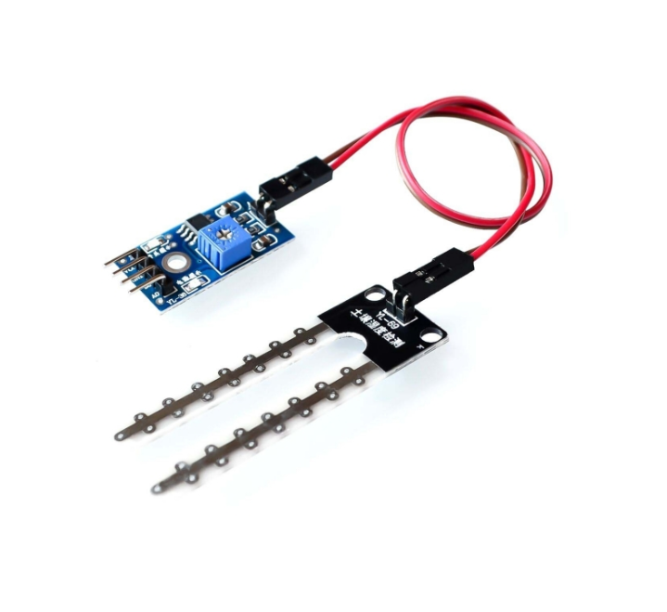
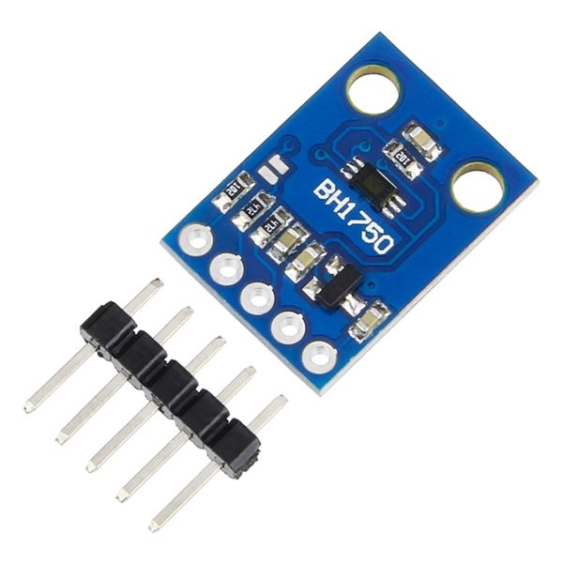

Slide 10
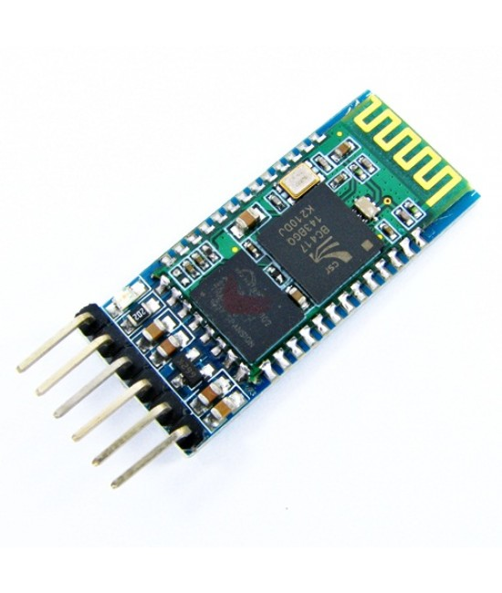
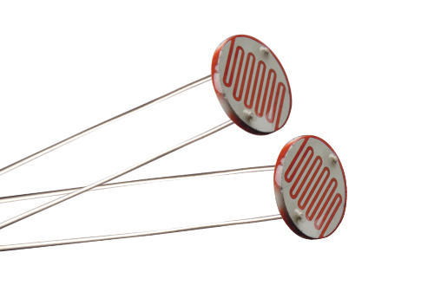
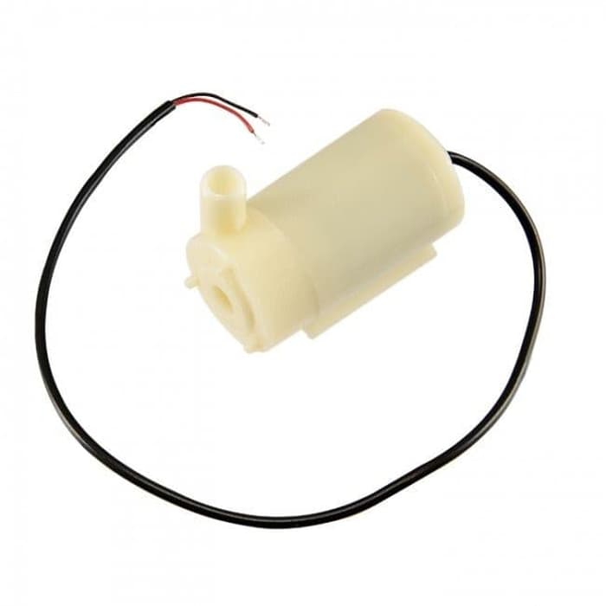
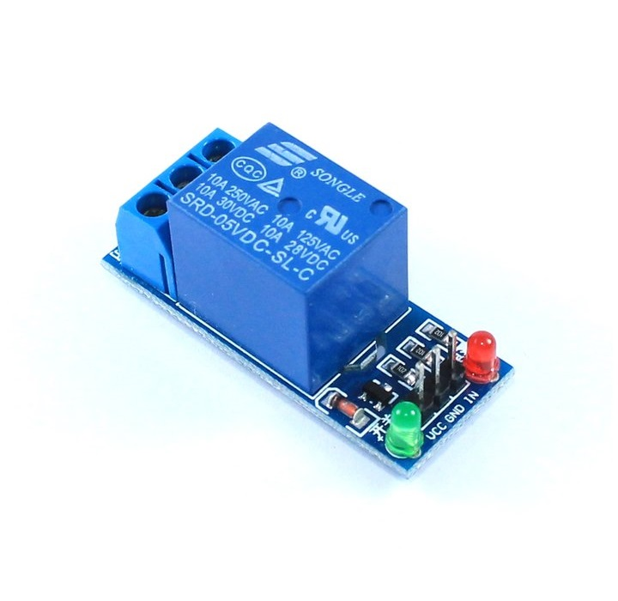

Slide 11
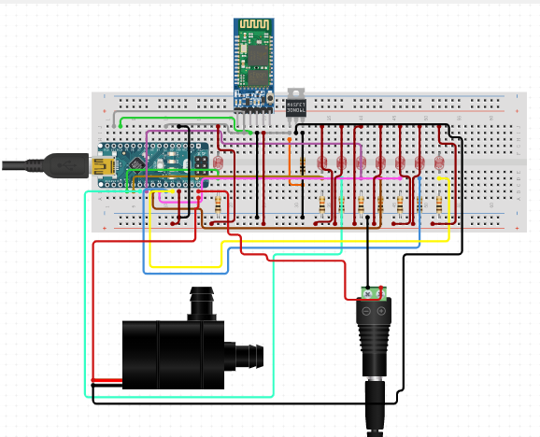
Irrigation

Slide 12
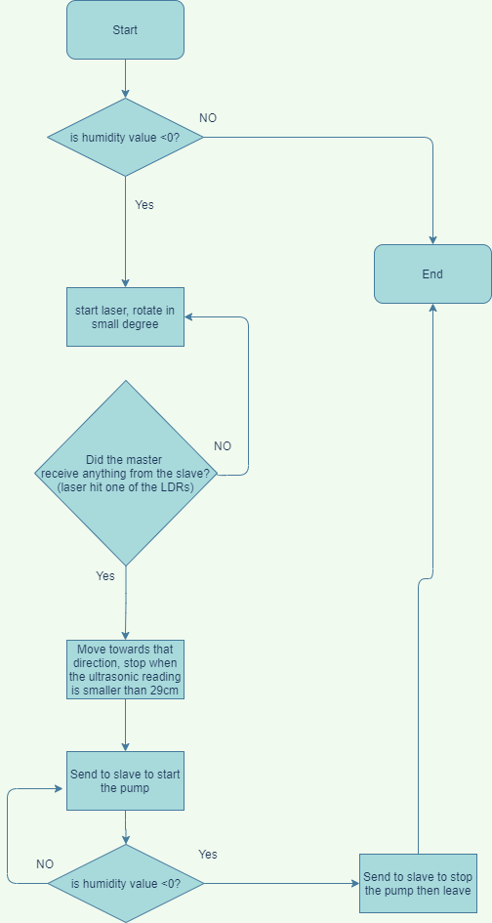

Slide 13
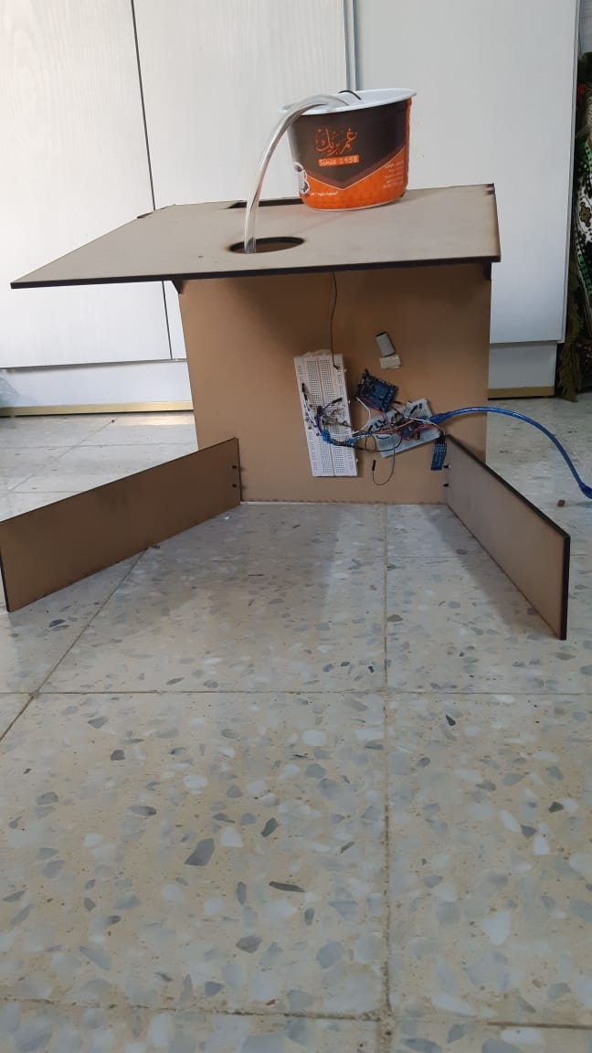
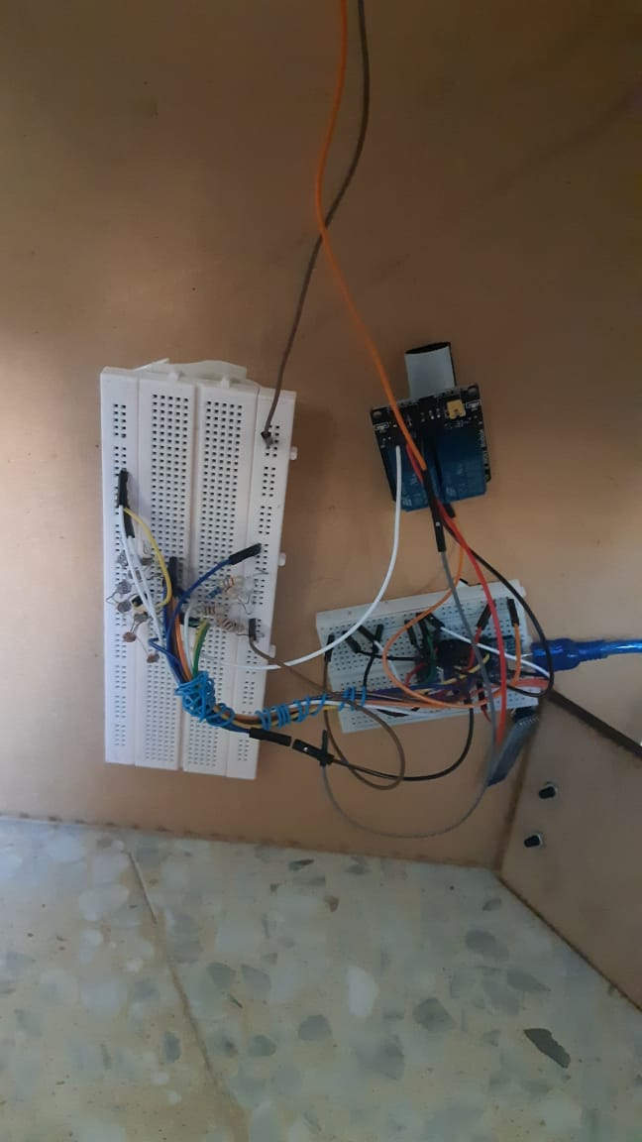
The Faucet

Slide 14
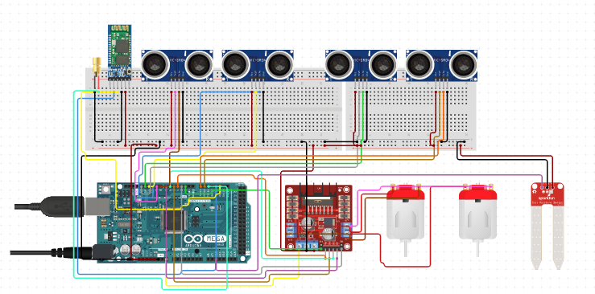
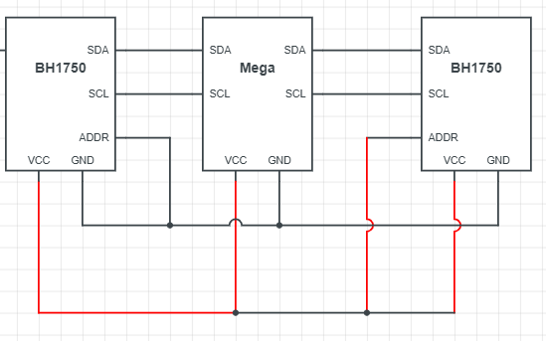
Light searching:

Slide 15
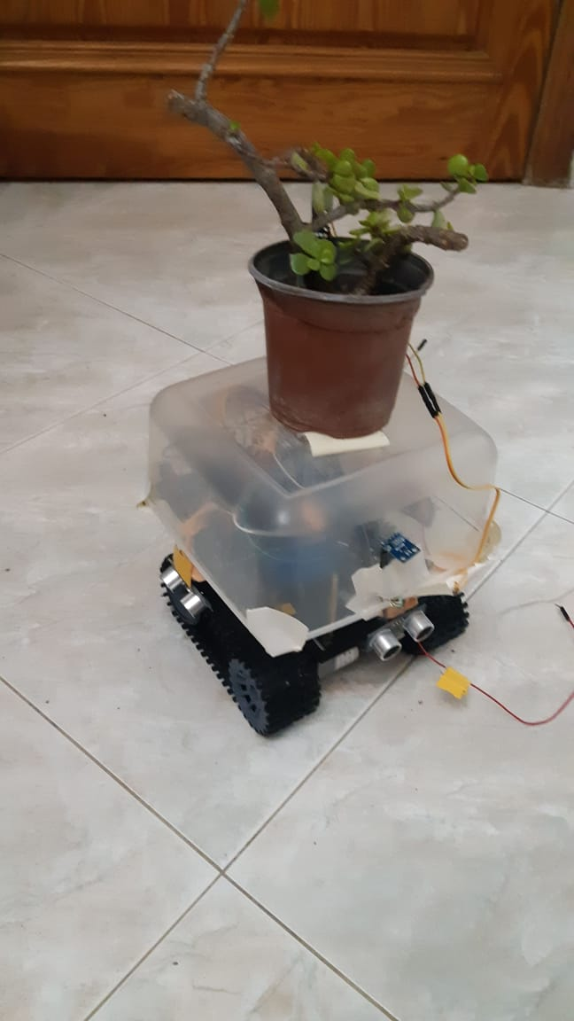
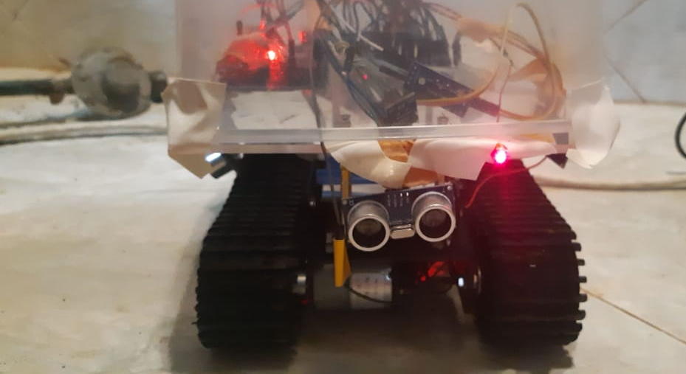
The Car

Slide 16
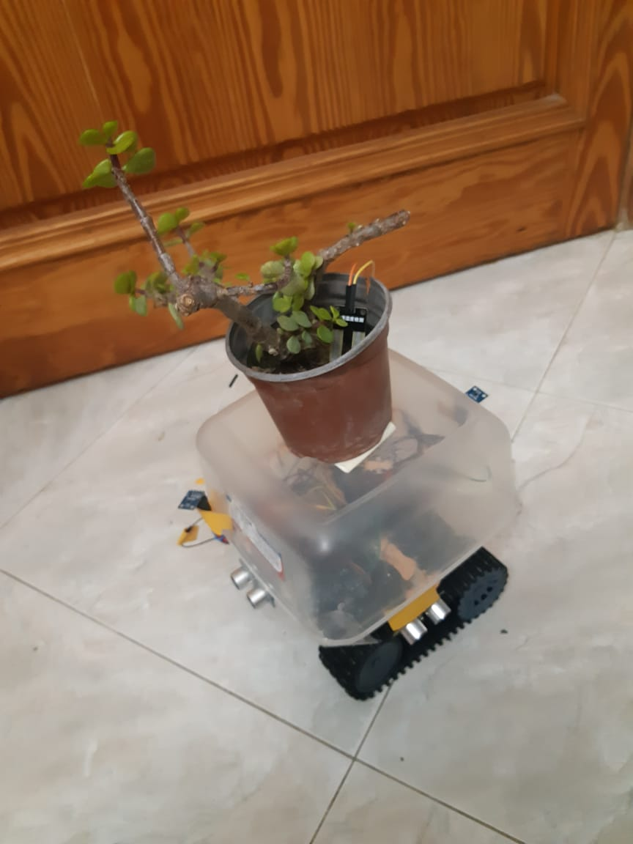
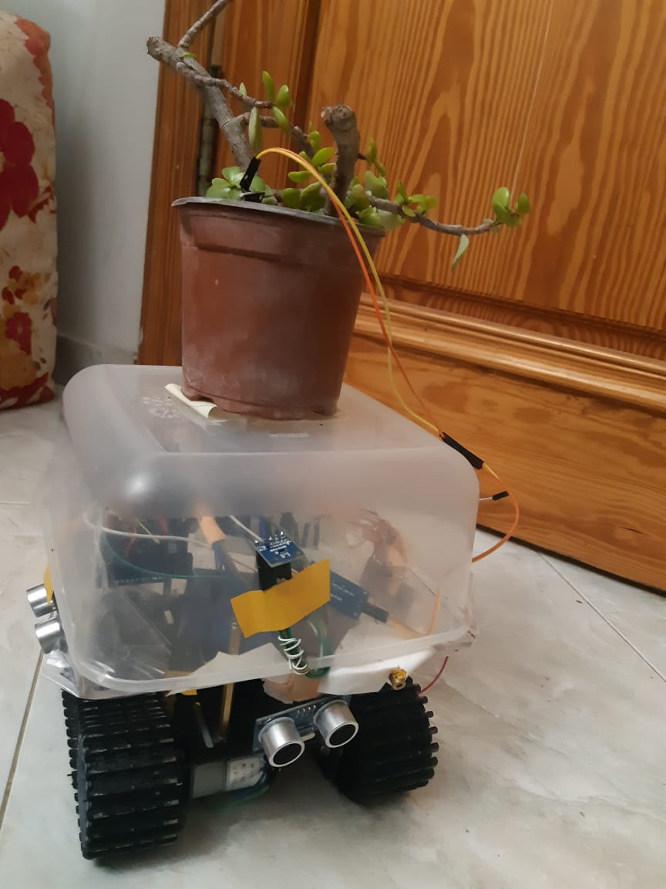

Slide 17
Algorithm:
Move forward
Start a timer with max time of 3 seconds
Stop the timer in case an obstacle is found
Back to position 0 by using the previous timer
Repeat in all directions
Get the highest reading
Go to the highest reading and stop in case an obstacle is found

Slide 18
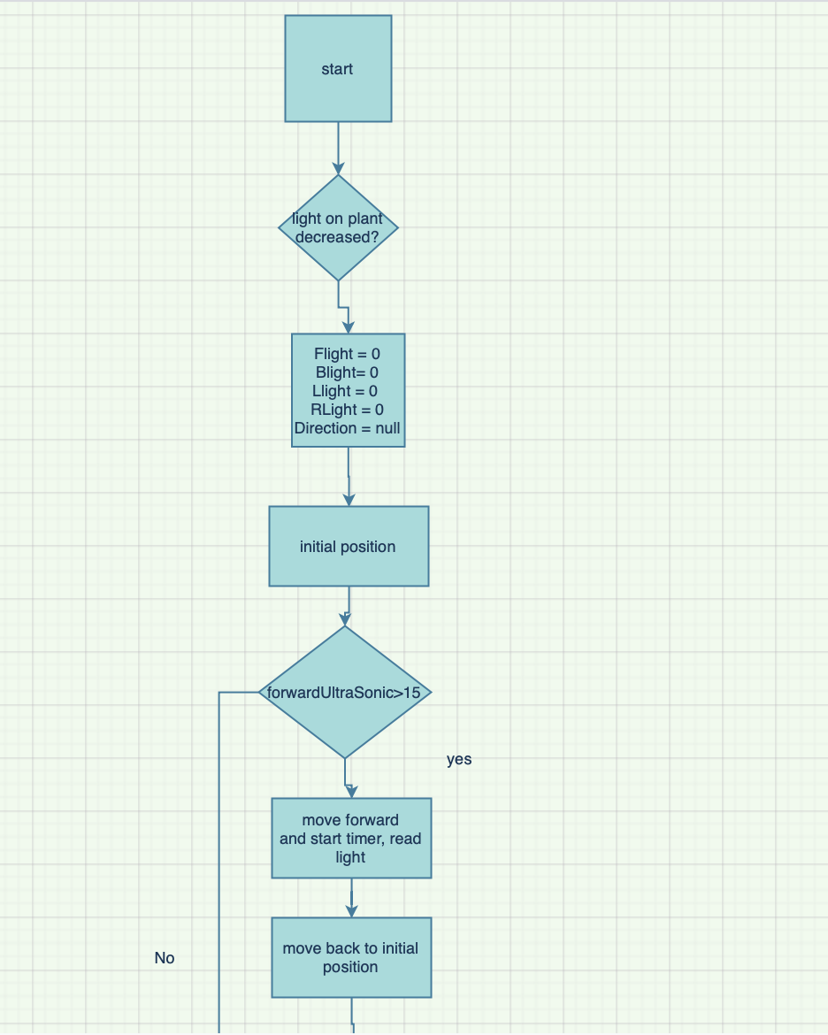

Slide 19
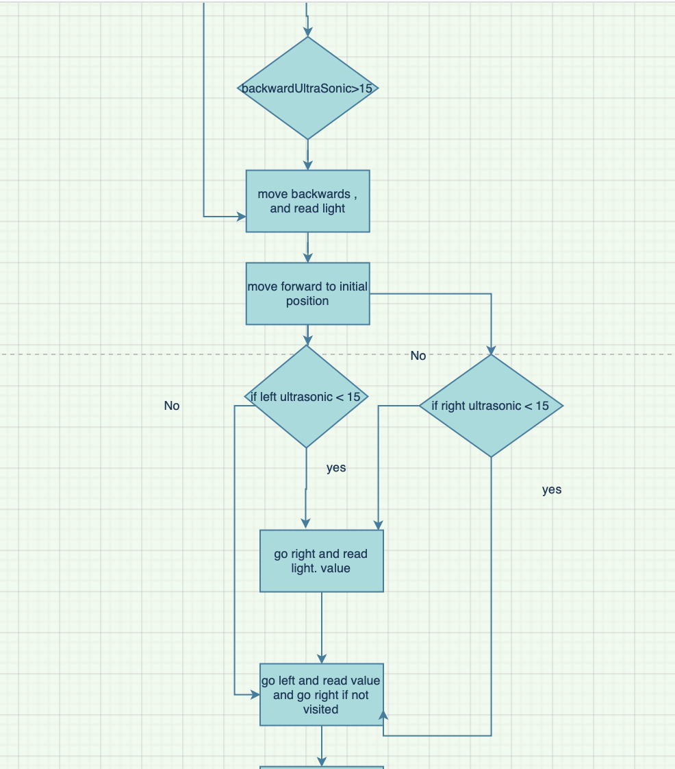

Slide 20
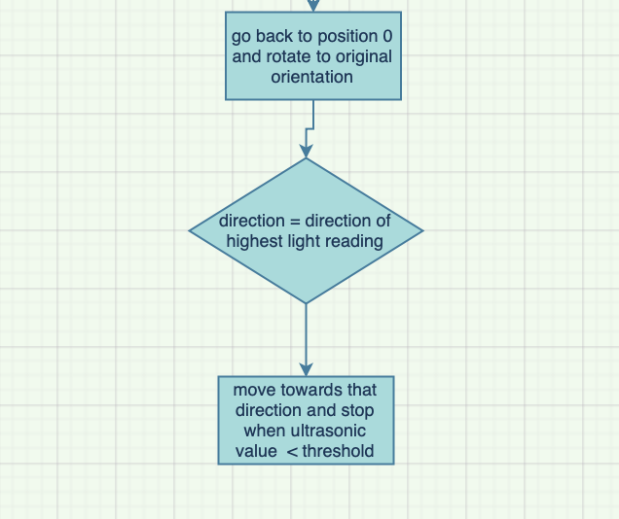

Slide 21
Challenges
THE PANDEMIC
Hardware Components
Mechanical car issues

Slide 22
Future Work
Adding more features eg: Light bulb with DHT11 temperature and humidity sensor

Slide 23
Thank you for the past 5 years of our lives.

