Slide 1
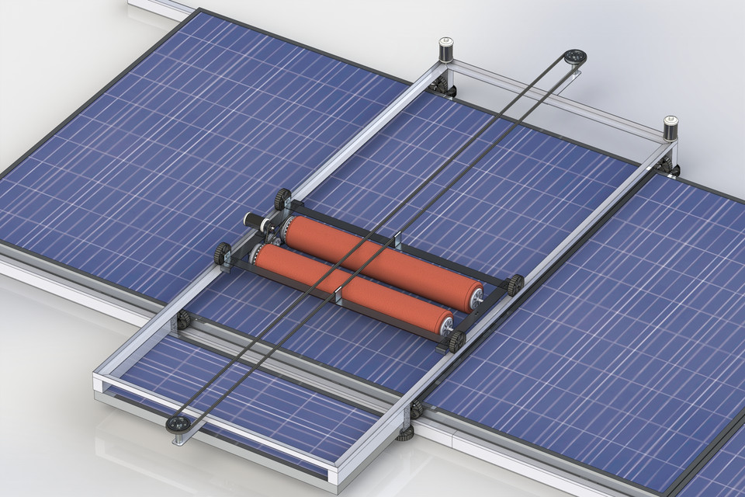
PV PANELS CLEANING ROBOTICS SEYSTEM

Slide 2
Abstract
Nowadays, the use of solar cells has increased dramatically and clearly in our time to produce electricity, and many projects today use thousands of solar cells to sell electricity and profit from it, One of the biggest and common problems affecting solar cells is the dirt and dust accumulated on them, which weakens the access of light to cells and thus reduces the efficiency of the production of these cells for electricity.
To reduce the dirt accumulated on these cells, we need a system that will clean these cells by itself, there are certainly solutions to this problem, but we want to modify them to get a better system, and at a lower cost than other systems used to clean solar panels.
In this project, we have developed a new system of cleaning cells based primarily on the sensing of the dirt and dust and then decides to operate the automated cleaning system or not.

Slide 3
Problem of statement.
With the growth and development of solar systems in Palestine and the start of investment with the construction of large solar stations, the need to design a system for washing solar cells and providing continuous cleanliness and high efficiency of the system has entered.
Solar cells provide human effort, especially with systems installed on rooftops that are difficult to clean for their location.
The Productivity of solar panels can be reduced 20 percent due to dust, pollen, grime and other particulates that accumulate on the solar panel . For high dust, pollen or desert areas, a dirty solar panel can reduce its power capabilities by up to 30 percent , this means the percent of produced electricity will be reduced

Slide 4
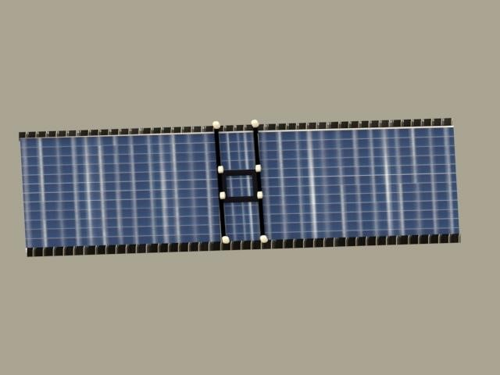
System description
:
Our designed cleaning mechanism solar panel should be consisting of two main parts
1. sensing the dust through color processing : the cleanliness of the panels is measured with these of a color sensor.
2. the cleaning tool: it is can remove the dust over the rover’s solar panel.

Slide 5
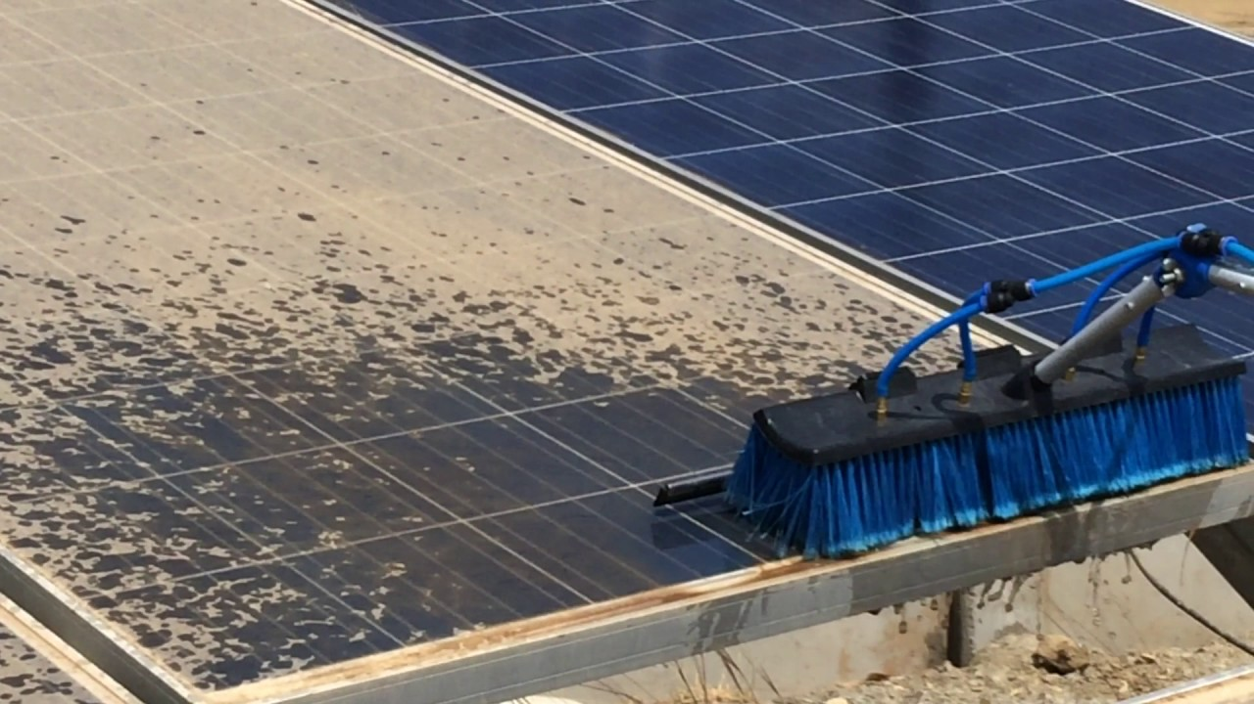
Importance of the system
1. solar cells face an ongoing problem of accumulating dirt on cells, thereby reducing cell productivity.
2. design of a system that works on the continuous automatic cleaning of solar cells without resorting to the need for human cleaning.
3. the system works to wash and clean the cell from the dirt and dust accumulated or from the dust of the residual rain suspended on the cell.

Slide 6
Aims
We aspire through our project to implement an automated system that works automatically, systematically and orderly without the need for human intervention to provide greater efficiency and provide the best productivity and efficiency of the system.
Objectives
Have a high efficiency power from pvs modules.
Least human effort and cost.

Slide 7
  ENGINEERING STANDARDS.
here are several international standards associated with piezoelectric material:
the IEC 61724-1 Photovoltaic system performance monitoring.
Guidelines for measurement ,data exchange, and analysis.
aims
keep measurement errors within specified limits, it does so by establishing “accuracy classes” for monitoring systems

Slide 8
DESIGN CONSTRAINTS.
There must be constraints in each project, which negatively affect the progress of the project, some of these are:
The cell area that we are working on
the power source for this system, which can put a suitable battery or solar cell for the system to power it or through its connection to a direct power source.
The system to work with water, because water helps in the cleaning process, water is likely to affect the electrical equipment used in the system, so we have to isolate the sensitive devices from the water, and the second problem in the water problem is how to deliver water to this mobile system.

Slide 9
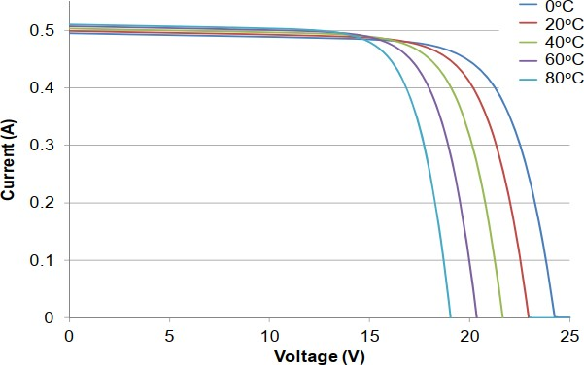
Temperature effect on PV module performance

Slide 10
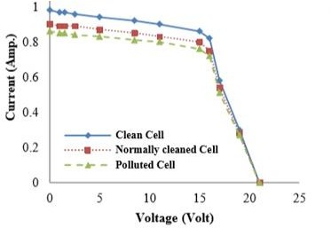
Influence of dust on pv system
represents the I-V characteristics of the cells
The figure curves clarify that the cleaned cell produced the maximum current and voltage while the polluted one produced the minimum I-V.

Slide 11
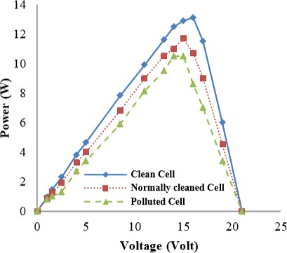
P-V characteristics of the cells
The produced I and V results in the power, The cell power reduced with pollution accumulation as well as with naturally cleaned. The PV cell power obtained at variable irradiance intensities. At any given irradiance the power calculated and for a measured current and voltage,

Slide 12
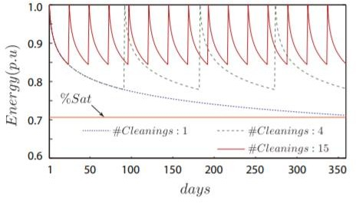
  The effect of cleaning on pv efficiency and productivity
When the PV panels are not cleaned in the year, the energy is considerably reduced, but as the number of cleanings in the year increases, the average energy produced also grows.
little energy is wasted because of the temperature of cell decrease.

Slide 13
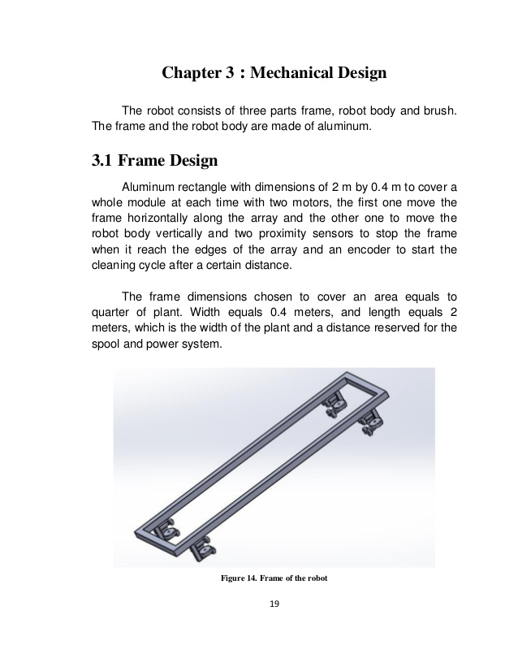
  System components
Equipment :
1. Robot body
in this project there is two frames to cleaning the cells
main frame
This frame moves horizontally along the arrays and it carry the secondary frame.

Slide 14
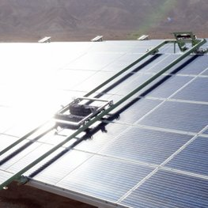
secondary frame:
This framework is responsible for the cell cleaning process, it’s carrying the brush that cleans the cells and it moves vertically on the mainframe, it’s better to have a tire made of aluminum because this material is light to reduce the load on the motors you're moving.

Slide 15
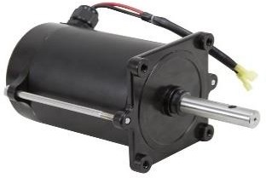
2. Motors:
It's responsible for frames and brush movement
DC motor
DC Motor is a two-wire continuous rotation motor and the two wires are power and ground. When the supply is applied, a DC motor will start rotating until that power is detached. Most of the DC motors run at high revolutions per minute (RPM). The DC motor speed can be controlled by using PWM.

Slide 16
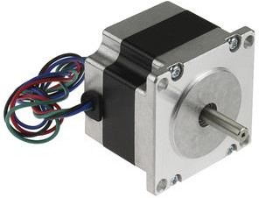
steper motor:
A stepper motor is fundamentally a servo motor that uses a different method of motorization. Where a motor includes a continuous rotation DC motor and combined controller circuit, stepper motors utilize multiple notched electromagnets arranged around a piece of central equipment to describe the position.

Slide 17
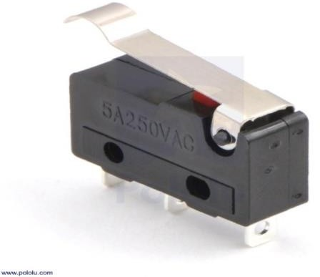
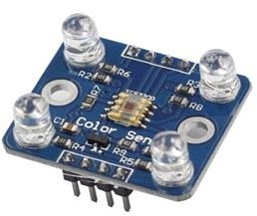
3. Sensors
Switch Sensor
This sensor is used to stop the motoring of the motor by using controller
Color sensor
  This sensor is used to sense dust on the surface of cells.

Slide 18
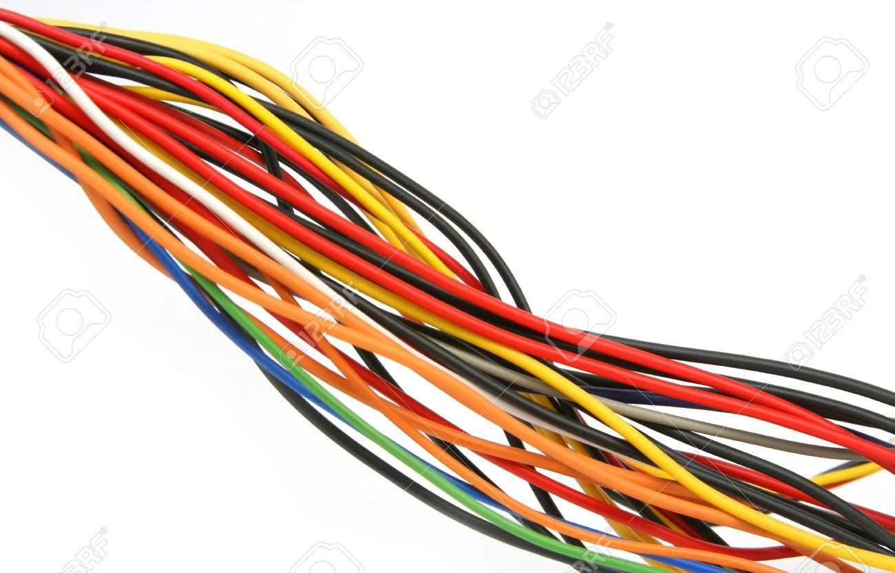
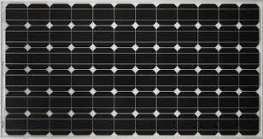
3. Wires
we need wires to connect between controller to all sensor.
4.PV Module

Slide 19
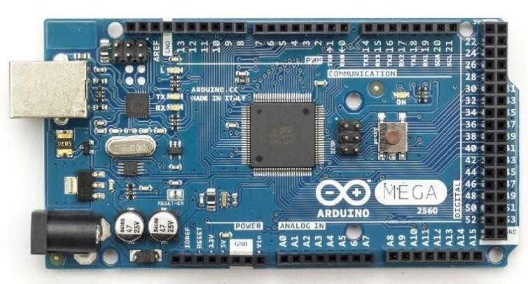
5. Controller
The controller is used to control the whole process. Arduino

Slide 20
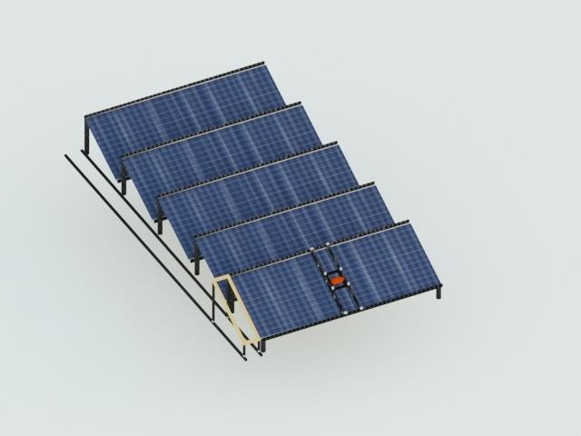
  How the system work
When there is a change in the color of the cells due to the dirt accumulated on them, the controller gives an order to the motors to move the frames of the secondary tire as well as the brush begins to move to clean and when the cleaning process is finished the color of the solar cells is checked again and then the mainframe moves to complete the process Cleaning.

Slide 21
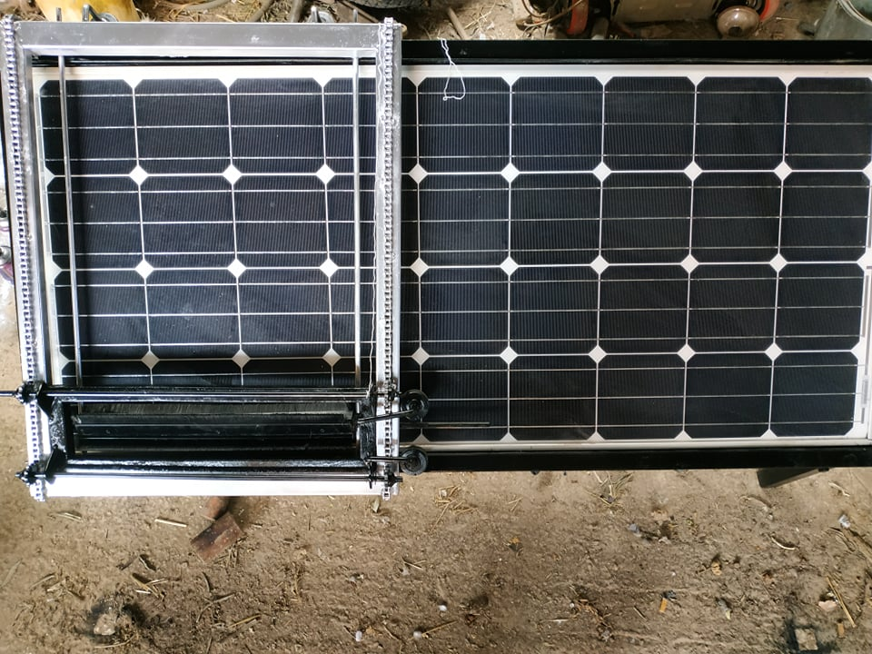
Problems
.
During the system building time, we faced several problems:
During the construction of the system, we changed the mechanism of its work,

Slide 22
where we faced the problem of the inability of the wheel to move up and down due to the cell's 30-degree tilt Therefore, we replaced the calf with a chain for the system to move and function
Besides, due to the outbreak of the Covid19 (Coronavirus), we were unable to bring all the necessary parts for the project Later, due to the closure of movement between Palestinian cities, we were unable to complete the project

Slide 23
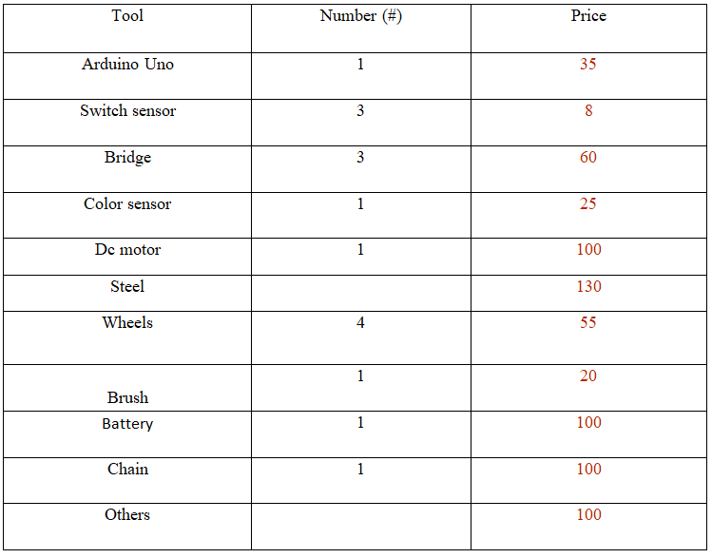
Cost of the system

Slide 24
Reason for choosing this system
By using the method of sensing dirt by color, the system is operated in a time when the productivity of cells is affected by the amount of dust, all of which happen automatically, in addition to the system is not expensive and it has high efficiency.

Slide 25
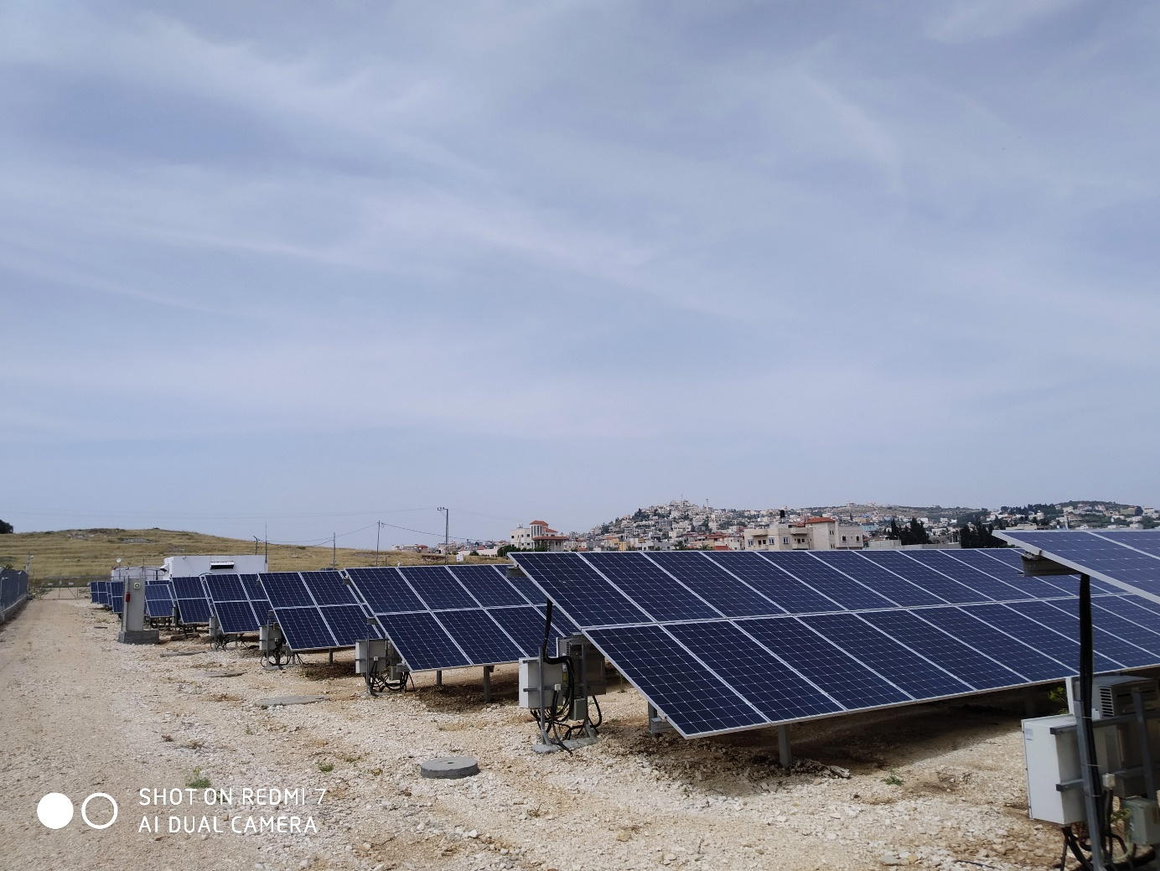
Feasibility study of productivity for pv farm before and after the cleaning process
In a real practical study on a solar field that produces electricity for the importance of periodic washing on the solar cells and increasing the productivity and efficiency of the entire plant
We went to the Ajja station and took all the necessary values for the study.

Slide 26
Each inverter contains 200 solar cell and reads the cell productivity for each row. Therefore, we monitored the reading of the inverter No. 11 cleaning process.
Knowing that the productivity of this station work between 5AM to 7PM and the values ​​were as follows, Station productivity data is stored every five minutes.
By studying the productivity of the solar cells connected to the inverter 11 in the plant after washing the cells connected to it and noticing the quantity of production and thus increasing the volume of profits after cleaning.

Slide 27
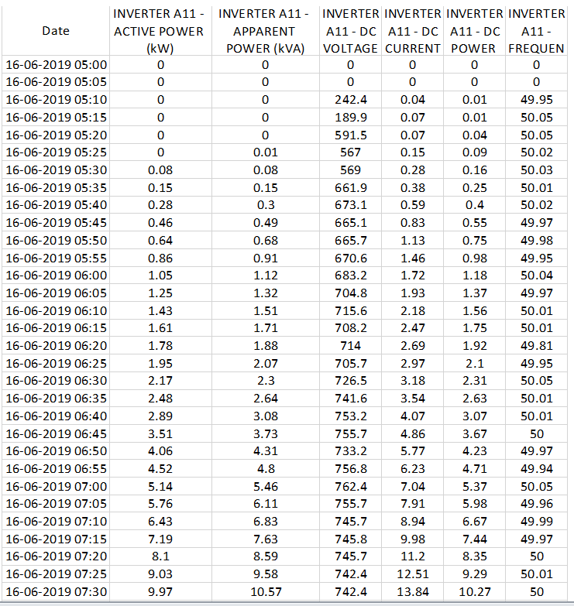
this table shows Inverter readings before washing

Slide 28
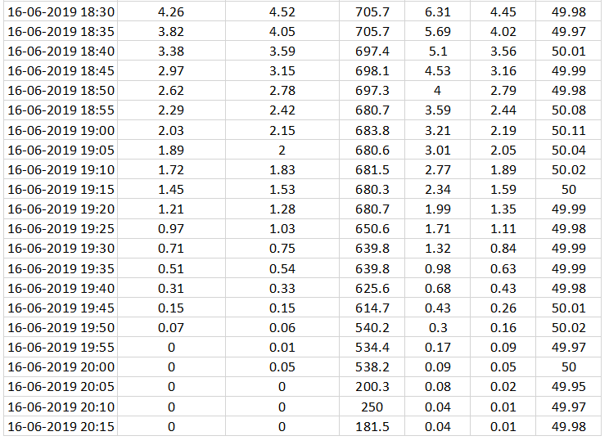

Slide 29
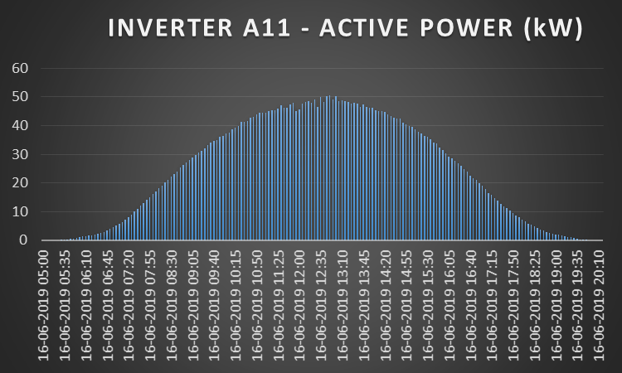
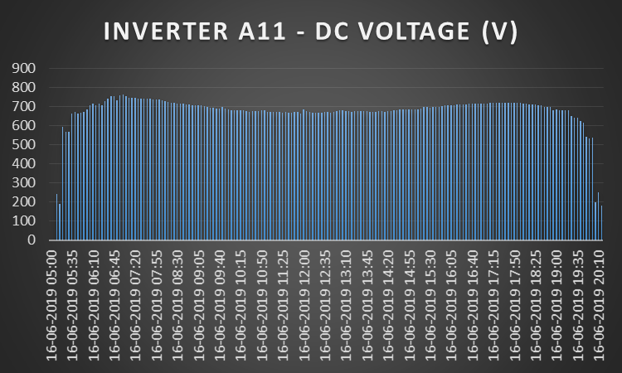
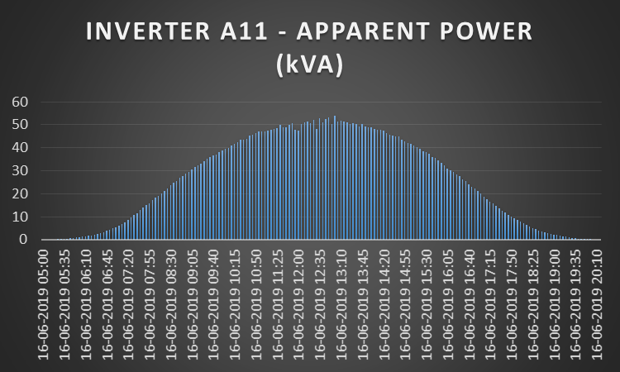

Slide 30
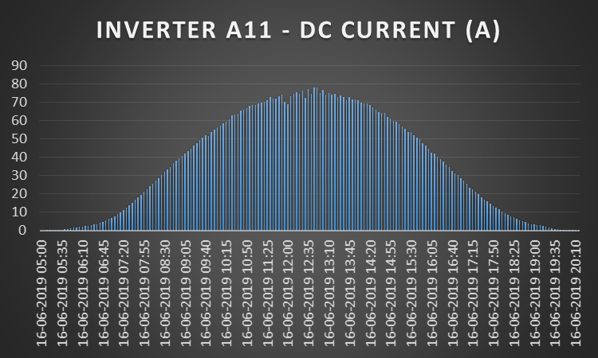
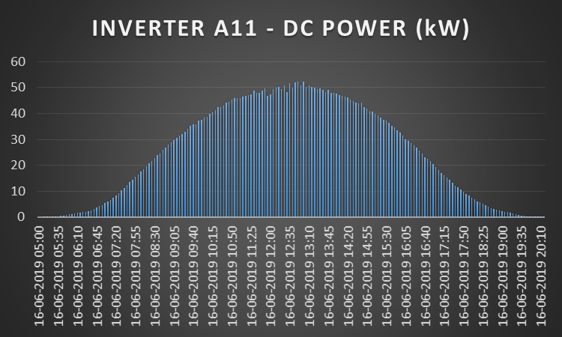

Slide 31
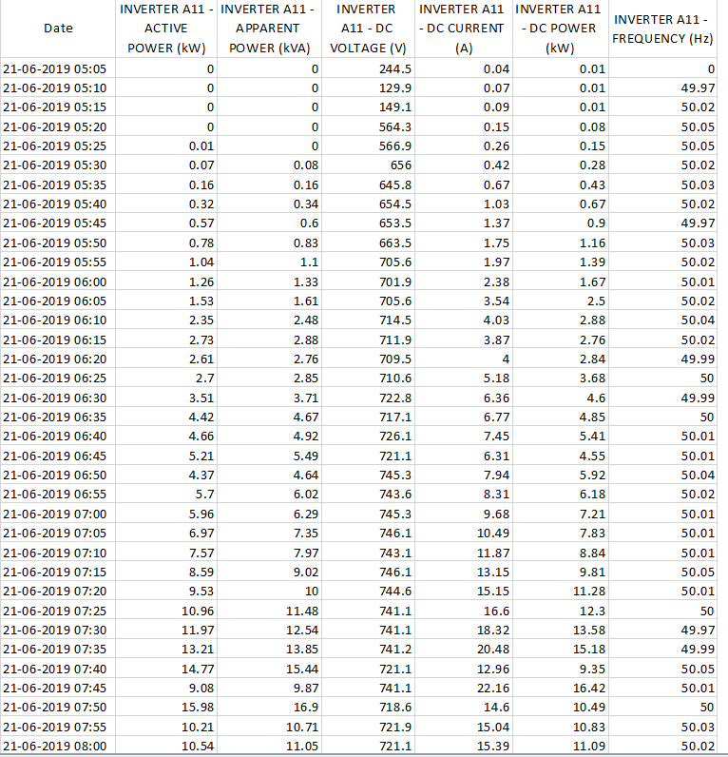
this table shows Inverter readings After washing

Slide 32
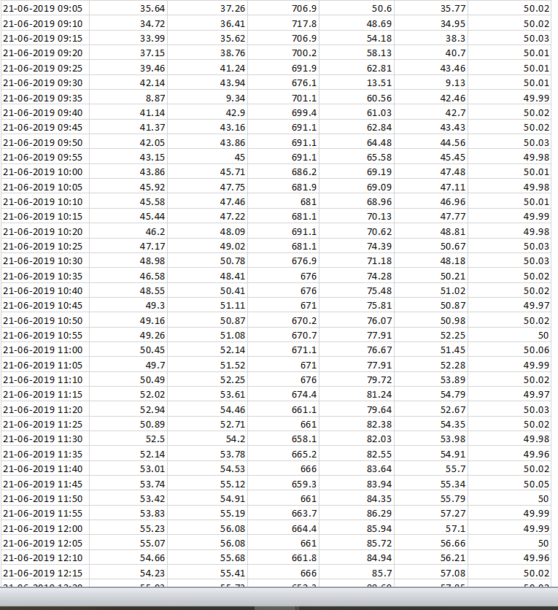

Slide 33
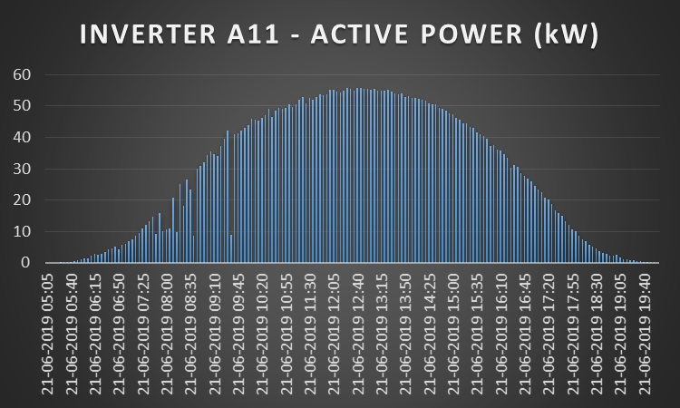
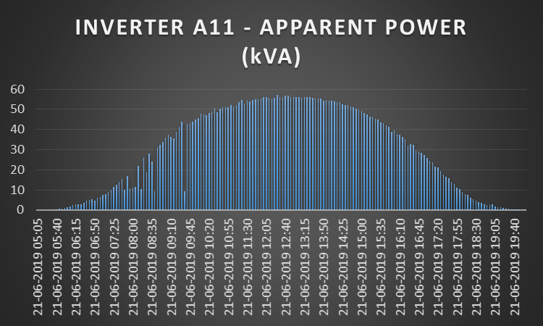

Slide 34
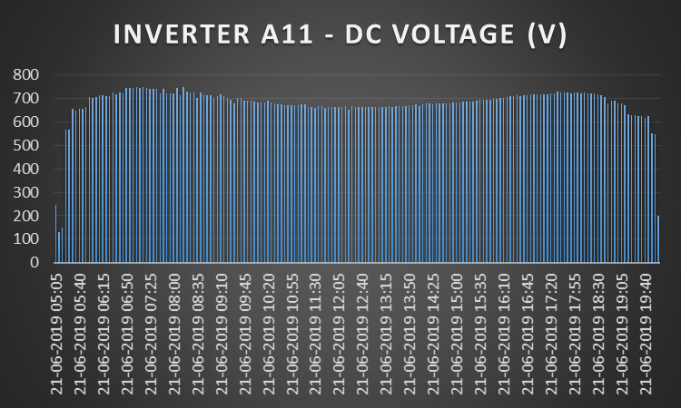
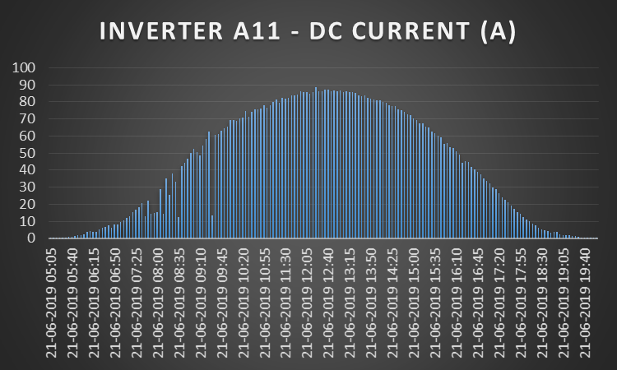

Slide 35
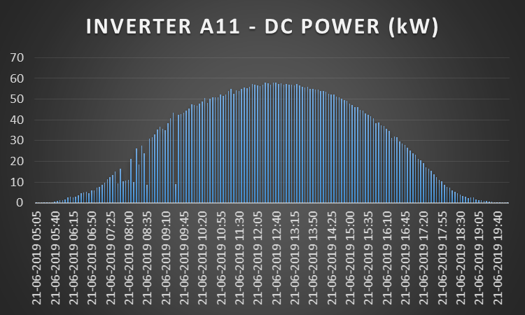

Slide 36
Calculation for our project
we take the values and calculate the average power (KW/Hour) in day
Productivity of solar cells on the inverter number 11 during working hours per day before cleaning
O’clock | Avg. power(kw.hour)
5 | 0.205
6 | 2.39
7 | 9.72
8 | 21.64
9 | 32.47
10 | 40.87
11 | 45.8
12 | 48.4
1 | 47.9
2 | 43.56
3 | 43.56
4 | 25.22
5 | 13.46
6 | 4.76
7 | 0.918
 | 380.87 KW.h
The total productivity at all hour in day = 380.87KWh

Slide 37
we take the values and calculate the average power (KW/Hour) in day
Productivity of solar cells on the inverter number 11during working hours per day after cleaning
O’clock | Avg. power(kw.hour)
5 | 0.24
6 | 3.42
7 | 10.4
8 | 20.57
9 | 36.17
10 | 47.16
11 | 52.09
12 | 55.22
1 | 54.37
2 | 50.64
3 | 42.89
4 | 31.6
5 | 17.8
6 | 5.2
7 | 0.806
 | 428.576 KWh
The total productivity at all hour in day =428.576 KWh

Slide 38
We have 2MWP
1kwp produce 1800kwh/year
so 2MWP=2*1000*1800 =3600Mwh/year
If we assume after cleaning 10%
without cleaning: 3240Mwh
with cleaning: 3600Mwh
saving /year=3600-3240 = 360Mwh/year
If we assume 5% so: 0.5*360
=180Mwh /year
=180000Kwh/year
each Kwh=0.5NIS
the saving =0.5*180000
=90000NIS/year
The saving =90000-5000 = 85000NIS at first year
another years=90000-1000 = 89000NIS
the total cost of our device is 1000 shekel
We have 28 inverter in ajja station, that’s mean there is 28 rows, if we put at every 7 rows 1 device ,so we need 4 devices, and every year need 1000 NIS for maintenance, then we need 5000 NIS at first year.

Slide 39
Future vision
In this project, we aspire in the future to remove all barriers facing solar cells Through the development of the project to satisfy large solar farms that travel through railways covering all rows of power stations
Also, in the future, we seek to add water as additional support with the project to clean the cells and wash them
We hope to link the station to an online library on the meteorological department to read the weather in advance and work Consequently
If there is rain, the project does not work with water, and if there are moving winds, the project does not work

Slide 40
PV PANELS CLEANING ROBOTICS SEYSTEM
Supervised by
Dr.Moien Omar
Mostafa Ahmad Alawneh (11525946)
Baraa Horani(11527482)
Mohammad Abu Hania (11525206)
Rafeef Durgham Jian (11526242)

