Slide 1

An-Najah National University
Faculty of Engineering
Civil Engineering Department
Graduation Project II
Structural Analysis and Design of Palestine Red Crescent Society School For Deaf

Slide 2
Prepared by: Ahmad yahya 11714678
Madleen Bzoor 11612158
Mohammad Ibrahim 11714763
Obaida Zaben 11440709
Rasha Yameen 11715486
Supervisor Name: Dr. Munther Diab
AcademicYear: 2020-2021

Slide 3
Outline
General Description.
Structural System Design and Analysis.
Three Dimensional Modeling & Analysis.
Final Design of Structural Elements.

Slide 4
General Description.

Slide 5
Project Description :
This project is analysis and design The Palestine Red Crescent Society School for the Deaf in Ramallah.
This building has seven floors, two of them Underground (basement) and five above ground . This building includes: classrooms, halls, mechanical rooms, various laboratories, Elevators and water tanks

Slide 6
  General Information:
Floor Name | Floor Height (m) | Floor Area (m²)
The second Basement | 3.9 | 813.95
The first Basement | 3.9 | 711
The ground floor | 3.9 | 629.69
The first floor | 3.9 | 675.02
The second floor | 3.9 | 675.02
The third floor | 3.9 | 675.02
The fourth floor | 3.9 | 675.02
Roof | 2.5 | 22.4

Slide 7
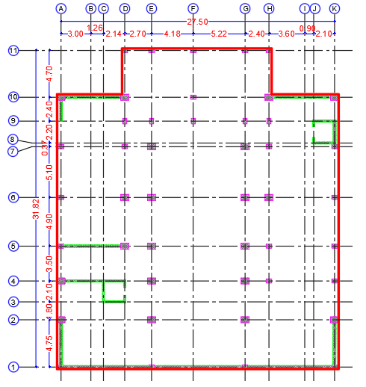
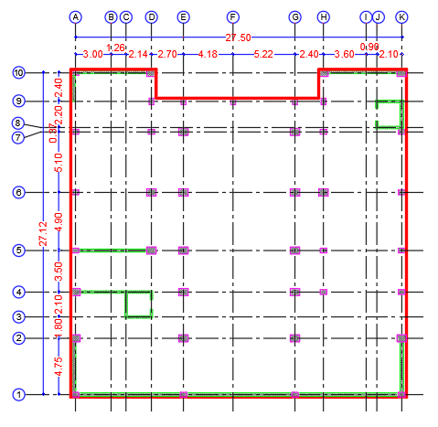
Architectural Plans:
For Basement 2
For Basement 1

Slide 8
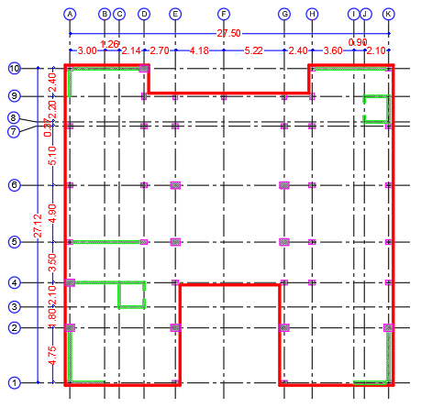
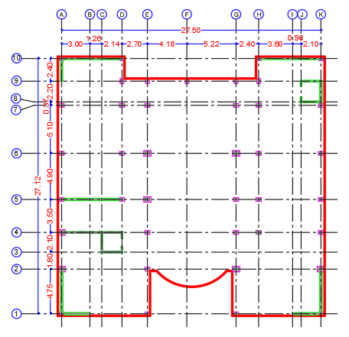
For Ground floor
For first floor

Slide 9
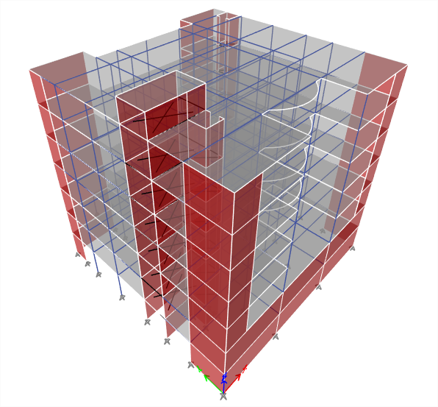
3D Model

Slide 10
  Codes and standards:
  American Society for Civil Engineering (ASCE 7-16).
  American Society for Materials (ASTM).
  American Concrete Institute (ACI 318- 14)
  International Building Code (IBC- 2018).

Slide 11
Materials
There are two types of materials which used in the building, such as :
Structural element materials : concrete and steel.
For concrete :
For Steel :
Property | Value
Cylindrical Compressive strength ( fc ) | 28 MPa
Modulus of elasticity ( Ec) | 24.8 GPa
Unit weight (Ɣ) | 25 KN/m3
Property | Value
Yielding strength (fy) | 420 MPa
Modulus of elasticity ( Es) | 200 GPa

Slide 12
2. Nonstructural element materials : blocks , tiles , masonry stone and wood.
Material | Unit Weight Ɣ(kN/m3)
Tiles | 27
Blocks | 15
Masonry Stones | 27
Filling Materials | 18
Plaster | 23
Concrete Mortar | 23
Aggregate | 15
Sand | 18

Slide 13
Loads :
The common types of loads on the structures are as follow:
Gravitational loads such as: Live, Dead and Superimposed Dead loads.
Dead Load :
It is mainly the own weight of the structural elements and any permanent equipment, which can be defined as the load that does not change with time progressing.

Slide 14
Live Load :
It can be defined as the loads that are variable by time progressing. However, it is mainly caused by people, furniture, or any other movable objects
Occupancy or use | Live Load (kN/m2)
Laboratories | 4.79
Class room | 1.92
Corridors in first floor | 4.79
Corridors above first floor | 3.83
Bathrooms | 1.92
Dining rooms and restaurants | 4.79
stairs | 4.79
Use Live Load for all floors = 5 KN/m²

Slide 15
Superimposed Dead Load :
This load is mainly caused by the nonstructural elements of the building, it
consists of the weight of walls, floors, ceilings, partitions, finishes, cladding
and fixed service equipment, such as mechanical ducts and electrical wires.

Slide 16
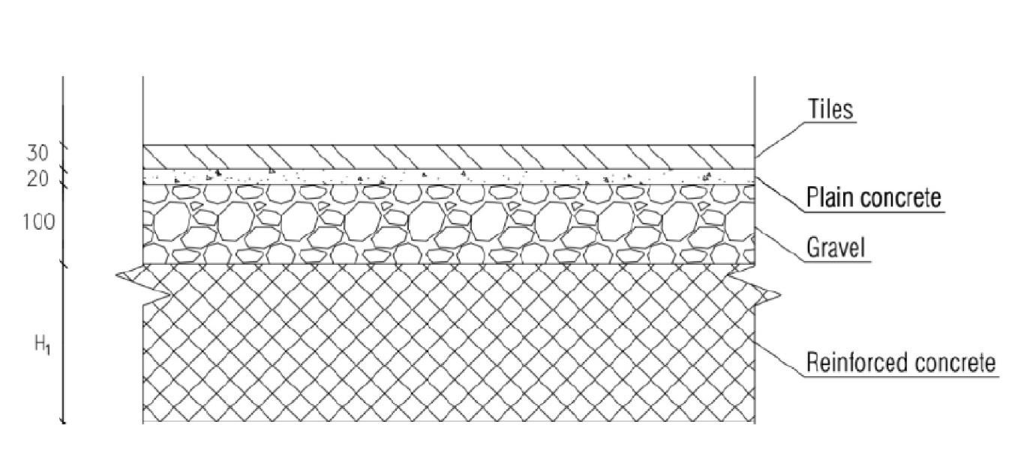
Superimposed Dead Load :
Calculation far Superimposed dead load :
Floor Layers :
Total weight of layers = 0.03*27+0.02*23+0.1*18=3.07 KN/m²

Slide 17
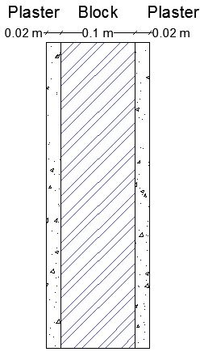
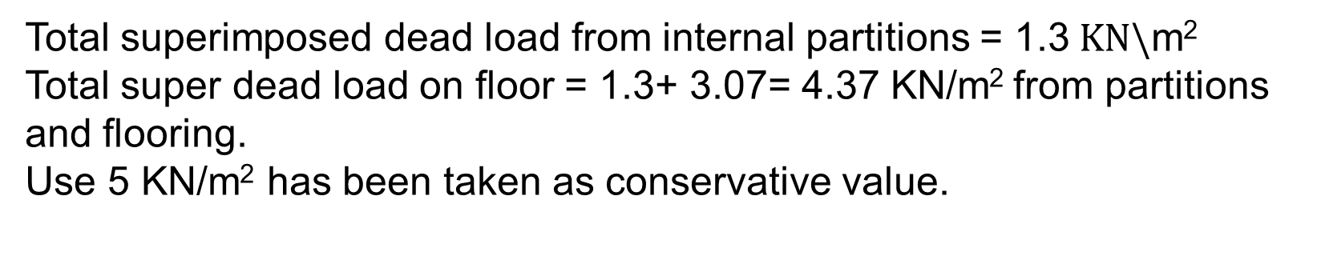
Internal partitions :
Total superimposed dead load from internal partitions = 1.3$KN\backslash$m²
Total super dead load on floor = 1.3+ 3.07= 4.37 KN/m² from partitions and flooring.
Use 5 KN/m² has been taken as conservative value.

Slide 18
2. Lateral loads such as: wind, soil pressure and earthquakes .
Lateral Soil Pressure:
In the design of structures below grade, provision shall be made for the lateral pressure of adjacent soil.

Slide 19
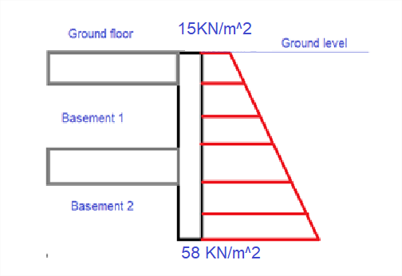
Earthquake Load :
ASCE7-16 code will be used for seismic analysis to evaluate the building under
Lateral forces.

Slide 20
Load Combinations :
Ultimate Load Combination
1.4D
1.2 D + 1.6 L+0.5S
1.2 D + L+1.6S
1.2 D + 1.0W + L+0.5S
1.2 D + 1.0E + L+0.2S
0.9D+1.0W
0.9D+1.0E
Service Load Combination
D
D+L
D+S
D+0.75(0.6W)+0.75L+0.75S
D+0.75(0.7E)+0.75L+0.75S
0.6D+0.6W
0.6D+0.7E

Slide 21
Computer Programs :
ETABS 2018 to Build a 3D model for the structure, and to take reinforcing steel results for structural elements.
AutoCAD 2017 to draw plans, and reinforcing details.
SAFE 2016 to design the footing .

Slide 22
Structural System Design and Analysis.

Slide 23
Structural System:
Wall bearing structure
Moment Resisting Frame
Building System
The Dual system

Slide 24
Structural Element:
Slab System
Beams System
Columns System

Slide 25
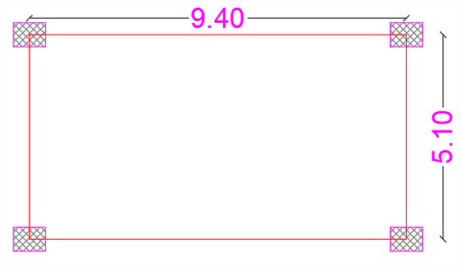
Preliminary Design :
Slab Thickness :
The ratio of the longer to the shorter side (L/B) of the slab less than 2 so it’s preferable to design the slab as two way slab.
To find an initial thickness of slabs, take the critical panel as seen in figure below :

Slide 26
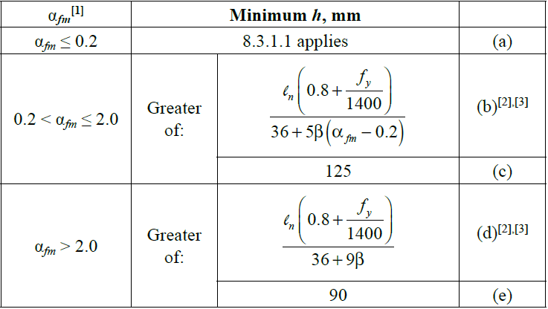
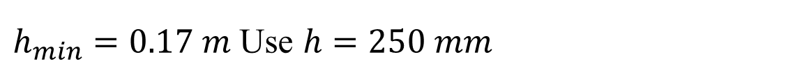
ACI Code for minimum slab thickness in two way slabs with beams between all supports .
$h_{min}=0.17 m$ Use $h=250 mm$

Slide 27
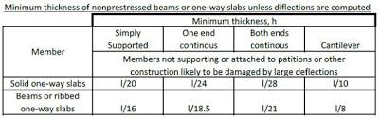
Beams Dimensions :
Beams have been designed according to the ACI code :

Slide 28
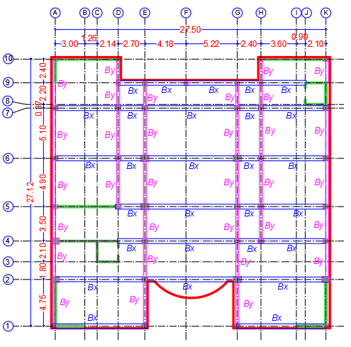
Beam Direction | Width (mm) | Depth (mm)
X-Direction | 500 | 650
Y-Direction | 300 | 400

Slide 29
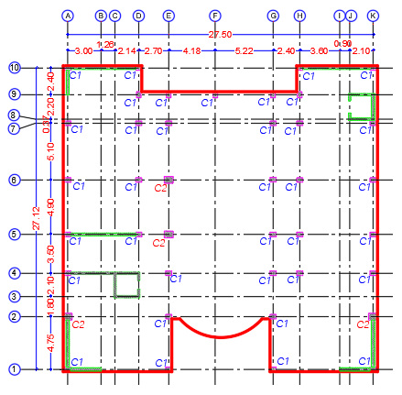
Column Dimensions :
Column | Width (mm) | Depth (mm)
C1 | 400 | 550
C2 | 800 | 600
C3 | 550 | 250

Slide 30
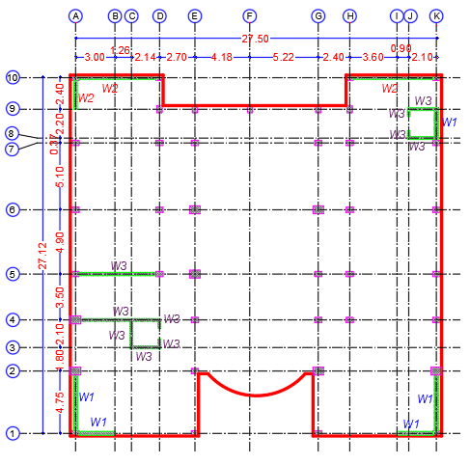
Wall Thickness :
Wall | Depth (mm)
W1 | 300
W2 | 200
W3 | 250

Slide 31
Modifiers for structural elements:
structural elements | Modifiers
Slab | 0.25
Beams | 0.35
Columns | 0.7
Wall | 0.7

Slide 32
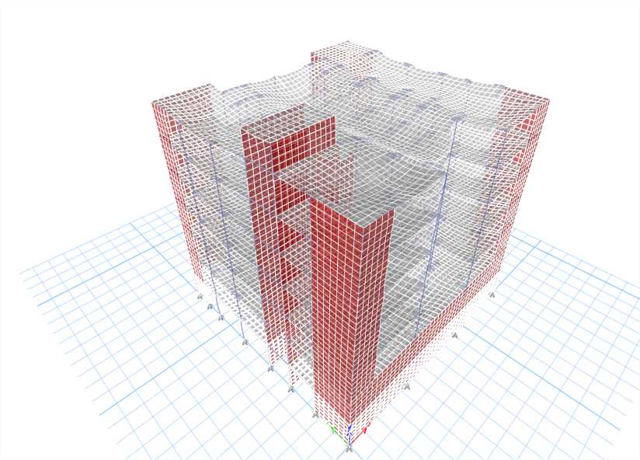
Structural Model Verification :
Compatibility Check :

Slide 33
Equilibrium Check :
Load Type | Hand Result | ETABS Result | %Difference
Dead | 58223.9 | 58186.25 | 0.06%
SD | 29997.75 | 29997.76 | 0.00%
Live | 23327.56 | 23327.56 | 0.00%

Slide 34
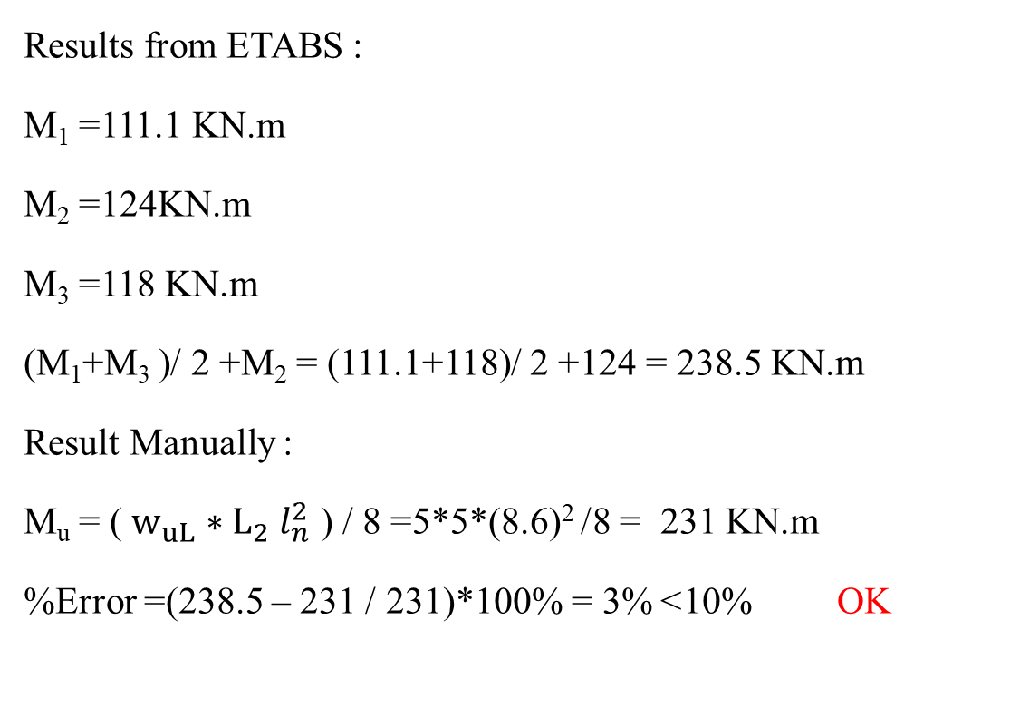
Internal Forces Check :
Fream Check :
Results from ETABS :
M₁ =111.1 KN.m
M₂ =124KN.m
M₃ =118 KN.m
(M₁+M₃ )/ 2 +M₂ = (111.1+118)/ 2 +124 = 238.5 KN.m
Result Manually :
M_{u} = ( $w_{uL}$ $∗L_{2}$ $l_{n}^{2}$ ) / 8 =5*5*(8.6)² /8 = 231 KN.m
%Error =(238.5 – 231 / 231)*100% = 3%> 10% OK

Slide 35
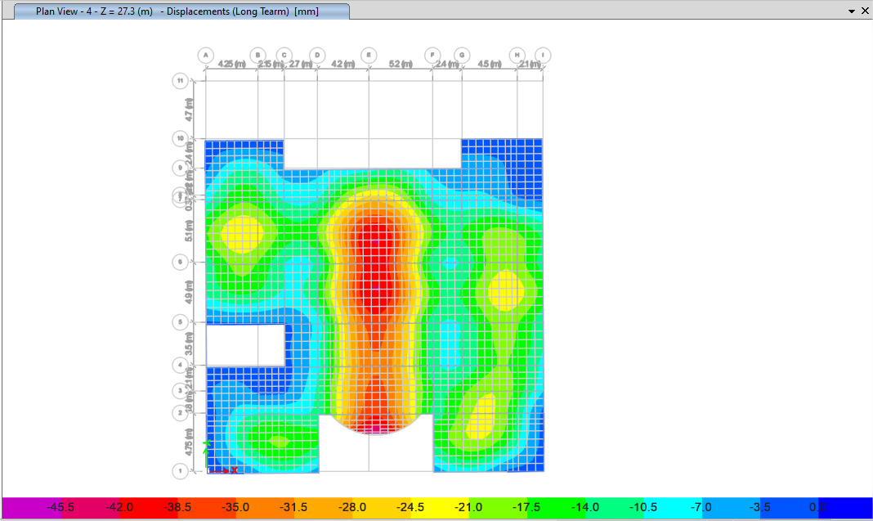
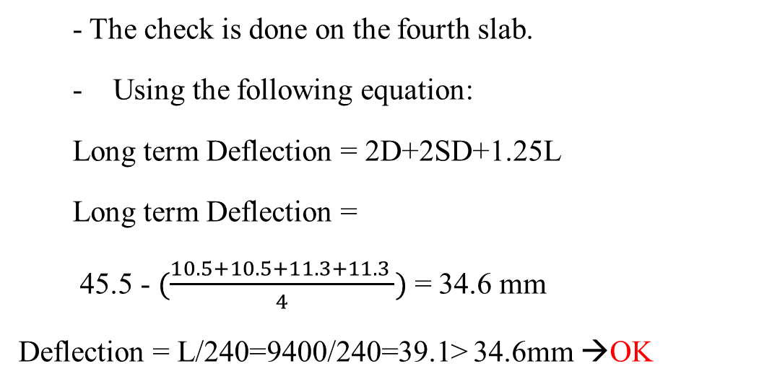
Deflection Check :
- The check is done on the fourth slab.
Using the following equation:
Long term Deflection = 2D+2SD+1.25L
Long term Deflection =
45.5 - $(\frac{10.5+10.5+11.3+11.3 }{4})$ = 34.6 mm
Deflection = L/240=9400/240=39.1> 34.6mm →OK

Slide 36
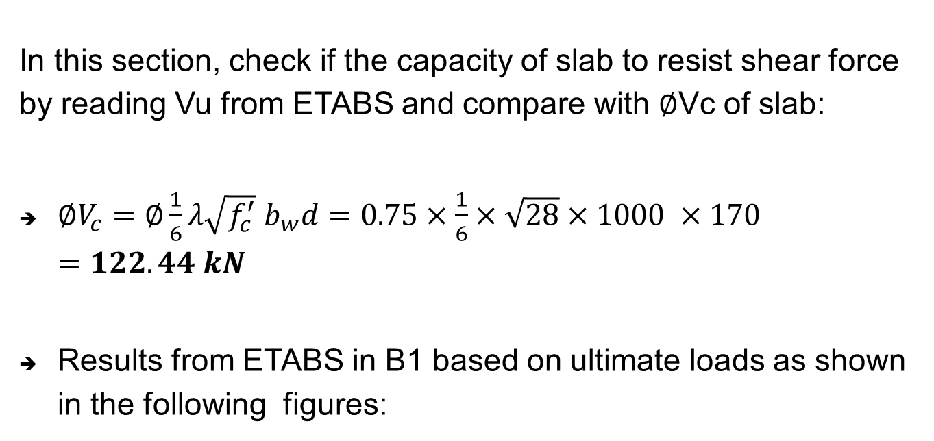
Slab shear Check :
In this section, check if the capacity of slab to resist shear force by reading Vu from ETABS and compare with $∅$Vc of slab:
${∅V}_{c}=∅\frac{1}{6}λ\sqrt{f_{c}^{′}} b_{w}d=0.75×\frac{1}{6}×\sqrt{28}×1000 ×170=122.44 kN$
Results from ETABS in B1 based on ultimate loads as shown in the following figures:

Slide 37
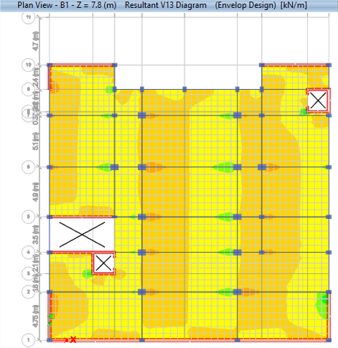
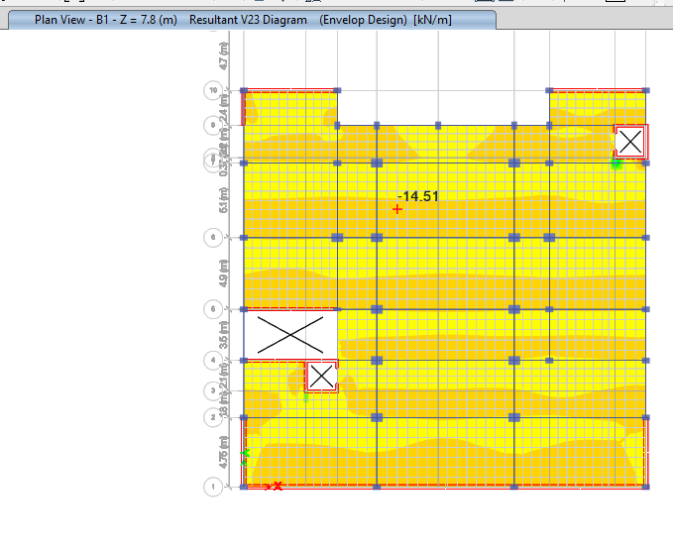

Based on results Vu < $∅V_{c}$→ OK

Slide 38
Three Dimensional Dynamic Evaluation

Slide 39
Determine the Risk Category:
The building is used for educational purposes. Therefore, the risk category was determined as shown in Table 1.5-1:

Slide 40
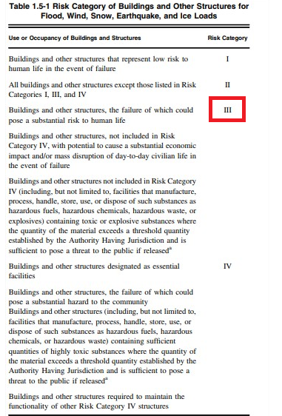

Slide 41
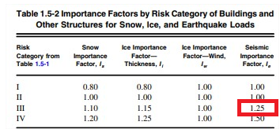
Determine the Importance Factor I_{e}:
The importance factor is a function from the risk category and it is determined from Table 1.5-2 :

Slide 42
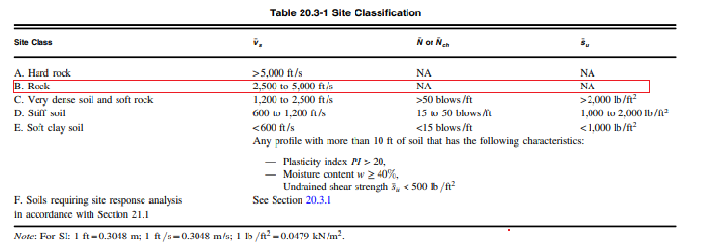
Determine Site Soil Classification:
The selecting of site class is based on soil stiffness. According to Table 20.3-1, the type of soil is rock with allowable bearing capacity = 450 KN/m².
So the site class is (B).

Slide 43
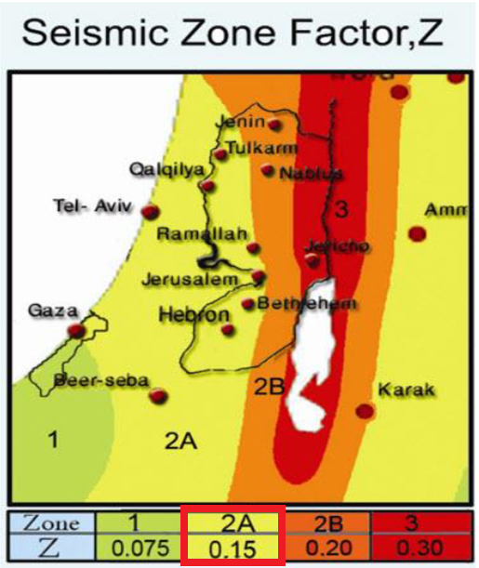
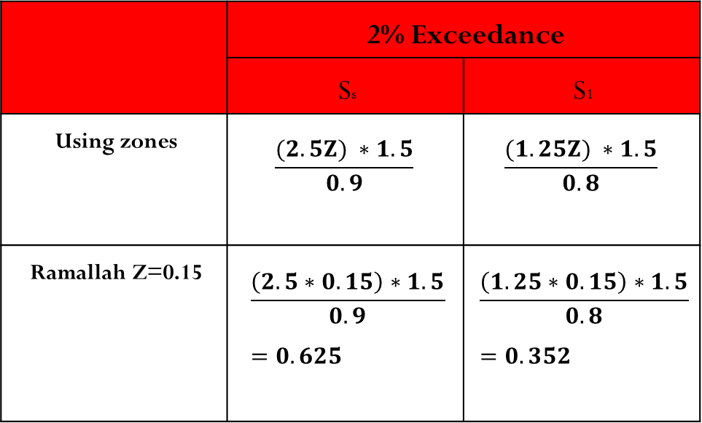
  Mapped acceleration parameters:
    S_{s} = 0.625
    S₁ = 0.352
 | 2% Exceedance
 | Ss | S1
Using zones | $$\frac{(2.5Z) ∗1.5}{0.9}$$ | $$\frac{(1.25Z) ∗1.5}{0.8}$$
Ramallah Z=0.15 | $$\frac{\left(2.5∗0.15\right)∗1.5}{0.9}=0.625$$ | $$\frac{\left(1.25∗0.15\right)∗1.5}{0.8}=0.352$$

Slide 44
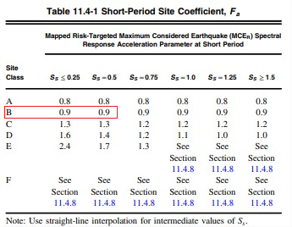
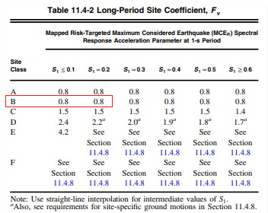
Define the Site Coefficients, F_{a} and F_{v}:
These coefficients are based on site class and mapped spectral accelerations, S_{s} & S₁.

Slide 45
Spectral Response Acceleration Parameters :
S_{MS} = F_{a}·S_{S} = 0.9 X 0.625= 0.5625
S_{M1} = F_{v}·S₁ = 0.8 X 0.352 = 0.2816
Design Spectral Acceleration Parameters :
S_{DS} = 2/3.S_{MS} = 0.375
S_{D1} = 2/3.S_{M1} = 0.188

Slide 46
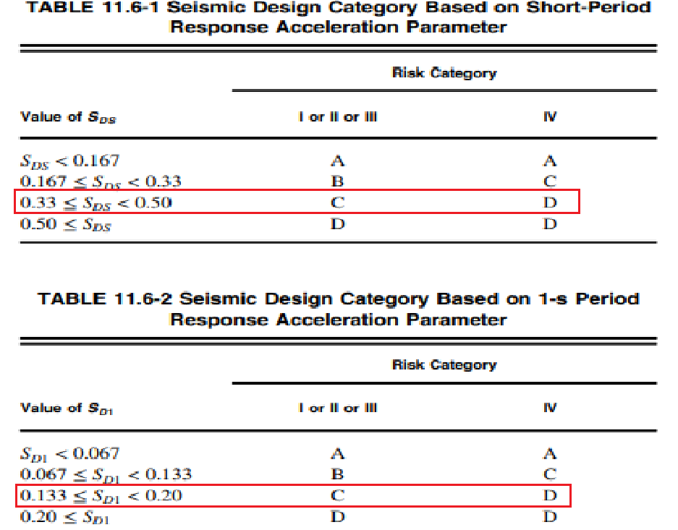
Seismic design category (SDC): C

Slide 47
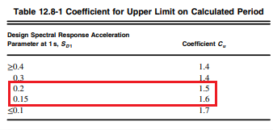
The Fundamental Natural Period:
According to ASCE7-16 Code, the fundamental period in each direction calculated as follows:
T = C_{u} T_{a}
By Using the Interpolation Cu =1.524

Slide 48
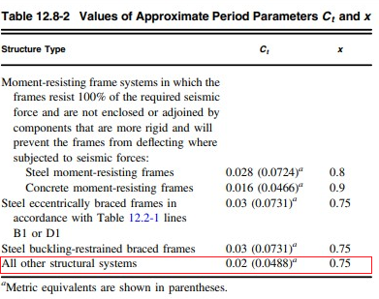
Section 12.8.2.1 of the ASCE7-16 provides an empirical formula to calculate the approximate period , T_{a} as follows:
T_{a} = C_{t} (ℎ_{n})^{x}
T = 1.524X 0.622 = 0.95 sec.

Slide 49
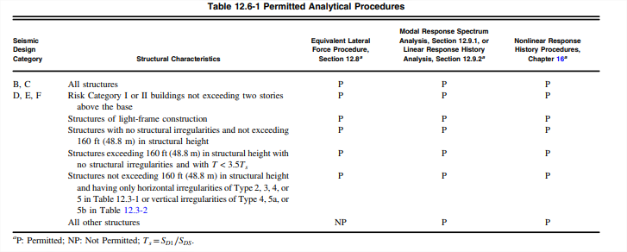
The Seismic Analysis Methods :
Equivalent Lateral Force Method (ELF)
Modal Response Spectrum Method (MRS):
Time History

Slide 50
Determine Design Coefficients and Factors for LFRS:
These factors will be determined according to the types of lateral force resisting system listed in Table 12.2-1 of ASCE7-16 code.
According to the Table 12.2-1 in ASCE7-16, the LFRS will be Building Frame System with Ordinary reinforced concrete shear walls and check using equivalent lateral force procedure to make sure that shear walls take the lateral forces.

Slide 51
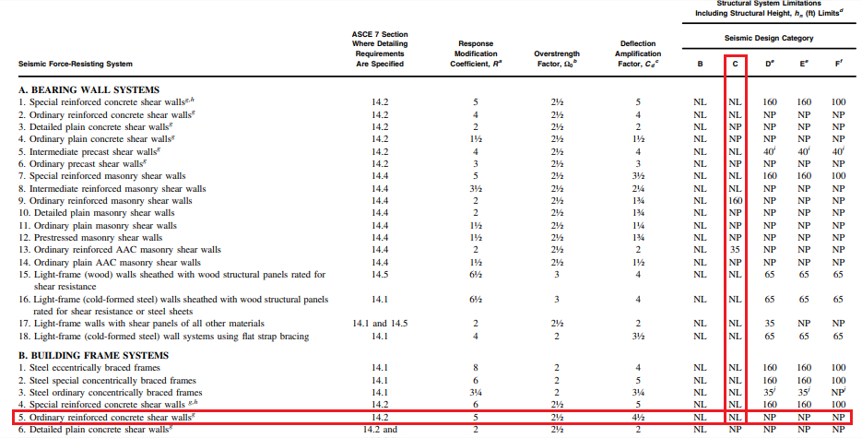

Slide 52
Response modification coefficient (R) = 5
Overstrength factor (Ω₀ ) = 2.5
Deflection amplification factor (C_{d}) = 4.5
Direction | Shear wall reactions (KN) | Total Base shear(KN) | % of load
X-direction | 6493.2 | 6494.4 | 99.98%
Y-direction | 4573.4 | 4576.7 | 99.99%

Slide 53
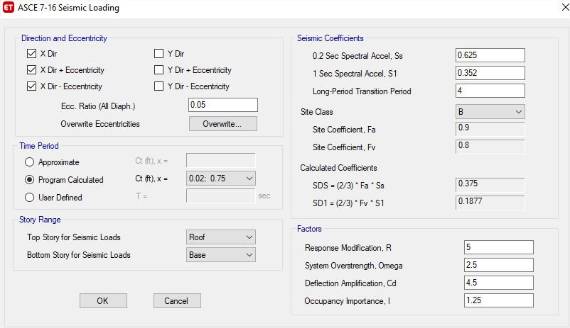

Equivalent Lateral Force Method (ELF) :

Slide 54
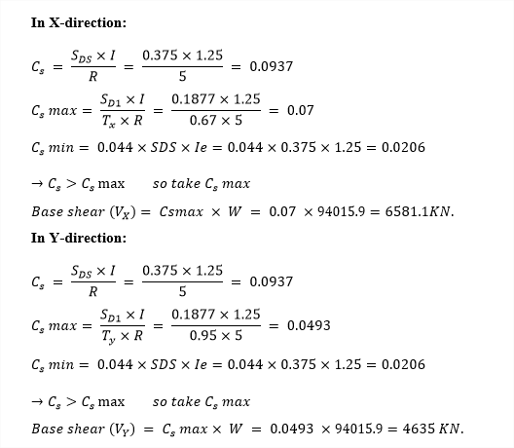
Hand calculations for ELF:

Slide 55
Direction | Hand (KN) | ETABS (KN) | Difference %
X | 6581.1 | 6502.2 | 1.2%
Y | 4635 | 4597.8 | 0.8 %
The difference between hand results and ETABS results less than the allowable (10%) so it is Ok.

Slide 56
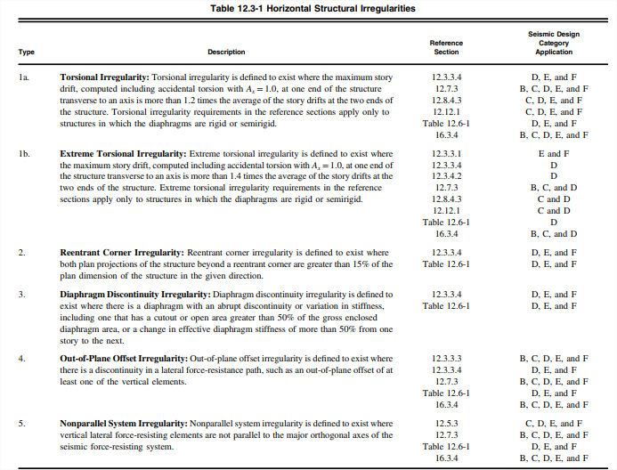
  Structural Irregularities Checks:
    Horizontal Irregularity:

Slide 57
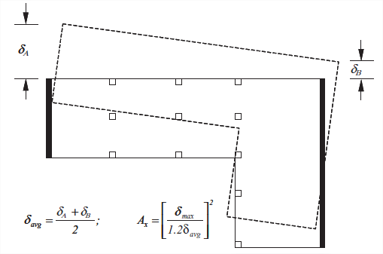
  1a-Torsional irregularity:
Accidental eccentricity, e = A_{x} * 0.05

Slide 58
  Torsional irregularity in X-direction:
    Irregularity does not exist
Story | DX | Ex3
 |  | Displacement |  | Ratio | Check | Ax₁ | Eccentricity
 |  | δmax | δavg
4 | 27.5 | 16.64 | 16.497 | 1.009 | OK | - | 0.05 | -
3 | 27.5 | 13.528 | 13.205 | 1.024 | OK | - | 0.05 | -
2 | 27.5 | 10.39 | 9.889 | 1.051 | OK | - | 0.05 | -
1 | 27.5 | 7.378 | 6.69 | 1.103 | OK | - | 0.05 | -
G | 27.5 | 4.314 | 3.713 | 1.162 | OK | - | 0.05 | -

Slide 59
  Torsional irregularity in Y-direction:
    Irregularity exist
Story | DY | Ey3
 |  | Displacement |  | Ratio | Check | Ay₁ | Eccentricity
 |  | δmax | δavg
4 | 27 | 30.885 | 30.008 | 1.029 | Not OK | 1.032 | 0.052 | 1.4
3 | 27 | 25.325 | 24.554 | 1.031 | Not OK | 1.035 | 0.052 | 1.4
2 | 27 | 19.657 | 19.026 | 1.033 | Not OK | 1.034 | 0.052 | 1.4
1 | 27 | 14.14 | 13.65 | 1.036 | Not OK | 1.025 | 0.051 | 1.4
G | 27 | 9.105 | 8.728 | 1.043 | Not OK | 1.007 | 0.050 | 1.4

Slide 60
  Reentrant corner irregularity:
  Does not exist
  diaphragm discontinuity irregularity:
  Does not exist

Slide 61
  Out of plane offset irregularity:
  Does not exist
  Non parallel system irregularity:
  Does not exist

Slide 62
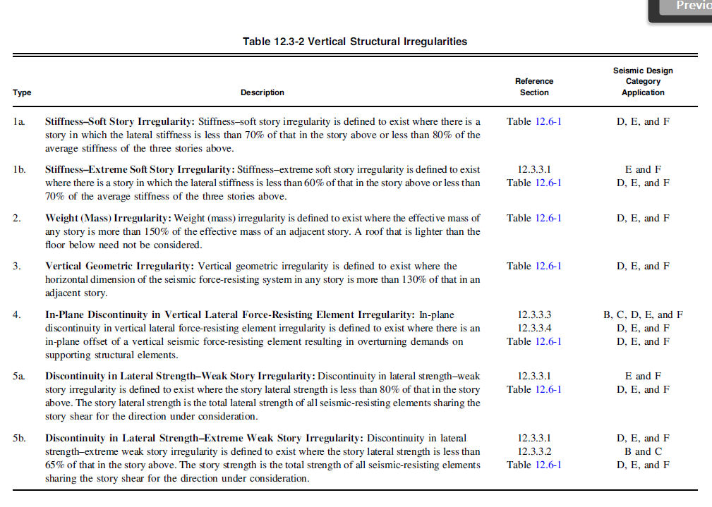
    Vertical Irregularity:

Slide 63
Stiffness Irregularities:
  Does not exist
  Mass (weight) irregularity:
  Does not exist

Slide 64
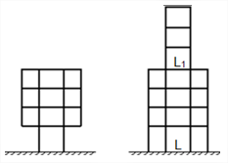
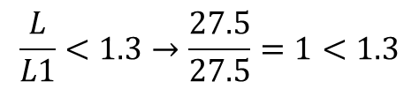
Vertical geometric irregularity
$$\frac{L}{L1}<1.3→\frac{27.5}{27.5}=1<1.3$$
  Does not exist
In-Plane Discontinuity in Vertical Lateral Force Resisting Elements:
  Does not exist

Slide 65
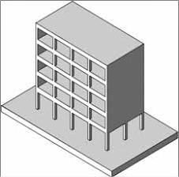
Discontinuity in Lateral Strength:
a- Weak Story Irregularity.
b- Extreme Weak Story Irregularity.
  Does not exist

Slide 66
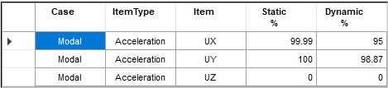
Response Spectrum Method :
Minimum Number of Modes:

Slide 67
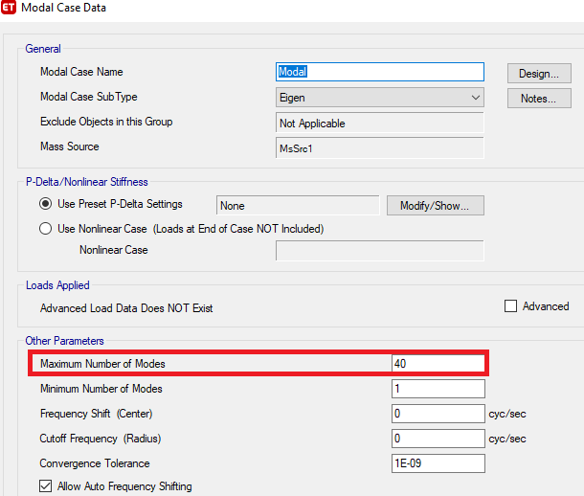

Slide 68
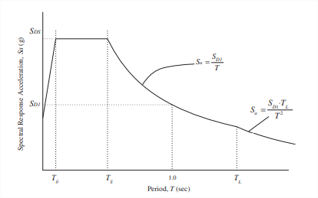
Response Spectrum Curve:
SDS =0.375
SD1 =0.188
T = the fundamental period of the structure.
To = 0.2 SD1/SDS = 0.1 sec
TS = SD1/SDS = 0.5 sec
TL = 4sec (Israeli code).
Sa = the design spectral response acceleration.

Slide 69
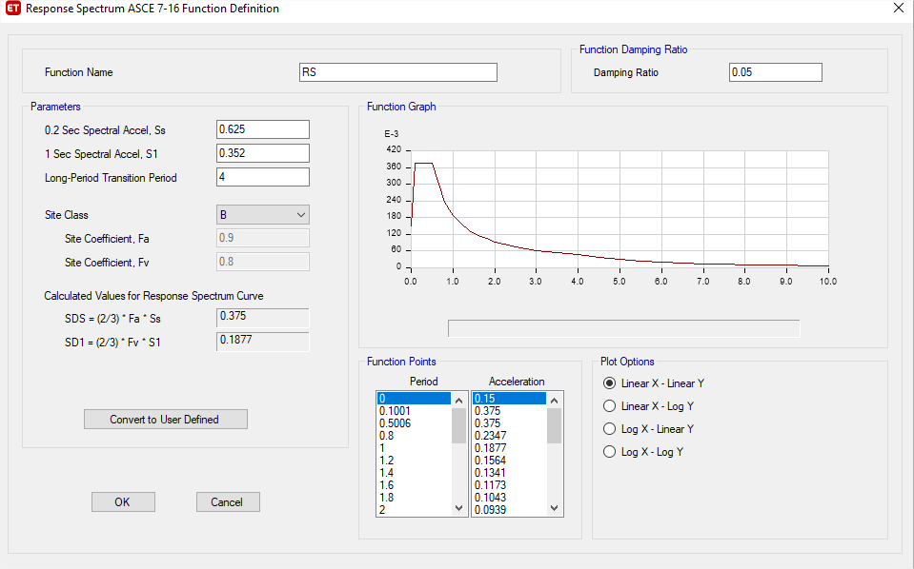
Response Spectrum Definition:

Slide 70
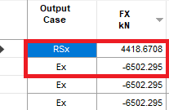

Checking for Dynamic Response Spectrum Analysis:
Scaling in X–direction:

Slide 71
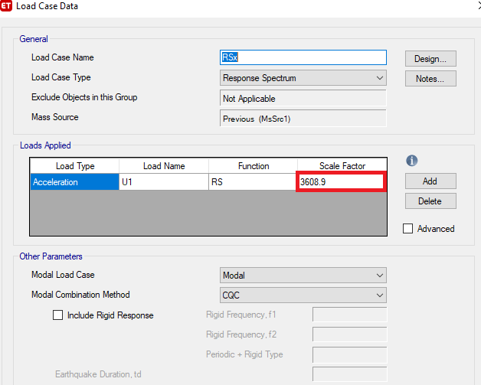
$→Scale Factor=\frac{g×I}{R}×\frac{(Ex)}{(RSx)}=\frac{9810×1.25}{5}×\frac{6502.295}{4418.6708}=$3608.9

Slide 72


Scaling in Y–direction:

Slide 73
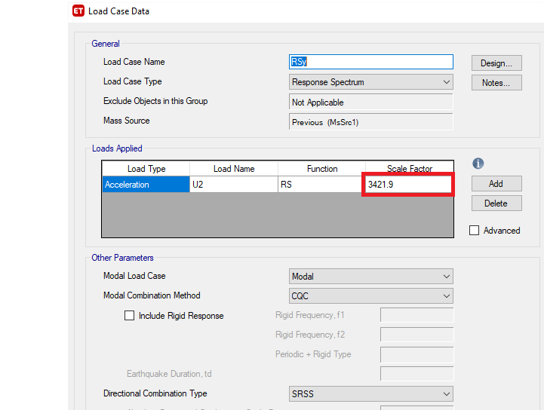
$→Scale Factor=\frac{g×I}{R}×\frac{(Ey)}{(RSy)}=\frac{9810×1.25}{5}×\frac{4597.8113}{3295.256}=$3421.9

Slide 74



  Check for Story Drift.
$$δx = \frac{C_{d} δ_{xe}}{I_{e}}$$

Slide 75
Story | Load Case/Combo | Direction | Drift |  | Check
Roof | Envelop Service | X | 0.000191 | 0.000688 | OK
4 | Envelop Service | X | 0.00028 | 0.001008 | OK
3 | Envelop Service | X | 0.000279 | 0.001004 | OK
2 | Envelop Service | X | 0.000269 | 0.000968 | OK
1 | Envelop Service | X | 0.000267 | 0.000961 | OK
G | Envelop Service | X | 0.000265 | 0.000954 | OK
B1 | Envelop Service | X | 0.000128 | 0.000461 | OK
B2 | Envelop Service | X | 0.000054 | 0.000194 | OK

Slide 76

  Check for P-Delta.
$$θ= \frac{Px Δ Ie}{Vx hsx Cd}$$
( P-Delta ) -RSx
Story | Height | P | VX | UX | ∆X | ƟX | Check
 | mm | kN | kN | mm | mm | 0.077
Roof | 2500 | 420.0938 | 23.3763 | 5.83 | 0.84 | 0.0060 | Neglect P-Delta
4 | 3900 | 14152.3 | 727.9088 | 4.994 | 0.99 | 0.0049 | Neglect P-Delta
3 | 3900 | 27747.48 | 1100.584 | 4.003 | 0.97 | 0.0063 | Neglect P-Delta
2 | 3900 | 41389.94 | 1316.521 | 3.035 | 0.93 | 0.0075 | Neglect P-Delta
1 | 3900 | 55099.7 | 1540.417 | 2.106 | 0.84 | 0.0077 | Neglect P-Delta
G | 3900 | 68196.44 | 1779.966 | 1.27 | 0.73 | 0.0072 | Neglect P-Delta

Slide 77
  Load Combinations:
Seismic Load Effect:
Use E = E_{h} + E_{v}
Where:
E_{h} = Q_{E}
Q_{E} = effects of horizontal seismic forces.
Q_{E}x = Ex + 0.3Ey
Q_{E}y = Ey + 0.3Ex
Ev = the load effect resulting from the vertical component of the earthquake ground motion and it is equal to an addition of (0.2S_{DS})D to the dead load effect.
E_{v} = 0.2S_{DS}D = 0.2*0.375D = 0.075D

Slide 78


Slide 79


Slide 80

  Diaphragm Rigidity:
There are two types of diaphragms are flexible and rigid

Slide 81
Final Design of Structural Elements.

Slide 82


  Slab Design:
Design for flexure:
For Moment in direction x:
For Moment in direction Y :

Slide 83


For Top reinforcement in x-direction :
For Bottom reinforcement in X-direction
So for M_{u} ≤ 38.4 KN.m/m use minimum reinforcement of 1Ø10/200 mm for top reinforcement and 1Ø10/150 mm for bottom reinforcement.
This figures show the As is enough or not , when we need more As use 1Ø10/100 mm .

Slide 84


For Top reinforcement in Y-direction :
For Bottom reinforcement in Y-direction
So for M_{u} ≤ 38.4 KN.m/m use minimum reinforcement of 1Ø10/200 mm for top reinforcement and 1Ø10/150 mm for bottom reinforcement.
This figures show the As is enough or not , when we need more As use 1Ø10/100 mm .

Slide 85

  Beam Design:
Design for flexure:

Slide 86
Beam Number | Span | Location | As(mm²) ETABS |  | As Used mm² | Number of Bars
 |  |  | Moment | Torsion
Beam 1 | A-D | Negative-Left | 1349 | 644 | 2198 | 7 Ø20
 |  | Positive | 762 | 644 | 1570 | 5 Ø20
 |  | Negative-Right | 885 | 644 | 1570 | 5 Ø20
 | F-I | Negative-Left | 834 | 763 | 1884 | 6 Ø20
 |  | Positive | 819 | 763 | 1570 | 5 Ø20
 |  | Negative-Right | 1482 | 763 | 2512 | 8 Ø20
Beam 2 | A-D | Negative-Left | 983 | 570 | 1570 | 5 Ø20
 |  | Positive | 655 | 570 | 1256 | 4 Ø20
 |  | Negative-Right | 1306 | 570 | 1884 | 6 Ø20
 | D-F | Negative-Left | 2125 | 0 | 2198 | 7 Ø20
 |  | Positive | 1752 | 0 | 1884 | 6 Ø20
 |  | Negative-Right | 2296 | 0 | 2512 | 8 Ø20
 | F-I | Negative-Left | 1772 | 0 | 1884 | 6 Ø20
 |  | Positive | 1216 | 0 | 1256 | 4 Ø20
 |  | Negative-Right | 1480 | 0 | 1570 | 5 Ø20

Slide 87



Example for Calculation :
For Negative moment M=229.4 KN.m
$ρ=\frac{0.85f^{′}c}{fy}\left(1−\sqrt{1−\frac{2.61Mu}{bd^{2}f^{′}c}} \right)$ = $\frac{0.85(28)}{420}$ $(1−\sqrt{1−\frac{2.61∗229.4∗{10}^{6}}{{500∗590}^{2}∗28}} )$ = 0.00386
${As}_{calculated}$ = ρbd = 0.00386*500*590=1139 mm²
${As}_{minimmum}$ = ρ_{min}bd = 0.00333*500*590=982.5mm²
%Error = (1141 – 1139 / 1139)*100% =0.1 %> 10% OK

Slide 88
Design for Shear:
Beam Number | Span | Location | Av/s + 2At/s |  | Spacing | Number of stirrups
 |  |  | Av/s | 2At/s
Beam 1 | A-D | Left | 416 | 662 | 100 | 1Ø12/100mm
 |  | Medill | 416 | 662 | 100 | 1Ø12/100mm
 |  | Right | 416 | 662 | 100 | 1Ø12/100mm
 | F-I | Left | 416 | 784 | 90 | 1Ø12/90mm
 |  | Medill | 416 | 784 | 90 | 1Ø12/90mm
 |  | Right | 416 | 784 | 90 | 1Ø12/90mm
Beam 2 | A-D | Left | 416 | 586 | 110 | 1Ø12/110mm
 |  | Medill | 416 | 586 | 110 | 1Ø12/110mm
 |  | Right | 416 | 586 | 110 | 1Ø12/110mm
 | D-F | Left | 710 | 0 | 160 | 1Ø12/160mm
 |  | Medill | 416 | 0 | 200 | 1Ø12/200mm
 |  | Right | 743 | 0 | 150 | 1Ø12/150mm
 | F-I | Left | 624 | 0 | 180 | 1Ø12/180mm
 |  | Medill | 416 | 0 | 200 | 1Ø12/200mm
 |  | Right | 416 | 0 | 200 | 1Ø12/200mm

Slide 89


Slide 90

  Column Design:
Column Section | A_{s} (mm²) | Number of Bars
400*550 | 2200 | 10Ø18
800*600 | 4800 | 16Ø20
550*250 | 1375 | 8Ø16

Slide 91


For Column (400*550)
Check Distance Between bars if < 150 :
In X-Direction =$\frac{Total Length −2∗(cover)}{Number of bars−1}=$ $\frac{400−120}{2}$ =140 < 150 OK
In Y-Direction =$\frac{Total Length −2∗(cover)}{Number of bars−1}=$ $\frac{550−120}{3}$ =143 < 150 OK
Strips $≤$ 24$d_{s}$ = 10*24 = 240
$≤$ 8$d_{b}$ = 8*18 = 144 take s= 140 mm
$≤$ Least Dimensions /2 =200

Slide 92

For Column (600*800)
Check Distance Between bars if < 150 :
In X-Direction =$\frac{Total Length −2∗(cover)}{Number of bars−1}=$ $\frac{600−120}{2}$ =160 > 150 NOT OK
In Y-Direction =$\frac{Total Length −2∗(cover)}{Number of bars−1}=$ $\frac{800−120}{3}$ =136 < 150 OK
𝑆₀ = 𝑀𝑖𝑛 (𝑙𝑒𝑎𝑠𝑡 𝑐𝑜𝑙𝑢𝑚𝑛 𝑑𝑖𝑚, 8𝑑_{𝑏}, 24𝑑_{𝑠}, 300) = 𝑀𝑖𝑛 (600, 160, 240, 300)
Use 𝑆₀ = 150 mm.
L$\text{0}=800mm$

Slide 93


Slide 94
  Shear Wall Design:
Shear Wall Name | Thickness(mm) | Longitudinal Reinforcement for Each face | Transverse Reinforcement for Each face
P1 | 250 | 1Ø 10 /250mm | 1Ø 10 /250mm
P 2 | 300 | 1Ø 10 /200mm | 1Ø 10 /200mm
P 3 | 250 | 1Ø 10 /250mm | 1Ø 10 /250mm
P 4 | 250 | 1Ø 10 /250mm | 1Ø 10 /250mm
P 5 | 300 | 1Ø 10 /200mm | 1Ø 10 /200mm
P 7 | 300 | 1Ø 10 /200mm | 1Ø 10 /200mm
P 9 | 200 | 1Ø 10 /300mm | 1Ø 10 /300mm
P 10 | 200 | 1Ø 10 /250mm | 1Ø 10 /300mm
P 11 | 200 | 1Ø 10 /300mm | 1Ø 10 /300mm
P 12 | 300 | 1Ø 10 /200mm | 1Ø 10 /200mm
P 13 | 200 | 1Ø 10 /250mm | 1Ø 10 /300mm

Slide 95


${As}_{minimmum}$ = ρ_{min}bh = 0.0025*1000*250=625mm²/m
1Ø 10 /250mm
As from ETABS = 4000 mm²
Length = 6.4 m
As = 4000/6.4 =625 mm² /m
%Error = (625 – 625 / 625)*100% = 0 %> 10% OK

Slide 96

  Design of Foundations :
Area of footing = $\frac{Total service load }{Allowable bearing capacity }$=$\frac{11511.58}{450 }$ = 247.8 m²
Area of building = 813.95 m².
The Percentage of area of footing = 30 % on the area of building .
Area of footings < 50% Area of building, Use single footing , combined footing , mat footing and Wall footing .

Slide 97


Slide 98
  Sections of footing :
For Single footing :
use depth 40 cm , 60 cm , 70 cm , 80 cm according to Punching shear check .
For combined footing :
use depth 60 cm , 70 cm , 80 cm according to Punching shear check .
For mat footing :
use depth 60 cm , 90 cm according to Punching shear check .
For stiff is the area that moment of inertia is more large and it is use for column and wall location .

Slide 99

  Soil Property:

Slide 100

  Checks Using ETABS :
Bearing capacity Check :

Slide 101

2. Punching Shear capacity check :
As we can see all ratios <1, so it is OK.

Slide 102
Number | Length (m) | Width (m) | Depth (m) | Bottom Reinforcement in X-Direction | Bottom Reinforcement in Y-Direction | Top Reinforcement in X-Direction | Top Reinforcement in Y-Direction
F1 | 1.5 | 1.5 | 0.4 | 1Ø 14 /200mm | 1Ø 14 /200mm | 1Ø 14 /200mm | 1Ø 14 /200mm
F2 | 1.5 | 1.5 | 0.4 | 1Ø 14 /200mm | 1Ø 14 /200mm | 1Ø 14 /200mm | 1Ø 14 /200mm
F3 | 1.5 | 1.5 | 0.4 | 1Ø 14 /200mm | 1Ø 14 /200mm | 1Ø 14 /200mm | 1Ø 14 /200mm
F4 | 1.5 | 1.5 | 0.4 | 1Ø 14 /200mm | 1Ø 14 /200mm | 1Ø 14 /200mm | 1Ø 14 /200mm
F5 | 1.5 | 1.5 | 0.4 | 1Ø 14 /200mm | 1Ø 14 /200mm | 1Ø 14 /200mm | 1Ø 14 /200mm
F6 | 11.7 | 7 | 0.6 | 1Ø 22 /150mm | 1Ø 22 /150mm | 1Ø 22 /150mm | 1Ø 22 /150mm
F7 | 5 | 2.2 | 0.6 | 1Ø 22 /200mm | 1Ø 22 /200mm | 1Ø 20/200mm | 1Ø 20/200mm
F8 | 11.5 | 7.2 | 0.6 | 1Ø 22 /150mm | 1Ø 22 /150mm | 1Ø 22 /150mm | 1Ø 22 /150mm
F9 | 2.5 | 2.5 | 0.6 | 1Ø 20 /200mm | 1Ø 20 /200mm | 1Ø 18/200mm | 1Ø 18/200mm
F10 | 6.7 | 3.4 | 0.8 | 1Ø 22 /200mm | 1Ø 22 /200mm | 1Ø 20/200mm | 1Ø 20/200mm
F11 | 7.4 | 3.4 | 0.8 | 1Ø 25 /150mm | 1Ø 25 /150mm | 1Ø 20/200mm | 1Ø20/200mm
F12 | 2.5 | 2.5 | 0.6 | 1Ø 22 /150mm | 1Ø 22 /150mm | 1Ø 18/200mm | 1Ø 18/200mm
F13 | 11.1 | 9.65 | 0.9 | 1Ø 22 /150mm | 1Ø 22 /150mm | 1Ø 22 /150mm | 1Ø 22 /150mm
F14 | 6.9 | 2.9 | 0.7 | 1Ø 25 /150mm | 1Ø 25 /150mm | 1Ø 20/200mm | 1Ø 20/200mm
F15 | 2.5 | 2.5 | 0.6 | 1Ø 20 /200mm | 1Ø 20 /200mm | 1Ø 18/200mm | 1Ø 18/200mm
F16 | 5.9 | 2.5 | 0.7 | 1Ø 25 /150mm | 1Ø 25 /150mm | 1Ø 20/200mm | 1Ø 20/200mm
F17 | 2.5 | 2.5 | 0.6 | 1Ø 20 /200mm | 1Ø 20 /200mm | 1Ø 18/200mm | 1Ø 18/200mm
F18 | 4 | 3 | 0.8 | 1Ø 22 /200mm | 1Ø 22 /200mm | 1Ø 18/200mm | 1Ø 18/200mm
F19 | 29.7 | 6.95 | 0.5 | 1Ø 20 /200mm | 1Ø 20 /200mm | 1Ø 16/200mm | 1Ø 16/200mm

Slide 103

Design for flexure:
Mu = $\frac{qu∗L^2}{2}=\frac{468.1∗1.6∗1.6}{2}$ = 599 KN.m
$ρ=\frac{0.85f^{′}c}{fy}\left(1−\sqrt{1−\frac{2.61Mu}{bd^{2}f^{′}c}} \right)$ = $\frac{0.85(28)}{420}$ $(1−\sqrt{1−\frac{2.61∗599∗{10}^{6}}{{1000∗740}^{2}∗28}} )$ = 0.00297
In x-direction & Y-direction :
As = $ρ$*B*d = 0.00297*1000*740 = 2200 mm²
As_{min} =$ρmin$*B*h = 0.0018*1000*800 = 1440 mm²
As_{min} < As use As=2200 mm²
For bottom reinforcement 1Ø 20 /200mm
For Top reinforcement put $\frac{1}{2}$ As_{min} = 1Ø16 /200mm
Use 1Ø18 /200 mm and it is ok.

Slide 104

  Design of Tie Beams :
This section of tie beam (Depth =600 and Width =300 mm) is commonly used
A_{g} = 300*600

Slide 105

  Design of Stairs :
Dimensions of stair:
The following dimensions of stair as in architectural drawings.
Landing width = 3.1m
Landing length = 1.2m
Span length of flight = 4.5 m
Rise=0.17 m
Going = 0.3m

Slide 106

Loads on the stair:
For flight:
h =$\frac{L}{28}$ = $\frac{4.5}{28}$ = 0.16 try h = 0.2 m
Dead load = 0.2 *25 = 5 KN\m²
For SD load = Tiles weight + Mortar weight + Sand weight
= $0.03×27+0.02∗23 +0.05∗18 =2.1$ KN\m²
Live load =5 KN\m²
Wu = 1.2D+1.6L = 1.2(5+2.1) +1.6(5) = 16.52 KN\m2

Slide 107

For Landing :
Take h = thickness of slab = 0.25 m
Dead load = 0.25 *25 = 6.25 KN\m²
For SD load = 5 KN\m²
Live load =5 KN\m²
W_{u} = 1.2D+1.6L
= 1.2(6.25+5) +1.6(5) = 21.5 KN\m²

Slide 108


