Slide 1


An-Najah National University
Faculty of Engineering and Information Technology
Building Engineering Department
Graduation Project II
“Integrated design of Al-Bukhari Center for Qur’an Memorization”
PREPERED BY:
Mohamad Ghassan Hamdan
Raif Daragmah
Hilal Jalal Atout
SUPERVISOR:
DR. Mutasim baba
Presented in partial fulfilment of the requirements. for Bachelor degree in (Building Engineering)
May 2022

Slide 2
Introduction
Al-Bukhari Center for Qur’an memorization is a religious educational building consisting of 4 floors with a total area of 1281.1 m2.
It is under construction.

Slide 3
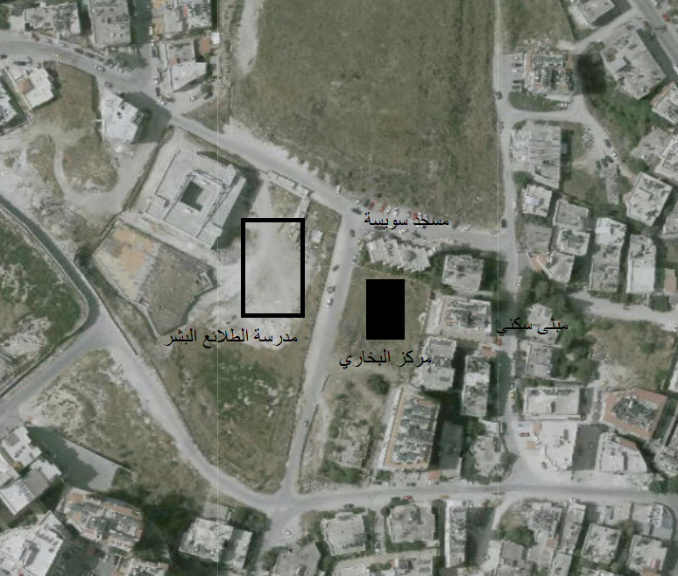
Site analysis
The site is located in the city of Nablus on Al-Bukhari Street.
Land area 668 m2.

Slide 4
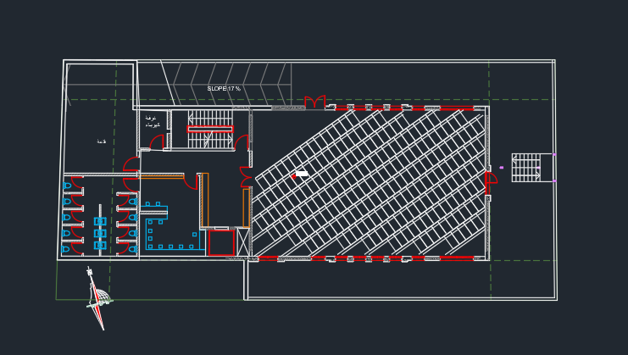
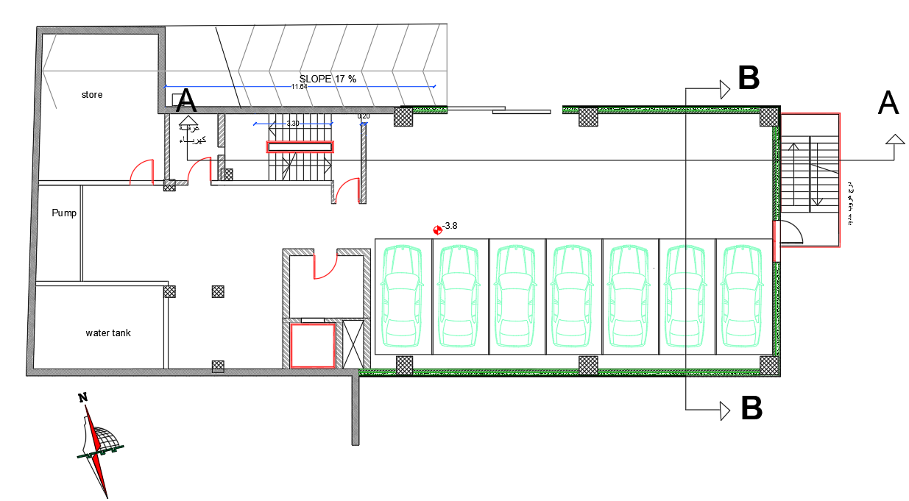
Architectural Aspects
Basement Floor
Before
After

Slide 5
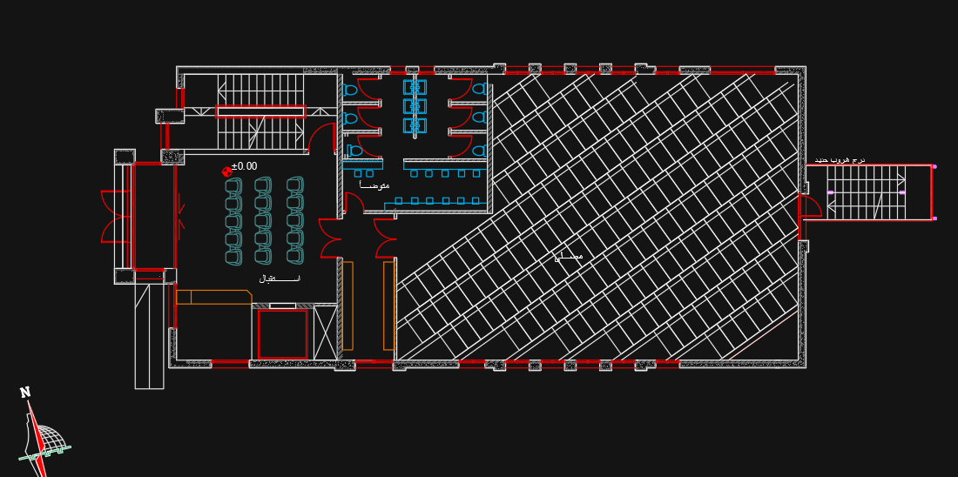
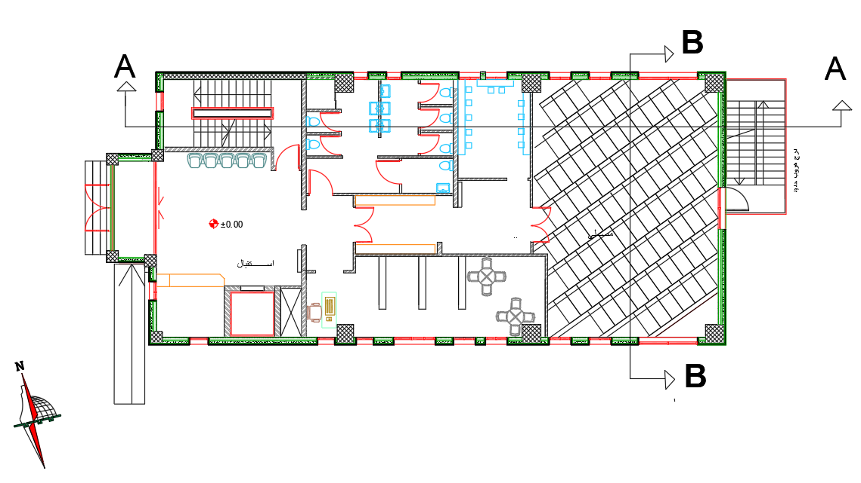
Architectural Aspects
Ground Floor
Before
After

Slide 6
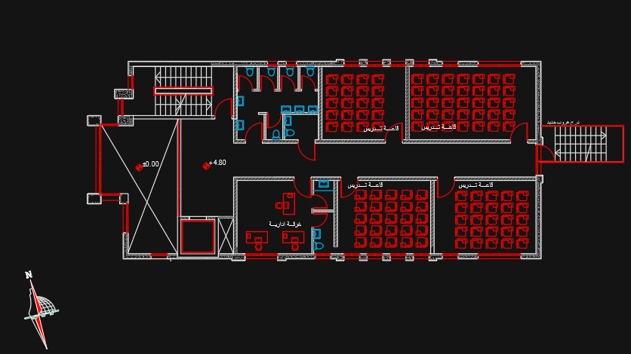
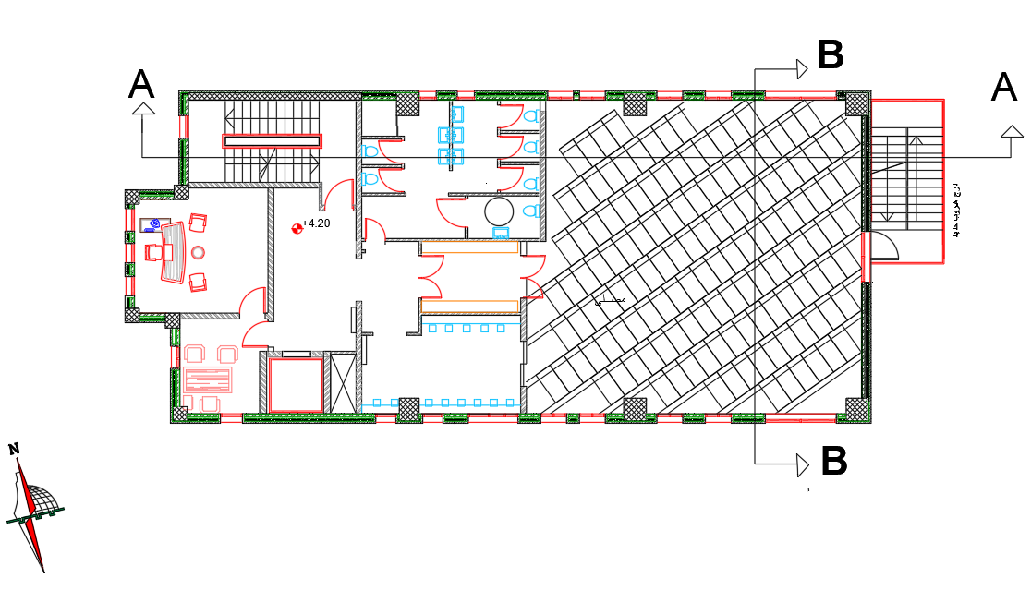
Architectural Aspects
First Floor
Before
After

Slide 7
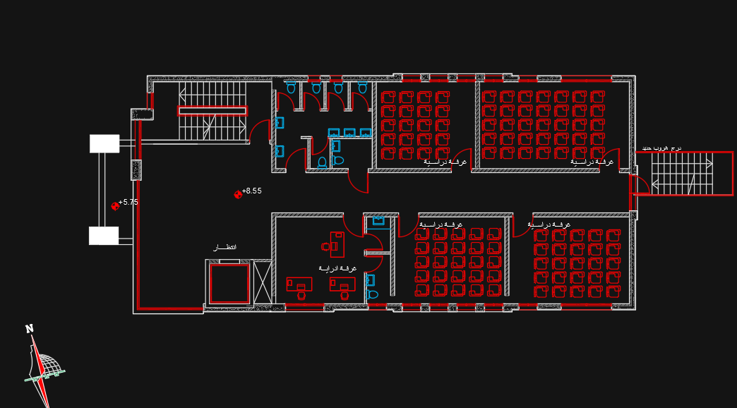
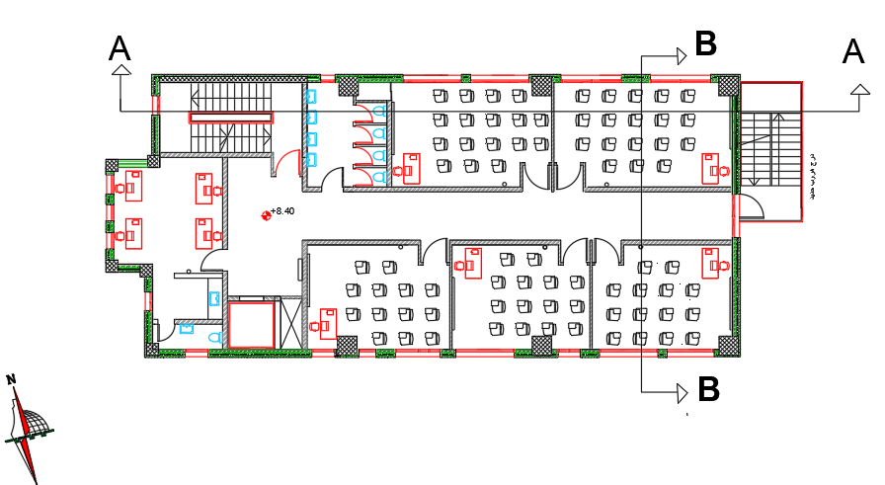
Architectural Aspects
Second Floor
Before
After

Slide 8
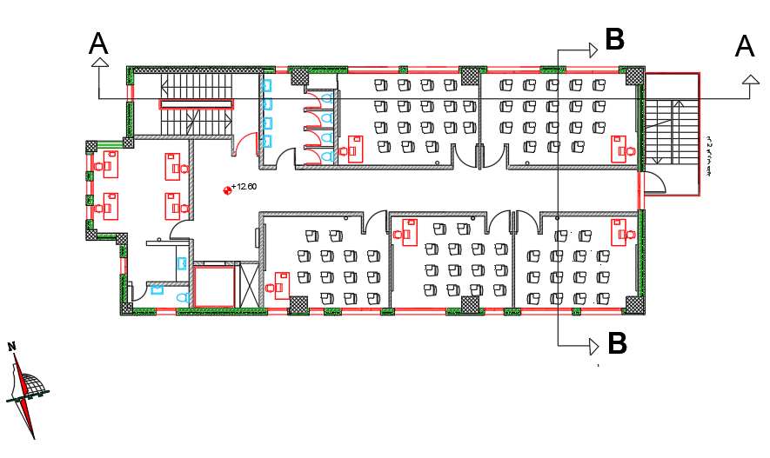
Architectural Aspects
Third Floor
Addition floor
After

Slide 9
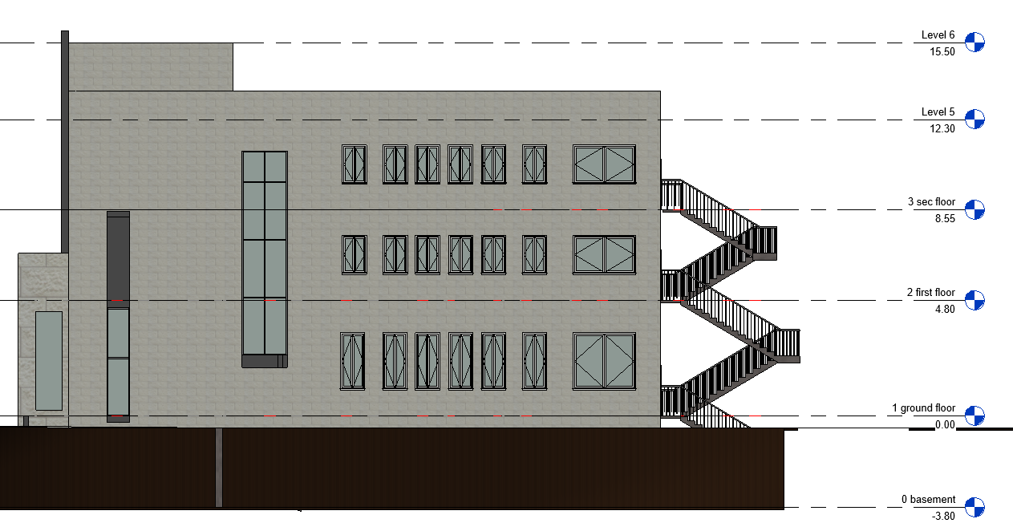
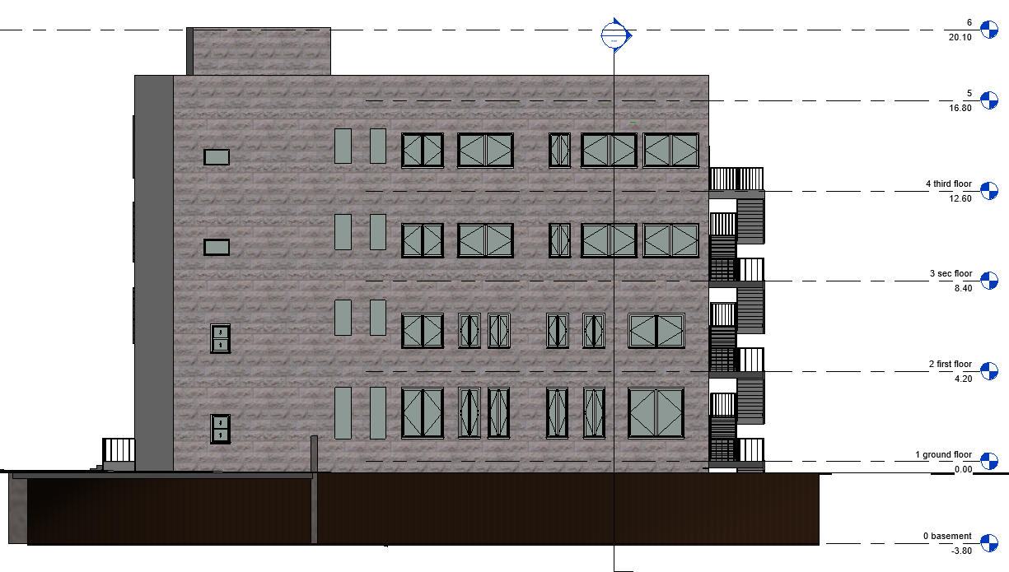
Architectural Aspects
Southwestern elevation
Before
After

Slide 10
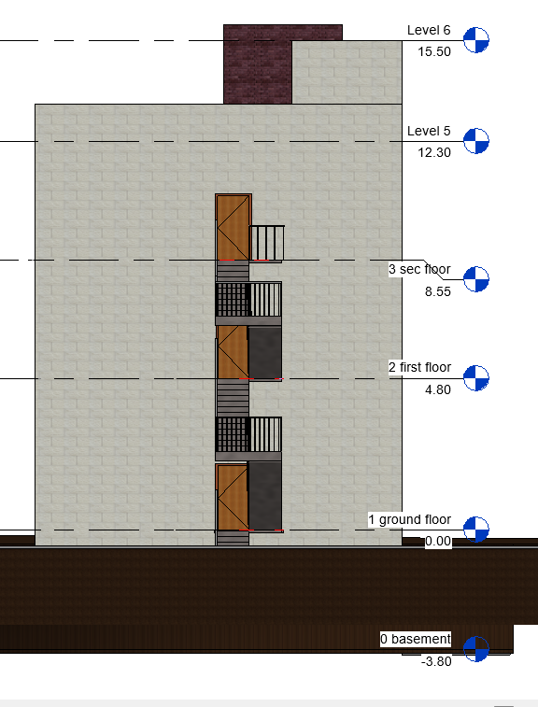
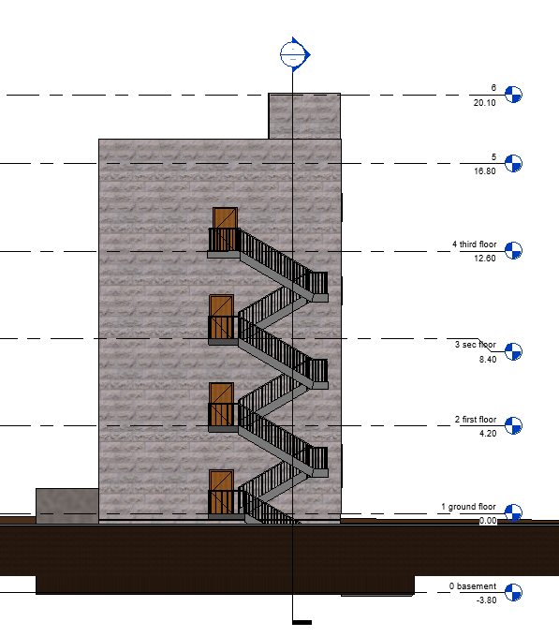
Architectural Aspects
Southeastern elevation
Before
After

Slide 11
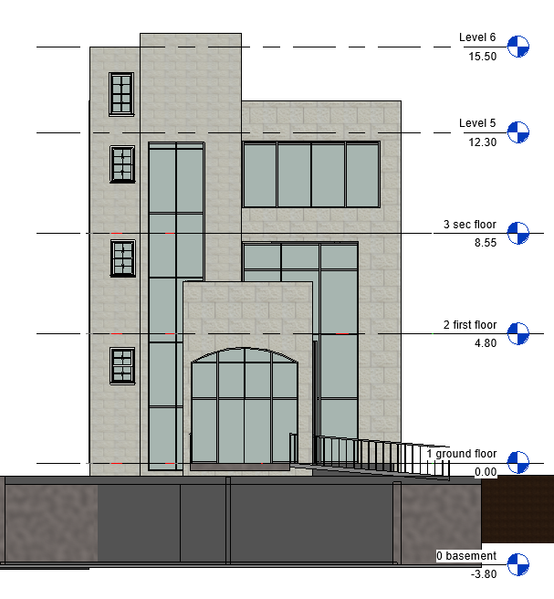
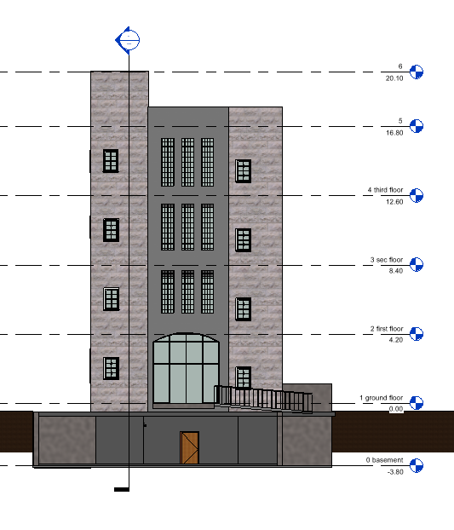
Architectural Aspects
Northwestern elevation
Before
After

Slide 12
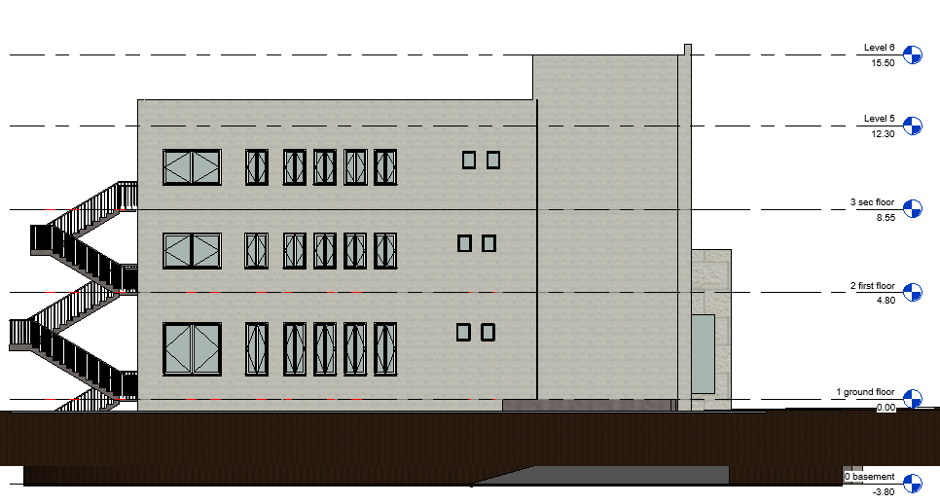
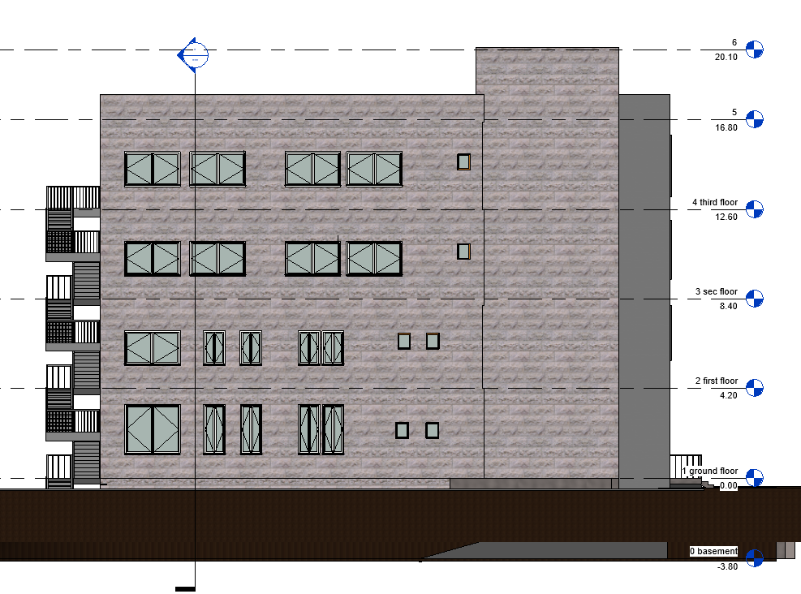
Architectural Aspects
Northeastern elevation
Before
After

Slide 13
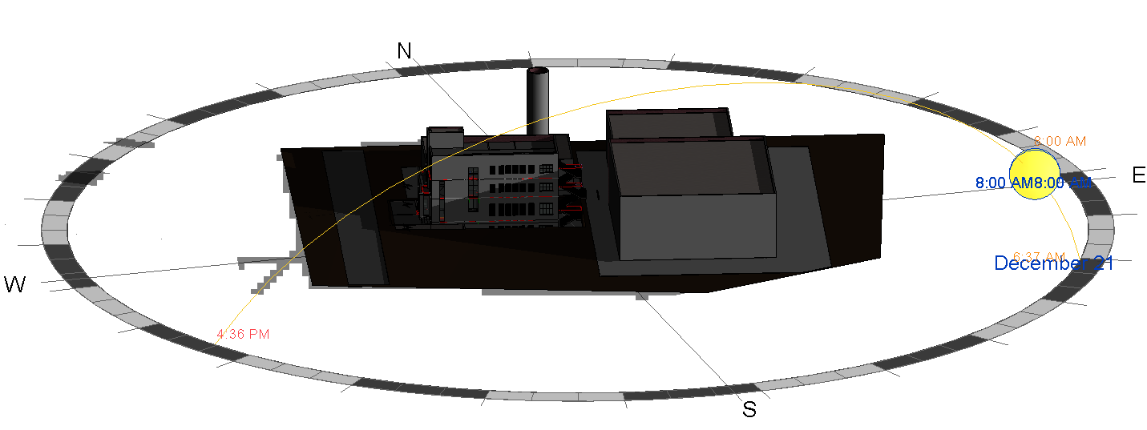
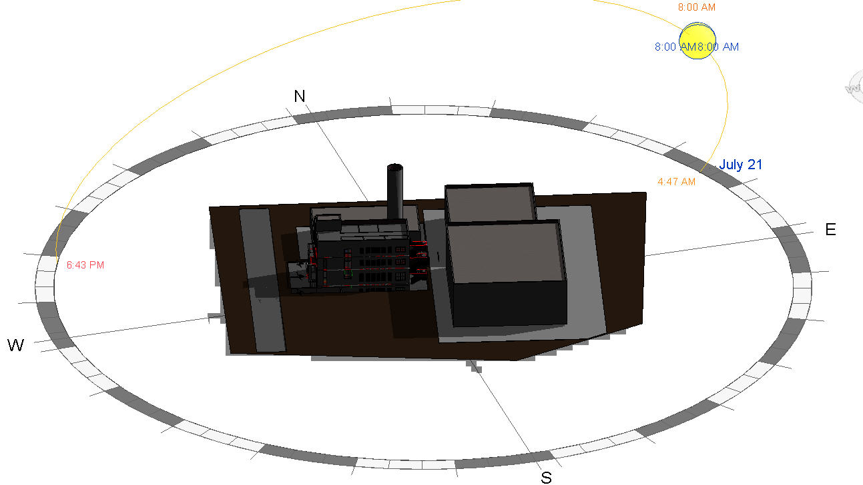
Environmental Aspects
Shading
in Winter at(21/12)
in Summer at(21/7)
Effect of Shading in winter at 8:00 am
Effect of Shading in summer at 8:00 am

Slide 14
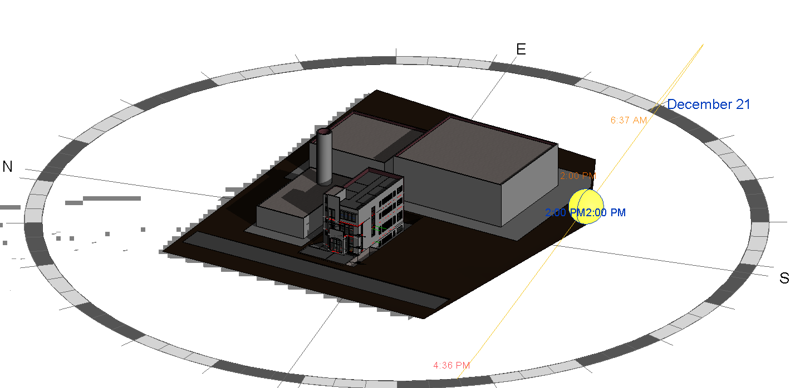
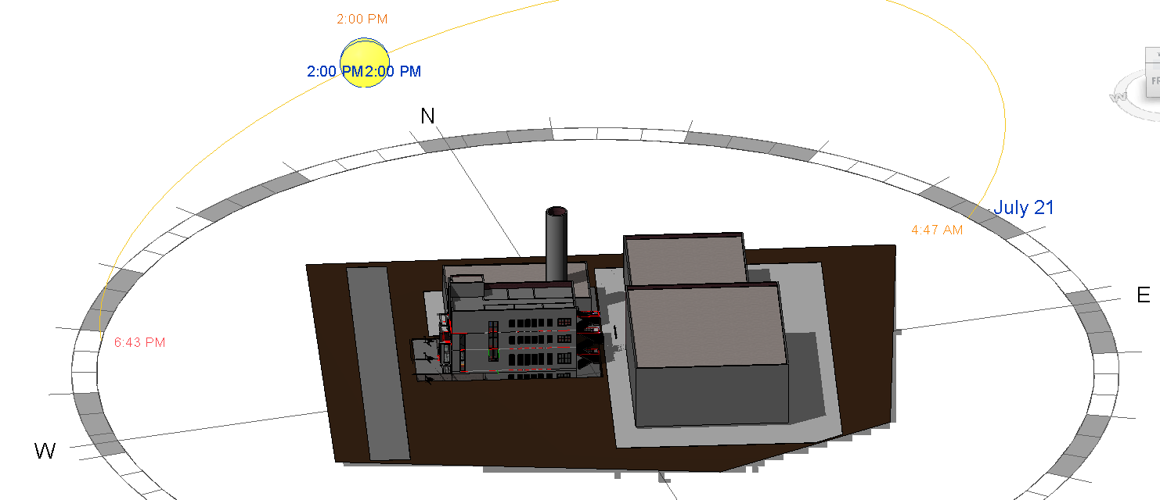
Environmental Aspects
Shading
in Winter at(21/12)
in Summer at(21/7)
Effect of Shading in winter at 2:00 pm
Effect of Shading in summer at 2:00 pm

Slide 15
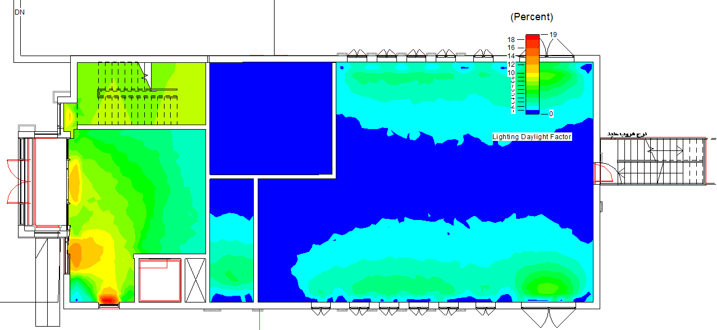
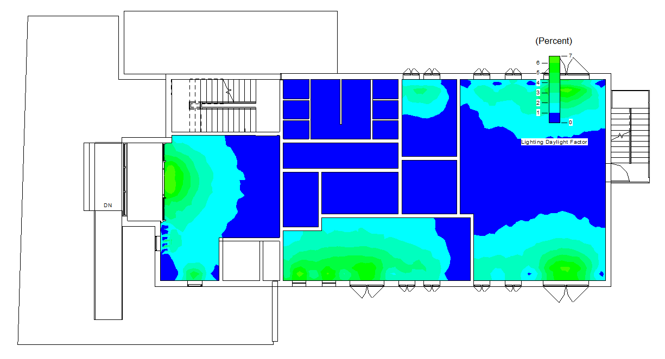
Environmental Aspects
Daylight analysis
Ground floor
Before
After

Slide 16
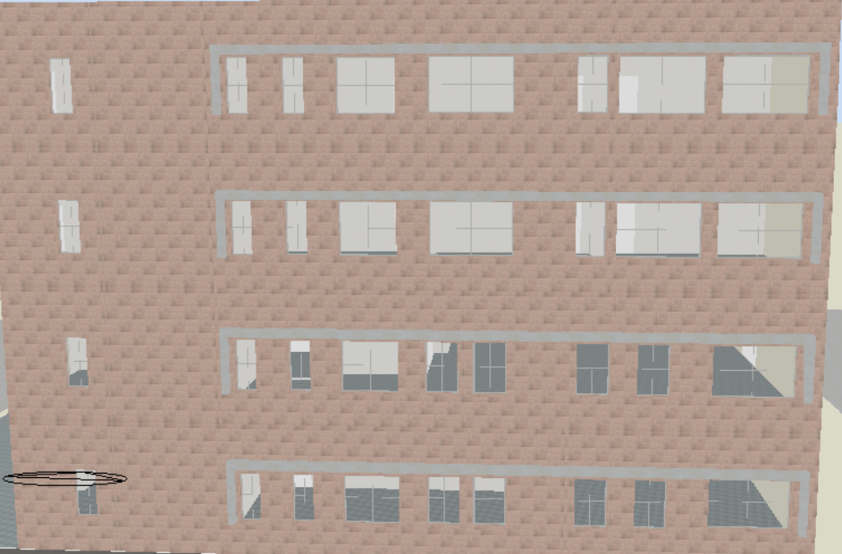
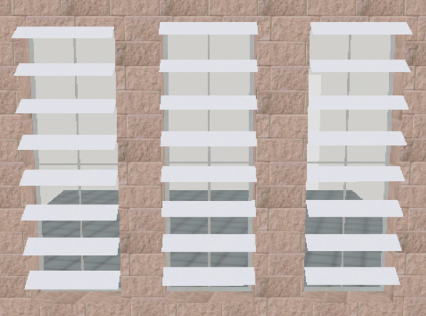
Design Builder software analysis
Improvement & treatment

Slide 17
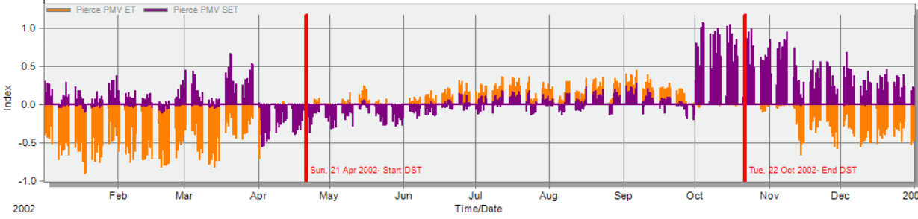
Design Builder software analysis
PMV

Slide 18
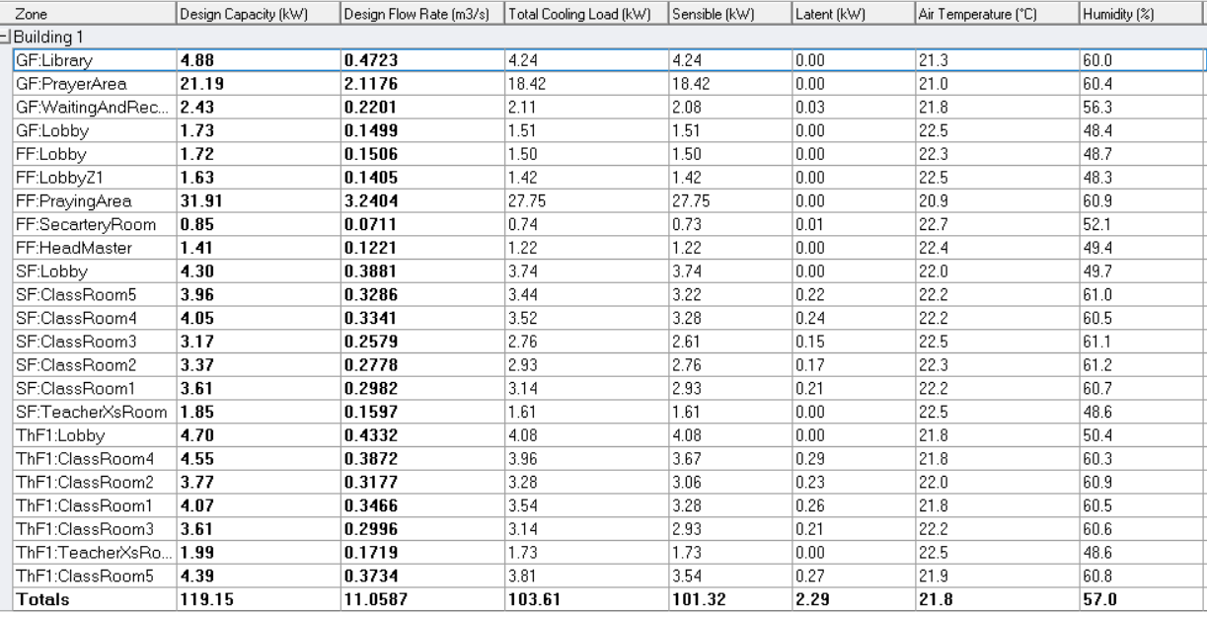
Design Builder software analysis
Cooling load

Slide 19
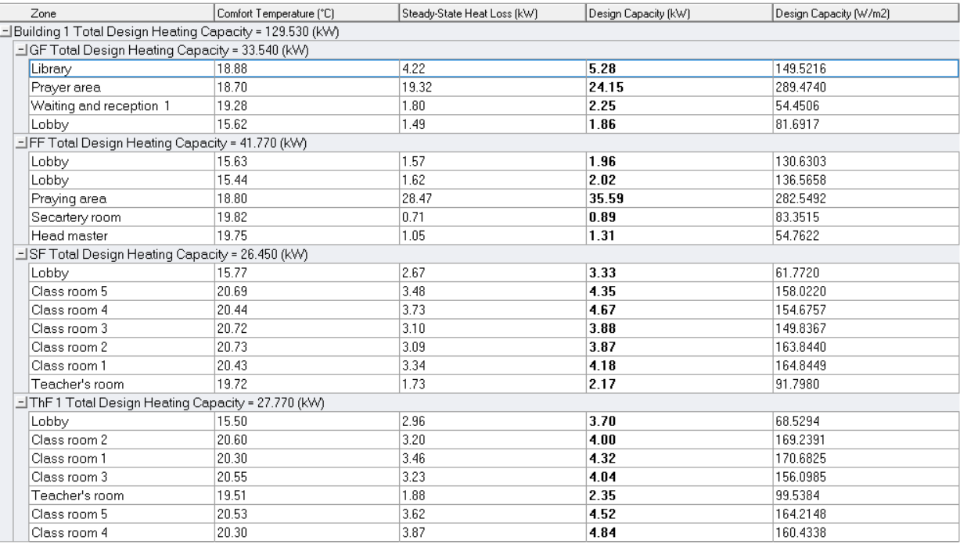
Design Builder software analysis
Heating load

Slide 20
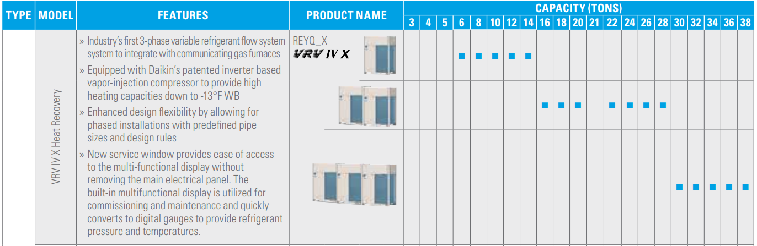
Electrotechnical aspects
1. HVAC system
VRV unit

Slide 21
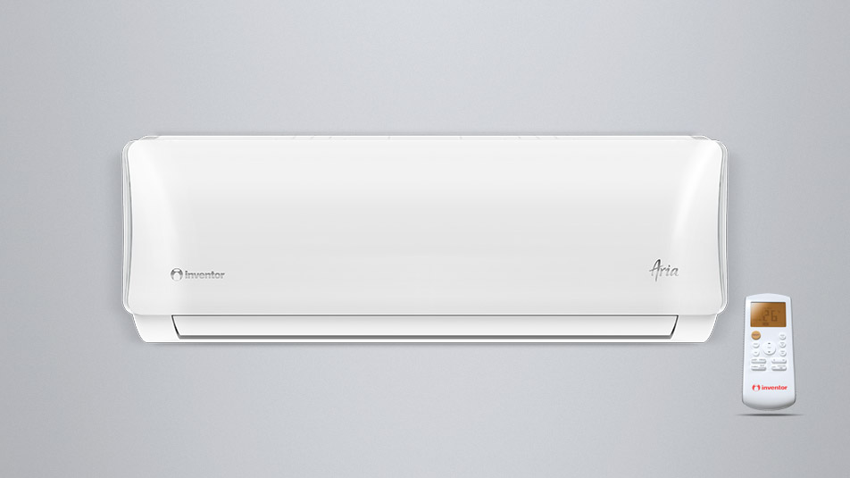
Electrotechnical aspects
1. HVAC system
Wall mounted unit

Slide 22
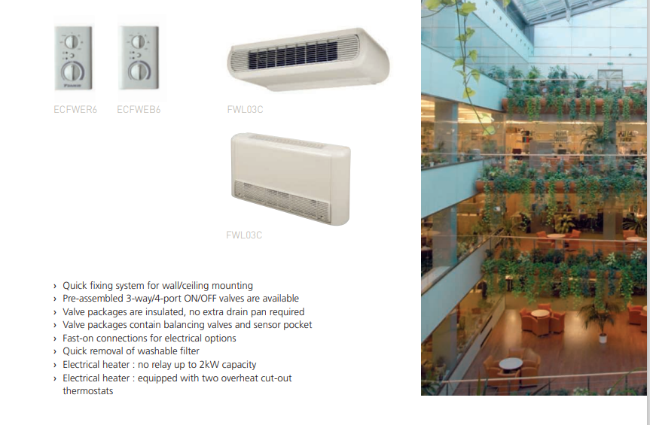
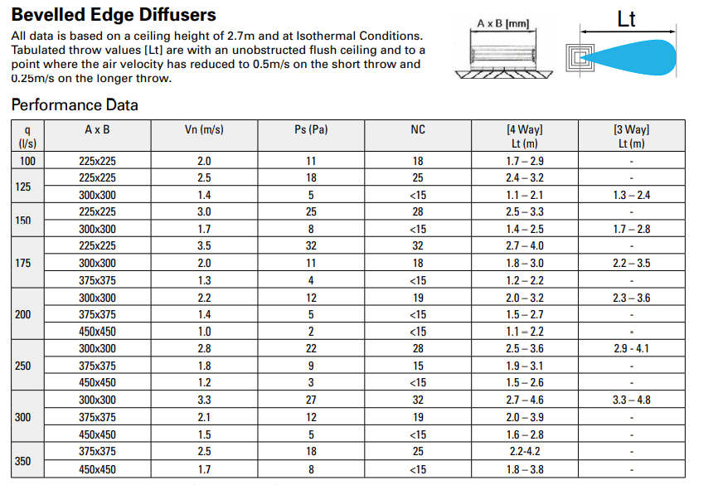
Electrotechnical aspects
1. HVAC system
Fan coil unit Diffusers

Slide 23
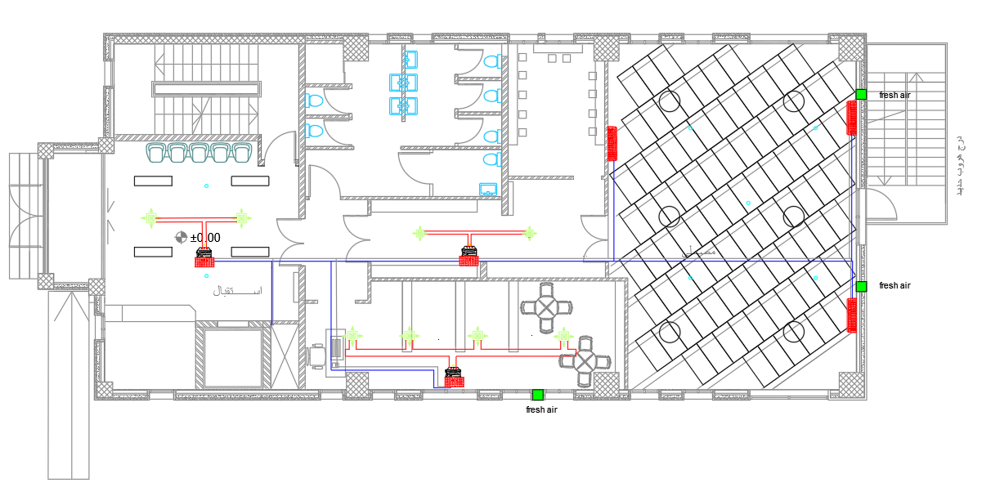
Electrotechnical aspects
1. HVAC system
HVAC unit distribution in GF

Slide 24
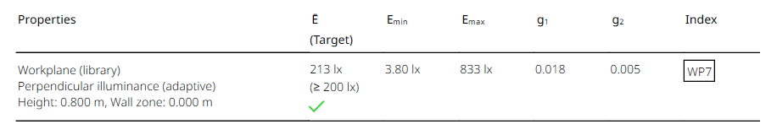
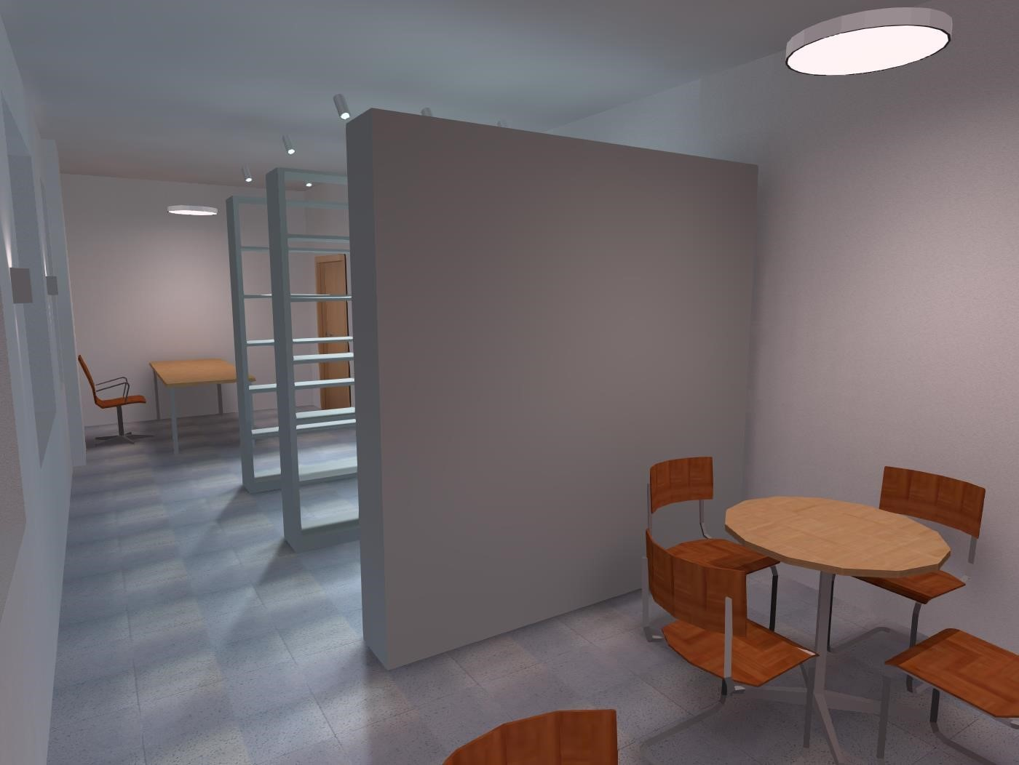
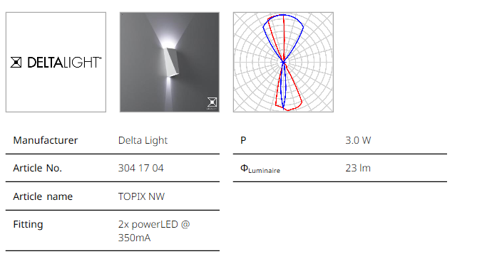
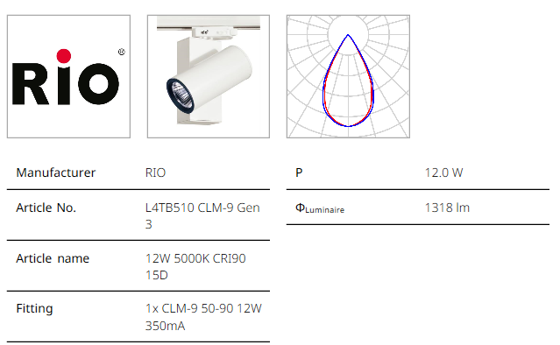
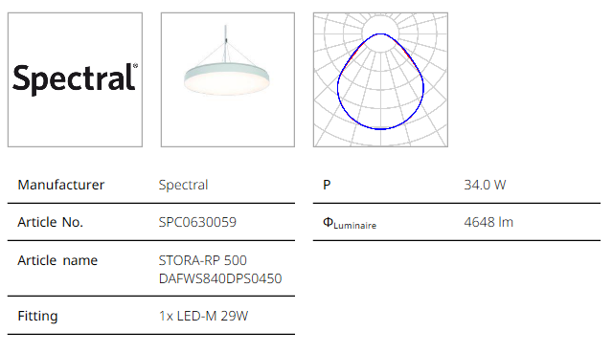
Electrotechnical aspects
2. Electrical aspects
Lighting distribution in library

Slide 25
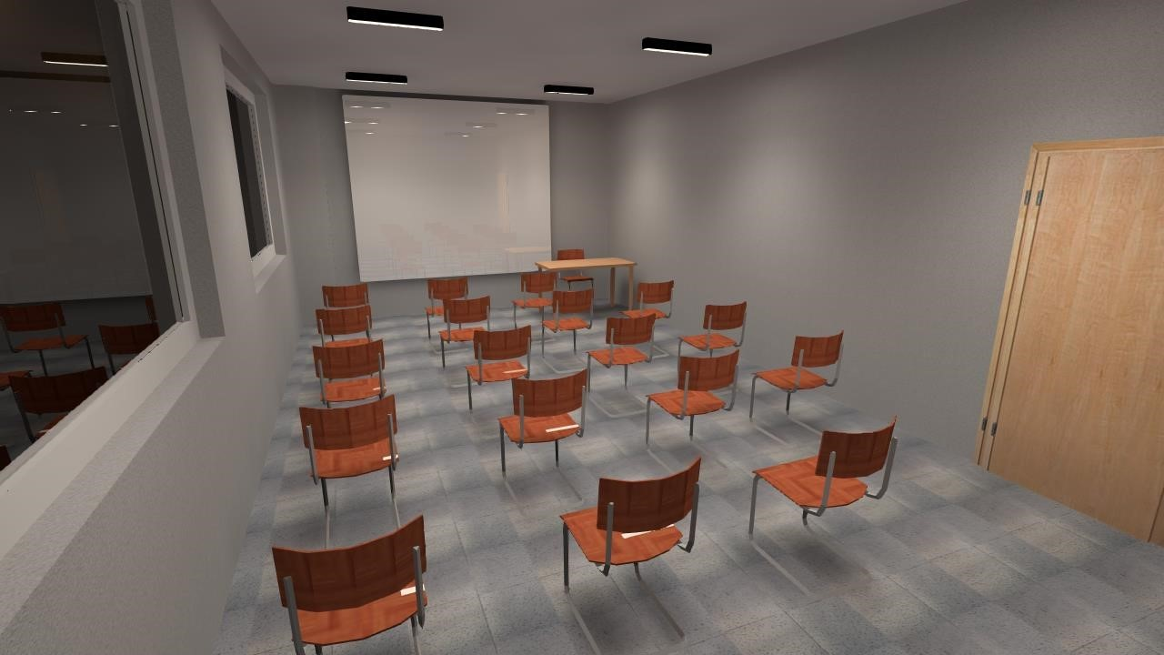
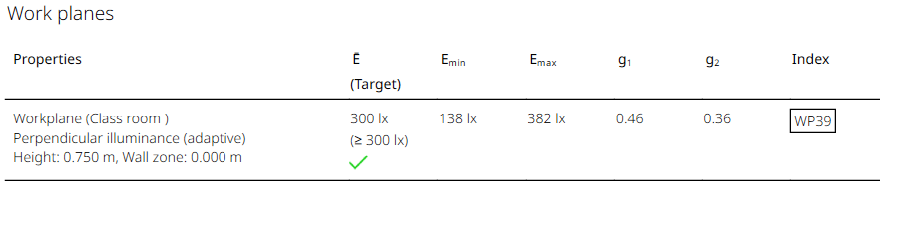
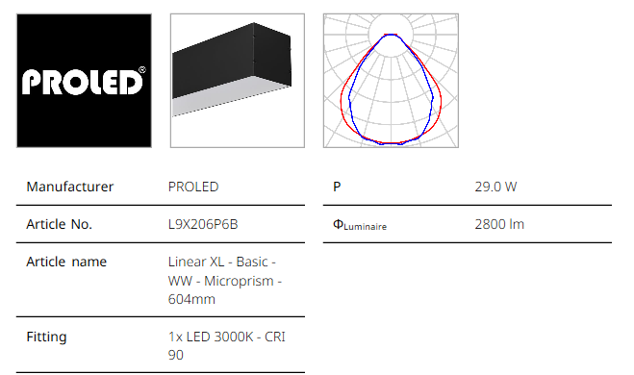
Electrotechnical aspects
2. Electrical aspects
Lighting distribution in classroom

Slide 26
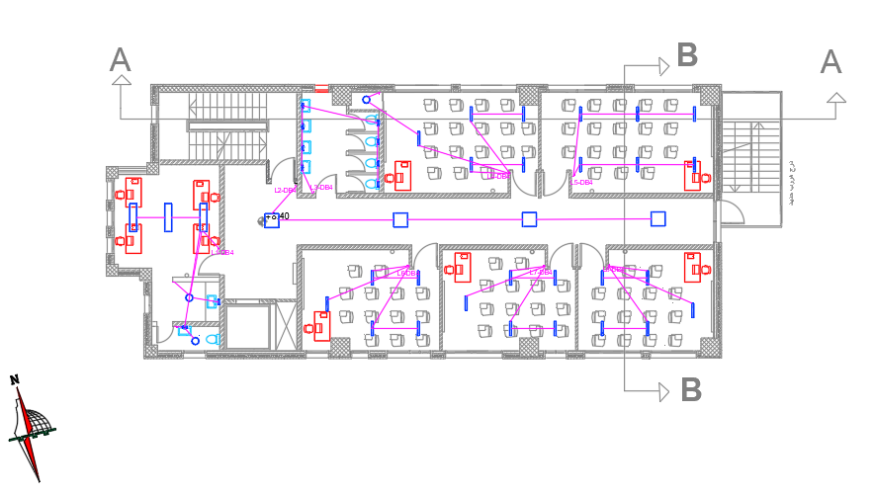
Electrotechnical aspects
2. Electrical aspects
Lighting distribution in SF

Slide 27
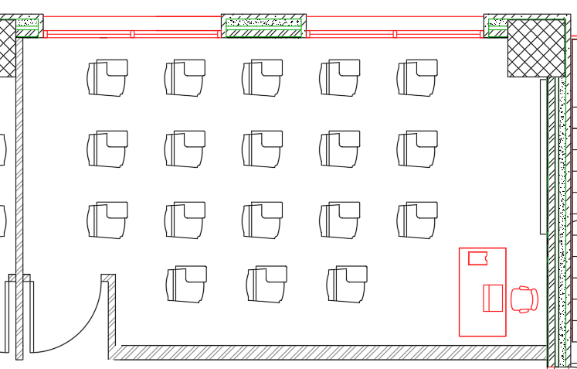
Electrotechnical aspects
3. Acoustical aspects
SPL | BN | S/N | RT60 | AL | Artictulation
82.2 | 35 | 47.2 | 0.67 | 6 | 94
 |  | good |  | accept
AL< 10% accept
Frequency | RT60
63 HZ | 0.66
125 HZ | 0.77
250 HZ | 0.98
500 HZ | 1.08
1K HZ | 0.91
2K HZ | 0.64
4K HZ | 0.46
8K HZ | 0.27
16K HZ | 0.28
SAverage | 0.672222222
Classroom plan
Standard reverberation time (0.5-0.9)

Slide 28
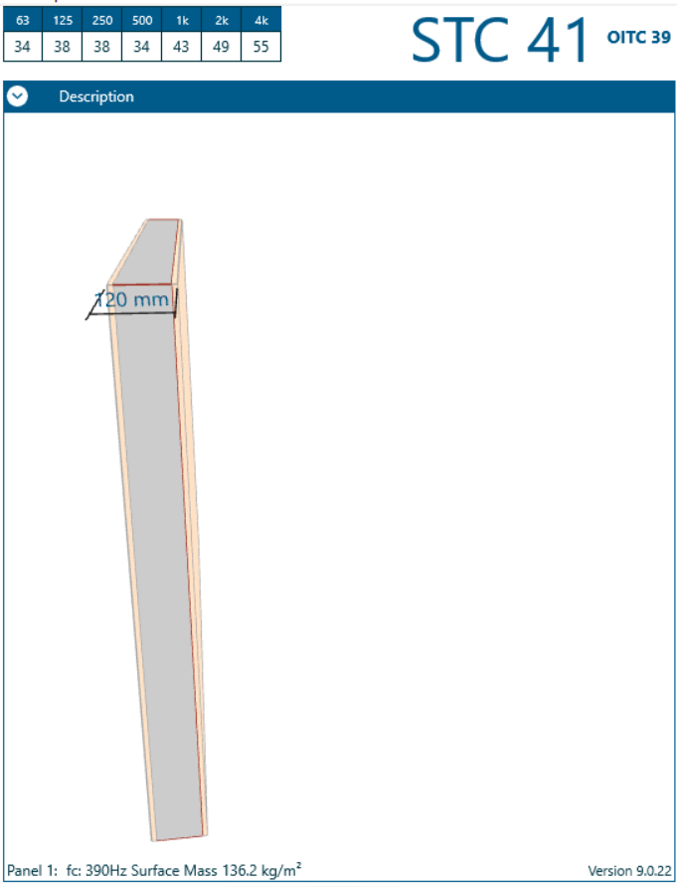
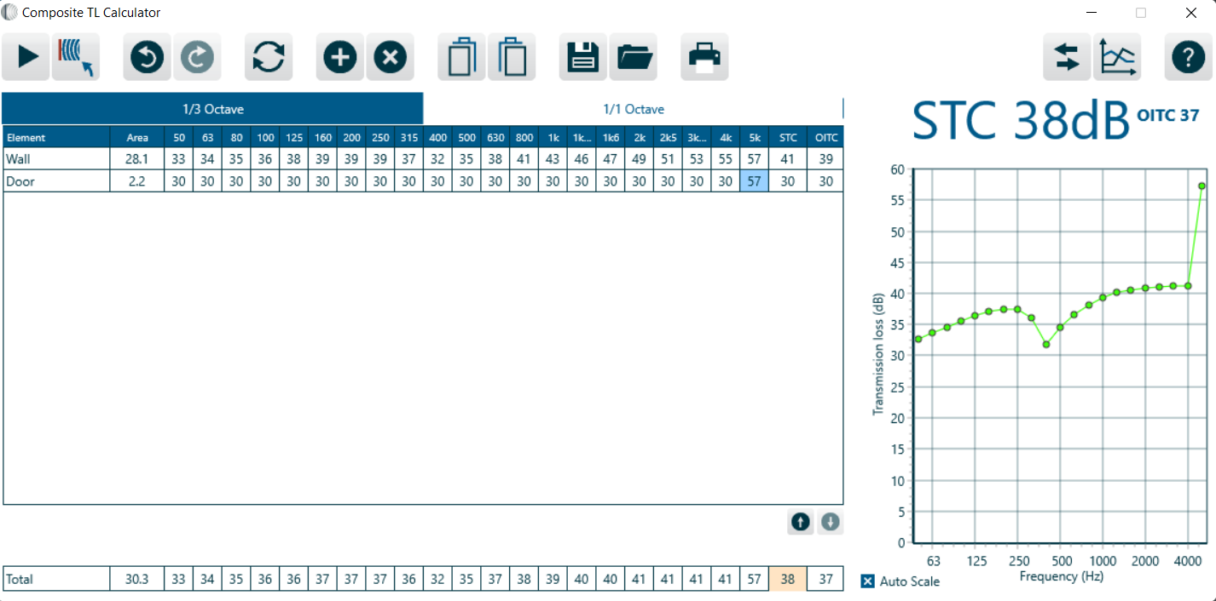
Electrotechnical aspects
3. Acoustical aspects
STC for barrier between Classroom and adjacent classroom
Composite TL for barrier between Classroom and corridor
Standard STC 40
Standard STC 38

Slide 29
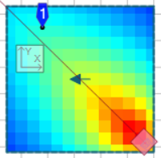

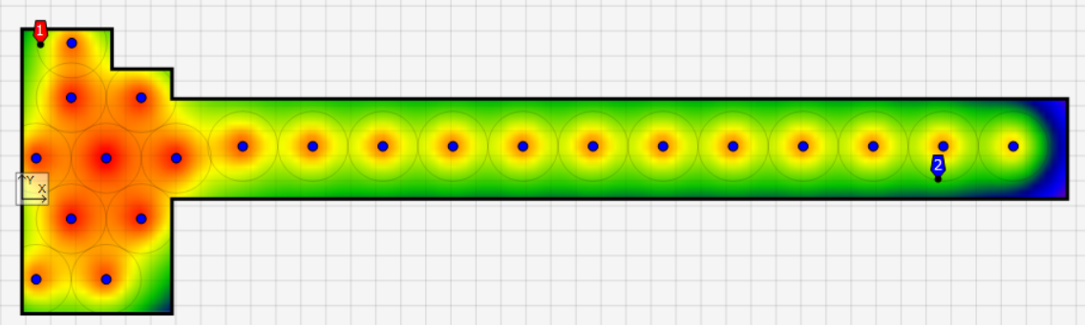
Electrotechnical aspects
3. Acoustical aspects
recommendation 87 dB
recommendation 80 dB

Slide 30
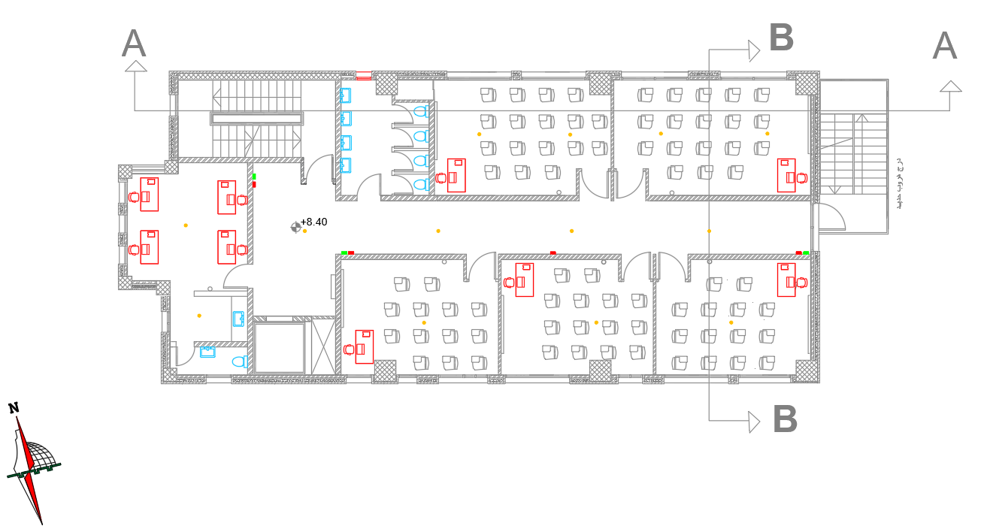
Electrotechnical aspects
4. Fire fighting aspects
Alarm system
Manual ,Detector & Alarm in S.F

Slide 31
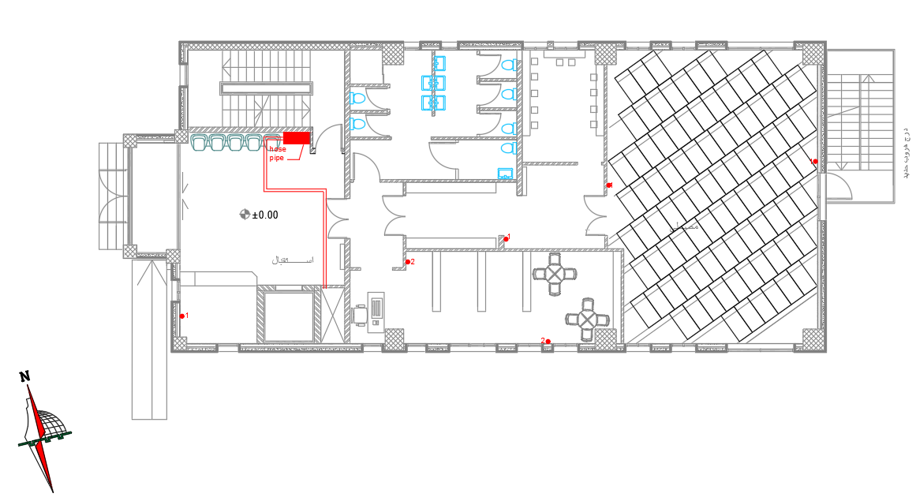

Electrotechnical aspects
4. Fire fighting aspects
Protection system
Manual protection in ground floor
Automatic protection (sprinkler) in ground floor

Slide 32

Electrotechnical aspects
5. Water supply aspects
Floor | WSFU's | Total WSFU'S
GF | 6 WC's*5 | 42
 | 6 Lavatory*2
FF | 6 WC's*5 | 42
 | 6 lavatory*2
SF | 5 WC's*5 | 39
 | 5 lavatory*2
 | 1 Kitchen sink*4
TH.F | 5 WC's*5 | 39
 | 5 lavatory*2
 | 1 Kitchen sink*4
Total |  | 162
Selected | GF | FF
Line | Vertical | Horizontal | Branch | Total losses
diameter | 4" | 2" | 11/2"
Press. Loss | 1.91 | 0.04 | 0.046764 | 1.996764
Selected | SF | TH
Line | Vertical | Horizontal | Branch | Total losses
diameter | 4" | 2" | 11/2"
Press. Loss | 1.91 | 0.03 | 0.03996 | 1.97996

Slide 33
Electrotechnical aspects
5. Drainage system
Floors | Dfu's
Ground Floor | 6 WC's*4 | 41
 | 17 Lavatory*1
First Floor | 6 WC's*4 | 43
 | 19 lavatory*1
Second Floor | 5 WC's*4 | 27
 | 5 lavatory*1
 | 1 Kitchen sink*2
Third Floor | 5WC's*4 | 27
 | 5 lavatory*1
 | 1 Kitchen sink*2
Total |  | 138
Type of fixture | Diameter (inch) | Slope %
Vent | 4 | 0
Sewer | 4 | 1
Drainage | 4 | 1
Between manhole | 6 | 1

Slide 34

Structural Analysis
Etabs models :
Structural model from ETABS

Slide 35
Structural Analysis check’s
Analysis Checks
Check: | Result
Compatibility Check | Ok
Equilibrium check | Ok
Internal Force Check
Columns | Ok
Beams | Ok
Slab | Ok
Design Check
Check: | Result
Deflection | Ok
Beam | Ok
Shear Check | Ok
Tow way ribbed slab | Ok
Seismic Checks
Check: | Result
Period check. | Ok
Modal mass participation ratio | Ok
Base shear (scale factor) | Ok
Drift | Ok

Slide 36

Structural Analysis
Footing plan :

Slide 37


Structural Analysis
Footing detailing:
Single footing:

Slide 38


Structural Analysis
Combined footing:

Slide 39


Structural Analysis
wall footing:

Slide 40


Structural Analysis
Mat foundation:

Slide 41


Structural Analysis
Shear wall design :

Slide 42

Structural Analysis
Column layout:

Slide 43



Structural Analysis
Column detailing:

Slide 44

Structural Analysis
beam layout:
Layout 1:

Slide 45

Structural Analysis
beam layout:
Layout 2:

Slide 46

Structural Analysis
Type of beam:

Slide 47

Structural Analysis
Design of Beam :
frame 1:

Slide 48


Structural Analysis
Slab layout & design:
Slab 1:

Slide 49

Structural Analysis
Slab 2 layout & design :

Slide 50
Structural Analysis
Tie beam layout :

Slide 51


Structural Analysis
Tie beam design :

Slide 52

Structural Analysis
Stairs Design:

Slide 53
cost estimate Aspects
Work | Total cost | Total price
Earth Work | 531150.2 | 637380.3
Structure work | 2146515 | 2575818
Mechanical Work | 148636.6 | 178363.9
Electrical Work | 33331 | 35677.2
Total | 2859633 | 3427239
 | Unit cost/M2 | Total Cost
NIS | 1972.161 | 2860000
JOD | 410.3359 | 600000
$ | 578.7536 | 840000
At the end we figure out and get to a conclusion that the total estimate cost of the building is around 2.86 million NIS.

Slide 54
Thank you

