Slide 1

Design and Development of Microemulsion
Drug Delivery System for Improvement of
Drug Solubility
Dr. Husni Odeh
Eng. Mohamad Shana’a
5th international chemistry conference , at NNU Nablus 1/6/2011

Slide 2

The Aims of Project
The aims of the present study was: 1.Design o/w microemulsion .
2.Improvement the solubility of Glimepiride

Slide 3
Topics of presentation
Introduction to Microemulsion (ME)
Previous ME studies
Experimental work
Results and discussion
Future work

Slide 4
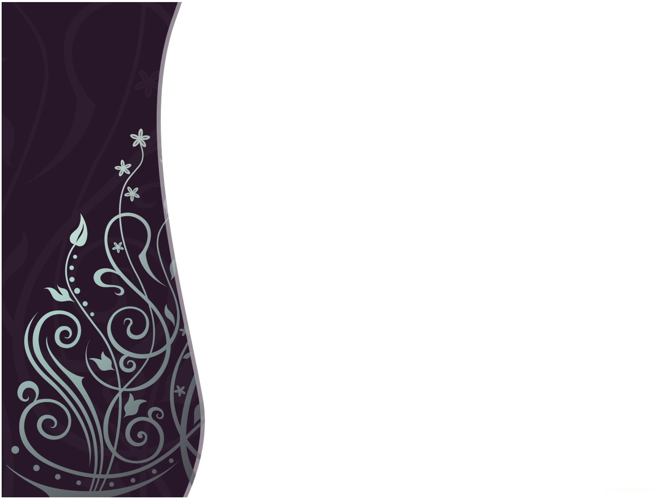
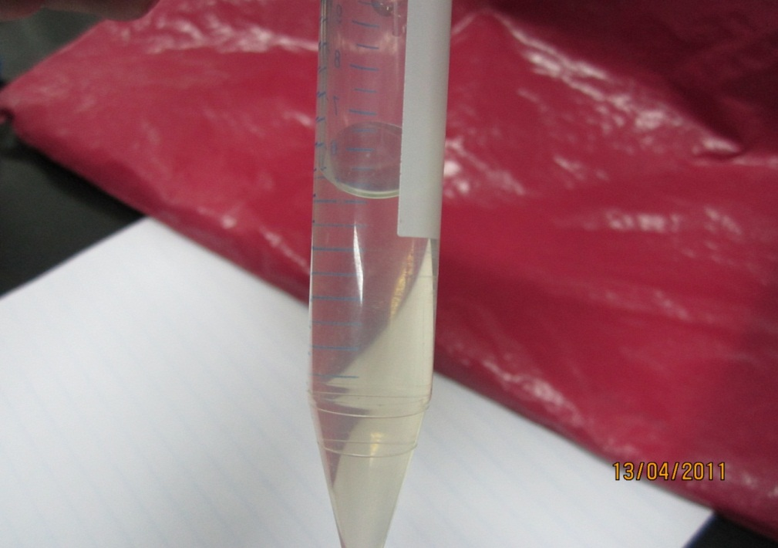
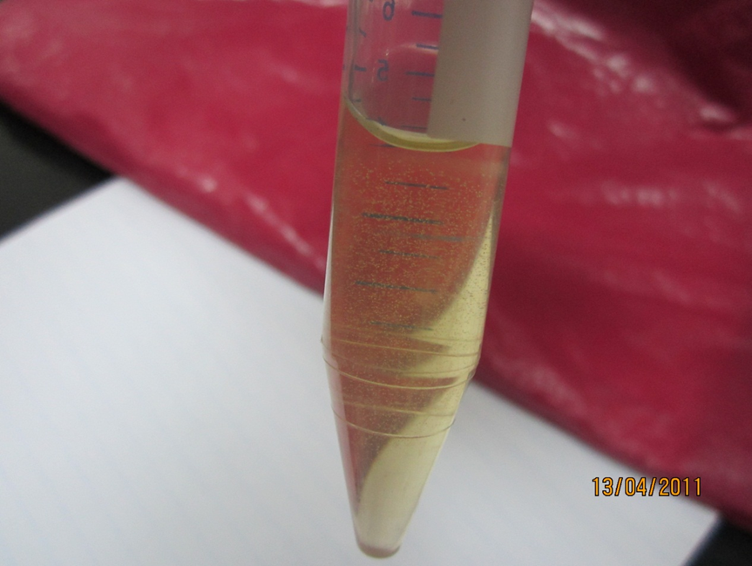
Microemulsion
Microemulsions are mono-dispersed spherical droplets (diameter < 100 nm) of water in oil or oil in water, with presence of surfactants and co-surfactants, as seen in these vials.

Slide 5
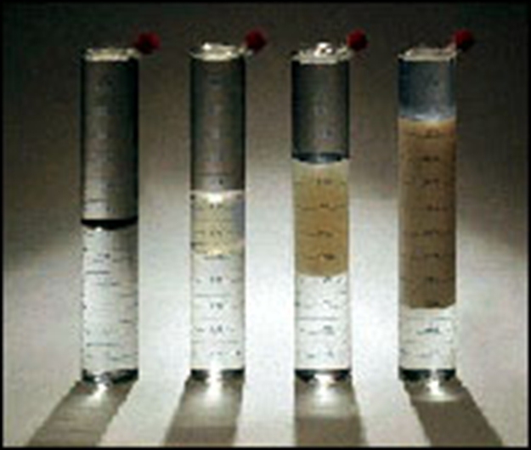
Composition of microemulsion
Microemulsion is defined as transparent dispersion consisting of (1) Oil.
(2) Surfactant.
(3) Cosurfactant.
(4) water.
.

Slide 6
Microemulsion as vehicle
Microemulsion has a unique solubilization properties.
microemulsions have attracted increasing attention as potential drug delivery systems. As in the case of curcumin, valsartan, glimepiride,…..

Slide 7
Section One
Previous (M.E)
Studies

Slide 8

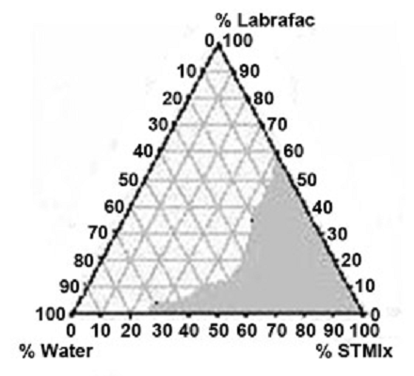
ME for Acyclovir drug
Kumar Ghosh (2006) has developed an oral microemulsion for enhancing the bioavailability of acyclovir.
ME developed consists of : A Labrafac as oil with Labrasol as surfactant and Plurol Oleique as cosurfactant
Phase Diagram
A pseudoternary phase diagram of the investigated quaternary system water /Labrasol/Plurol Oleique/Labrafac is presented

Slide 9
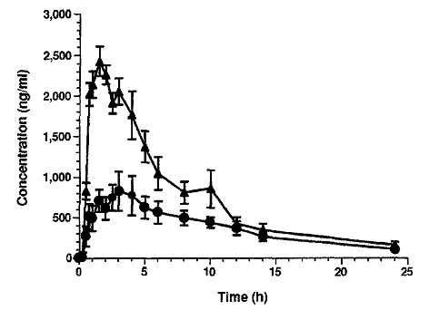
ME for Acyclovir drug
Patients with cystic fibrosis absorb cyclosporin poorly and erratically. Wallwork etal. have compared the relative bioavailability of cyclosporin from conventional and micro-emulsion formulations in 5 adult heart-lung transplant candidates with cystic fibrosis. (9)
Bioavailability Study
Wallwork etal. (1995) have compared the relative bioavailability of cyclosporin from conventional and micro-emulsion formulations
Bioavailability studying [doses of conventional (circles) and microemulsion (triangles).]

Slide 10
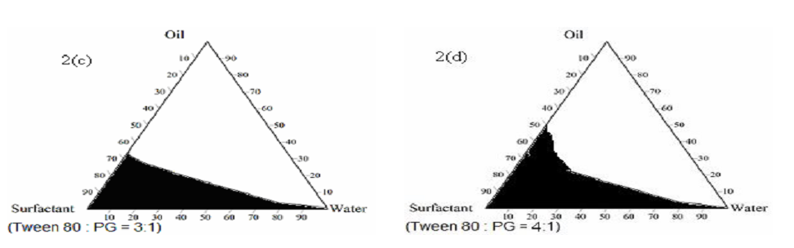
ME for Saquinavir drug
Increasing drug bioavailability of Saquinavir
Mendel and coworker 2009 have developed an oral microemulsion based drug delivery system for enhancing the bioavailability of Saquinavir
The surfactant cosurfactant mixture are Tween 80/PEG 400=3/1
Pseudo Ternary Phase Diagram Study

Slide 11
Research Paper for Glimepiride drug
Increasing drug Solubility of Glimepiride
***O.P. Baliar Singh, S. Biswal*, J. Sahoo and P. N. Murthy2009 have developed an Solubility of Glimepiride in Solid Dispersions with Polyethylene Glycol
*** Solubility Result :
The stability constant was found to be 0.128 mg/ml.
Increased solubility may be due to the improved dissolution of
glimepiride particles .
Ref. : O.P. Baliar Singh, S. Biswal*, J. Sahoo and P. N. Murthy. Physicochemical Properties of Glimepiride in Solid Dispersions with Polyethylene Glycol 20000. Orissa, India, July – September 2009.

Slide 12
EXPERIMENTAL WORK
Raw material preparation
2.Design of Microemulsion System
3.Improvement the glimepiride solubility

Slide 13
Raw material preparation
Table (1) : Sources of raw Material
Oil
Turmic oil | Al-Oba Company
Ethyl Oleate | Prepared on Unit Operation lab –Najah University
Aqueous phase
Milli Q Water | Al-Quds University - (Jerusalem)
Surfactants
Tween 80 | Gift from Al-Quds pharmaceutical Industry
Spans 80 | Gift from Al-Quds pharmaceutical Industry
Tween 20 | Gift from Al-Quds pharmaceutical Industry
Effective materials
Curcumin | Prepared on Unit Operation lab –Najah University
Atorvastatin | Gift from Al-Quds pharmaceutical Industry
Glimepiride | Gift from Al-Quds pharmaceutical Industry
Valsartan | Gift from Al-Quds pharmaceutical Industry
Glibenclamide | Gift from Al-Quds pharmaceutical Industry
**Curcumin : By Extraction And Leaching From the roots of Curcumin
**Ethyl Oleate: By Esterification between Oleic acid(99%) and ethanol(99%)

Slide 14
Design of Microemulsion System
The Composition in each System is Variable ( To Cover whole Composition in phase diagram ) .
Table (2): The composition of (oil , tween 80, MilliQ water) as Variable.
The type of oils is Variable (There are three System with different oils)
1- Ethyl Oleate & Turmic Oil / Tween 80
2- Ethyl Oleate & Clove Oil / Tween 80
3- Oleic acid / Tween 80
Comparing as | Tube 1 | Tube 2 | Tube 3 | Tube 4 | Tube 5 | Tube 6 | Tube 7 | Tube 8 | Tube 9 | Tube 10
Mix. Of Oil | 0.1 | 0.2 | 0.3 | 0.4 | 0.5 | 0.6 | 0.7 | 0.8 | 0.9 | 1.0
Surfactant (Tween 80) | 0.9 | 0.8 | 0.7 | 0.6 | 0.5 | 0.4 | 0.3 | 0.2 | 0.1 | 0
Milli Q Water | droplet | droplet | droplet | droplet | droplet | droplet | droplet | droplet | droplet | No M.E

Slide 15
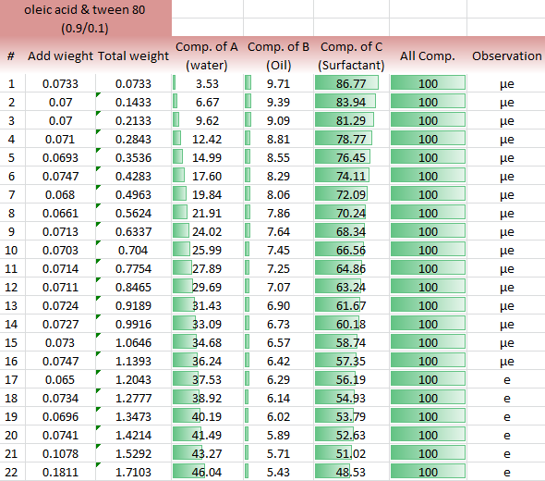
Design of Microemulsion System
Analysis of data
Table (3): Analysis data for one vial until 22 day
This table shows the changing on composition in one vial with each day.

Slide 16
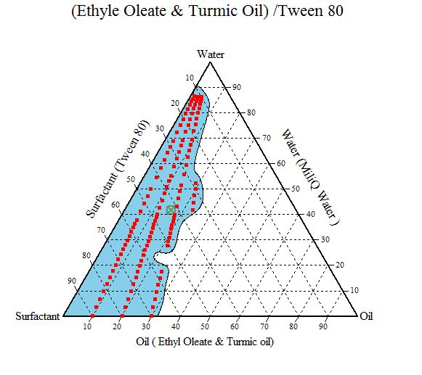
Phase diagram study
First System (Ethyl Oleate & Turmic Oil /Tween 80 /Milli Q water)
The Area of microemulsion = 34.8%
Low concentration of surfactant and oil
High concentration of water and low viscosity
These properties have many advantages .
Figure (1) : phase diagram of Ethyl Oleate / Turmic Oil / Tween 80 /Milli Q water

Slide 17
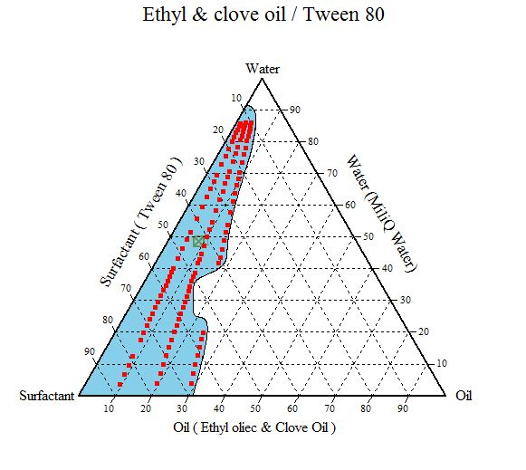
Phase diagram study
Second System (Ethyl Oleate & Clove Oil /Tween 80 /Milli Q water)
For this system the area of microemulsion domain is 30.5% of the whole area (the microemulsion domain is shaded) .
In the figure (23) it is important to know that after construction this three phase diagram man can directly prepared the required composition of any microemulsion
Figure (2) : phase diagram of Ethyl Oleate / Clove Oil / Tween 80 /Milli Q water

Slide 18
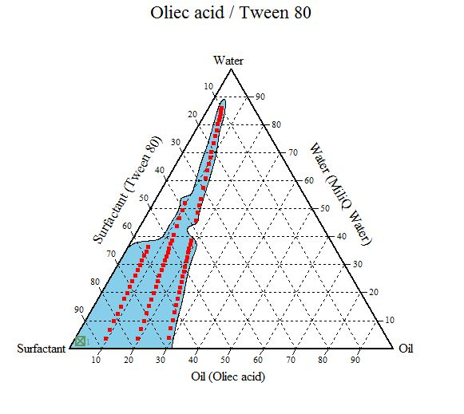
Phase diagram study
Third System (Ethyl Oleate & Clove Oil /Tween 80 /Milli Q water)
For this system the Area of microemulsion is 24% , So it is possible to develop micro-emulsion with more than 80% of water and low concentration of surfactant and oil this is important because the best micro-emulsion which has low surfactant concentration and high water concentration . The low area of microemulsion because that no ethyl Oleate on this system as we expect.
Figure (3) : phase diagram of Ethyl Oleate / Clove Oil / Tween 80 /Milli Q water

Slide 19
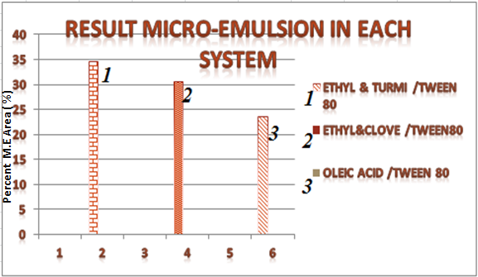
Phase diagram study
Compare between areas of Phase diagram study
When we use ethyl Oleate on the system with another oil the area of microemulsion is increased

Slide 20
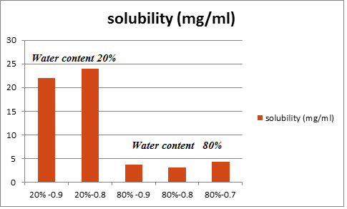
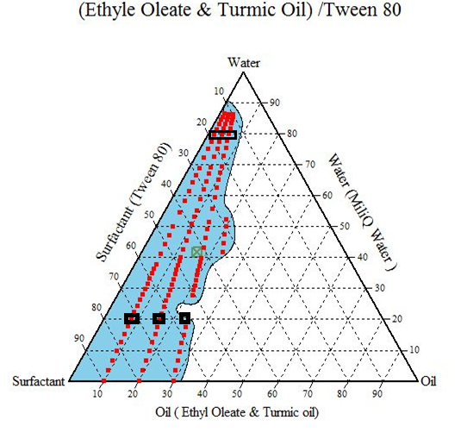
Solubility study
First system (Ethyl Oleate & Turmic Oil /Tween 80 /Milli Q water)
Figure (5): solubility value for ethyl Oleate & Turmic oil system
Figure (4) : phase diagram of Ethyl Oleate / Clove Oil / Tween 80 /Milli Q water
In the figure (4) the compositions are chosen in this system appear on the phase diagram and we Know when the 80% water formed (o/w) microemulsion but when 20% water (w/o) microemulsion.

Slide 21
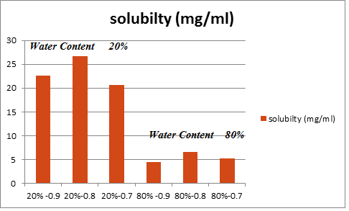
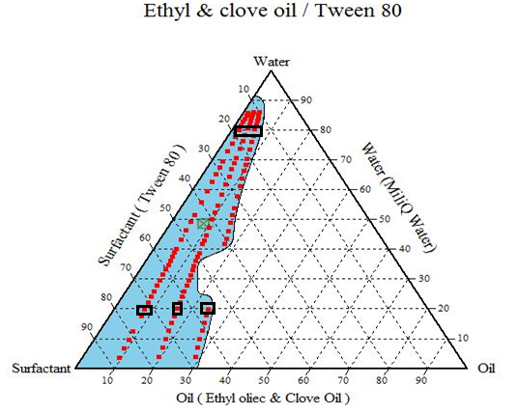
Solubility study
Second system System (Ethyl Oleate & Clove oil /Tween 80 /Milli Q water)
Figure (7): solubility value for ethyl Oleate & Turmic oil system
Figure (6) : phase diagram of Ethyl Oleate / Clove Oil / Tween 80 /Milli Q water
In the figure (6) the compositions are chosen in this system appear on the phase diagram and we Know when the 80% water formed (o/w) microemulsion but when 20% water (w/o) microemulsion.

Slide 22
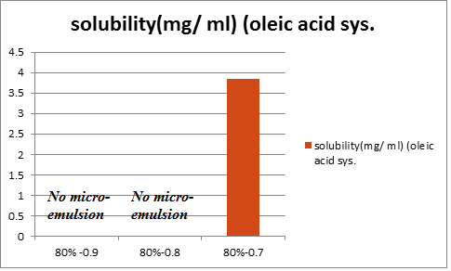
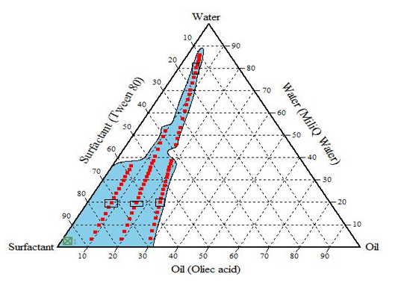
Solubility study
Third system (Oleic acid /Tween 80 /Milli Q water)
Figure (9): solubility value for Oleic acid system
Figure (8) : phase diagram of Oleic acid / Tween 80 /Milli Q water
In the figure (7) the compositions are chosen in this system appear on the phase diagram and we Know when the 80% water formed (o/w) microemulsion but when 20% water (w/o) microemulsion.

Slide 23
Discussion of solubility
AMARYL® (glimepiride tablets) is an oral blood-glucose-lowering drug , formulated into tablets of 1-mg, 2-mg, and 4-mg strengths for oral administration.
At (Ethyl Oleate & clove oil) and (Ethyl Oleate & Turmic oil) we exceed the maximum traditional dose 4mg at (80% water content).
Glimepiride very poor solubility (at 370C, <0.004 mg/ml) which may cause poor dissolution , the Solubility of Glimepiride at the (O/W) microemulsion was increased by 1625 times to that of pure water .
If we study the type of microemulsion on phase diagram , we can take the minimum Volume of (o/w) and that due to rising the solubility more than this result .

Slide 24
Recommendation
1. More than one variable must be studied for each system not only oil as variable but parameter surfactant and cosurfactant as variable .
2. Use more effective way for mixing.
3. Increase the cooperation between our department and the outside center or saving some device as HPLC and GC and who expert on this equipment’s.
4. When doing graduation project on microemulsion topics start with experimental work from first semester beside theoretical part.
5. The raw material must be ordered from first semester.
6. More accurate Measuring instrument weight must be used on solubility study

Slide 25
Future Studies
Stability Study
Dissolution Study
3. Bioavailability Study

Slide 26
الى كل من وقف الى جانبنا نتوجه بالشكر الى :
1.شركة القدس للمستحضرات الطبية.
2.شركة الشمس – نابلس
3. شركة النصر جنين .
.4.مختبر المراقبة الدوائية – جامعة النجاح الوطنية
5. جامعة القدس – (ابو ديس ).
6.د.حكمت الحكيم على توجيهاته لنا في المشروع .

Slide 27
Cont. ….
Why the (o/w) less solubility than (w/o)
**That’s because in (o/w) the continuous phase is the water and that very poor soluble to glimepiride but the continuous phase in (w/o) is the oil and that soluble to glimepiride .
** When the drug soluble in oil due to more degradation of glimepiride but the M.E vehicle Capsulate the drug and protect it .
** To achieving from previous points must be studying the stability of M.E drug

Slide 28
Why we preferred M.E with high content of water
The high content of water give us (o/w) M.E and that due to :
Low viscosity : more absorption inside the body and no pain with injection .
More cheap than high content of oil .
Formation the o/w (continuous phase is water ) due to capsulated drug inside the droplet .
Low surfactant (<10%) at high content of water (>80%) due to reduce the side effects of surfactant .

