Slide 1

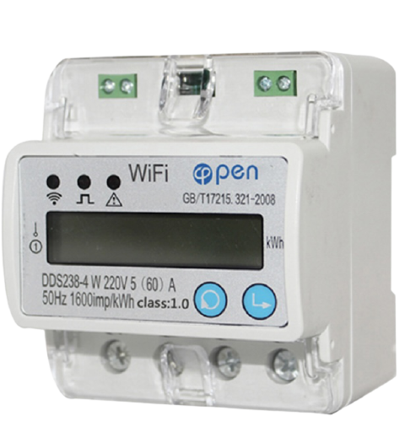

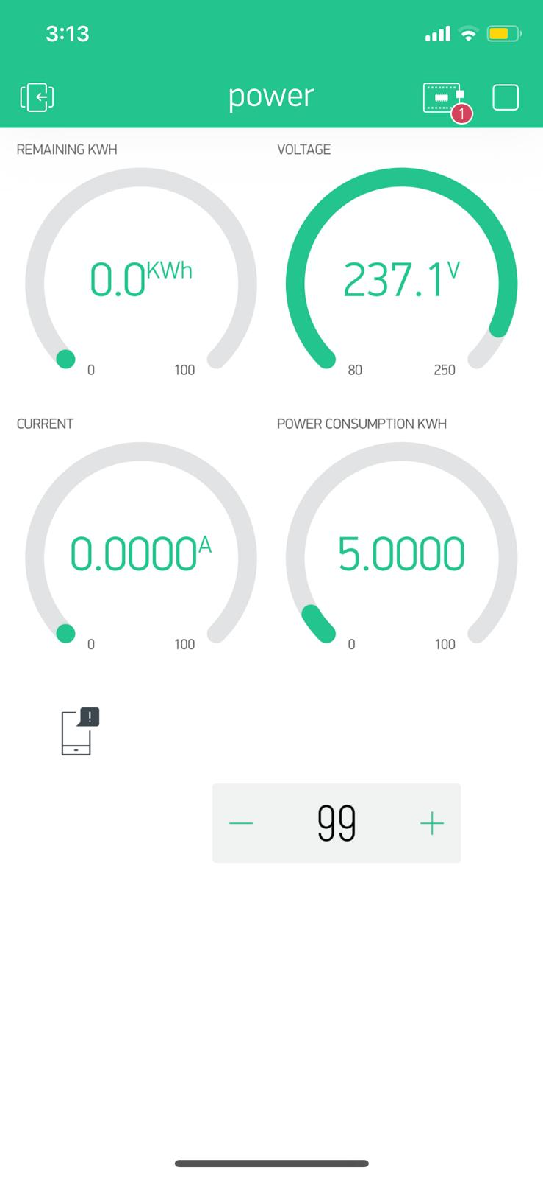
Smart energy meter with wifi
Prepared by:
Lilia Hajali
Noor hweati
Rajaa Zamel
Supervisor : Dr.Saed Tarapiah
May 2021

Slide 2
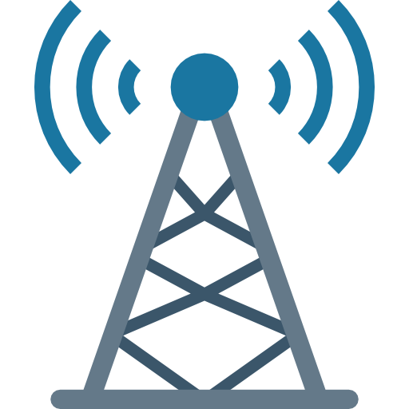
Contents:
Introduction
How the system works
Design and construction
SWOT analysis
Results
Conclusion
Future work

Slide 3

Introduction:
The goal of our project is to design a system with wifi in order to charge the electrical meter remotely and easily by application in a smart phone.

Slide 4
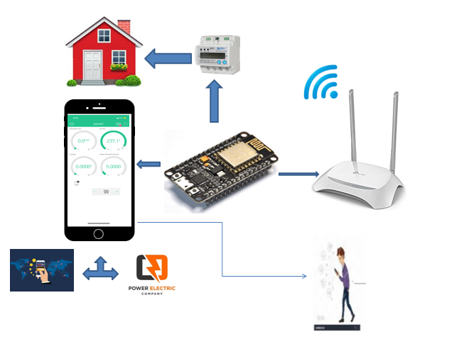
How the system work:
Architectural model:

Slide 5
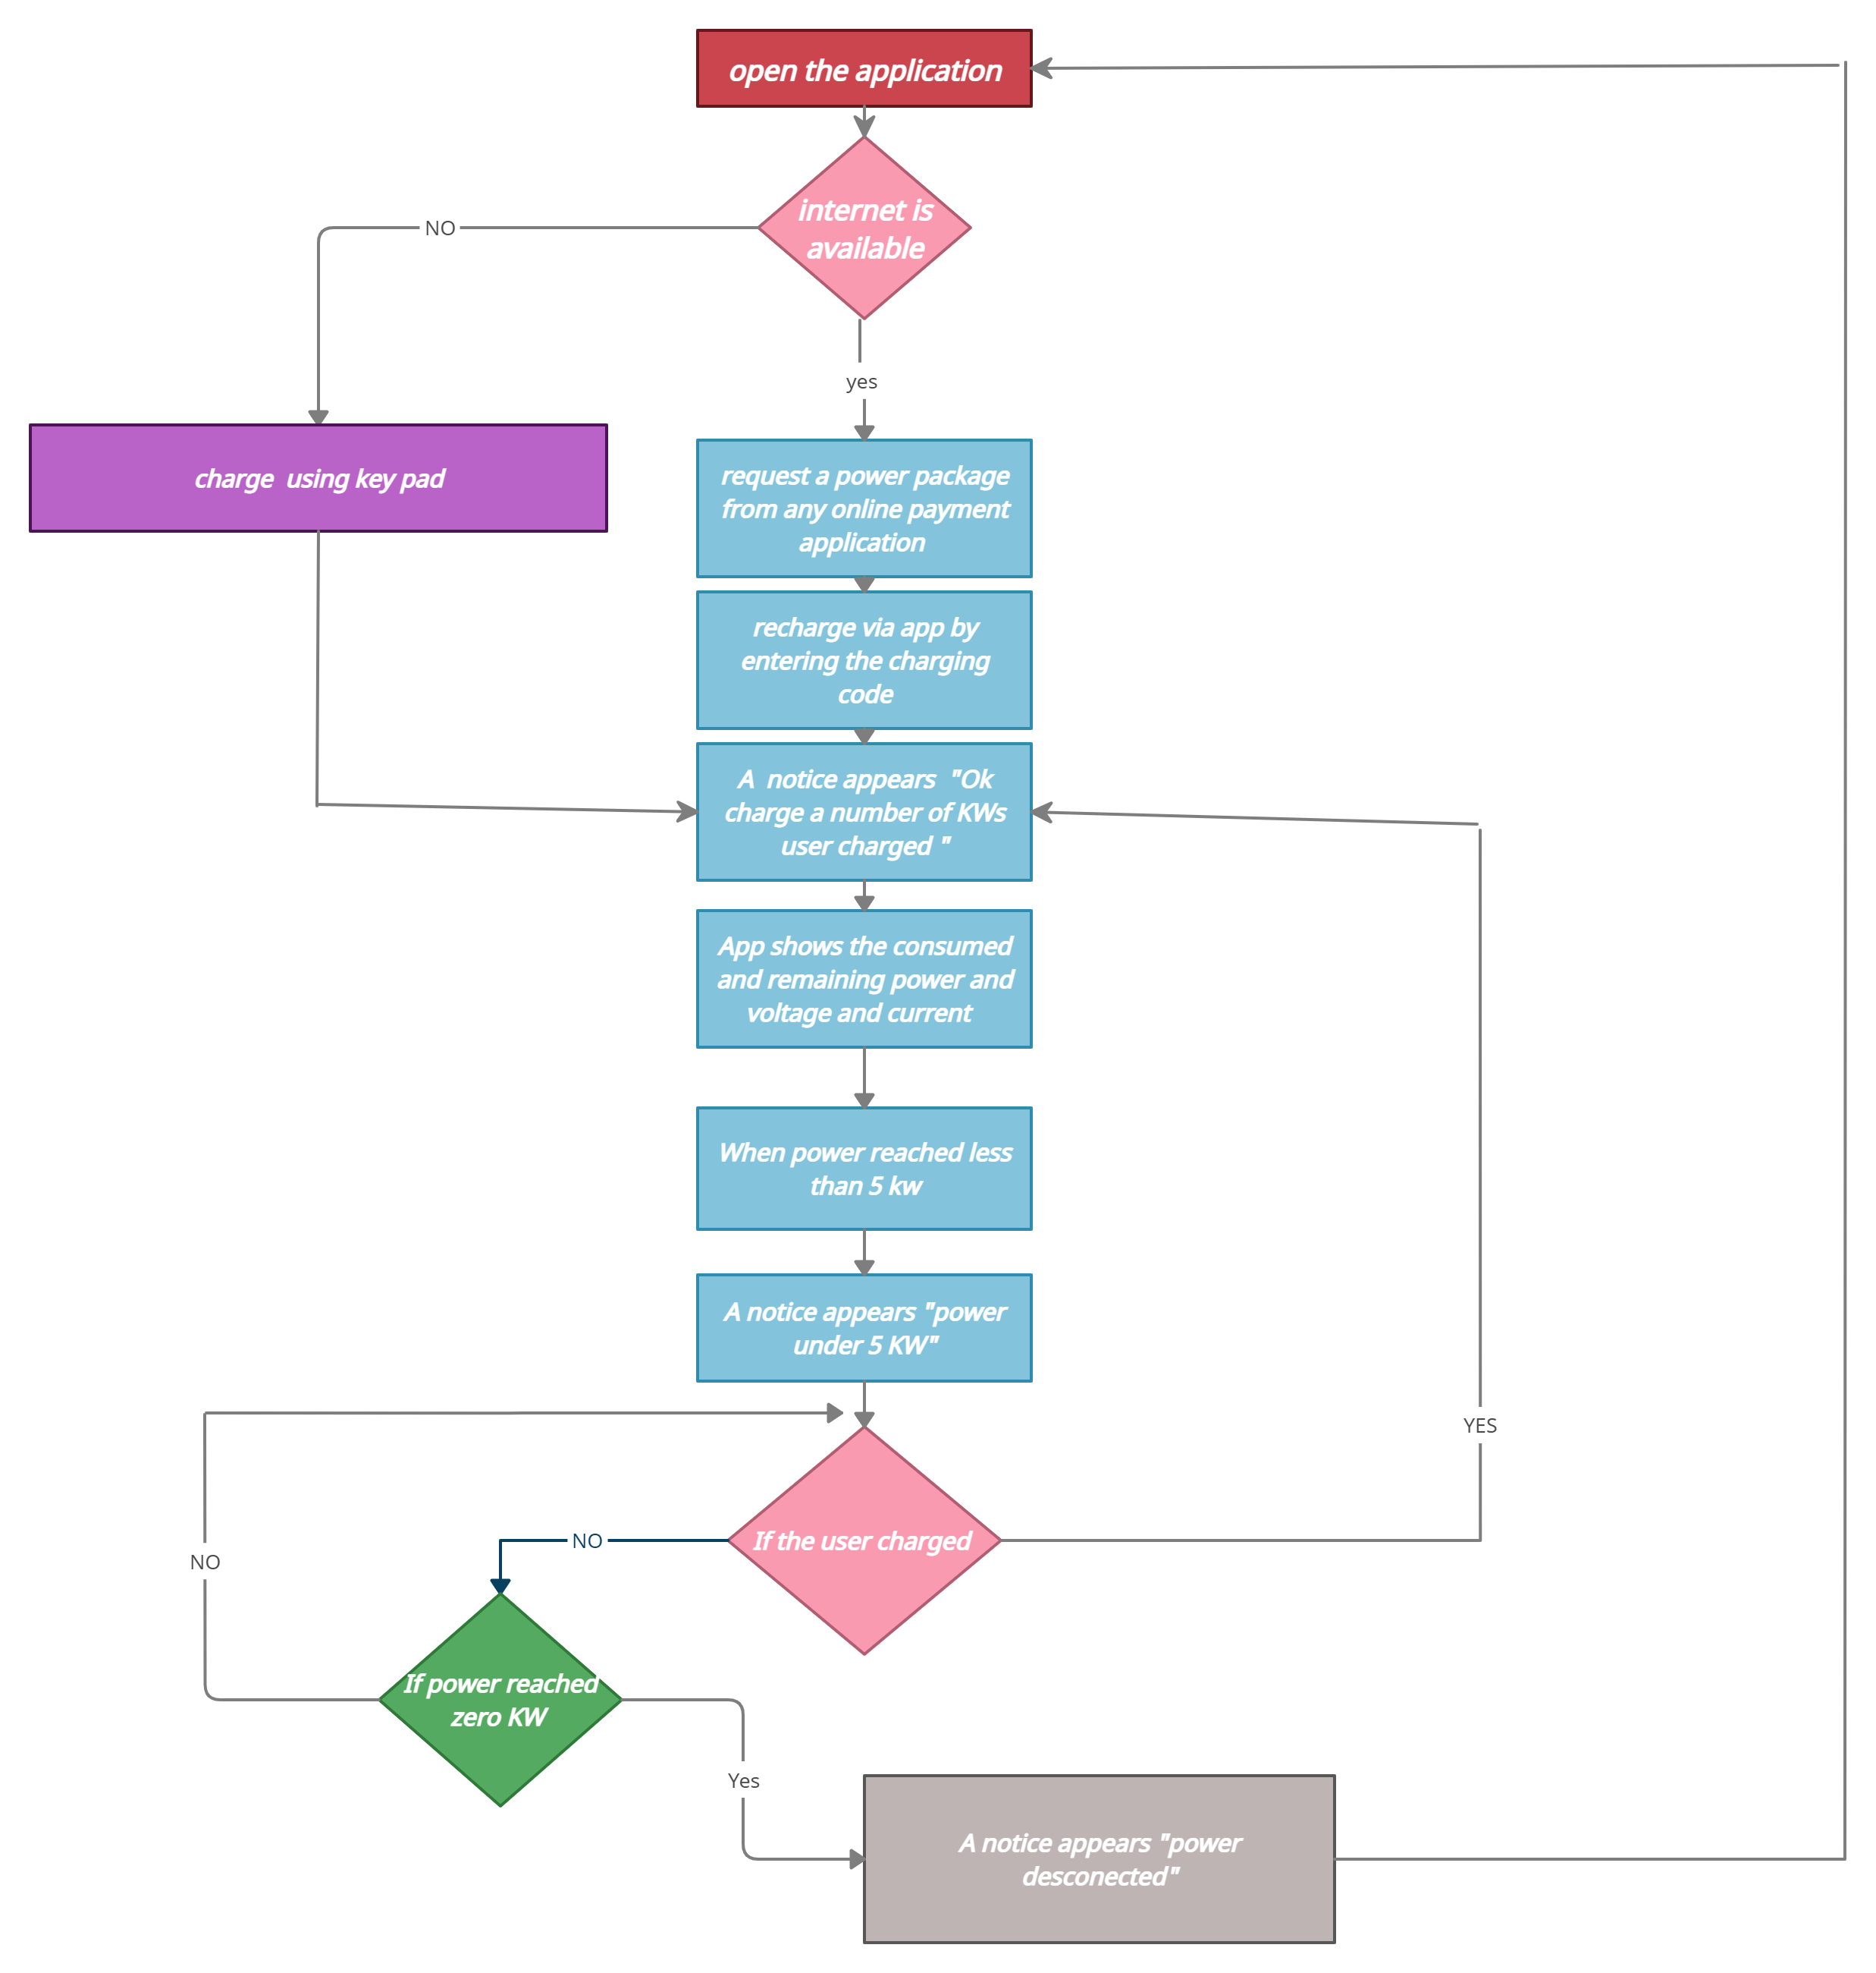
Flow Chart:

Slide 6

Now we will show you how the project works

Slide 7
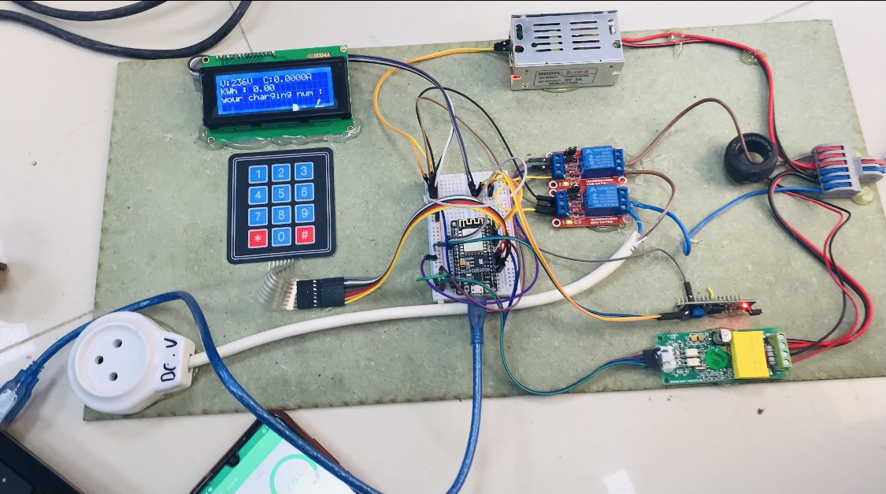
Design and construction:
Hardware Design:

Slide 8
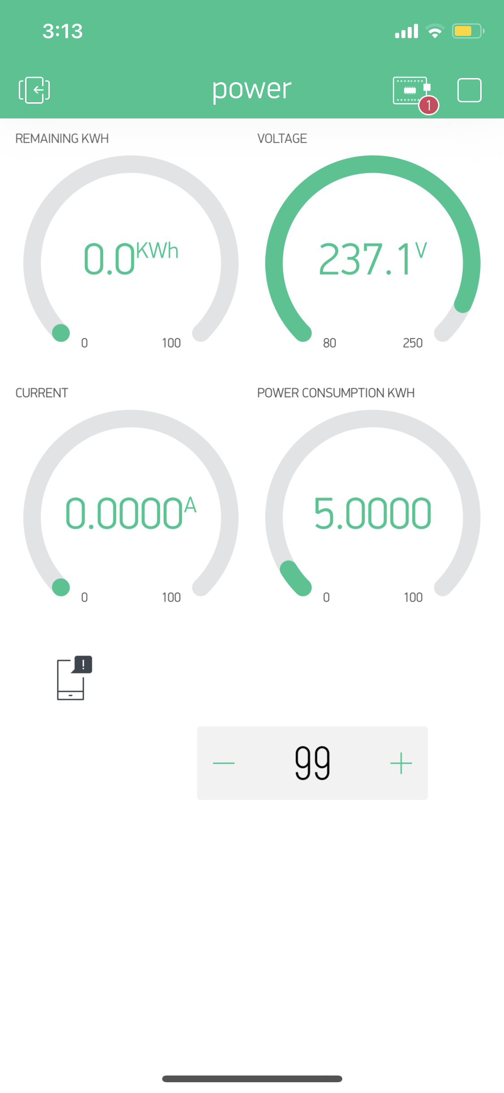
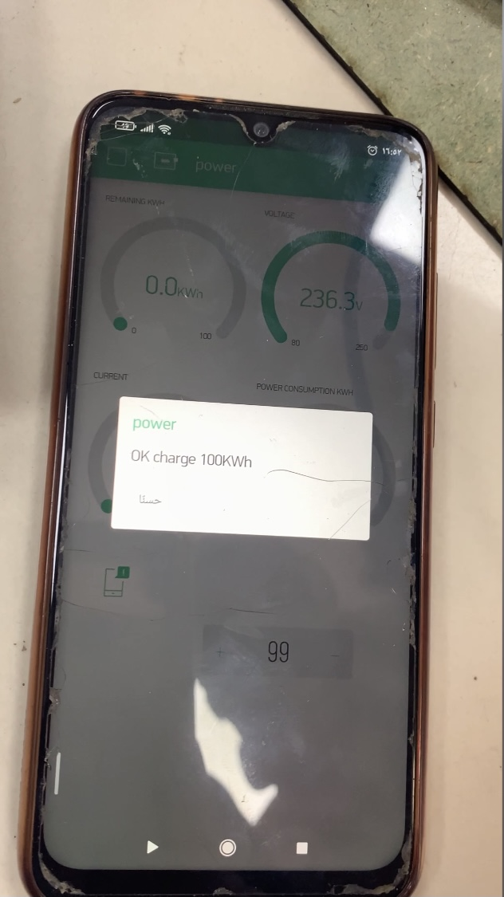
Software design:

Slide 9
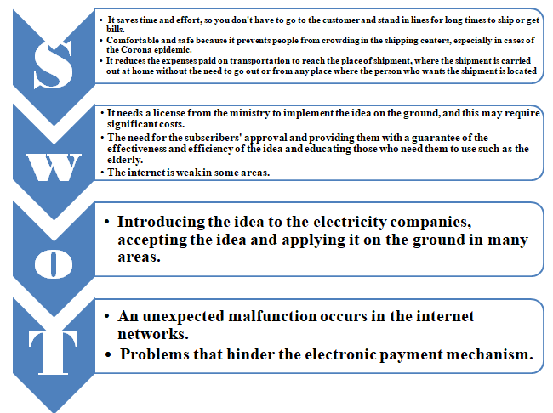
Swot analysis:

Slide 10
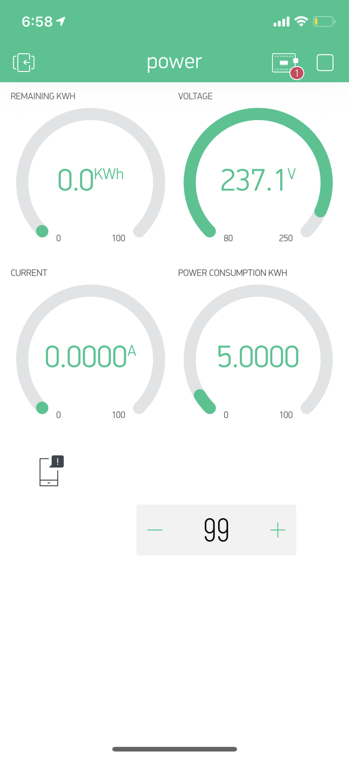
Result:
The app screen shows the consumed and remaining power as well as the current and voltages, also the field which we enter the charge code through it.

Slide 11
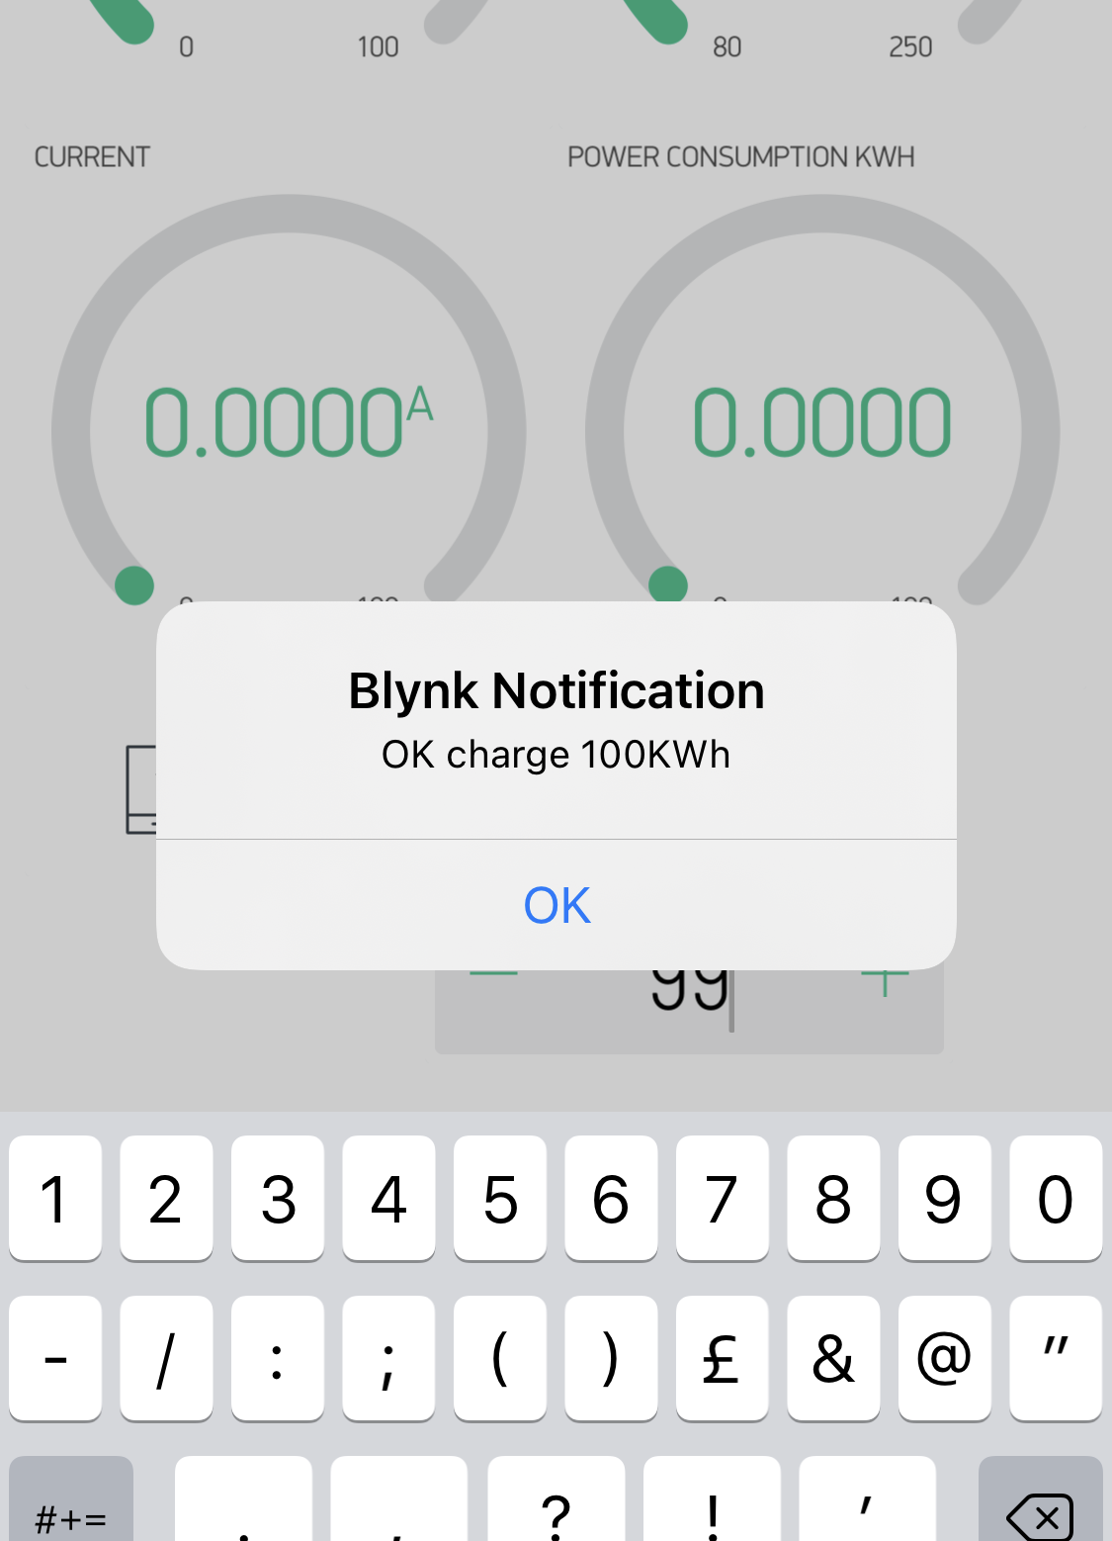
This notification appears when the user charging either from the app by entering 99 or from key pad by entering 1234#

Slide 12
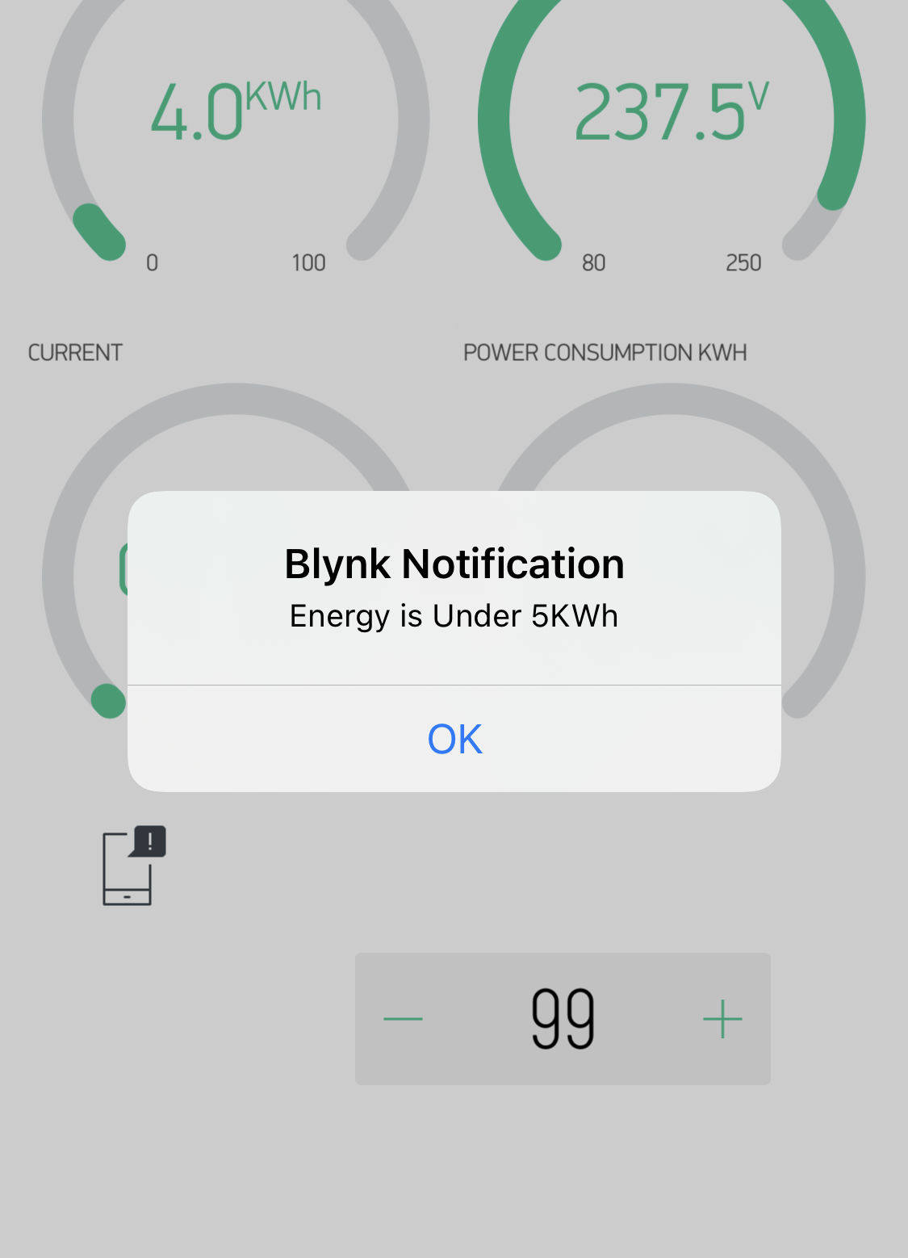
This notification appears when the power reaches the minimum power we have assumed which is 5KW.

Slide 13
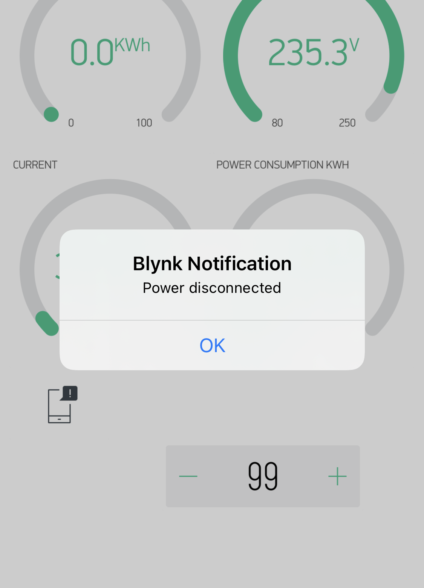
This notification appears if the user consumed all power and does not recharge after he noticed that the power is low.

Slide 14

Conclusion:
In this project we implemented a smart system for charging electrical meter, that can be able to charge the electrical energy meter via application using wifi.

Slide 15
Future work:
We will work on developing this project to become more simulated reality so that it can be used on a large number of meters, by adding the "meter number" field and communicating with any of the online payment companies such as Jawwal pay, palpay, maalchat, or online banking services.

Slide 16
Dedicate:
Finally, we dedicate this success and achievement that we have achieved and it was a fruit of our fatigue and perseverance during the five years to our parents who stood with us, supported us, endured us and gave us more than they could, then to our supervisor who provided us with great support and helped us step by step, and to all our teachers who endured us and supported us until we reach this moment, and to the friends of the moment in five years, to whom all of us thank you very much and most sincerely.

Slide 17


