Slide 1

Structural Analysis and Design of Bakeer Building in Nablus City
By:
Assim Hantoli.
Asem Mohaibish.
Raffat soliman.
Akram Hanoon.
Under supervision of: Dr. Ibrahim Arman.
Fall 2019

Slide 2
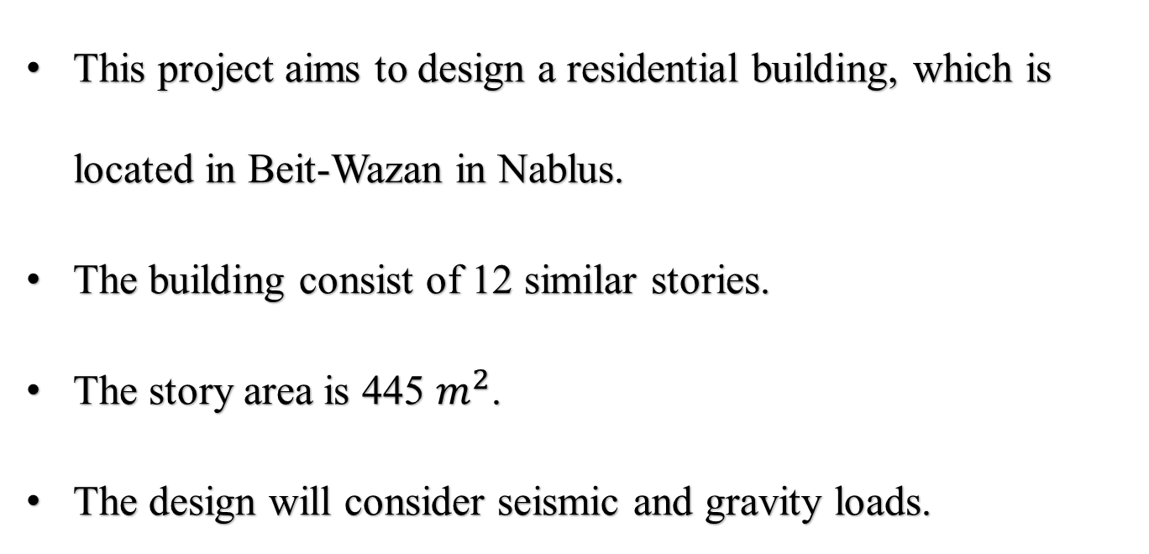
PREFACE
This project aims to design a residential building, which is located in Beit-Wazan in Nablus.
The building consist of 12 similar stories.
The story area is 445 $m^{2}$.
The design will consider seismic and gravity loads.

Slide 3
OUTLINE
Introduction
  Project Description
  Codes & Standards
  Programs
  Materials
  Soil Properties
  Seismic definitions.
  Seismicity of the site & Structure
  Load & Load Combination
Preliminary
Design
  Slabs
  Beams
  Columns
  Walls
  Modeling
    Section Modifier
    Response Spectrum Definition
    Model Checks
Design Checks
  Base Shear
  Irregularities checks
  Drift
  P-Delta
  Deflection
  Preliminary Design Check
  Element Design
    Shear Walls
    Columns
    Beams
    Slabs
    Foundation
    Stair
Element Detailing
  Slab
  Beams
  Columns
  Walls
  Foundation
  Stair

Slide 4
INTRODUCTION

Slide 5
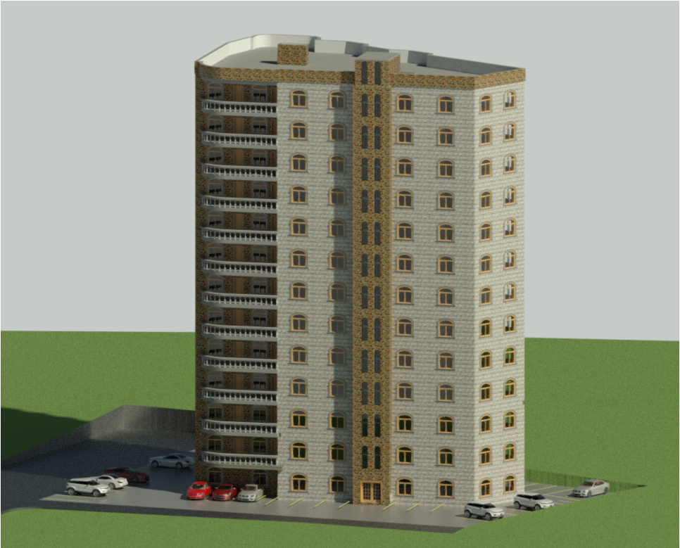
Project Description
3D view of the building

Slide 6
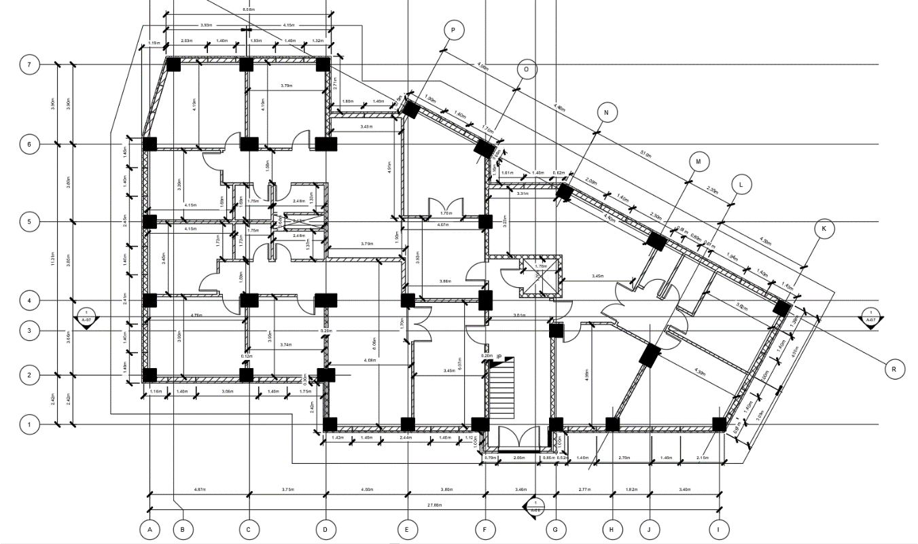
Project Description
Ground Floor Plan

Slide 7

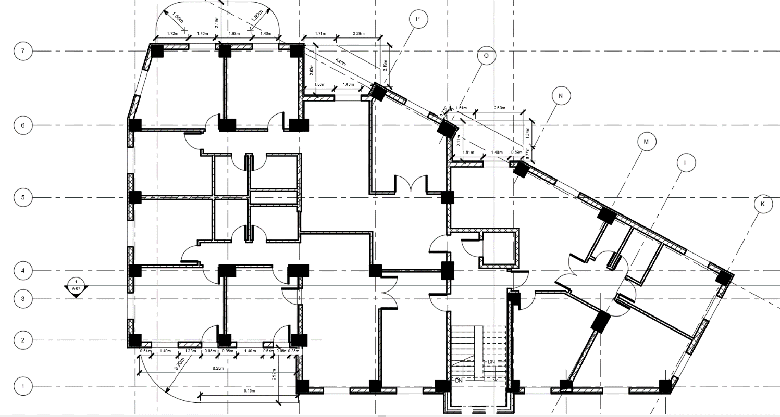
Project Description
Floor 1 to Floor 12 Typical Plan

Slide 8
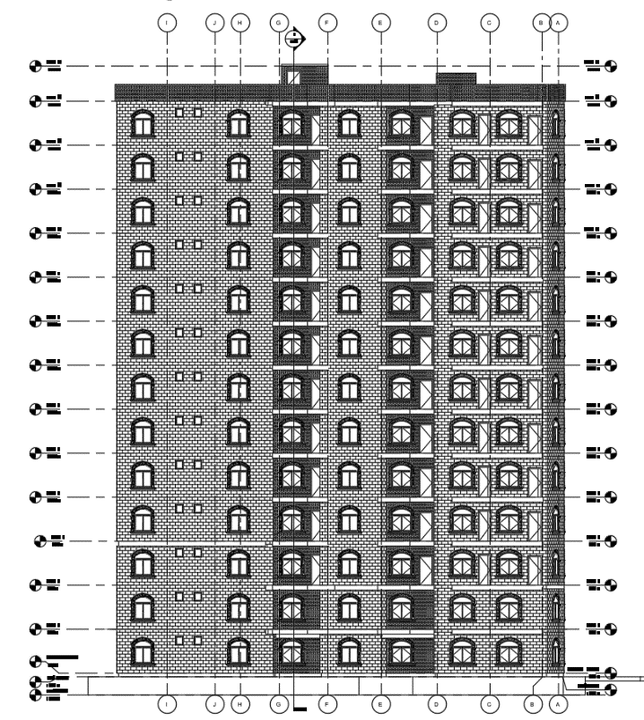
Project Description
North Elevation

Slide 9
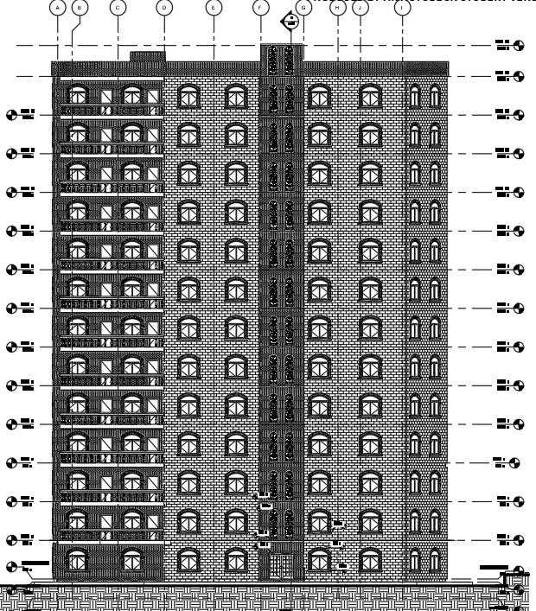
Project Description
South Elevation

Slide 10
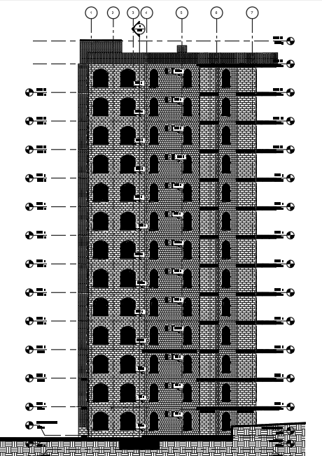
Project Description
East Elevation

Slide 11
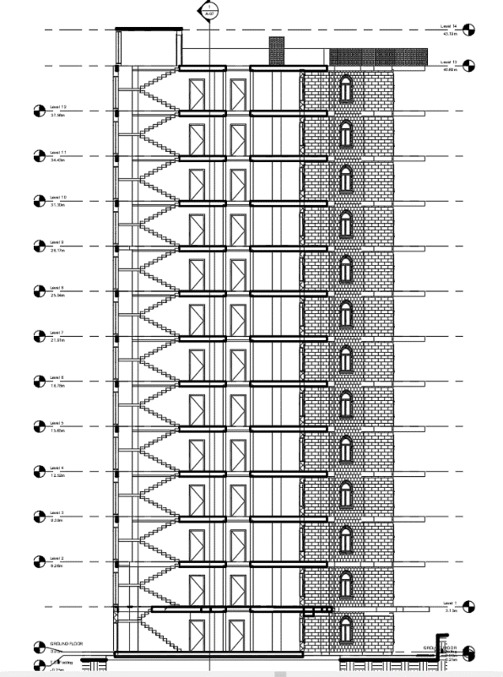
Project Description
Section 1-1

Slide 12
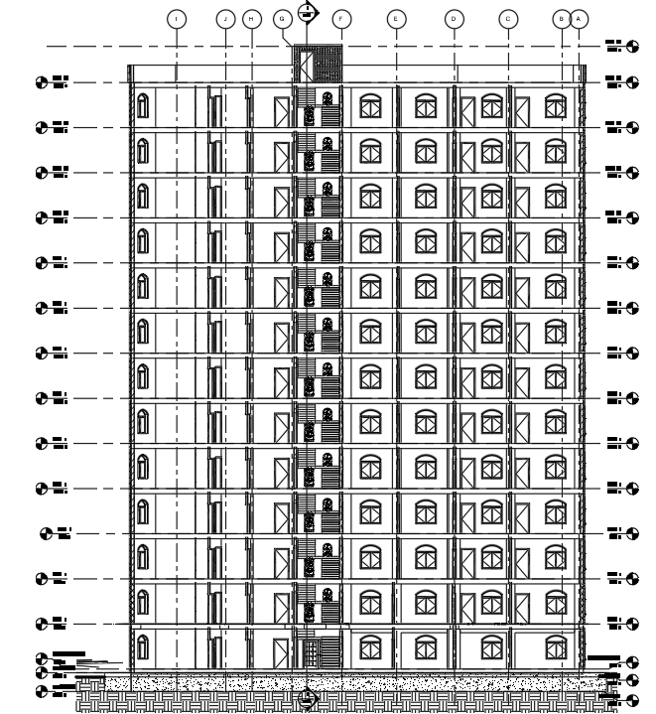
Project Description
Section 2-2

Slide 13


Codes & Standards
ACI 318-11
ASCE 7-10

Slide 14



Programs
AutoCAD
Revit
ETABS

Slide 15
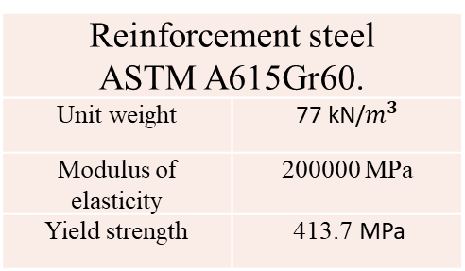
Materials
Materials used in structural elements:
Steel:
Concrete
Used for | Slabs, Beams, Columns and Shear Walls
Compressive strength | 28 (mpa)
Modules of elasticity | 24870 (mpa)
Unit weight of plain concrete | 23 kN/m3
Unit weight of reinforced concrete | 25 kN/m3

Slide 16
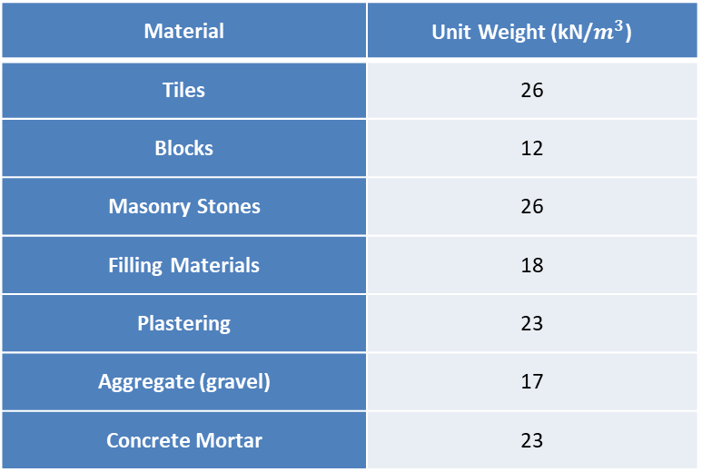
Materials
Materials used in non-structural elements:
Material | Unit Weight (kN/$m^{3}$)
Tiles | 26
Blocks | 12
Masonry Stones | 26
Filling Materials | 18
Plastering | 23
Aggregate (gravel) | 17
Concrete Mortar | 23

Slide 17
Soil Properties
Bearing Capacity: 380 kPa
Site Class: Soft Rock “Type C”

Slide 18
Gravity Loads
Gravity loads:
Dead load
Live load:
Area | Floor | Balcony | Stairs
Live load | 2.5 kN/m2 | 3.75 kN/m2 | 5 kN/m2

Slide 19
Gravity Loads
Super Dead Load
Location | Floor | Exterior beams | Balconies edges | Walls
Super Dead Load | 5 kN/m2 | 15.5 kN/m | 4.5 kN/m | 3.2 kN/m2

Slide 20
Seismic load
Determination of Seismic Design Parameters:
Select risk category
Set the importance factor I_{e}
Determination of S_{s} and S₁
Determination of seismic design category
Calculate the design spectral acceleration S_{DS} & S_{D1}
Determination of response accelerations S_{ms} and S_{m1}
Design Coefficients and Factors for seismic Force - Resisting Systems

Slide 21
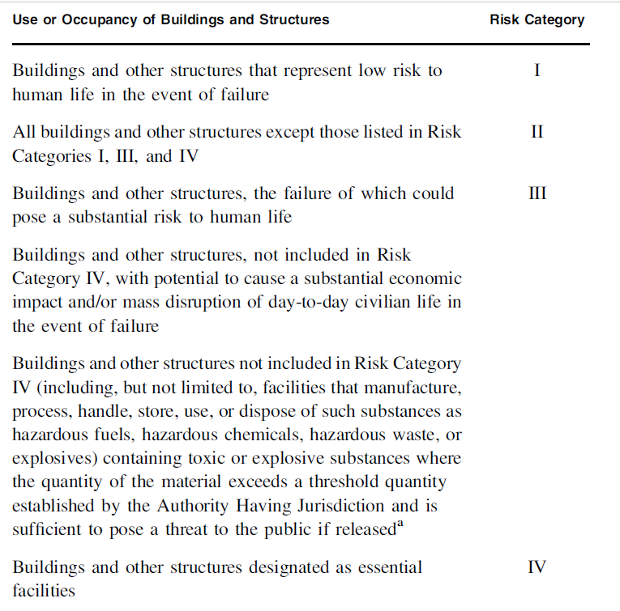
Seismic definitions
Selection of Risk Category
According ASCE 7-10
Use risk category III.

Slide 22
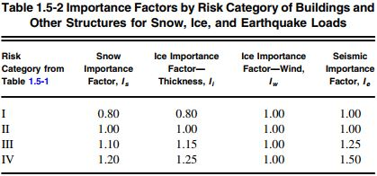
Seismic definitions
Set importance factor Ie
I=1.25

Slide 23
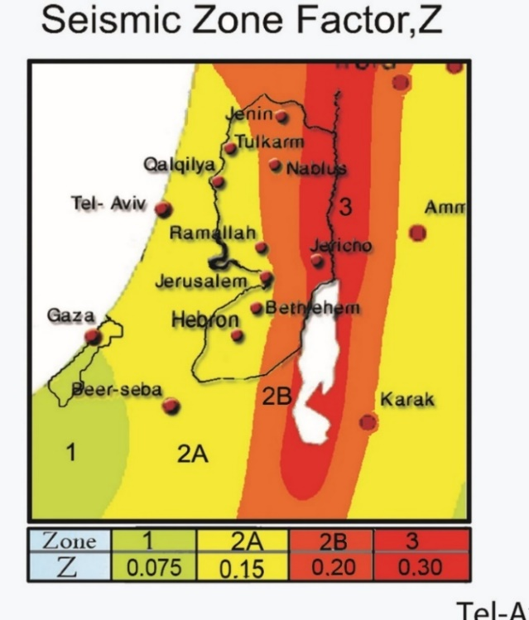
Seismic definitions
Determination of Ss and s1
Seismic zone factor (z):
Our project is located in Nablus so the
zone factor (z) =0.2g.

Slide 24
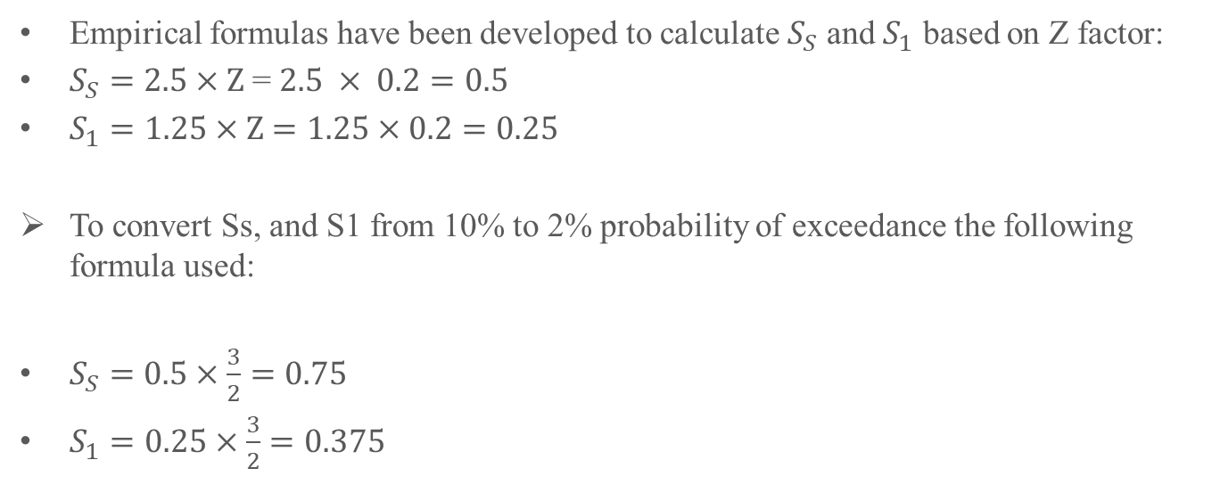
Seismic definitions
Determination of Ss and s1
Empirical formulas have been developed to calculate $S_{S}$ and $S_{1}$ based on Z factor:
$S_{S}=2.5×Z$ = $2.5 × 0.2=0.5$
$S_{1}=1.25×Z$ $=1.25×0.2=0.25$
To convert Ss, and S1 from 10% to 2% probability of exceedance the following formula used:
$S_{S}=0.5×\frac{3}{2}=0.75$
$S_{1}=0.25×\frac{3}{2}=0.375$

Slide 25
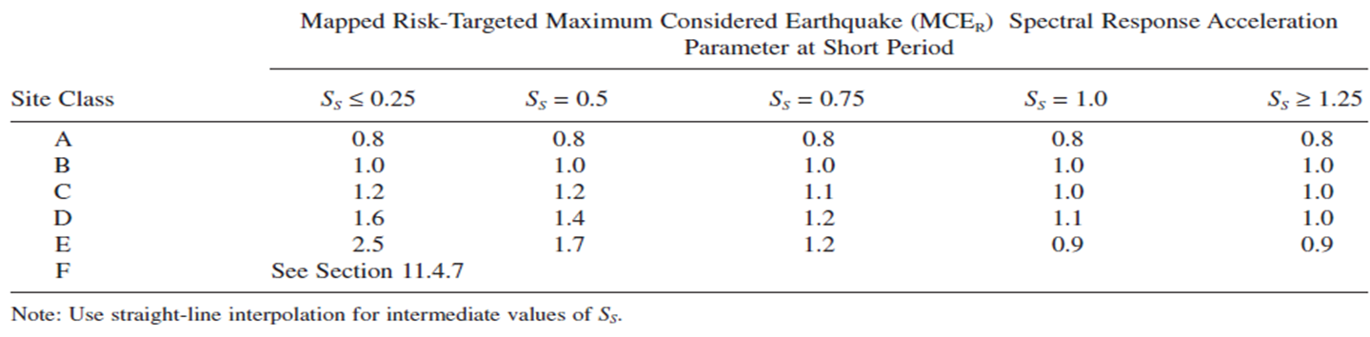
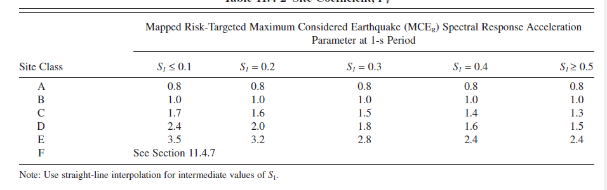


Seismic definitions
Determination of $S_{ms}$and $S_{m1}$
Fa = 1.1 , Fv = 1.425 determined from the below tables .
The amplified accelerations, Sms, and Sm1:
$$S_{MS}=F_{a}× S_{S}=1.1×0.75=0.825$$
$$S_{M1}=F_{v}×{ S}_{1}=1.425×0.375=0.534$$

Slide 26

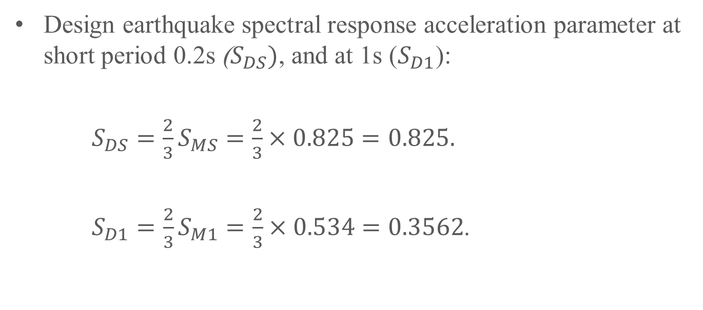
Seismic definitions
Calculation of $S_{Ds}$ and $S_{D1}$
Design earthquake spectral response acceleration parameter at short period 0.2s ($S_{DS})$, and at 1s ($S_{D1}$):
$S_{DS}=\frac{2}{3}S_{MS}=\frac{2}{3}×0.825=0.825.$
$S_{D1}=\frac{2}{3}S_{M1}=\frac{2}{3}×0.534=0.3562$.

Slide 27
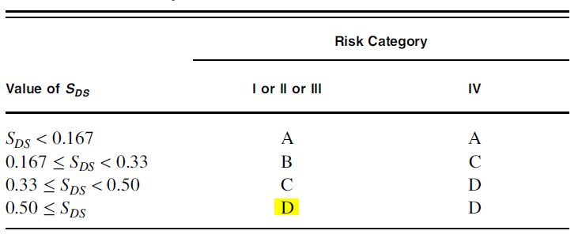
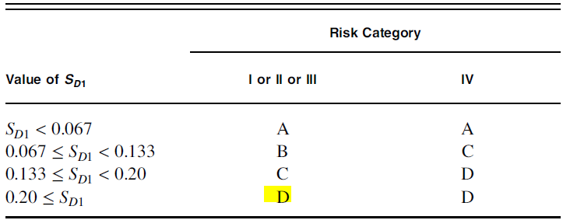
Seismic definitions
Seismic design category
Seismic design category:
According to the previous tables the seismic design category is D.

Slide 28
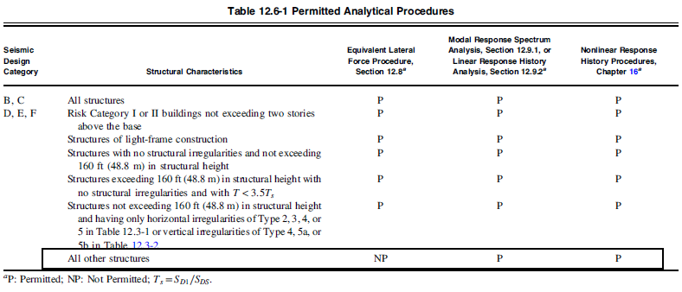
Seismic definitions
Method of analysis
In this project modal response spectrum method will be used

Slide 29
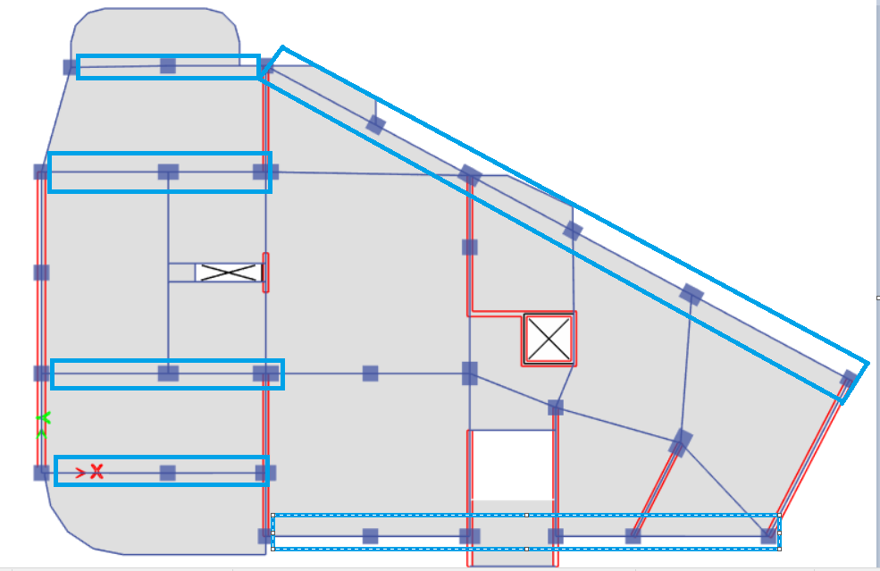
Seismic definitions
Seismic force resisting system
X-direction selected frames to take the seismic load.

Slide 30
Seismic definitions
Seismic force resisting system
In this project two systems will be used:
Y-direction system:
the system is special reinforced shear walls, with design coefficients as shown in the table below.
Response Modification coefficient Rª | Over strength factor Ω₀^{g} | Deflection amplification factor C_{d}^{b}
6 | 2.5 | 5

Slide 31
Seismic definitions
Seismic force resisting system
In this project two systems will be used:
X-direction system:
the system is special reinforced moment resisting frames, with design coefficients as shown in the table below.
Response Modification coefficient Rª | Over strength factor Ω₀^{g} | Deflection amplification factor C_{d}^{b}
8 | 3 | 5.5

Slide 32
Load combinations
Ultimate load combinations:
Combination | D | L | Ex | Ey
ULT1 | 1.4 | - | - | -
ULT2 | 1.2 | 1.6 | - | -
ULT3a | 1.31 | 1 | 1.3 | 0.39
ULT3b | 1.31 | 1 | 0.39 | 1.3
ULT4a | 0.79 | - | 1.3 | 0.39
ULT4b | 0.79 | - | 0.39 | 1.39

Slide 33
Load combinations
Service load combinations:
Combination | D | L | Ex | Ey
Serv1 | 1 | - | - | -
Serv2 | 1 | 1 | - | -
Serv3a | 1.077 | - | 0.91 | 0.273
Serv3b | 1.077 | - | 0.273 | 0.91
Serv4a | 1.0577 | 0.75 | 0.6825 | 0.2047
Serv4b | 1.0577 | 0.75 | 0.2047 | 0.6825
Serv 5a | 0.523 | - | 0.91 | 0.273
Serv 5b | 0.523 | - | 0.273 | 0.91

Slide 34
Preliminary design

Slide 35
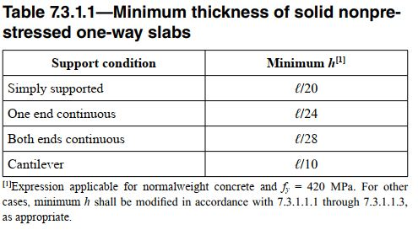
Preliminary design
Beams:

Slide 36
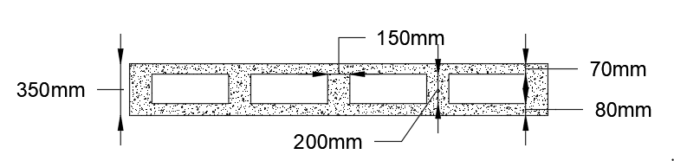
Preliminary design
Beams:
Slab: The slab will be Two way U-boot slab.
Group number | Dimensions
1 | 400 x 600 mm
2 | 400 x 500 mm
3 | 400 x 350 mm

Slide 37
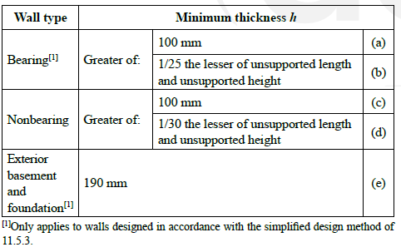
Preliminary design
Columns:
Shear walls:
Shear wall thickness=20cm
Group number | Dimensions
1 | 400 x 400 mm
2 | 400 x 600 mm
3 | 400 x 800 mm
4 | 400 x 1000 mm
5 | 900 x 600 mm

Slide 38
Modeling
U-Boot slab Modifiers:
M11 | 0.2993
M22 | 0.2993
M13 | 0.5565
V13 | 0.2238806
V23 | 0.2238806
F11 | 0.5565032
F22 | 0.5565032
weight | 0.6546
mass | 0.6546

Slide 39
Modeling
Beams modifiers:
Section Properties | Modifier
Torsional Constant | 0.01
Moment of inertia about 2 axis | 0.35
Moment of inertia about 3 axis | 0.35
Mass | 1
Weight | 1

Slide 40
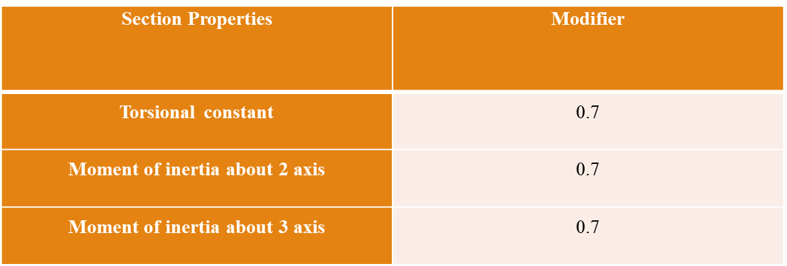
Modeling
Columns modifiers:

Slide 41
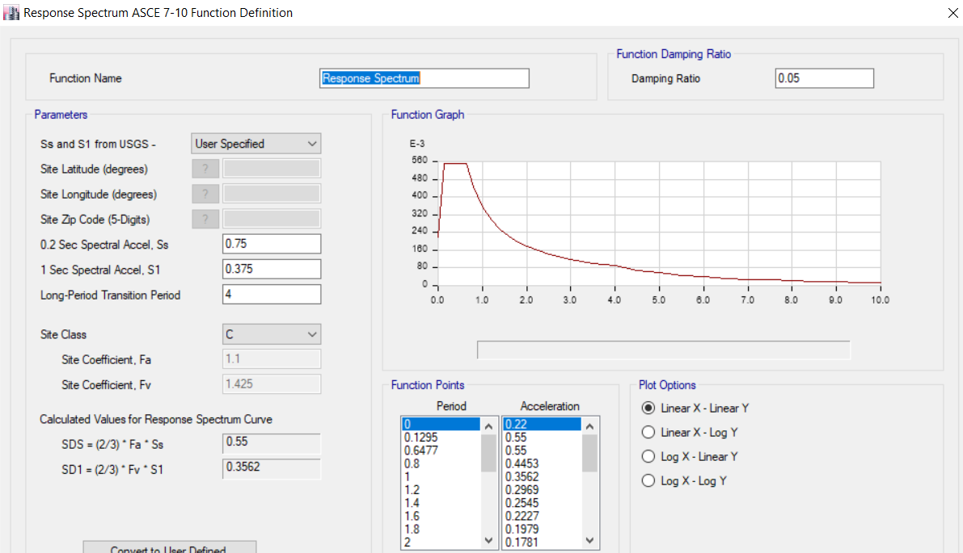
Modeling
Response spectrum definition

Slide 42
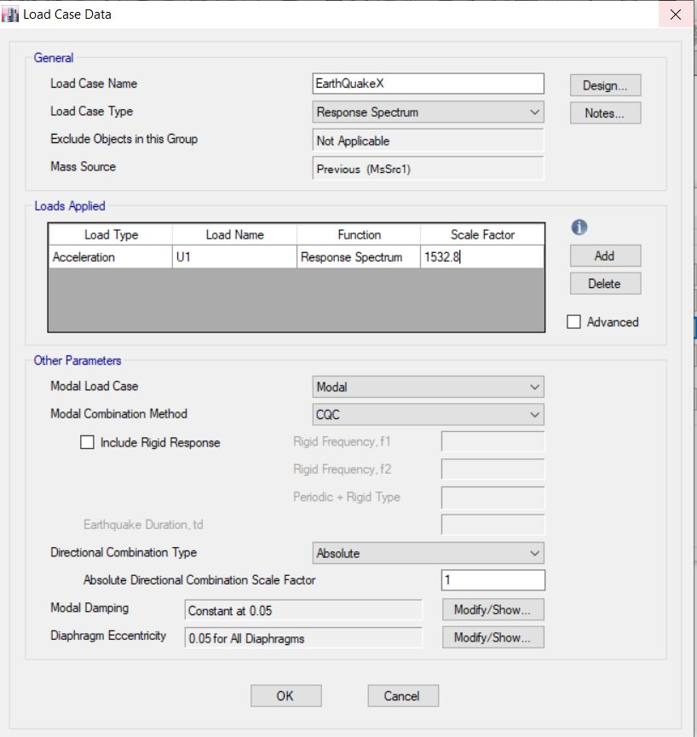

Modeling
Load cases
Load cases definition:
Load case in X direction:
$Scale factor=\frac{g×I}{R}$
$Scale factor=\frac{9810×1.25}{8}=1532$

Slide 43
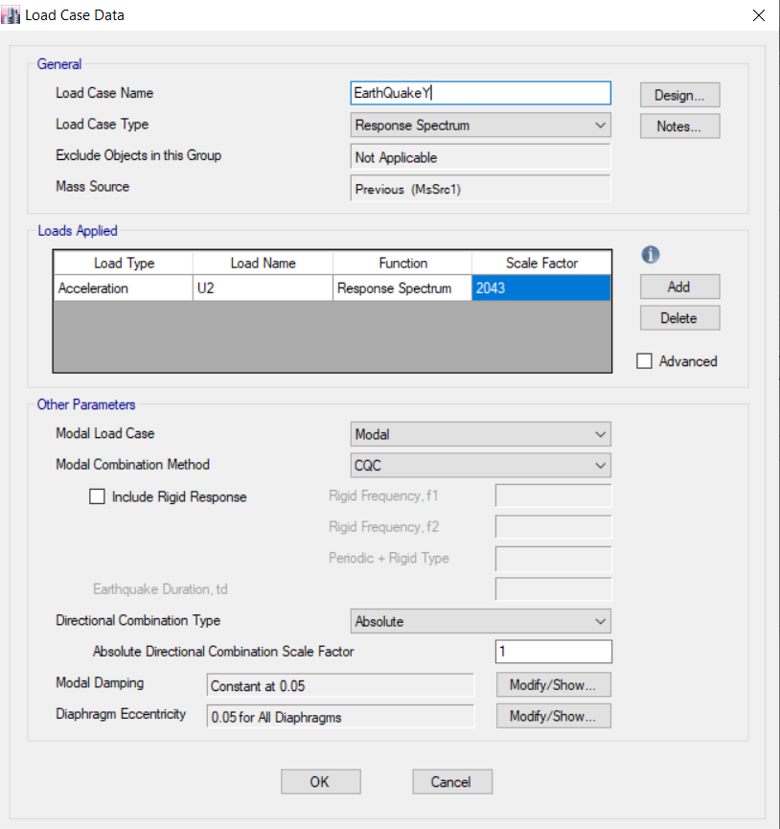

Modeling
Load cases
Load cases definition:
Load case in Y direction:
$Scale factor=\frac{g×I}{R}$
$Scale factor=\frac{9810×1.25}{6}=2043$

Slide 44
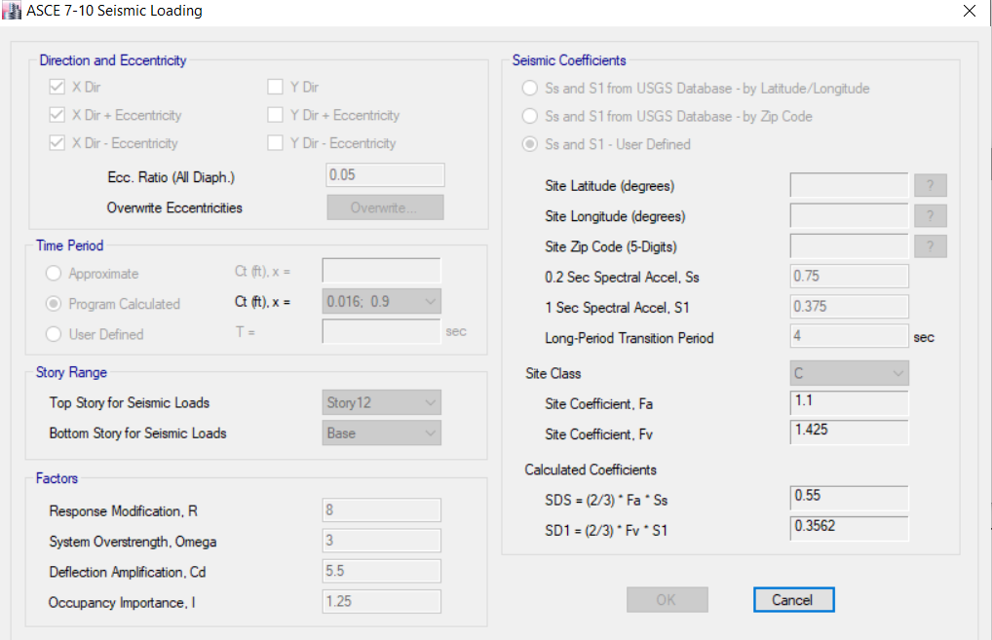
Modeling
Equivalent static load
X-direction

Slide 45
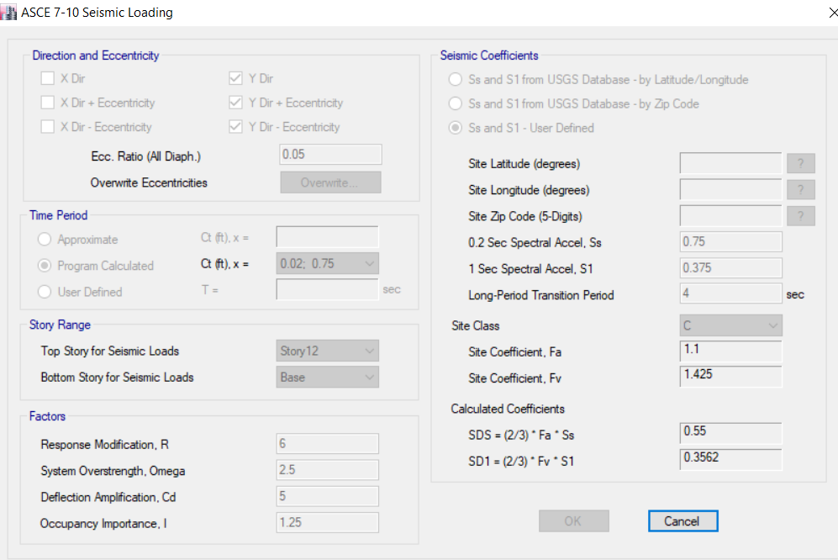
Modeling
Equivalent static load
Y-direction

Slide 46
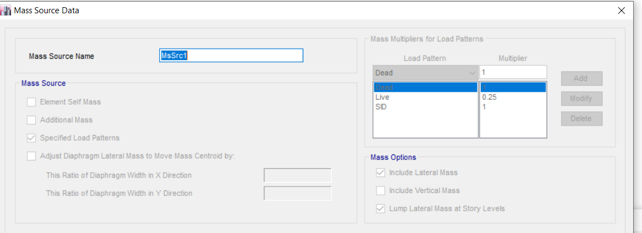
Modeling
Mass source

Slide 47
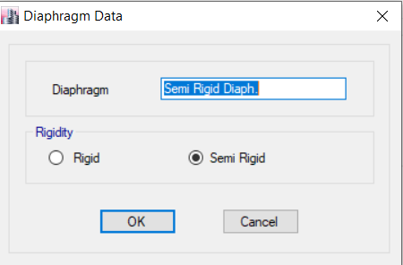
Modeling
Diaphragm definition

Slide 48
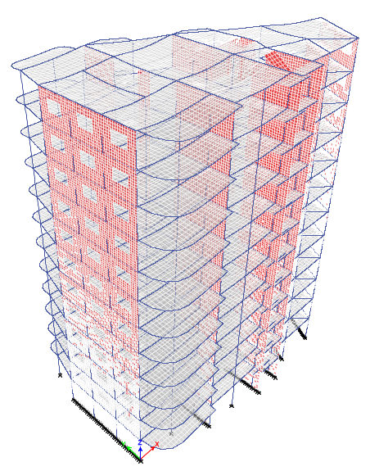
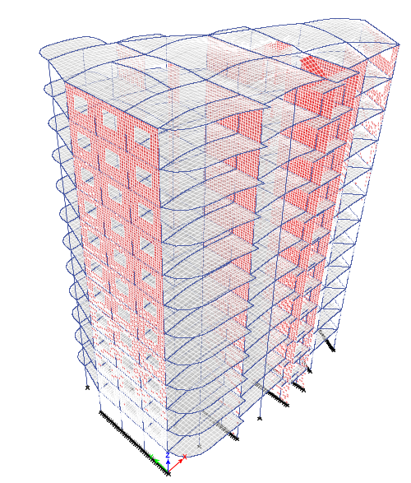
Model checks
Compatibility check

Slide 49
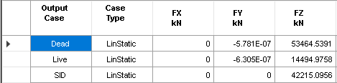
Model checks
Equilibrium check
ETABS base reactions.

Slide 50
Model checks
Equilibrium check
Difference between manual calculations and ETABS results:
Load Pattern | Manual (kN) | ETABS (kN) | Difference (%)
Dead Load | 53991 | 53464 | 0.9
Live Load | 14403 | 14495 | 0.6
Super Dead | 41843 | 42215 | 0.8

Slide 51
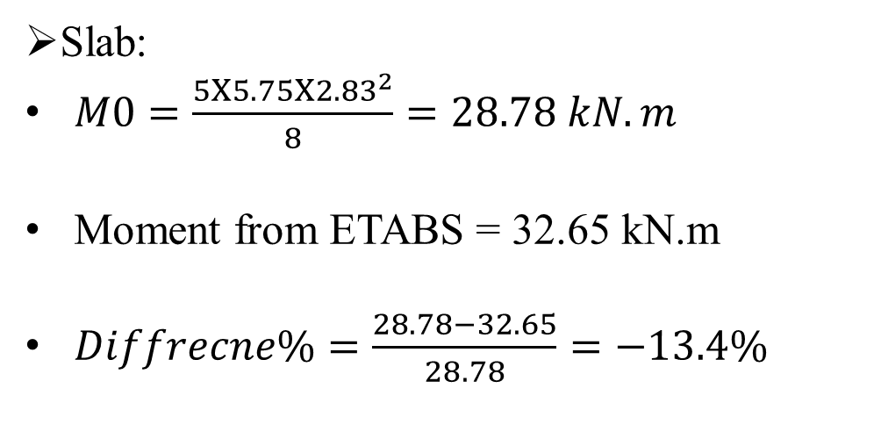
Model checks
Stress strain check
Slab:
$M0=\frac{5Χ5.75Χ{2.83}^{2}}{8}=28.78 kN.m$
Moment from ETABS = 32.65 kN.m
$Diffrecne\%=\frac{28.78−32.65}{28.78}=−13.4\%$

Slide 52
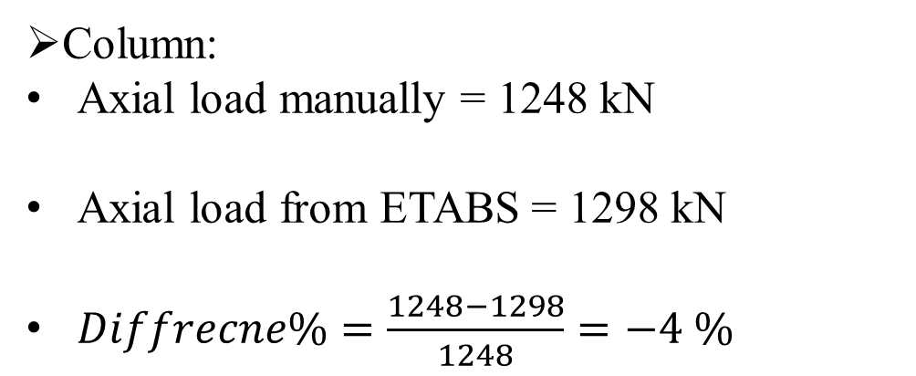
Model checks
Stress strain check
Column:
Axial load manually = 1248 kN
Axial load from ETABS = 1298 kN
$Diffrecne\%=\frac{1248−1298}{1248}=−4 \%$

Slide 53
Design checks
Minimum number of modes.
Base shear check.
Irregularities check.
Drift check.
P-delta check.
Deflection check.

Slide 54
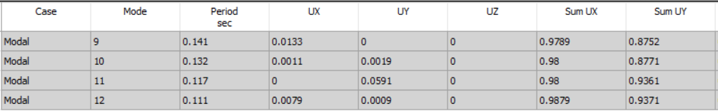
Design checks
Minimum number of modes
ASCE 7-10 require cumulative modal participating mass ratio (Sum UX and Sum UY) of at least 90% for response spectrum analysis. The required number of modes to get this percent is 12 mode.

Slide 55
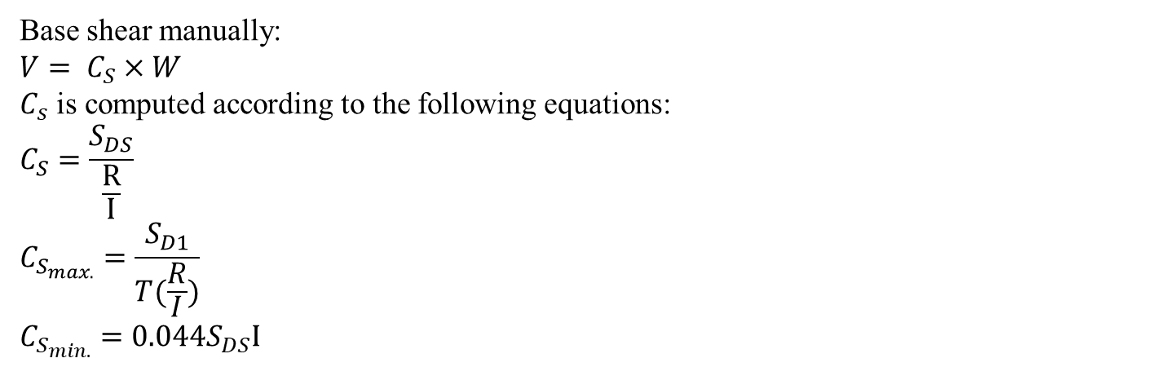
Design checks
Base shear check
Base shear manually:
$$V= C_{S}×W$$
$C_{s}$ is computed according to the following equations:
$$C_{S}=\frac{S_{DS}}{\frac{R}{I}}$$
$$C_{S_{max.}}=\frac{S_{D1}}{T(\frac{R}{I})}$$
$$C_{S_{min.}}=0.044S_{DS}I$$

Slide 56
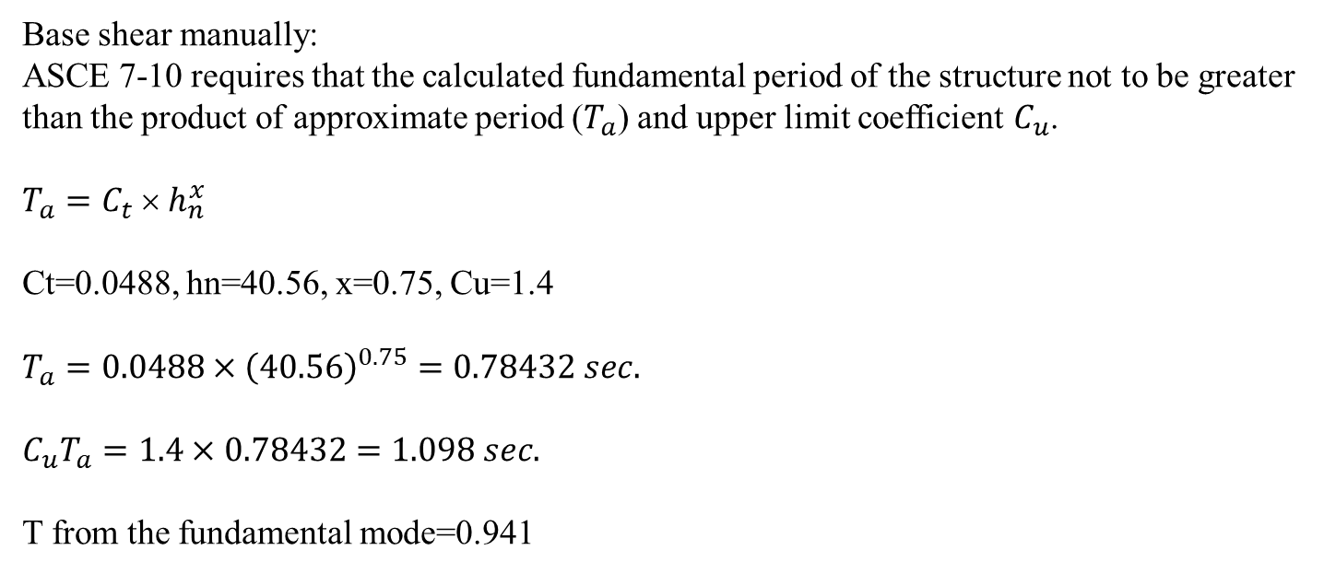
Design checks
Base shear check Y-direction
Base shear manually:
ASCE 7-10 requires that the calculated fundamental period of the structure not to be greater than the product of approximate period ($T_{a}$) and upper limit coefficient $C_{u}$.
$$T_{a}=C_{t}  h_{n}^{x}$$
Ct=0.0488, hn=40.56, x=0.75, Cu=1.4
$$T_{a}=0.0488×{\left(40.56\right)}^{0.75}=0.78432 sec.$$
$$C_{u}T_{a}=1.4×0.78432=1.098 sec.$$
T from the fundamental mode=0.941

Slide 57

Design checks
Base shear check Y-direction
Base shear manually:
$C_{s}=\frac{0.55}{\frac{6}{1.25}}=0.115$ and
$$C_{s_{max.}}=\frac{0.3562}{0.941\left(\frac{6}{1.25}\right)}=0.0788$$
$${C_{s}}_{min.}=0.044×0.55×1.25=0.03025$$
Cs=0.0788
W=$98814.58395$ KN
$$V=0.0788×98814.58395=7792 kN$$

Slide 58
Design checks
Base shear check
Base shear From ETABS:
 | FX (kN) | FY(kN)
Response Spectrum
EQx | 2749.7545 | 451.8108
EQy | 602.4151 | 5820.5974
Equivalent Static Force
Ex | -3269.5551 | 1.83E-06
Ey | 7.552E-07 | 7772.0024

Slide 59
Design checks
Base shear check
ETABS results
 | FX (kN) | FY(kN)
Response Spectrum
EQx | 2749.7545 | 451.8108
EQy | 602.4151 | 5820.5974
Equivalent Static Force
Ex | -3269.5551 | 1.83E-06
Ey | 7.552E-07 | 7772.0024

Slide 60
Design checks
Base shear check
direction | Base shear manually | Base shear from ETABS (Equivalent static) | Base shear from ETABS (Response Spectrum) | (v/vt) | Difference
X | 3277 | 3269 | 2749 | 1.189159694 | 0.24%
Y | 7792 | 7770 | 5820 | 1.335051546 | 0.28%

Slide 61
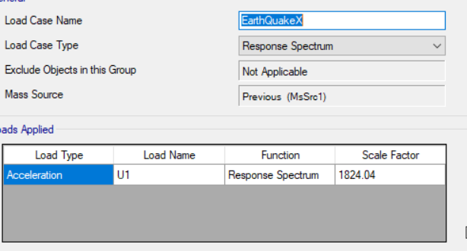
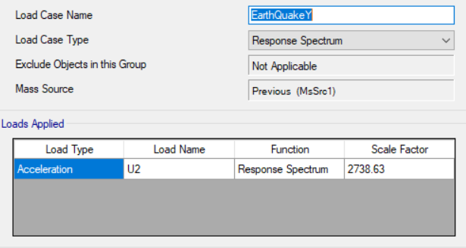
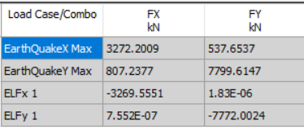
Design checks
Modification of RS

Slide 62
Design checks torsional irregularity check
According to ASCE 7-10, there is no torsional irregularity if (max drift/average drift)<1.2 or Ax<1.
To check the torsional irregularity the following combination used:
D+L+SD+Eqx+Eqy

Slide 63
Design checks torsional irregularity check X
Story | Combination | Direction | Max Displacement | Avg Displacement | (Max/avg) DISP | Ax
Story12 | Dx Max | X | 39.862 | 39.12 | 1.019 | 0.721084
Story11 | Dx Max | X | 37.143 | 36.56 | 1.016 | 0.716844
Story10 | Dx Max | X | 34.395 | 33.794 | 1.018 | 0.719669
Story9 | Dx Max | X | 31.38 | 30.747 | 1.021 | 0.723917
Story8 | Dx Max | X | 28.07 | 27.41 | 1.024 | 0.728178
Story7 | Dx Max | X | 24.497 | 23.834 | 1.028 | 0.733878
Story6 | Dx Max | X | 20.708 | 20.064 | 1.032 | 0.7396
Story5 | Dx Max | X | 16.768 | 16.124 | 1.04 | 0.751111
Story4 | Dx Max | X | 12.761 | 12.166 | 1.049 | 0.764167
Story3 | Dx Max | X | 8.817 | 8.319 | 1.06 | 0.780278
Story2 | Dx Max | X | 5.141 | 4.793 | 1.073 | 0.799534
Story1 | Dx Max | X | 1.931 | 1.77 | 1.091 | 0.826584

Slide 64
Design checks torsional irregularity check Y
Story | Combination | Direction | Max displacement | Avg displacement | (Max/avg) DISP | Ax
Story12 | Dy Max | Y | 52.748 | 45.226 | 1.166 | 0.944136
Story11 | Dy Max | Y | 47.607 | 40.892 | 1.164 | 0.9409
Story10 | Dy Max | Y | 42.38 | 36.449 | 1.163 | 0.939284
Story9 | Dy Max | Y | 37.064 | 31.915 | 1.161 | 0.936056
Story8 | Dy Max | Y | 31.705 | 27.328 | 1.16 | 0.934444
Story7 | Dy Max | Y | 26.364 | 22.747 | 1.159 | 0.932834
Story6 | Dy Max | Y | 21.134 | 18.253 | 1.158 | 0.931225
Story5 | Dy Max | Y | 16.128 | 13.944 | 1.157 | 0.929617
Story4 | Dy Max | Y | 11.485 | 9.937 | 1.156 | 0.928011
Story3 | Dy Max | Y | 7.365 | 6.368 | 1.157 | 0.929617
Story2 | Dy Max | Y | 3.948 | 3.394 | 1.163 | 0.939284
Story1 | Dy Max | Y | 1.42 | 1.162 | 1.222 | 1.037003

Slide 65
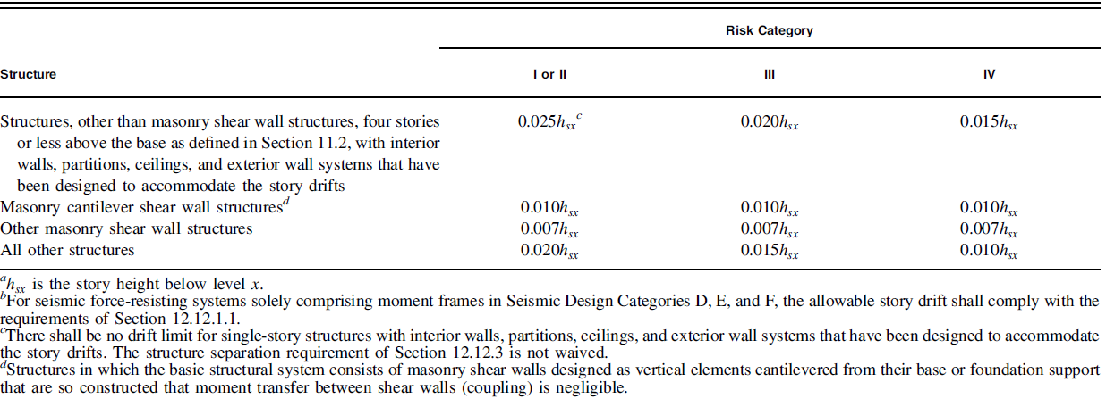
Design checks
Drift check
Allowable story drift according to ASCE7-10:

Slide 66
Design checks
Drift check X
Story | Combination | Direction | Elastic drift(mm) | Cd/I | Design drift(mm) | Limit(mm) | OK or NOT
Story12 | Dx Max | X | 0.00293384 | 4.4 | 0.012909 | 0.0507 | OK
Story11 | Dx Max | X | 0.0033462 | 4.4 | 0.014723 | 0.0507 | OK
Story10 | Dx Max | X | 0.00361998 | 4.4 | 0.015928 | 0.0507 | OK
Story9 | Dx Max | X | 0.00383292 | 4.4 | 0.016865 | 0.0507 | OK
Story8 | Dx Max | X | 0.00398502 | 4.4 | 0.017534 | 0.0507 | OK
Story7 | Dx Max | X | 0.00406952 | 4.4 | 0.017906 | 0.0507 | OK
Story6 | Dx Max | X | 0.00410332 | 4.4 | 0.018055 | 0.0507 | OK
Story5 | Dx Max | X | 0.0041236 | 4.4 | 0.018144 | 0.0507 | OK
Story4 | Dx Max | X | 0.00402558 | 4.4 | 0.017713 | 0.0507 | OK
Story3 | Dx Max | X | 0.0037349 | 4.4 | 0.016434 | 0.0507 | OK
Story2 | Dx Max | X | 0.00325832 | 4.4 | 0.014337 | 0.0507 | OK
Story1 | Dx Max | X | 0.00192998 | 4.4 | 0.008492 | 0.0507 | OK

Slide 67
Design checks
Drift check Y
Story | Combination | Direction | Elastic drift(mm) | Cd/I | Design drift(mm) | Limit (mm) | OK or NOT
Story12 | Dy Max | Y | 0.00517478 | 4 | 0.0206991 | 0.0507 | OK
Story11 | Dy Max | Y | 0.0052728 | 4 | 0.0210912 | 0.0507 | OK
Story10 | Dy Max | Y | 0.00536406 | 4 | 0.0214562 | 0.0507 | OK
Story9 | Dy Max | Y | 0.005408 | 4 | 0.021632 | 0.0507 | OK
Story8 | Dy Max | Y | 0.00537758 | 4 | 0.0215103 | 0.0507 | OK
Story7 | Dy Max | Y | 0.00525928 | 4 | 0.0210371 | 0.0507 | OK
Story6 | Dy Max | Y | 0.00502606 | 4 | 0.0201042 | 0.0507 | OK
Story5 | Dy Max | Y | 0.00465426 | 4 | 0.018617 | 0.0507 | OK
Story4 | Dy Max | Y | 0.00412698 | 4 | 0.0165079 | 0.0507 | OK
Story3 | Dy Max | Y | 0.00342056 | 4 | 0.0136822 | 0.0507 | OK
Story2 | Dy Max | Y | 0.00253162 | 4 | 0.0101265 | 0.0507 | OK
Story1 | Dy Max | Y | 0.0014196 | 4 | 0.0056784 | 0.0507 | OK

Slide 68
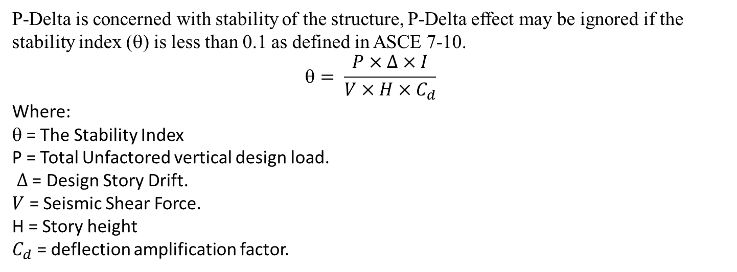
Design checks
P-delta check
P-Delta is concerned with stability of the structure, P-Delta effect may be ignored if the stability index (θ) is less than 0.1 as defined in ASCE 7-10.
$$= \frac{P×∆×I}{V×H×C_{d}}$$
Where:
θ = The Stability Index
P = Total Unfactored vertical design load.
$∆$ = Design Story Drift.
$V$ = Seismic Shear Force.
H = Story height
$C_{d}$ = deflection amplification factor.

Slide 69
Design checks
P-delta check X
Story | P | Drift | Shear | H | ɵ | Allowable limit
 | kN | m | kN | m
Story12 | 10309.9318 | 0.0129089 | 664.9687 | 40.56 | 0.00112 | 0.1
Story11 | 19392.3555 | 0.01472328 | 1197.3252 | 37.18 | 0.00146 | 0.1
Story10 | 28474.7789 | 0.01592791 | 1576.2675 | 33.8 | 0.00193 | 0.1
Story9 | 37568.5758 | 0.01686485 | 1851.4846 | 30.42 | 0.00256 | 0.1
Story8 | 46662.2552 | 0.01753409 | 2063.7157 | 27.04 | 0.00333 | 0.1
Story7 | 55755.9347 | 0.01790589 | 2248.0451 | 23.66 | 0.00427 | 0.1
Story6 | 64849.7318 | 0.01805461 | 2432.797 | 20.28 | 0.00539 | 0.1
Story5 | 73943.4115 | 0.01814384 | 2630.2819 | 16.9 | 0.00686 | 0.1
Story4 | 83037.0912 | 0.01771255 | 2836.5143 | 13.52 | 0.00872 | 0.1
Story3 | 92144.3962 | 0.01643356 | 3030.6123 | 10.14 | 0.0112 | 0.1
Story2 | 101238.0759 | 0.01433661 | 3187.8897 | 6.76 | 0.01531 | 0.1
Story1 | 110332.7478 | 0.00849191 | 3271.3593 | 3.38 | 0.01926 | 0.1

Slide 70
Design checks
P-delta check Y
Story | P | Drift | Shear | H | ɵ | Allowable limit
 | kN | m | kN | m
Story12 | 10309.9318 | 0.02069912 | 1405.5207 | 40.56 | 0.00094 | 0.1
Story11 | 19392.3555 | 0.0210912 | 2669.2404 | 37.18 | 0.00103 | 0.1
Story10 | 28474.7789 | 0.02145624 | 3669.549 | 33.8 | 0.00123 | 0.1
Story9 | 37568.5758 | 0.021632 | 4473.544 | 30.42 | 0.00149 | 0.1
Story8 | 46662.2552 | 0.02151032 | 5151.5316 | 27.04 | 0.0018 | 0.1
Story7 | 55755.9347 | 0.02103712 | 5745.1959 | 23.66 | 0.00216 | 0.1
Story6 | 64849.7318 | 0.02010424 | 6271.497 | 20.28 | 0.00256 | 0.1
Story5 | 73943.4115 | 0.01861704 | 6737.3889 | 16.9 | 0.00302 | 0.1
Story4 | 83037.0912 | 0.01650792 | 7143.4311 | 13.52 | 0.00355 | 0.1
Story3 | 92144.3962 | 0.01368224 | 7474.182 | 10.14 | 0.00416 | 0.1
Story2 | 101238.0759 | 0.01012648 | 7699.4617 | 6.76 | 0.00492 | 0.1
Story1 | 110332.7478 | 0.0056784 | 7798.7015 | 3.38 | 0.00594 | 0.1

Slide 71
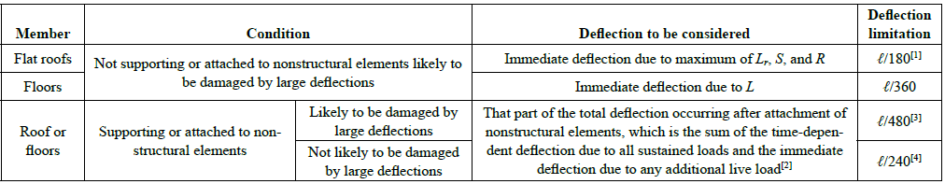
Design checks
Deflection check
The deflection check will consider:
Immediate deflection.
Long term deflection.
Allowable deflection according to ACI code:

Slide 72


Design checks
Deflection check
Immediate deflection:
Allowable values:
$allowable deflection=\frac{𝓁}{360}=\frac{7.5}{360}=20.8 mm$
Allowable value on balconies $\frac{𝓁}{360}=\frac{3.12}{360}=8.6 mm$
The figure shows the deflection from live load, and the deflection is less than allowable deflection.

Slide 73

Design checks
Deflection check
Long term deflection:
Long term deflection:
$$Δ_{LT}=Δ_{L}+λ_{∞}∆_{D}+λ_{t}Δ_{LS}$$
Where:
$Δ_{L}=$ Immediate live load deflection
$∆_{D} =$ Immediate dead load deflection
$Δ_{LS}$ = Immediate sustained live load deflection
$λ_{Δ}=$ Multiplier for additional deflection due to long-term effects
Using $λ_{Δ}=2$, $Δ_{LT}$
$allowable deflection=\frac{𝓁}{240}=\frac{7.5}{240}=31.25 mm$
Allowable value on balconies $\frac{𝓁}{120}=\frac{3.12}{120}=26 mm$

Slide 74

Design checks
Deflection check
Long term deflection:
The long term defection on the slab is 24.
Long term deflection on balconies is 25.
So the deflection is less than the allowable limits.

Slide 75
Design

Slide 76
Design
In order to design this project several models used:
The first: is the model with out any changes.
The second: is the model with the shear modifiers of hidden beams columns, and shear walls set to zero.
The third: is the model with the shear modifiers of all the columns set to zero.
The fourth: is the model without the shear walls.

Slide 77
Changes on preliminary design
Beams:
Group number | Dimensions
1 | 600 x 600 mm
2 | 600 x 650 mm
3 | 600 x 350 mm

Slide 78
Changes on preliminary design
Columns:
Group number | Dimensions
1 | 600 x 600 mm
2 | 600 x 600 mm
3 | 600 x 800 mm
4 | 600 x 1000 mm
5 | 900 x 600 mm

Slide 79

Changes on preliminary design
Walls:
Wall A: 20 cm.
Wall B: 25 cm.
Wall C: 30 cm.

Slide 80
Elements design
Beams design.
Columns design.
Shear walls design.
Slab design.
Stairs design.
Matt foundation design.

Slide 81

Beams design
First step to check if the beam will behave as a flexural member:
The factored axial load should be less than 0.1 A_{g} f′_{c.}
25<1092 so design as beam.

Slide 82

Beams design
Dimensions limit:
Clear span ℓn shall be at least 4d
L_{u} = 3.71 – 0.6 = 3.11 $≥$ 4(0.59) = 2.36 m
Width b_{w} shall be at least the lesser of 0.3h and 250 mm.
b_{w} = 600 mm $≥$ 0.3(650) = 195 mm$≥$ 250 mm
Projection of the beam width beyond the width of the supporting column on each side shall not exceed the lesser of c2 and 0.75c1.
Transverse projection in column = 0 .

Slide 83


Beams design
Design for flexure:
Maximum negative moment on the beam:
ρ = $\frac{0.85f^{′}c}{fy}(1−\sqrt{1−\frac{2.61Mu}{bd^{2}f^{′}c}}=0.005751$
A_{s} = 0.005751*600*590 = 2036 mm2

Slide 84

Beams design
Design for flexure:
Check if compression steel is needed:
The compression reinforcements are required if a > a_{max}.
$a=d−\sqrt{d^{2}−\frac{2Mu}{0.85∗fc∗∅b}}$
$a\max{=β1 cmax}$
$β1=0.85 from 28 mpa concrete$
$$Cmax= \frac{ε_{cmax}}{ε_{cmax}+ε_{smin}}$$
𝞮_{cmax}=0.003
𝞮_{smin}=0.005
So a = 59 mm.
Cmax = 221mm
A max = 188mm
A < a max → no need for compression reinforcements.

Slide 85

Beams design
The ETABS results:
%Difference = (2036-2069)/2036 *100% =-1.6% < 10% →Ok.

Slide 86

Beams design
Shear design:
Design shear force shall be the max of:
V_{e} = $\frac{Mpr1+Mpr2}{Ln}$ + $\frac{Wu Ln}{2}$
V_{u.}
M_{pr} = M_{d} = $Ø$ As f_{y} (d-a/2)
where:
$Ø$ = 1 and 1.25 f_{y} shall be used.

Slide 87


Beams design
Shear design:
$M_{Pr1}=591 kN.m$
$M_{Pr2}=424 kN.m$
Vg= 152.5 kN

Slide 88


Beams design
Shear design:
V_{e} = $\frac{Mpr1+Mpr2}{Ln}$ + $\frac{Wu Ln}{2}$ $=\frac{591+424}{3.11}+152.5=478.5 kN$
Vu =630 kN.
Design shear= 630 kN.

Slide 89


Beams design
Shear design:
$\frac{Av}{S} = \frac{Vs}{fy d} = \frac{630∗{10}^{3}}{0.6∗420∗0.59} = 4237.2 mm2/m$
ETABS results:
$\%Difference = \frac{(4237.2−4306)}{4237.2} = 1.6\% < 10\% →Ok.$

Slide 90

Columns design
Column slenderness:
The column selected for the check is 600*600mm:
In non-sway (braced) frames, slenderness effects can be ignored if:
$$\frac{klu}{r}≤34−12\frac{M1}{M2} ≤40$$
k will assumed to be 1.0.
l_{u}: length of the column from the faces of the beams = 3.38 – 0.65 = 2.73 m.
r: radius of gyration = I/A, approximately = 0.3h = 0.30 x 6.0 = 0.18 m.

Slide 91

Columns design
Column slenderness:
The check will done with gravity loads:
M1= -27 kN.m
M2= 21 kN.m
Slenderness ratio = $\frac{1.0 x 2.73}{0.180}$ = 9.1 $≤34+12\frac{27}{21}$ ,
Slenderness may be ignored.

Slide 92


Columns design
Column slenderness:
In sway (unbraced) frames, slenderness effects can be ignored if:
$\frac{klu}{r}≤22$
Ψ_{A =0} (fixed end).
Ψ_{B}=1.1
K=1.3
Slenderness ratio = $\frac{klu}{r}$ = $\frac{1.3x2.73}{0.18}$ = 19.7,
which is less than 22,
so the column is considered to be short.

Slide 93
Columns design
Dimensions limits:
The shortest cross sectional dimension is at least 300 mm.
The ratio of the shortest cross-sectional dimension to the perpendicular dimension shall be at least 0.4.

Slide 94


Columns design
Longitudinal reinforcements check:
Pu= 3881 kN.
M3=373 kN.m
M2=165 kN.m
The column will be reinforced with 1%.
To check the adequacy of the reinforcements,
Breslar method will be used:
$\frac{1}{φPn}=\frac{1}{φP3}+\frac{1}{φP2}−\frac{1}{φpno}$

Slide 95


Columns design
𝞍Pn=5035 kN.
3881 < 5035 →Ok.

Slide 96
Columns design
Strong column weak beam check:
A requirement for special columns that specify a minimum flexural strength for columns is:
ΣM_{nc} ≥ (6/5)ΣM_{nb}
ΣM_{nb} = 674.4 kN.m
ΣM_{nc} = 1199.7 kN.m
1.2 ΣM_{nb} = 1.2 x 674.4 kN.m = 809.3 kN.m < ΣM_{nc} = 1199.7 kN.m →Ok.

Slide 97

Columns design
Shear design check:
Design shear= max(Ve, Vu)
Mpr3 = Mpr4 =281.25 kN.
V_{E} =(281.25*2)/2.73=206 kN.
Vu =226 kN
Design shear = 226 kN.

Slide 98

Columns design
Shear design check:
Shear reinforcement calculation:
V_{s} = V_{n} – V_{c}
V_{s} = $\frac{226}{0.6}$ – 0 = 301 kN.
A_{v}/S = $\frac{Vs}{fyt d}$ = $\frac{301 x {10}^{3}}{420 x 590}$ = 1.52 mm2/mm
ETABS result for A_{v}/S = 1.538 mm2/mm
Difference percentage = 1.18% <10%, acceptable.

Slide 99

Walls design
Spandrel design:
The figure shows the wall that will be checked
H=2.08m
Ln=1.8m

Slide 100



Walls design
Spandrel design:
Flexural design:
Mu = 1119 kN.m.
ρ = $\frac{0.85f^{′}c}{fy}(1−\sqrt{1−\frac{2.61Mu}{bd^{2}f^{′}c}}=0.0029$
A_{s} = ρ_{L} A_{g} = 0.0029(2080)(300) =1809 mm2
%Difference = (1809-1872)/1809*100 = 3.4%
3.4%<10% → ok.

Slide 101


Walls design
Spandrel design:
Shear design:
For V_{u} = 1253 kN.
ØV_{c} = $\frac{\sqrt{28}}{6}$*0.6*1872*300 /1000 =303 kN.
ØV_{s} = 1253 - 303 =950 kN.
A_{v}/s =ØV_{s}/ Ø d f_{y} =950/(0.6*1.8*420)*1000 = 2013 mm2/m.
%Difference = (2013-2044)/2013*100 = 1.5%
Less than 10% $→$Ok for shear reinforcement.

Slide 102

Walls design
Spandrel design:
Spandrel diagonal reinforcements:
Coupling beams with (ℓ_{n}/h) < 2 and with V_{u} ≥ 0.33 λ $\sqrt{f′c }$ A_{cw} shall be reinforced diagonally.
$\frac{ln}{h}=\frac{1.8}{2.08}=0.86<2$
$Vu=1253>0.33∗\sqrt{28}∗2.08∗300=1089kN$
So the spandrel reinforcements required.

Slide 103


Walls design
Spandrel design:
Spandrel diagonal reinforcements:
$Vn=2Avd∗fy∗sinα≤0.83∗\sqrt{fc}∗Acw$
$Vn=\frac{1253}{0.85}=1474≤0.83∗\sqrt{28}∗2.08∗300=2740 kN$
$sinα=\frac{0.8Hs}{\sqrt{{Ls}^{2}+{0.8Hs}^{2}}}$
$Avd=\frac{1253}{0.85∗2∗420∗0.67}=2619kN$
%difference = 0.2% →ok.

Slide 104

Walls design
Pier design:

Slide 105
Walls design
Pier design:
Flexural design:
Length of pier = 4053 mm.
Thickness =250 mm.
1/P_{n} = 1/P_{nx} + 1/P_{ny} – 1/P₀
P₀ = 13115 kN.
Pnx and Pny from interaction diagrams.

Slide 106

Walls design
Pier design:
Flexural design:
ETABS results:

Slide 107
Walls design
Pier design:
Flexural design:
For M_{u3} = 2927kN.m, P_{n} = 13177 kN.
For M_{u2} = 0.1617 kN.m, P_{n} = 13177 kN.
𝞍Pn=13239 kN>4047 → ok.

Slide 108



Walls design
Pier design:
Shear design:
V2=1195 kN.
V3=0.6 kN.
ØV_{c} = $\frac{\sqrt{28}}{6}$*0.75*4053.2*190 /1000 = 509 kN
$→$Ok for minor shear.

Slide 109

Walls design
Pier design:
Shear design:
For major shear
$Vc=α_{c}∗\sqrt{fc}∗A_{cv}$ = 804 kN.
Vu= 1195 kN.
The computed Av/s less than the minimum reinforcement ration=0.0025.

Slide 110
Walls design
Pier design:
Boundary element check:
The stress method will be used for this check:
If compressive stresses exceeds a nominal critical value equal to 0.2fc. Then the boundary element is required.

Slide 111


Walls design
Pier design:
Boundary element check:
Stress =10.38 > 5.6 mpa.
So the boundary element required.

Slide 112


Walls design
Pier design:
Boundary element check:
Length of boundary element is the greater of {C – 0.1Lw} and {C/2 }:
C – 0.1Lw = 1605.3 – 0.1 (4030) = 660 mm
C/2 = 1605.3/2 =802 mm
$$Pleft or P right=\frac{Mu}{Lw−boundary elemet length}=933 kN$$
$$As=\frac{P}{φfy}=\frac{933∗1000}{0.9∗420}=2468{mm}^{2}$$
Use 14 ø16 for each end.

Slide 113

Slab design
Shear check:
$∅V_{c}=∅1/6\sqrt{f_{c}^{′}}bd$
$=0.75Χ1/6Χ\sqrt{28} Χ150Χ310$
$=30.75 kN$

Slide 114


Slab design
Shear check:
V13
V23

Slide 115


Slab design
Shear check:
Vu=114 kN> $∅V_{c}$
So shear reinforcements required:
V_{s} = V_{n} – V_{c}
V_{s} = $\frac{114}{0.75}$ – 30.75 = 121.25 kN.
A_{v}/S = $\frac{Vs}{fyt d}$ = $\frac{121.25 x {10}^{3}}{420 x 310}$ = 931 mm2/m
Use 1 ø 10 / 8cm.

Slide 116

Slab design
Flexural design:
AS min = 630 mm2
5 ø 14 /m.
M min = 88.2 kN.m
All the moment less than minimum

Slide 117

Design of foundation
Type of foundation:
$Area required of total foundations= \frac{Total vertical loads }{Bearing capacity}=\frac{121957}{380}=320m^{2}$
Percent of the foundation to the floor area = 320/445 = 71%.
So mat foundation will be used.

Slide 118

Design of foundation
Soil pressure:
The pressure is less than the bearing capacity.

Slide 119

Design of foundation
Punching check:
The foundation thickness will be used is 1.3m.

Slide 120



Design of foundation
Wide beam shear
$${φV}_{c}=φ1/6\sqrt{f_{c}^{′}}b_{w}d \\ =0.75×1/6×\sqrt{28}∗1000×1230=813 kN$$

Slide 121


Design of foundation
Flexural design:
$A_{s_{min.}}=ρ_{sh.}bh=0.0018×1000×1300$
$$=2340 {mm}^{2}$$
Thus, one can use 5$∅$25mm/m (2453.12 mm²)
M min = 1120 kN.m
All the moment is less than minimum.

Slide 122

Stairs design
Check for shear:
$∅V_{c}=∅1/6\sqrt{f_{c}^{′}}bd$
$=0.75Χ1/6Χ\sqrt{28} Χ1000Χ120$
$=79.4kN$

Slide 123


Stairs design
Check for shear:

Slide 124


Stairs design
Flexural design:
$${A_{s}}_{min.}=A_{sh.}=ρ_{sh.}bh \\ =0.0018Χ1000Χ150$$
$=270\frac{{mm}^{2}}{m} (4∅10)$
M min = 14 kN.m

Slide 125
ELEMENT DETAILS

Slide 126

Slab Details

Slide 127


Beam Details

Slide 128

Column Details

Slide 129

Column Details

Slide 130

Wall Details

Slide 131


Wall Details

Slide 132

Mat Details

Slide 133

Mat Details

Slide 134

Stair Details

Slide 135

Stair Details

Slide 136
References
ACI Committee 318, “Building Code Requirements for Structural Concrete (ACI 318M-11)”, American Concrete Institute, Michigan, 2011.
ASCE Committee, “American Society of Civil Engineers, Minimum Design Loads for Buildings and Other Structures” Edition 7-10.
ETABS 2016 design documentations.

