Slide 1
Graduation Project Report (2)
Off-grid solar system design.
Supervisor Name:
Dr. Raed Jaber
Student Names:
Zaid khayat (11939052)
Farah ghazal (11821433)
Adnan Basha (11717928).

Slide 2
Contents:
Introduction.
Comparison between one house and twelve house .
Implementation of the project (1) by pv syst .
Implementation of the project (1) by MATLAB software.
Designing a complete system for all 12 houses, and calculating the devices needed for the system.
Economic feasibility of the project.
A comparison between installing a system for each home and installing a complete system for all homes
Conclusion.

Slide 3
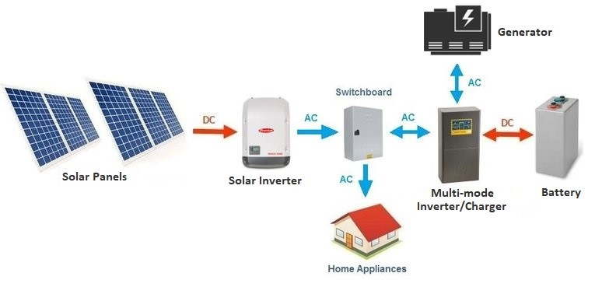
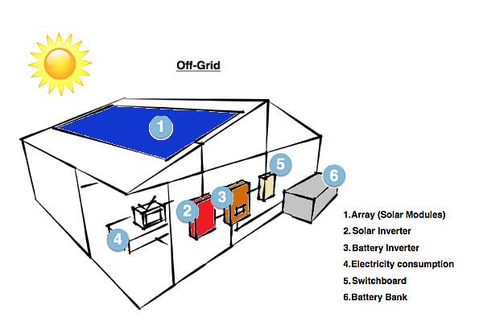
Introduction:
Study to complete project 1 to create an off-grid system and compare between connecting the houses in one system for 12 houses or connecting each house separately.

Slide 4
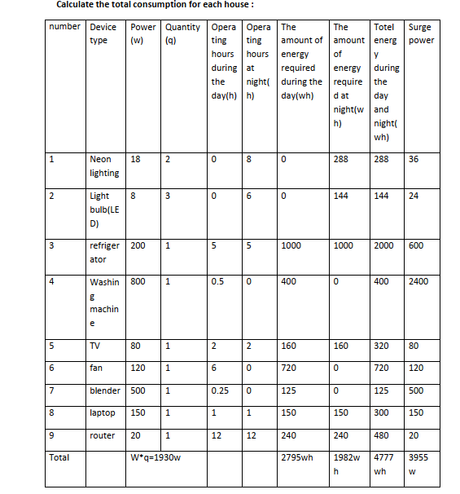
Daily consumption for each house
Total (12) = Total(1) * 12

Slide 5
Comparison between one house and twelve house .
Panels
House number | Total power consumption during the 24 hours | Solar panels energy | Number of panels |  |  | Solar System Size
 |  |  | Capacity 580w | Capacity 590w | Capacity 610w
1 | 4.777 KWH | 4.777 KWH *1.3 / 5.56 = 1.12 KWH | 2 | - | - | 1.16 kw
12 | 4.777kwh *12 =57324kwh | 57.324kwh *1.3 / 5.56 = 13.403kwH | 13.403kw /580 = 23.1 ~ 24 | 13.403kw /590 = 22.7 ~ 23 | 13.403kw /610 = 21.97 ~ 22 | 22*610w = 13.42kw
We use this equation
The number of solar panel = panel energy / panel capacity(w)

Slide 6
Comparison between one house and twelve house
Inverter.
OFF Grid Inverter with Built in Solar Charge Controller:
Type of system (house) | Type of phases | capacity
1 | single phase | 1930 ~2kw
12 | 3 phase | 1930*12 =23160 ~20kw

Slide 7
Comparison between one house and twelve house
Charge control.
for one house : Maximum DC operating voltage according to the panel connection. If it is in series, we increase the voltage, and if it is parallel, we increase the current.
• If the panels are connected in series, then Voc = 81 v Isc=18.27A .
for twelve house : The panels are connected in two groups in parallel, and each group consists of 11 panels in a row , Panels effort for each group Voc =41.7* 11panel=458.7 v Isc=18.57A
The total effort of the two groups will be Voc =458.7*2=917.4 v Isc=18.57*2=37.14A

Slide 8
Comparison between one house and twelve house
Batteries
system voltage | Battery bank capacity = ( energy quantity * Number of standby days )/( DOD * System efficiency * system voltage) | number of batteries = Battery bank capacity / Single battery capacity = Battery bank capacity / 100Ah = | number of batteries = Battery bank capacity / Single battery capacity = Battery bank capacity / 200Ah =
24v | (4.777kw * 1 )/( 80% * 0.8 * system voltage)= 311Ah | 3.11 ~ 4 | 1.555 ~ 2
48v | = (57324kw * 1 )/( 80% * 0.8 * system voltage)= 1866.015Ah | 18.66 ~ 19 | 9.33 ~ 10
We use this equation
number of batteries = Battery bank capacity / Single battery capacity

Slide 9
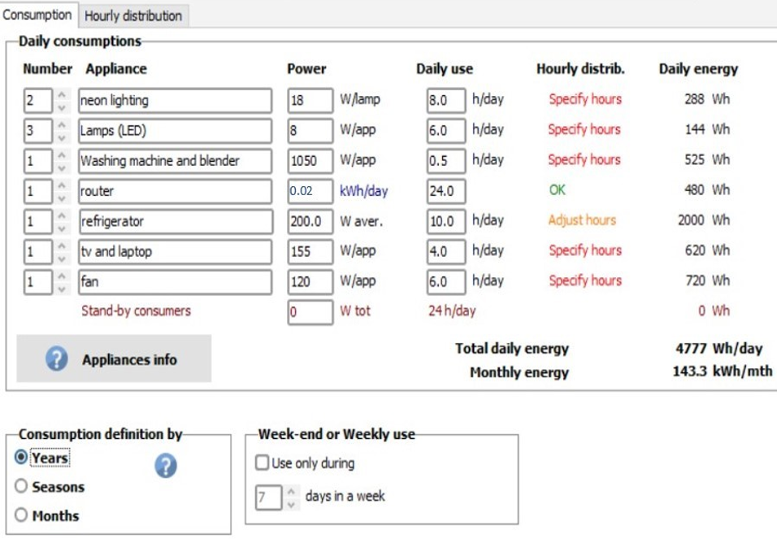
Designing stand-alone PV-system. by pv sys program .
We choose the following electrical loads for each house:

Slide 10
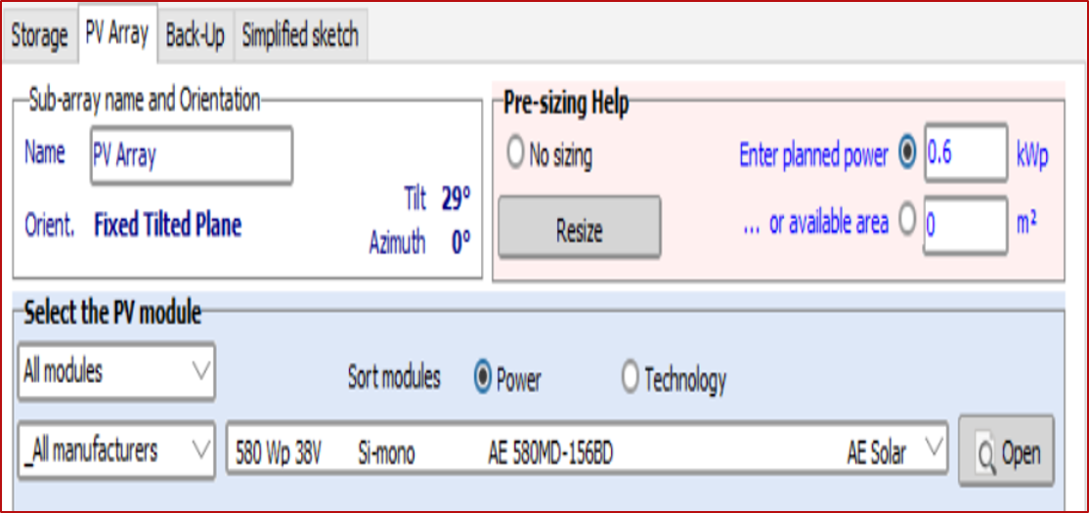
PV energy system.
We choose the type and energy of the solar cell

Slide 11
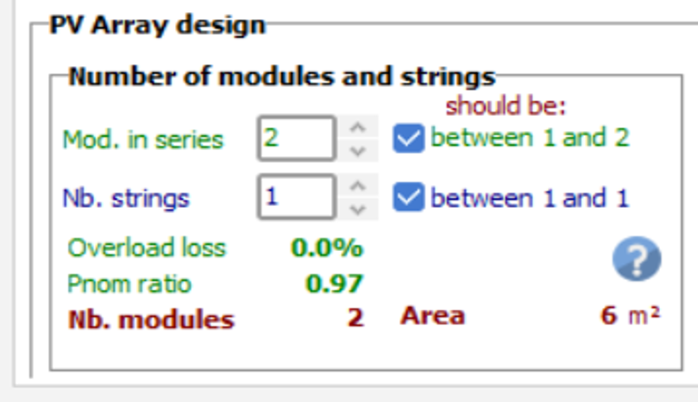
Determine the phase number of solar cells in series, parallel and area Photovoltaic units

Slide 12
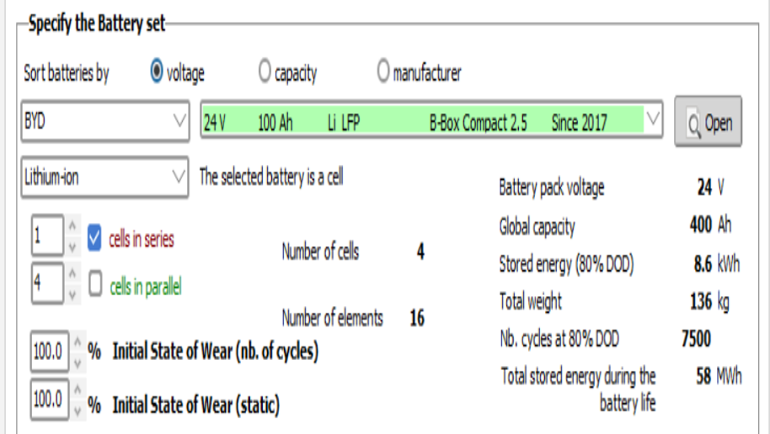
We choose the type and size of the battery, and the program determines the number of batteries needed, and how to connect them in series and parallel, as we choose one day without sunlight, so we need 4 batteries to feed the load for one day without sun

Slide 13
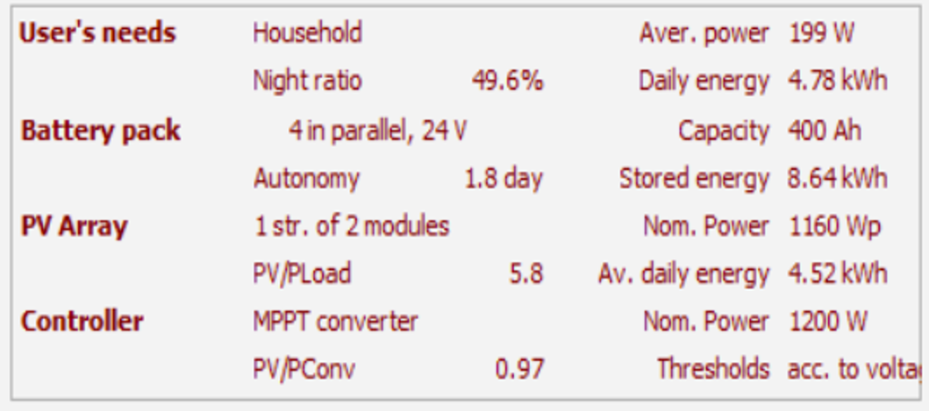
The summary of the design

Slide 14
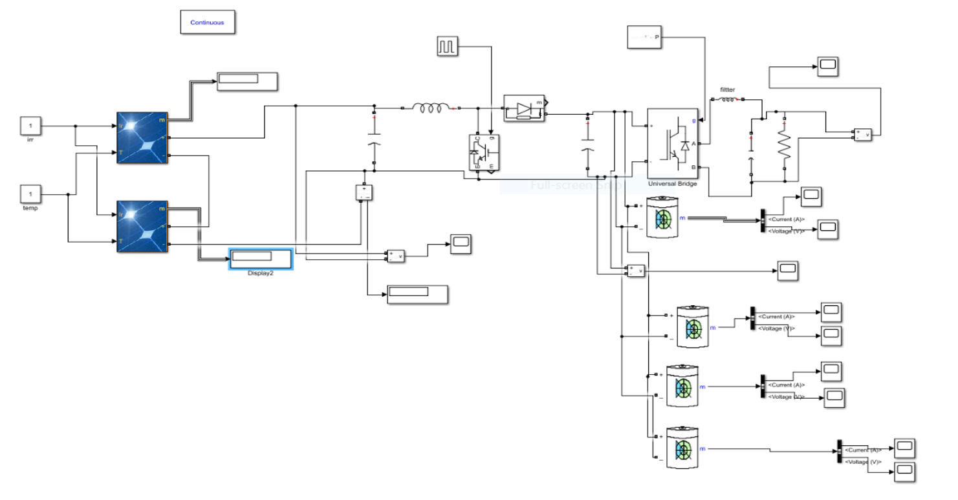
. Implementation of the project 1 by MATLAB software.

Slide 15
Economic feasibility

Slide 16
A complete off-grid solar power system of 1.16Kwp
Note : The price for each one project for 1.16 kw = 19800Nis
Note : Consumption of diesel generators:
The cost of diesel generators producing 1 kilo of electricity is equivalent to the price of 2.5 Nis.
daily consumption= (4.777w) * (2.5 Nis)= 11.9425 Nis
monthly consumption= daily consumption * (30 days)
=11.9425*30=358.275 Nis
Annual consumption=11.94* ( 365 days )=4359 Nis
Capital recovery period=
(Total project costs=19800 Nis ) / (cost of daily consumption=11.94 Nis) = 1658.29~(1659days)
The payback period is 4.54 years

Slide 17
: Economic feasibility of a system designed to supply the electricity needs of 12 homes
Install 13.42Kwp
No. | the Requirements | quantity for the entire solar system | U.P/NIS per unit | Total Cost of Solar Power System Designed for 12 Homes
1 | units of PV Modules 610Wp | 22 | 740 | 16280
2 | Off Grid Inverter with built in solar charge controller | 1 | 33000 | 33000
3 | units of LifePO3 lithium Batteries 48V\100Ah | 19 | 5000 | 95000
4 | Hot deep Galvanized Structure | 2 | 2800 | 5600
5 | Electrical cabinet for batteries | 2 | 2500 | 5000
6 | Electrical cabinet for system | 2 | 3000 | 6000
7 | Electrical cabinet for inverter | 1 | 2000 | 2000
8 | Electrical cabinet for dispensar meters | 1 | 4000 | 4000
9 | Dispensar meter to determine the energy needed for each house | 12 | 450 | 5400
10 | Earth System | 12 | 500 | 6000
11 | Main Distribution Board . | 12 | 200 | 2400
12 | Accessories for installing the system such DC,AC protection, Slive,,,ect | 1 | 3000 | 3000
13 | DC and AC cables to install the unit. | 1 | 3000 | 3000
14 | Installation cost including labor work and cost of any needed materials for installation non mention above . | 1 | 1000 | 1000
 | Total price |  |  | 187680
Note : The cost for all project for 13.42 kw =187680 Nis
Note : The cost per home = The cost of the complete system for 12 houses / the number of 12 houses
187680 Nis /12 houses =15640 Nis
Note : Consumption of diesel generators:
The cost of diesel generators producing 1 kilo of electricity is equivalent to the price of 2.5 Nis.
daily consumption= (57.324)* (2.5 Nis)= 143.31 Nis
monthly consumption= daily consumption * (30 days)
=143.31*30=4299.3 Nis
Annual consumption )=143.31)* ( 365 days )=52308.15 Nis
Capital recovery period=
(Total project costs=187680Nis ) / (cost of daily consumption 143.31 Nis) = 1309.60 ~(1310 days)
The payback period is 3.589 years .

Slide 18
: A comparison between installing a system for each home and installing a complete system for all homes
No. | the Requirements | System cost for one house | Total Costs of Solar Power Systems for 12 Homes | Total Cost of Solar Power System Designed for 12 Homes
1 | units of PV | 1400 | 16800 | 16280
2 | Off Grid Inverter with built in solar charge controller | 4000 | 48000 | 33000
3 | units of LifePO3 lithium Batteries | 10000 | 120000 | 95000
4 | Hot deep Galvanized Structure | 600 | 7200 | 5600
5 | Electrical cabinet for batteries | ---- | ---- | 5000
6 | Electrical cabinet for system | 2300 | 27600 | 6000
7 | Electrical cabinet for inverter | --- | --- | 2000
8 | Electrical cabinet for dispensar meters | ---- | ---- | 4000
9 | Dispensar meter to determine the energy needed for each house | ---- | ---- | 5400
10 | Earth System | 500 | 6000 | 6000
11 | Main Distribution Board . | 200 | 2400 | 2400
12 | Accessories for installing the system such DC,AC protection, Slive,,,ect | 300 | 3600 | 3000
13 | DC and AC cables to install the unit. | 300 | 3600 | 3000
14 | Installation cost including labor work and cost of any needed materials for installation non mention above . | 200 | 2400 | 1000
 | Total price | 19800 nis | 237600 nis | 187680 Nis

Slide 19
The final comparison between the cost of designing a system for one house, and the cost of a house from a system designed for 12 houses :
 | System cost for one house | The total cost per house of a solar power system designed for 12 homes
cost | 19800 nis | 187680/12=15640 Nis
Payback period | 4.54 years | 3.589 years
maintenance costs over the years | lower | higher
So designing a complete system for 12 houses is better than many things, including the costs, as the difference in the total costs of the project for one house is 4160 shekels, and also the recovery period for the project’s capital is earlier than designing a system for one house.

Slide 20
Conclusion:
To summarize, based on the feasibility study, it appears that the solar energy system that includes 12 houses in one system is the better option. This system saves on equipment, installation, and maintenance costs, requires less land space, making it more efficient. Additionally, the payback period is less with this system.
Where the cost of the project will be recovered within 3 years and 7 months, and homeowners will get free electricity during the remaining period , free of environmental damage and technical problems of generators.
By adopting the system, it is valid for at least 15-20 years.
Through these results, we were able to prove the benefit of this system to the people
of the village .

