Slide 1



Slide 2
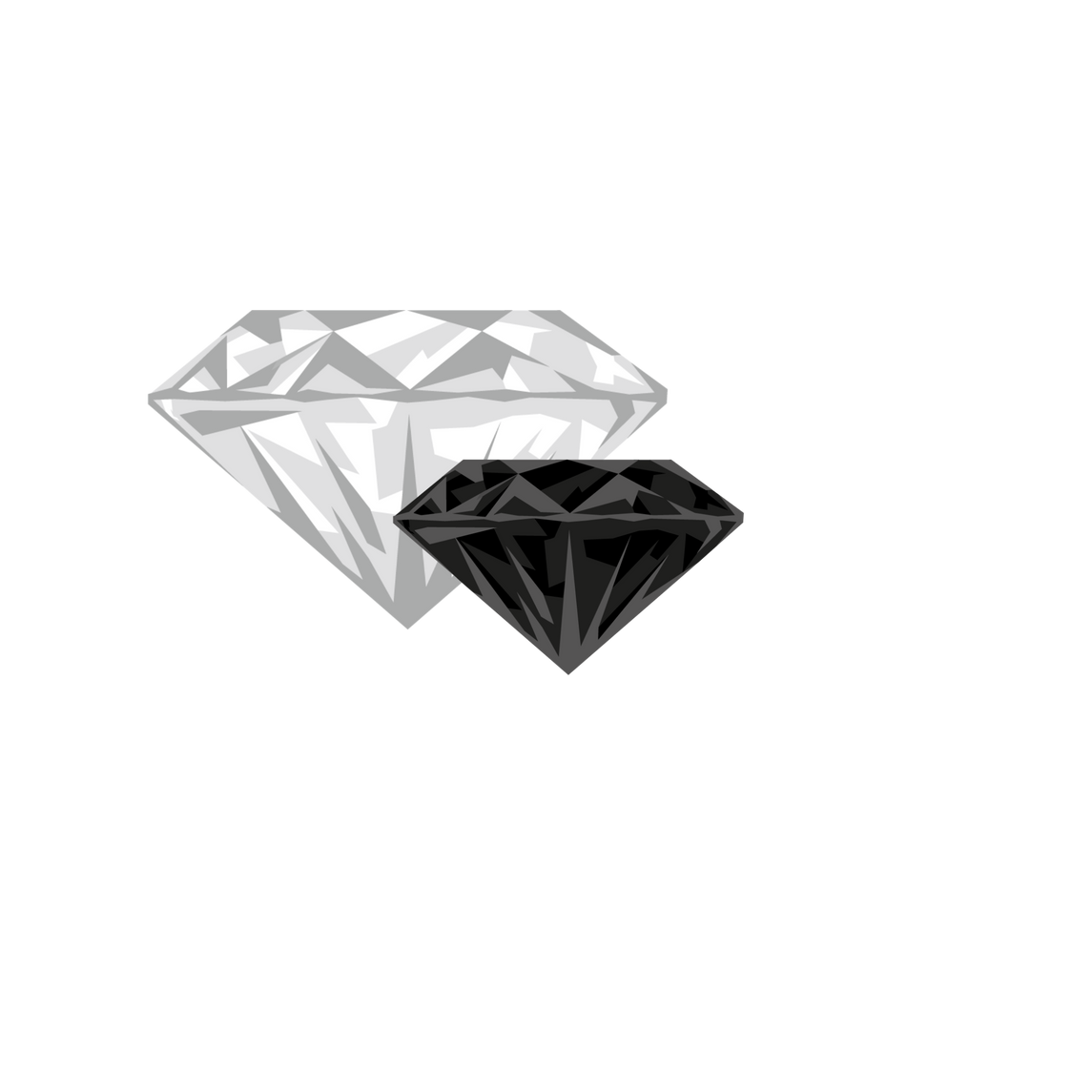

IRIS JEWELLRY
TABLE OF CONTENTS
INTRODUCTION
IRIS FEATURES
CONSTRAINTS
FUTURE WORK

Slide 3

IRIS JEWELLRY
INTRODUCTION

Slide 4
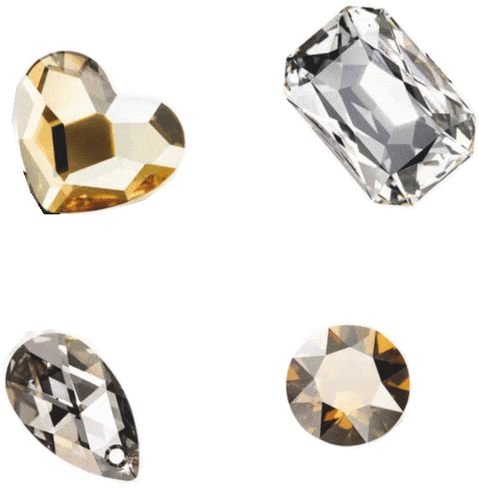
IRIS JEWELLRY
PROBLEM
JEWELRY CUSTOMERS FACE CHALLENGES IN REACHING AND VIEWING ITEMS IN SPECIFIC STORES DUE TO LOCATION PROBLEMS , ESPECIALLY THESE DAYS IF THE STORE IS NOT LOCATED IN THEIR CITY .

Slide 5

IRIS JEWELLRY
OBJECTIVES
EFFICIENT JEWELRY SHOPPING
FACILITATE EASY NAVIGATION
PROVIDE DETAILED PRODUCT INFORMATION
CUSTOM JEWELRY ORDERS
OFFER TRY-ON FEATURE
DELIVER CUSTOMER SUPPORT
OFFER FLEXIBLE PAYMENT OPTIONS
PROVIDE SEARCH FUNCTIONALITY

Slide 6
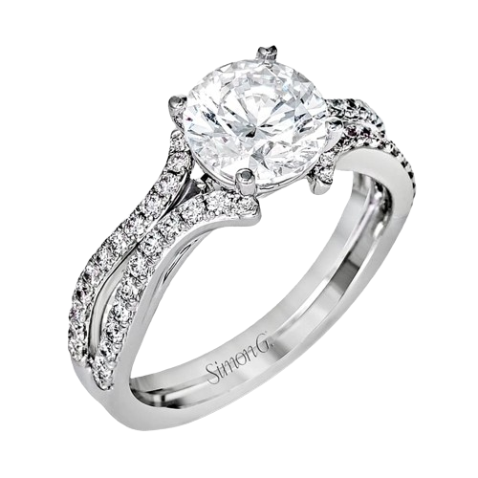
IRIS JEWELLRY
IRIS
"IRIS" IS A MODERN APP AND WEBSITE THAT SIMPLIFIES JEWELRY SHOPPING BY OFFERING A VAST COLLECTION OF HIGH-QUALITY, AUTHENTIC PIECES. WITH DETAILED DESCRIPTIONS, HIGH-QUALITY IMAGES, AND PERSONALIZED FEATURES LIKE AN INTERACTIVE TRY-ON TOOL, CUSTOM ORDERS, AND DIAMOND SHAPE RECOMMENDATIONS, IRIS ENSURES A USER-FRIENDLY SHOPPING EXPERIENCE.

Slide 7

IRIS JEWELLRY
TECHNOLOGIES & TOOLS
TECHNOLOGIES :
FRONTEND : FLUTTER & DART
BACKEND : NODE JS
DATABASE : MONGODB & EXPRESS
TOOLS :
VS CODE
ANDROID STUDIO
MONGODB COMPASS
PLATFORMS :
GITHUB
FIREBASE : STORAGE , MESSAGING AND FIREBASE DATABASE
POSTMAN

Slide 8
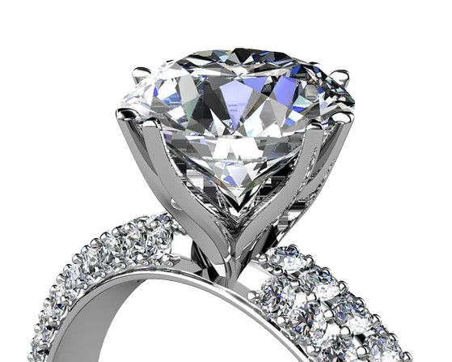
IRIS JEWELLRY
IRIS FEATURES

Slide 9
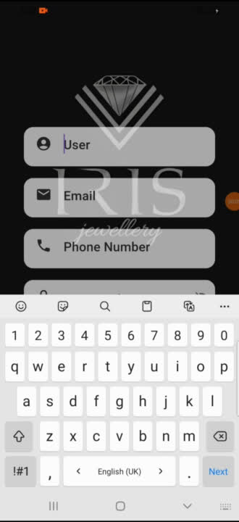
USER LOG IN /
SIGN UP

Slide 10
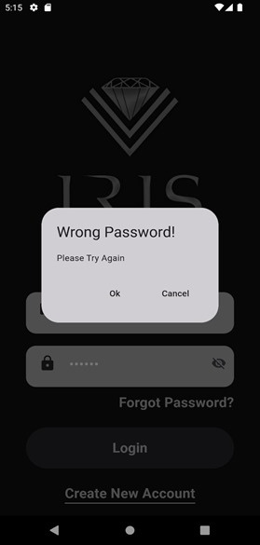
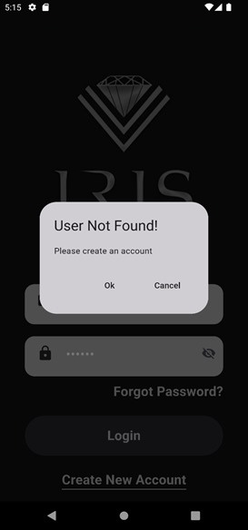
USER LOG IN
VALIDATION

Slide 11
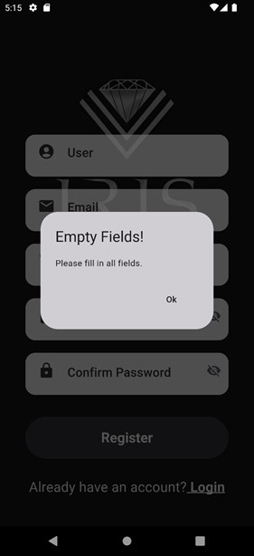
USER SIGN UP
VALIDATION

Slide 12
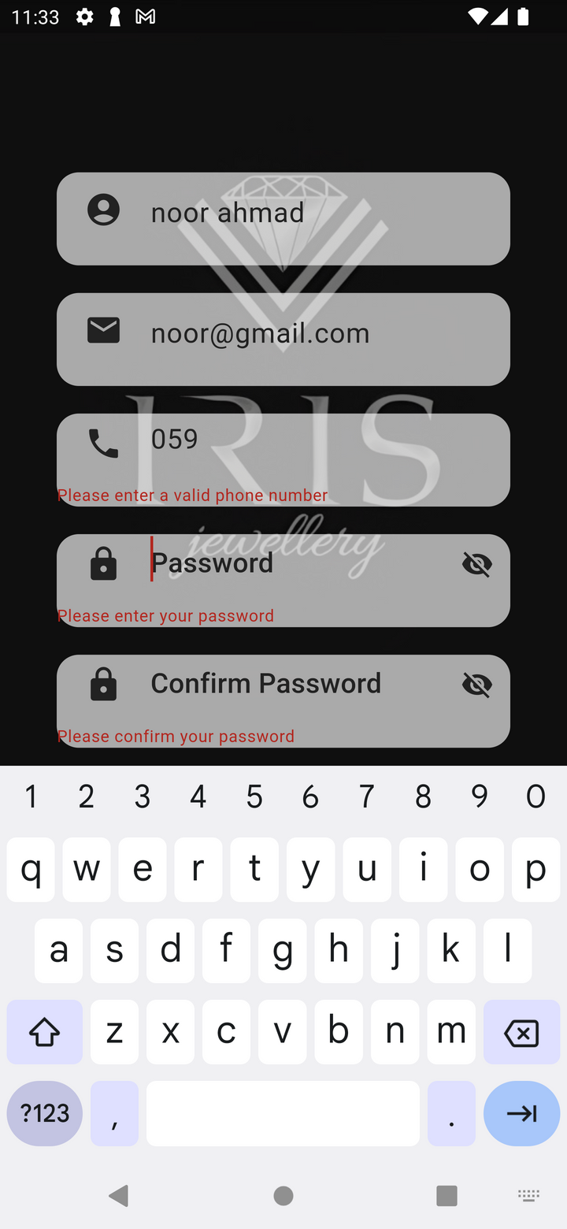
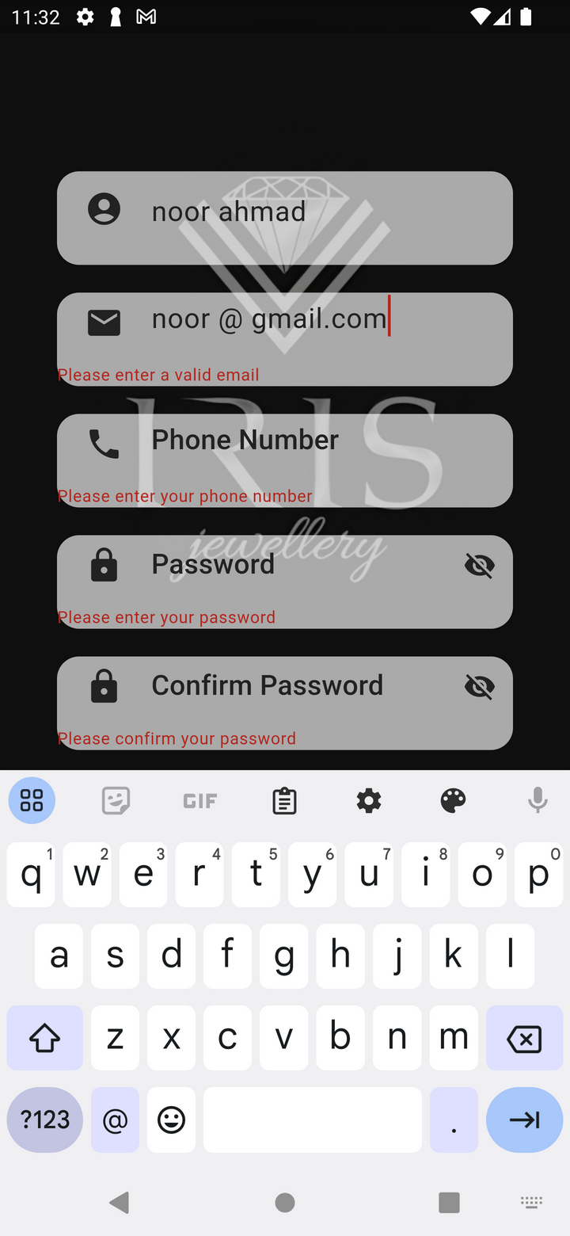
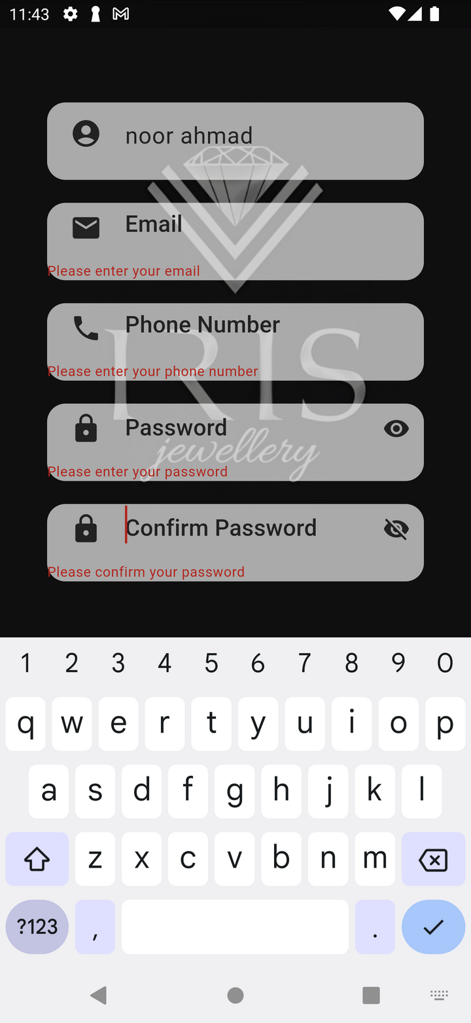

Slide 13
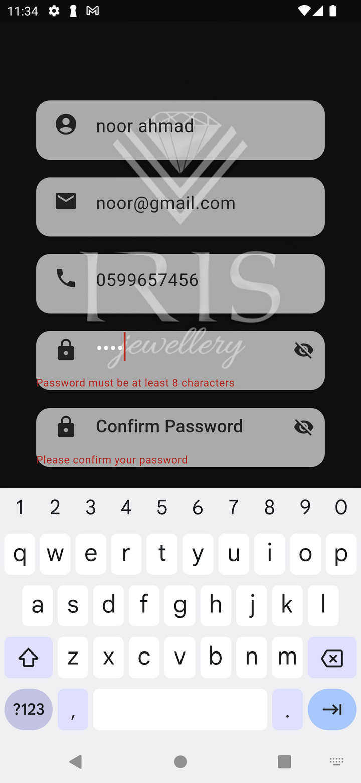
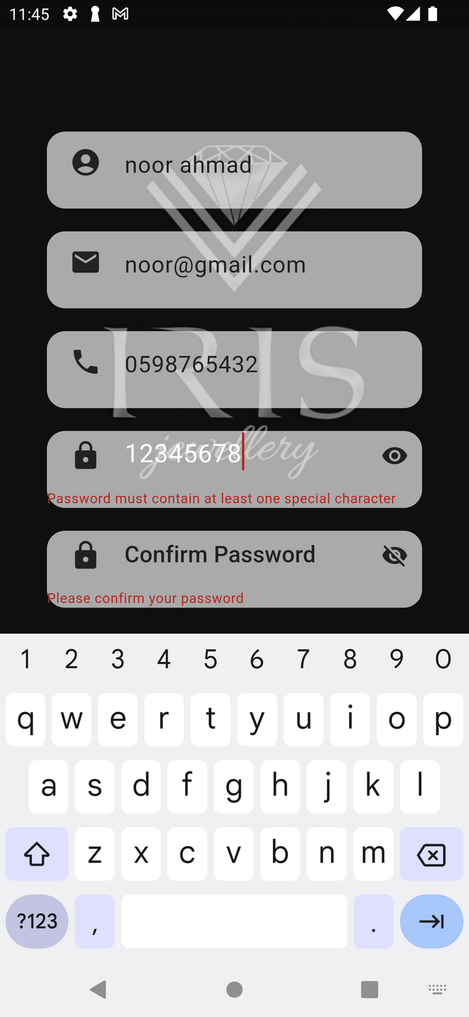
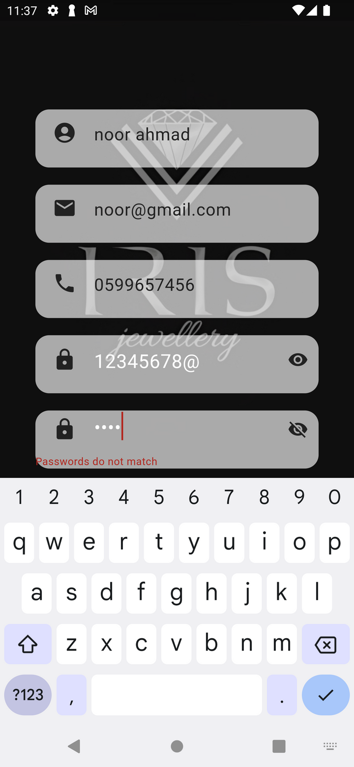

Slide 14
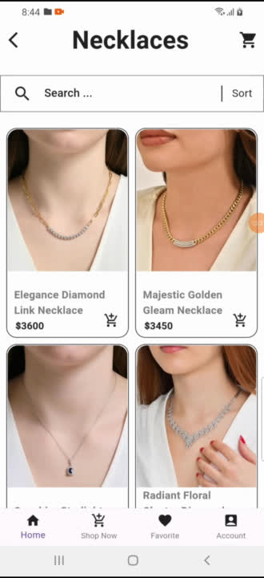
DIAMOND SECTION
IRIS CATEGORIES

Slide 15
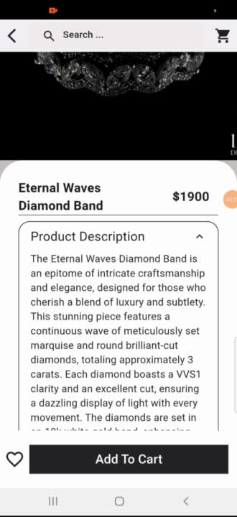
DIAMOND SECTION
RING CATEGORY & PRODUCT DETAILS

Slide 16
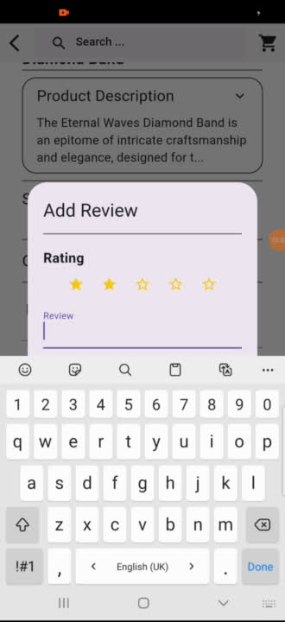
ADDING A REVIEW & RECOMMENDED FOR YOU SECTION

Slide 17
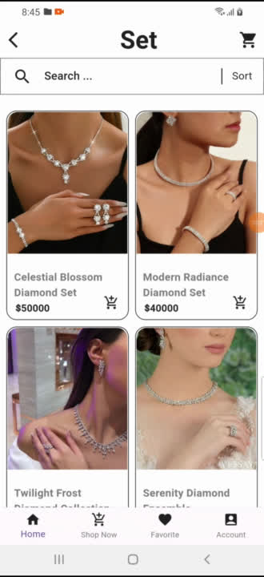
SORTING ITEMS

Slide 18
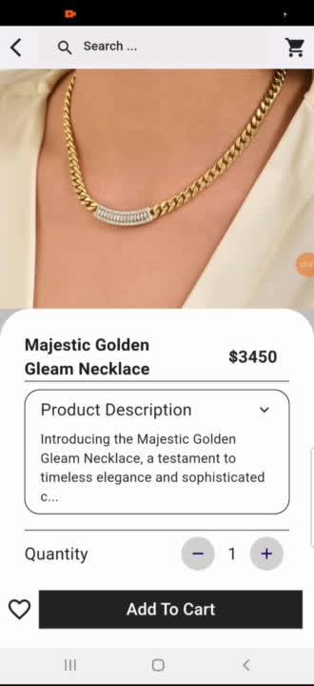
SEARCH FEATURE

Slide 19
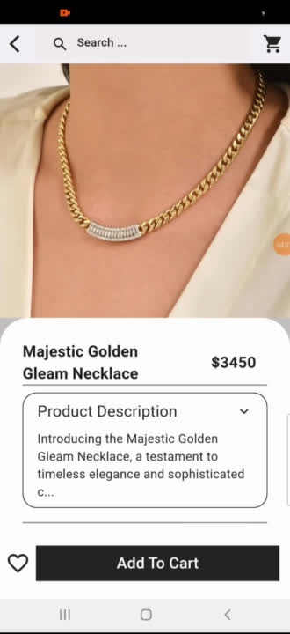
ADD ITEM TO CART

Slide 20
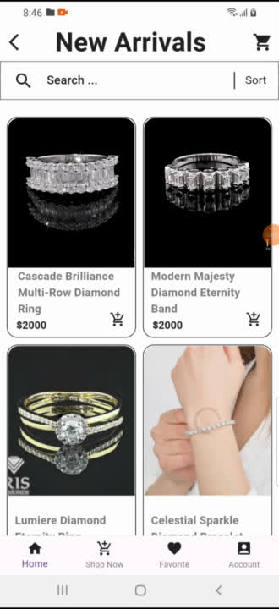
NEW ARRIVALS &
BEST SELLERS

Slide 21
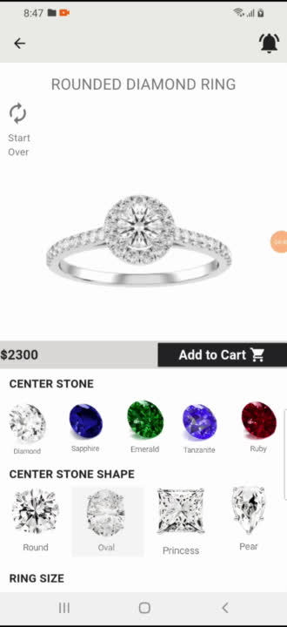
DESIGN YOUR OWN RING FEATURE

Slide 22
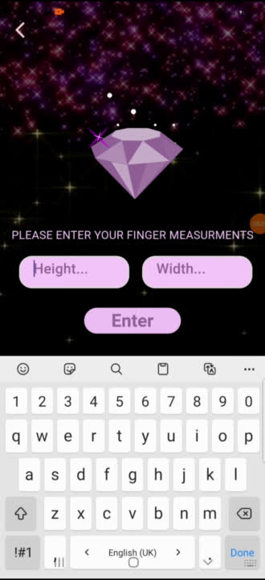
MY PERFECT DIAMOND FEATURE

Slide 23
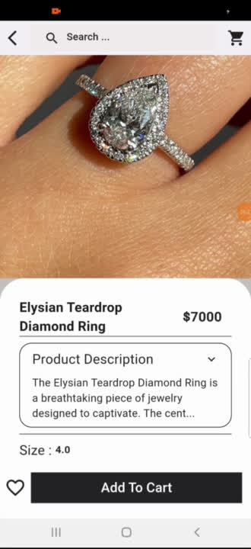
TRY RING ON HAND FEATURE

Slide 24
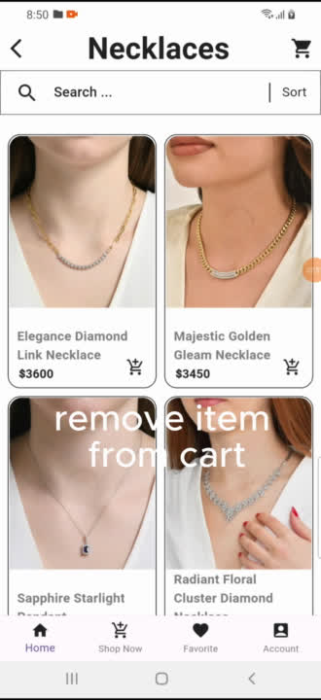
WISHLIST

Slide 25
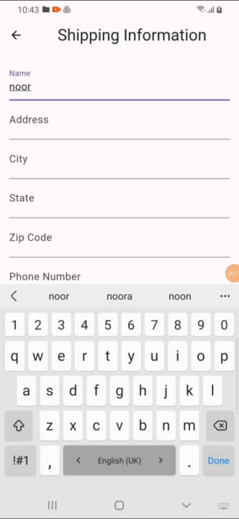
REMOVE ITEM FROM CART
& CHECKOUT PROCESS

Slide 26
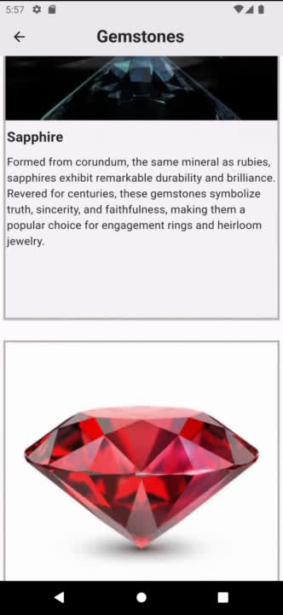
GEMSTONES SECTION

Slide 27
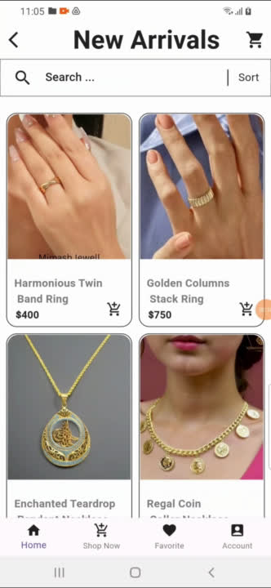
GOLD SECTION

Slide 28
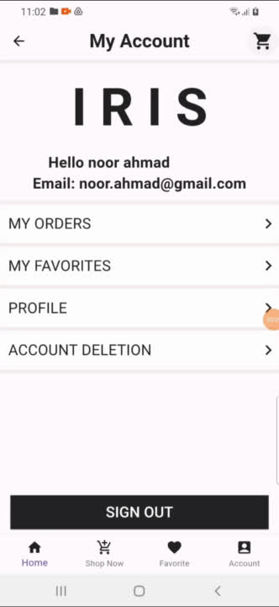
USER PROFILE

Slide 29
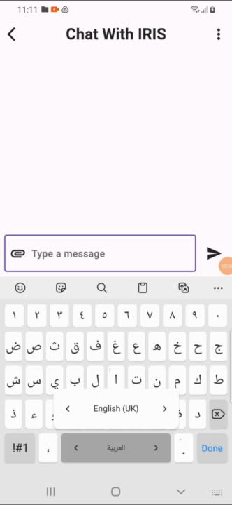
CHAT WITH IRIS
USER SIDE

Slide 30
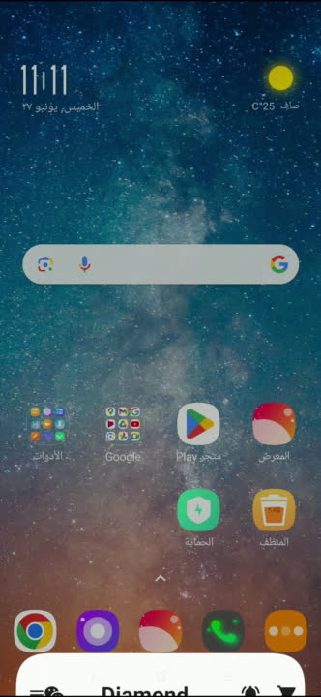
NOTIFICATION

Slide 31
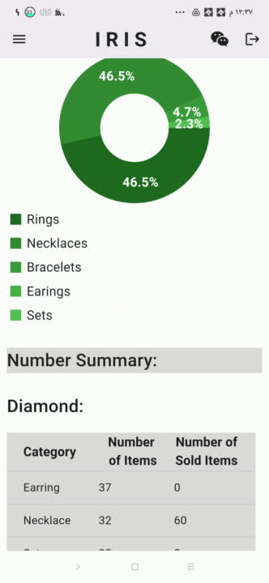
ADMIN
SECTION
HOME PAGE &
SEARCH FEATURE

Slide 32
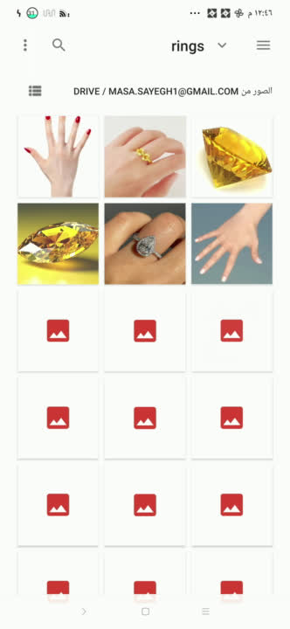
ADMIN
SECTION
ADD NEW ITEMS &
UPDATE GOLD PEICES

Slide 33
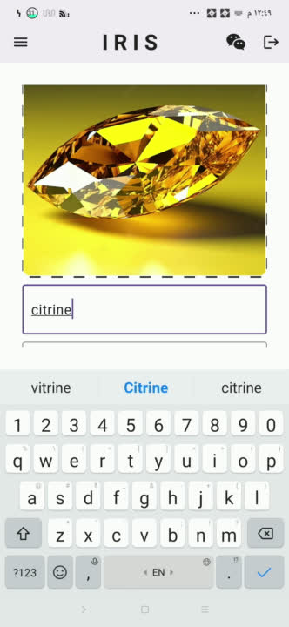
ADMIN
SECTION
ADD NEW GEMSTONE

Slide 34
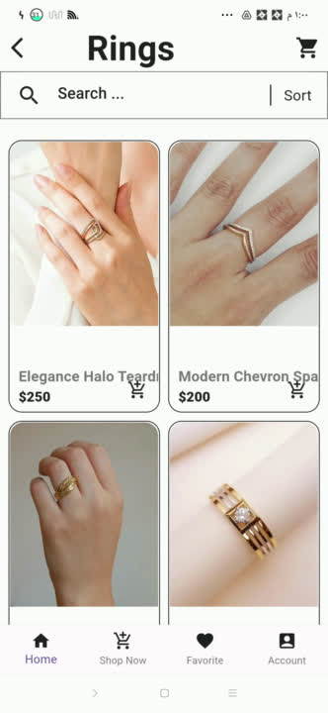
ADMIN
SECTION
VIEW ADDED ITEMS ,
GEMSTONES & UPDATED GOLD PRICES
IN USER SECTION

Slide 35
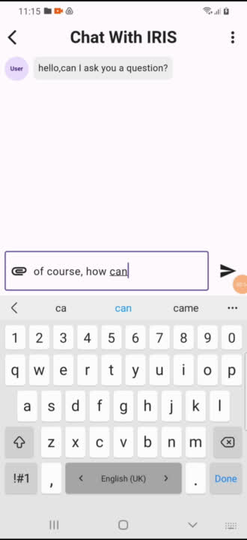
ADMIN
SECTION
CHAT

Slide 36
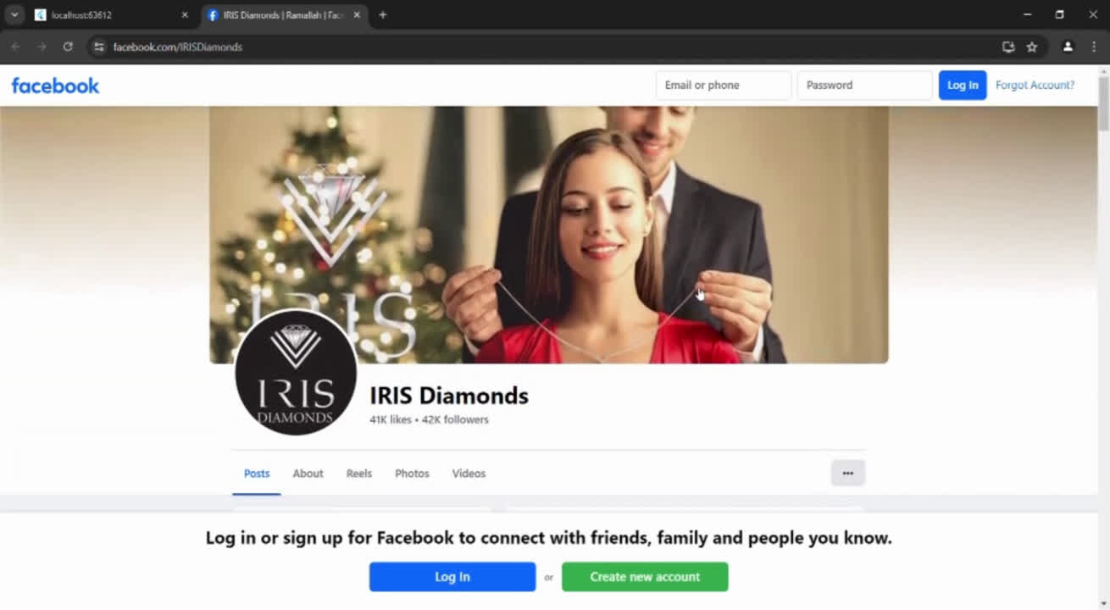
WEBSITE

Slide 37

IRIS JEWELLRY
CHALLENGES

Slide 38
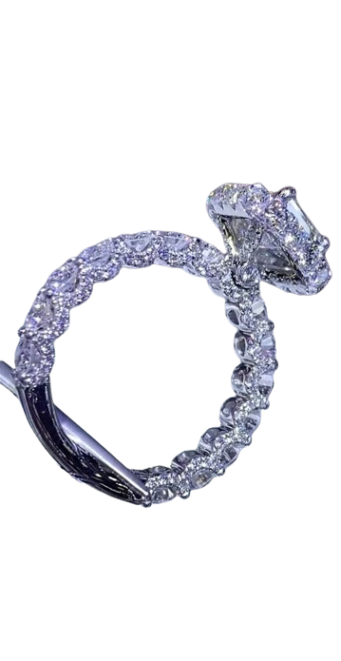
IRIS JEWELLRY
CONNECTING FIREBASE WITH FLUTTER
USER INTERFACE DESIGNING
IMPLEMENTING SUITABLE
DIAMOND &
TRY ON HAND FEATURES
DEPENDENCIES COMPATABILITY
LEARNING ABOUT MONGODB
CONNECTION BETWEEN
WEBSITE & NODE JS

Slide 39
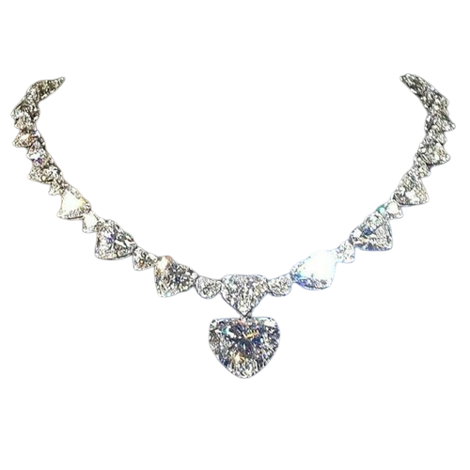
IRIS JEWELLRY
FUTURE WORK

Slide 40
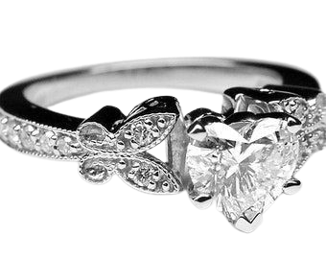
IRIS JEWELLRY
ADDING AI & MACHINE LEARNING
DEVELOPING A MORE INTERACTIVE DESIGN
ADDING A LOCATION SYSTEM
DEVELOPING GOLD SECTION
ADDING MORE TYPES OF JEWELRY

Slide 41

IRIS JEWELLRY
THANK YOU FOR LISTENING!

