Slide 1

The impact of using rubber on asphalt mix design
Graduation Project II
Prepared by : Ibraheem Solimea Supervisor: Dr. Amjad Issa
Raghad Al-Zerie
Rinal Abdulallh

Slide 2
Outline :
Introduction
Objectives
Methodology
Performed Tests
Optimum Asphalt Content
Results & Discussion
Conclusion
Recommendations

Slide 3
Introduction
Problem
Used tire disposal and recovery is a great challenge.
Suggestion
Using car tires in asphalt mixture.
An environmentally friendly solution for the waste problem of tires

Slide 4
Objectives
The main objective of this project is to study the change in asphalt mixture properties after adding tires rubber.
Make a new asphalt mixture with the same properties or with properties close to those of the traditional mixture in an environmentally friendly manner.
Reduce the amount of bitumen in paving mixture which is expected to improve stability and durability.
Notes:
To assess effectively the security needs of an organization and to evaluate and choose various security products and policies, the manager responsible for security needs some systematic way of defining the requirements for security and characterizing the approaches to satisfying those requirements. This is difficult enough in a centralized data processing environment; with the use of local and wide area networks the problems are compounded. ITU-T Recommendation X.800, Security Architecture for OSI, defines such a systematic approach. The OSI security architecture is useful to managers as a way of organizing the task of providing security.

Slide 5
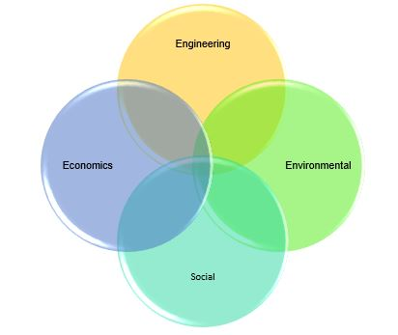
Importance of the Project

Slide 6
Methodology
Obtain the materials
Select experiments needed for the asphalt mix design
Put a work plan
Determine the percent of rubber added to optimum asphalt content
Compare the results and properties
(modified & unmodified)
Collect and analyze the results
Mix the rubber with bitumen
Make samples of each percentage to do tests
Calculate the optimum asphalt content

Slide 7
Performed Tests Diagram
Tests
Marshal Test for Asphalt Mix Samples
Air Voids Vs. %Rubber
Density Vs. %Rubber
Bitumen Tests
Ductility test
Softening point
Stability Vs. %Rubber
Flow Vs. %Rubber
VMA% Vs. %Rubber
VFB% Vs. %Rubber
Marshal Test for Asphalt Mix Samples (optimum)
Air Voids Vs. Asphalt Content
Density Vs. Asphalt Content
Stability Vs. Asphalt Content
Flow Vs. Asphalt Content
VMA% Vs. Asphalt Content
VFB% Vs. Asphalt Content
Notes:
Access control
Not every user should have access to your network. To keep out potential attackers, you need to recognize each user and each device. Then you can enforce your security policies. You can block noncompliant endpoint devices or give them only limited access. This process is network access control (NAC).

Slide 8
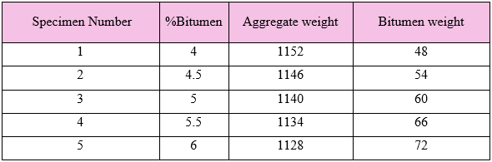
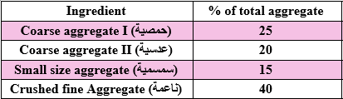
Optimum asphalt content:
Bitumen and aggregate weights used in the test
Aggregate percentages used in the test

Slide 9
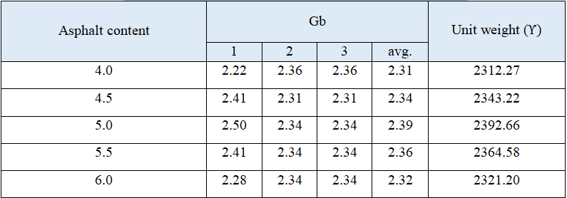
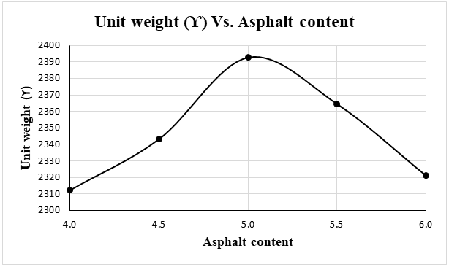
Marshall method of asphalt pavement mix design
Unit weight
Bulk Specific Gravity and Unit Weight Results
The relation between asphalt content and corresponding Unit Weight

Slide 10
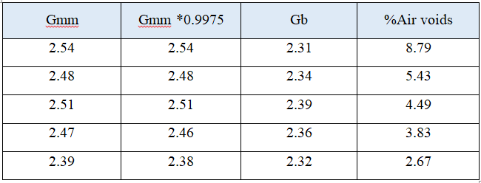
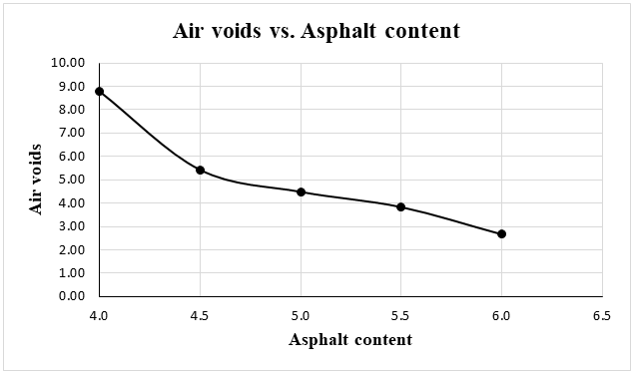
Air voids
Calculation of % of air voids.
Percentage of rubber and corresponding air voids

Slide 11
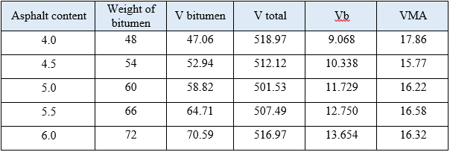
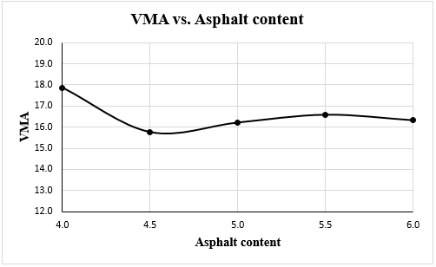
Voids in mineral aggregate (VMA)
Calculation of voids in mineral aggregate
Asphalt content-VMA graphical representation

Slide 12
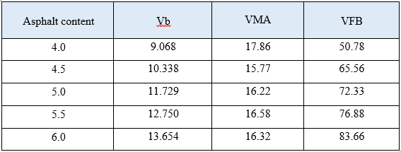
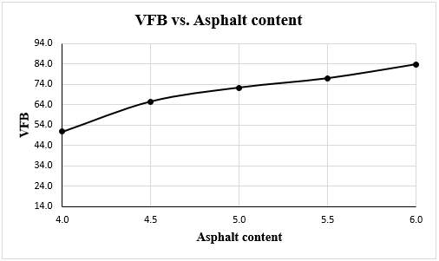
Voids filled with bitumen (VFB)
Calculation of voids filled with bitumen (VFB)
Asphalt content-VFB graphical relation

Slide 13
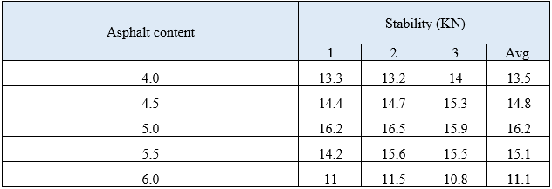
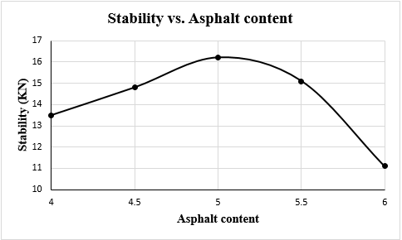
Marshall Stability
Results of Marshall stability
Asphalt content-Stability relation

Slide 14
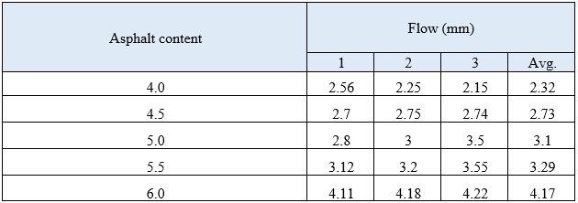
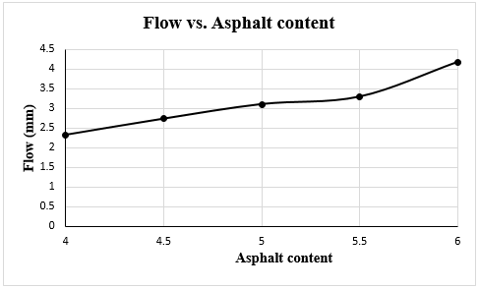
Flow
Results of Flow
Asphalt content-Flow graphical relation

Slide 16
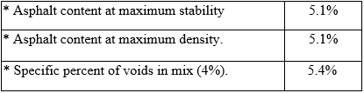
Optimum asphalt content:
The optimum asphalt content can be calculated as the average of the following.

Slide 17
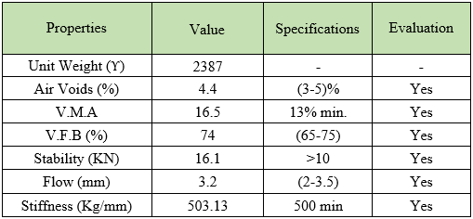
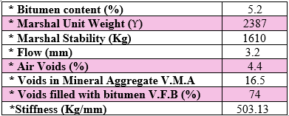

Slide 18
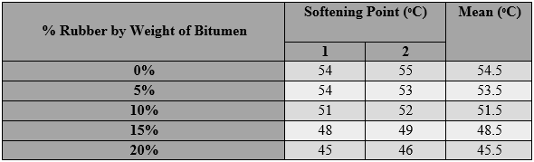
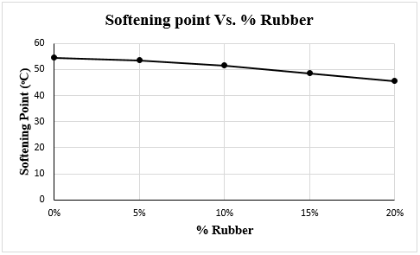
Softening point test (using the ring and ball apparatus)
Softening Point Test Results
The relation between %rubber and softening point in terms of temperature

Slide 19
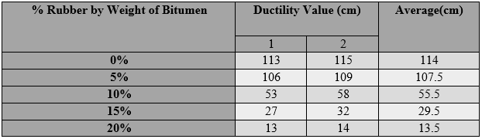
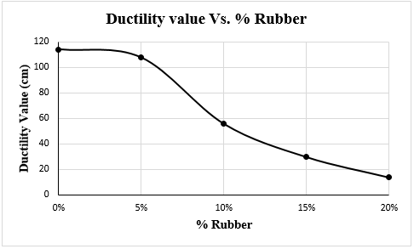
Ductility of bitumen test
Ductility Test Results
Ductility test graphical presentation
Notes:
Use of an Authentication Server in 802.11i

Slide 20
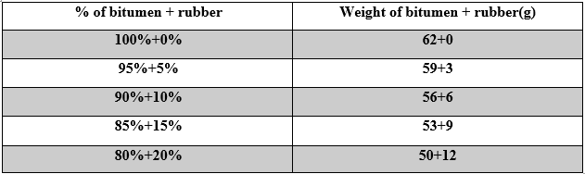
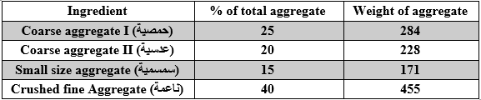
Marshall method of rubberized asphalt mix design
% of bitumen = 5.2%
Bitumen and corresponding rubber used in the test
Aggregate quantities by weight used in the test

Slide 21
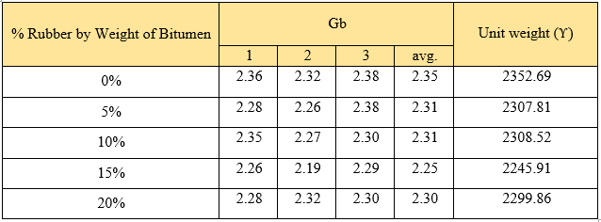
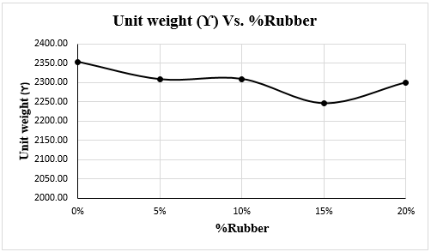
Unit weight
Bulk Specific Gravity and Unit Weight Results
The relation between % of rubber and corresponding Unit Weight
Notes:
IPsec provides three degrees of freedom.
First, it is highly modular, allowing users (or more likely, system administrators) to select from a variety of cryptographic algorithms and specialized security protocols.
Second, IPsec allows users to select from a large menu of security properties, including access control, integrity, authentication, originality, and confidentiality.
Third, IPsec can be used to protect “narrow” streams (e.g., packets belonging to a particular TCP connection being sent between a pair of hosts) or “wide” streams (e.g., all packets flowing between a pair of routers).
In a transport mode SA, ESP’s payload data is simply a message for a higher layer such as UDP or TCP.
In this mode, IPsec acts as an intermediate protocol layer, much like SSL/TLS does between TCP and a higher layer.
When an ESP message is received, its payload is passed to the higher level protocol.
In a tunnel mode SA, however, ESP’s payload data is itself an IP packet

Slide 22
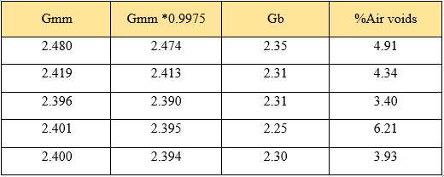
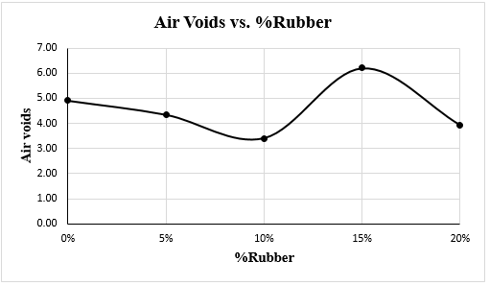
Air voids
Calculation of % of air voids.
Percentage of rubber and corresponding air voids

Slide 23
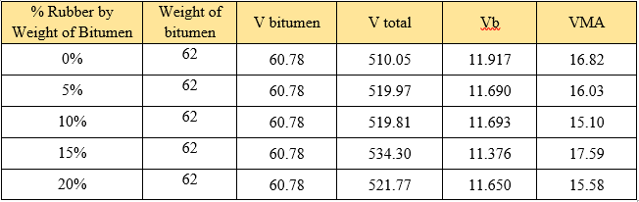
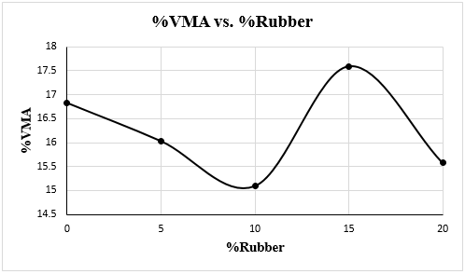
Voids in mineral aggregate (VMA)
Calculation of voids in mineral aggregate
Rubber-VMA graphical representation

Slide 24
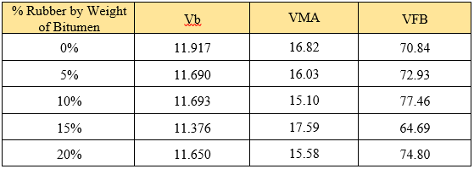
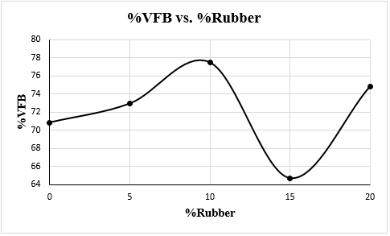
Voids filled with bitumen (VFB)
Calculation of voids filled with bitumen (VFB)
Rubber-VFB graphical relation

Slide 25
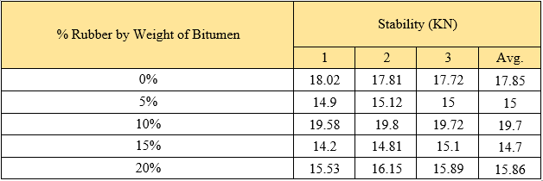
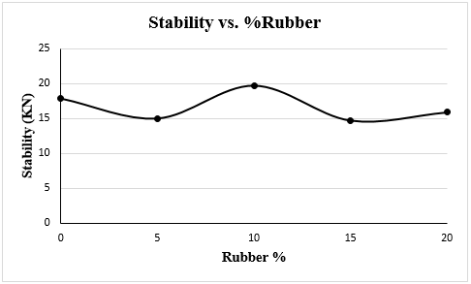
Marshall Stability
Results of Marshall stability
% of Rubber-Stability relation

Slide 26
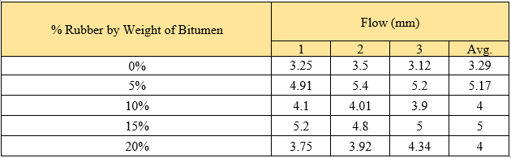
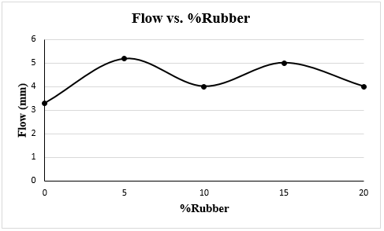
Flow
Results of Flow
% of Rubber-Flow graphical relation

Slide 27
Conclusion
Waste tires rubber can be used in asphalt pavement with optimum replacement ratio of 5% by weight of total bitumen.
The average stability for 10 % rubber modified mixture was higher than the 0% rubber mixture.
Most test values are consistent with the specifications limits.

Slide 28
Recommendations
Based on the research results, we recommended to use a percent of 5% in the modified mixtures, because it gives the best results of (Stability & Flow) compared with traditional mixing.
Proposing an appropriate methodology of waste rubber tires and transform it to a special dump.

Slide 29
