Slide 1
CLINIC BABY
Amna Msalam & Rehan Alashqar
Supervised By: Dr. Aladdin masri & Dr. Emad Natsheh

Slide 2

Introduction
For Whom
Used Technology
Features
Explain our project
Conclusion
Demo
Notes:
Animated pointer and light-up text
(Advanced)
To reproduce the background effects on this slide, do the following:
On the Home tab, in the Slides group, click Layout, and then click Blank.
Right-click the slide background area, and then click Format Background. In the Format Background dialog box, click Fill in the left pane, select Solid fill in the right pane, and select White, Background 1 (first row, first option from the left).
To reproduce the rectangle on this slide, do the following:
On the Home tab, in the Drawing group, click Shapes, and then under Rectangles click Rounded Rectangle (second option from the left). On the slide, drag to draw a rounded rectangle.
Select the rectangle. Drag the yellow diamond adjustment handle to the left to decrease the amount of rounding on the corners.
With the rounded rectangle still selected, under Drawing Tools, on the Format tab, in the Size group, do the following:
In the Shape Height box, enter 3.5”.
In the Shape Width box, enter 0.25”.
Under Drawing Tools, on the Format tab, in the bottom right corner of the Shape Styles group, click the Format Shape dialog box launcher. In the Format Shape dialog box, click Fill in the left pane. In the Fill pane, select Solid fill, click the button next to Color, and then under Theme Colors click White, Background 1, Darker 15% (third row, first option from the left).
Also in the Format Shape dialog box, click Line Color in the left pane. In the Line Color pane, select No line.
Also in the Format Shape dialog box, click Shadow in the left pane. In the Shadow pane, click the button next to Presets, under Outer select Offset Bottom (first row, second option from the left), and then do the following:
In the Transparency box, enter 0%.
In the Size box, enter 100%.
In the Blur box, enter 8.5 pt.
In the Angle box, enter 90°.
In the Distance box, enter 1 pt.
Also in the Format Shape dialog box, click 3-D Format in the left pane. In the 3-D Format tab, do the following:
Under Bevel, click the button next to Top, and then under Bevel click Circle (first row, first option from the left). Next to Top, in the Width box, enter 5 pt, and in the Height box, enter 5 pt.
Under Surface, click the button next to Material, and then under Standard click Matte (first row, first option from the left). Click the button next to Lighting, and then under Neutral click Soft (first row, third option from the left).
On the slide, select the rounded rectangle. On the Home tab, in the Clipboard group, click the arrow to the right of Copy, and then click Duplicate.
Select the duplicate rectangle. On the Home tab, in the Drawing group, do the following:
Click the arrow next to Shape Fill, and then click No Fill.
Click the arrow next to Shape Outline, and then click No Outline.
Drag the second rectangle above the first rectangle until the lower edge overlays the top edge of the first rectangle. (Note: When the spinning animation effect is created later for these rectangles, the spin will center where the edges of the rectangles meet.)
Press and hold CTRL, and then select both rectangles. On the Home tab, in the Drawing group, click Arrange, and do the following:
Point to Align, and then click Align Selected Objects.
Point to Align, and then click Align Center.
Click Group.
On the slide, drag the group until it is centered horizontally on the left edge of the slide (straddling the edge).
On the Home tab, in the Drawing group, click Arrange, point to Align, and then do the following:
Click Align to Slide.
Click Align Middle.
To reproduce the dashed arc on this slide, do the following:
On the Home tab, in the Drawing group, click Shapes, and then under Basic Shapes click Arc (third row, 12th option from the left). On the slide, drag to draw an arc.
Select the arc. Under Drawing Tools, on the Format tab, in the Size group, do the following:
In the Shape Height box, enter 7.5”.
In the Shape Width box, enter 7.5”.
With the arc still selected, on the Home tab, in the Drawing group, click the arrow next to Shape Outline and then do the following:
Under Theme Colors, click White, Background 1, Darker 15% (third row, first option from the left).
Point to Dashes, and then click Dash (fourth option from the top).
On the slide, drag the yellow diamond adjustment handle on the right side of the arc to the bottom of the arc to create a half circle.
Drag the arc until the yellow diamond adjustment handles are on the left edge of the slide.
With the arc still selected, on the Home tab, in the Drawing group, click the arrow under Arrange, point to Align, and then do the following:
Click Align to Slide.
Click Align Middle.
To reproduce the half circle on this slide, do the following:
On the slide, select the arc. On the Home tab, in the Clipboard group, click the arrow to the right of Copy, and then click Duplicate.
Select the duplicate arc. Under Drawing Tools, on the Format tab, in the Size group, do the following:
In the Shape Height box, enter 3.33”.
In the Shape Width box, enter 3.33”.
With the second arc still selected, under Drawing Tools, on the Format tab, in the Shape Styles group, click the arrow next to Shape Fill, and then under Theme Colors click White, Background 1, Darker 5% (second row, first option from the left).
Under Drawing Tools, on the Format tab, in the Shape Styles group, click the arrow next to Shape Outline, and then click No Outline.
Under Drawing Tools, on the Format tab, in the Shape Styles group, click Shape Effects, point to Shadow, and then click Shadow Options. In the Format Shape dialog box, click Shadow in the left pane. In the Shadow pane, click the button next to Presets , under Inner click Inside Right (second row, third option from the left), and then do the following:
In the Transparency box, enter 86%.
In the Blur box, enter 24 pt.
In the Angle box, enter 315°.
In the Distance box, enter 4 pt.
On the slide, drag the second arc until the yellow diamond adjustment handles are on the left edge of the slide. On the Home tab, in the Drawing group, click Arrange, and then do the following:
Point to Align, and then click Align to Slide.
Point to Align, and then click Align Middle.
Click Send to Back.
To reproduce the button shapes on this slide, do the following:
On the Home tab, in the Drawing group, click Shapes, and then under Basic Shapes click Oval (first row, second option from the left). On the slide, drag to draw an oval.
Select the oval. Under Drawing Tools, on the Format tab, in the Size group, do the following:
In the Shape Height box, enter 0.34”.
In the Shape Width box, enter 0.34”.
Under Drawing Tools, on the Format tab, in the Shape Styles group, click More, and then click Light 1 Outline, Colored Fill – Olive Green, Accent 3 (third row, first option from the left).
Under Drawing Tools, on the Format tab, in the bottom right corner of the Shape Styles group, click the Format Shape dialog box launcher. In the Format Shape dialog box, click Fill in the left pane. In the Fill pane, select Solid Fill. Click the button next to Color, and then under Theme Colors click Olive Green, Accent 3, Lighter 80° (second row, seventh option from the left).
Also in the Format Shape dialog box, click Line Color in the left pane. In the Line Color pane, select No line.
Also in the Format Shape dialog box, click Shadow in the left pane. In the Shadow pane, click the button next to Presets, under Outer click Offset Bottom (first row, second option from the left), and then do the following:
In the Transparency box, enter 0%.
In the Size box, enter 100%.
In the Blur box, enter 8.5 pt.
In the Angle box, enter 90°.
In the Distance box, enter 1 pt.
Also in the Format Shape dialog box, click 3-D Format in the left pane, and then do the following in the 3-D Format pane:
Under Bevel, click the button next to Top, and then under Bevel click Art Deco (third row, fourth option from the left). Next to Top, in the Width box, enter 5 pt, and in the Height box, enter 5 pt.
Under Contour, click the button next to Color, and then under Theme Colors click White, Background 1 (first row, first option from the left). In the Size box, enter 3.5 pt.
Under Surface, click the button next to Material, and then under Standard click Matte (first row, first option from the left). Click the button next to Lighting, and then under Neutral click Soft (first row, third option from the left).
On the slide, select the oval. Under Drawing Tools, on the Format tab, in the bottom right corner of the Size group, click the Size and Position dialog box launcher. In the Format Shape dialog box, click Position in the left pane, and in the Position pane, do the following to position the third and fourth ovals:
In the Horizontal box, enter 2.98”.
In the Vertical box, enter 1.5”.
Select the oval. On the Home tab, in the Clipboard group, click the arrow under Paste, and then click Duplicate.
Select the duplicate oval. Under Drawing Tools, on the Format tab, in the bottom right corner of the Size group, click the Size and Position dialog box launcher. In the Format Shape dialog box, click Position in the left pane, and in the Position pane, do the following to position the third and fourth ovals:
In the Horizontal box, enter 3.52”.
In the Vertical box, enter 2.98”.
Repeat step 9 two more times, for a total of four ovals. Under Drawing Tools, on the Format tab, in the bottom right corner of the Size group, click the Size and Position dialog box launcher. In the Format Shape dialog box, click Position in the left pane, and in the Position pane, do the following to position the third and fourth ovals:
Select the third oval on the slide, and then enter 3.52” in the Horizontal box and 4.27” in the Vertical box.
Select the fourth oval on the slide, and then enter 2.99” in the Horizontal box and 5.66” in the Vertical box.
To reproduce the text on this slide, do the following:
On the Insert tab, in the Text group, click Text Box, and then on the slide, drag to draw the text box.
Enter text in the text box and select the text. On the Home tab, in the Font group, do the following:
In the Font list, select Corbel.
In the Font Size list, select 22.
Click the arrow next to Font Color, and then under Theme Colors click White, Background 1, Darker 50% (sixth row, first option from the left).
On the Home tab, in the Paragraph group, click Align Text Left to align the text left in the text box.
On the slide, drag the text box to the right of the first oval.
Select the text box. On the Home tab, in the Clipboard group, click the arrow to the right of Copy, and then click Duplicate.
Click in the text box and edit the text.
Drag the second text box to the right of the second oval.
Repeat steps 5-7 to create the third and fourth text boxes, dragging them to the right of the third and fourth ovals.
To reproduce the animation effects on this slide, do the following:
On the Home tab, in the Editing group, click Select, and then click Selection Pane.
In the Selection and Visibility task pane, select the rectangle group.
On the Animations tab, in the Advanced Animation group, click Add Animation, and then under Emphasis click Spin.
Also on the Animations tab, in the Animation group, click the Effect Options dialog box launcher. In the Spin dialog box, do the following:
On the Effects tab, in the Amount list, in the Custom box, enter 123°, and then press ENTER. Also in the Amount list, click Counterclockwise.
On the Timing tab, in the Duration box, select 1.00.
On the Timing tab, in the Start list, select With Previous.
On the slide, select the first oval. On the Animations tab, in the Advanced Animation group, click Add Animation, and then click More Emphasis Effects. In the Add Emphasis Effect dialog box, under Basic, click Fill Color.
On the Animations tab, in the Animation group, click the Effect Options dialog box launcher. In Fill Color dialog box, the do the following:
On the Effects tab, in the Fill Color list, click More Colors. In the Colors dialog box, on the Custom tab, enter values for Red:130, Green:153, Blue: 117.
On the Timing tab, in the Duration box, , enter 0.50.
On the Timing tab, in the Start list, select After Previous.
On the slide, select the first text box. On the Animations tab, in the Advanced Animation group, click Add Animation, and then under Entrance click Fade.
Also on the Animations tab, in the Timing group, do the following:
In the Start list, select With Previous.
In the Duration box, enter 0.50.
In the Selection and Visibility task pane, select the rectangle group. On the Animations tab, in the Advanced Animation group, click Add Animation, and then under Emphasis click Spin.
Also on the Animations tab, in the Animation group, click the Effect Options dialog box launcher. In the Spin dialog box, do the following:
On the Effects tab, in the Amount list, in the Custom box, enter 22°, and then press ENTER. Also in the Amount list, click Clockwise.
On the Timing tab, in the Start list, select On Click.
On the Timing tab, in the Duration box, enter 0.50.
On the slide, select the second oval. On the Animations tab, in the Advanced Animation group, click Add Animation, and then click More Emphasis Effects. In the Add Emphasis Effect dialog box, under Basic, click Fill Color.
On the Animations tab, in the Animation group, click the Effect Options dialog box launcher. In the Fill Color dialog box, do the following:
On the Effects tab, in the Fill Color list, click More Colors. In the Colors dialog box, on the Custom tab, enter values for Red:130, Green:153, Blue: 117.
On the Timing tab, in the Start list, select After Previous.
On the Timing tab, in the Duration box, enter 0.50.
On the slide, select the second text box. On the Animations tab, in the Advanced Animation group, click Add Animation, and then under Entrance click Fade.
Also on the Animations tab, in the Timing group, do the following:
In the Start list, select With Previous.
In the Duration box, enter 0.50.
On the slide, select the third oval. On the Animations tab, in the Advanced Animation group, click Add Animation, and then click More Emphasis Effects. In the Add Emphasis Effect dialog box, under Basic, click Fill Color.
On the Animations tab, in the Animation group, click the Effect Options dialog box launcher. In the Fill Color dialog box, do the following:
On the Effects tab, in the Fill Color list, click More Colors. In the Colors dialog box, on the Custom tab, enter values for Red:130, Green:153, Blue: 117.
On the Timing tab, in the Start list, select After Previous.
On the Timing tab, in the Speed list, select Very Fast.
On the slide, select the third text box. On the Animations tab, in the Advanced Animation group, click Add Animation, and then under Entrance click Fade.
Also on the Animations tab, in the Timing group, do the following:
In the Start list, select With Previous.
In the Duration box, enter 0.50.
On the slide, select the fourth oval. On the Animations tab, in the Advanced Animation group, click Add Animation, and then click More Emphasis Effects. In the Add Emphasis Effect dialog box, under Basic, click Fill Color.
On the Animations tab, in the Animation group, click the Effect Options dialog box launcher. In the Fill Color dialog box, do the following:
On the Effects tab, in the Fill Color list, click More Colors. In the Colors dialog box, on the Custom tab, enter values for Red:130, Green:153, Blue: 117.
On the Timing tab, in the Start list, select After Previous.
On the Timing tab, in the Duration box, enter 0.50.
On the slide, select the fourth text box. On the Animations tab, in the Advanced Animation group, click Add Animation, and then under Entrance click Fade.
On the Animations tab, in the Timing group, do the following:
In the Start list, select With Previous.
In the Duration box, enter 0:50.

Slide 3
Introduction
There is so much information that a mother can keep in her head at one time.
Also there is very important information about new baby can be used in future. so need to repeat some tests to insure from some information.
When the person go to the hospital or any doctor and need for medicine this medicine may be not suitable for this person because he have sensitivity with this medicine.

Slide 4
Well then, here is the solution:
Clinic Baby System.

Slide 5
For whom?
Mobile Application for:
The Website for:
For parents
Doctors
Hospitals
Clinics
Ministry of Interior
Ministry of health
Your own footer
Your Logo

Slide 6
Used Technology
Website (WEB)
HTML5, Jquery ,CSS ,AJAX , JavaScript for developing front-end, PHP, MySQL database for back-end of the web application.
Mobile (android)
Java for android, json for http connection to the php server

Slide 7

Our project consists of:
Backend System
Mobile Application for Parents
Expert system
Web interface for managing the clinic data and all the important information about baby that can be used in future

Slide 8
Mobile Application:
Help parents
Helps parents track the growth of their children and take notification about date vaccination and Care appointment from clinic, also show the doctor times and then can appointment booking in empty time for doctor
A text message will be sent from clinic to the mother’s mobile about new events in clinic.
Smart tool help the mother in diagnosis her baby from common health problems

Slide 9
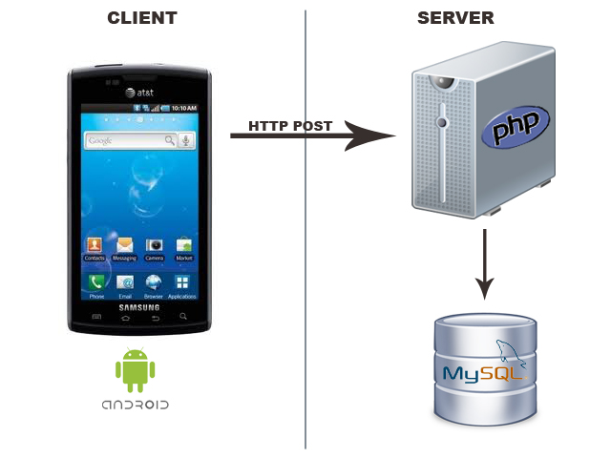
Mobile Application
Request sent by the mobile App.
Response sent from the php server

Slide 10
Website Application:
Help ministry of interior to add new children and give him new id number.
Help ministry of health to view all important health information needed about one person.
Help doctors and nurse to add new child to clinic and store all information about children.

Slide 11
Features
Features For Mobile Application
Getting an Appointment for doctor
Getting a Notification from clinic about time of vaccination
Getting a Notification from clinic about time of care
Getting a Charts from clinic about growth of children
Getting a New Events from clinic
Determine the illness that the child suffer from it.
Chatting between mothers and doctors.

Slide 12
Features
Features For Website Application
Page for ministry of interior to added new child and give him id number
Page for ministry of health to view all important health information needed about one person and added new doctors to the website
Page for doctors and nurse to mange all information about children and give
appointment to mothers
Chatting between mothers and doctors

Slide 13
Features
Features For Website Application
Doctor And Nurse can add new child to the clinic and any doctor can store
information about child by enter the id number for child and only this doctor can
update these information.
Doctor can see health history of child and make decisions depend on this history.
Doctor can see new news from Ministry of Health.
Doctor can manage appointments for his to see from parents.

Slide 14
Features
Features For Website Application
Prevent store repeated information about one child in any side
Prevent add new child to clinic without has id number from Ministry Of Interior

Slide 15
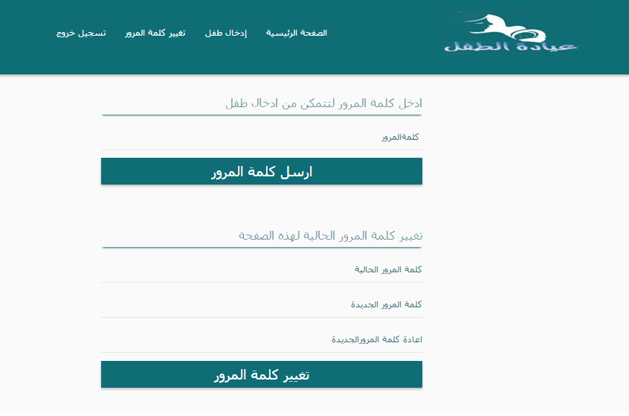
Ministry of interior
Can get child new id number by follow some form of information after enter the password to go to add new child page.

Slide 16
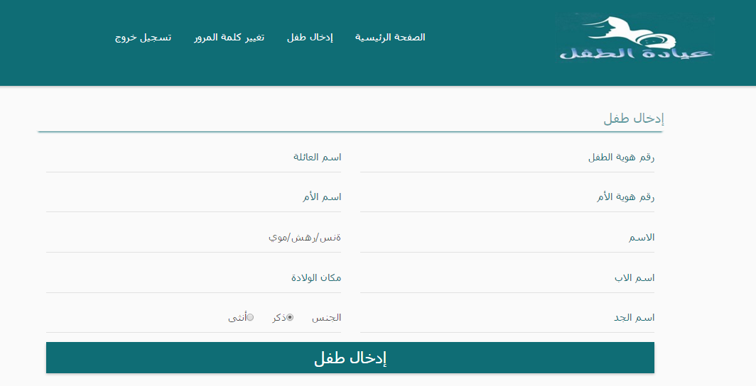
Ministry of interior

Slide 17
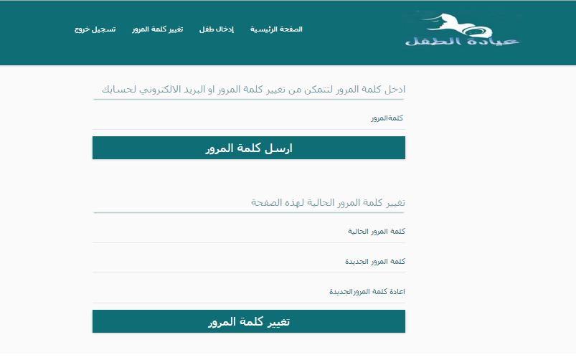
Ministry of interior
Also can change the password and email for the ministry page and the password to enter the add child page.

Slide 18
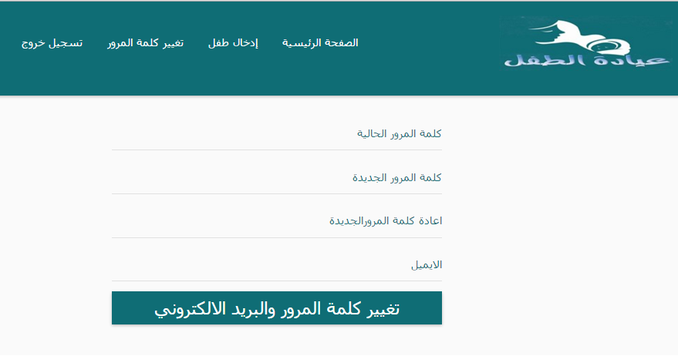
Ministry of interior

Slide 19
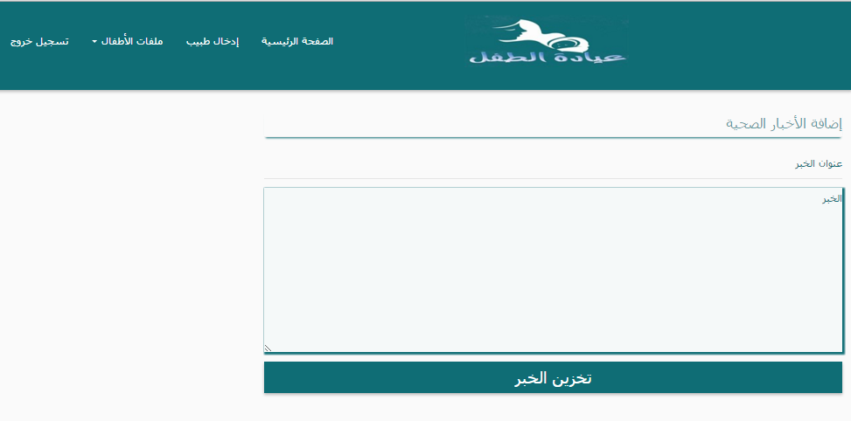
Ministry of health
Can send new news to the doctors.

Slide 20
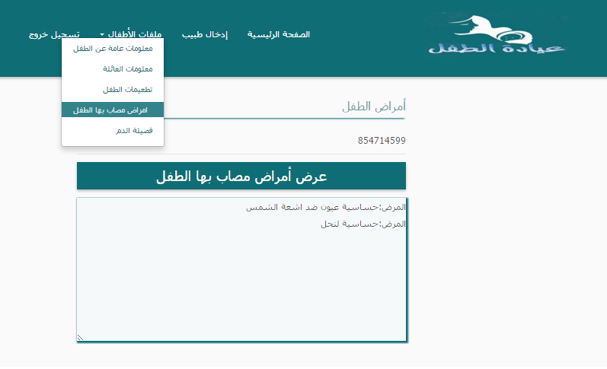
Ministry of health
Can show all important information needed about any child

Slide 21
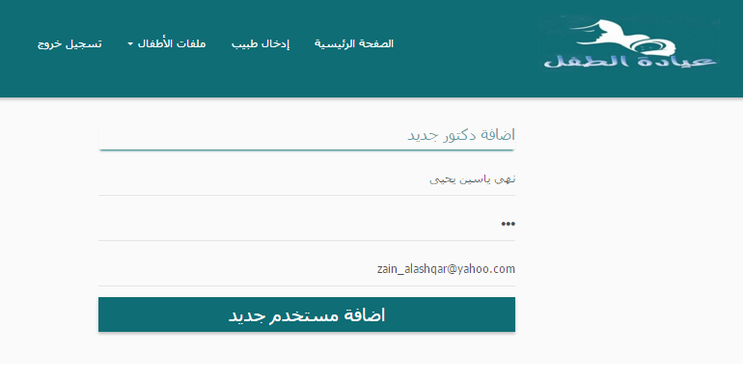
Ministry of health
Can add new doctor to the clinic then he can mange information about children

Slide 22
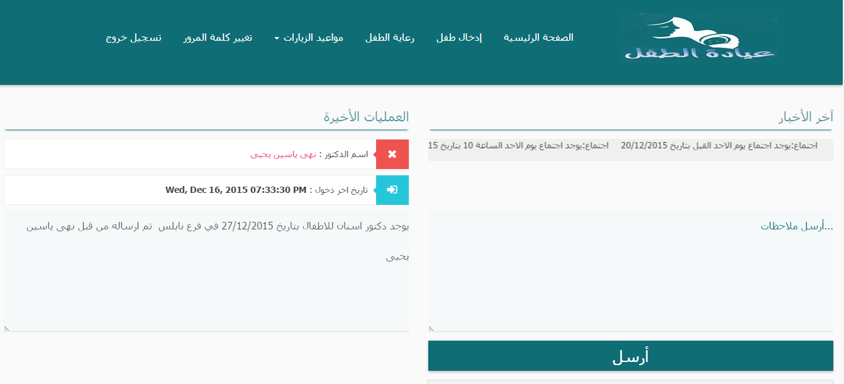
The doctors
Can see new news from ministry of health and send new event to all mothers and see the last time enter to the website.

Slide 23

The doctors
Can answer questions from mothers by enter to the chat conversation and see questions from mothers.

Slide 24
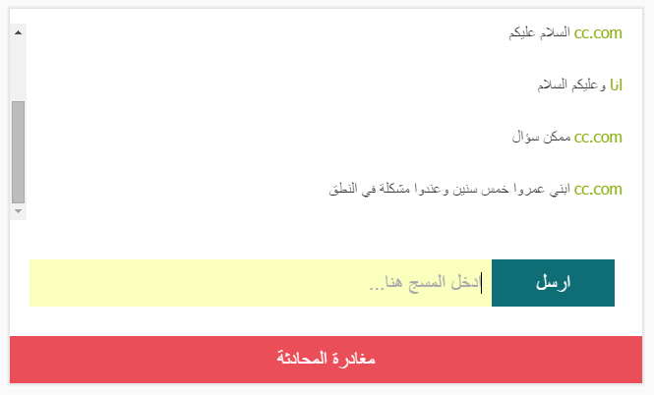
The doctors
Can answer questions from mothers by enter to the chat conversation and see questions from mothers.

Slide 25
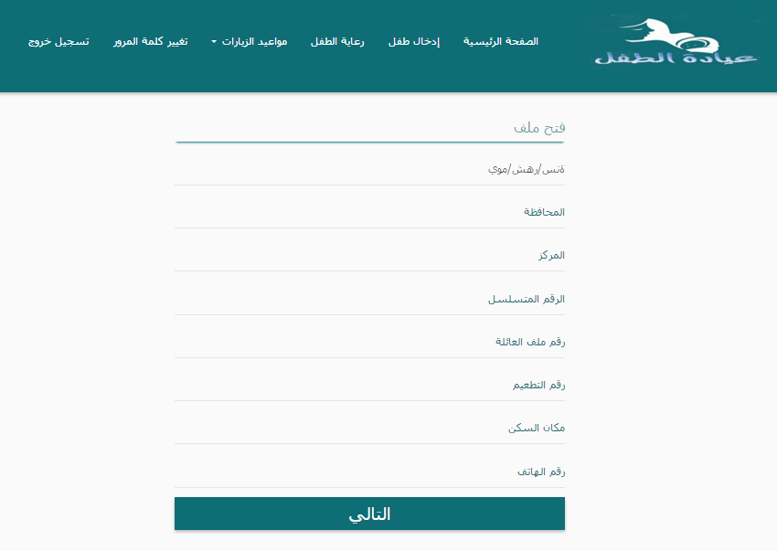
The doctors
Can add new child to the clinic if he had id number from ministry of interior the doctor or nurse fill information about child to add the child to the clinic

Slide 26
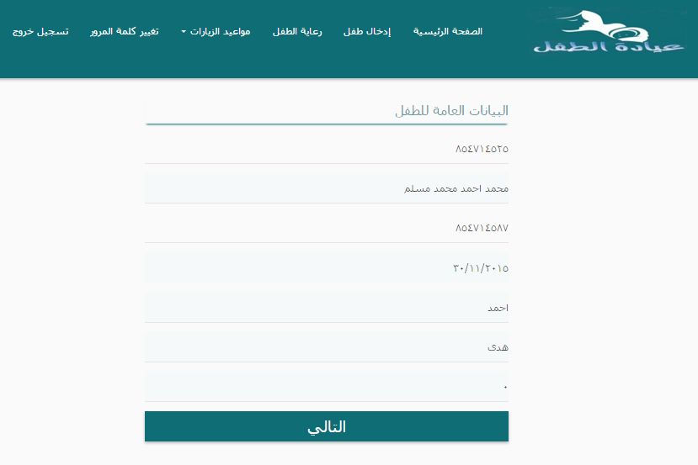
The doctors
The next step when add child enter id number and then all information fill from ministry of interior then enter to the next to continue add child.

Slide 27
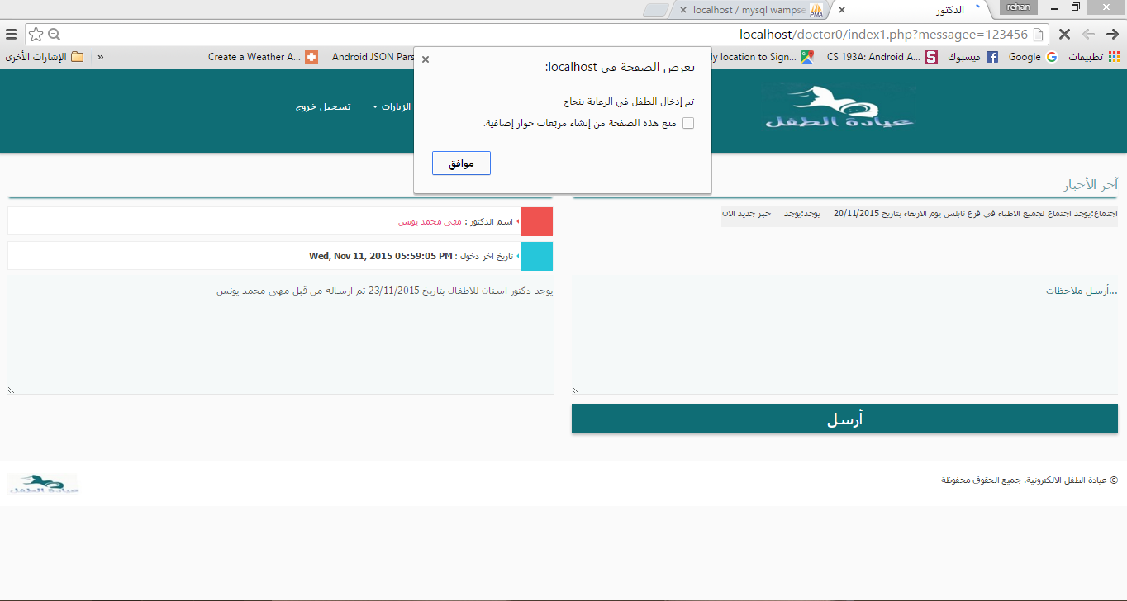
The doctors
The next step when add child enter id number and then all information fill from ministry of interior then enter to the next to continue add child.

Slide 28
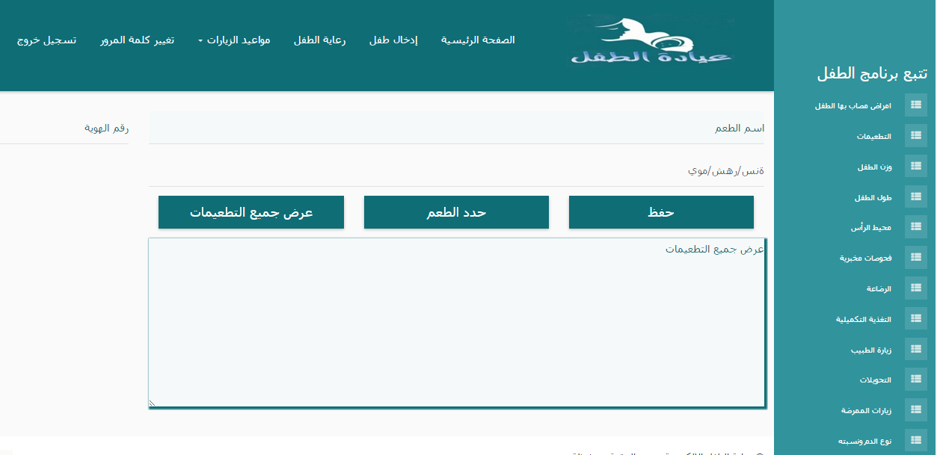
The doctors
In this page the doctors and nurses can mange all important information about child in the clinic.

Slide 29
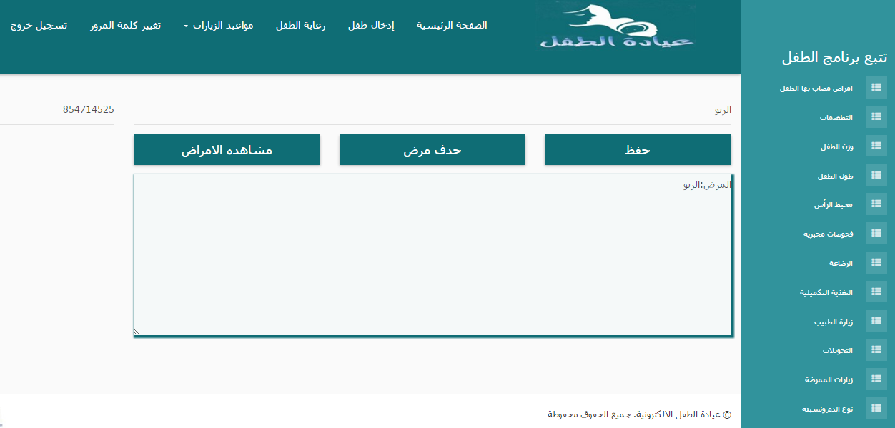
The doctors
In this page the doctors can add or see illnesses for specific child suffer from it.

Slide 30
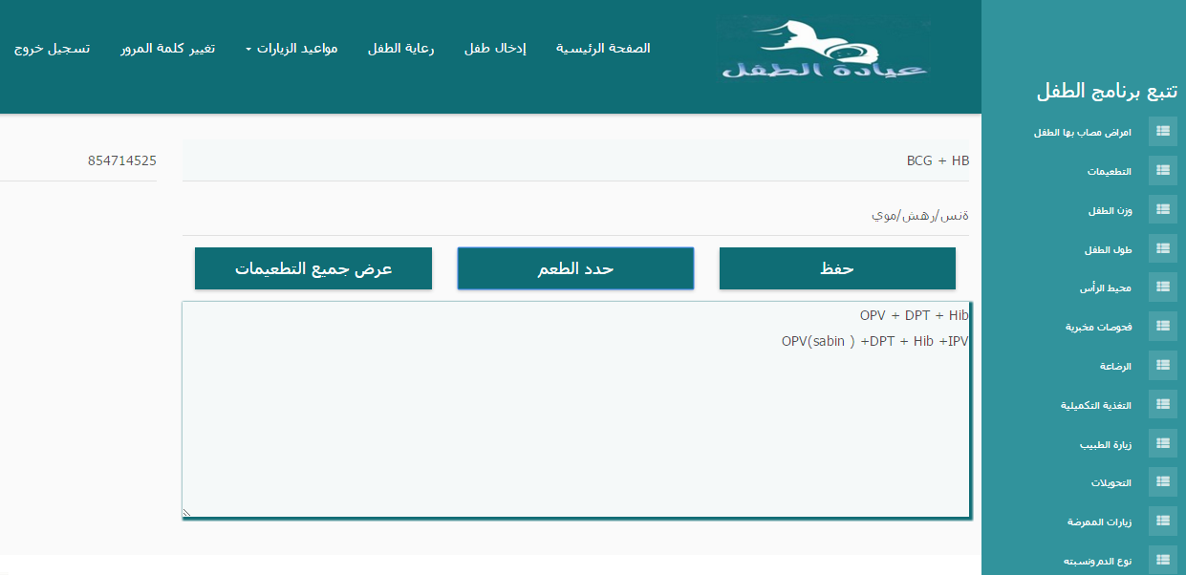
The doctors
In this page the doctor or nurse can add or see vaccinations for specific child the name of vaccination not enter, by click on define vaccination the name of vaccination show depend on the age of child.

Slide 31
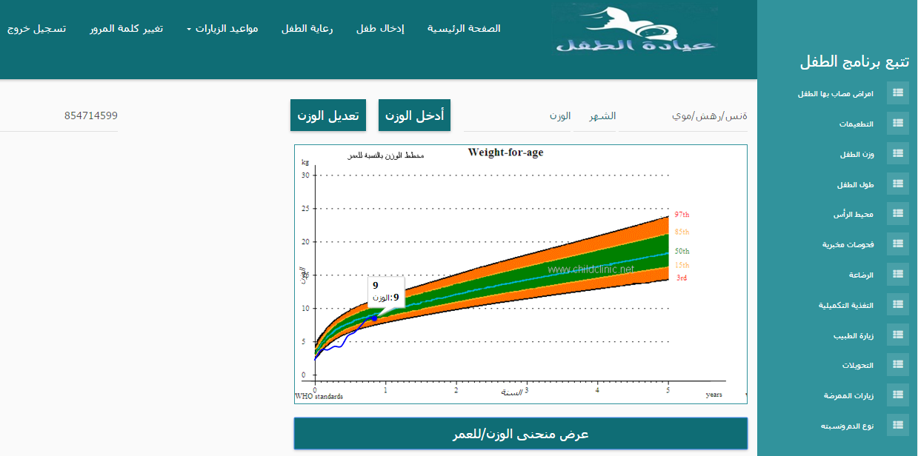
The doctors
In this page the doctor or nurse can add, update and see the weight for child.

Slide 32
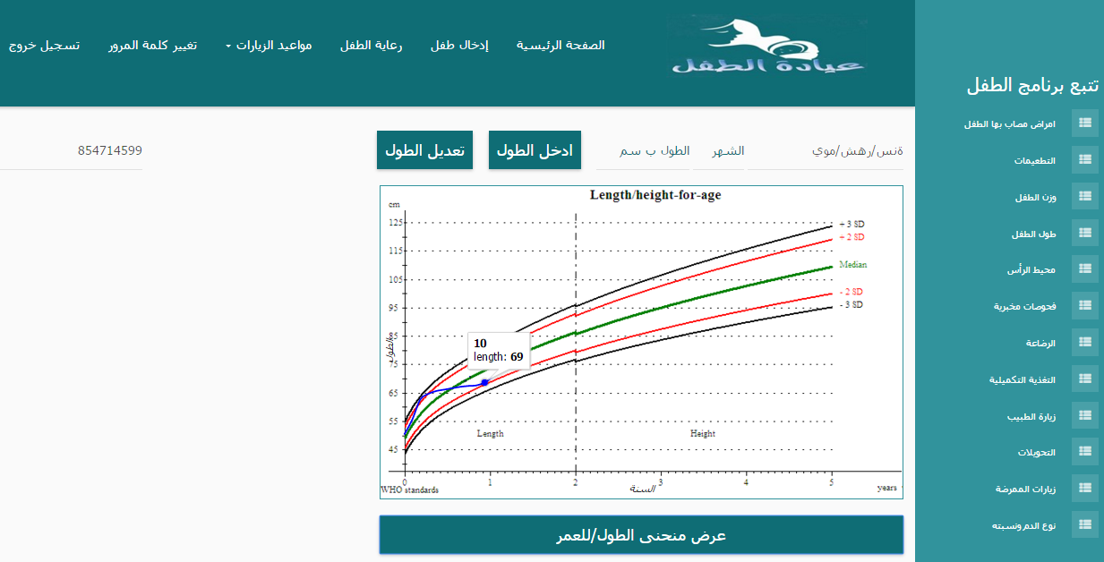
The doctors
In this page the doctor or nurse can add, update and see the length for child .

Slide 33
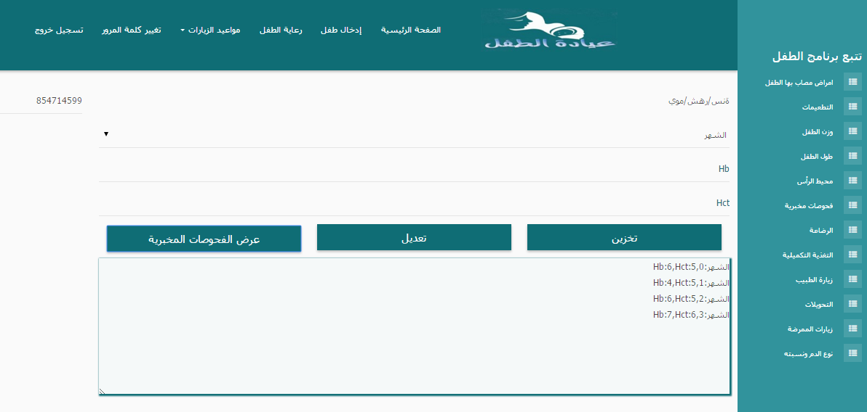
The doctors
In this page the doctor or nurse can add, update and see the laboratory tests for child at each month.

Slide 34
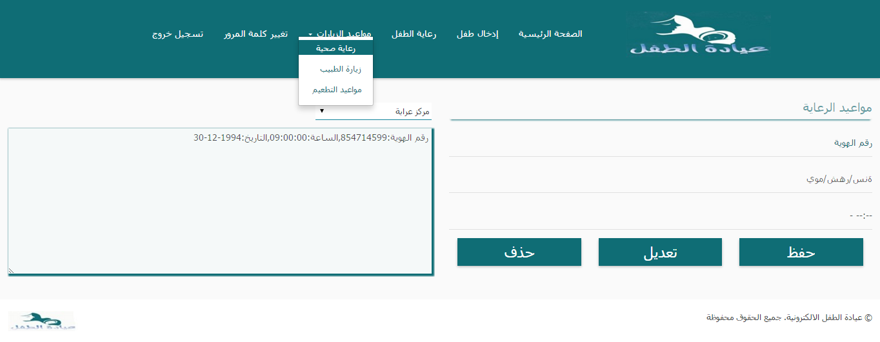
The doctors
In this page the doctor or nurse can add, update and see all the appointment of care for children then send the appointment to the mother as notification .

Slide 35
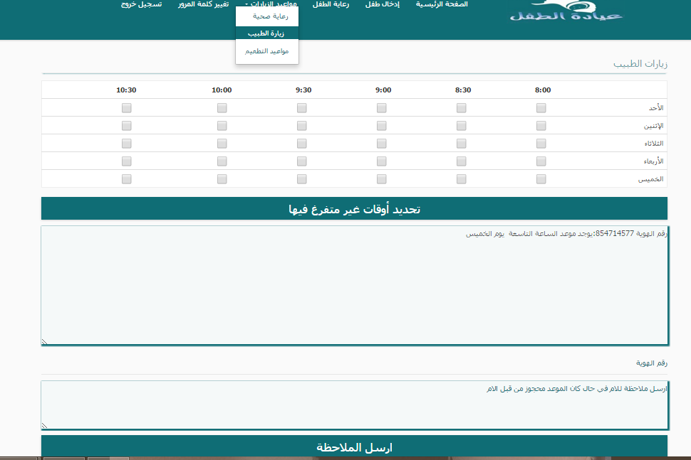
The doctors
In this page the doctor can see the appointments reserved by mothers, check the time where he busy to prevent
mothers to check it ,also can send notification to mother if she reserved in time where the doctor become busy

Slide 36
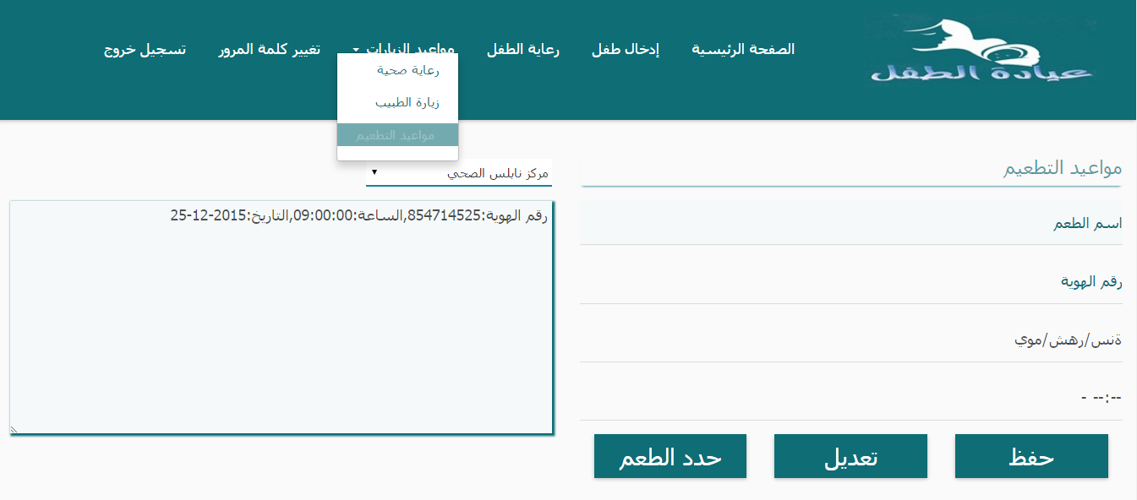
The doctors
In this page the doctor or nurse can add, update and see the appointments of vaccination for children then send the appointment to the mother as notification, if he see the past time means the mother not came then resend the notification again.

Slide 37
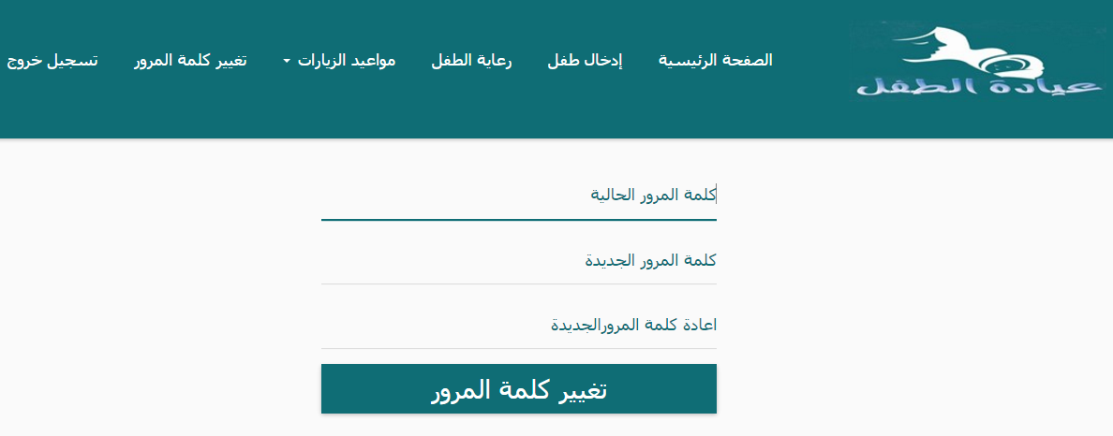
The doctors
In this page the doctor can change the password for his account, also the doctor can click on log out to exit from his account and go to the home page.

Slide 38

Mobile application
In this page the mothers can login to the application by enter the email and password after she register in the application.

Slide 39
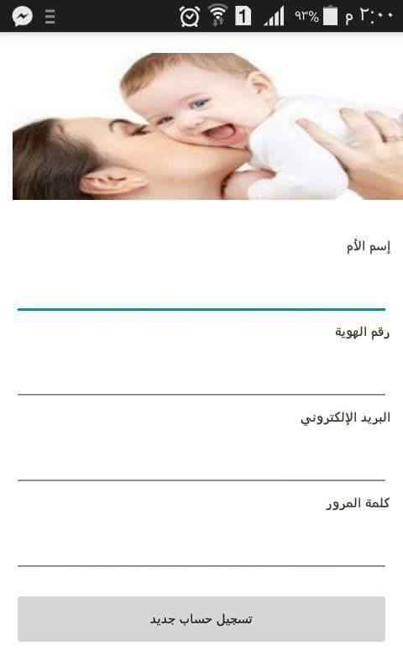
Mobile application
In this page the mothers can register to the application after this step she can use this application.

Slide 40
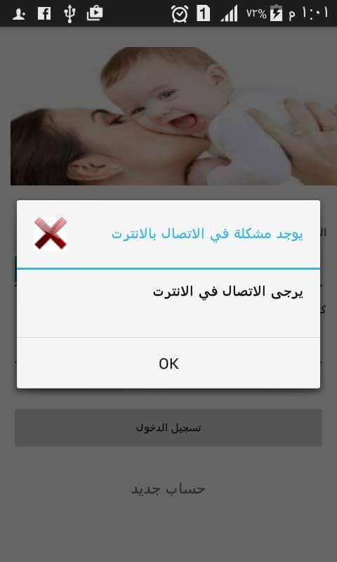
Mobile application
The application need internet to work if the internet disconnect this figure will show.

Slide 41
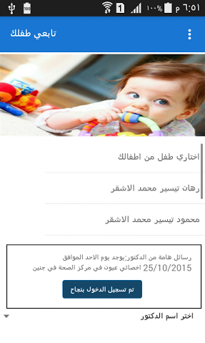
Mobile application
This page is the home page of the application after login to it the mother can see her children and see the new event from clinic.

Slide 42
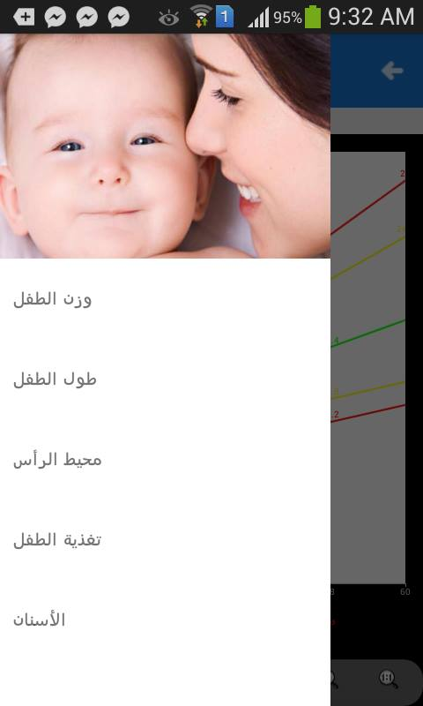
Mobile application
If the mother click on one of her children the child page will show and the mother can click on any part to see the curve for her child.

Slide 43
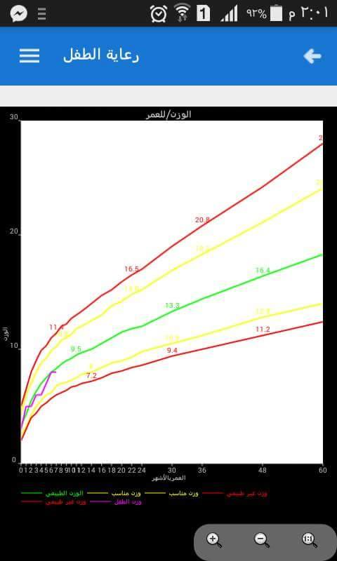
Mobile application
If the mother click on the weight the curve of her child will see and will note if her child weight is good or not same thing for the length and head circumference of the child.

Slide 44
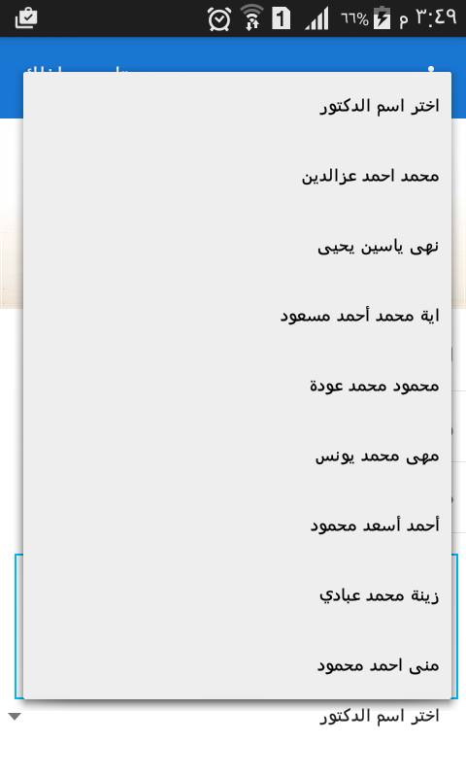
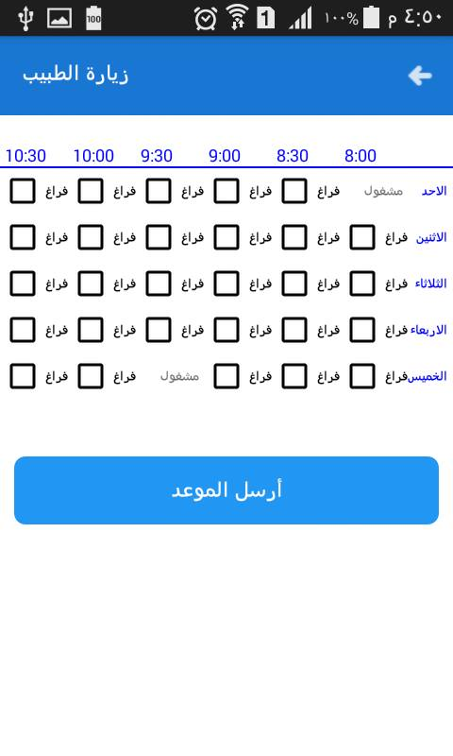
Mobile application
If the mother click on one of the doctors on the home page she will see the appointment table for the doctor and then can select only one appointment and send it to the doctor.

Slide 45
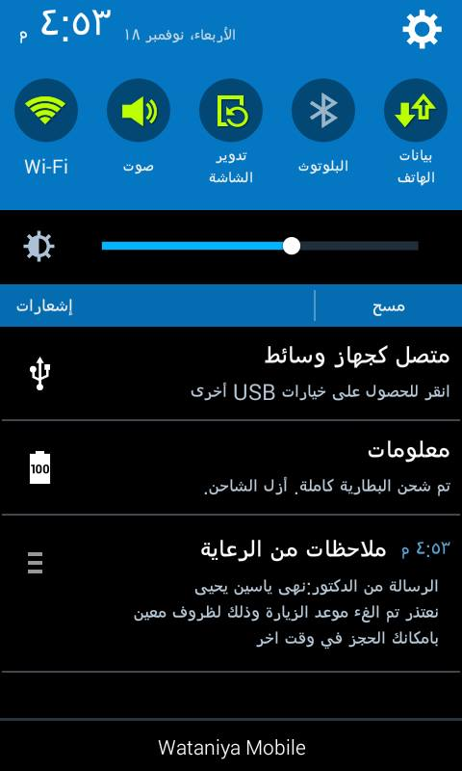
Mobile application
If the doctor has become busy in the time the mother reserved the doctor send notification to mother about cancel the reservation.

Slide 46
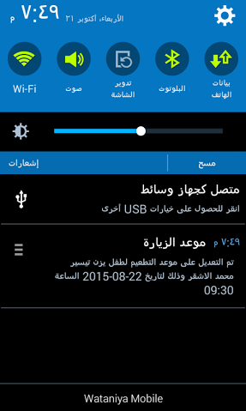
Mobile application
The mother can see the time for vaccination, care appointment also can see the update on the time.

Slide 47
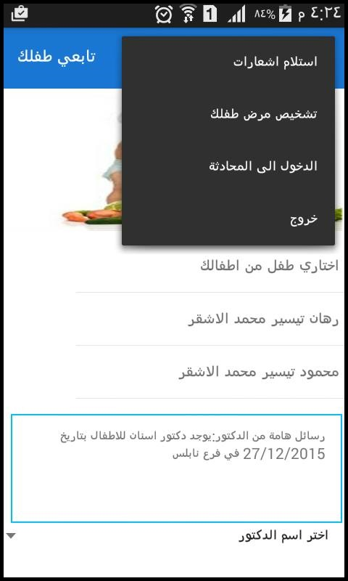
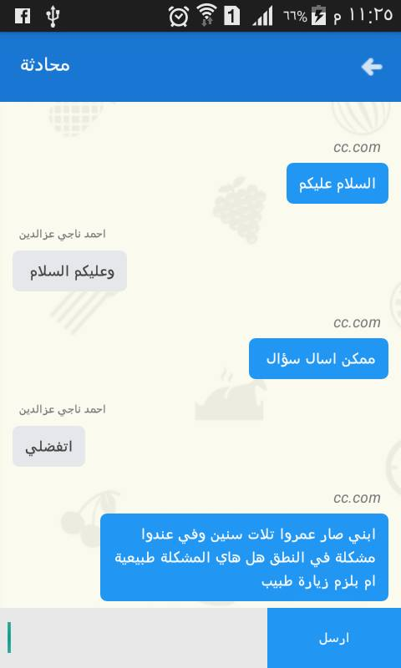
Mobile application
If the mother click on enter to the chat, she enter the chat conversation and then can send question and any doctor on line can answer the mother.

Slide 48
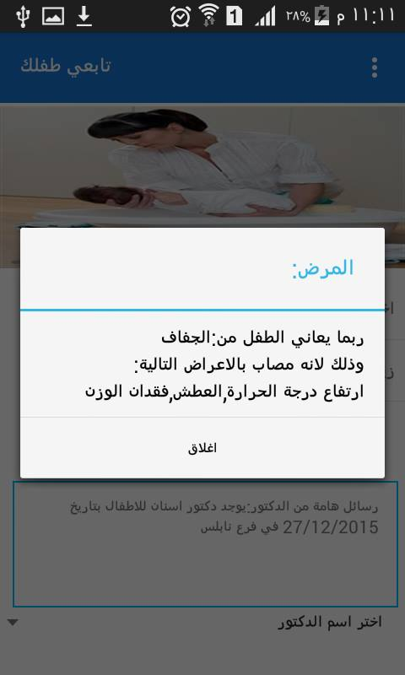
Mobile application
If the mother click on diagnosis illness the series of questions will show depend on answer on the one question and then the system will show to the mother the illness the child may suffer from it.

Slide 49
Conclusion:
Our system help the doctors to mange the important information about children and
show any important information needed about child.
Easy communication between the mothers and doctors.
Graphical user interface for the website more user friendly make the job of doctors,
ministry of health, ministry of interior more easily.

