Slide 1
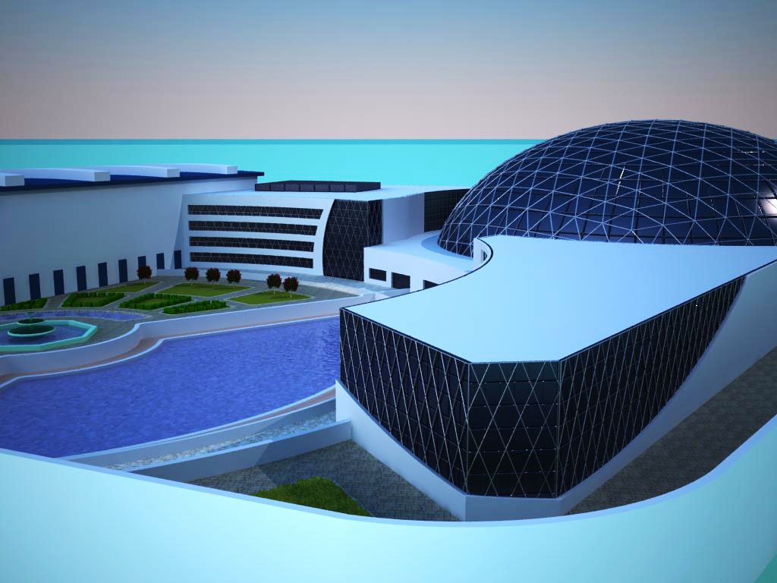

An-Najah National University
Faculty Of Engineering
Building Engineering Department
Graduation Project – 2
An-Najah Sport Center
Prepared By:
Alaa Sholi
Fakher Qassem
Mohammad Yaaqbeh
Project supervisor:
Dr. Asaad Arandi

Slide 2
Outline:
Introduction
Site of the Project
Architectural design
Structural design
Environmental design
Mechanical design
Electrical design

Slide 3
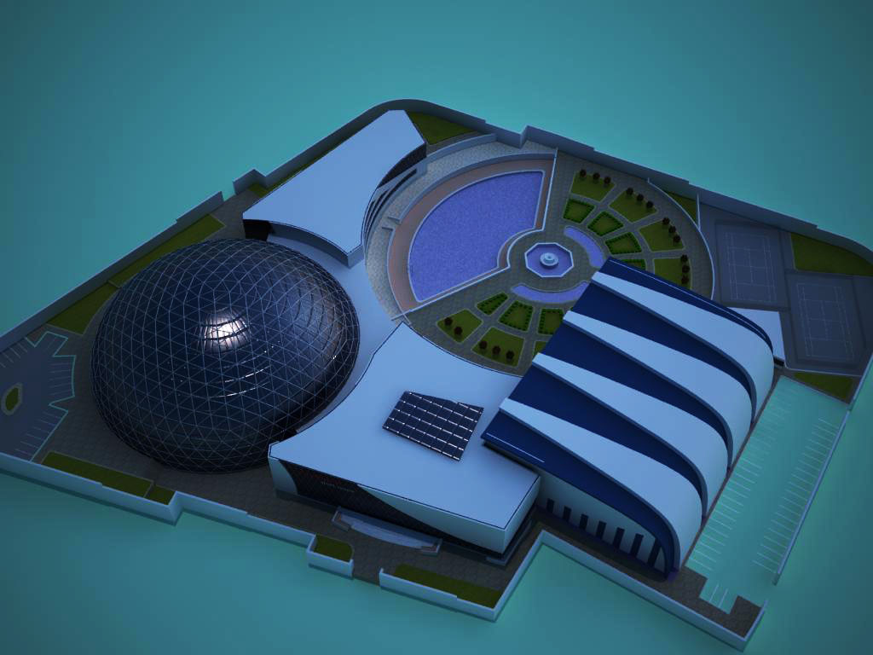
Introduction :
1: Main Building
Area : 1570 m2 for each floor
4
2: Olympic Swimming pool
Area : 3040 m2
3
3: Basket Ball court
2
Area : 3200 m2
1
4: Multipurpose Building
Area : 1200 m2 for each floor

Slide 4
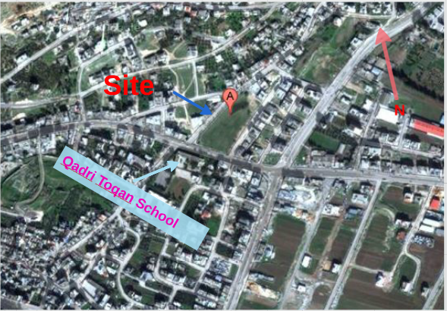
Site of the project :
Eastern of Nablus city.
In front of “Qadri Toqan School”.
Area = 18000 m2

Slide 5
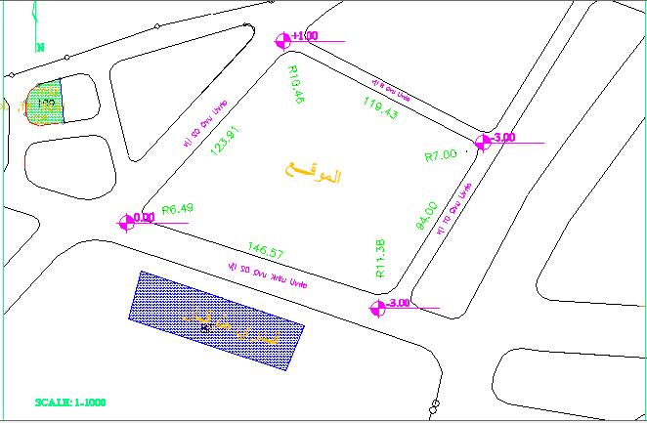
Topography of site:

Slide 6
Architectural design

Slide 7
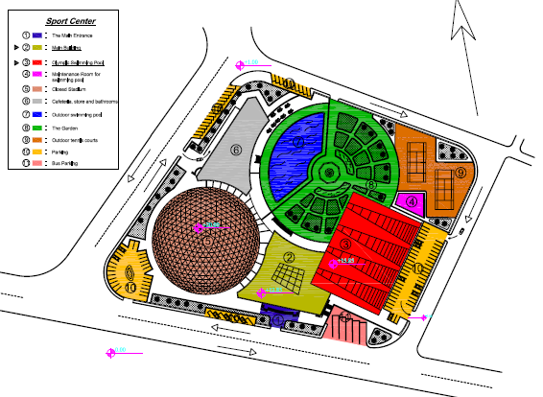
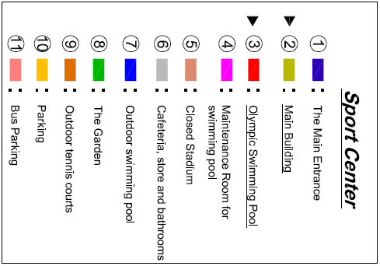
Site Plan:

Slide 8
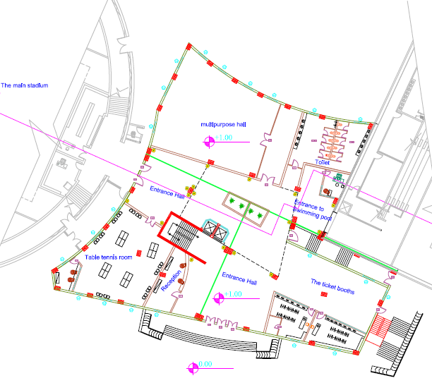
Main Building Plans :
Ground Floor
Total Area= 1570m2

Slide 9
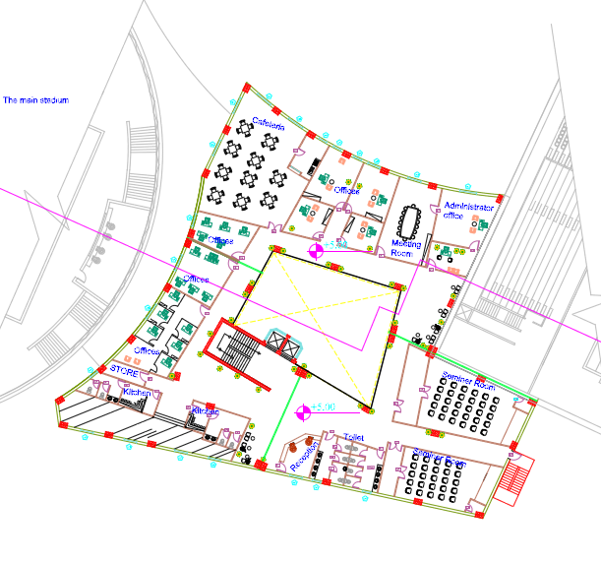
Main Building Plans :
First Floor
Total Area= 1570m2

Slide 10
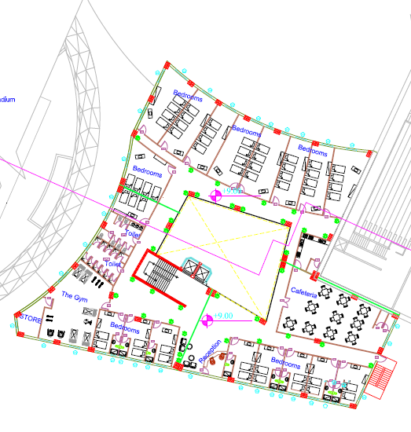
Main Building Plans :
Second floor
Total Area= 1570m2

Slide 11
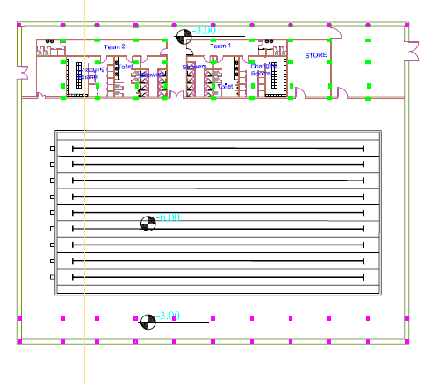
Pool Building plans:
Basment floor
Total Area= 3040m2

Slide 12
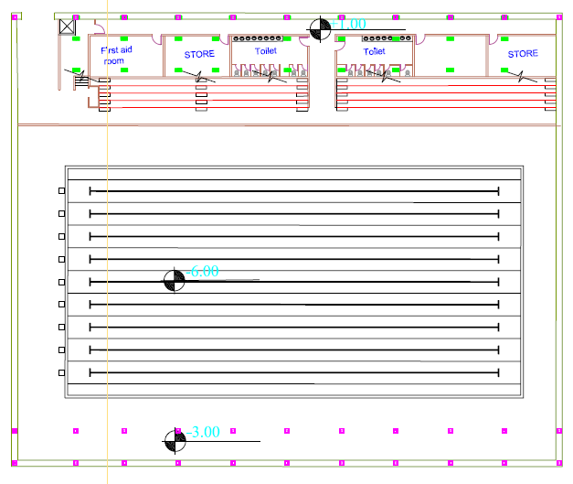
Pool Building plans:
Ground floor
Total Area= 3040m2

Slide 13
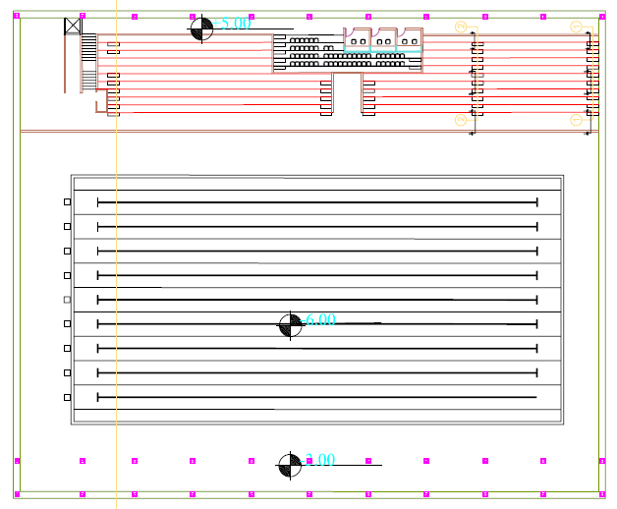
Pool Building plans:
First floor
Total Area= 3040m2

Slide 14
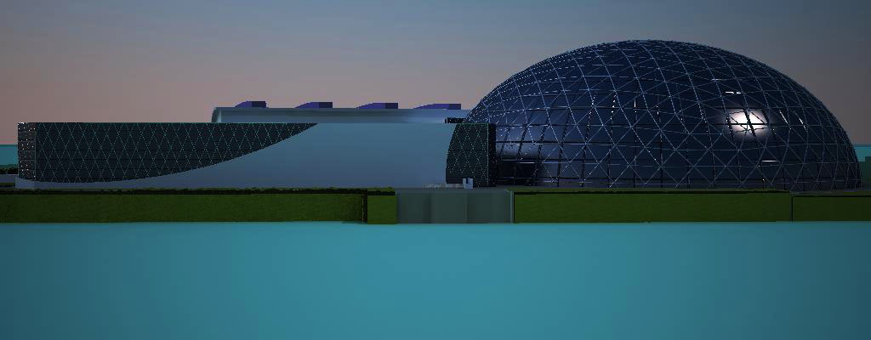
Elevations:
West Elevation

Slide 15
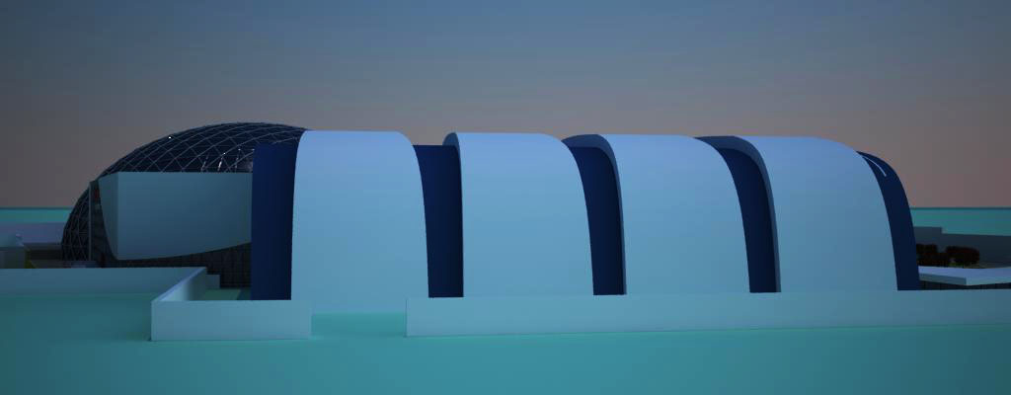
Elevations:
East Elevation

Slide 16
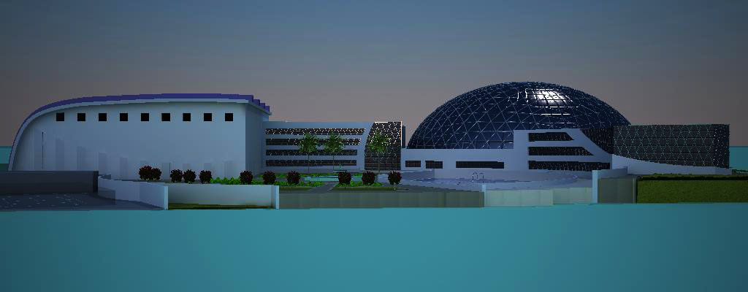
Elevations:
North Elevation

Slide 17
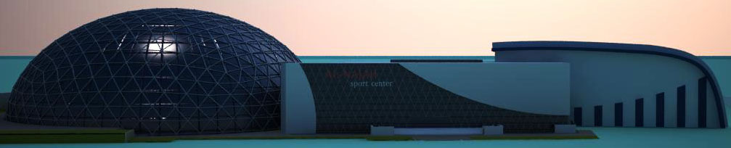
Elevations:
South Elevation

Slide 18
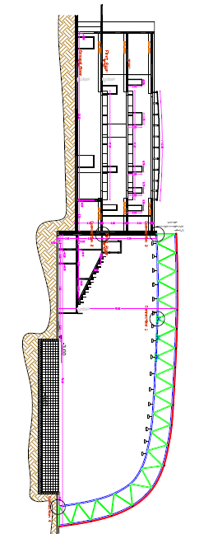
Section:
Section A-A

Slide 19
Environmental design

Slide 20
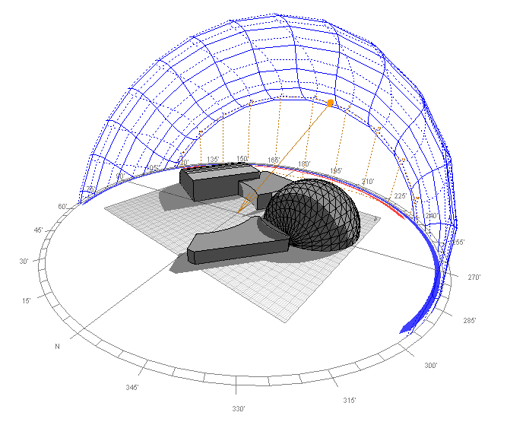
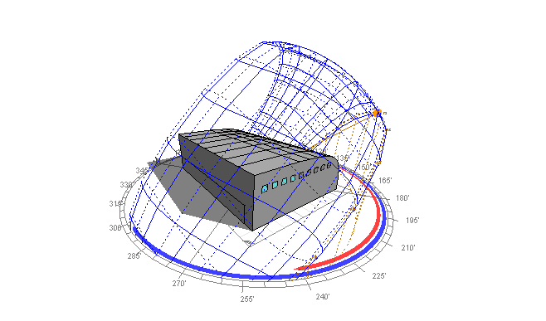
Ecotect analysis:

Slide 21
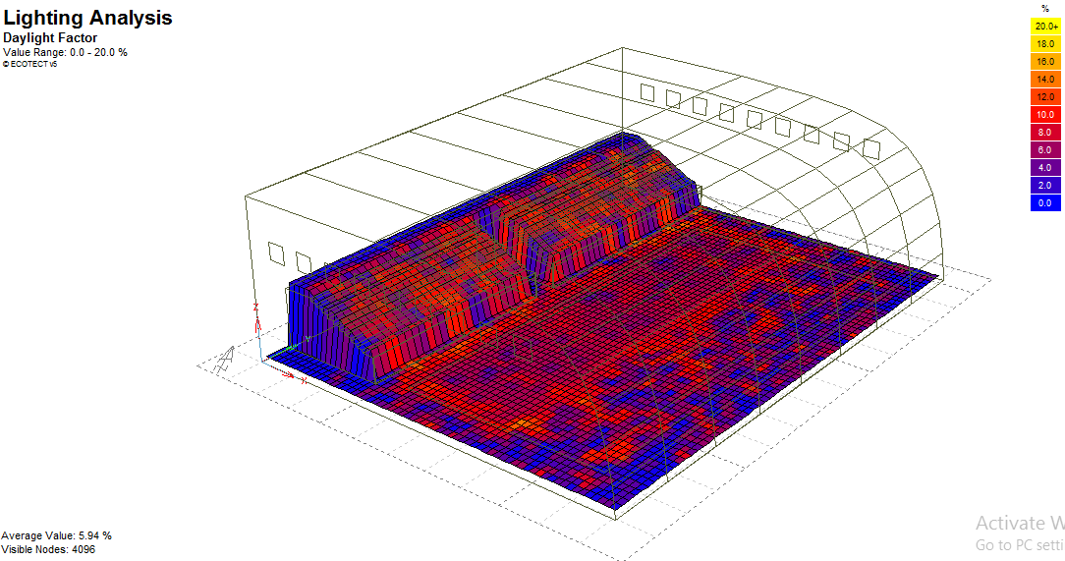

Daylight factor:

Slide 22
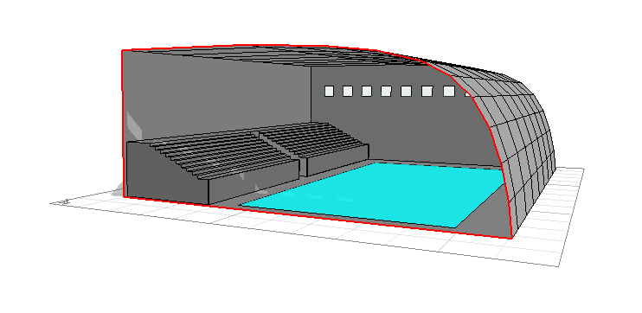
Day light factor:

Slide 23
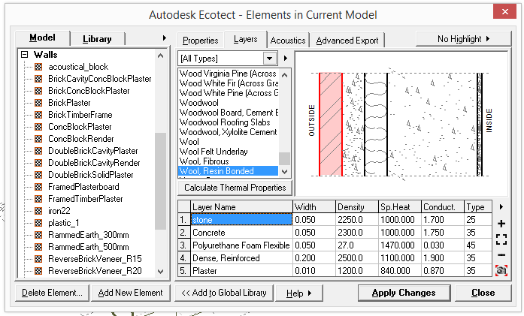
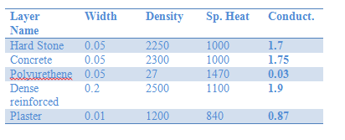
Layers of side walls:

Slide 24
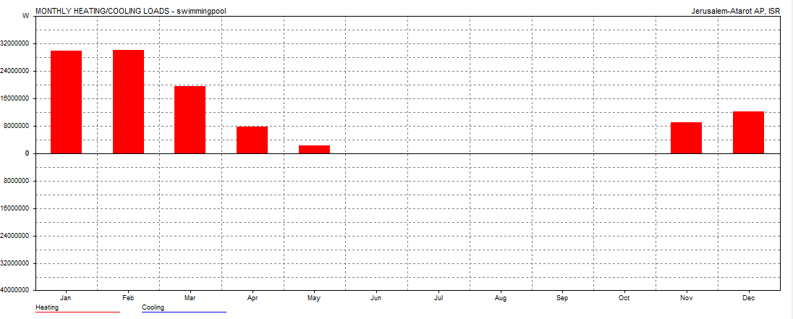
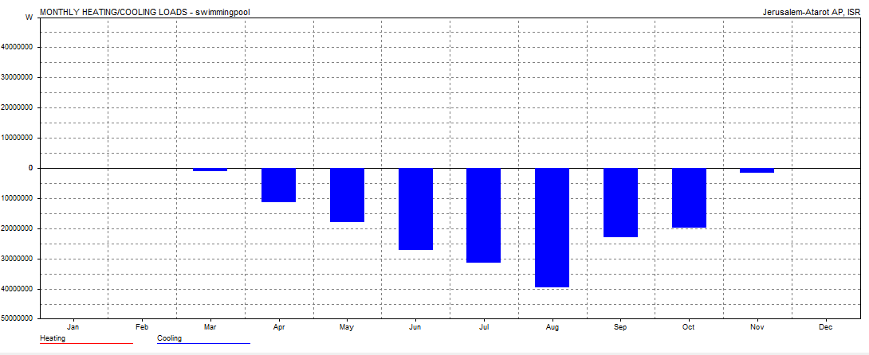
Thermal Loads :
Heating load :
Max Heating: 269736 W at 12:00 on 18th January
Cooling load :
Max Cooling: 464773 W at 13:00 on 15th August

Slide 25
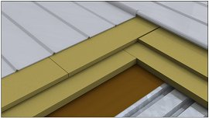
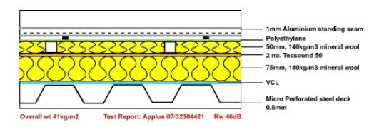
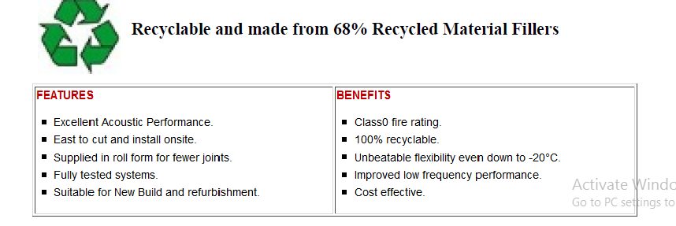
Acoustical Solution:
Tecsound Acoustic Roof Membrane

Slide 26
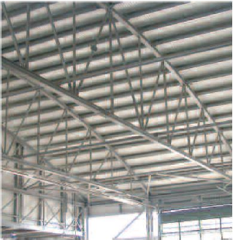
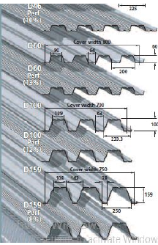
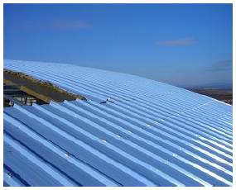
Acoustical Solution:
Micro perforated steel Deck
Inside view
Outside view

Slide 27
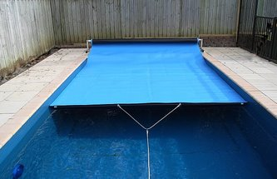
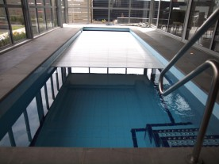
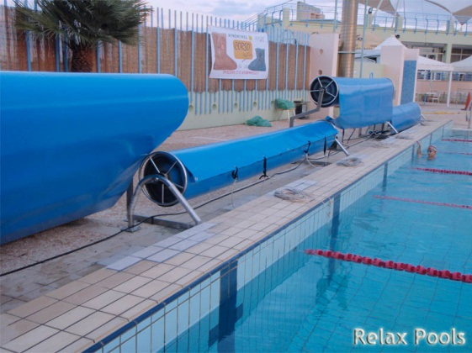
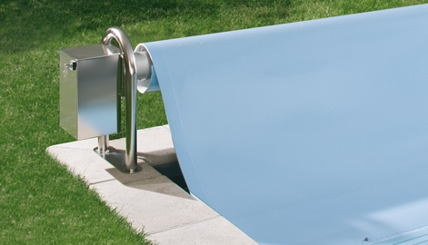
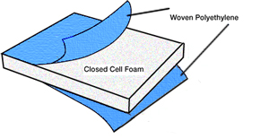
Recommended pool insulation :
Thermal Covering :

Slide 28
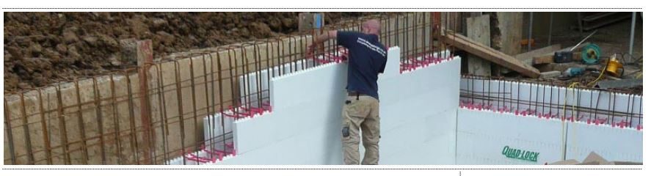
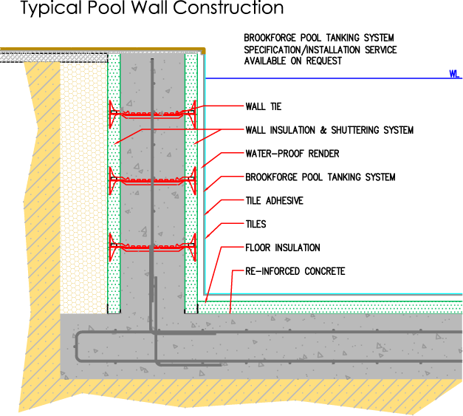
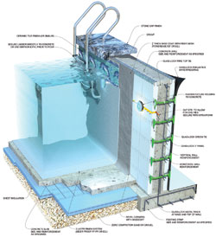
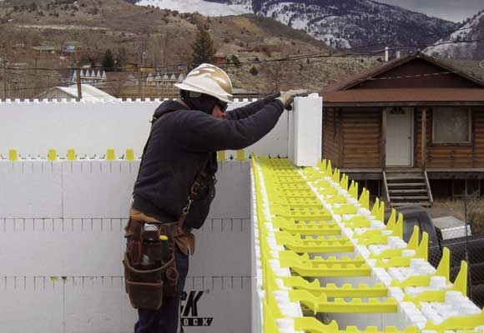
Recommended pool insulation :
Wall insulation: “Quad-lock Panels, U-value = 0.15-0.28 W/m2.k”

Slide 29
Structural design

Slide 30
Design codes:
The American Concrete Institute code (ACI 318-08).
American Institute Of Steel Construction code (AISC 360-05)
The seismic design according to UBC-97.
The analysis and design were done using SAP2000, and Etabs 2013 programs.

Slide 31
Design data :
1. Concrete compressive strength
f’c =24 MPa for slabs and beams.
f’c =28MPa for shear walls, columns and footings.
2.Yielding strength of steel
The yield strength of steel Fy= 420MPa
3. Bearing capacity of soil
the bearing capacity of soil = 200 KN/m2

Slide 32
Structural systems :
Two way solid slab with drop beams “Main Building”
Truss system “Pool Building”
One way ribbed slab “Pool Building”
Thickness :
Two way solid slab = 25cm
Truss system span = 3m
One way ribbed slab = 30cm

Slide 33
Structural elements:
Main building :
1. Beams :
2.Columns dimension
3.Footing dimension
Type | Dimensions(mm)
Main beams | 600X700
Type | Dimensions(mm)
rec. column | 600X900
Type | Dimensions(m)
Isolated Footing (interior) | 4.8X4.5X0.85
Isolated Footing (Edge) | 4.1X3.8X0.90
Isolated Footing (Corner) | 3.1X2.8X0.90
Combined Footing | 4.35X7.75X0.80

Slide 34

Structural elements:
Pool building :
1. Truss members sections :
2. Stadium: “ 10 Steps, slope 27$°$”
3. Olympic swimming pool : (50X25X3)m
Type | Dimensions(mm)
Hollow rec. section (Top) | 168X240X10
Hollow rec. section (Bottom) | 260X182X10
Hollow rec. section (Braces) | 140X140X7
Type | Dimensions(cm)
Landing | 80
Run | 40

Slide 35
Structural elements:
Pool Building:
3. Beams :
4.Columns dimension
5.Footing dimensions
Type | Dimensions(mm)
Main beams | 750X400
Secondary beams | 400X300
Type | Dimensions(mm)
Rec. column | 750X400
Type | Dimensions(m)
F(1) | 1.5X1.8X0.50
F(2) | 2.30X2.00X0.50
Combined Footing | 4.20X2.10X0.50

Slide 36
Structural design for
Main Building

Slide 37
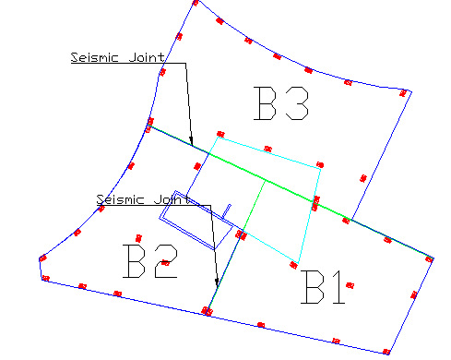
Distribution of Columns:

Slide 38
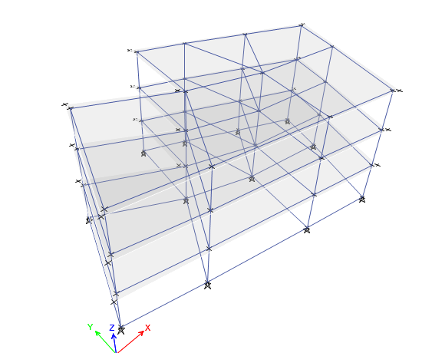
3D Model in etabs for B1

Slide 39
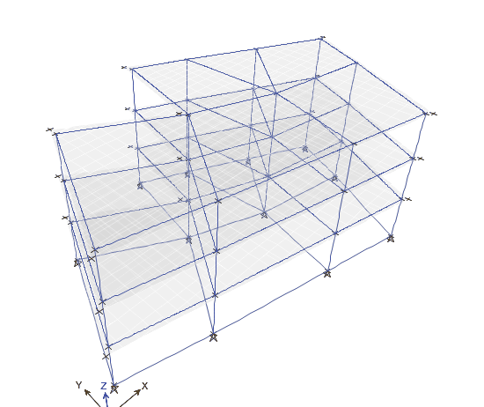
Checks :
1. Compatibility :

Slide 40
Checks :
2. Equilibrium :
 | Manual | Etabs | % Error
Dead load | 15610.8 | 15431 | 1.15%

Slide 41
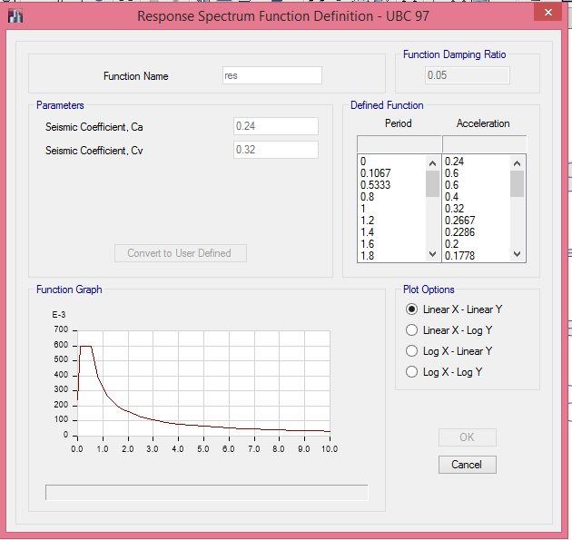
Seismic design Using response spectrum
W= 23637.18 kn , Include D.L+S.D+0.25LL
I = 1
R= 4.5
Ca=0.24
Cv=0.32
T = 0.314 sec
V = 315.1 ton

Slide 42
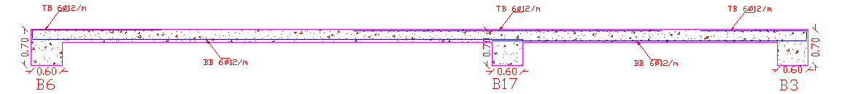
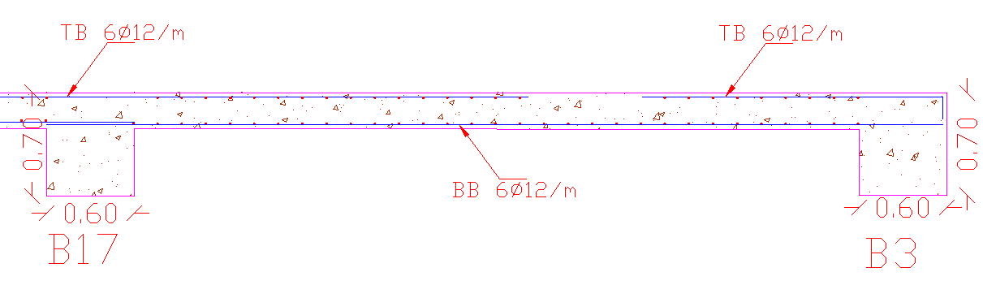
Slab reinforcement :

Slide 43
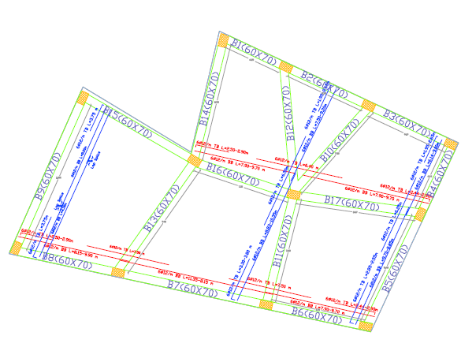
Slab reinforcement :

Slide 44
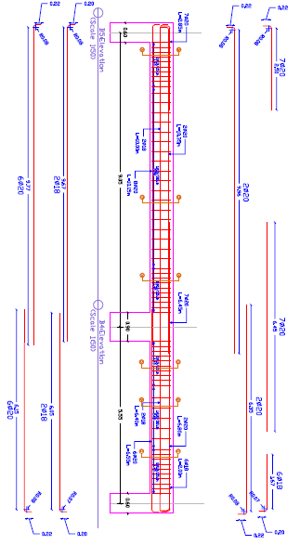
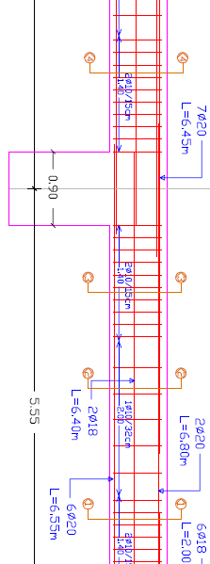
Beams reinforcement :

Slide 45


Column reinforcement :

Slide 46

Footing design :

Slide 47


Footing reinforcement : (Isolated footing F1)

Slide 48

Footing reinforcement : (Combined footing CF)

Slide 49

Footing reinforcement : (Combined footing CF)

Slide 50
Structural design for
Pool Building

Slide 51

Truss system:

Slide 52

Truss system:

Slide 53


Truss system: (designed sections)
For top bars: (TUBO 240X168X10)
For Bottom members : (TUBO 260X182X10)

Slide 54


Truss system: (designed sections)
For Braces: (TUBO 140X140X7.1)
For steel column (HLS 280):

Slide 55

Truss system: (Connections)

Slide 56

Truss system: (Connections)
Connection 1

Slide 57


Truss system: (Connections)
Connection 2

Slide 58


Truss system: (Connections)
Connection 3
Connection 4

Slide 59

Swimming pool design:
SAP Model :

Slide 60


Swimming pool design:
Reinforcement :

Slide 61

Distribution of Columns:

Slide 62


Slab and Beams:
Slab Sec.

Slide 63

Beams reinforcement:
Main Beams :

Slide 64

Beams reinforcement:
Secondary beams :

Slide 65

Distribution of Footings:

Slide 66



Design of Footings:
CF

Slide 67


Stadium design:
Sap model :

Slide 68


Stadium design:
Reinforcement:

Slide 69
Electrical Design

Slide 70

Distribution
of sockets for
main building:

Slide 71

Distribution
of lighting for
main building:

Slide 72

Distribution of socket for pool building:

Slide 73

Distribution of lighting for pool building:

Slide 74

Distribution of lighting for pool :

Slide 75

Main Distributed board for Cricket breakers
MDB
DB1
DB2
DB3
DB4

Slide 76



Artificial lighting using “Dialux” for pool building
Ceiling suspended lighting

Slide 77



Artificial lighting using “Dialux” for pool building
Wall’s mounted lighting:

Slide 78



Artificial lighting using “Dialux” for pool building
Under water lighting

Slide 79
Mechanical Design

Slide 80
General
Mechanical design of a building involves many aspects
Including :
1- water supply system
2- drainage system
3- HVAC system

Slide 81

Water supply system
The capacity of underground water tank = 300 m3
The total capacity of water tanks on
the roof = 30 m3

Slide 82

Water supply system

Slide 83
Water supply system
We've divided the building into seven zones and we compute the sizes of the pipes for main vertical feeder, main horizontal feeder and branches for each zone.
Water demand (gpm) | Number of F.U | Type of supply control | Main feeder
35 | 65 | Flush Tank | Zone A
30 | 51 | Flush Tank | Zone B
11 | 16 | Flush Tank | Zone C
11 | 16 | Flush Tank | Zone D
40 | 79 | Flush Tank | Zone E
12 | 18 | Flush Tank | Zone F
20 | 30 | Flush Tank | Zone G

Slide 84

Water supply system
Ground floor water supply

Slide 85

Water supply system
First floor water supply

Slide 86

Water supply system
Second floor water supply

Slide 87
Water supply system
Calculations
Water demand (gpm) | Number of F.U | Type of supply control | Main feeder
35 | 65 | Flush Tank | Zone A
30 | 51 | Flush Tank | Zone B
11 | 16 | Flush Tank | Zone C
11 | 16 | Flush Tank | Zone D
40 | 79 | Flush Tank | Zone E
12 | 18 | Flush Tank | Zone F
20 | 30 | Flush Tank | Zone G
Pipes Diameter for Zone A
Main vertical feeder (steel) = 2.5 inch
Main horizontal feeder (PVC) = 2 inch
Branches (PVC) = 3\4 inch

Slide 88

Water supply system

Slide 89


Drainage system
the drainage system divided into two types:
Black water
Gray water

Slide 90

Drainage system

Slide 91


Drainage system

Slide 92
Drainage system (pipes diameters)
The vertical stack pipe diameter = 4 inch.
horizontal pipes for Gray water = 2 inch @ ¼ inch per foot slope.
Horizontal pipes for Black water = 4 inch @ 1/8 inch per foot slope
The diameter of vent = 4 inch, and it is raising 4 foot above slab.
The main drain pipes (underground pipes) diameter = 6 inch @ 1% slope.

Slide 93

HVAC system
The duct system that designed based on the loads was taken from ECOTECT ,for 465 cooling load.

Slide 94

HVAC system
For solving the problem of height of building, (JET diffuser) was selected for this objective

Slide 95


HVAC system
Ventilation system with dehumidifier

Slide 96

Thanks for listening

