Slide 1
Graduation Project II
Design and Control Sweets Production Line
Supervisor: Dr.Osaid Abdulfattah
Students:
Suliman Khraishi
Taha Al-Araj
Mohammed Rawhi Samaro
Abdullah Kalbouneh

Slide 2
Outline
Mechanical Design.
Control System of the production line.
The Practical Work.

Slide 3
Introduction
What is the project ?
This project is about a machine that is designed to stuff and form edible products.
There are some steps to form the final shape, starting with encrusting and ending with stamping.

Slide 4
Mechanical Design:
The encrusting machine consist of material containers, screw feeders, pipes and the encrusting part (Cutting and twisting) with a specifications:
Quantity of products | 3600 piece/hour
Ratio between the casing and the filling | 1:1
Diameter of filling nozzle | 3 cm
Diameter of casing nozzle (dough nozzle) | 4.25 cm (to achieve 1:1 ratio)
Height of a single piece | 5 cm
Size of the product | 71 cm³

Slide 5
1 – Encrusting Machine components:
1 - The base : This part is the part holding all the pieces together from the motors to the conveyer belt attached.

Slide 6
2 - Containers and upper part : The upper part holds the other mechanical parts that are in direct contact with the edible materials and holds the feeding pumps and the mold.

Slide 7
3 - Screw feeders and rollers : The pump that extrudes and squeezes out the edible materials from the nozzle.

Slide 8
4 - Mold and Nozzles: the materials flows from the containers into the mold which contains a mechanical parts designed to adjust the flow attached to nozzles that will extrudes the materials from the machine.

Slide 9
A -The mold: The materials (dough and filling) will leave the containers due to pump rotation into the mold through the front holes.

Slide 10
B - Filling path and Nozzle: After the filling flows into the mold it goes into filling tube which has a nozzle attached to it from the bottom side.
The filling will flow into the hole where the dough (casing) will flow around the tube making the shape of a ring.

Slide 11
C - Casing Nozzle (Outer Nozzle): The outer nozzle and the holding ring are attached to the mold from the bottom side, the casing will flow out of the nozzle in the shape of a ring.

Slide 12
2 - Encrusting Part (Cutting tool)
Encrusting means cutting and twisting in the same time.
Cutting the cylindrical product (dough with filling) from the previous part and turn it into a spherical shape.

Slide 13
The results of using this method and how it gives the required shape:

Slide 14
Part components:
Encrusting part consist of several components working together in harmonic.
1 - The base: It’s fixed and the other components installed on it.

Slide 15
2 – Rotating Ring: It rotates approximately 30 degrees c.c.w then 30 degrees c.w repeatedly making the cutters opening and closing.

Slide 16
3 – Cutter: The cutters are responsible for cutting and twisting and they are connected together through the base and rotating ring.
The twisting helps to close the both side of the cut pieces.

Slide 17
4 - The cover and arm: after all components assembled together, cover and arm will be used to finish the part.
The arm located on the top of the base to transfer the reciprocating motion through a rod attached to motor (slider crank mechanism) and move the cutters to perform cutting and twisting.

Slide 18
The final shape of the mechanical part the same as shown in figures below once when the cutters are opened and once when the cutters are closed.

Slide 19
Part movement mechanism: The arm moves with a reciprocating motion comes from the motor by using slider-crank mechanism which converts the rotational motion of the motor into linear motion through a rod.

Slide 20
3 – Conveyor Belts:
Belt with a continuous movement: To deliver the pieces continuously to the rounder machine then to the belt with an interrupted movement.

Slide 21
Material Selection
In this production line conveyer we are using Teflon mesh belt (PTFE).
Teflon mesh belt is made of fiberglass mesh impregnating with suspended PTFE

Slide 22
Properties:
High temperature resistance - working range: -70℃～260℃.
Non-sticky, stains can be easily removed.
Chemical resistance, resisting all kinds of organic solvent.
Good dimensional stability, high strength, excellent mechanical properties.

Slide 23
Dough rounding belts: dough is cut down in to the conveyer, the moving dough on the conveyer will run into two conveyer belts that is vertical to the main belt.

Slide 24
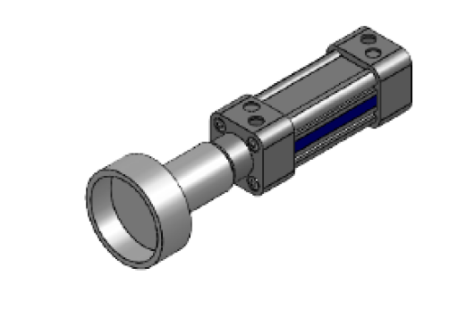
4 – Stamping
Give the pieces a unique design through a mold attached to pneumatic stamper.

Slide 25
The pneumatic circuit for the system:

Slide 26
Control System of the production line
The control part discuses the required motors, main controller, switch’s, sensors and wiring circuits.
1 – Motors:
The whole production line need 6 motors will distribute as the follows:
1 – Two Induction motors for the first mechanism: feeder screws movement.
2 – One Induction motor for the second mechanism: encrusting movement.
3 – One Induction motor for the third mechanism: continuous conveyer belt movement.
4 - One Induction motor for the fourth mechanism: rounder movement.
5 – One Stepper motor for the fifth mechanism: interrupted conveyer belt movement

Slide 27
Each motor need a special control called VFD ( variable frequency drive).
A variable-frequency drive (VFD) is a system for controlling the rotational speed or torque of an alternating current (AC) electric motor by controlling the frequency of the electric power supplied to the motor.

Slide 28
The wiring diagram of the VFD with motor.

Slide 29
The controller for the stepper is a special driver connected with a pulse generator(PLC works as a pulse generator).

Slide 30
2 – Switches and sensors:
In this production line there are switches will be added to the system and distributed as the follows:
1 - Two pushbuttons, one to latch the production line and the other to unlatch.
2 - Emergency stop switch.
In the production line there are two sensors used and located on the first and end of the system.
The type of sensor used for stamping machine is through beam sensor (normally closed), it has a high range distance than other sensors, and the other is a capacitive sensor (normally open) for the material level in the containers.

Slide 31
3 – The main controller
In this production line a PLC (Programmable Logic Controller) is used to control the operation.
In this project there is an attempt to use specific PLC programming software called (RSL ogix Microstarter) for Allen Bradley PLC and the specifications are:
1 - Mico logix 1100 series B (3-rackes)
2 - 8 input 10/30 vdc
3 - 8 output vdc
4 - 4 channel Analog

Slide 32
The written Ladder diagram for the digital inputs:

Slide 33
Conclusion
The project is conducted and the parts were designed to produce the required amount, shape and size of the products.
Solidworks was used to display most of the machine parts.
the machine is sold in china and several countries and it is quite expensive ranges between 30k~40k dollars.
To conclude this project we will show you some of the practical work

Slide 34
The Practical Work

Slide 35
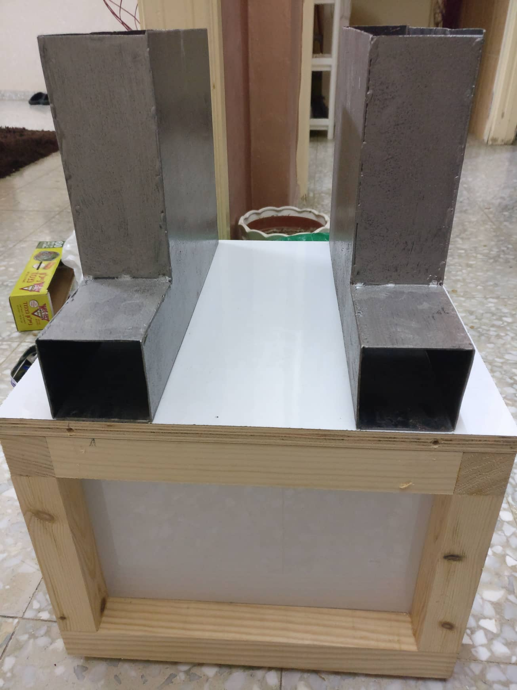
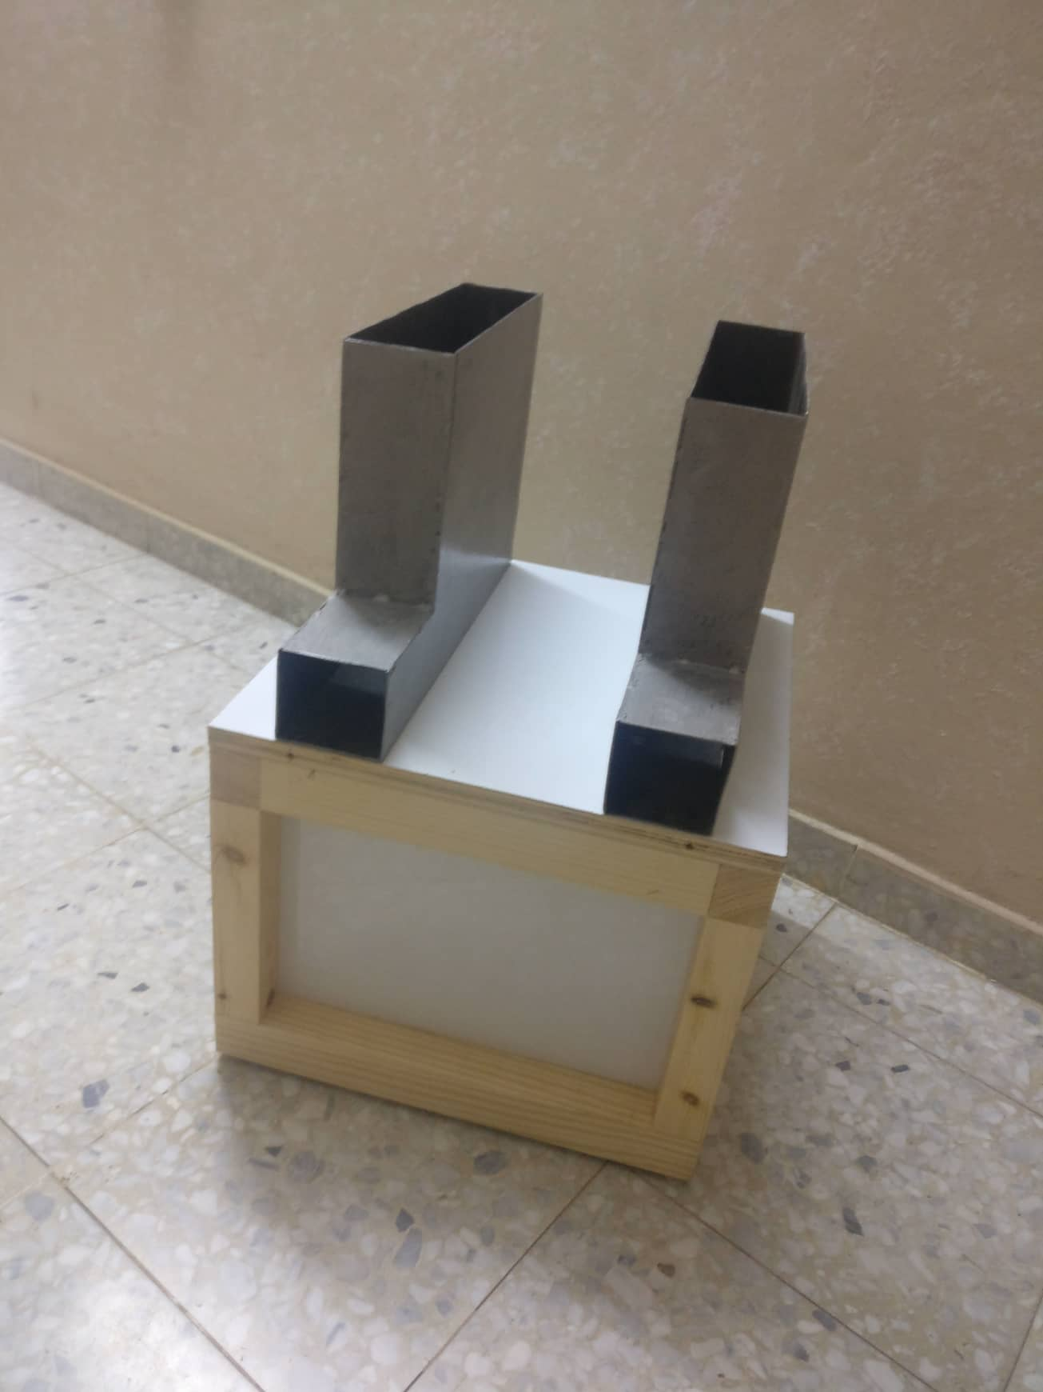

Slide 36
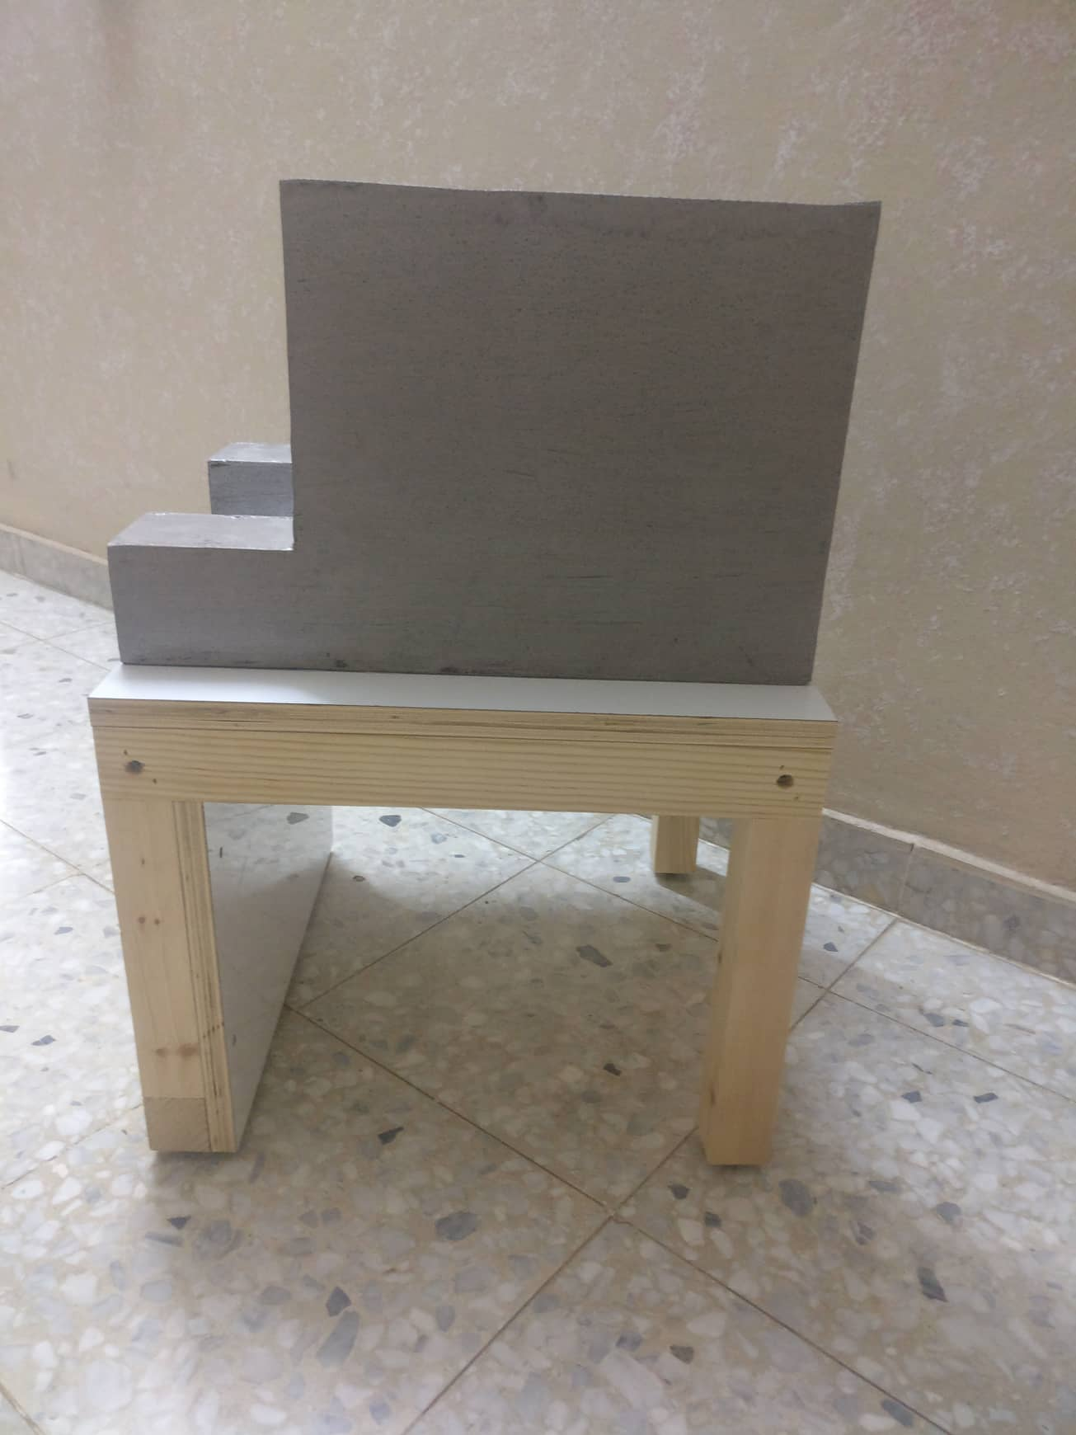

Slide 37
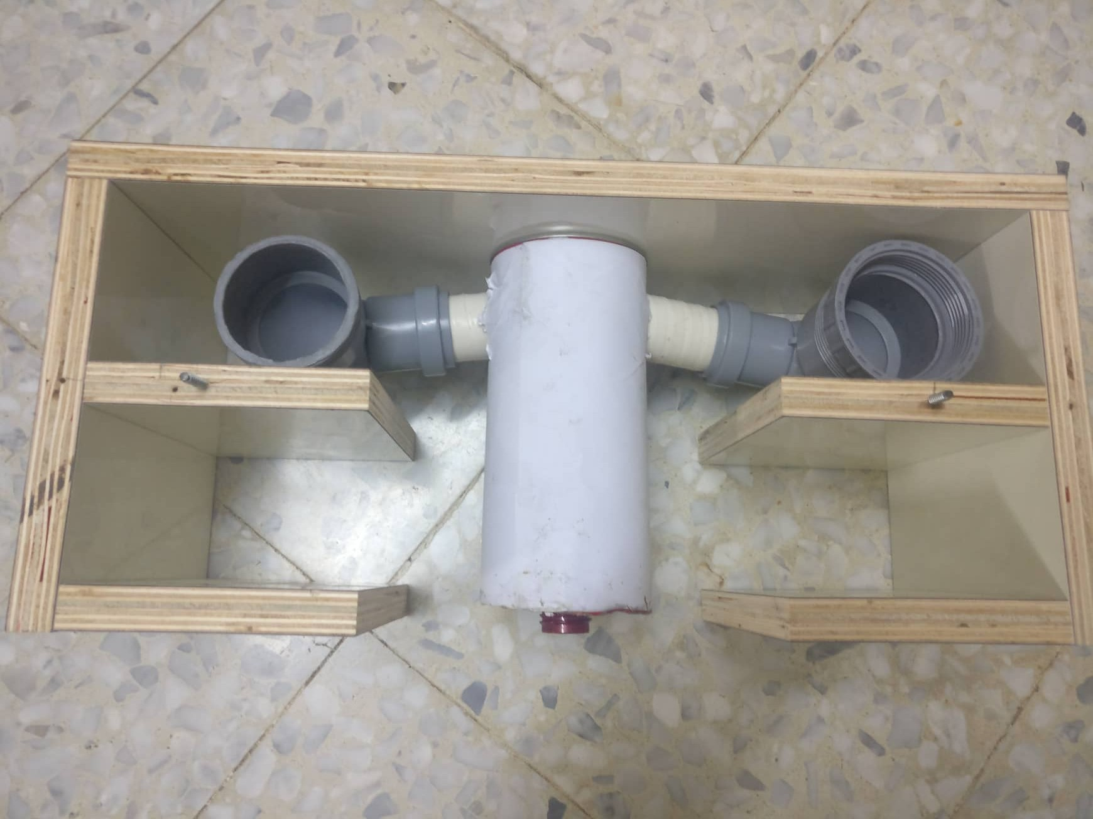

Slide 38
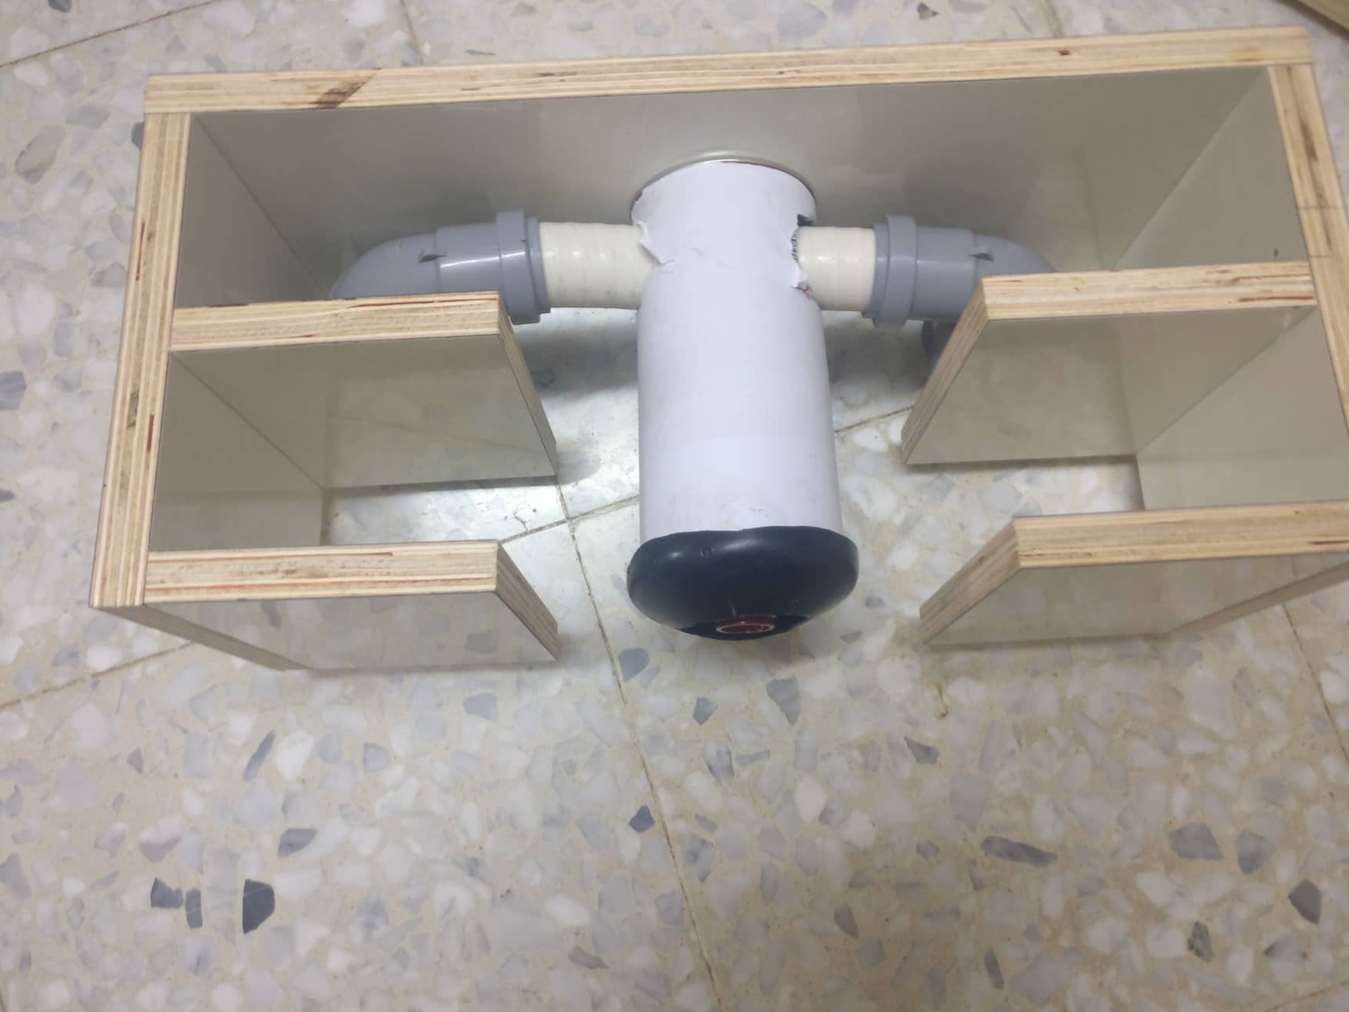

Slide 39
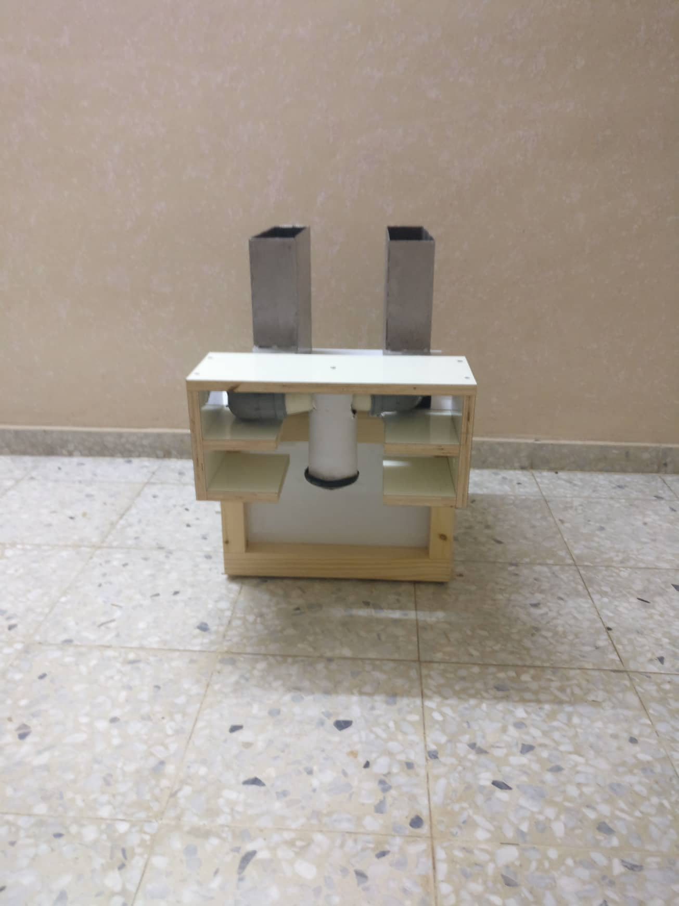

Slide 40
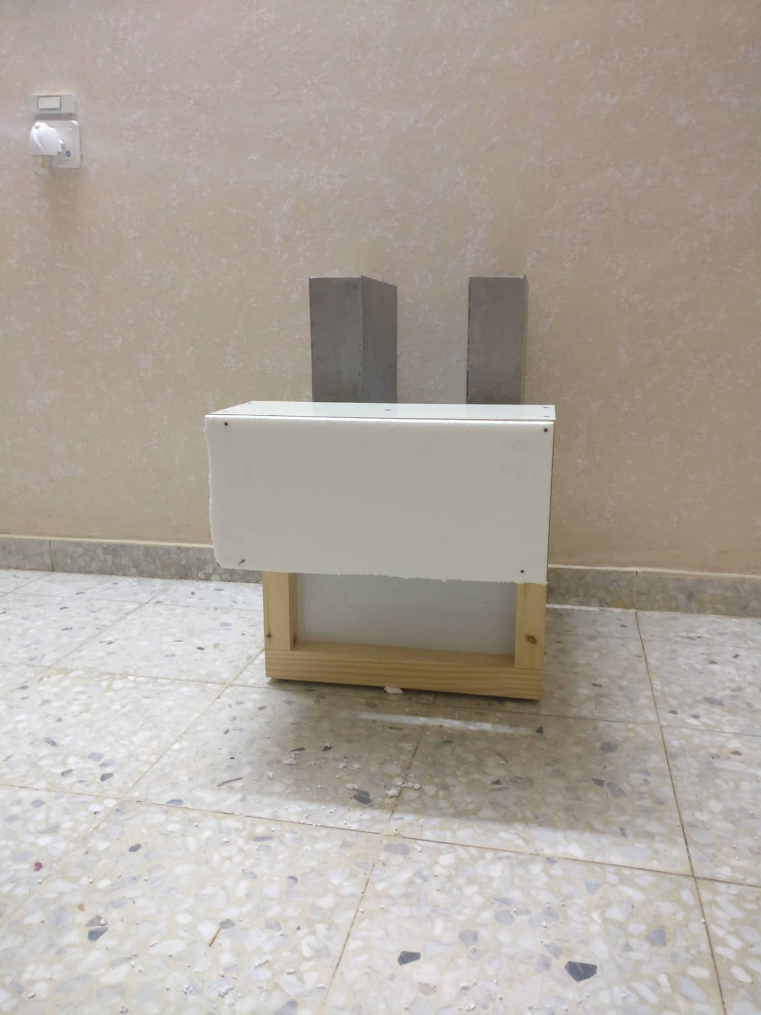
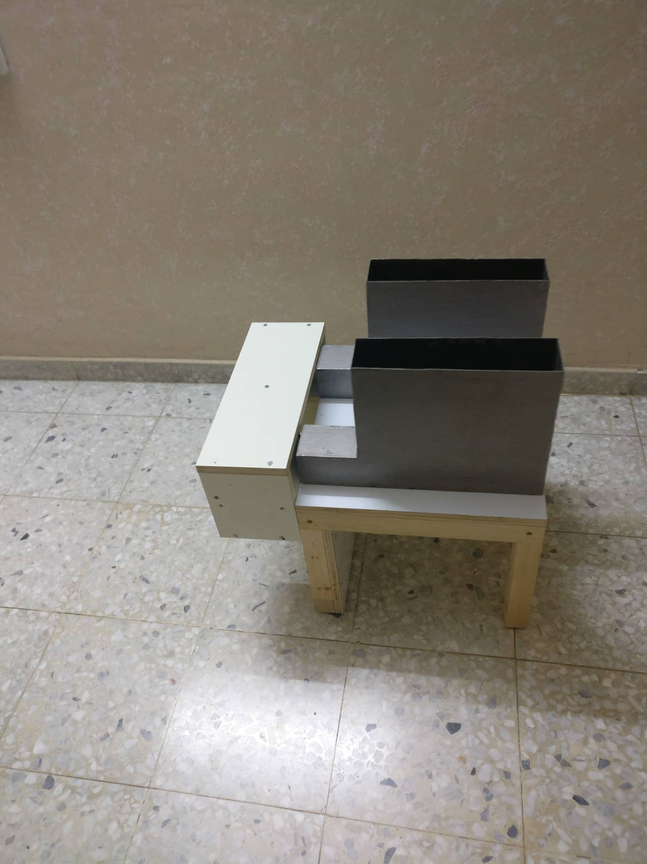

Slide 41
Thank you for listening
All your Questions are welcome

