Slide 1

AN-NAJAH NATIONAL UNIVERSITY
FACULTY OF ENGINEERING
DEPARTMENT OF MECHANICAL ENGINEERING
Production of high quality olive oil
Prepared by:
Darwesh Abd Al-Nabi
Haif Ibrahim
Hazem Abuarra
Supervisor :
Dr. Bashir Nouri

Slide 2
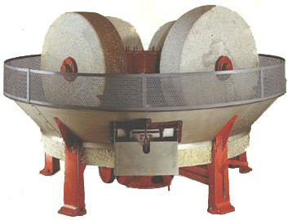
Production of high quality olive oil
The aim purpose of our project is to design a Machine which can be produced an oil; not any oil ; the oil that possesses a High Quality specifications , by separate the Pit from the olive seeds and extraction the oil from the skin part only.
In our project mill consists of three main parts : Feeder , Conveyor , Separator .
Milling the Fruit : Grinding up the fruit into a paste depends on so many factors and is ultimately dependent upon the style of oil desired such as the olive.
Method of olive milling :
There are many methods of mill such as :
1 )Stone Mills :
Stone rollers or wheels roll in circles on a slab of granite to grind the olives into a paste , this method has advantage and disadvantage :
Advantages:
The stones do not cut the olive skin, so less chlorophyll is released.
Larger size drops of oil are formed, which minimizes mixing times.
The paste is not heated.
A lower level of polyphenols is extracted so the oil is less bitter.
Disadvantages:
They are bulky.
The stones are difficult to clean.
Green olives prolong grinding time.

Slide 3
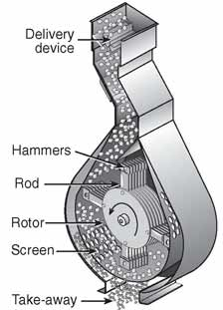
2) Hammer mills:
A hammer mill has swinging arms that push the olives into the sides of a rotating chamber through centrifugal action. The mill may have one to several hammers.
Advantages:
The process is continuous with a high throughput.
Cleaning is easier than stone mills.
They tolerate debris such as rocks and grit better than stone mills.
It is a well-known, perfected technology.
More polyphonls are extracted so the oil has a longer shelf life.
Disadvantages:
They may create an emulsion that impedes the separation
between the oil and water, specially with very ripe, over-watered fruit.
More polyphonls are extracted so the oil is bitterer than oil extracted
with stone mills. This may be an advantage with
mild olives or with olives with naturally
low levels of polyphonls , such as Arbequina.
There is some wear and tear of the metal parts.
The paste may heat up.

Slide 4
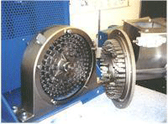
3 ) Metal Toothed Grinders:
The olives are fed into the center of the grinder. An electric motor attached to a toothed grinder pulverizes the olives as they are flung away from the center.
Advantages
The process is continuous with a high throughput.
They are less expensive than other equipment.
They may give the oil a longer shelf life than stone mills.
Disadvantages
The olive paste fragment size is not easily modified.
They may create an emulsion that impedes the separation between the oil and water.
More polyphenlos may be extracted, so the oil may be bitterer than oil made with stone mills. This may be an advantage with mild olives.
One stone alone can break an expensive tooth on the grinder.
The oil paste may heat up.

Slide 5
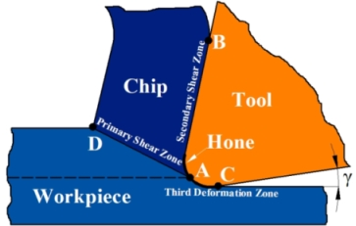
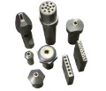
Main parts of mill
Machines have very wide range of components and application ,like the machines that use to produce juice or oil like ; Carrot squeezer , Olive oil press , Sugar-cane squeezer,...etc.
This machines are contain three main parts :cutting tools which use to grind the raw material ,feeder which use to move the raw material ,and metal mesh which use to filter the production from the Impurities of grinding .
Cutting tool :
A cutting tool (or cutter) is any tool that is used to remove material from the work piece by means of shear deformation.
Types of cutting tool:
1) Single pint cutting tool:
2) Multi-point cutting tool.

Slide 6
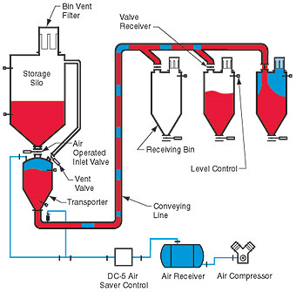
Feeder conveyor
A conveyor system is a common piece of mechanical handling equipment that moves materials from one location to another .
Types of feeder conveyor
1) pneumatic system conveyor
Every pneumatic system makes use of pipes or ducts called transportation lines that carry mixture of materials and a stream of air. These materials are such as dry pulverized or light powdery materials like cement, fly ash etc. these materials can be transported conveniently to various destinations by means of a stream of high velocity air through pipe line.

Slide 7
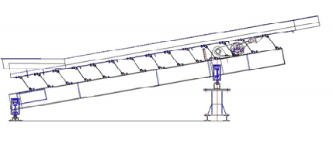
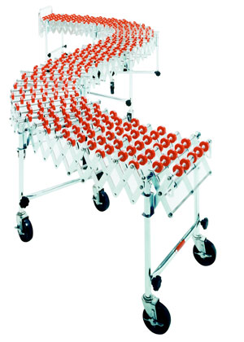
2) A Vibrating Conveyor: they are used extensively in food grade applications where sanitation, wash down, and low maintenance are essential. Vibrating conveyors have been built to convey material at angles exceeding 45° from horizontal using special pan shapes.
3) The flexible conveyor is based on a conveyor beam in aluminum or stainless steel, with low friction slide rails guiding a plastic multi-flexing chain, Products to be conveyed travel directly on the conveyor, or on pallets/carriers .
Advantage of the conveyor:
Conveyors are able to safely transport materials
from one level to another, which when done by human
labor would be strenuous and expensive.
They can be installed almost anywhere,
and are much safer than using a forklift
or other machine to move materials.

Slide 8

Mesh
Mesh consists of semi-permeable barrier made of connected strands of metal, fiber, or other flexible/ductile material. Mesh is similar to web or net in that it has many attached or woven strands.
Types of mesh
A plastic mesh is extruded, oriented, expanded or tubular. Plastic mesh can be made from polypropylene, polyethylene, nylon, PVC or PTFE.
A metal mesh can be woven, knitted, welded, expanded, photo-chemically etched or electroformed (screen filter) from steel or other metals.
Uses of meshes
Metal and nylon wire mesh filters are used in filtration
Wire mesh can be fabricated to produce park
benches.

Slide 9

Grinding
Grinding: is an abrasive machining process that uses a grinding wheel as the cutting tool. A wide variety of machines are used for grinding:
Hand-cranked knife-sharpening stones (grindstones)
Handheld power tools such as angle grinders and die grinders
Various kinds of expensive industrial machine tools called grinding machines
Principle of Grinding Machine
Every grinding operation can be described as a machining process with an undefined cutting edge because the angle of cut is in the range from about ( -45º to -80º ) , depending on the abrasive used (type of grain) and the conditions of use. Machining is not done here by only one cutter, as in processes with a defined cutting edge (milling, turning, `broaching etc.), but by a usually unknown number of individual cutters simultaneously. The effective number of cutters is not determined by individual grains, but by the conditioning (dressing and profiling). An indeterminate number
of tiny individual cutters is formed on a single grain by chipping
of the grain during conditioning, depending on the grain size,
the conditioning tool and the conditioning parameters.

Slide 10
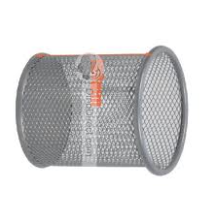
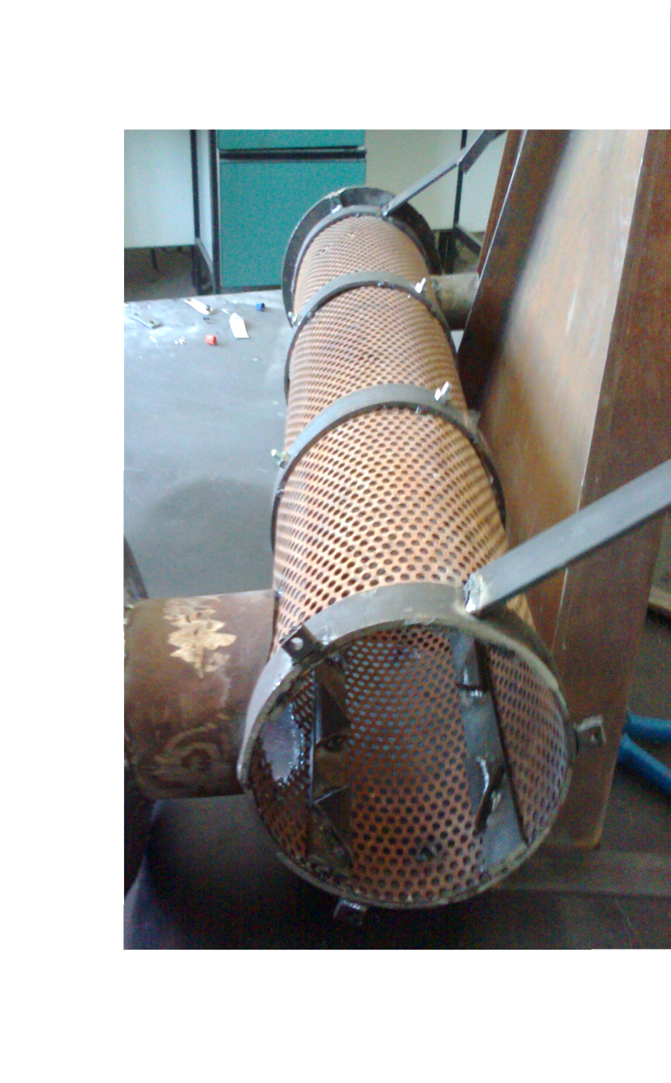
Machine design
There are many mechanical components in this project
Metal mesh design :
The metal mesh is one of the main parts of machine an d it can be designed as :
We need a metal mash that have holes with diameter (6mm) , in order not to allow the olive particle to bass through it before it grinded .
A metal mesh had been cut in a rectangular shape with (80cm)length and (54cm)width
The rectangular metal mesh had been bent in a cylindrical shape with (17cm) diameter.
The metal mesh had been welded at the end of the bent

Slide 11
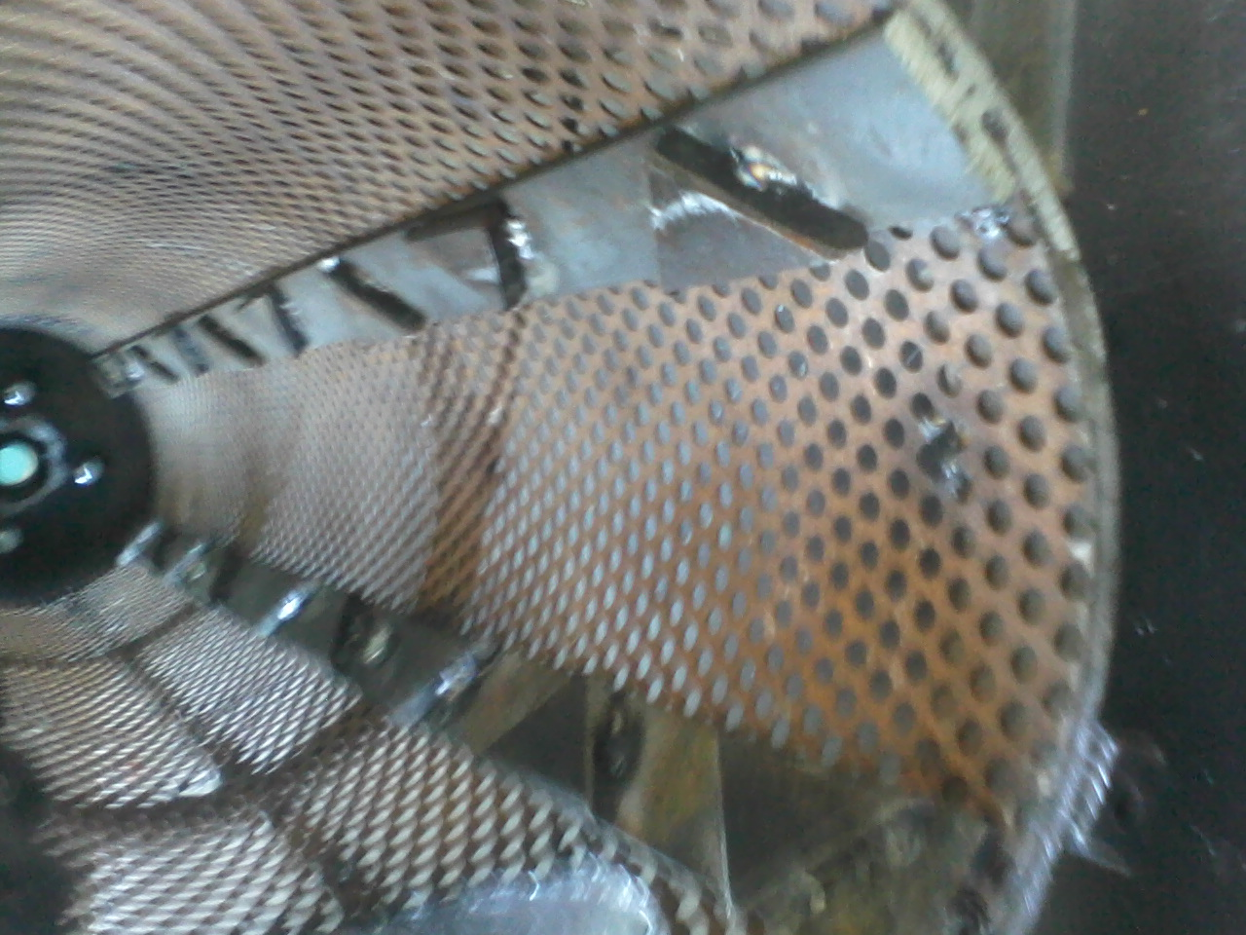
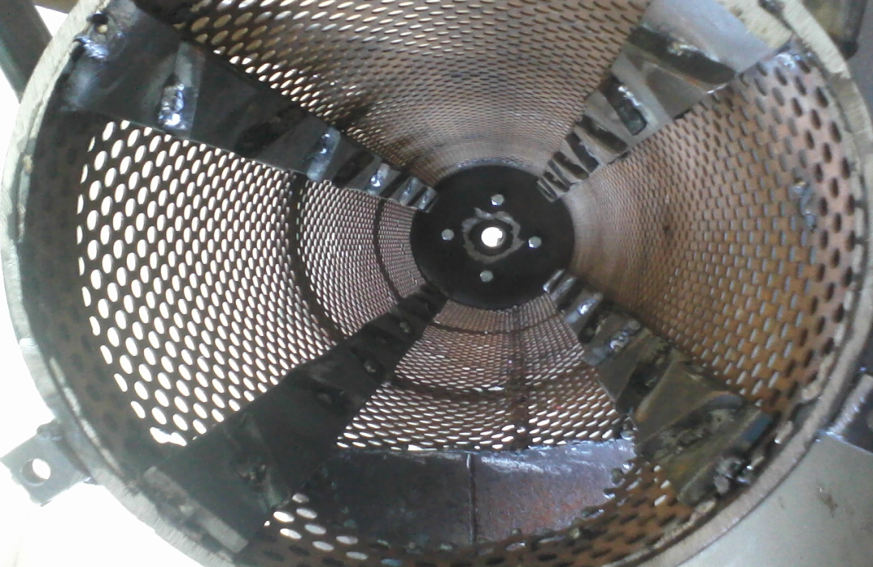
2) Cutting Tools Design
Design concept :
We need a six long pieces of steel ; four of them had an exact length which is(80cm) and the other pieces no matter how its long.
The tow long pieces had been cut in a triangular shape.
The triangular cutting tool had been welded in the pieces which have 80 cm
The four long pieces with cutting tool which had been fixed on it were ready to be welded in the cylindrical metal mesh

Slide 12
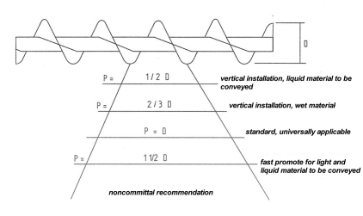

screw conveyor design :
A screw conveyor is a mechanism that uses a rotating helical screw blade within a tube to move liquid or granular materials.
Design concept :
Characteristics:
Flight outside diameter, type of blades,
spacing between the blades thickness
of the external diameter and interior
shaft and rotation direction
Procedure of design:
Step (1): Establish Known Factors :
Type of material to be conveyed . Capacity required . Maximum size of hard lumps
Percentage of hard lumps by volume . Distance material to be conveyed
Any additional factors that may affect conveyor or operations
Step (2): we choose that the suitable one is the Vertical installation screw conveyor
Screw pitch 2/3 D,( P) = 2/3 Screw Diameter outside(D) .
P=0.15 m where D=0.22 m
Step (3): Material Flux Calculation :
Conveyor housing filled area S ( m² ) = λ
S= 4.752*10^{^-3} m²
Type of load | λ
Heavy and abrasive | 0,125
Heavy and a little abrasive | 0,25
Light and a little abrasive | 0,32
Light not abrasive | 0,4

Slide 13
Step (4): Screw speed: Inversely proportional to:
Weight of the bulk material.
Abrasive materials.
Screw diameter.
Note: Heavy materials< n≈ 50 rpm.
Lighter materials> n≈50 rpm. ; let the n = 1200 r.p.m
Travelling speed (m/s) = v =
v=3m/s where n=1200 rpm t=0.15m
When rotating speed increases then traveling speed increases .
Step (5): Transported Material Flux (t/h) = Q= 3600.s.v. γ. K
Where: S = Conveyor housing filled area , v =Travelling speed (m/s) = v = , γ = Material density (t/m 3) = 0.86 ton/m³ , K =constant depend on inclination of conveyor housing.
Step (6): POWER:
P= P H +P N +PSt
Where:
P H : is the required power to move the material horizontally ;(P_{H} ( KW ) = c₀ *QLg /3600 = c₀*QL / 367).
P N : is the required power to operate an unloaded screw .(P N ( KW ) = DL/ 20 ).
P St : is the required power for an inclined screw conveyor . (P St ( KW ) = QH / 367).

Slide 14


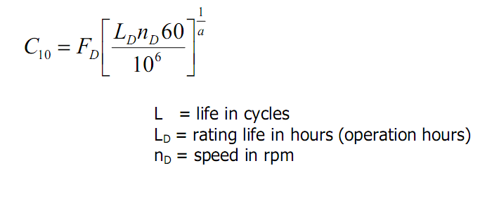
4) Bearing design
A bearing is a device to allow constrained relative motion between two or more parts, typically rotation or linear movement.
Types of Bearings:
There are many types of bearings, each used for different purposes. These include ball bearings, roller bearings, ball thrust bearings, roller thrust bearings and tapered roller thrust bearings.
Design concept :
The force had been analyzed in equilibrium state ,the force in the end of the shaft is multiply by two according to has bully with two belts.
Power = Torque * Angular speed
F = (T/r)/2 = (38.32/ 0.05) / 2 = 383.2 N
F_{B} = 437.5 N (The Max).
F_{A} = 328.9N where (r-radius of the bully- =0.05m; angular speed=125.7rad/s, torque=38.32 N.m , power=4.8 kw).
Assume that: L_{D}= 60Kh , n_{D} =1200 r.p.m ,
C₁₀ = 7.13
The bore diameter =15 mm

Slide 15
There are many problems that faced us :
In the Metal Mesh Design: The problem is how to design the cylindrical shape from the mesh?.
In the Cutting Tools Design: The problem is how to make a complete grinding for the olive grains?
In Screw Conveyor Design: The problem is how to install it in the specific place without Influence on the sharp blades (triangular cutting tools)?
In the Ball Bearing Design: The problem is how to select a suitable bearing that carries a desired load without fracture.

