Slide 1
Structural Design of
Al-Fidai Stadium
Prepared by: Bisan Khader
Yasmeen Abu Oun
Under Supervision of:
Dr. Ibrahim Arman

Slide 2
OUTLINE
Introduction
Preliminary Design
Three-Dimensional Analysis and Design

Slide 3
INTRUDUCTION

Slide 4
INTRUDUCTION
Background Information …
Location: Eastern area from Nablus, Palestine
Nablus’s Height: 400m above mean sea level
Soil Type: Rock
Bearing Capacity = 350 KN/m²
Soil Site Class: C

Slide 5
INTRUDUCTION
Architectural and Structural Design …
Field area of about 54000 m²
Capacity of about 50000
Part One: Concrete Structure
Four Stories
Total area of about 71420 m²
Divided into Eight Blocks
Part Two: Steel Structure
Total height of about 40.5 m
Length of about 50 m

Slide 6
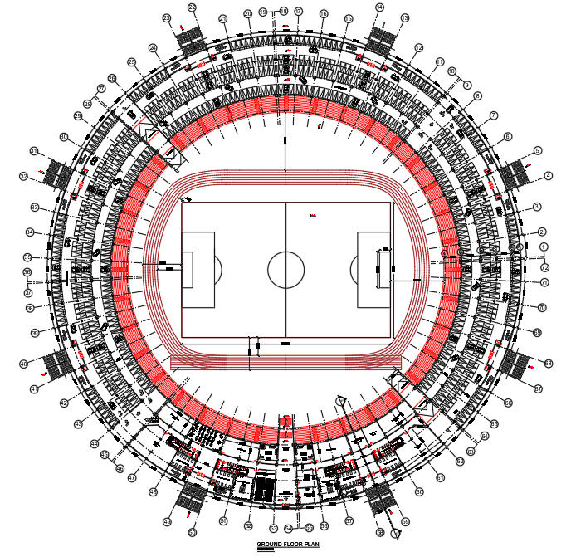
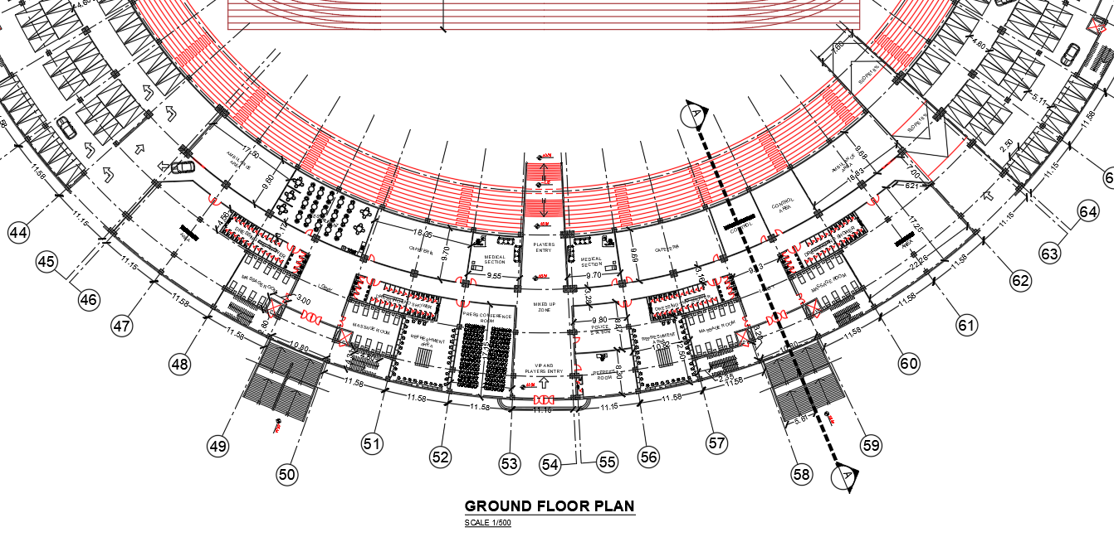

Slide 7
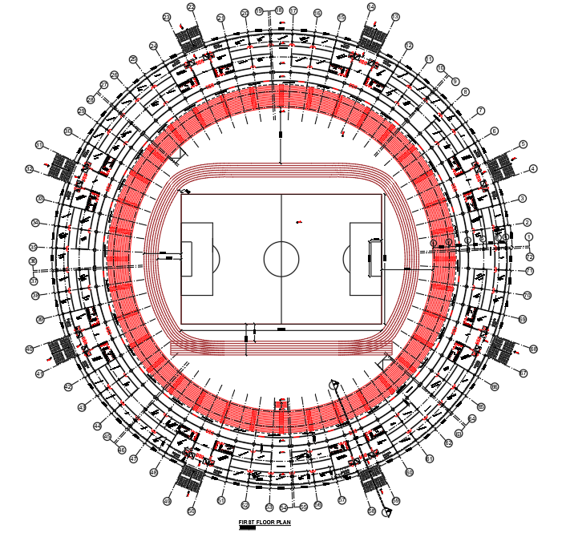
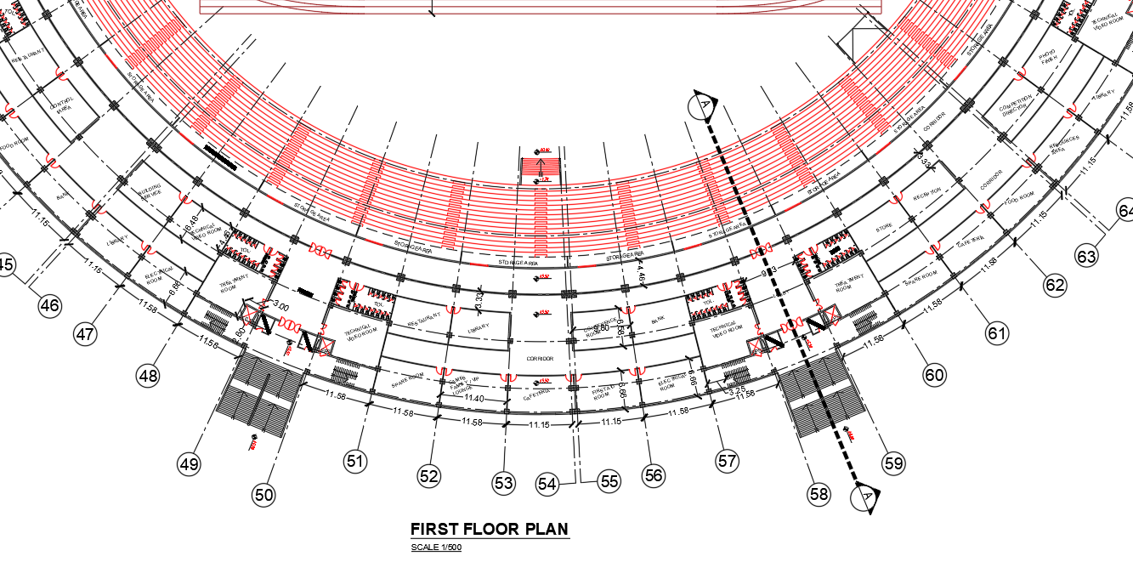

Slide 8
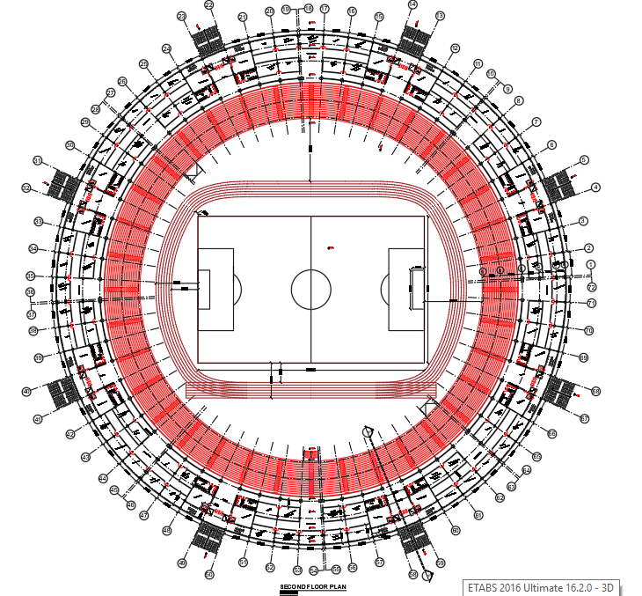
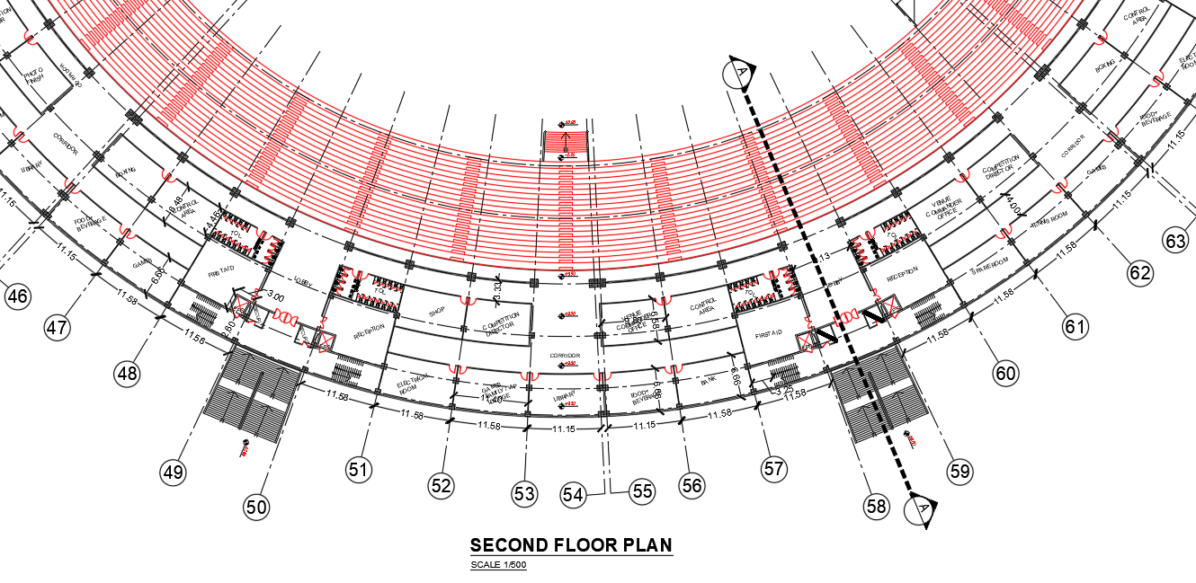

Slide 9
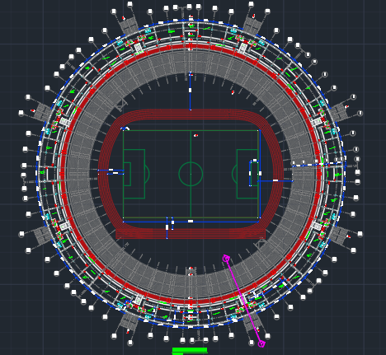
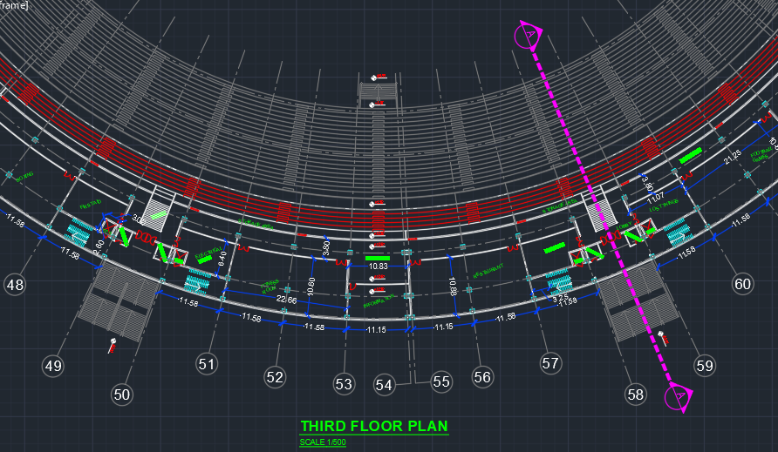

Slide 10
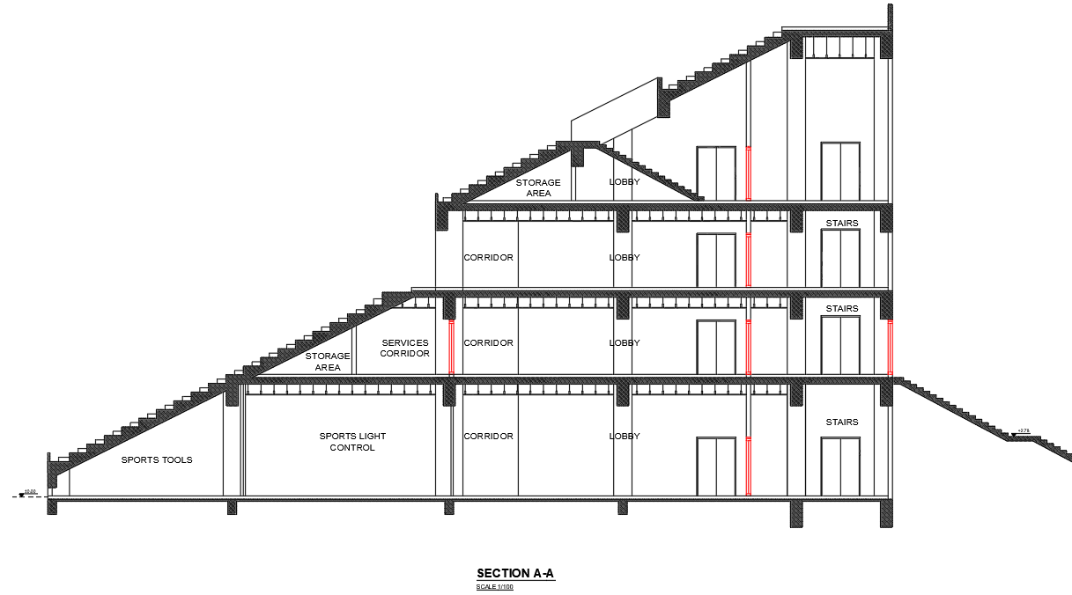

Slide 11
PART ONE : CONCRETE STRUCTURE

Slide 12
INTRUDUCTION
Architectural and Structural Design …
Height (m) | Area (m²)
5.5 | 3000 | Ground Floor
4 | 2430 | First Floor
4 | 1850 | Second Floor
8 | 1700 | Third Floor
Block

Slide 13
INTRUDUCTION
Codes and Standards …
American Society of Civil Engineers (ASCE 7-10)
American Concrete Institute (ACI 318-14)
Jordanian Code for Loads and Forces
American Society for Testing Materials (ASTM)
Israeli Code SI 413

Slide 14
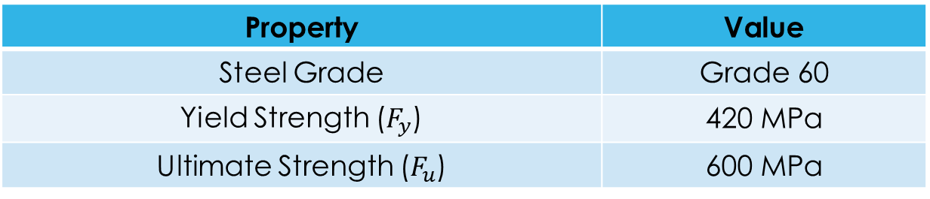
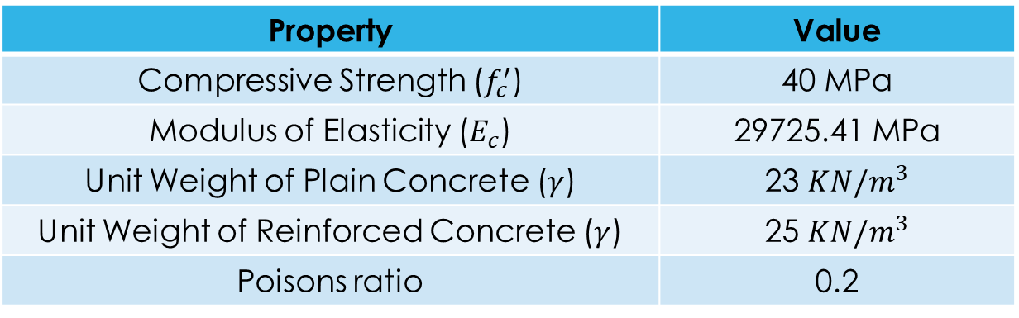
INTRUDUCTION
Materials …
Structural Materials
Concrete
Steel
Value | Property
40 MPa | Compressive Strength ($f_{c}^{′}$)
29725.41 MPa | Modulus of Elasticity ($E_{c}$)
23 $KN/m^{3}$ | Unit Weight of Plain Concrete ($γ$)
25 $KN/m^{3}$ | Unit Weight of Reinforced Concrete ($γ$)
0.2 | Poisons ratio
Value | Property
Grade 60 | Steel Grade
420 MPa | Yield Strength ($F_{y}$)
600 MPa | Ultimate Strength ($F_{u}$)

Slide 15
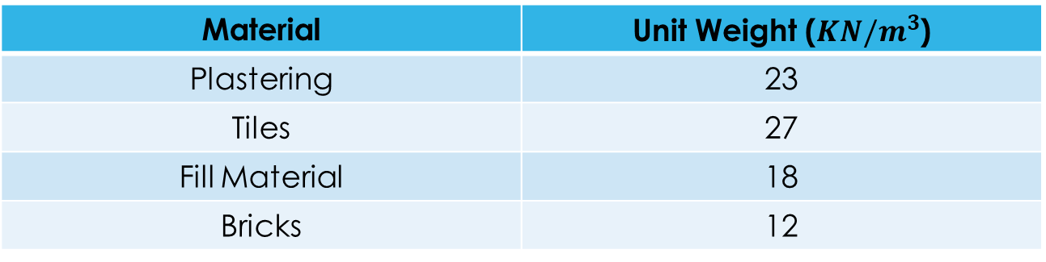
INTRUDUCTION
Materials …
Nonstructural Materials
Unit Weight ($KN/m^{3}$) | Material
23 | Plastering
27 | Tiles
18 | Fill Material
12 | Bricks

Slide 16
INTRUDUCTION
Loads …
Loads
Gravity
Dead
Live
Temperature
Seismic
Lateral

Slide 17

INTRUDUCTION
Gravity Loads …
Dead Loads: Own Weight
Super-imposed dead load
Live load: all rooms have 5 KN/m²
Except: Storage area has 6 KN/m²
Temperature Load …
From Jordanian Code: the expected value of the temperature changes is 20$℃$.

Slide 18
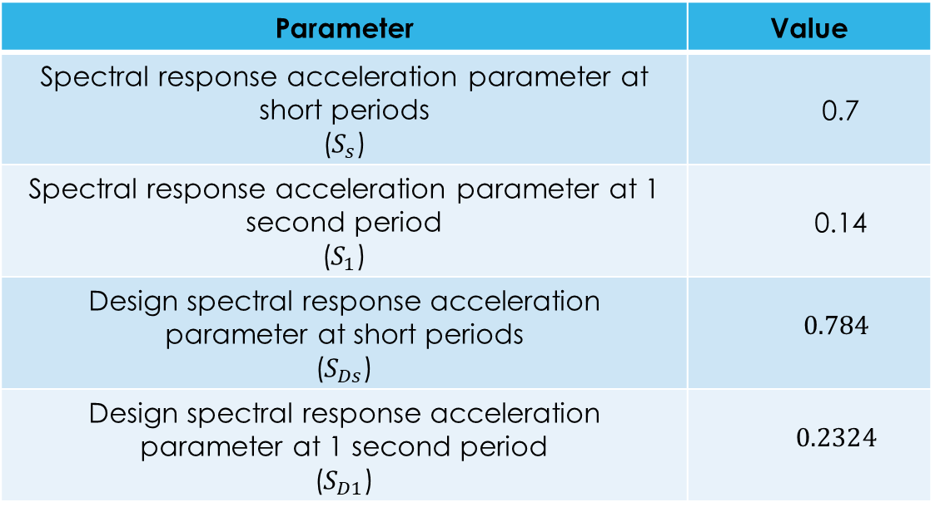
INTRUDUCTION
Lateral Loads …
Value | Parameter
0.7 | Spectral response acceleration parameter at short periods ($S_{s}$)
0.14 | Spectral response acceleration parameter at 1 second period ($S_{1}$)
$$0.784$$ | Design spectral response acceleration parameter at short periods ($S_{Ds}$)
$$0.2324$$ | Design spectral response acceleration parameter at 1 second period ($S_{D1}$)
Seismic Loads
Seismic Parameters
Site Class is C
Risk Category III
Seismic Importance Factor = 1.25
Seismic Design Category is D

Slide 19
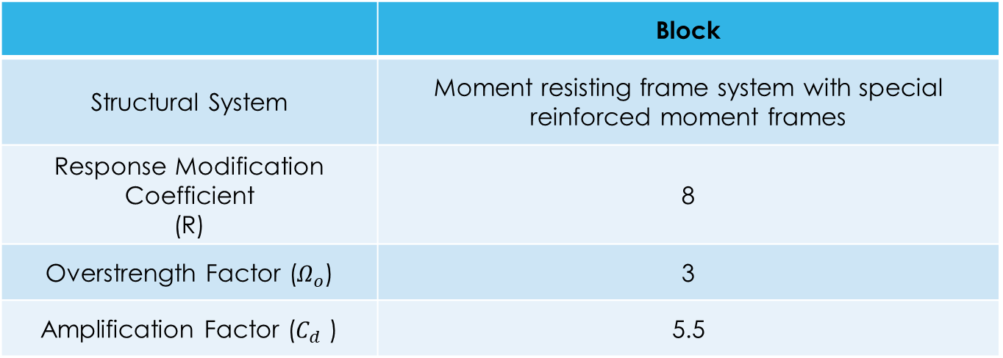
INTRUDUCTION
Type of Lateral Forces Resisting System …
Type of lateral forces resisting system
Block
Moment resisting frame system with special reinforced moment frames | Structural System
8 | Response Modification Coefficient (R)
3 | Overstrength Factor ($Ω_{o}$)
5.5 | Amplification Factor ($C_{d}$ )

Slide 20
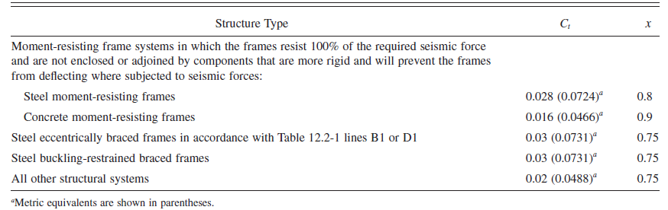

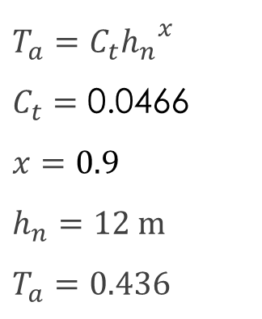

INTRUDUCTION
Approximate Fundamental Period …
$$T_{a}=C_{t}{h_{n}}^{x}$$
$$C_{t}=\text{0}\text{.}\text{0466}$$
$$x=0.9$$
$$h_{n}=12 m$$
$$T_{a}=0.436$$
Values of Approximate Period Parameters $C_{t}$ and $x$
$$C_{u}=1.47$$
$$C_{u}T_{a}=0.64$$

Slide 21
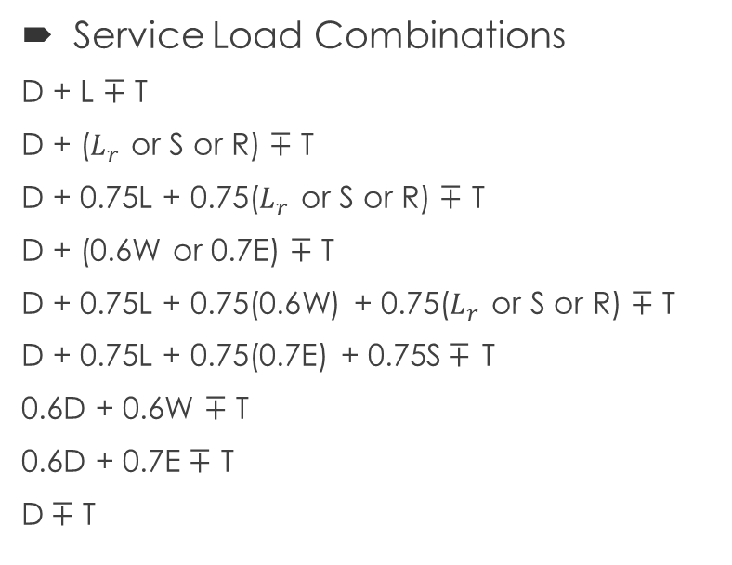
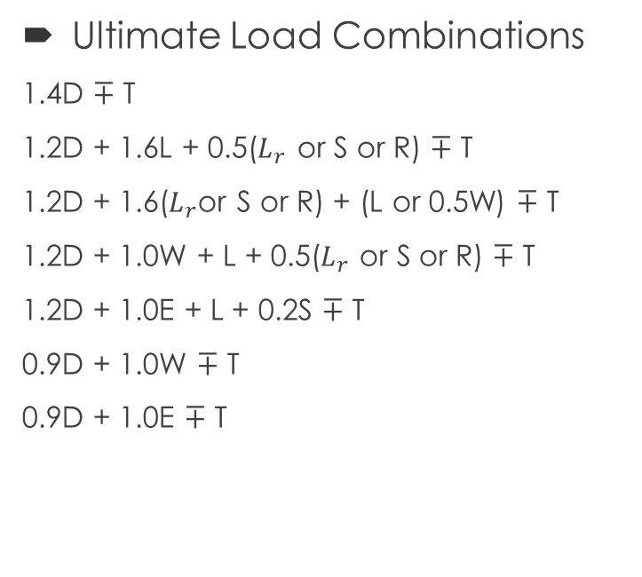
INTRUDUCTION
Load Combinations …
Service Load Combinations
D + L $∓$ T
D + ($L_{r}$ or S or R) $∓$ T
D + 0.75L + 0.75($L_{r}$ or S or R) $∓$ T
D + (0.6W or 0.7E) $∓$ T
D + 0.75L + 0.75(0.6W) + 0.75($L_{r}$ or S or R) $∓$ T
D + 0.75L + 0.75(0.7E) + 0.75S$∓$ T
0.6D + 0.6W $∓$ T
0.6D + 0.7E$∓$ T
D$∓$ T
Ultimate Load Combinations
1.4D $∓$ T
1.2D + 1.6L + 0.5($L_{r}$ or S or R) $∓$ T
1.2D + 1.6($L_{r}$or S or R) + (L or 0.5W) $∓$ T
1.2D + 1.0W + L + 0.5($L_{r}$ or S or R) $∓$ T
1.2D + 1.0E + L + 0.2S $∓$ T
0.9D + 1.0W $∓$ T
0.9D + 1.0E $∓$ T

Slide 22
PRELIMINARY DESIGN

Slide 23
PRELIMINARY DESIGN
Preliminary Dimensions for …
Beams
Slabs
Columns

Slide 24
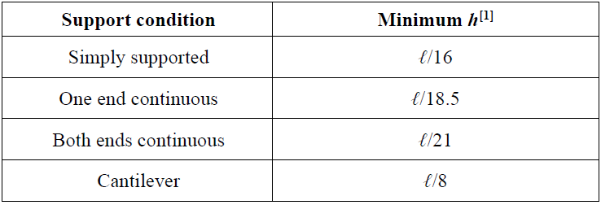
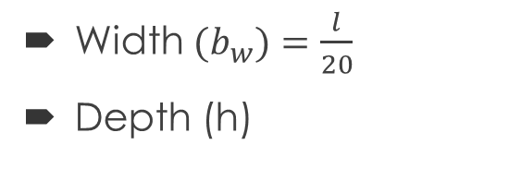
PRELIMINARY DESIGN
Preliminary Dimensions of Beams …
Width ${(b}_{w})=\frac{l}{20}$
Depth (h)
Minimum depth of beams
Preliminary dimensions of beams
Block
300X400 | 1
400X600 | 2
500X700 | 3
600X850 | 4

Slide 25
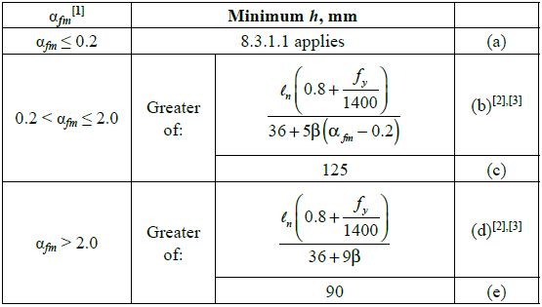
PRELIMINARY DESIGN
Preliminary Thickness of Slabs …
Minimum thickness of two-way solid slabs
Two Way Solid Slab

Slide 26
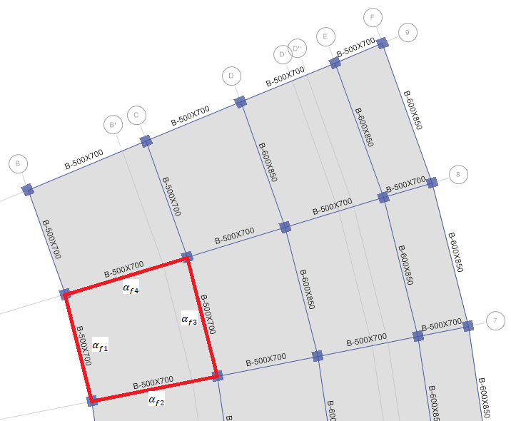
PRELIMINARY DESIGN
Ground Floor
Critical panel in ground floor

Slide 27
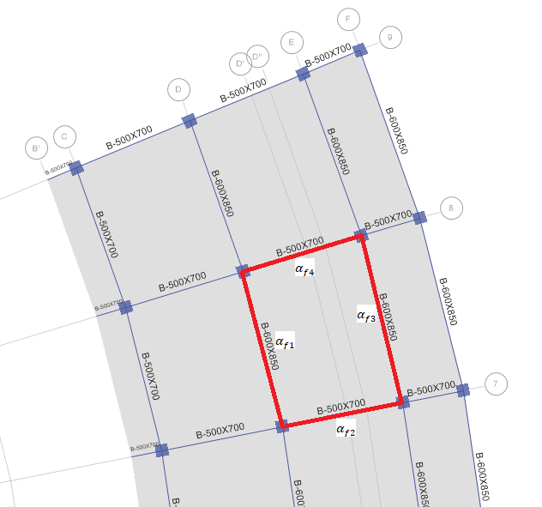
PRELIMINARY DESIGN
First Floor
Critical panel in first floor

Slide 28
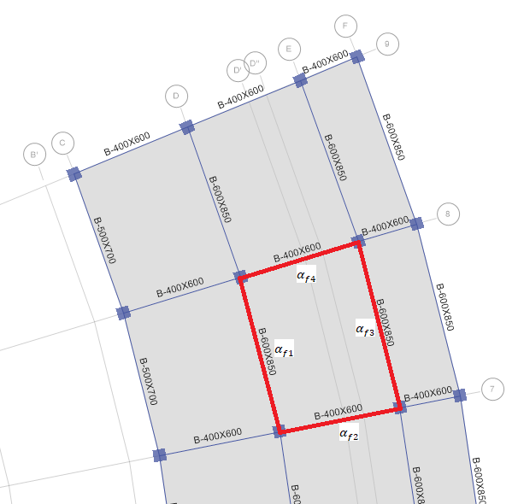
PRELIMINARY DESIGN
Second Floor
Critical panel in second floor

Slide 29
INTRUDUCTION
Preliminary Thickness of Slabs …
The final preliminary thickness of slabs
 | Block
Floor | Ground Floor | First Floor | Second Floor | Third Floor | Stands
Slab Thickness | 250mm | 250mm | 250mm | 250mm | 250mm
Preliminary Thickness of Columns …
Square Columns 800X800

Slide 30
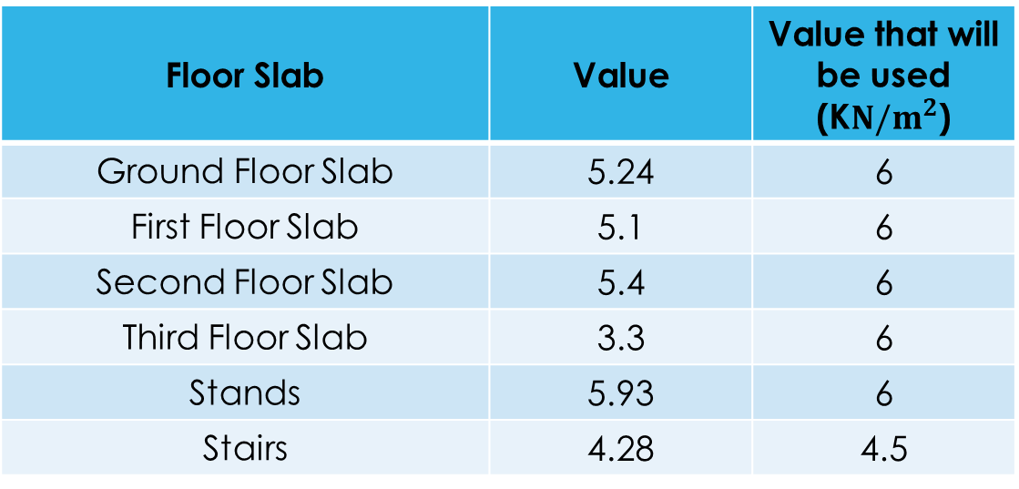
INTRUDUCTION
Slab Superimposed Dead Load …
Slab superimposed dead load
Value that will be used (K$N/m^{2}$) | Value | Floor Slab
6 | 5.24 | Ground Floor Slab
6 | 5.1 | First Floor Slab
6 | 5.4 | Second Floor Slab
6 | 3.3 | Third Floor Slab
6 | 5.93 | Stands
4.5 | 4.28 | Stairs

Slide 31
THREE-DIMENSIONAL ANALYSIS

Slide 32

THREE-DIMENTIONAL ANALYSIS
By using ETABS software

Slide 33
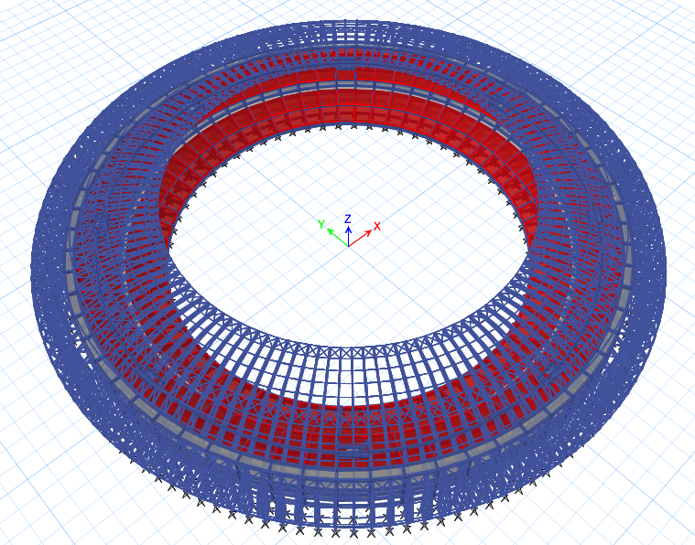

Slide 34
THREE-DIMENTIONAL ANALYSIS
Section Properties …
No. | Section Name | Property Name | Material | Section Type | Dimensions (mm) | Flexural Modifier | Torsional Modifier
1 | Frame sections | B-400X400 | C-40MPa | Rectangular Beam | 400X400 | 0.35 | 0.001
2 |  | B-500X400 | C-40MPa | Rectangular Beam | 500X400 | 0.35 | 0.001
3 |  | B-400X700 | C-40MPa | Rectangular Beam | 400X700 | 0.35 | 0.001
4 |  | B-550X1300 | C-40MPa | Rectangular Beam | 550X1300 | 0.35 | 0.001
5 |  | B-550X1300 | C-40MPa | Rectangular Beam | 550X1300 | 0.001 | 0.001
6 |  | C-800X800 | C-40MPa | Rectangular Column | 800X800 | 0.7 | 0.001
7 |  | C-1200X1200 | C-40MPa | Rectangular Column | 1200X1200 | 0.7 | 0.001
8 | Shell sections | GF-S-300 | C-40MPa | Slab | t = 300 | 0.35 | 0.35
9 |  | F1-S-300 | C-40MPa | Slab | t = 300 | 0.35 | 0.35
10 |  | F2-S-300 | C-40MPa | Slab | t = 300 | 0.35 | 0.35
11 |  | F3-S-300 | C-40MPa | Slab | t = 300 | 0.35 | 0.35
12 |  | STANDS-300 | C-40MPa | Slab | t = 300 | 0.35 | 0.35
13 |  | STAIR-200 | C-40MPa | Slab | t = 200 | 0.001 | 0.001

Slide 35
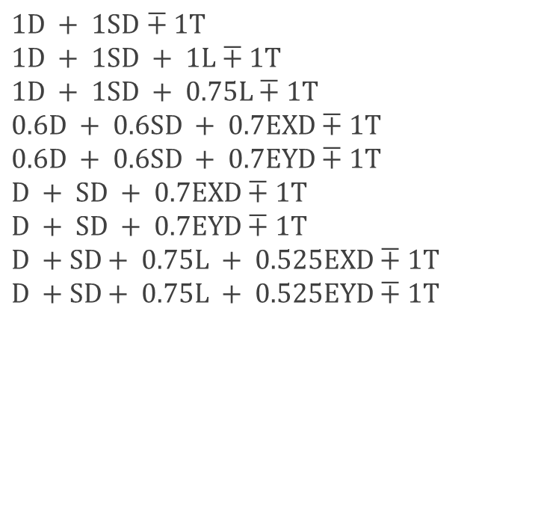
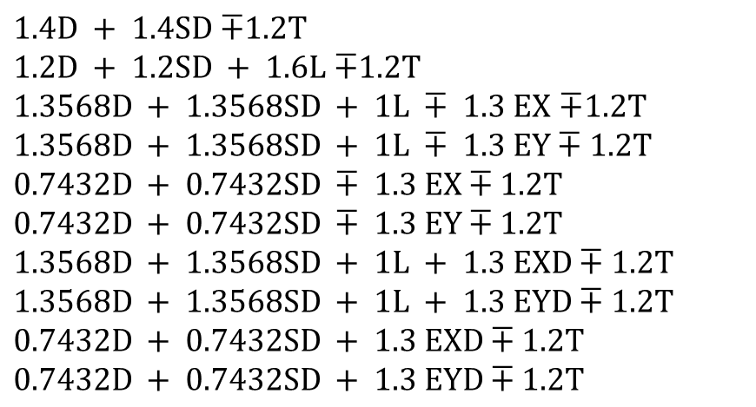
THREE-DIMENTIONAL ANALYSIS
Design Load Combinations …
Service Load Combination
Ultimate Load Combinations
$1D + 1SD$ $∓ 1T$
$$1D + 1SD + 1L∓1T$$
$$1D + 1SD + 0.75L∓1T$$
$$0.6D + 0.6SD + 0.7EXD∓1T$$
$$0.6D + 0.6SD + 0.7EYD∓1T$$
$$D + SD + 0.7EXD∓1T$$
$$D + SD + 0.7EYD∓1T$$
$$D +SD+ 0.75L + 0.525EXD∓1T$$
$$D +SD+ 0.75L + 0.525EYD∓1T$$
$1.4D + 1.4SD$ $∓1.2T$
$1.2D + 1.2SD + 1.6L$ $∓1.2T$
$1.3568D + 1.3568SD + 1L ∓ 1.3 EX$ $∓1.2T$
$$1.3568D + 1.3568SD + 1L ∓ 1.3 EY∓1.2T$$
$$0.7432D + 0.7432SD ∓ 1.3 EX∓1.2T$$
$$0.7432D + 0.7432SD ∓ 1.3 EY∓1.2T$$
$$1.3568D + 1.3568SD + 1L + 1.3 EXD∓1.2T$$
$$1.3568D + 1.3568SD + 1L + 1.3 EYD∓1.2T$$
$$0.7432D + 0.7432SD + 1.3 EXD∓1.2T$$
$$0.7432D + 0.7432SD + 1.3 EYD∓1.2T$$

Slide 36
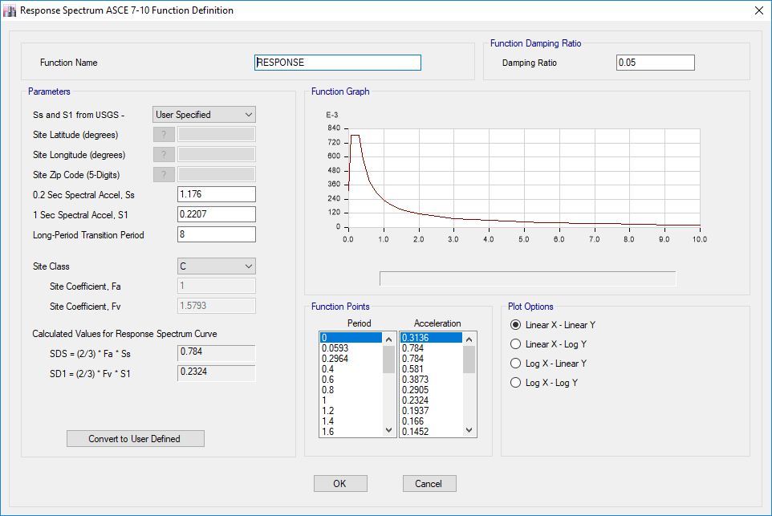
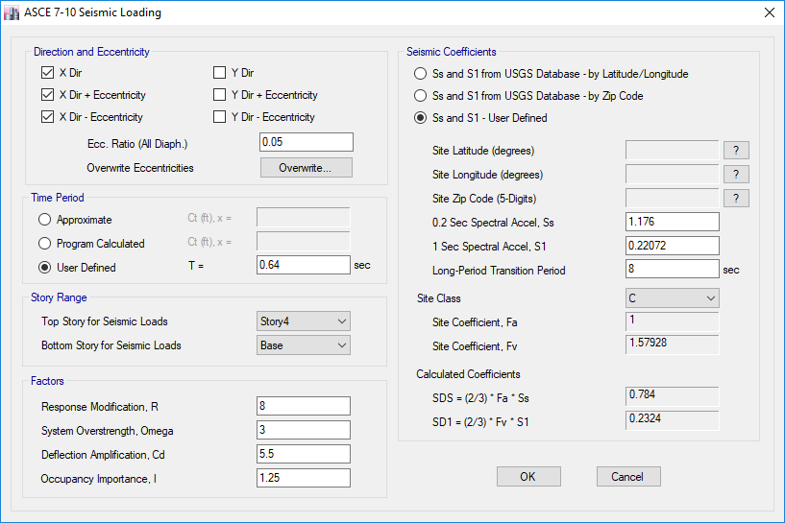
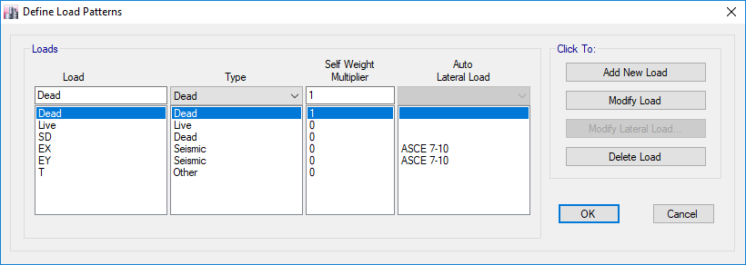
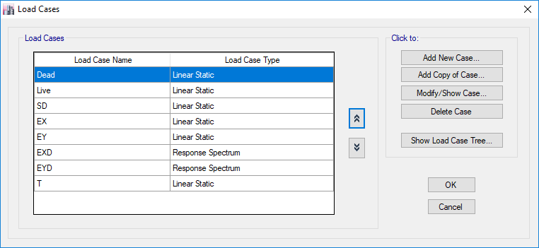
THREE-DIMENTIONAL ANALYSIS
Load Definitions …
Load Patterns
Seismic Load
Load Cases
Response Spectrum Function
Seismic Load Cases
EYD |  | EXD |  | Load Case
Y | X | Y | X | Direction
1532.81 | 459.84 | 459.84 | 1532.81 | Scale Factor
EXD is the dynamic seismic load in X-direction
EYD is the dynamic seismic load in Y-direction

Slide 37
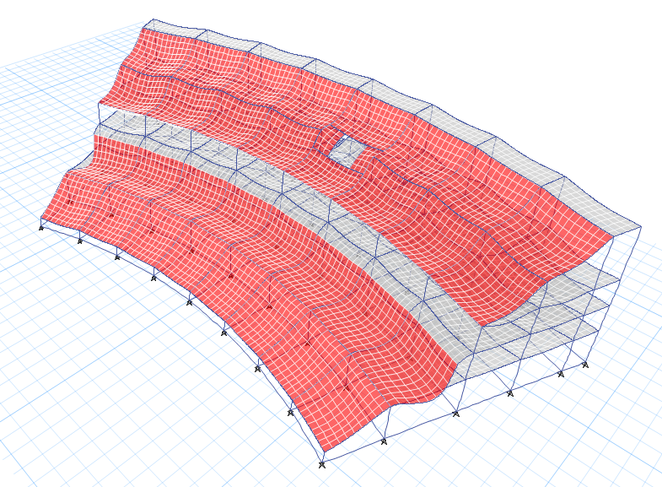
THREE-DIMENTIONAL ANALYSIS
Verification of Structural Analysis …
Compatibility Check
Equilibrium Check
Equilibrium for the block
Difference | ETABS Result | Manual Result
0.53 % | 124571.4808 | 125229.3749 | Own Weight
0 % | 65255.2771 | 65255.388 | Superimposed Dead Load
0% | 45663.0048 | 45662.79 | Live Load
Compatibility for the block

Slide 38
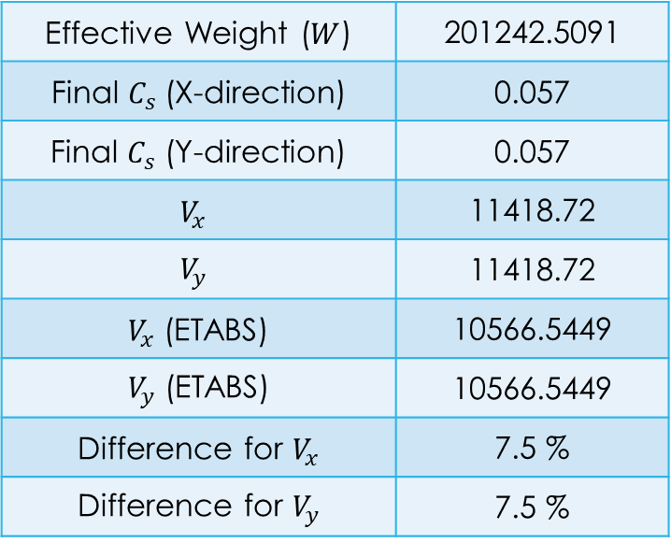

THREE-DIMENTIONAL ANALYSIS
Check Equilibrium for Base Shear …
Effective Weight ($W$) = DL + SD + 0.25 LL
$C_{s}=\frac{S_{DS}}{\left(\frac{R}{I_{e}}\right)}$
$C_{s,min}$ = $0.044S_{Ds}I_{e}$
$C_{s,max}=\frac{S_{D1}}{T\left(\frac{R}{I_{e}}\right)}$
$V=W∗C_{s}$
201242.5091 | Effective Weight ($W$)
0.057 | Final $C_{s}$(X-direction)
0.057 | Final $C_{s}$ (Y-direction)
11418.72 | $$V_{x}$$
11418.72 | $$V_{y}$$
10566.5449 | $V_{x}$ (ETABS)
10566.5449 | $V_{y}$ (ETABS)
7.5 % | Difference for $V_{x}$
7.5 % | Difference for $V_{y}$

Slide 39
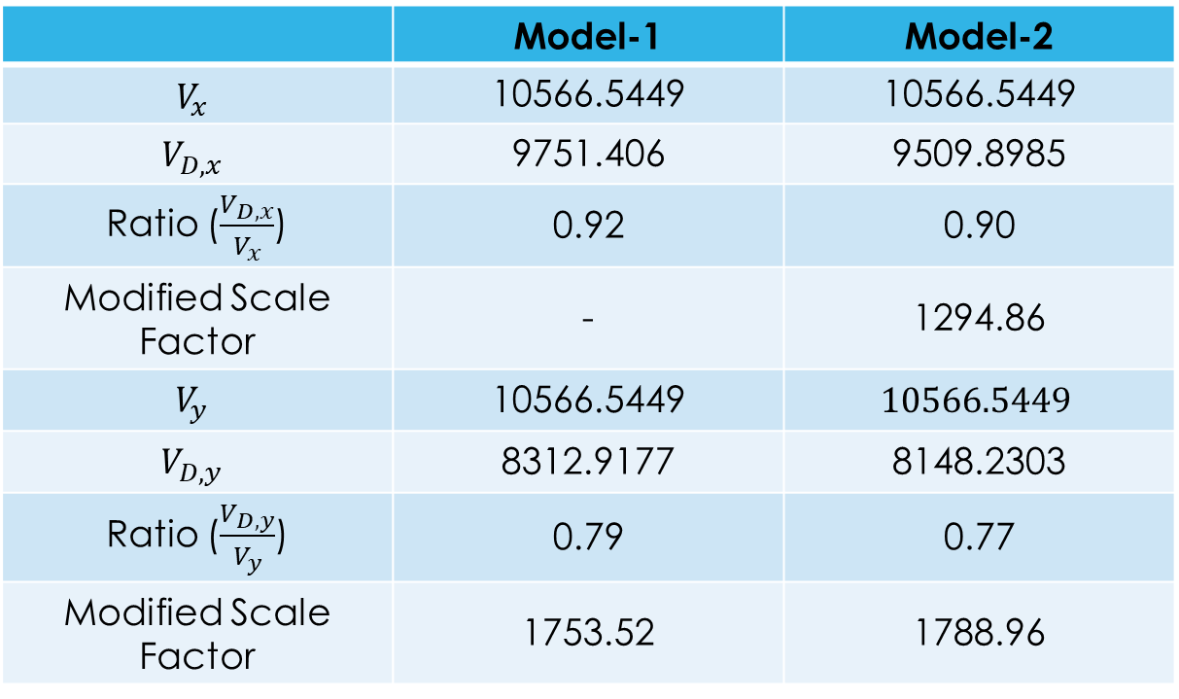
THREE-DIMENTIONAL ANALYSIS
Checking for Dynamic Response Spectrum …
Model-2 | Model-1
10566.5449 | 10566.5449 | $$V_{x}$$
9509.8985 | 9751.406 | $$V_{D,x}$$
0.90 | 0.92 | Ratio ($\frac{V_{D,x}}{V_{x}}$)
1294.86 | - | Modified Scale Factor
$$10566.5449$$ | 10566.5449 | $$V_{y}$$
8148.2303 | 8312.9177 | $$V_{D,y}$$
0.77 | 0.79 | Ratio ($\frac{V_{D,y}}{V_{y}}$)
1788.96 | 1753.52 | Modified Scale Factor

Slide 40
THREE-DIMENTIONAL ANALYSIS
Structural Irregularities …
Horizontal Irregularities
Horizontal Irregularities
Model-2 | Model-1
Yes | Yes | Type 1
No | No | Type 2
No | No | Type 3
No | No | Type 4
No | No | Type 5

Slide 41
THREE-DIMENTIONAL ANALYSIS
Structural Irregularities …
Vertical Irregularities
Vertical Irregularities
Model-2 | Model-1
Yes | Yes | Type 1
No | No | Type 2
No | No | Type 3
No | No | Type 4
No | No | Type 5

Slide 42
THREE-DIMENTIONAL ANALYSIS
Torsional Irregularity …
Torsional Irregularity
 | Direction | Max drift (mm) | Average drift (mm) | Ratio | Check
Story4 | X | 0.3 | 0.243 | 1.236 | Yes
Story3 | X | 4.362 | 3.572 | 1.221 | Yes
Story2 | X | 2.683 | 2.114 | 1.269 | Yes
Story1 | X | 5.33 | 4.35 | 1.225 | Yes
Story4 | Y | 0.125 | 0.113 | 1.11 | No
Story3 | Y | 1.935 | 1.538 | 1.258 | Yes
Story2 | Y | 1.178 | 0.72 | 1.637 | Yes
Story1 | Y | 6.557 | 4.933 | 1.329 | Yes
 | Direction | Max drift (mm) | Average drift (mm) | Ratio | Check
Story4 | X | 0.2 | 0.164 | 1.216 | Yes
Story3 | X | 2.888 | 2.399 | 1.204 | Yes
Story2 | X | 0.921 | 0.702 | 1.311 | Yes
Story1 | X | 5 | 4.063 | 1.23 | Yes
Story4 | Y | 0.13 | 0.119 | 1.094 | No
Story3 | Y | 1.554 | 1.381 | 1.126 | No
Story2 | Y | 1.289 | 0.81 | 1.591 | Yes
Story1 | Y | 6.435 | 4.883 | 1.318 | Yes
Model-2
Model-1

Slide 43
THREE-DIMENTIONAL ANALYSIS
Stiffness-Soft Story Irregularity…
Stiffness-soft story irregularity
 | Load Case | Stiffness X (KN/m) | Stiffness Y (KN/m) | Ratio % | Check
Story4 | EXD | 10338782 | 14557255.01 | - | -
Story3 | EXD | 1583686.62 | 2445302.293 | 15.3 | Yes
Story2 | EXD | 3510399.98 | 5506136.54 | 221.6 | No
Story1 | EXD | 2222069.98 | 1777157.871 | 63.3 | Yes
Story4 | EYD | 3958362.46 | 17501453.36 | - | -
Story3 | EYD | 656041.952 | 2963182.391 | 16.9 | Yes
Story2 | EYD | 1316516.17 | 7852321.903 | 265.0 | No
Story1 | EYD | 935484.351 | 2181814.705 | 27.9 | Yes
 | Load Case | Stiffness X (KN/m) | Stiffness Y (KN/m) | Ratio % | Check
Story4 | EXD | 13963507.96 | 15205577 | - | -
Story3 | EXD | 2167724.845 | 2823636 | 15.5 | Yes
Story2 | EXD | 10573830.9 | 8629178 | 487.8 | No
Story1 | EXD | 2379316.502 | 1611536 | 22.5 | Yes
Story4 | EYD | 5557591.047 | 16976553 | - | -
Story3 | EYD | 947317.861 | 3354133 | 19.7 | Yes
Story2 | EYD | 3807720.174 | 11344938 | 338.2 | No
Story1 | EYD | 973867.487 | 2006525 | 17.7 | Yes
Model-2
Model-1

Slide 44
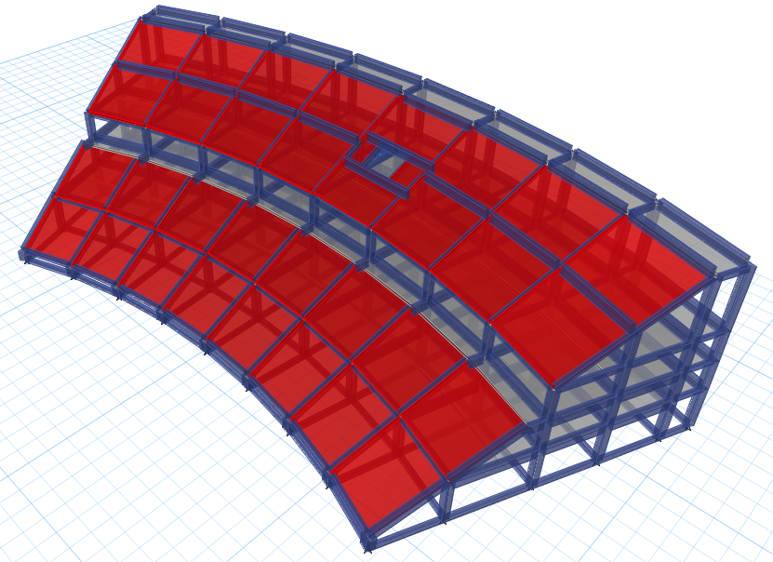
THREE-DIMENTIONAL ANALYSIS
Vertical Geometric Irregularity …
Vertical geometric irregularity is defined to exist where the horizontal dimension of the seismic force-resisting system in any story is more than 130% of that in an adjacent story.

Slide 45
THREE-DIMENTIONAL ANALYSIS
Check Type of Diaphragm …
Type of diaphragm in Model-2
Type of diaphragm in Model-1
Story | Direction | Average displacement (mm) | Mid-Point displacement (mm) | 2*Avg. displacement | Rigid/Flexible
Story1 | X | 5.487 | 4.085 | 10.974 | Rigid
Story2 | X | 6.445 | 4.756 | 12.89 | Rigid
Story3 | X | 9.334 | 7.111 | 18.668 | Rigid
Story4 | X | 9.512 | 7.252 | 19.024 | Rigid
Story1 | Y | 6.406 | 5.466 | 12.812 | Rigid
Story2 | Y | 7.286 | 6.396 | 14.572 | Rigid
Story3 | Y | 9.131 | 8.005 | 18.262 | Rigid
Story4 | Y | 10.216 | 9.237 | 20.432 | Rigid
Story | Direction | Average displacement (mm) | Mid-Point displacement (mm) | 2*Avg. displacement | Rigid/Flexible
Story1 | X | 5.717 | 4.261 | 11.434 | Rigid
Story2 | X | 8.003 | 5.882 | 16.006 | Rigid
Story3 | X | 11.719 | 8.819 | 23.438 | Rigid
Story4 | X | 11.992 | 9.025 | 23.984 | Rigid
Story1 | Y | 6.067 | 5.189 | 12.134 | Rigid
Story2 | Y | 7.071 | 5.995 | 14.142 | Rigid
Story3 | Y | 9.032 | 7.604 | 18.064 | Rigid
Story4 | Y | 9.791 | 8.734 | 19.582 | Rigid

Slide 46
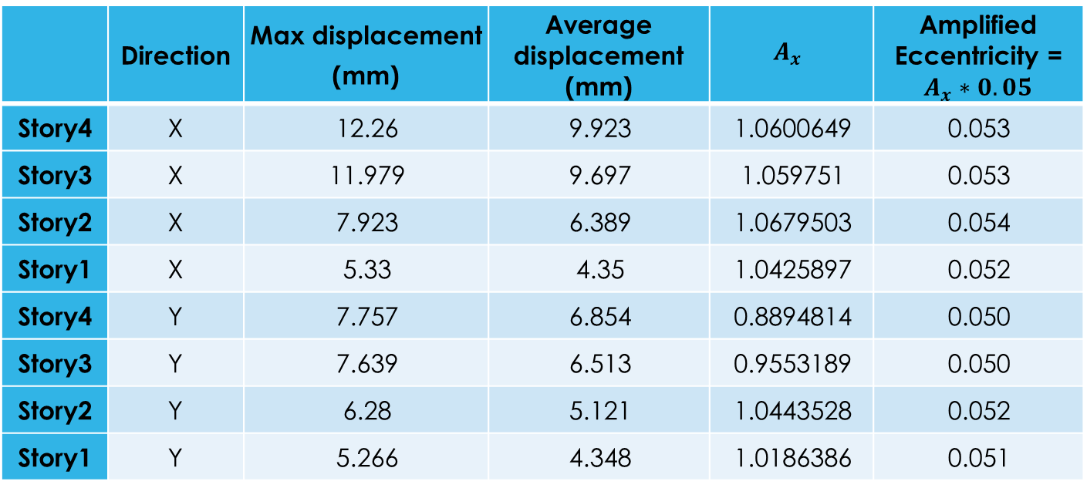
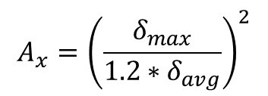
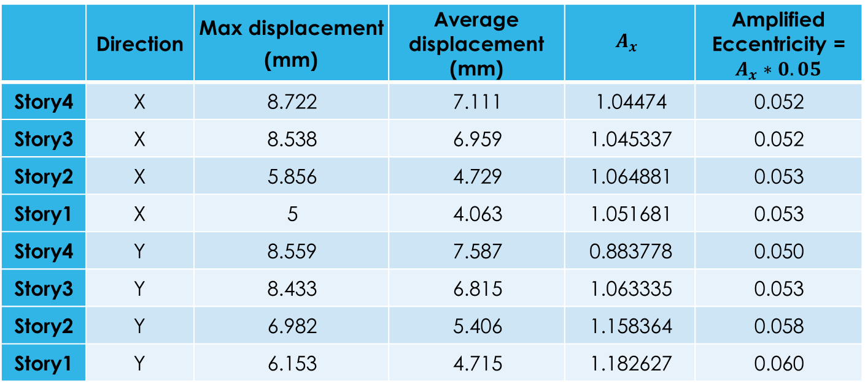
THREE-DIMENTIONAL ANALYSIS
Check Amplification of Accidental Eccentricity …
Check amplification of accidental eccentricity (Model-1)
Check amplification of accidental eccentricity (Model-2)
 | Direction | Max displacement (mm) | Average displacement (mm) | $$A_{x}$$ | Amplified Eccentricity = $A_{x}∗0.05$
Story4 | X | 8.722 | 7.111 | 1.04474 | 0.052
Story3 | X | 8.538 | 6.959 | 1.045337 | 0.052
Story2 | X | 5.856 | 4.729 | 1.064881 | 0.053
Story1 | X | 5 | 4.063 | 1.051681 | 0.053
Story4 | Y | 8.559 | 7.587 | 0.883778 | 0.050
Story3 | Y | 8.433 | 6.815 | 1.063335 | 0.053
Story2 | Y | 6.982 | 5.406 | 1.158364 | 0.058
Story1 | Y | 6.153 | 4.715 | 1.182627 | 0.060
 | Direction | Max displacement (mm) | Average displacement (mm) | $$A_{x}$$ | Amplified Eccentricity = $A_{x}∗0.05$
Story4 | X | 12.26 | 9.923 | 1.0600649 | 0.053
Story3 | X | 11.979 | 9.697 | 1.059751 | 0.053
Story2 | X | 7.923 | 6.389 | 1.0679503 | 0.054
Story1 | X | 5.33 | 4.35 | 1.0425897 | 0.052
Story4 | Y | 7.757 | 6.854 | 0.8894814 | 0.050
Story3 | Y | 7.639 | 6.513 | 0.9553189 | 0.050
Story2 | Y | 6.28 | 5.121 | 1.0443528 | 0.052
Story1 | Y | 5.266 | 4.348 | 1.0186386 | 0.051
$$A_{x}={\left(\frac{δ_{max}}{1.2∗δ_{avg}}\right)}^{2}$$

Slide 47
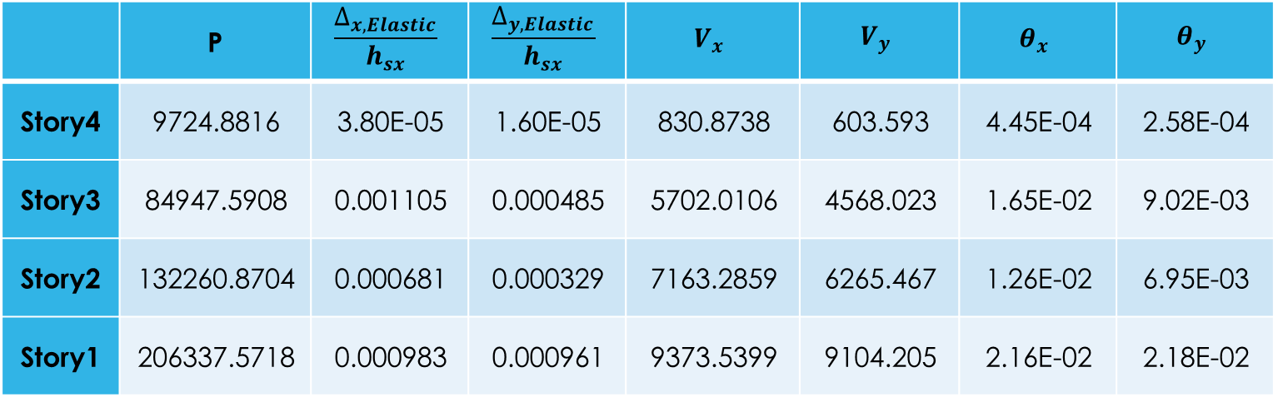

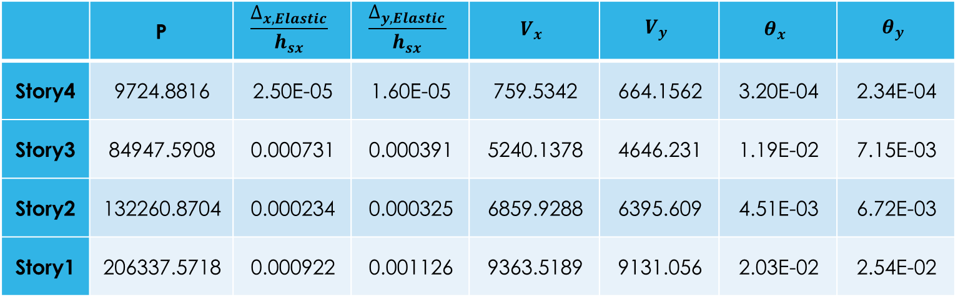
THREE-DIMENTIONAL ANALYSIS
Effect of P-delta …
$$θ=\frac{P_{x}∆_{Inelastic}I_{e}}{V_{x}h_{sx}C_{d}}=\frac{P_{x}∆_{Elastic}}{V_{x}h_{sx}}$$
Effect of P-delta (Model-1)
Effect of P-delta (Model-2)
 | P | $$\frac{∆_{x,Elastic}}{h_{sx}}$$ | $$\frac{∆_{y,Elastic}}{h_{sx}}$$ | $$V_{x}$$ | $$V_{y}$$ | $$θ_{x}$$ | $$θ_{y}$$
Story4 | 9724.8816 | 3.80E-05 | 1.60E-05 | 830.8738 | 603.593 | 4.45E-04 | 2.58E-04
Story3 | 84947.5908 | 0.001105 | 0.000485 | 5702.0106 | 4568.023 | 1.65E-02 | 9.02E-03
Story2 | 132260.8704 | 0.000681 | 0.000329 | 7163.2859 | 6265.467 | 1.26E-02 | 6.95E-03
Story1 | 206337.5718 | 0.000983 | 0.000961 | 9373.5399 | 9104.205 | 2.16E-02 | 2.18E-02
 | P | $$\frac{∆_{x,Elastic}}{h_{sx}}$$ | $$\frac{∆_{y,Elastic}}{h_{sx}}$$ | $$V_{x}$$ | $$V_{y}$$ | $$θ_{x}$$ | $$θ_{y}$$
Story4 | 9724.8816 | 2.50E-05 | 1.60E-05 | 759.5342 | 664.1562 | 3.20E-04 | 2.34E-04
Story3 | 84947.5908 | 0.000731 | 0.000391 | 5240.1378 | 4646.231 | 1.19E-02 | 7.15E-03
Story2 | 132260.8704 | 0.000234 | 0.000325 | 6859.9288 | 6395.609 | 4.51E-03 | 6.72E-03
Story1 | 206337.5718 | 0.000922 | 0.001126 | 9363.5189 | 9131.056 | 2.03E-02 | 2.54E-02

Slide 48
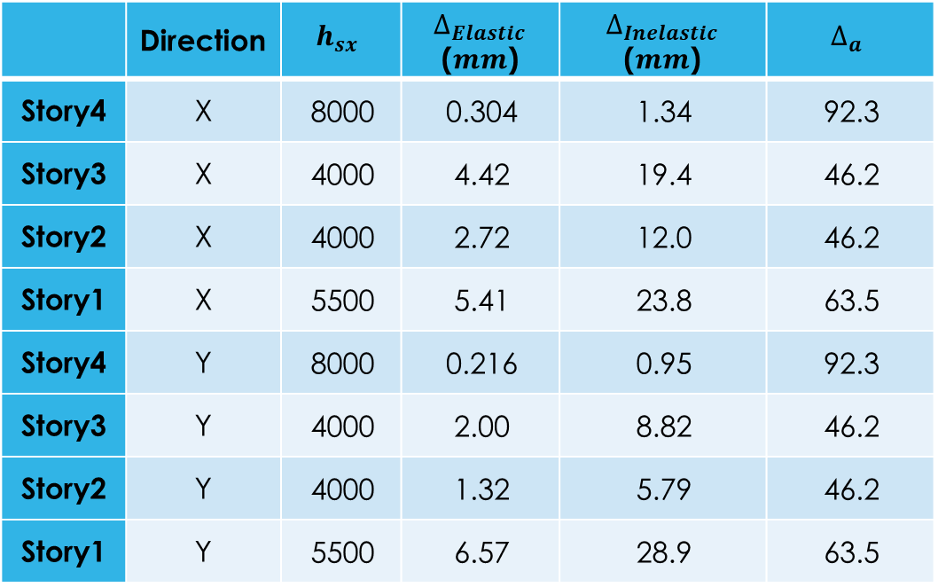
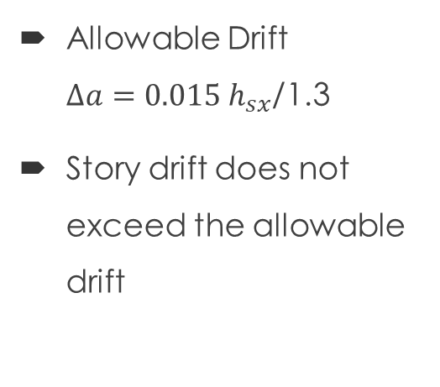
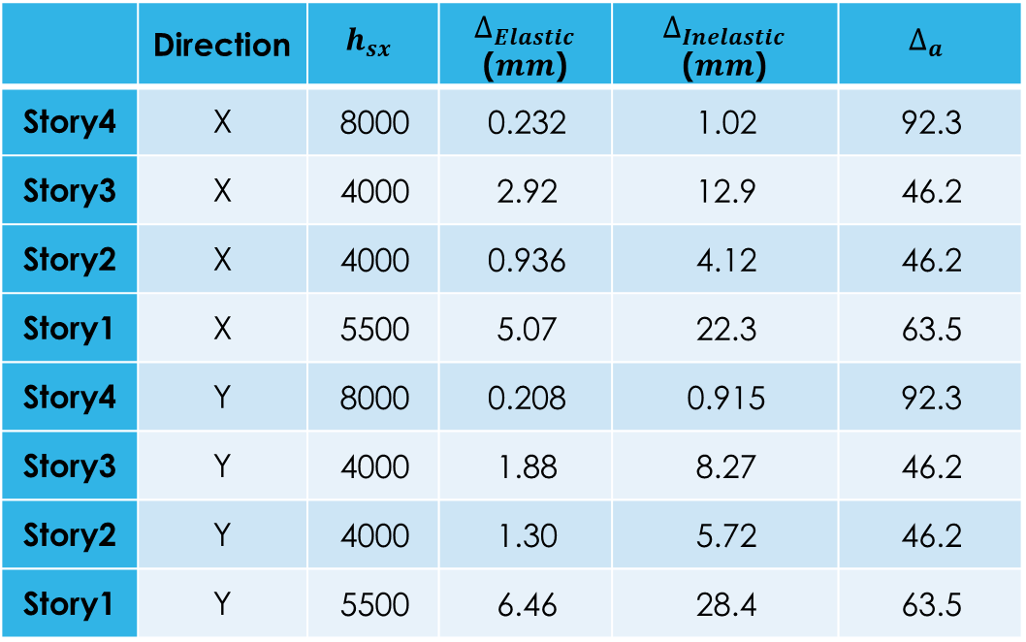
THREE-DIMENTIONAL ANALYSIS
Story Drift Check …
Allowable Drift
$∆a=0.015 h_{sx}$/1.3
Story drift does not exceed the allowable drift
Story drift for Model-2
Story drift for Model-1
 | Direction | $$h_{sx}$$ | $∆_{Elastic}$ ($mm$) | $∆_{Inelastic}$ ($mm$) | $$∆_{a}$$
Story4 | X | 8000 | 0.304 | 1.34 | 92.3
Story3 | X | 4000 | 4.42 | 19.4 | 46.2
Story2 | X | 4000 | 2.72 | 12.0 | 46.2
Story1 | X | 5500 | 5.41 | 23.8 | 63.5
Story4 | Y | 8000 | 0.216 | 0.95 | 92.3
Story3 | Y | 4000 | 2.00 | 8.82 | 46.2
Story2 | Y | 4000 | 1.32 | 5.79 | 46.2
Story1 | Y | 5500 | 6.57 | 28.9 | 63.5
 | Direction | $$h_{sx}$$ | $∆_{Elastic}$ ($mm$) | $∆_{Inelastic}$ ($mm$) | $$∆_{a}$$
Story4 | X | 8000 | 0.232 | 1.02 | 92.3
Story3 | X | 4000 | 2.92 | 12.9 | 46.2
Story2 | X | 4000 | 0.936 | 4.12 | 46.2
Story1 | X | 5500 | 5.07 | 22.3 | 63.5
Story4 | Y | 8000 | 0.208 | 0.915 | 92.3
Story3 | Y | 4000 | 1.88 | 8.27 | 46.2
Story2 | Y | 4000 | 1.30 | 5.72 | 46.2
Story1 | Y | 5500 | 6.46 | 28.4 | 63.5

Slide 49
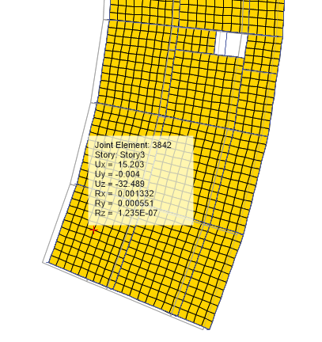
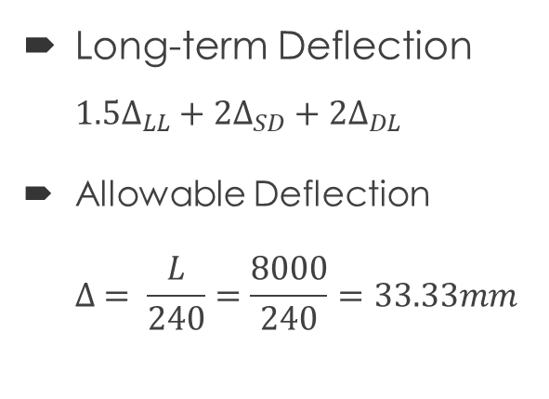
THREE-DIMENTIONAL ANALYSIS
Deflection Check …
Long-term Deflection $1.5∆_{LL}+2∆_{SD}+2∆_{DL}$
Allowable Deflection
$∆ = \frac{L}{240}=\frac{8000}{240}=33.33mm$
Long-term deflection

Slide 50
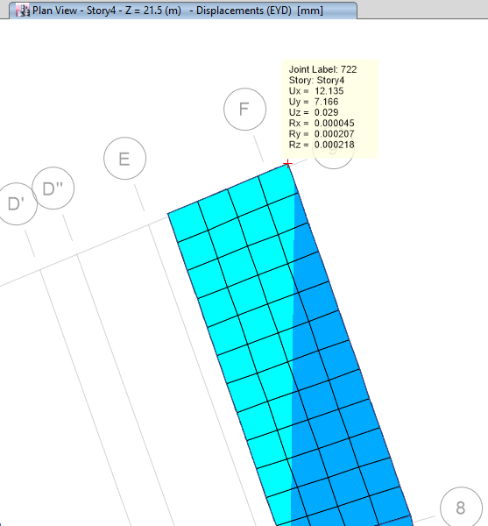
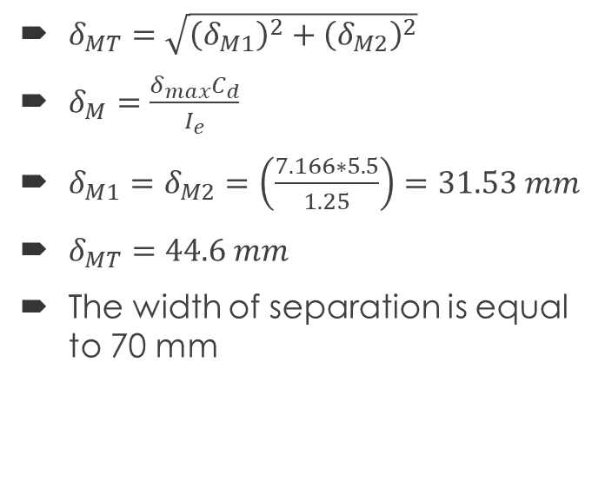
THREE-DIMENTIONAL ANALYSIS
Width of Separation …
$δ_{MT}=\sqrt{{\left(δ_{M1}\right)}^{2}+{\left(δ_{M2}\right)}^{2}}$
$δ_{M}=\frac{δ_{max}C_{d}}{I_{e}}$
$δ_{M1}=δ_{M2}=\left(\frac{7.166∗5.5}{1.25}\right)=31.53 mm$
$δ_{MT}=44.6 mm$
The width of separation is equal to 70 mm
Max elastic displacement

Slide 51
CONCRETE STRUCTURAL DESIGN

Slide 52

CONCRETE STRUCTURAL DESIGN
Design of Slabs …

Slide 53

CONCRETE STRUCTURAL DESIGN
Design of Beams …
$\text{The} \text{reinforcement} \text{ratio} \text{(}ρ\text{) }\text{shall} \text{not} \text{exceed} \text{0.025}\text{.}$
The first hoop shall be located not more than 50 mm from the face of a supporting column.
$Stirrups at distance 2h from the face of the supporting column:$
$≤$d/4.
$≤$ 6db.
$≤$150 mm.
$Stirrups at mid of the beam$ $≤\frac{d}{2}.$
Spacing of the transverse reinforcement enclosing the lap-spliced bars shall not exceed the lesser of d/4 and 100 mm.
The spacing of transversely supported flexural reinforcing bars shall not exceed 350 mm.

Slide 54


CONCRETE STRUCTURAL DESIGN
Design of Columns …
$l_{o}$ $≥$ The depth of the column at the face
$≥$ One-sixth of the clear span of the column
$≥$ 450 mm
S ≤ 1/4 minimum member dimension.
≤ 6 db.
≤ $S_{o}$
$S^{′}=min\left\{\begin{aligned}6 db \\ 150 mm\end{aligned}\right.$
Lap splicing = 1.3 development length

Slide 55




CONCRETE STRUCTURAL DESIGN

Slide 56
PART TWO : STEEL STRUCTURE

Slide 57




Steel Structure
Steel Structure plan
3D Modeling
Shape of single unit truss
1. Hight = 40.5 m
2. Length = 50m
3. 4 m away from concrete
structure

Slide 58
Design of Steel
Loads…
Loads
Gravity
Dead
Live
Lateral
Snow
Wind

Slide 59
Design of Steel
Loads…
Dead Loads: Own weight
Super-imposed dead load = 0.5 KN/m²
Live load = 0.5 KN/m² (maintenance)
Snow load = 1.5 KN/m²
Wind load

Slide 60


Wind Loads…
Horizontal part …
Joints and tributary area

Slide 61

Wind Loads…
Horizontal part …
Wind Load calculation:
- The type of structure is open building.
- Basic Wind Speed, $V = 142 km/hr (88.23 mph).$
- Wind directionality factor, $kd=0.85$.
- Topographic factor, $kzt=1$.
- Gust-effect factor$=0.85$
- Mean roof height $H=38 m$
- $K_{z}=1.05$by interpolation
- Velocity pressure,$q_{z}$:
- $q_{z}$ = 0.613$K_{z}K_{zt}K_{d}V^{2}$ (N/$m^{2}$); V in m/s
- $q_{z}$ = 851.22 N/m²

Slide 62


Wind Loads…
Horizontal part …
For open structure:
$$P=q_{z}∗G∗C_{N}$$
$Where :$
$C_{N}$: net pressure coefficient.
To calculate $C_{N}$ there is three cases for monoslope:

Slide 63


Wind Loads…
Horizontal part …
Values of $C_{N} :$

Slide 64


Wind Loads…
Horizontal part …
Values of pressure:
$P=q_{z}∗G∗C_{N}$

Slide 65


Wind Loads…
Vertical part …
Vertical Tributary area:
For vertical open truss (pressure at vertical joints):
$P = qz∗G∗Cf$
Where:
$${ q}_{z}=q_{h}=851.22kN/m^{2}$$
$G=0.85$
$Cf=4∈^{2}−5.9∈+4$
$Cf=4∈^{2}−5.9∈+4=3.715$
$∈=\frac{solid area}{all area}=\frac{0.3073}{6.24}=0.05$
$P=851.22∗0.85∗3.715=2687.94 N/m^{2}$

Slide 66






Design of connections…
Types of members.
Check steel design using ETABS.
Tension and compression forces.
Welding.
$F_{EXX}=70 psi$
Weld fracture $=∅_{w}∗0.6∗F_{EXX}∗a∗cos45$
Weld fracture >= F

Slide 67
THANK YOU

