Slide 1


Slide 2



Smart
Architecture Modeling
Presented By :
Suhaib Baba & Mahdi Nassar
Supervisor: Dr. Raed Qadi.
Notes:
hi

Slide 3
Outline:
What is 3D Smart Architecture Modeling
Tools of the application
How to Modify Components
Problems & Challenges
Future Work
Video

Slide 4
What is 3D Smart Architecture Modeling :
It’s a mobile application:
To be used by designers, engineers and others
Can run on any Android Device
Friendly for people without experience in Architectural Modeling
Fast and requires relatively small memory

Slide 5
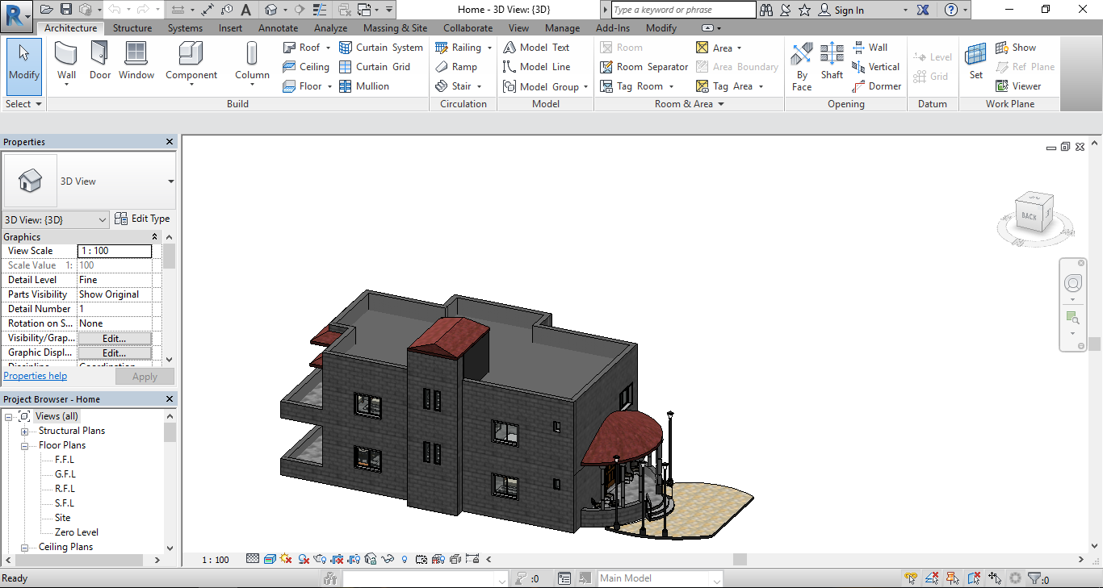
What is 3D Smart Architecture Modeling :

Slide 6





Tools:

Slide 7







Slide 8
Modify Components:
There are two types of modifications:
1- Modify Construction components.
2- Modify Materials and Textures of components.

Slide 9
Modify
Construction components

Slide 10
Combine construction Component
Execute operations
01
02
03
04
Fill construction Component
Choose
operations from menu

Slide 11
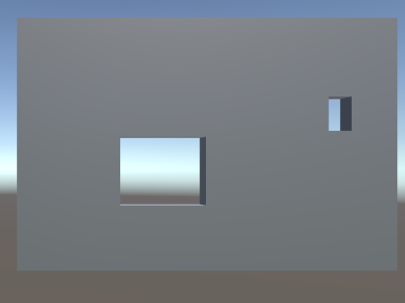
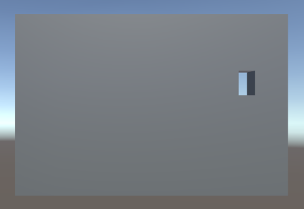
Step 1 & Step 2:
Before :
After :

Slide 12
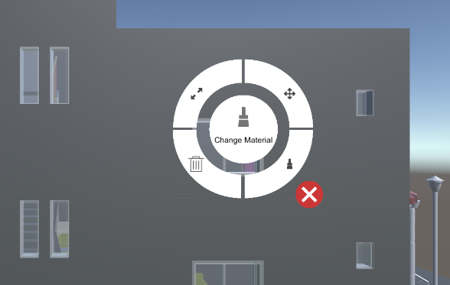
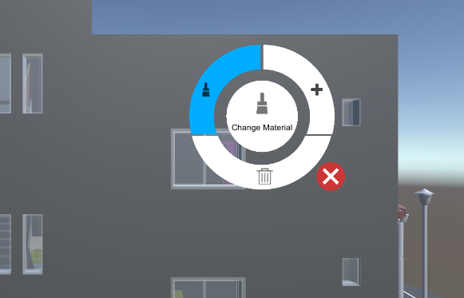
Step 3 & 4:
4 Operations
3 Operations

Slide 13
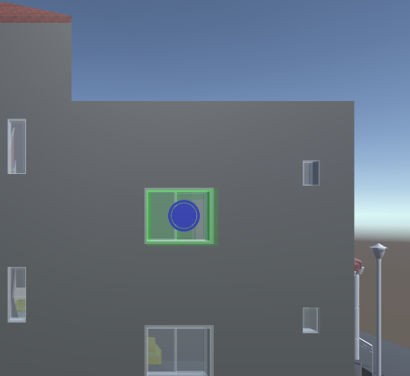
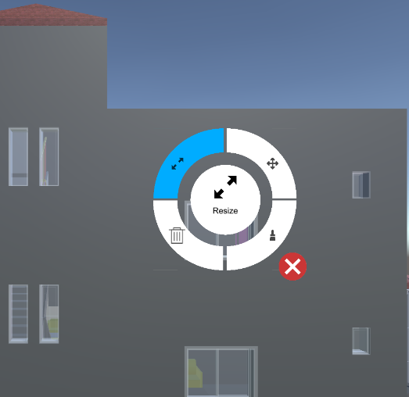
Resize Component:

Slide 14
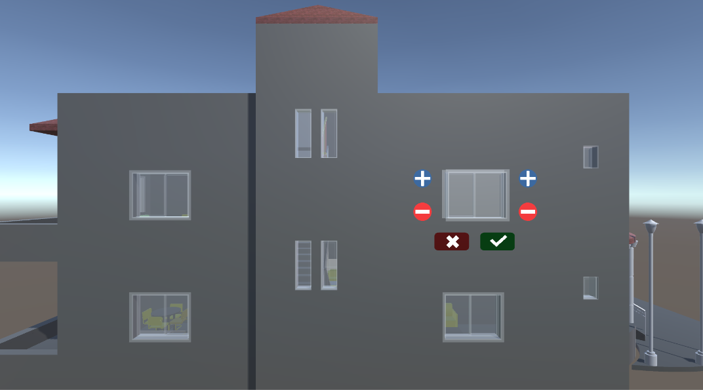
Resize Component:

Slide 15
Some of problems:
Can’t modify width and height for each open window in the wall
Pivot point not correct.

Slide 16
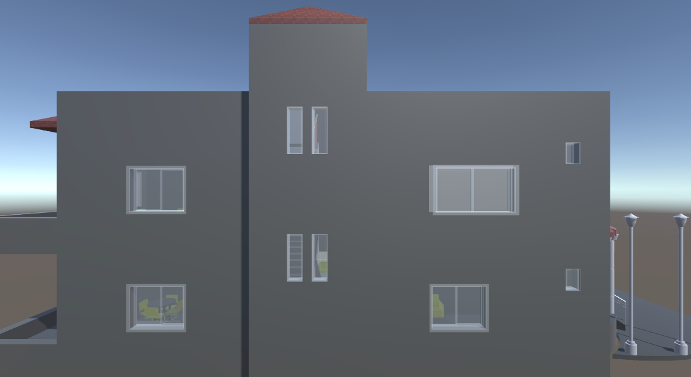
Resize Component:

Slide 17
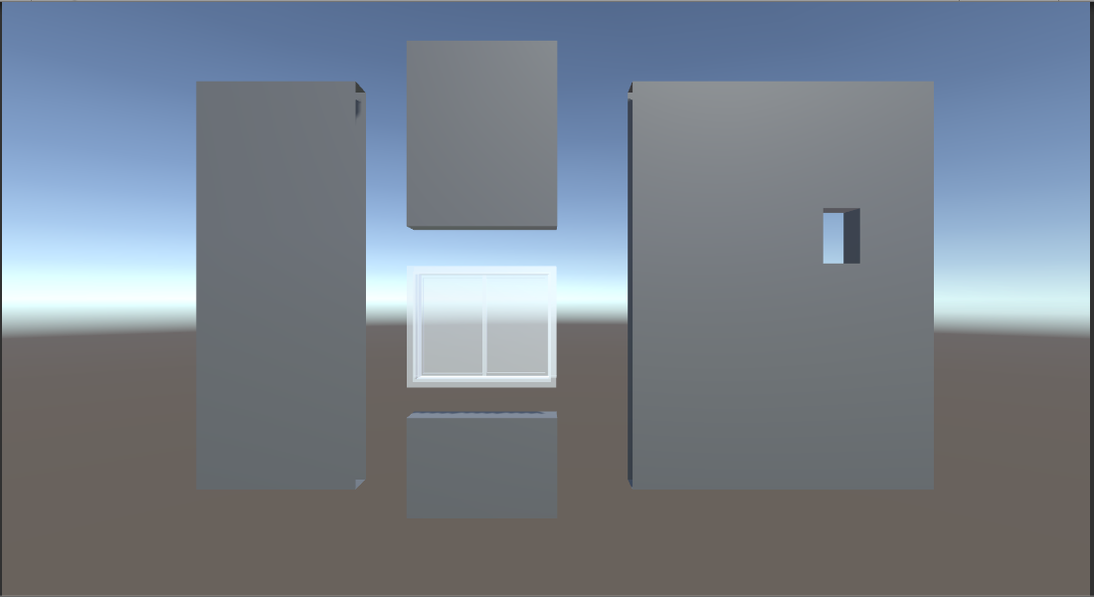
Resize Component:

Slide 18
Modify
Material & Texture
components

Slide 19
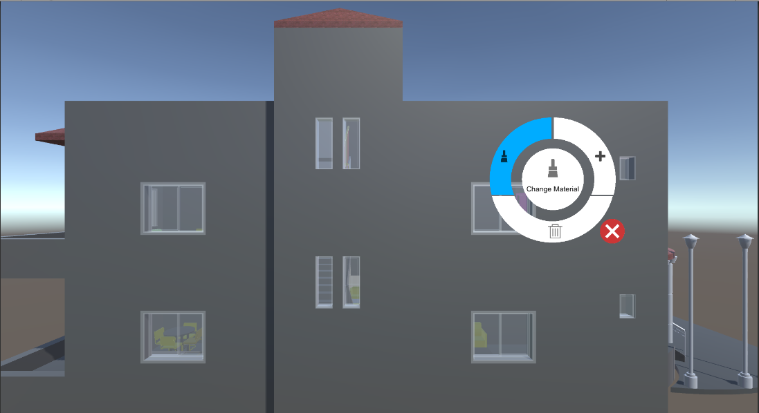

Slide 20
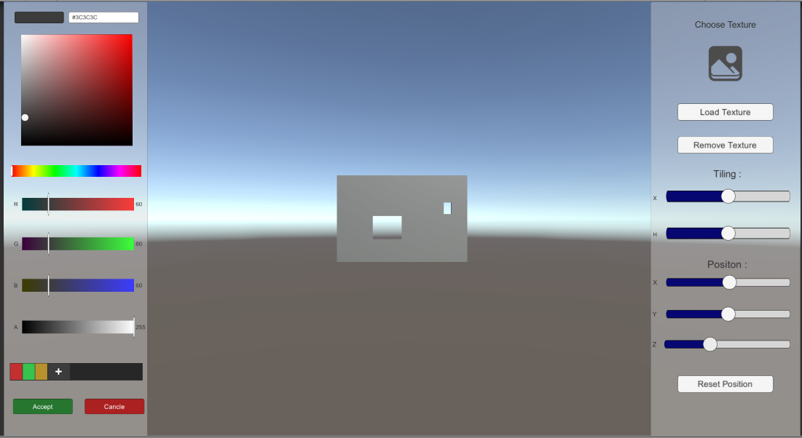

Slide 21
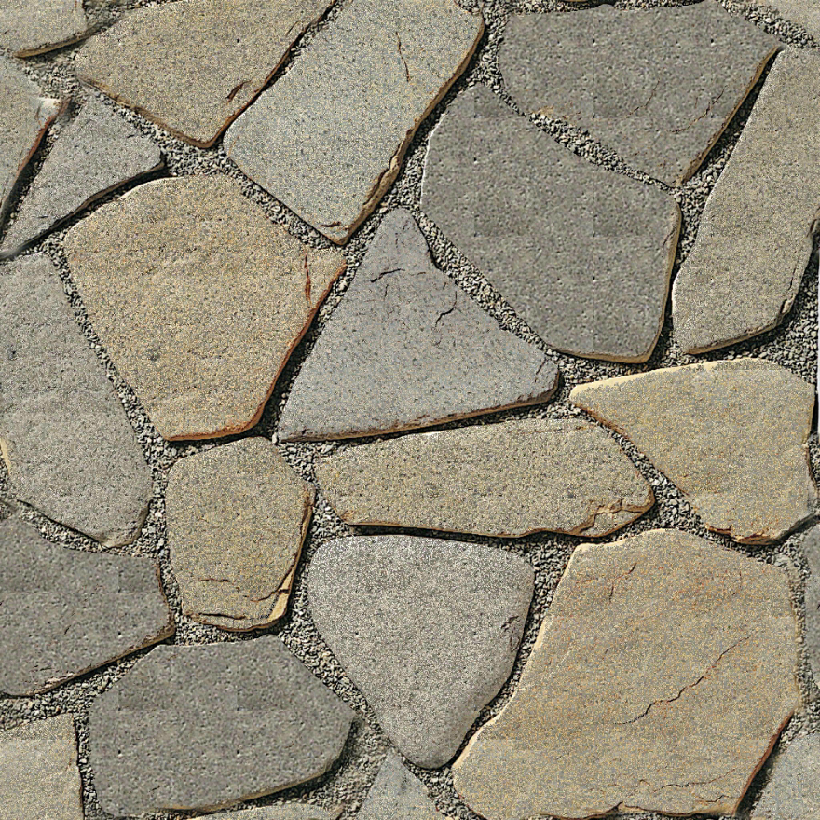
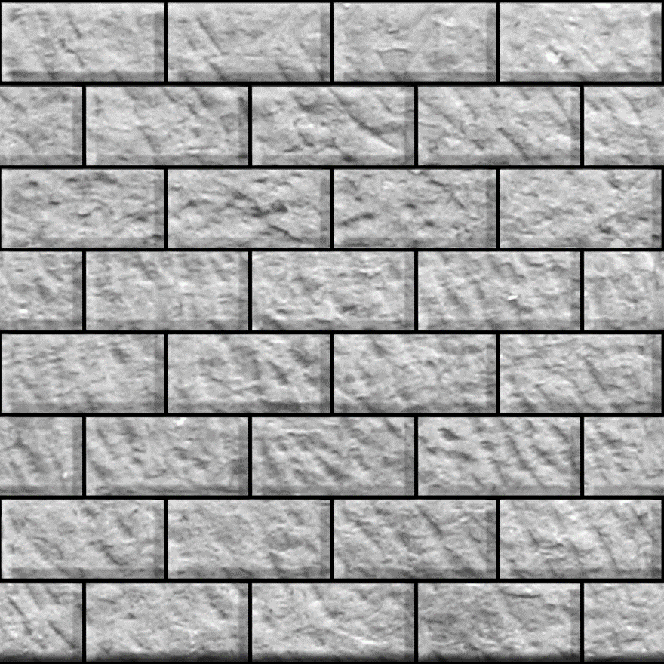
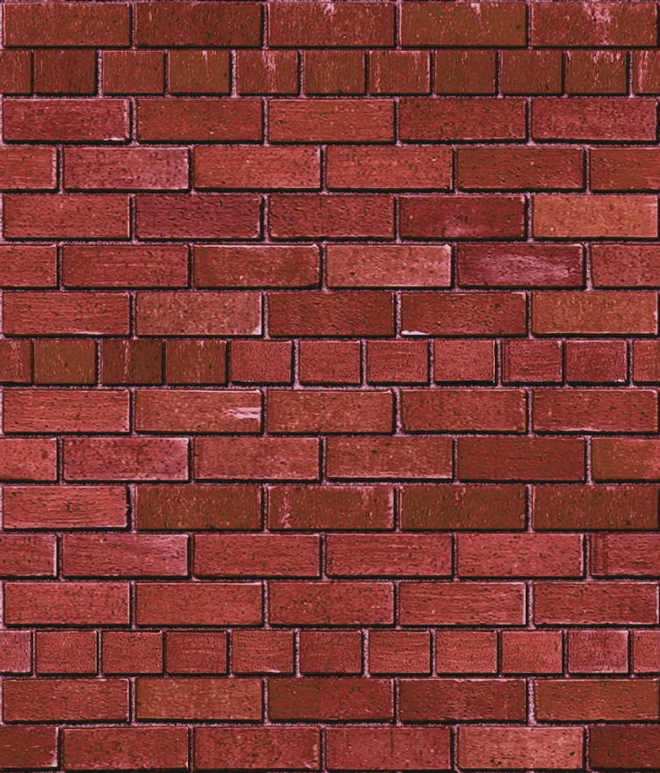
Texture

Slide 22
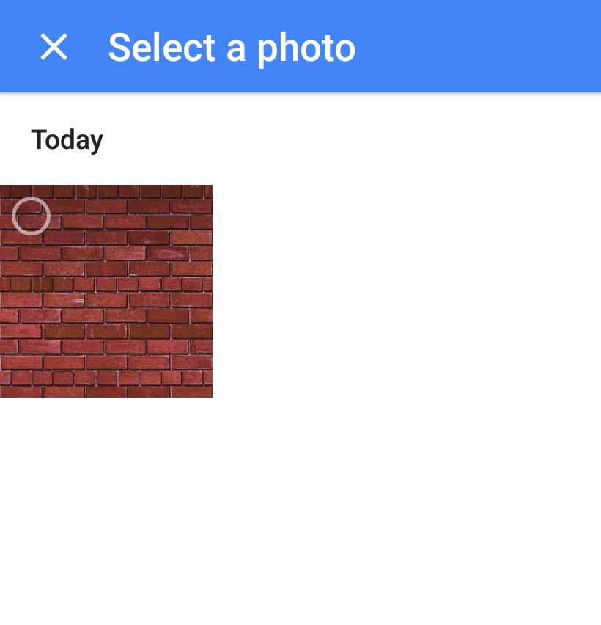
Texture

Slide 23
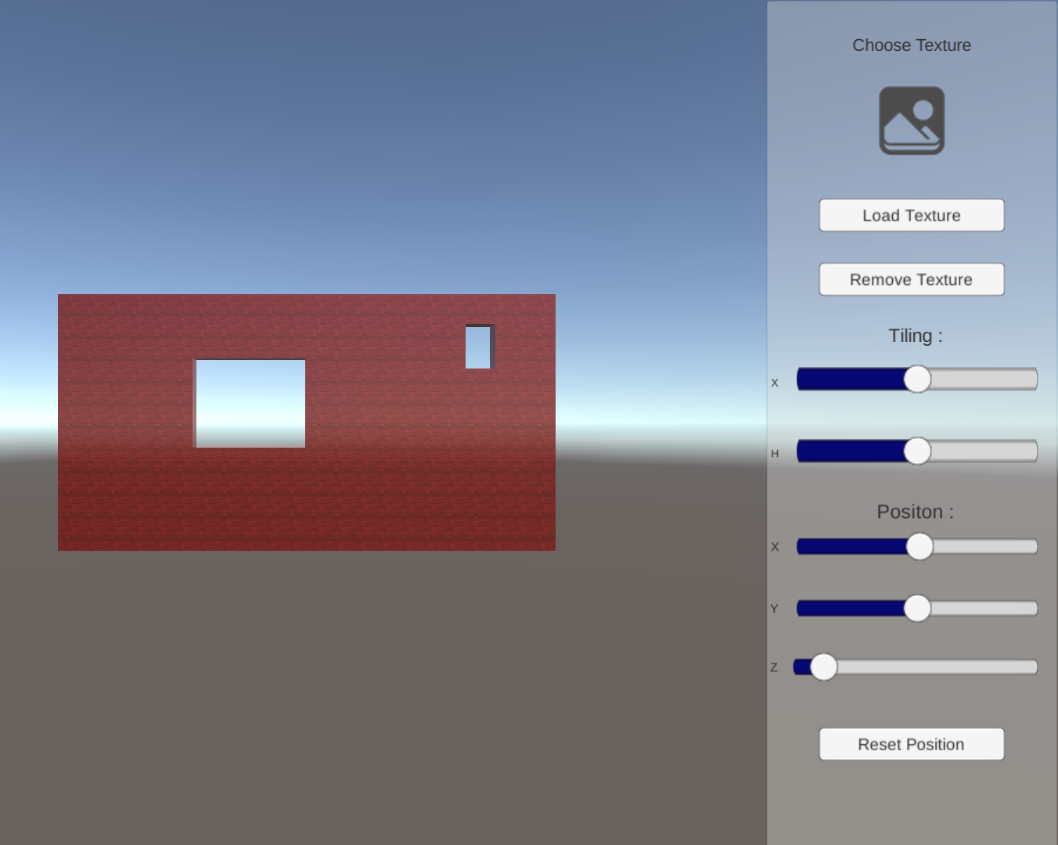
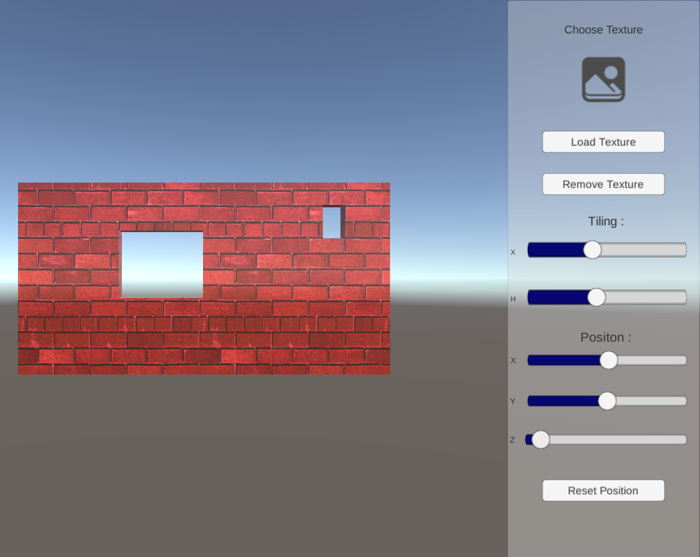
Texture - Tiling

Slide 24
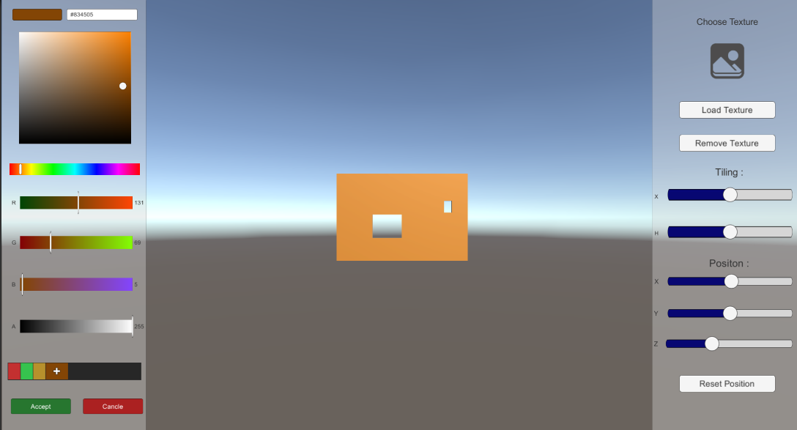
Material - Color

Slide 25
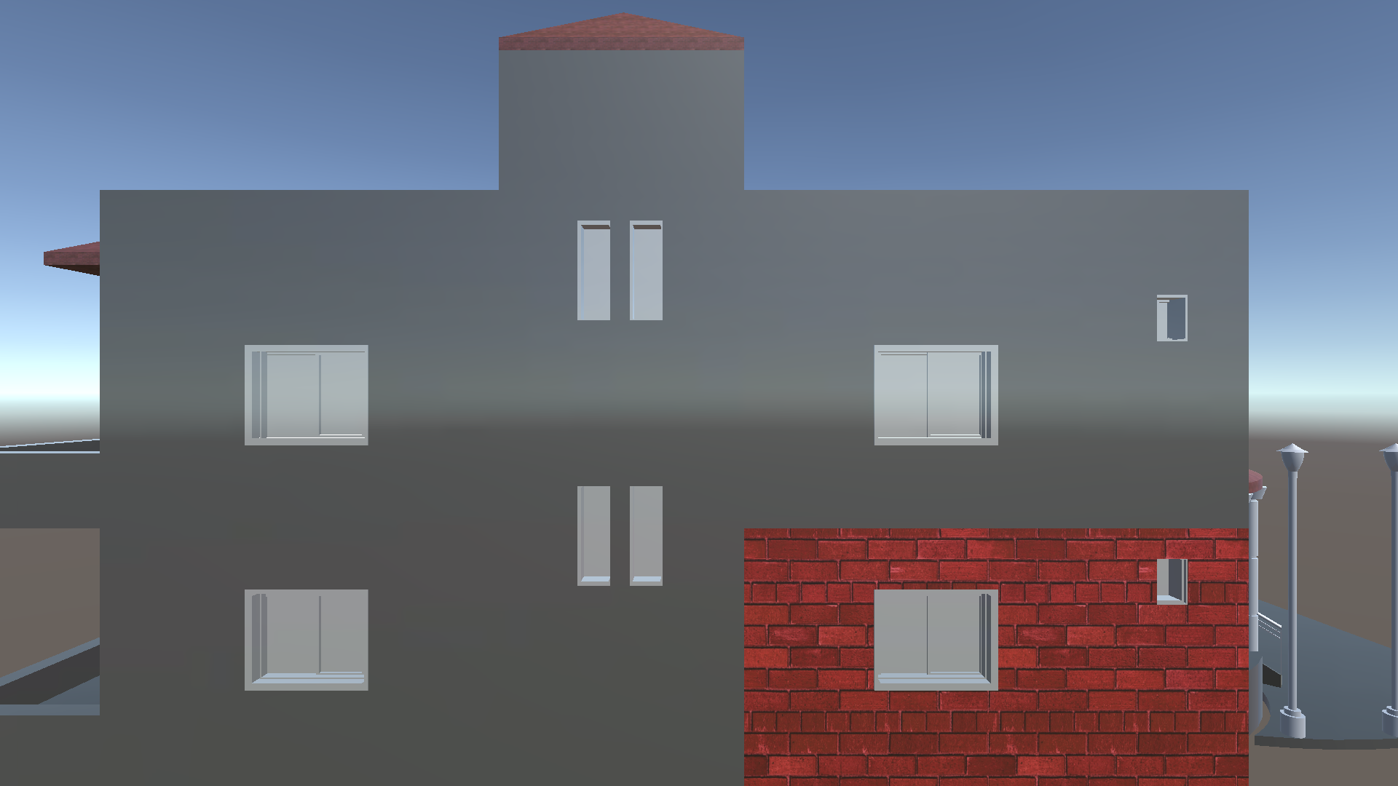
Material

Slide 26
Website & Mobile Application

Slide 27
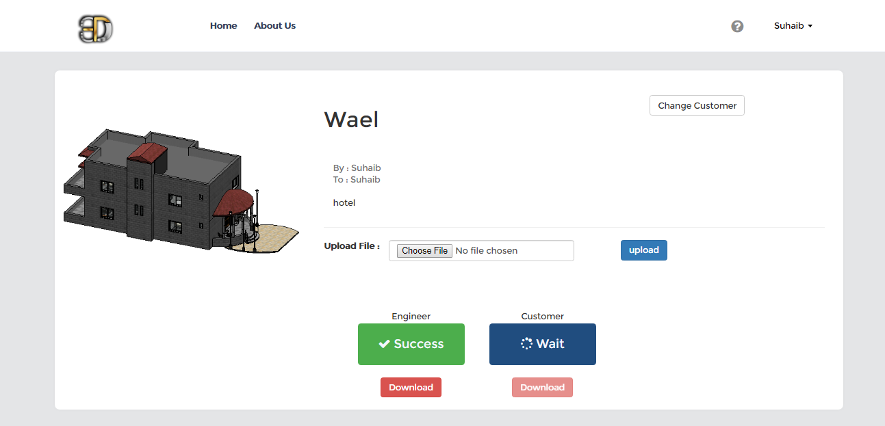
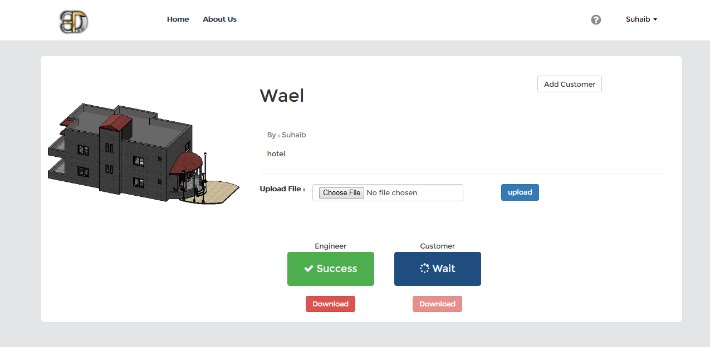
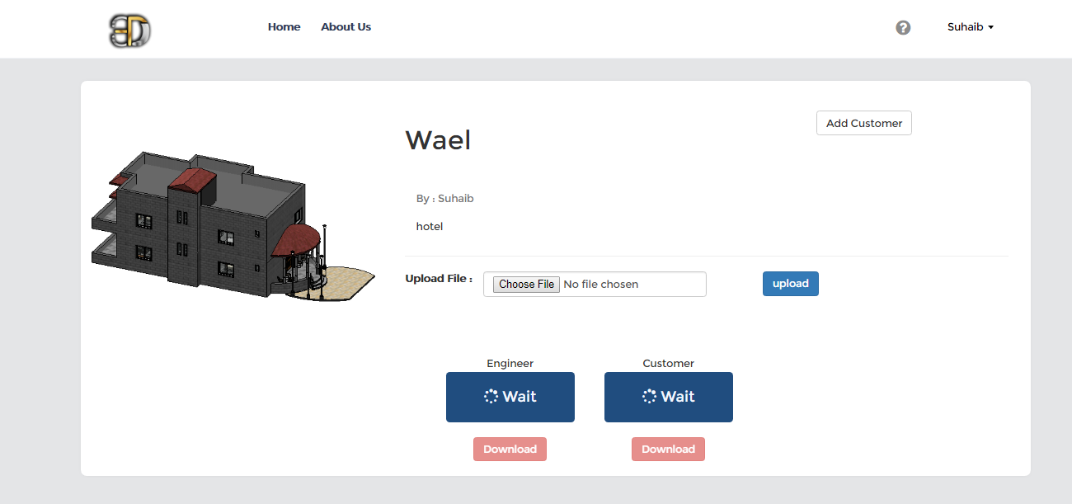
Website

Slide 28
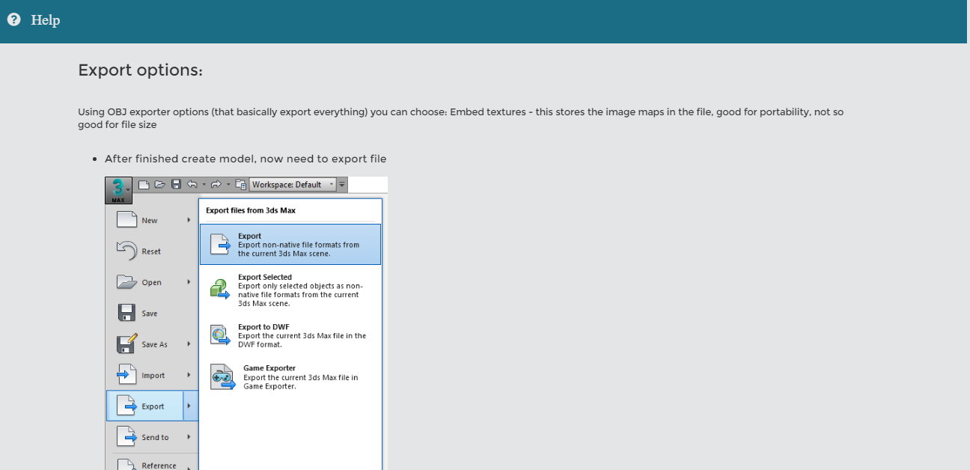
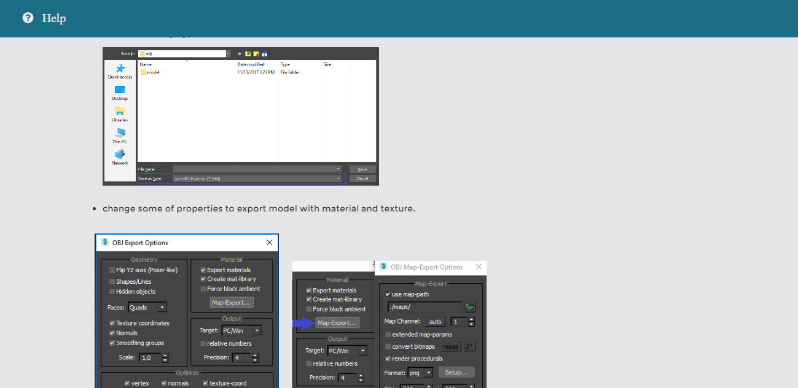
Website - Tutorial

Slide 29
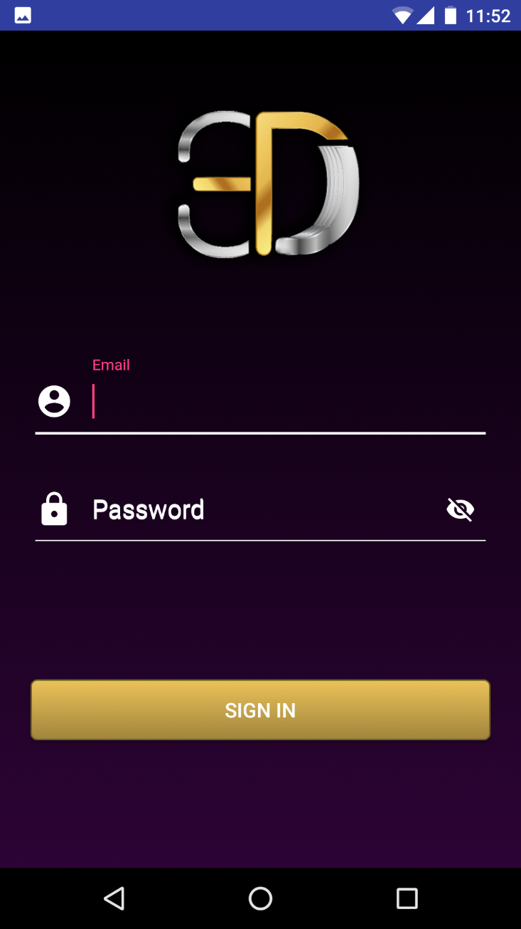
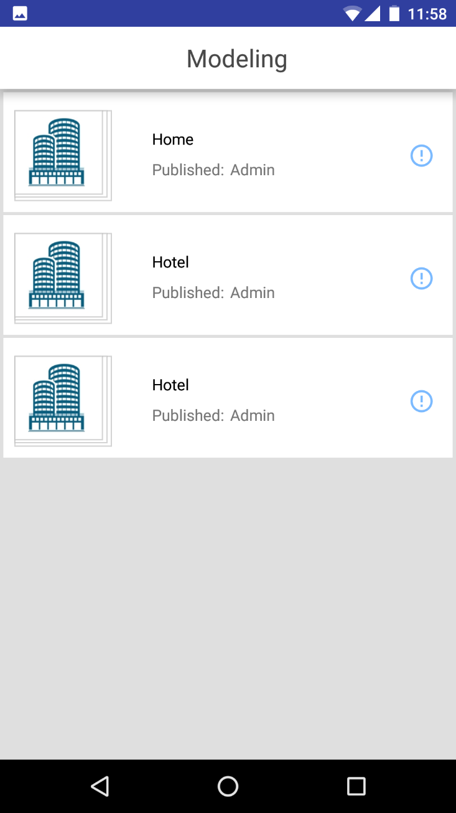
Mobile Application

Slide 30


5
4
3
2
1
6
7
8
9
Challenge

Slide 31
Smart
3D
Modeling
high speed
hard to use
easy to use
3D MAX
Revit
BIMX
low speed

Slide 32
Future Work
Support Virtual Reality (VR) technology.
Support many of extensions such as FBX, RVT.
Support logging file to show all modify on model.

Slide 33

Video

Slide 34

Any Questions ?

Slide 35
Thank You

