Slide 1
Cutting wood machine
1- Bassam Mazen Odeh 11042595
2-Hamza Mazen Shawahna 11210589
3- Wael Yousef Abu Garbieh 11042555
4- Mahmood Abu Alhuda

Slide 2
Type of cutting wood :-
1- In ancient
2- In modern
Firstly in ancient:-
It was an old wood cut and separated by a simple tools.
1- Axe
2- Saw

Slide 3
Secondly in modern :-
Wood cutting process recently has been developed where it was discovered several ways to cut wood. These way:-
1- The Jig and Dado:
A stacked dado is two blades with a set of chippers in between. This is used for cutting grooves, or removing large parts of stock.
2- The Router:
A plunge router allows you to plunge the bit into the wood, make your cut, then lift it back out.

Slide 4
3- The Radial Arm Saw:
The radial arm saw is usually used to perform cross cuts. However, you can use it for bevels and miters, dadoes, rabbets, moldings, and even as a router guide.
4- Water Jet Cutter:
Water is pushed hard high pressure and speed of paying high, that cause cutting wood.
5- Laser Machine:
The laser machines of the latest machinery equipped with high-tech focus the laser beam on the high-energy non-metal ores and the machining or drilling by force can also be controlled using the latest computer design programs

Slide 5
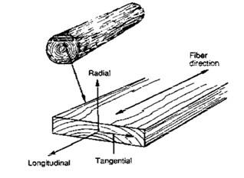
Wood properties:-
Wood properties different from the other material, this properties Contribute in desgin wood.
These properties is:-
1- directional properties: -
Wood is an orthotropic material with unique and independent properties in different directions. Because of the orientation of the wood fibers, and the manner in which a tree increases in diameter as it grows. properties vary along three mutually perpendicular axes .

Slide 6
2- Mechanical properties:
Mechanical properties describe the characteristics of a material in response to externally applied forces.
1- elastic properties:-
which measure resistance to deformation and distortion, and strength properties, which measure the ultimate resistance to applied loads.
2- Modulus of Elasticity:
Modulus of elasticity relates the stress applied along one axis to the strain occurring on the same axis.

Slide 7
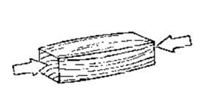
4- Compression:
When compression is applied parallel to grain, it produces stress that deforms (shortens) the wood cells along their longitudinal axis.
3- Strength proerties:
Strength properties describe the ultimate resistance of a material to applied loads. They include material behavior related to compression, tension, shear, bending, torsion, and shock resistance. mechanical properties are collectively described only for directions parallel to grain and perpendicular to grain.

Slide 8
5- Bending:
When wood specimens are loaded in bending, the portion of the wood on one side of the neutral axis is stressed in compression parallel to grain. Bending also produces horizontal shear parallel to grain.

Slide 9
DESIGN CALCULATION AND ANALYSIS:
Every project has specific dimensions and every dimension value needs calculations as we have studied the different parts of the project hydrous now it’s time to calculate the excite dimensions of the project.

