Slide 1
ERP system at PPIC
Presented by
Waleed Rawhi
Ahmed Tomeh
Mohamad shtaiwy
Siham Abu Rabie

Slide 2
Covered Topics
Project overview.
ERP Requirements.
Current State Analysis.
- Internal processes.
- Sales system.
- Inventory system.
Suggested improvements.
- Future sales system.
- Future inventory system.
Recommendations.

Slide 3
Project Over View
What is ERP?
Project Objectives.
Project Methodology.

Slide 4
What is ERP ?
commercial software package that promises the seamless integration of all the information flowing through the company–financial, accounting, human resources, supply chain and customer information”
ERP Modules
Planning
Purchasing
Inventory
Sales
Marketing
Financial
HR

Slide 5
Benefits of ERP
Integration of a single source of data
A real-time system
Increased productivity
Common data definition
Reduced operating costs
Improved internal communication
Foundation for future improvement

Slide 6
Project Objectives
Study the current state systems in the company.
Evaluate current systems and assess them.
Construct a new systems that the company should have.
Improve the information flow by 30%.

Slide 7
Methodology
Coding new systems.
Evaluate new systems.
Construct new systems
Evaluate current systems.

Slide 8
ERP Requirements
Sales functions.
Inventory functions.
Production functions.

Slide 9
Sales Functions
Sales inquiry handling
Margin control
Sales Pricing control
Items Prices
Discounts.
Sales contract handling
Sales order control
Sales invoicing
Quotations
Long term agreements with customers
Contracts for new customers
Manage sales order, cost order.
Commissions
Customer returns.
Accounts control
Billing functions

Slide 10
The main system is
Forecasting system
Which it is the key in planning issues.
We will discuss later on this presentation

Slide 11
Inventory Functions
Barcode Picking
Groups / Kits / BOM
Product List
Track stock levels
Inter Store Stock Transfers
Price Matrix
Price Movement Tracking
Stock Adjustments
Supplier Price and Code Listing

Slide 12
Production functions
Material Planning
Shop floor management
Traceability
Labor & material costing
Work center scheduling
Plant maintenance

Slide 13
Current state analysis
Internal processes.
Sales analysis.
Inventory analysis

Slide 14
Sales processes
The arrival of an order from the customer
Feedback from the stores when the order is complete.
Ensure the availability of stock.
Make Production order.

Slide 15
Production Processes
Production request received from inventories.
Production order is issued.
Raw materials arrival.
Production scheduling
Production start.
Financial manager approval on accounting system
Quality control approval
Daily reports
Delivery of finished products to stores

Slide 16
Inventory Processes
Receipt of raw materials.
Receipt of final product and under processing items
Delivery of raw materials and materials under processing to the production department .

Slide 17
Sales current state analysis

Slide 18
Sales Analysis Methodology
Choose the suitable forecasting system.
Forecasting models tests.
Products ABC classifications
Sales data collection

Slide 19
Three Types of products
Preforms ( PET )
Pipes.
Bottles.

Slide 20
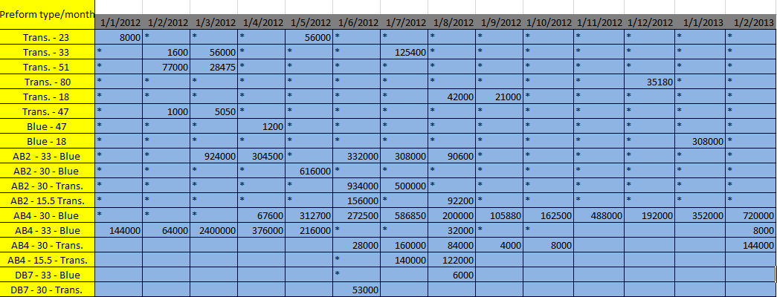
Data Collection for Preforms
Preform Sales at 2012

Slide 21
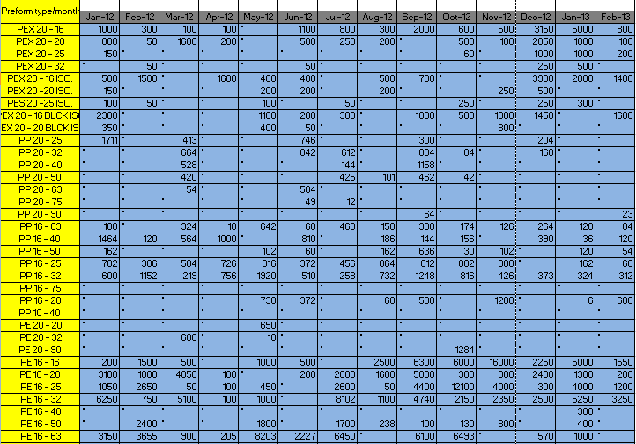
Data collection for Pipes
Pipes Sales

Slide 22
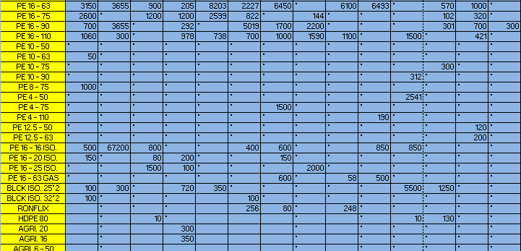

Slide 23
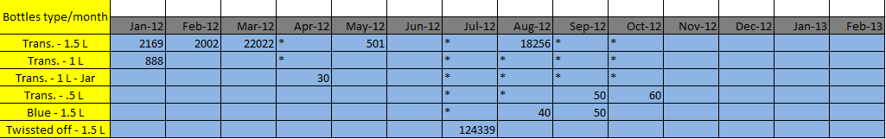
Data collection for bottles
Bottles sales

Slide 24
ABC Classification for preforms
Description | Total number of parts | Percentage of items in the sales | Cumulative usage value | Percentage of annual sales value | Cumulative of annual sales value
A | 4 | %22 | %22 | %82 | %82
B | 4 | %22 | %44 | %13 | %95
C | 10 | %56 | %100 | %5 | %100
Total | 18 | %100 |  | %100

Slide 25
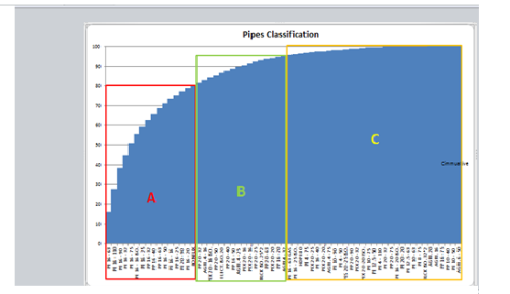
ABC Classification for Pipes
Description | Total number of parts | Percentage of items in the sales | Cumulative usage value | Percentage of annual sales value | Cumulative of annual sales value
A | 16 | %25 | %25 | %80 | %80
B | 16 | %25 | %50 | %15 | %95
C | 31 | %50 | %100 | %5 | 100%
Total | 63 | %100 |  | 100%

Slide 26
ABC Classification for bottles
Description | Total number of parts | Percentage of items in the sales | Cumulative usage value | Percentage of annual sales value | Cumulative of annual sales value
A | 1 | %17 | %17 | 70% | %70
B | 1 | %17 | %34 | %29 | %99
C | 4 | %66 | %100 | %1 | %100
Total | 6 | %100 |  | %100

Slide 27
Forecasting systems
For the current forecasting system we found that there is no accurate forecasting system.
- The company forecasts its sales by the last quantity produced in the last year.
Which means that all over the forecasted year the quantity remains the same.

Slide 28
Pipes Forecasting ( moving average )

Slide 29
Pipes Forecasting ( Single Exponential smoothing )

Slide 30
Pipes Forecasting ( Naïve forecasting)

Slide 31
Pipes Forecasting
Date | Method of forecast | Standard Error | Accuracy measure
14 months From 1/1/2012 To 28/2/2013 | Naïve Method | _______
 | Moving Averages | 109288.5535 | MAPE 81 MAD 16327
 | Exponential Smoothing | 179996.6564 | MAPE 78 MAD 18372

Slide 32
Preform Forecasting ( Moving Average)

Slide 33
Preform Forecasting ( Single exponential smoothing)

Slide 34
Preform forecasting
Date | Method of forecast | Standard Error | Accuracy measure
14 months From 1/1/2012 To 28/2/2013 | Naïve Method | _______
 | Moving Averages | 109288.5535 | MAPE 81 MAD 16327
 | Exponential Smoothing | 179996.6564 | MAPE 78 MAD 18372

Slide 35
Bottles Forecasting (Moving Average )

Slide 36
Bottles Forecasting (Single exponential smoothing)

Slide 37
Bottles forecasting
Date | Method of forecast | Standard Error | Accuracy measure
14 months From 1/1/2012 To 28/2/2013 | Naïve Method | _______
 | Moving Averages | 235611 | MAPE 26393 MAD 2479
 | Exponential Smoothing | 350221.7 | MAPE 5822 MAD 16286

Slide 38
Inventory current state analysis

Slide 39
Inventory analysis methodology
Implement the model
Inventory model
Inventory ABC classifications
Inventory data collection

Slide 40
Three types of inventories
Raw material inventory.
- Pipes raw material.
- PEX raw material.
- Poly ethylene raw material.
Finished goods inventory.
Commercial inventory.

Slide 41
Pipes Raw Material inventory ABC classification
Description | Category | Cum % of Total Usage
Poly Ethylene RM | A | 74.59310897
HDPE RM( مجروش ) | B | 86.52154129
PEX RM | B | 94.59420105
Black color | C | 96.42562021
Calcium Carbonate RM | C | 97.50423181
برابيش 25 mmتدكيك | C | 98.49766113
White Catalyst | C | 98.8875339
Yellow ink solvent | C | 99.26539379
برابيش 32 mmتدكيك | C | 99.53877796
Yellow ink | C | 99.79359677
Printer cleaner | C | 100

Slide 42
PEX raw material Classification

Slide 43
Preform Raw material ABC classification
Description | Category | Cum % of Total Usage
PET RM | A | 95.67305
Alto Blue -2 | B | 97.21377
Alto Blue -4 | C | 98.68748
Ultra-Pure | C | 99.57653
Dasani Blue -7 | C | 100

Slide 44
ABC Classification for Poly Ethylene finished product
Description | Category | Cum % of Total Usage
L.D.B.E Hieden 0509 | A | 57.24233068
RONFLIX PIPE | B | 99.63213558
Prog RM | C | 99.81606779
118 RM | C | 100
PalPipe 50mm-16 | C | 100

Slide 45
Commercial Pipes Classification

Slide 46
ABC Classification for Poly Propylene connectors commercial.

Slide 47
ABC Classification for Agriculture connectors commercial

Slide 48
ABC Classification of Irrigation Pipes.

Slide 49
ABC Classification for Packaging and Filling Inventories

Slide 50
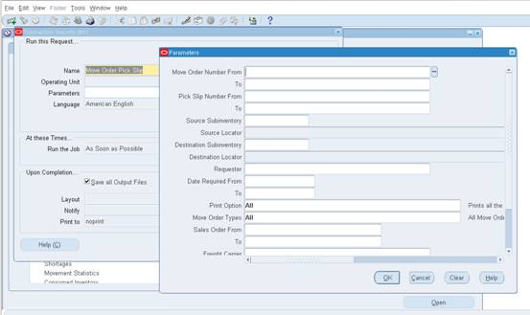
Suggested Improvements
Electronic pick slip report for the warehouse/ transportation

Slide 51
Suggested Improvements
ERP system contains two modules , the first one concern with sales.
The second one concern with inventory.

Slide 52
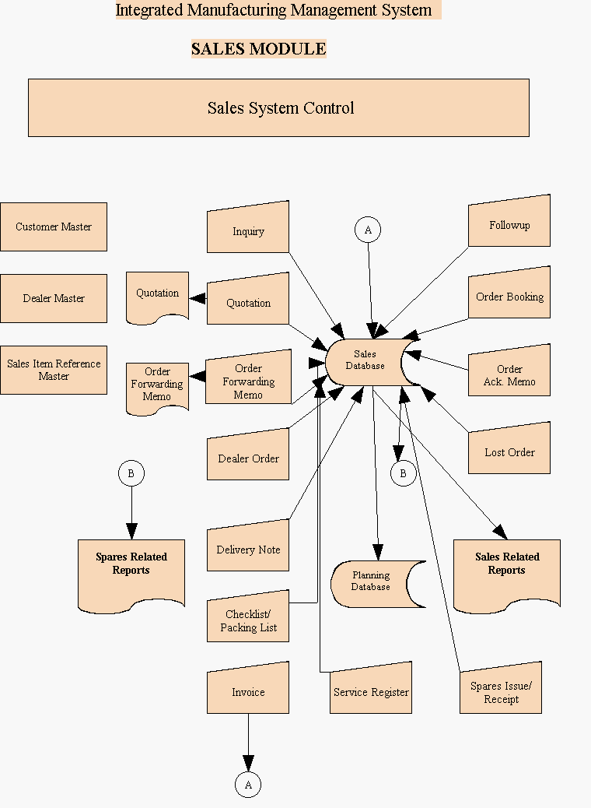
ERP Sales Module

Slide 53
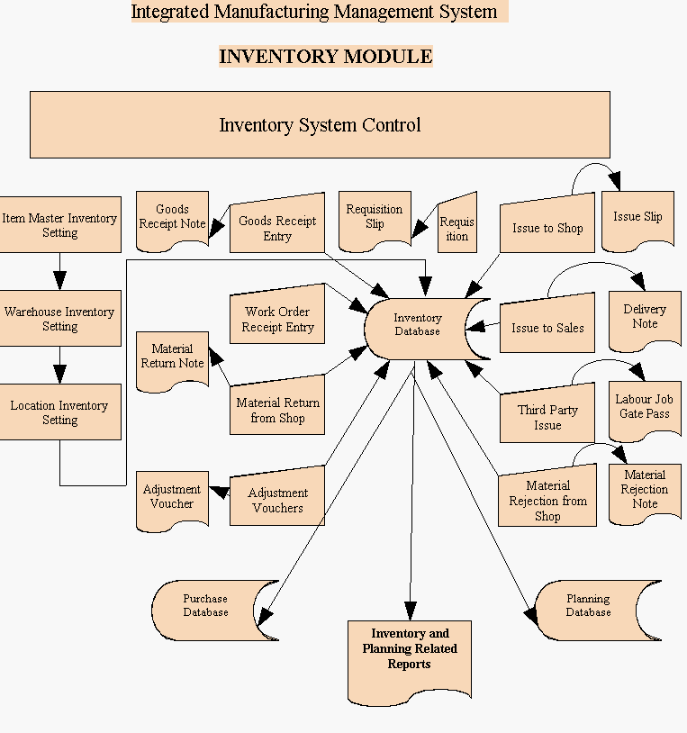
ERP Inventory Module

Slide 54
Recommendations

Slide 55
Thank you For listening

