Slide 1
HVAC SYSTEM DESIGN
Businessmen Club
Supervisor:
Dr Salameh Abdulfattah
The students:
Ameer Khaled (10716625)
Nabil abu hanih (10840770)
Saleem Sama’neh (10716714)
Tariq Ismail (10740129)

Slide 2
The Aim of The Project
The aim of this project is to design installation of heating, ventilation and air condition system (HVAC) for buissnessmen club in ramallah .
VRV system will be used to design air conditioning.
Water service and plumping design is required for service system inside the building
Fire protection system will used in the building

Slide 3
Presentation out line
  - Building Description.
  - Heating And Cooling loads.
  - Duct Design.
  - Plumping System .
  - Fire Fighting System.

Slide 4
Businessmen Club
club location
City: Ramallah, Tira, Tal Es-Safa.
Elevation: 840 m above sea level.
Latitude: 32˚
Building face is to the south direction
Basement 2 | Pool mechanical room, electric room, kitchen, relaxing area, store, massage room, manicure pedicure room, gym.
Basement 1 | Swimming room, Jacuzzi, shower area, storage, lockers room, steam room, sauna, mechanical room.
Ground floor | Pantry, multi-purpose hall, kitchen, electric and server room, restaurant.
First floor | Open kitchen restaurant, pantry, cloak room, foyer, kitchen, lobby, lounge bar.

Slide 5
climate zone in winter
-Inside and out side design condition in winter (heating):
Outside design condition | Inside design condition | Parameters
6 °C | 22 °C | T: temperature
65 % | 50 % | Φ : relative humidity
3.5 g of water/kg of dry air | 8.75 g of water/kg of dry air | W : moisture content
14 °C |  | Tun: unconditioned temperature
9 °C |  | Tg : ground temperature
10.8 m/s. |  | The wind speed

Slide 6
The Heat load Equation :
1. Q = U* A* ( Ti - To )
V_{vent} = n * value of ventilation
V_{inf} = (ACH * inside volume *1000) /3600
2. Q_{s})_{vent , inf} = 1.2 V_{vent,inf}*(T_{i}-T_{o})
Q_{l})_{vent , inf} = 3 V_{vent,inf}*(T_{i}-T_{o}).
3. Q_{building} = Q_{s)cond} + Q_{s)v,inf} + Q_{l)v ,inf}
4. Q_{boiler} = 1.1*Qw

Slide 7
Summary for heating load
Heating load (kw) | Floor
37.86 | Basement 2
29.75 | Basement 1
42.2 | Ground
63.46 | First
164.2 | Total

Slide 8
climate zone in summer
Inside and out side design condition in summer (cooling)
Outside design condition | Inside design condition | Parameters
32 °C | 23 °C | T: temperature
44% | 50 % | Φ : relative humidity
14.75 g of water/kg of dry air | 8.75 g of water/kg of dry air | W : moisture content
14 °C |  | Tun: unconditioned temperature
29°C |  | Tg : ground temperature
>5 m/s. |  | The wind speed

Slide 9
Cooling Load equation :
1 ) For ceiling :
Q=U*A*(CLTD)_{corr}
(CLTD)_{corr} = (CLTD + LM) K + (25.5 – Ti )+ (To – 29.4)
Where :
K=0.5 light color
2) For walls :
Q =U*A*(CLTD)_{corr}
Where :
K= o.65
3)For glass :
Heat transmitted through glass:
Q=A*(SHG)*(SC)*(CLF)
Convection heat gain:
Q=U*A*(CLTD)_{corr}

Slide 10
Cooling Load equation :
4 ) For people:
Q_{s}= q_{s}*n*CLF
Q_{L}= q_{L}*n
5) For lighting:
Q_{s}= A*q*CLF
6) For equipments:
Q_{s}= q_{s}*CLF
Q_{L}= q_{L}

Slide 11
Summary of cooling load
Cooling load (kw) | Floor
68.1 | Basement 2
45.8 | Basement 1
88.6 | Ground
105 | First
307.5 | Total

Slide 12
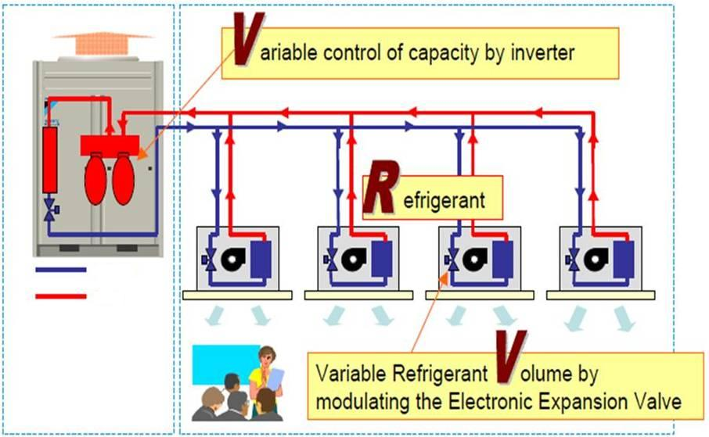
VRV SYSTEM:

Slide 13
Duct design:
          Design procedures:
1. The total sensible heat was calculated.
2. The Vcirculation was calculated.
3. The flow rate (CFM) was calculated.
4. Number of diffusers are calculated and distributed uniformly.
5. The initial velocity for the main duct is 5 m/s.
6. The pressure drop is depend on the initial velocity for the main duct and flow rate (CFM).
7. The main diameter is calculated.
8. The height and width of the rectangular ducts are determined from the tables.

Slide 14
Sample Calculation For Duct Design
section | Flow ratee (CFM) | Velocity (fpm) | ∆P/L (pa/m) | D(mm) | H(mm) | W(mm)
A-B | 3200 | 1300 | 0.872 | 539.6 | 550 | 450
B-C | 1600 | 1096.5 | 0.872 | 415.5 | 400 | 350
C-D | 400 | 778.3 | 0.872 | 264.7 | 250 | 200
C-E | 1200 | 1021.8 | 0.872 | 372.7 | 300 | 400
E-F | 800 | 924.6 | 0.872 | 320.1 | 250 | 350
F-G | 400 | 778.3 | 0.872 | 264.7 | 250 | 200

Slide 15
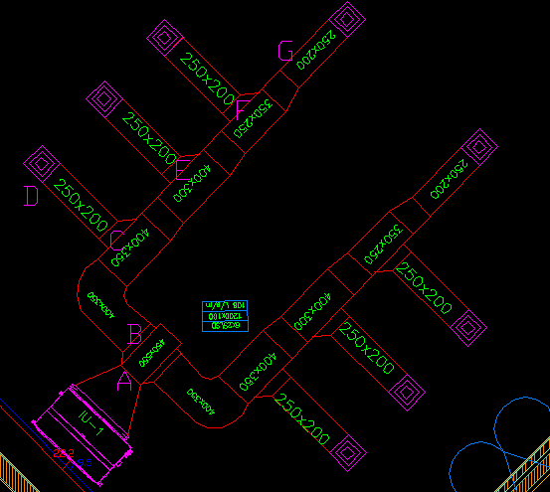

Slide 16
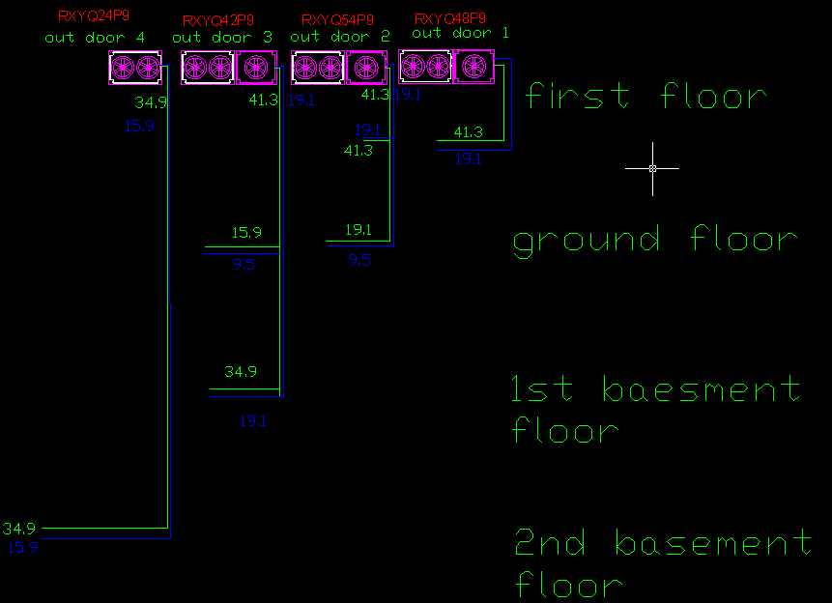

Slide 17
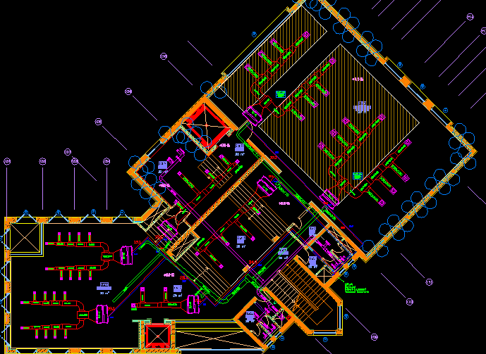

Slide 18
Plumping system
Plumping system consist of:
Potable water system.
Drainage system.
Firefighting system.

Slide 19
Plumbing System
Total demand water :
Demand Water (L/S) | Totally Fixture Unit | Type Of Supply Water
7.41 | 360 | Cold
4.2 | 95 | Hot

Slide 20
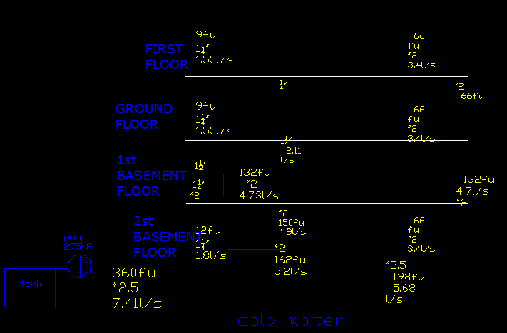
20
20

Slide 21
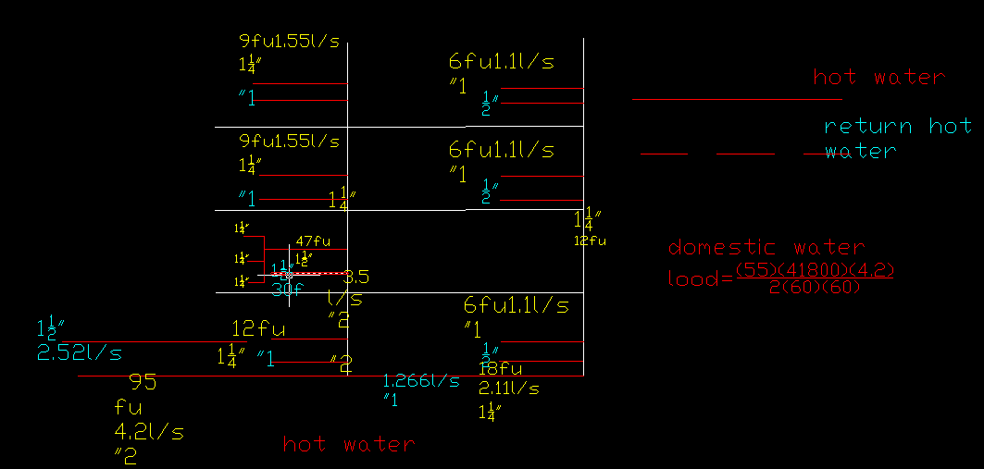

Slide 22
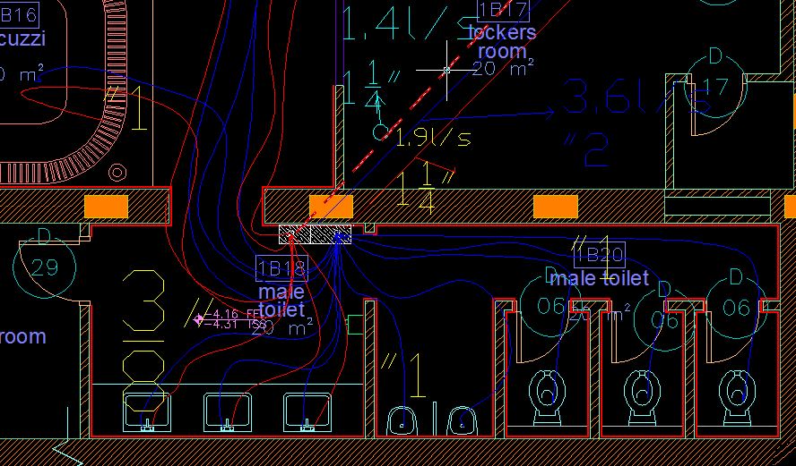
22
22

Slide 23
Sample of calculation for determined number of fixture unit:
Total Fixture |  |  | Quantity | Pipe Size |  | Fixture |  |  | Type
total | hot | cold |  | hot | cold | total | hot | Cold
30 |  | 10 | 3 |  | 1 | 10 |  | 10 | W C
6 | 5 | 5 | 3 | 3/8 | 3/8 | 2 | 1.5 | 1.5 | Lavatory
12 | 9 | 9 | 3 | 1/2 | 1/2 | 4 | 3 | 3 | shower
20 |  | 10 | 2 |  | 1 | 10 |  | 10 | urinal
68 | 14 | 34 |  |  |  |  |  |  | Total Fixture
3.6 | 1.91 | 2.75 |  |  |  |  |  |  | Total Demand ( L/S )

Slide 24
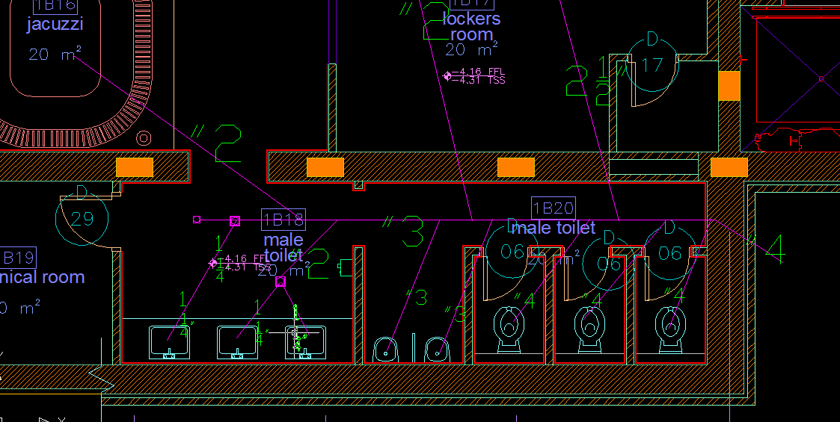
24

Slide 25
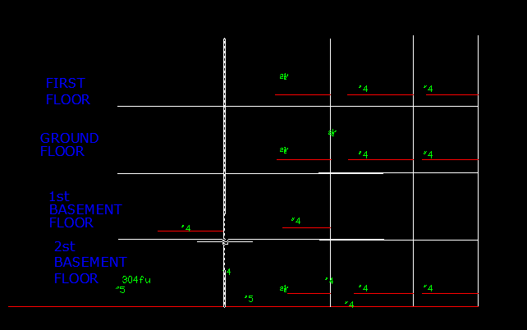
25

Slide 26
Fire Fighting Design
The net area of each floor is less than 7432 m² (80000 ft²) that means we should use one raiser only.
The building has one raiser which takes 250 GPM and has a pipe diameter of 4".
* We chose to use the standpipe system which consists of two main part:
Cabinet: Diameter of the hose = 1½ ".
Flow rate = 100 GPM.
Pressure = 65 Psi.
Land valve: Diameter = 2½ ".
Flow rate = 250 GPM.
Pressure = 100 Psi.

Slide 27
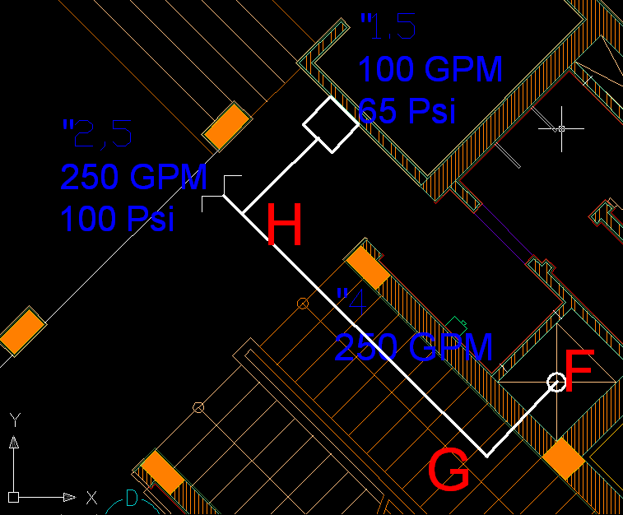
Fire Fighting Design

Slide 28
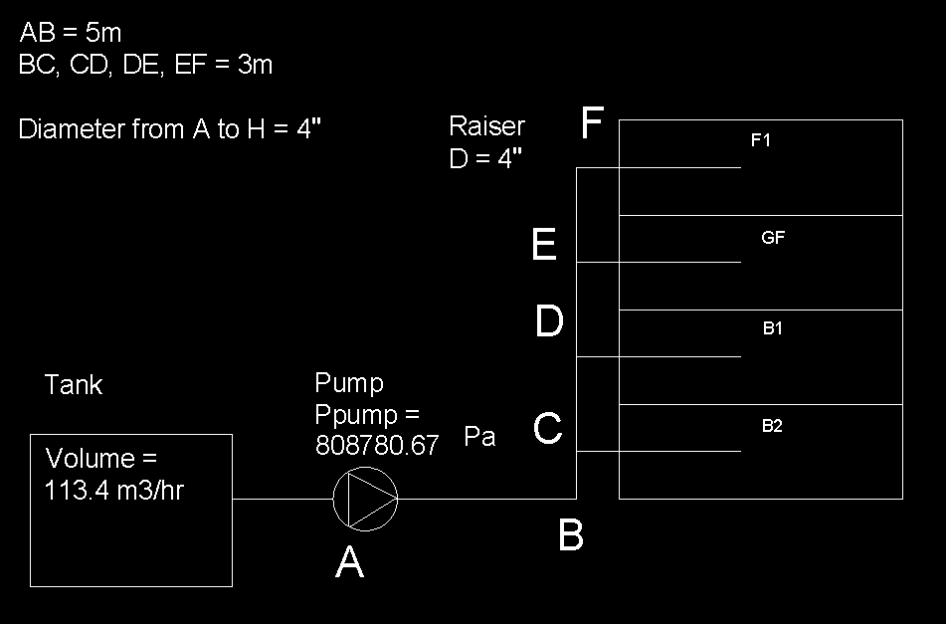

Slide 29
L_{AF} = 19.21 m.
L_{FH} = 0.91 m.
ΔPpump = ΔP(friction + fitting) + ΔPhead + Δpflow
ΔPfriction = (ΔP/L)_{AF} * L_{AF} + (ΔP/L)_{FH} * L_{FH}
= (1)(19.21) + (15)(.91)
= 32.86 Psi
To convert it to Pa:
ΔPfriction = (32.86)*(3.3*6.8*1000/100)
= (32.86)*(224.4)
= 7373.784 Pa
ΔP(friction + fitting) = 1.5 ΔPfriction = 1.5 *7373.784
= 11060.67 Pa.

Slide 30
ΔPhead = L_{head} *
= 12 * 9.81 *10³
= 117720 Pa.
ΔPflow = 100 Psi for the landing valve.
= 100*6.8*10³
= 680000 Pa.
ΔPpump = ΔP(friction + fitting) + ΔPhead + ΔPflow
= 11060.67 + 117720 +680000
= 808.780 kPa.
Tank volume = (Q*Time*3.78)/1000
= (250*2*60*3.78)/1000
= 113.4 m³/hr.

Slide 31


