Slide 1

Smart Home
Represented by:
Rami Ghuzzi
Oday Yamen
Supervisor: Dr. Abdul-Allah Rashed

Slide 2
Contents
Introduction
Problems and Constraints
Methodology
Results and Conclusion
Future Work

Slide 3
Introduction
Overview
Description

Slide 4
Problems and Constraints
Constraints
Hardware Issues
Software Issues
Earlier Coursework

Slide 5
Methodology
Description and Tools
Technologies
Scenarios

Slide 6
Results and Conclusion
Safe houses.
Easy life and controlling.
Keep aware of what is going on in your house with your absence.
Simplicity which encourages people to go through this kind of technology and apply it.
Protected house from burning and water flooding.
Reducing costs and time for police and fire departments in case of fire when they follow the system position and information.
Large field of development and investment

Slide 7
Future Work
Supply house with clean power and use LDR’s for this methodology.
Connect the house with police or fire departments.
Application development.
Authentication and the Security of the house.
Interaction between smart appliances and the system.

Slide 8
Thanks a Lot
Best wishes

Slide 9
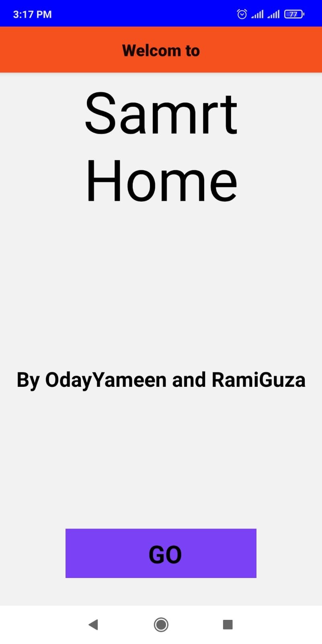
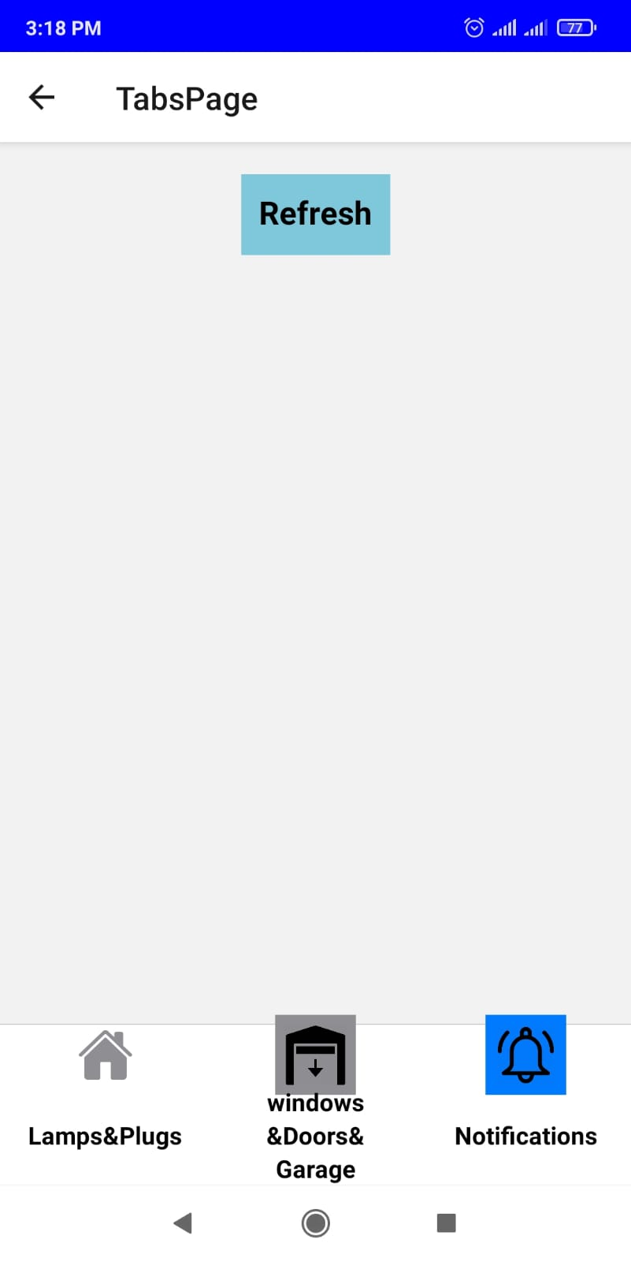
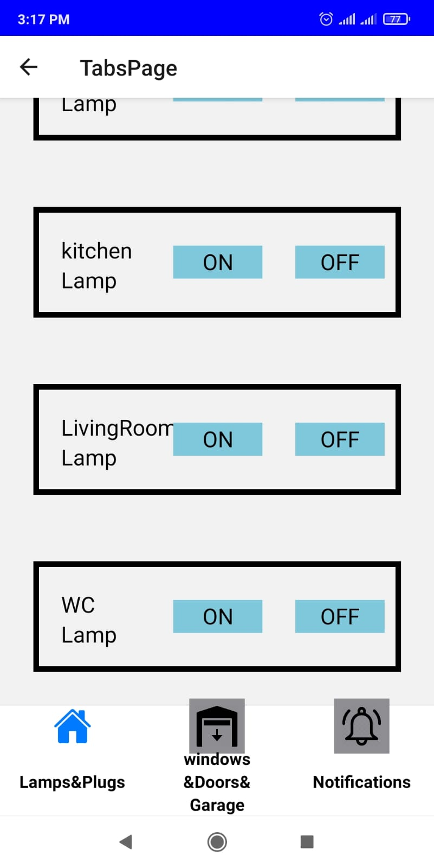
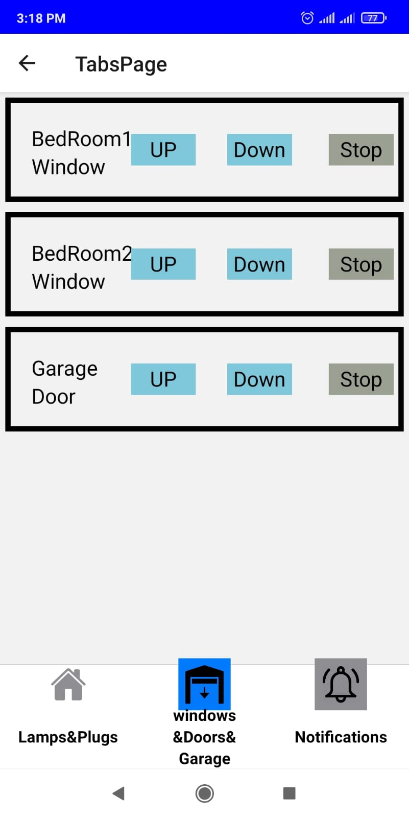

Slide 10
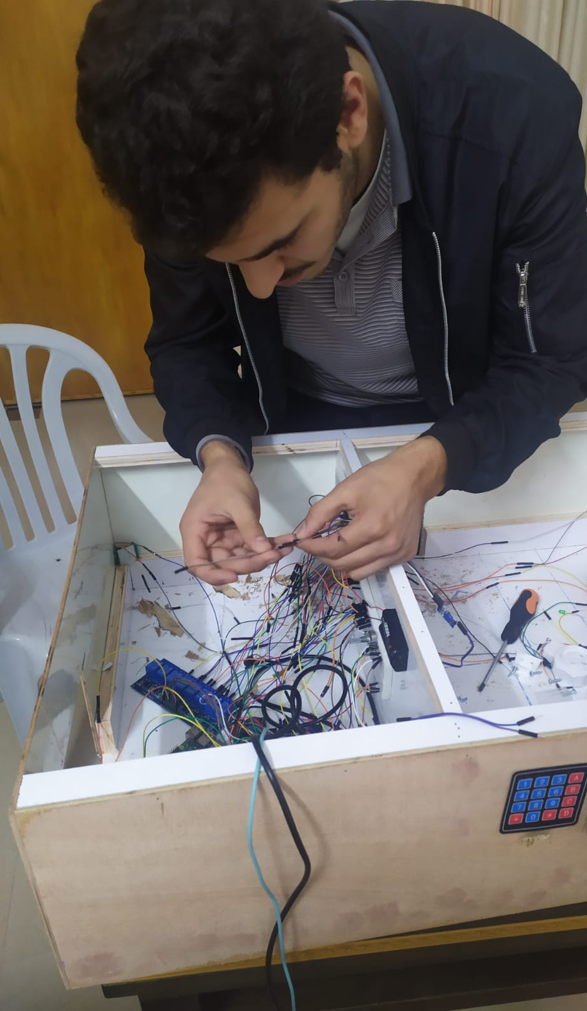
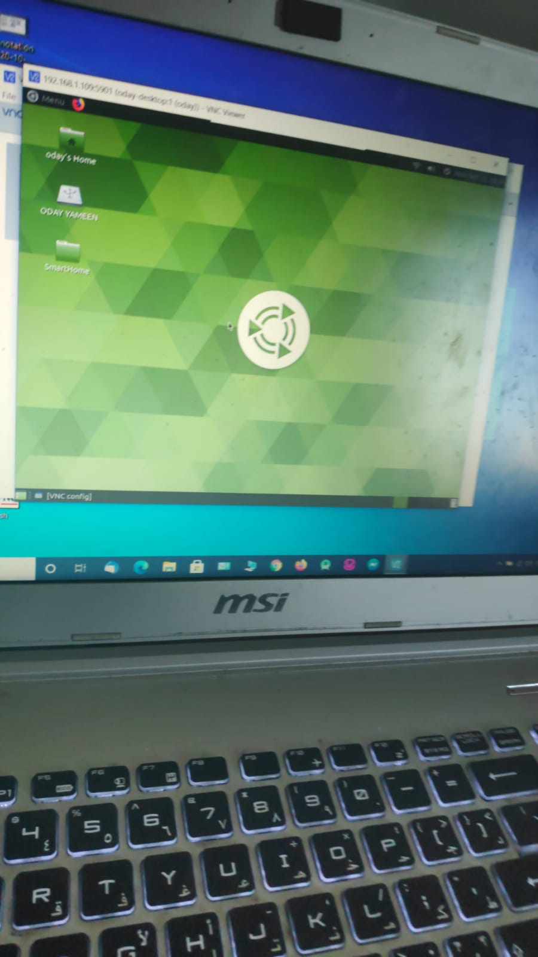
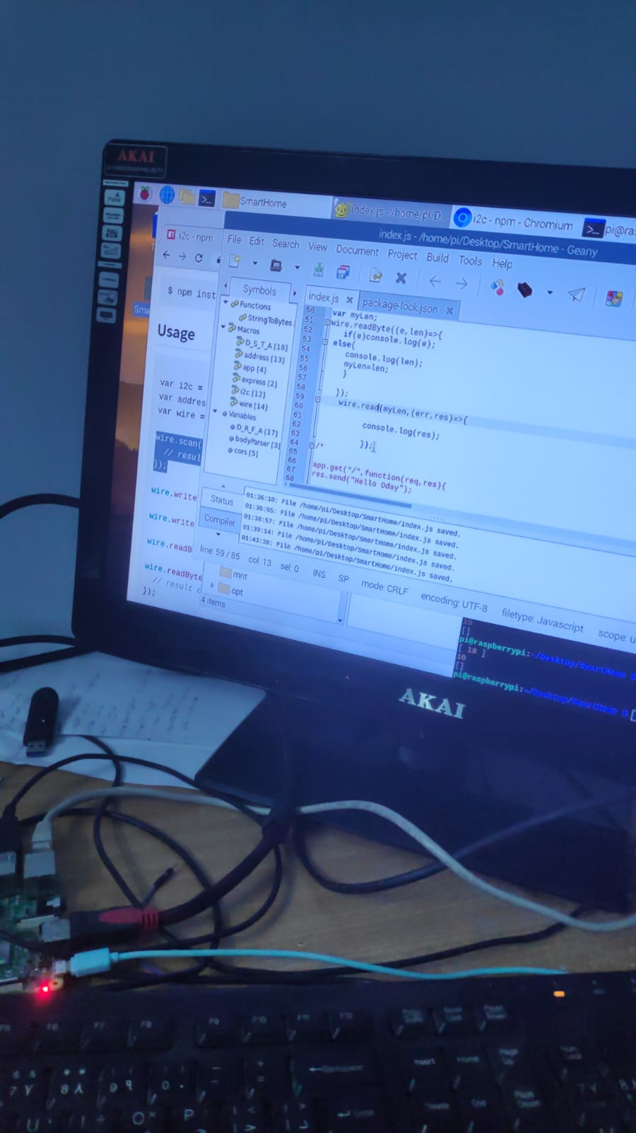

Slide 11
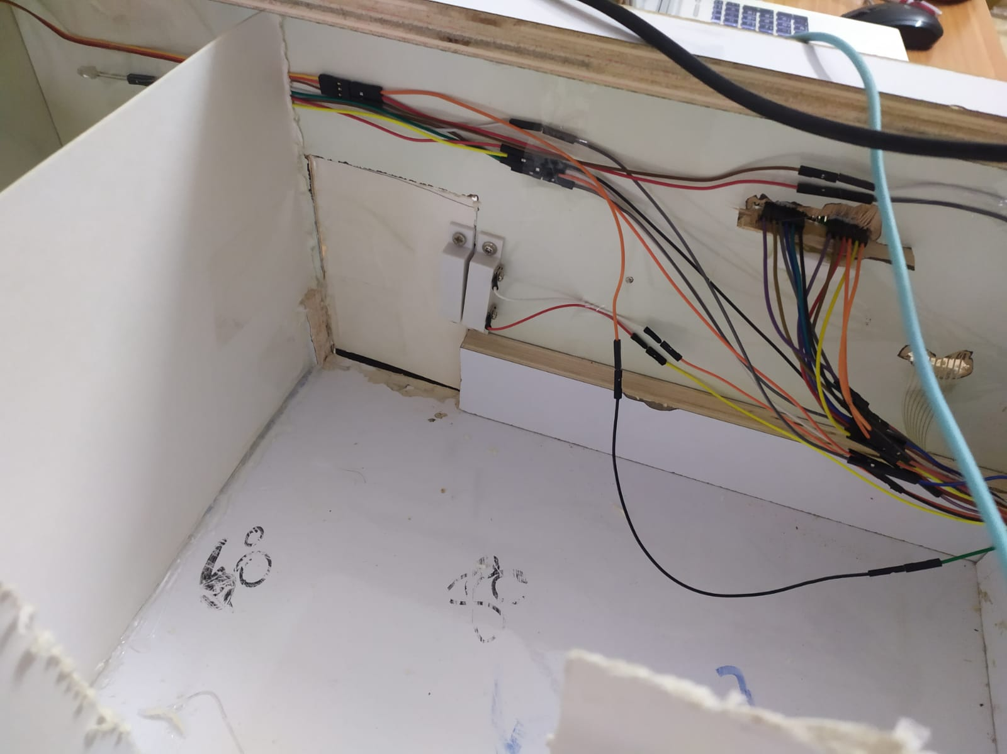
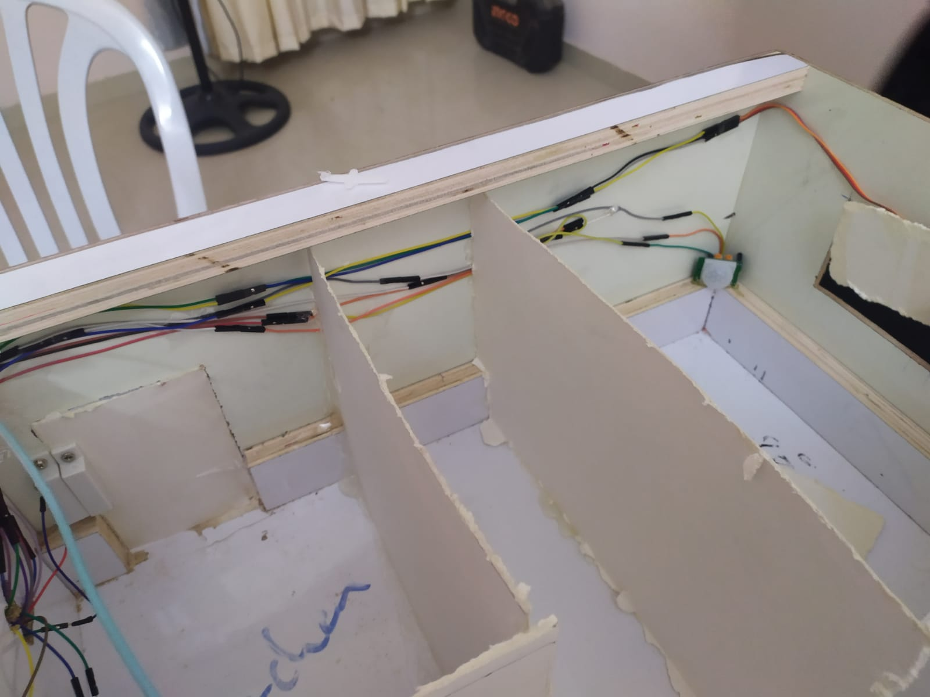
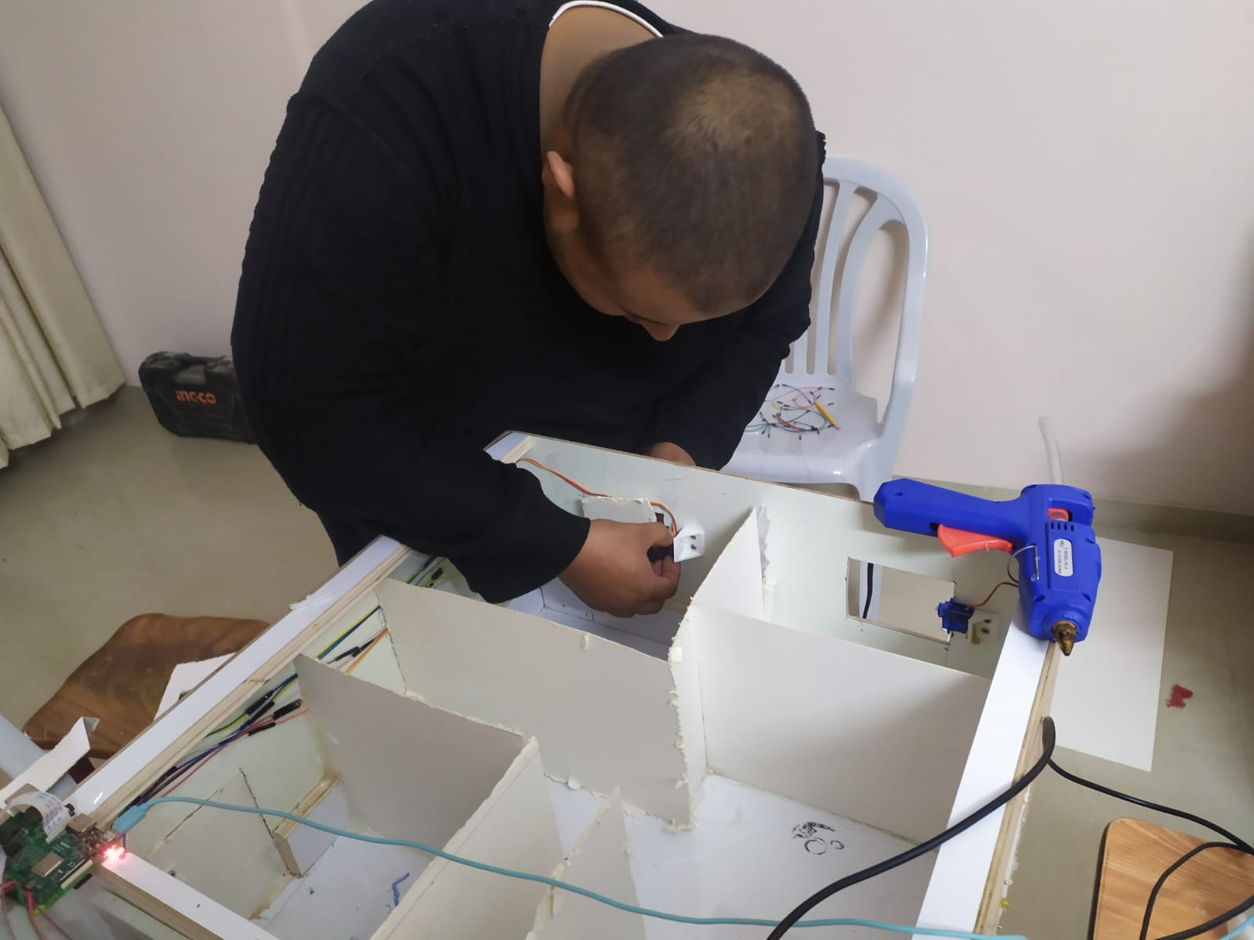

Slide 12
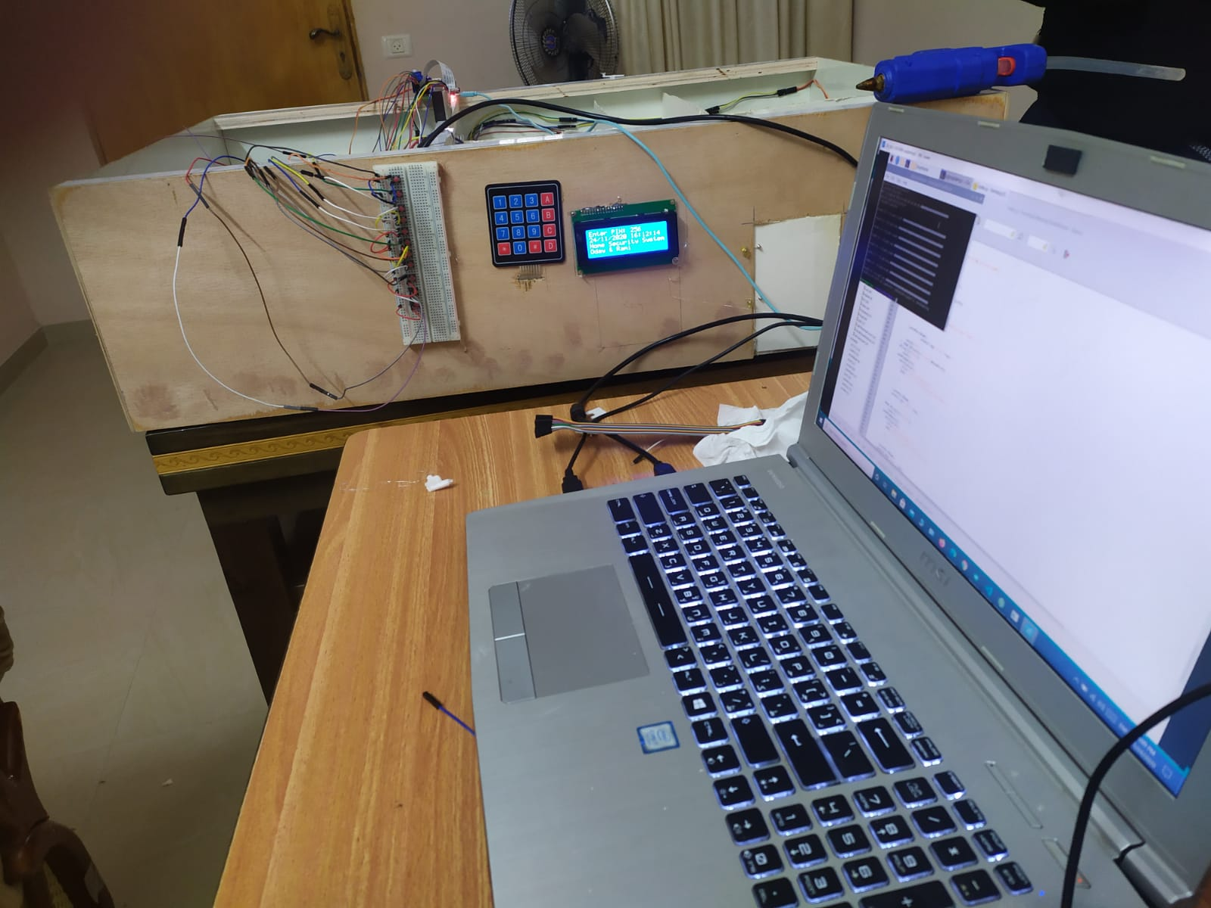
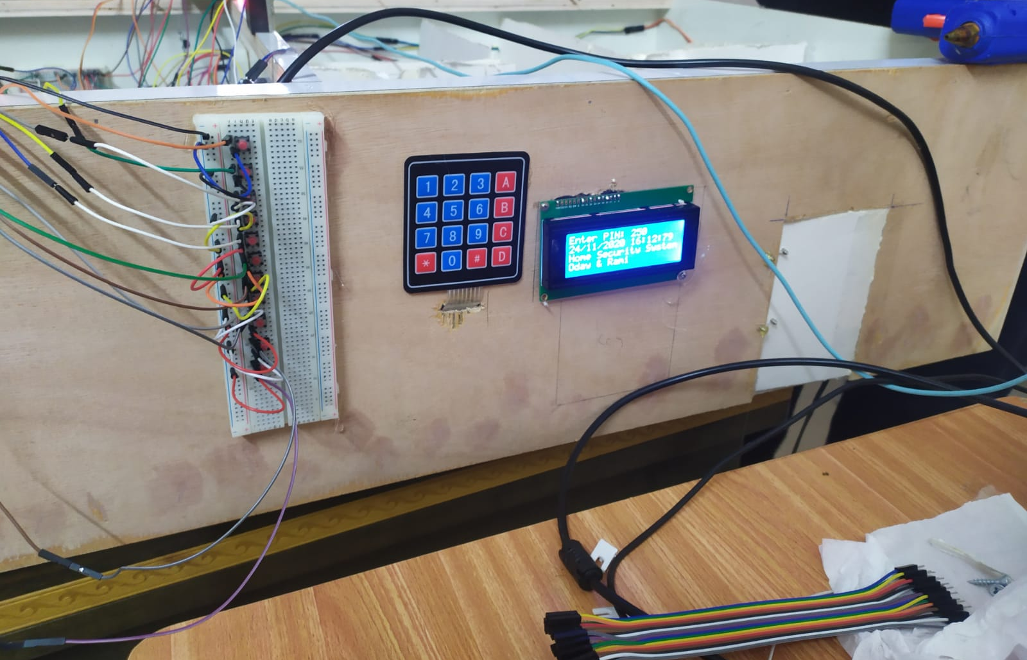

Slide 13
