Slide 1



BOTTLE SEPARATOR ROBOT

Slide 2
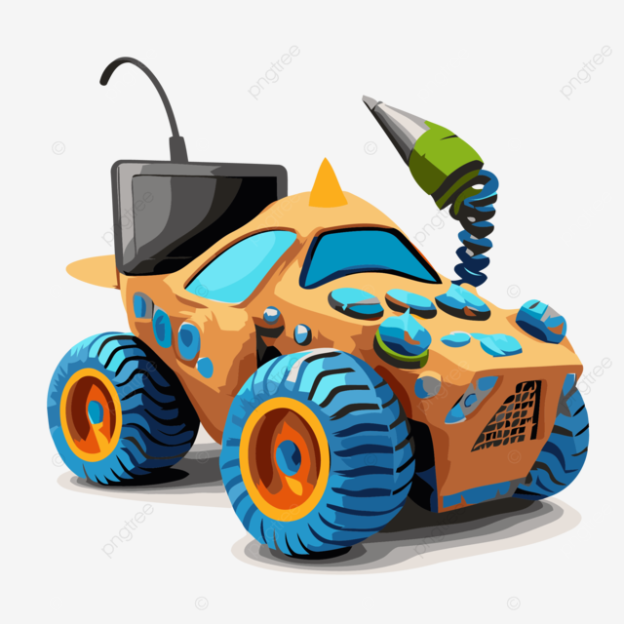
Content
01
Introduction
02
Methodology
03
Constraint
04
Feature Work
05
Thank You
06
QA

Slide 3

Introduction
This project involves a robot that autonomously identifies and sorts plastic and metal bottles using Image Processing and AI, reducing the need for manual labor.

Slide 4
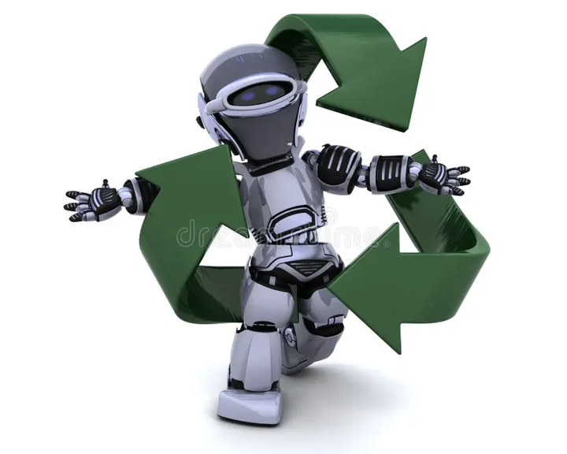
Methodology
1. System Design & Planning The project started with detailed planning and system design, including hardware and software requirements. The key components are a robotic arm, stepper motors, servo motors, an OAK-D camera for object detection, and sensors for proximity and navigation.

Slide 5
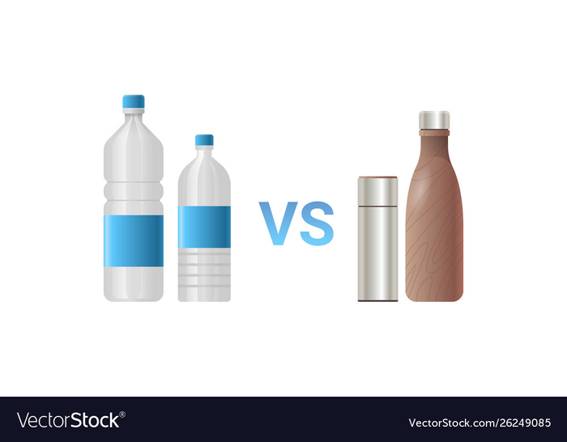
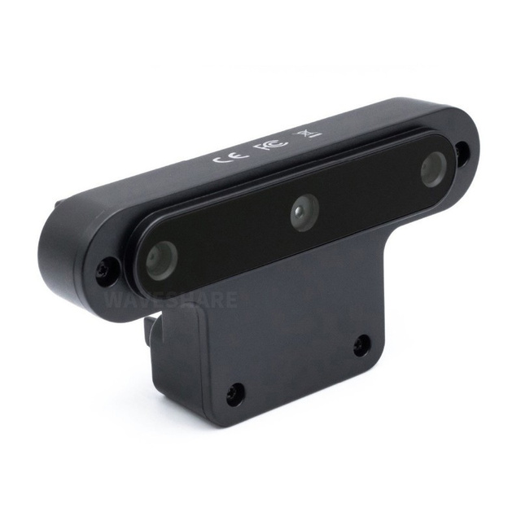
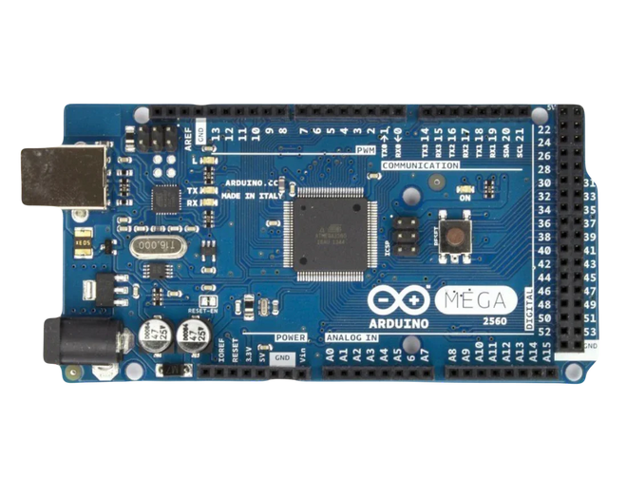
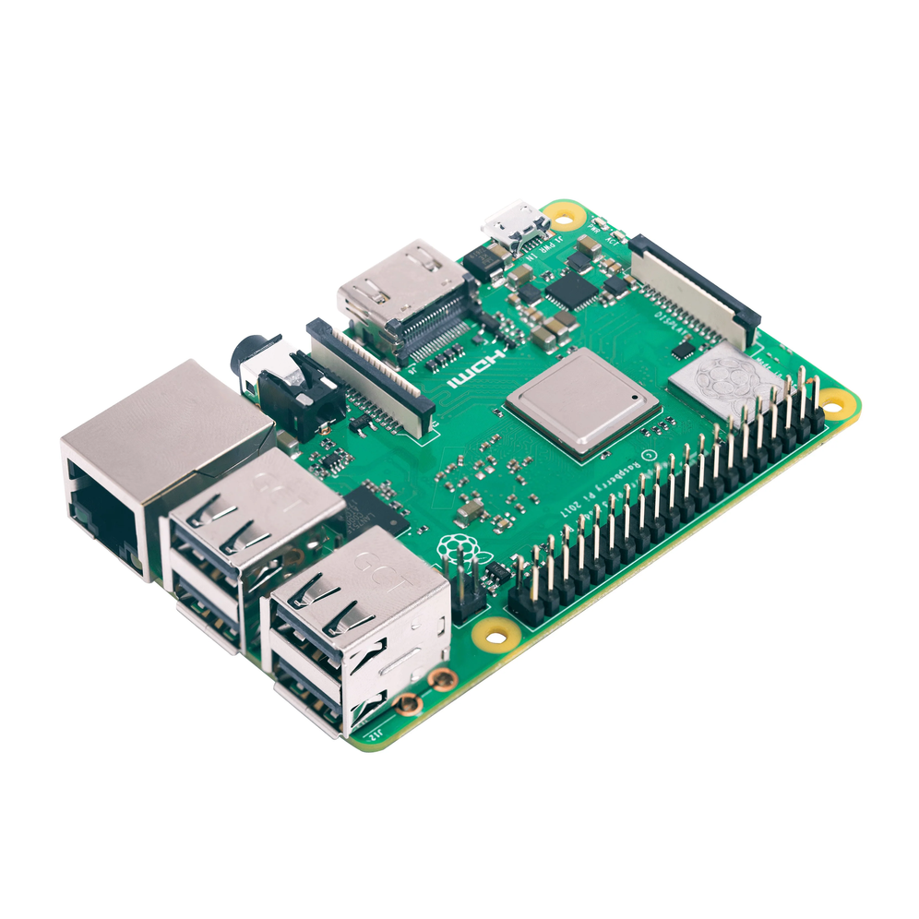
Methodology
2. Object Detection & Classification The OAK-D camera, coupled with a TensorFlow Lite model, is used for image processing and classification of bottles. The robot identifies whether a bottle is plastic or metal based on visual characteristics. A Python-based script runs on a Raspberry Pi, sending a signal ('G' for recyclable or 'N' for non-recyclable) to the Arduino controller based on the classification.

Slide 6
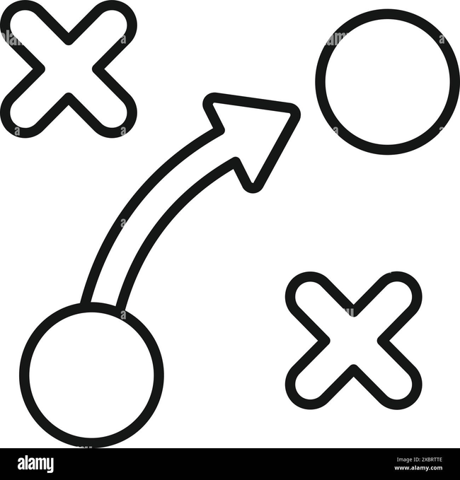
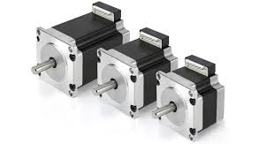
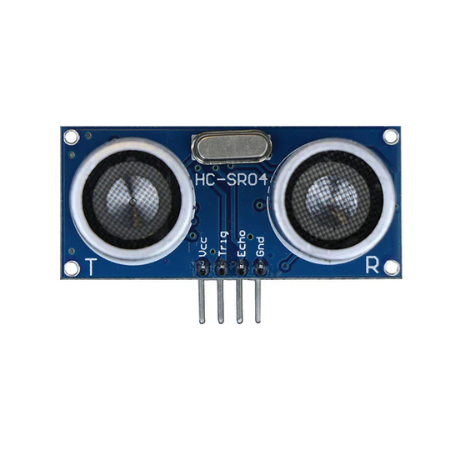
Methodology
3. Robot Control & Movement
The robot uses stepper motors to control its movement. Two motors are used for forward and backward motion, while one is used for turning. Ultrasonic sensors are employed to detect obstacles, stopping the robot when an object is within 20 cm.

Slide 7

Methodology
4. Arm Mechanism for Sorting
The robotic arm consists of two axes controlled by stepper motors and a servo motor for the gripper. The arm picks up the detected bottles, then sorts them into designated bins (plastic or metal) using another servo-controlled basket. The movement and sorting are triggered based on the signal received from the classification module.

Slide 8
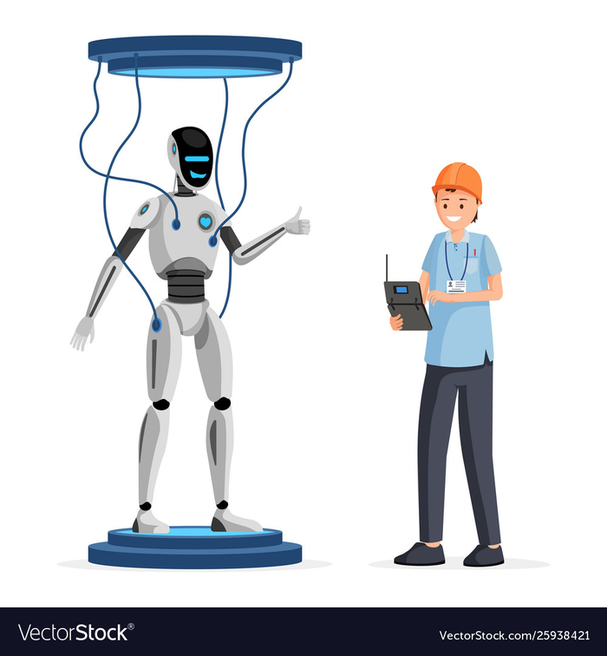
Methodology
5. Testing & Calibration
Continuous testing was carried out to refine the accuracy of object detection, motor coordination, and sorting operations. Calibration of the camera and sensors ensured reliable performance, especially in real-world conditions.

Slide 9
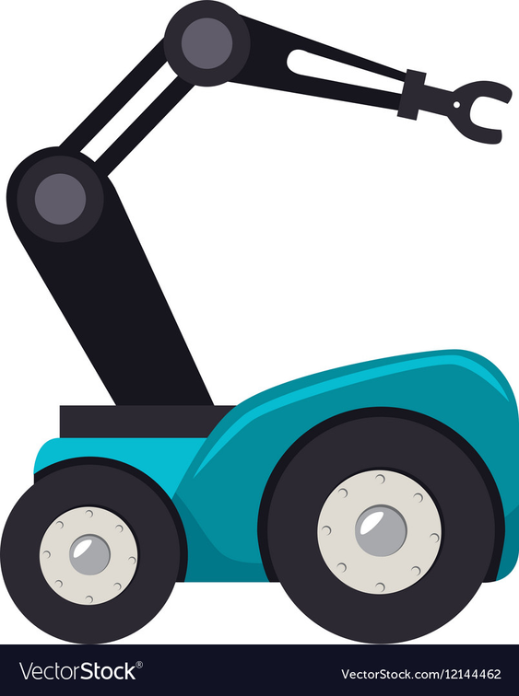
Methodology
6. Integration & Final Assembly
After successful testing, all components were integrated into a single, fully functioning system. Hardware, including the robotic arm and sensors, was securely assembled, and the software was synchronized to ensure smooth coordination between detection, movement, and sorting operations.

Slide 10
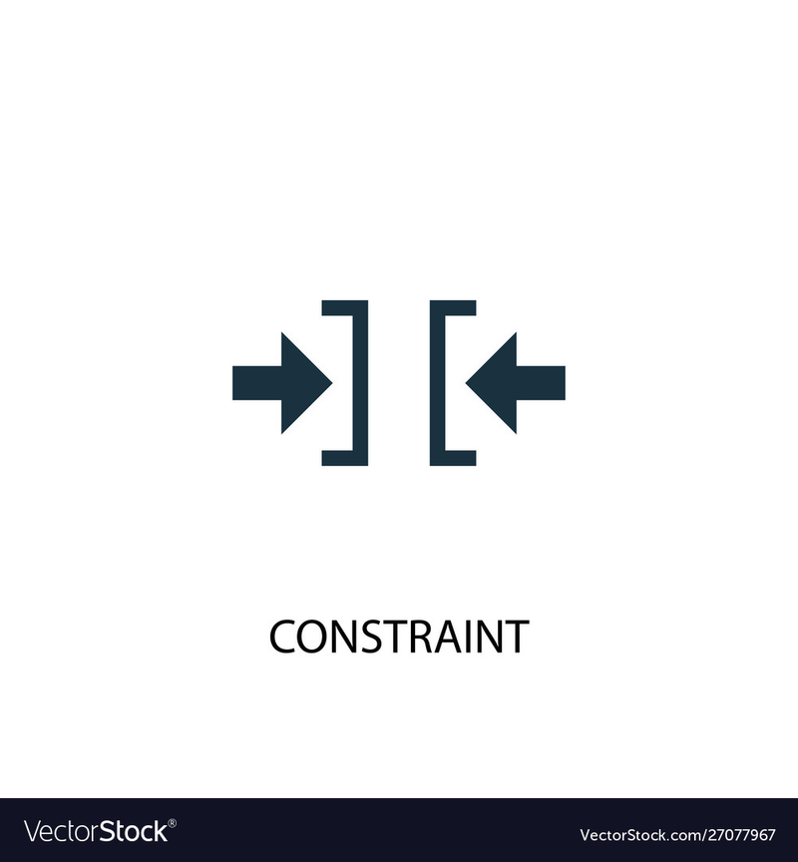
Constraints
AI model accuracy
Environmental factors
Low sensor accuracy
Overweight robot
Sudden component crashes

Slide 11

Future Work:
Scale system for larger waste volumes and complex environments
Expand material recognition capabilities
Deploy in real-world scenarios for practical testing and performance evaluation
Implement manual mode controlled by an app

Slide 12
Thank You
ENJOY WATCHING THE ROBOT IN ACTION

Slide 13
Questions
Feel free to ask if you have any questions.

