Slide 1
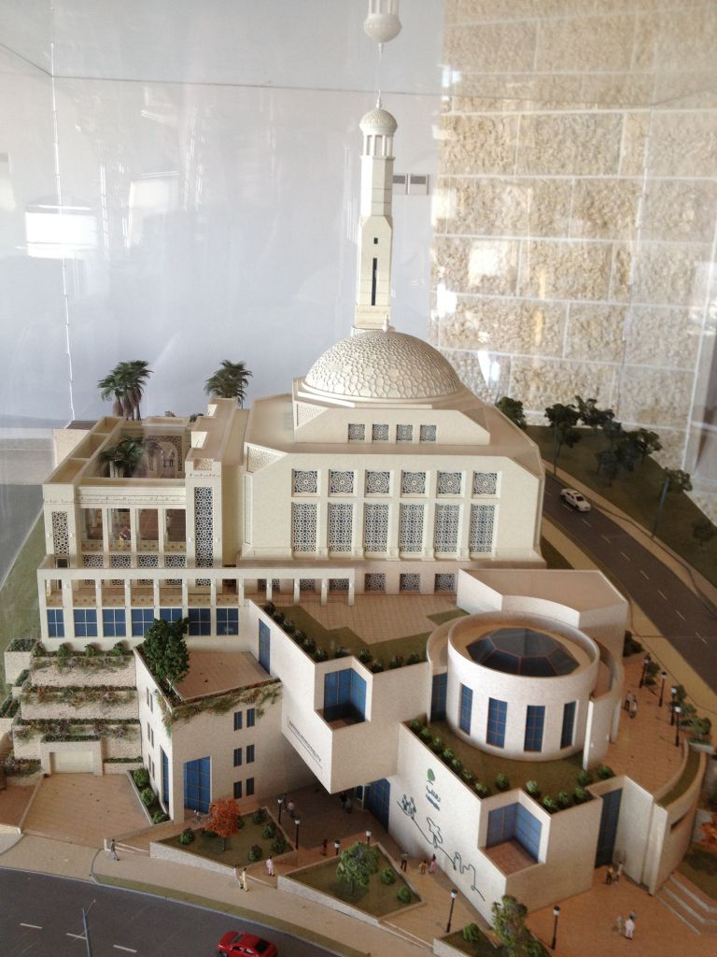
3D Seismic Design Of Mosque and Municipality of
Rawabi City
Prepared By : Noorah Ismail
Dana Nassar
Saja Abu Thraa
Samah Hindeya
Under Supervision of: Monther Thiab
2018-2019

Slide 2
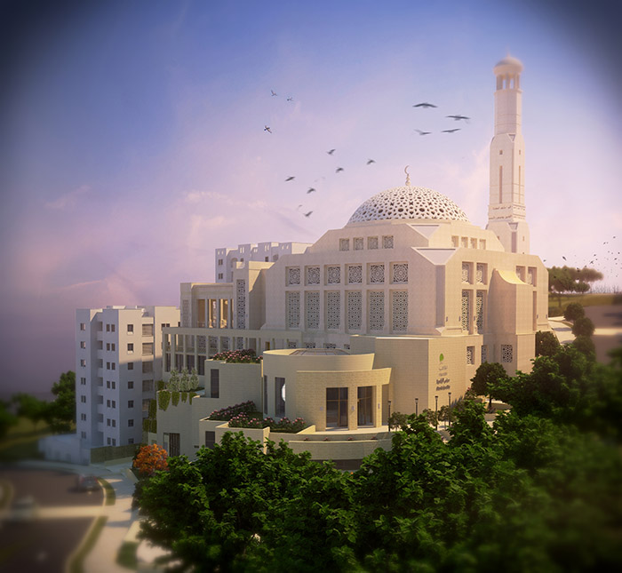
Structural Analysis and Design of
Mosque and Municipality of
Rawabi City under
Seismic load

Slide 3
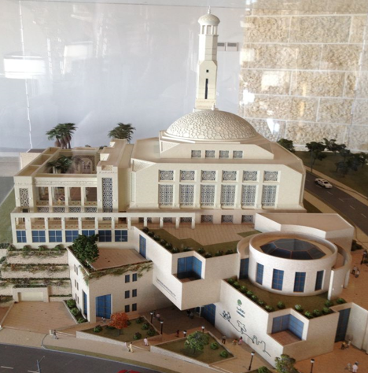
Outline
1 Project description
2 Seismic Design Parameters
3 Challenges
4 Model Checks
5 Structural Element Design
6 Footing Design
7 Stairs Design
8 Dome Design
9 Recommendations

Slide 4
Project Description
The project is located in Rawabi which is far 9 Km north of Ramallah
It consists of two blocks separated by seismic joints
Block A and Block B consist of six floors include the basement
Total Building Area = 12548.6m²
We design the two Blocks A & B

Slide 6
Loads
Loads
Gravity
Dead
Live
Lateral
seismic
wind

Slide 7
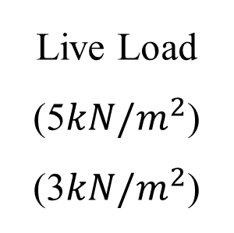
Load Types
Live Load
(5$kN/m^{2}$)
(3$kN/m^{2}$)
Super imposed dead loads
(3 KN/m2)
GF & BF Mosque
Gravity Loads
Barking Floors in Mosque
Mosque Floors
Municipality Floors
Municipality Floors

Slide 8
The Codes Used in This Project
The Codes used in this project are the following :
1
  ACI 318-14 (American Concrete Institute)
2
  UBC 1997 (Uniform Building Code)
3
  ASCE-7 (2010)

Slide 9
Materials Types
Concrete
Structural element | Compressive strength(fc’) (MPa)
Slab, beam | 24
Column, footing, shear wall, Stair | 28
Reinforcement Steel
Yielding strength (Fy) = 420MPa
Modulus of elasticity (Es) = 200GP

Slide 10
Material
Materials Unit Weight
Material | Unit weight, γ (KN/m³)
Plain concrete | 23
Reinforced concrete | 25
Tiles | 26
Filling material | 23

Slide 11
Structural System Type
Building frame system
Intermediate concrete shear walls

Slide 12
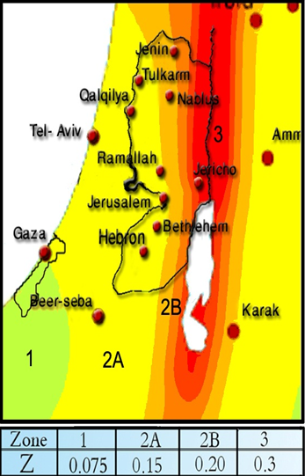
Seismic Design Parameters
For Ramallah City, seismic zone is 2A
Seismic zone factor, Z = 0.2
Importance Factor , I = 1.25
  Over strength factor, R = 5.5
 | Block 1 | Block 2
Soil type | SC | SC
Ca | 0.18 | 0.18
Cv | 0.25 | 0.25

Slide 13
Load Combinations
The Ultimate load combinations used in design
  1.4D
1
  1.2D + 1.6L
2
3
  1.2D + 1.0L + 1.0E
4
  1.2D + 1.6L + 0.5(Lr or S or R)
  0.9D + 1.0E
5

Slide 14
Load Combinations
The service load combinations used in checks are
  D
1
  D +L
2
3
  D +0.75L +0.75(0.7E)
4
  D +0.7E
  0.6D+0.7E
5

Slide 15
Computer programs
ETABS
Word and Excel
AutoCAD
SAFE
SAP
2000

Slide 16
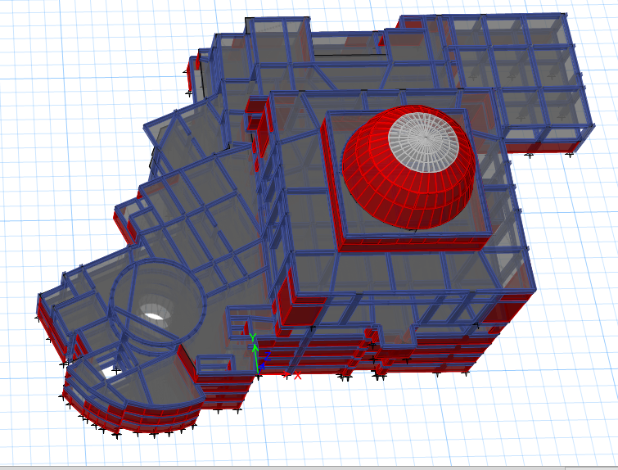
Challenges
First challenge
irregularity and discontinuity
of the vertical
structural element

Slide 17
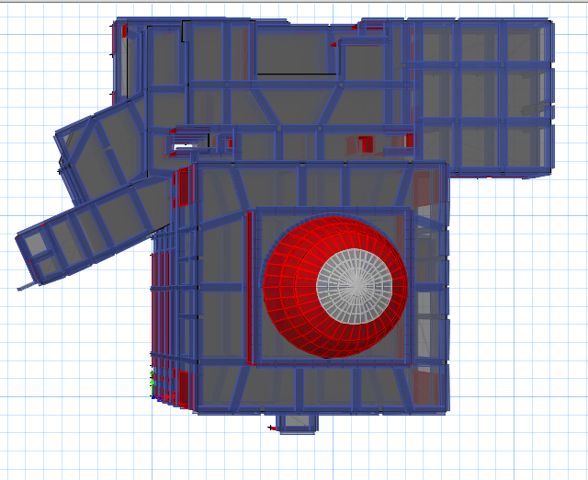
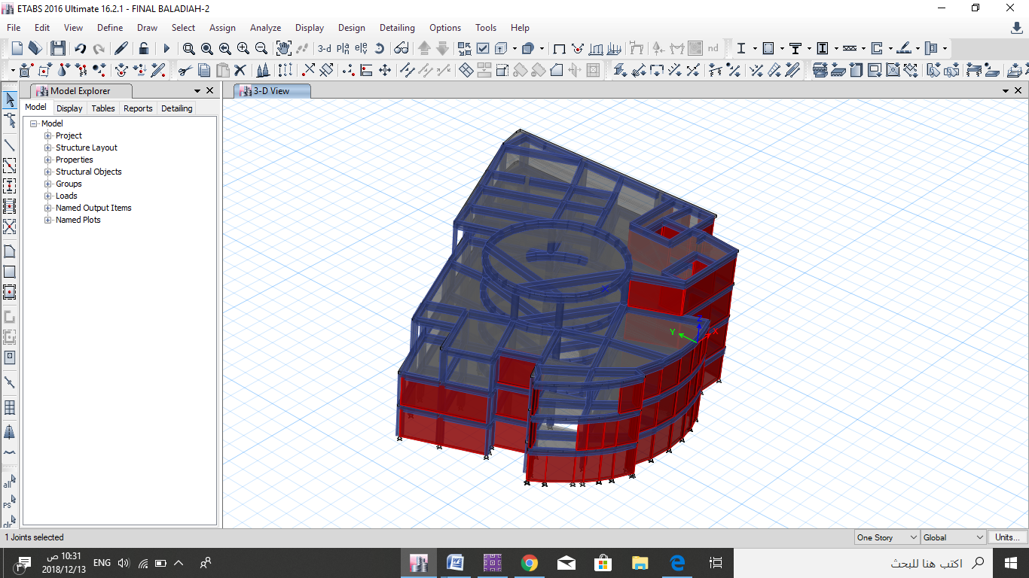
Challenges
Block 1
Block 2

Slide 18
Challenges
Model Name | Period | Mode
Together Model | 0.422 | Mode 106
Mosque Model | 0.421 | Mode 98
Municipality Modal | 0.331 | Mode 6

Slide 19
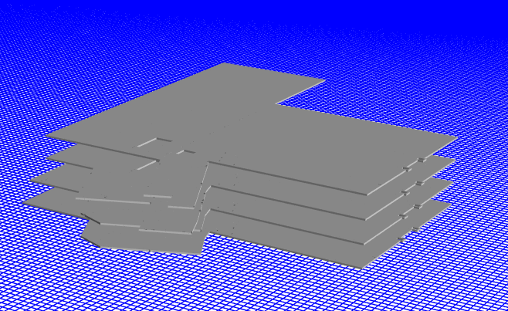
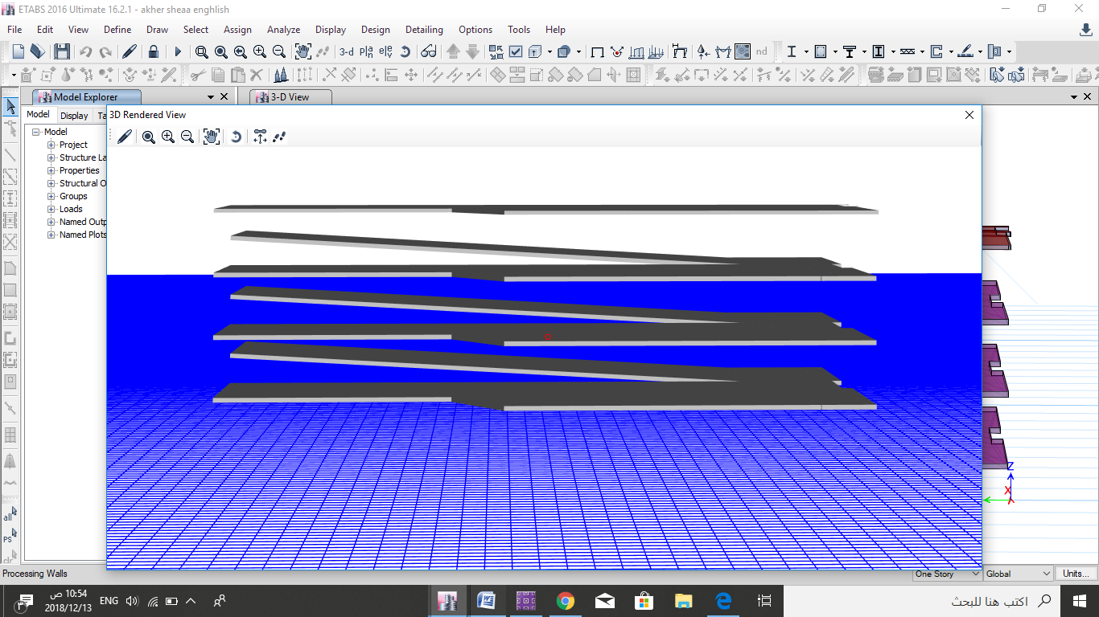
Second Challenge
Inclined surfaces (slabs) with drop beams structures are often highly differentiated

Slide 20
Comparison between inclined and flat mosque
Model Name | Period
Flat slab mosque | 0.421
Inclined - slab mosque | 0.382
Model Name | Flat slab mosque |  | Inclined slab mosque
Axial Force | Beam | Column | Beam | Column
 | 00.00 | 1961 | 30.08 | 2434
Shear Force | 106.7 | 15.3 | 40.7 | 79.83
Moment Force | 116.98 | 27.6 | 68.6 | 575.23

Slide 21
Inclined
Decrease in moment
Increase in axial
Why ?

Slide 22
Inclined
Increase in moment
Increase in axial
Why ?

Slide 23
ETABS Model Checks
Compatiity
Equilibrium
Base Shear
Participating mass ratio
Drift
Checks
Period

Slide 24
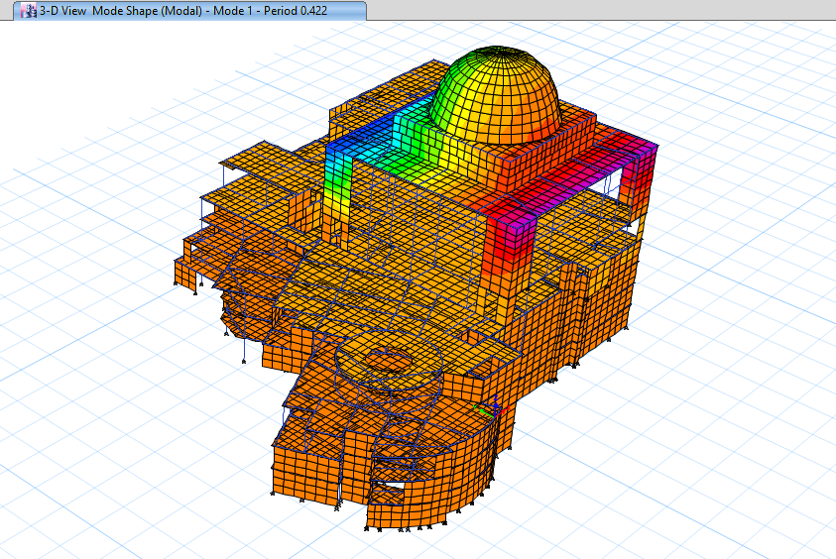
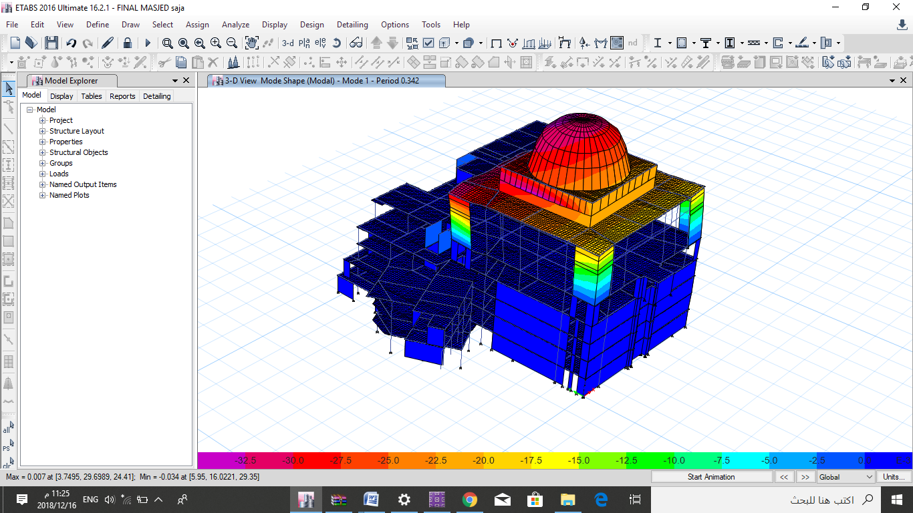
ETABS Model Checks
1 Compatibility

Slide 25
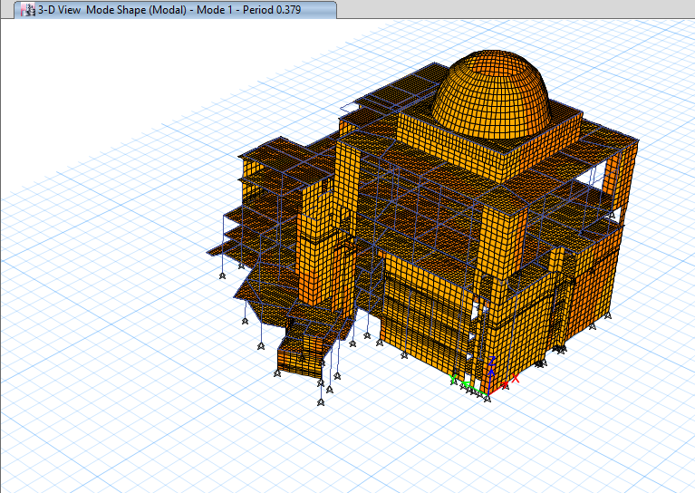
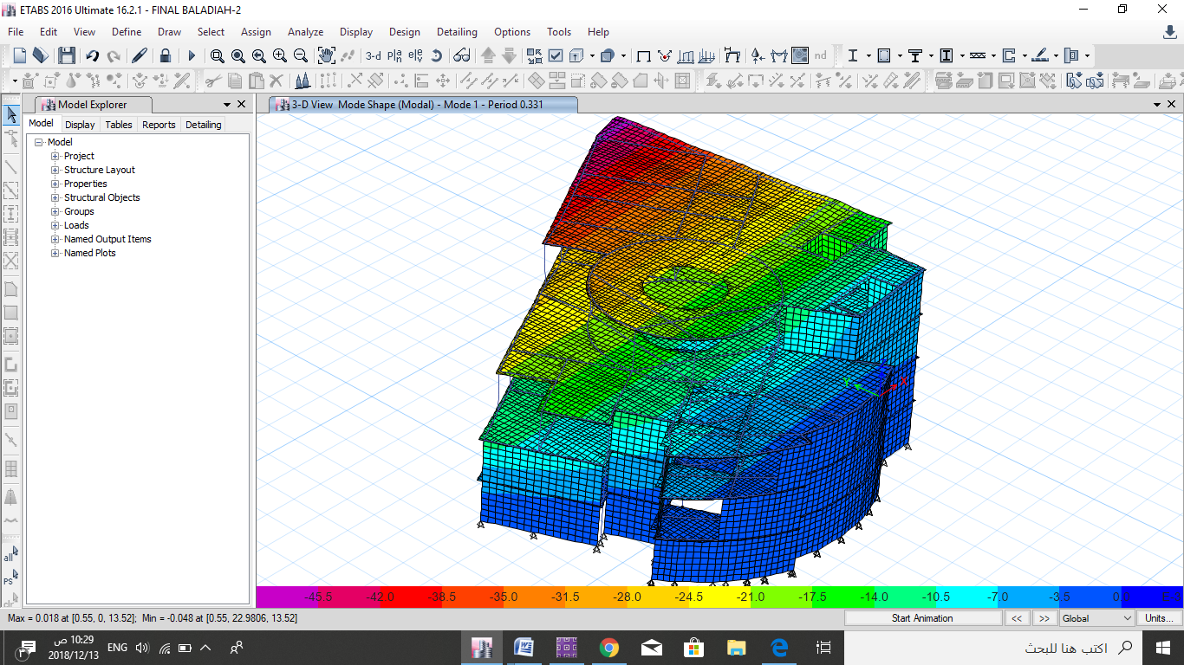
ETABS Model Checks
1 Compatibility

Slide 26
ETABS Model Checks
2 Equilibrium
Together
TABLE: Base Reactions
Load Case | Fz ETABS (kN) | Manually (kN) | %Difference
Dead | 145374.4338 | 140050.02 | 3.65
Live | 45520.6815 | 455776.06 | 0.12
SID | 32542.7373 | 32575.94 | 0.1

Slide 27
ETABS Model Checks
2 Equilibrium
Ibraheem AL-Khalil Flat Mosque
TABLE: Base Reactions
Load Case | Fz ETABS (kN) | Manually (kN) | %Difference
Dead | 12448.1237 | 12225.23 | 1.80
Live | 33362.743 | 33311.95 | 0.037
SID | 26141.2487 | 26100.51 | 0.0043

Slide 28
ETABS Model Checks
2 Equilibrium
Ibraheem AL-Khalil Inclined Mosque
TABLE: Base Reactions
Load Case | Fz ETABS (kN) | Manually (kN) | %Difference
Dead | 129322.04 | 128546.7 | 1.39
Live | 33362.7417 | 35788.1 | 8.9
SID | 26141.2474 | 28722.08 | 6.7

Slide 29
ETABS Model Checks
2 Equilibrium
Rawabi Municipality
TABLE: Base Reactions
Load Case | Fz ETABS (kN) | Manually (kN) | %Difference
Dead | 26543.9471 | 25600.24 | 3.55
Live | 10924.11 | 11021.4 | 0.72
SID | 6565.265 | 6612.84 | 0.72

Slide 30
ETABS Model Checks
3 Period
TABLE: Period
Model Name | Period | Ta | 1.55*Ta | Period <1.55*Ta
Together | 0.422 | 0.764 | 1.184 | OK
 | 0.421 | 0.764 | 1.184 | OK
 | 0.379 | 0.764 | 1.184 | OK
 | 0.331 | 0.344 | 0.5332 | OK
Ibraheem AL-Khalil Flat Mosque
Ibraheem AL-Khalil Inclined Mosque
Rawabi Municipality

Slide 31
ETABS Model Checks
4 Participating mass ratio
TABLE: Period
Model Name |  | Mode Number
Together | 0.9105 | 106
 | 0.9495 | 98
 | 0.9124 | 109
 | 0.9632 | 6
Participating mass ratio
Ibraheem AL-Khalil Flat Mosque
Ibraheem AL-Khalil Inclined Mosque
Rawabi Municipality

Slide 32
ETABS Model Checks
5 Base Shear
TABLE: Base Shear
Model Name | V | Fx | Fy | V< Fx &Fy
Together | 18196 | 26869.6176 | 21776.6598 | OK
 | 14601 | 20214.2717 | 15437.5332 | OK
 | 16419.41 | 28706.5335 | 29216.3578 | OK
 | 3295 | 3492 | 4193.376 | OK
Ibraheem AL-Khalil Flat Mosque
Ibraheem AL-Khalil Inclined Mosque
Rawabi Municipality

Slide 33
ETABS Model Checks
6 Drift
TABLE: Period
Model Name | Drift Manual | Drift Etabs X | Drift Etabs Y | V< Fx &Fy
Together | 99 | 1.19E-18 | 1.19E-18 | OK
 | 99 | -7.80626E-18 | 1.19262E-18 | OK
 | 84.5 | 8.67362E-19 | 6.07153E-18 | OK
 | 84.5 | 0.001513 | 0.00087395 | OK
Ibraheem AL-Khalil Flat Mosque
Ibraheem AL-Khalil Inclined Mosque
Rawabi Municipality

Slide 34
Inclined
Flat slab model | Inclined slab model
600*600 | 800*800
400*400 | 600*600
300*400 | 600*600
300*600 | 600*600
300*800 | 450*800

Slide 35
Members
Slabs
Shear walls
Beams
Columns
Staircase
Footing

Slide 36
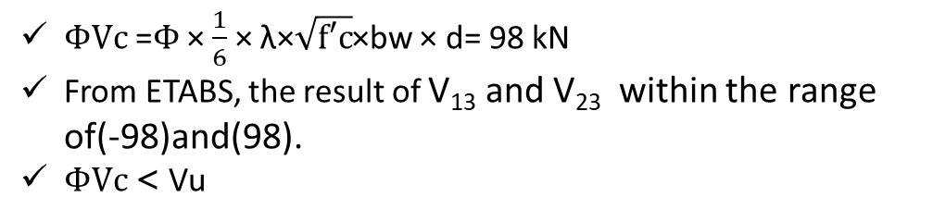
Design and Detailing
Slab Design
Check wide beam shear
$ΦVc$ =$Φ$ × $\frac{1}{6}$ × λ×$\sqrt{f′c}$×bw × d= 98 kN
From ETABS, the result of V₁₃ and V₂₃ within the range of(-98)and(98).
$ΦVc$< Vu

Slide 37
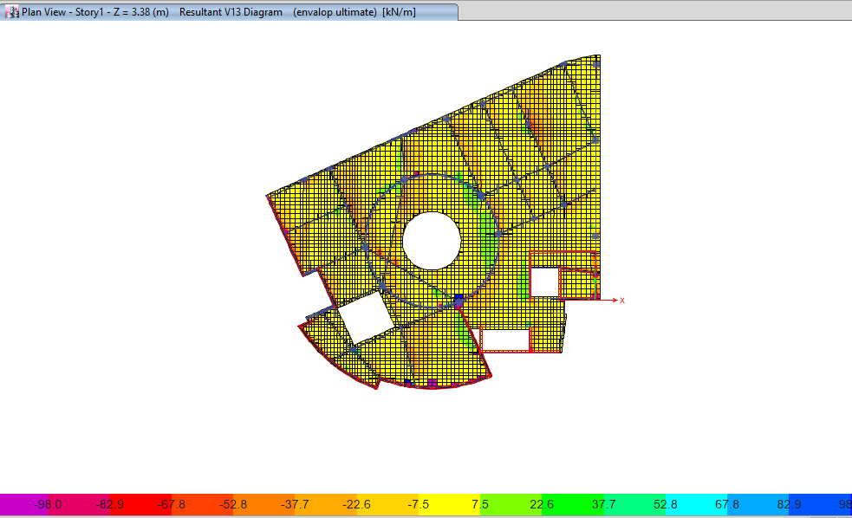

Slide 38
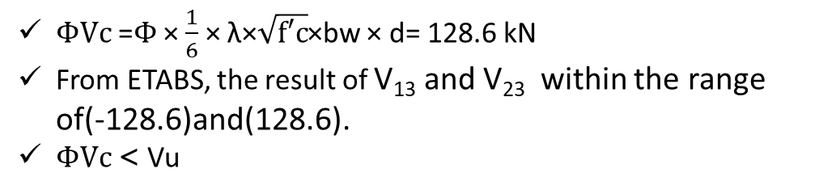
Design and Detailing
Slab Design
Check wide beam shear
$ΦVc$ =$Φ$ × $\frac{1}{6}$ × λ×$\sqrt{f′c}$×bw × d= 128.6 kN
From ETABS, the result of V₁₃ and V₂₃ within the range of(-128.6)and(128.6).
$ΦVc$< Vu

Slide 39
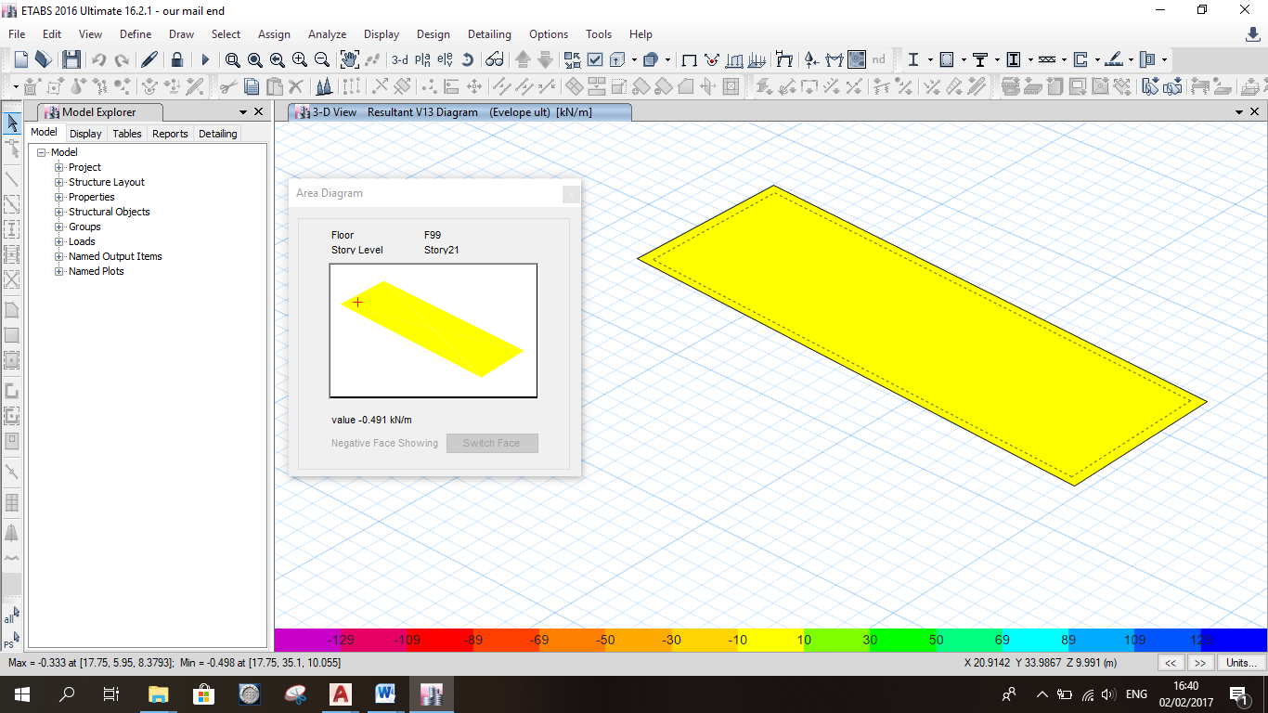

Slide 40
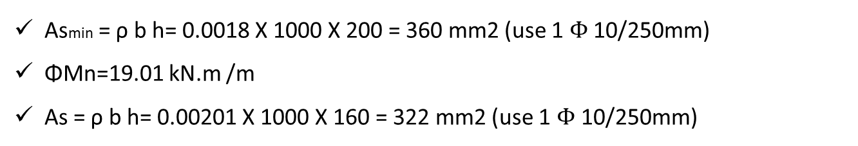
Design and Detailing
Slab Design
Design the slab for flexure
Asmin = ρ b h= 0.0018 X 1000 X 200 = 360 mm2 (use 1 $Φ$ 10/250mm)
ΦMn=19.01 kN.m /m
As = ρ b h= 0.00201 X 1000 X 160 = 322 mm2 (use 1 $Φ$ 10/250mm)

Slide 41
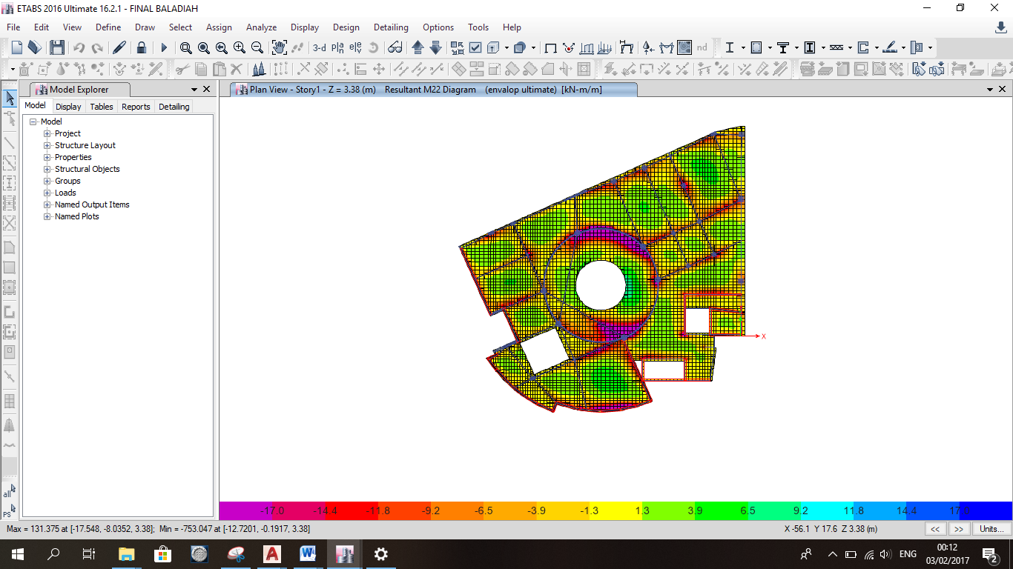

Slide 42
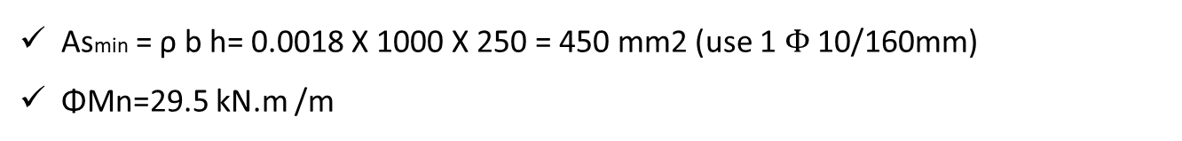
Design and Detailing
Slab Design
Design the slab for flexure
Asmin = ρ b h= 0.0018 X 1000 X 250 = 450 mm2 (use 1 $Φ$10/160mm)
ΦMn=29.5 kN.m /m

Slide 43
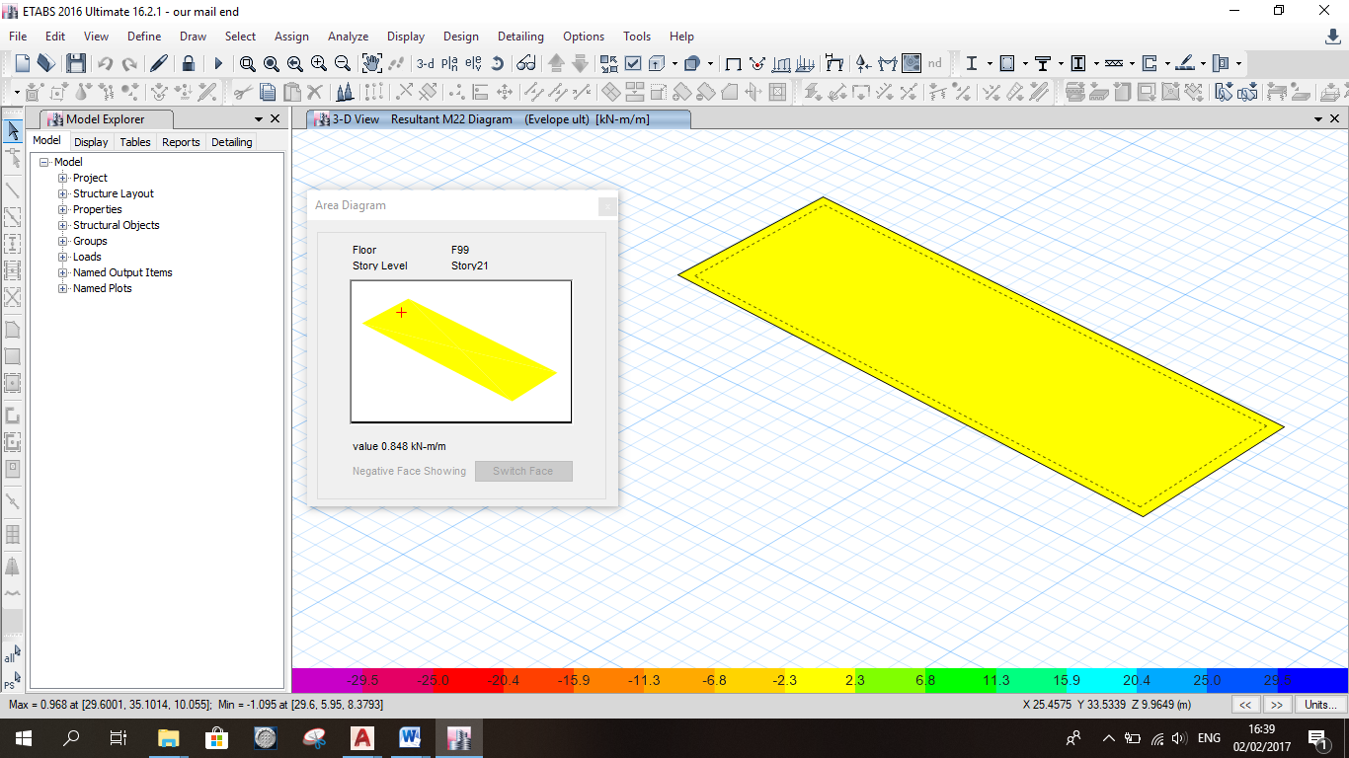

Slide 44
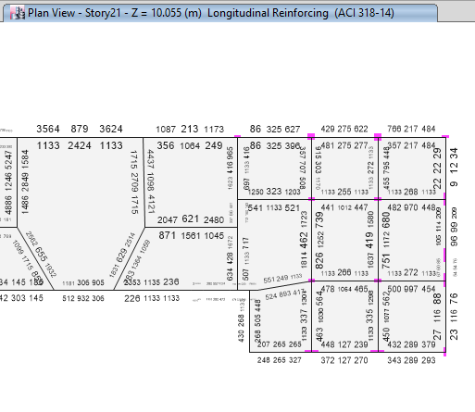
Design and Detailing
Beam Design

Slide 45

Design and Detailing
Longitudinal bar for beam
1000*400
Type | Al (mm²) | AL (torsion) | Main area steel | φ | NO. of bars
Top steel in right side | 1133 | 0 | 1332 | 16 | 6
Top steel in left side | 1133 | 0 | 1332 | 16 | 6
Bottom steel | 1064 | 0 | 1332 | 16 | 6

Slide 46

Design and Detailing
Shear reinforcement for beam
1000*400
Av/s | At/s | Av+t/s | (Av+t/s) min | adjusted (Av+t/s) | Ø , ( Av+t) | S | S max | adjusted S | final s
0 | 0 | 0 | 0.0 | 00 | 12,(2*78.5) | - | 180 | - | 2Ø10/200

Slide 47
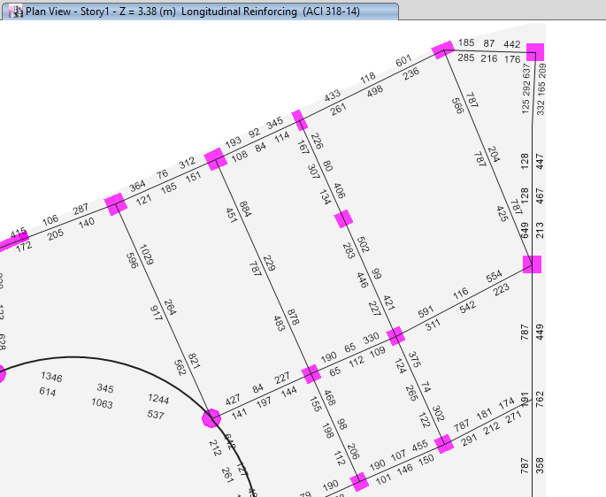
Design and Detailing
Beam Design

Slide 48
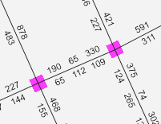
Design and Detailing
Longitudinal bar for beam
1000*400
Type | Al (mm²) | AL (torsion) | Main area steel | φ | NO. of bars
Top steel in right side | 330 | 0 | 1332 | 16 | 6
Top steel in left side | 190 | 0 | 1332 | 16 | 6
Bottom steel | 112 | 0 | 1332 | 16 | 6

Slide 49
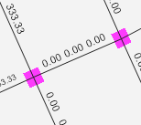
Design and Detailing
Shear reinforcement for beam
1000*400
Av/s | At/s | Av+t/s | (Av+t/s) min | adjusted (Av+t/s) | Ø , ( Av+t) | S | S max | adjusted S | final s
0 | 0 | 0 | 0.0 | 00 | 12,(2*78.5) | - | 180 | - | 2Ø10/200

Slide 50
Design and Detailing
Column
Check for Slenderness
KL/r where :
L : length of column
R : radius of gyration =0.3*h for rectangular column
K : stiffness coefficient
R=0.3 X h = 0.3 X 0.4 = 0.12 m , L = 3.38 , K = 1
KL/r = 1 X 3.38/ 0.12 = 28 should be less than 34− 12 M11/M22
34− 12 M11= 31.68 > 28 , so is a short column
M22
Axial force in column=520.95kN
M22=2.7396kN.m
M33=14.1709kN.m

Slide 51
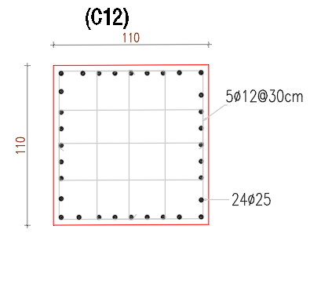
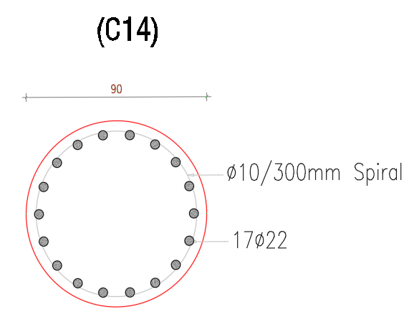
Design and Detailing
Column Reinforcement

Slide 52
Checks
Bearing capaciy
Shear capacity
Deflection

Slide 53
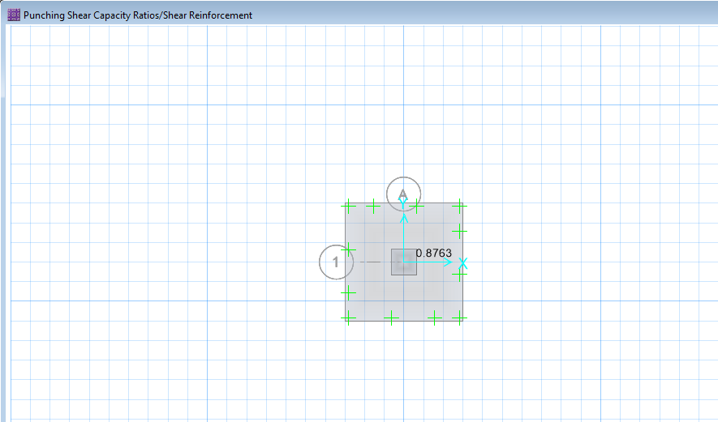
Design and Detailing
Footings Design
Check for Punching
Allowable displacement in the single foundation is10mm.
The maximum displacement of the footings joints is shown in figure and it is approximant equal 10mm… ok

Slide 54
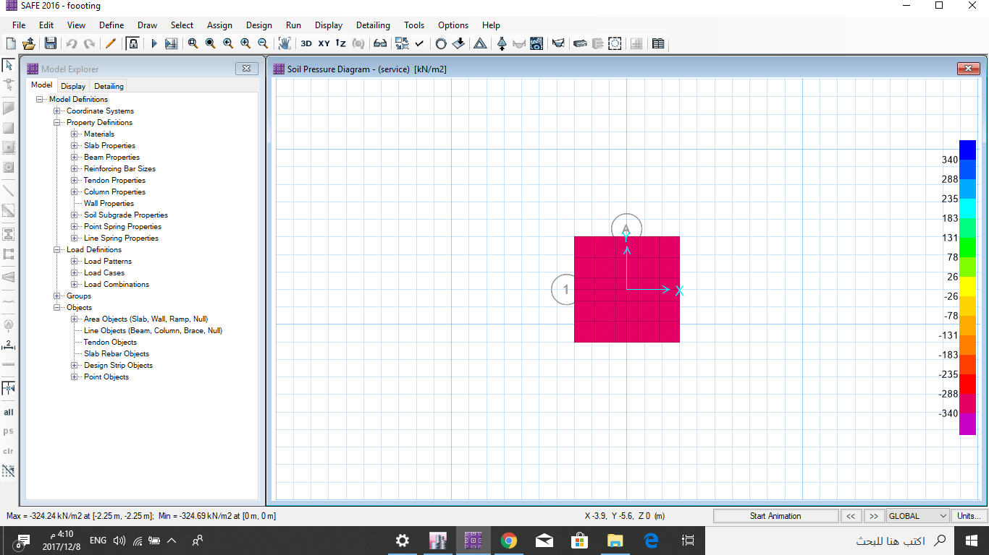
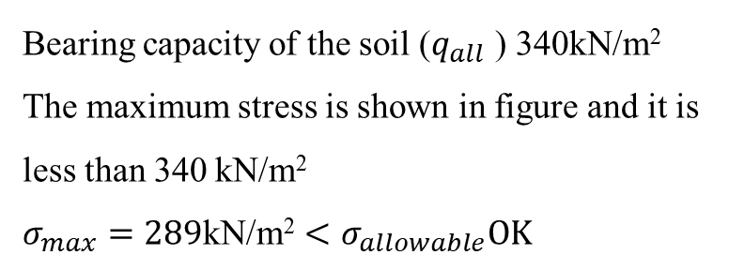
Design and Detailing
Footings Design
Check for soil pressure
Bearing capacity of the soil ($q_{all}$ ) 340kN/m²
The maximum stress is shown in figure and it is less than 340 kN/m²
$$σ_{max}=2\text{89}\text{kN}\text{/}\text{m}\text{2}<σ_{allowable}OK$$

Slide 55
Design and Detailing
Footings Design
F ID | Dimensions m*m | Depth mm | Thickness mm | Reinforcement X | Reinforcement y
F1 | 3.5*3.5 | 630 | 700 | 1 Ø16 mm/20cm | 1 Ø16 mm/20cm
F2 | 3*3 | 1070 | 1140 | 1 Ø16 mm/25cm | 1 Ø16 mm/25cm
F3 | 3*3 | 600 | 670 | 1 Ø16 mm/16cm | 1 Ø16 mm/20cm
F4 | 2*2 | 380 | 450 | 1 Ø16 mm/30cm | 1 Ø16 mm/30cm
F5 | 2*2 | 300 | 370 | 1 Ø16 mm/30cm | 1 Ø16 mm/30cm

Slide 56
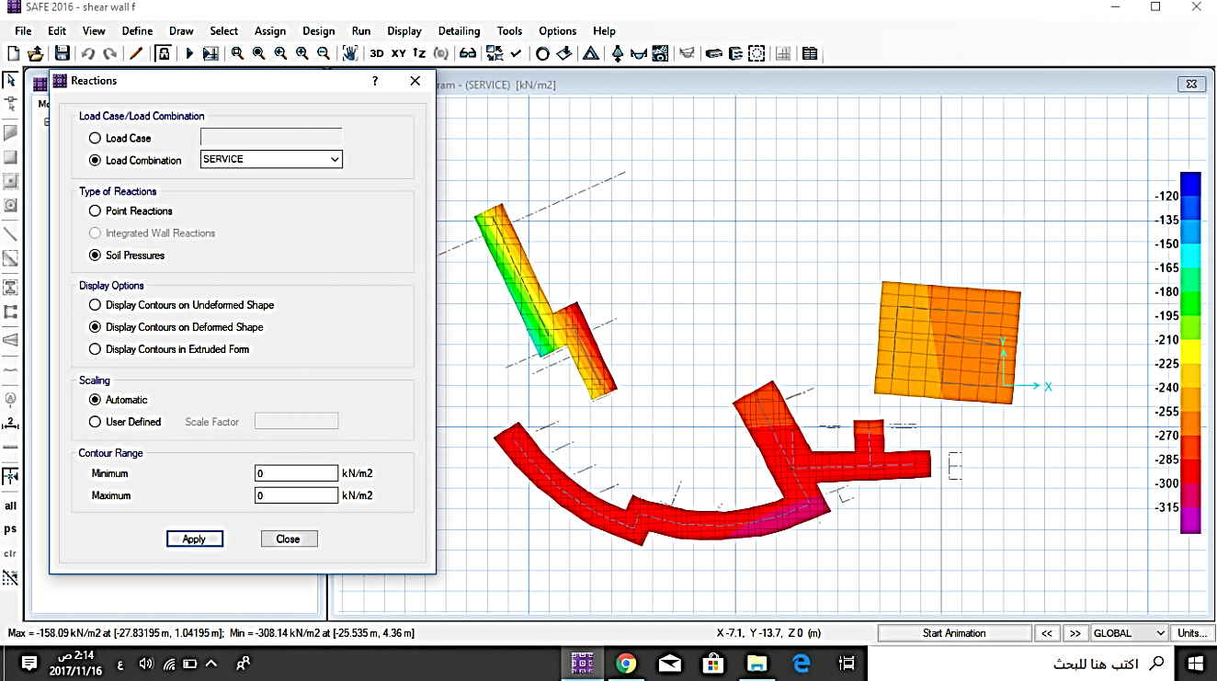
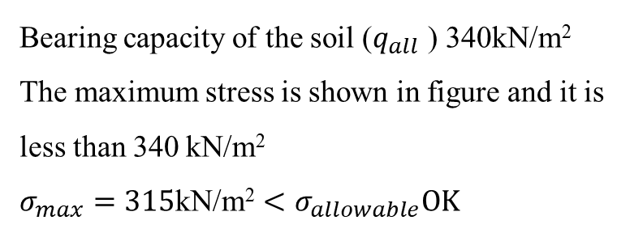
Design and Detailing
Footings Design
Check for soil pressure
Bearing capacity of the soil ($q_{all}$ ) 340kN/m²
The maximum stress is shown in figure and it is less than 340 kN/m²
$$σ_{max}=315\text{kN}\text{/}\text{m}\text{2}<σ_{allowable}OK$$

Slide 57
Checks
Deflection
Shear Checks

Slide 58
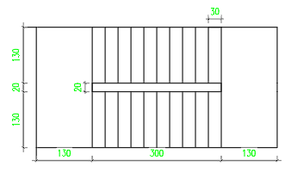
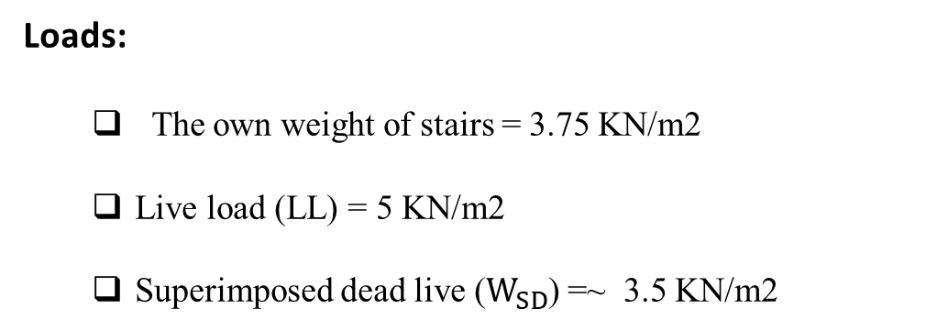
Design and Detailing
Slab Thickness
The thickness of stair slab is assumed based on ACI 318-11 ,which equal 150 mm (landing and flight)
Loads:
  The own weight of stairs = 3.75 KN/m2
  Live load (LL) = 5 KN/m2
  Superimposed dead live ($W_{SD}$) =~ 3.5 KN/m2

Slide 59
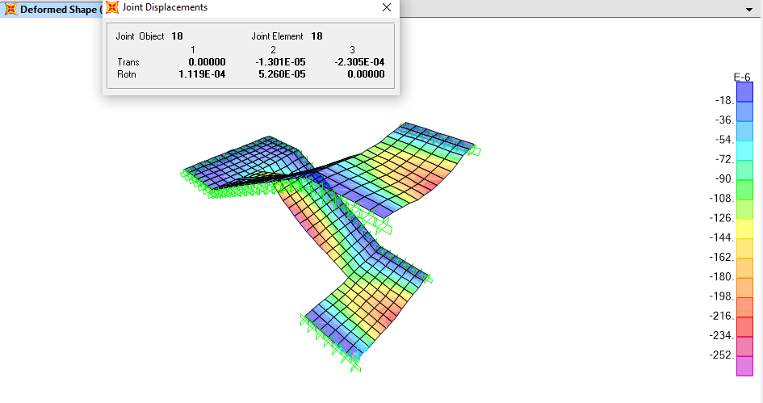
Design and Detailing
Check for Deflection
A𝑙𝑙𝑎𝑤𝑎𝑏𝑙𝑒 𝐿𝑜𝑛𝑔 𝑡𝑒𝑟𝑚 deflection, ∆𝐿/ 240≤ 12 mm
The long term deflection from SAP found approximately 0.23 mm
which means that is smaller than the allowable deflection
So, Its OK

Slide 60
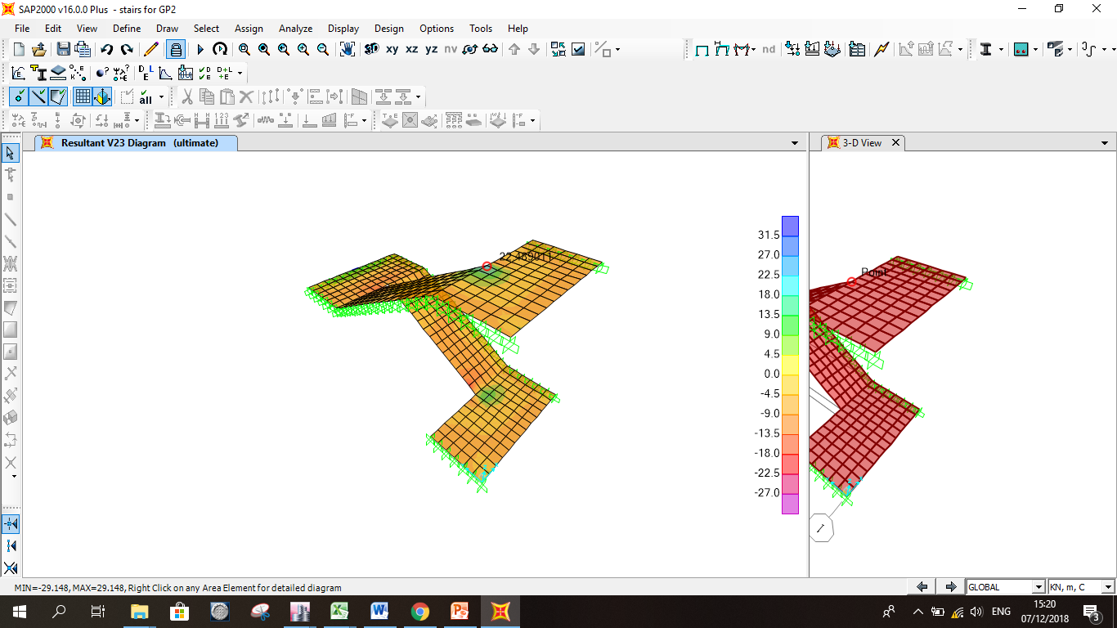
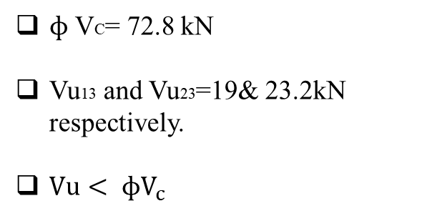
Design and Detailing
Check for shear
$ɸ$ VC= 72.8 kN
Vu13 and Vu23=19& 23.2kN respectively.
$Vu< ɸV_{c}$
So, The slab thickness is OK

Slide 61
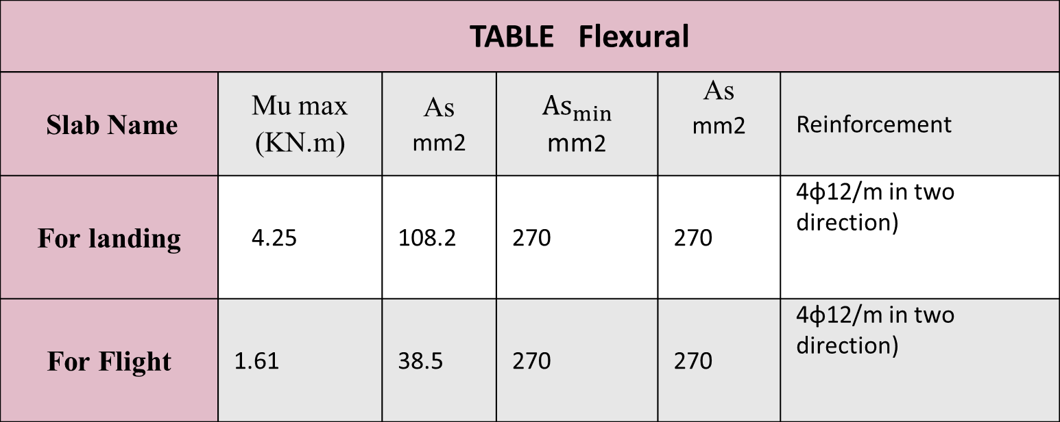
Design and Detailing
Design for flexural
TABLE Flexural
Slab Name | Mu max (KN.m) | As mm2 | $${As}_{min}$$ mm2 | As mm2 | Reinforcement
For landing | 4.25 | 108.2 | 270 | 270 | 4ɸ12/m in two direction)
For Flight | 1.61 | 38.5 | 270 | 270 | 4ɸ12/m in two direction)

Slide 62
Design and Detailing
Slab Thickness
The thickness of Dom slab is assumed to be equal 120 mm
Loads
  The own weight of Dom = 3 KN/m2
  Live load (LL) = 1.5 KN/m2

Slide 63
Design and Detailing
Calculation
TABLE: Gravity Projection
∅ | N∅ | Nϴ
0 | -11.595 | -11.6
79.47 | -19.6 | -15.36

Slide 64
Design and Detailing
Calculation
TABLE: Live Projection
R | N∅ | Nϴ
7.73 | -5.8 | -5.4

Slide 65
Design and Detailing
Design
ØP n= Øλ (0.85 fc` (Ag-As) + fy × As)
Ø = 0.65
λ=0.85
Ag = 120*1000
ØP n = 1485 KN >>N∅ ,Nϴ
Use min steel
As = 0.003*1000*120 = 360 mm2 1Ø12/250 mm

Slide 66
Design and Detailing
Special Shear Wall Design
TABLE: Reinforced shear wall
Model Name | Wall Thickness | L | Longitudinal |  | shear
 | 200 | 15 | 16419 | 1∅ 12 / 350 mm | 10950 | 1∅12 / 150 mm
 | 250 | 12 | 3676 | 1∅ 12 / 100 mm | 7500 | 1∅12 / 180 mm
 | 200 | 5 | 1896 | 1∅ 12 / 290 mm | 2500 | 1∅12 / 200 mm
 | 250 | 8 | 3325 | 1∅ 12 / 270 mm | 5000 | 1∅12 / 180 mm
 | 300 | 4 | 2488 | 1∅ 12 / 180 mm | 3000 | 1∅12 / 150 mm
Ibraheem AL-Khalil Inclined Mosque
Rawabi Municipality

Slide 67
Recommendations
For First Challenge
Based on the previous results which explained in presentation , which show the importance of separating this structure to reduce the irregularity of the building .
In general, we recommend to do the necessary analysis in the future projects which face like this challenge , and separating these structures depend on analysis studies .

Slide 68
Recommendations
For Second Challenge
we recommend designing inclined slabs with beams in structures
that contains parking floors ( Ramps) instead of horizontal – flat slabs structures , which reduce the internal forces of the structural elements such as beams.

