Slide 1
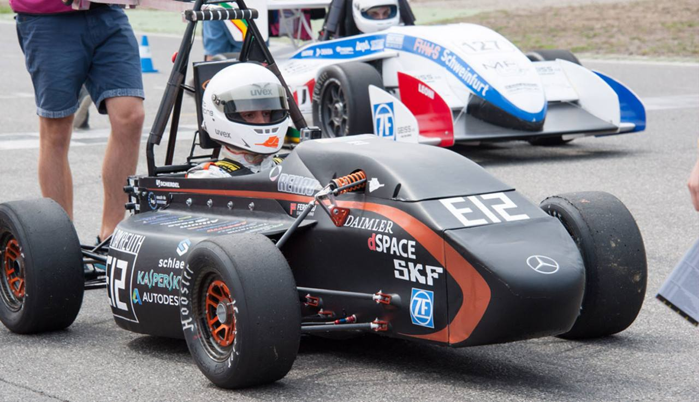
Formula Student SAE Car

Slide 2
The project aims to design and manufacture a small formula-style racecar, based on certain rules by a team of three groups (Powertrain group, Aerodynamics group and our group which is responsible for setting up and testing the car), at the first semester we designed and set up the chassis and installed the suspension system of the car, and in the second semester we continued working by collecting and installing the other parts of the car like (engine,wheels,drive shaft and the body of the car).

Slide 3
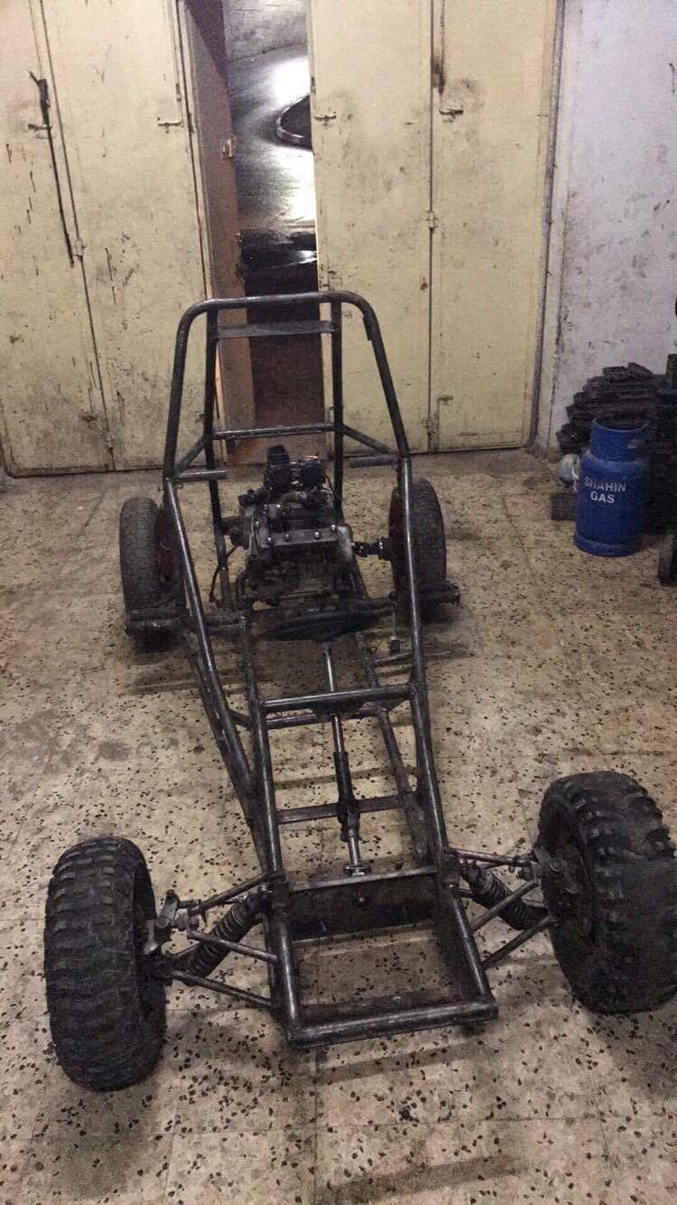
Specifications:
-The Weight of chassis 61 kg
34 mm and 28mm of out and inner radius
3 mm thickness
Steel iron.
The dimensions is:
250 cm long.
130 width .

Slide 4
The process in project 2
Assembly
Engine
Brake system .
Clutch
Gearbox to the wheels
Suspension system

Slide 5
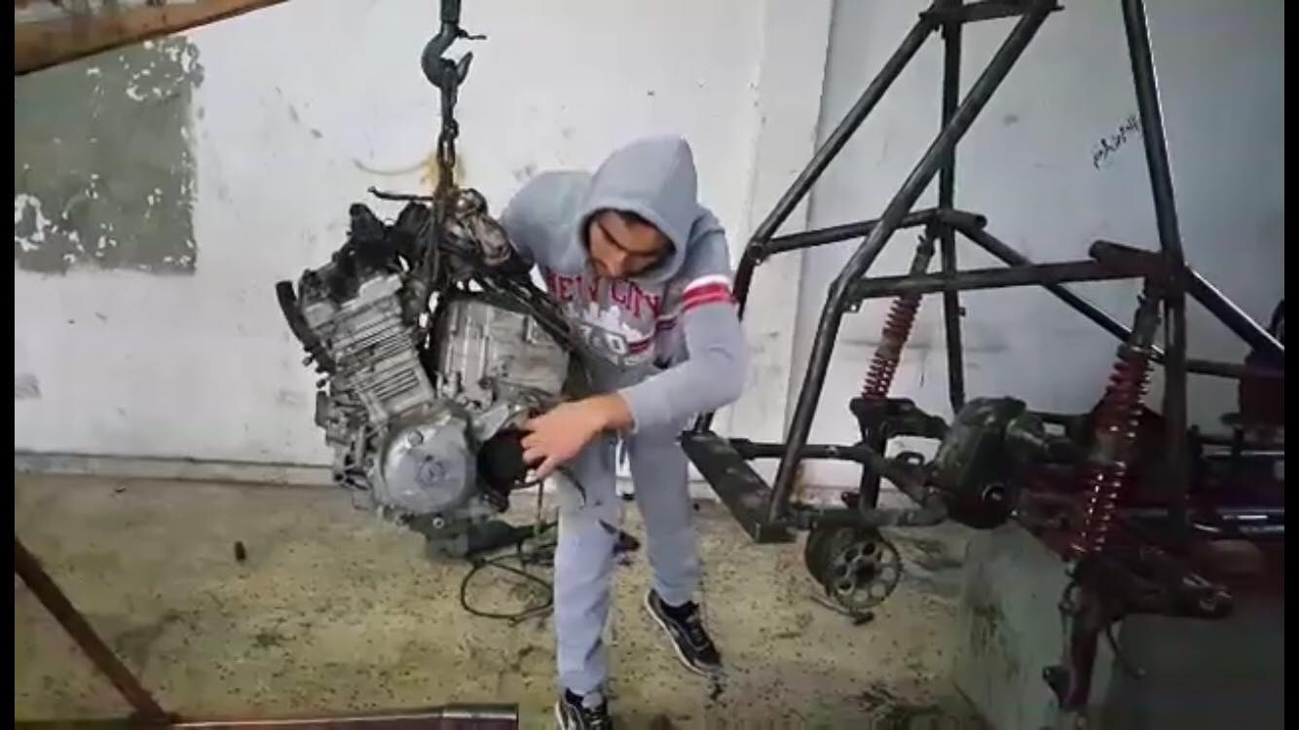
engine

Slide 6
Brake system
Brake Master Cylinder.
Drum
The brake shoes.

Slide 7
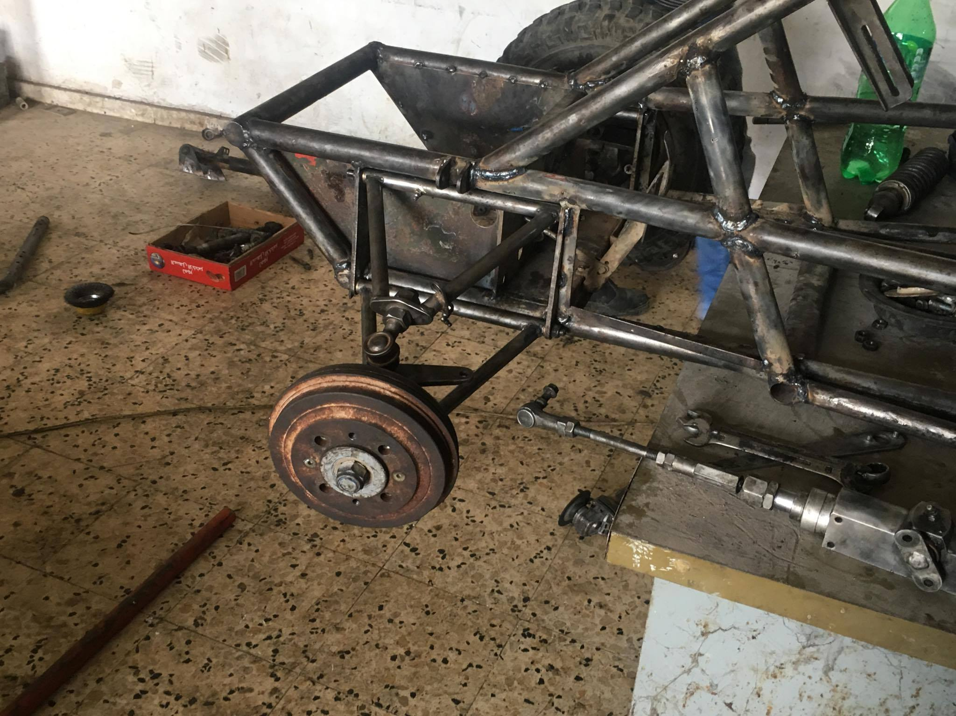
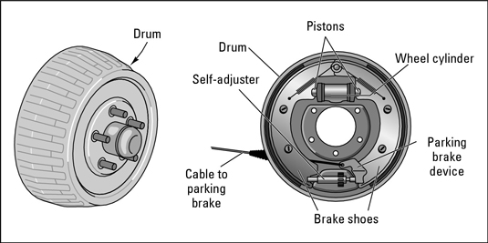
Brake system

Slide 8
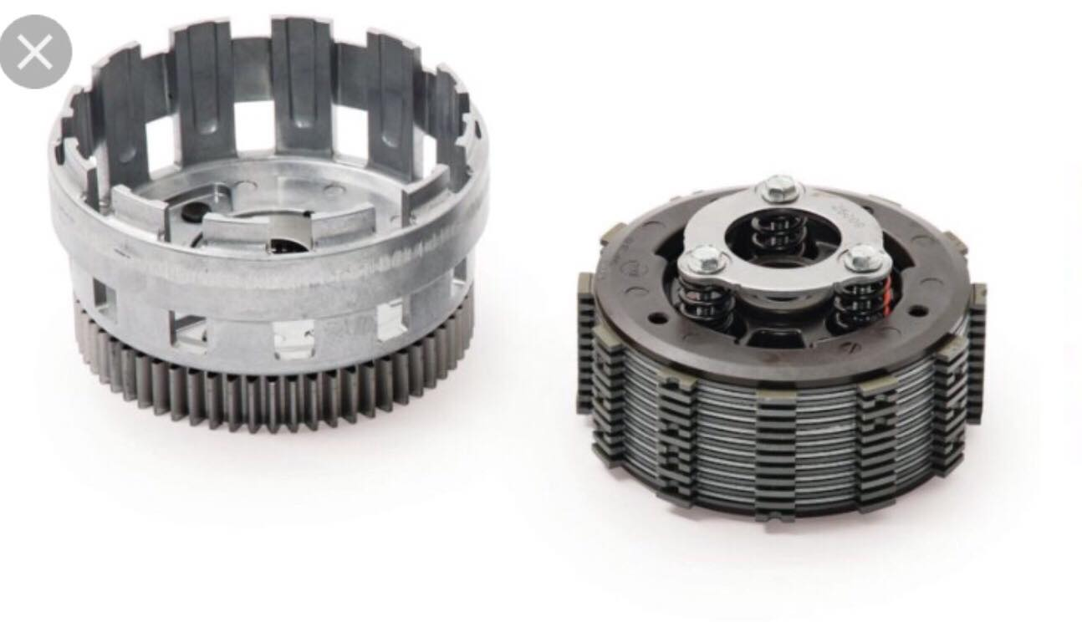
clutch

Slide 9
suspensions system
components :
Spring.
Damper.
Control Bushing arm.
Brake system .
Steering system.

Slide 10
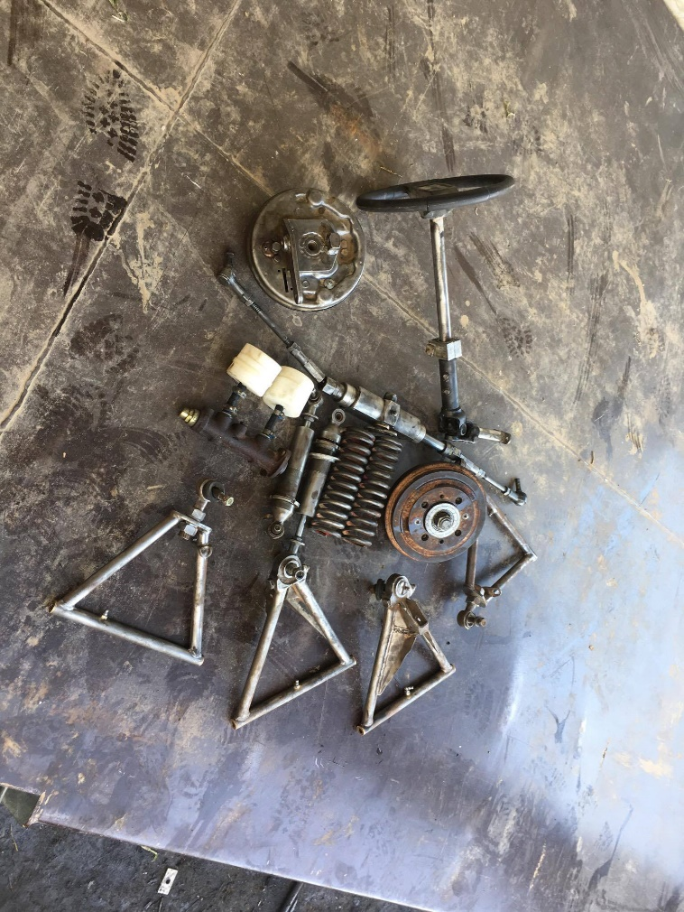
suspensions system
A system that connects the vehicle to it’s wheels and allows relative motion between the two.

Slide 11
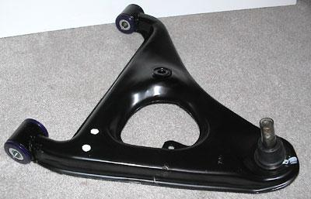
control Bushing arm
It connects the brake drum and the spring to the chassis .
Makes the car more stable and the wheels vertical.

Slide 12
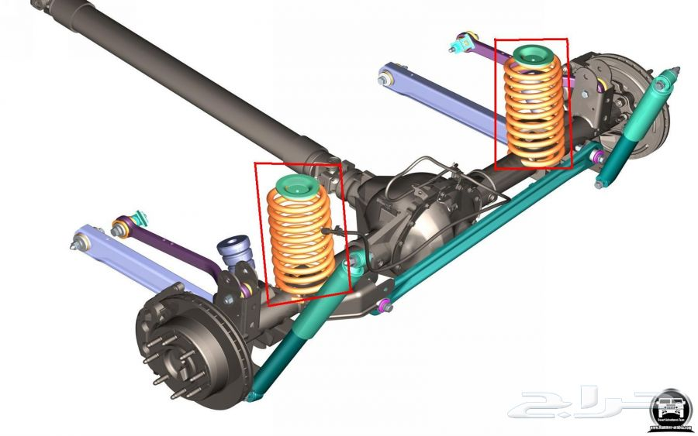
spring system
It connects the car with the wheels.
The springs are used to store energy that is caused by the shocks of the road. and makes the car stable .
The damper absorbs the shock and dissolves it.
The driver does not feel the vibration relatively because of springs .

Slide 13
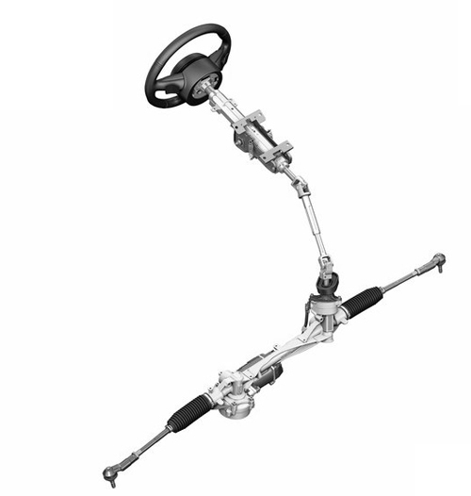
steering system
The main purpose of the steering system is to allow the driver to direct the vehicle.

Slide 14
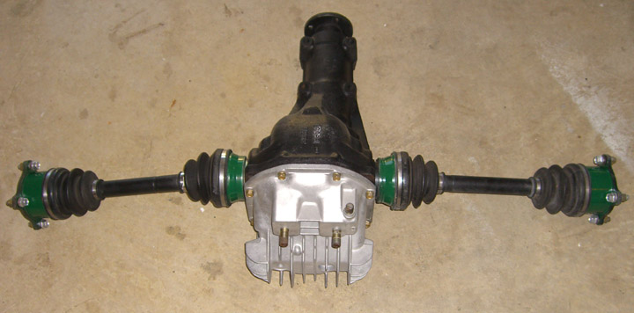
Back axle system
It is used to is transmit the movement from the gearbox to the wheels.
The axel is the Connection between the motor &gear.

Slide 15
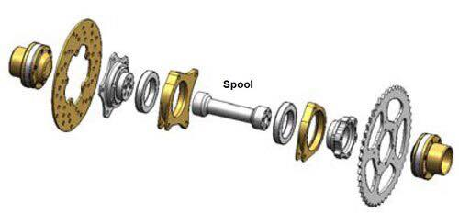
Transmission system:

Slide 16
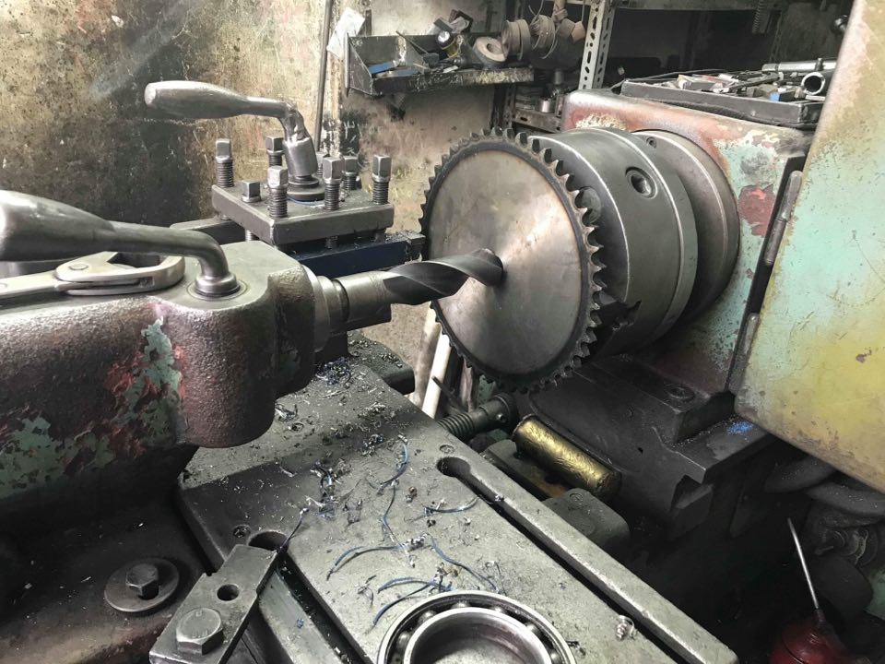
Machining

Slide 17
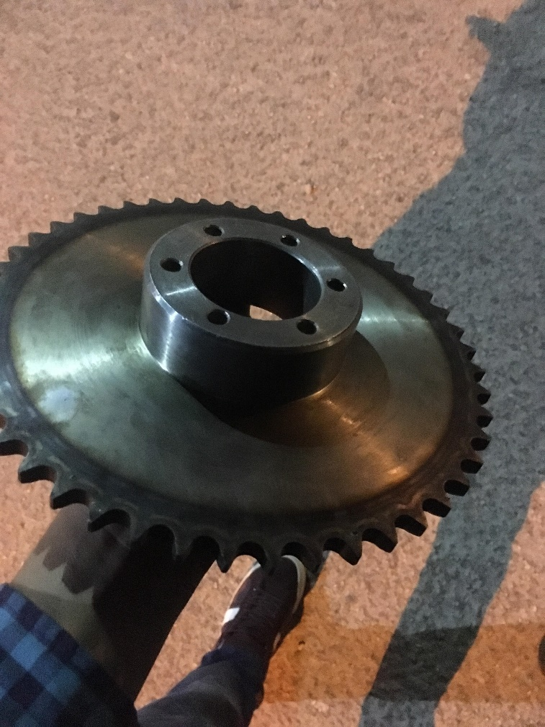
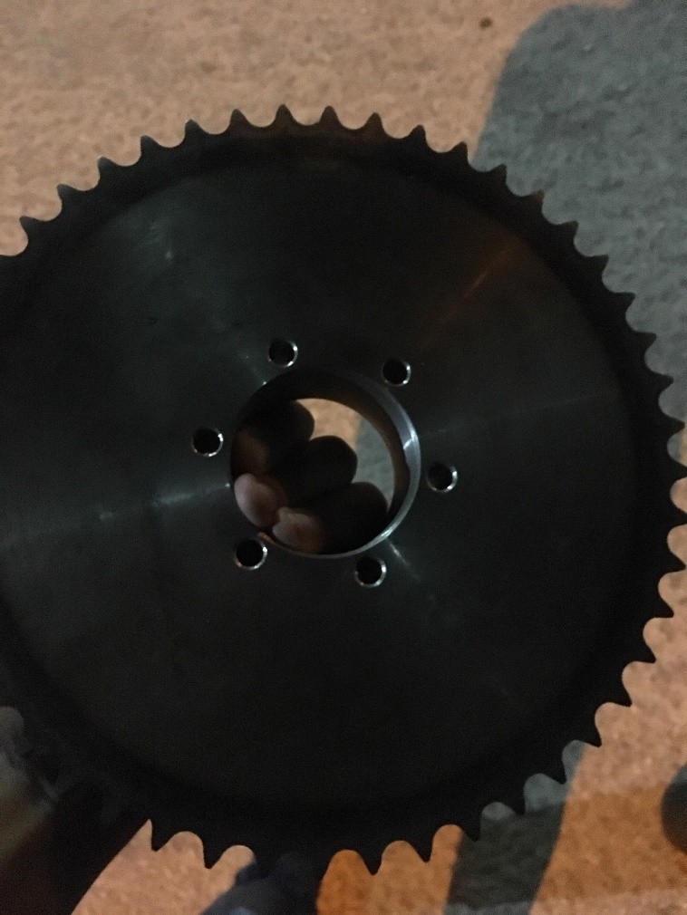

Slide 18
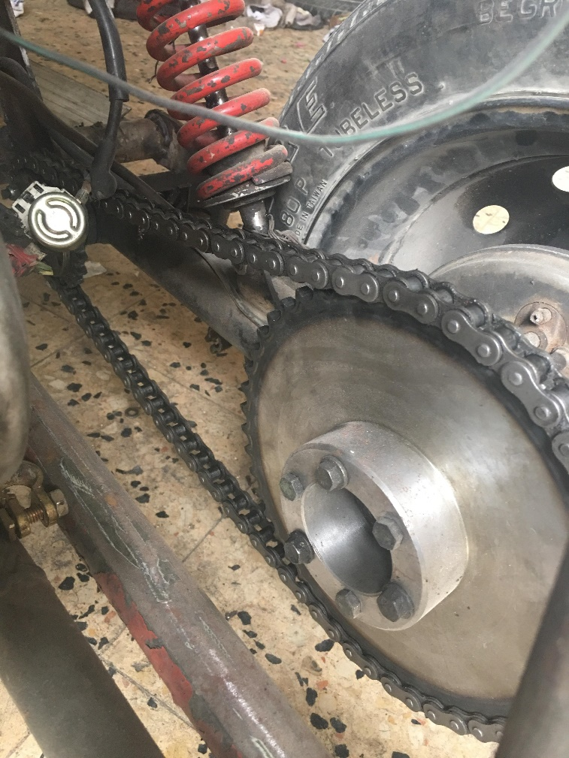
chain

Slide 19
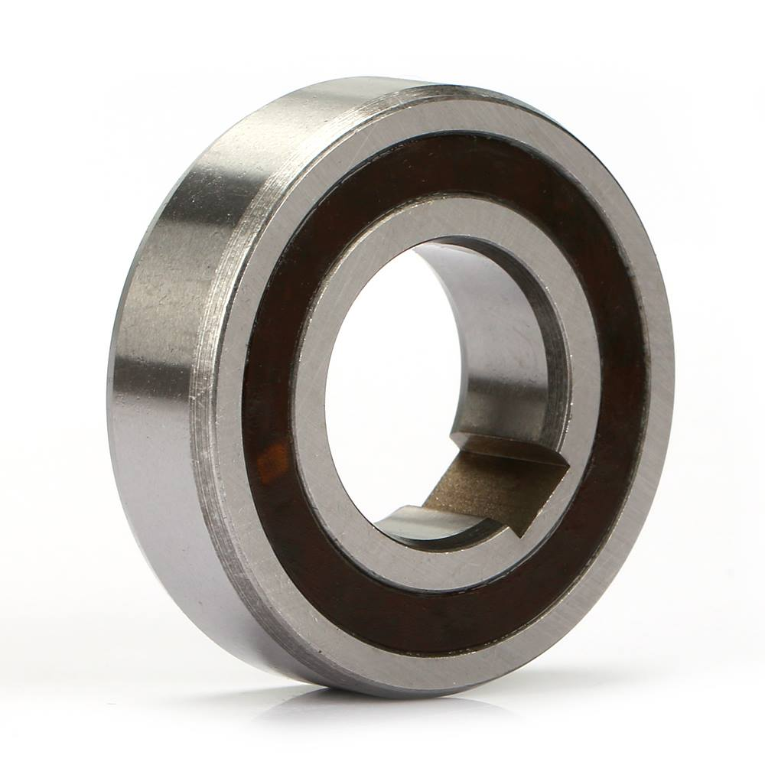
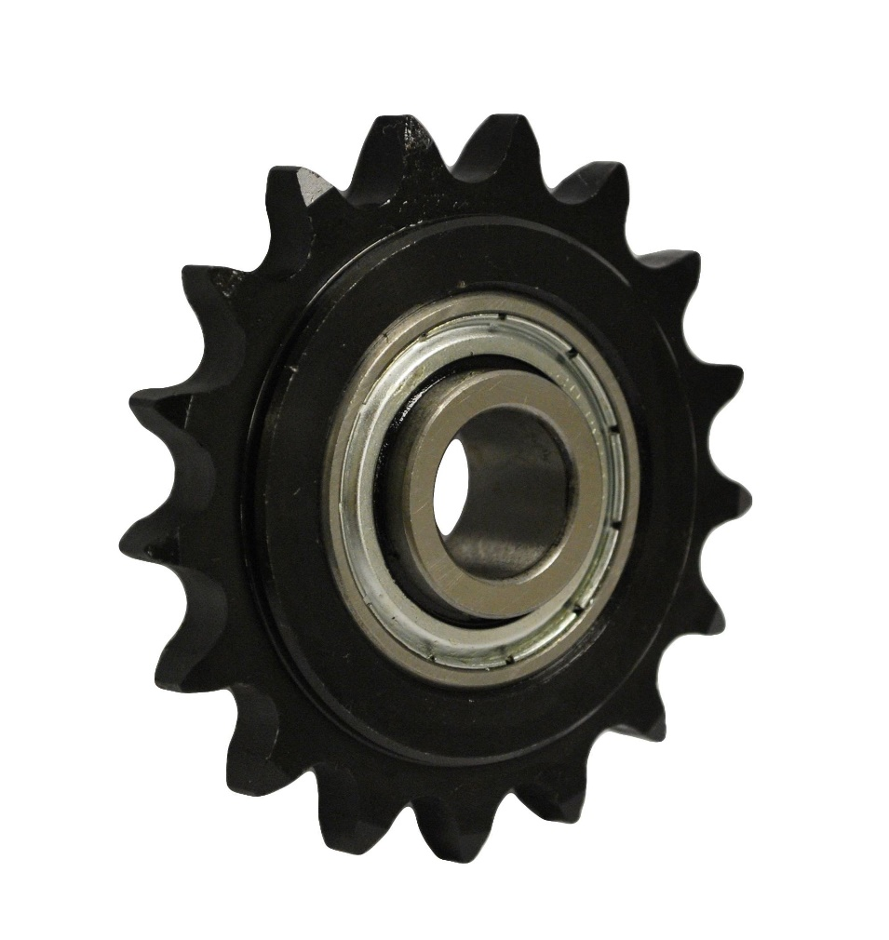
bearing

Slide 20
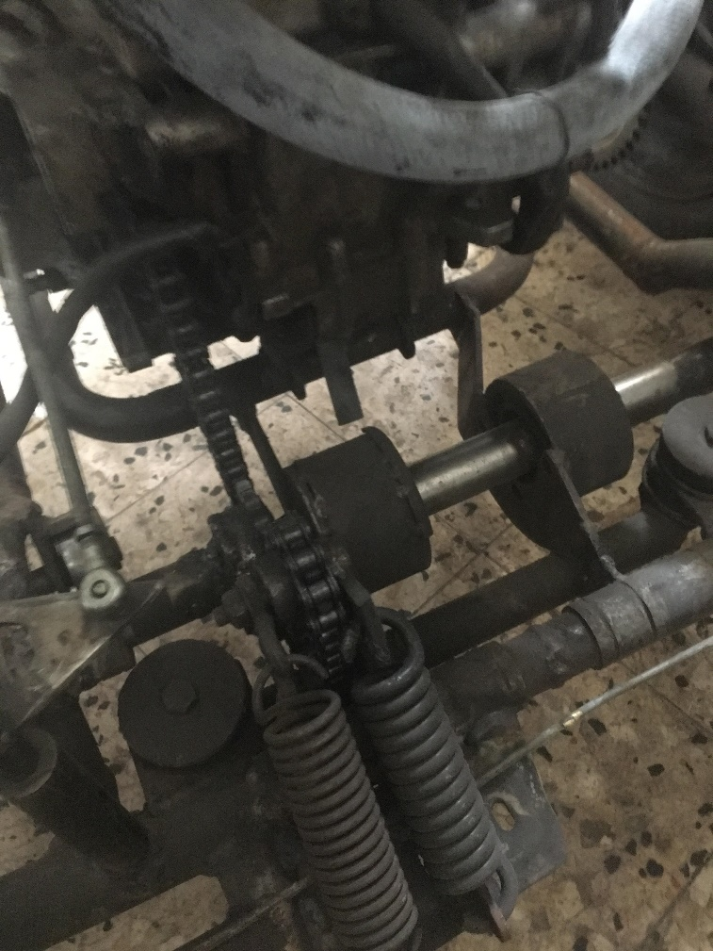
Problems and solutions
chains calibration

Slide 21
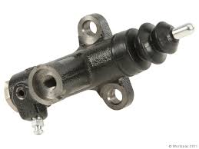
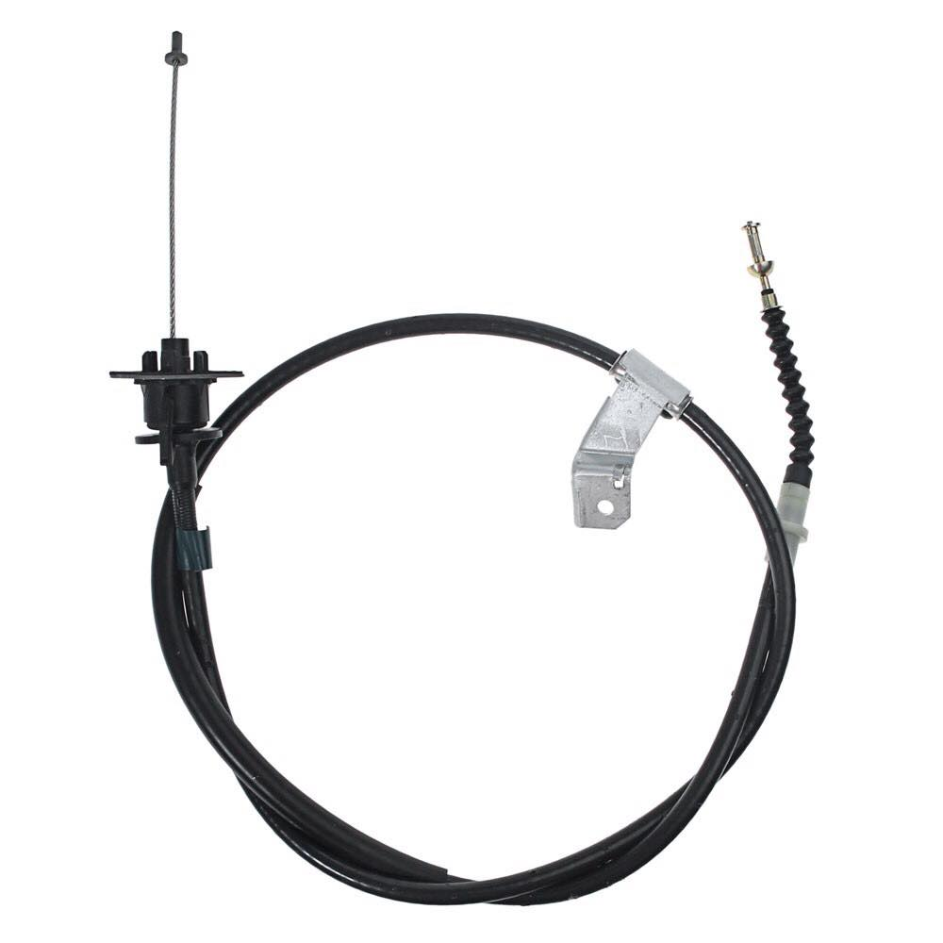
Clutch pump
clutch cable

Slide 22
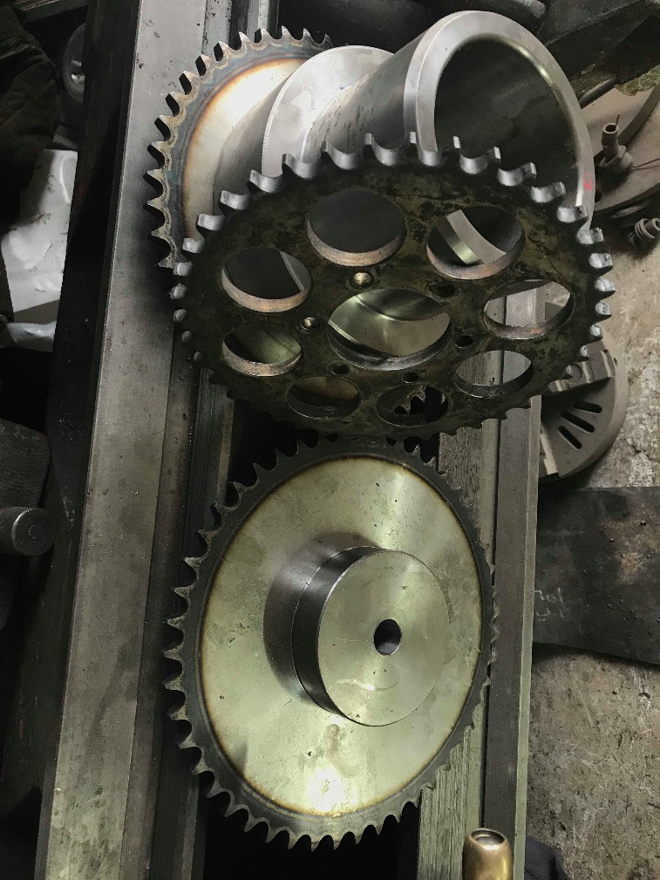

Slide 23
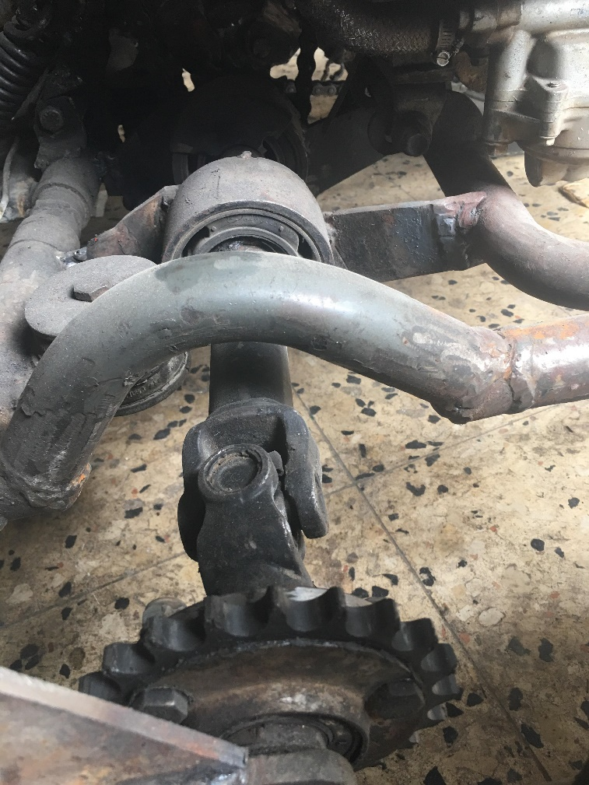

Slide 24
Final specifications

Slide 25
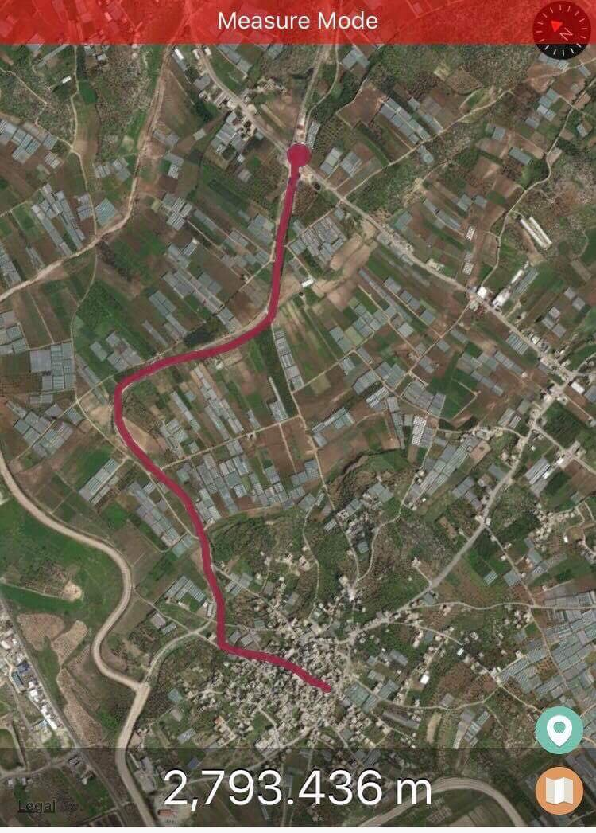
Test on the road
2.7/.2L .
13.5/ 1 L .
@ gear 1 run 70km/h .
Good stability on road .

