Slide 1

Improving Service Performance at Wassel Logistic Company
Prepared by:
Zakia Hanani
Lara Shaheen
Hala Abdel-haq
Rand Matour
Supervised By:
Dr. Yahya Saleh
24/5/2017

Slide 2
Contents
Background
Literature Review
Problem Statement
Methodology
Theory of the Work
Results
Conclusion and recommendations

Slide 3

Background
Wassel is a Palestinian Company for distribution and logistics
Established in 2005
Wassel has four branches in Palestine which are Nablus, Ramallah, Hebron, Jerusalem
Two of these branches are a hub logistic which are Ramallah and Hebron hub

Slide 4
Literature Review
Logistic Systems | Professionals, as the process of planning, implementing and controlling the procedure for efficient and effective transportation, storage of the related information and includes all movements (internal, external, outbound and inbound) for achieving customer requirements (Winser , 2012)
Simulation In Logistics | Simulation models in logistics represent an attempt to replicate mathematically the functional relationships between the logistical activities of facility location, transportation, inventory, order processing and material movement (Bowersox et al 1973).

Slide 5
Logistic Hub | A logistics hub is a center or specific area designated to deal with activities related to transportation, organization, separation, coordination and distribution of goods for national and international transit, on a commercial basis by various operators (Haughton, 2013).
DMAIC | Joseph (2004) has defined DMAIC as a data-driven method for achieving near-perfect quality by using a traditional set of quality tools that have been evolving for years. In the 1980s, everyone had a different problem-solving method for improving quality. One of the most universally used was Juran’s five-step method that provided a standardized way of achieving DMAIC results

Slide 6
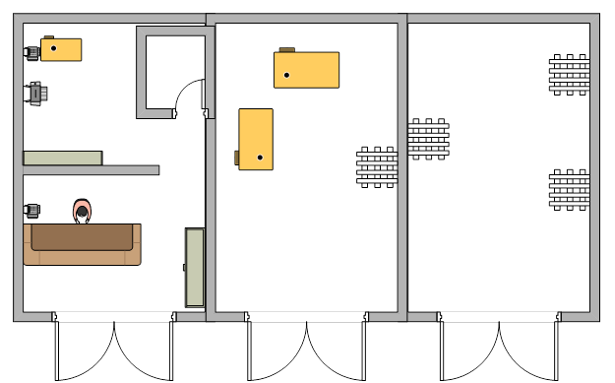
Problem Statement
Wassel company has an office in Nablus with an area of 90 square meters, 30 square meters that already activated and utilized

Slide 7
The company daily transferred about 300 packages that collected from the north area from Nablus to the hub in Ramallah
Objectives
Studying the current situation of the Nablus office
Examining feasibility (technical and economic) to transfer Nablus office to a logistic hub

Slide 8
Methodology
Meeting
Gathering data
Analyzing the overall process
Applying DMAIC methodology
Results
Consolations and recommendations

Slide 9
Work Methodology
DMAIC Methodology is a five step problem-solving procedure
It is an integral part of six sigma imitative
Has a core process phases which are
Define
Measure
Analyze
Improve
Control

Slide 10
Define | Who customers are. What their requirements are for products and services. What their expectations are .
Measure The performance of the Core Business Process involved, which include | Develop a data collection for the process. Collect data from many sources to determine types of defects and metrics. Compare to customer survey results to determine shortfall.
Analyze the data collected and process map to determine | Root causes of defects Opportunities for improvement, which include Identify gaps between current performance and goal performance Prioritize opportunities to improve Identify sources of variation.

Slide 11
Improve | The target process by designing creative solutions to fix and prevent problems, which include, create innovate solutions using technology and discipline.
Control The improvements to keep the process on the new course. | Prevent reverting back to the “old way”. Require the development documentation and implementation of an ongoing monitoring plan Institutionalize the improvements through the modification of systems and structures .

Slide 12
Results
Define phase
1. Defined the process by
Developing a flow chart for the general process in Wassel
Build a process chart for Nablus office

Slide 13
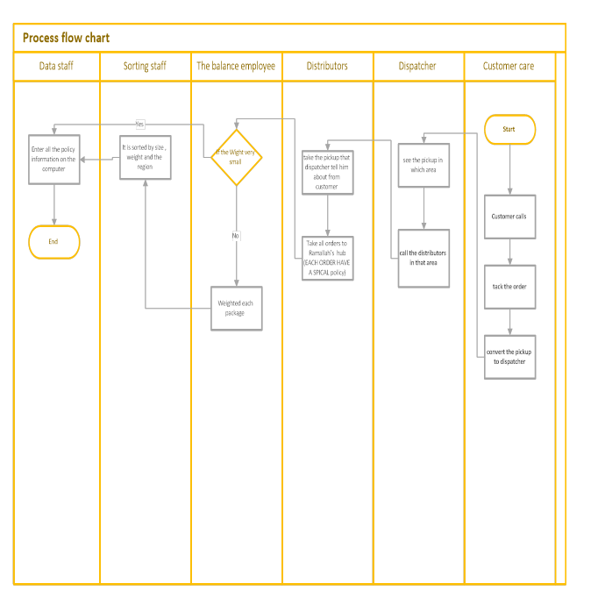

Slide 14
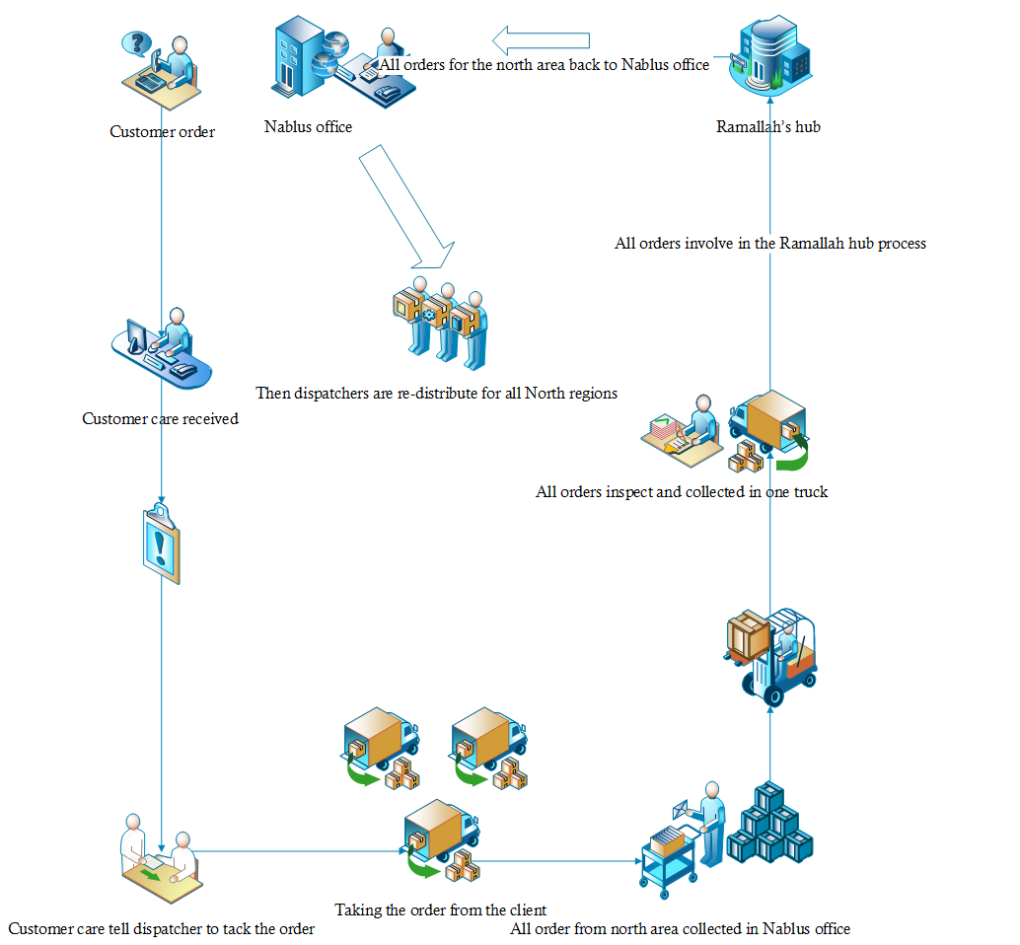

Slide 15
2. Defined the customer requirement
Lead to customer satisfaction
Customers express about dissatisfaction by returns or reject to receive the orders .
There is a 1.725795 % returns orders for a one year for Wassel company .

Slide 16
Measure phase
In this phase the objective consists of measuring the actual performance of the process.
Improved reliability in three domains as a follows:
1. Quality 2. Cost

Slide 17
Quality
Reflected in the delivery time, delays and rejection orders.
Delivery Time
Delay Rate and Returns

Slide 19
Average and variance delivery time
ORIGIN | Average Delivery Time (hours)to destination | Variance In Delivery Time (hours)to destination
Nablus | 120.2959 | 8968.773
Jenin | 113.662 | 8380.002
Salfeet | 87.15435 | 6509.521
Tolkarem | 108.9919 | 8047.466
Qalqelia | 89.15764 | 5295.834
Ramallah | 91.14491 | 6227.816

Slide 20
2. Delay Rate and Returns
There is a 1.725795 % returns orders for different reason.
Delivery rate for the cities three days that is equivalent of 72 working hours.

Slide 21
Average Delays in (hours) for North Area Region
Origin | Average number of hours delays
Nablus | 40.0866
Salfeet | 15.1543
Qalqelia | 17.1576
Tolkarem | 36.8821
Jenin | 41.599

Slide 22
Cost
Current Running Costs for Nablus office
Cost | NIS per month
Wages | 21489
Transportation | 19138
Rent | 1700
Electricity | 250
Telephones and Internet | 592
Water | 100
Consumables | 300
Total | 43569

Slide 23
Analyze phase
Analyze the reason for choosing Nablus to open as a logistic hub for the north area.
Analyze if the opining is economically feasible or not by Payback Period.

Slide 25
Payback Period
Materials and labor requirements costs computations for opening the hub
Item | Number of units needed (a) | Available quantity (b) | Quantity needed (c=a-b) | Cost (NIS /unit) (d) | Cost of items needed (e=c*d)
Materials Requirements-Fixed Costs
Iron cupboards | 1 | 0 | 1 | 3000 | 3000
Weighing Machine (Balance) | 1 | 1 | 0 | 3000 | 0
Hand Crane | 1 | 1 | 0 | 2000 | 0
Bar codes | 2 | 1 | 0 | 760 | 0
Sorting table | 1 | 0 | 1 | 1000 | 1000
PC | 1 | 0 | 1 | 3000 | 3000
Refrigerator | 1 | 0 | 1 | 1000 | 1000
Camera system | 1 | 0 | 1 | 2000 | 2000
Total costs (NIS) |  |  |  |  | 10000⁽¹⁾
Monthly Operating Labor Costs
Employee(for Sorting ,Data Entry ) (NIS/month) | 2 | 0 | 2 | 2000 (NIS/month-person) | 4000⁽²⁾ (NIS/month)

Slide 26
summarizes the monthly number of shipments from northern cities transferred to Ramallah’s hub accompanied with respective running costs.
Period | Northern No. of Shipments (a) | Revenues (30*a) (NIS) | Running cost (From Table (3)) (NIS) | Profit (NIS) (Revenues -Running cost) | Net cash flow(NIS) (Profit-4000)
Nov-Dec 2015 | 4808 | 144240 | 43569 | 100671 | 96671
Dec 2015-Jan 2016 | 4880 | 146400 | 43569 | 102831 | 98831
Jan-Feb 2016 | 4504 | 135120 | 43569 | 91551 | 87551
Feb-Mar 2016 | 4183 | 125490 | 43569 | 81921 | 77921
Mar-Apr 2016 | 5195 | 155850 | 43569 | 112281 | 108281
Apr-May 2016 | 4315 | 129450 | 43569 | 85881 | 81881
May-June 2016 | 4195 | 125850 | 43569 | 82281 | 78281
June-July 2016 | 4855 | 145650 | 43569 | 102081 | 98081
July-Aug 2016 | 4287 | 128610 | 43569 | 85041 | 81041
Aug-Sep 2016 | 5591 | 167730 | 43569 | 124161 | 120161
Sep-Oct 2016 | 3822 | 114660 | 43569 | 71091 | 67091
Oct-Nov 2016 | 5360 | 160800 | 43569 | 117231 | 113231

Slide 27
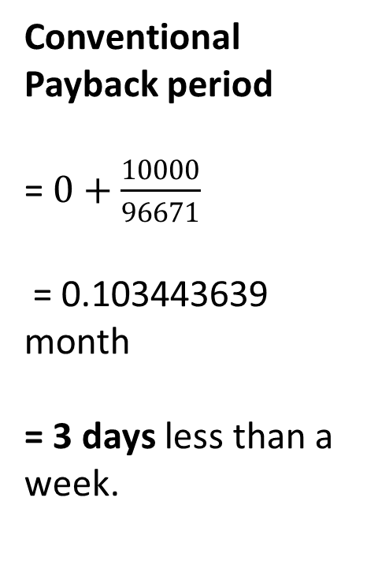
Months | Cash flow | cumulative
0 | -10000 | -10000
1 | 96671 | 86671
2 | 98831 | 185502
3 | 87551 | 273053
4 | 77921 | 350974
5 | 108281 | 459255
6 | 81881 | 541136
7 | 78281 | 619417
8 | 98081 | 717498
9 | 81041 | 798539
10 | 120161 | 918700
11 | 67091 | 985791
12 | 113231 | 1099022
PB (month) |  | 0.103443639
Conventional Payback period
=$0+\frac{10000}{96671}$
= 0.103443639 month
= 3 days less than a week.

Slide 28
Improve phase
Simulation model
Location | Activity time Distribution ( mean ,STD ) | Activity recourses | Next location | Move trigger | Move time | Move resources
1. Customer care received the order | Lognormal ( 3.2888 , 3.21746) min | Customer care | Dispatcher | None | None | None
2.Customer care tell dispatcher to take the order | Normal (21.863 , 12.0904 ) min | Customer care | Distributors | None | None | None
3. Tacking the order from client | Normal ( 21.5694 , 7.5386 ) min | Distributors | Nablus office | When the cars with the distributors available in the region | 60 min | Cars
4. Sorting, weighting and data inserting | Lognormal (4.2814 , 1.3638) min | employee | Client | None | 60 min | None
5. Re-distribute for the north region | Lognormal (50.8 , 34.6173)min | Distributors | Client | None | None | Cars
Origin city | Percentage (%)
Nablus | 49.42164
Salfeet | 14.06716
Qalqelia | 2.761194
Tolkarem | 5.634328
Jenin | 28.11567
Receiving cities | Percentage (%)
Nablus | 19.75604
Salfeet | 7.8643
Qalqelia | 8.430625
Tolkarem | 12.699848
Jenin | 13.026574
Ramallah | 38.22261

Slide 29
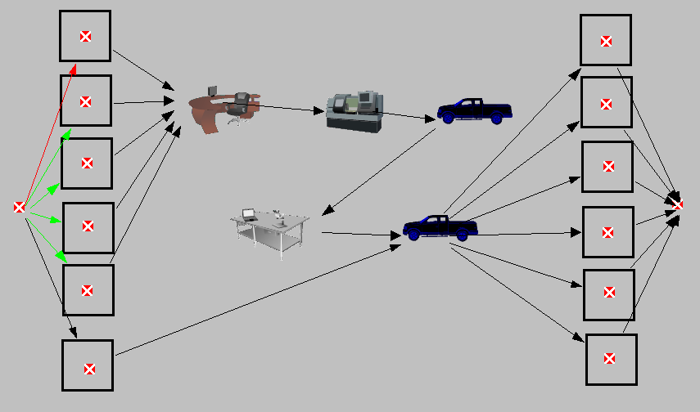

Slide 30
Comparison before and after
Configuration
Cost
Quality

Slide 31
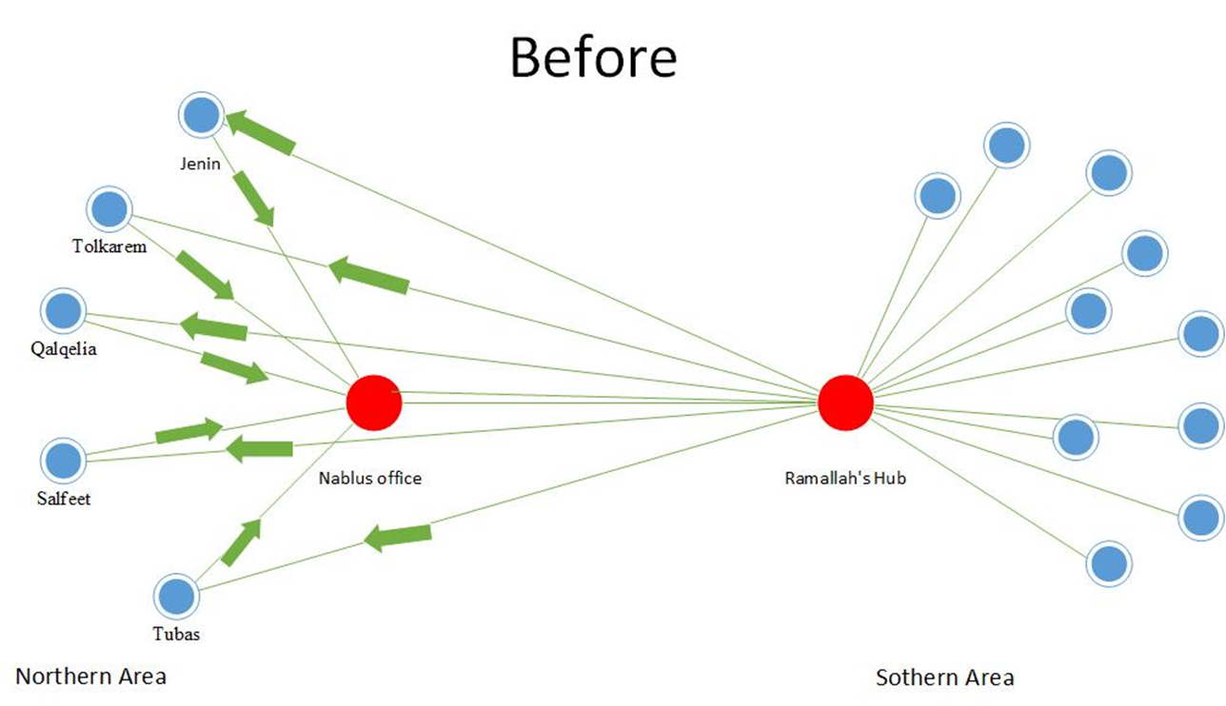
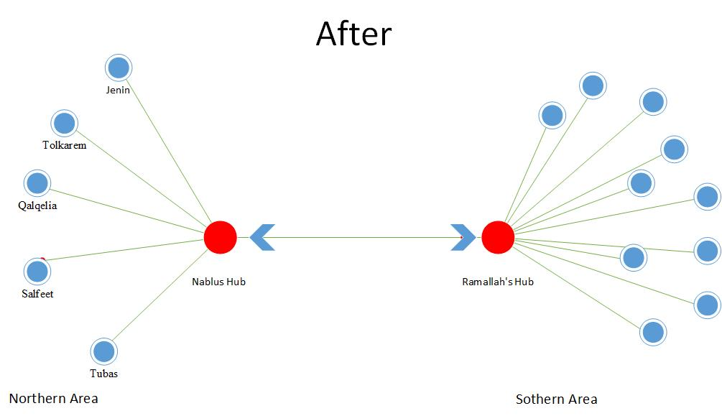

Slide 32
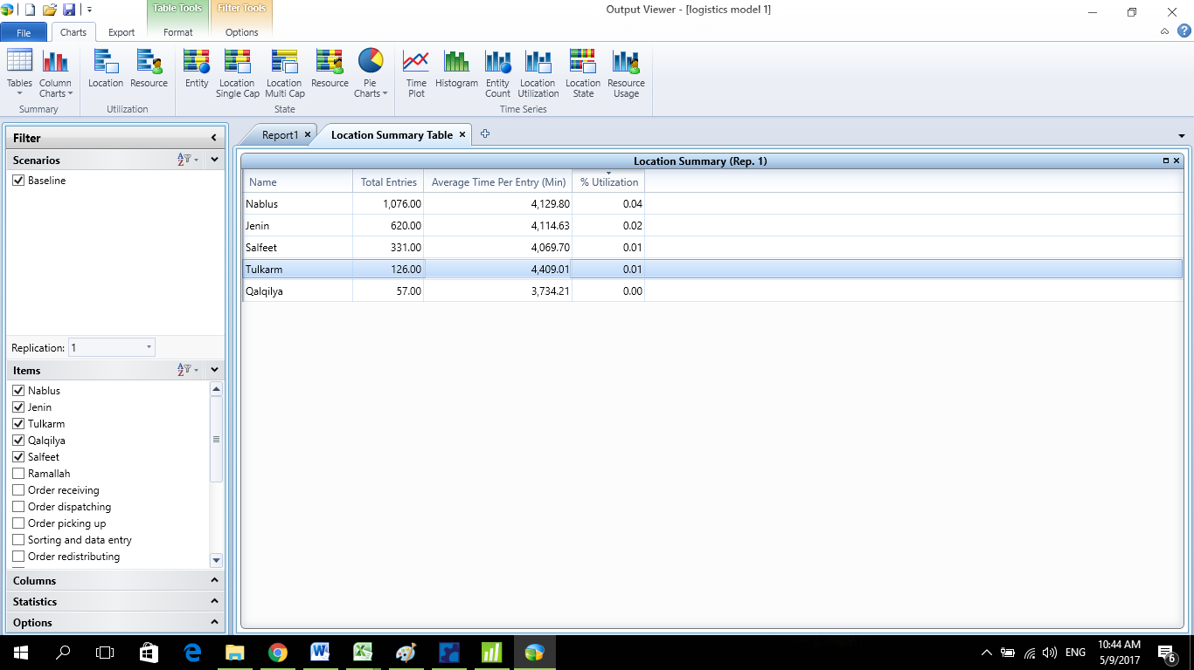
Quality
1. Average delivery time
Origins | Average delivery time (hours/month) Before | Average delivery time (hours/month) After
Nablus | 120.2959 | 68.83
Jenin | 113.662 | 68.58
Salfeet | 87.15435 | 67.83
Tolkarem | 108.9919 | 73.48
Qalqilya | 89.15764 | 62.24

Slide 33
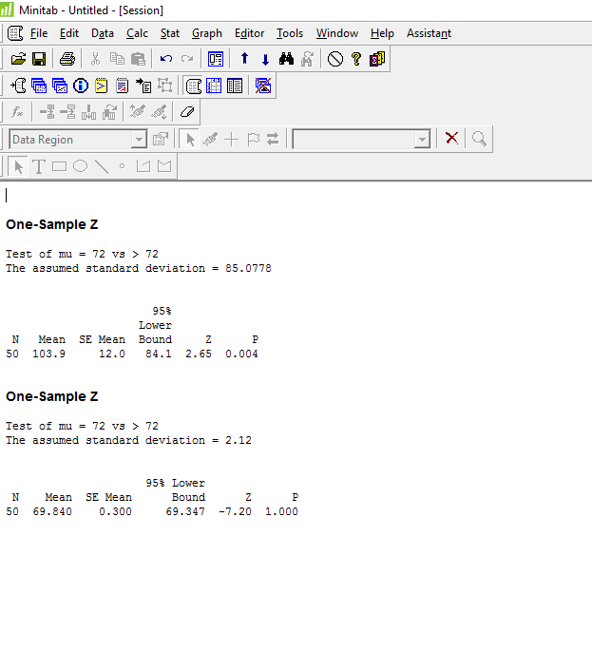
Hypothesis testing of Average Delivery Time (hours)
Before (from the last month) | After (from the simulation model.)
μ =103.8524 STD= 85.07782 | μ = 69.84 STD =2.12

Slide 34
2. Delays rate

Slide 35
Cost
Before | After
The company pays rent for the full place but just one-third is used. | Will pay money for the opining which measured before. Payback period is small which mean the money will be restored in short period. Save some money in transportation cost that push forward to green logistic.

Slide 36
Control phase
The last phase in DMAIC methodology and it is the conclusion of the team's journey.
Keep monitoring the new model that need to permanently updating for the data .

Slide 37
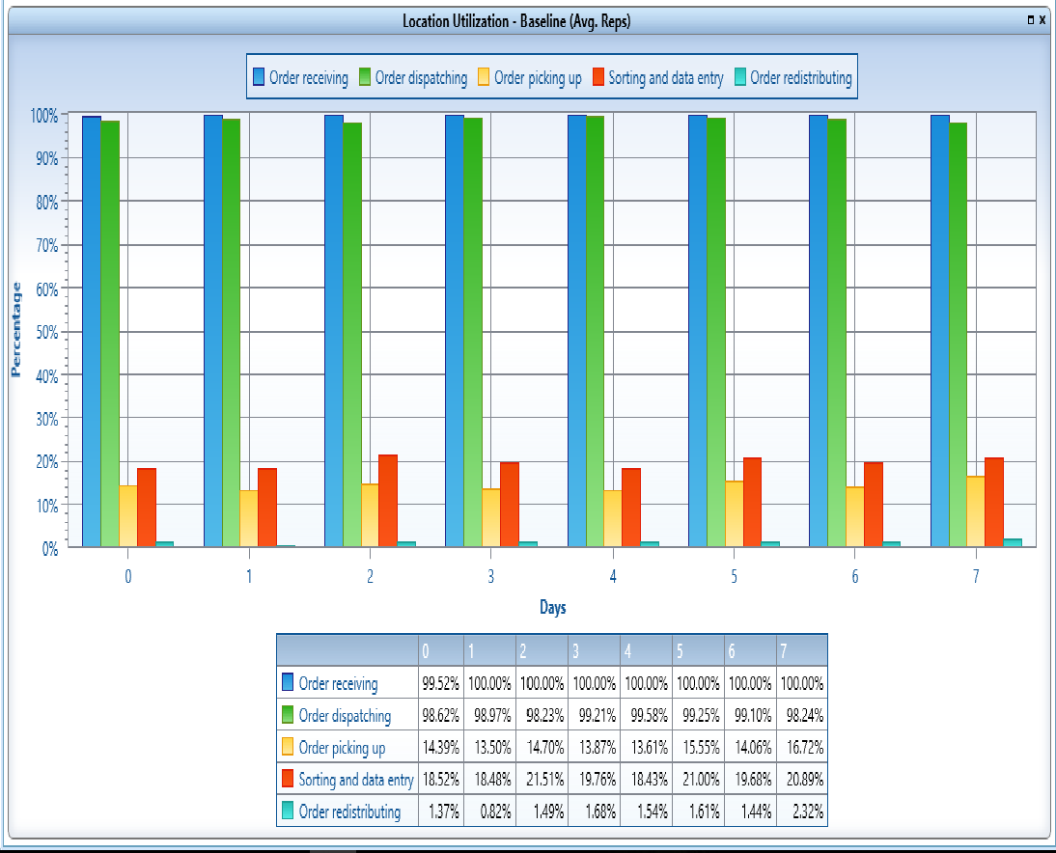
Percentage utilization for station on Nablus hub

Slide 38
Conclusions
Transferring Nablus office of Wessel logistic company to a logistic hub is economically feasible.
Performance for Wassel company will be improved.
Improved utilization
Reduced average delivery time
Reduced average delay rate

Slide 39
Recommendations
Wassel should expedite trasnfering Nablus office to a logistic hub
Wassel company needs to adopt a barcode system to eliminate the errors in entry.
Wassel company must document everything, by adopting a computerized documentation system.
Wassel company can build a software program which allow the customers to enter their data This solution will can decrease the pressure of work and reduce the time of waiting.

Slide 40


