Slide 1
SMART DESK
Eman Abd Alaziz
Samya Hamed
Dr. Emad Natsheh

Slide 2
Overview
1
Introduction
2
Features
3
Overall Design
4
Mobile App
5
Constraints
6
Future Work

Slide 3
Introduction
Problem Statement

Slide 4
Problem Statement
Traditional desks lack interactivity, flexibility, and ergonomic support, negatively impacting users' comfort and productivity, especially in modern environments such as universities
and studios. Studies indicate that a large percentage of people, particularly students and office workers, suffer from comfort and organization issues due to these desks, which fail
to meet their diverse needs for customization, environmental control, and space organization.

Slide 5
What is a smart disk?
A smart desk is a smart office equipped with advanced technologies that aim to enhance the user experience through automated interaction and provide a comfortable and customizable work environment.
It features features such as:
🔹 User recognition and storage of personal preferences.
🔹 Automatic adjustment of desk height and tilt angle.
🔹 Smart storage system for organizing items.
🔹 Smart air conditioning system that responds to ambient temperature.
🔹 Visual and audio notification system.
🔹 Smart lighting that adapts to ambient light.

Slide 6
Features in detail

Slide 7
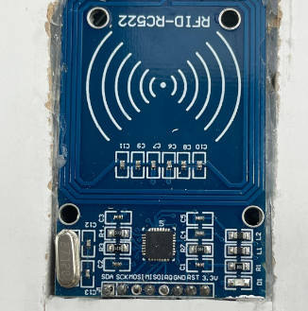
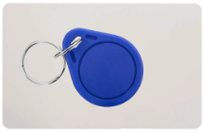
Login(Authentication)

Slide 8
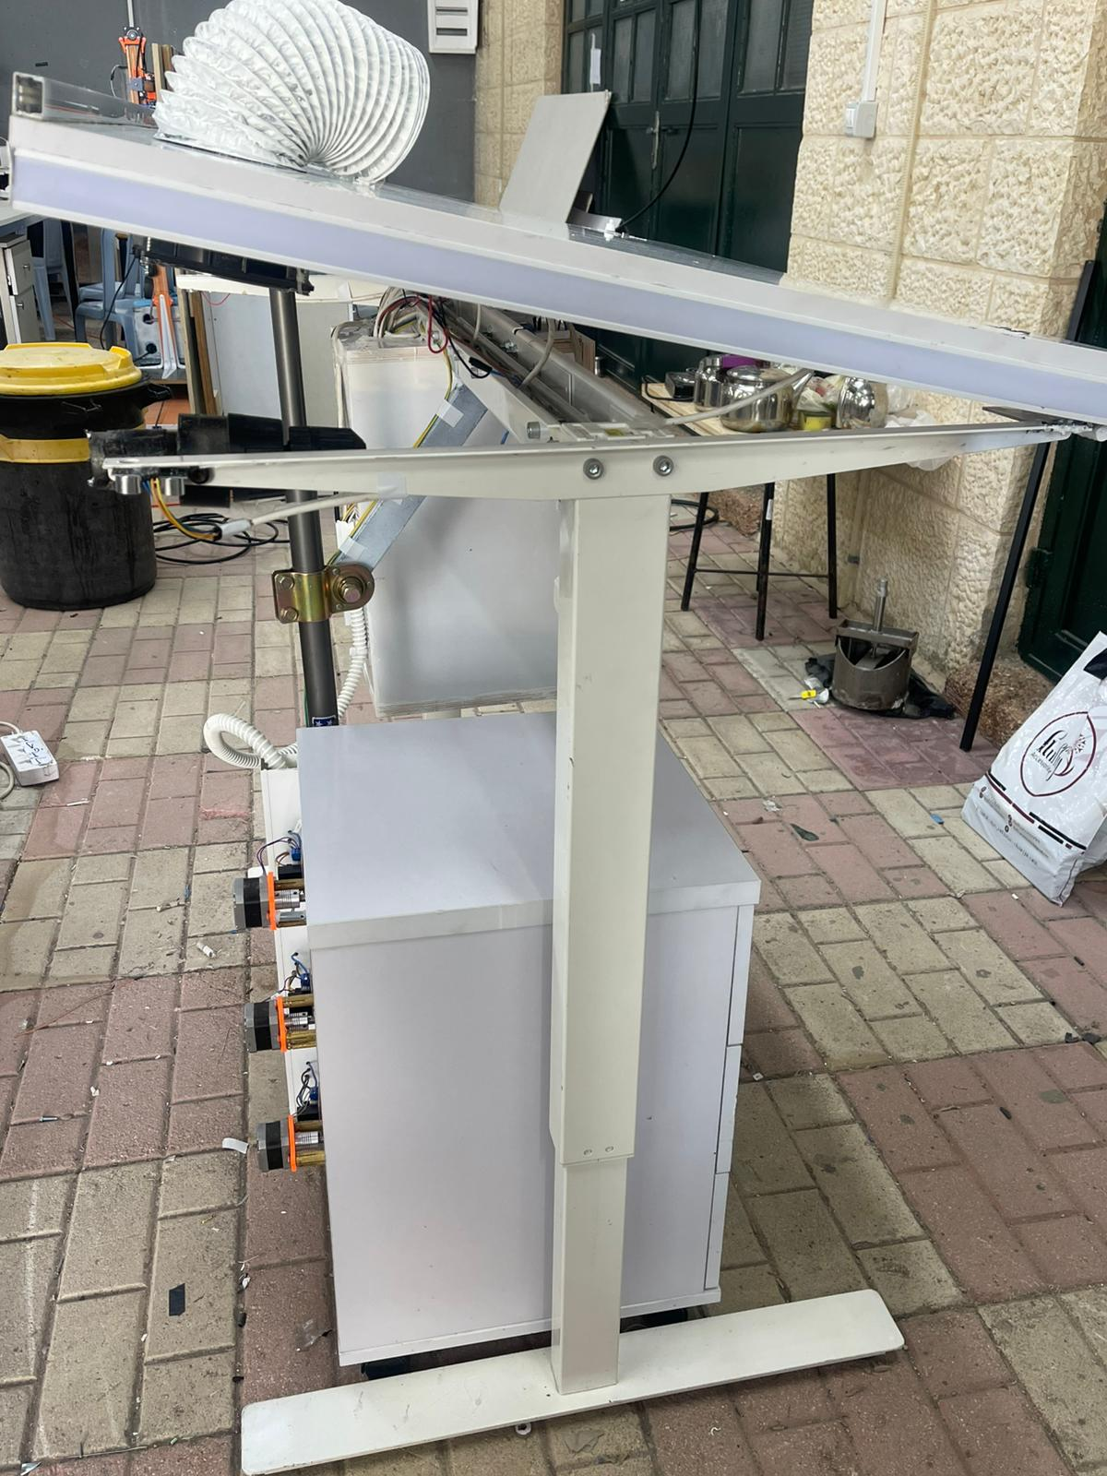
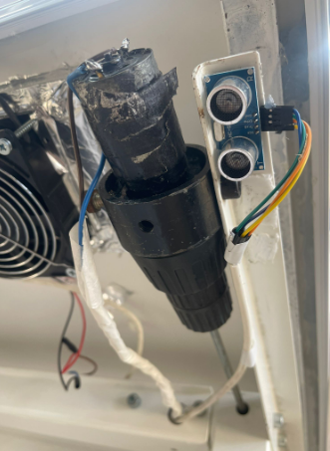
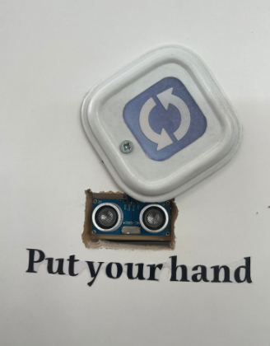
Change Height

Slide 9
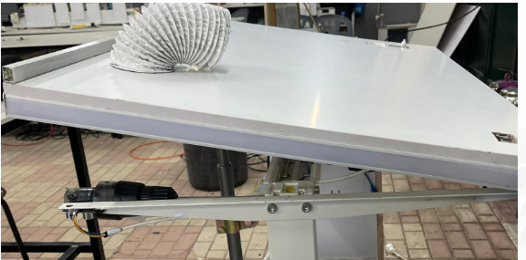
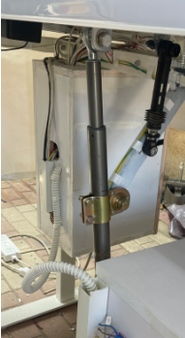
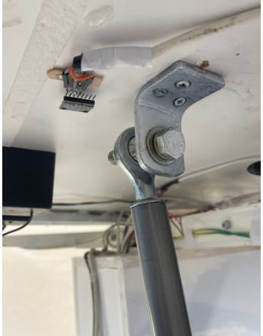
Change Angle

Slide 10

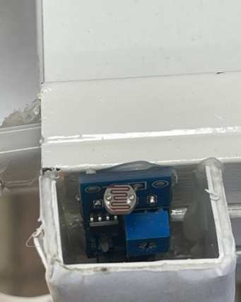
Light

Slide 11

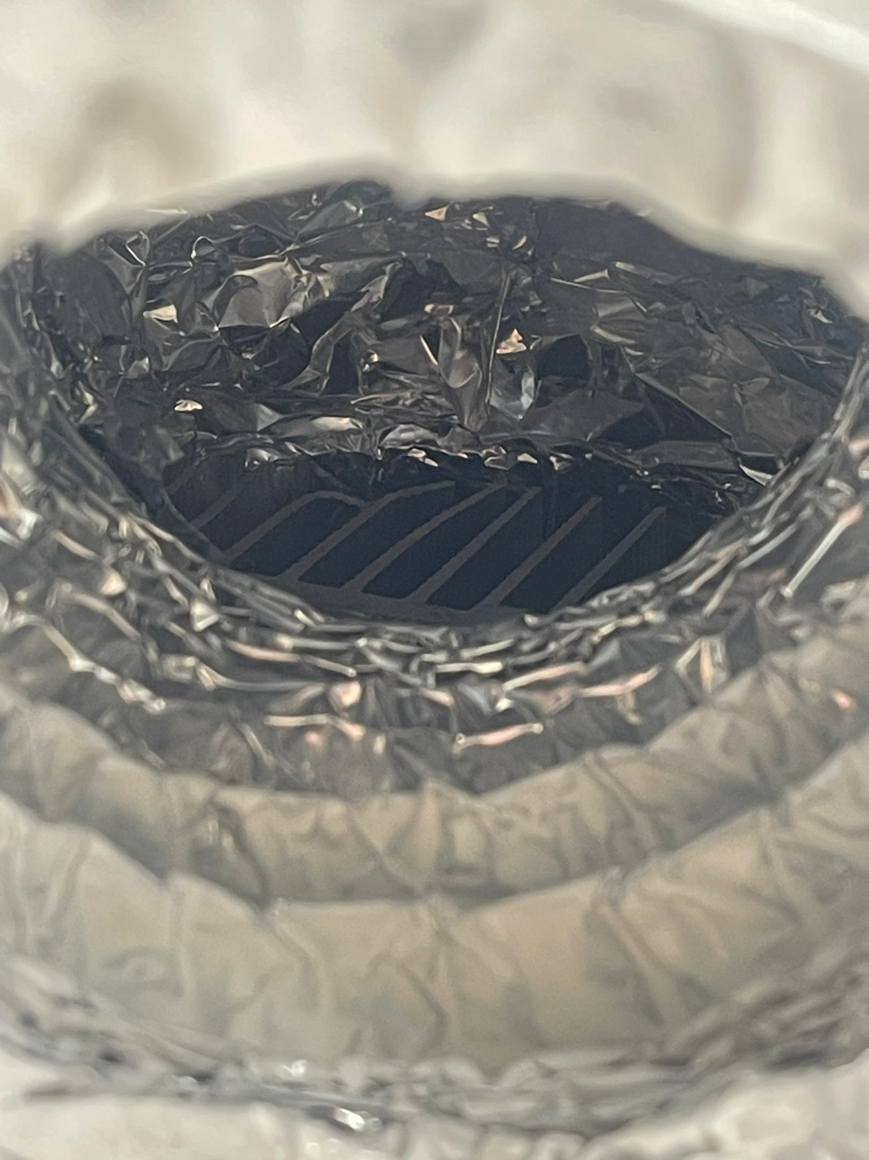
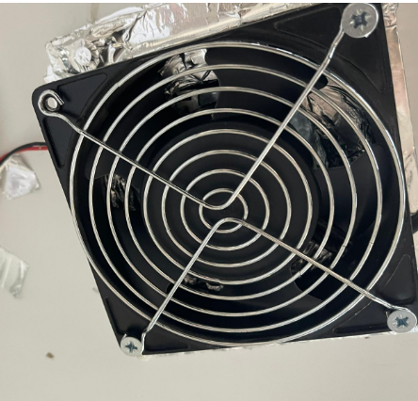
Air Conditioner

Slide 12
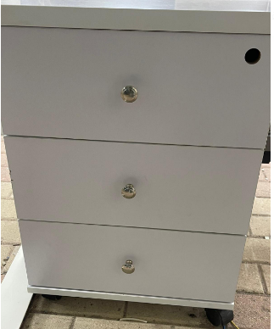
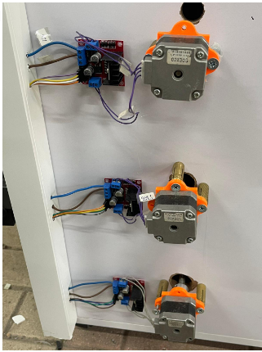
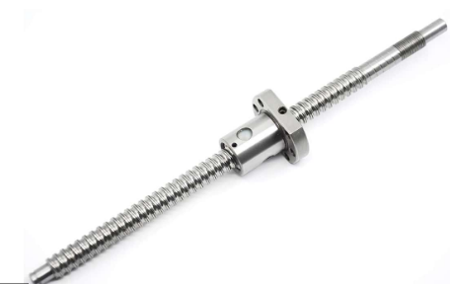
Storage System

Slide 13
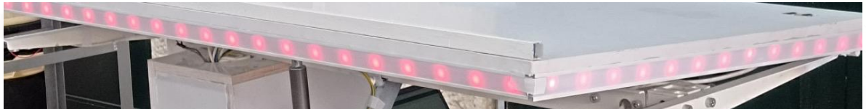

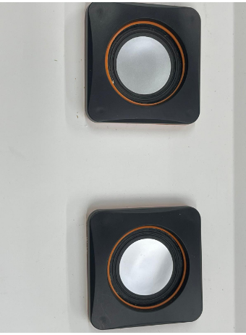
Notification System

Slide 14
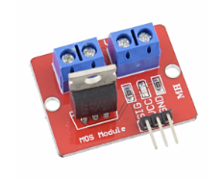
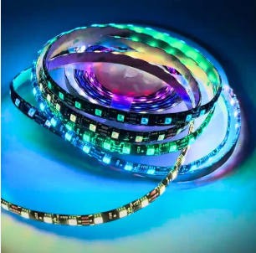
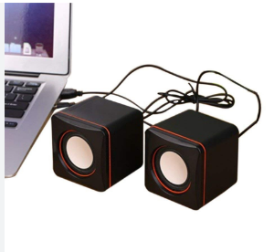
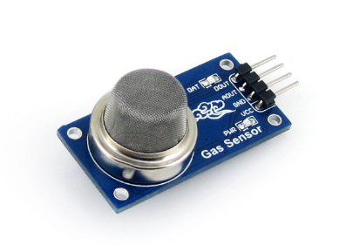
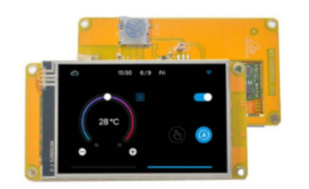
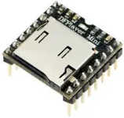
Components
Driver
RGB Led
Speaker
Gas Sensor
Audio Module
Screen

Slide 15
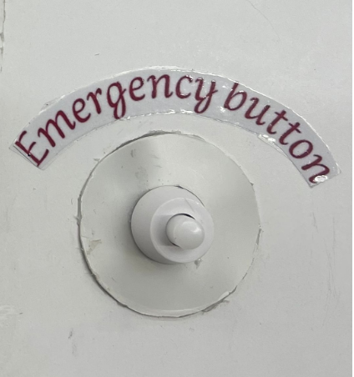
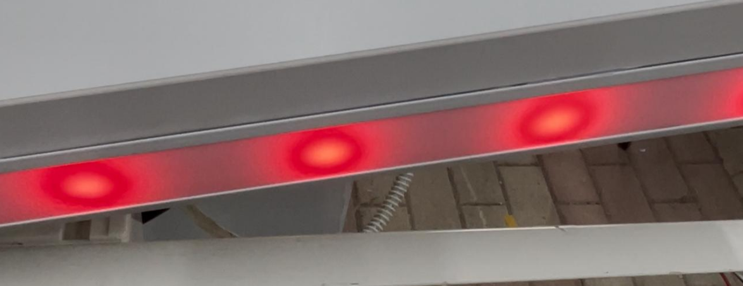
Emergency

Slide 16
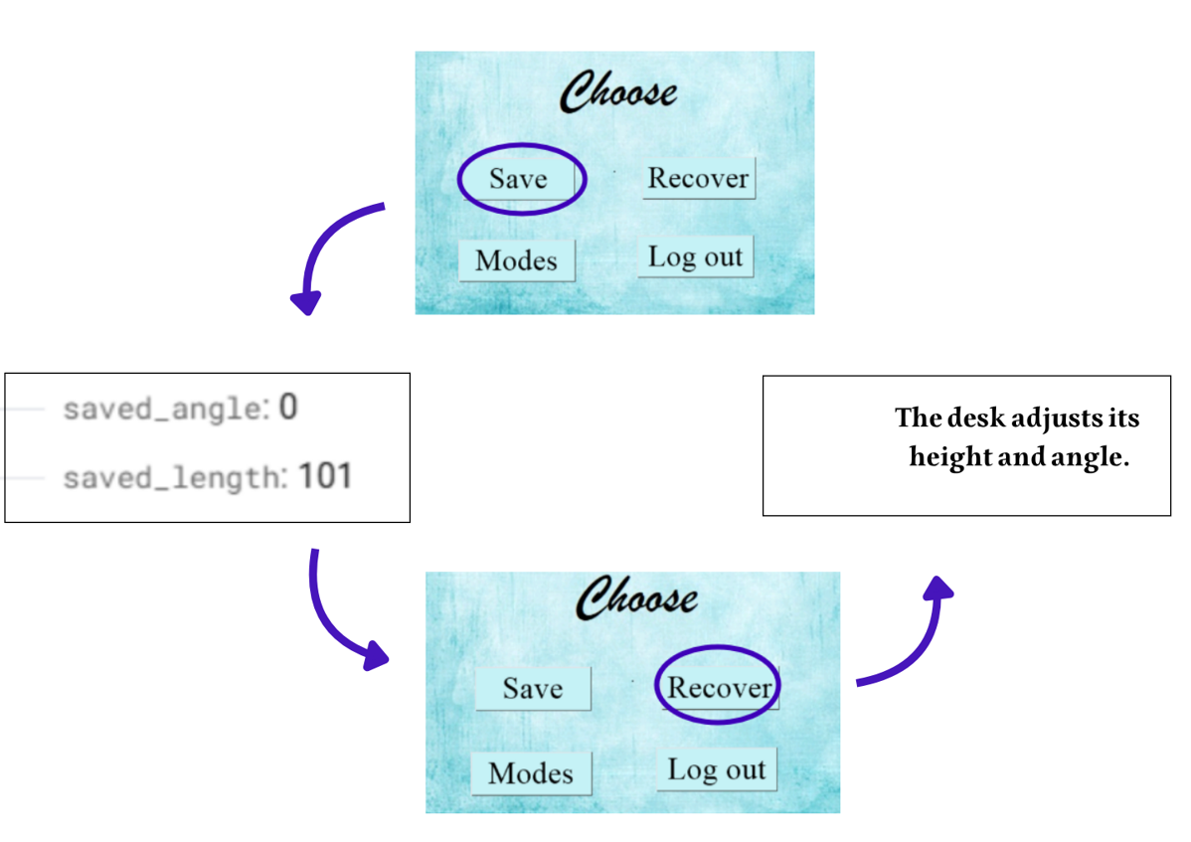
Save and Recover

Slide 17
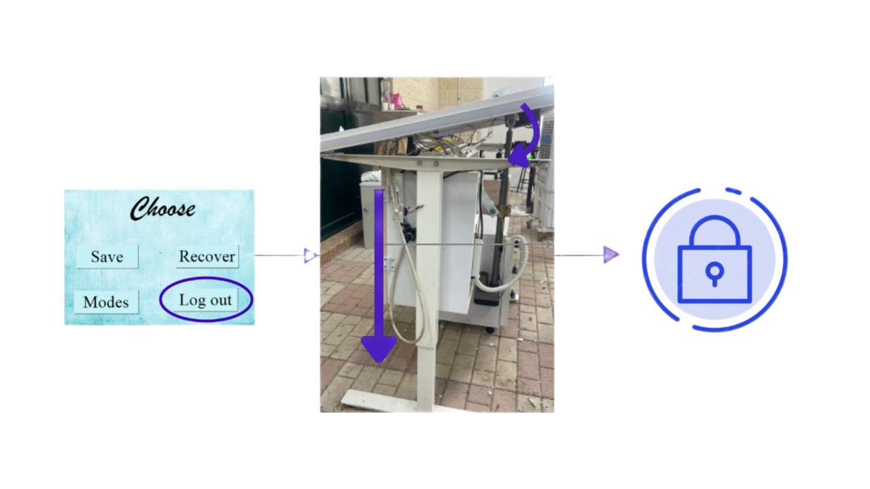
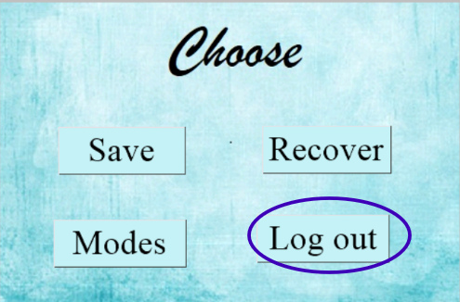
logout

Slide 18
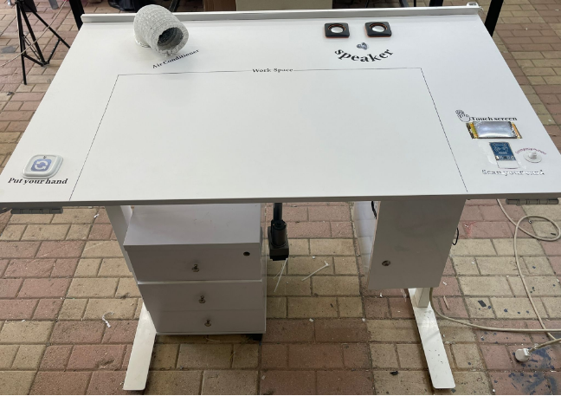
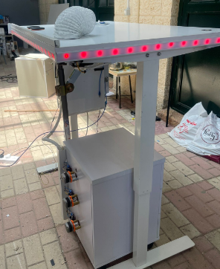
Overall Design

Slide 19
Mobile App

Slide 20
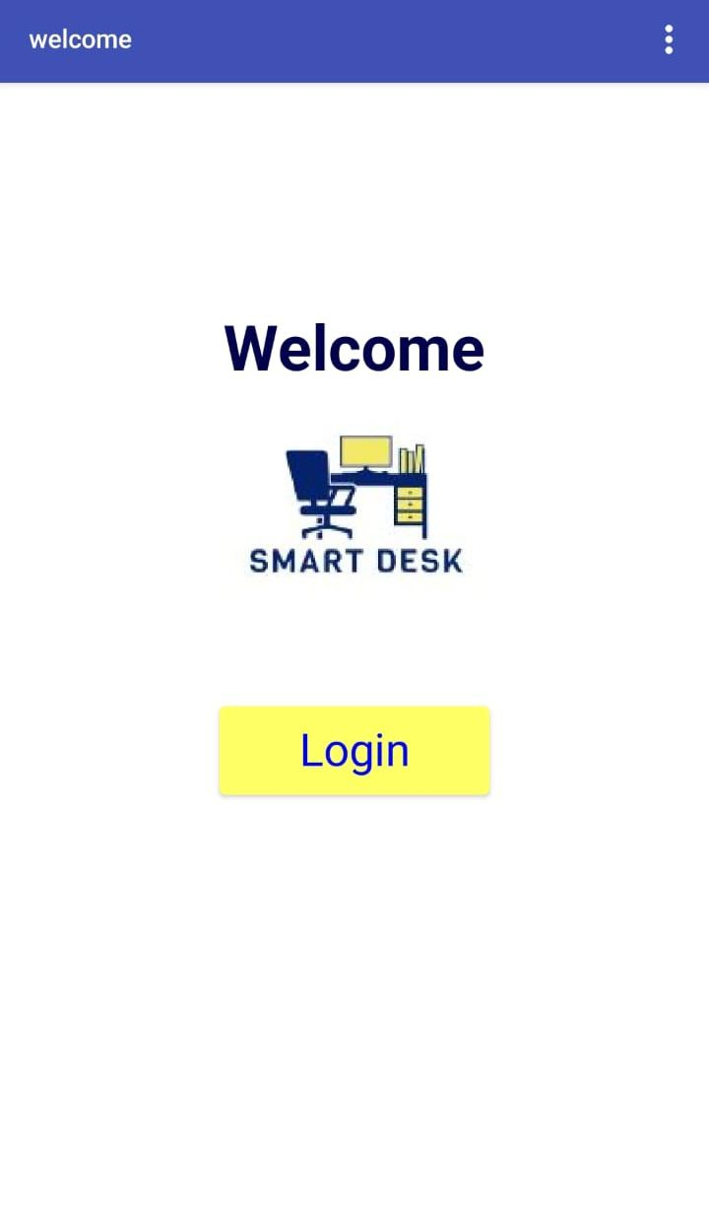
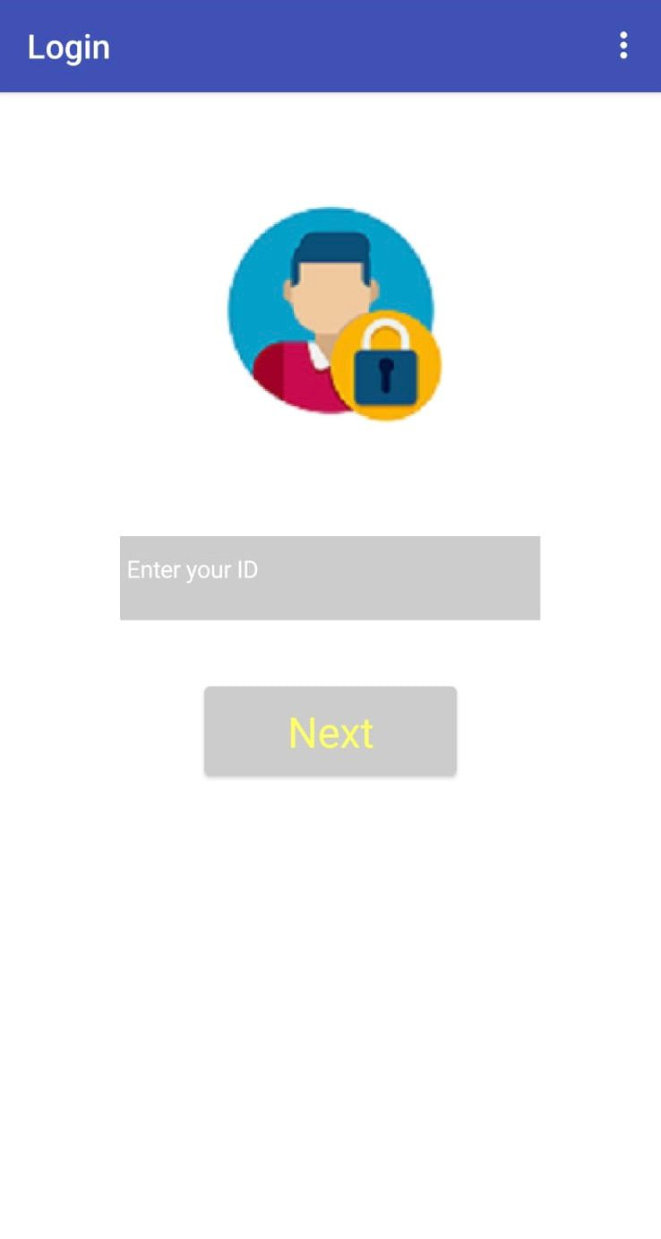
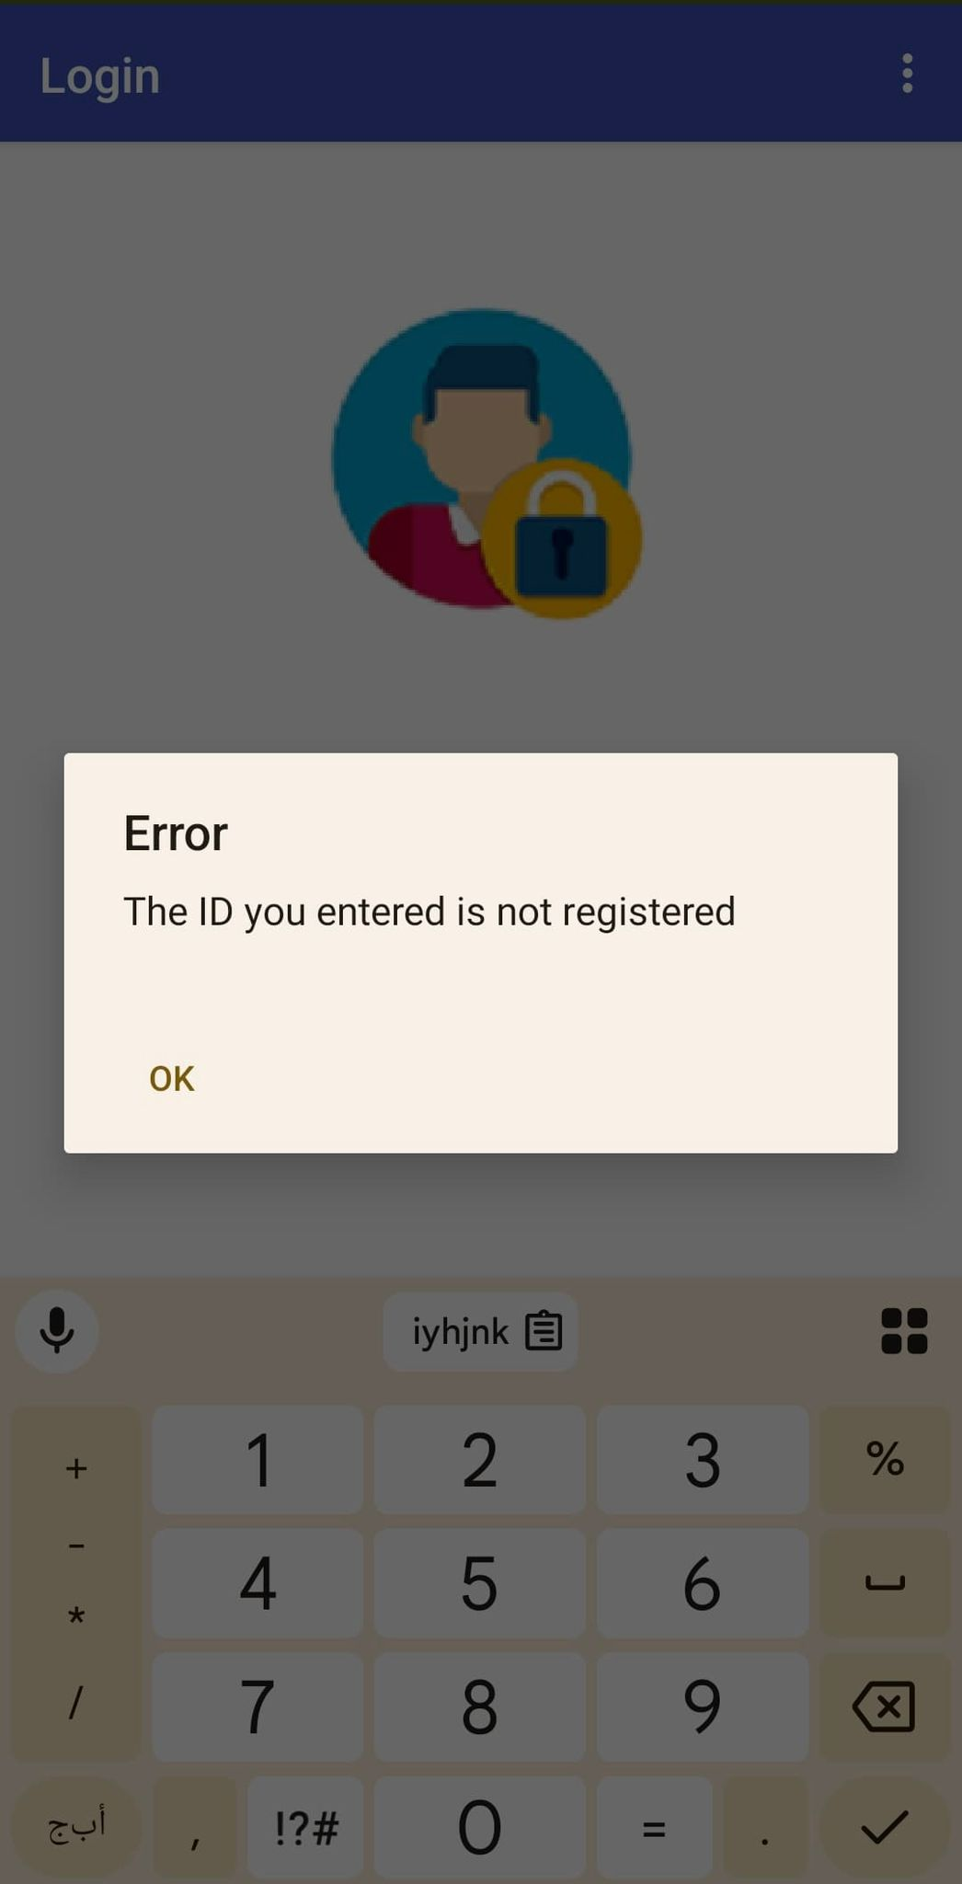

Slide 21
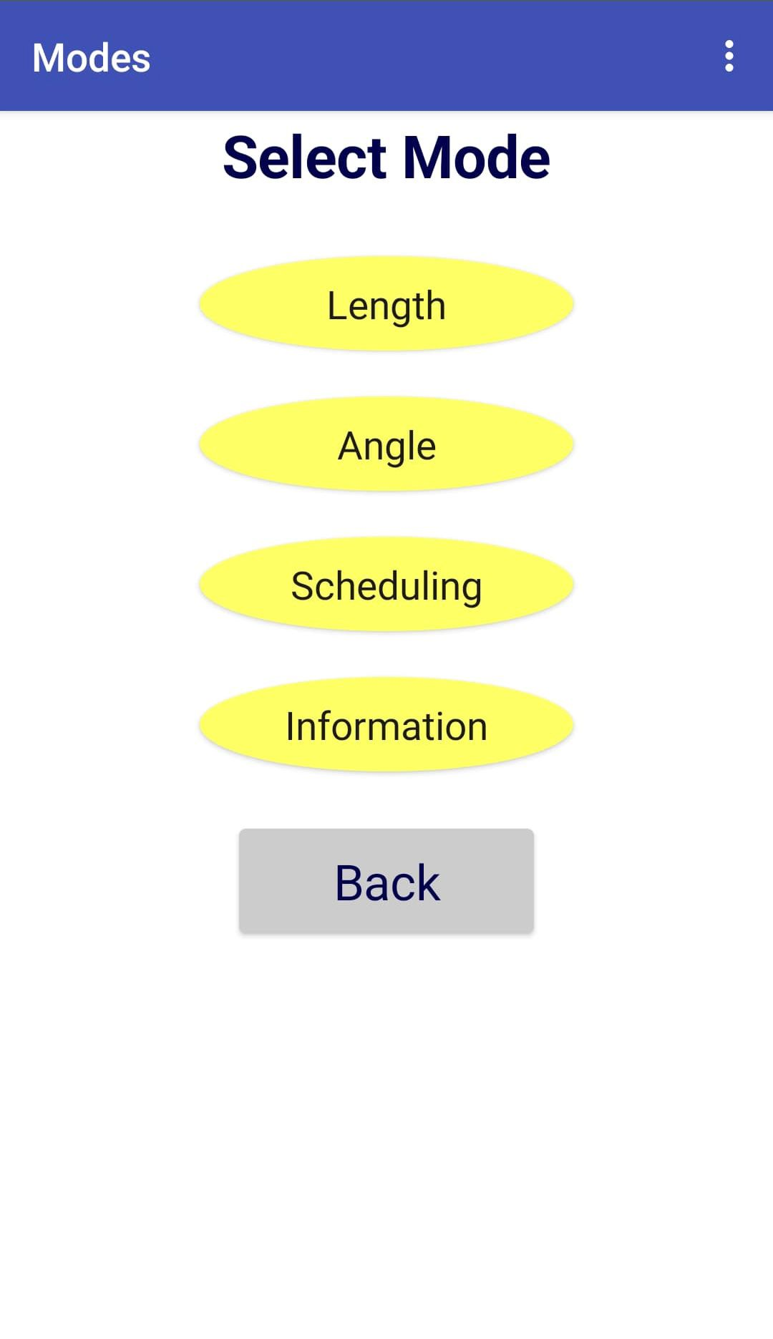
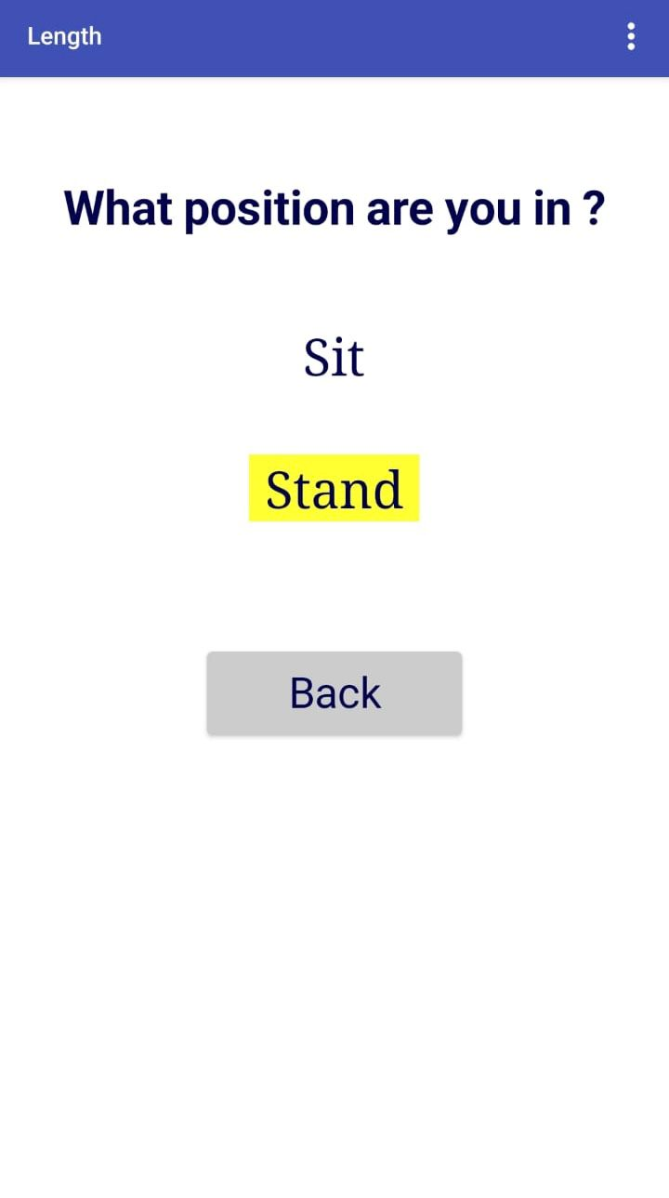
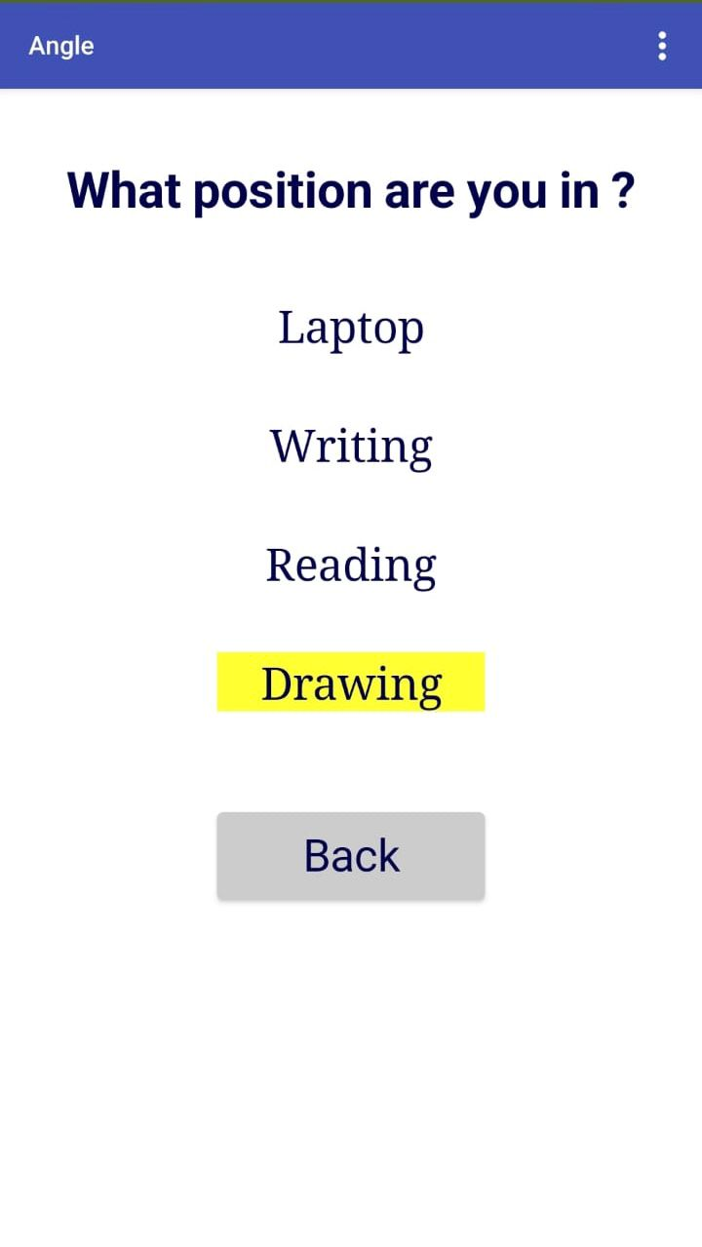

Slide 22
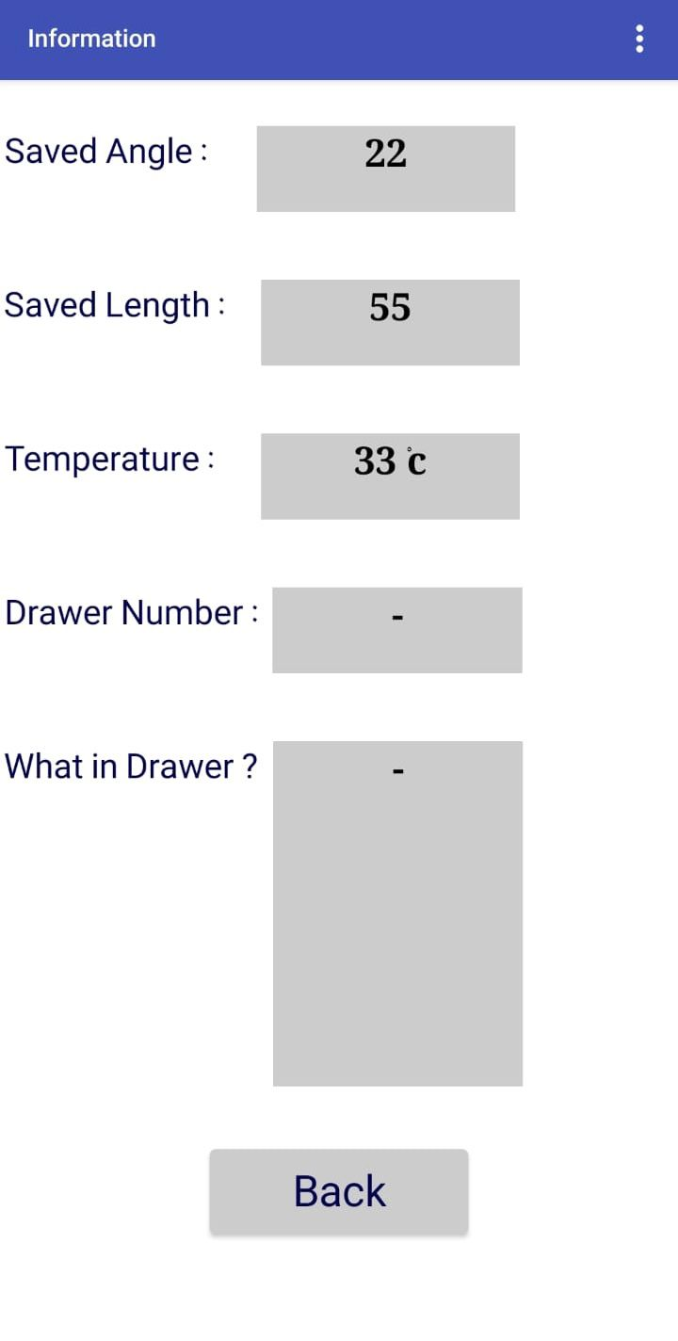
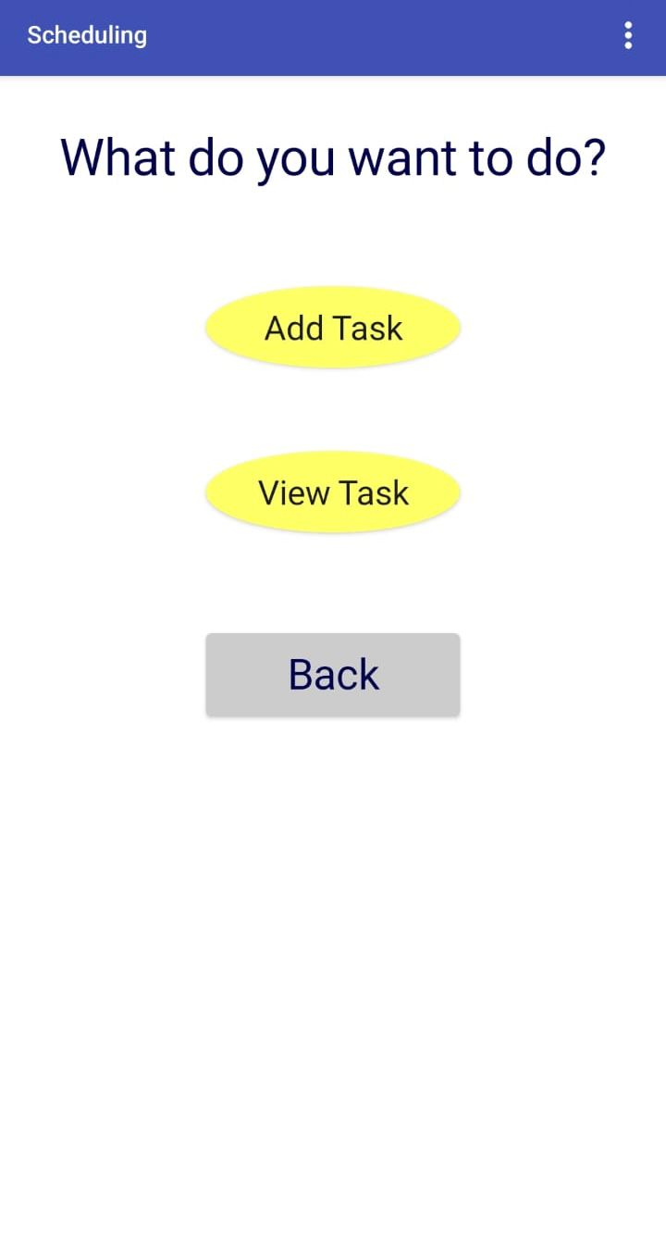
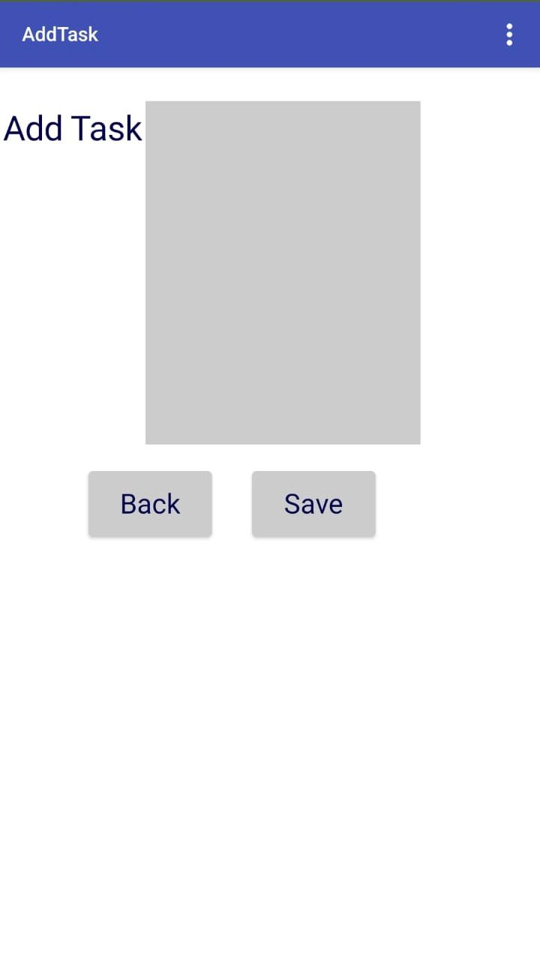

Slide 23
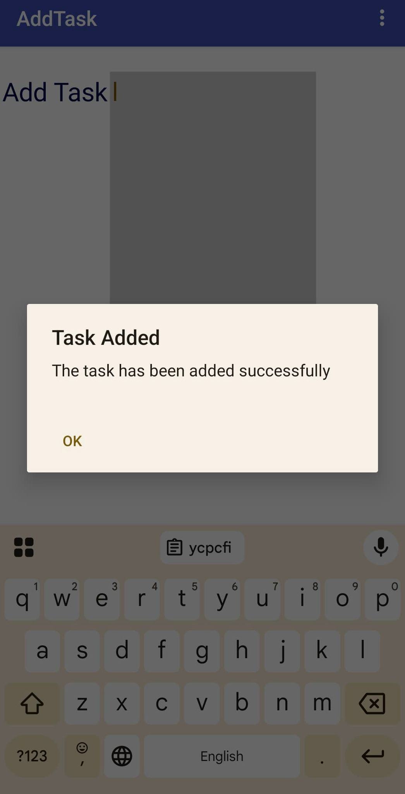
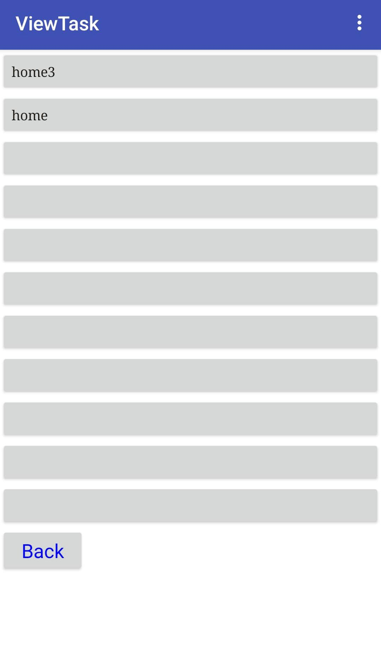
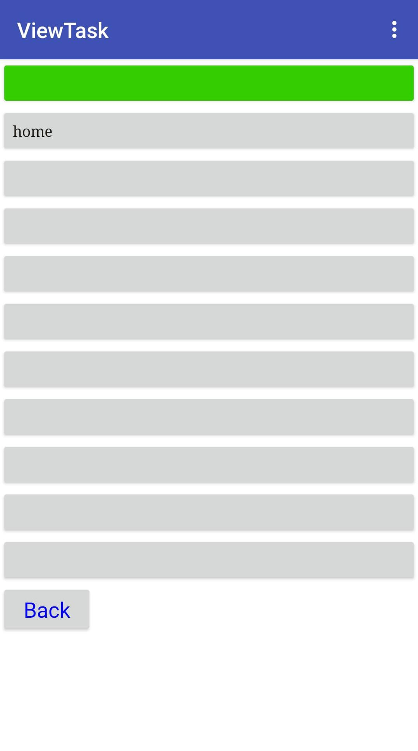

Slide 24
Constraints

Slide 25
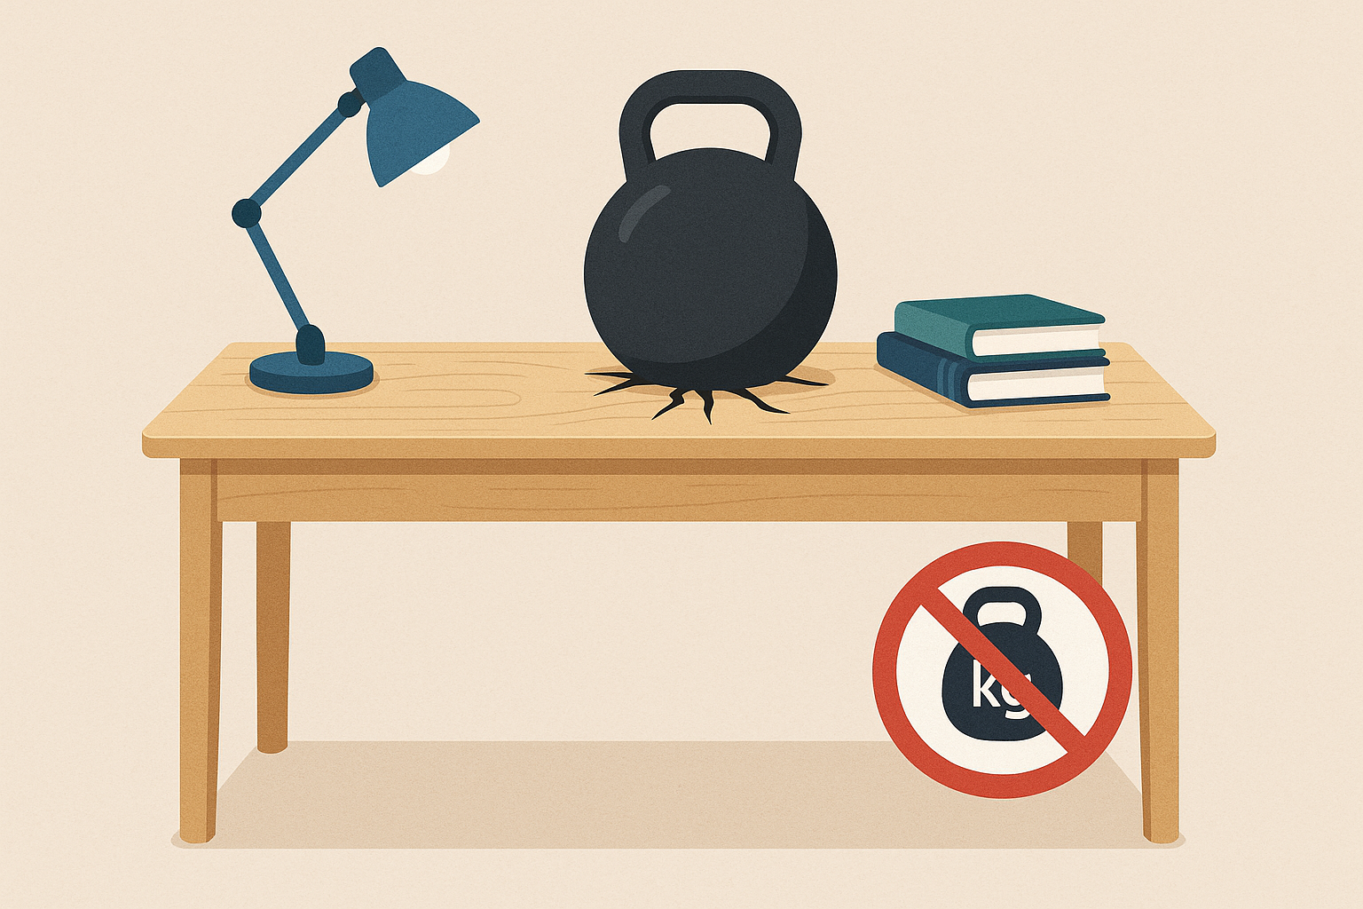
Constraints
The desk can't support heavy weight on top because the satellite motor can't handle heavy loads. This makes it harder and slower to change the angle.

Slide 26
Future Work
Office chair
Voice control
Study mode
prediction model

Slide 27
Thanks
Any Question?

