Slide 1
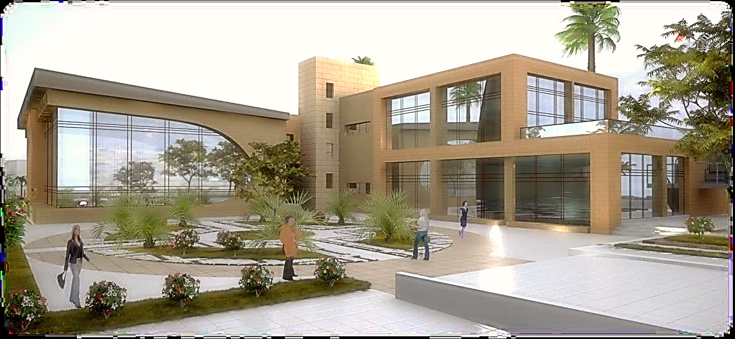
An-Najah National University
Building Engineering Department
Women Recreation Center Project
Prepared by :Hama Kamal Mansour
Isra’ Yousef Dwaikat
Lana Faisal Sabbah
Supervisor Dr. Mokarram Abbas

Slide 2
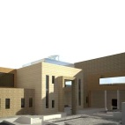
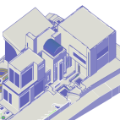
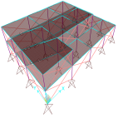
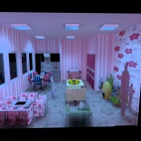
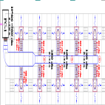
Outline
Architectural Design Concept & Functional Relations
Environmental Design
Structure of Building & Detailing
Lighting & Electrical Considerations
Mechanical Design
BOQ Surveying
Notes:
Arch. Hama
Str. Isra
Env. Hama
Mech./ Elec. Isra
BOQ Lana

Slide 3
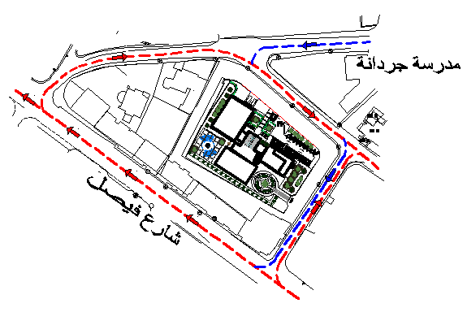
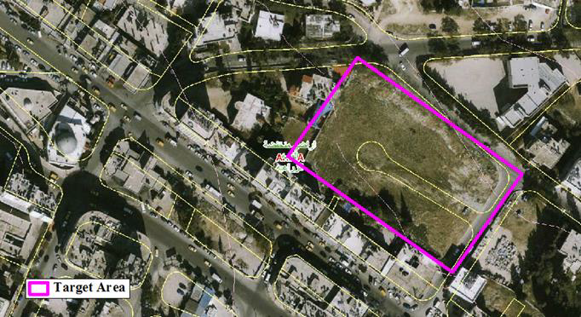
Architectural Design
Target Area and Traffic Direction:

Slide 4
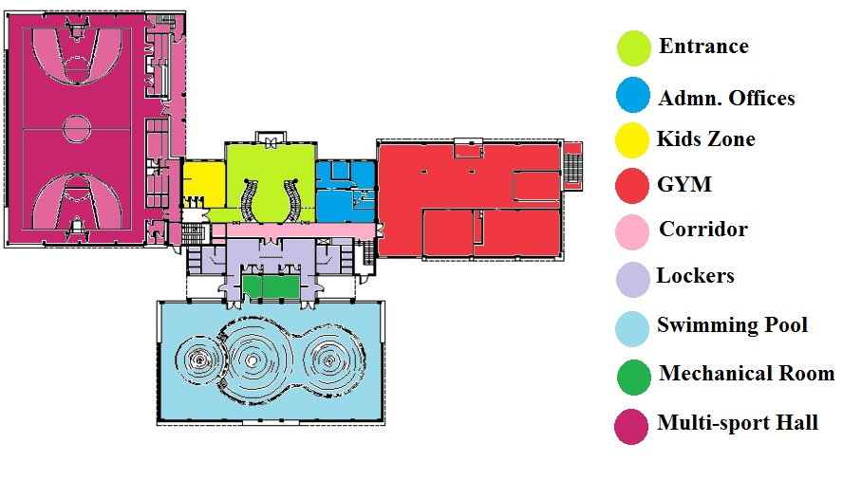
Ground Floor- Plan
Notes:
Arch. Hama
Str. Isra
Env. Hama
Mech./ Elec. Isra
BOQ Lana

Slide 5
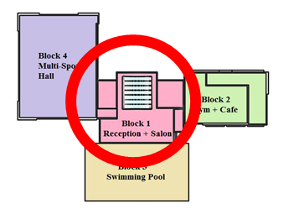
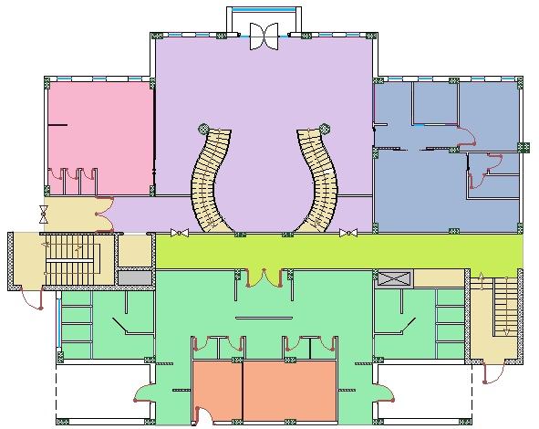
Ground Floor – Block1
Lobby &
Reception
Administrative
Offices
Kids Zone
Lockers
Mechanical
Room

Slide 6
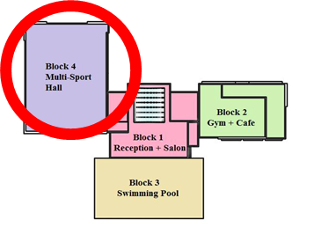
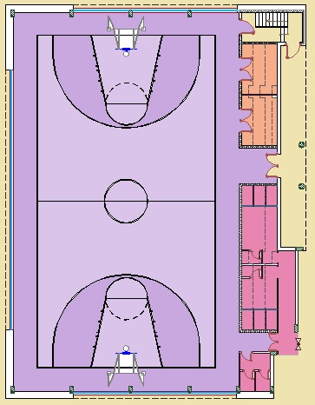
Ground Floor – Block2
Storage
Multi-Sports Hall
Lockers & WCs

Slide 7
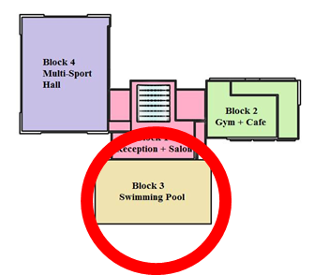
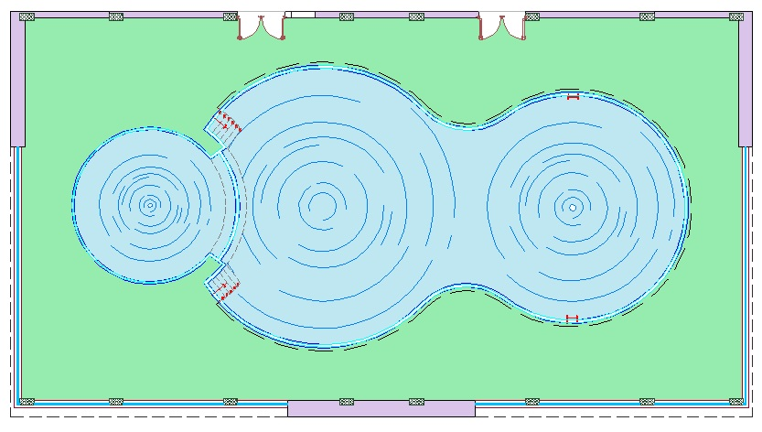
Ground Floor – Block3
Swimming Pool

Slide 8
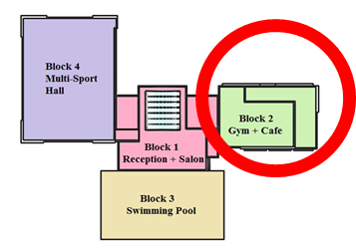
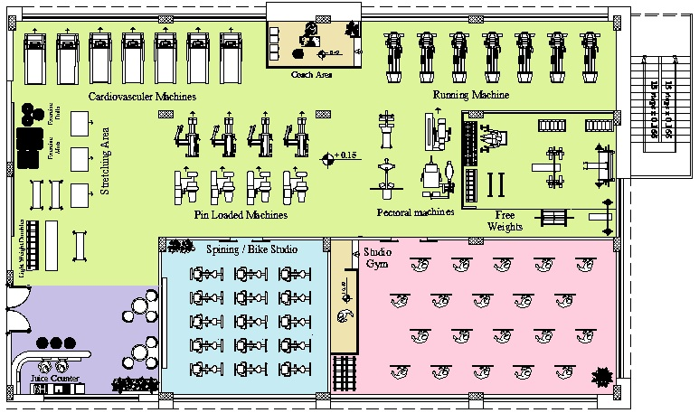
Ground Floor – Block4
GYM
Juice
Bar
Dance
Studio
Spinning

Slide 9
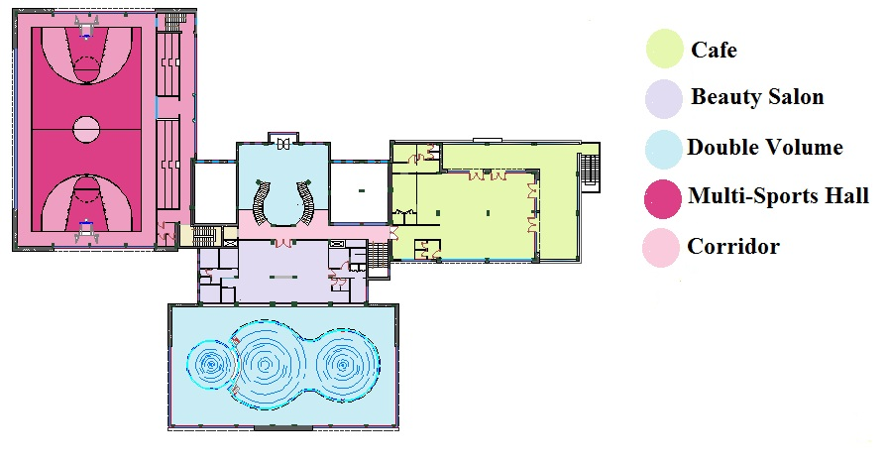
First Floor – Plan

Slide 10
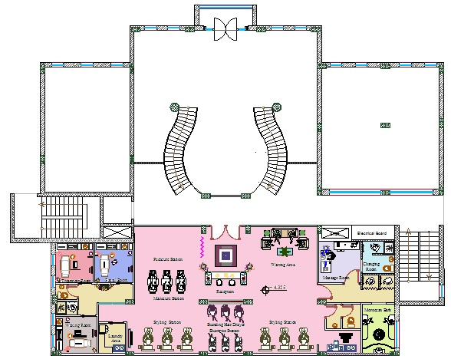
First Floor- Block 1

Slide 11
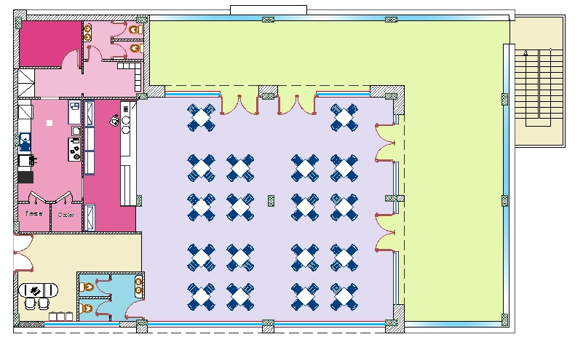
First Floor- Block 4:
Dinning Area
Storage
Terrace
Kitchen
Bar
Cashier

Slide 12
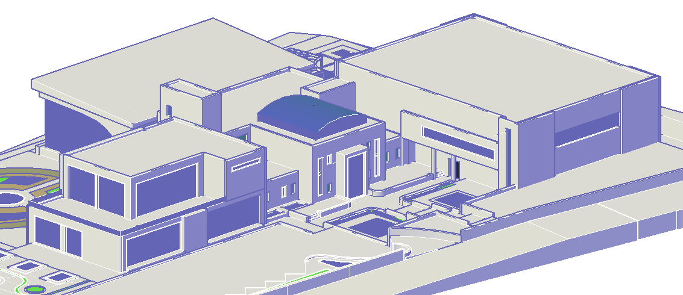
Environmental Design

Slide 13
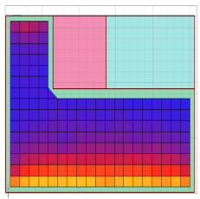
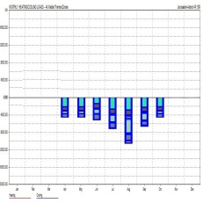
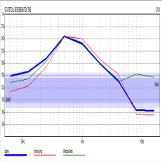
Environmental Design
Daylight Calculation
Thermal Calculation
Acoustical Design

Slide 14
Environmental Design
Avg. Daylight Values:
Zone | Maintained IL luminance | Value
 |  | D.F | Lux
GYM | 500 | 11.1% | 999
Spinning | 300 | 3.32% | 296.69
Studio | 300 | 4.21% | 378.54
Manager | 500 | 3.24% | 201.61
Secretary | 500 | 4.39% | 395
Kids Zone | 300 | 2.86% | 257.07
Restaurant | 500 | 4.59% | 413.38

Slide 15
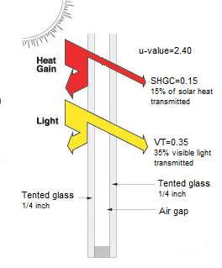
Environmental Design
Double Tented Glass:
U-Value = 2.4
Solar Heat transmitted = 15%
Visible Light Transmitted =35%

Slide 16
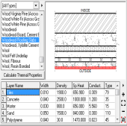
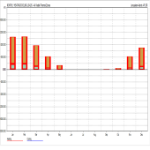
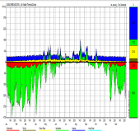
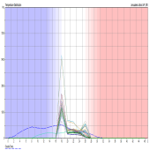
Environmental Design
Thermal Design:
Material properties
Heating and Cooling Load
Heat Gain Breakdown
Temperature Distribution.

Slide 17
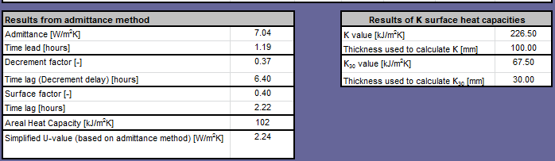
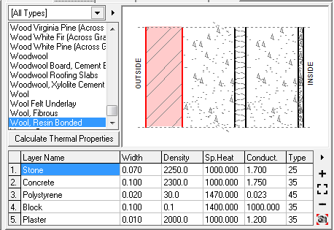
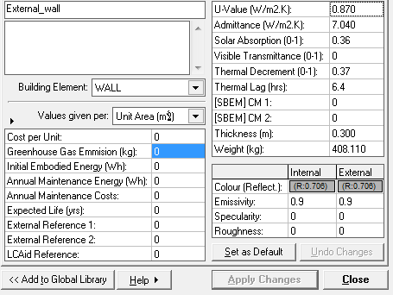
Environmental Design
Material properties
External Wall Details
U-value = 0.87 W/m2.K
Thermal Lag= 6.4 hrs.

Slide 18
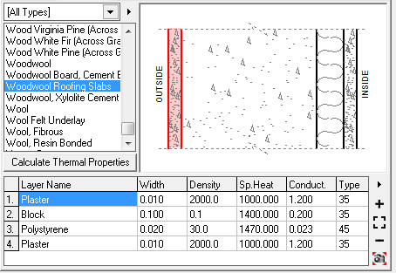
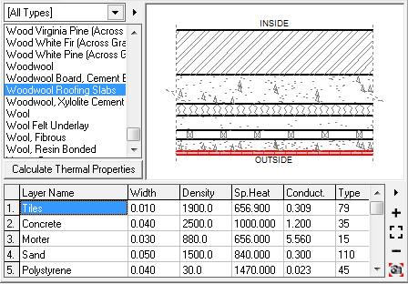
Environmental Design
Material properties
Internal Wall
Ground Floor
U-value = 0.64 W/m2.K
U-value = 0.39 W/m2.K
Thermal Lag= 0.74 hrs.
Thermal Lag= 14.14 hrs.

Slide 19
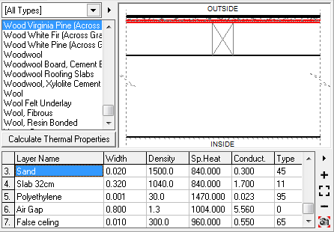
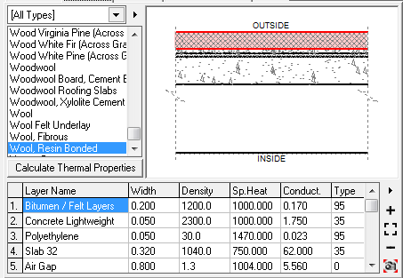
Environmental Design
Material properties
Ceiling
Roof
U-value = 0.51 W/m2.K
U-value = 0.27 W/m2.K
Thermal Lag= 9.55 hrs.
Thermal Lag= 0.6 hrs.

Slide 20


Environmental Design
Heating and Cooling Load
@ Winter:
Total Heating = 23.3 KWh/m2
@ Summer:
Total Cooling = 49.5 KWh/m2

Slide 21
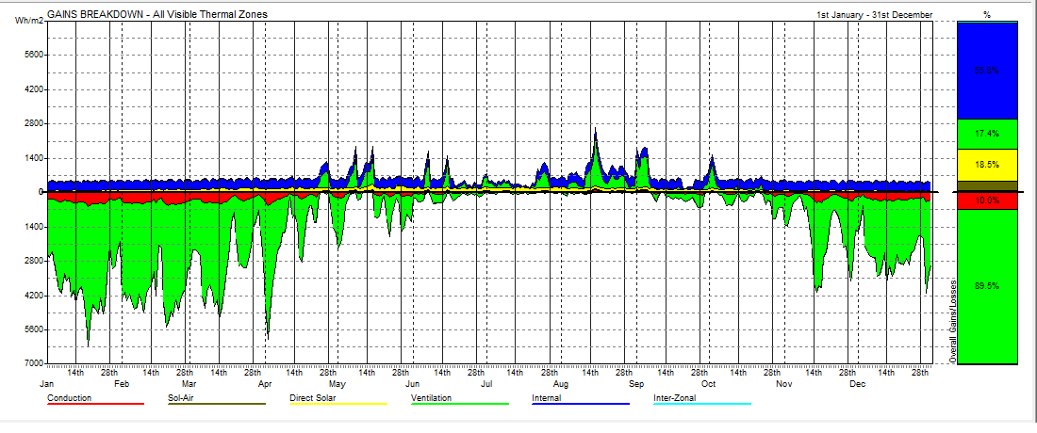
Heat Gain Breakdown:
Heat Gain
Increase Cooling
load or decrease
Heating load
55.8%
17.4%
18.5%
10.0%
Heat Loss
Increase Heating
load or decrease
Cooling load
89.50%

Slide 22

Environmental Design
Temperature Distribution:
Cold
In Comfort
Hot

Slide 23
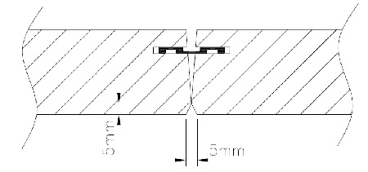
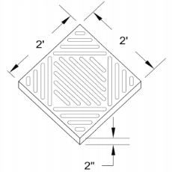
Environmental Design
Acoustical Design
RT 60
STC
IIC

Slide 24
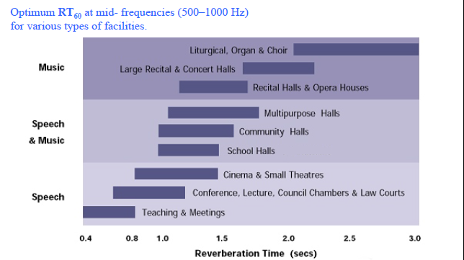
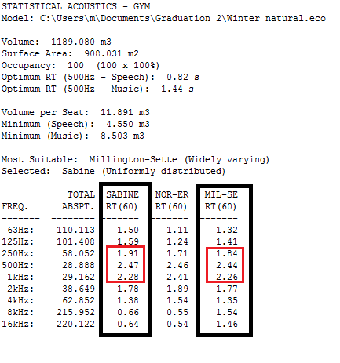
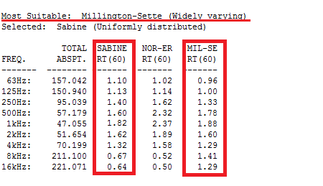
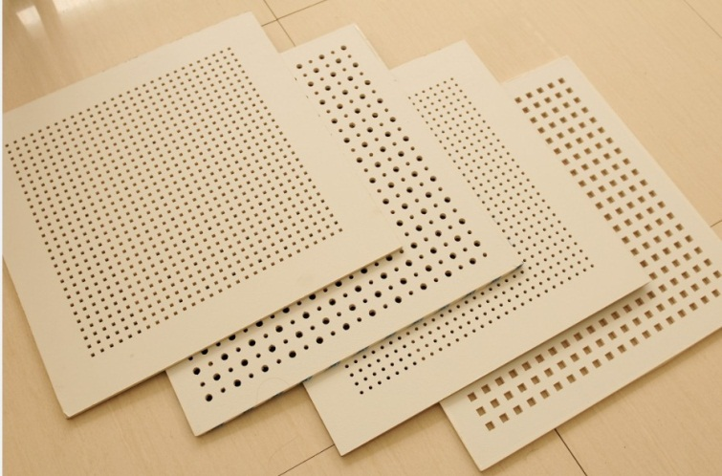
Environmental Design
Acoustical Design for Gym:
Values for Original wall
Values for Modified wall

Slide 25
Environmental Design
STC & IIC Values
For Inner Wall between Spinning and GYM:
Total STC of wall = 63 db .
TLwall =56 db TLdoor(wood door )= 38
TL tot (cal)= 10 log ( Atot /∑Si*10^-0.1*TLi)
= 60.1 db > 60 db
- STC (External Wall) = 63 db > 60 db
- IIC (False Ceiling) = 68 db > 60

Slide 26
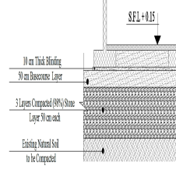

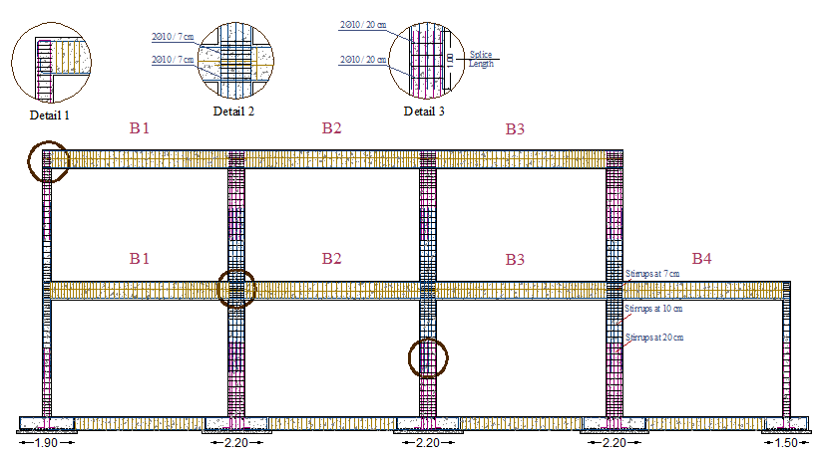
Building Structure & Detailing
Soil Improvement and Properties
SAP - 3D Dynamic Model
Structural Elements Detailing

Slide 27
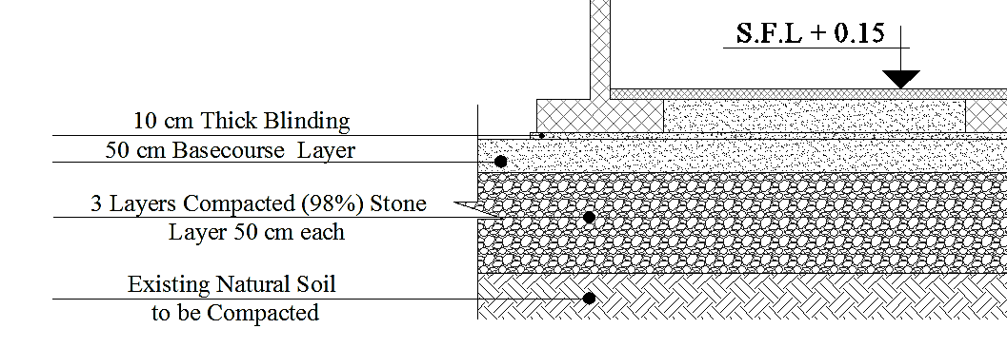
Building Structure & Detailing
Soil Improvement and Properties
Brownish Silt Clay Soil Bearing Capacity
Before Improvements = 150 KN/m²
2 m
Soil Bearing Capacity After Improvement = 200 KN/m²

Slide 28
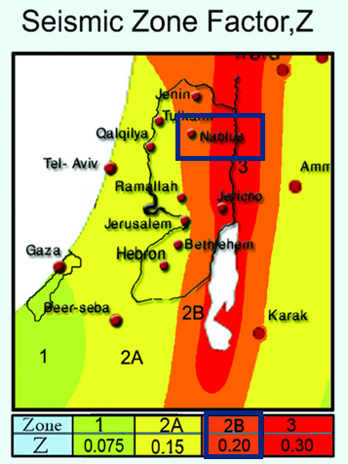
Seismic Design
Importance factor (I) = 1
Soil profile: Silt Clay
Seismic Coefficient (Cv)= 0.32
Seismic Coefficient (Ca)= 0.24
Structural system Coefficient (R) = 5.5
The Structural System in Nablus
Sway Intermediate

Slide 29
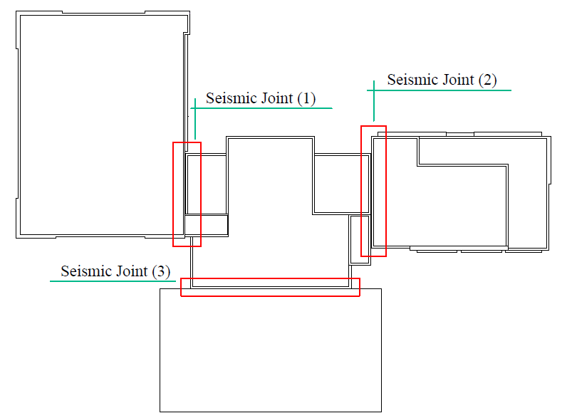
Building Structure & Detailing
Seismic Joints
Seismic Joint Thickness = 4 cm for Each

Slide 30
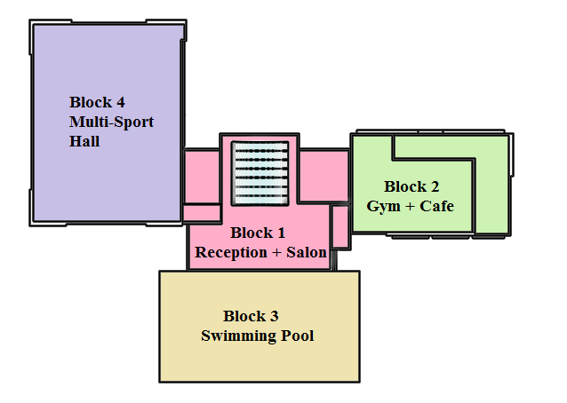
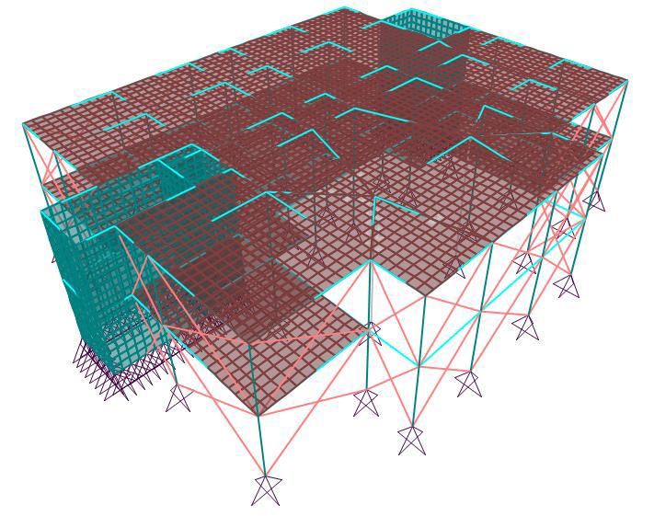

Building Structure & Detailing
Project Blocks
3D Dynamic Model - SAP
3D Model SAP - Block 1
3D Model SAP - Block 2

Slide 31



SAP Validation Checks – Block 2
1- Compatibility Check
2- Equilibrium Check
Load | Manual | Sap | Error
Dead load | 8164 KN | 8265 KN | 1.2 %
Live load | 2888 KN | 2902 KN | 0.48 %
Super Imposed | 2206 KN | 2216.5 KN | 0.47 %
3- Internal Forces Check
Element | Error
Slab | 3.86 %
Beam | 2.37 %
Columns | 11%

Slide 32

Footing and Tie Beams Layout – Block 2

Slide 33


Isolated Footing Detailing
Footing | Dimensions
F1 | 2.90*2.60
F2 | 2.30*2.00
F3 | 2.20*1.90
F4 | 1.80*1.50
Top View – F1
Section 1-1 in F1

Slide 34




Tie Beams Detailing

Slide 35


Columns and Frame Detailing – Block 2
Columns Dimensions 60*30 cm

Slide 36

Columns and Frame Detailing
Frame Detailing

Slide 37



One Way Ribbed Slab Detailing – Block 2

Slide 38


One Way Ribbed Slab Detailing – Block 2
Section 1-1 in Rib

Slide 39



Main Beams Detailing – Block 2
Section 1-1
B12

Slide 40



Secondary Beams Detailing – Block 2
Section 1-1
B31

Slide 41
Block 1

Slide 42



Shear Wall Design - Block 1
Shear Wall (1) Detailing

Slide 43

Stairs Detailing - Block 1

Slide 44



Lighting and Electrical Considerations
Luminaire Distribution
Socket Arrangement
Electrical Distribution Boards

Slide 45



Lighting and Electrical Considerations
Luminaire Distribution
Fitness GYM
Frameless Recessed
Luminaire Square 60*60 cm
Power = 72 Watt
Avg. Lux = 575
Standard Lux = 500
UGR = 14
Uniformity = 0.645

Slide 46



Lighting and Electrical Considerations
Luminaire Distribution
Fitness GYM Artificial Lighting
Arrangement

Slide 47



Lighting and Electrical Considerations
Luminaire Distribution
Kids Zone
Frameless Ceiling mounted
luminaire square 60*60 cm
Power = 72 Watt
Avg. Lux = 381 - 457
Standard Lux = 400
UGR = 13
Uniformity = 0.567 – 0.69

Slide 48



Lighting and Electrical Considerations
Sockets Arrangement
Table Sockets Water Proof Sockets Underground Sockets

Slide 49



Essential Distribution Boards

Slide 50

Main Distribution Boards

Slide 51

Essential Distribution Boards with Generator

Slide 52



Mechanical Design
Water Supply System
Drainage System
HVAC System

Slide 53

Mechanical Design
Water Supply System:
Individual demand in club building from water is 50 liter/person.
The size of the tank will be computed over three days.
30% of the tank size is for firefighting and cleaning.
We have four tanks and each two tanks give one pipe for supply

Slide 54

Mechanical Design
Water Supply System:

Slide 55

Mechanical Design
Drainage System
Street Manhole
Septic tank

Slide 56

Mechanical Design
Drainage System:
Gray water
Black water

Slide 57

Mechanical Design
Drainage System:

Slide 58
Mechanical Design
HVAC System:
- Cooling Load:
Zone | Cooling Load | Zone | Cooling Load
GYM | 36 | Restaurant | 22.849
Spinning | 4.09 | Kitchen | 3.208
Studio | 7.19 | Rest Room | 0.205
Manager | 1.68 | Break Room | 0.38
Secretary | 0.467 | Beauty Salon | 13.597
Marketing | 0.561 | Treatment | 0.4453
Corridor | 0.821 | Facial | 0.45
Common Area | 3.16 | Waxing | 0.486
Kids Zone | 4.39 | Massage | 0.573
Corridor GF | 2.301 | Corridor FF | 4.31
Locker | 5.33 | Lobby | 12.5

Slide 59
Mechanical Design
HVAC System:
- Heating Load:
Zone | Heating Load | Zone | Heating Load
GYM | 1.843 | Restaurant | 13.744
Spinning | 0.478 | Kitchen | 0.07
Studio | 1.3 | Rest Room | 0.094
Manager | 0.845 | Break Room | 0.065
Secretary | 0.273 | Beauty Salon | 0.301
Marketing | 0.059 | Treatment | 0.140
Corridor | 0. 3 | Facial | 0.117
Common Area | 1.124 | Waxing | 0.215
Kids Zone | 1.605 | Massage | 0.246
Corridor GF | 1. 14 | Corridor FF | 1.416
Locker | 0.982 | Lobby | 8.067

Slide 60

Mechanical Design
HVAC System

Slide 61


Mechanical Design
HVAC System
For Studio Gym Zone:
Cooling Load = 7.19
Heating Load = 1.3

Slide 62

Mechanical Design
HVAC System
For Lookers Zone:

Slide 63
Safety Design
Fire extinguishers and sprinklers
Safety Signs
Emergency exits

Slide 64

Safety Design
Fire Extinguishers and Sprinklers

Slide 65

Safety Design
Fire Extinguishers and Sprinklers
Fire extinguisher
sprinklers

Slide 66

Safety Design
Safety signs:

Slide 67

Safety Design
Safety signs:
Evacuation Route

Slide 68


Safety Design
Emergency Exits for First Floor:

Slide 69
B.O.Q Surveying
Type | Cost ($)
Structural Design | 67665
Electrical Design | 42550
Mechanical Design | 143467
Finishes | 126750
Total cost\ m² | 540 $\m²

