Slide 1
ASHRAE Type 2 Energy Audit for Rafidia Hospital
By:
Ziad Tuffaha
Majed Tayyem
Supervisor: Dr. Mohammed AlSayed

Slide 2
Outline
01.
Introduction
02.
Methodology
Data Collection
Information Management Systems
04.
03.
Saving Opportunities
Conclusion
05.
06.

Slide 3
01.
Introduction

Slide 4
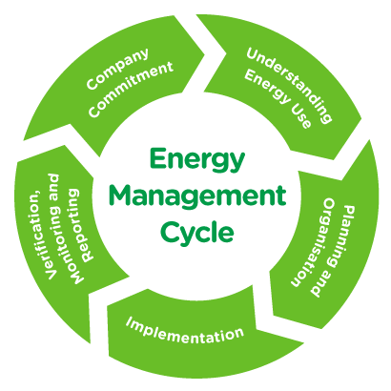
Energy Management and Audits
Energy audits are an integral part of energy management systems.
Energy audits are a method to decrease energy consumption and increase energy efficiency without disrupting the output or quality of life of the audited establishment.
Energy audits aim to improve energy efficiency, decrease energy consumption and greenhouse gasses.

Slide 5
Rafidia Hospital
Built in 1976, it is one of the largest hospitals in the entire West Bank, providing services to an estimated population of 500,000
The hospital has an emergency department, a general operation department, and a specialized surgery department
The number of beds in the hospital is 212.
The hospital has an occupancy rate of 100%.

Slide 6
02.
Methodology

Slide 7
ASHRAE Type 2 Energy Audits
Level 1
Level 2
Level 3
Detailed Analysis of Capital-Intensive Modifications
Walk-through Analysis
Energy Survey and Engineering Analysis

Slide 8
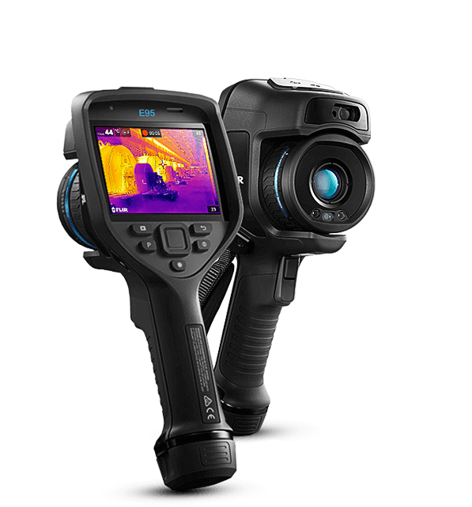
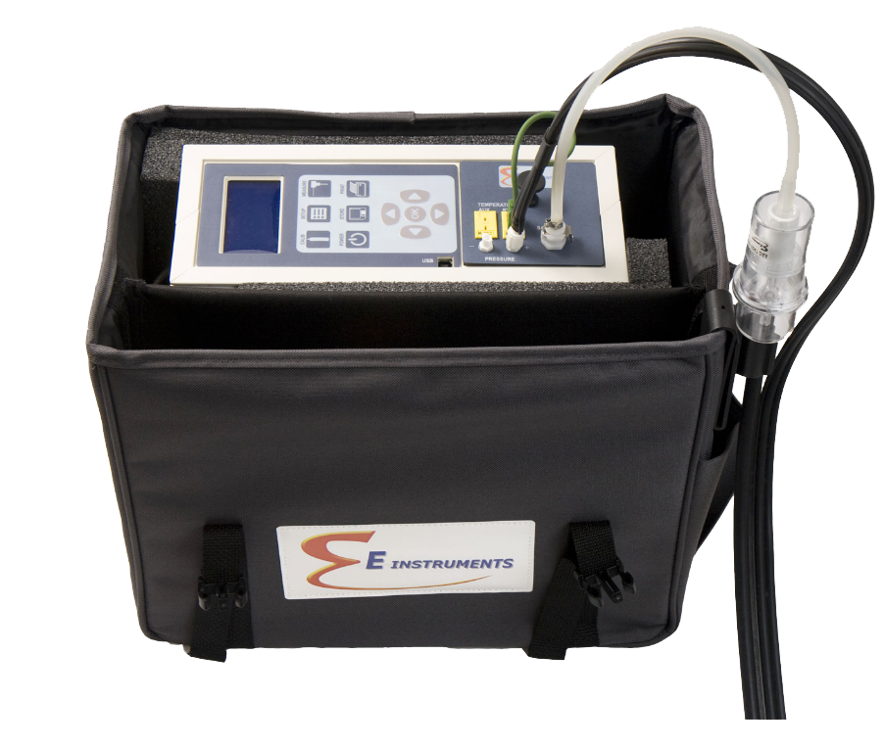
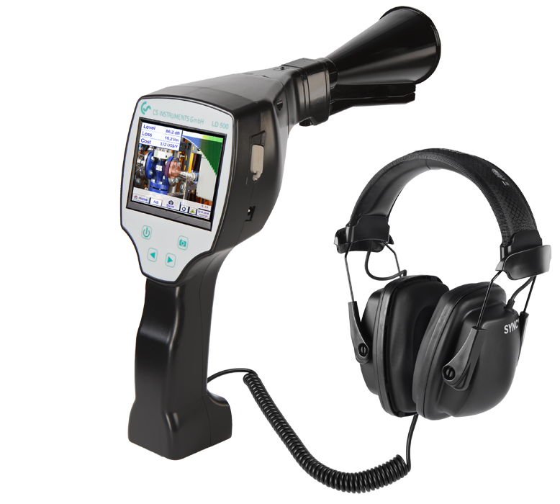
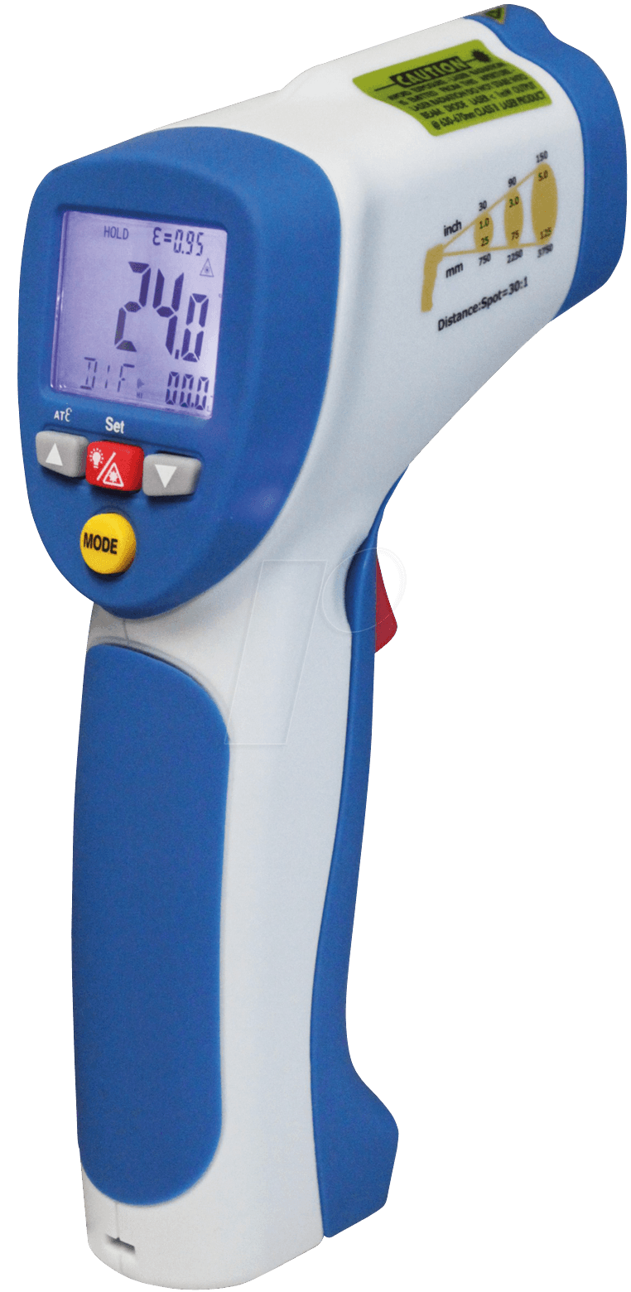
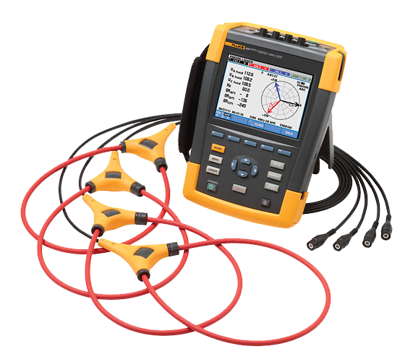
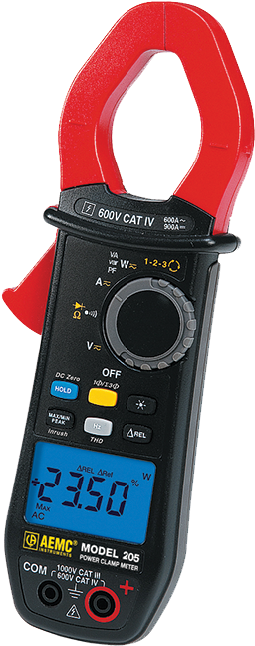
Equipment List
Flue Gas Analyzer
Ultra Sonic Leak
Detector
Thermal Camera
Thermal Gun
Clamp Meter
Power Analyzer

Slide 9
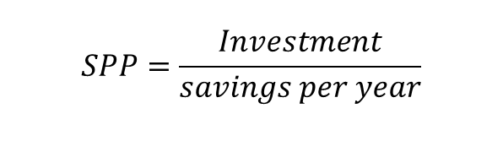


Economic Evaluation
Simple Payback Period
Rate of Return
$$SPP=\frac{Investment}{savings per year}$$
$$\sum{PVinvestmen }=\sum{PVrevenues }$$
Present Value
$$P=A \left(P/A.i.n\right)$$

Slide 10
03.
Data Collection

Slide 11

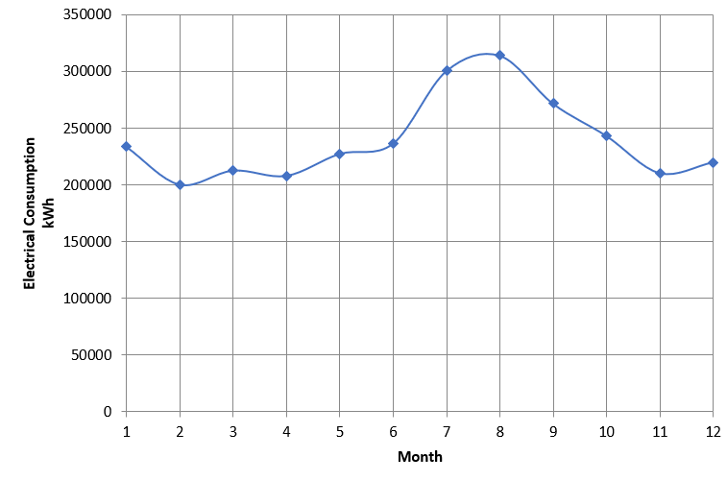
Electricity Consumption
The electricity and water consumption for the hospital were obtained by analyzing and collecting the hospital’s electricity and water bills from 2021.

Slide 12

Water Consumption

Slide 13
Utilities List
The utilities list was compiled during the walk-through analysis. Utilities with high rated power were registered into the list, which include:
Boilers
Chillers
Walk-in Cold Rooms
Pumps
HVAC systems
Compressors
Washing Machines

Slide 14
Cooling Degree Days
Month | Avg temp (°C)
Jan | 13
Feb | 13
Mar | 16
Apr | 19
May | 22
Jun | 25
Jul | 27
Aug | 27
Sep | 26
Oct | 23
Nov | 19
Dec | 14

Slide 15
04.
Information Management Systems

Slide 16
Information Management Systems
Multiple visits to the hospital showed that there were some gaps with the data in the hospital and the way information is logged and stored. Information management systems are suggested such as:
Electricity Tracking
Diesel Tracking
Updating the Layout and Plans
Labelling Electric Panels and Circuit Breakers

Slide 17
5.
Saving Opportunities

Slide 18
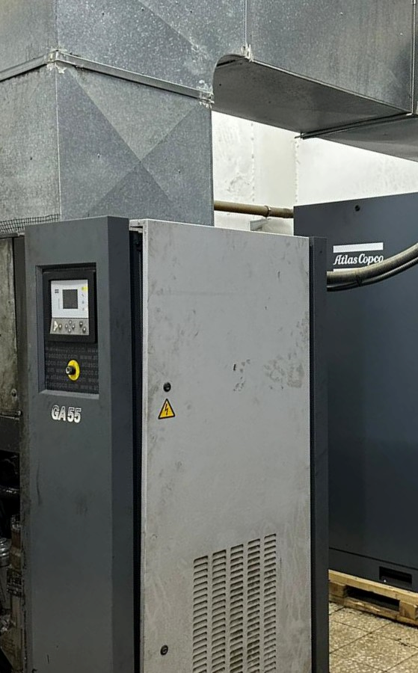
Compressor Saving Opportunities

Slide 19
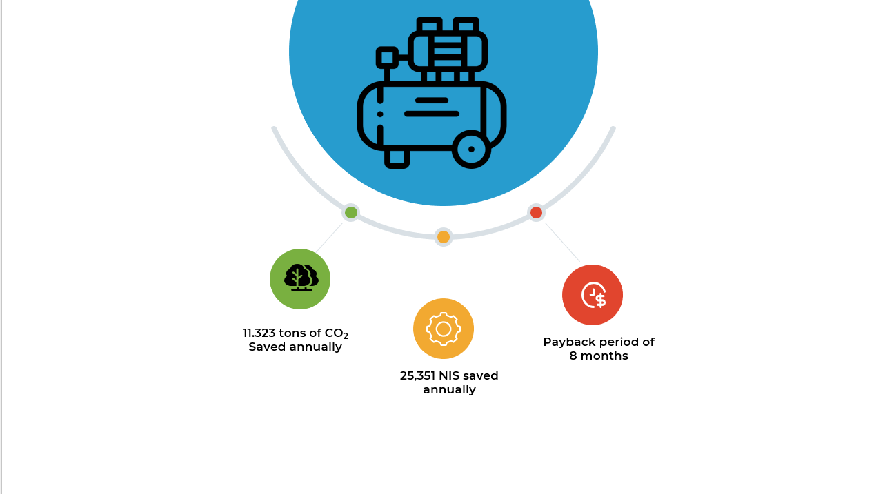
Compressor Saving Opportunities

Slide 20
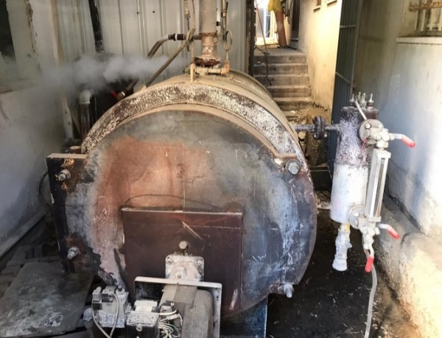
Steam Boiler Saving Opportunities

Slide 21
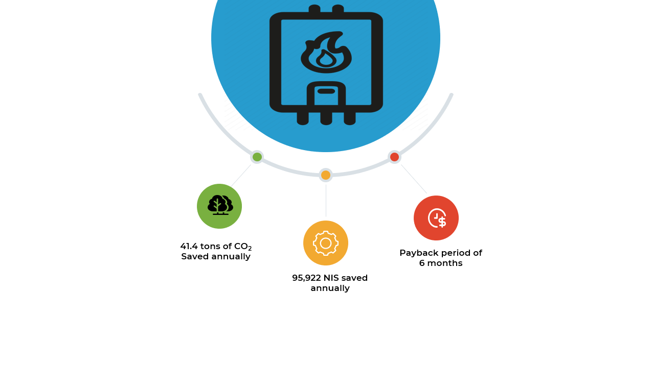
Steam Boiler Saving Opportunities

Slide 22
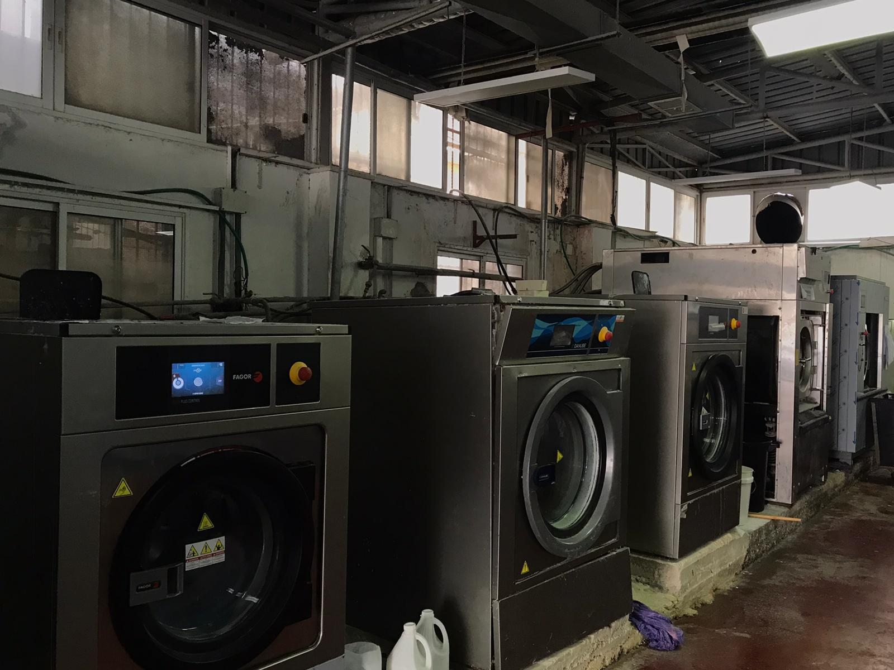
Washing Machine Saving Opportunities

Slide 23
6.
Conclusion

Slide 24
Conclusion
Utilizing an information management system
02
02
Meeting with Hospital Administration
Exploring more opportunities
Final Takeaways
01
03

Slide 25
Thank you for
listening!

