Slide 1



Faculty of Engineering & Information Technology
Department of Building Engineering
“Design of Health Center ”
Supervisor :
Dr. Nirmeen Al-Barq
Prepared By:
Razan Qablawi
&
Taimaa Nazzal
2020
New design
New design
New design
Case study analysis
Motivation
Codes
Task
Contents
Methodology

Slide 2



Contents
New design
Case study analysis
Codes
Task
Contents
Methodology
Motivation
1
2
3
Case Study
Architectural Aspect and analysis
Structural Design

Slide 3

Contents
New design
Case study analysis
Codes
Task
Contents
Methodology
Motivation
4
5
6
7
Electro-
Mechanical
Fire Fighting
Cost Estimation
Acoustical
Design

Slide 4
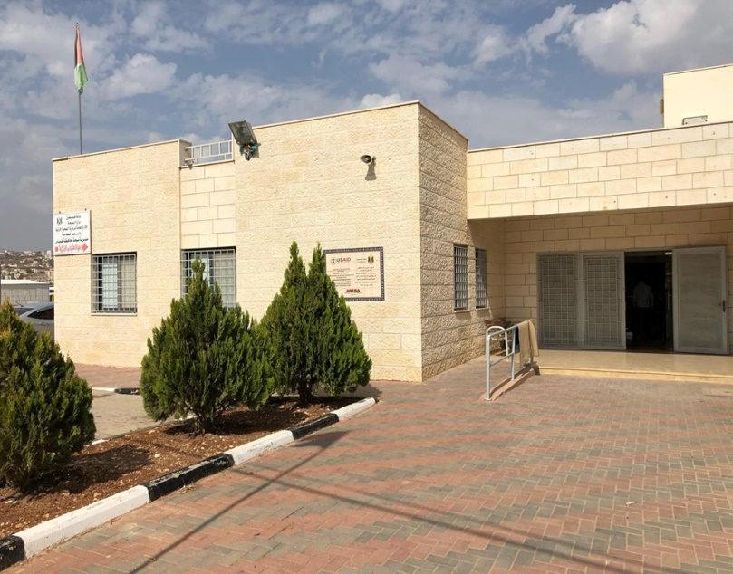
Task
To reach and understand the design requirements.
Case study.
New design
Case study analysis
Codes
Task
Contents
Methodology
Motivation

Slide 5
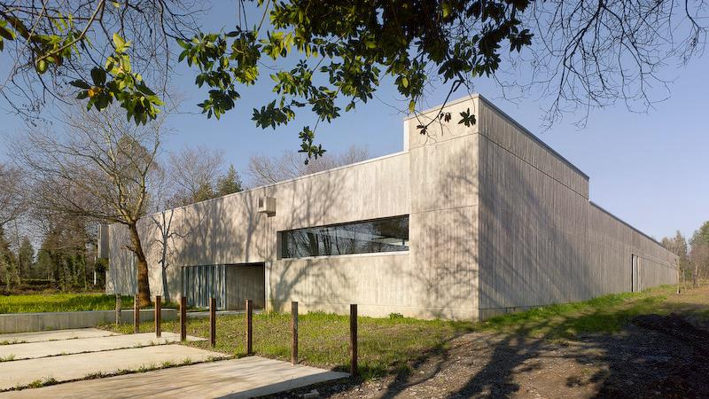
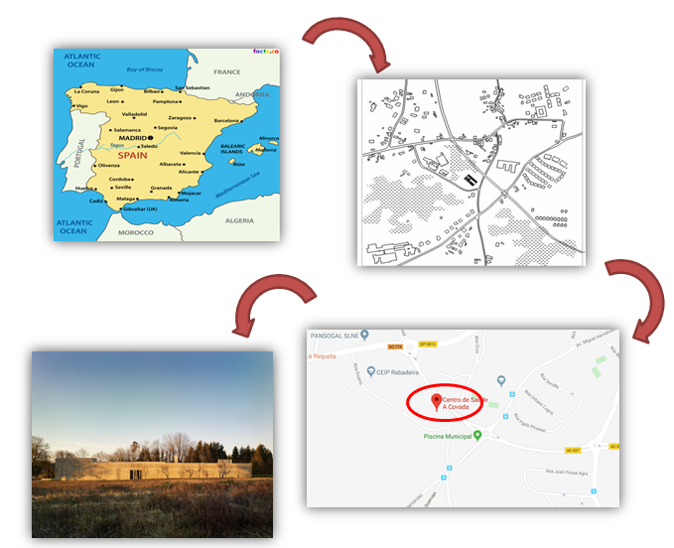
Case study analysis
Project name : Health Center
Project location : Spain.
Area : 3981.0 sqm .
Year : 2006-2009
CASE STUDY 1
Case study analysis
Codes
Task
Contents
Methodology
Motivation

Slide 6
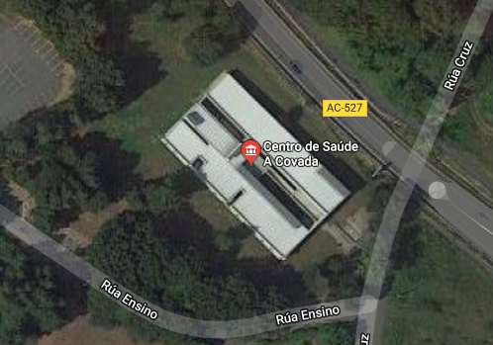
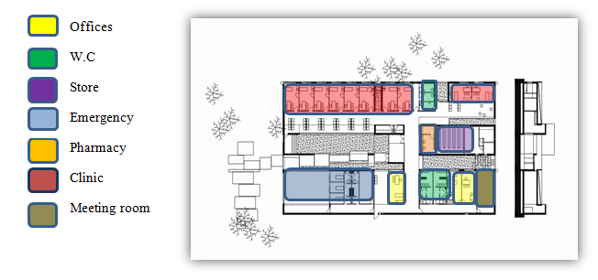
DESIGN IDEA :A single organization H shaped
was the design idea for our project
B)The requirement and functions for the building.
CASE STUDY 1
Case study analysis
Codes
Task
Contents
Methodology
Motivation

Slide 7
Architectural aspect and analysis :
Site analysis
Standard
Bubble Diagram
3D model
The existing building
Case study analysis
Codes
Task
Contents
Methodology
Motivation

Slide 8
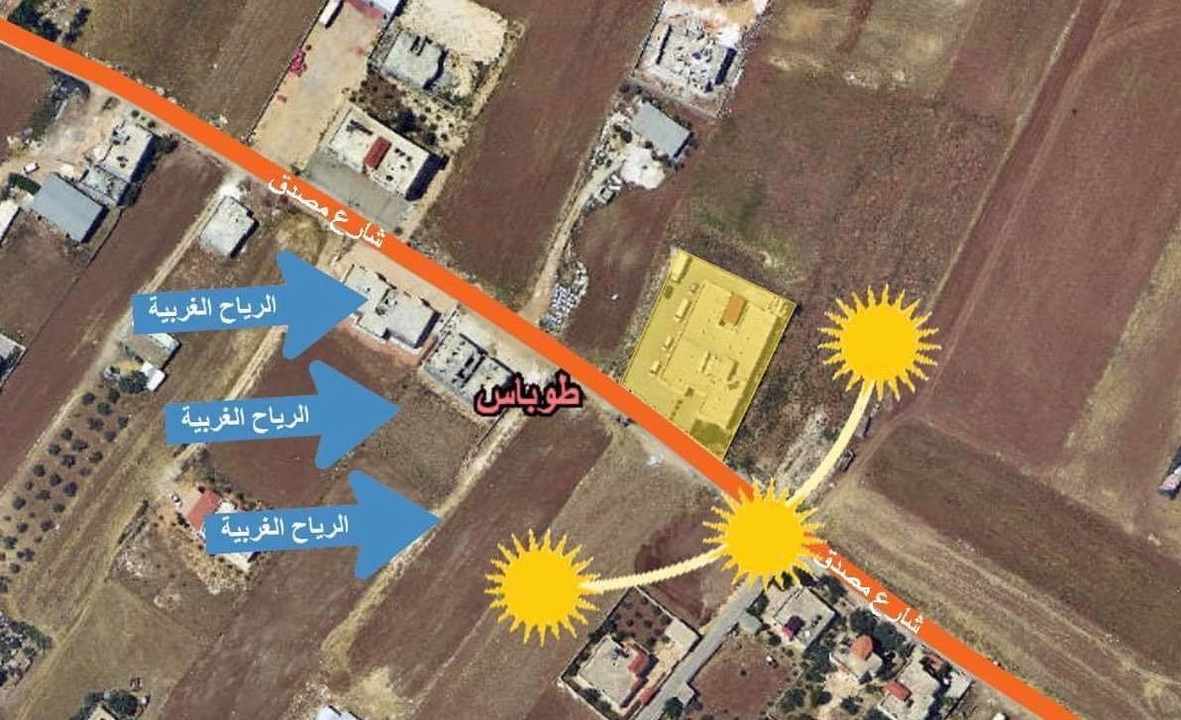
Architectural analysis :
Site Location and Analysis of the movement of the sun and wind .
New design
Codes
Task
Contents
Case study analysis
Methodology
Motivation

Slide 9
Bubble Diagram
Main entrance
Reception
Clinics
Pharmecy
X-ray room
Store
laboratory
back door
mechanical room
New design
Case study analysis
Codes
Task
Contents
Methodology
Motivation

Slide 10
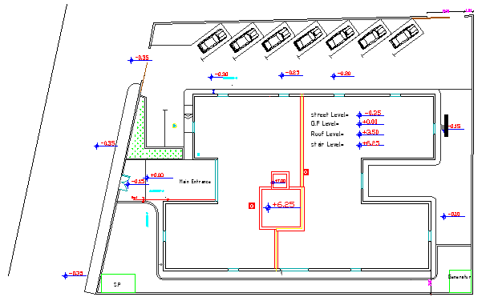
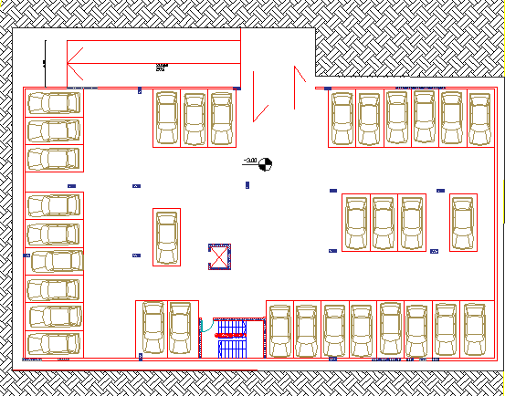
Standard
♦ Parking
New design
Case study analysis
Codes
Task
Contents
Methodology
Motivation

Slide 11
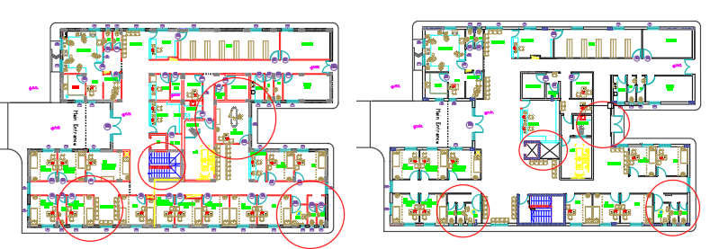
Standard
♦ Ground Floor
New design
Case study analysis
Codes
Task
Contents
Methodology
Motivation
Before
After

Slide 12
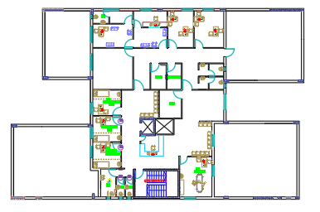
Standard
♦ First Floor
New design
Case study analysis
Codes
Task
Contents
Methodology
Motivation

Slide 13
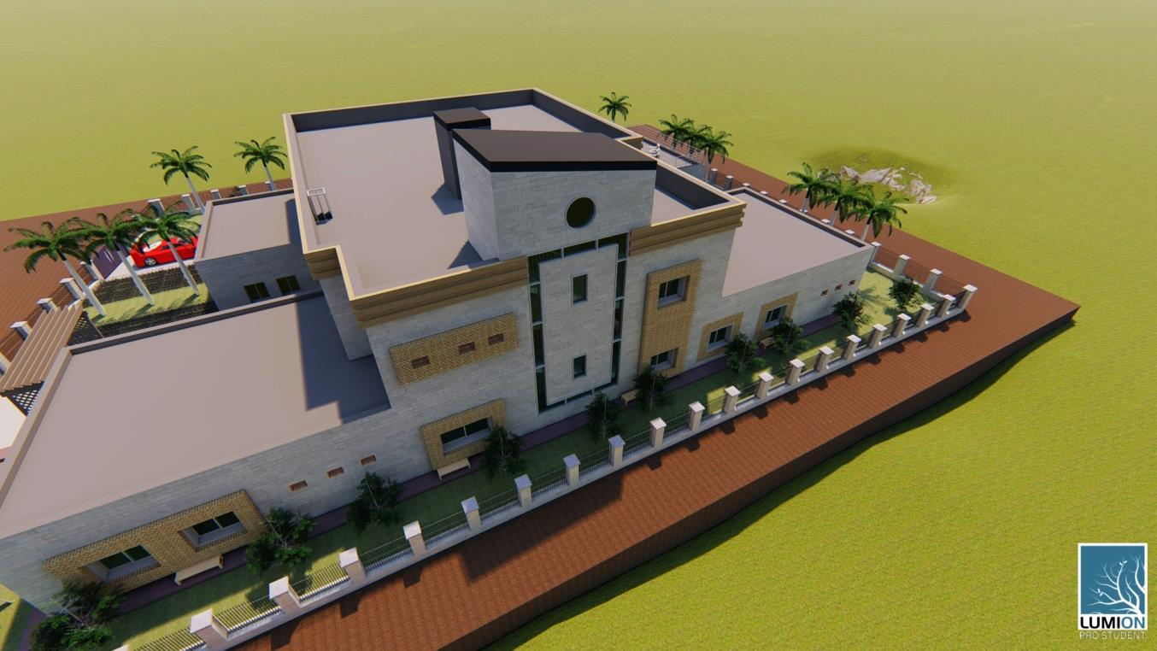
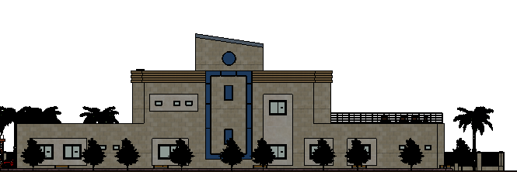
3D model
New design
Case study analysis
Codes
Task
Contents
Methodology
Motivation

Slide 14
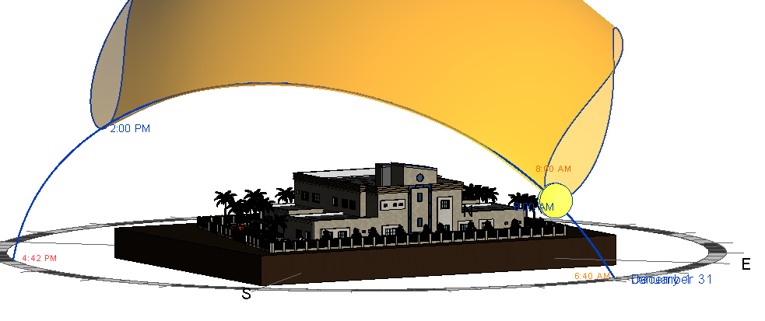
Environmental analysis :
3D model Design builder and materials
Shadow analysis
Day lighting
Solar analysis
New design
Case study analysis
Codes
Task
Contents
Methodology
Motivation

Slide 15
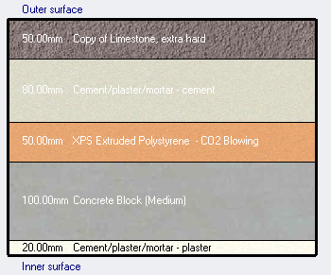
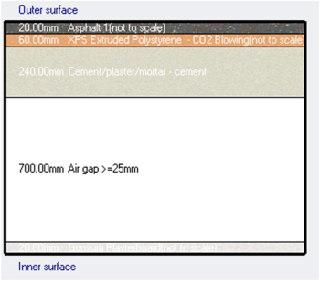
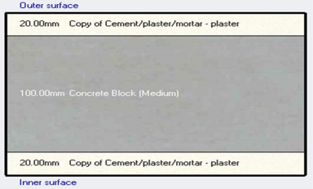
3D model Design and materials
♦ U-Glass(double clear) =2.67 W/m²-k → U-Glass(double glazing clear )= 1.5
♦ U-wall = 0.807 W/m²-k → U-wall = 0.49 W/m²-k
♦ U-Roof=0.396 W/m2-k which is approximately less than 0.39 W/m2-k
New design
Case study analysis
Codes
Task
Contents
Methodology
Motivation

Slide 16
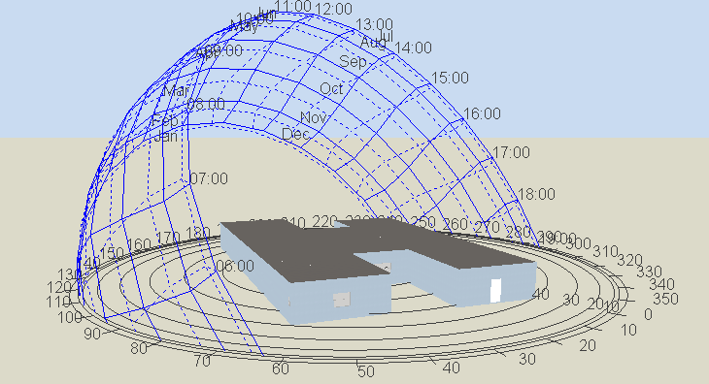
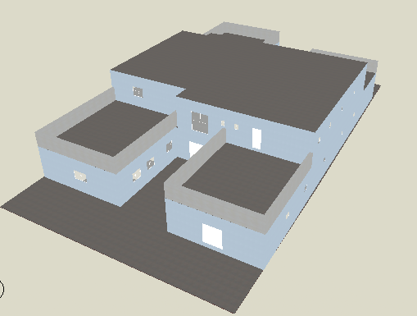
3D model Design builder and materials
New design
Case study analysis
Codes
Task
Contents
Methodology
Motivation

Slide 17
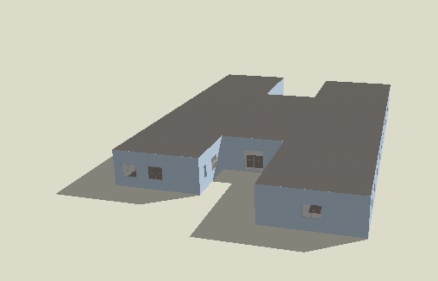
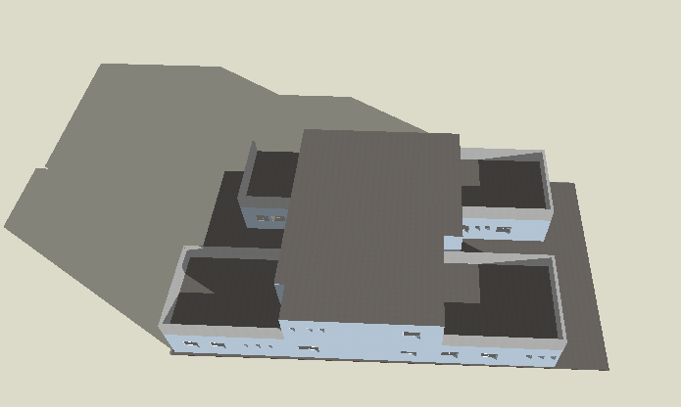
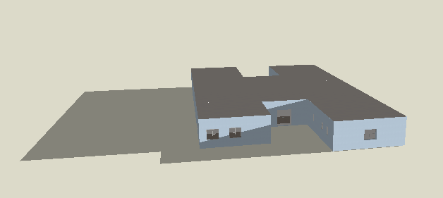
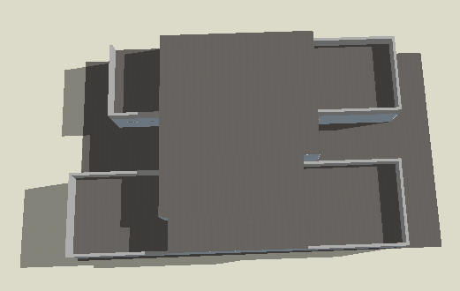
Shadow analysis
♦ The shadow analysis was done at 8 AM, 12 PM, 14 PM , the results :
in morning is semi shaded at 21 – January & 21 – June
Winter
New design
Case study analysis
Codes
Task
Contents
Methodology
Motivation
Summer

Slide 18
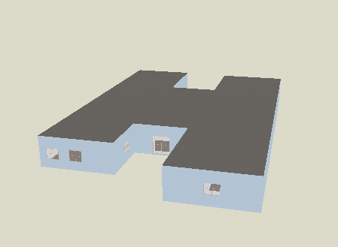
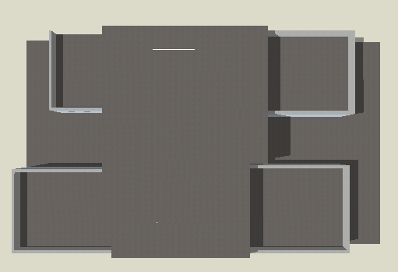
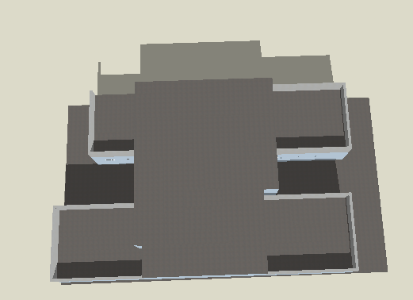
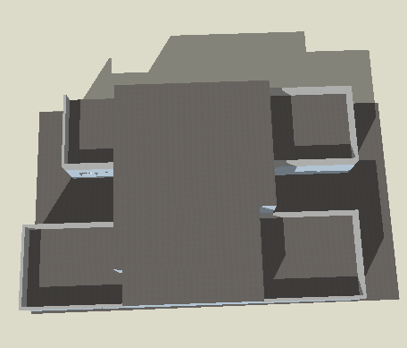
Shadow analysis
→ In afternoon is full exposed to sun
New design
Summer
Case study analysis
Codes
Task
Contents
Methodology
Motivation
Winter

Slide 19
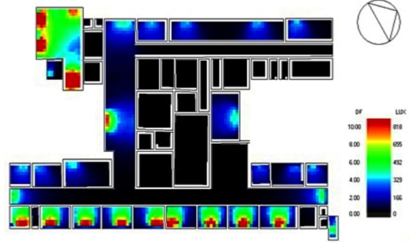
Day lighting
Day lighting analysis is made to make a thermally comfortable spaces in building by making a solution for the room that have a day light factor less than 2 % and more than 6 %.
Day lighting For the Existing building
New design
Case study analysis
Codes
Task
Contents
Methodology
Motivation

Slide 20
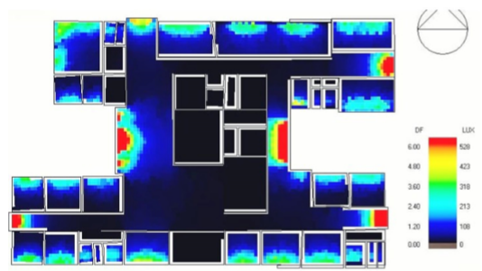
Day lighting
D.F%(before) | Areas | Solutions | D.F %(after)
0% | Kitchen , corridors | Area of Window is expanded | 2% - 6%
0% | Vaccination room , X-ray, storage and laundry room | Artificial lighting
10% | The lab and Clinics | Use a double glass window and louvers | 2%-6%
New design
Case study analysis
Codes
Task
Contents
Day lighting for ground floor (after solution)
Methodology
Motivation

Slide 21
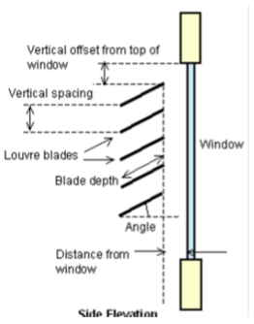
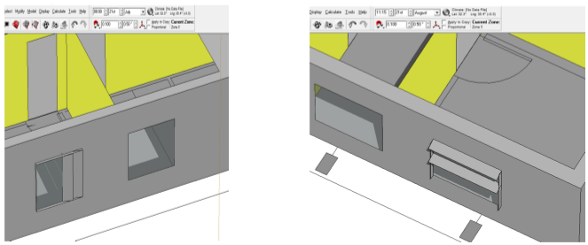
Shadow analysis
This analysis is done to prevent direct sun to pass through windows and to minimize the electrical usage, this is done by using Design Builder and Ecotect programs
New design
Case study analysis
Codes
Task
Contents
Methodology
Motivation

Slide 22
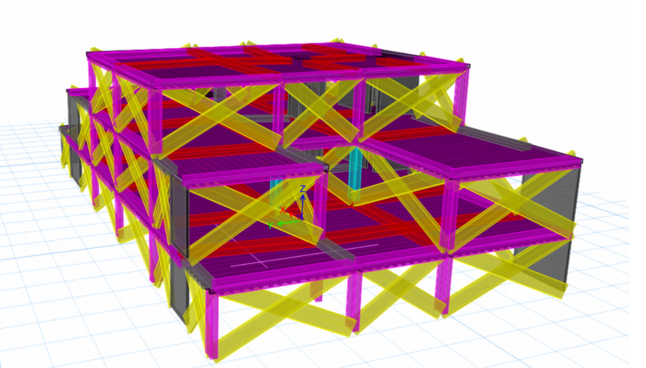
Structural Design
Structural distribution
ETAB Modeling
Model check
Seismic design
Footing , G.B and column layout
Elements design
The existing building
Case study analysis
Codes
Task
Contents
Methodology
Motivation

Slide 23
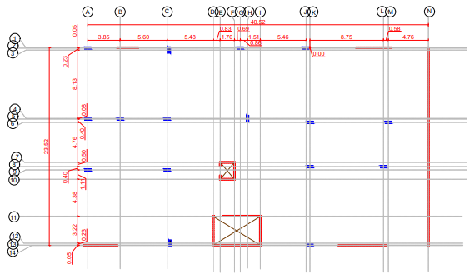
Structural distribution
The existing building
Case study analysis
Codes
Task
Contents
Methodology
Motivation

Slide 24
ETAB modeling
Compressive strength for columns and wall Concrete f′_{c} = 28MPa and for beams and slab Concrete f′c = 24MPa.
Yielding strength of steel fy = 420MPa.
.
The existing building
Section type | The defined dimensions (mm)
corner columns | (300*750)
side columns | (300*750)
middle columns | (400*800)
Beam 1 | (400*900)
Beam 2 | (700*400)
Beam 3 | (900*500)
Slab | 400
Codes
Task
Contents
Methodology
Motivation

Slide 25
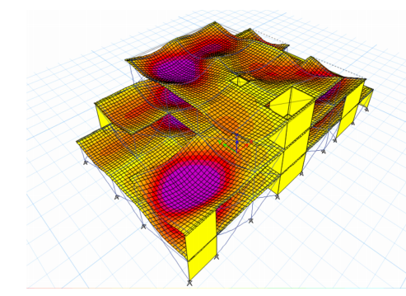
Model check
1-Compatibility check → ok
The existing building
Case study analysis
Codes
Task
Contents
Methodology
Motivation

Slide 26
Model check
2-Equilibrium check : All errors are less than 10%. → ok
Load case | Reaction from Etabs (KN) | Manual reaction (KN) | Error
dead | 21587.5336 | 22537.9 | 4.22%
Live | 6172.0617 | 6171.99 | 0.0011%
SD | 14151.5801 | 15451.7289 | 8.4%
The existing building
Case study analysis
Codes
Task
Contents
Methodology
Motivation

Slide 27
Model check
3-Stress strain check → ok
 | ETABS Value | Manual Value | % Error
Beam | 375 | 405 kN.m | 7.75 %
The existing building
4-Check wide beam shear→ All the values is within the range (-249.33-249.33), slabs So, no shear design is required, use 3ø10 stirrups per meter in rib.
Codes
Task
Contents
Methodology
Motivation
Check slab thickness for shear: ØVc=249.33 KN/m

Slide 28
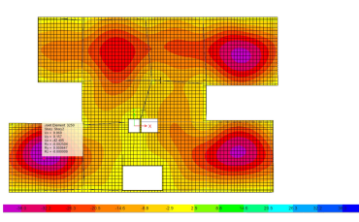
Model check
3-Deflection check → ok
✓ Immediate deflection due to live load : 9.13/360 = 25.36 mm
✓ Immediate deflection due to service load: 9.13/240 = 38 mm
The existing building
✓ The average deflection of beams in GF around the purple area = 20
Codes
Task
Contents
Methodology
Motivation
slab deflection = 43-20 = 23 mm << 38 mm < ok

Slide 29
Seismic design:
zone 2B which has a micro zonation factor (Z) = 0.20.
Soil profile type of very dense soil and soft rock (Sc).
Seismic importance factor (I)= 1.00
Building frame concrete system (R)= 5.5.
Acceleration seismic coefficient (Ca) = 0.24.
velocity seismic coefficient (Cv) = 0.32.
The existing building
Codes
Task
Contents
Methodology
Motivation

Slide 30
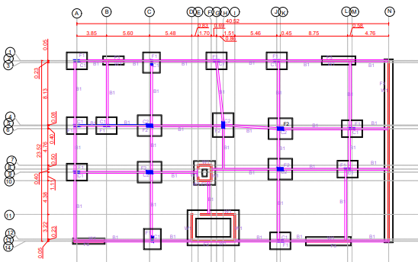
Footings, G.B and columns layout:
The existing building
Codes
Task
Contents
Methodology
Motivation

Slide 31
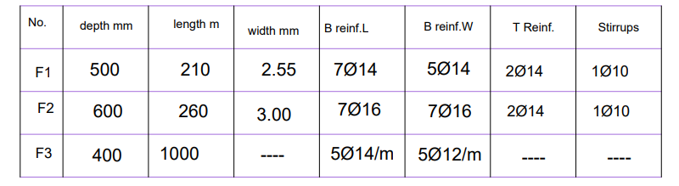
Footings design
The existing building
Codes
Task
Contents
Methodology
Motivation

Slide 32
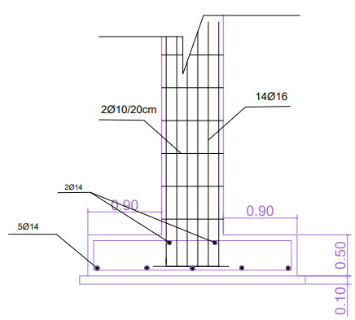
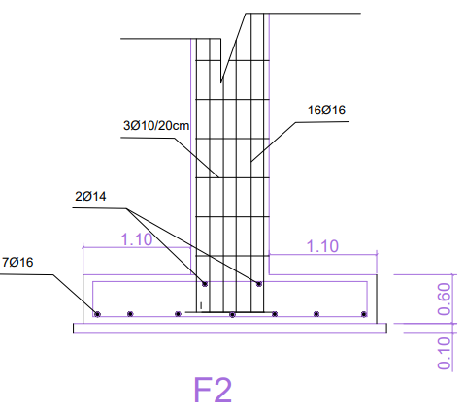
Footings design
The existing building
Codes
Task
Contents
Methodology
Motivation

Slide 33
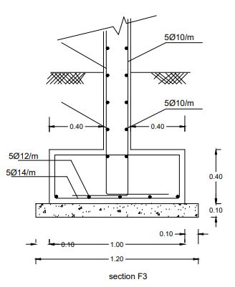
Footings design
The existing building
Codes
Task
Contents
Methodology
Motivation

Slide 34
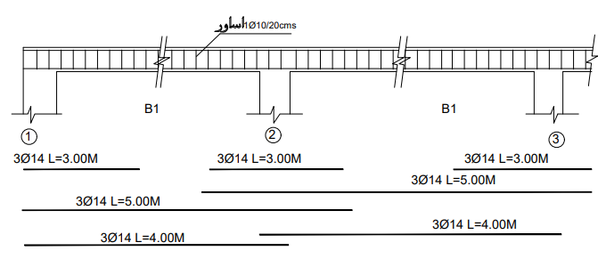
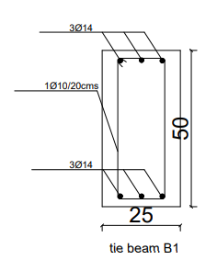
Ground beams design
No. | Depth (cm) | Width | Length | T reinf | B Reinf. | Stirrups
G.Beam | 50 | 25 | 2.55 | 3Ø14 | 3Ø14 | 1Ø10
The existing building
Codes
Task
Contents
Methodology
Motivation

Slide 35
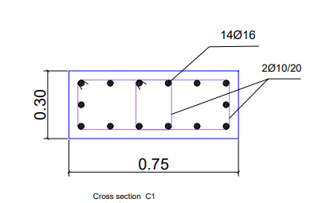
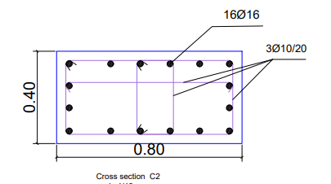
Columns design
The existing building
Codes
Task
Contents
Methodology
Motivation

Slide 36
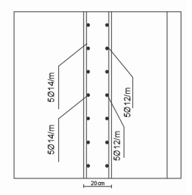
Wall design
No. | Depth (cm) | Width | Reinforcement.
Wall | 200 | --- | 5Ø12/20 cm
The existing building
Codes
Task
Contents
Methodology
Motivation

Slide 37
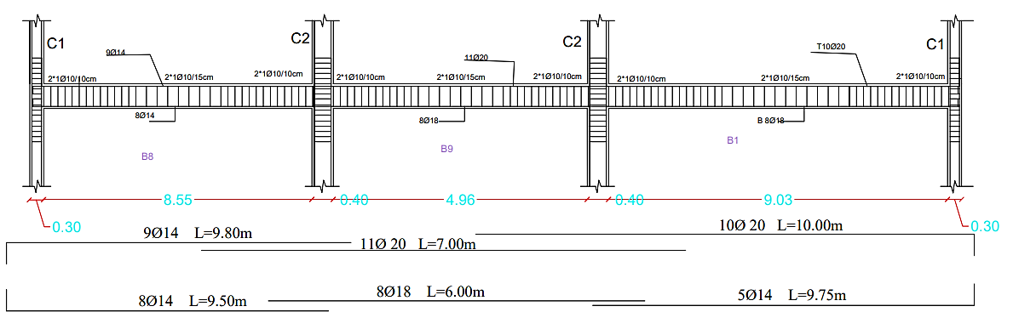
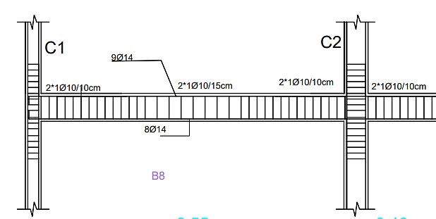
Beams design
The existing building
Codes
Task
Contents
Methodology
Motivation

Slide 38
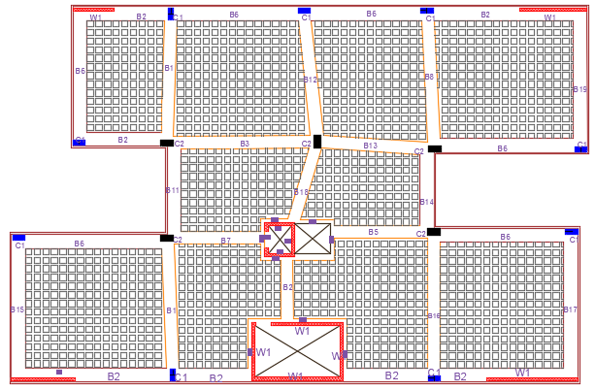
Beams design
The existing building
Codes
Task
Contents
Methodology
Motivation

Slide 39
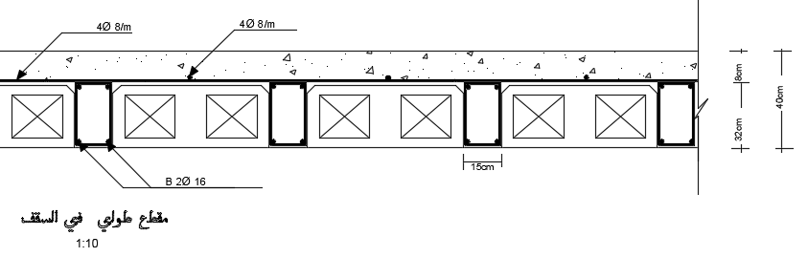
Slab design
֍ For main steel: Use 2Ø16/ rib Top and bottom steel
֍ For shrinkage steel: 4 Ø8 /m
The existing building
Codes
Task
Contents
Methodology
Motivation

Slide 40
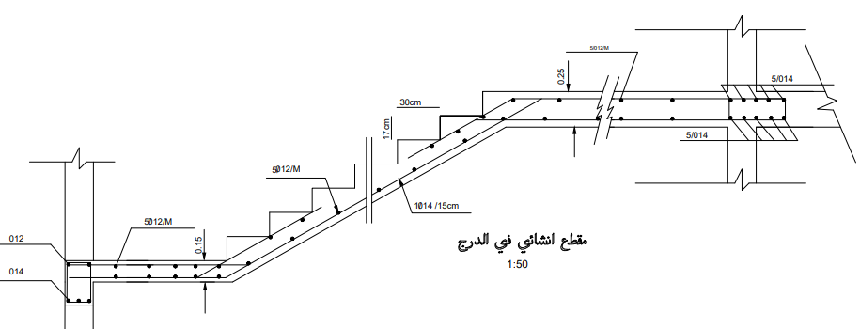
Stair design
The existing building
Codes
Task
Contents
Methodology
Motivation

Slide 41
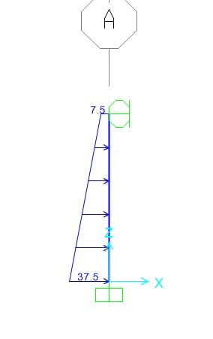

Retaining wall design
Friction angle (ϕ) = 30⁰
γ (soil) = 20 kN/m³,
The height of basement wall is 3 m.
Service Loads on the wall:
  Surcharge Load= 15kN/m2
  Q1= 7.5 kN/m
  Q2= 30 kN/m
The existing building
Codes
Task
Contents
Methodology
Motivation

Slide 42

Ramp design
Load on the ramp
Dead load = 12.5KN/m2
Live load = 5 KN/m2
  1.Check Compatibility
The existing building
Codes
Task
Contents
Methodology
Motivation

Slide 43
Ramp design
  2. Equilibrium Check
Load type | Hand results | Sap results (KN) | Differences %
Dead load | 794 | 794 | 0 < 5 OK
Live load | 317.5 | 317.5 | 0 < 5 OK
The existing building
Codes
Task
Contents
3.Internal force
Methodology
Motivation
Mu(hand)=203KN.m/m
Mu(Etab)= 223KN.m/m
%error = 9 <10 % (accepted)

Slide 44


Ramp design
  4-Deflection check
Max Deflection =0.02 mm
Deflection allowable =35mm>0,02mm→OK
The existing building
Codes
Task
Contents
Methodology
Motivation

Slide 45


Electromechanical
♦ Water supply system:
The existing building
Codes
Task
Contents
Methodology
Motivation

Slide 46

Electromechanical
♦ Drainage system:
2" diameter sewer from sinks and lavatories to floor trap.
4"diameter sewer from floor trap to the risers
The existing building
Codes
Task
Contents
Methodology
Motivation

Slide 47

Electromechanical
♦ Drainage system:
6"diameter used between manholes with a slope of 1%.
The existing building
Codes
Task
Contents
Methodology
Motivation

Slide 48

Electromechanical
♦ HVAC system (VRF):
1-outdoor unit
The maximum cooling load equal 47.87 kW.
From LG company a two model of MULTI V 5 were selected with 8 tons for the ground floor and 6 Tons for the second floor
The existing building
Codes
Task
Contents
Methodology
Motivation

Slide 49

Electromechanical
♦ HVAC system (VRF):
The existing building
Codes
Task
Contents
Methodology
Motivation

Slide 50

Electromechanical
♦ HVAC system (VRF) for G.F
The existing building
Codes
Task
Contents
Methodology
Motivation

Slide 51


Electromechanical
♦ Artificial lighting
The existing building
Codes
Task
Contents
Methodology
Motivation

Slide 52

Electromechanical
♦ Artificial lighting
The existing building
Codes
Task
Contents
Methodology
Motivation

Slide 53




Electromechanical
♦ Artificial lighting
1-Clinic Room
The existing building
Codes
Task
Contents
Methodology
Motivation

Slide 54




Electromechanical
♦ Artificial lighting
2-Meeting room
The existing building
Codes
Task
Contents
Methodology
Motivation

Slide 55

Electromechanical
♦ Artificial lighting for ground floor
The existing building
Codes
Task
Contents
Methodology
Motivation

Slide 56

Electromechanical
♦ Artificial lighting for ground floor
The existing building
Task
Contents
Codes
Motivation
Methodology

Slide 57
Electromechanical
♦Electrical system :
♦The total power for lighting for ground floor is 35750 watts.
♦ The total number of ring circuit needed for the G.F is 41 loop circuit.
♦ Every ring circuit have 8 A max rating.
♦ The cable size for every rings is 2.5 mm^2.
♦ The C.B for every rings is 16 A..
♦ The demand factor has used for lighting is 40%.
The existing building
Task
Contents
Codes
Motivation
Methodology

Slide 58

Electromechanical
♦Electrical system :
The existing building
Task
Contents
Codes
Motivation
Methodology

Slide 59

Electromechanical
♦Electrical system :
The distribution of circuit breaker in distribution board.
The existing building
Task
Contents
Codes
Motivation
Methodology

Slide 60

Electromechanical
♦Electrical system :
The demand factor for some kinds of buildings
The existing building
Task
Contents
Codes
Motivation
Methodology

Slide 61

Electromechanical
♦Electrical system :
The SDB for G.F
The existing building
Task
Contents
Codes
Motivation
Methodology

Slide 62


Electromechanical
♦Electrical system :
Grounding design
● d=0.019m.
●L= 1.5m long.
●N=3m.
●R=57
●Rn=19.2 Ω
The existing building
Codes
Task
Contents
Methodology
Motivation

Slide 63
Electromechanical
♦Electrical system :
Electricity consumption
●Number of working hours in month = 156 hrs./month.
●Total daily Power for ground floor = 22755.6 watt/day.
●Total power for the ground floor =22.76 Kw/day.
●The total consumption of lighting power per month = 591.78 kW
●Cost of consumption for ground floor = 384.66 Nis/Month.
●Total Cost of consumption for the building = 576 Nis/month.
The existing building
Codes
Task
Contents
Methodology
Motivation

Slide 64





Electromechanical
♦Fire Fighting system :
The existing building
Codes
Task
Contents
Methodology
Motivation

Slide 65



Electromechanical
♦ evacuation plan :
The existing building
Codes
Task
Contents
Methodology
Motivation

Slide 66


Acoustical Design
♦ Sound Transmission Loss (STC):
The sound transmission loss (STC) for the internal walls between different spaces.
The existing building
Codes
Task
Contents
♦The sound transmission loss (STC) for the internal walls between different spaces.
Methodology
Motivation

Slide 67





Acoustical Design
♦ Reverberation Time (RT60):
The reverberation time for the Clinic room according to Sabine
The reverberation time for the Office room according to Sabine
The existing building
Codes
Task
Contents
Methodology
Motivation

Slide 68

Cost Estimation
♦Quantity Surveying :
The total cost of the building is 3,380,642.23NIS and the total area of the building is 2026.54 $m^{2}$ which means that the total unit cost per $m^{2}$is 1668.18 NIS/ $m^{2}$
The existing building
Task
Contents
Codes
Motivation
Methodology

Slide 69
Cost Estimation
♦Percentage for each work from total cost of the faculty :
4%
Project
11%
Project
Electrical works cost is equal to 40066.62 NIS.
Mechanical works cost is equal to 360043.25 NIS .
The existing building
65%
Project
20%
Project
Task
Contents
Structural works cost is equal to 2196404.97 NIS.
Architectural works cost is equal to 656662.61 NIS.
Codes
Motivation
Methodology

Slide 70


