Slide 1
IOTV: Internet Over TV Band
Prepared by: Ruba Daragmeh
Aseel Darawseh

Slide 2
OUTLINES
Objectives
Importance of work
IOTV
Problems of old oscillator design
New Oscillator design
Microwave transistor amplifier
Conclusion
Future work

Slide 3
Objectives
Redesign of local oscillator
Design a transistor microwave amplifier
exploit unused TV band

Slide 4
Importance of work
The importance of this work come from that 2.4 GHz which is free band frequency used for WIFI, Bluetooth, Zigbee,… etc. This frequency really crowded and the coverage area doesn't exceeds some meters, so We would like to utilize the unused TV band spectrum band from 400 to 800 MHz So we could provide broadband internet services to rural areas.

Slide 5
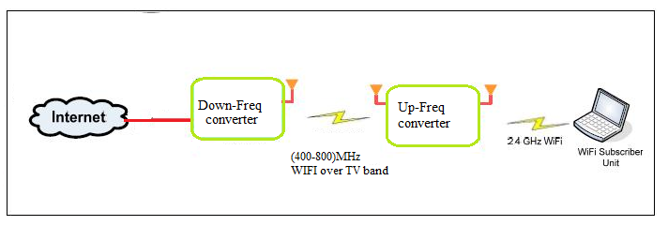
IOTV
IOTV: Is a project aims to transfer the Wi-Fi signals over the TV band instead of 2.54 GHz ISM band based on Cognitive Radio technique, and utilizing the white space. In order to cover rural and remote areas.

Slide 6
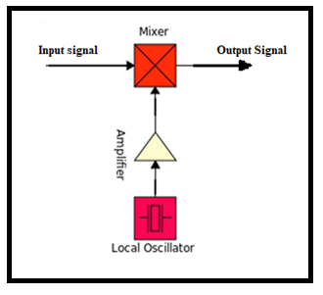
IOTV
Down frequency converter circuit for downshift WIFI frequency[2.45 GHz] into TV frequency band [400-800]MHz .

Slide 7
New Oscillator design
New oscillator design satisfied the 2GHz resonance frequency and improved stability by using varactor diode.

Slide 8
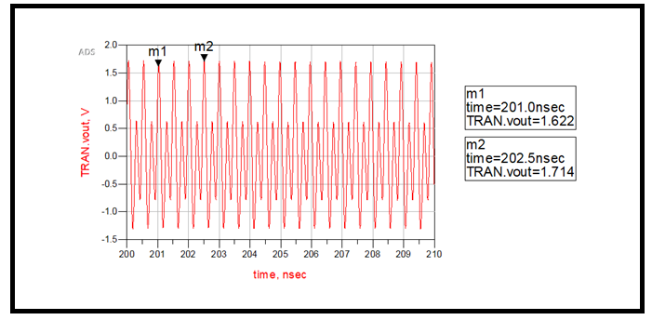
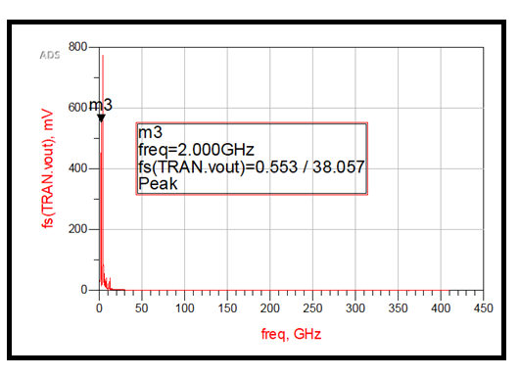
LO new design representation in time domain and frequency domain using ADS program.
The output signal of the LO satisfy the requirement oscillation at frequency 2GHz .

Slide 9
Microwave transistor amplifier
When the strength of a weak signal is increased by a device, the device along with its matching and biasing circuitry is known as an amplifier.
  Microwave transistor amplifier was designed in order to increase the gain of signals that generated by the local oscillator.

Slide 10
Classification of amplifier
There are several types of amplifiers, categorized by their operation, application or characteristics. Some of them are:
Transistor Amplifiers.
Power Amplifiers.
Differential Amplifiers.
operational Amplifiers.
valve (or) Vacuum Amplifiers.

Slide 11
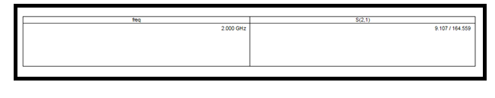
Microwave transistor amplifier
The achievable gain for a single stage was 9.107dB and this is good since the desired gain from the whole amplifier is 20 dB .

Slide 12
conclusion
The design and simulation of Local Oscillator and Microwave Transistor Amplifier was done in this part of the project. The design and simulation of these circuits was done by ADS.
The amplifier was designed at F=2Ghz and with a sufficient gain in order to amplify the signal generated by the LO at F= 2GHz before it enters the double balanced mixer which shift the signal to a lower frequency equal to 450MHz and this frequency lies on the TV band.

Slide 13
Future work
Implement the LO and the amplifier and do measurements for both.
Complete the double balanced mixer which was implemented by a group in An-Najah National University in their graduation project (DOUBLE BALNCE MIXER) and not completed.
Build a chip contain all of these component LO, Amplifier, Double Balance Mixer.

Slide 14


