Slide 1


AN-NAJAH NATIONAL UNIVERSITY
FACULTY OF ENGINEERING
DEPARTMENT OF MECHATRONICS ENGINEERING
Soft Dough Divider Machine
Supervisor: Dr. Aladdin Masri
Prepared by:
Atheer Salameh
Ra’ed Ghanem
Soha Ali
.

Slide 2
Outline
Introduction
Overview of The Project
Projects parts
Mechanical part (VDDM)
Electrical Motor part
Control and Software part (programming)
Summary

Slide 3
Soft dough
  Is one of the most food in our life.
  Main Component : water (55%-65% greater than hard dough).
  Hard to be automated ( so soft)
  >>Operated manually.

Slide 4
Project objective
  Automating the manual production of soft dough.
  Making commercially, applicable and competitive machine.

Slide 5
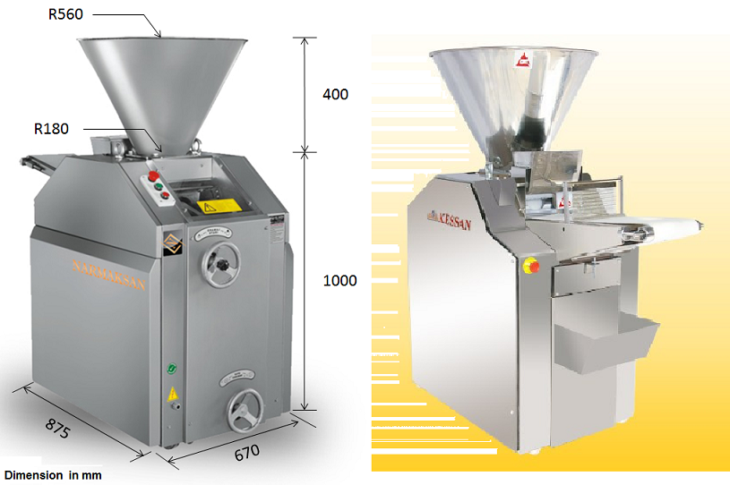
Design of Soft Dough Dividing Machine

Slide 6
Mechanical part
  Identifying the volumetric dough divider machine components and function of these components
  Dough conveyer belt
  Procedure and Weights of Dough Accounts
  Operating principle

Slide 7
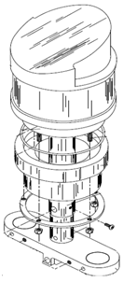
principle operation of VDDM
Dough fed into hopper.
The dough cut by piston cylindrical movement.
By adjustment of the volume of the chamber
located in the drum the result is variation of the weight .

Slide 8
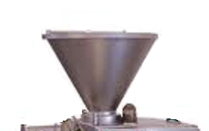
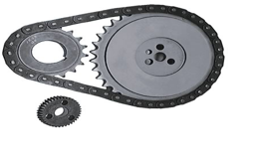
Mechanical part
  Mechanical component
  Hopper : mounted over the feed throat.
  Piston divider – Drum.
  Transmission system (Gear, pulley and drive system).

Slide 9
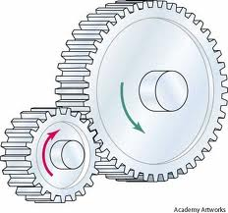
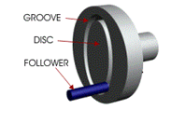
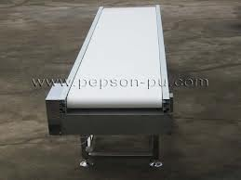
Mechanical part
  Mechanical component
  Cams.
  Closed circuit oiling system.
  Conveyer belt.

Slide 10


Procedure and Weights of Dough Accounts
  Calculating the density of the dough using an empty cylinder .
  Calculating the relation between change of volume and number of turn.
  Then calculating the relation between the required weight of dough and the
  time of dc-motor running .

Slide 11
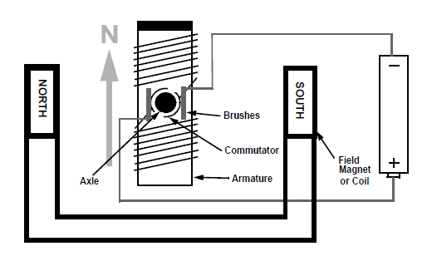
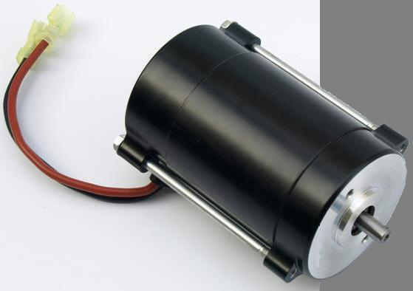
Electrical Motor Part
Brushed-DC motor which use with
H-bridge.

Slide 12
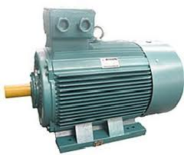
Electrical Motor Part
  Three phase AC induction motor with squirrel
  cage rotor.

Slide 13
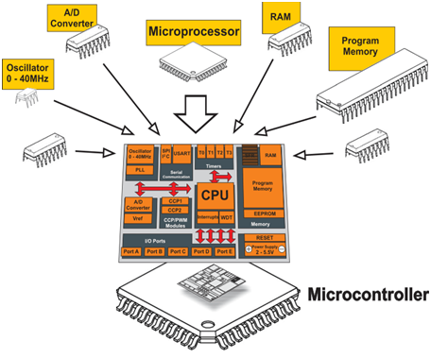
Control and Software part
  Identifying the all microcontroller
  component and function
  of these component.

Slide 14
Control and Software part
  Microcontroller Used to controlling:
Number of turns of dc motor, and piston stroke.
Drum movement, and the number of pieces.

Slide 15
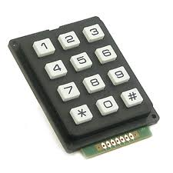
Control and Software part
  control part will consist of :
  PIC16F88 : is used to control machine.
  Keypad

Slide 16
Control and Software part
  Pushbutton switches
  Light Sensor

Slide 17
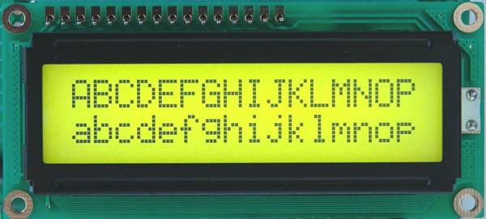
Control and Software part
  LCD
  Encoder sensor motor

Slide 18
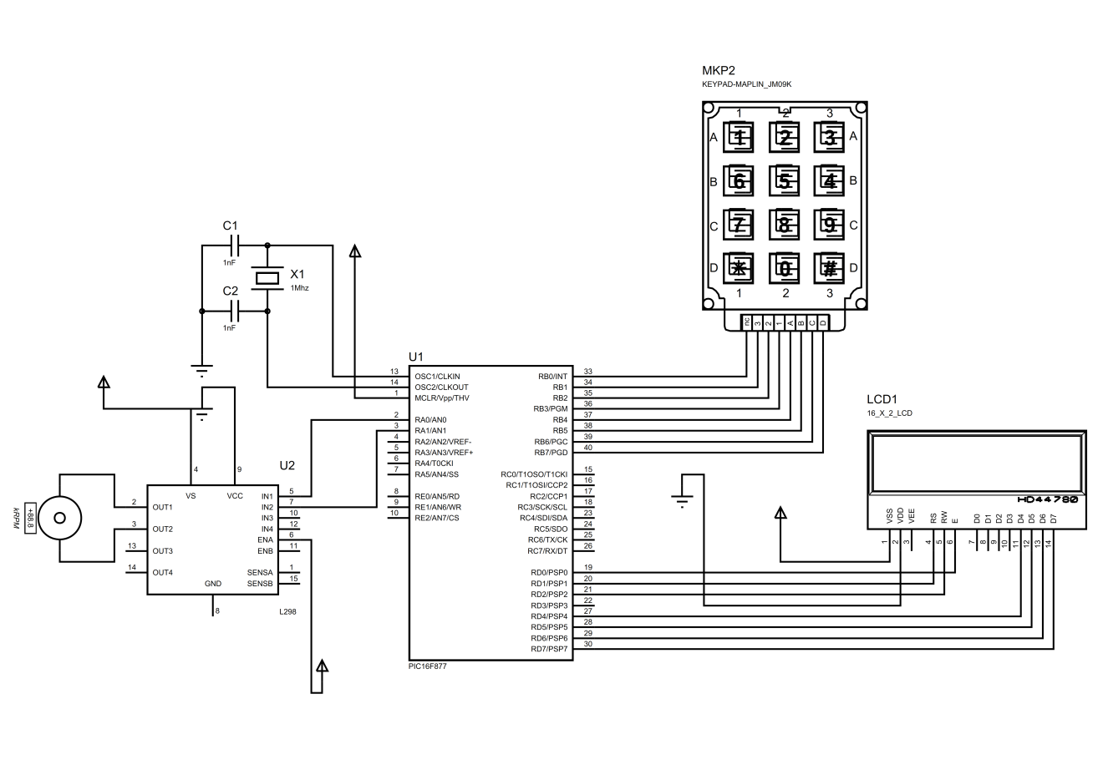
Control and Software part
Circuit connection

Slide 19
process
Enter the desired weight
Software processing
Mechanical Actuation
Equal pieces of dough
Controlling

Slide 20
Conclusion and result
  Soft dough divider machine give an equal pieces of dough
  Size of piece and number of it, controlled by PIC microcontroller.
  Increase the efficiency of the operations.
  decrease the production time.
  reduce the labor cost .
  reduce the losses in row materials

Slide 21
Thank you for listening

