Slide 1
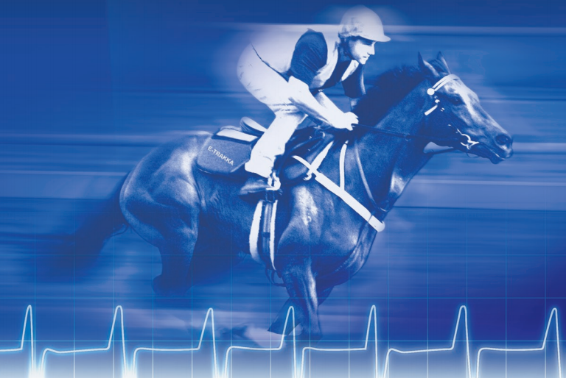
Studying the performance of wireless network using simulation tool- Horse’s monitoring
Prepared by : Razan Hamadni Rahma Sawalha Islam Zamel
To : Dr- Saed Tarapiah

Slide 2
objectives
The used technology
Outlines
Results and conclusion
About graduation project 1
Software that we used
Mobility in WSN

Slide 3
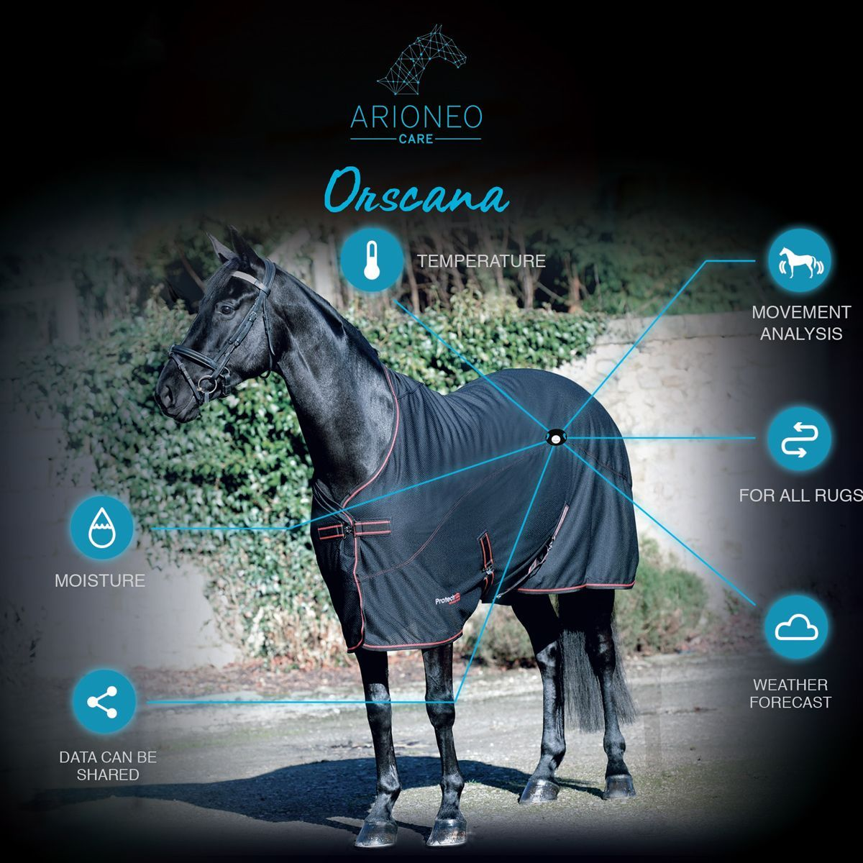
Objectives :
in this project we hope to design a monitoring system for the horses in the outdoor using WSN simulated by cooja, in order to be aware of their condition and act as quickly as possible in case of need and allowing owners and/or breeders to easily monitor horses’ vital signs and anxiety.

Slide 4
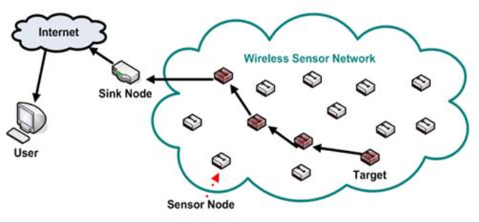
The used technology :WSN
WSN is a promising technology to support the Internet of Things (IoT) because the use of low power wireless devices is becoming part of our daily life.
Wireless sensor networks consist of many sensor nodes which can transmit data to each other. This network can be used to monitor various conditions and send back the information to the central controller.

Slide 5
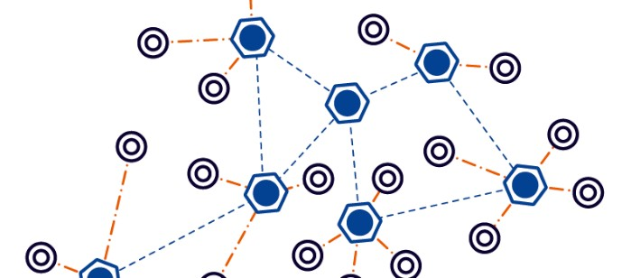
WSN as applied in two scenario:
We applied WSN in two scenarios of nodes :
1) static nodes ( as we applied in the first project)
2) mobile nodes ( as will be discussed in the (second project

Slide 6
The achievements of the graduation project 1:
In the first part of our project, we were able to perform a cooja simulation for agriculture monitoring by using 6lowPAN WSN. The presented simulation hope to be able to collect the data measured by the sensors and analyze the collected data to support decision making process. Which will lead to improve the quality of agriculture production with minimum cost.

Slide 7
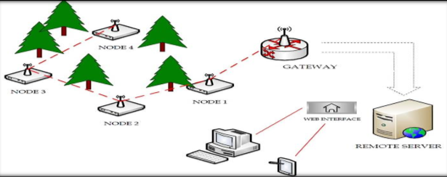
Figure 1: system model of agriculture using WSN

Slide 8
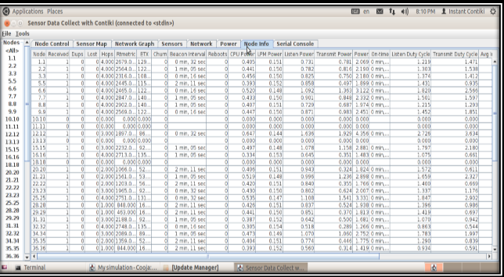
Figure 2: nodes information using static nodes

Slide 9
Sensor Nodes Mobility:
The increase demand for mobility in various applications such as environmental monitoring, medical, home automation, and military, raises the question howIPv6Routing Protocol for Low-Power and Lossy Networks(RPL)would perform under these mobility applications..

Slide 10

We use WSN based on mobility in different applications:
1. Horse's farming .
2. Zoos.
3. Cars and bus stations…. etc.
We will study about horse's monitoring in farms in our project

Slide 11
Why we need to monitor the horses?
Horse monitoring is essential for a number of reasons, including the fact that horses are prone to sudden illness, such as colic, which may cause death. Being able to remotely and constantly monitor horses can, thus, be very important, in order to be aware of their condition and act as quickly as possible in case of need.

Slide 12
Mobility models:
random waypoint model
the random waypoint model is a random model for the movement of mobile users, and how their location, velocity and acceleration change over time
It is a very simple model based on pause time between changing direction/speed. It has many parameters :
1. the mobility area ( X,Y) positions.
2.number of nodes .
3. max and min speed of nodes

Slide 13
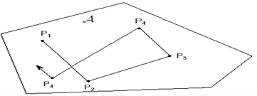
Description of the model :

Slide 14
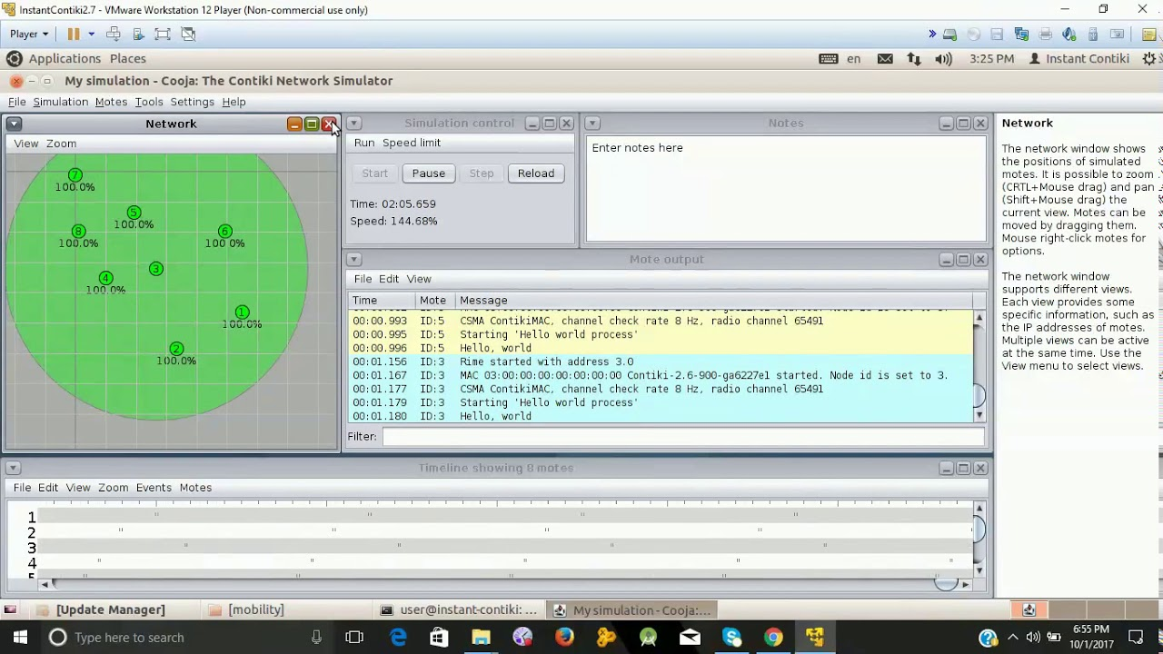
software components and :programming language:
Contiki and Cooja
Contiki is an open source, it was chosen as the operating system for the sensor nodes which used C language as the programming language. It has many advantages compared with other sensor network operating systems.
It includes an embedded simulation tool: COOJA, which can compile and simulate the application software conveniently and fast.
Cooja makes is a low-power protocols and mechanisms thereby increasing the understanding of the behavior of sensor network

Slide 15
Analysis Tool:
Bonn Motion
Bonn Motion is one of the tool to generate mobility scenarios based on random waypoint model and many other mobility models
it is a Java software which creates analyzes mobility scenarios
used as a tool for the investigation of mobile ad hoc network characteristics.
can also be exported for several network simulators, such as ns-2, ns-3, COOJA

Slide 16
Bonmotion commands
./bm -f test1 Random Waypoint -n -d -i -x -y -h -l
where n: number of nodes, d: mobility duration, x and y: mobility area, i: initial phase to be skipped
h, l: The maximum and minimum speeds of the motes respectively.
:./bmWiseML -f test1 -L 1 –I.
./wml2dat test1.wml positions.dat.

Slide 17
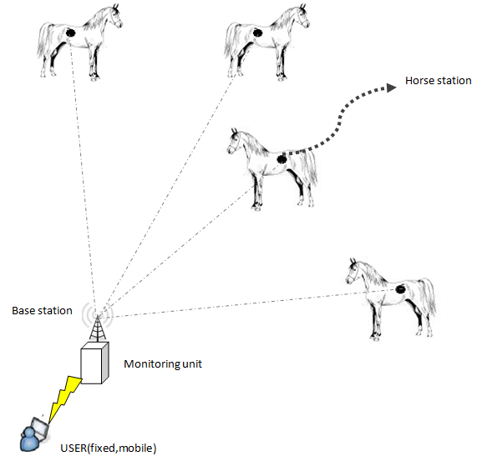
System Model:
our Monitoring horses scenario relies on a set of sensors that communicate with a central point

Slide 18
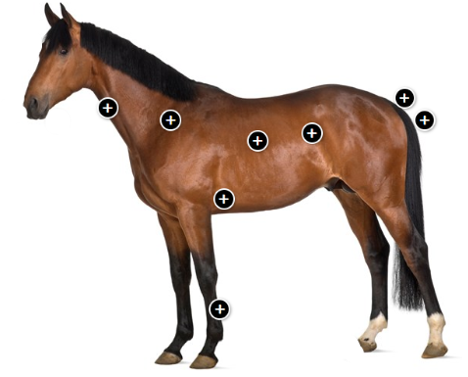
Normal Vital Signs
It's essential that every horse owner know his or her horse's normal vital signs, to allow handling for assessment of vital signs. For help on how to take decision about horse's health

Slide 19
Type of sensor | Normal rang
Horse Heart Rate sensor | For normal Horse average heart rate(28-44 beats )per minute
Speed rate sensor | For normal Horse average speed rate(16-27 km) per hour
Air flow sensor | For Normal Horse Breathing Rate (10-24 breaths) per minute
Body temperature sensor | For Normal Horse(37.2-38.3)degC
Indicate colic sensor | If the sound is weak or there is no sound inside the horse's intestines, it is an abnormal horse

Slide 20
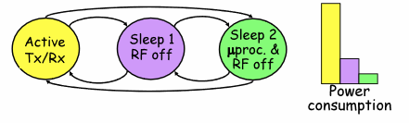
Energy Saving
Wireless sensor networks (WSNs)
Energy efficiency is necessary in every level of WSN operations (e.g., sensing, computing, switching, transmission). the energy consumption of radio communication mainly depends on the number of bits of data to be transmitted within the network.
We save energy by using compression to reduce the number of bits to be transmitted has the potential to drastically reduce communication energy costs and increase network lifetime

Slide 21

Economic/financial Feasibility Study
budget expected cost :the relatively low cost of sensors that used to monitor horses, it’s cost range between (20-200) $.

Slide 22
Simulation setting:
Number of node used | 31
Type of routing | Ipv6
Standard used | 6lowPan IEEE 802.15.4
Scenario area | 40*40
Type of transport protocol | UDP
Transmission range and interface range | 20, 40
Transmission ratio and receiver ratio | 80\100
Mobility model | Random way point

Slide 23
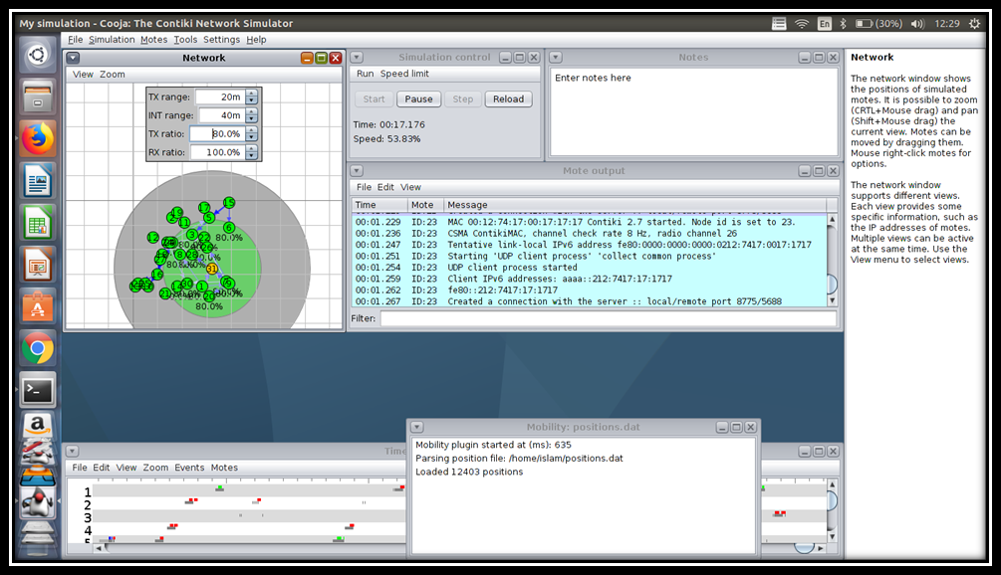
Simulation analysis:

Slide 24
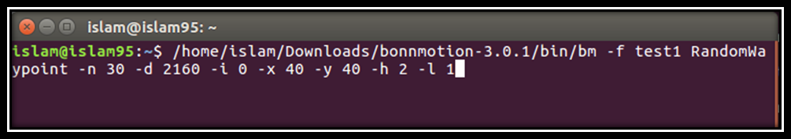
Mobility generation:
Random way point mobility generation.

Slide 25
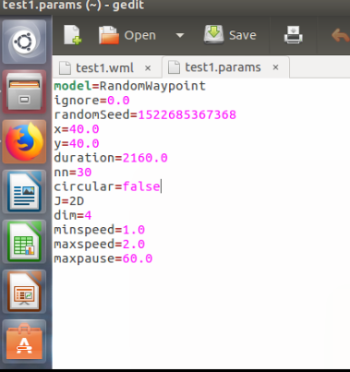

Slide 26


Slide 27
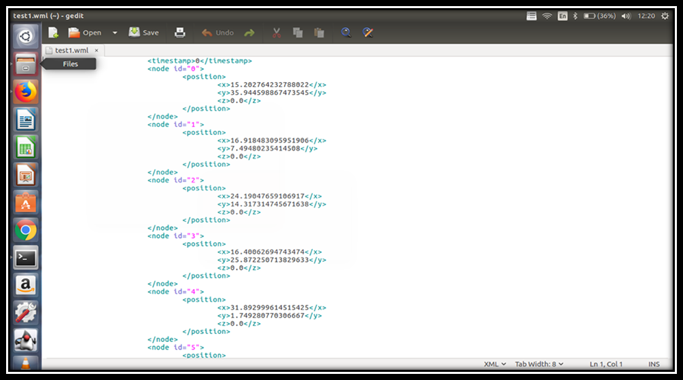

Slide 28
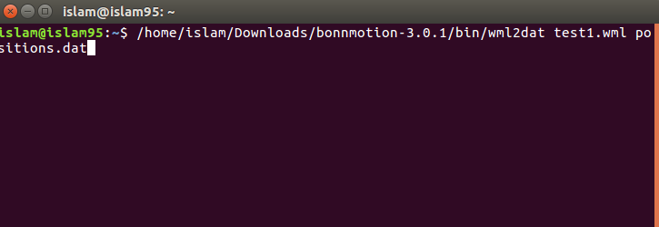

Slide 29
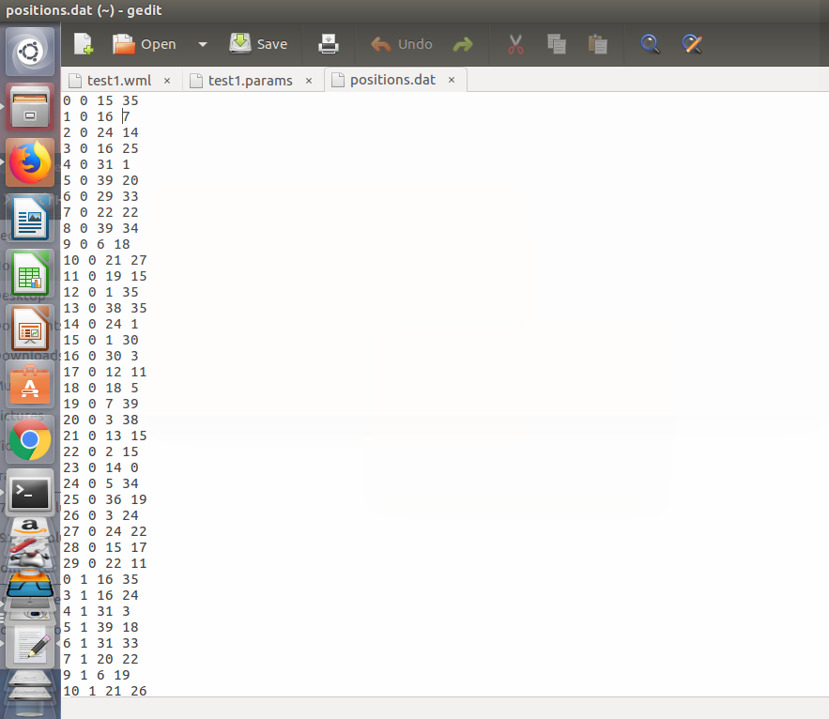

Slide 30
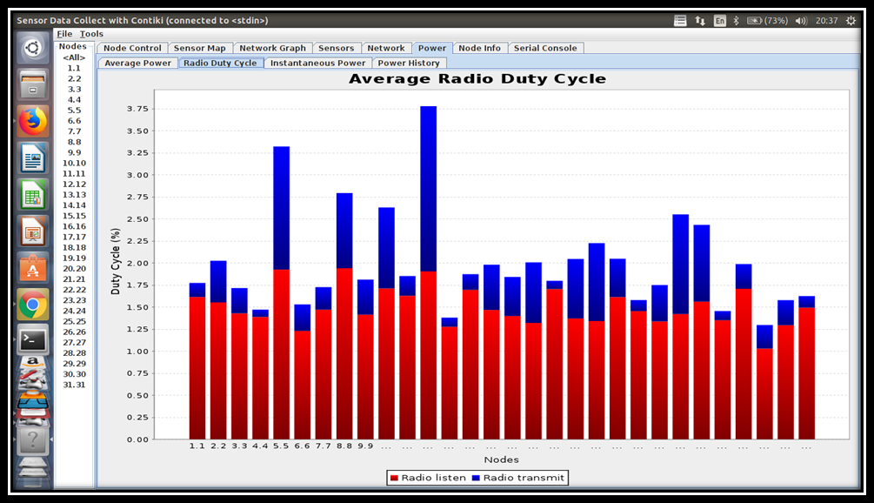
Results analysis:
Average radio Duty cycle.
Avg listen power | 1.75
Avg Tx power | 2.5

Slide 31
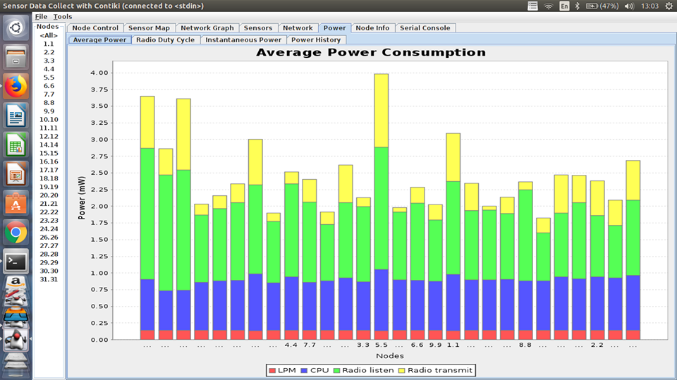
Average power consumption:
LPM | .1 mW
CPU | .85 mW
Avg Radio listen | 2.75 mW
Avg Radio TX | 3 mW

Slide 32
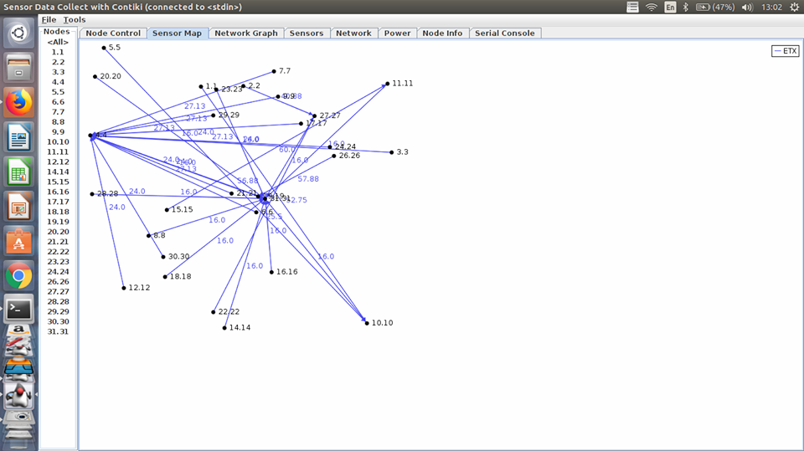
Network graph:

Slide 33
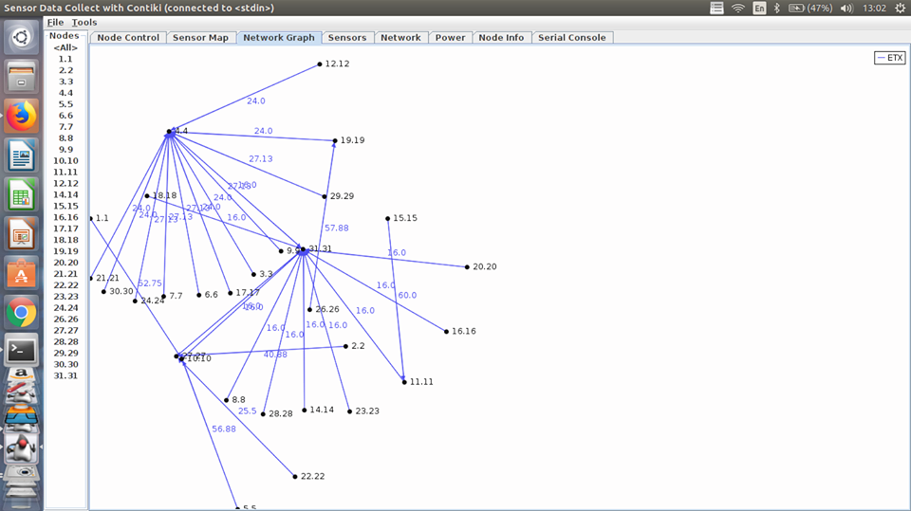
Sensor map:

Slide 34
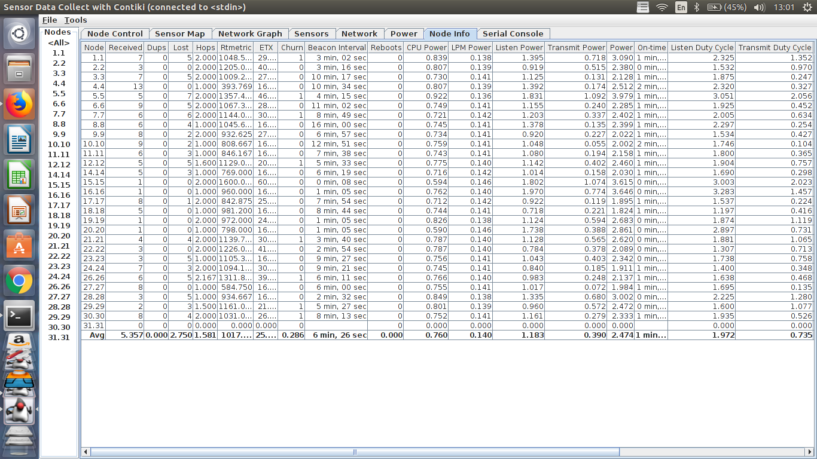
Node information:

Slide 35
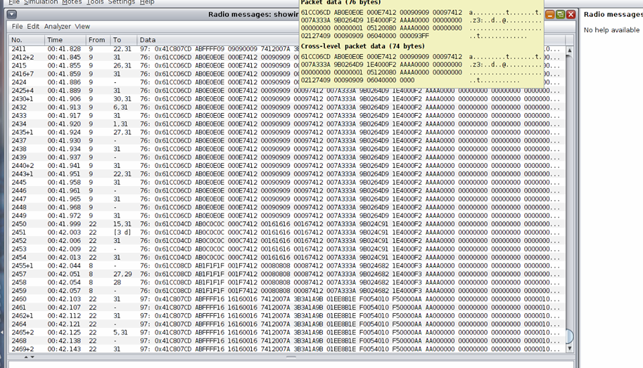
Analyzing radio message:

Slide 36

Wire shark:

Slide 37
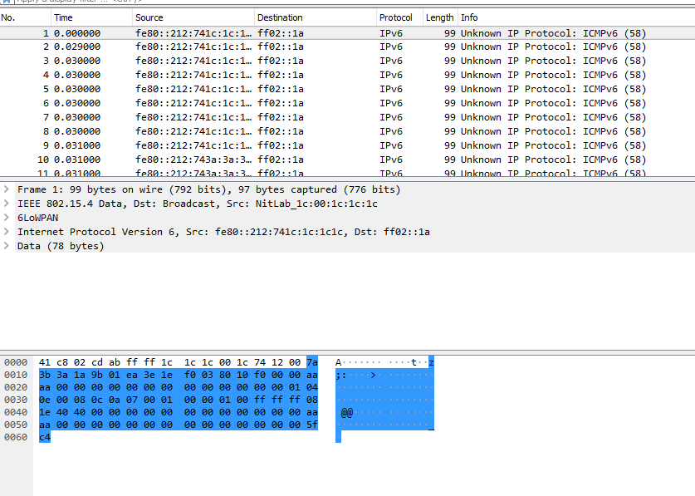
Analyzing data with Wire shark:

Slide 38
Conclusion and future work:
In graduation project 1 we were able to design agriculture monitoring system.
In graduation project 2 we were able to design horse monitoring system .
We were able to learn new simulation tool cooja which is considered to be one of the most important simulation tool in the study of IOT.
This tool could be used to study and analyze different types of attacks and how to protect the network from these attacks.

Slide 39
Thank you for listening
any questions ?

