Slide 1
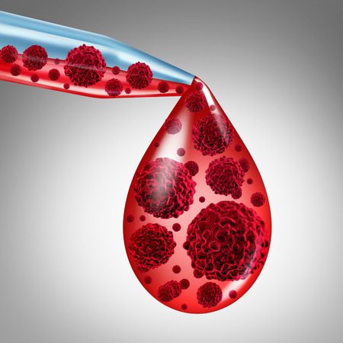
DR.AMJAD HAWASH
Leukemia Detection Algorithms: Comparative study
Sada riad
Maryam wazani
Aleen Abuzant

Slide 2
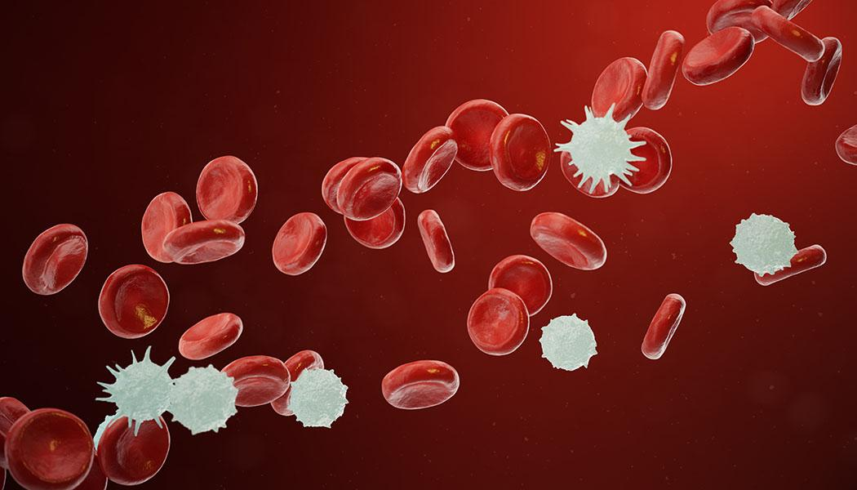
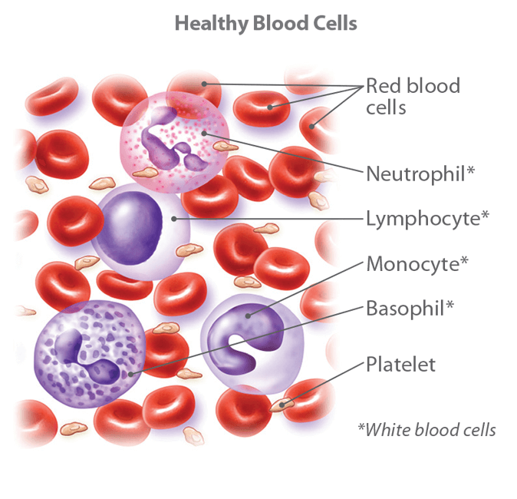
Problem

Slide 3


Tools

Slide 4
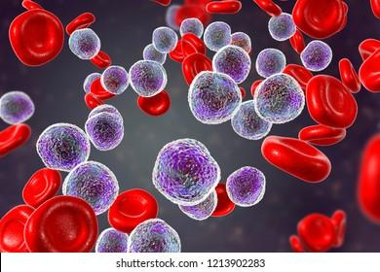
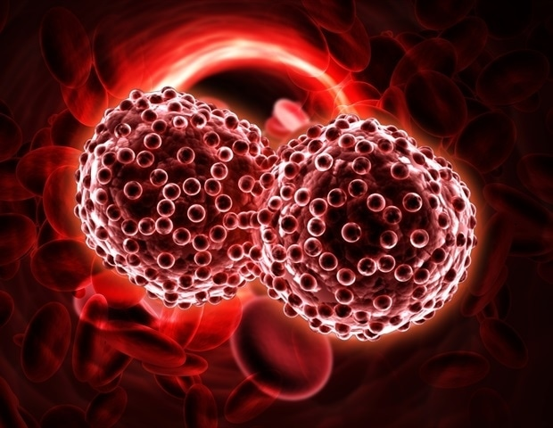
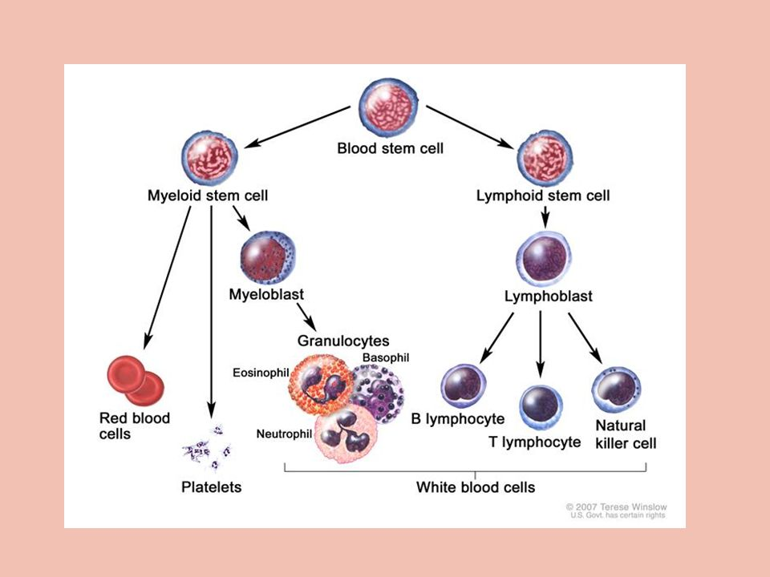
Goals
Introduction
Algorithm 1
Algorithm 2
Results

Slide 5
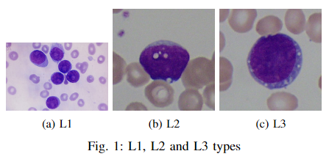
Introduction
Leukemia is a type of cancer that affects the white blood
cells (WBCs) . In leukemia, white blood cells become
abnormal, divide and grow in an uncontrolled way

Slide 6
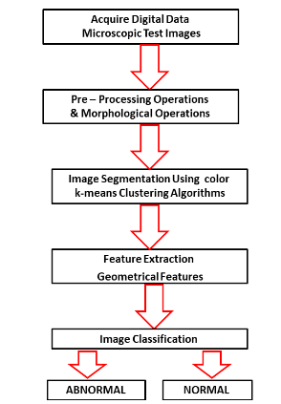
Color K-mean clustering algorithm(CKC)

Slide 7
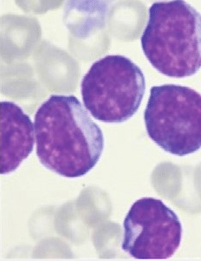
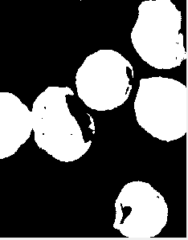
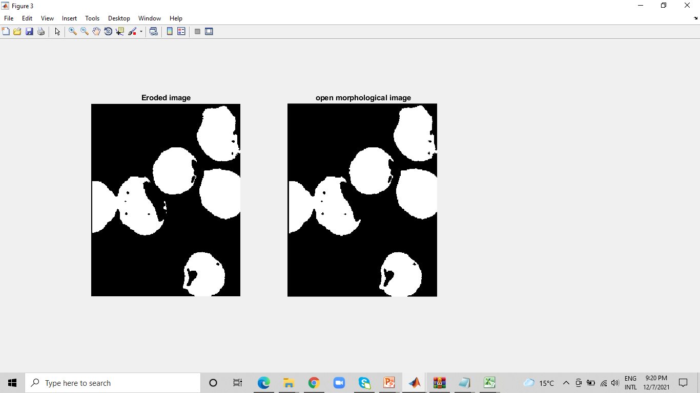
Image Preprocessing
a
b
c
Fig. 3. (a) Original Image (b) Binary image (c) Eroded image

Slide 8
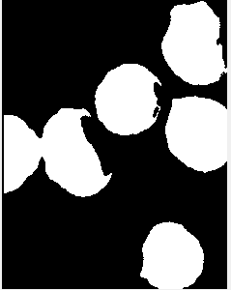
d
e
Fig. 3. (e) Open morphological image (d) Fill holes image

Slide 9
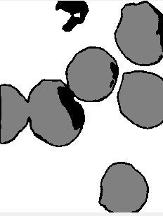
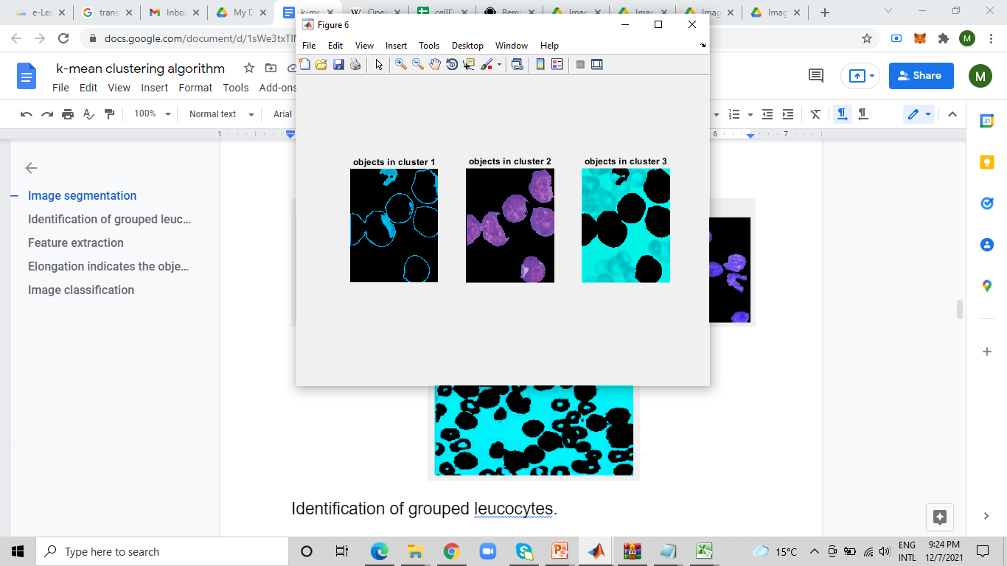
Image Segmentation
a
b
Fig. 4. (a) Cluster index image (b) Cluster 1

Slide 10
c
d
Fig. 4. (c) cluster 2 (d) Cluster 3

Slide 11
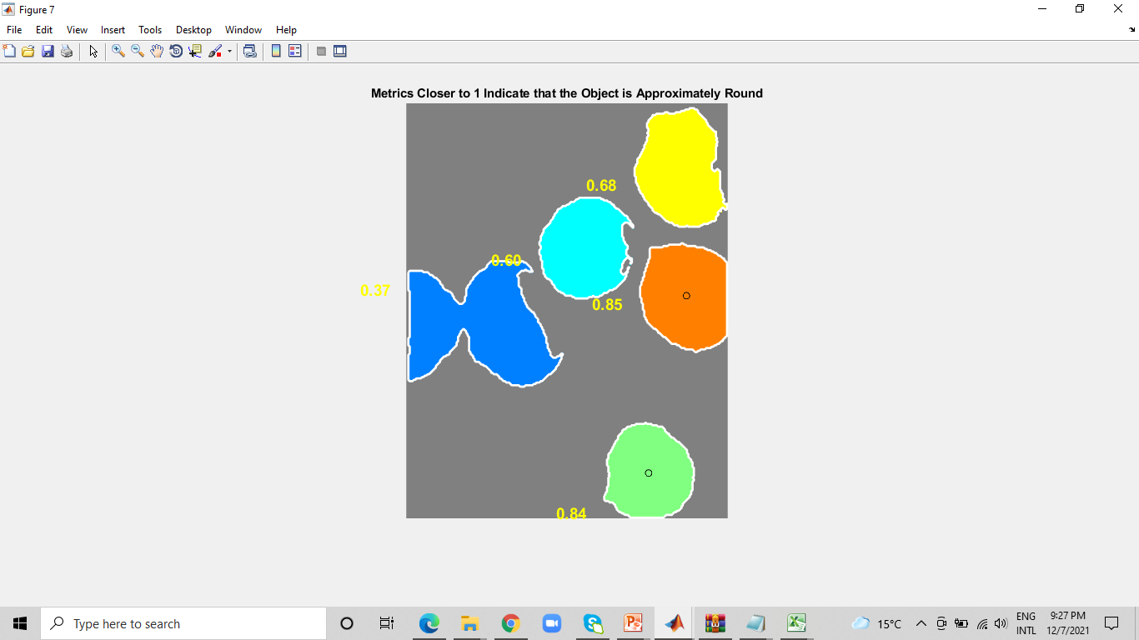

Identification
of grouped leucocytes
c
Fig. 5. Roundness

Slide 12




Feature extraction

Slide 13



Slide 14
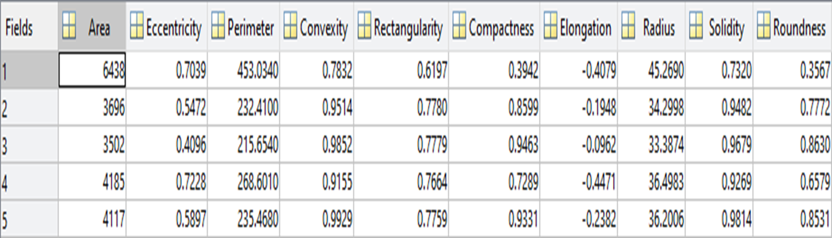

Slide 15
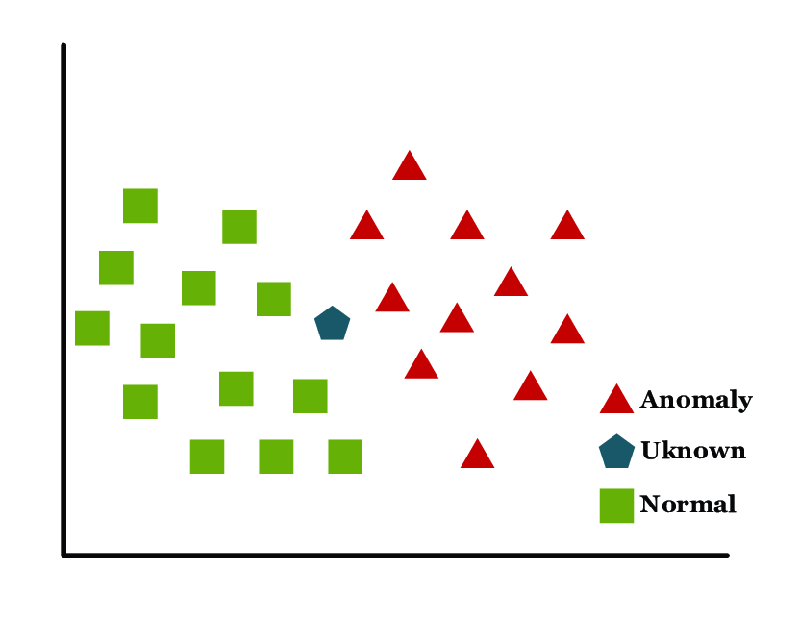
Image Classification
K-Nearest Neighbor Classifier (knn) is used to classify data or features to know if they are infected or not.

Slide 16
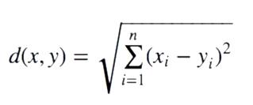
The distance computed between each cell in the input image with the training data of cells using the following equation:

Slide 17
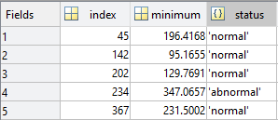

Slide 18
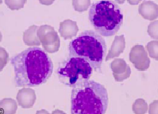
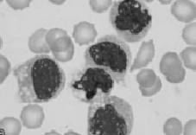
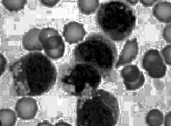
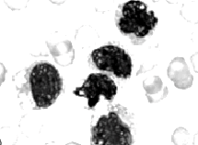
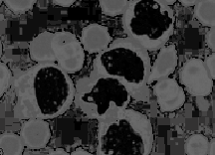
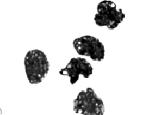
Acute lymphoblastic Leukemia Detection based on its sub-
types features(ALLS)
Image Preprocessing:1.1. Nuclei Separation
a
b
c
d
e
f
Fig. 6. (a) Original Image (b) Gray level Image (c) Histogram Equalized Contrast Enhanced Image.(d) Addition processed Image (e) Subtraction processed Image (f) Addition of (d) & (e) image

Slide 19
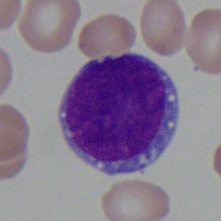
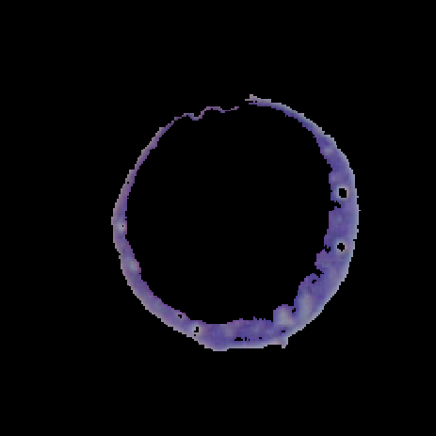
Cytoplasm Separation
a
b
fig(7) (a) original image (b) Separation of the cytoplasm

Slide 20



morphological on segmented nuclei and cytoplasm :
a
b
c
fig(8) (a) binary image of nuclei (b) binary nuclei image after removing small components (c)binary cytoplasm image

Slide 21
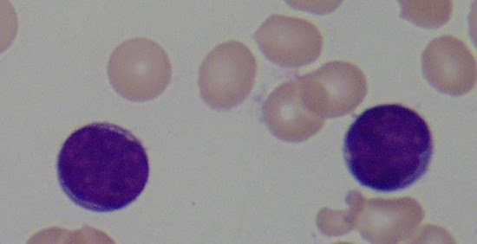
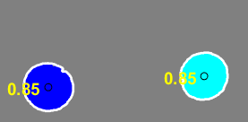
Feature extraction
a
area | cell
8337 | cell1
7857 | cell2
Table 1 the area for each cell in image
b
fig(10) (a) the original image (b) the roundness check image

Slide 22
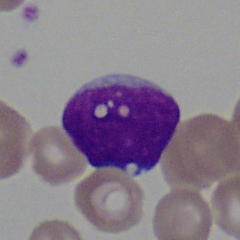

Feature extraction
feature extraction
a
b
fig(9) (a) original image ,(b) nuclei detection image .

Slide 23
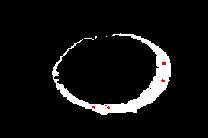
fig(11) (a) original image (b) cytoplasm vacuoles detection.

Slide 24
MatLab results
Measures | Algorithms
 | Algorithm 1(CKC) | Algorithm 2(ALLS)
Precision | 0.910714 | 0.90716
Recall | 0.809524 | 0.98387
Accuracy | 0.822917 | 0.93103
F-measure | 0.953271 | 0.94
Speed | 10 minutes | 7.5 minutes

Slide 25
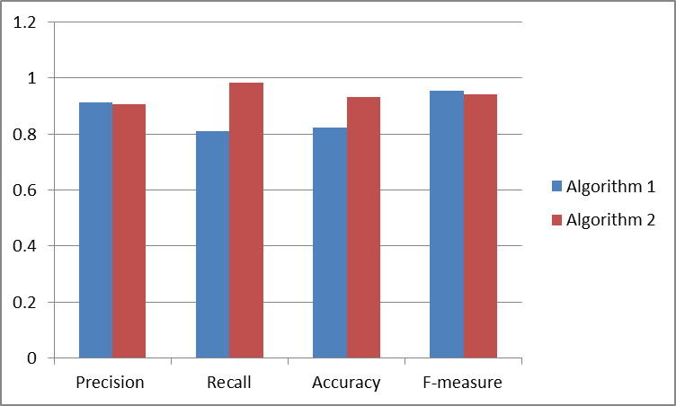

Slide 26
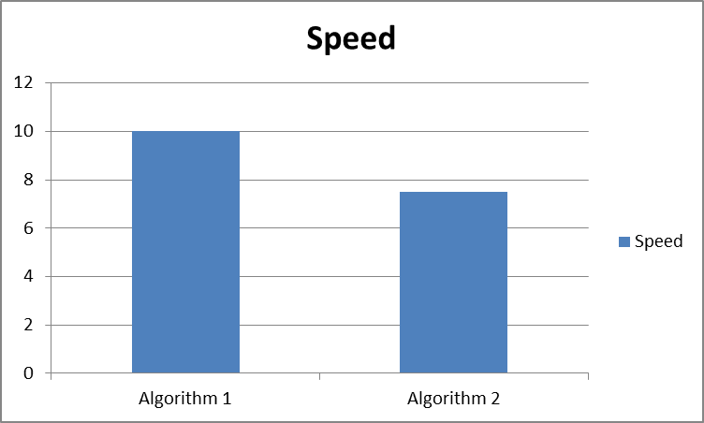

Slide 27
Experimental results using weka
The proposed techniques are applied on microscopic blood
images of the Acute Lymphoblastic Leukemia Image Database (ALL-IDB1) for image processing dataset.
classifier | Algorithm 1 CKC classification using weka
 | accuracy | TP rate | FP rate | precision | recall | f-measure
RandomForest | 0.835 | 0.925 | 0.429 | 0.864 | 0.925 | 0.894
KStar | 0.861 | 0.862 | 0.236 | 0.861 | 0.862 | 0.861
REPTree | 0.786 | 0.9 | 0.545 | 0.829 | 0.9 | 0.863

Slide 28
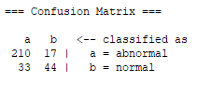
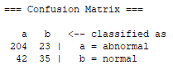
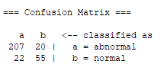
Algorithm 1 CKC
Random Forest
REP tree
K Star

Slide 29
classifier | Algorithm 2 ALLS classification using weka
 | accuracy | TP rate | FP rate | precession | recall | f-measure
RandomForest | 0.939 | 0.940 | 0.051 | 0.944 | 0.940 | 0.940
KStar | 0.931 | 0.931 | 0.057 | 0.937 | 0.931 | 0.931
REPTree | 0.905 | 0.905 | 0.077 | 0.917 | 0.905 | 0.906

Slide 30
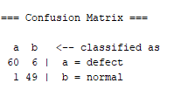
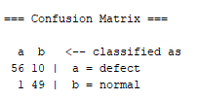
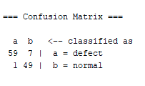
Algorithm 2
Random Forest
REP tree
K Star

Slide 31
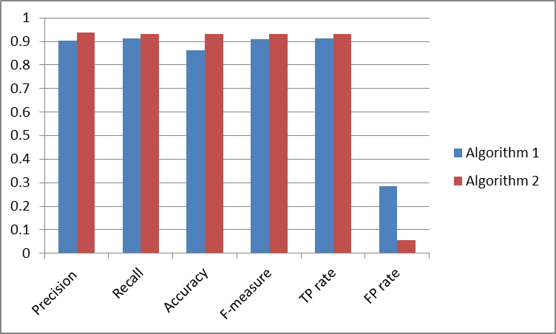
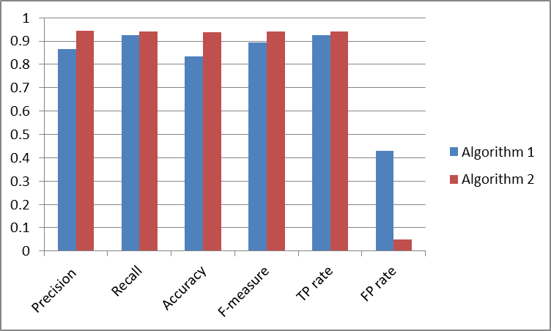
Random Forest

Slide 32
K Star

Slide 33
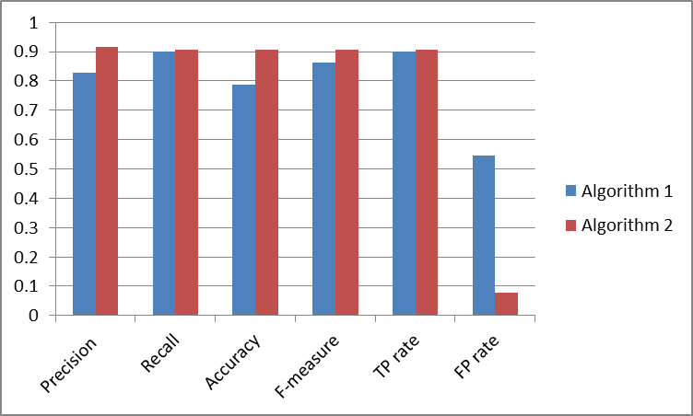
REP tree

Slide 34
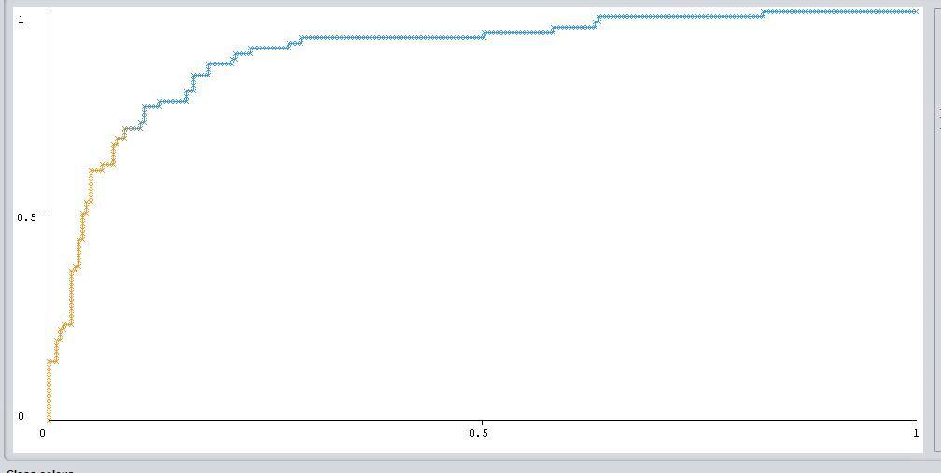
Algorithm 1 CKC ROC curve
Figure 12 ROC Curve for Kstar classifier of normal cells

Slide 35
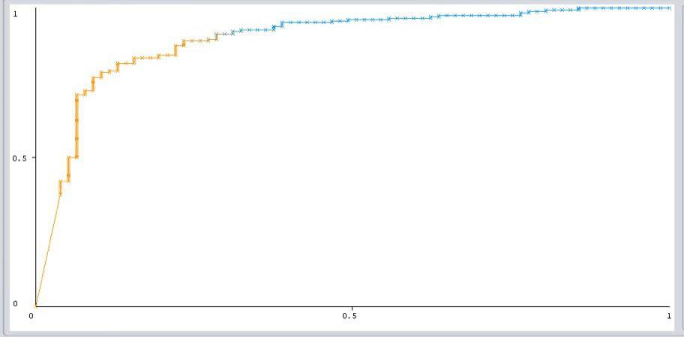
Algorithm 1 CKC ROC curve
Figure 13 ROC Curve for Kstar classifier of defect cells

Slide 36
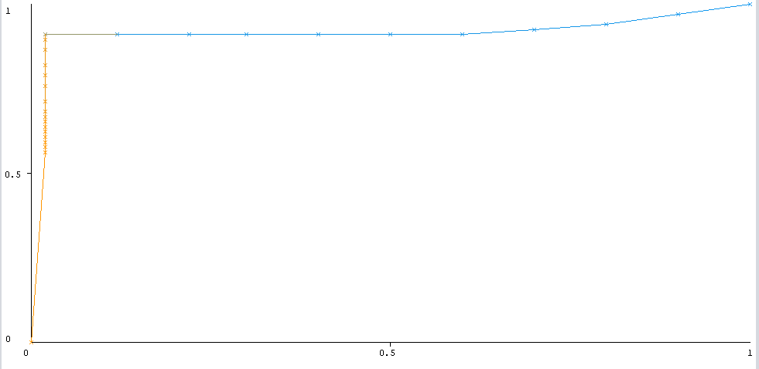
Algorithm 2 ALLS ROC curve
Figure (14) ROC Curve for random forest classifier of defect cells

Slide 37
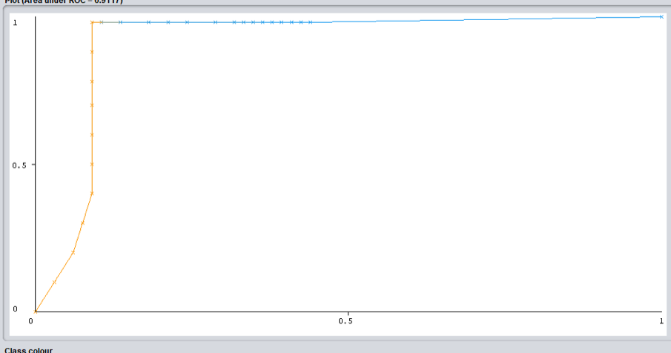
Algorithm 2 ALLS ROC curve
Figure (15) ROC Curve for random forest classifier of normal cells

Slide 38
Future Work
deploy deep learning models to learn from scratch with larger image data sets so that these diagnostic system can be used in everyday life and help the pathologist and oncologist to diagnose the leukemia in better way
01
02
develop an automated detection system for AML so that other different types of blood cancer can be automated.
Compare the proposed study with Acute Lymphoblastic Leukemia Detection and Classification of Its Subtypes Using Pretrained Deep Convolutional Neural Networks
03

Slide 39

THANK YOU

