Slide 1

An-Najah National University
Faculty of Engineering
Civil Engineering Department
GRADUATION PROJECT II
3D Analysis and Design of WebTech Company Building With Supplementary Steel Frame
Supervisor : Dr. Monther Diab

Slide 2
Prepared by:
Ahmad Ghassan Mubarak
Jamal Samer Harb
Omar Samer Shaheen

Slide 3
Outline : PART 1 (CONTINUED)
Chapter 5: Dynamic Analysis and Static Check
5.1 Calculation of Center of Rigidity and Center of Mass
5.2 Static Analysis
5.3 Dynamic Analysis
Chapter 6: Analysis and Design Of Foundations
6.1 Design of Strip Footing
6.2 Design of Combined Footing
6.3 Design of Isolated Footing
6.4 Design of Tie Beam
Chapter 7: Design of Helical Stair

Slide 4
Outline : PART 2
Static Analysis and Design of Steel Frame Structure
{ SUPPLEMENT STORAGE BUILDING }
Chapter 1: Introduction
1.1 Project Description
1.2 Location and Function
1.3 Site and Geology
1.4 Design Codes
1.5 Materials
1.6 Basic Date Used for Design
1.7 Layout and Elevation of the Structure

Slide 5
Outline : PART 2
Chapter 2: Checks and Verification of 3D SAP Model
2.1 introduction
2.2 Compatibility Check
2.3 Equilibrium Check
2.4 Stress Strain Relationships

Slide 6
Outline : PART 2
Chapter 3: Static Design and Check of Structure
3.1 Introduction
3.2 Check Serviceability of Structure
3.3 Design of Purlins
3.4 Design of the Rafter Beam
3.5 Design of the Columns
3.6 Design of Bracing System:
3.7 Design of the Connections
3.8 Design of the Base Plate
3.9 Design of Foundation Underneath Base Plate

Slide 7
Introduction
A company branch building that consists of 5 stories, with an area of 1741.2 m²/story, in addition to a parking lot, Located at “Al-Toor “ in Jarzeem mountain in Nablus city.
The building will be built on rock soil that has a bearing capacity of 400 KN/m².
The structural system of the building will be traditional system that consists of frames .
The building is designed as two way solid slab with drop beams.

Slide 8
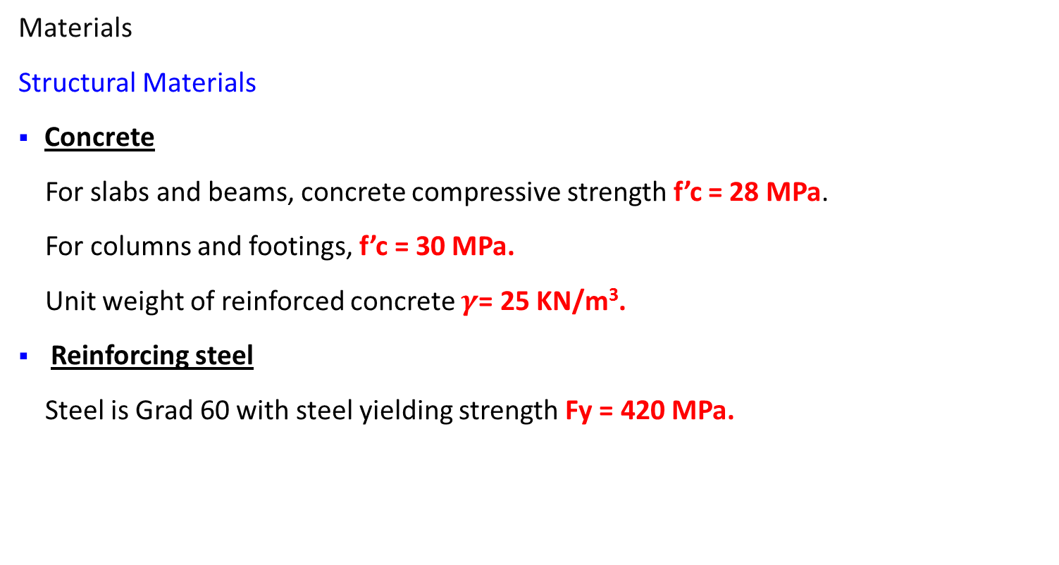
Design Determinants
Materials
Structural Materials
Concrete
For slabs and beams, concrete compressive strength f’c = 28 MPa.
For columns and footings, f’c = 30 MPa.
Unit weight of reinforced concrete $γ$= 25 KN/m³.
Reinforcing steel
Steel is Grad 60 with steel yielding strength Fy = 420 MPa.

Slide 9
Design Determinants
Non-structural Materials
Material | Unit Weight KN/m³ .
Plain Concrete (Mortar) | 23
Filler | 18
Polystyrene | 0.3
Blocks | 12
Tiles | 22
Masonry stone | 27
Glass | 25

Slide 10
Design Determinants
Loads
Dead loads : Static permanent loads composed from the weight of structural elements as well as partitions ( Superimposed) .
Superimposed dead load = 4.2 KN/m²
Live Load : is the load produced by the use and occupancy of the structure,
for Office buildings, uniformly distributed live load 50psf ( 2.5 KN/m² )
which has been stated using IBC Code / Table 1607.1

Slide 11
Design Determinants
Concrete Design Codes
The American Concrete Institute Code (ACI 318-08).
International Building Code (IBC 2009).

Slide 12
Center of Mass , Center of Rigidity
Center of Rigidity = ∑ (K d)/ ∑K
Center of Mass using centroid equation = ∑ (Ad)/ ∑A
Hand calculation of CR : X = 22.64117 , Y = 23.04124
Shear wall | Ix | Iy | x | y | X x Ix | Y x Iy
1 | 4.1438 | 4.143818 | 0.8984 | 44.784 | 3.7228 | 185.58
2 | 9.7168 | 11.15071 | 1.39 | 2.3567 | 13.506 | 26.279
3 | 11.151 | 9.716808 | 43.326 | 44.293 | 483.12 | 430.38
4 | 0.8694 | 0.856714 | 26.985 | 26.611 | 23.461 | 22.798
5 | 0.8637 | 0.867348 | 19.059 | 18.69 | 16.461 | 16.211
6 | 14.879 | 14.8865 | 27.027 | 18.659 | 402.13 | 277.77
Total | 41.623 | 41.62189 |  |  | 942.4 | 959.02

Slide 13
Center of mass using Autocad: X = 20.5672 , Y = 25.1157
Etabs result of CM and CR :
Error in CM is small and differences in CR due to hand calculation based on rigidity of shear wall only
The differences in Center of Rigidity is less than 10% , (Acceptable)
Story | XCM | YCM | XCR | YCR
 | m | m | m | m
Story1 | 19.6863 | 25.9923 | 19.5819 | 26.0627
Story2 | 19.601 | 26.0773 | 21.0961 | 24.6603
Story3 | 19.6864 | 25.9924 | 21.9285 | 23.9117
Story4 | 19.6862 | 25.9923 | 22.3428 | 23.5578
Story5 | 19.6008 | 26.0777 | 22.5656 | 23.374
Story6 | 19.7258 | 25.9539 | 22.7095 | 23.2495

Slide 14
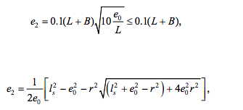
Differences in center of rigidity between stories due to torsional twist of the story Combined with the transitional displacement
Reduced by reducing the deference between CM and CR
Torsion effect on stiffness center from Eurocode 8 the smallest of :

Slide 15
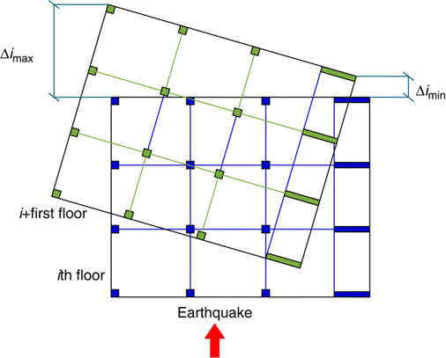
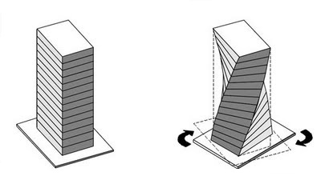
Combination of transitional and twist movement :

Slide 16
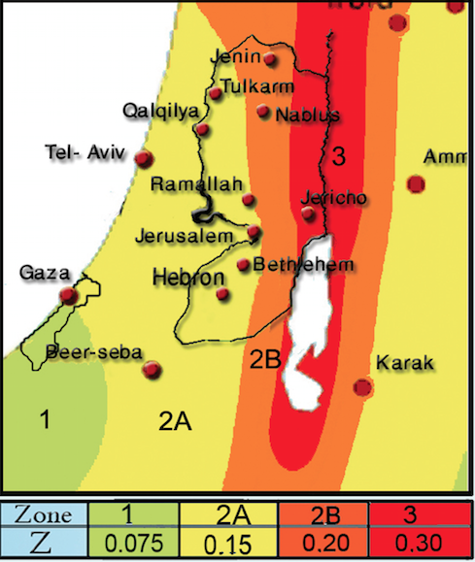
Equivalent Static Method :
According to method B UBC97 Section 1630.2.2
Period = 1.3 sec
For Nablus we take zone 2B for seismic acceleration
Solid Profile: SB
Ductility factor R = 4.5 as we have bearing shear wall
Load Pattern | Hand Calculation
Live Load | 25226.33
Superimposed | 52338.48
Dead Load | 99774.47

Slide 17
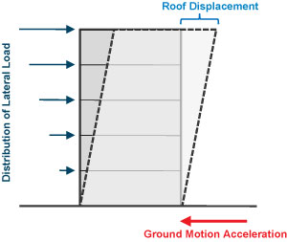
Base Shear UBC97 Section 1630.2.1
Cs= (Cv x I)/(R x T)
V= Cs x W = 5416 KN
For Weight we take W= DL+SD+ 0.25L = 158419.5 KN
Etabs Result: W= 161414.64
Base Shear V = 5521 KN The value is accepted since the error =1%

Slide 18
Dynamic Analysis Using Response Spectrum:
According to UBC97 we have to take horizontal load cases as the following
Ehx = Ex + 0.3 Ey
Ehy = Ey + 0.3 Ex
A factor of gI/R must be multiplied to the Response Spectrum Function
Priliminary factor used = 2.18
Base shear = 4464 KN less than static base shear (5521 KN )

Slide 19
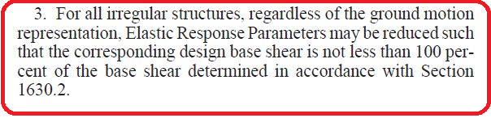
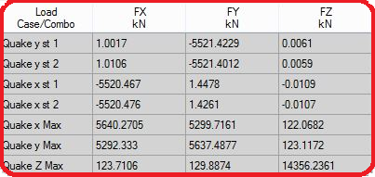
According to UBC97 Section 1631.5.4
Increase factor by (5521/4464 ) = 1.23
Result static base shear = dynamic

Slide 20
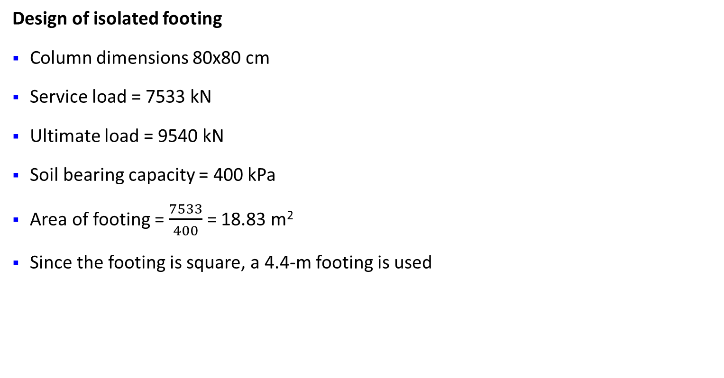
Chapter 6: Analysis and Design of Footings
Design of isolated footing
Column dimensions 80x80 cm
Service load = 7533 kN
Ultimate load = 9540 kN
Soil bearing capacity = 400 kPa
Area of footing = $\frac{7533}{400}$ = 18.83 m²
Since the footing is square, a 4.4-m footing is used

Slide 21
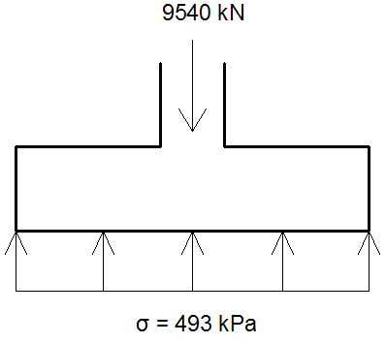
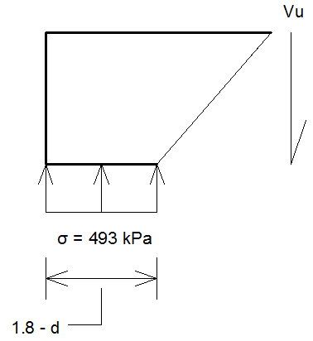

Thickness Determination
Based on wide beam shear
V_{u} = 493 (1.8 - $\frac{d}{1000}$)
ØV_{c} = 0.75 × $\frac{1}{6}$ × $\sqrt{30}$ × 1000 × d / 1000
V_{u} = ØV_{c} -------> d = 753.53 mm.
Take d = 760 mm ------> h = 850 mm.

Slide 22

Check for punching shear
ØV_{c} = 0.75 × $\frac{1}{3}$ × $\sqrt{30}$ × 6240 × 760 / 1000 = 6494 kN.
V_{u} = 9540 – 493 × 6.240 ×0.760 = 7202 kN > ØV_{c}
Using an approximate formula
d = 10 $\sqrt{P_{u}}$ = 977 mm, say 1000 mm.
h = 1100 mm.

Slide 23

Design for flexure
M_{u} = $\frac{σ L^{2}}{2}$ = 798.7 kN.m/m
ρ = 0.00215 /m
A_{s} = 2150 mm²/m
A_{s,min} = 0.0018 × 1000 × 1100 = 1980 mm²/m < A_{s}
Use 5Ø24 /m both directions

Slide 24
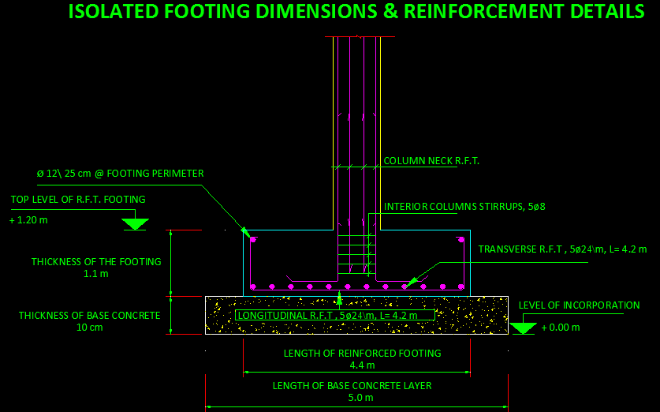
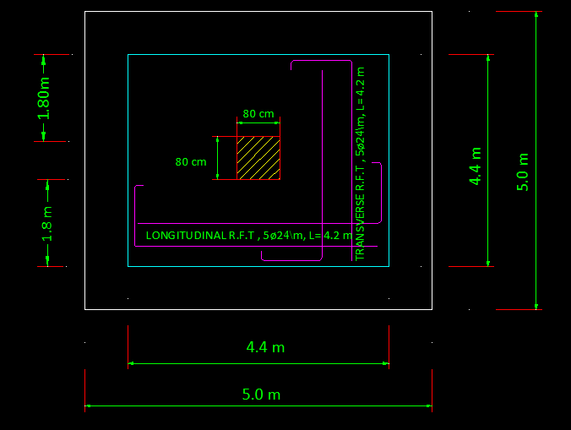
ISOLATED FOOTING DIMENSIONS & REINFORCEMENT DETAILS

Slide 25
Design of Tie Beam
Tie Beam: Max load 8782 KN.
10% x 8782 = 878 KN tension
T = Fy As
878/(420*10^3) = 0.00209 m² steel = 2091 mm² steel
Use 1% as steel ratio
Area of concrete = 2091/0.01 = 209095 mm²
Use section 40 x 60 width (Area = 2400 cm²)
For all tie beam use steel 10Y18 steel 5 bars top 5 bars bottom

Slide 26
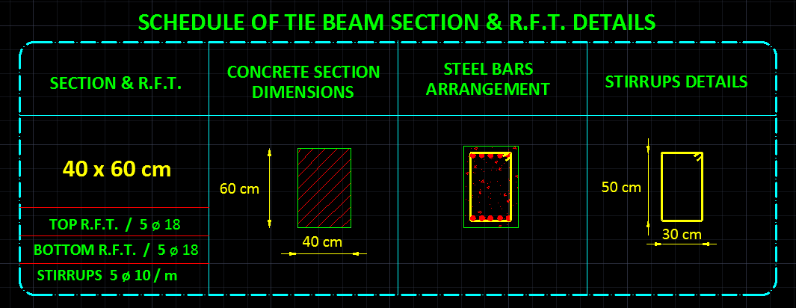
SCHEDULE OF TIE BEAM SECTION &R.F.T DETAILS

Slide 27
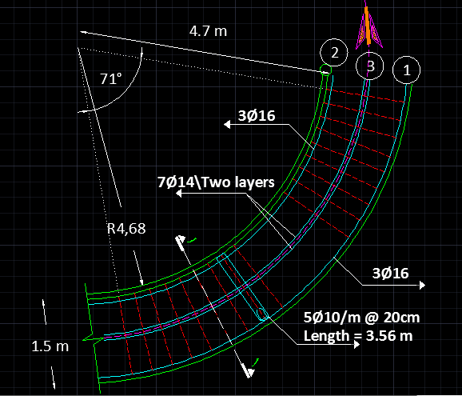
Design of Helical Stair
The following is the detailing of Helical Stair of 1.5 m width and 4.0 m height.

Slide 28
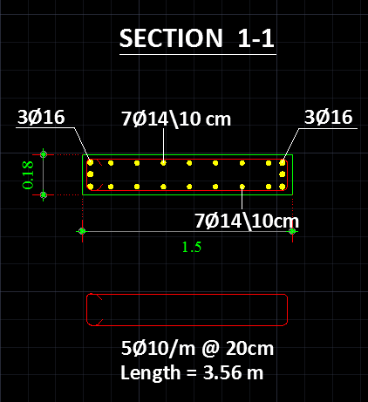
Design of Helical Stair: Cross Section

Slide 29
PART II
Static Analysis and Design of Steel Frame Structure
{ SUPPLEMENT STORAGE BUILDING }

Slide 30
Chapter 1: Introduction
Project Description
This part of the project is a structural analysis and design of supplement steel storage frame for WebTech company branch at Nablus city, the design consists of steel frame, bracings and interlocking systems.
1.4 Design Codes
In this project, the following codes will be used:
Steel Design Specifications and Code ( AISC 2005 )
Loads are calculated according to Egyptian Code for Loads (EPC 2012)
Palestinian Central Bureau of Statistics (PCBS)

Slide 31
Basic Data Used for Design
The structure is assumed to be in Nablus\ Al_Toor.
Steel used in design is mild steel (A36_Steel).
Concrete compressive strength for foundation f’c = 30MPa.
Assume using A325 Bolts (Fu = 827MPa) for connections.
Threaded rods for base connections according to ASTM A354 Grade BD.
Any other assumptions will be clarified through design.

Slide 32
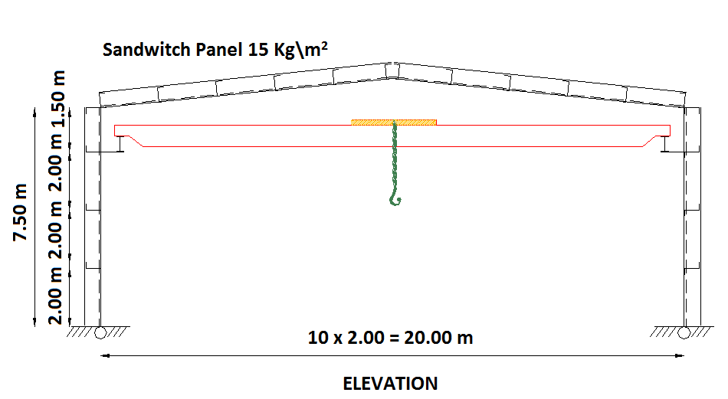
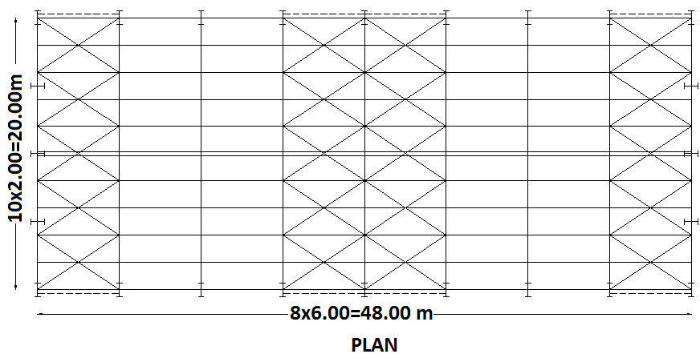
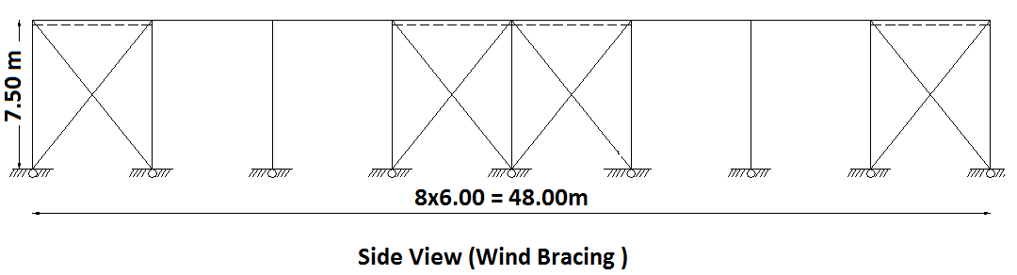
Layout and Elevation of the Structure

Slide 33
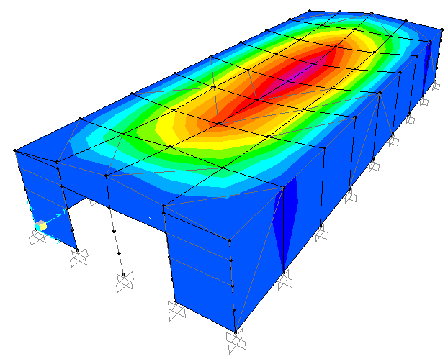
Chapter 2: Checks and Verification of 3D SAP Model
Compatibility Check
Compatibility has been checked as shown in figure, and it seems that the modeling is ok.

Slide 34

Equilibrium Check
Sum of sections weight = 83430.67 Kg → 834.31 KN.
SAP result = 846.46 KN.
Percent of error = $\frac{846.46−834.31}{846.46 }$ x 100% = 1.43% (Acceptable)
Section Type | Weight (Kg\m) | Length (m) | Number | Total weight (Kg)
HE 600 x 151 | 151 | 9.6 | 16 | 23193.6
HE 300 A | 88.3 | 7.5 | 24 | 15894.0
IPE 400 O | 75.7 | 10.05 | 18 | 13694.13
IPE 270 | 36.1 | 6.0 | 16 | 3465.6
L 203 x 203 x 19 | 57.9 | 7.2 | 16 | 6679.34
UKPFC 300 x 100 x 46 | 45.5 | 6 | 64 | 17472.0
UPN 260 | 37.9 | 5 | 16 | 3032.0

Slide 35
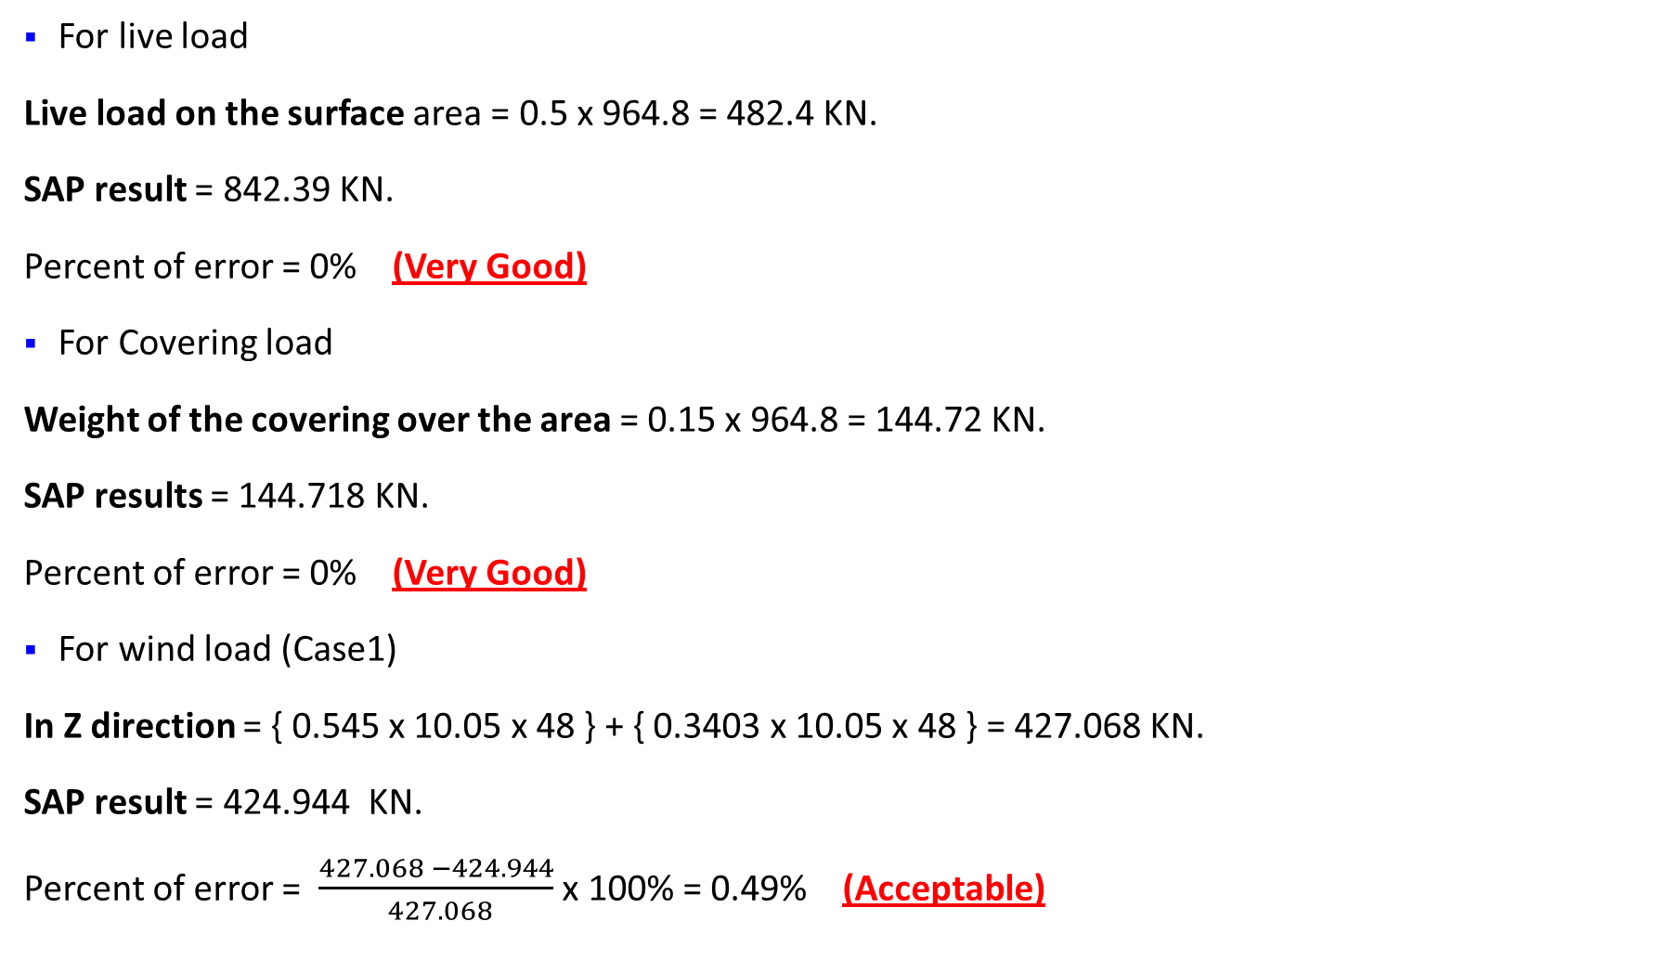
For live load
Live load on the surface area = 0.5 x 964.8 = 482.4 KN.
SAP result = 842.39 KN.
Percent of error = 0% (Very Good)
For Covering load
Weight of the covering over the area = 0.15 x 964.8 = 144.72 KN.
SAP results = 144.718 KN.
Percent of error = 0% (Very Good)
For wind load (Case1)
In Z direction = { 0.545 x 10.05 x 48 } + { 0.3403 x 10.05 x 48 } = 427.068 KN.
SAP result = 424.944 KN.
Percent of error = $\frac{427.068 −424.944}{ 427.068}$ x 100% = 0.49% (Acceptable)

Slide 36
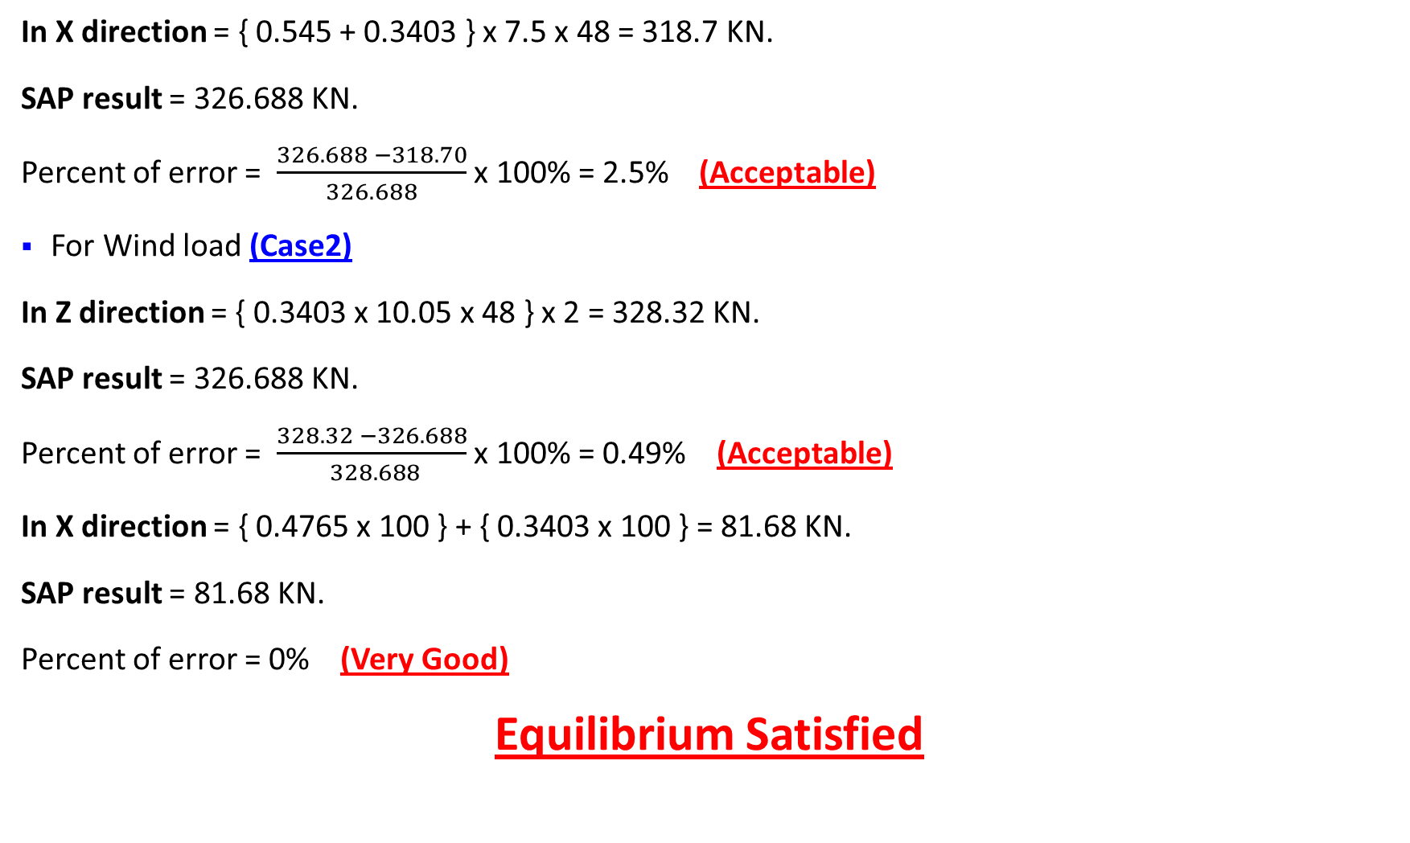
In X direction = { 0.545 + 0.3403 } x 7.5 x 48 = 318.7 KN.
SAP result = 326.688 KN.
Percent of error = $\frac{326.688 −318.70}{326.688}$ x 100% = 2.5% (Acceptable)
For Wind load (Case2)
In Z direction = { 0.3403 x 10.05 x 48 } x 2 = 328.32 KN.
SAP result = 326.688 KN.
Percent of error = $\frac{328.32 −326.688}{ 328.688}$ x 100% = 0.49% (Acceptable)
In X direction = { 0.4765 x 100 } + { 0.3403 x 100 } = 81.68 KN.
SAP result = 81.68 KN.
Percent of error = 0% (Very Good)
Equilibrium Satisfied

Slide 37
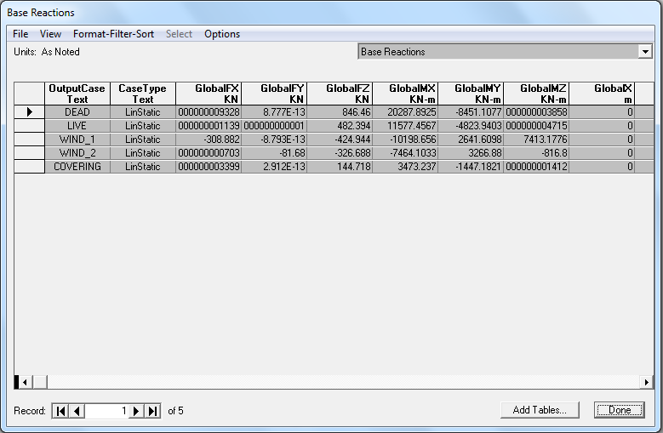

Slide 38
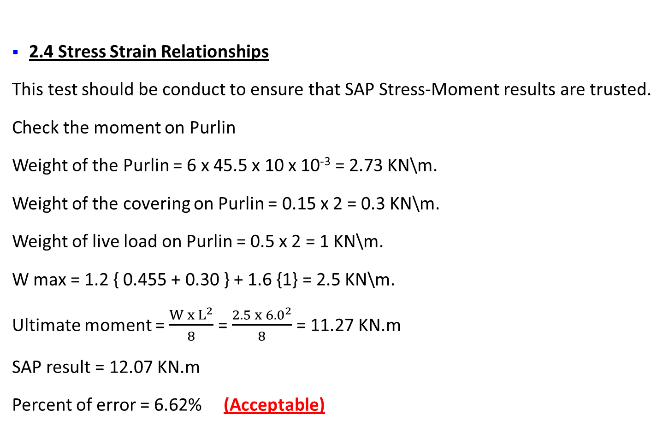
2.4 Stress Strain Relationships
This test should be conduct to ensure that SAP Stress-Moment results are trusted.
Check the moment on Purlin
Weight of the Purlin = 6 x 45.5 x 10 x 10⁻³ = 2.73 KN\m.
Weight of the covering on Purlin = 0.15 x 2 = 0.3 KN\m.
Weight of live load on Purlin = 0.5 x 2 = 1 KN\m.
W max = 1.2 { 0.455 + 0.30 } + 1.6 {1} = 2.5 KN\m.
Ultimate moment = $\frac{W x L^{2}}{8}$ = $\frac{2.5 x {6.0}^{2}}{8}$ = 11.27 KN.m
SAP result = 12.07 KN.m
Percent of error = 6.62% (Acceptable)

Slide 39
Chapter 3: Static Design Check of Structure
Loads
For superimposed dead load (Covering), sandwitch panel of 15 Kg\m², i.e (0.15KN\m²).
According to table 4.1 in EPC 2012, live load can be taken 0.5 KN\m² for inclined surfaces.
Calculation of wind load
q = 0.5 (1.25)(33)²(1.0)(1.0) = 680 .6 N\m²
Here we have two cases:
Case 1: Pressure on exterior surfaces when the wind comes from side of the structure
Case 2: Pressure on exterior surfaces when the wind comes from front of the structure

Slide 40
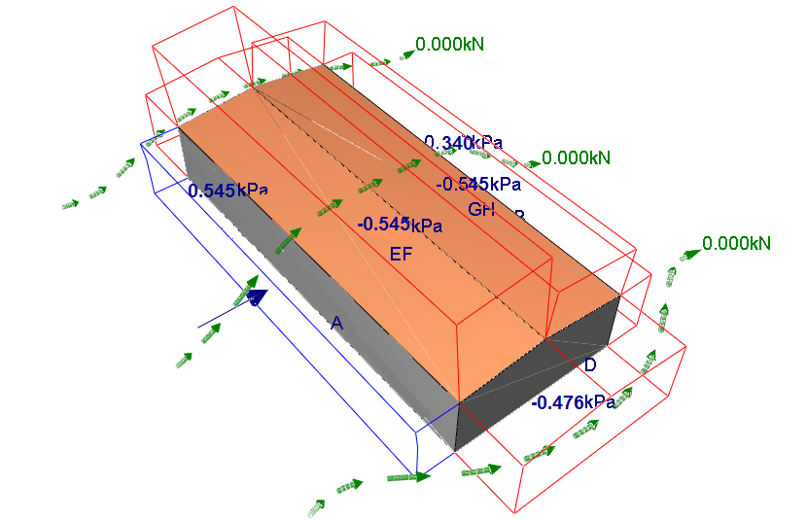
Wind Effect Case 1:

Slide 41
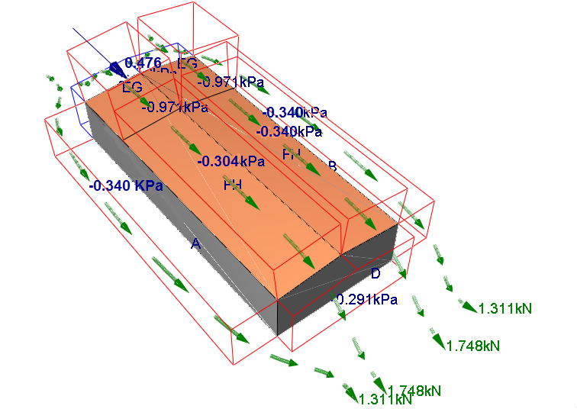
Wind effect Case 2:

Slide 42
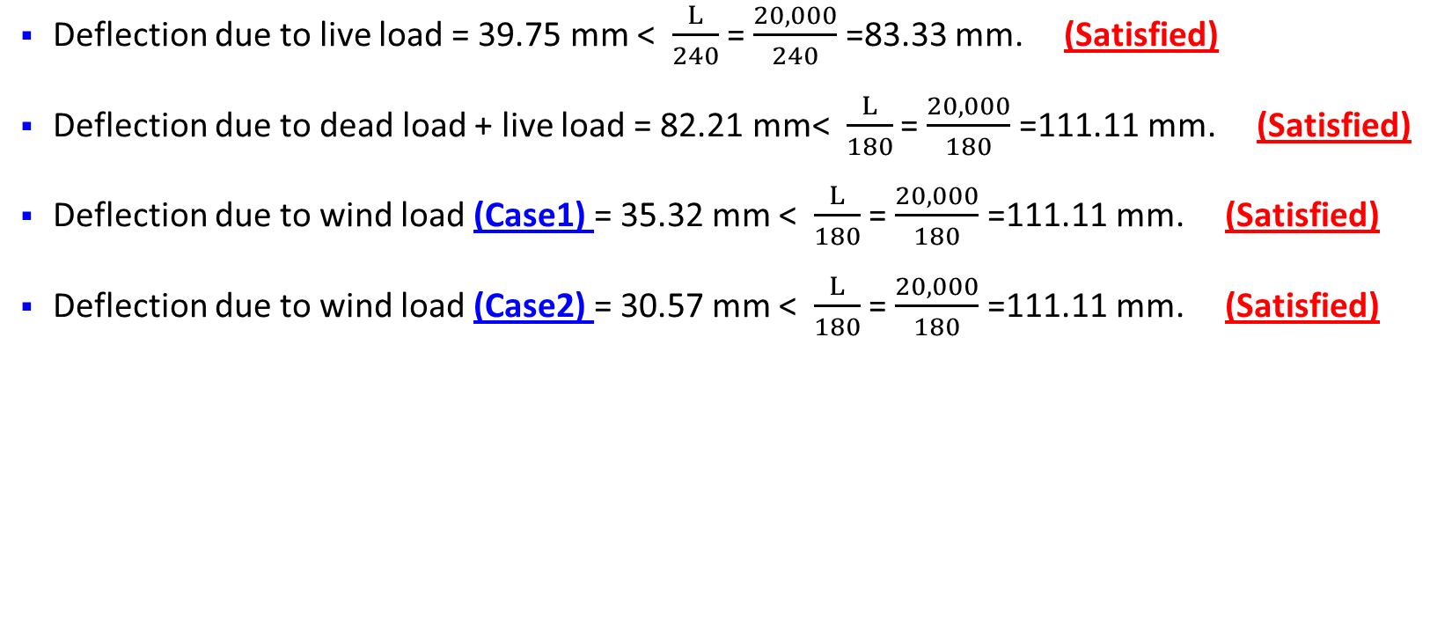
Check Serviceability of Structure
Deflection due to live load = 39.75 mm < $\frac{L}{240}$ = $\frac{20,000}{240}$ =83.33 mm. (Satisfied)
Deflection due to dead load + live load = 82.21 mm< $\frac{L}{180}$ = $\frac{20,000}{180}$ =111.11 mm. (Satisfied)
Deflection due to wind load (Case1) = 35.32 mm < $\frac{L}{180}$ = $\frac{20,000}{180}$ =111.11 mm. (Satisfied)
Deflection due to wind load (Case2) = 30.57 mm < $\frac{L}{180}$ = $\frac{20,000}{180}$ =111.11 mm. (Satisfied)

Slide 43
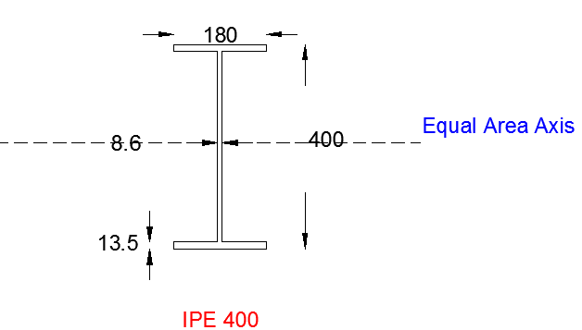
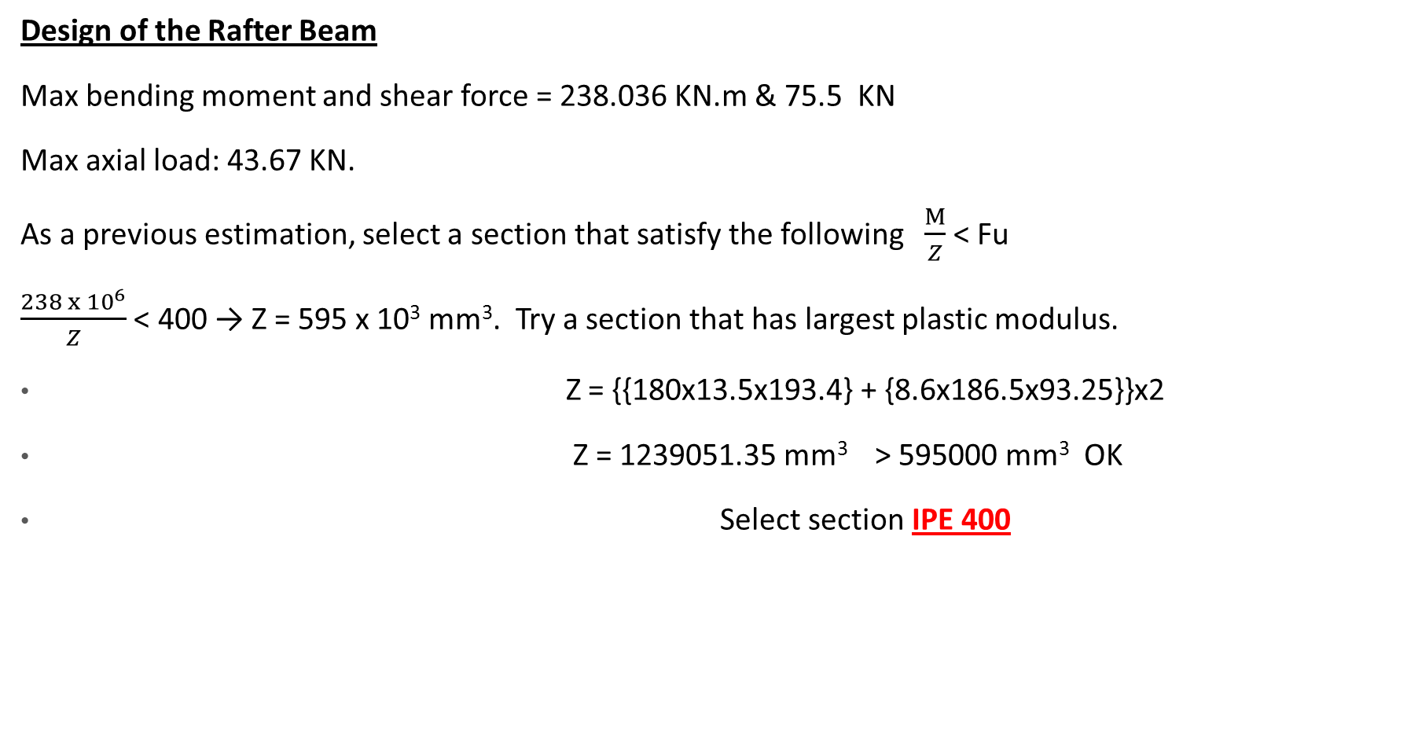
Design of the Rafter Beam
Max bending moment and shear force = 238.036 KN.m & 75.5 KN
Max axial load: 43.67 KN.
As a previous estimation, select a section that satisfy the following $\frac{M}{Z}$ < Fu
$\frac{238 x {10}^{6}}{Z}$ < 400 → Z = 595 x 10³ mm³. Try a section that has largest plastic modulus.
Z = {{180x13.5x193.4} + {8.6x186.5x93.25}}x2
Z = 1239051.35 mm³ > 595000 mm³ OK
Select section IPE 400

Slide 44

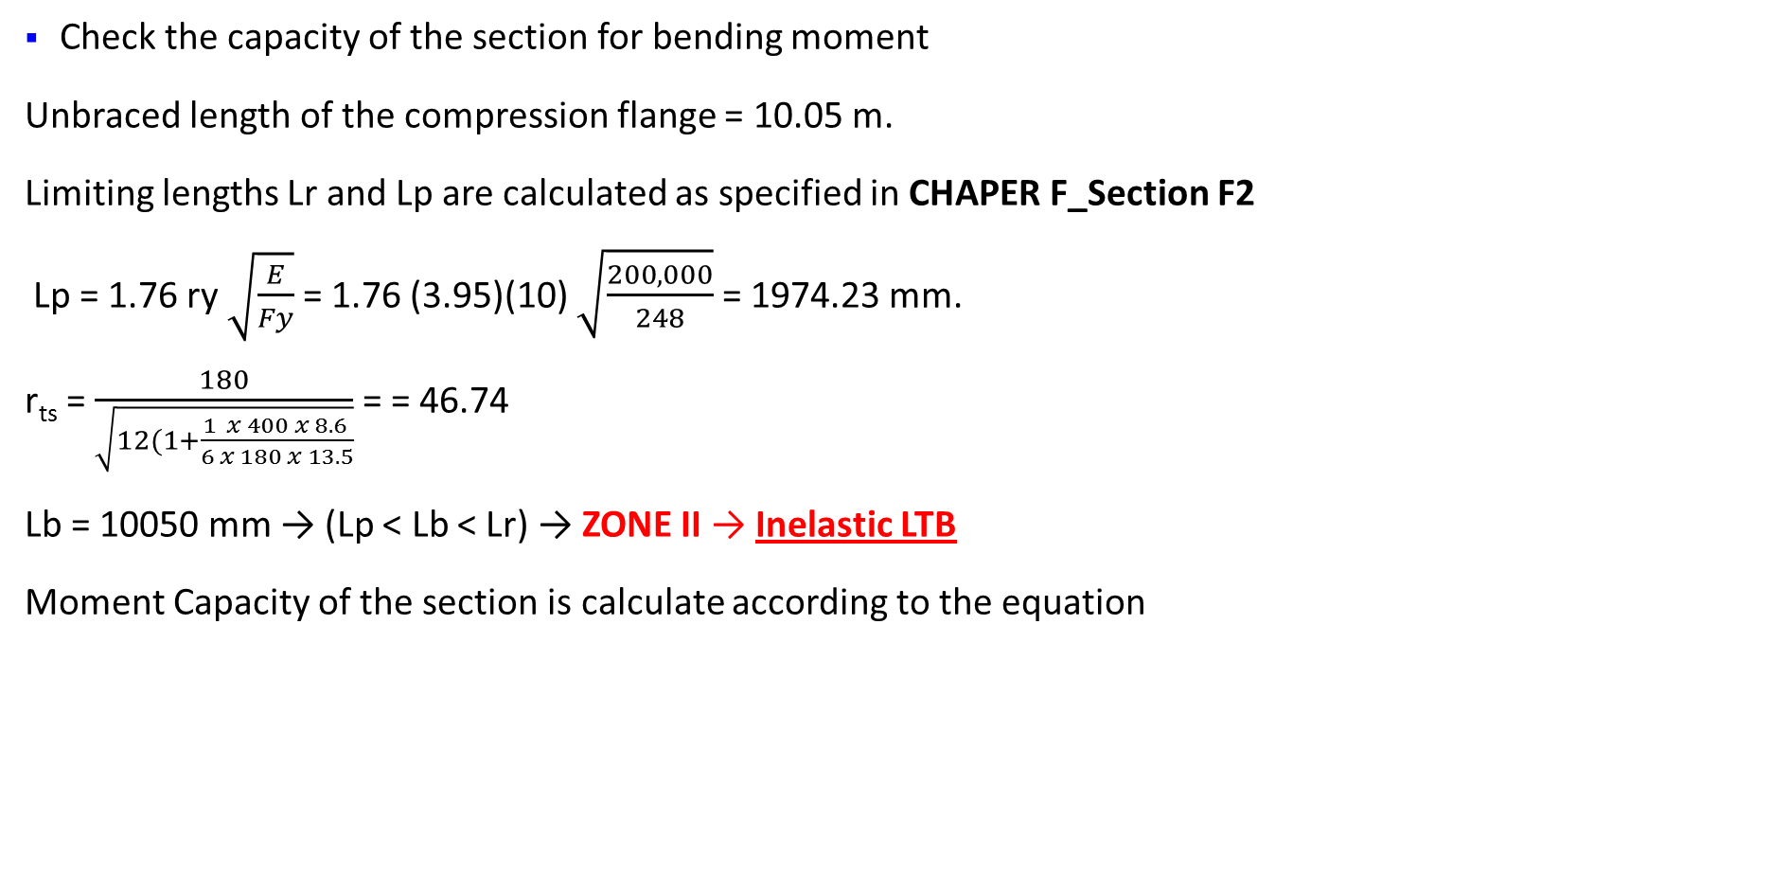
Check the adequacy of the previous section
Check the capacity of the section for bending moment
Unbraced length of the compression flange = 10.05 m.
Limiting lengths Lr and Lp are calculated as specified in CHAPER F_Section F2
Lp = 1.76 ry $\sqrt{\frac{E}{Fy}}$ = 1.76 (3.95)(10) $\sqrt{\frac{200,000}{248}}$ = 1974.23 mm.
r_{ts} = $\frac{180}{\sqrt{12(1+\frac{1}{6 }\frac{x 400 x 8.6}{x 180 x 13.5}}}$ = = 46.74
Lb = 10050 mm → (Lp < Lb < Lr) → ZONE II → Inelastic LTB
Moment Capacity of the section is calculate according to the equation

Slide 45
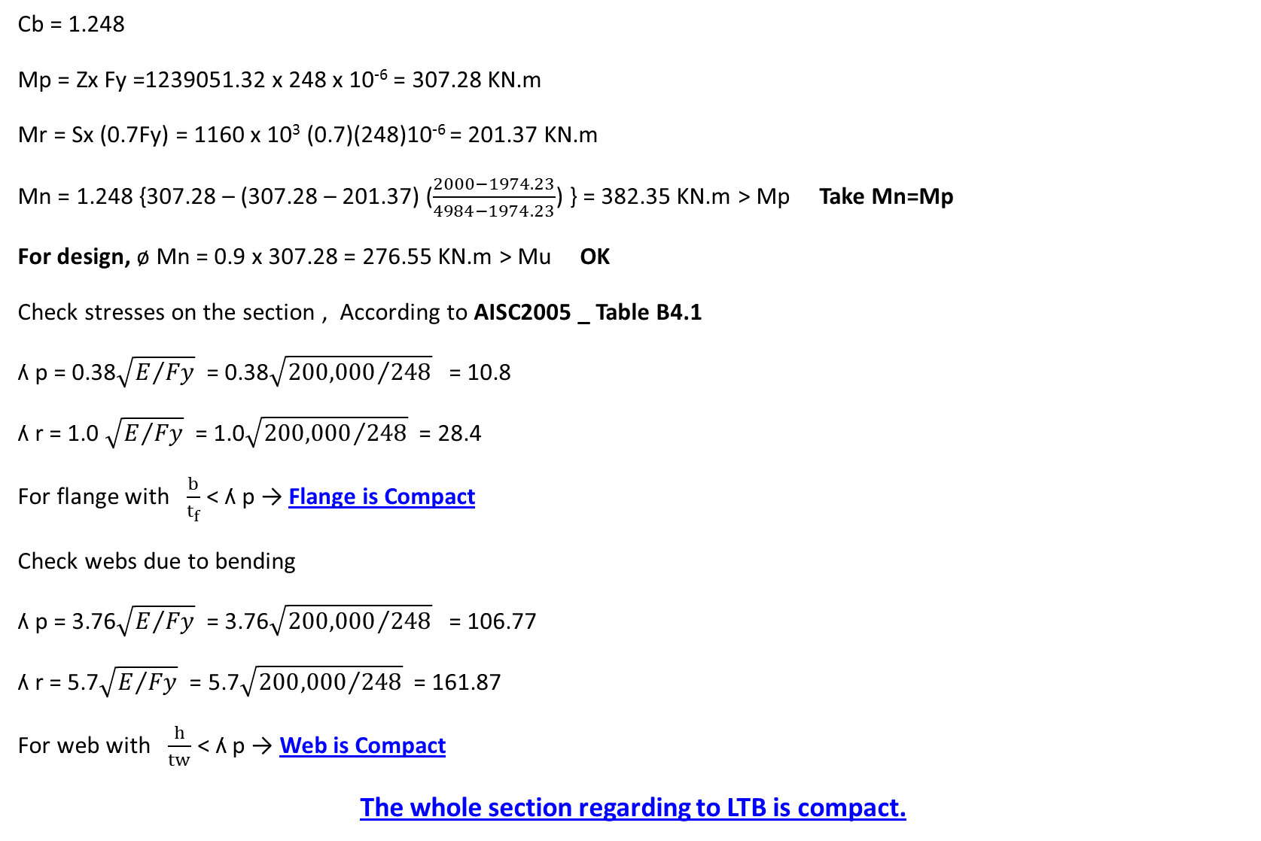
Cb = 1.248
Mp = Zx Fy =1239051.32 x 248 x 10⁻⁶ = 307.28 KN.m
Mr = Sx (0.7Fy) = 1160 x 10³ (0.7)(248)10⁻⁶ = 201.37 KN.m
Mn = 1.248 {307.28 – (307.28 – 201.37) ($\frac{2000−1974.23}{4984−1974.23}$) } = 382.35 KN.m > Mp Take Mn=Mp
For design, ø Mn = 0.9 x 307.28 = 276.55 KN.m > Mu OK
Check stresses on the section , According to AISC2005 _ Table B4.1
ʎ p = 0.38$\sqrt{E/{Fy}}$ = 0.38$\sqrt{{200,000}/{248}}$ = 10.8
ʎ r = 1.0 $\sqrt{E/{Fy}}$ = 1.0$\sqrt{{200,000}/{248}}$ = 28.4
For flange with $\frac{b}{t_{f}}$ < ʎ p → Flange is Compact
Check webs due to bending
ʎ p = 3.76$\sqrt{E/{Fy}}$ = 3.76$\sqrt{{200,000}/{248}}$ = 106.77
ʎ r = 5.7$\sqrt{E/{Fy}}$ = 5.7$\sqrt{{200,000}/{248}}$ = 161.87
For web with $\frac{h}{tw}$ < ʎ p → Web is Compact
The whole section regarding to LTB is compact.

Slide 46
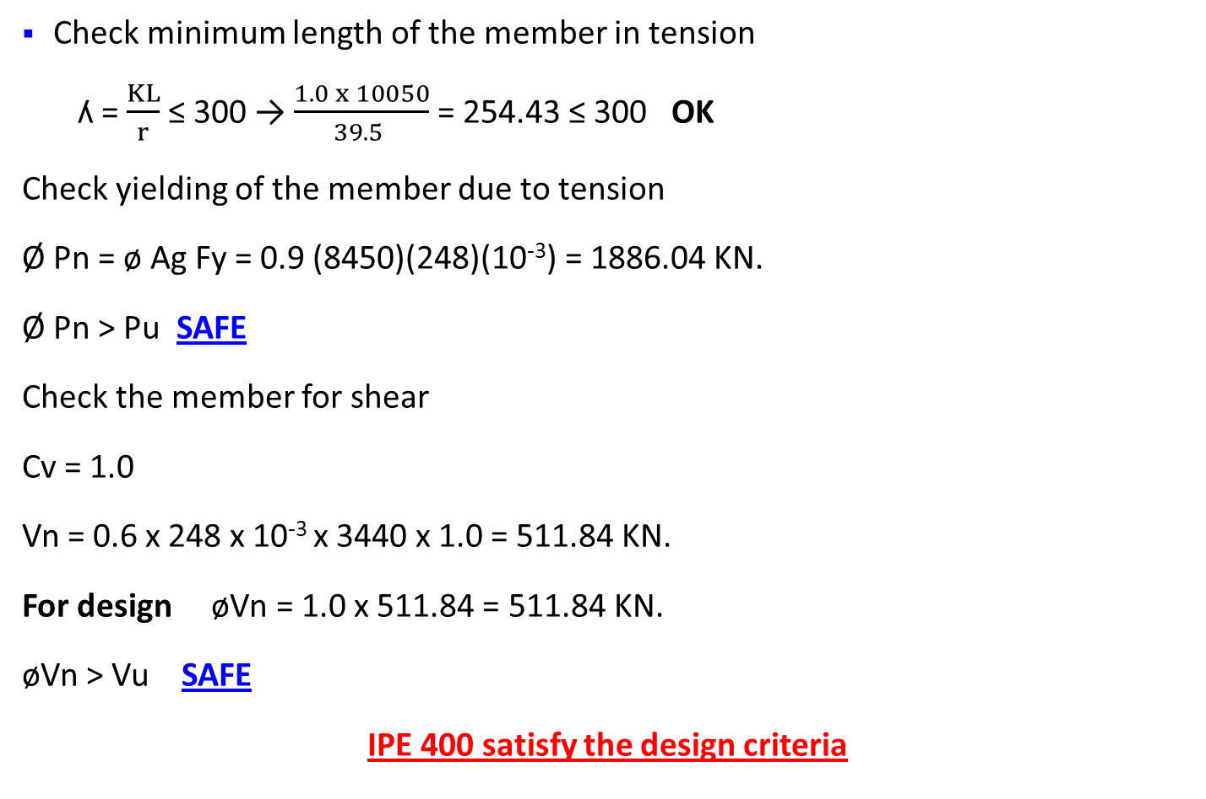
Check minimum length of the member in tension
ʎ = $\frac{KL}{r}$ ≤ 300 → $\frac{1.0 x 10050}{39.5 }$ = 254.43 ≤ 300 OK
Check yielding of the member due to tension
Ø Pn = ø Ag Fy = 0.9 (8450)(248)(10⁻³) = 1886.04 KN.
Ø Pn > Pu SAFE
Check the member for shear
Cv = 1.0
Vn = 0.6 x 248 x 10⁻³ x 3440 x 1.0 = 511.84 KN.
For design øVn = 1.0 x 511.84 = 511.84 KN.
øVn > Vu SAFE
IPE 400 satisfy the design criteria

Slide 47
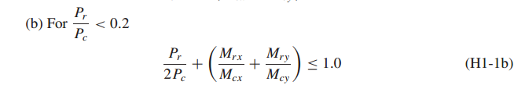
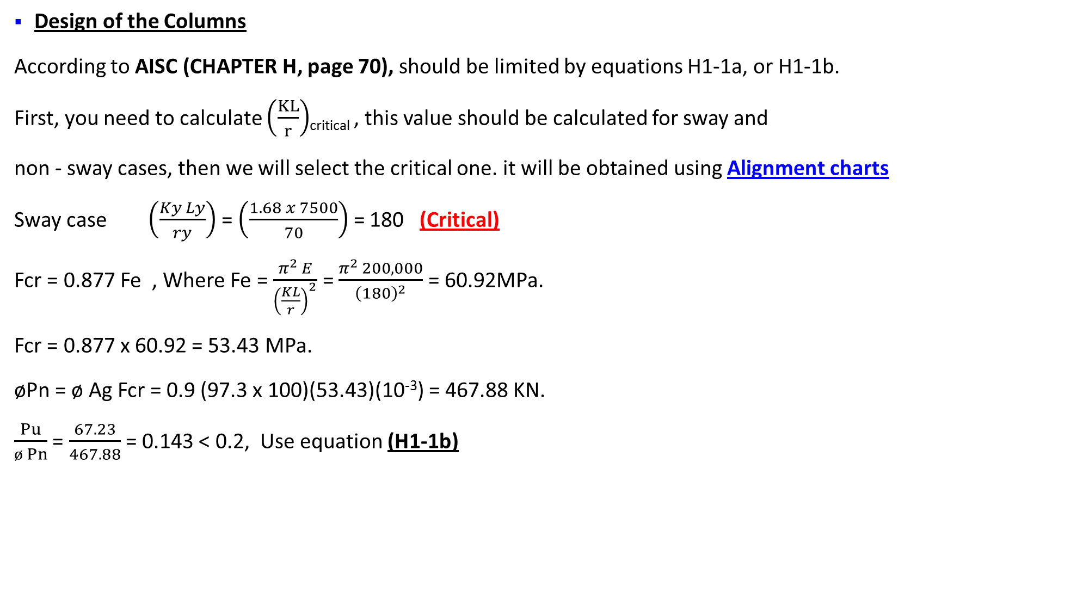
Design of the Columns
According to AISC (CHAPTER H, page 70), should be limited by equations H1-1a, or H1-1b.
First, you need to calculate $\left(\frac{KL}{r}\right)$_{critical} , this value should be calculated for sway and
non - sway cases, then we will select the critical one. it will be obtained using Alignment charts
Sway case $\left(\frac{Ky Ly}{ry}\right)$ = $\left(\frac{1.68 x 7500}{70}\right)$ = 180 (Critical)
Fcr = 0.877 Fe , Where Fe = $\frac{π^{2 }E}{{\left(\frac{KL}{r}\right)}^{2}}$ = $\frac{π^{2 }200,000}{{\left(180\right)}^{2}}$ = 60.92MPa.
Fcr = 0.877 x 60.92 = 53.43 MPa.
øPn = ø Ag Fcr = 0.9 (97.3 x 100)(53.43)(10⁻³) = 467.88 KN.
$\frac{Pu}{ø Pn}$ = $\frac{67.23}{467.88}$ = 0.143 < 0.2, Use equation (H1-1b)

Slide 48
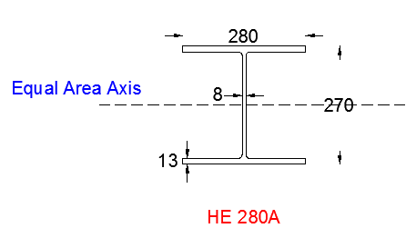
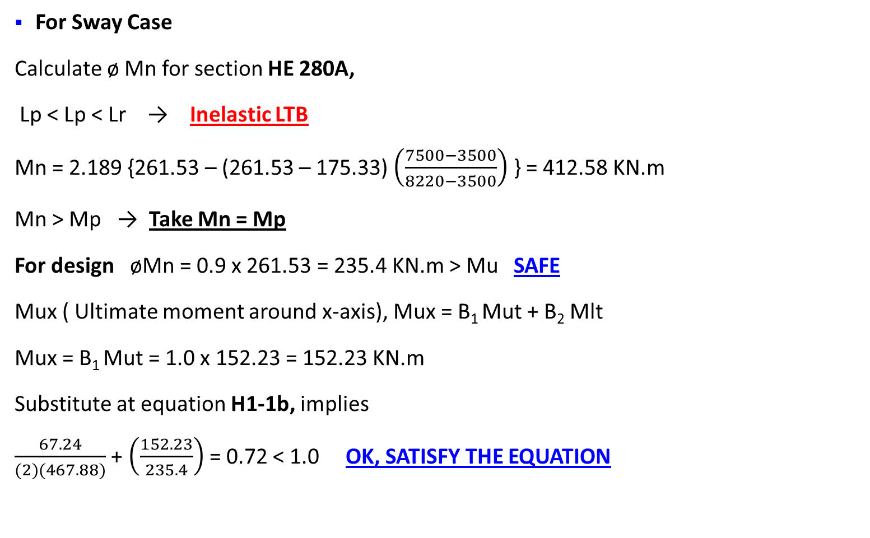
For Sway Case
Calculate ø Mn for section HE 280A,
Lp < Lp < Lr → Inelastic LTB
Mn = 2.189 {261.53 – (261.53 – 175.33) $\left(\frac{7500−3500}{8220−3500}\right)$ } = 412.58 KN.m
Mn > Mp → Take Mn = Mp
For design øMn = 0.9 x 261.53 = 235.4 KN.m > Mu SAFE
Mux ( Ultimate moment around x-axis), Mux = B₁ Mut + B₂ Mlt
Mux = B₁ Mut = 1.0 x 152.23 = 152.23 KN.m
Substitute at equation H1-1b, implies
$\frac{67.24}{(2)(467.88)}$ + $\left(\frac{152.23}{235.4}\right)$ = 0.72 < 1.0 OK, SATISFY THE EQUATION

Slide 49
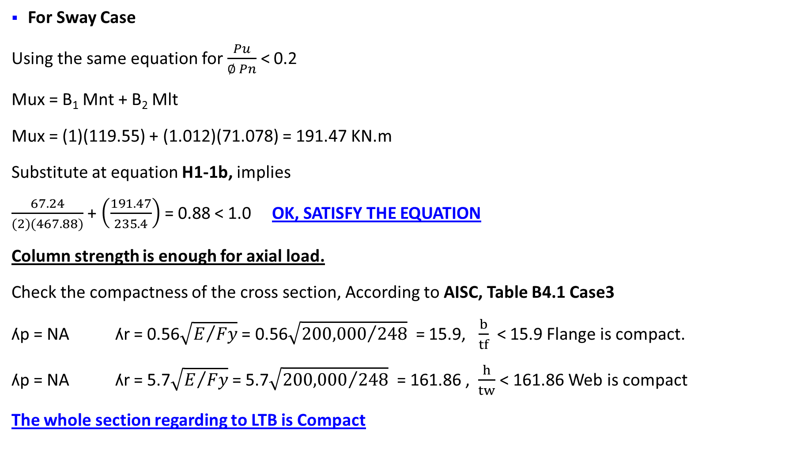
For Sway Case
Using the same equation for $\frac{Pu}{∅ Pn}$ < 0.2
Mux = B₁ Mnt + B₂ Mlt
Mux = (1)(119.55) + (1.012)(71.078) = 191.47 KN.m
Substitute at equation H1-1b, implies
$\frac{67.24}{(2)(467.88)}$ + $\left(\frac{191.47}{235.4}\right)$ = 0.88 < 1.0 OK, SATISFY THE EQUATION
Column strength is enough for axial load.
Check the compactness of the cross section, According to AISC, Table B4.1 Case3
ʎp = NA ʎr = 0.56$\sqrt{E/{Fy}}$ = 0.56$\sqrt{{200,000}/{248}}$ = 15.9, $\frac{b}{tf}$ < 15.9 Flange is compact.
ʎp = NA ʎr = 5.7$\sqrt{E/{Fy}}$ = 5.7$\sqrt{{200,000}/{248}}$ = 161.86 , $\frac{h}{tw}$ < 161.86 Web is compact
The whole section regarding to LTB is Compact

Slide 50
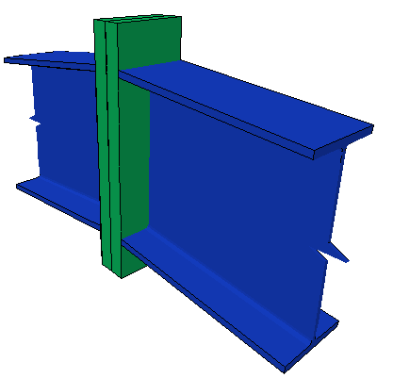
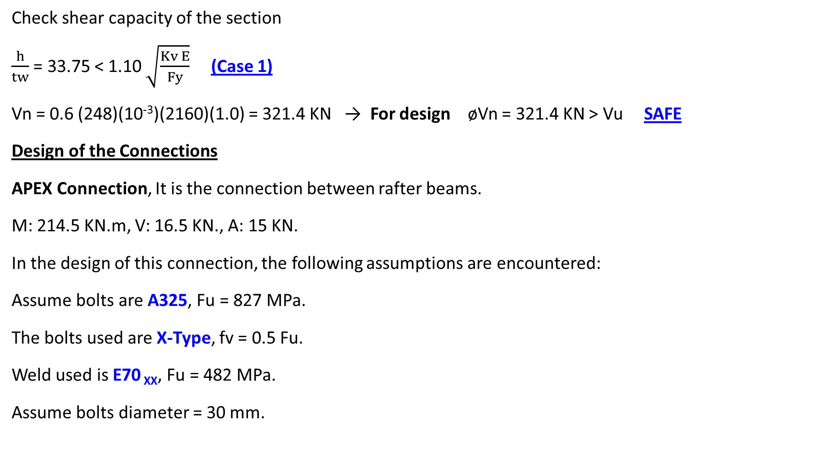
Check shear capacity of the section
$\frac{h}{tw}$ = 33.75 < 1.10 $\sqrt{\frac{Kv E}{Fy}}$ (Case 1)
Vn = 0.6 (248)(10⁻³)(2160)(1.0) = 321.4 KN → For design øVn = 321.4 KN > Vu SAFE
Design of the Connections
APEX Connection, It is the connection between rafter beams.
M: 214.5 KN.m, V: 16.5 KN., A: 15 KN.
In the design of this connection, the following assumptions are encountered:
Assume bolts are A325, Fu = 827 MPa.
The bolts used are X-Type, fv = 0.5 Fu.
Weld used is E70 _{XX}, Fu = 482 MPa.
Assume bolts diameter = 30 mm.

Slide 51
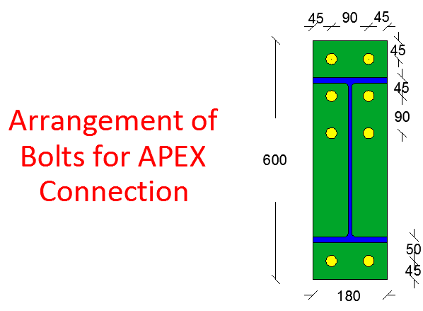
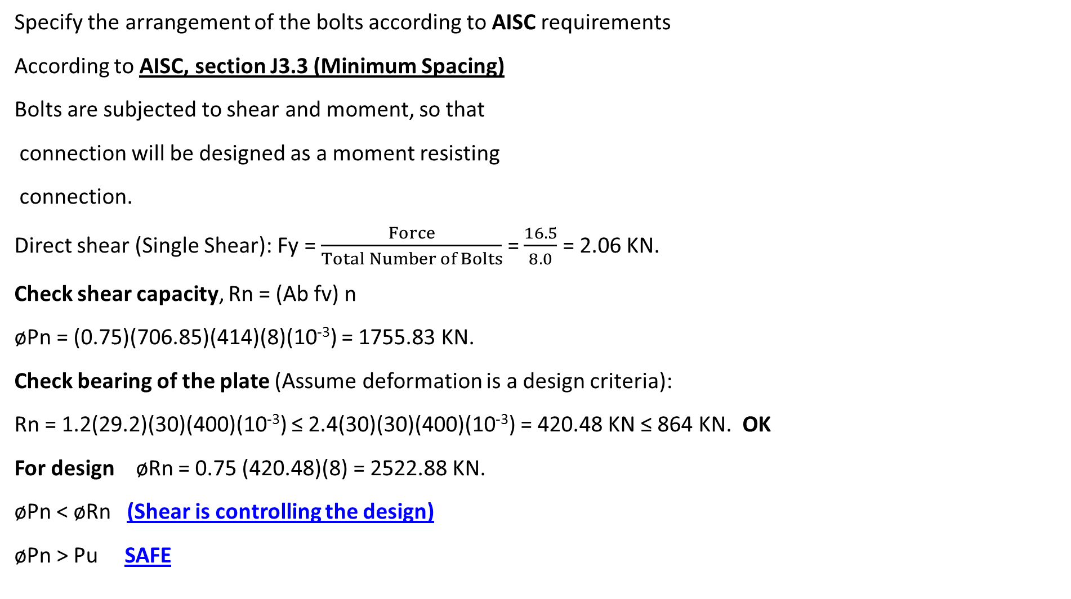
Specify the arrangement of the bolts according to AISC requirements
According to AISC, section J3.3 (Minimum Spacing)
Bolts are subjected to shear and moment, so that
connection will be designed as a moment resisting
connection.
Direct shear (Single Shear): Fy = $\frac{Force}{Total Number of Bolts}$ = $\frac{16.5}{8.0}$ = 2.06 KN.
Check shear capacity, Rn = (Ab fv) n
øPn = (0.75)(706.85)(414)(8)(10⁻³) = 1755.83 KN.
Check bearing of the plate (Assume deformation is a design criteria):
Rn = 1.2(29.2)(30)(400)(10⁻³) ≤ 2.4(30)(30)(400)(10⁻³) = 420.48 KN ≤ 864 KN. OK
For design øRn = 0.75 (420.48)(8) = 2522.88 KN.
øPn < øRn (Shear is controlling the design)
øPn > Pu SAFE

Slide 52
Fz (Due to axial force) = 1.87 KN.
This is the value of axial due to direct axial force, there is another component resulted from moment around the X-axis.
Fmxz = , Where, Mx = 214.5 KN.m
Total axial force = 1.87 + 231.74 = 233.62 KN.
øRn = 0.75 Fnt Ab = 0.75 (0.75 x 827)(10⁻³) = 328.82 KN → øRn > Pu SAFE
You have to account for the combined effect of shear and tension
= 1.3(0.75 x 827) - x 2.917 = 800.5 MPa.
= 800.5 > Fnt ( Take Fnt’ = Fnt = 620.25 MPa)
For design øFnt’ = 0.75 (620.25) = 465.18 MPa.
Direct tension stress Ft = = 41.31 MPa.
Since øFnt’ > Ft SAFE

Slide 53
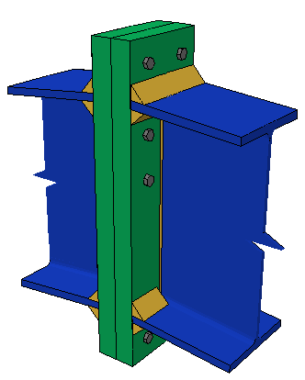
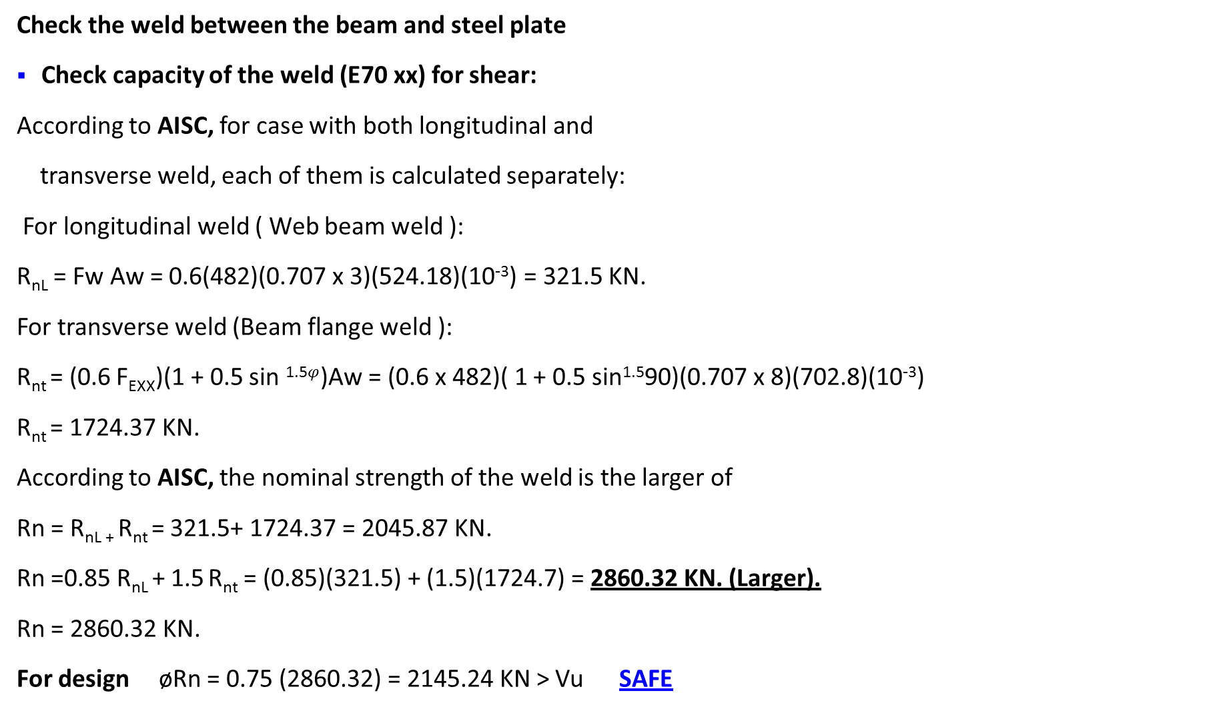
Check the weld between the beam and steel plate
Check capacity of the weld (E70 xx) for shear:
According to AISC, for case with both longitudinal and
transverse weld, each of them is calculated separately:
For longitudinal weld ( Web beam weld ):
R_{nL} = Fw Aw = 0.6(482)(0.707 x 3)(524.18)(10⁻³) = 321.5 KN.
For transverse weld (Beam flange weld ):
R_{nt} = (0.6 F_{EXX})(1 + 0.5 sin ^{1.5}$φ$)Aw = (0.6 x 482)( 1 + 0.5 sin^{1.5}90)(0.707 x 8)(702.8)(10⁻³)
R_{nt} = 1724.37 KN.
According to AISC, the nominal strength of the weld is the larger of
Rn = R_{nL +} R_{nt} = 321.5+ 1724.37 = 2045.87 KN.
Rn =0.85 R_{nL} + 1.5 R_{nt} = (0.85)(321.5) + (1.5)(1724.7) = 2860.32 KN. (Larger).
Rn = 2860.32 KN.
For design øRn = 0.75 (2860.32) = 2145.24 KN > Vu SAFE

Slide 54
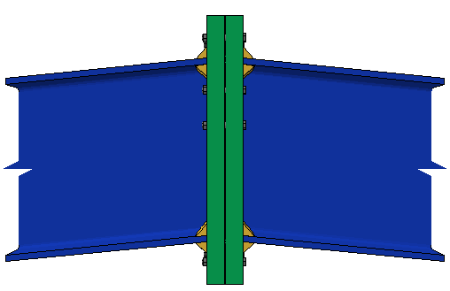
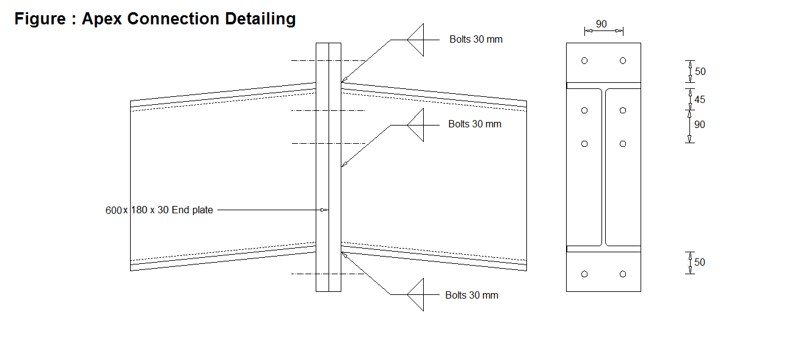
The following shows the detailing and solid work simulation for APEX Connection

Slide 55
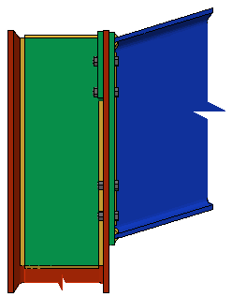

Beam to Column Connection, It’s the connection between column and rafter beam.
It was also designed in the same way
The following are the details

Slide 56


Design of the Base Plate
Column is HE 280A
Take the Ultimate Factored Load in all base plates at which it will design for.
Fz = 421.00 KN.
Fy = 163.20 KN.
Fx = -39.54 KN.
Mx = 66.50 KN.m
My = -147.40 KN.
Assuming that Base Plate covers a part of area of the footing:

Slide 57



Take Pp = 1.7 f’c A₁ → 421.00 x 103 = 0.6(1.7)(25)(A₁) Solve for A₁ = 16509.8 mm².
A₁ = B x L → (2 n + 0.95 D) (2 n + 0.8 Bf) = 16509.8
Solving for n = 60.8 mm.
B = 2(60.8) + 244 = 356.6, Try 370mm.
L = 2(60.8) + 256.5 = 378.1, Try 380mm.
To find the thickness of the plate
T = l $\sqrt{\frac{2Pu}{0.9 BL Fy}}$ , where l is the max of (m or n)
m = $\frac{L−0.95 D}{2 }$ = $\frac{380 −0.95 (270)}{2 }$ = 61.75
n = $\frac{B− 0.8 Bf}{2 }$ = $\frac{370 − 0.8 (280)}{2 }$ = 73.00 MAX
T = 73.00 $\sqrt{\frac{2\left(421\right)(1000)}{0.9 (370)(380)(248)}}$ = 11.95 mm USE 12 mm.

Slide 58

Design of Foundation Underneath Base Plate
Dead load = 110.5 KN , M_{D} = 8.3 KN.m
Covering = 35.2 KN , M_{C} = 2.82 KN.m
Live load = 117.38 KN , M_{L} = 9.4 KN.m
Area dimensions = 1.2 m x 0.85 m .
Take d = 250 mm, h = 300 mm.
Check Punching Shear
Vu = 481.74 x 1.2 x 0.85 = 491.37 KN.
øVc = 0.75 x 0.333 x $\sqrt{f′c}$ x d b_{o} = 0.75 x 0.333 x $\sqrt{30}$ x 250 x 2500 x 10⁻³ = 855.8 KN.
øVc > Vu SAFE

Slide 59


Check Wide Beam Shear
Vu = 481.74 x 0.16 = 77.07 KN.
øVc = 0.75 x (1/6) x $\sqrt{30}$ x 1000 x 250 x 10⁻³ = 171.16 KN\m
øVc > Vu SAFE
Reinforcement
For long direction
Mu = $\frac{σu x L^{2}}{2}$ = $\frac{481.74 x {0.41}^{2}}{2}$ = 40.5 KN.m\m
b = 1000 mm , d = 250 mm. ρ = 1.73 x 10⁻³ , As = 434 mm²\m
As Min = 0.0018 bh = 540 mm²\m. As < As Min USE As Min
For short direction
Mu = 13.87 KN.m\m , As = 158 mm² , As < As Min USE As Min

Slide 60

Thanks for Listening

