Slide 1
Faculty of engineering and information technology
MIS and CSS department
E-Menu Berlin graduation project
By:
Basel Najjar 11211093 (MIS)
Islam Taha 11210629 (CIS)

Slide 2


Slide 3
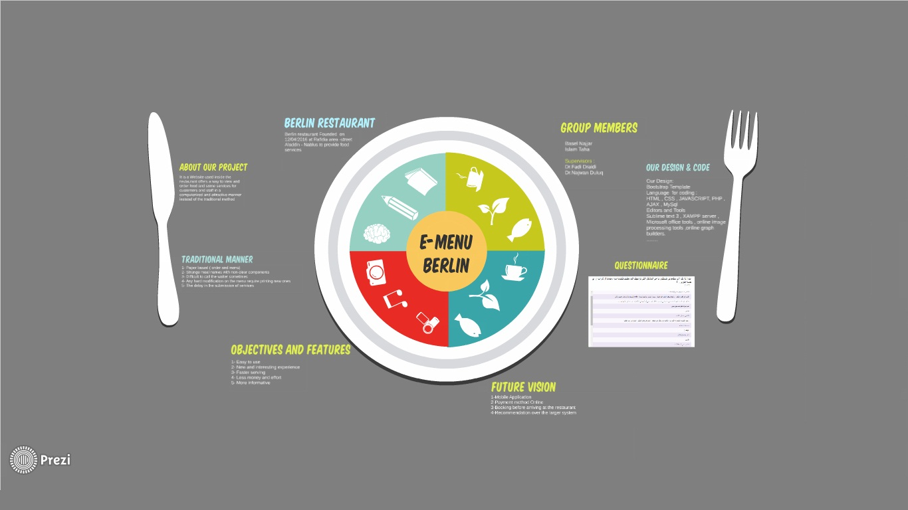

Slide 4


Slide 5
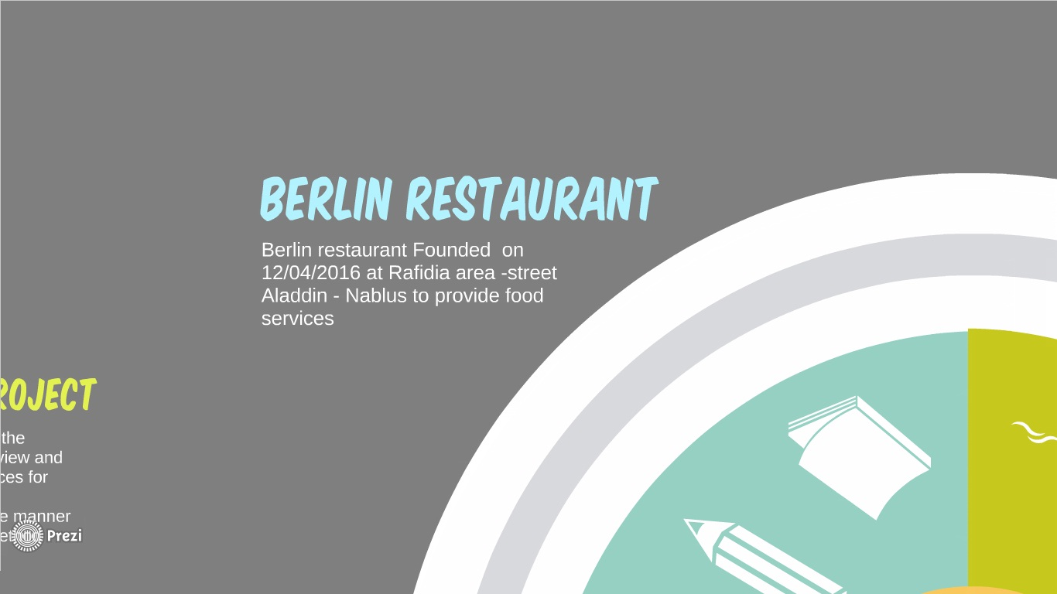

Slide 6
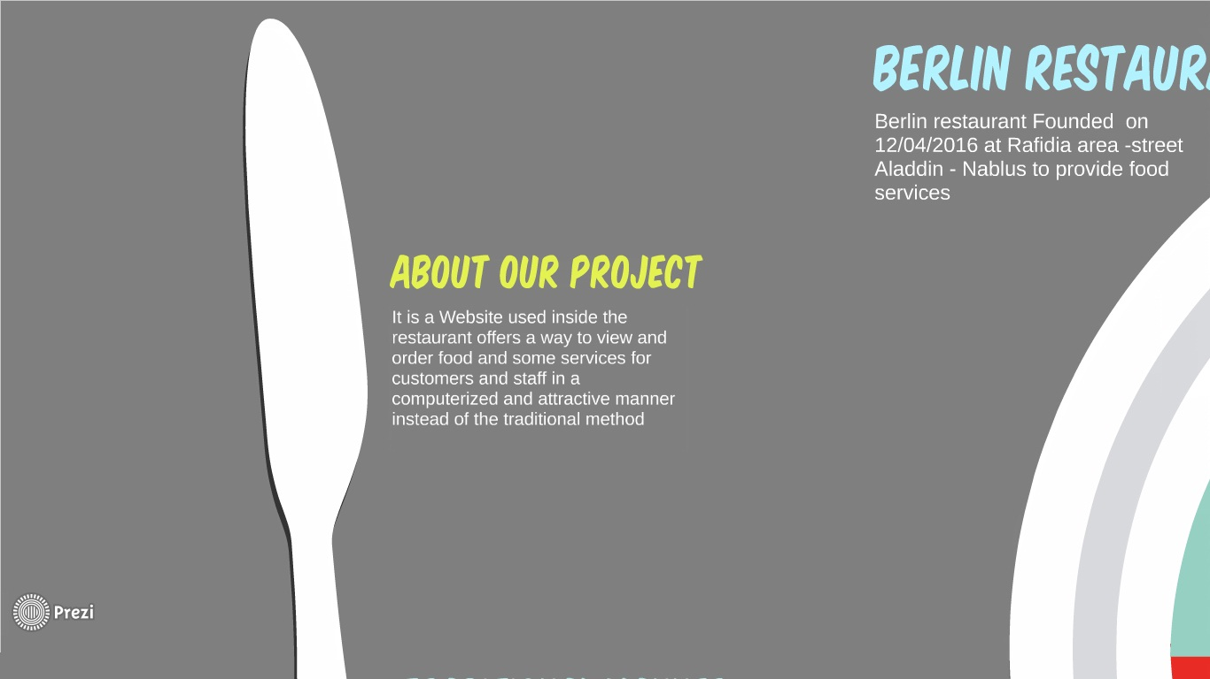

Slide 7
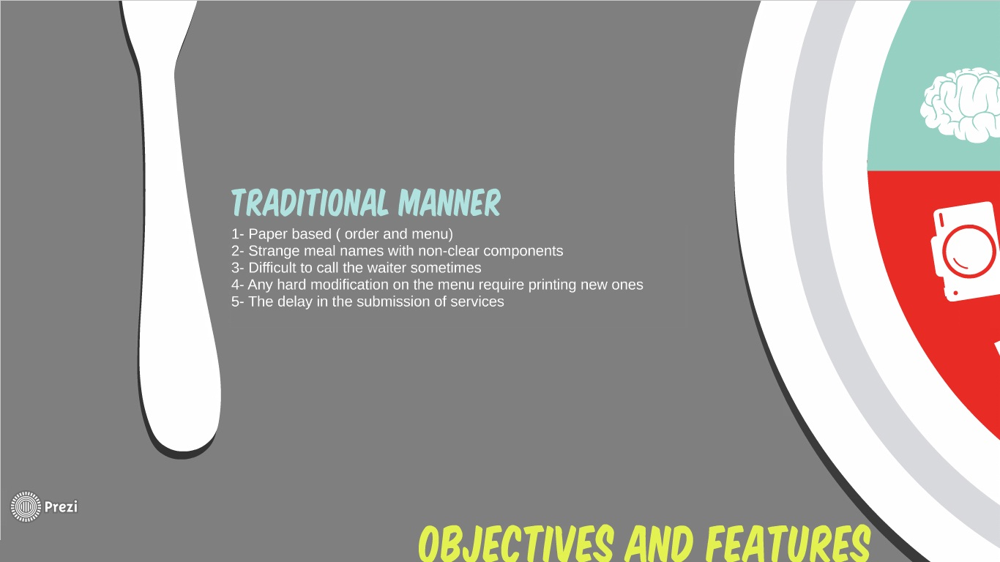

Slide 8
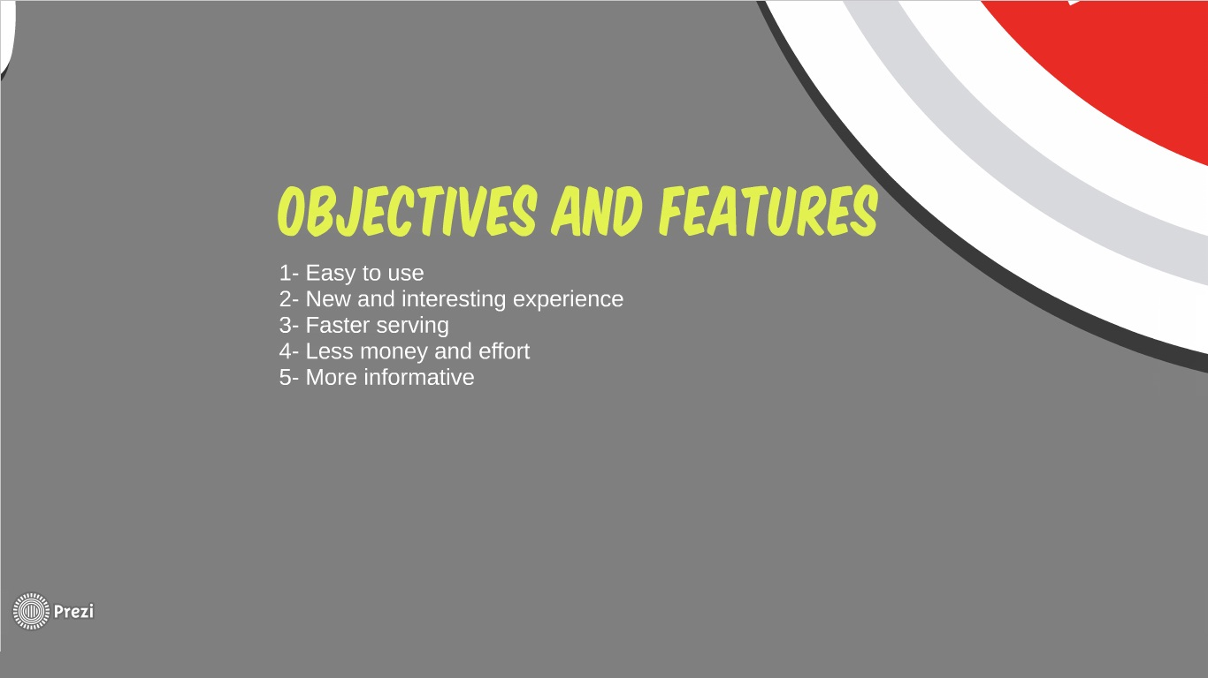

Slide 9
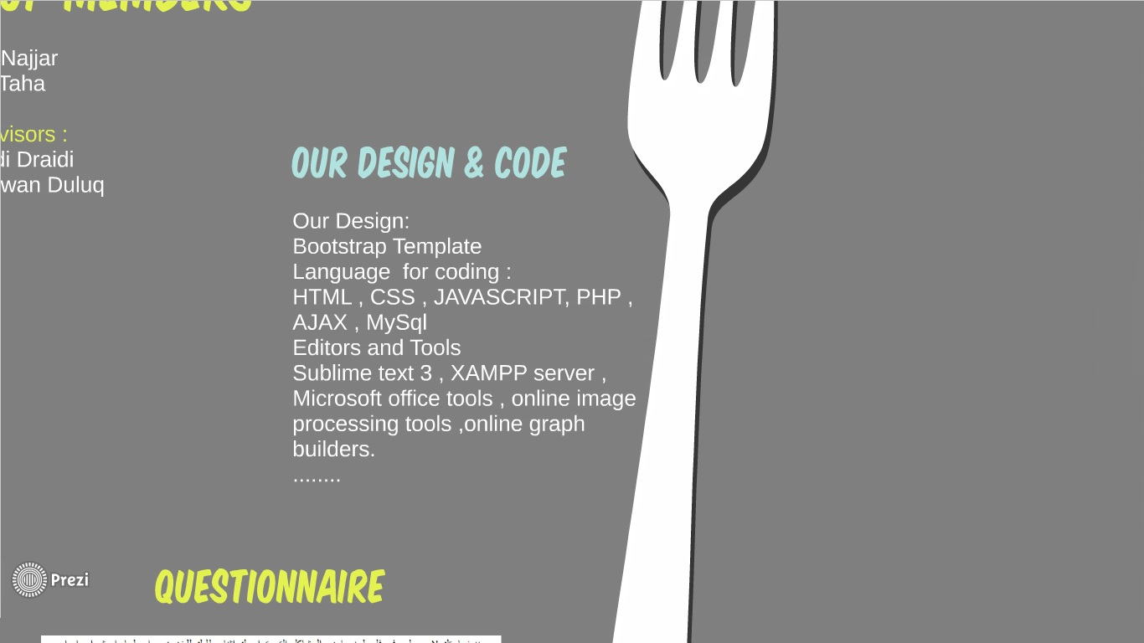

Slide 10
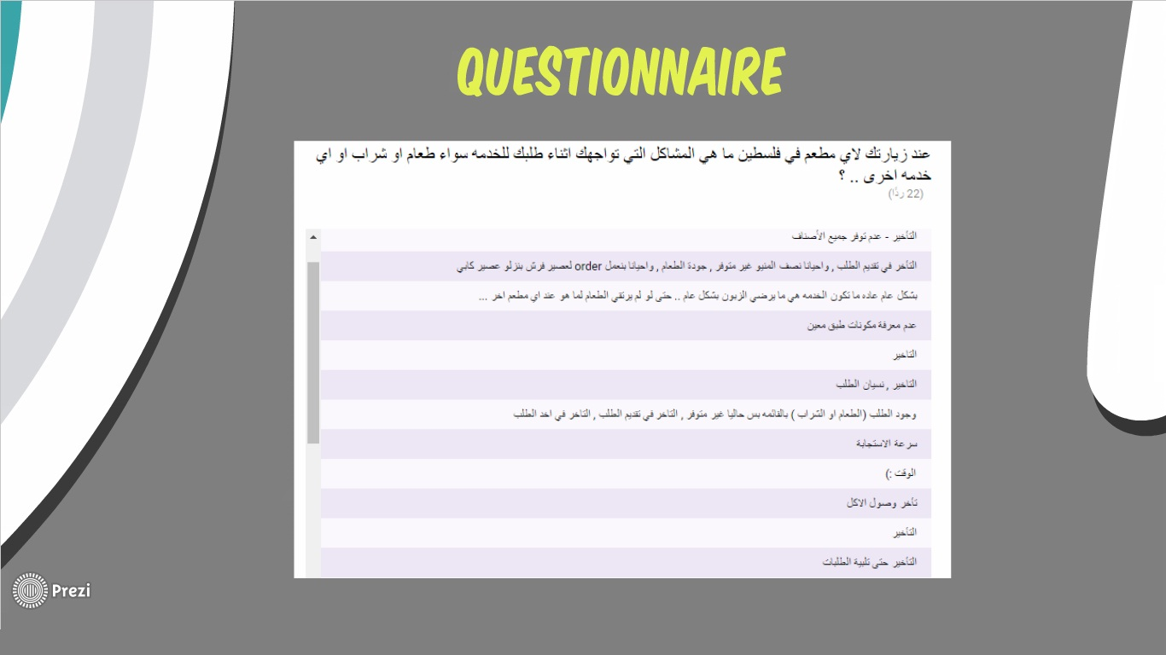

Slide 11
