Slide 1
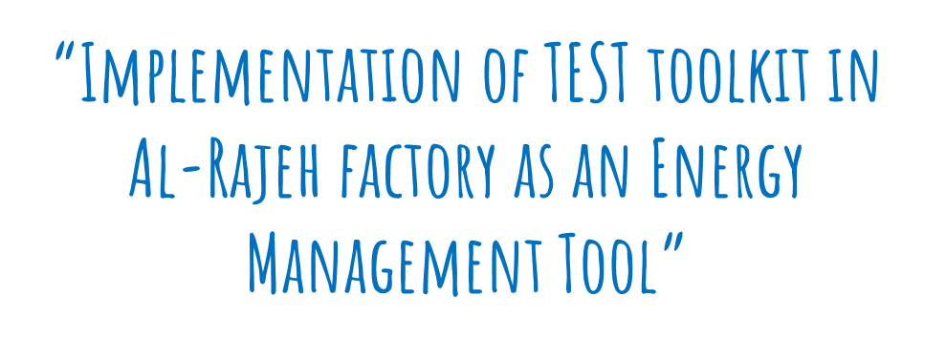

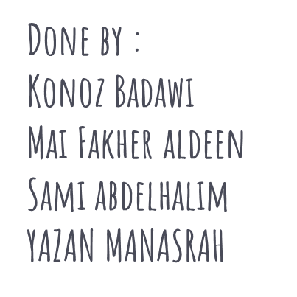

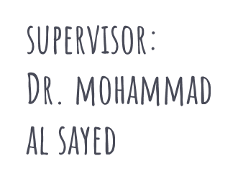
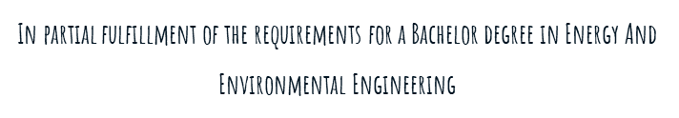

Slide 2
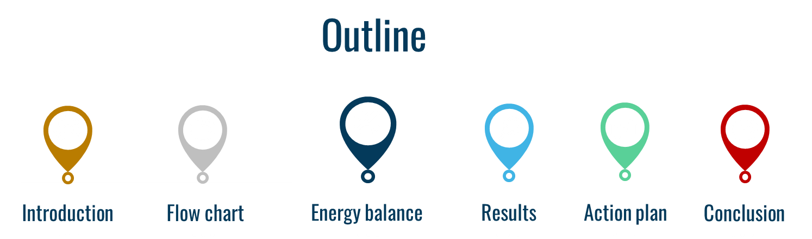

Slide 3



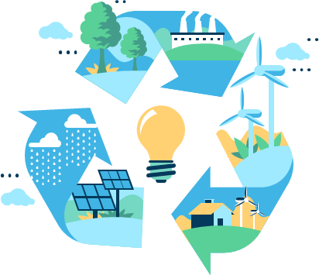

Energy consumption is increasing rapidly, so energy management is necessary. Energy management “EnM” involves conservation, analysis, and imperative actions that lead to a decrease in the system losses for efficient use of available conventional and renewable energy resources of the region.

Slide 4
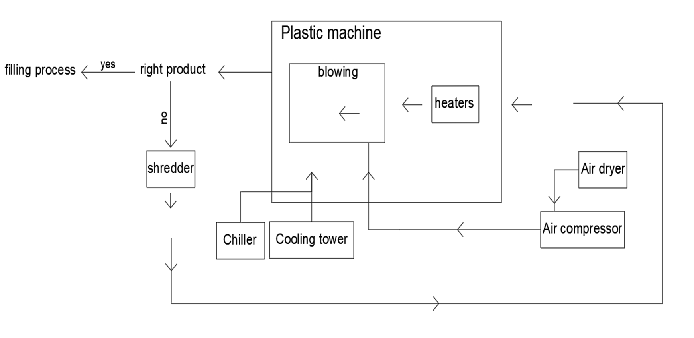
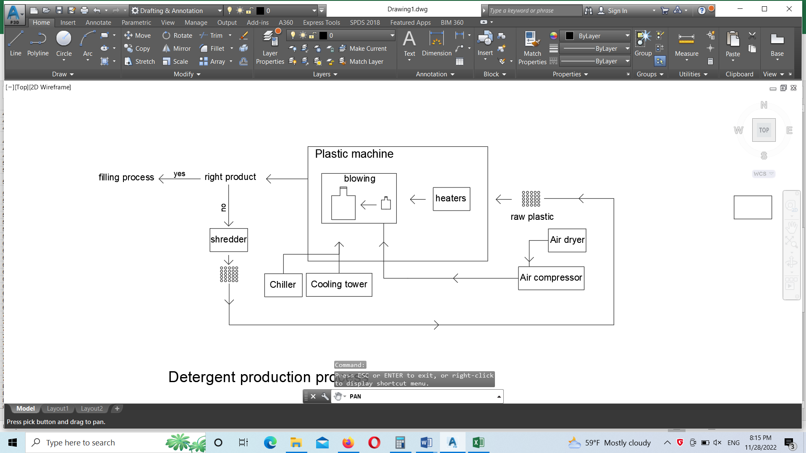
Flow chart
Figure (1) Plastic production process’s flow chart

Slide 5
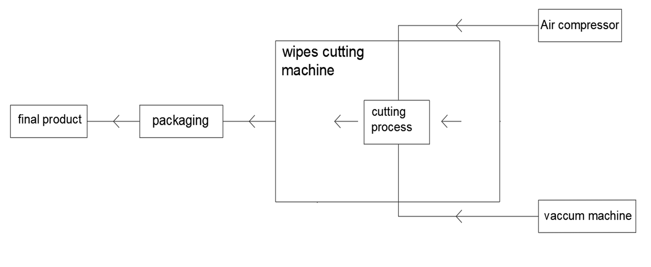
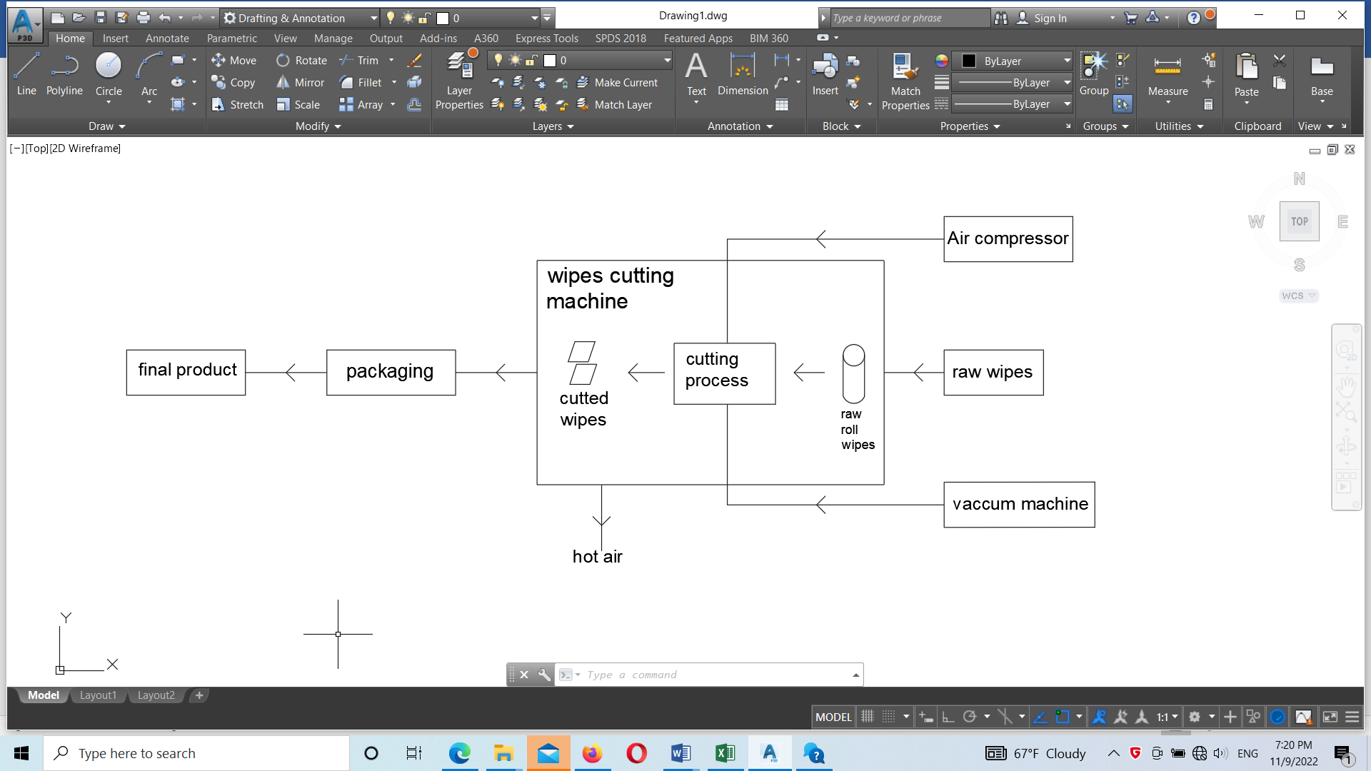
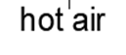
Flow chart
Figure (2) Wipes production process’s flow chart

Slide 6
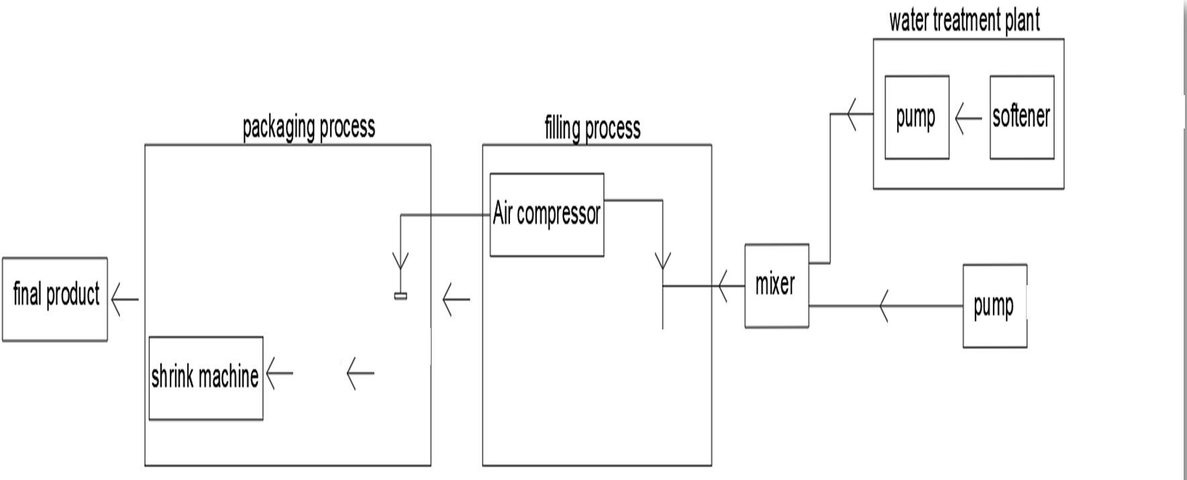
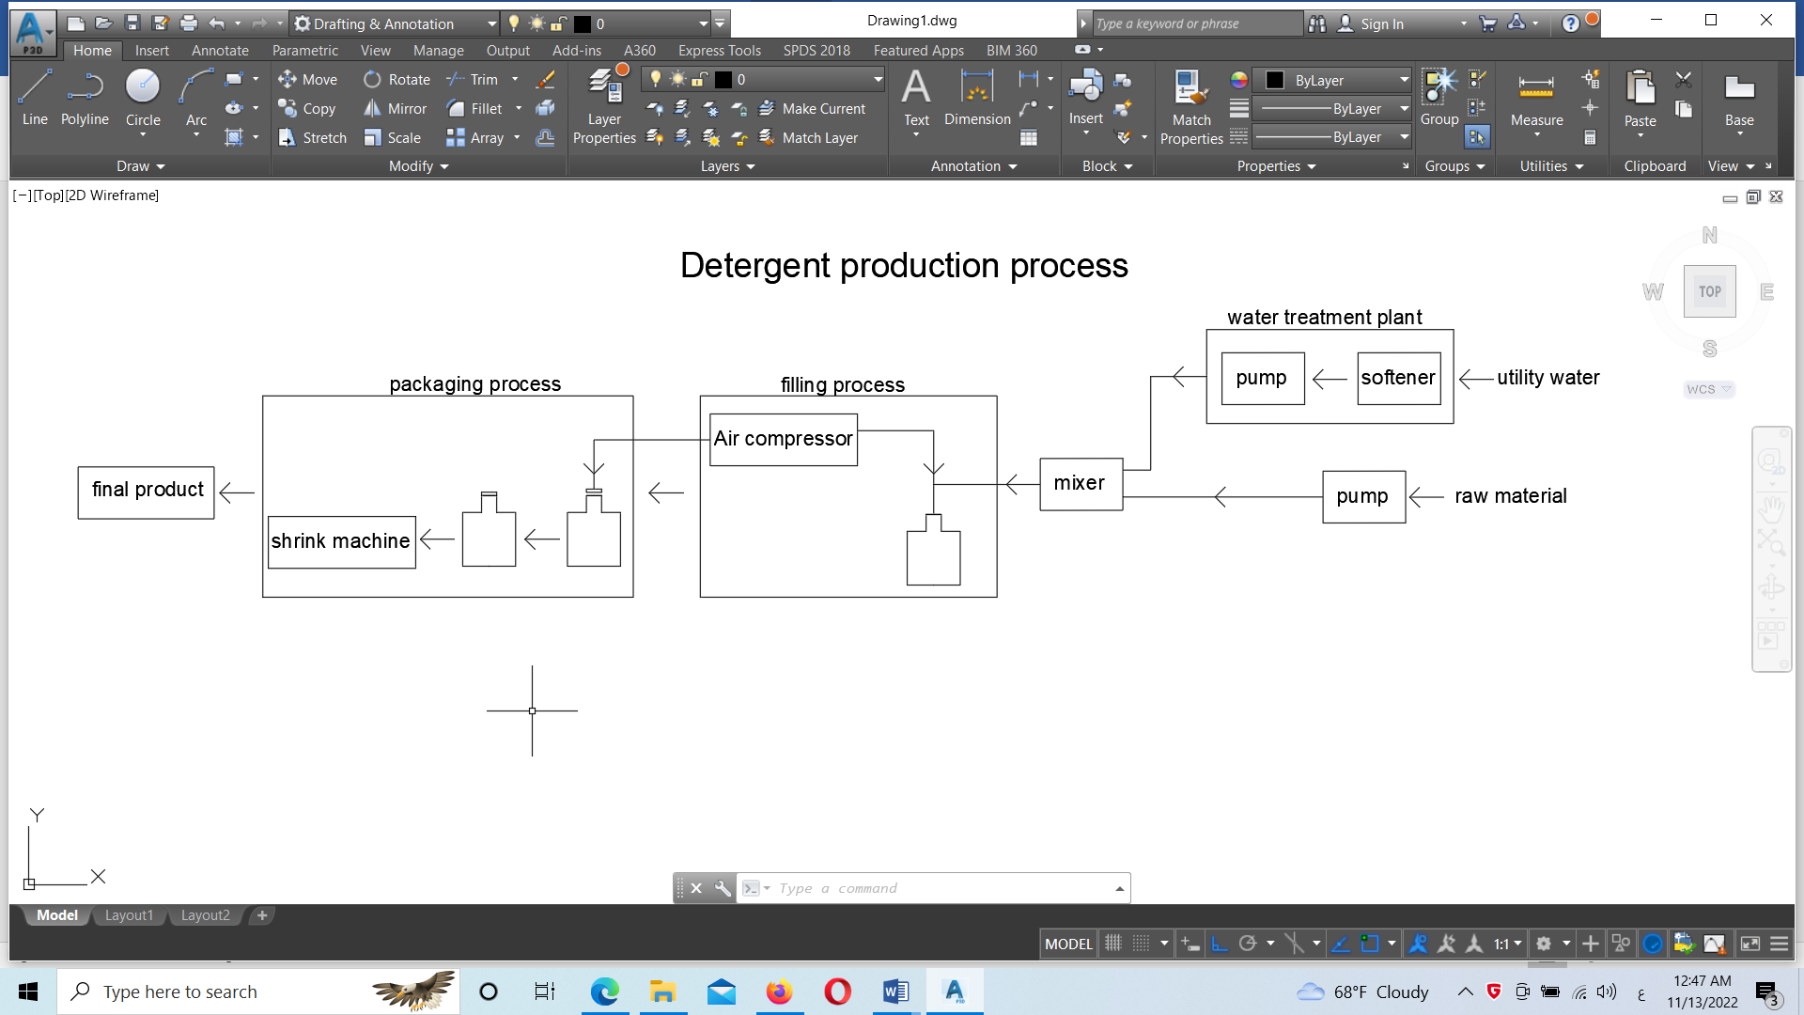
Flow chart
Figure (3) Detergents production process’s flow chart

Slide 7
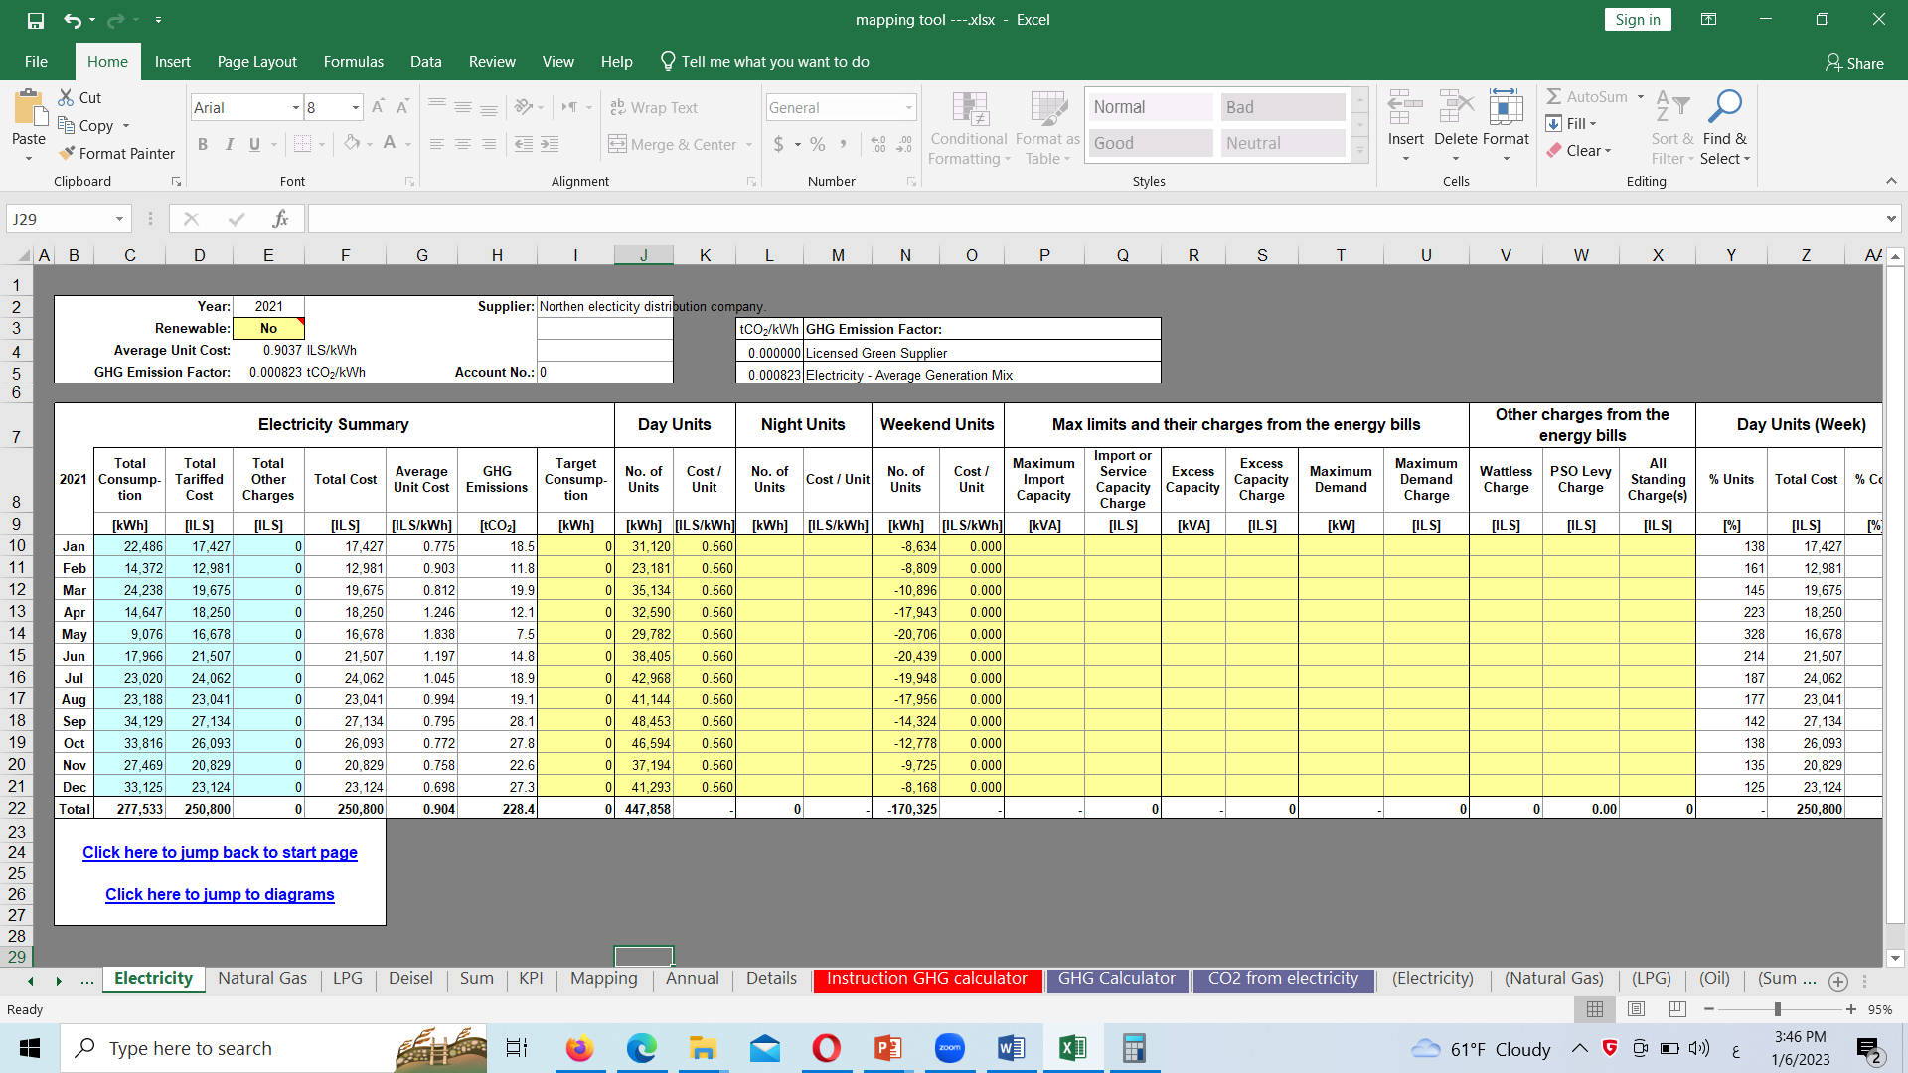
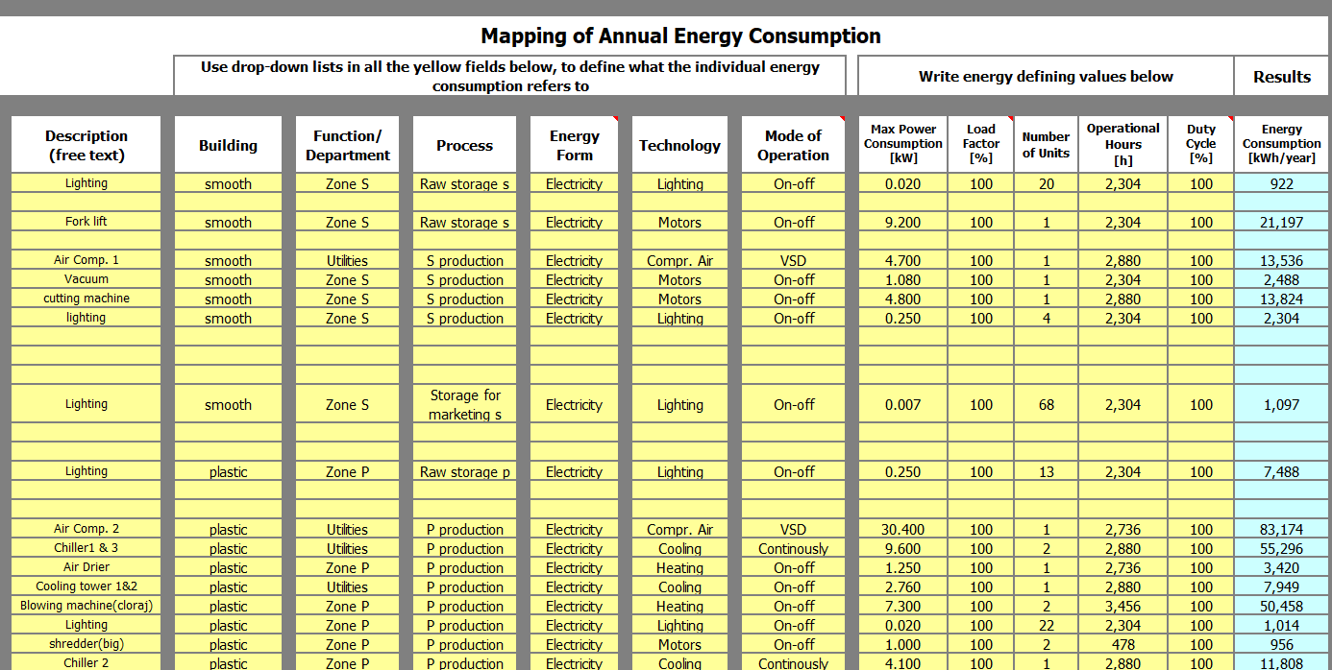
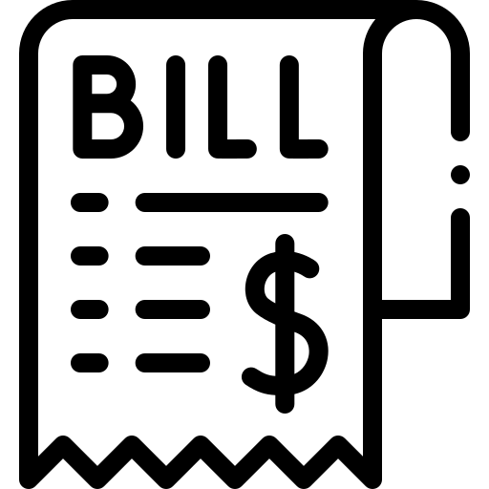
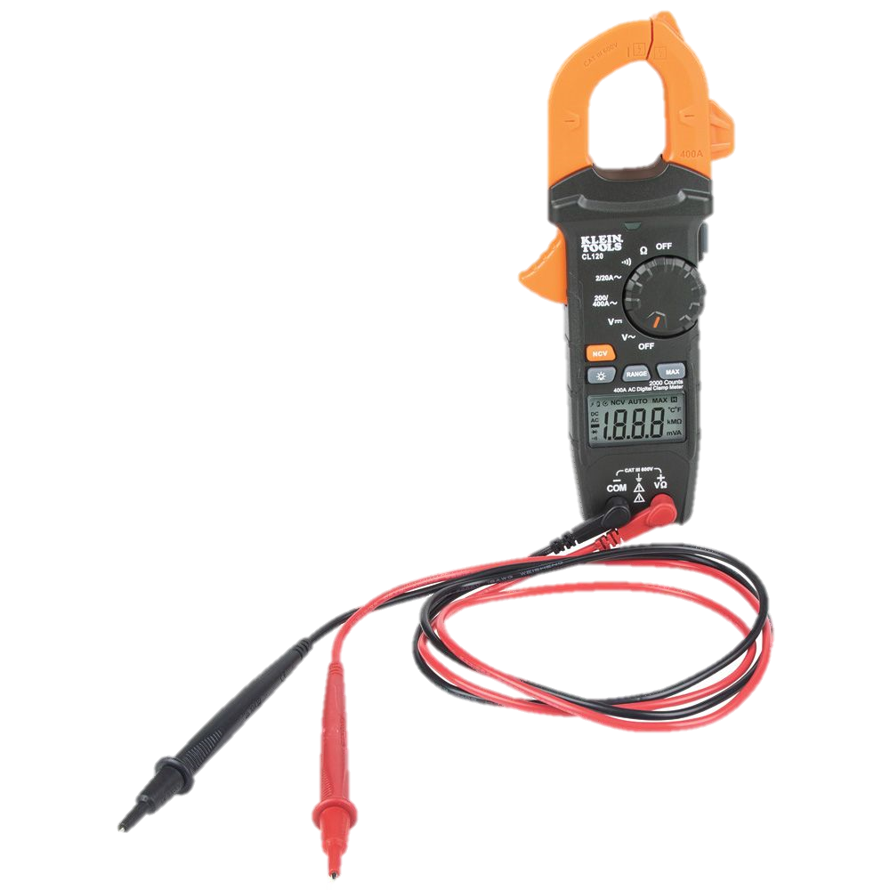
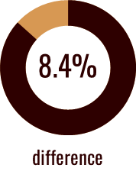
Energy Balance
Energy Consumption =
447,858 kWh/year
Energy Consumption =
413,120 kWh/year

Slide 8

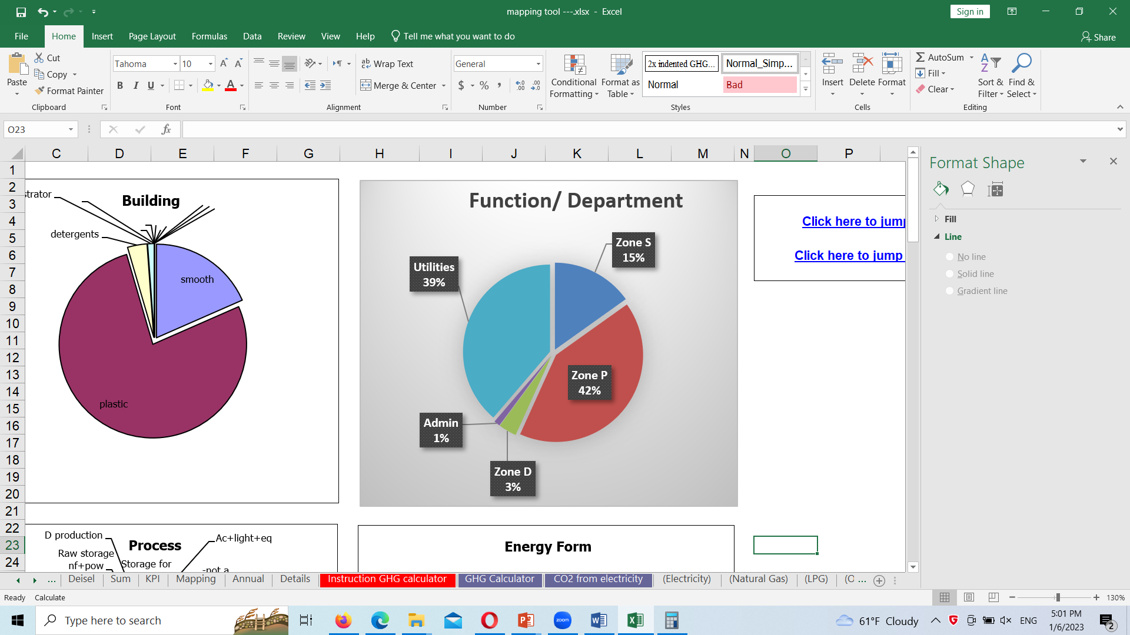


Slide 9
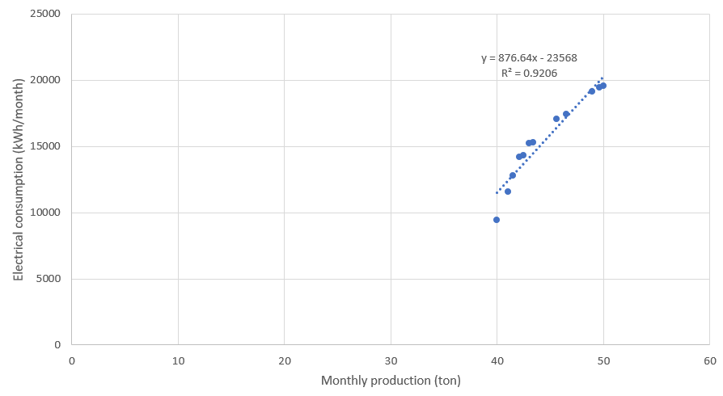
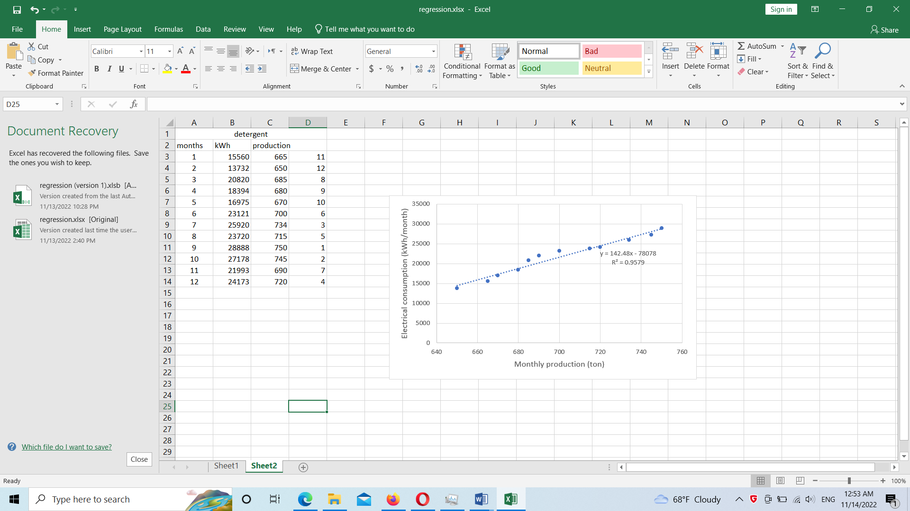
Regression analysis
Figure (4). The relation between the consumption, and the production for the wipes section.
Figure (5). The relation between the consumption, and the production for the detergents section.

Slide 10
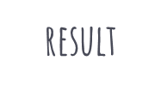
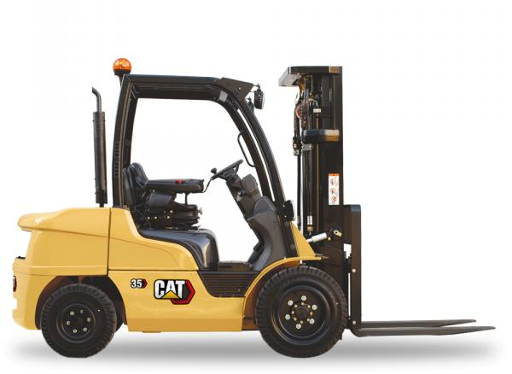
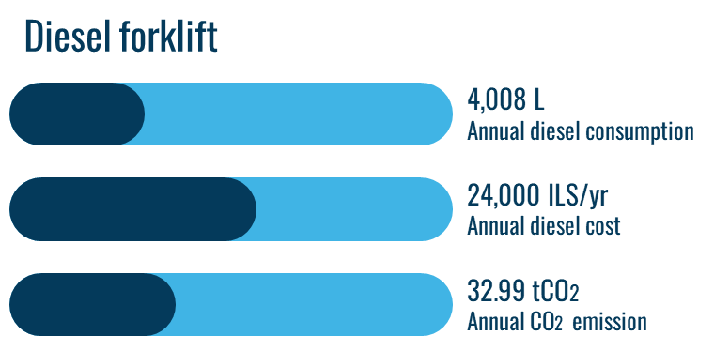
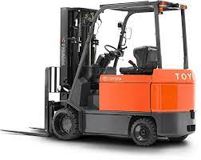
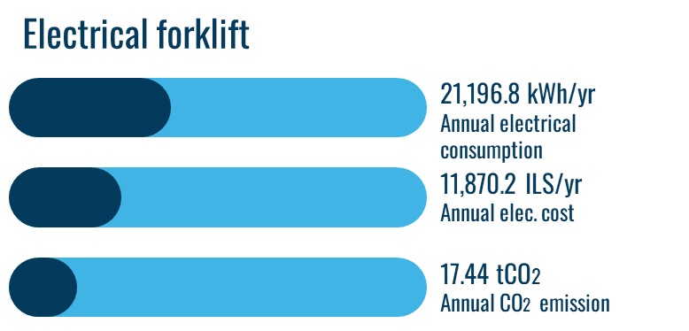
1. Changing diesel forklift to electrical forklift.
(Current situation)
(Proposal)

Slide 11
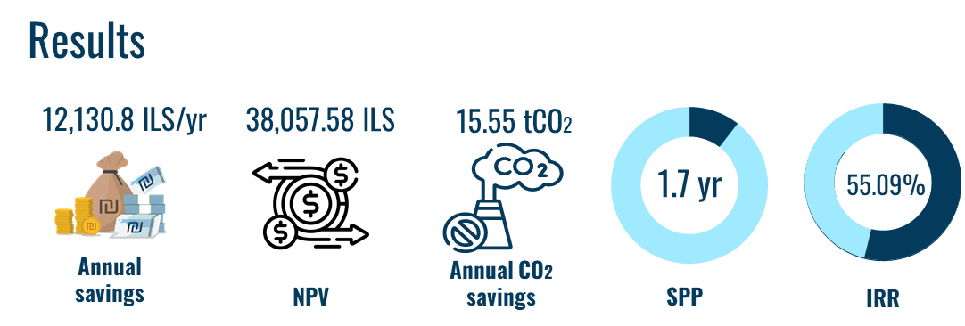
1. Changing diesel forklift to electrical forklift (continue).

Slide 12
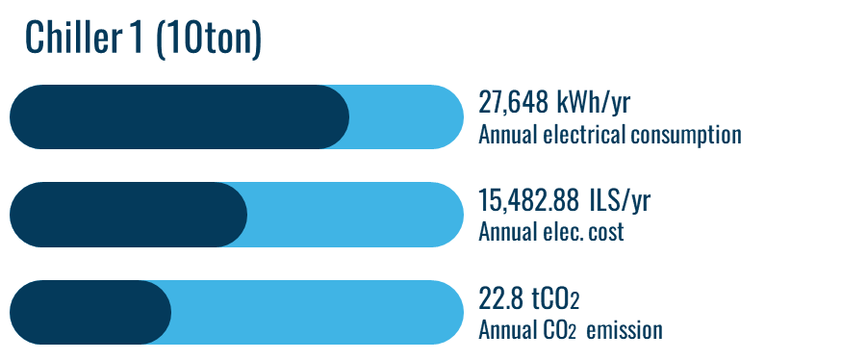

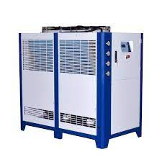
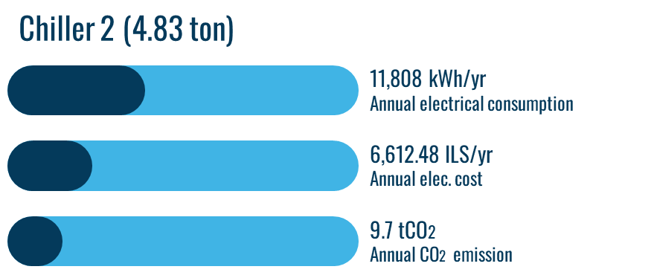
2. Changing the cooling system equipment by two central chiller, and installing inverter (VSD).
(Current situation)
Annual electrical consumption =67,104 kWh/year
Annual electrical cost = 37,578.24 ILS
Annual CO2 emission = 55.2 tCO2/year

Slide 13
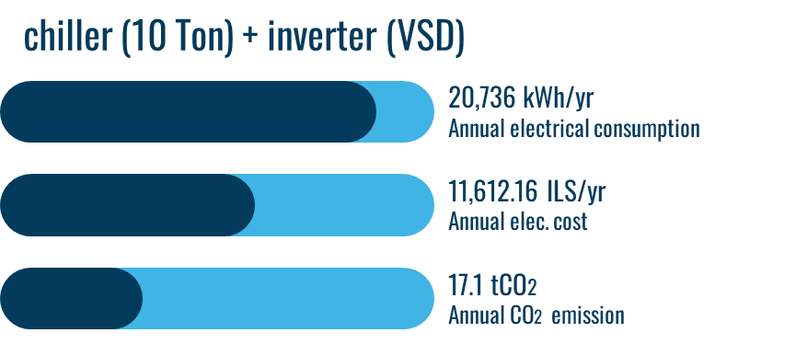

2. Changing the cooling system equipment by two central chiller, and installing inverter (VSD). (continue)
(Proposal)
Annual electrical consumption = 61,992 kWh/year
Annual electrical cost = 34,715.52 ILS
Annual CO2 emission = 51.02 tCO2/year

Slide 14
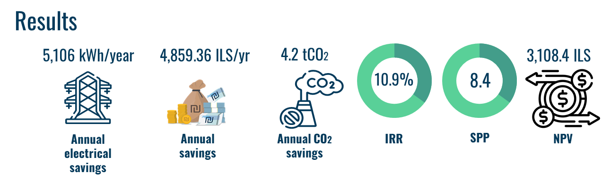
2. Changing the cooling system equipment by two central chiller, and installing inverter (VSD). (continue)

Slide 15
3. Changing the cooling system equipment by central chiller, and installing inverter (VSD).
(Current situation)
Annual electrical consumption =67,104 kWh/year
Annual electrical cost = 37,578.24 ILS
Annual CO2 emission = 55.2 tCO2/year

Slide 16
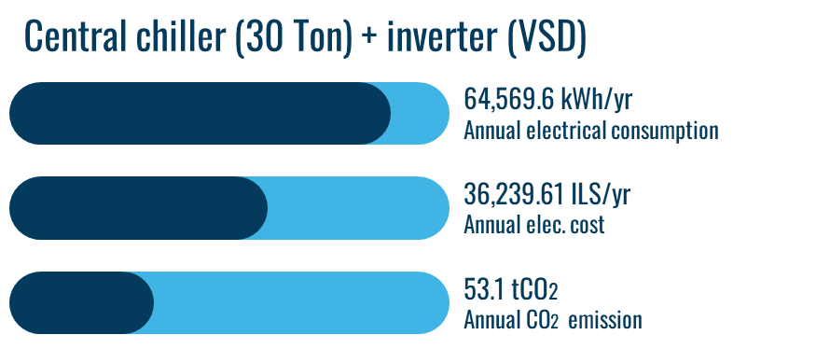

3. Changing the cooling system equipment by central chiller, and installing inverter (VSD).(continue)
(Proposal)

Slide 17
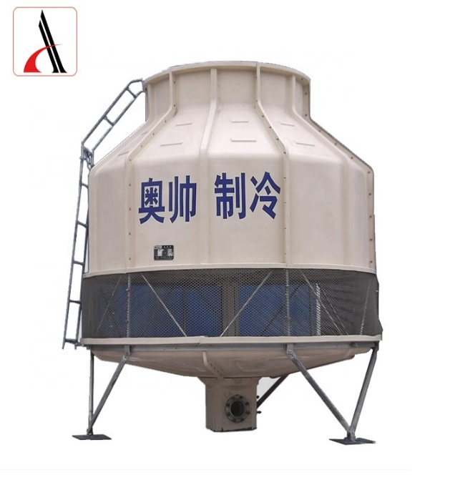
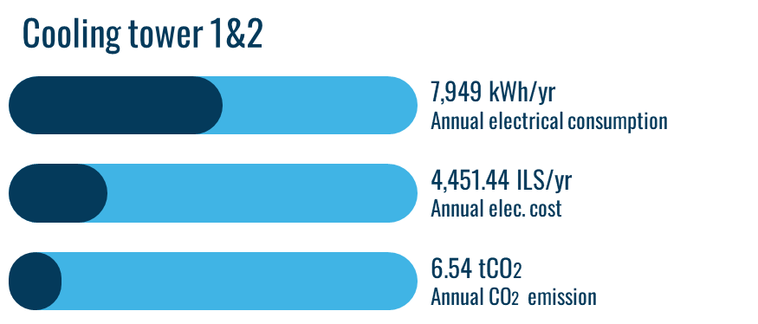
4. Purchase the plastic bottles from outside instead of producing it inside.
(Current situation)

Slide 18
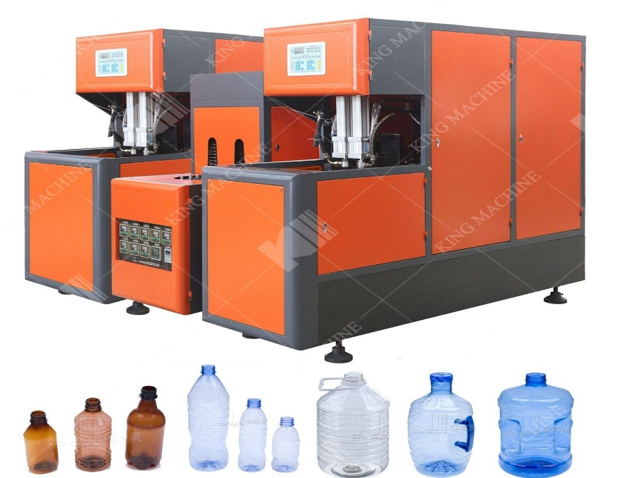

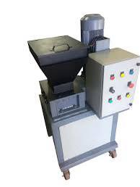
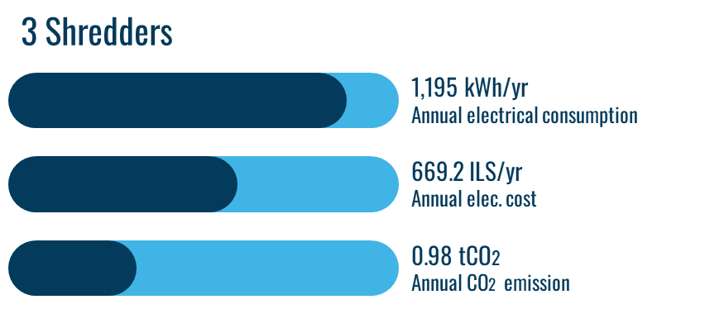
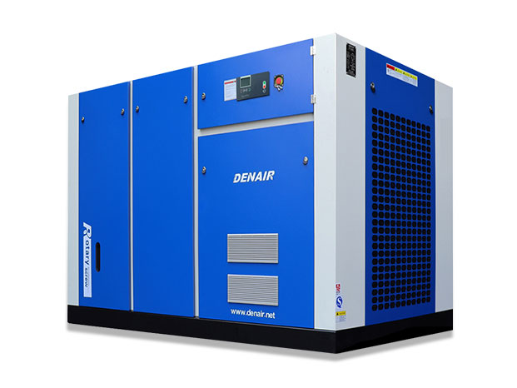

4. Purchase the plastic bottles from outside instead of producing it inside (cont.)
(Current situation)

Slide 19
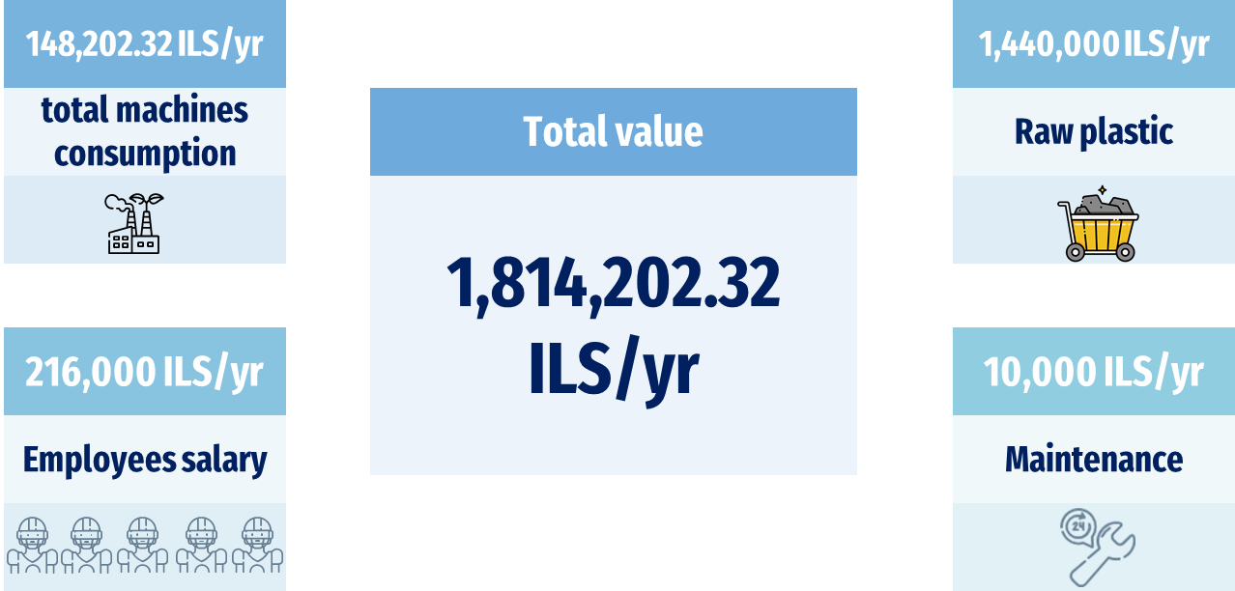
4. Purchase the plastic bottles from outside instead of producing it inside (cont.)
(Current situation summary)

Slide 20




4. Purchase the plastic bottles from outside instead of producing it inside (cont.)
(Proposal)
To purchase the bottles from local market , whereas one bottle will cost : 0.8 ILS
50% of load
Turn off

Slide 21
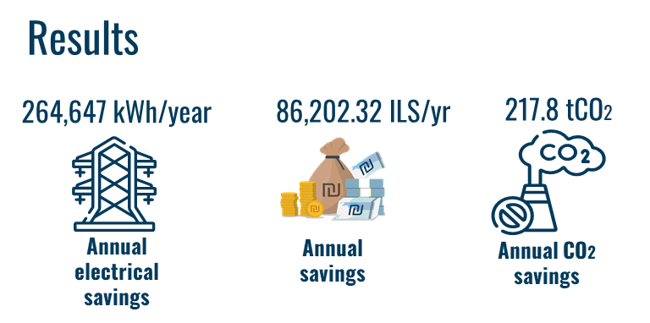
4. Purchase the plastic bottles from outside instead of producing it inside (cont.)

Slide 22
4. Purchase the plastic bottles from outside instead of producing it inside (cont.)
Furthermore, the plastic machines, shredders, cooling towers, and chillers may offer for sale with a price of 252,370 ILS.

Slide 23
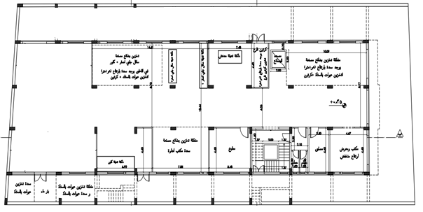
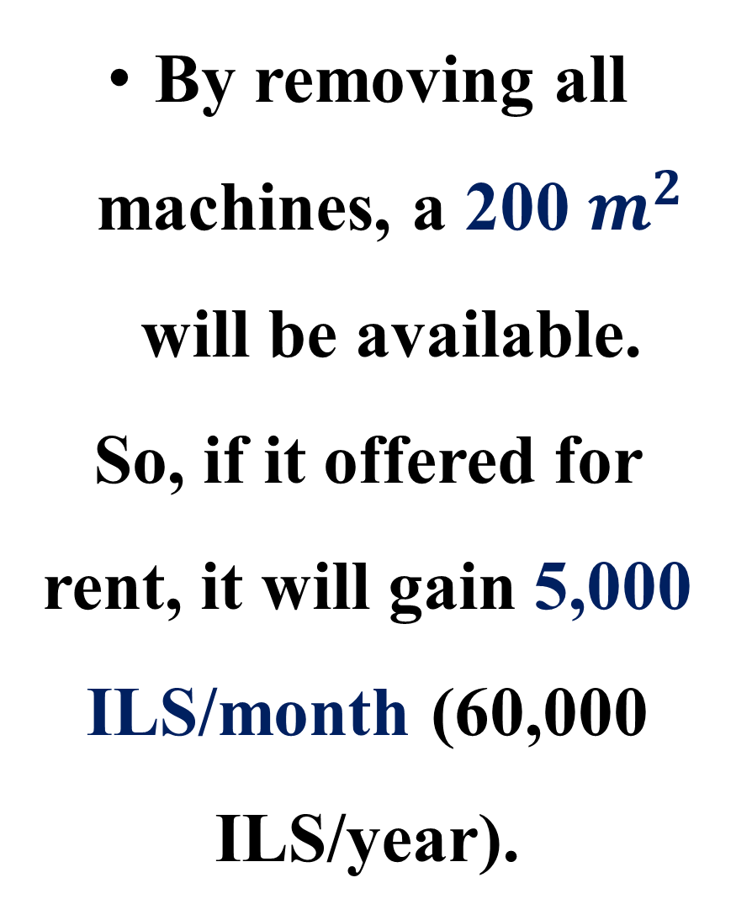
4. Purchase the plastic bottles from outside instead of producing it inside (cont.)
By removing all machines, a 200 $m^{2}$ will be available.
So, if it offered for rent, it will gain 5,000 ILS/month (60,000 ILS/year).

Slide 24
5. Installing inverter (VSD) for each cooling equipment.
(Current situation)
Annual electrical consumption = 75,053 kWh/year
Annual electrical cost = 42,029.68 ILS
Annual CO2 emission = 61.76 tCO2/year

Slide 25

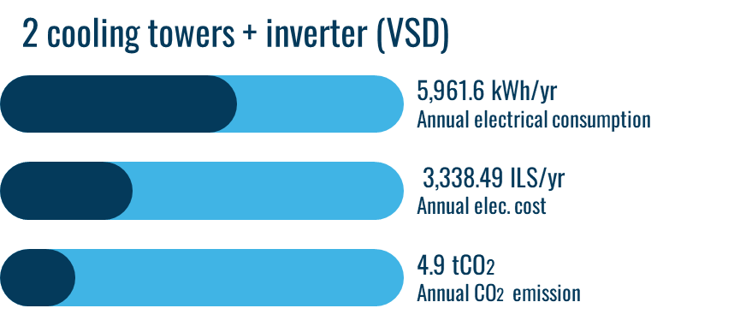
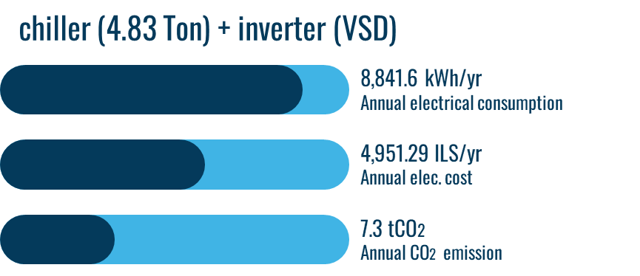
5. Installing inverter (VSD) for each cooling equipment. (continue)
(Proposal)
Annual electrical consumption =56,275.2 kWh/year
Annual electrical cost = 31,514.112 ILS
Annual CO2 emission = 46.31 tCO2/year
25

Slide 26
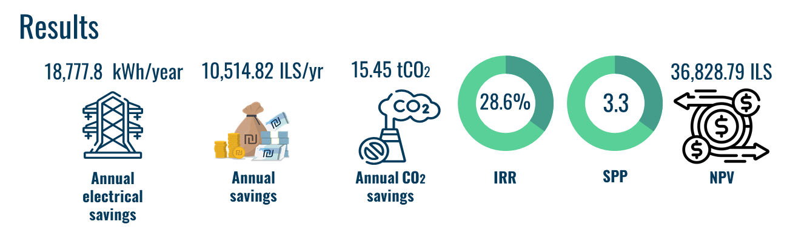
5. Installing inverter (VSD) for each cooling equipment. (continue)
26

Slide 27



1- Improved an integrated information system, that contain stock management system, cost accounting system, and production planning. Enterprise resource planning (ERP) system is an example that you can applicate it.
2- If you go with approach of changing the 3 chillers with central one, you have to make a periodic maintenance, to prevent any shortage in the production process.

Slide 28
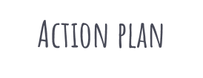
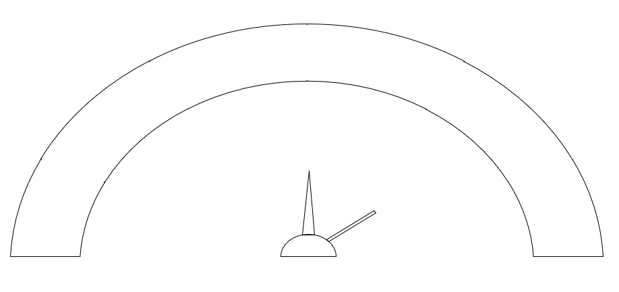
Purchase the plastic bottles from outside instead of producing them inside.
Changing the cooling system equipment by two chillers, and installing inverter (VSD).
Installing inverter (VSD) for each cooling equipment.
Changing the cooling system equipment by central chiller, and installing inverter (VSD).
Changing diesel forklift to electrical forklift.

Slide 29

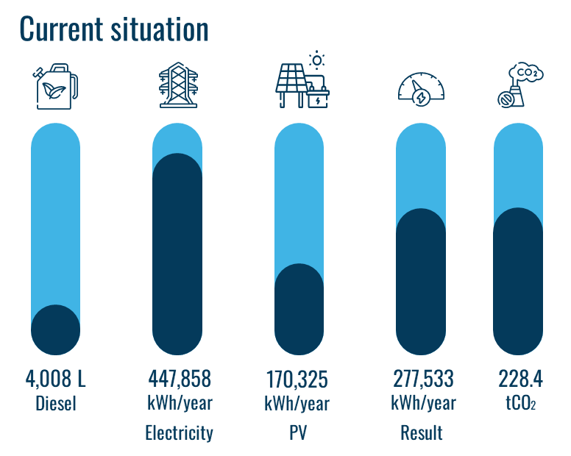
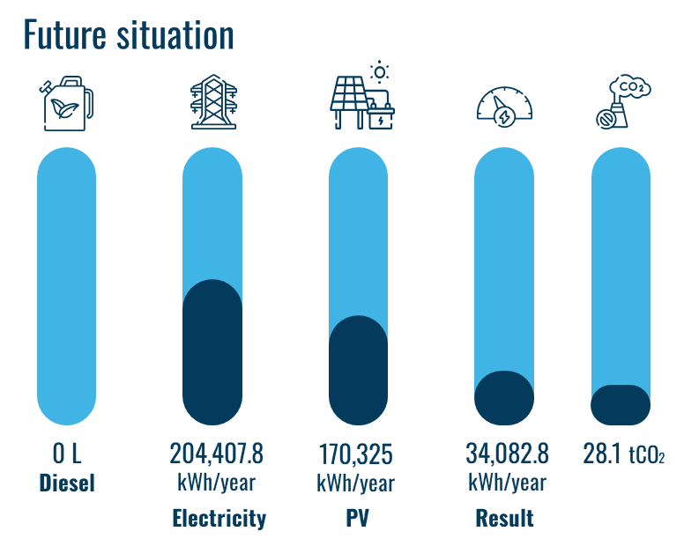

Slide 30






Slide 31










The end

