Slide 1
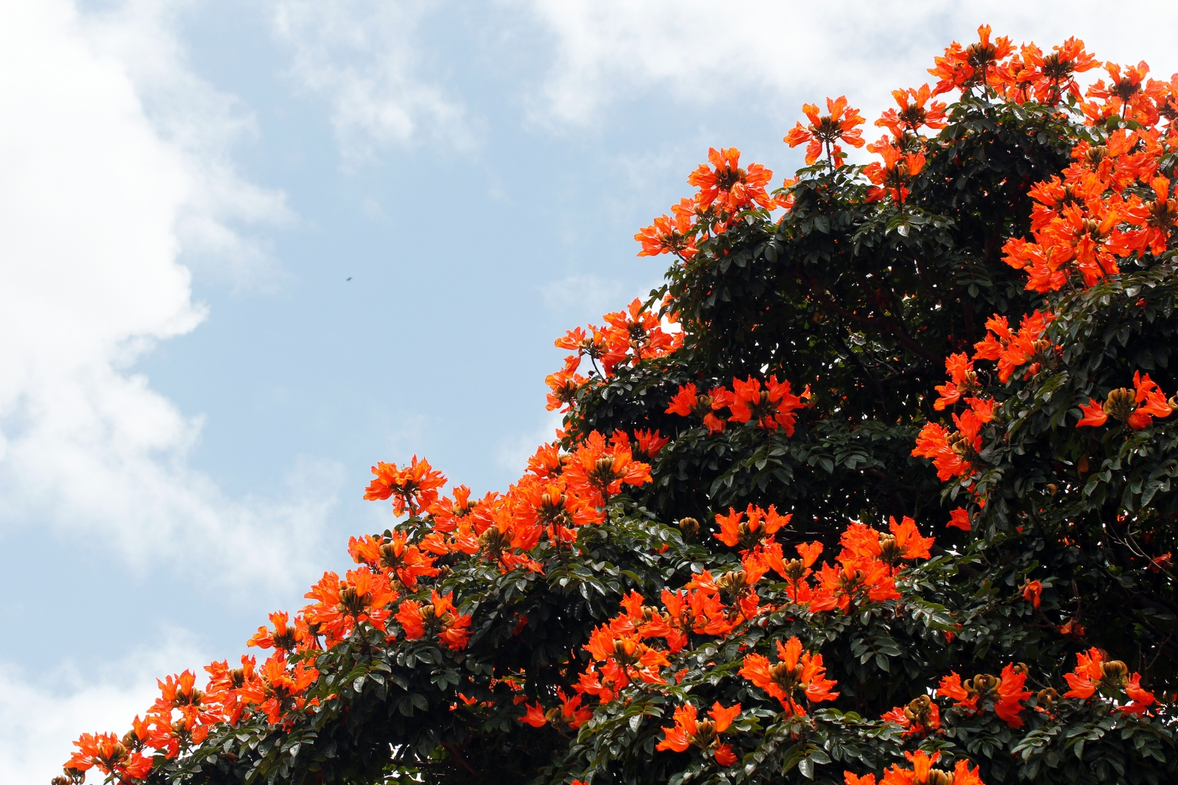
Smart Plant Robot
Prepared by
Haya De’bas
Jumanah Salhab
Supervisor
Dr. Ra’ed Al-Qadi

Slide 2

Outline
What is smart plant robot
Overview
Motivation
Constraints
Methodology
Future Work

Slide 3
What is smart plant robot?
It’s a robot that allows indoor plants to search for the sunniest spot in a room.
It also allows them to measure the soil moisture, so when needed, it can go towards water spray that is placed in a certain location in the room and make it start itself .

Slide 4
Overview
Our robot is controlled by an Arduino Uno microcontroller and driven by two stepper motors.
The robot seeks sunshine with the help of two solar panels and two LDRs that detect sunlight from all directions
Two ultrasonic range detectors keep the planter from running into obstacles

Slide 5
Overview
The moisture sensor reading is read periodically. So, when the plant needs water it goes towards the water spray which is located at a specific location in the room.
The water spray is connected to an IR sensor in order to detect when the robot becomes beneath it so the water spray starts.

Slide 6
Motivation
As we know, Plants need water to survive and light to do the photosynthesis process.
Our robot allows the indoor plants to independently serve themselves in terms of these two main needs without the involvement of humans.

Slide 7
Constraints
Lack of electrical and mechanical components, so we had to use alternatives.
  We wanted to use two continuous rotation servo motors because their movement is regular but they were not available so we used two stepper motors instead.
At the beginning, we worked with a heavier model and used larger stepper motors. But it’s movement was not as good as we wanted.
  We tried to use a gear box to improve it’s movement but we also could not get them. So, we used a lighter model.

Slide 8
Methodology
We will talk about three main ideas:
Movement of the stepper motors and detecting obstacles using ultrasonic range detectors.
2. Detecting the sunniest spot using solar panels and LDRs and the used algorithm.
3. Measuring the soil moisture then moving towards the water spray and starting it.

Slide 9
Robot Movement
Stepper Motors :
Our robot has 2 wheels each connected to a stepper motor and a third wheel which is not connected to a motor (free wheel).
  it’s only used for supporting movement in all directions and maintaining the robot stability.
It’s very important to use a driver with the stepper motor because it keeps the power that drives the motors separate from the power that is on the arduino.
  We used H-bridges to drive the stepper motors.

Slide 10
Robot Movement
Ultrasonic range detectors
In order for the robot to avoid obstacles we used 2 ultrasonic range detectors in our project.
One Ultrasonic sensor detects obstacles while moving forward, and the other one detects obstacles while moving backward.
When the sensor detects an obstacle within a distance less than 20 cm it rotates trying to find another path.
Stepper movement

Slide 11
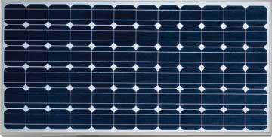
Robot Movement
Solar Panels and LDRs
We used 2 solar panels that detect the light coming from left and right sides, also 2 LDRs that detect light from front and back.
Stepper movement
Detecting sunniest spot

Slide 12
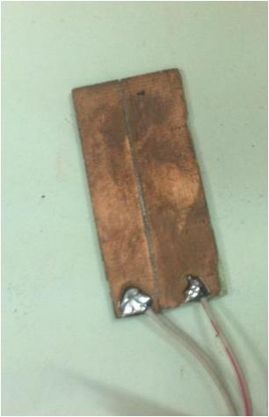
Robot Movement
We read the soil moisture using a manually built sensor which is mainly constructed from two close copper pieces connected in series to a resistor.
  So, when the moisture increases the conductance increases and so the output voltage.
Stepper movement
Detecting sunniest spot
Starting the water spray

Slide 13
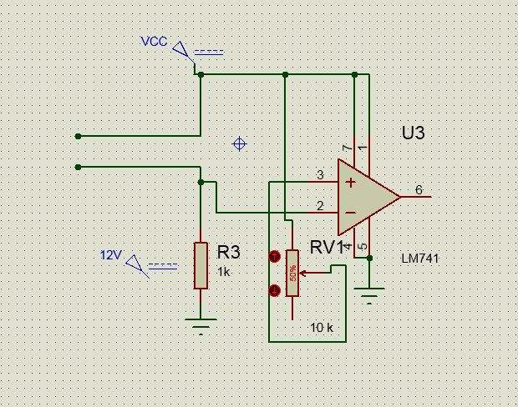
Robot Movement
Stepper movement
Detecting sunniest spot
Starting the water spray

Slide 14
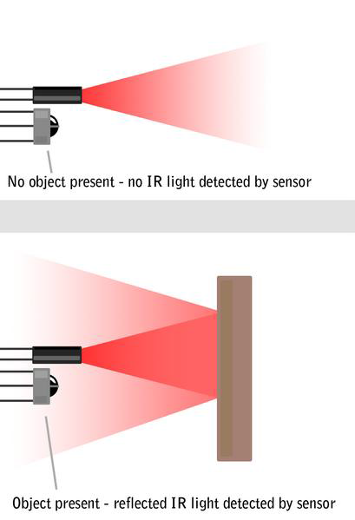
Robot Movement
An IR sensor is connected to the water spray, so when the sensor detects the reflected signal it knows that the robot has come and so the water spray should start.
Stepper movement
Detecting sunniest spot
Starting the water spray

Slide 15
Robot Movement
The water spray keeps watering the plant until the moisture sensor reading becomes acceptable (above 50%)
Stepper movement
Detecting sunniest spot
Starting the water spray

Slide 16
First Algorithm
This algorithm has two parts:
The first part searches for the sunniest area by comparing the current lighting value with a threshold.
If the current lighting value is above the threshold, the algorithm compares the values of the LDRs and Solar Panels and goes towards the highest value.

Slide 17



First
Algorithm
Solar1 = 120
LDR1 = 80
LDR2 = 110
Solar2 = 100
Solar1 = 110
Solar1 = 115
LDR1 = 60
LDR1 = 75
LDR2 = 100
LDR2 = 110
Solar2 = 90
Solar2 = 90

Slide 18
First Algorithm
If the current lighting value is below a threshold, the Algorithm compares distances from the Ultrasonics and goes towards the larger distance.
It keeps searching until it reaches the threshold then completes as the first part.

Slide 19
First
Algorithm
Solar1 = 30
Solar1 = 80
LDR1 = 20
D2 70
D1 = 30
LDR1 = 50
LDR2 = 25
LDR2 = 60
Solar2 = 25
Solar2 = 60

Slide 20
Second Algorithm
This algorithm does an exhaustive search trying to find the sunniest point.
It moves in a zigzag way covering the whole room and comparing the value of the lighting at each point with the maximum stored one.

Slide 21
Second Algorithm
Obstacle Detected
Room End
Obstacle Detected
Obstacle Detected
No Obstacle Detected
Right
Right
Obstacle Detected
Right
90
Lightest Point
Lightest Point
Lightest Point
Check wetness
Left
90
Left
Left
Left
Obstacle Detected
Obstacle Detected
No Obstacle Detected

Slide 22
Results
In the first algorithm, we found out that it may not find the sunniest point always. But it gives faster results.
The second Algorithm does an exhaustive search. It always finds the sunniest point but it may take longer time compared with the other one.

Slide 23
Future Work
Our future work is to improve this project more mainly by improving the used Algorithm.
Also using a technique to allocate the water spray position so that wherever the robot starts from, it can always return to the water spray correctly.

Slide 24
Demo

