Slide 1
Structural Design of a Residential Tower in Nablus
By
Asem Bashar Abdullah
Hasan Dirar Al Qadah
Nedal Ayman Bibi
Under supervision of: MsC. Ibrahim Arman
Spring 2018

Slide 2
Project I:
Introduction: Project description, codes, materials, loads.
Preliminary design: Slab, beams, columns, walls.
3D modeling: 3D models, evaluation, verifications.
Project II:
Design: Slab, beams, columns, walls, Foundation.
Drawings: Fully detailed drawings.

Slide 3
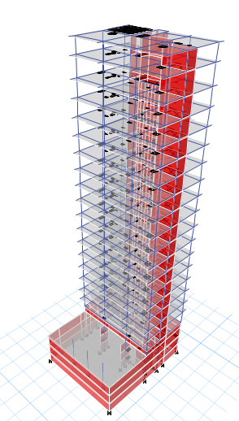
Content List:
Abstract
Design of Slabs.
Design of Beams.
Design of Columns.
Design of Shear Walls.
Design of Stairs.
Design of Diaphragms and Collectors.
Design of Foundation.

Slide 4
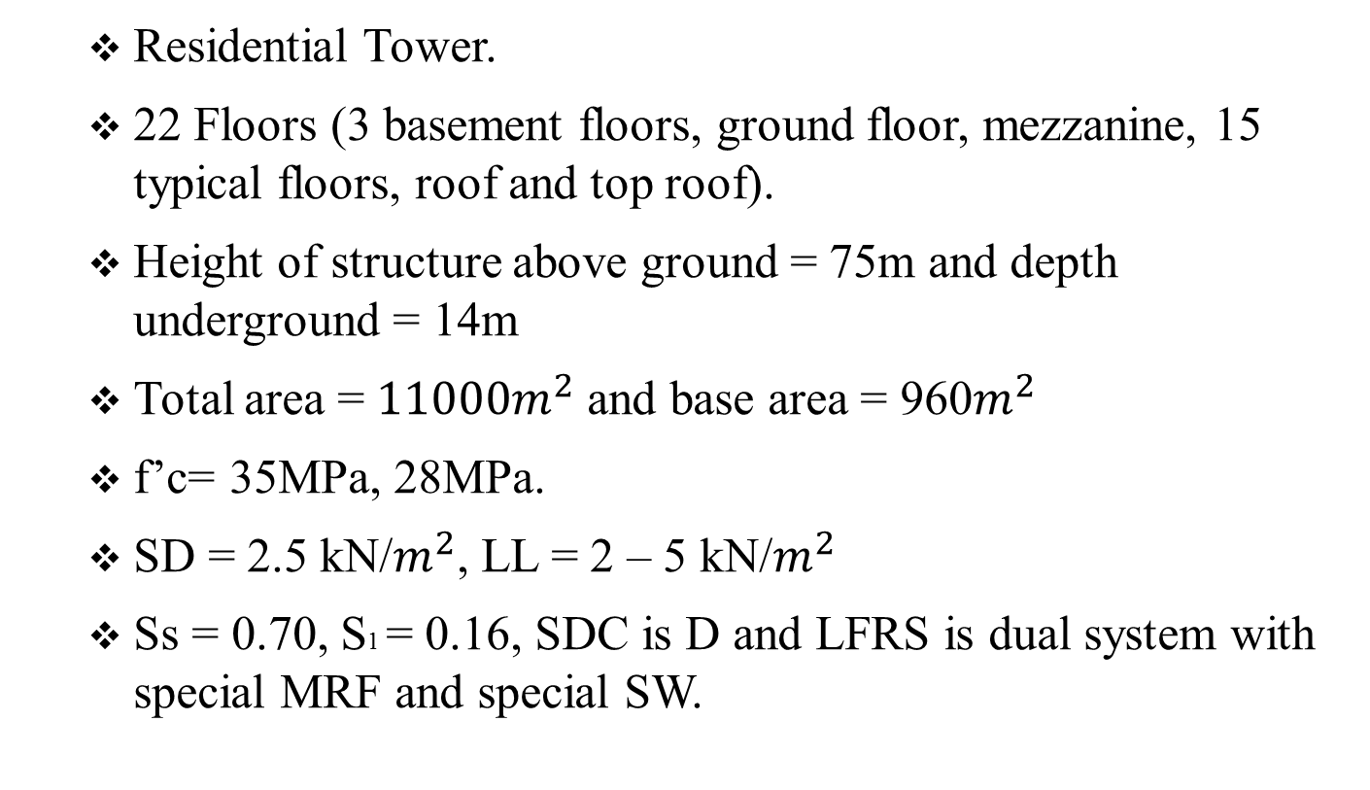
Abstract
  Residential Tower.
  22 Floors (3 basement floors, ground floor, mezzanine, 15 typical floors, roof and top roof).
  Height of structure above ground = 75m and depth underground = 14m
  Total area = ${11000m}^{2}$ and base area = 960$m^{2}$
  f’c= 35MPa, 28MPa.
  SD = 2.5 kN/$m^{2}$, LL = 2 – 5 kN/$m^{2}$
  Ss = 0.70, S1 = 0.16, SDC is D and LFRS is dual system with special MRF and special SW.

Slide 5
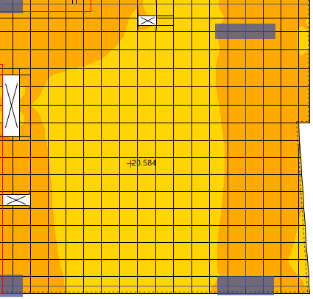

1. Design of Slab
- Verification of Structural Design.
Internal moment:
The value obtained from the following figure is used to
find A_{st}.
$ρ=\frac{0.85f^{′}c}{fy}(1−\sqrt{1−\frac{2.61Mu}{bd^{2}f^{′}c}} )$ = 0.00125(M=20.6 kN.m/m)
A_{st}= 0.00125*1000*210 = 263 mm2/m.

Slide 6
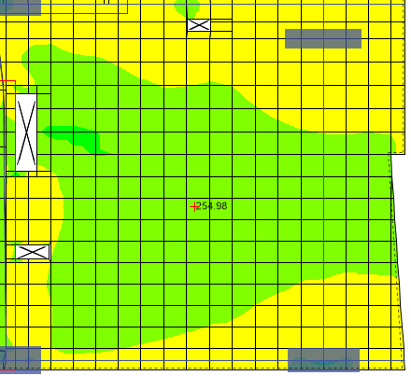
1. Design of Slab
- Verification of Structural Design.
Design Results:
A_{s} = 255 mm2/m
Difference = (263-255)/263 *100% = 3% < 10% →OK.

Slide 7
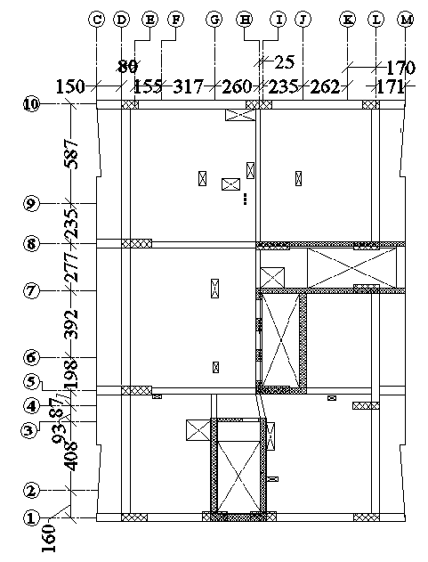
1. Design of Slab
- Design.
Wide-beam shear check:
Story 1 will be used as an example but all stories will be
checked.
W_{u} = 1.2 (2.5+25*0.25) + 1.6*2 =13.7 kN/m2.
Largest panel is 8.67m (5 to 8) by 7.72m (D to H).
V_{u} = 1.15 WL/2 = 1.15*13.7*7.72/2 = 60.8 kN.
ØV_{c} = 6% A_{g} = 0.06*100*25 = 150 kN > 60.8 kN
→Thickness is OK.

Slide 8
1. Design of Slab
- Design.
Flexural Design:
All four models will be compared to produce a final result with maximum values.
Results near openings will be ignored since they tend to be exaggerated and openings will be designed separately.
A_{s,min} = 0.0018*1000*250 = 450 mm2/m.
Top mesh: 1Ø14/200mm →770 mm2/m.
Bottom mesh: 1Ø12/200mm →565 mm2/m.
A_{s} additional to previously mentioned top and bottom meshes will be checked for each slab to produce final drawings of additional reinforcement.

Slide 9
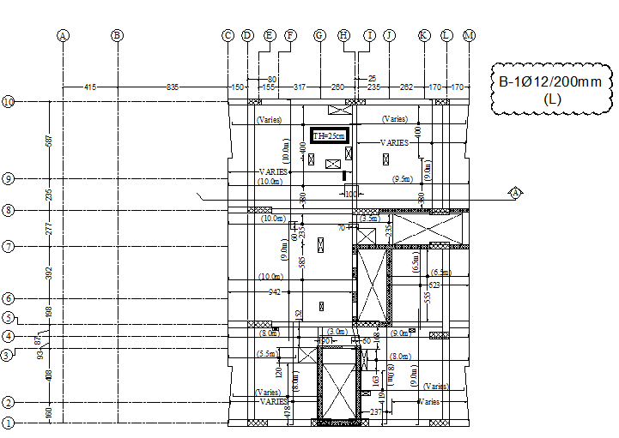
1. Design of Slab

Slide 10
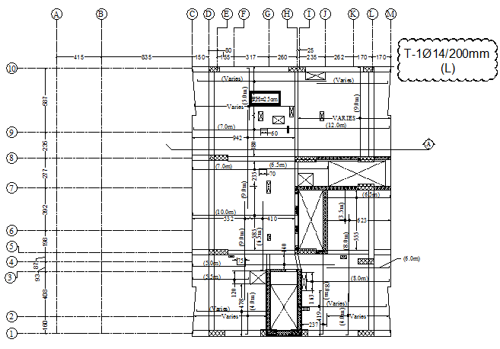
1. Design of Slab

Slide 11
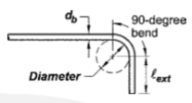
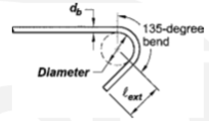
2. Design of Beams.
- General Requirements.
  Dimensions limit: requirements on dimension for special beams .
  Minimum spacing of longitudinal bars: minimum between 25 mm and db.
  Stirrups used for torsion or integrity reinforcement shall be closed stirrups.
  Standard hook for longitudinal bars: 90 degree hook was used with straight extension 12 db.
  Standard hook for stirrups: 135 degree hook was used with straight extension 6 ds.
  Development length for hooks in tension: Ldh = 19 db.
  Lap splicing used in tension: For positive moment 1.3Ldt, for negative moment 1.3(1.3) Ldt.
  Cover for beams = 60 mm.

Slide 12
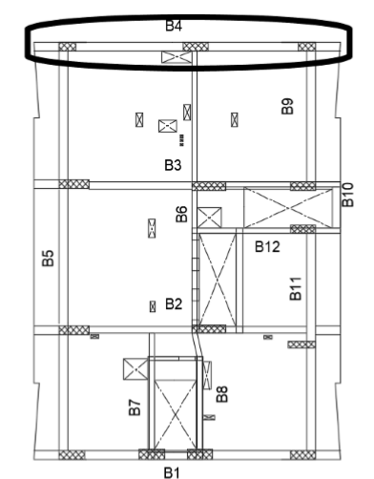
2. Design of Beams.
- Verification of Structural Design.
Beam B4 (500x800) on frame 10 in first floor selected to verify the structural design.

Slide 13
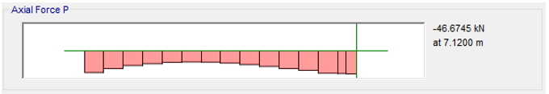
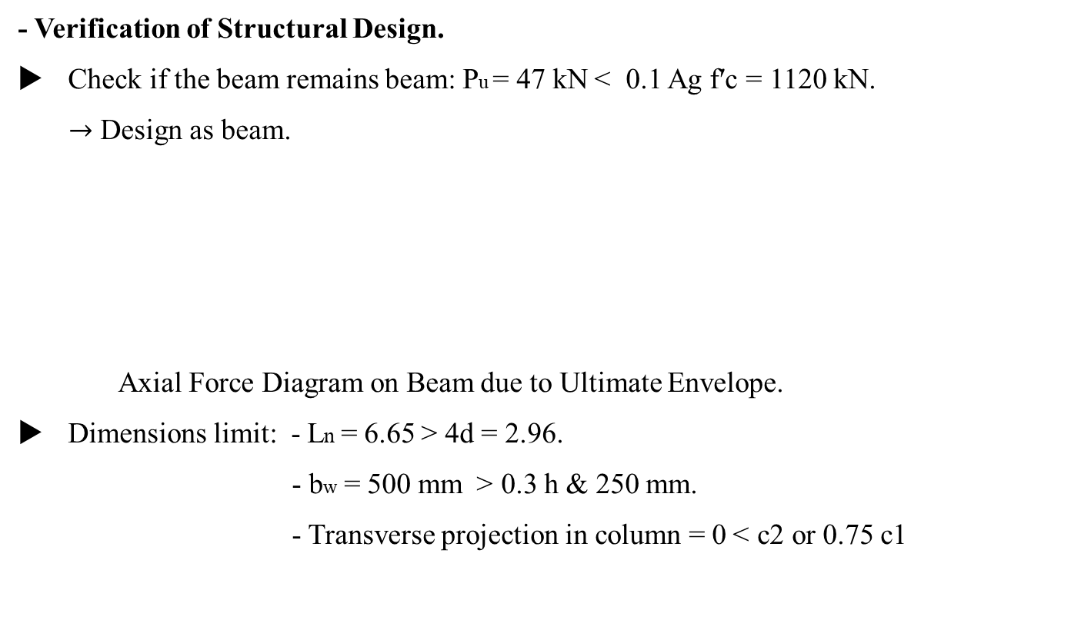
2. Design of Beams.
- Verification of Structural Design.
Check if the beam remains beam: Pu = 47 kN > 0.1 Ag f′c = 1120 kN.
  $→$ Design as beam.
  Axial Force Diagram on Beam due to Ultimate Envelope.
Dimensions limit: - Ln = 6.65 < 4d = 2.96.
          - bw = 500 mm < 0.3 h & 250 mm.
          - Transverse projection in column = 0 > c2 or 0.75 c1

Slide 14
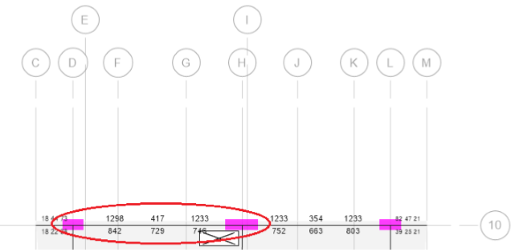
2. Design of Beams.
- Verification of Structural Design.
Design for flexure: ETABS results are shown in the following figure.
Design Mu for top steel is taken from UDCon17 and design Mu for bottom steel in the middle is taken from UDCon16 are shown in the following figures respectively.

Slide 15
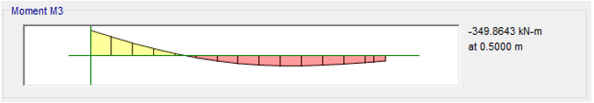
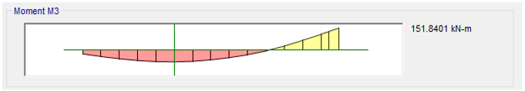
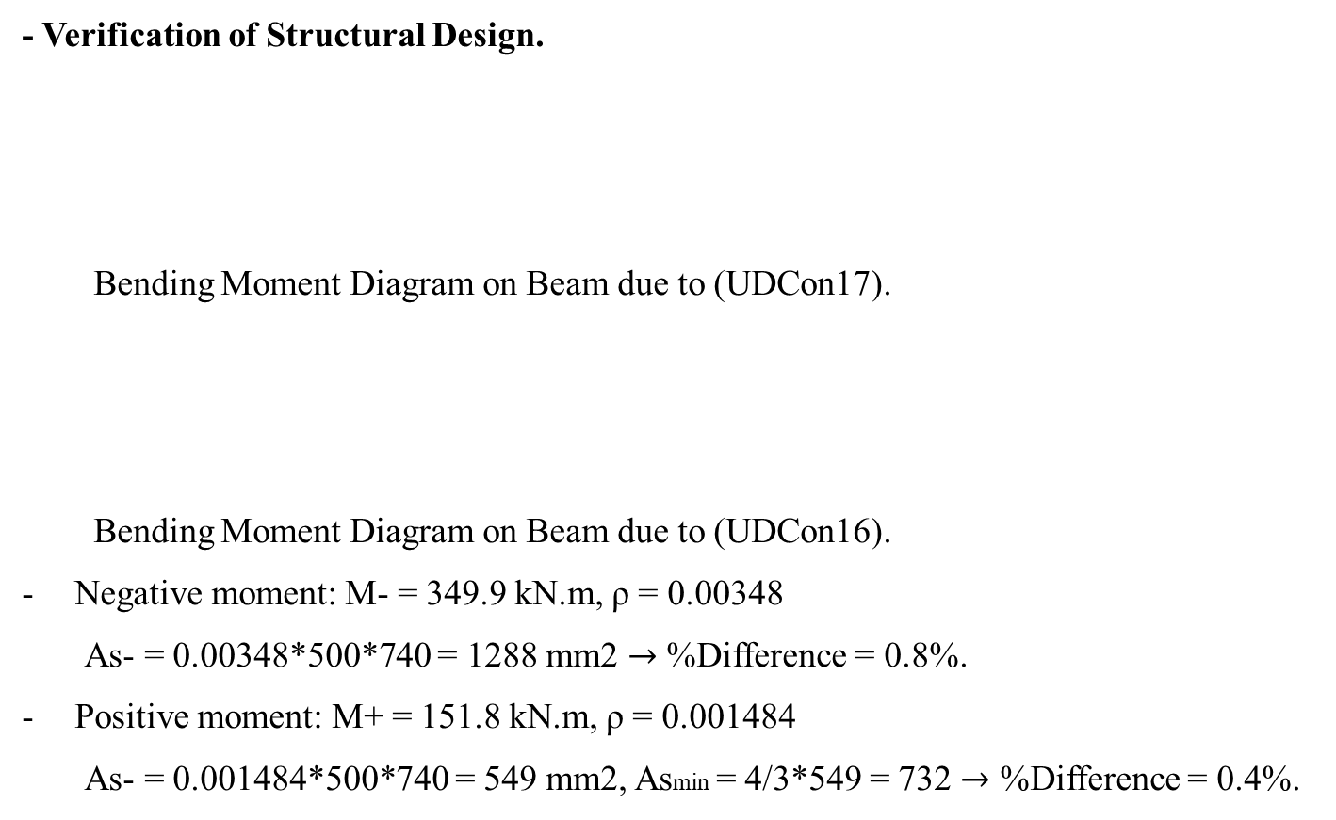
2. Design of Beams.
- Verification of Structural Design.
Bending Moment Diagram on Beam due to (UDCon17).
Bending Moment Diagram on Beam due to (UDCon16).
Negative moment: M- = 349.9 kN.m, ρ = 0.00348
  As- = 0.00348*500*740 = 1288 mm2 $→$ %Difference = 0.8%.
Positive moment: M+ = 151.8 kN.m, ρ = 0.001484
  As- = 0.001484*500*740 = 549 mm2, Asmin = 4/3*549 = 732 $→$ %Difference = 0.4%.

Slide 16
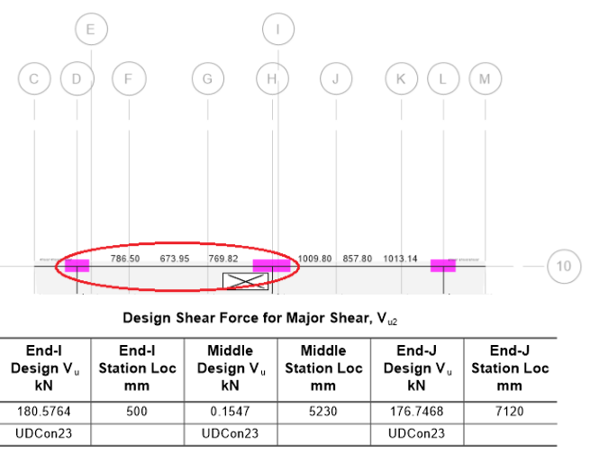
2. Design of Beams.
- Verification of Structural Design.
Design for shear: ETABS results are shown in the following figure.

Slide 17
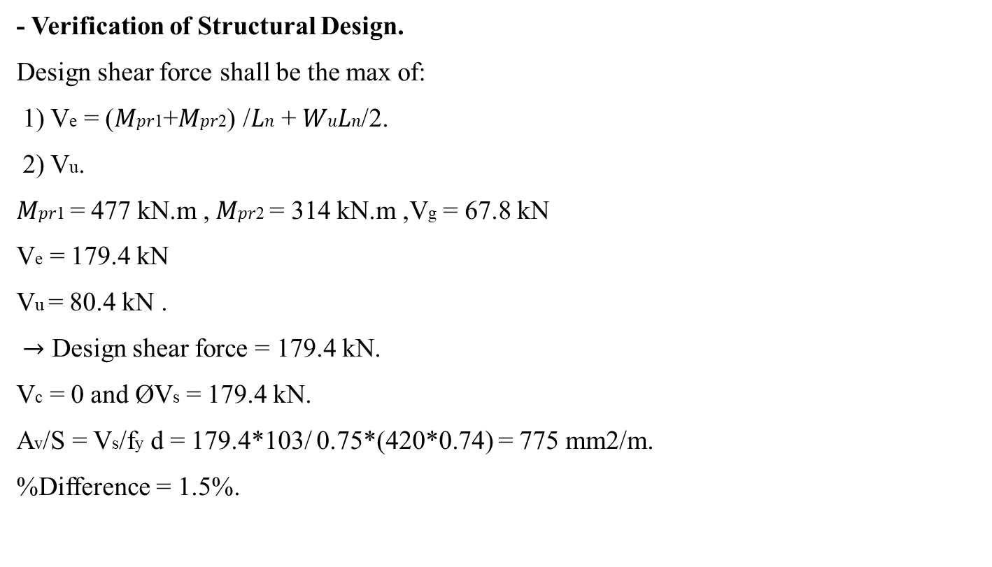
2. Design of Beams.
- Verification of Structural Design.
Design shear force shall be the max of:
1) Ve = (𝑀𝑝𝑟1+𝑀𝑝𝑟2) /𝐿𝑛 + 𝑊𝑢𝐿𝑛/2.
2) Vu.
𝑀𝑝𝑟1 = 477 kN.m , 𝑀𝑝𝑟2 = 314 kN.m ,Vg = 67.8 kN
Ve = 179.4 kN
Vu = 80.4 kN .
$→$ Design shear force = 179.4 kN.
Vc = 0 and ØVs = 179.4 kN.
Av/S = Vs/fy d = 179.4*103/ 0.75*(420*0.74) = 775 mm2/m.
%Difference = 1.5%.

Slide 18
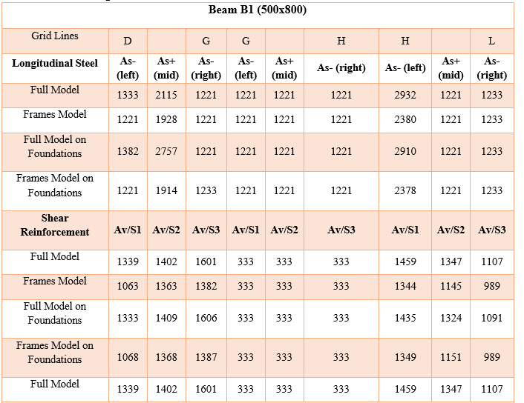
2. Design of Beams.
Design.
We have four models of this structure, so we take the maximum reinforcement for each beam. The following table shows longitudinal and shear reinforcement from all models for B1.

Slide 19
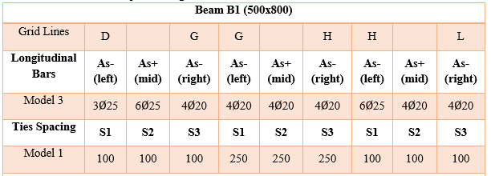
2. Design of Beams.
Design.
The following table shows maximum longitudinal bars and stirrups spacing for B1.

Slide 20
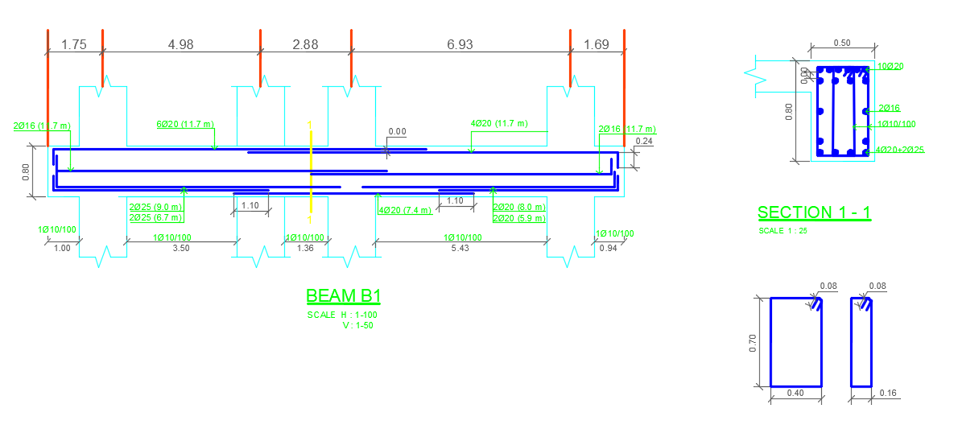
2. Design of Beams.
Design.
The following figure shows detailed plan for B1 reinforcement and splicing.

Slide 21
3. Design of Columns.
- General Requirements.
Dimensions limit: requirements on dimension for special columns .
1) The shortest cross sectional dimension is at least 300 mm.
→Ok, since 500 mm is the shortest dimension.
2) The ratio of the shortest cross-sectional dimension to the perpendicular dimension shall be at least 0.4
→500\1000 = 0.50, ok.
  Maximum spacing of longitudinal bars: 150 mm to ensure confinement.
  Closed stirrups and hook requirements as beams.
  Cross ties used in columns
  Lap splicing used in tension: 1.3Ldt .
  Cover for columns = 40 mm.

Slide 22



3. Design of Columns.
Where,
- General Requirements.
Spacing in the stirrups of special columns shall be as in the figure
ls = 1.3 Ldt

Slide 23
3. Design of Columns.
Where,
- General Requirements.
A requirement for special columns that specify a minimum flexural strength for columns is
ΣM_{nc} ≥ (6/5)ΣM_{nb}
Where,
ΣM_{nc} is sum of nominal flexural strengths of columns framing into the joint, evaluated at the faces of the joint.
ΣM_{nb} is sum of nominal flexural strengths of the beams framing into the joint, evaluated at the faces of the joint.
This requirement in order to achieve the concept of weak beam strong column that is very essential in the earthquake engineering. See figure.

Slide 24
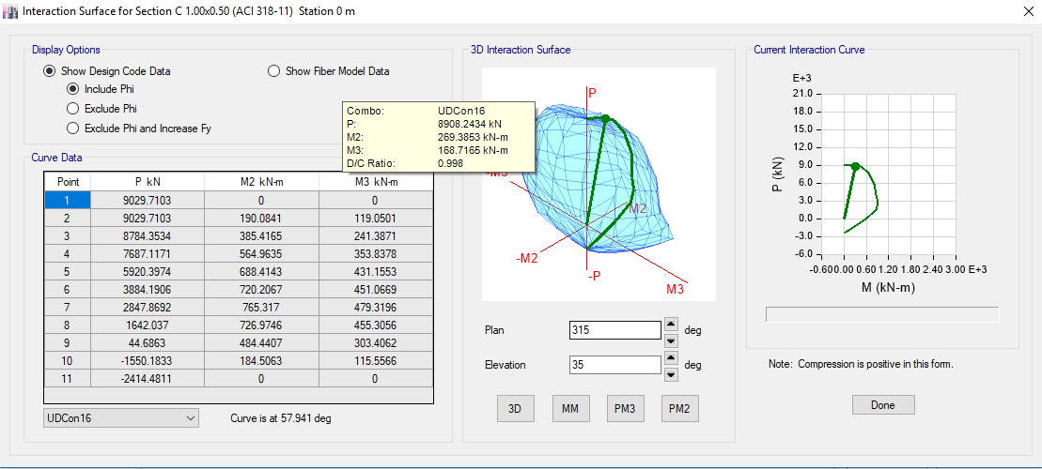
3. Design of Columns.
- Verification of Structural Design.
Design verification for axial and flexural reinforcement
Verification will be conducted on the column lies on the gridlines intersection 10L, at the first story.
Dimensions: 0.50 m x 1.00 m
Story height 3.40 m.
Design load combination that controls the design is 1.34D + 1.0L + 1.3EQ_{x}, UDCon16 on ETABS.
Slenderness of the column ignored; the column is short.
forces on the column: axial (P), moment about the major axis (M3) and moment about the minor axis (M2).
ETABS establishes
interaction diagrams
for the column as
shown in the figure

Slide 25
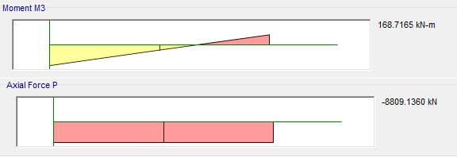
3. Design of Columns.
- Verification of Structural Design.
Design verification for axial and flexural reinforcement.
since the intersection of
P&M coincides with IAD,
we can trust in the
methodology of the
program in designing for
Internal forces from design load combination (UDcon16): flexure and axial.

Slide 26
3. Design of Columns.
- Verification of Structural Design.
Design verification for shear reinforcement.
Verification will be conducted on the column lies on the gridlines intersection 10H, at the top roof story.
Dimensions: 0.50 m x 1.50 m
Story height 3.65 m.
Design load combination that controls the shear design is 1.34D + 1.0L + 1.3EQ_{x}, UDCon16 on ETABS.
Slenderness of the column ignored; the column is short.
For design, shear (V) used for design is the maximum of:
- Vu : shear from the ultimate combination.
- Ve : the design shear force including seismic effect.

Slide 27
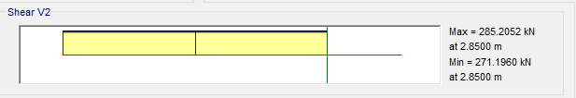
3. Design of Columns.
- Verification of Structural Design.
Design verification for shear reinforcement.
Vu : shear force from the ultimate combination. Which is UDcon16 on ETABS.
from the figure Vu = 285 kN.

Slide 28
3. Design of Columns.
- Verification of Structural Design.
Design verification for shear reinforcement.
Ve : the design shear force including seismic effect. Shall be evaluated according to the maximum
probable shear that can develop in the section due to probable moments (Mpr). See the following figure:
Probable moment, Mpr: is the nominal moment
using stress in steel equal to at least 1.25fy
and the strength reduction factor = 1.0.
Calculation of Mpr3, Mpr4 and Ve:
Area of steel in the column = 7500 mm²
Mpr3 = 711.25 kN.m
Mpr4 = 711.25 kN.m
Lu = 3.65 – 0.80 = 2.85 m. (the columns intersects two beams with depth 0.8m each)
Ve = 2x711.25/2.85 = 499 kN.

Slide 29
3. Design of Columns.
- Verification of Structural Design.
Design verification for shear reinforcement.
Design shear force = max. of {Vu = 285 kN, Ve = 499 kN} = 499 kN.
Consequently, the required design shear strength may be expressed as:
V_{n} = V_{c} + V_{s}
The design shear above must be resisted by the nominal shear strength of the member, V_{n}, which consists of concrete contribution (V_{c}) and steel contribution (V_{s}). However, the contribution of the concrete shall be ignored under the following two conditions when they occur simultaneously:
(a) The earthquake-induced shear force V_{e} represents at least one-half or more of the maximum required shear strength within those lengths. 499 > 0.5*285=142.5 kN.
(b) The factored axial compressive force P_{u} including earthquake effects is less than A_{g}f’_{c}/20.
Check: Agfc′/20 = 500 x 1500 x 35 /20 = 1312.50 kN > P_{u} on column = 477 kN.
→from (a) and (b), V_{c} = 0.

Slide 30
3. Design of Columns.
- Verification of Structural Design.
Design verification for shear reinforcement.
Calculation of shear reinforcement (Av/s):
Vs = Vn – Vc
Vs = 499 /0.75 – 0 = 655 kN.
Av/S = 1.10 mm2/mm
ETABS result for Av/S = 1.132 mm2/mm
Difference percentage = 3% <10%, acceptable.

Slide 31
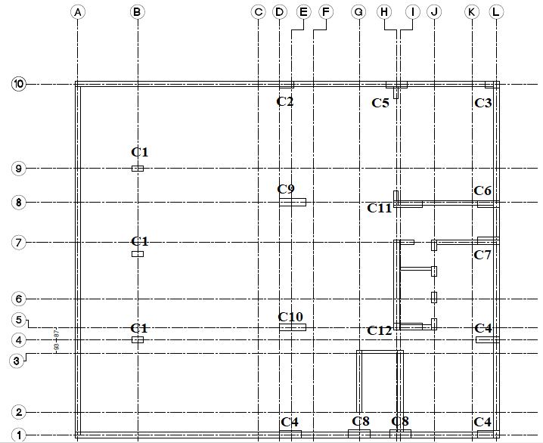
3. Design of Columns.
Design.
Columns layout

Slide 32
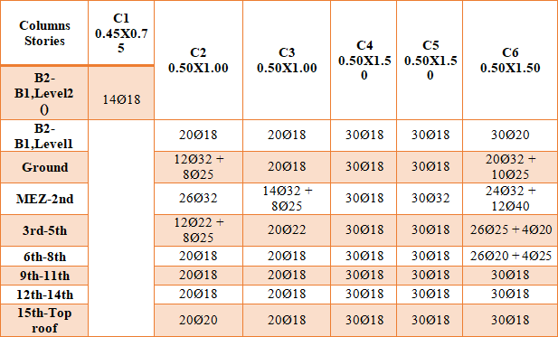
3. Design of Columns.
Design.
Longitudinal steel in columns

Slide 33
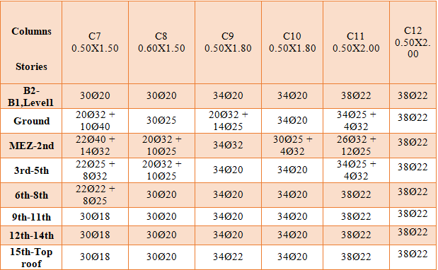
3. Design of Columns.
Design.
Longitudinal steel in columns

Slide 34
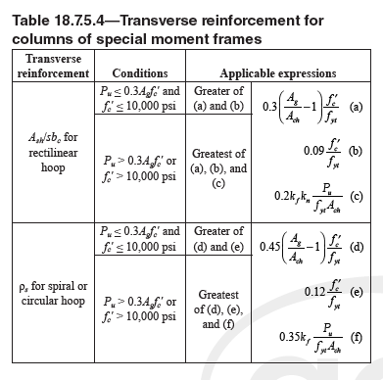
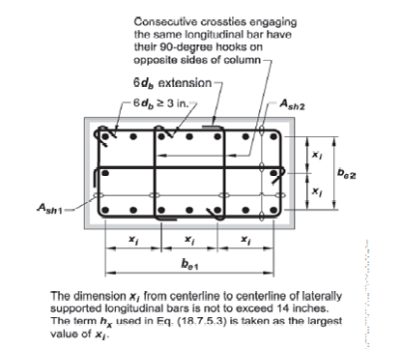
3. Design of Columns.
Design.
Transverse steel in columns
According to ACI code, a special column must assure ductility by having an adequate amount of transverse reinforcement (A_{sh}), figure shows table 18.7.5.4 in the ACI318-11 code

Slide 35
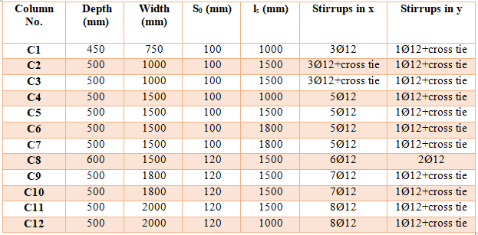
3. Design of Columns.
Design.
Transverse steel in columns

Slide 36
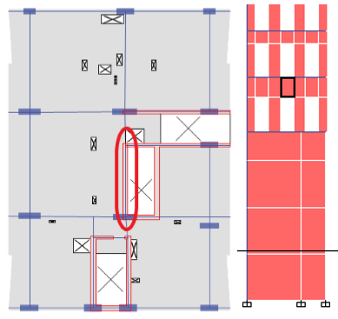
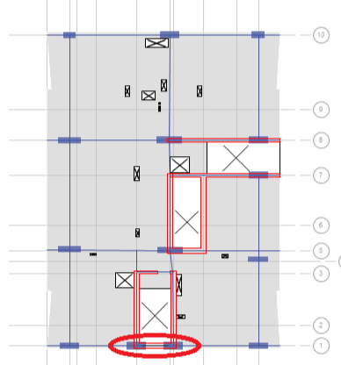
4. Design of Shear Walls.
- Verification of Structural Design.
The following figures show the selected spandrel and pier.
Spandrel Pier

Slide 37
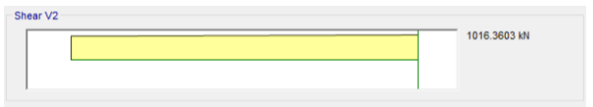
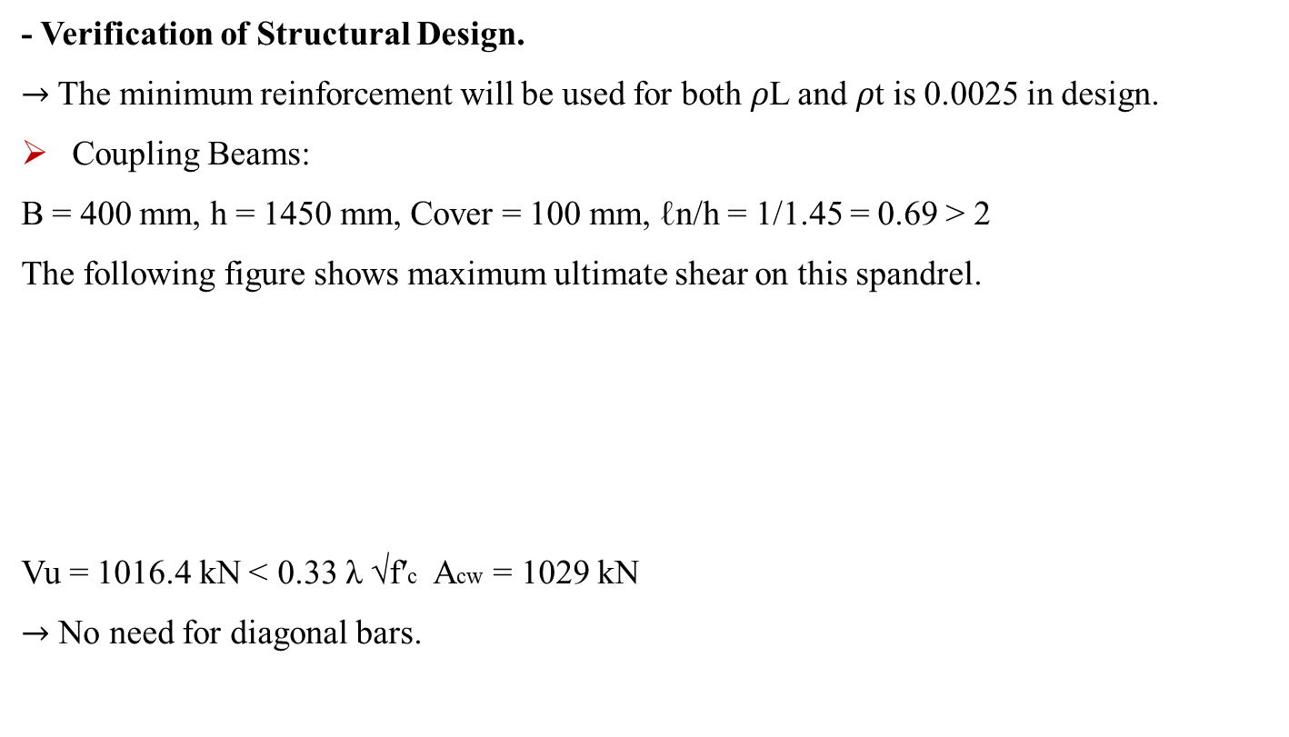
4. Design of Shear Walls.
- Verification of Structural Design.
$→$The minimum reinforcement will be used for both 𝜌L and 𝜌t is 0.0025 in design.
Coupling Beams:
B = 400 mm, h = 1450 mm, Cover = 100 mm, ℓn/h = 1/1.45 = 0.69 > 2
The following figure shows maximum ultimate shear on this spandrel.
Vu = 1016.4 kN > 0.33 λ √f′c Acw = 1029 kN
$→$ No need for diagonal bars.

Slide 38
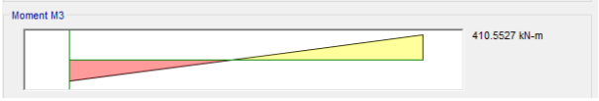
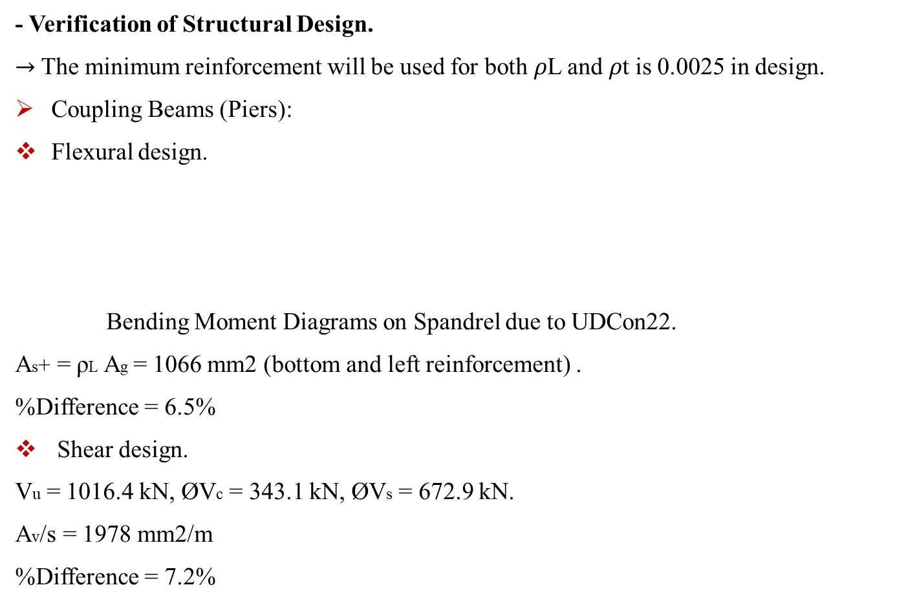
4. Design of Shear Walls.
- Verification of Structural Design.
$→$The minimum reinforcement will be used for both 𝜌L and 𝜌t is 0.0025 in design.
Coupling Beams (Piers):
Flexural design.
Bending Moment Diagrams on Spandrel due to UDCon22.
As+ = ρL Ag = 1066 mm2 (bottom and left reinforcement) .
%Difference = 6.5%
Shear design.
Vu = 1016.4 kN, ØVc = 343.1 kN, ØVs = 672.9 kN.
Av/s = 1978 mm2/m
%Difference = 7.2%

Slide 39
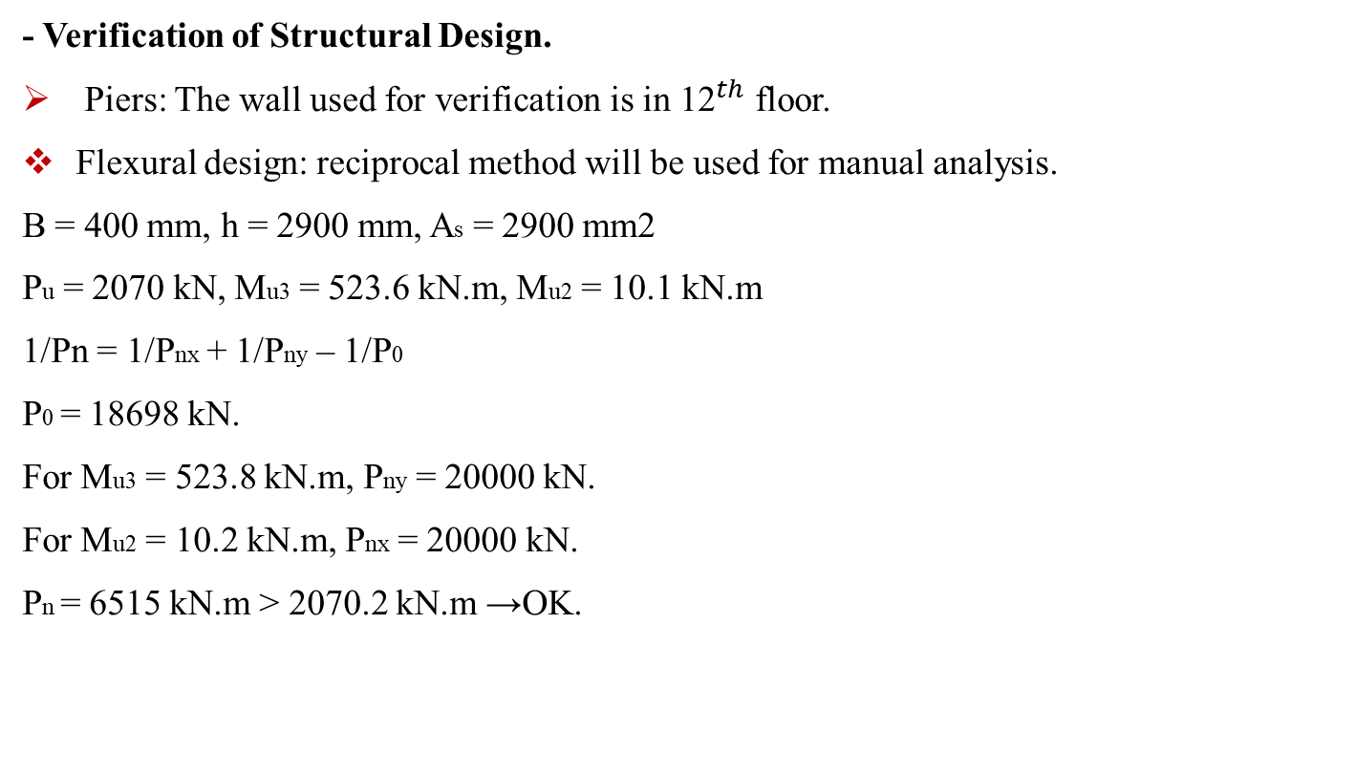
4. Design of Shear Walls.
- Verification of Structural Design.
Piers: The wall used for verification is in ${\text{12}}^{th}$ floor.
Flexural design: reciprocal method will be used for manual analysis.
B = 400 mm, h = 2900 mm, As = 2900 mm2
Pu = 2070 kN, Mu3 = 523.6 kN.m, Mu2 = 10.1 kN.m
1/Pn = 1/Pnx + 1/Pny – 1/P0
P0 = 18698 kN.
For Mu3 = 523.8 kN.m, Pny = 20000 kN.
For Mu2 = 10.2 kN.m, Pnx = 20000 kN.
Pn = 6515 kN.m > 2070.2 kN.m →OK.

Slide 40
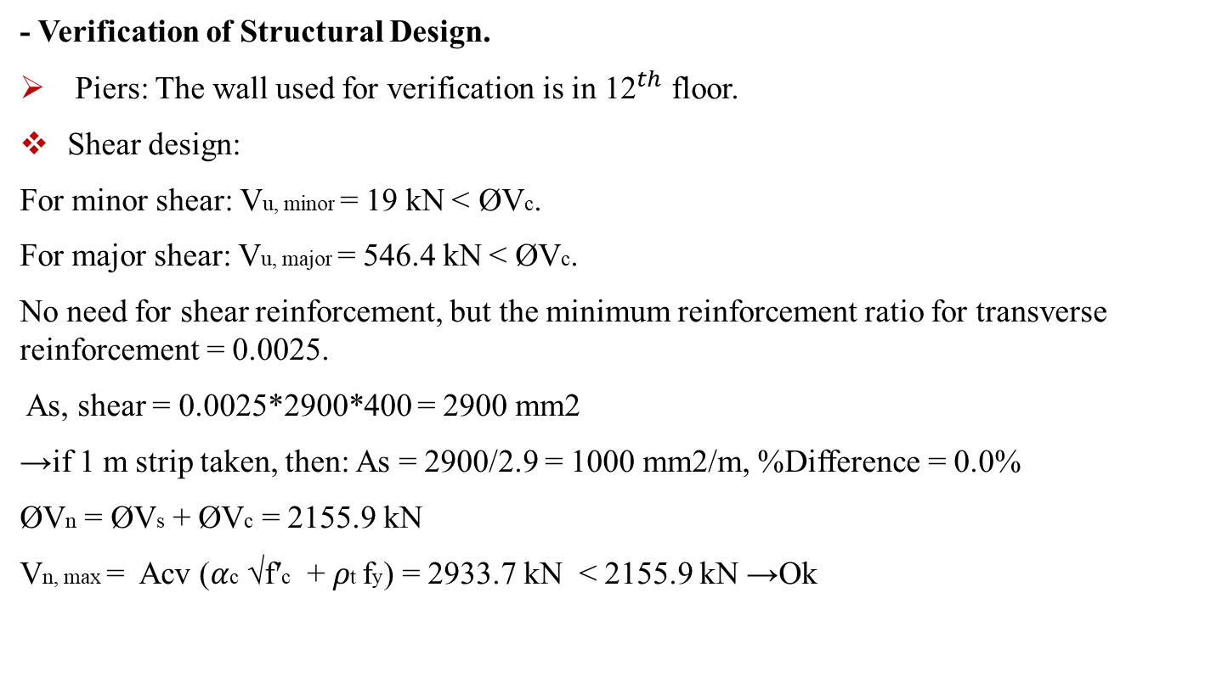
4. Design of Shear Walls.
- Verification of Structural Design.
Piers: The wall used for verification is in ${\text{12}}^{th}$ floor.
Shear design:
For minor shear: Vu, minor = 19 kN > ØVc.
For major shear: Vu, major = 546.4 kN > ØVc.
No need for shear reinforcement, but the minimum reinforcement ratio for transverse reinforcement = 0.0025.
As, shear = 0.0025*2900*400 = 2900 mm2
→if 1 m strip taken, then: As = 2900/2.9 = 1000 mm2/m, %Difference = 0.0%
ØVn = ØVs + ØVc = 2155.9 kN
Vn, max = Acv (𝛼c √f′c + 𝜌t fy) = 2933.7 kN < 2155.9 kN →Ok

Slide 41
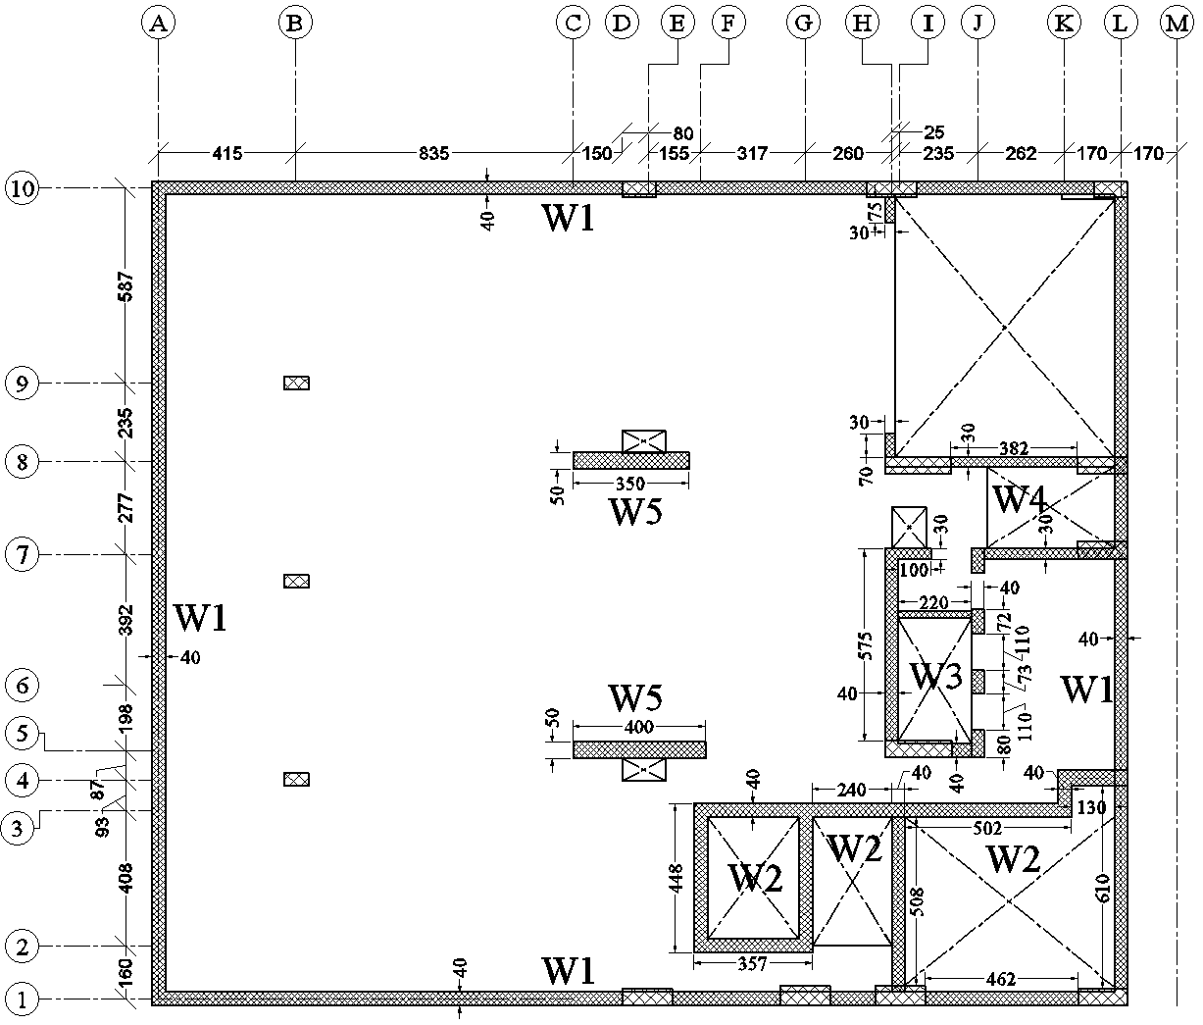
4. Design of Shear Walls.
- Design.
Designing of shear walls is a somewhat different than other elements like beams, slabs and columns. Initial reinforcement shall be given to the program, then the design is carried out and required reinforcement is produced. Initial reinforcement shall be modified to meet the required ratio, and then checked again.

Slide 42
4. Design of Shear Walls.
- Design.
The following table summarizes the piers’ thicknesses and their longitudinal and horizontal reinforcement, on each side.
Wall | Location | Thickness | Longitudinal Reinforcement | Horizontal Reinforcement
W1 | External | 400mm | 1Ø18/200mm | 1Ø12/200mm
W2 | Internal | 400mm | 1Ø18/250mm | 1Ø12/200mm
W3 | Internal | 400mm | 1Ø16/250mm | 1Ø12/200mm
W4 | Internal | 300mm | 1Ø18/250mm | 1Ø12/200mm
W5 | Internal | 500mm | 1Ø16/250mm | 1Ø14/200mm
W6 | Internal | 400mm | 1Ø20/200mm | 1Ø12/200mm
W7 | External | 400mm | 1Ø25/200mm | 1Ø12/200mm
W8 | Internal | 400mm | 1Ø14/250mm | 1Ø12/200mm
W9 | Internal | 400mm | 1Ø32/200mm | 1Ø14/100mm
W10 | Internal | 400mm | 1Ø16/200mm | 1Ø12/200mm
W11 | Internal | 300mm | 1Ø25/200mm | 1Ø12/200mm
W12 | Internal | 300mm | 1Ø16/200mm | 1Ø12/250mm

Slide 43
4. Design of Shear Walls.
- Design.
The following table summarizes the spandrels’ thicknesses and their top and bottom flexural reinforcement as well as their shear reinforcement.
Wall | Thickness | Location (GL+d)* |  | Flexural Reinforcement
 |  | Left | Right | Top |  | Bottom
 |  |  |  | Left | Right | Left | Right
S1 | 500mm | 10 | 1 | 7Ø25 | 7Ø25 | 6Ø16 | 6Ø16
S2 | 400mm | G +1.6m | H | 4Ø25 | 4Ø25 | 4Ø25 | 4Ø25
S3 | 400mm | 5 + 0.6m | 6 – 0.25m | 4Ø25 | 4Ø25 | 4Ø25 | 4Ø25
 |  | 7 – 0.25m | 7 – 1.62m
S4 | 400mm | 6 + 0.47m | 6 + 1.57m | 3Ø25 | 3Ø25 | 3Ø25 | 3Ø25
Wall | Shear Reinforcement
 | Left |  | Right |  | Diagonal
 | A_{s vertical} | A_{s horizontal} | A_{s vertical} | A_{s horizontal}
S1 | 1Ø12/80mm | 1Ø12/350mm | 1Ø12/80mm | 1Ø12/350mm | -
S2 | 1Ø12/100mm | 1Ø12/350mm | 1Ø12/100mm | 1Ø12/350mm | -
S3 | 1Ø14/100mm | 1Ø12/350mm | 1Ø14/100mm | 1Ø12/350mm | 4Ø32
S4 | 1Ø14/100mm | 1Ø12/350mm | 1Ø14/100mm | 1Ø12/350mm | 4Ø32

Slide 44
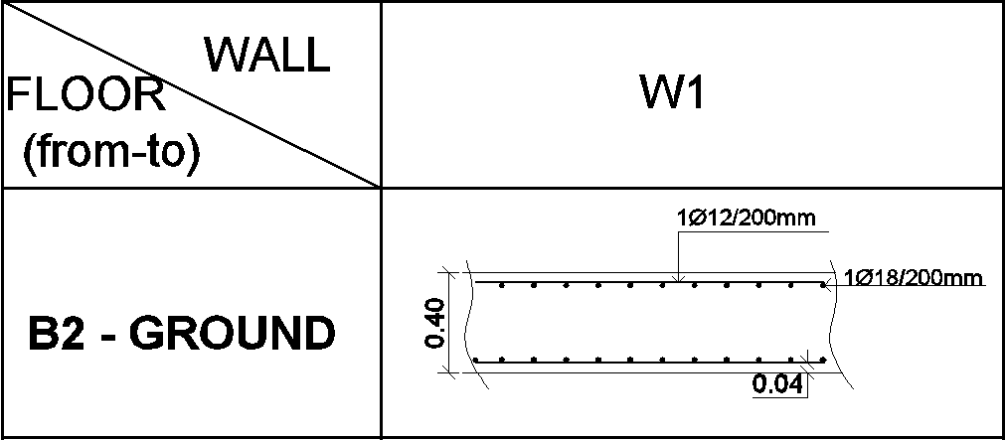
4. Design of Shear Walls.

Slide 45
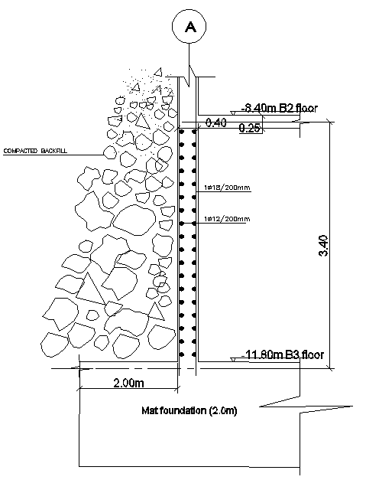
4. Design of Shear Walls.

Slide 46
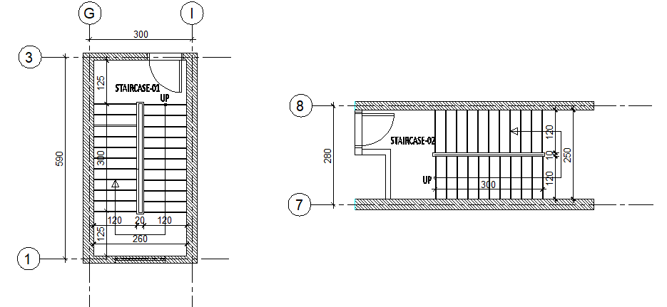
5. Design of Stairs.
Modeling and analysis.
Staircases plans

Slide 47
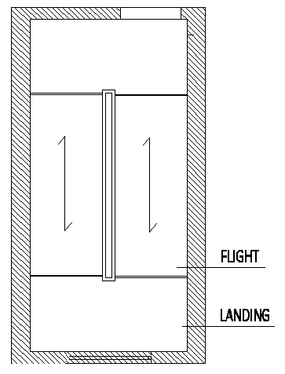
5. Design of Stairs.
Modeling and analysis.
Assumptions:
One dimensional analysis
Stairs’ slabs were modeled and analyzed apart of the whole structure.
Stairs’ slabs are called the flight and the landing, as illustrated in the figure

Slide 48
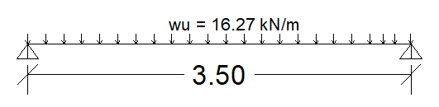
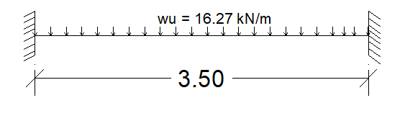
5. Design of Stairs.
Modeling and analysis of flight slab
Load transmission :
Preliminary dimensions: L/20, thickness = 17.5 cm
Loads computations: DL = 4.89 kN/m2, SDL = 2kN/m2 and LL = 5kN/m2.
1-D Structural model: 1)
Analysis:
Mu⁺ = wu l²/8
Mu⁻ = wu l²/12 2)

Slide 49
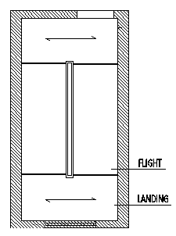
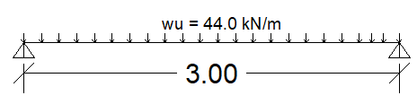
5. Design of Stairs.
Modeling and analysis of landing slab
Load transmission :
Preliminary dimensions: same thickness of flight slab = 17.5 cm
Loads computations: DL = 4.25 kN/m2, SDL = 2kN/m2 and LL = 5kN/m2.
In addition to reaction (R) from the flight on the landing slab which is computed as follows:
Wu on flight span = 16.27 x 3.5/2 = 28.50 kN, R = 28.50 kN per meter.
1-D Structural model:
Analysis: Mu⁺ = wu l²/8

Slide 50
5. Design of Stairs.
- Design:
Check shear: no shear reinforcement needed.
Flexural design:
Flight slab: bottom steel 1Ø14/250 mm.
top steel 1Ø12/250 mm.
Landing slab: bottom steel 1Ø16/200 mm.
top steel 1Ø12/250 mm.

Slide 51
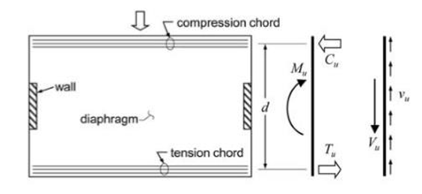
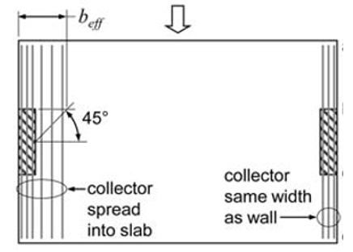
6. Design of Diaphragms and Collectors.
- A diaphragms are horizontal elements that serve to transfer lateral forces to vertical elements of the lateral-force-resisting system.
- A collector is a region of a diaphragm that transfers forces between the diaphragm and a vertical element of the lateral-force-resisting system.
Following figures show the stresses zones in diaphragm when it subjected to horizontal forces from wind and earthquake loads.

Slide 52
6. Design of Diaphragms and Collectors.
This system (Flat plate) to simplify the understanding of the diaphragm actions in horizontal forces.
But, the system used in this structure is two way solid slab with drop beams between all columns and shear walls which means the compression and tension chords and collector zones are concentrated in beams as axial forces. So, these beams shall be designed for these axial forces. Collector zone can be formed in diaphragm, but it will be consider in beams only with allow to some cracks developed.

Slide 53
7. Design of Foundation.
- Preliminary Dimensions:
As it is already known, the bearing capacity depends on depth of foundation and dimensions of footing, and since the mat is 11.80m underground, the bearing capacity aforementioned in section 1.8 does not apply here.
In order to calculate the bearing capacity, the dimensions of the mat will be assumed as the dimensions of the building plus 1.8m for each side on X-axis and 2.1m for each side on Y-axis (33x29).
Flat plate mat will be used, with area = 957 m2.
Thickness = 2.00m

Slide 54
7. Design of Foundation.
- Bearing Capacity:
As per section 1.8, Ø=30°, c = 15 kN/m2 and q_{all} =480 kN/m2 for a square footing with dimensions of 2x2m, D_{f} = 2m and F.S = 5.
Using the general bearing capacity equation:
q_{ult} = cN_{c}F_{cs}F_{cd}F_{ci} + qN_{q}F_{qs}F_{qd}F_{qi} + 0.5γBN_{γ}F_{γs}F_{γd}F_{γi}
By substituting the variables in the equation, q_{ult} = 13050 kN/m2.
q_{all} = 13050/5 = 2600 kN/m2, but this value is too high and will be reduced to 1000 kN/m2.

Slide 55

7. Design of Foundation.
- Three-Dimensional Analysis:
In order to consider soil-structure interaction, a 3D model of the structure with mat foundation is used.
Equilibrium check:
  1) Dead load:
    Dead _{(ETABS)} = 205649 kN.
    Original dead load = 157740 kN.
    Weight of mat = 33*29*2*25 =47850 kN.
    Total dead load = 155740+47850 = 205590 kN
    →difference = 0%.
  2) Response spectrum analysis results are adjusted.

Slide 56

7. Design of Foundation.
- Three-Dimensional Analysis:
Evaluation of preliminary dimensions.
The following figure shows soil
pressure on mat.
The maximum pressure is 700 kN/m2
which is less than b.c.
Dimensions are OK.

Slide 57

7. Design of Foundation.
- Three-Dimensional Analysis:
Shear check.
Shear capacity ØV_{c}= 0.75*(1/6)*$\sqrt{35}$*1000*1900 = 1405 kN.
Since the mesh is approximately 0.5m or less, shear value checked will be 4 to 5 squares away from center of support, which is half the thickness of the support plus distance d= 1.9m.
V13 and V23 from ultimate envelope were shown and the capacity is not exceeded.

Slide 58
7. Design of Foundation.
- Three-Dimensional Analysis:
Flexural design.
A_{s,min} = 0.0018bh = 1.8*2000 = 3600 mm2/m →use 1Ø32/150mm top and bottom.
No additional top or bottom steel is required for directions 1 and 2.

Slide 59

7. Design of Foundation.

Slide 60
  Thank You

