Slide 1
The effect of Covid-19 on food industry

Slide 2
review on the first project

Slide 3
Problem statement
food sector is an important part of every country because it takes a big part of the economy and it supplies a necessity to the people.
The food industry on the outside seems to be benefiting from the pandemic because the huge increase in demand and sacristy of the people to run out of food but the food producers says otherwise.
The focus on the impacts of this pandemic, such as product expiry and safe consumption, shortage of working force, and limited ability of distributors.
The study will propose several strategies that can be adopted to improve resiliency in the changing environment during and after the COVID-19 era and good strategic and risk management.

Slide 4
Objectives & aims
evaluate the Impact on Human resources, staffing, wages, salaries, benefits, job security.
Evaluate the impact on revenues, sales, marketing, expired materials, local sales, export markets.
Evaluate the impact on distribution cost, hygiene, packing.
Evaluate the impact on financial results, based on 2019 the financial result shall be compared.
Evaluate the impact on expansion strategies and decisions.
Evaluate the impact on cash cycle.
Evaluate the Impact on government income.

Slide 5
COVID- 19 impacts on the Palestinian food system
Respondents reported shortages and increased prices of agricultural inputs, particularly fodder.
Respondents reported markets for inputs closed earlier than usual and operated at a reduced pace.
Traders reported that border closures limited shipments of agricultural inputs.
The terms for purchasing inputs shifted from credit to upfront cash payments. The agro-food sector is exempted from movement restrictions, but agricultural workers were not willing to work
Workers were unwilling to travel to their place of work, due to concerns for viral contamination.
Family obligations to attend to children not at school limited women’s presence at work
Refernce: FAO. Coronavirus Disease 2019 (COVID-19)—Addressing the Impacts of COVID-19

Slide 6
Questionnaire design
Data will be collected using online questionnaires that will be distributed on a number of food companies working in the West Bank.
These questionnaires will be filled by the administrators, quality managers in each company.
all participants were fully Informed and acknowledged the study requirements and gave their approval for data sharing and privacy Policy.
The questionnaire consisted of 26 one-option, multiple choice, and open questions.
The questionnaire has eight dimensions (Raw materials, finished products, exports, production, labour, local sales, collection cycle, bad debt)
The questionnaire will be conducted and analysed in the next semester

Slide 7
Results
The group received 57 respondents, which gives a 90 percent confidence interval and a 10 percent error. Due to diversity of subject matter of questions, within the COVID-19 context, the questions are based on subjects such as HR, supply chain. The respondents where group of manufacturers each one of them produce products considered part of the essential food basket of the Palestinian household to see the effect of the covid-19 pandemic on those manufacturers and compare their responses to the believed positive effect that people expect.

Slide 8
closing the boarders
Export their products to the outside markets
The result of the questionnaire showed that a big number of manufacturers depend on importing of their product or the essential raw materials to produce it and we found that 63.16% depends on importing their product and raw materials and 36.84% doesn’t depend on importing rather they focus on using local raw materials.
Manufacturers who export their products to the outside markets which make 28.07% of the respondents got a very bad effect because they depend on exporting their products to the outside market while the 71.93% who don’t depend on exporting their products didn’t get affected and rather focused on opening the Palestinian boarders to receive their raw materials.

Slide 9
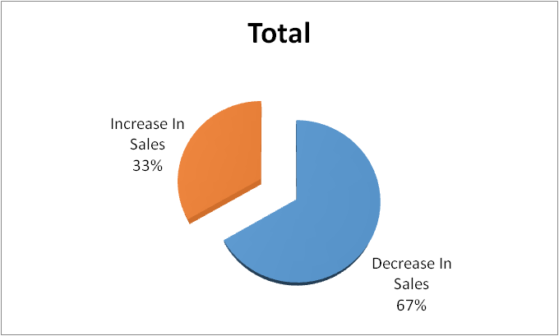
The effect of covid 19 on the sales of the food sector
As in contrast to what many people believe the food sector has suffered a lot because of the pandemic and huge number of manufacturers have suffered losses in their sales in contrary to their sales before the corona virus while some manufacturers have flowerished during this period and they saw an increase in their sales better than their sales before the pandemic

Slide 10
Collecting debts
Customer commitment
Closing banks
The pandemic had a huge effects on collecting debts which are considered a major source of income for any manufacturer not to metion the difficulty of collecting it because the huge downfall of the economy and the companies were divided into three cases , customers are fully committed to paying debts, customers not committed to paying and the last case is there is difficulty in collecting debts but there is a responsiveness.
Closing the banks was a major part of these problem not to mention the laws that were put during the panadmic and its effects on the banks themselves or the lockdowns that played a huge parts on stopping the work of major establishments and by our study we found that 59.65% got affected by the closure of banks while 40.35% were affected slightly or didn’t effect.

Slide 11
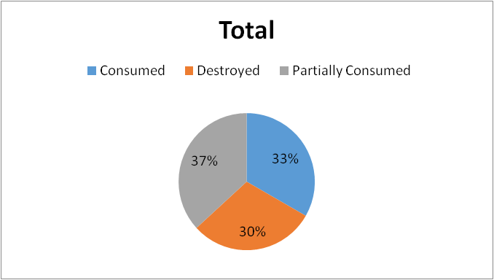
The effect of the pandemic on the shelf life of the products
Study sought to know the fate of the products and raw materials and if they got consumed or destroyed and through the study we found out that a large number was consumed or partially consumed as its shown in the figure

Slide 12
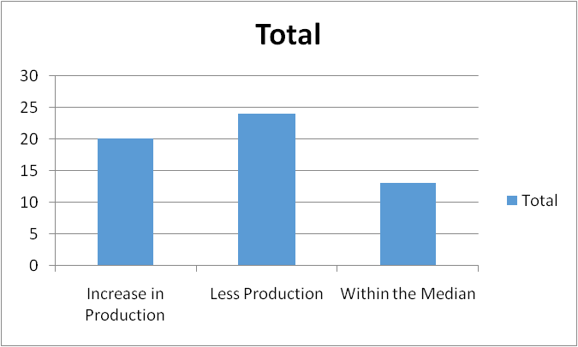
The effect of the pandemic on the production
One of our aims of the study was to see if their was an increase in production or did it acutly decrease on the opposite thoughts of the end customers and as the figure demonstrate that their was a decrease in production on the contrary of what many people thought a lot of the manufacturers saw a decrease while others saw an increase in their sales and their was a minority that say they didn’t see a difference in sale and to mention that our study focused on the general outcome of the questionnaire not on the rise and decrease of some products on others.

Slide 13
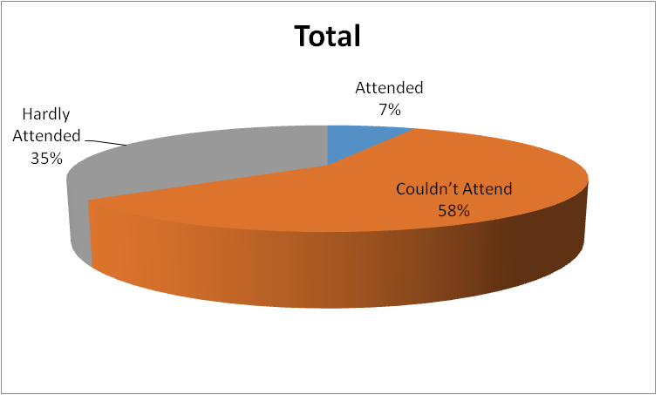
Study showed that many employees had a hard time coming to their workplace because of the many difficulties imposed by the situation and the constant lockdowns and the figure below shows that a big part of the employees haven’t been able to come or had a hard time coming to their work place unlike the few minority that didn’t have a problem and could attend.

Slide 14
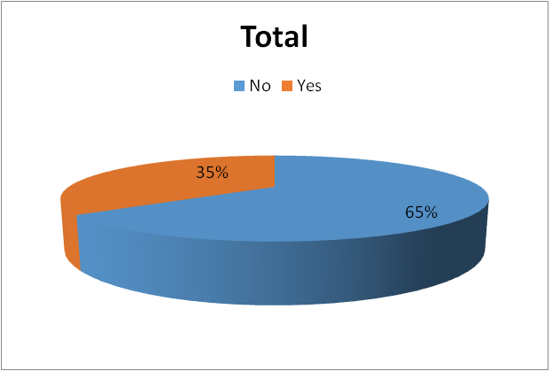
Employees and risk of infection
Each worker faces the risk of getting infected of the virus and any infection in the workplace could lead to major problems and sometimes the closing of the manufacturing facility to see if any cases of testing positive of covid 19 happened in the workplace and what was the procedures done by those manufacturers to face such incidents. The respondents of the study showed that there was cases of testing positive and it was alarming with huge risks of upcoming waves of covid 19 as we can see from the figure below

Slide 15
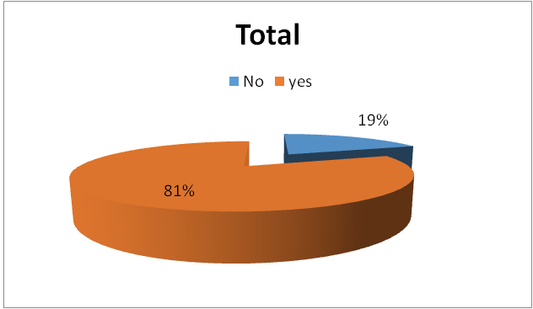
Extra expenses
Manufacturers had many extra expenses during the pandemic and our respondents through the questionnaire have showed us that a big majority of them have extra expenses and we tried to determine what are those expenses were through the questionnaire and as we can see from the figure

Slide 16

The extra expenses that were paid be the manufacturers were on different things like
Automatic hand sanitizers
Temperature detection cameras.
Payments were given to the employees despite the lowered production due to the pandemic
Masks, gloves, and hand sanitizers
Extra cleaning and cleaning tools
Transportation of workers from their homes to the facility and back
Increase in the price of raw materials
Extra expenses for delivering raw material and products
Extra costs for storing the products and raw materials
Packaging the products that were previously unpackaged

Slide 17
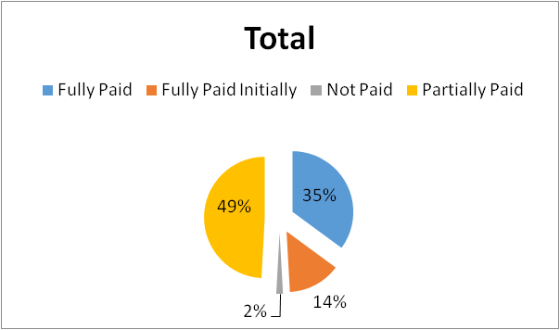
The pandemic and its effects on the workers’ salaries , Tax and the profit margin
Covid 19 and its effects on the salaries
The figure that 49% were partially paid which contribute to half and that is an alarming number. The current crisis is causing a labour market shock with an outsized impact on the earnings of the working population thanks to both an increased number of jobs lost and a pointy drop by working hours. With none government compensation, the. This loss is essentially thanks to the employed peoples that were absent from work or working reduced hours.

Slide 18
The effect of covid 19 on the profit margin of the food manufacturers
The causes of the impact: _
Added expenses needed to perform an equivalent level of service and revenue declines.
The need for providers to take care of some level of pandemic readiness.
Decreased capital spending as results of organizations scrutinizing every dollar spent.
Organizations moving faraway from fee-for-service.

Slide 19
Conclusion
the worldwide pandemic extend; resilience of various foods; their significance for nutrition and wellbeing. Industry should also identify the essential ingredients with the very best probability of shortage just in case of a pandemic(s), and develop strategies for manufacturing their products with alternative ingredients locally available or modified recipes which may fit with their production lines without investments. Existing and new technologies, including digital and physical, are likely to play key roles within the operation and maintenance of those enriched food chains, also as in ensuring food safety and hygienic practices. The tutorial community is named to spot and discuss the relevant underpinning challenges openly. This needs an interdisciplinary approach which will involve disciplines from food-related engineering to social or computer sciences, also as businesses, and policy/regulation representatives. COVID-19 has fostered global flexibility. Universities have turned online within weeks, while physical distancing restrictions stretch the system to unknown territories. And that we with constant care this pandemic will end and that we will learn and develop tons for the longer term.

Slide 20
Thank you
Any questions

