Slide 1

Smart Hospital Enhancement System (SHES)
WELLNESS MEDICAL
Presented By: Amer Hatem Sami Haji
SUPERVISED:
Eng. Muhannad AL-Jabi

Slide 2

The problem?
WELLNESS MEDICAL
Many hospitals still suffer from outdated or semi-digital systems that lead to appointment conflicts, inefficient leave management, and poor communication between patients and doctors. These limitations result in delays, administrative overload, and lack of real-time interaction. SHES was developed to address these issues by introducing a modular system that enhances existing hospital infrastructure without replacing the core HIS, enabling smart scheduling, performance tracking, and real-time doctor-patient messaging

Slide 3

Project Objectives
WELLNESS MEDICAL
The SHES platform aims to streamline hospital operations and enhance the healthcare experience. It provides a smart medical diagnostic chatbot, real-time doctor-patient messaging, digital leave management, and performance tracking—while integrating smoothly with existing hospital systems
Diagnostic Chatbot
Real-Time Messaging

Slide 4

System Overview
WELLNESS MEDICAL
The Smart Hospital Enhancement System (SHES) is a modular platform that improves hospital efficiency while preserving the existing Hospital Information System (HIS).
It supports appointment scheduling, smart medical diagnostics via chatbot, doctor-patient messaging, and role-based dashboards—ensuring seamless service across web and mobile platforms
Integrated doctor-patient chat system
Smart chatbot for early symptom guidance

Slide 5

Technologies Used
WELLNESS MEDICAL
Our system integrates modern technologies across web, mobile, and cloud platforms to deliver a secure, responsive, and intelligent hospital management experience. From frontend design to backend architecture, each component was carefully selected to ensure performance, scalability, and data security
Frontend
React.js for building the web interface.
Backend
ASP.NET Core (C#) for building secure, RESTful APIs.
Entity Framework Core (Code-First).
Clean Architecture. Microsoft Azure.
Security & Development Tools
JWT (JSON Web Token) Role-based Authorization Visual Studio / Visual Studio Code
Swagger & Postman
React Native for developing the mobile app on both Android and iOS
04

Slide 6
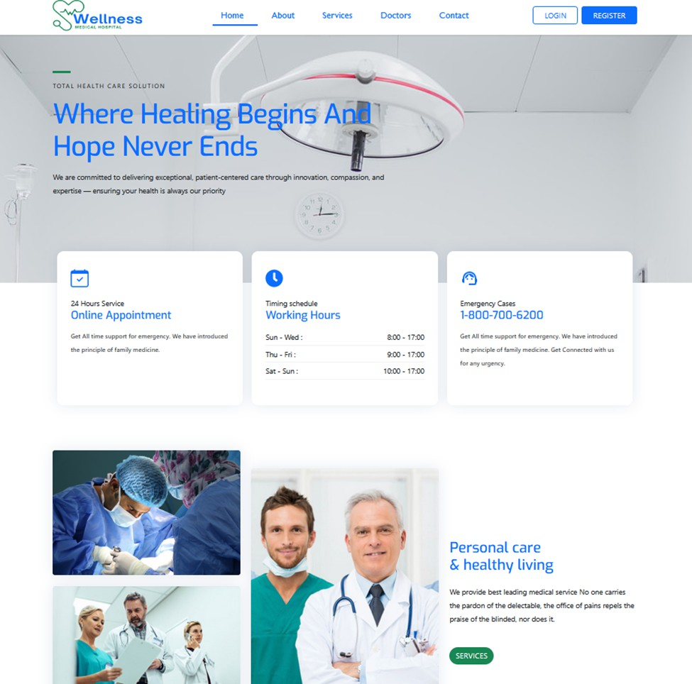
User Interface Overview
WELLNESS MEDICAL
HOME PAGE

Slide 7
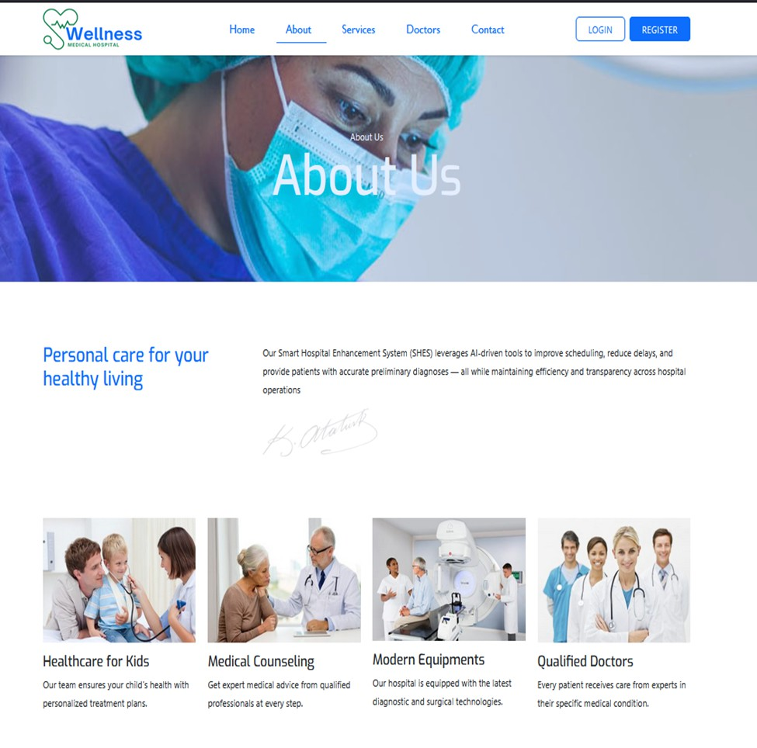
User Interface Overview
WELLNESS MEDICAL
ABOUT PAGE

Slide 8
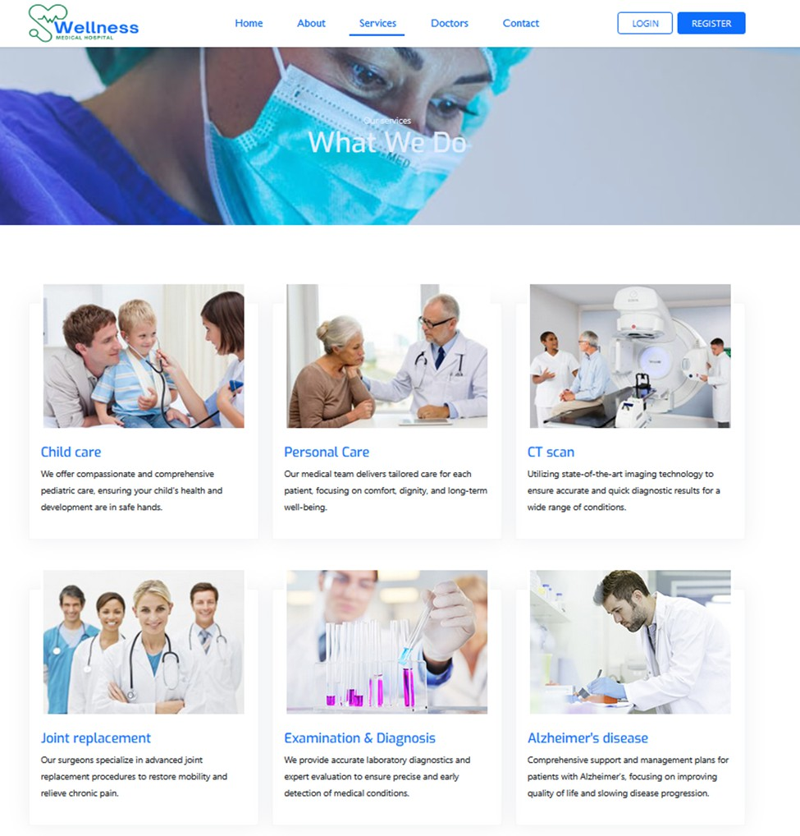
User Interface Overview
WELLNESS MEDICAL
SERVICE PAGE

Slide 9
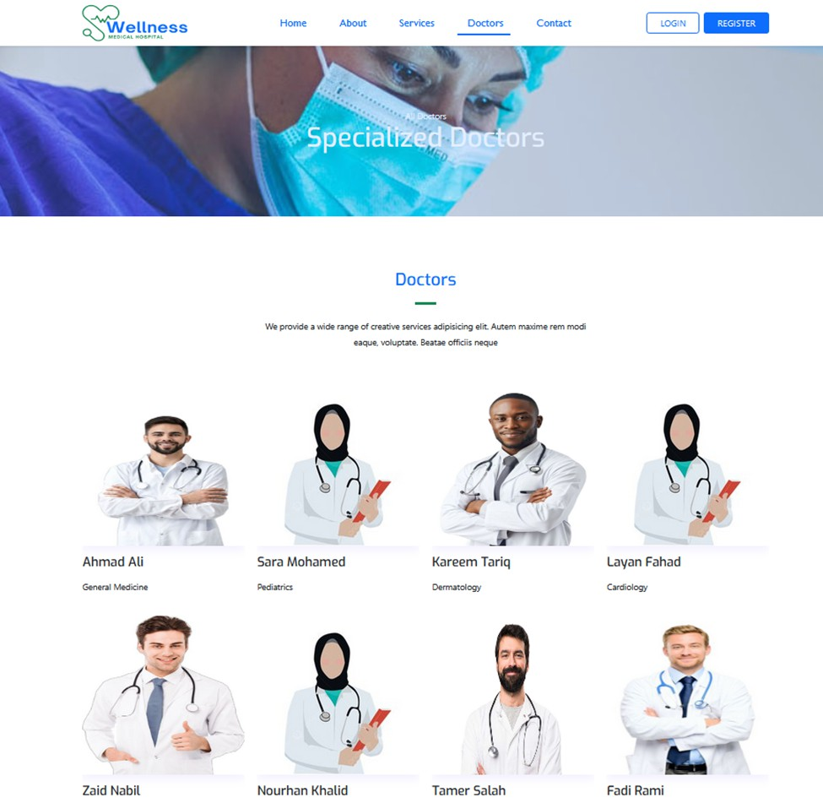
User Interface Overview
WELLNESS MEDICAL
DOCTOR PAGE

Slide 10
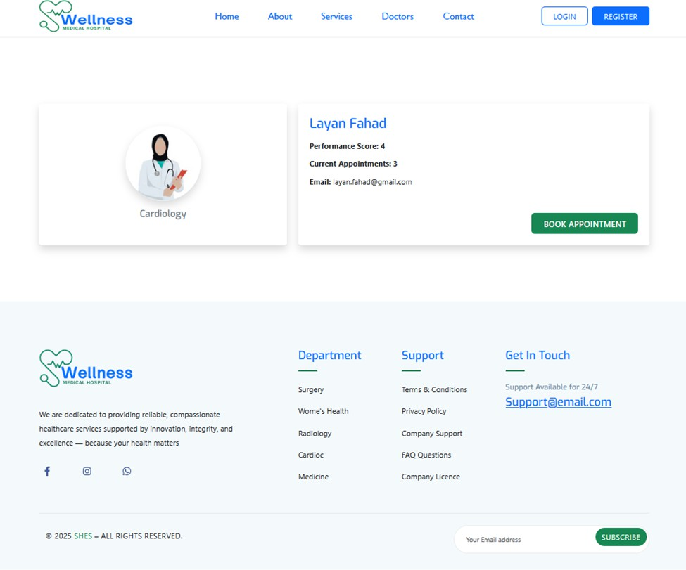
User Interface Overview
WELLNESS MEDICAL
DOCTOR PROFILE

Slide 11
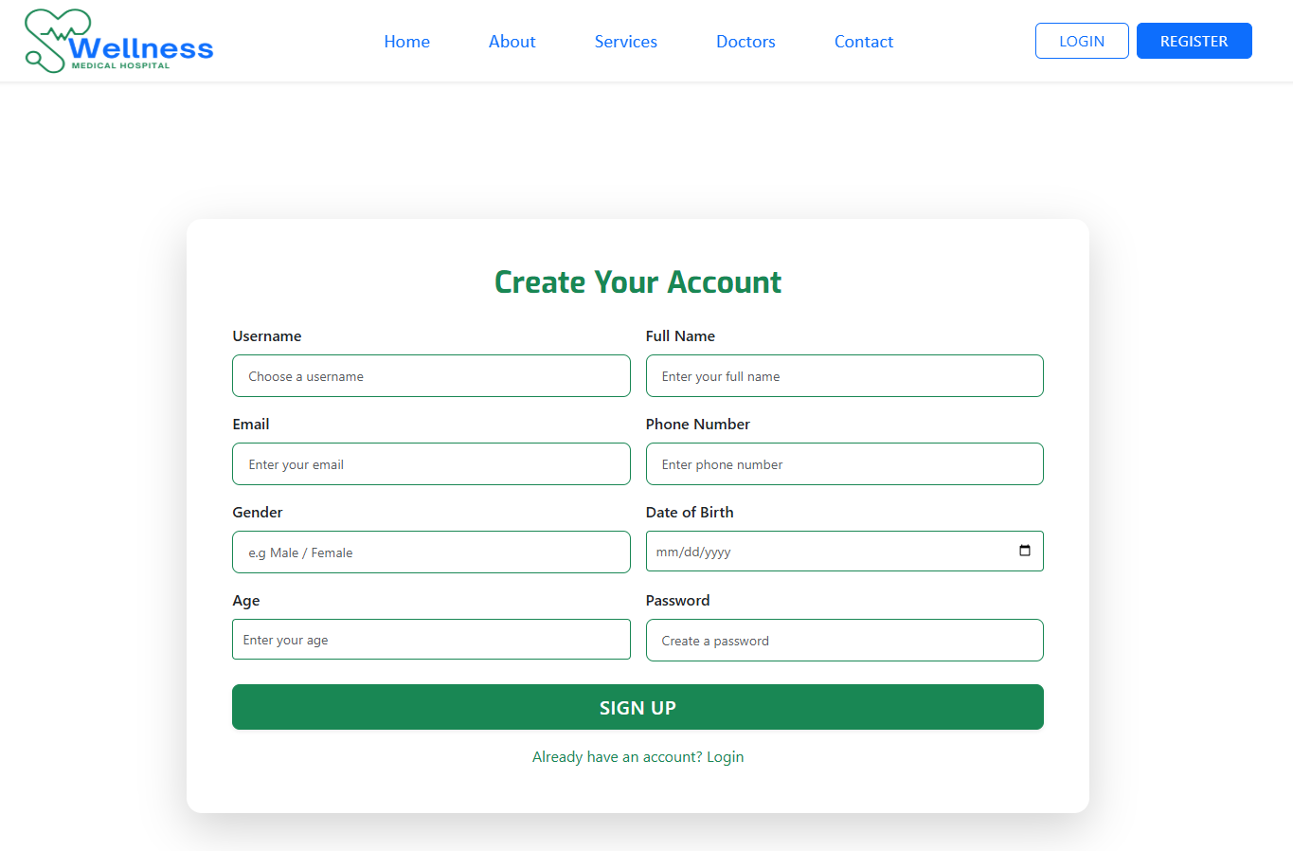
User Interface Overview
WELLNESS MEDICAL

Slide 12
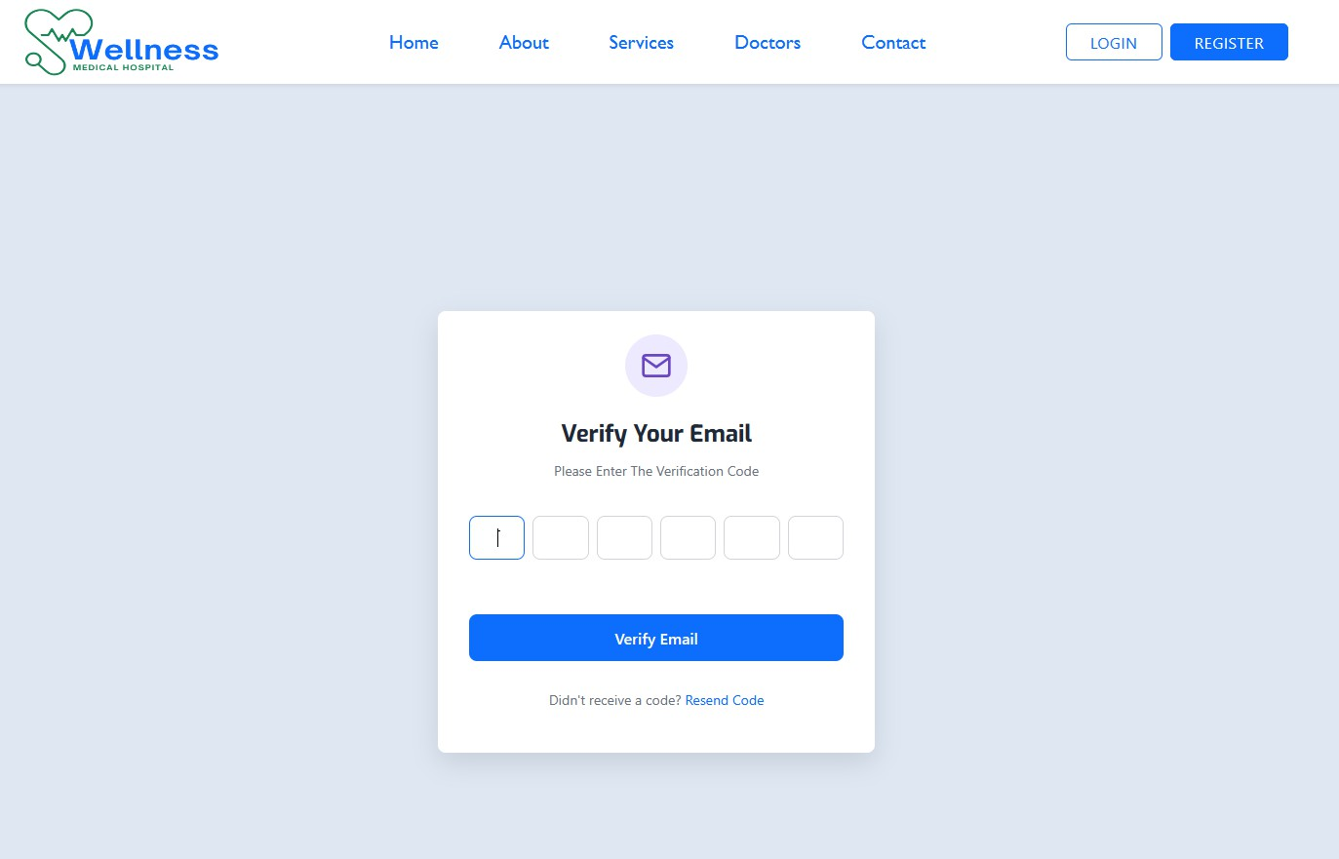
User Interface Overview
WELLNESS MEDICAL

Slide 13
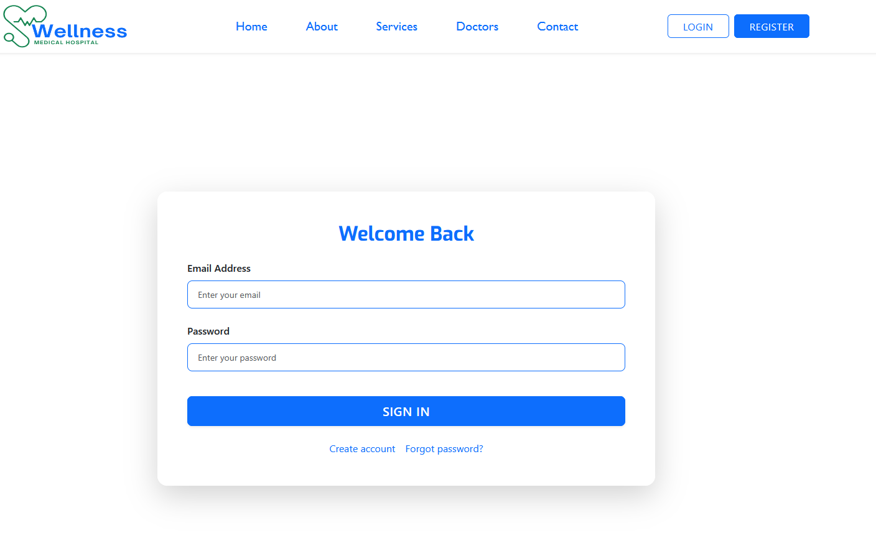
User Interface Overview
WELLNESS MEDICAL

Slide 14
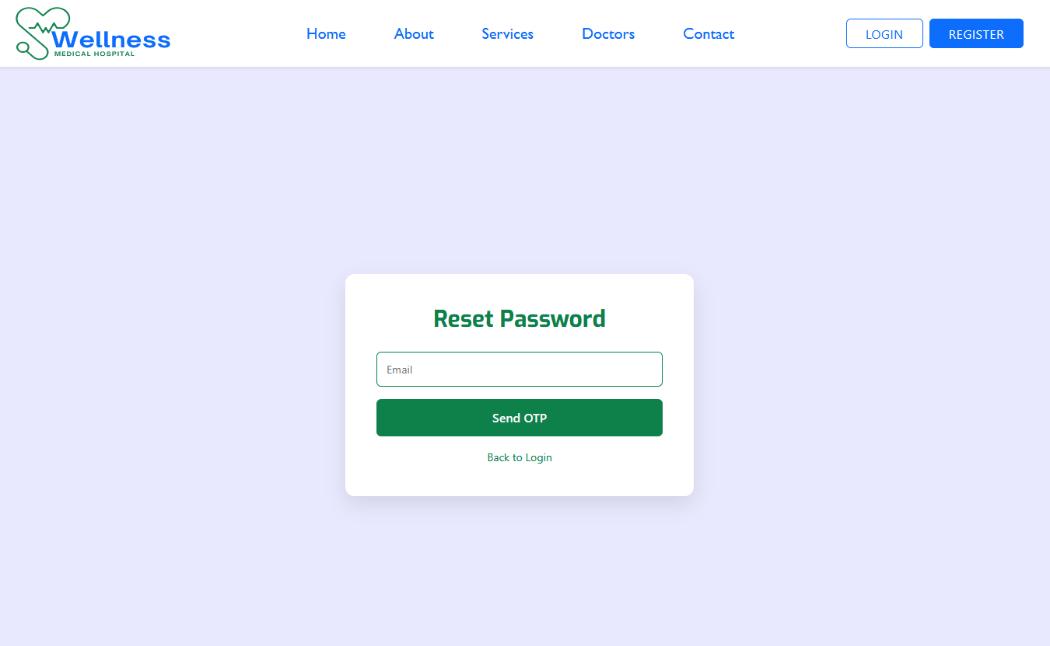
User Interface Overview
WELLNESS MEDICAL

Slide 15
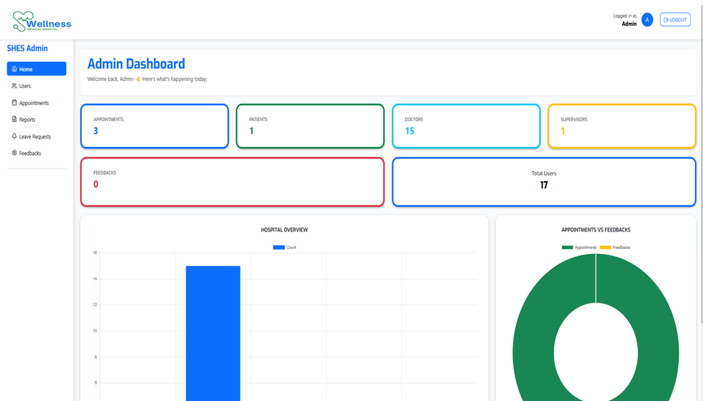
User Interface Overview
WELLNESS MEDICAL

Slide 16
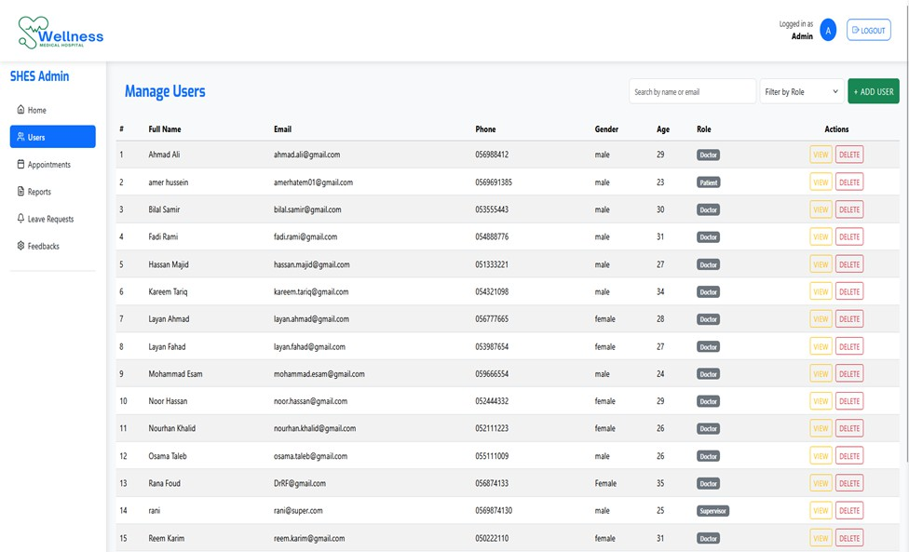
User Interface Overview
WELLNESS MEDICAL

Slide 17
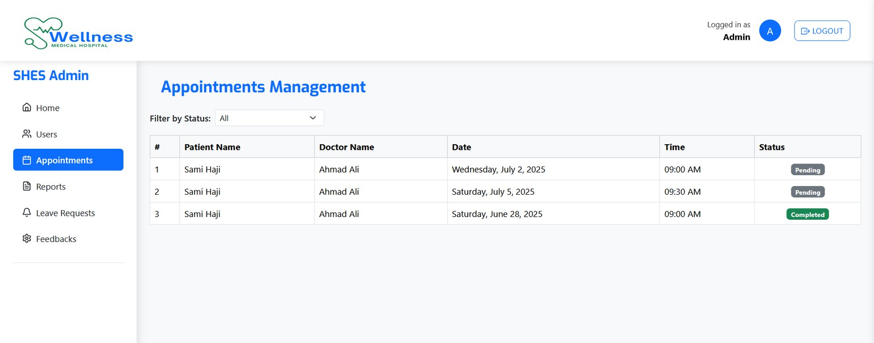
User Interface Overview
WELLNESS MEDICAL

Slide 18
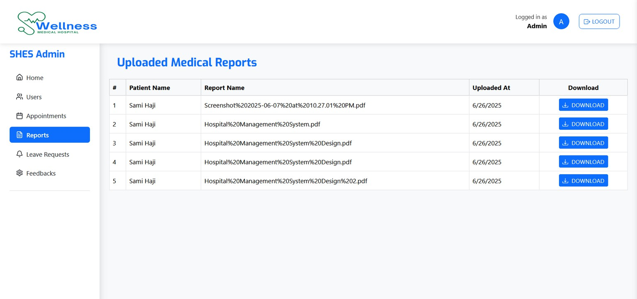
User Interface Overview
WELLNESS MEDICAL

Slide 19
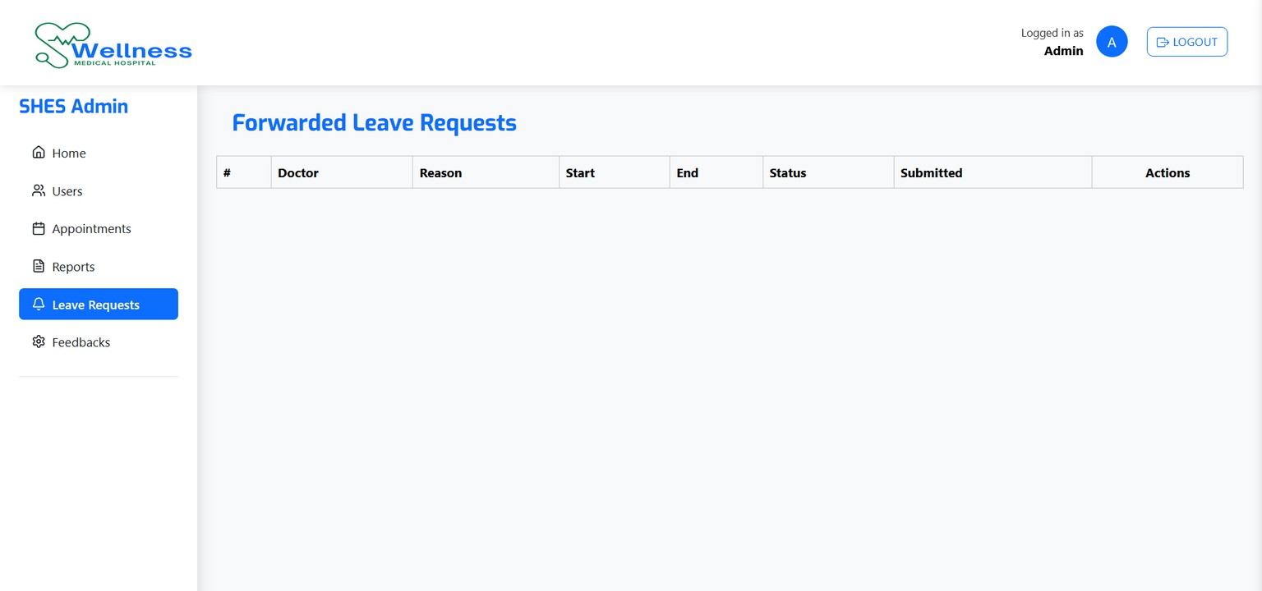
User Interface Overview
WELLNESS MEDICAL

Slide 20
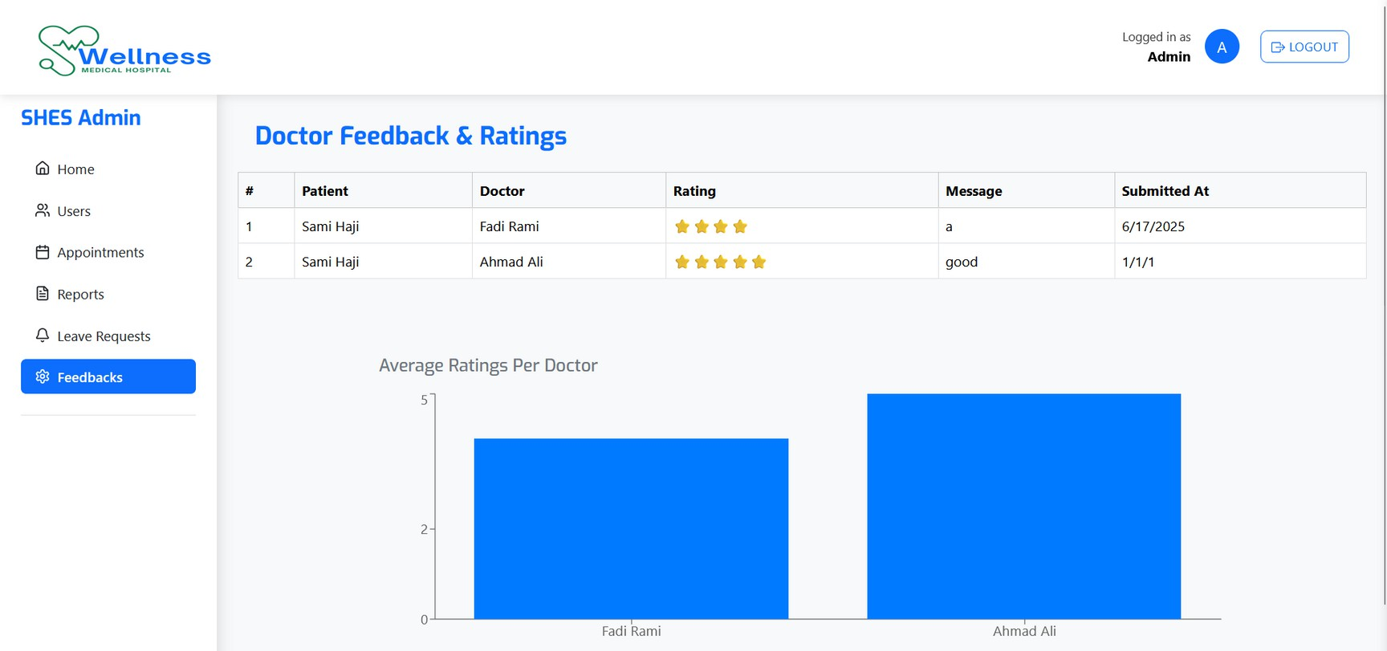
User Interface Overview
WELLNESS MEDICAL

Slide 21
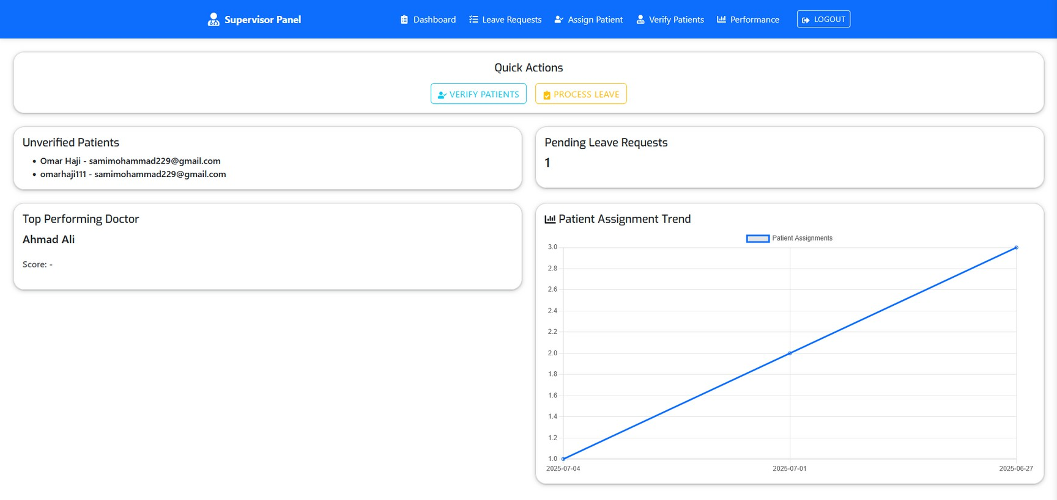
User Interface Overview
WELLNESS MEDICAL

Slide 22
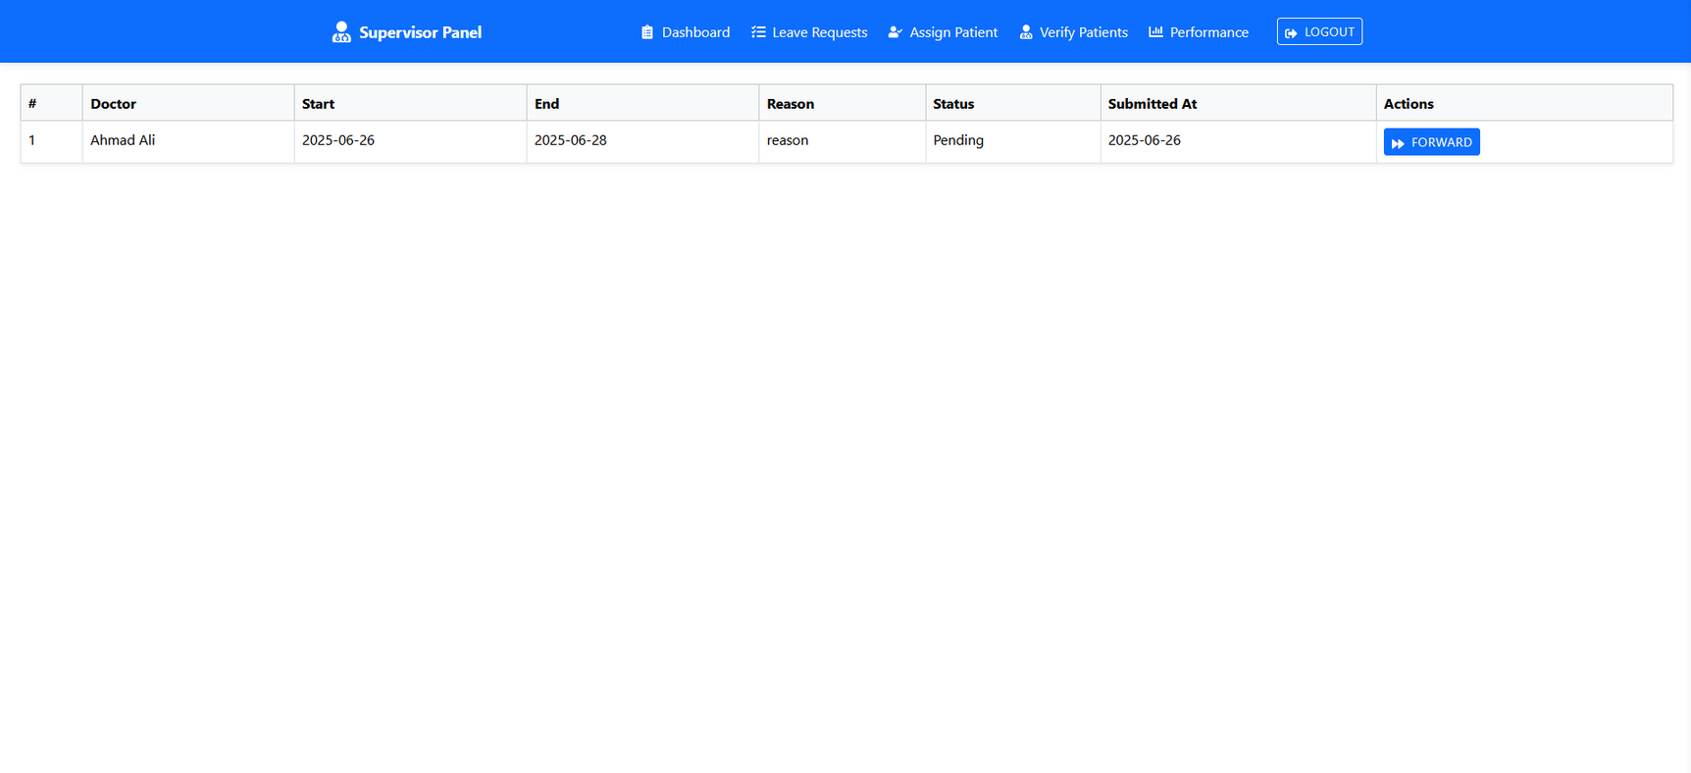
User Interface Overview
WELLNESS MEDICAL

Slide 23
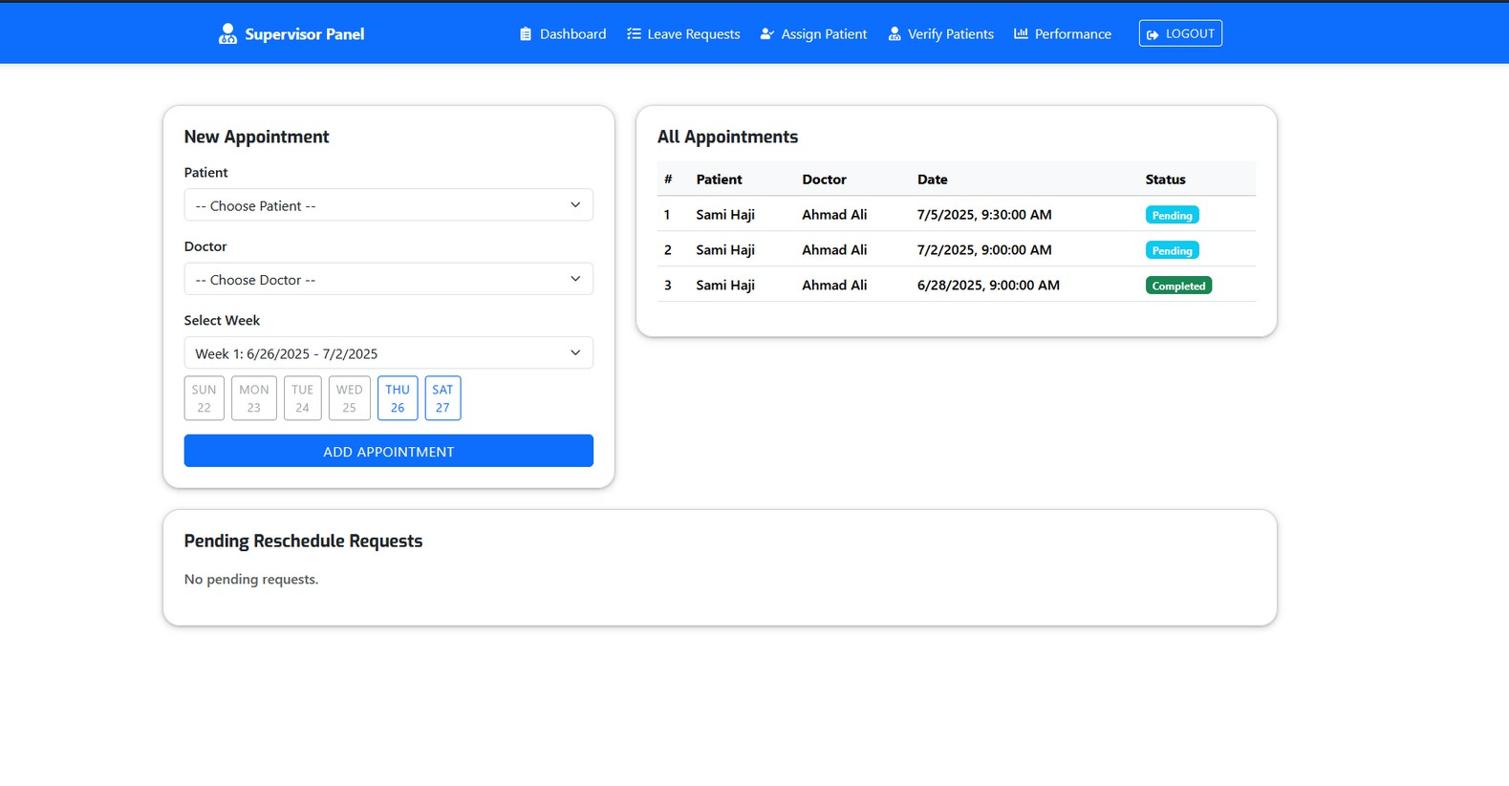
User Interface Overview
WELLNESS MEDICAL

Slide 24
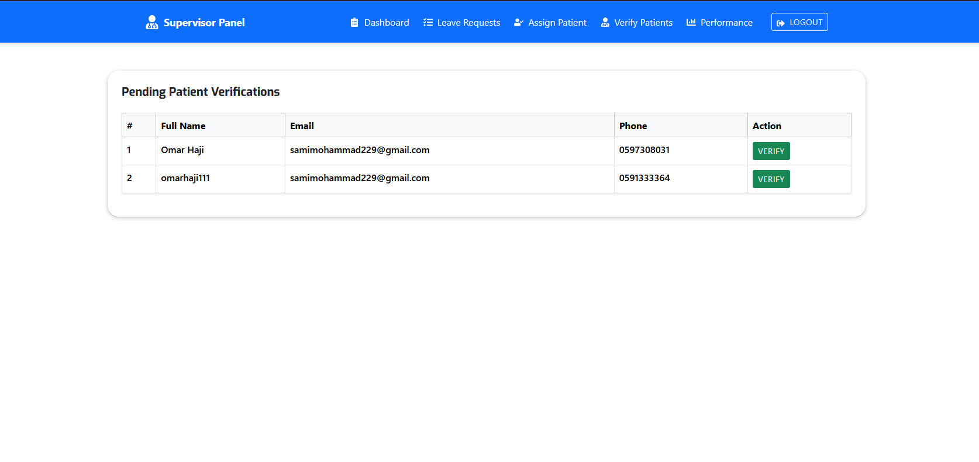
User Interface Overview
WELLNESS MEDICAL

Slide 25
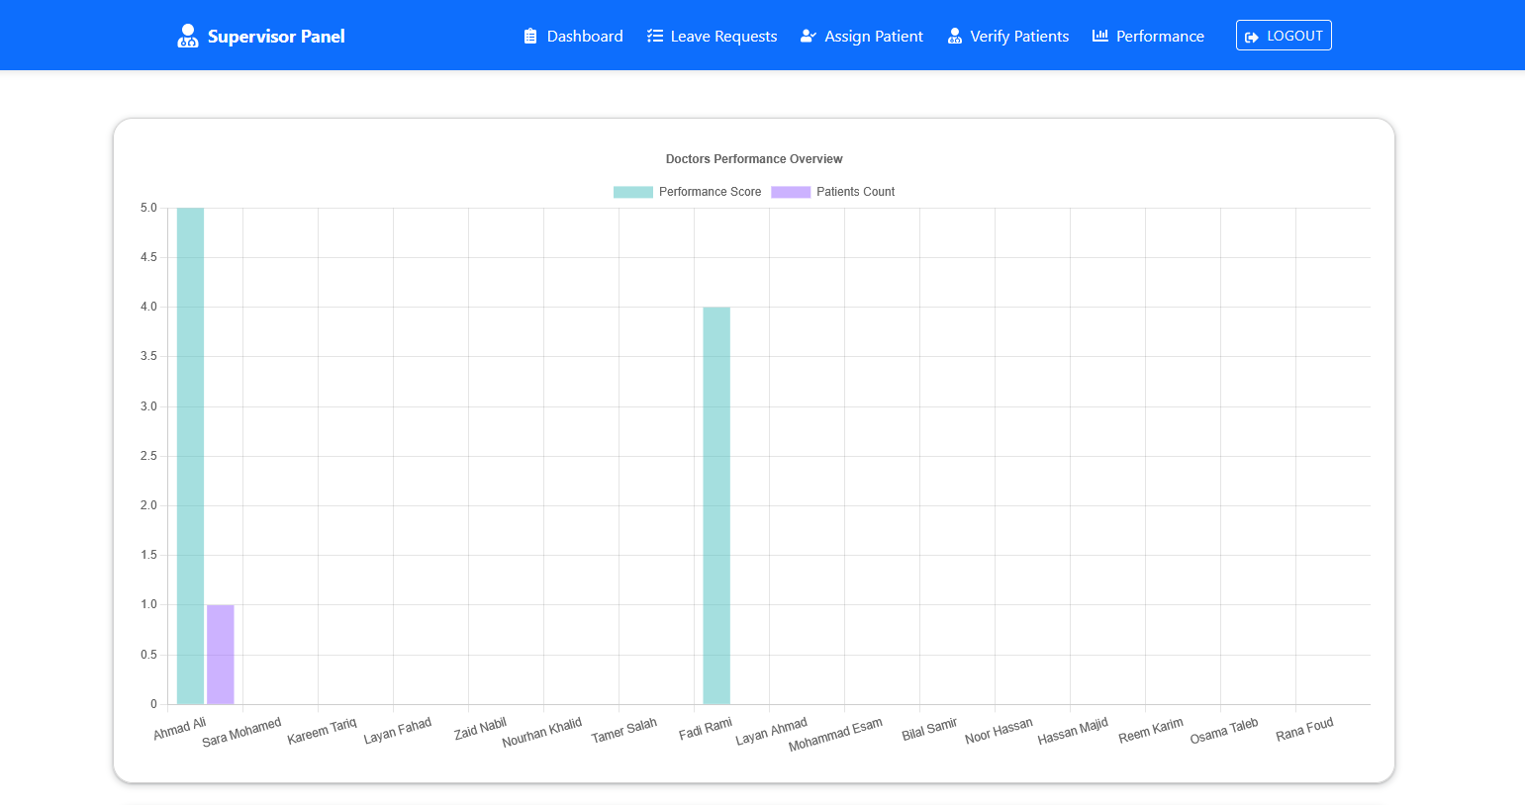
User Interface Overview
WELLNESS MEDICAL

Slide 26
MOBILE APPLICATION
The foundation of a healthy life
WELLNESS MEDICAL

Slide 27
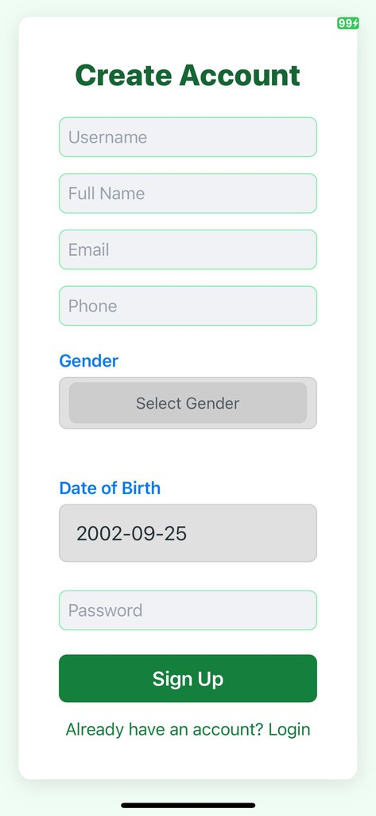
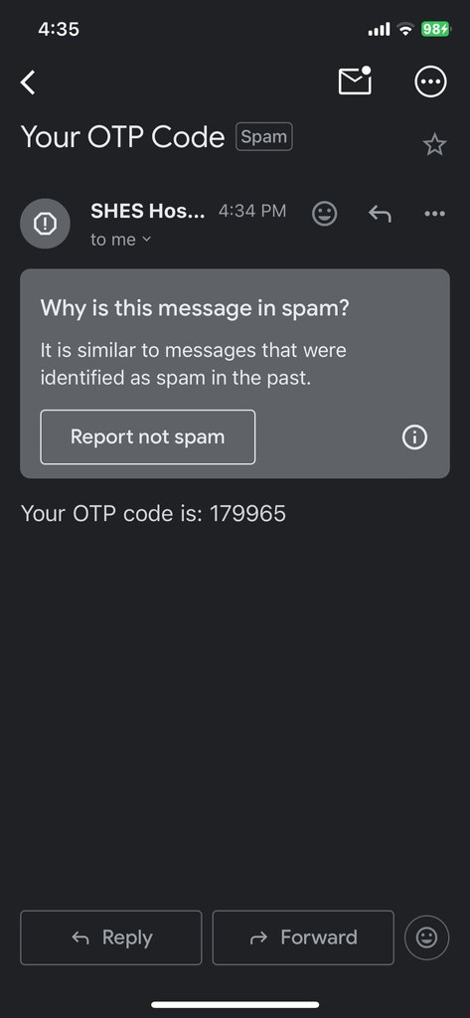
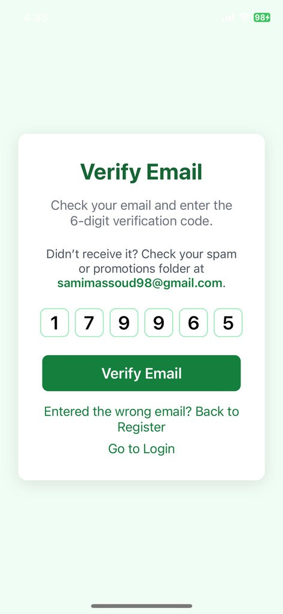
User Interface Overview
WELLNESS MEDICAL

Slide 28
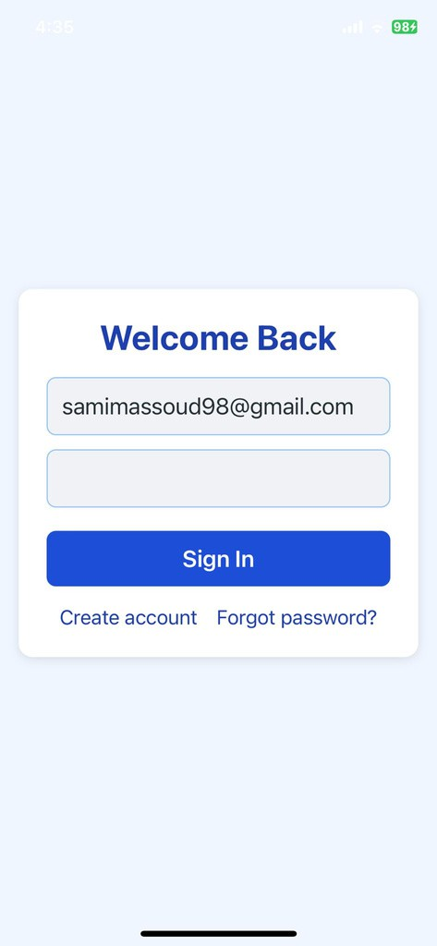
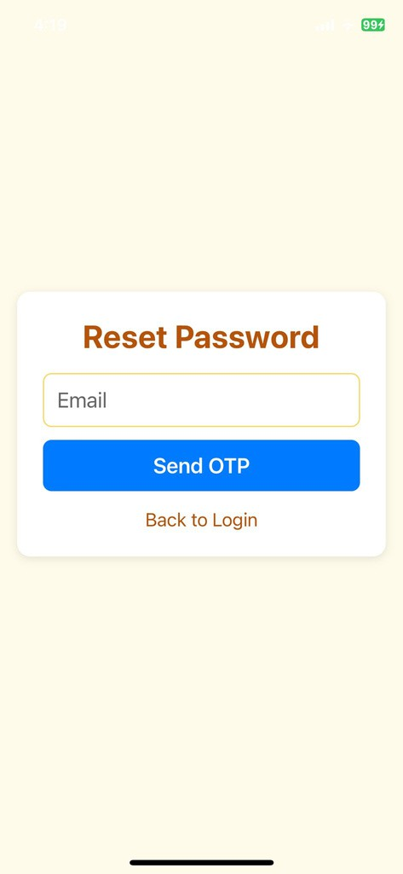
User Interface Overview
WELLNESS MEDICAL

Slide 29
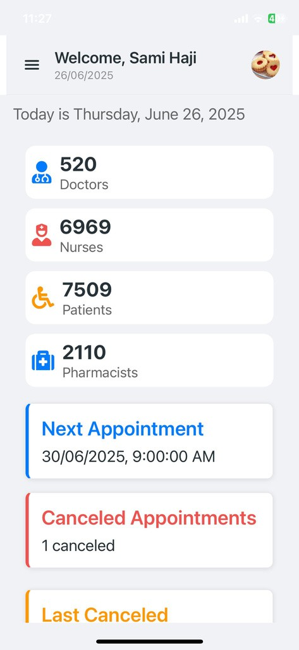
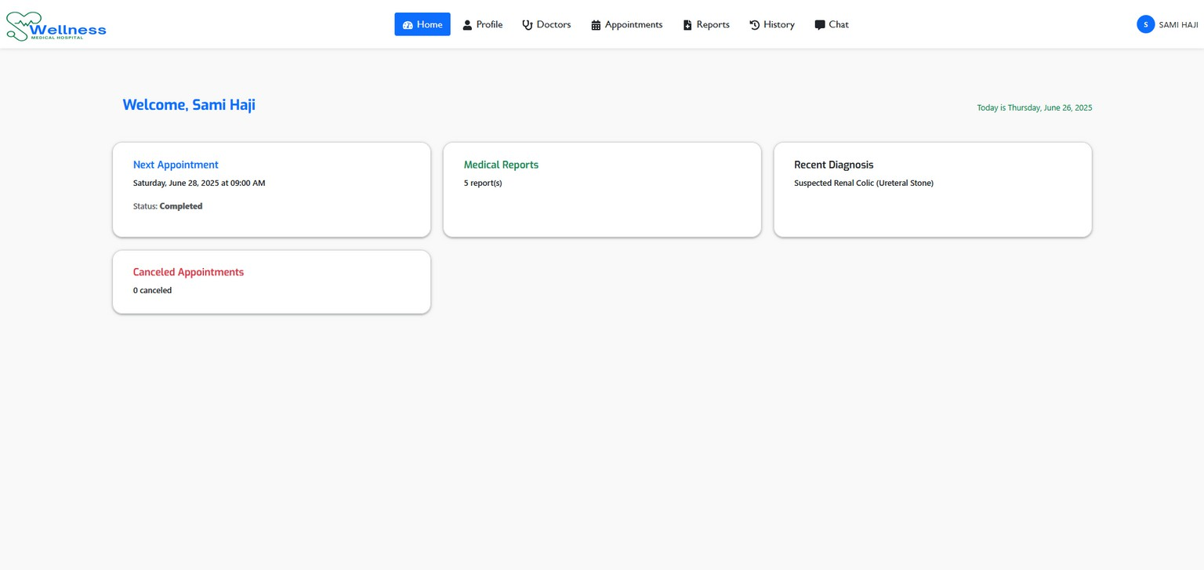
User Interface Overview
WELLNESS MEDICAL

Slide 30
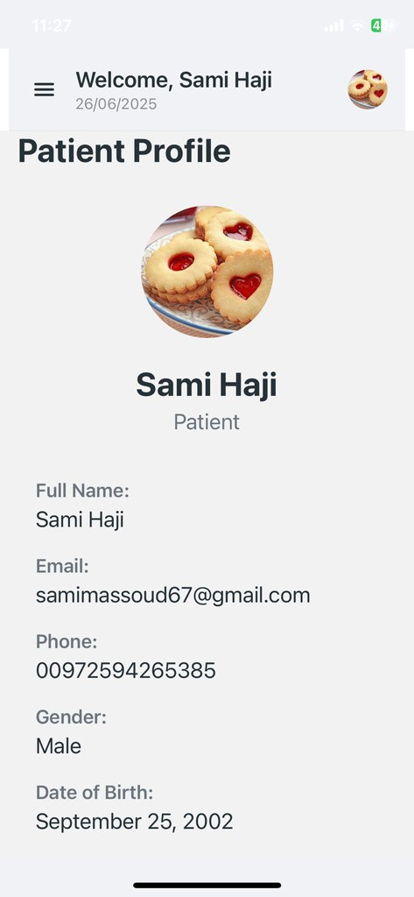
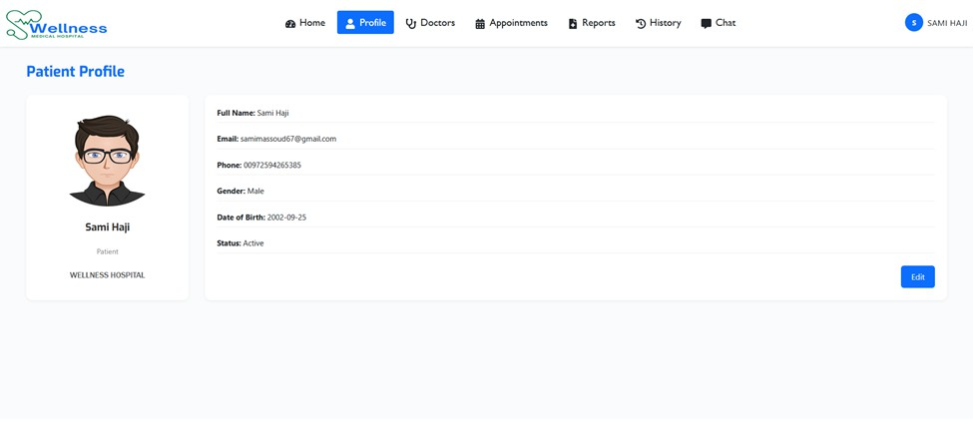
User Interface Overview
WELLNESS MEDICAL

Slide 31
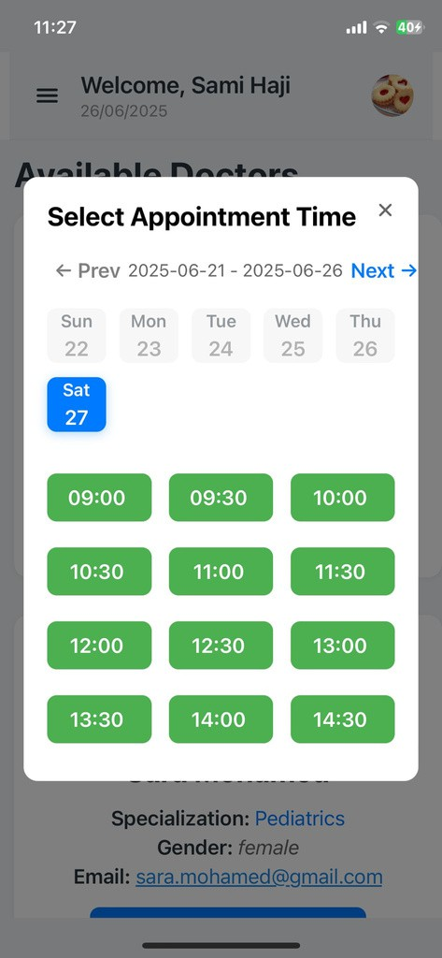
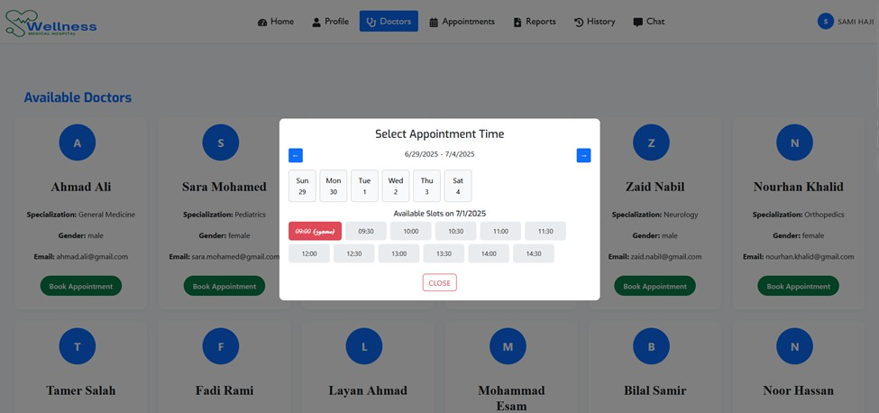
User Interface Overview
WELLNESS MEDICAL

Slide 32
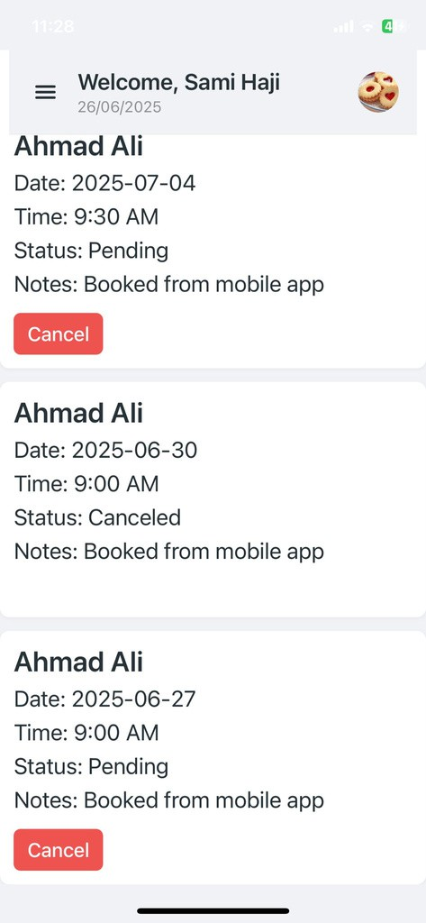
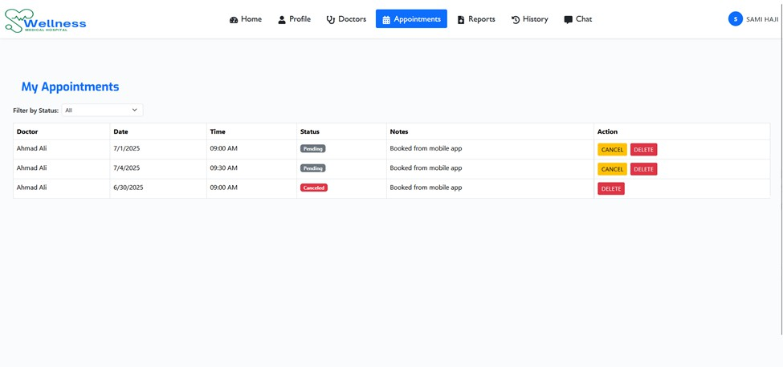
User Interface Overview
WELLNESS MEDICAL

Slide 33
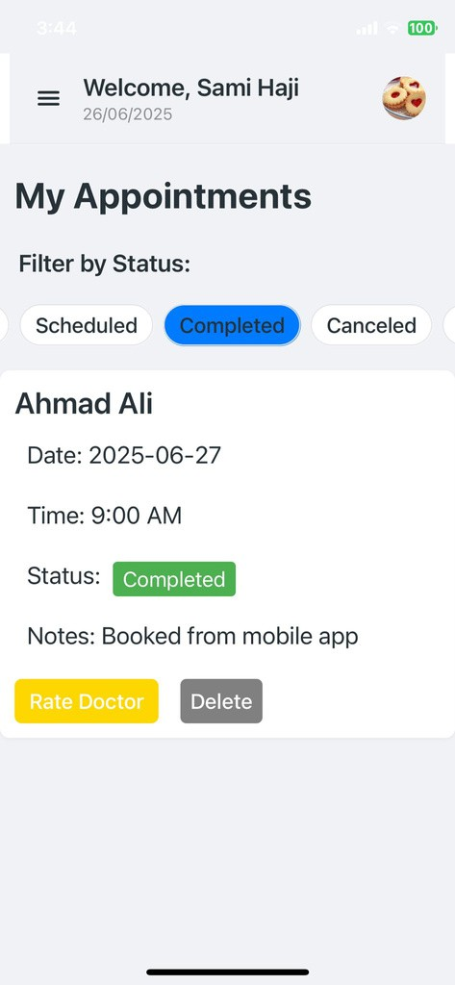
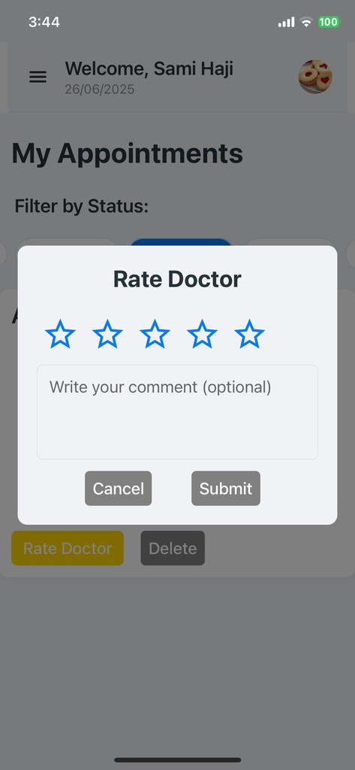
User Interface Overview
WELLNESS MEDICAL

Slide 34
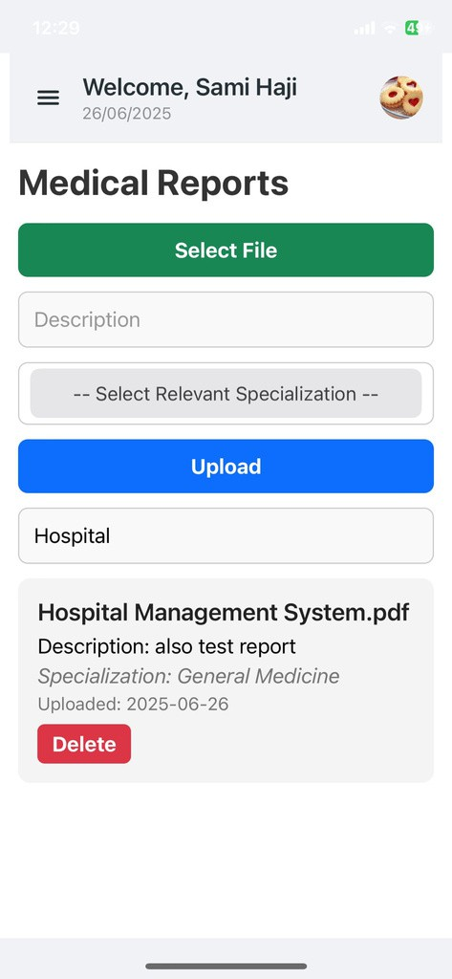
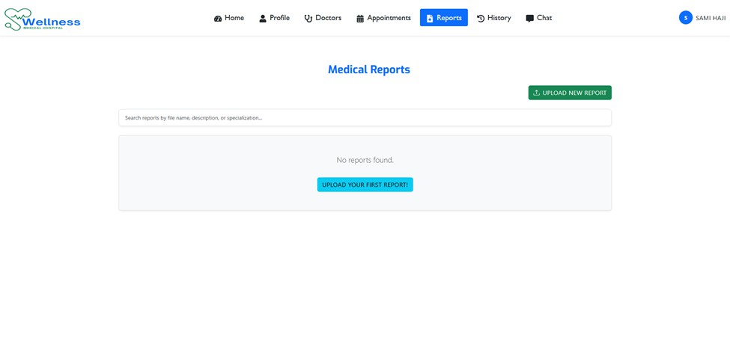
User Interface Overview
WELLNESS MEDICAL

Slide 35
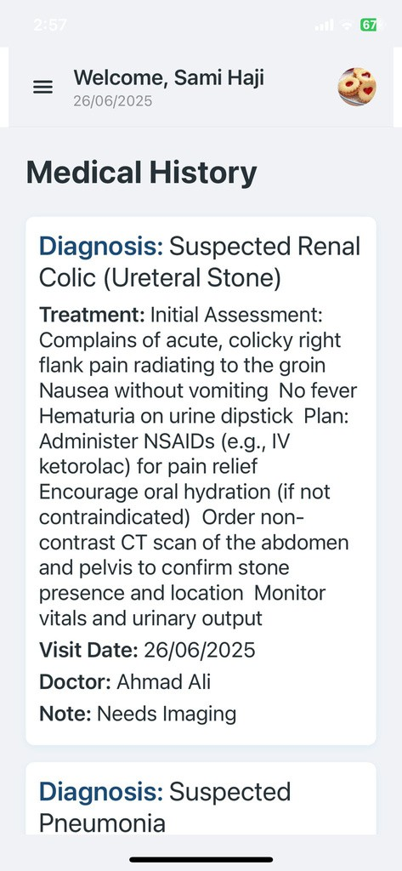
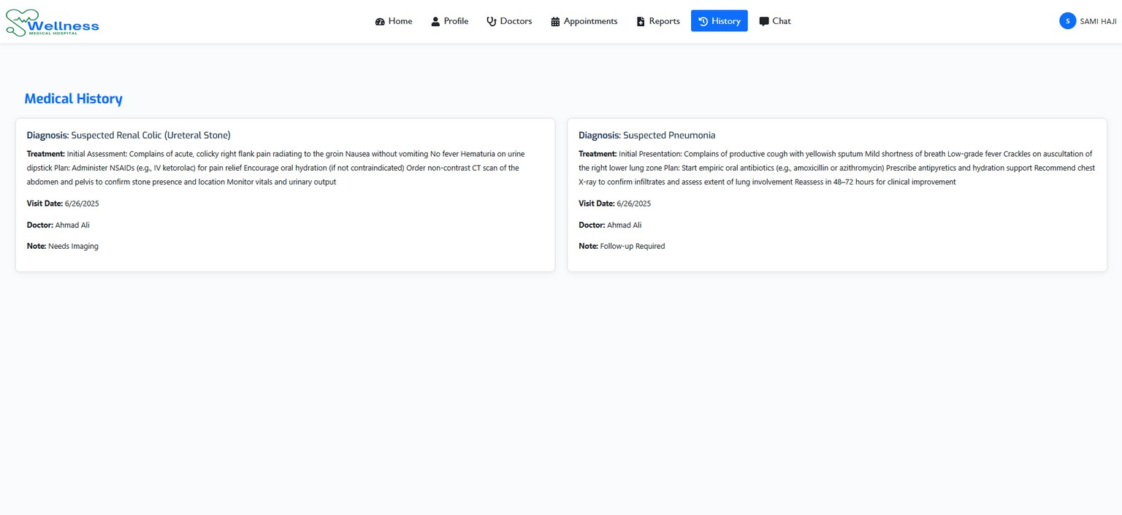
User Interface Overview
WELLNESS MEDICAL

Slide 36
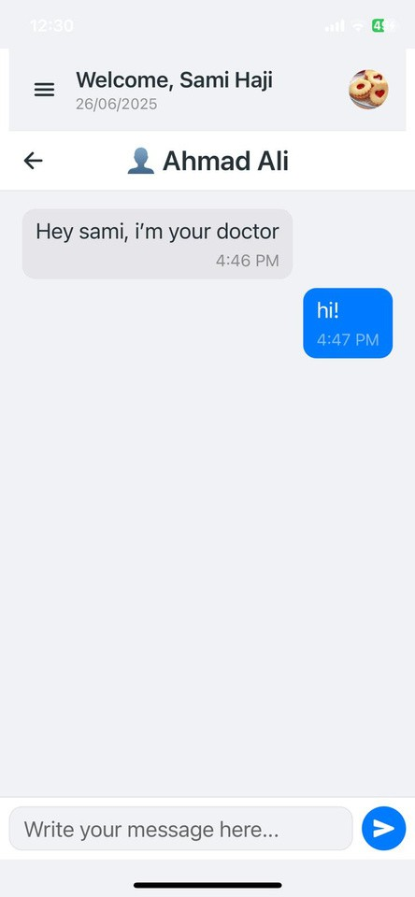
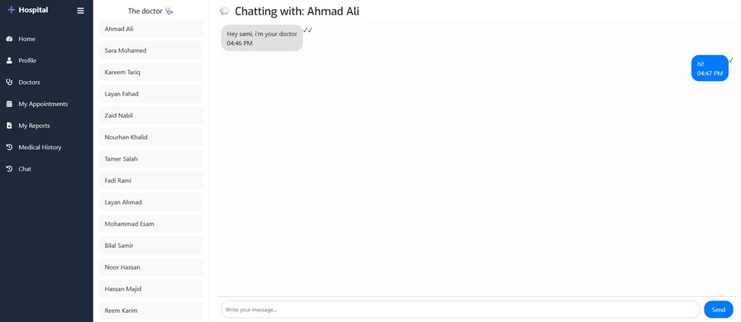
User Interface Overview
WELLNESS MEDICAL

Slide 37
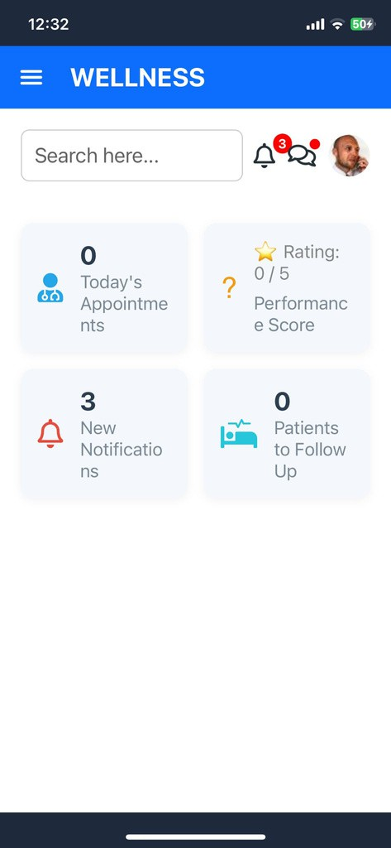
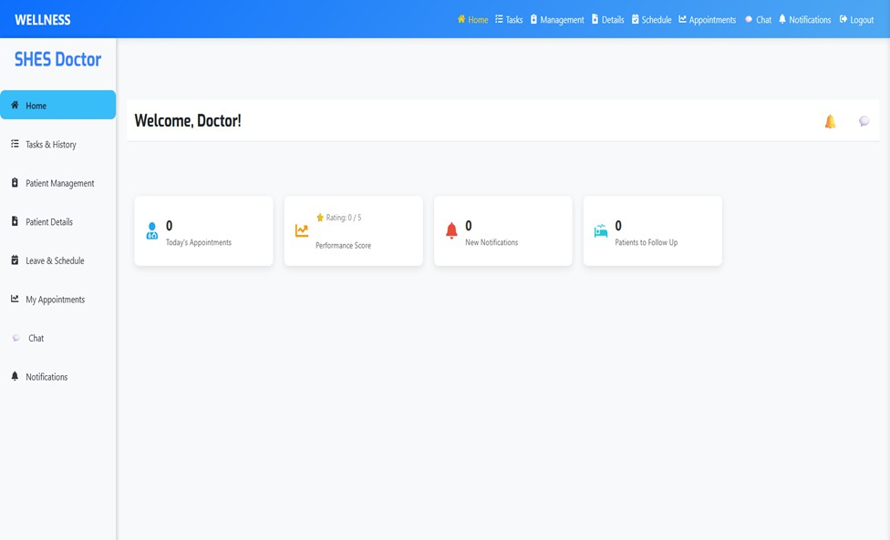
User Interface Overview
WELLNESS MEDICAL

Slide 38
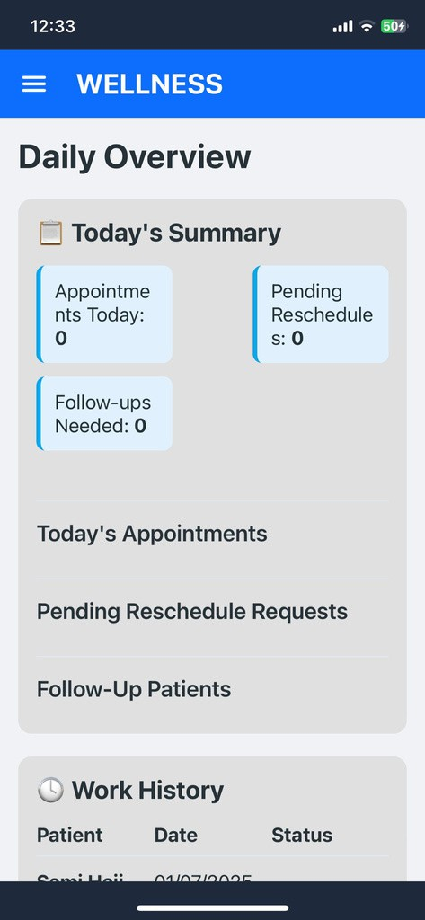
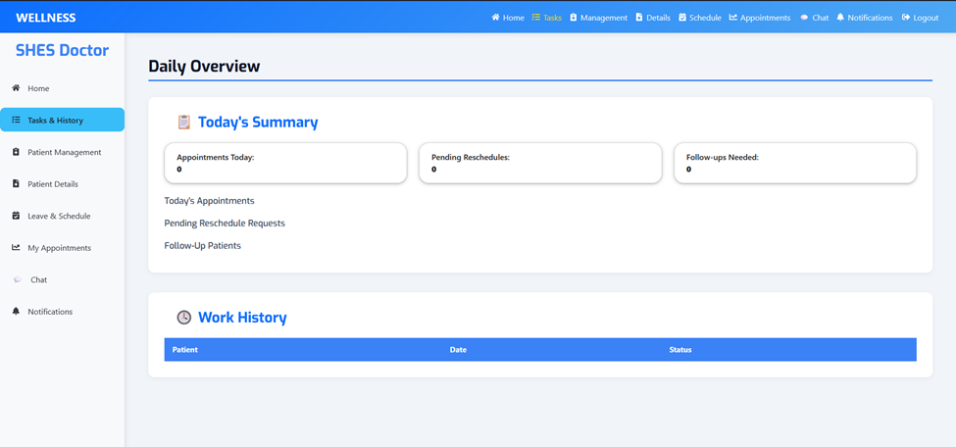
User Interface Overview
WELLNESS MEDICAL

Slide 39
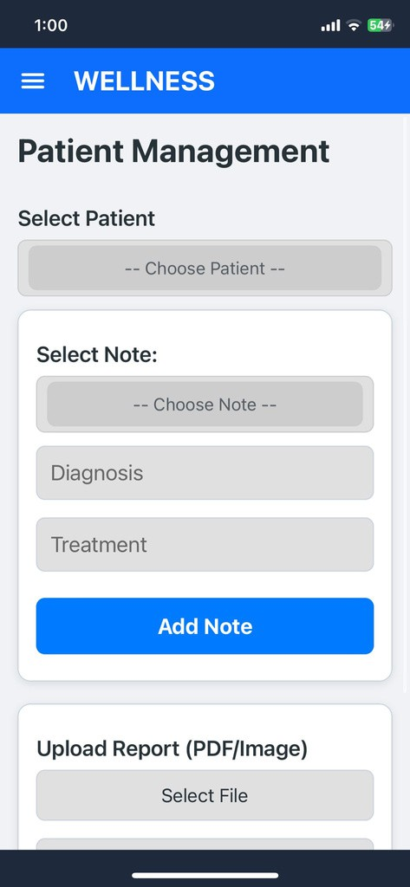
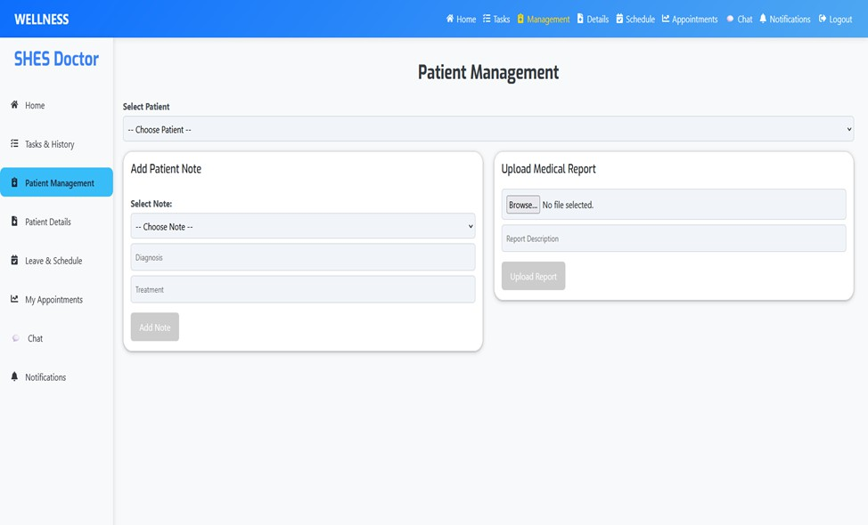
User Interface Overview
WELLNESS MEDICAL

Slide 40
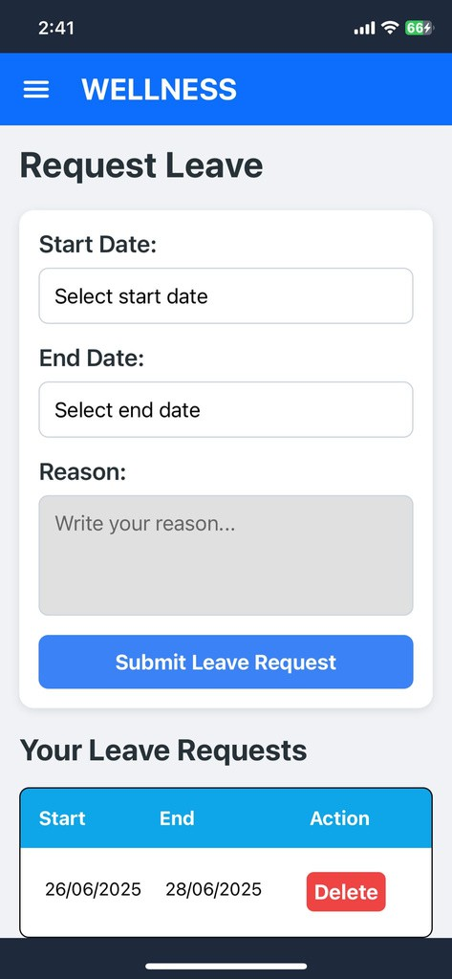
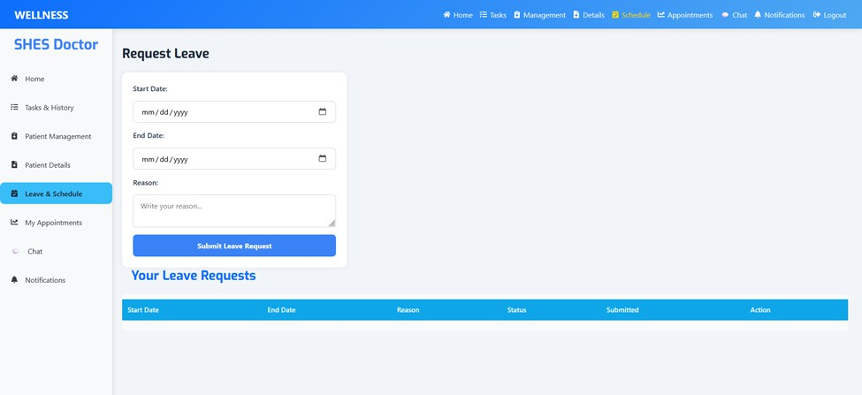
User Interface Overview
WELLNESS MEDICAL

Slide 41
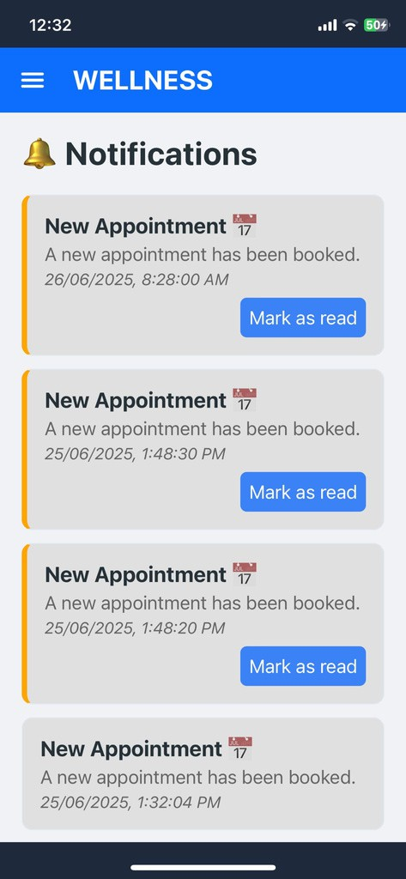

User Interface Overview
WELLNESS MEDICAL

Slide 42


User Interface Overview
WELLNESS MEDICAL

Slide 43


User Interface Overview
WELLNESS MEDICAL

Slide 44

User Interface Overview
WELLNESS MEDICAL

Slide 45















FUTURE WORK
Medical Technology
WELLNESS MEDICAL
Multilingual Support
Expand system accessibility to users with different languages
Video Consultation
Enable remote doctor-patient interactions via video calls
Real-Time Notifications
Send appointment and system alerts via SMS or mobile push
Smart Inventory Management
Monitor and automate medication/supply stock handling
Enhanced AI Diagnosis
Use machine learning and patient history for smarter symptom analysis

Slide 46




Conclusion
WELLNESS MEDICAL
The Smart Hospital Enhancement System (SHES) successfully addresses key operational challenges in modern healthcare by introducing intelligent, role- based tools for patients, doctors, and administrators. Through smart scheduling, real-time communication, and performance tracking, SHES enhances hospital
efficiency and foundation for solutions
patient experience—laying the scalable, future-ready healthcare
Improves heart and muscle strength

Slide 47
WELLNESS MEDICAL
Thank You.
For Your Attention

